Slide 1
CSCE-637 Complexity Theory
Fall 2020
Instructor: Jianer Chen
Office: HRBB 338C
Phone: 845-4259
Email: chen@cse.tamu.edu
Notes 2: Computational Models

Slide 2
Preliminaries
Problems and Languages
Complexity Classes
Turing Machines
Reductions
Completeness

Slide 3
Problems and Languages
Need formal notion of “computational problem”.

Slide 4
Problems and Languages
Need formal notion of “computational problem”.
Examples:
  Given graph G, vertices s, t, find the shortest path from s to t
  Given matrices A and B, compute AB
  Given an integer, find its prime factors
  Given a Boolean formula, find a satisfying assignment

Slide 5
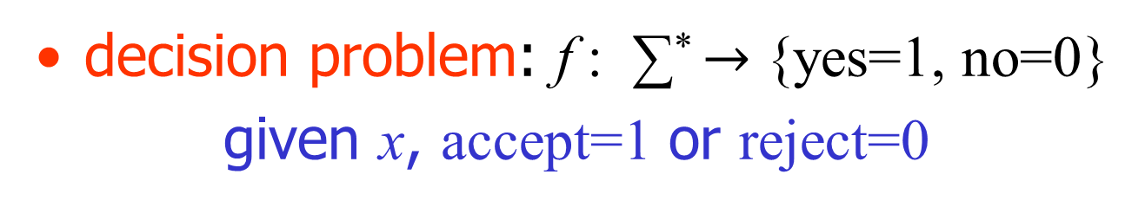


Problems and Languages
One possibility: function from strings to strings
f : ∑* $→$ ∑*
function problem: f : ∑* $→$ ∑*
given x, compute f (x)
decision problem: f : ∑* $→$ {yes=1, no=0}
given x, accept=1 or reject=0

Slide 6
Problems and Languages
simplification doesn’t give up much:

Slide 7
Problems and Languages
simplification doesn’t give up much:
  Given an integer n, find a prime factor of n

Slide 8
Problems and Languages
simplification doesn’t give up much:
  Given an integer n, find a prime factor of n
  Given an integer n and an integer k, is there a factor of n that is < k?

Slide 9
Problems and Languages
simplification doesn’t give up much:
  Given an integer n, find a prime factor of n
  Given an integer n and an integer k, is there a factor of n that is < k?
  Given a Boolean formula F, find a satisfying assignment for F

Slide 10
Problems and Languages
simplification doesn’t give up much:
  Given an integer n, find a prime factor of n
  Given an integer n and an integer k, is there a factor of n that is < k?
  Given a Boolean formula F, find a satisfying assignment for F
  Given a Boolean formula F, is it satisfiable?

Slide 11
Problems and Languages
simplification doesn’t give up much:
  Given an integer n, find a prime factor of n
  Given an integer n and an integer k, is there a factor of n that is < k?
  Given a Boolean formula F, find a satisfying assignment for F
  Given a Boolean formula F, is it satisfiable?
solve a function problem efficiently using a related decision problem (how?)

Slide 12
Problems and Languages
simplification doesn’t give up much:
  Given an integer n, find a prime factor of n
  Given an integer n and an integer k, is there a factor of n that is < k?
  Given a Boolean formula F, find a satisfying assignment for F
  Given a Boolean formula F, is it satisfiable?
solve a function problem efficiently using a related decision problem (how?)
We will work mostly with decision problems

Slide 13
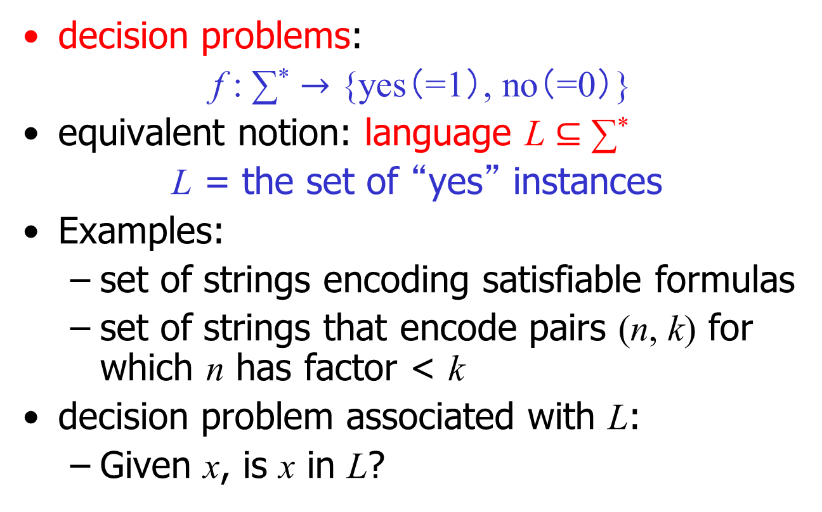
Problems and Languages
decision problems:
f : ∑* $→$ {yes（=1）, no（=0）}
equivalent notion: language L $⊆$ ∑*
L = the set of “yes” instances
Examples:
  set of strings encoding satisfiable formulas
  set of strings that encode pairs (n, k) for which n has factor < k
decision problem associated with L:
  Given x, is x in L?

Slide 14
Problems and Languages
Two encoding issues
implicitly assume we’ve agreed on a way to encode inputs (and outputs) as strings
  sometimes relevant in fine-grained analysis (e.g. adj. matrix vs. adj. list for graphs)
  almost never an issue in this class
  avoid silly encodings: e.g. unary

Slide 15
Problems and Languages
some strings not valid encodings of any input -- treat as “no”
invalid
∑*
L
“no”
“yes”
invalid
∑*
“no”
“yes”
officially: co-L

Slide 16
Complexity Classes
complexity class = class of languages
set-theoretic definition – no reference to computation (!)
example:
  TALLY = languages in which every yes instance has form 0^{n}
  e.g. L = { 0^{n} : n prime }

Slide 17
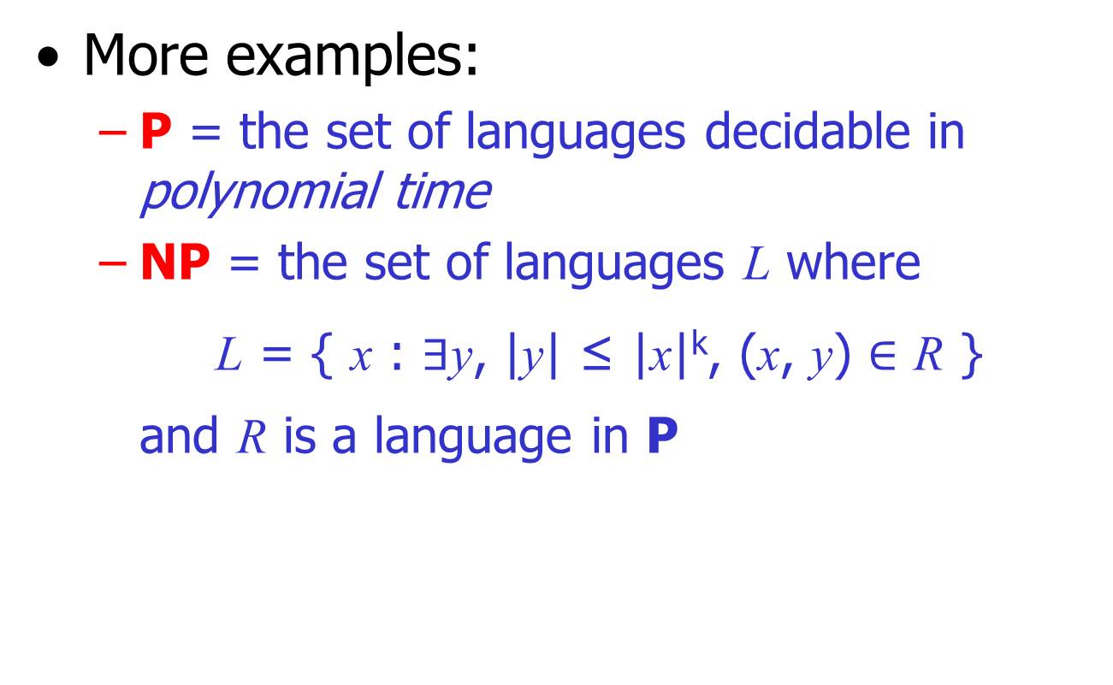
Complexity Classes
More examples:
  P = the set of languages decidable in polynomial time
  NP = the set of languages L where
  L = { x : $∃$y, |y| ≤ |x|^{k}, (x, y) $∈$ R }
  and R is a language in P

Slide 18
Complexity Classes
need a model of computation to define classes that capture important aspects of computation
Our model of computation: Turing Machine

Slide 19
Complexity Classes
need a model of computation to define classes that capture important aspects of computation
Our model of computation: Turing Machine
infinite tape
. . .
a | b | a | b
read/write head
finite control

Slide 20
Complexity Classes
need a model of computation to define classes that capture important aspects of computation
Our model of computation: Turing Machine
infinite tape
. . .
a | b | a | b
read/write head
finite control
A Turing machine:
M = (Q, ∑, δ, q_{s}, q_{acc}, q_{rej})

Slide 21
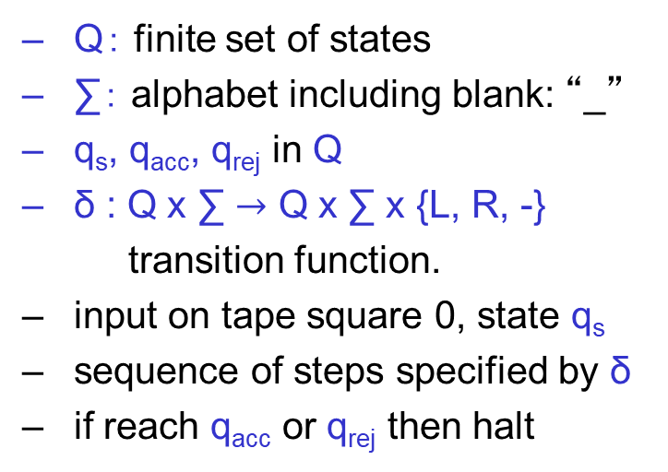
Complexity Classes
need a model of computation to define classes that capture important aspects of computation
Our model of computation: Turing Machine
infinite tape
. . .
a | b | a | b
Q： finite set of states
∑： alphabet including blank: “_”
q_{s}, q_{acc}, q_{rej} in Q
δ : Q x ∑ $→$ Q x ∑ x {L, R, -}
transition function.
input on tape square 0, state q_{s}
sequence of steps specified by δ
if reach q_{acc} or q_{rej} then halt
read/write head
finite control
A Turing machine:
M = (Q, ∑, δ, q_{s}, q_{acc}, q_{rej})

Slide 22
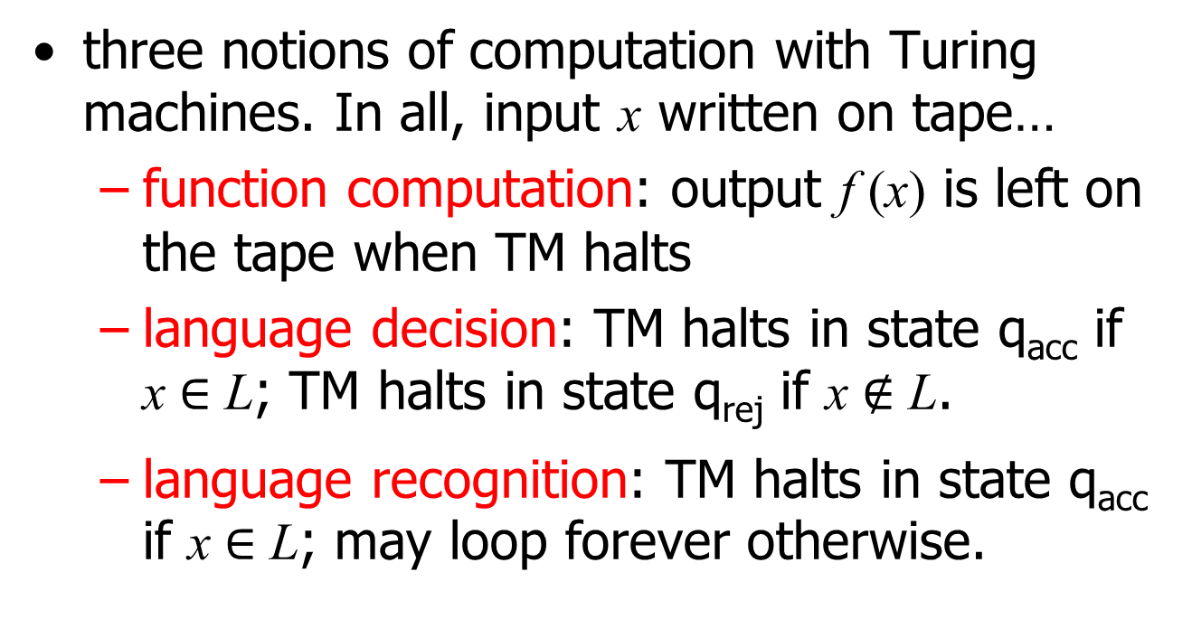
Turing Machines
three notions of computation with Turing machines. In all, input x written on tape…
  function computation: output f (x) is left on the tape when TM halts
  language decision: TM halts in state q_{acc} if x $∈$ L; TM halts in state q_{rej} if x $∉$ L.
  language recognition: TM halts in state q_{acc} if x $∈$ L; may loop forever otherwise.

Slide 23
Turing Machines
Example. A TM that compares
Input: x#y \\ x, y: bin. numbers
Output: accept if x = y

Slide 24
Turing Machines
Example. A TM that compares
Input: x#y \\ x, y: bin. numbers
Output: accept if x = y
infinite tape

Slide 25
Turing Machines
Example. A TM that compares
Input: x#y \\ x, y: bin. numbers
Output: accept if x = y
infinite tape
The Turing machine:
M = (Q, ∑, δ, q_{s}, q_{acc}, q_{rej})
Q = {q_{s}, q₀, q₁, q₂, q₃, q₄, q_{acc}, q_{rej}}
∑ = { 0, 1, #, $, _ }

Slide 26
Turing Machines
Example. A TM that compares
Input: x#y \\ x, y: bin. numbers
Output: accept if x = y
1. δ(q_{s},0) = (q₀,$,R)
2. δ(q_{s},1) = (q₁,$,R)
δ(q₀,0/1) = (q₀,0/1,R)
δ(q₁,0/1) = (q₁,0/1,R)
δ(q₀,#) = (q₂,#,R)
δ(q₂,#) = (q₂,#,R)
δ(q₂,0) = (q₄,#,L)
δ(q₁,#) = (q₃,#,R)
δ(q₃,#) = (q₃,#,R)
δ(q₃,1) = (q₄,#,L)
δ(q₄,0/1/#) = (q₄,0/1/#,L)
δ(q₄,$) = (q_{s},$,R)
δ(q_{s},#) = (q_{s},#,R)
δ(q_{s},_) = (q_{acc},_,-)
For any case not listed above
δ(*,*) = (q_{rej},*,-)
infinite tape
The Turing machine:
M = (Q, ∑, δ, q_{s}, q_{acc}, q_{rej})
Q = {q_{s}, q₀, q₁, q₂, q₃, q₄, q_{acc}, q_{rej}}
∑ = { 0, 1, #, $, _ }

Slide 27
Turing Machines
Example. A TM that compares
Input: x#y \\ x, y: bin. numbers
Output: accept if x = y
1. δ(q_{s},0) = (q₀,$,R)
2. δ(q_{s},1) = (q₁,$,R)
δ(q₀,0/1) = (q₀,0/1,R)
δ(q₁,0/1) = (q₁,0/1,R)
δ(q₀,#) = (q₂,#,R)
δ(q₂,#) = (q₂,#,R)
δ(q₂,0) = (q₄,#,L)
δ(q₁,#) = (q₃,#,R)
δ(q₃,#) = (q₃,#,R)
δ(q₃,1) = (q₄,#,L)
δ(q₄,0/1/#) = (q₄,0/1/#,L)
δ(q₄,$) = (q_{s},$,R)
δ(q_{s},#) = (q_{s},#,R)
δ(q_{s},_) = (q_{acc},_,-)
For any case not listed above
δ(*,*) = (q_{rej},*,-)
infinite tape
1 | 0 | 0 | 1 | # | 1 | 0 | 0 | 1
The Turing machine:
M = (Q, ∑, δ, q_{s}, q_{acc}, q_{rej})
Q = {q_{s}, q₀, q₁, q₂, q₃, q₄, q_{acc}, q_{rej}}
∑ = { 0, 1, #, $, _ }

Slide 28
Turing Machines
Example. A TM that compares
Input: x#y \\ x, y: bin. numbers
Output: accept if x = y
1. δ(q_{s},0) = (q₀,$,R)
2. δ(q_{s},1) = (q₁,$,R)
δ(q₀,0/1) = (q₀,0/1,R)
δ(q₁,0/1) = (q₁,0/1,R)
δ(q₀,#) = (q₂,#,R)
δ(q₂,#) = (q₂,#,R)
δ(q₂,0) = (q₄,#,L)
δ(q₁,#) = (q₃,#,R)
δ(q₃,#) = (q₃,#,R)
δ(q₃,1) = (q₄,#,L)
δ(q₄,0/1/#) = (q₄,0/1/#,L)
δ(q₄,$) = (q_{s},$,R)
δ(q_{s},#) = (q_{s},#,R)
δ(q_{s},_) = (q_{acc},_,-)
For any case not listed above
δ(*,*) = (q_{rej},*,-)
infinite tape
1 | 0 | 0 | 1 | # | 1 | 0 | 0 | 1
q_{s}
The Turing machine:
M = (Q, ∑, δ, q_{s}, q_{acc}, q_{rej})
Q = {q_{s}, q₀, q₁, q₂, q₃, q₄, q_{acc}, q_{rej}}
∑ = { 0, 1, #, $, _ }

Slide 29
Turing Machines
Example. A TM that compares
Input: x#y \\ x, y: bin. numbers
Output: accept if x = y
1. δ(q_{s},0) = (q₀,$,R)
2. δ(q_{s},1) = (q₁,$,R)
δ(q₀,0/1) = (q₀,0/1,R)
δ(q₁,0/1) = (q₁,0/1,R)
δ(q₀,#) = (q₂,#,R)
δ(q₂,#) = (q₂,#,R)
δ(q₂,0) = (q₄,#,L)
δ(q₁,#) = (q₃,#,R)
δ(q₃,#) = (q₃,#,R)
δ(q₃,1) = (q₄,#,L)
δ(q₄,0/1/#) = (q₄,0/1/#,L)
δ(q₄,$) = (q_{s},$,R)
δ(q_{s},#) = (q_{s},#,R)
δ(q_{s},_) = (q_{acc},_,-)
For any case not listed above
δ(*,*) = (q_{rej},*,-)
infinite tape
1 | 0 | 0 | 1 | # | 1 | 0 | 0 | 1
q_{s}
The Turing machine:
M = (Q, ∑, δ, q_{s}, q_{acc}, q_{rej})
Q = {q_{s}, q₀, q₁, q₂, q₃, q₄, q_{acc}, q_{rej}}
∑ = { 0, 1, #, $, _ }

Slide 30
Turing Machines
Example. A TM that compares
Input: x#y \\ x, y: bin. numbers
Output: accept if x = y
1. δ(q_{s},0) = (q₀,$,R)
2. δ(q_{s},1) = (q₁,$,R)
δ(q₀,0/1) = (q₀,0/1,R)
δ(q₁,0/1) = (q₁,0/1,R)
δ(q₀,#) = (q₂,#,R)
δ(q₂,#) = (q₂,#,R)
δ(q₂,0) = (q₄,#,L)
δ(q₁,#) = (q₃,#,R)
δ(q₃,#) = (q₃,#,R)
δ(q₃,1) = (q₄,#,L)
δ(q₄,0/1/#) = (q₄,0/1/#,L)
δ(q₄,$) = (q_{s},$,R)
δ(q_{s},#) = (q_{s},#,R)
δ(q_{s},_) = (q_{acc},_,-)
For any case not listed above
δ(*,*) = (q_{rej},*,-)
infinite tape
$ | 0 | 0 | 1 | # | 1 | 0 | 0 | 1
q₁
The Turing machine:
M = (Q, ∑, δ, q_{s}, q_{acc}, q_{rej})
Q = {q_{s}, q₀, q₁, q₂, q₃, q₄, q_{acc}, q_{rej}}
∑ = { 0, 1, #, $, _ }

Slide 31
Turing Machines
Example. A TM that compares
Input: x#y \\ x, y: bin. numbers
Output: accept if x = y
1. δ(q_{s},0) = (q₀,$,R)
2. δ(q_{s},1) = (q₁,$,R)
δ(q₀,0/1) = (q₀,0/1,R)
δ(q₁,0/1) = (q₁,0/1,R)
δ(q₀,#) = (q₂,#,R)
δ(q₂,#) = (q₂,#,R)
δ(q₂,0) = (q₄,#,L)
δ(q₁,#) = (q₃,#,R)
δ(q₃,#) = (q₃,#,R)
δ(q₃,1) = (q₄,#,L)
δ(q₄,0/1/#) = (q₄,0/1/#,L)
δ(q₄,$) = (q_{s},$,R)
δ(q_{s},#) = (q_{s},#,R)
δ(q_{s},_) = (q_{acc},_,-)
For any case not listed above
δ(*,*) = (q_{rej},*,-)
infinite tape
$ | 0 | 0 | 1 | # | 1 | 0 | 0 | 1
q₁
The Turing machine:
M = (Q, ∑, δ, q_{s}, q_{acc}, q_{rej})
Q = {q_{s}, q₀, q₁, q₂, q₃, q₄, q_{acc}, q_{rej}}
∑ = { 0, 1, #, $, _ }

Slide 32
Turing Machines
Example. A TM that compares
Input: x#y \\ x, y: bin. numbers
Output: accept if x = y
1. δ(q_{s},0) = (q₀,$,R)
2. δ(q_{s},1) = (q₁,$,R)
δ(q₀,0/1) = (q₀,0/1,R)
δ(q₁,0/1) = (q₁,0/1,R)
δ(q₀,#) = (q₂,#,R)
δ(q₂,#) = (q₂,#,R)
δ(q₂,0) = (q₄,#,L)
δ(q₁,#) = (q₃,#,R)
δ(q₃,#) = (q₃,#,R)
δ(q₃,1) = (q₄,#,L)
δ(q₄,0/1/#) = (q₄,0/1/#,L)
δ(q₄,$) = (q_{s},$,R)
δ(q_{s},#) = (q_{s},#,R)
δ(q_{s},_) = (q_{acc},_,-)
For any case not listed above
δ(*,*) = (q_{rej},*,-)
infinite tape
$ | 0 | 0 | 1 | # | 1 | 0 | 0 | 1
q₁
The Turing machine:
M = (Q, ∑, δ, q_{s}, q_{acc}, q_{rej})
Q = {q_{s}, q₀, q₁, q₂, q₃, q₄, q_{acc}, q_{rej}}
∑ = { 0, 1, #, $, _ }

Slide 33
Turing Machines
Example. A TM that compares
Input: x#y \\ x, y: bin. numbers
Output: accept if x = y
1. δ(q_{s},0) = (q₀,$,R)
2. δ(q_{s},1) = (q₁,$,R)
δ(q₀,0/1) = (q₀,0/1,R)
δ(q₁,0/1) = (q₁,0/1,R)
δ(q₀,#) = (q₂,#,R)
δ(q₂,#) = (q₂,#,R)
δ(q₂,0) = (q₄,#,L)
δ(q₁,#) = (q₃,#,R)
δ(q₃,#) = (q₃,#,R)
δ(q₃,1) = (q₄,#,L)
δ(q₄,0/1/#) = (q₄,0/1/#,L)
δ(q₄,$) = (q_{s},$,R)
δ(q_{s},#) = (q_{s},#,R)
δ(q_{s},_) = (q_{acc},_,-)
For any case not listed above
δ(*,*) = (q_{rej},*,-)
infinite tape
$ | 0 | 0 | 1 | # | 1 | 0 | 0 | 1
q₁
The Turing machine:
M = (Q, ∑, δ, q_{s}, q_{acc}, q_{rej})
Q = {q_{s}, q₀, q₁, q₂, q₃, q₄, q_{acc}, q_{rej}}
∑ = { 0, 1, #, $, _ }

Slide 34
Turing Machines
Example. A TM that compares
Input: x#y \\ x, y: bin. numbers
Output: accept if x = y
1. δ(q_{s},0) = (q₀,$,R)
2. δ(q_{s},1) = (q₁,$,R)
δ(q₀,0/1) = (q₀,0/1,R)
δ(q₁,0/1) = (q₁,0/1,R)
δ(q₀,#) = (q₂,#,R)
δ(q₂,#) = (q₂,#,R)
δ(q₂,0) = (q₄,#,L)
δ(q₁,#) = (q₃,#,R)
δ(q₃,#) = (q₃,#,R)
δ(q₃,1) = (q₄,#,L)
δ(q₄,0/1/#) = (q₄,0/1/#,L)
δ(q₄,$) = (q_{s},$,R)
δ(q_{s},#) = (q_{s},#,R)
δ(q_{s},_) = (q_{acc},_,-)
For any case not listed above
δ(*,*) = (q_{rej},*,-)
infinite tape
$ | 0 | 0 | 1 | # | 1 | 0 | 0 | 1
q₃
The Turing machine:
M = (Q, ∑, δ, q_{s}, q_{acc}, q_{rej})
Q = {q_{s}, q₀, q₁, q₂, q₃, q₄, q_{acc}, q_{rej}}
∑ = { 0, 1, #, $, _ }

Slide 35
Turing Machines
Example. A TM that compares
Input: x#y \\ x, y: bin. numbers
Output: accept if x = y
1. δ(q_{s},0) = (q₀,$,R)
2. δ(q_{s},1) = (q₁,$,R)
δ(q₀,0/1) = (q₀,0/1,R)
δ(q₁,0/1) = (q₁,0/1,R)
δ(q₀,#) = (q₂,#,R)
δ(q₂,#) = (q₂,#,R)
δ(q₂,0) = (q₄,#,L)
δ(q₁,#) = (q₃,#,R)
δ(q₃,#) = (q₃,#,R)
δ(q₃,1) = (q₄,#,L)
δ(q₄,0/1/#) = (q₄,0/1/#,L)
δ(q₄,$) = (q_{s},$,R)
δ(q_{s},#) = (q_{s},#,R)
δ(q_{s},_) = (q_{acc},_,-)
For any case not listed above
δ(*,*) = (q_{rej},*,-)
infinite tape
$ | 0 | 0 | 1 | # | 1 | 0 | 0 | 1
q₃
The Turing machine:
M = (Q, ∑, δ, q_{s}, q_{acc}, q_{rej})
Q = {q_{s}, q₀, q₁, q₂, q₃, q₄, q_{acc}, q_{rej}}
∑ = { 0, 1, #, $, _ }

Slide 36
Turing Machines
Example. A TM that compares
Input: x#y \\ x, y: bin. numbers
Output: accept if x = y
1. δ(q_{s},0) = (q₀,$,R)
2. δ(q_{s},1) = (q₁,$,R)
δ(q₀,0/1) = (q₀,0/1,R)
δ(q₁,0/1) = (q₁,0/1,R)
δ(q₀,#) = (q₂,#,R)
δ(q₂,#) = (q₂,#,R)
δ(q₂,0) = (q₄,#,L)
δ(q₁,#) = (q₃,#,R)
δ(q₃,#) = (q₃,#,R)
δ(q₃,1) = (q₄,#,L)
δ(q₄,0/1/#) = (q₄,0/1/#,L)
δ(q₄,$) = (q_{s},$,R)
δ(q_{s},#) = (q_{s},#,R)
δ(q_{s},_) = (q_{acc},_,-)
For any case not listed above
δ(*,*) = (q_{rej},*,-)
infinite tape
$ | 0 | 0 | 1 | # | # | 0 | 0 | 1
q₄
The Turing machine:
M = (Q, ∑, δ, q_{s}, q_{acc}, q_{rej})
Q = {q_{s}, q₀, q₁, q₂, q₃, q₄, q_{acc}, q_{rej}}
∑ = { 0, 1, #, $, _ }

Slide 37
Turing Machines
Example. A TM that compares
Input: x#y \\ x, y: bin. numbers
Output: accept if x = y
1. δ(q_{s},0) = (q₀,$,R)
2. δ(q_{s},1) = (q₁,$,R)
δ(q₀,0/1) = (q₀,0/1,R)
δ(q₁,0/1) = (q₁,0/1,R)
δ(q₀,#) = (q₂,#,R)
δ(q₂,#) = (q₂,#,R)
δ(q₂,0) = (q₄,#,L)
δ(q₁,#) = (q₃,#,R)
δ(q₃,#) = (q₃,#,R)
δ(q₃,1) = (q₄,#,L)
δ(q₄,0/1/#) = (q₄,0/1/#,L)
δ(q₄,$) = (q_{s},$,R)
δ(q_{s},#) = (q_{s},#,R)
δ(q_{s},_) = (q_{acc},_,-)
For any case not listed above
δ(*,*) = (q_{rej},*,-)
infinite tape
$ | 0 | 0 | 1 | # | # | 0 | 0 | 1
q₄
The Turing machine:
M = (Q, ∑, δ, q_{s}, q_{acc}, q_{rej})
Q = {q_{s}, q₀, q₁, q₂, q₃, q₄, q_{acc}, q_{rej}}
∑ = { 0, 1, #, $, _ }

Slide 38
Turing Machines
Example. A TM that compares
Input: x#y \\ x, y: bin. numbers
Output: accept if x = y
1. δ(q_{s},0) = (q₀,$,R)
2. δ(q_{s},1) = (q₁,$,R)
δ(q₀,0/1) = (q₀,0/1,R)
δ(q₁,0/1) = (q₁,0/1,R)
δ(q₀,#) = (q₂,#,R)
δ(q₂,#) = (q₂,#,R)
δ(q₂,0) = (q₄,#,L)
δ(q₁,#) = (q₃,#,R)
δ(q₃,#) = (q₃,#,R)
δ(q₃,1) = (q₄,#,L)
δ(q₄,0/1/#) = (q₄,0/1/#,L)
δ(q₄,$) = (q_{s},$,R)
δ(q_{s},#) = (q_{s},#,R)
δ(q_{s},_) = (q_{acc},_,-)
For any case not listed above
δ(*,*) = (q_{rej},*,-)
infinite tape
$ | 0 | 0 | 1 | # | # | 0 | 0 | 1
q₄
The Turing machine:
M = (Q, ∑, δ, q_{s}, q_{acc}, q_{rej})
Q = {q_{s}, q₀, q₁, q₂, q₃, q₄, q_{acc}, q_{rej}}
∑ = { 0, 1, #, $, _ }

Slide 39
Turing Machines
Example. A TM that compares
Input: x#y \\ x, y: bin. numbers
Output: accept if x = y
1. δ(q_{s},0) = (q₀,$,R)
2. δ(q_{s},1) = (q₁,$,R)
δ(q₀,0/1) = (q₀,0/1,R)
δ(q₁,0/1) = (q₁,0/1,R)
δ(q₀,#) = (q₂,#,R)
δ(q₂,#) = (q₂,#,R)
δ(q₂,0) = (q₄,#,L)
δ(q₁,#) = (q₃,#,R)
δ(q₃,#) = (q₃,#,R)
δ(q₃,1) = (q₄,#,L)
δ(q₄,0/1/#) = (q₄,0/1/#,L)
δ(q₄,$) = (q_{s},$,R)
δ(q_{s},#) = (q_{s},#,R)
δ(q_{s},_) = (q_{acc},_,-)
For any case not listed above
δ(*,*) = (q_{rej},*,-)
infinite tape
$ | 0 | 0 | 1 | # | # | 0 | 0 | 1
q₄
The Turing machine:
M = (Q, ∑, δ, q_{s}, q_{acc}, q_{rej})
Q = {q_{s}, q₀, q₁, q₂, q₃, q₄, q_{acc}, q_{rej}}
∑ = { 0, 1, #, $, _ }

Slide 40
Turing Machines
Example. A TM that compares
Input: x#y \\ x, y: bin. numbers
Output: accept if x = y
1. δ(q_{s},0) = (q₀,$,R)
2. δ(q_{s},1) = (q₁,$,R)
δ(q₀,0/1) = (q₀,0/1,R)
δ(q₁,0/1) = (q₁,0/1,R)
δ(q₀,#) = (q₂,#,R)
δ(q₂,#) = (q₂,#,R)
δ(q₂,0) = (q₄,#,L)
δ(q₁,#) = (q₃,#,R)
δ(q₃,#) = (q₃,#,R)
δ(q₃,1) = (q₄,#,L)
δ(q₄,0/1/#) = (q₄,0/1/#,L)
δ(q₄,$) = (q_{s},$,R)
δ(q_{s},#) = (q_{s},#,R)
δ(q_{s},_) = (q_{acc},_,-)
For any case not listed above
δ(*,*) = (q_{rej},*,-)
infinite tape
$ | 0 | 0 | 1 | # | # | 0 | 0 | 1
q_{s}
The Turing machine:
M = (Q, ∑, δ, q_{s}, q_{acc}, q_{rej})
Q = {q_{s}, q₀, q₁, q₂, q₃, q₄, q_{acc}, q_{rej}}
∑ = { 0, 1, #, $, _ }

Slide 41
Turing Machines
Example. A TM that compares
Input: x#y \\ x, y: bin. numbers
Output: accept if x = y
1. δ(q_{s},0) = (q₀,$,R)
2. δ(q_{s},1) = (q₁,$,R)
δ(q₀,0/1) = (q₀,0/1,R)
δ(q₁,0/1) = (q₁,0/1,R)
δ(q₀,#) = (q₂,#,R)
δ(q₂,#) = (q₂,#,R)
δ(q₂,0) = (q₄,#,L)
δ(q₁,#) = (q₃,#,R)
δ(q₃,#) = (q₃,#,R)
δ(q₃,1) = (q₄,#,L)
δ(q₄,0/1/#) = (q₄,0/1/#,L)
δ(q₄,$) = (q_{s},$,R)
δ(q_{s},#) = (q_{s},#,R)
δ(q_{s},_) = (q_{acc},_,-)
For any case not listed above
δ(*,*) = (q_{rej},*,-)
infinite tape
$ | 0 | 0 | 1 | # | # | 0 | 0 | 1
q_{s}
The Turing machine:
M = (Q, ∑, δ, q_{s}, q_{acc}, q_{rej})
Q = {q_{s}, q₀, q₁, q₂, q₃, q₄, q_{acc}, q_{rej}}
∑ = { 0, 1, #, $, _ }

Slide 42
Turing Machines
Example. A TM that compares
Input: x#y \\ x, y: bin. numbers
Output: accept if x = y
1. δ(q_{s},0) = (q₀,$,R)
2. δ(q_{s},1) = (q₁,$,R)
δ(q₀,0/1) = (q₀,0/1,R)
δ(q₁,0/1) = (q₁,0/1,R)
δ(q₀,#) = (q₂,#,R)
δ(q₂,#) = (q₂,#,R)
δ(q₂,0) = (q₄,#,L)
δ(q₁,#) = (q₃,#,R)
δ(q₃,#) = (q₃,#,R)
δ(q₃,1) = (q₄,#,L)
δ(q₄,0/1/#) = (q₄,0/1/#,L)
δ(q₄,$) = (q_{s},$,R)
δ(q_{s},#) = (q_{s},#,R)
δ(q_{s},_) = (q_{acc},_,-)
For any case not listed above
δ(*,*) = (q_{rej},*,-)
infinite tape
$ | 0 | 0 | 1 | # | # | 0 | 0 | 1
q_{s}
The Turing machine:
M = (Q, ∑, δ, q_{s}, q_{acc}, q_{rej})
Q = {q_{s}, q₀, q₁, q₂, q₃, q₄, q_{acc}, q_{rej}}
∑ = { 0, 1, #, $, _ }

Slide 43
Turing Machines
Example. A TM that compares
Input: x#y \\ x, y: bin. numbers
Output: accept if x = y
1. δ(q_{s},0) = (q₀,$,R)
2. δ(q_{s},1) = (q₁,$,R)
δ(q₀,0/1) = (q₀,0/1,R)
δ(q₁,0/1) = (q₁,0/1,R)
δ(q₀,#) = (q₂,#,R)
δ(q₂,#) = (q₂,#,R)
δ(q₂,0) = (q₄,#,L)
δ(q₁,#) = (q₃,#,R)
δ(q₃,#) = (q₃,#,R)
δ(q₃,1) = (q₄,#,L)
δ(q₄,0/1/#) = (q₄,0/1/#,L)
δ(q₄,$) = (q_{s},$,R)
δ(q_{s},#) = (q_{s},#,R)
δ(q_{s},_) = (q_{acc},_,-)
For any case not listed above
δ(*,*) = (q_{rej},*,-)
infinite tape
$ | $ | 0 | 1 | # | # | 0 | 0 | 1
q₂
The Turing machine:
M = (Q, ∑, δ, q_{s}, q_{acc}, q_{rej})
Q = {q_{s}, q₀, q₁, q₂, q₃, q₄, q_{acc}, q_{rej}}
∑ = { 0, 1, #, $, _ }

Slide 44
Turing Machines
Example. A TM that compares
Input: x#y \\ x, y: bin. numbers
Output: accept if x = y
1. δ(q_{s},0) = (q₀,$,R)
2. δ(q_{s},1) = (q₁,$,R)
δ(q₀,0/1) = (q₀,0/1,R)
δ(q₁,0/1) = (q₁,0/1,R)
δ(q₀,#) = (q₂,#,R)
δ(q₂,#) = (q₂,#,R)
δ(q₂,0) = (q₄,#,L)
δ(q₁,#) = (q₃,#,R)
δ(q₃,#) = (q₃,#,R)
δ(q₃,1) = (q₄,#,L)
δ(q₄,0/1/#) = (q₄,0/1/#,L)
δ(q₄,$) = (q_{s},$,R)
δ(q_{s},#) = (q_{s},#,R)
δ(q_{s},_) = (q_{acc},_,-)
For any case not listed above
δ(*,*) = (q_{rej},*,-)
infinite tape
$ | $ | 0 | 1 | # | # | 0 | 0 | 1
q₂
The Turing machine:
M = (Q, ∑, δ, q_{s}, q_{acc}, q_{rej})
Q = {q_{s}, q₀, q₁, q₂, q₃, q₄, q_{acc}, q_{rej}}
∑ = { 0, 1, #, $, _ }

Slide 45
Turing Machines
Example. A TM that compares
Input: x#y \\ x, y: bin. numbers
Output: accept if x = y
1. δ(q_{s},0) = (q₀,$,R)
2. δ(q_{s},1) = (q₁,$,R)
δ(q₀,0/1) = (q₀,0/1,R)
δ(q₁,0/1) = (q₁,0/1,R)
δ(q₀,#) = (q₂,#,R)
δ(q₂,#) = (q₂,#,R)
δ(q₂,0) = (q₄,#,L)
δ(q₁,#) = (q₃,#,R)
δ(q₃,#) = (q₃,#,R)
δ(q₃,1) = (q₄,#,L)
δ(q₄,0/1/#) = (q₄,0/1/#,L)
δ(q₄,$) = (q_{s},$,R)
δ(q_{s},#) = (q_{s},#,R)
δ(q_{s},_) = (q_{acc},_,-)
For any case not listed above
δ(*,*) = (q_{rej},*,-)
infinite tape
$ | $ | 0 | 1 | # | # | # | 0 | 1
q₄
The Turing machine:
M = (Q, ∑, δ, q_{s}, q_{acc}, q_{rej})
Q = {q_{s}, q₀, q₁, q₂, q₃, q₄, q_{acc}, q_{rej}}
∑ = { 0, 1, #, $, _ }

Slide 46
Turing Machines
Example. A TM that compares
Input: x#y \\ x, y: bin. numbers
Output: accept if x = y
1. δ(q_{s},0) = (q₀,$,R)
2. δ(q_{s},1) = (q₁,$,R)
δ(q₀,0/1) = (q₀,0/1,R)
δ(q₁,0/1) = (q₁,0/1,R)
δ(q₀,#) = (q₂,#,R)
δ(q₂,#) = (q₂,#,R)
δ(q₂,0) = (q₄,#,L)
δ(q₁,#) = (q₃,#,R)
δ(q₃,#) = (q₃,#,R)
δ(q₃,1) = (q₄,#,L)
δ(q₄,0/1/#) = (q₄,0/1/#,L)
δ(q₄,$) = (q_{s},$,R)
δ(q_{s},#) = (q_{s},#,R)
δ(q_{s},_) = (q_{acc},_,-)
For any case not listed above
δ(*,*) = (q_{rej},*,-)
infinite tape
$ | $ | 0 | 1 | # | # | # | 0 | 1
q₄
The Turing machine:
M = (Q, ∑, δ, q_{s}, q_{acc}, q_{rej})
Q = {q_{s}, q₀, q₁, q₂, q₃, q₄, q_{acc}, q_{rej}}
∑ = { 0, 1, #, $, _ }

Slide 47
Turing Machines
Example. A TM that compares
Input: x#y \\ x, y: bin. numbers
Output: accept if x = y
1. δ(q_{s},0) = (q₀,$,R)
2. δ(q_{s},1) = (q₁,$,R)
δ(q₀,0/1) = (q₀,0/1,R)
δ(q₁,0/1) = (q₁,0/1,R)
δ(q₀,#) = (q₂,#,R)
δ(q₂,#) = (q₂,#,R)
δ(q₂,0) = (q₄,#,L)
δ(q₁,#) = (q₃,#,R)
δ(q₃,#) = (q₃,#,R)
δ(q₃,1) = (q₄,#,L)
δ(q₄,0/1/#) = (q₄,0/1/#,L)
δ(q₄,$) = (q_{s},$,R)
δ(q_{s},#) = (q_{s},#,R)
δ(q_{s},_) = (q_{acc},_,-)
For any case not listed above
δ(*,*) = (q_{rej},*,-)
infinite tape
$ | $ | 0 | 1 | # | # | # | 0 | 1
q₄
The Turing machine:
M = (Q, ∑, δ, q_{s}, q_{acc}, q_{rej})
Q = {q_{s}, q₀, q₁, q₂, q₃, q₄, q_{acc}, q_{rej}}
∑ = { 0, 1, #, $, _ }

Slide 48
Turing Machines
Example. A TM that compares
Input: x#y \\ x, y: bin. numbers
Output: accept if x = y
1. δ(q_{s},0) = (q₀,$,R)
2. δ(q_{s},1) = (q₁,$,R)
δ(q₀,0/1) = (q₀,0/1,R)
δ(q₁,0/1) = (q₁,0/1,R)
δ(q₀,#) = (q₂,#,R)
δ(q₂,#) = (q₂,#,R)
δ(q₂,0) = (q₄,#,L)
δ(q₁,#) = (q₃,#,R)
δ(q₃,#) = (q₃,#,R)
δ(q₃,1) = (q₄,#,L)
δ(q₄,0/1/#) = (q₄,0/1/#,L)
δ(q₄,$) = (q_{s},$,R)
δ(q_{s},#) = (q_{s},#,R)
δ(q_{s},_) = (q_{acc},_,-)
For any case not listed above
δ(*,*) = (q_{rej},*,-)
infinite tape
$ | $ | 0 | 1 | # | # | # | 0 | 1
q₂
The Turing machine:
M = (Q, ∑, δ, q_{s}, q_{acc}, q_{rej})
Q = {q_{s}, q₀, q₁, q₂, q₃, q₄, q_{acc}, q_{rej}}
∑ = { 0, 1, #, $, _ }

Slide 49
Turing Machines
Example. A TM that compares
Input: x#y \\ x, y: bin. numbers
Output: accept if x = y
1. δ(q_{s},0) = (q₀,$,R)
2. δ(q_{s},1) = (q₁,$,R)
δ(q₀,0/1) = (q₀,0/1,R)
δ(q₁,0/1) = (q₁,0/1,R)
δ(q₀,#) = (q₂,#,R)
δ(q₂,#) = (q₂,#,R)
δ(q₂,0) = (q₄,#,L)
δ(q₁,#) = (q₃,#,R)
δ(q₃,#) = (q₃,#,R)
δ(q₃,1) = (q₄,#,L)
δ(q₄,0/1/#) = (q₄,0/1/#,L)
δ(q₄,$) = (q_{s},$,R)
δ(q_{s},#) = (q_{s},#,R)
δ(q_{s},_) = (q_{acc},_,-)
For any case not listed above
δ(*,*) = (q_{rej},*,-)
infinite tape
$ | $ | 0 | 1 | # | # | # | 0 | 1
q_{s}
The Turing machine:
M = (Q, ∑, δ, q_{s}, q_{acc}, q_{rej})
Q = {q_{s}, q₀, q₁, q₂, q₃, q₄, q_{acc}, q_{rej}}
∑ = { 0, 1, #, $, _ }

Slide 50
Turing Machines
Example. A TM that compares
Input: x#y \\ x, y: bin. numbers
Output: accept if x = y
1. δ(q_{s},0) = (q₀,$,R)
2. δ(q_{s},1) = (q₁,$,R)
δ(q₀,0/1) = (q₀,0/1,R)
δ(q₁,0/1) = (q₁,0/1,R)
δ(q₀,#) = (q₂,#,R)
δ(q₂,#) = (q₂,#,R)
δ(q₂,0) = (q₄,#,L)
δ(q₁,#) = (q₃,#,R)
δ(q₃,#) = (q₃,#,R)
δ(q₃,1) = (q₄,#,L)
δ(q₄,0/1/#) = (q₄,0/1/#,L)
δ(q₄,$) = (q_{s},$,R)
δ(q_{s},#) = (q_{s},#,R)
δ(q_{s},_) = (q_{acc},_,-)
For any case not listed above
δ(*,*) = (q_{rej},*,-)
infinite tape
$ | $ | $ | $ | # | # | # | # | #
q₄
The Turing machine:
M = (Q, ∑, δ, q_{s}, q_{acc}, q_{rej})
Q = {q_{s}, q₀, q₁, q₂, q₃, q₄, q_{acc}, q_{rej}}
∑ = { 0, 1, #, $, _ }

Slide 51
Turing Machines
Example. A TM that compares
Input: x#y \\ x, y: bin. numbers
Output: accept if x = y
1. δ(q_{s},0) = (q₀,$,R)
2. δ(q_{s},1) = (q₁,$,R)
δ(q₀,0/1) = (q₀,0/1,R)
δ(q₁,0/1) = (q₁,0/1,R)
δ(q₀,#) = (q₂,#,R)
δ(q₂,#) = (q₂,#,R)
δ(q₂,0) = (q₄,#,L)
δ(q₁,#) = (q₃,#,R)
δ(q₃,#) = (q₃,#,R)
δ(q₃,1) = (q₄,#,L)
δ(q₄,0/1/#) = (q₄,0/1/#,L)
δ(q₄,$) = (q_{s},$,R)
δ(q_{s},#) = (q_{s},#,R)
δ(q_{s},_) = (q_{acc},_,-)
For any case not listed above
δ(*,*) = (q_{rej},*,-)
infinite tape
$ | $ | $ | $ | # | # | # | # | #
q₄
The Turing machine:
M = (Q, ∑, δ, q_{s}, q_{acc}, q_{rej})
Q = {q_{s}, q₀, q₁, q₂, q₃, q₄, q_{acc}, q_{rej}}
∑ = { 0, 1, #, $, _ }

Slide 52
Turing Machines
Example. A TM that compares
Input: x#y \\ x, y: bin. numbers
Output: accept if x = y
1. δ(q_{s},0) = (q₀,$,R)
2. δ(q_{s},1) = (q₁,$,R)
δ(q₀,0/1) = (q₀,0/1,R)
δ(q₁,0/1) = (q₁,0/1,R)
δ(q₀,#) = (q₂,#,R)
δ(q₂,#) = (q₂,#,R)
δ(q₂,0) = (q₄,#,L)
δ(q₁,#) = (q₃,#,R)
δ(q₃,#) = (q₃,#,R)
δ(q₃,1) = (q₄,#,L)
δ(q₄,0/1/#) = (q₄,0/1/#,L)
δ(q₄,$) = (q_{s},$,R)
δ(q_{s},#) = (q_{s},#,R)
δ(q_{s},_) = (q_{acc},_,-)
For any case not listed above
δ(*,*) = (q_{rej},*,-)
infinite tape
$ | $ | $ | $ | # | # | # | # | #
q_{s}
The Turing machine:
M = (Q, ∑, δ, q_{s}, q_{acc}, q_{rej})
Q = {q_{s}, q₀, q₁, q₂, q₃, q₄, q_{acc}, q_{rej}}
∑ = { 0, 1, #, $, _ }

Slide 53
Turing Machines
Example. A TM that compares
Input: x#y \\ x, y: bin. numbers
Output: accept if x = y
1. δ(q_{s},0) = (q₀,$,R)
2. δ(q_{s},1) = (q₁,$,R)
δ(q₀,0/1) = (q₀,0/1,R)
δ(q₁,0/1) = (q₁,0/1,R)
δ(q₀,#) = (q₂,#,R)
δ(q₂,#) = (q₂,#,R)
δ(q₂,0) = (q₄,#,L)
δ(q₁,#) = (q₃,#,R)
δ(q₃,#) = (q₃,#,R)
δ(q₃,1) = (q₄,#,L)
δ(q₄,0/1/#) = (q₄,0/1/#,L)
δ(q₄,$) = (q_{s},$,R)
δ(q_{s},#) = (q_{s},#,R)
δ(q_{s},_) = (q_{acc},_,-)
For any case not listed above
δ(*,*) = (q_{rej},*,-)
infinite tape
$ | $ | $ | $ | # | # | # | # | #
q_{s}
The Turing machine:
M = (Q, ∑, δ, q_{s}, q_{acc}, q_{rej})
Q = {q_{s}, q₀, q₁, q₂, q₃, q₄, q_{acc}, q_{rej}}
∑ = { 0, 1, #, $, _ }

Slide 54
Turing Machines
Example. A TM that compares
Input: x#y \\ x, y: bin. numbers
Output: accept if x = y
1. δ(q_{s},0) = (q₀,$,R)
2. δ(q_{s},1) = (q₁,$,R)
δ(q₀,0/1) = (q₀,0/1,R)
δ(q₁,0/1) = (q₁,0/1,R)
δ(q₀,#) = (q₂,#,R)
δ(q₂,#) = (q₂,#,R)
δ(q₂,0) = (q₄,#,L)
δ(q₁,#) = (q₃,#,R)
δ(q₃,#) = (q₃,#,R)
δ(q₃,1) = (q₄,#,L)
δ(q₄,0/1/#) = (q₄,0/1/#,L)
δ(q₄,$) = (q_{s},$,R)
δ(q_{s},#) = (q_{s},#,R)
δ(q_{s},_) = (q_{acc},_,-)
For any case not listed above
δ(*,*) = (q_{rej},*,-)
infinite tape
$ | $ | $ | $ | # | # | # | # | #
q_{s}
The Turing machine:
M = (Q, ∑, δ, q_{s}, q_{acc}, q_{rej})
Q = {q_{s}, q₀, q₁, q₂, q₃, q₄, q_{acc}, q_{rej}}
∑ = { 0, 1, #, $, _ }

Slide 55
Turing Machines
Example. A TM that compares
Input: x#y \\ x, y: bin. numbers
Output: accept if x = y
1. δ(q_{s},0) = (q₀,$,R)
2. δ(q_{s},1) = (q₁,$,R)
δ(q₀,0/1) = (q₀,0/1,R)
δ(q₁,0/1) = (q₁,0/1,R)
δ(q₀,#) = (q₂,#,R)
δ(q₂,#) = (q₂,#,R)
δ(q₂,0) = (q₄,#,L)
δ(q₁,#) = (q₃,#,R)
δ(q₃,#) = (q₃,#,R)
δ(q₃,1) = (q₄,#,L)
δ(q₄,0/1/#) = (q₄,0/1/#,L)
δ(q₄,$) = (q_{s},$,R)
δ(q_{s},#) = (q_{s},#,R)
δ(q_{s},_) = (q_{acc},_,-)
For any case not listed above
δ(*,*) = (q_{rej},*,-)
infinite tape
$ | $ | $ | $ | # | # | # | # | #
q_{acc}
The Turing machine:
M = (Q, ∑, δ, q_{s}, q_{acc}, q_{rej})
Q = {q_{s}, q₀, q₁, q₂, q₃, q₄, q_{acc}, q_{rej}}
∑ = { 0, 1, #, $, _ }

Slide 56
Turing Machines
Example. A TM that compares
Input: x#y \\ x, y: bin. numbers
Output: accept if x = y
1. δ(q_{s},0) = (q₀,$,R)
2. δ(q_{s},1) = (q₁,$,R)
δ(q₀,0/1) = (q₀,0/1,R)
δ(q₁,0/1) = (q₁,0/1,R)
δ(q₀,#) = (q₂,#,R)
δ(q₂,#) = (q₂,#,R)
δ(q₂,0) = (q₄,#,L)
δ(q₁,#) = (q₃,#,R)
δ(q₃,#) = (q₃,#,R)
δ(q₃,1) = (q₄,#,L)
δ(q₄,0/1/#) = (q₄,0/1/#,L)
δ(q₄,$) = (q_{s},$,R)
δ(q_{s},#) = (q_{s},#,R)
δ(q_{s},_) = (q_{acc},_,-)
For any case not listed above
δ(*,*) = (q_{rej},*,-)
infinite tape
$ | $ | $ | $ | # | # | # | # | #
finite control
Q = {q_{s}, q₀, q₁, q₂, q₃, q₄, q_{acc}, q_{rej}}
q_{s} = start (comparison for the next bit)
q₀, q₁ = remember the bit in x
q₂/q₃ = q₀/q₁ has seen #
q₄ = has seen the matching bit in y
q_{acc}/q_{rej} = accept/reject

Slide 57
Turing Machines
Example. A TM that compares
Input: x#y \\ x, y: bin. numbers
Output: accept if x = y
1. δ(q_{s},0) = (q₀,$,R)
2. δ(q_{s},1) = (q₁,$,R)
δ(q₀,0/1) = (q₀,0/1,R)
δ(q₁,0/1) = (q₁,0/1,R)
δ(q₀,#) = (q₂,#,R)
δ(q₂,#) = (q₂,#,R)
δ(q₂,0) = (q₄,#,L)
δ(q₁,#) = (q₃,#,R)
δ(q₃,#) = (q₃,#,R)
δ(q₃,1) = (q₄,#,L)
δ(q₄,0/1/#) = (q₄,0/1/#,L)
δ(q₄,$) = (q_{s},$,R)
δ(q_{s},#) = (q_{s},#,R)
δ(q_{s},_) = (q_{acc},_,-)
For any case not listed above
δ(*,*) = (q_{rej},*,-)
infinite tape
$ | $ | $ | $ | # | # | # | # | #
finite control
Q = {q_{s}, q₀, q₁, q₂, q₃, q₄, q_{acc}, q_{rej}}
q_{s} = start (comparison for the next bit)
q₀, q₁ = remember the bit in x
q₂/q₃ = q₀/q₁ has seen #
q₄ = has seen the matching bit in y
q_{acc}/q_{rej} = accept/reject

Slide 58
Turing Machines
Example. A TM that compares
Input: x#y \\ x, y: bin. numbers
Output: accept if x = y
1. δ(q_{s},0) = (q₀,$,R)
2. δ(q_{s},1) = (q₁,$,R)
δ(q₀,0/1) = (q₀,0/1,R)
δ(q₁,0/1) = (q₁,0/1,R)
δ(q₀,#) = (q₂,#,R)
δ(q₂,#) = (q₂,#,R)
δ(q₂,0) = (q₄,#,L)
δ(q₁,#) = (q₃,#,R)
δ(q₃,#) = (q₃,#,R)
δ(q₃,1) = (q₄,#,L)
δ(q₄,0/1/#) = (q₄,0/1/#,L)
δ(q₄,$) = (q_{s},$,R)
δ(q_{s},#) = (q_{s},#,R)
δ(q_{s},_) = (q_{acc},_,-)
For any case not listed above
δ(*,*) = (q_{rej},*,-)
infinite tape
$ | $ | $ | $ | # | # | # | # | #
finite control
Q = {q_{s}, q₀, q₁, q₂, q₃, q₄, q_{acc}, q_{rej}}
q_{s} = start (comparison for the next bit)
q₀, q₁ = remember the bit in x
q₂/q₃ = q₀/q₁ has seen #
q₄ = has seen the matching bit in y
q_{acc}/q_{rej} = accept/reject

Slide 59
Turing Machines
Example. A TM that compares
Input: x#y \\ x, y: bin. numbers
Output: accept if x = y
1. δ(q_{s},0) = (q₀,$,R)
2. δ(q_{s},1) = (q₁,$,R)
δ(q₀,0/1) = (q₀,0/1,R)
δ(q₁,0/1) = (q₁,0/1,R)
δ(q₀,#) = (q₂,#,R)
δ(q₂,#) = (q₂,#,R)
δ(q₂,0) = (q₄,#,L)
δ(q₁,#) = (q₃,#,R)
δ(q₃,#) = (q₃,#,R)
δ(q₃,1) = (q₄,#,L)
δ(q₄,0/1/#) = (q₄,0/1/#,L)
δ(q₄,$) = (q_{s},$,R)
δ(q_{s},#) = (q_{s},#,R)
δ(q_{s},_) = (q_{acc},_,-)
For any case not listed above
δ(*,*) = (q_{rej},*,-)
infinite tape
$ | $ | $ | $ | # | # | # | # | #
finite control
Q = {q_{s}, q₀, q₁, q₂, q₃, q₄, q_{acc}, q_{rej}}
q_{s} = start (comparison for the next bit)
q₀, q₁ = remember the bit in x
q₂/q₃ = q₀/q₁ has seen #
q₄ = has seen the matching bit in y
q_{acc}/q_{rej} = accept/reject

Slide 60
Turing Machines
Example. A TM that compares
Input: x#y \\ x, y: bin. numbers
Output: accept if x = y
1. δ(q_{s},0) = (q₀,$,R)
2. δ(q_{s},1) = (q₁,$,R)
δ(q₀,0/1) = (q₀,0/1,R)
δ(q₁,0/1) = (q₁,0/1,R)
δ(q₀,#) = (q₂,#,R)
δ(q₂,#) = (q₂,#,R)
δ(q₂,0) = (q₄,#,L)
δ(q₁,#) = (q₃,#,R)
δ(q₃,#) = (q₃,#,R)
δ(q₃,1) = (q₄,#,L)
δ(q₄,0/1/#) = (q₄,0/1/#,L)
δ(q₄,$) = (q_{s},$,R)
δ(q_{s},#) = (q_{s},#,R)
δ(q_{s},_) = (q_{acc},_,-)
For any case not listed above
δ(*,*) = (q_{rej},*,-)
infinite tape
$ | $ | $ | $ | # | # | # | # | #
finite control
Q = {q_{s}, q₀, q₁, q₂, q₃, q₄, q_{acc}, q_{rej}}
q_{s} = start (comparison for the next bit)
q₀, q₁ = remember the bit in x
q₂/q₃ = q₀/q₁ has seen #
q₄ = has seen the matching bit in y
q_{acc}/q_{rej} = accept/reject

Slide 61
Turing Machines
Example. A TM that compares
Input: x#y \\ x, y: bin. numbers
Output: accept if x = y
1. δ(q_{s},0) = (q₀,$,R)
2. δ(q_{s},1) = (q₁,$,R)
δ(q₀,0/1) = (q₀,0/1,R)
δ(q₁,0/1) = (q₁,0/1,R)
δ(q₀,#) = (q₂,#,R)
δ(q₂,#) = (q₂,#,R)
δ(q₂,0) = (q₄,#,L)
δ(q₁,#) = (q₃,#,R)
δ(q₃,#) = (q₃,#,R)
δ(q₃,1) = (q₄,#,L)
δ(q₄,0/1/#) = (q₄,0/1/#,L)
δ(q₄,$) = (q_{s},$,R)
δ(q_{s},#) = (q_{s},#,R)
δ(q_{s},_) = (q_{acc},_,-)
For any case not listed above
δ(*,*) = (q_{rej},*,-)
infinite tape
$ | $ | $ | $ | # | # | # | # | #
finite control
Q = {q_{s}, q₀, q₁, q₂, q₃, q₄, q_{acc}, q_{rej}}
q_{s} = start (comparison for the next bit)
q₀, q₁ = remember the bit in x
q₂/q₃ = q₀/q₁ has seen #
q₄ = has seen the matching bit in y
q_{acc}/q_{rej} = accept/reject

Slide 62
Turing Machines
Remarks.
A TM is a program (i.e., an algorithm);
1. δ(q_{s},0) = (q₀,$,R)
2. δ(q_{s},1) = (q₁,$,R)
δ(q₀,0/1) = (q₀,0/1,R)
δ(q₁,0/1) = (q₁,0/1,R)
δ(q₀,#) = (q₂,#,R)
δ(q₂,#) = (q₂,#,R)
δ(q₂,0) = (q₄,#,L)
δ(q₁,#) = (q₃,#,R)
δ(q₃,#) = (q₃,#,R)
δ(q₃,1) = (q₄,#,L)
δ(q₄,0/1/#) = (q₄,0/1/#,L)
δ(q₄,$) = (q_{s},$,R)
δ(q_{s},#) = (q_{s},#,R)
δ(q_{s},_) = (q_{acc},_,-)
For any case not listed above
δ(*,*) = (q_{rej},*,-)
Q = {q_{s}, q₀, q₁, q₂, q₃, q₄, q_{acc}, q_{rej}}
q_{s} = start (comparison for the next bit)
q₀, q₁ = remember the bit in x
q₂/q₃ = q₀/q₁ has seen #
q₄ = has seen the matching bit in y
q_{acc}/q_{rej} = accept/reject

Slide 63
Turing Machines
Remarks.
A TM is a program (i.e., an algorithm);
The states of a TM can be interpreted as the “labels” of the statements;
1. δ(q_{s},0) = (q₀,$,R)
2. δ(q_{s},1) = (q₁,$,R)
δ(q₀,0/1) = (q₀,0/1,R)
δ(q₁,0/1) = (q₁,0/1,R)
δ(q₀,#) = (q₂,#,R)
δ(q₂,#) = (q₂,#,R)
δ(q₂,0) = (q₄,#,L)
δ(q₁,#) = (q₃,#,R)
δ(q₃,#) = (q₃,#,R)
δ(q₃,1) = (q₄,#,L)
δ(q₄,0/1/#) = (q₄,0/1/#,L)
δ(q₄,$) = (q_{s},$,R)
δ(q_{s},#) = (q_{s},#,R)
δ(q_{s},_) = (q_{acc},_,-)
For any case not listed above
δ(*,*) = (q_{rej},*,-)
Q = {q_{s}, q₀, q₁, q₂, q₃, q₄, q_{acc}, q_{rej}}
q_{s} = start (comparison for the next bit)
q₀, q₁ = remember the bit in x
q₂/q₃ = q₀/q₁ has seen #
q₄ = has seen the matching bit in y
q_{acc}/q_{rej} = accept/reject

Slide 64
Turing Machines
Remarks.
A TM is a program (i.e., an algorithm);
The states of a TM can be interpreted as the “labels” of the statements;
1. δ(q_{s},0) = (q₀,$,R)
2. δ(q_{s},1) = (q₁,$,R)
δ(q₀,0/1) = (q₀,0/1,R)
δ(q₁,0/1) = (q₁,0/1,R)
δ(q₀,#) = (q₂,#,R)
δ(q₂,#) = (q₂,#,R)
δ(q₂,0) = (q₄,#,L)
δ(q₁,#) = (q₃,#,R)
δ(q₃,#) = (q₃,#,R)
δ(q₃,1) = (q₄,#,L)
δ(q₄,0/1/#) = (q₄,0/1/#,L)
δ(q₄,$) = (q_{s},$,R)
δ(q_{s},#) = (q_{s},#,R)
δ(q_{s},_) = (q_{acc},_,-)
For any case not listed above
δ(*,*) = (q_{rej},*,-)
Q = {q_{s}, q₀, q₁, q₂, q₃, q₄, q_{acc}, q_{rej}}
q_{s} = start (comparison for the next bit)
q₀, q₁ = remember the bit in x
q₂/q₃ = q₀/q₁ has seen #
q₄ = has seen the matching bit in y
q_{acc}/q_{rej} = accept/reject

Slide 65
Turing Machines
Remarks.
A TM is a program (i.e., an algorithm);
The states of a TM can be interpreted as the “labels” of the statements;
1. δ(q_{s},0) = (q₀,$,R)
2. δ(q_{s},1) = (q₁,$,R)
δ(q₀,0/1) = (q₀,0/1,R)
δ(q₁,0/1) = (q₁,0/1,R)
δ(q₀,#) = (q₂,#,R)
δ(q₂,#) = (q₂,#,R)
δ(q₂,0) = (q₄,#,L)
δ(q₁,#) = (q₃,#,R)
δ(q₃,#) = (q₃,#,R)
δ(q₃,1) = (q₄,#,L)
δ(q₄,0/1/#) = (q₄,0/1/#,L)
δ(q₄,$) = (q_{s},$,R)
δ(q_{s},#) = (q_{s},#,R)
δ(q_{s},_) = (q_{acc},_,-)
For any case not listed above
δ(*,*) = (q_{rej},*,-)
q₀: if (the current symbol is 0 or 1)
then { unchange the symbol;
move the head to the right;
goto q₀;}
else if (the current symbol is #)
then { unchange the symbol;
move the head to the right;
goto q₂;}
else goto q_{rej};
Q = {q_{s}, q₀, q₁, q₂, q₃, q₄, q_{acc}, q_{rej}}
q_{s} = start (comparison for the next bit)
q₀, q₁ = remember the bit in x
q₂/q₃ = q₀/q₁ has seen #
q₄ = has seen the matching bit in y
q_{acc}/q_{rej} = accept/reject

Slide 66
Turing Machines
Remarks.
A TM is a program (i.e., an algorithm);
The states of a TM can be interpreted as the “labels” of the statements;
A TM can be encoded into a finite string;
1. δ(q_{s},0) = (q₀,$,R)
2. δ(q_{s},1) = (q₁,$,R)
δ(q₀,0/1) = (q₀,0/1,R)
δ(q₁,0/1) = (q₁,0/1,R)
δ(q₀,#) = (q₂,#,R)
δ(q₂,#) = (q₂,#,R)
δ(q₂,0) = (q₄,#,L)
δ(q₁,#) = (q₃,#,R)
δ(q₃,#) = (q₃,#,R)
δ(q₃,1) = (q₄,#,L)
δ(q₄,0/1/#) = (q₄,0/1/#,L)
δ(q₄,$) = (q_{s},$,R)
δ(q_{s},#) = (q_{s},#,R)
δ(q_{s},_) = (q_{acc},_,-)
For any case not listed above
δ(*,*) = (q_{rej},*,-)
Q = {q_{s}, q₀, q₁, q₂, q₃, q₄, q_{acc}, q_{rej}}
q_{s} = start (comparison for the next bit)
q₀, q₁ = remember the bit in x
q₂/q₃ = q₀/q₁ has seen #
q₄ = has seen the matching bit in y
q_{acc}/q_{rej} = accept/reject

Slide 67
Turing Machines
Remarks.
A TM is a program (i.e., an algorithm);
The states of a TM can be interpreted as the “labels” of the statements;
A TM can be encoded into a finite string;
Thus, we can construct a TM U that is a general simulator, which, on the input (M, x) that encodes a TM M and an input x to M, simulates M on input x.
1. δ(q_{s},0) = (q₀,$,R)
2. δ(q_{s},1) = (q₁,$,R)
δ(q₀,0/1) = (q₀,0/1,R)
δ(q₁,0/1) = (q₁,0/1,R)
δ(q₀,#) = (q₂,#,R)
δ(q₂,#) = (q₂,#,R)
δ(q₂,0) = (q₄,#,L)
δ(q₁,#) = (q₃,#,R)
δ(q₃,#) = (q₃,#,R)
δ(q₃,1) = (q₄,#,L)
δ(q₄,0/1/#) = (q₄,0/1/#,L)
δ(q₄,$) = (q_{s},$,R)
δ(q_{s},#) = (q_{s},#,R)
δ(q_{s},_) = (q_{acc},_,-)
For any case not listed above
δ(*,*) = (q_{rej},*,-)
Q = {q_{s}, q₀, q₁, q₂, q₃, q₄, q_{acc}, q_{rej}}
q_{s} = start (comparison for the next bit)
q₀, q₁ = remember the bit in x
q₂/q₃ = q₀/q₁ has seen #
q₄ = has seen the matching bit in y
q_{acc}/q_{rej} = accept/reject

Slide 68
Turing Machines
Remarks.
A TM is a program (i.e., an algorithm);
The states of a TM can be interpreted as the “labels” of the statements;
A TM can be encoded into a finite string;
Thus, we can construct a TM U that is a general simulator, which, on the input (M, x) that encodes a TM M and an input x to M, simulates M on input x.
This is the invention of computers!!
1. δ(q_{s},0) = (q₀,$,R)
2. δ(q_{s},1) = (q₁,$,R)
δ(q₀,0/1) = (q₀,0/1,R)
δ(q₁,0/1) = (q₁,0/1,R)
δ(q₀,#) = (q₂,#,R)
δ(q₂,#) = (q₂,#,R)
δ(q₂,0) = (q₄,#,L)
δ(q₁,#) = (q₃,#,R)
δ(q₃,#) = (q₃,#,R)
δ(q₃,1) = (q₄,#,L)
δ(q₄,0/1/#) = (q₄,0/1/#,L)
δ(q₄,$) = (q_{s},$,R)
δ(q_{s},#) = (q_{s},#,R)
δ(q_{s},_) = (q_{acc},_,-)
For any case not listed above
δ(*,*) = (q_{rej},*,-)
Q = {q_{s}, q₀, q₁, q₂, q₃, q₄, q_{acc}, q_{rej}}
q_{s} = start (comparison for the next bit)
q₀, q₁ = remember the bit in x
q₂/q₃ = q₀/q₁ has seen #
q₄ = has seen the matching bit in y
q_{acc}/q_{rej} = accept/reject

