Slide 1
CSCE-637 Complexity Theory
Fall 2020
Instructor: Jianer Chen
Office: HRBB 338C
Phone: 845-4259
Email: chen@cse.tamu.edu
Notes 19: The Classes BPP and ZPP

Slide 2
Probabilistic Complexity Classes
Definition. A decision problem L is in PP if there is a poly-time probabilistic Turing machine M such that for each x in L, M on x returns YES with probability > 1/2 and for each y not in L, M on y returns NO with probability ≥ 1/2.
Definition. A decision problem L is in BPP if there is a poly-time probabilistic Turing machine M such that for each x in L, M on x returns YES with probability ≥ 2/3 and for each y not in L, M on y returns NO with probability ≥ 2/3.
Definition. A decision problem L is in VPP (or R) if there is a poly-time probabilistic Turing machine M such that for each x in L, M on x returns YES with probability ≥ 1/2 and for each y not in L, M on y returns NO with probability 1.

Slide 3
Probabilistic Complexity Classes
Definition. A decision problem L is in PP if there is a poly-time probabilistic Turing machine M such that for each x in L, M on x returns YES with probability > 1/2 and for each y not in L, M on y returns NO with probability ≥ 1/2.
Definition. A decision problem L is in BPP if there is a poly-time probabilistic Turing machine M such that for each x in L, M on x returns YES with probability ≥ 2/3 and for each y not in L, M on y returns NO with probability ≥ 2/3.
Definition. A decision problem L is in VPP (or R) if there is a poly-time probabilistic Turing machine M such that for each x in L, M on x returns YES with probability ≥ 1/2 and for each y not in L, M on y returns NO with probability 1.
Theorem. R $⊆$BPP $⊆$PP, R $⊆$NP $⊆$PP, PP $⊆$PSPACE.
Theorem. BPP = co-BPP, PP = co-PP.

Slide 4
Probabilistic Complexity Classes
Definition. A decision problem L is in PP if there is a poly-time probabilistic Turing machine M such that for each x in L, M on x returns YES with probability > 1/2 and for each y not in L, M on y returns NO with probability ≥ 1/2.
Definition. A decision problem L is in BPP if there is a poly-time probabilistic Turing machine M such that for each x in L, M on x returns YES with probability ≥ 2/3 and for each y not in L, M on y returns NO with probability ≥ 2/3.
Definition. A decision problem L is in VPP (or R) if there is a poly-time probabilistic Turing machine M such that for each x in L, M on x returns YES with probability ≥ 1/2 and for each y not in L, M on y returns NO with probability 1.
Theorem. R $⊆$BPP $⊆$PP, R $⊆$NP $⊆$PP, PP $⊆$PSPACE.
Theorem. BPP = co-BPP, PP = co-PP.
Question. Is R = co-R?

Slide 5
Probabilistic Complexity Classes
Definition. A decision problem L is in PP if there is a poly-time probabilistic Turing machine M such that for each x in L, M on x returns YES with probability > 1/2 and for each y not in L, M on y returns NO with probability ≥ 1/2.
Definition. A decision problem L is in BPP if there is a poly-time probabilistic Turing machine M such that for each x in L, M on x returns YES with probability ≥ 2/3 and for each y not in L, M on y returns NO with probability ≥ 2/3.
Definition. A decision problem L is in VPP (or R) if there is a poly-time probabilistic Turing machine M such that for each x in L, M on x returns YES with probability ≥ 1/2 and for each y not in L, M on y returns NO with probability 1.
Theorem. R $⊆$BPP $⊆$PP, R $⊆$NP $⊆$PP, PP $⊆$PSPACE.
Theorem. BPP = co-BPP, PP = co-PP.
Question. Is R = co-R?
Open

Slide 6
Probabilistic Complexity Classes
Definition. A decision problem L is in PP if there is a poly-time probabilistic Turing machine M such that for each x in L, M on x returns YES with probability > 1/2 and for each y not in L, M on y returns NO with probability ≥ 1/2.
Definition. A decision problem L is in BPP if there is a poly-time probabilistic Turing machine M such that for each x in L, M on x returns YES with probability ≥ 2/3 and for each y not in L, M on y returns NO with probability ≥ 2/3.
Definition. A decision problem L is in VPP (or R) if there is a poly-time probabilistic Turing machine M such that for each x in L, M on x returns YES with probability ≥ 1/2 and for each y not in L, M on y returns NO with probability 1.
Theorem. R $⊆$BPP $⊆$PP, R $⊆$NP $⊆$PP, PP $⊆$PSPACE.
Theorem. BPP = co-BPP, PP = co-PP.
Question. Is R = co-R?
Open
Historically, Primality-Test was a problem in both R and co-R, i.e., in R ∩ co-R, but not known to be in P.

Slide 7
Probabilistic Complexity Classes
Definition. A decision problem L is in PP if there is a poly-time probabilistic Turing machine M such that for each x in L, M on x returns YES with probability > 1/2 and for each y not in L, M on y returns NO with probability ≥ 1/2.
Definition. A decision problem L is in BPP if there is a poly-time probabilistic Turing machine M such that for each x in L, M on x returns YES with probability ≥ 2/3 and for each y not in L, M on y returns NO with probability ≥ 2/3.
Definition. A decision problem L is in VPP (or R) if there is a poly-time probabilistic Turing machine M such that for each x in L, M on x returns YES with probability ≥ 1/2 and for each y not in L, M on y returns NO with probability 1.
Theorem. R $⊆$BPP $⊆$PP, R $⊆$NP $⊆$PP, PP $⊆$PSPACE.
Theorem. BPP = co-BPP, PP = co-PP.
Question. Is R = co-R? What is R ∩ co-R?
Historically, Primality-Test was a problem in both R and co-R, i.e., in R ∩ co-R, but not known to be in P.

Slide 8
Probabilistic Complexity Classes
Definition. A decision problem L is in PP if there is a poly-time probabilistic Turing machine M such that for each x in L, M on x returns YES with probability > 1/2 and for each y not in L, M on y returns NO with probability ≥ 1/2.
Definition. A decision problem L is in BPP if there is a poly-time probabilistic Turing machine M such that for each x in L, M on x returns YES with probability ≥ 2/3 and for each y not in L, M on y returns NO with probability ≥ 2/3.
Definition. A decision problem L is in VPP (or R) if there is a poly-time probabilistic Turing machine M such that for each x in L, M on x returns YES with probability ≥ 1/2 and for each y not in L, M on y returns NO with probability 1.
Theorem. R $⊆$BPP $⊆$PP, R $⊆$NP $⊆$PP, PP $⊆$PSPACE.
Theorem. BPP = co-BPP, PP = co-PP.
Question. Is R = co-R? What is R ∩ co-R?
Intuitively, for a problem Q in R, you have a good chance to find a solution, and the solution can be easily verified.

Slide 9
Probabilistic Complexity Classes
Definition. A decision problem L is in PP if there is a poly-time probabilistic Turing machine M such that for each x in L, M on x returns YES with probability > 1/2 and for each y not in L, M on y returns NO with probability ≥ 1/2.
Definition. A decision problem L is in BPP if there is a poly-time probabilistic Turing machine M such that for each x in L, M on x returns YES with probability ≥ 2/3 and for each y not in L, M on y returns NO with probability ≥ 2/3.
Definition. A decision problem L is in VPP (or R) if there is a poly-time probabilistic Turing machine M such that for each x in L, M on x returns YES with probability ≥ 1/2 and for each y not in L, M on y returns NO with probability 1.
Theorem. R $⊆$BPP $⊆$PP, R $⊆$NP $⊆$PP, PP $⊆$PSPACE.
Theorem. BPP = co-BPP, PP = co-PP.
Question. Is R = co-R? What is R ∩ co-R?
Intuitively, for a problem Q in R, you have a good chance to find a solution, and the solution can be easily verified.
R-algorithm for Min-Cut:
Given a graph G and k, is the min-cut of G has size ≤ k?

Slide 10
Probabilistic Complexity Classes
Definition. A decision problem L is in PP if there is a poly-time probabilistic Turing machine M such that for each x in L, M on x returns YES with probability > 1/2 and for each y not in L, M on y returns NO with probability ≥ 1/2.
Definition. A decision problem L is in BPP if there is a poly-time probabilistic Turing machine M such that for each x in L, M on x returns YES with probability ≥ 2/3 and for each y not in L, M on y returns NO with probability ≥ 2/3.
Definition. A decision problem L is in VPP (or R) if there is a poly-time probabilistic Turing machine M such that for each x in L, M on x returns YES with probability ≥ 1/2 and for each y not in L, M on y returns NO with probability 1.
Theorem. R $⊆$BPP $⊆$PP, R $⊆$NP $⊆$PP, PP $⊆$PSPACE.
Theorem. BPP = co-BPP, PP = co-PP.
Question. Is R = co-R? What is R ∩ co-R?
Intuitively, for a problem Q in R, you have a good chance to find a solution, and the solution can be easily verified.
Input: a graph G, and integer k
1. Repeat 5n² times
1.1 G₁ = G; minC = E;
1.2 While (G₁ has > 1 vertex)
randomly pick an edge in G₁ and shrink it;
1.3 let E’ be the set of edges between the 2 vertices of G₁;
1.4 If (|E’| ≤ k) return(“YES”);
2. return(“NO”).
R-algorithm for Min-Cut:
Given a graph G and k, is the min-cut of G has size ≤ k?

Slide 11
Probabilistic Complexity Classes
Definition. A decision problem L is in PP if there is a poly-time probabilistic Turing machine M such that for each x in L, M on x returns YES with probability > 1/2 and for each y not in L, M on y returns NO with probability ≥ 1/2.
Definition. A decision problem L is in BPP if there is a poly-time probabilistic Turing machine M such that for each x in L, M on x returns YES with probability ≥ 2/3 and for each y not in L, M on y returns NO with probability ≥ 2/3.
Definition. A decision problem L is in VPP (or R) if there is a poly-time probabilistic Turing machine M such that for each x in L, M on x returns YES with probability ≥ 1/2 and for each y not in L, M on y returns NO with probability 1.
Theorem. R $⊆$BPP $⊆$PP, R $⊆$NP $⊆$PP, PP $⊆$PSPACE.
Theorem. BPP = co-BPP, PP = co-PP.
Question. Is R = co-R? What is R ∩ co-R?
Intuitively, for a problem Q in R, you have a good chance to find a solution, and the solution can be easily verified.
Input: a graph G, and integer k
1. Repeat 5n² times
1.1 G₁ = G; minC = E;
1.2 While (G₁ has > 1 vertex)
randomly pick an edge in G₁ and shrink it;
1.3 let E’ be the set of edges between the 2 vertices of G₁;
1.4 If (|E’| ≤ k) return(“YES”);
2. return(“NO”).
R-algorithm for Min-Cut:
Given a graph G and k, is the min-cut of G has size ≤ k?

Slide 12
Probabilistic Complexity Classes
Definition. A decision problem L is in PP if there is a poly-time probabilistic Turing machine M such that for each x in L, M on x returns YES with probability > 1/2 and for each y not in L, M on y returns NO with probability ≥ 1/2.
Definition. A decision problem L is in BPP if there is a poly-time probabilistic Turing machine M such that for each x in L, M on x returns YES with probability ≥ 2/3 and for each y not in L, M on y returns NO with probability ≥ 2/3.
Definition. A decision problem L is in VPP (or R) if there is a poly-time probabilistic Turing machine M such that for each x in L, M on x returns YES with probability ≥ 1/2 and for each y not in L, M on y returns NO with probability 1.
Theorem. R $⊆$BPP $⊆$PP, R $⊆$NP $⊆$PP, PP $⊆$PSPACE.
Theorem. BPP = co-BPP, PP = co-PP.
Question. Is R = co-R? What is R ∩ co-R?
Intuitively, for a problem Q in R, you have a good chance to find a solution, and the solution can be easily verified.
For a problem Q in co-R, you have a good chance to find an “evidence”, which can be easily verified, and allows you to conclude the nonexistence of a solution.

Slide 13
Probabilistic Complexity Classes
Definition. A decision problem L is in PP if there is a poly-time probabilistic Turing machine M such that for each x in L, M on x returns YES with probability > 1/2 and for each y not in L, M on y returns NO with probability ≥ 1/2.
Definition. A decision problem L is in BPP if there is a poly-time probabilistic Turing machine M such that for each x in L, M on x returns YES with probability ≥ 2/3 and for each y not in L, M on y returns NO with probability ≥ 2/3.
Definition. A decision problem L is in VPP (or R) if there is a poly-time probabilistic Turing machine M such that for each x in L, M on x returns YES with probability ≥ 1/2 and for each y not in L, M on y returns NO with probability 1.
Theorem. R $⊆$BPP $⊆$PP, R $⊆$NP $⊆$PP, PP $⊆$PSPACE.
Theorem. BPP = co-BPP, PP = co-PP.
Question. Is R = co-R? What is R ∩ co-R?
Intuitively, for a problem Q in R, you have a good chance to find a solution, and the solution can be easily verified.
For a problem Q in R ∩ co-R, on any instance x, you have a good chance to find an easily verified “evidence”, which is either a solution to x or allows you to conclude the nonexistence of solution to x.
For a problem Q in co-R, you have a good chance to find an “evidence”, which can be easily verified, and allows you to conclude the nonexistence of a solution.

Slide 14
Probabilistic Complexity Classes
Definition. A decision problem L is in PP if there is a poly-time probabilistic Turing machine M such that for each x in L, M on x returns YES with probability > 1/2 and for each y not in L, M on y returns NO with probability ≥ 1/2.
Definition. A decision problem L is in BPP if there is a poly-time probabilistic Turing machine M such that for each x in L, M on x returns YES with probability ≥ 2/3 and for each y not in L, M on y returns NO with probability ≥ 2/3.
Definition. A decision problem L is in VPP (or R) if there is a poly-time probabilistic Turing machine M such that for each x in L, M on x returns YES with probability ≥ 1/2 and for each y not in L, M on y returns NO with probability 1.
Theorem. R $⊆$BPP $⊆$PP, R $⊆$NP $⊆$PP, PP $⊆$PSPACE.
Theorem. BPP = co-BPP, PP = co-PP.
Question. Is R = co-R? What is R ∩ co-R?
For a problem Q in R ∩ co-R, on any instance x, you have a good chance to find an easily verified “evidence”, which is either a solution to x or allows you to conclude the nonexistence of solution to x.

Slide 15
Probabilistic Complexity Classes
Definition. A decision problem L is in PP if there is a poly-time probabilistic Turing machine M such that for each x in L, M on x returns YES with probability > 1/2 and for each y not in L, M on y returns NO with probability ≥ 1/2.
Definition. A decision problem L is in BPP if there is a poly-time probabilistic Turing machine M such that for each x in L, M on x returns YES with probability ≥ 2/3 and for each y not in L, M on y returns NO with probability ≥ 2/3.
Definition. A decision problem L is in VPP (or R) if there is a poly-time probabilistic Turing machine M such that for each x in L, M on x returns YES with probability ≥ 1/2 and for each y not in L, M on y returns NO with probability 1.
Theorem. R $⊆$BPP $⊆$PP, R $⊆$NP $⊆$PP, PP $⊆$PSPACE.
Theorem. BPP = co-BPP, PP = co-PP.
Question. Is R = co-R? What is R ∩ co-R?
Let Q ϵ R ∩ co-R,
M: R-machine for Q,
M’: R-machine for Ǭ
For a problem Q in R ∩ co-R, on any instance x, you have a good chance to find an easily verified “evidence”, which is either a solution to x or allows you to conclude the nonexistence of solution to x.

Slide 16
Probabilistic Complexity Classes
Definition. A decision problem L is in PP if there is a poly-time probabilistic Turing machine M such that for each x in L, M on x returns YES with probability > 1/2 and for each y not in L, M on y returns NO with probability ≥ 1/2.
Definition. A decision problem L is in BPP if there is a poly-time probabilistic Turing machine M such that for each x in L, M on x returns YES with probability ≥ 2/3 and for each y not in L, M on y returns NO with probability ≥ 2/3.
Definition. A decision problem L is in VPP (or R) if there is a poly-time probabilistic Turing machine M such that for each x in L, M on x returns YES with probability ≥ 1/2 and for each y not in L, M on y returns NO with probability 1.
Theorem. R $⊆$BPP $⊆$PP, R $⊆$NP $⊆$PP, PP $⊆$PSPACE.
Theorem. BPP = co-BPP, PP = co-PP.
Question. Is R = co-R? What is R ∩ co-R?
Let Q ϵ R ∩ co-R,
M: R-machine for Q,
M’: R-machine for Ǭ
For a problem Q in R ∩ co-R, on any instance x, you have a good chance to find an easily verified “evidence”, which is either a solution to x or allows you to conclude the nonexistence of solution to x.
Input: x \\ to decide if x ϵ Q
loop:
If M(x) accepts, then accept;
If M’(x) accepts, then reject.
M_{Q}

Slide 17
Probabilistic Complexity Classes
Definition. A decision problem L is in PP if there is a poly-time probabilistic Turing machine M such that for each x in L, M on x returns YES with probability > 1/2 and for each y not in L, M on y returns NO with probability ≥ 1/2.
Definition. A decision problem L is in BPP if there is a poly-time probabilistic Turing machine M such that for each x in L, M on x returns YES with probability ≥ 2/3 and for each y not in L, M on y returns NO with probability ≥ 2/3.
Definition. A decision problem L is in VPP (or R) if there is a poly-time probabilistic Turing machine M such that for each x in L, M on x returns YES with probability ≥ 1/2 and for each y not in L, M on y returns NO with probability 1.
Theorem. R $⊆$BPP $⊆$PP, R $⊆$NP $⊆$PP, PP $⊆$PSPACE.
Theorem. BPP = co-BPP, PP = co-PP.
Question. Is R = co-R? What is R ∩ co-R?
Let Q ϵ R ∩ co-R,
M: R-machine for Q,
M’: R-machine for Ǭ
Remarks.
For a problem Q in R ∩ co-R, on any instance x, you have a good chance to find an easily verified “evidence”, which is either a solution to x or allows you to conclude the nonexistence of solution to x.
Input: x \\ to decide if x ϵ Q
loop:
If M(x) accepts, then accept;
If M’(x) accepts, then reject.
M_{Q}

Slide 18
Probabilistic Complexity Classes
Definition. A decision problem L is in PP if there is a poly-time probabilistic Turing machine M such that for each x in L, M on x returns YES with probability > 1/2 and for each y not in L, M on y returns NO with probability ≥ 1/2.
Definition. A decision problem L is in BPP if there is a poly-time probabilistic Turing machine M such that for each x in L, M on x returns YES with probability ≥ 2/3 and for each y not in L, M on y returns NO with probability ≥ 2/3.
Definition. A decision problem L is in VPP (or R) if there is a poly-time probabilistic Turing machine M such that for each x in L, M on x returns YES with probability ≥ 1/2 and for each y not in L, M on y returns NO with probability 1.
Theorem. R $⊆$BPP $⊆$PP, R $⊆$NP $⊆$PP, PP $⊆$PSPACE.
Theorem. BPP = co-BPP, PP = co-PP.
Question. Is R = co-R? What is R ∩ co-R?
Let Q ϵ R ∩ co-R,
M: R-machine for Q,
M’: R-machine for Ǭ
Remarks.
1. M_{Q} never makes
mistakes (0 error);
For a problem Q in R ∩ co-R, on any instance x, you have a good chance to find an easily verified “evidence”, which is either a solution to x or allows you to conclude the nonexistence of solution to x.
Input: x \\ to decide if x ϵ Q
loop:
If M(x) accepts, then accept;
If M’(x) accepts, then reject.
M_{Q}

Slide 19
Probabilistic Complexity Classes
Definition. A decision problem L is in PP if there is a poly-time probabilistic Turing machine M such that for each x in L, M on x returns YES with probability > 1/2 and for each y not in L, M on y returns NO with probability ≥ 1/2.
Definition. A decision problem L is in BPP if there is a poly-time probabilistic Turing machine M such that for each x in L, M on x returns YES with probability ≥ 2/3 and for each y not in L, M on y returns NO with probability ≥ 2/3.
Definition. A decision problem L is in VPP (or R) if there is a poly-time probabilistic Turing machine M such that for each x in L, M on x returns YES with probability ≥ 1/2 and for each y not in L, M on y returns NO with probability 1.
Theorem. R $⊆$BPP $⊆$PP, R $⊆$NP $⊆$PP, PP $⊆$PSPACE.
Theorem. BPP = co-BPP, PP = co-PP.
Question. Is R = co-R? What is R ∩ co-R?
Let Q ϵ R ∩ co-R,
M: R-machine for Q,
M’: R-machine for Ǭ
Remarks.
1. M_{Q} never makes
mistakes (0 error);
2. M_{Q} may loop forever;
For a problem Q in R ∩ co-R, on any instance x, you have a good chance to find an easily verified “evidence”, which is either a solution to x or allows you to conclude the nonexistence of solution to x.
Input: x \\ to decide if x ϵ Q
loop:
If M(x) accepts, then accept;
If M’(x) accepts, then reject.
M_{Q}

Slide 20
Probabilistic Complexity Classes
Definition. A decision problem L is in PP if there is a poly-time probabilistic Turing machine M such that for each x in L, M on x returns YES with probability > 1/2 and for each y not in L, M on y returns NO with probability ≥ 1/2.
Definition. A decision problem L is in BPP if there is a poly-time probabilistic Turing machine M such that for each x in L, M on x returns YES with probability ≥ 2/3 and for each y not in L, M on y returns NO with probability ≥ 2/3.
Definition. A decision problem L is in VPP (or R) if there is a poly-time probabilistic Turing machine M such that for each x in L, M on x returns YES with probability ≥ 1/2 and for each y not in L, M on y returns NO with probability 1.
Theorem. R $⊆$BPP $⊆$PP, R $⊆$NP $⊆$PP, PP $⊆$PSPACE.
Theorem. BPP = co-BPP, PP = co-PP.
Question. Is R = co-R? What is R ∩ co-R?
Let Q ϵ R ∩ co-R,
M: R-machine for Q,
M’: R-machine for Ǭ
Remarks.
1. M_{Q} never makes
mistakes (0 error);
2. M_{Q} may loop forever;
3. polynomial expected
running time.
For a problem Q in R ∩ co-R, on any instance x, you have a good chance to find an easily verified “evidence”, which is either a solution to x or allows you to conclude the nonexistence of solution to x.
Input: x \\ to decide if x ϵ Q
loop:
If M(x) accepts, then accept;
If M’(x) accepts, then reject.
M_{Q}

Slide 21
Probabilistic Complexity Classes
Definition. A decision problem L is in PP if there is a poly-time probabilistic Turing machine M such that for each x in L, M on x returns YES with probability > 1/2 and for each y not in L, M on y returns NO with probability ≥ 1/2.
Definition. A decision problem L is in BPP if there is a poly-time probabilistic Turing machine M such that for each x in L, M on x returns YES with probability ≥ 2/3 and for each y not in L, M on y returns NO with probability ≥ 2/3.
Definition. A decision problem L is in VPP (or R) if there is a poly-time probabilistic Turing machine M such that for each x in L, M on x returns YES with probability ≥ 1/2 and for each y not in L, M on y returns NO with probability 1.
Theorem. R $⊆$BPP $⊆$PP, R $⊆$NP $⊆$PP, PP $⊆$PSPACE.
Theorem. BPP = co-BPP, PP = co-PP.
Question. Is R = co-R? What is R ∩ co-R?
Definition. ZPP = R ∩ co-R.

Slide 22
Probabilistic Complexity Classes
Definition. A decision problem L is in PP if there is a poly-time probabilistic Turing machine M such that for each x in L, M on x returns YES with probability > 1/2 and for each y not in L, M on y returns NO with probability ≥ 1/2.
Definition. A decision problem L is in BPP if there is a poly-time probabilistic Turing machine M such that for each x in L, M on x returns YES with probability ≥ 2/3 and for each y not in L, M on y returns NO with probability ≥ 2/3.
Definition. A decision problem L is in VPP (or R) if there is a poly-time probabilistic Turing machine M such that for each x in L, M on x returns YES with probability ≥ 1/2 and for each y not in L, M on y returns NO with probability 1.
Theorem. R $⊆$BPP $⊆$PP, R $⊆$NP $⊆$PP, PP $⊆$PSPACE.
Theorem. BPP = co-BPP, PP = co-PP.
Question. Is R = co-R? What is R ∩ co-R?
Definition. ZPP = R ∩ co-R.
Theorem. P $⊆$ZPP $⊆$ R.

Slide 23
Probabilistic Complexity Classes
Definition. A decision problem L is in PP if there is a poly-time probabilistic Turing machine M such that for each x in L, M on x returns YES with probability > 1/2 and for each y not in L, M on y returns NO with probability ≥ 1/2.
Definition. A decision problem L is in BPP if there is a poly-time probabilistic Turing machine M such that for each x in L, M on x returns YES with probability ≥ 2/3 and for each y not in L, M on y returns NO with probability ≥ 2/3.
Definition. A decision problem L is in VPP (or R) if there is a poly-time probabilistic Turing machine M such that for each x in L, M on x returns YES with probability ≥ 1/2 and for each y not in L, M on y returns NO with probability 1.
Theorem. R $⊆$BPP $⊆$PP, R $⊆$NP $⊆$PP, PP $⊆$PSPACE.
Theorem. BPP = co-BPP, PP = co-PP.
Question. Is R = co-R? What is R ∩ co-R?
Definition. ZPP = R ∩ co-R.
Theorem. P $⊆$ZPP $⊆$ R.
Theorem. ZPP = co-ZPP.

Slide 24











Probabilistic Complexity Classes
Definition. A decision problem L is in PP if there is a poly-time probabilistic Turing machine M such that for each x in L, M on x returns YES with probability > 1/2 and for each y not in L, M on y returns NO with probability ≥ 1/2.
Definition. A decision problem L is in BPP if there is a poly-time probabilistic Turing machine M such that for each x in L, M on x returns YES with probability ≥ 2/3 and for each y not in L, M on y returns NO with probability ≥ 2/3.
Definition. A decision problem L is in VPP (or R) if there is a poly-time probabilistic Turing machine M such that for each x in L, M on x returns YES with probability ≥ 1/2 and for each y not in L, M on y returns NO with probability 1.
The positions in the map of complexity classes
R
$$⊆$$
NP
$$⊆$$
$$⊆$$
$$⊆$$
P $⊆$ZPP
BPP
$$⊆$$
PP
$$⊆$$
PSPACE
$$⊆$$
$$⊆$$
co-R
$$⊆$$
co-NP
$$⊆$$

Slide 25
Probabilistic Complexity Classes
Definition. A decision problem L is in PP if there is a poly-time probabilistic Turing machine M such that for each x in L, M on x returns YES with probability > 1/2 and for each y not in L, M on y returns NO with probability ≥ 1/2.
Definition. A decision problem L is in BPP if there is a poly-time probabilistic Turing machine M such that for each x in L, M on x returns YES with probability ≥ 2/3 and for each y not in L, M on y returns NO with probability ≥ 2/3.
Definition. A decision problem L is in VPP (or R) if there is a poly-time probabilistic Turing machine M such that for each x in L, M on x returns YES with probability ≥ 1/2 and for each y not in L, M on y returns NO with probability 1.
The positions in the map of complexity classes
R
$$⊆$$
NP
$$⊆$$
$$⊆$$
$$⊆$$
P $⊆$ZPP
BPP
$$⊆$$
PP
$$⊆$$
PSPACE
$$⊆$$
$$⊆$$
co-R
$$⊆$$
co-NP
$$⊆$$

Slide 26

Probabilistic Complexity Classes
Definition. A decision problem L is in PP if there is a poly-time probabilistic Turing machine M such that for each x in L, M on x returns YES with probability > 1/2 and for each y not in L, M on y returns NO with probability ≥ 1/2.
Definition. A decision problem L is in BPP if there is a poly-time probabilistic Turing machine M such that for each x in L, M on x returns YES with probability ≥ 2/3 and for each y not in L, M on y returns NO with probability ≥ 2/3.
Definition. A decision problem L is in VPP (or R) if there is a poly-time probabilistic Turing machine M such that for each x in L, M on x returns YES with probability ≥ 1/2 and for each y not in L, M on y returns NO with probability 1.
The positions in the map of complexity classes
R
$$⊆$$
NP
$$⊆$$
$$⊆$$
$$⊆$$
P $⊆$ZPP
BPP
$$⊆$$
PP
$$⊆$$
PSPACE
$$⊆$$
$$⊆$$
co-R
$$⊆$$
co-NP
$$⊆$$
In particular, is NP = BPP or NP $⊆$ BPP?

Slide 27
The Class BPP
Definition. A decision problem L is in BPP if there is a poly-time probabilistic Turing machine M such that for each x in L, M on x returns YES with probability ≥ 1/2 + ϵ and for each y not in L, M on y returns NO with probability ≥ 1/2 + ϵ., 0 < ϵ < 1/2.

Slide 28
The Class BPP
Definition. A decision problem L is in BPP if there is a poly-time probabilistic Turing machine M such that for each x in L, M on x returns YES with probability ≥ 1/2 + ϵ and for each y not in L, M on y returns NO with probability ≥ 1/2 + ϵ., 0 < ϵ < 1/2.
Amplification of Success Probability.

Slide 29
The Class BPP
Definition. A decision problem L is in BPP if there is a poly-time probabilistic Turing machine M such that for each x in L, M on x returns YES with probability ≥ 1/2 + ϵ and for each y not in L, M on y returns NO with probability ≥ 1/2 + ϵ., 0 < ϵ < 1/2.
Amplification of Success Probability.
Let L be in BPP and accepted by a poly-time prob. algorithm M with success prob. 1/2 + ϵ.

Slide 30
The Class BPP
Definition. A decision problem L is in BPP if there is a poly-time probabilistic Turing machine M such that for each x in L, M on x returns YES with probability ≥ 1/2 + ϵ and for each y not in L, M on y returns NO with probability ≥ 1/2 + ϵ., 0 < ϵ < 1/2.
Amplification of Success Probability.
Let L be in BPP and accepted by a poly-time prob. algorithm M with success prob. 1/2 + ϵ.
Algorithm M_{2t}(x)
run the algorithm M
on x 2t times;
2. take the majority
outcomes.

Slide 31
The Class BPP
Definition. A decision problem L is in BPP if there is a poly-time probabilistic Turing machine M such that for each x in L, M on x returns YES with probability ≥ 1/2 + ϵ and for each y not in L, M on y returns NO with probability ≥ 1/2 + ϵ., 0 < ϵ < 1/2.
Amplification of Success Probability.
Let L be in BPP and accepted by a poly-time prob. algorithm M with success prob. 1/2 + ϵ.
Algorithm M_{2t}(x)
run the algorithm M
on x 2t times;
2. take the majority
outcomes.
M on x has success prob. ½ + ϵ_{x}, with ½ ≥ ϵ_{x} ≥ ϵ

Slide 32
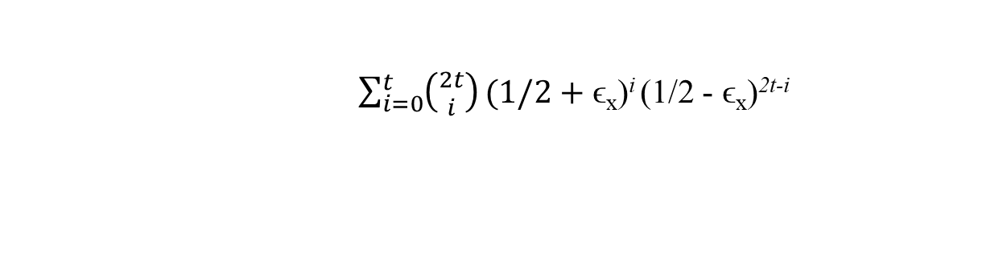
The Class BPP
Definition. A decision problem L is in BPP if there is a poly-time probabilistic Turing machine M such that for each x in L, M on x returns YES with probability ≥ 1/2 + ϵ and for each y not in L, M on y returns NO with probability ≥ 1/2 + ϵ., 0 < ϵ < 1/2.
Amplification of Success Probability.
Let L be in BPP and accepted by a poly-time prob. algorithm M with success prob. 1/2 + ϵ.
Algorithm M_{2t}(x)
run the algorithm M
on x 2t times;
2. take the majority
outcomes.
M on x has success prob. ½ + ϵ_{x}, with ½ ≥ ϵ_{x} ≥ ϵ
The prob. that M on x fails at least t times is
$\sum_{i=0}^{t}{\left({2t \atop i}\right)}(1/2+$ϵ_{x})^{i} (1/2 - ϵ_{x})^{2t-i}

Slide 33
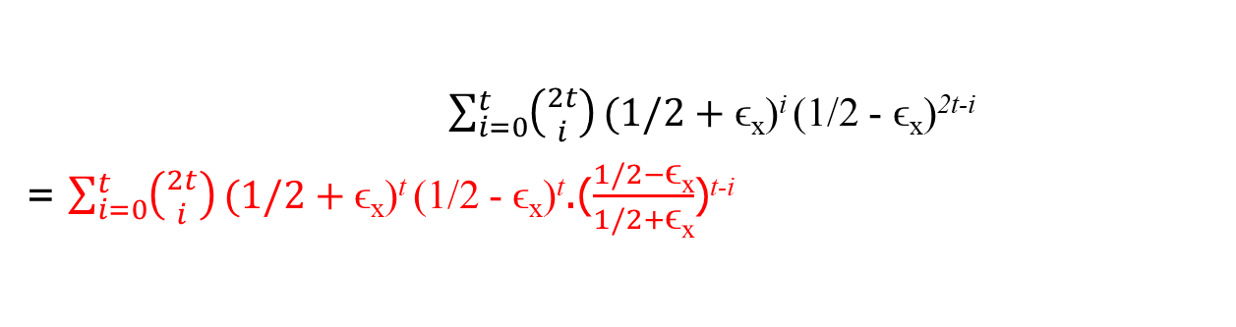
The Class BPP
Definition. A decision problem L is in BPP if there is a poly-time probabilistic Turing machine M such that for each x in L, M on x returns YES with probability ≥ 1/2 + ϵ and for each y not in L, M on y returns NO with probability ≥ 1/2 + ϵ., 0 < ϵ < 1/2.
Amplification of Success Probability.
Let L be in BPP and accepted by a poly-time prob. algorithm M with success prob. 1/2 + ϵ.
Algorithm M_{2t}(x)
run the algorithm M
on x 2t times;
2. take the majority
outcomes.
M on x has success prob. ½ + ϵ_{x}, with ½ ≥ ϵ_{x} ≥ ϵ
The prob. that M on x fails at least t times is
$\sum_{i=0}^{t}{\left({2t \atop i}\right)}(1/2+$ϵ_{x})^{i} (1/2 - ϵ_{x})^{2t-i}
= $\sum_{i=0}^{t}{\left({2t \atop i}\right)}(1/2+$ϵ_{x})^{t} (1/2 - ϵ_{x})^{t}.($\frac{1/2−\text{ϵ}\text{x}}{1/2+\text{ϵ}\text{x}}$)^{t-i}

Slide 34
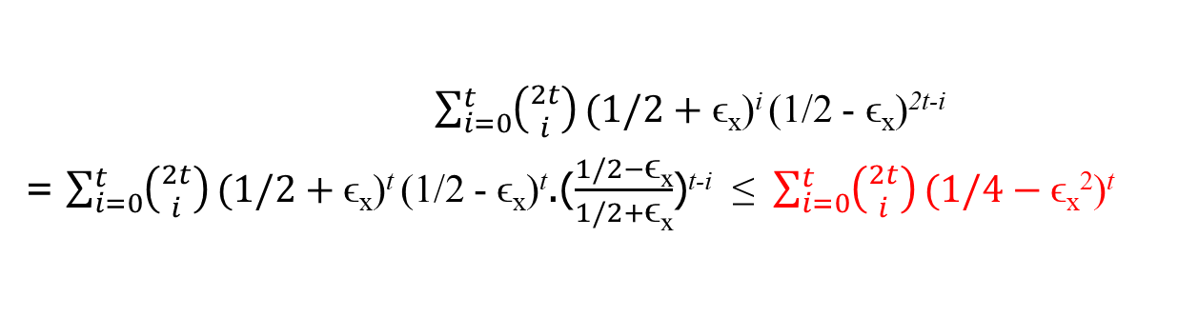
The Class BPP
Definition. A decision problem L is in BPP if there is a poly-time probabilistic Turing machine M such that for each x in L, M on x returns YES with probability ≥ 1/2 + ϵ and for each y not in L, M on y returns NO with probability ≥ 1/2 + ϵ., 0 < ϵ < 1/2.
Amplification of Success Probability.
Let L be in BPP and accepted by a poly-time prob. algorithm M with success prob. 1/2 + ϵ.
Algorithm M_{2t}(x)
run the algorithm M
on x 2t times;
2. take the majority
outcomes.
M on x has success prob. ½ + ϵ_{x}, with ½ ≥ ϵ_{x} ≥ ϵ
The prob. that M on x fails at least t times is
$\sum_{i=0}^{t}{\left({2t \atop i}\right)}(1/2+$ϵ_{x})^{i} (1/2 - ϵ_{x})^{2t-i}
= $\sum_{i=0}^{t}{\left({2t \atop i}\right)}(1/2+$ϵ_{x})^{t} (1/2 - ϵ_{x})^{t}.($\frac{1/2−\text{ϵ}\text{x}}{1/2+\text{ϵ}\text{x}}$)^{t-i} ≤ $\sum_{i=0}^{t}{\left({2t \atop i}\right)}(1/4−$ϵ_{x}²)^{t}

Slide 35
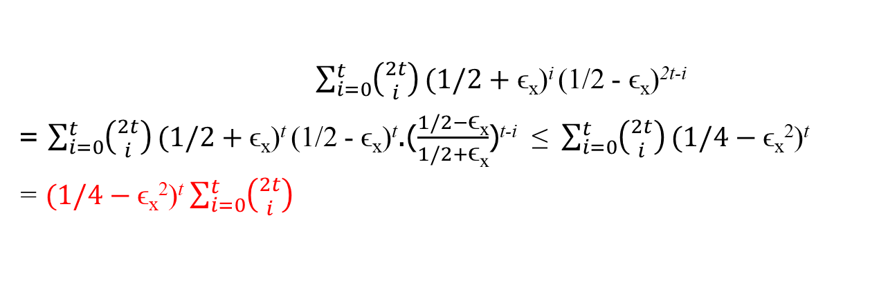
The Class BPP
Definition. A decision problem L is in BPP if there is a poly-time probabilistic Turing machine M such that for each x in L, M on x returns YES with probability ≥ 1/2 + ϵ and for each y not in L, M on y returns NO with probability ≥ 1/2 + ϵ., 0 < ϵ < 1/2.
Amplification of Success Probability.
Let L be in BPP and accepted by a poly-time prob. algorithm M with success prob. 1/2 + ϵ.
Algorithm M_{2t}(x)
run the algorithm M
on x 2t times;
2. take the majority
outcomes.
M on x has success prob. ½ + ϵ_{x}, with ½ ≥ ϵ_{x} ≥ ϵ
The prob. that M on x fails at least t times is
$\sum_{i=0}^{t}{\left({2t \atop i}\right)}(1/2+$ϵ_{x})^{i} (1/2 - ϵ_{x})^{2t-i}
= $\sum_{i=0}^{t}{\left({2t \atop i}\right)}(1/2+$ϵ_{x})^{t} (1/2 - ϵ_{x})^{t}.($\frac{1/2−\text{ϵ}\text{x}}{1/2+\text{ϵ}\text{x}}$)^{t-i} ≤ $\sum_{i=0}^{t}{\left({2t \atop i}\right)}(1/4−$ϵ_{x}²)^{t}
= $(1/4−$ϵ_{x}²)^{t} $\sum_{i=0}^{t}{\left({2t \atop i}\right)}$

Slide 36
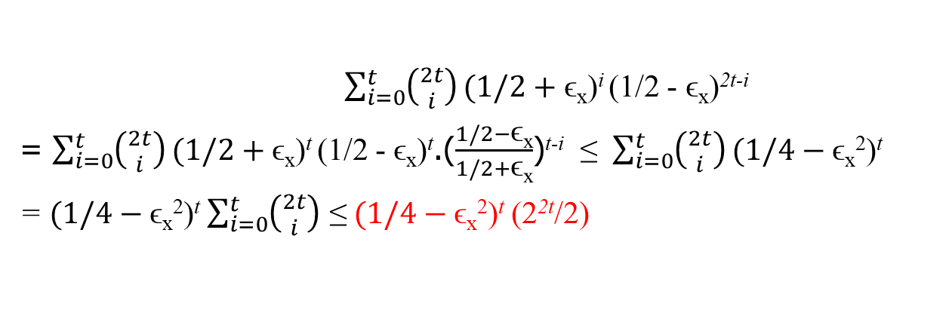
The Class BPP
Definition. A decision problem L is in BPP if there is a poly-time probabilistic Turing machine M such that for each x in L, M on x returns YES with probability ≥ 1/2 + ϵ and for each y not in L, M on y returns NO with probability ≥ 1/2 + ϵ., 0 < ϵ < 1/2.
Amplification of Success Probability.
Let L be in BPP and accepted by a poly-time prob. algorithm M with success prob. 1/2 + ϵ.
Algorithm M_{2t}(x)
run the algorithm M
on x 2t times;
2. take the majority
outcomes.
M on x has success prob. ½ + ϵ_{x}, with ½ ≥ ϵ_{x} ≥ ϵ
The prob. that M on x fails at least t times is
$\sum_{i=0}^{t}{\left({2t \atop i}\right)}(1/2+$ϵ_{x})^{i} (1/2 - ϵ_{x})^{2t-i}
= $\sum_{i=0}^{t}{\left({2t \atop i}\right)}(1/2+$ϵ_{x})^{t} (1/2 - ϵ_{x})^{t}.($\frac{1/2−\text{ϵ}\text{x}}{1/2+\text{ϵ}\text{x}}$)^{t-i} ≤ $\sum_{i=0}^{t}{\left({2t \atop i}\right)}(1/4−$ϵ_{x}²)^{t}
= $(1/4−$ϵ_{x}²)^{t} $\sum_{i=0}^{t}{\left({2t \atop i}\right)}$ ≤ $(1/4−$ϵ_{x}²)^{t} (2^{2t}/2)

Slide 37
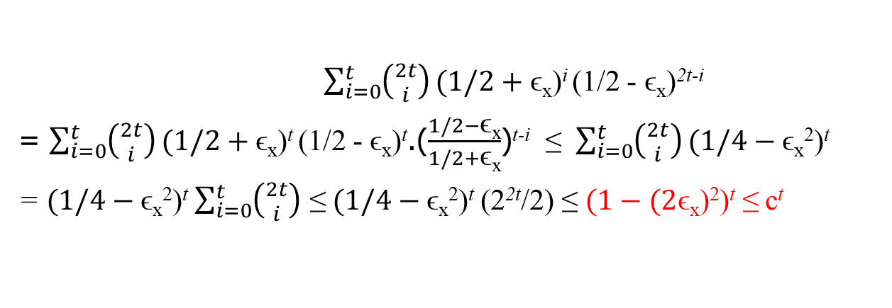
The Class BPP
Definition. A decision problem L is in BPP if there is a poly-time probabilistic Turing machine M such that for each x in L, M on x returns YES with probability ≥ 1/2 + ϵ and for each y not in L, M on y returns NO with probability ≥ 1/2 + ϵ., 0 < ϵ < 1/2.
Amplification of Success Probability.
Let L be in BPP and accepted by a poly-time prob. algorithm M with success prob. 1/2 + ϵ.
Algorithm M_{2t}(x)
run the algorithm M
on x 2t times;
2. take the majority
outcomes.
M on x has success prob. ½ + ϵ_{x}, with ½ ≥ ϵ_{x} ≥ ϵ
The prob. that M on x fails at least t times is
$\sum_{i=0}^{t}{\left({2t \atop i}\right)}(1/2+$ϵ_{x})^{i} (1/2 - ϵ_{x})^{2t-i}
= $\sum_{i=0}^{t}{\left({2t \atop i}\right)}(1/2+$ϵ_{x})^{t} (1/2 - ϵ_{x})^{t}.($\frac{1/2−\text{ϵ}\text{x}}{1/2+\text{ϵ}\text{x}}$)^{t-i} ≤ $\sum_{i=0}^{t}{\left({2t \atop i}\right)}(1/4−$ϵ_{x}²)^{t}
= $(1/4−$ϵ_{x}²)^{t} $\sum_{i=0}^{t}{\left({2t \atop i}\right)}$ ≤ $(1/4−$ϵ_{x}²)^{t} (2^{2t}/2) ≤ $(1−(2$ϵ_{x})²)^{t} ≤ c^{t}

Slide 38
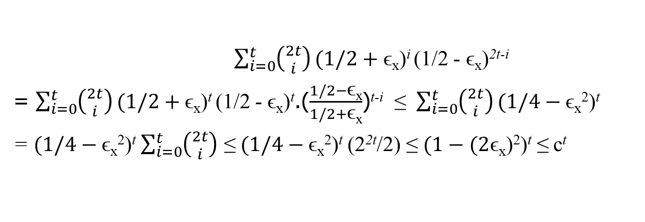
The Class BPP
Definition. A decision problem L is in BPP if there is a poly-time probabilistic Turing machine M such that for each x in L, M on x returns YES with probability ≥ 1/2 + ϵ and for each y not in L, M on y returns NO with probability ≥ 1/2 + ϵ., 0 < ϵ < 1/2.
Amplification of Success Probability.
Let L be in BPP and accepted by a poly-time prob. algorithm M with success prob. 1/2 + ϵ.
Algorithm M_{2t}(x)
run the algorithm M
on x 2t times;
2. take the majority
outcomes.
M on x has success prob. ½ + ϵ_{x}, with ½ ≥ ϵ_{x} ≥ ϵ
The prob. that M on x fails at least t times is
$\sum_{i=0}^{t}{\left({2t \atop i}\right)}(1/2+$ϵ_{x})^{i} (1/2 - ϵ_{x})^{2t-i}
= $\sum_{i=0}^{t}{\left({2t \atop i}\right)}(1/2+$ϵ_{x})^{t} (1/2 - ϵ_{x})^{t}.($\frac{1/2−\text{ϵ}\text{x}}{1/2+\text{ϵ}\text{x}}$)^{t-i} ≤ $\sum_{i=0}^{t}{\left({2t \atop i}\right)}(1/4−$ϵ_{x}²)^{t}
= $(1/4−$ϵ_{x}²)^{t} $\sum_{i=0}^{t}{\left({2t \atop i}\right)}$ ≤ $(1/4−$ϵ_{x}²)^{t} (2^{2t}/2) ≤ $(1−(2$ϵ_{x})²)^{t} ≤ c^{t}
Since ½ ≥ ϵ_{x} ≥ ϵ, 1 – (2ϵ_{x})² ≤ 1 – (2ϵ)² = c < 1,

Slide 39
The Class BPP
Definition. A decision problem L is in BPP if there is a poly-time probabilistic Turing machine M such that for each x in L, M on x returns YES with probability ≥ 1/2 + ϵ and for each y not in L, M on y returns NO with probability ≥ 1/2 + ϵ., 0 < ϵ < 1/2.
Amplification of Success Probability.
Let L be in BPP and accepted by a poly-time prob. algorithm M with success prob. 1/2 + ϵ.
Algorithm M_{2t}(x)
run the algorithm M
on x 2t times;
2. take the majority
outcomes.
M on x has success prob. ½ + ϵ_{x}, with ½ ≥ ϵ_{x} ≥ ϵ
The prob. that M on x fails at least t times is
$\sum_{i=0}^{t}{\left({2t \atop i}\right)}(1/2+$ϵ_{x})^{i} (1/2 - ϵ_{x})^{2t-i}
= $\sum_{i=0}^{t}{\left({2t \atop i}\right)}(1/2+$ϵ_{x})^{t} (1/2 - ϵ_{x})^{t}.($\frac{1/2−\text{ϵ}\text{x}}{1/2+\text{ϵ}\text{x}}$)^{t-i} ≤ $\sum_{i=0}^{t}{\left({2t \atop i}\right)}(1/4−$ϵ_{x}²)^{t}
= $(1/4−$ϵ_{x}²)^{t} $\sum_{i=0}^{t}{\left({2t \atop i}\right)}$ ≤ $(1/4−$ϵ_{x}²)^{t} (2^{2t}/2) ≤ $(1−(2$ϵ_{x})²)^{t} ≤ c^{t}
Since ½ ≥ ϵ_{x} ≥ ϵ, 1 – (2ϵ_{x})² ≤ 1 – (2ϵ)² = c < 1, Thus, c^{t} can be arbitrarily small when t is sufficiently large.

Slide 40
The Class BPP
Definition. A decision problem L is in BPP if there is a poly-time probabilistic Turing machine M such that for each x in L, M on x returns YES with probability ≥ 1/2 + ϵ and for each y not in L, M on y returns NO with probability ≥ 1/2 + ϵ., 0 < ϵ < 1/2.
Amplification of Success Probability.
Let L be in BPP and accepted by a poly-time prob. algorithm M with success prob. 1/2 + ϵ.
Algorithm M_{2t}(x)
run the algorithm M
on x 2t times;
2. take the majority
outcomes.
M on x has success prob. ½ + ϵ_{x}, with ½ ≥ ϵ_{x} ≥ ϵ
The prob. that M on x fails at least t times is
$\sum_{i=0}^{t}{\left({2t \atop i}\right)}(1/2+$ϵ_{x})^{i} (1/2 - ϵ_{x})^{2t-i}
= $\sum_{i=0}^{t}{\left({2t \atop i}\right)}(1/2+$ϵ_{x})^{t} (1/2 - ϵ_{x})^{t}.($\frac{1/2−\text{ϵ}\text{x}}{1/2+\text{ϵ}\text{x}}$)^{t-i} ≤ $\sum_{i=0}^{t}{\left({2t \atop i}\right)}(1/4−$ϵ_{x}²)^{t}
= $(1/4−$ϵ_{x}²)^{t} $\sum_{i=0}^{t}{\left({2t \atop i}\right)}$ ≤ $(1/4−$ϵ_{x}²)^{t} (2^{2t}/2) ≤ $(1−(2$ϵ_{x})²)^{t} ≤ c^{t}
Since ½ ≥ ϵ_{x} ≥ ϵ, 1 – (2ϵ_{x})² ≤ 1 – (2ϵ)² = c < 1, Thus, c^{t} can be arbitrarily small when t is sufficiently large.
The success prob. of M_{2t} is ≥ 1 - c^{t}, which can be arbitrarily close to 1

Slide 41
The Class BPP
Definition. A decision problem L is in BPP if there is a poly-time probabilistic Turing machine M such that for each x in L, M on x returns YES with probability ≥ 1/2 + ϵ and for each y not in L, M on y returns NO with probability ≥ 1/2 + ϵ., 0 < ϵ < 1/2.
Algorithm M_{2t}(x)
run the algorithm M on x 2t times;
2. take the majority outcomes.

Slide 42
The Class BPP
Definition. A decision problem L is in BPP if there is a poly-time probabilistic Turing machine M such that for each x in L, M on x returns YES with probability ≥ 1/2 + ϵ and for each y not in L, M on y returns NO with probability ≥ 1/2 + ϵ., 0 < ϵ < 1/2.
Algorithm M_{2t}(x)
run the algorithm M on x 2t times;
2. take the majority outcomes.
If L is accepted by BPP-machine M with success probability 1/2+ϵ, then L is accepted by M_{2t} with success probability ≥ 1 - c^{t}, i.e., with error probability bounded by c^{t}, where c < 1 is a constant.

Slide 43
The Class BPP
Definition. A decision problem L is in BPP if there is a poly-time probabilistic Turing machine M such that for each x in L, M on x returns YES with probability ≥ 1/2 + ϵ and for each y not in L, M on y returns NO with probability ≥ 1/2 + ϵ., 0 < ϵ < 1/2.
Algorithm M_{2t}(x)
run the algorithm M on x 2t times;
2. take the majority outcomes.
If L is accepted by BPP-machine M with success probability 1/2+ϵ, then L is accepted by M_{2t} with success probability ≥ 1 - c^{t}, i.e., with error probability bounded by c^{t}, where c < 1 is a constant.
As long as t is a polynomial of n, M_{2t} runs in polynomial time.

Slide 44
The Class BPP
Definition. A decision problem L is in BPP if there is a poly-time probabilistic Turing machine M such that for each x in L, M on x returns YES with probability ≥ 1/2 + ϵ and for each y not in L, M on y returns NO with probability ≥ 1/2 + ϵ., 0 < ϵ < 1/2.
Algorithm M_{2t}(x)
run the algorithm M on x 2t times;
2. take the majority outcomes.
If L is accepted by BPP-machine M with success probability 1/2+ϵ, then L is accepted by M_{2t} with success probability ≥ 1 - c^{t}, i.e., with error probability bounded by c^{t}, where c < 1 is a constant.
As long as t is a polynomial of n, M_{2t} runs in polynomial time.
Therefore, for a language L in BPP, and for any polynomial p(n), there is a BPP-machine accepting L with error bound 1/2^{p(n)}.

