Slide 1
CSCE-637 Complexity Theory
Fall 2020
Instructor: Jianer Chen
Office: HRBB 338C
Phone: 845-4259
Email: chen@cse.tamu.edu
Notes 15: Polynomial-Time Hierarchy

Slide 2
Polynomial-Time Hierarchy
Oracle Turing Machine M^{A}:
A TM M equipped with an oracle (i.e. a subroutine) that can (magically) answer the yes/no on the associate oracle language A
work tape
M^{A}
oracle tape for A

Slide 3
Polynomial-Time Hierarchy
Definition. Let C be a complexity class. A language L is in P^{C} (resp. NP^{C}) if L is accepted by a deterministic (resp. nondeterministic) poly-time oracle TM M^{A}, where A is a language in C. The computational cost spent on the oracle is not counted.

Slide 4




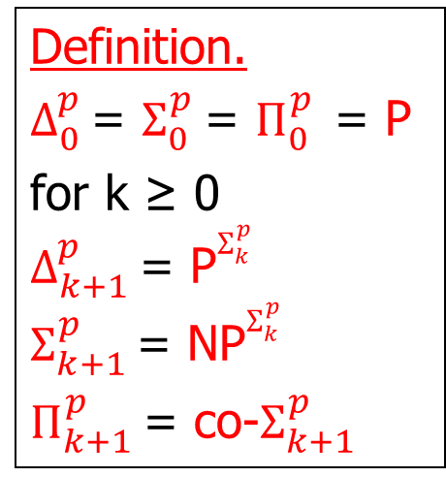
























Polynomial-Time Hierarchy
Definition. Let C be a complexity class. A language L is in P^{C} (resp. NP^{C}) if L is accepted by a deterministic (resp. nondeterministic) poly-time oracle TM M^{A}, where A is a language in C. The computational cost spent on the oracle is not counted.
Definition.
$Δ_{0}^{p}$ = $Σ_{0}^{p}$ = $Π_{0}^{p}$ = P
for k ≥ 0
$Δ_{k+1}^{p}$ = P$Σ_{k}^{p}$
$Σ_{k+1}^{p}$ = NP$Σ_{k}^{p}$
$Π_{k+1}^{p}$ = co-$Σ_{k+1}^{p}$
⁝
$$Σ_{3}^{p}$$
⁝
$$Π_{3}^{p}$$
$$Σ_{3}^{p}$$
$$Π_{3}^{p}$$
$$⊆$$
$$⊆$$
$$Δ_{3}^{p}$$
$$Δ_{3}^{p}$$
$$⊆$$
$$⊆$$
$$Σ_{2}^{p}$$
$$Π_{2}^{p}$$
$$Σ_{2}^{p}$$
$$Π_{2}^{p}$$
$$⊆$$
$$⊆$$
$$Δ_{2}^{p}$$
$$Δ_{2}^{p}$$
$$⊆$$
$$⊆$$
$$Σ_{1}^{p}$$
$$Π_{1}^{p}$$
NP=$Σ_{1}^{p}$
$Π_{1}^{p}$=coNP
$$⊆$$
$$⊆$$
P = $Δ_{1}^{p}$
P = $Δ_{1}^{p}$

Slide 5
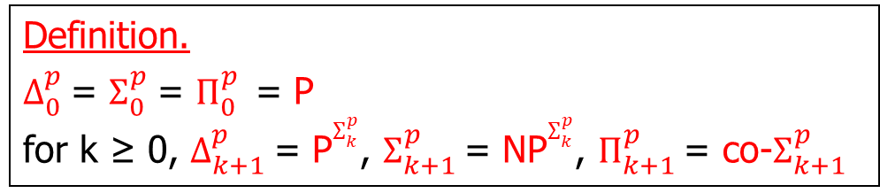
Polynomial-Time Hierarchy
Definition.
$Δ_{0}^{p}$ = $Σ_{0}^{p}$ = $Π_{0}^{p}$ = P
for k ≥ 0, $Δ_{k+1}^{p}$ = P$Σ_{k}^{p}$, $Σ_{k+1}^{p}$ = NP$Σ_{k}^{p}$, $Π_{k+1}^{p}$ = co-$Σ_{k+1}^{p}$

Slide 6
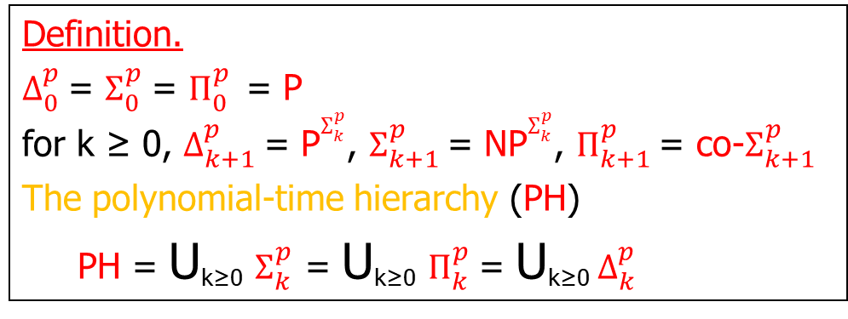
Polynomial-Time Hierarchy
Definition.
$Δ_{0}^{p}$ = $Σ_{0}^{p}$ = $Π_{0}^{p}$ = P
for k ≥ 0, $Δ_{k+1}^{p}$ = P$Σ_{k}^{p}$, $Σ_{k+1}^{p}$ = NP$Σ_{k}^{p}$, $Π_{k+1}^{p}$ = co-$Σ_{k+1}^{p}$
The polynomial-time hierarchy (PH)
PH = Ս_{k≥0} $Σ_{k}^{p}$ = Ս_{k≥0} $Π_{k}^{p}$= Ս_{k≥0}${ Δ}_{k}^{p}$

Slide 7
Polynomial-Time Hierarchy
Definition.
$Δ_{0}^{p}$ = $Σ_{0}^{p}$ = $Π_{0}^{p}$ = P
for k ≥ 0, $Δ_{k+1}^{p}$ = P$Σ_{k}^{p}$, $Σ_{k+1}^{p}$ = NP$Σ_{k}^{p}$, $Π_{k+1}^{p}$ = co-$Σ_{k+1}^{p}$
The polynomial-time hierarchy (PH)
PH = Ս_{k≥0} $Σ_{k}^{p}$ = Ս_{k≥0} $Π_{k}^{p}$= Ս_{k≥0}${ Δ}_{k}^{p}$
Basic Facts:

Slide 8
Polynomial-Time Hierarchy
Definition.
$Δ_{0}^{p}$ = $Σ_{0}^{p}$ = $Π_{0}^{p}$ = P
for k ≥ 0, $Δ_{k+1}^{p}$ = P$Σ_{k}^{p}$, $Σ_{k+1}^{p}$ = NP$Σ_{k}^{p}$, $Π_{k+1}^{p}$ = co-$Σ_{k+1}^{p}$
The polynomial-time hierarchy (PH)
PH = Ս_{k≥0} $Σ_{k}^{p}$ = Ս_{k≥0} $Π_{k}^{p}$= Ս_{k≥0}${ Δ}_{k}^{p}$
Basic Facts:
$Δ_{1}^{p}$ = P, $Δ_{k+1}^{p}$ = co-$Δ_{k+1}^{p}$.

Slide 9
Polynomial-Time Hierarchy
Definition.
$Δ_{0}^{p}$ = $Σ_{0}^{p}$ = $Π_{0}^{p}$ = P
for k ≥ 0, $Δ_{k+1}^{p}$ = P$Σ_{k}^{p}$, $Σ_{k+1}^{p}$ = NP$Σ_{k}^{p}$, $Π_{k+1}^{p}$ = co-$Σ_{k+1}^{p}$
The polynomial-time hierarchy (PH)
PH = Ս_{k≥0} $Σ_{k}^{p}$ = Ս_{k≥0} $Π_{k}^{p}$= Ս_{k≥0}${ Δ}_{k}^{p}$
Basic Facts:
$Δ_{1}^{p}$ = P, $Δ_{k+1}^{p}$ = co-$Δ_{k+1}^{p}$.
$Δ_{k}^{p}⊆$ $Σ_{k}^{p}$, ${ Δ}_{k}^{p}⊆Π_{k}^{p}$, ${ Σ}_{k}^{p}$, $Π_{k}^{p}⊆Δ_{k+1}^{p}$.

Slide 10
Polynomial-Time Hierarchy
Definition.
$Δ_{0}^{p}$ = $Σ_{0}^{p}$ = $Π_{0}^{p}$ = P
for k ≥ 0, $Δ_{k+1}^{p}$ = P$Σ_{k}^{p}$, $Σ_{k+1}^{p}$ = NP$Σ_{k}^{p}$, $Π_{k+1}^{p}$ = co-$Σ_{k+1}^{p}$
The polynomial-time hierarchy (PH)
PH = Ս_{k≥0} $Σ_{k}^{p}$ = Ս_{k≥0} $Π_{k}^{p}$= Ս_{k≥0}${ Δ}_{k}^{p}$
Basic Facts:
$Δ_{1}^{p}$ = P, $Δ_{k+1}^{p}$ = co-$Δ_{k+1}^{p}$.
$Δ_{k}^{p}⊆$ $Σ_{k}^{p}$, ${ Δ}_{k}^{p}⊆Π_{k}^{p}$, ${ Σ}_{k}^{p}$, $Π_{k}^{p}⊆Δ_{k+1}^{p}$.
If $Σ_{k}^{p}$ = $Σ_{k+1}^{p}$, then PH = $Σ_{k}^{p}$ (the poly-time hierarchy collapses)

Slide 11
Polynomial-Time Hierarchy
Definition.
$Δ_{0}^{p}$ = $Σ_{0}^{p}$ = $Π_{0}^{p}$ = P
for k ≥ 0, $Δ_{k+1}^{p}$ = P$Σ_{k}^{p}$, $Σ_{k+1}^{p}$ = NP$Σ_{k}^{p}$, $Π_{k+1}^{p}$ = co-$Σ_{k+1}^{p}$
The polynomial-time hierarchy (PH)
PH = Ս_{k≥0} $Σ_{k}^{p}$ = Ս_{k≥0} $Π_{k}^{p}$= Ս_{k≥0}${ Δ}_{k}^{p}$
Basic Facts:
$Δ_{1}^{p}$ = P, $Δ_{k+1}^{p}$ = co-$Δ_{k+1}^{p}$.
$Δ_{k}^{p}⊆$ $Σ_{k}^{p}$, ${ Δ}_{k}^{p}⊆Π_{k}^{p}$, ${ Σ}_{k}^{p}$, $Π_{k}^{p}⊆Δ_{k+1}^{p}$.
If $Σ_{k}^{p}$ = $Σ_{k+1}^{p}$, then PH = $Σ_{k}^{p}$ (the poly-time hierarchy collapses)
In particular, If P = NP, then PH = P.

Slide 12
Polynomial-Time Hierarchy
Definition.
$Δ_{0}^{p}$ = $Σ_{0}^{p}$ = $Π_{0}^{p}$ = P
for k ≥ 0, $Δ_{k+1}^{p}$ = P$Σ_{k}^{p}$, $Σ_{k+1}^{p}$ = NP$Σ_{k}^{p}$, $Π_{k+1}^{p}$ = co-$Σ_{k+1}^{p}$
The polynomial-time hierarchy (PH)
PH = Ս_{k≥0} $Σ_{k}^{p}$ = Ս_{k≥0} $Π_{k}^{p}$= Ս_{k≥0}${ Δ}_{k}^{p}$
Basic Facts:
$Δ_{1}^{p}$ = P, $Δ_{k+1}^{p}$ = co-$Δ_{k+1}^{p}$.
$Δ_{k}^{p}⊆$ $Σ_{k}^{p}$, ${ Δ}_{k}^{p}⊆Π_{k}^{p}$, ${ Σ}_{k}^{p}$, $Π_{k}^{p}⊆Δ_{k+1}^{p}$.
If $Σ_{k}^{p}$ = $Σ_{k+1}^{p}$, then PH = $Σ_{k}^{p}$ (the poly-time hierarchy collapses)
In particular, If P = NP, then PH = P.
If PH has a complete problem (under poly-time reduction), then PH collapses.

Slide 13
Polynomial-Time Hierarchy
Definition.
$Δ_{0}^{p}$ = $Σ_{0}^{p}$ = $Π_{0}^{p}$ = P
for k ≥ 0, $Δ_{k+1}^{p}$ = P$Σ_{k}^{p}$, $Σ_{k+1}^{p}$ = NP$Σ_{k}^{p}$, $Π_{k+1}^{p}$ = co-$Σ_{k+1}^{p}$
The polynomial-time hierarchy (PH)
PH = Ս_{k≥0} $Σ_{k}^{p}$ = Ս_{k≥0} $Π_{k}^{p}$= Ս_{k≥0}${ Δ}_{k}^{p}$
Basic Facts:
$Δ_{1}^{p}$ = P, $Δ_{k+1}^{p}$ = co-$Δ_{k+1}^{p}$.
$Δ_{k}^{p}⊆$ $Σ_{k}^{p}$, ${ Δ}_{k}^{p}⊆Π_{k}^{p}$, ${ Σ}_{k}^{p}$, $Π_{k}^{p}⊆Δ_{k+1}^{p}$.
If $Σ_{k}^{p}$ = $Σ_{k+1}^{p}$, then PH = $Σ_{k}^{p}$ (the poly-time hierarchy collapses)
In particular, If P = NP, then PH = P.
If PH has a complete problem (under poly-time reduction), then PH collapses.
It is commonly believed that PH does not collapse.

Slide 14
Polynomial-Time Hierarchy
Definition.
$Δ_{0}^{p}$ = $Σ_{0}^{p}$ = $Π_{0}^{p}$ = P
for k ≥ 0, $Δ_{k+1}^{p}$ = P$Σ_{k}^{p}$, $Σ_{k+1}^{p}$ = NP$Σ_{k}^{p}$, $Π_{k+1}^{p}$ = co-$Σ_{k+1}^{p}$
The polynomial-time hierarchy (PH)
PH = Ս_{k≥0} $Σ_{k}^{p}$ = Ս_{k≥0} $Π_{k}^{p}$= Ս_{k≥0}${ Δ}_{k}^{p}$
Basic Facts:
$Σ_{k}^{p}$: A = { x | $∃$_{p}y₁$\text{∀}$_{p}y₂ ⸱⸱⸱ Q_{p}y_{k} F_{A}(x, y₁, y₂, …, y_{k}) = 1 } (QBF_{k})
$Π_{k}^{p}$: B = { x | $\text{∀}$_{p}y₁$∃$_{p}y₂ ⸱⸱⸱ Q_{p}y_{k} F_{B}(x, y₁, y₂, …, y_{k}) = 1 }

Slide 15
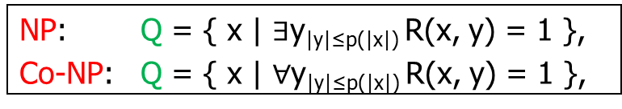
Polynomial-Time Hierarchy
Definition.
$Δ_{0}^{p}$ = $Σ_{0}^{p}$ = $Π_{0}^{p}$ = P
for k ≥ 0, $Δ_{k+1}^{p}$ = P$Σ_{k}^{p}$, $Σ_{k+1}^{p}$ = NP$Σ_{k}^{p}$, $Π_{k+1}^{p}$ = co-$Σ_{k+1}^{p}$
The polynomial-time hierarchy (PH)
PH = Ս_{k≥0} $Σ_{k}^{p}$ = Ս_{k≥0} $Π_{k}^{p}$= Ս_{k≥0}${ Δ}_{k}^{p}$
Basic Facts:
$Σ_{k}^{p}$: A = { x | $∃$_{p}y₁$\text{∀}$_{p}y₂ ⸱⸱⸱ Q_{p}y_{k} F_{A}(x, y₁, y₂, …, y_{k}) = 1 } (QBF_{k})
$Π_{k}^{p}$: B = { x | $\text{∀}$_{p}y₁$∃$_{p}y₂ ⸱⸱⸱ Q_{p}y_{k} F_{B}(x, y₁, y₂, …, y_{k}) = 1 }
Recall:
NP: Q = { x | $∃$y_{|y|≤p(|x|)} R(x, y) = 1 },
Co-NP: Q = { x | $∀$y_{|y|≤p(|x|)} R(x, y) = 1 },

Slide 16
Polynomial-Time Hierarchy
Definition.
$Δ_{0}^{p}$ = $Σ_{0}^{p}$ = $Π_{0}^{p}$ = P
for k ≥ 0, $Δ_{k+1}^{p}$ = P$Σ_{k}^{p}$, $Σ_{k+1}^{p}$ = NP$Σ_{k}^{p}$, $Π_{k+1}^{p}$ = co-$Σ_{k+1}^{p}$
The polynomial-time hierarchy (PH)
PH = Ս_{k≥0} $Σ_{k}^{p}$ = Ս_{k≥0} $Π_{k}^{p}$= Ս_{k≥0}${ Δ}_{k}^{p}$
Basic Facts:
$Σ_{k}^{p}$: A = { x | $∃$_{p}y₁$\text{∀}$_{p}y₂ ⸱⸱⸱ Q_{p}y_{k} F_{A}(x, y₁, y₂, …, y_{k}) = 1 } (QBF_{k})
$Π_{k}^{p}$: B = { x | $\text{∀}$_{p}y₁$∃$_{p}y₂ ⸱⸱⸱ Q_{p}y_{k} F_{B}(x, y₁, y₂, …, y_{k}) = 1 }
If $Σ_{k}^{p}$ = $Π_{k}^{p}$, then PH = $Σ_{k}^{p}$

Slide 17

Polynomial-Time Hierarchy
Definition.
$Δ_{0}^{p}$ = $Σ_{0}^{p}$ = $Π_{0}^{p}$ = P
for k ≥ 0, $Δ_{k+1}^{p}$ = P$Σ_{k}^{p}$, $Σ_{k+1}^{p}$ = NP$Σ_{k}^{p}$, $Π_{k+1}^{p}$ = co-$Σ_{k+1}^{p}$
The polynomial-time hierarchy (PH)
PH = Ս_{k≥0} $Σ_{k}^{p}$ = Ս_{k≥0} $Π_{k}^{p}$= Ս_{k≥0}${ Δ}_{k}^{p}$
Basic Facts:
$Σ_{k}^{p}$: A = { x | $∃$_{p}y₁$\text{∀}$_{p}y₂ ⸱⸱⸱ Q_{p}y_{k} F_{A}(x, y₁, y₂, …, y_{k}) = 1 } (QBF_{k})
$Π_{k}^{p}$: B = { x | $\text{∀}$_{p}y₁$∃$_{p}y₂ ⸱⸱⸱ Q_{p}y_{k} F_{B}(x, y₁, y₂, …, y_{k}) = 1 }
If $Σ_{k}^{p}$ = $Π_{k}^{p}$, then PH = $Σ_{k}^{p}$
Recall:
If $Σ_{k}^{p}$ = $Σ_{k+1}^{p}$, then PH = $Σ_{k}^{p}$

Slide 18
Polynomial-Time Hierarchy
Definition.
$Δ_{0}^{p}$ = $Σ_{0}^{p}$ = $Π_{0}^{p}$ = P
for k ≥ 0, $Δ_{k+1}^{p}$ = P$Σ_{k}^{p}$, $Σ_{k+1}^{p}$ = NP$Σ_{k}^{p}$, $Π_{k+1}^{p}$ = co-$Σ_{k+1}^{p}$
The polynomial-time hierarchy (PH)
PH = Ս_{k≥0} $Σ_{k}^{p}$ = Ս_{k≥0} $Π_{k}^{p}$= Ս_{k≥0}${ Δ}_{k}^{p}$
Basic Facts:
$Σ_{k}^{p}$: A = { x | $∃$_{p}y₁$\text{∀}$_{p}y₂ ⸱⸱⸱ Q_{p}y_{k} F_{A}(x, y₁, y₂, …, y_{k}) = 1 } (QBF_{k})
$Π_{k}^{p}$: B = { x | $\text{∀}$_{p}y₁$∃$_{p}y₂ ⸱⸱⸱ Q_{p}y_{k} F_{B}(x, y₁, y₂, …, y_{k}) = 1 }
If $Σ_{k}^{p}$ = $Π_{k}^{p}$, then PH = $Σ_{k}^{p}$
PSPACE-complete problem QBF:
QBF = {$∃$x₁$\text{∀}$x₂ ⸱⸱⸱ Qx_{n} F (x₁, x₂, …, x_{n}) = 1 }

Slide 19
Polynomial-Time Hierarchy
Definition.
$Δ_{0}^{p}$ = $Σ_{0}^{p}$ = $Π_{0}^{p}$ = P
for k ≥ 0, $Δ_{k+1}^{p}$ = P$Σ_{k}^{p}$, $Σ_{k+1}^{p}$ = NP$Σ_{k}^{p}$, $Π_{k+1}^{p}$ = co-$Σ_{k+1}^{p}$
The polynomial-time hierarchy (PH)
PH = Ս_{k≥0} $Σ_{k}^{p}$ = Ս_{k≥0} $Π_{k}^{p}$= Ս_{k≥0}${ Δ}_{k}^{p}$
Basic Facts:
$Σ_{k}^{p}$: A = { x | $∃$_{p}y₁$\text{∀}$_{p}y₂ ⸱⸱⸱ Q_{p}y_{k} F_{A}(x, y₁, y₂, …, y_{k}) = 1 } (QBF_{k})
$Π_{k}^{p}$: B = { x | $\text{∀}$_{p}y₁$∃$_{p}y₂ ⸱⸱⸱ Q_{p}y_{k} F_{B}(x, y₁, y₂, …, y_{k}) = 1 }
If $Σ_{k}^{p}$ = $Π_{k}^{p}$, then PH = $Σ_{k}^{p}$
PSPACE-complete problem QBF:
QBF = {$∃$x₁$\text{∀}$x₂ ⸱⸱⸱ Qx_{n} F (x₁, x₂, …, x_{n}) = 1 }
Thus, PH $⊆$ PSPACE.

Slide 20
Major Open Problems

Slide 21
Major Open Problems
NC₁ $⊆$ L $⊆$ NL $⊆$NC₂ $⊆$NC₃ $⊆$……. $⊆$ NC $⊆$ P $⊆$ NP $⊆$ PSPACE

Slide 22
Major Open Problems
NC₁ $⊆$ L $⊆$ NL $⊆$NC₂ $⊆$NC₃ $⊆$……. $⊆$ NC $⊆$ P $⊆$ NP $⊆$ PSPACE

Slide 23



















Major Open Problems
NC₁ $⊆$ L $⊆$ NL $⊆$NC₂ $⊆$NC₃ $⊆$……. $⊆$ NC $⊆$ P $⊆$ NP $⊆$ PSPACE
NP=$Σ_{1}^{p}$
$$⊆$$
$$Σ_{2}^{p}$$
$$⊆$$
$$⊆$$
$$⊆$$
$$⊆$$
P
$$Δ_{2}^{p}$$
$$Δ_{3}^{p}$$
$$…$$
$$⊆$$
PH
$$⊆$$
PSPACE
$$⊆$$
coNP=$Π_{1}^{p}$
$$⊆$$
$$⊆$$
$$Π_{2}^{p}$$
$$⊆$$
$$⊆$$

Slide 24
Major Open Problems
NC₁ $⊆$ L $⊆$ NL $⊆$NC₂ $⊆$NC₃ $⊆$……. $⊆$ NC $⊆$ P $⊆$ NP $⊆$ PSPACE
NP=$Σ_{1}^{p}$
$$⊆$$
$$Σ_{2}^{p}$$
$$⊆$$
$$⊆$$
$$⊆$$
$$⊆$$
P
$$Δ_{2}^{p}$$
$$Δ_{3}^{p}$$
$$…$$
$$⊆$$
PH
$$⊆$$
PSPACE
$$⊆$$
coNP=$Π_{1}^{p}$
$$⊆$$
$$⊆$$
$$Π_{2}^{p}$$
$$⊆$$
$$⊆$$
P = NP?

Slide 25
Major Open Problems
NC₁ $⊆$ L $⊆$ NL $⊆$NC₂ $⊆$NC₃ $⊆$……. $⊆$ NC $⊆$ P $⊆$ NP $⊆$ PSPACE
NP=$Σ_{1}^{p}$
$$⊆$$
$$Σ_{2}^{p}$$
$$⊆$$
$$⊆$$
$$⊆$$
$$⊆$$
P
$$Δ_{2}^{p}$$
$$Δ_{3}^{p}$$
$$…$$
$$⊆$$
PH
$$⊆$$
PSPACE
$$⊆$$
coNP=$Π_{1}^{p}$
$$⊆$$
$$⊆$$
$$Π_{2}^{p}$$
$$⊆$$
$$⊆$$
P = NP?
NP = coNP?

Slide 26
Major Open Problems
NC₁ $⊆$ L $⊆$ NL $⊆$NC₂ $⊆$NC₃ $⊆$……. $⊆$ NC $⊆$ P $⊆$ NP $⊆$ PSPACE
NP=$Σ_{1}^{p}$
$$⊆$$
$$Σ_{2}^{p}$$
$$⊆$$
$$⊆$$
$$⊆$$
$$⊆$$
P
$$Δ_{2}^{p}$$
$$Δ_{3}^{p}$$
$$…$$
$$⊆$$
PH
$$⊆$$
PSPACE
$$⊆$$
coNP=$Π_{1}^{p}$
$$⊆$$
$$⊆$$
$$Π_{2}^{p}$$
$$⊆$$
$$⊆$$
P = NP?
NP = coNP?
$Σ_{k}^{p}$ = $Σ_{k+1}^{p}$ for some k?
$Σ_{k}^{p}$ = $Π_{k}^{p}$ for some k?

Slide 27
Major Open Problems
NC₁ $⊆$ L $⊆$ NL $⊆$NC₂ $⊆$NC₃ $⊆$……. $⊆$ NC $⊆$ P $⊆$ NP $⊆$ PSPACE
NP=$Σ_{1}^{p}$
$$⊆$$
$$Σ_{2}^{p}$$
$$⊆$$
$$⊆$$
$$⊆$$
$$⊆$$
P
$$Δ_{2}^{p}$$
$$Δ_{3}^{p}$$
$$…$$
$$⊆$$
PH
$$⊆$$
PSPACE
$$⊆$$
coNP=$Π_{1}^{p}$
$$⊆$$
$$⊆$$
$$Π_{2}^{p}$$
$$⊆$$
$$⊆$$
P = NP?
NP = coNP?
$Σ_{k}^{p}$ = $Σ_{k+1}^{p}$ for some k?
}
does the PH collapse?
$Σ_{k}^{p}$ = $Π_{k}^{p}$ for some k?

Slide 28
Major Open Problems
NC₁ $⊆$ L $⊆$ NL $⊆$NC₂ $⊆$NC₃ $⊆$……. $⊆$ NC $⊆$ P $⊆$ NP $⊆$ PSPACE
NP=$Σ_{1}^{p}$
$$⊆$$
$$Σ_{2}^{p}$$
$$⊆$$
$$⊆$$
$$⊆$$
$$⊆$$
P
$$Δ_{2}^{p}$$
$$Δ_{3}^{p}$$
$$…$$
$$⊆$$
PH
$$⊆$$
PSPACE
$$⊆$$
coNP=$Π_{1}^{p}$
$$⊆$$
$$⊆$$
$$Π_{2}^{p}$$
$$⊆$$
$$⊆$$
P = NP?
NP = coNP?
$Σ_{k}^{p}$ = $Σ_{k+1}^{p}$ for some k?
}
does the PH collapse?
$Σ_{k}^{p}$ = $Π_{k}^{p}$ for some k?
PH = PSPACE?

Slide 29
Major Open Problems
NC₁ $⊆$ L $⊆$ NL $⊆$NC₂ $⊆$NC₃ $⊆$……. $⊆$ NC $⊆$ P $⊆$ NP $⊆$ PSPACE
NP=$Σ_{1}^{p}$
$$⊆$$
$$Σ_{2}^{p}$$
$$⊆$$
$$⊆$$
$$⊆$$
$$⊆$$
P
$$Δ_{2}^{p}$$
$$Δ_{3}^{p}$$
$$…$$
$$⊆$$
PH
$$⊆$$
PSPACE
$$⊆$$
coNP=$Π_{1}^{p}$
$$⊆$$
$$⊆$$
$$Π_{2}^{p}$$
$$⊆$$
$$⊆$$
P = NP?
NP = coNP?
$Σ_{k}^{p}$ = $Σ_{k+1}^{p}$ for some k?
}
does the PH collapse?
$Σ_{k}^{p}$ = $Π_{k}^{p}$ for some k?
PH = PSPACE?
We believe that the answers to all questions above are “NO”. Thus, any conjecture that implies an equality above is regarded as “unlikely.”

