Slide 1
CPSC-629 Analysis of Algorithms
Professor Jianer Chen
Room 428 PETR
November 28, 2022

Slide 2
NP-Completeness Theory
Definition. A problem is in P if it can be solved in polynomial time.
Definition. A problem Q is in NP if Q is a decision problem and there is an algorithm A_{Q} such that for any instance x of Q:
If x is a yes-instance, then there is a y such that A_{Q}(x, y) = 1;
If x is a no-instance, then for all y, A_{Q}(x, y) = 0;
A_{Q}(x, y) runs in time polynomial in |x|.
Definition. Let Q₁ and Q₂ be decision problems. We say that Q₁ is poly-time reducible to Q₂, written Q₁ $≤_{m}^{p}$ Q₂, if there is a poly-time algorithm R such that for any instance x₁ of Q₁, x₁ is a yes for Q₁ if and only if R(x₁) is a yes for Q₂.
Definition. (1) A problem Q is NP–hard if for every problem Q’ in NP, Q’ $≤_{m}^{p}$ Q. (2) A problem Q is NP–complete if it is in NP and NP–hard.
Cook Theorem. SAT is NP–complete.
Lemma. If Q₁ $≤_{m}^{p}$ Q₂, and Q₁ is NP–hard, then Q₂ is NP–hard.
A general procedure to prove NP–hardness of a problem Q₂:
(1) Start with a known NP–hard problem Q₁; (2) Show Q₁ $≤_{m}^{p}$ Q₂.

Slide 3
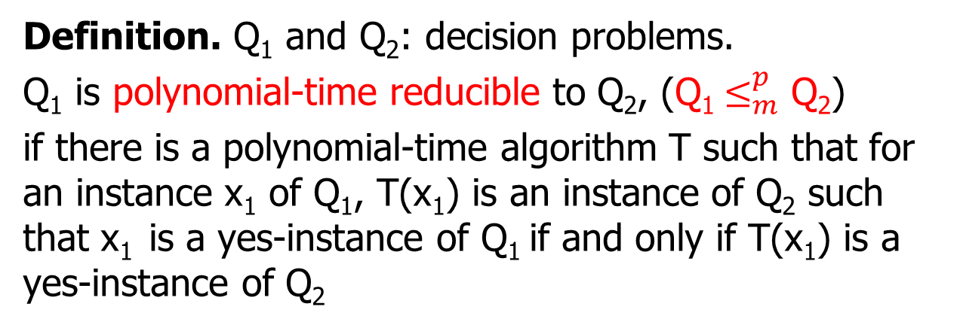
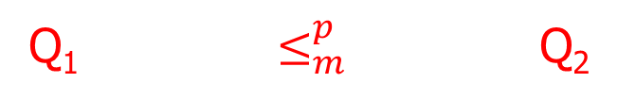
Polynomial-time Reduction
Definition. Q₁ and Q₂: decision problems.
Q₁ is polynomial-time reducible to Q₂, (Q₁ $≤_{m}^{p}$ Q₂)
if there is a polynomial-time algorithm T such that for an instance x₁ of Q₁, T(x₁) is an instance of Q₂ such that x₁ is a yes-instance of Q₁ if and only if T(x₁) is a yes-instance of Q₂
* Q₁ is not harder than Q₂
Q₁ $≤_{m}^{p}$ Q₂
T
x₁ T(x₁)
* If Q₂ is in P, then so is Q₁
* If Q₁ is not in P, then neither is Q₁
yes/no yes/no

Slide 4
Problems in NP that are not known to be in P
Satisfiability (SAT)
Given a CNF formula F, is F satisfiable?
Indepdent Set (IS)
Given a graph G and k, does G contain an independent set of k vertices?
Vertex Cover (VC)
Given a graph G and k, does G contain a vertex cover of k vertices?
Partition
Given n integers, can they be partitioned into two parts of equal sum?

Slide 5
NP-Completeness Theory
A general procedure to prove NP–hardness of a problem Q₂:
(1) Start with a known NP–hard problem Q₁; (2) Show Q₁ $≤_{m}^{p}$ Q₂.

Slide 6
NP-Completeness Theory
A general procedure to prove NP–hardness of a problem Q₂:
(1) Start with a known NP–hard problem Q₁; (2) Show Q₁ $≤_{m}^{p}$ Q₂.
Example 1. Independent-Set is NP–complete.
Independent Set (IS). Given (G, k), where G is a graph and k is an integer, can we find a set I of k vertices in G such that no two vertices in I are adjacent?
Satisfiability (SAT). Given a CNF formula F = F(x₁, x₂, …, x_{n}), is there an assignment to x₁, x₂, …, x_{n} to make F = true?

Slide 7
NP-Completeness Theory
A general procedure to prove NP–hardness of a problem Q₂:
(1) Start with a known NP–hard problem Q₁; (2) Show Q₁ $≤_{m}^{p}$ Q₂.
Example 1. Independent-Set is NP–complete.
Independent Set (IS). Given (G, k), where G is a graph and k is an integer, can we find a set I of k vertices in G such that no two vertices in I are adjacent?
Satisfiability (SAT). Given a CNF formula F = F(x₁, x₂, …, x_{n}), is there an assignment to x₁, x₂, …, x_{n} to make F = true?
We show:
SAT
$≤_{m}^{p}$
IS

Slide 8
NP-Completeness Theory
A general procedure to prove NP–hardness of a problem Q₂:
(1) Start with a known NP–hard problem Q₁; (2) Show Q₁ $≤_{m}^{p}$ Q₂.
Example 1. Independent-Set is NP–complete.
Independent Set (IS). Given (G, k), where G is a graph and k is an integer, can we find a set I of k vertices in G such that no two vertices in I are adjacent?
Satisfiability (SAT). Given a CNF formula F = F(x₁, x₂, …, x_{n}), is there an assignment to x₁, x₂, …, x_{n} to make F = true?
We show:
SAT
$≤_{m}^{p}$
IS
F = ($x_{1}$ $∨$ $\overline{x2}$ $∨$ $\overline{x3}$ $∨$ $x_{4}$ $∨\overline{x5}$) $∧$
($\overline{x1}$ $∨$ $\overline{x3}$ $∨$ $x_{5}$) $∧$
($x_{2}$ $∨$ $\overline{x4}$ $∨$ $\overline{x5}$) $∧$
($x_{2}$ $∨$ $\overline{x3}$ $∨$ $\overline{x4}$ $∨$ $x_{5}$) $∧$
($x_{3}$ $∨$ $\overline{x5}$) $∧$
($x_{3}$ $∨$ $\overline{x4}$ $∨$ $x_{5}$)

Slide 9
NP-Completeness Theory
A general procedure to prove NP–hardness of a problem Q₂:
(1) Start with a known NP–hard problem Q₁; (2) Show Q₁ $≤_{m}^{p}$ Q₂.
Example 1. Independent-Set is NP–complete.
Independent Set (IS). Given (G, k), where G is a graph and k is an integer, can we find a set I of k vertices in G such that no two vertices in I are adjacent?
Satisfiability (SAT). Given a CNF formula F = F(x₁, x₂, …, x_{n}), is there an assignment to x₁, x₂, …, x_{n} to make F = true?
We show:
SAT
$≤_{m}^{p}$
IS
$$\overline{x1}$$
$x_{2}$
$$\overline{x3}$$
F = ($x_{1}$ $∨$ $\overline{x2}$ $∨$ $\overline{x3}$ $∨$ $x_{4}$ $∨\overline{x5}$) $∧$
($\overline{x1}$ $∨$ $\overline{x3}$ $∨$ $x_{5}$) $∧$
($x_{2}$ $∨$ $\overline{x4}$ $∨$ $\overline{x5}$) $∧$
($x_{2}$ $∨$ $\overline{x3}$ $∨$ $\overline{x4}$ $∨$ $x_{5}$) $∧$
($x_{3}$ $∨$ $\overline{x5}$) $∧$
($x_{3}$ $∨$ $\overline{x4}$ $∨$ $x_{5}$)
$x_{1}$
$x_{5}$
$$\overline{x3}$$
$$\overline{x5}$$
$$\overline{x2}$$
$x_{2}$
$x_{5}$
$$\overline{x4}$$
$$\overline{x5}$$
$$\overline{x4}$$
$x_{3}$
$x_{4}$
$x_{3}$
$$\overline{x3}$$
$$\overline{x5}$$
$x_{5}$
$$\overline{x4}$$

Slide 10
NP-Completeness Theory
A general procedure to prove NP–hardness of a problem Q₂:
(1) Start with a known NP–hard problem Q₁; (2) Show Q₁ $≤_{m}^{p}$ Q₂.
Example 1. Independent-Set is NP–complete.
Independent Set (IS). Given (G, k), where G is a graph and k is an integer, can we find a set I of k vertices in G such that no two vertices in I are adjacent?
Satisfiability (SAT). Given a CNF formula F = F(x₁, x₂, …, x_{n}), is there an assignment to x₁, x₂, …, x_{n} to make F = true?
We show:
SAT
$≤_{m}^{p}$
IS
$$\overline{x1}$$
$x_{2}$
$$\overline{x3}$$
F = ($x_{1}$ $∨$ $\overline{x2}$ $∨$ $\overline{x3}$ $∨$ $x_{4}$ $∨\overline{x5}$) $∧$
($\overline{x1}$ $∨$ $\overline{x3}$ $∨$ $x_{5}$) $∧$
($x_{2}$ $∨$ $\overline{x4}$ $∨$ $\overline{x5}$) $∧$
($x_{2}$ $∨$ $\overline{x3}$ $∨$ $\overline{x4}$ $∨$ $x_{5}$) $∧$
($x_{3}$ $∨$ $\overline{x5}$) $∧$
($x_{3}$ $∨$ $\overline{x4}$ $∨$ $x_{5}$)
$x_{1}$
$x_{5}$
$$\overline{x3}$$
$$\overline{x5}$$
$$\overline{x2}$$
$x_{2}$
$x_{5}$
$$\overline{x4}$$
$$\overline{x5}$$
$$\overline{x4}$$
$x_{3}$
$x_{4}$
$x_{3}$
$$\overline{x3}$$
$$\overline{x5}$$
$x_{5}$
$$\overline{x4}$$
(G, 6)

Slide 11
NP-Completeness Theory
A general procedure to prove NP–hardness of a problem Q₂:
(1) Start with a known NP–hard problem Q₁; (2) Show Q₁ $≤_{m}^{p}$ Q₂.
Example 1. Independent-Set is NP–complete.
Independent Set (IS). Given (G, k), where G is a graph and k is an integer, can we find a set I of k vertices in G such that no two vertices in I are adjacent?
Satisfiability (SAT). Given a CNF formula F = F(x₁, x₂, …, x_{n}), is there an assignment to x₁, x₂, …, x_{n} to make F = true?
We show:
SAT
$≤_{m}^{p}$
IS
$$\overline{x1}$$
$x_{2}$
$$\overline{x3}$$
F = ($x_{1}$ $∨$ $\overline{x2}$ $∨$ $\overline{x3}$ $∨$ $x_{4}$ $∨\overline{x5}$) $∧$
($\overline{x1}$ $∨$ $\overline{x3}$ $∨$ $x_{5}$) $∧$
($x_{2}$ $∨$ $\overline{x4}$ $∨$ $\overline{x5}$) $∧$
($x_{2}$ $∨$ $\overline{x3}$ $∨$ $\overline{x4}$ $∨$ $x_{5}$) $∧$
($x_{3}$ $∨$ $\overline{x5}$) $∧$
($x_{3}$ $∨$ $\overline{x4}$ $∨$ $x_{5}$)
$x_{1}$
$x_{5}$
$$\overline{x3}$$
$$\overline{x5}$$
$$\overline{x2}$$
$x_{2}$
$x_{5}$
$$\overline{x4}$$
$$\overline{x5}$$
$$\overline{x4}$$
$x_{3}$
$x_{4}$
$x_{3}$
$$\overline{x3}$$
F is a yes for SAT if and only if (G, 6) is a yes for IS
$$\overline{x5}$$
$x_{5}$
$$\overline{x4}$$
(G, 6)

Slide 12
NP-Completeness Theory
A general procedure to prove NP–hardness of a problem Q₂:
(1) Start with a known NP–hard problem Q₁; (2) Show Q₁ $≤_{m}^{p}$ Q₂.
Now we have two NP–complete problems: SAT and IS.

