Slide 1
CSCE-608 Database Systems
Spring 2025
Instructor: Jianer Chen
Office: PETR 428
Phone: 845-4259
Email: chen@cse.tamu.edu
Notes 41: Big data and course review

Slide 2
DDL
complier
lock table
file
manager
concurrency
control
logging &
recovery
User-1
DDL
User-2
transaction
manager
index/file
manager
buffer
manager
User-3
……
query
execution
engine
DML
DML
complier
User-n
main
memory
buffers
secondary
storage
(disks)
DBMS

Slide 3
Brief Overview on
Bigdata, Hadoop, MapReduce

Slide 4
A Lot of Data
Google processes 160 PB/day (2020)
Facebook processes 4 PB/day (2020)
1.7MB of data is created per second per person (2020).
300+ billion emails are sent every day (2020)
2.5 EB of data are produced by humans every day (2020).
KB (kilobyte) = 10³ bytes; MB (megabyte) = 10⁶ bytes;
GB (gigabyte) = 10⁹ bytes; TB (terabyte) = 10¹² bytes;
PB (petabyte) = 10¹⁵ bytes EB (exabyte) = 10¹⁸ bytes

Slide 5
A Lot of Data
Google Example
20+ billion web pages x 20KB = 400+ TB * one computer reads 30-35 MB/sec from disk, so it will take more than 4 months to read the web pages
* 1,000 hard drives to store the web pages
Not scalable: takes even more to do something useful with the data!
A standard architecture for such problems has emerged * Cluster of commodity Linux nodes * Commodity network (ethernet) to connect them

Slide 6
Cluster Architecture: Many Machines
2-10 Gbps backbone between racks
Switch
1 Gbps between nodes in a rack
……
Switch
Switch
CPU
CPU
CPU
CPU
Mem
…
Mem
Mem
…
Mem
Disk
Disk
Disk
Disk
Each rack has 16-64 nodes
Google had 2.5 million machines (2016)

Slide 7
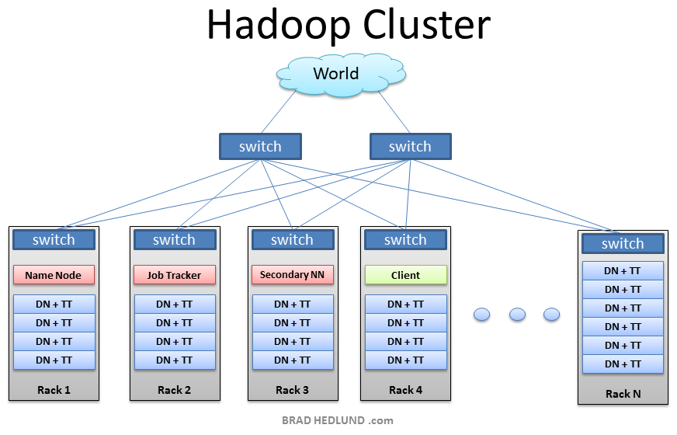
Hadoop Cluster
From: http://bradhedlund.com/2011/09/10/understanding-hadoop-clusters-and-the-network/
Cluster Architecture: Many Machines
Hadoop Cluster
DN: data node
TT: task tracker
NN: name node
Hadoop is an open-source software framework for storing data and running applications on clusters of commodity hardware. It provides massive storage for any kind of data, enormous processing power and the ability to handle virtually limitless concurrent tasks or jobs.

Slide 8
Cluster Computing:
A Classical Algorithmic Idea: Divide-and-Conquer
work
partition
work 1
work 2
work 3
work 4
“worker”
“worker”
“worker”
“worker”
solve
result 1
result 2
result 3
result 4
result
combine

Slide 9
Challenges in Cluster Computing

Slide 10
Challenges in Cluster Computing
How do we assign work units to workers?
What if we have more work units than workers?
What if workers need to share partial results?
How do we aggregate partial results?
How do we know all the workers have finished?
What if workers die?

Slide 11
Challenges in Cluster Computing
How do we assign work units to workers?
What if we have more work units than workers?
What if workers need to share partial results?
How do we aggregate partial results?
How do we know all the workers have finished?
What if workers die?
What is the common theme of all of these problems?

Slide 12
Challenges in Cluster Computing
How do we assign work units to workers?
What if we have more work units than workers?
What if workers need to share partial results?
How do we aggregate partial results?
How do we know all the workers have finished?
What if workers die?
What is the common theme of all of these problems?
Parallelization problems arise from: - Communication between workers (e.g., to exchange state) - Access to shared resources (e.g., data)
We need a synchronization mechanism.

Slide 13
Therefore,
We need the right level of abstraction
– new model more appropriate for the multicore/cluster
environment
Hide system-level details from the developers
– no more race conditions, lock contention, etc.
Separating the what from how
– developer specifies the computation that needs to be
performed
– execution framework handles actual execution

Slide 14
Therefore,
We need the right level of abstraction
– new model more appropriate for the multicore/cluster
environment
Hide system-level details from the developers
– no more race conditions, lock contention, etc.
Separating the what from how
– developer specifies the computation that needs to be
performed
– execution framework handles actual execution
This motivated MapReduce

Slide 15
MapReduce: Big Ideas

Slide 16
MapReduce: Big Ideas
Failures are common in Cluster systems
MapReduce implementation copes with failures (auto task
restart)

Slide 17
MapReduce: Big Ideas
Failures are common in Cluster systems
MapReduce implementation copes with failures (auto task
restart)
Data movements are expensive in supercomputers
MapReduce moves processing to data (leverage locality)

Slide 18
MapReduce: Big Ideas
Failures are common in Cluster systems
MapReduce implementation copes with failures (auto task
restart)
Data movements are expensive in supercomputers
MapReduce moves processing to data (leverage locality)
Disk I/O is time-consuming
MapReduce organizes computation into long streaming
operations

Slide 19
MapReduce: Big Ideas
Failures are common in Cluster systems
MapReduce implementation copes with failures (auto task
restart)
Data movements are expensive in supercomputers
MapReduce moves processing to data (leverage locality)
Disk I/O is time-consuming
MapReduce organizes computation into long streaming
operations
Developing distributed software is difficult
MapReduce isolates developers from implementation details.

Slide 20
Typical Large-Data Problem
Iterate over a large number of records
Extract something of interest from each
Shuffle and sort intermediate results
Aggregate intermediate results
Generate final output

Slide 21
Typical Large-Data Problem
map
Iterate over a large number of records
Extract something of interest from each
Shuffle and sort intermediate results
Aggregate intermediate results
Generate final output

Slide 22
Typical Large-Data Problem
map
Iterate over a large number of records
Extract something of interest from each
Shuffle and sort intermediate results
Aggregate intermediate results
Generate final output
Reduce

Slide 23
Typical Large-Data Problem
map
Iterate over a large number of records
Extract something of interest from each
Shuffle and sort intermediate results
Aggregate intermediate results
Generate final output
Reduce
Key idea of MapReduce: provide a functional abstraction for these two operations.
[Dean and Ghemawat, OSDI 2004]

Slide 24
MapReduce: Greneral Framework
input
map
map
……
map
map
reduce
……
reduce
……
reduce
output

Slide 25
MapReduce: Greneral Framework
input
InputSplit
map
map
……
map
map
Shuffle and Sort
reduce
……
reduce
……
reduce
Output written to DFS

Slide 26
MapReduce: Greneral Framework
input
InputSplit
map
map
……
map
map
System
provided
User
specified
Shuffle and Sort
reduce
……
reduce
……
reduce
Output written to DFS

Slide 27
MapReduce
Programmers specify two functions:
map (k₁, v₁) → (k₂, v₂)*
reduce (k₂, v₂*) → (k₃, v₃)*
All values with the same key are sent to the same reducer
The execution framework handles everything else.

Slide 28
MapReduce
Programmers specify two functions:
map (k₁, v₁) → (k₂, v₂)*
reduce (k₂, v₂*) → (k₃, v₃)*
All values with the same key are sent to the same reducer
The execution framework handles everything else.
Example: Word Count
Map(String docID, String text): map(docID, text) → (word, 1)* for each word w in text: Emit(w, 1)
Reduce(String word, Iterator<int> values): int sum = 0; for each v in values: reduce(word, [1, …, 1]) → (word, sum)* sum += v; Emit(word, sum);
k₁
v₁
k₂
v₂
k₂
v₂*
k₃
v₃

Slide 29
MapReduce: Word Count
Example: Word Count
Map(String docID,
String text):
for each word w in text:
Emit(w, 1)
Reduce(String word,
Iterator<int> values):
int sum = 0;
for each v in values:
sum += v;
Emit(word, sum);
docID
text
map
map
map
map
a
1
b
1
a
1
a
1
c
1
b
1
c
1
a
1
a
1
c
1
b
1
c
1
Shuffle and Sort: aggregate values by keys
a
1
1
1
1
1
b
1
1
1
c
1
1
1
1
reduce
reduce
reduce
a
5
b
3
c
4
Output written to DFS

Slide 30
MapReduce: Framework
Handles scheduling
– Assigns workers to map and reduce tasks
Handles “data distribution”
– Moves processes to data
Handles synchronization
– Gathers, sorts, and shuffles intermediate data
Handles errors and faults
– Detects worker failures and restarts
Everything happens on top of a distributed file system

Slide 31
MapReduce: User Specification
Programmers specify two functions:
map (k₁, v₁) → (k₂, v₂)*
reduce (k₂, v₂*) → (k₃, v₃)*
all values with the same key are sent to the same reducer

Slide 32
MapReduce: User Specification
Programmers specify two functions:
map (k₁, v₁) → (k₂, v₂)*
reduce (k₂, v₂*) → (k₃, v₃)*
all values with the same key are sent to the same reducer
Mappers & Reducers can specify any computation
– be careful with access to external resources!

Slide 33
MapReduce: User Specification
Programmers specify two functions:
map (k₁, v₁) → (k₂, v₂)*
reduce (k₂, v₂*) → (k₃, v₃)*
all values with the same key are sent to the same reducer
Mappers & Reducers can specify any computation
– be careful with access to external resources!
The execution framework handles everything else

Slide 34
Example: Join by MapReduce
Suppose we want to compute the natural join of Q(A,B) and S(B,C).

Slide 35
Example: Join by MapReduce
Suppose we want to compute the natural join of Q(A,B) and S(B,C).
Natural Join
Map(Q(A, B), Table-Q):
for each tuple (a, b) in Q
Emit(b, (a, Q))
Map(S(B, C), Table-S):
for each tuple (b, c) in S
Emit(b, (b, (c, S))
Reduce(b, [(a₁, Q), (c₁, S), …]):
for any two pairs (a₁, Q) and
(c₁, S) in [(a₁, Q), (c₁, S), …]
Emit(a₁, b, c₁)

Slide 36
Relational Data by MapReduce: Overview
MapReduce for processing relational data:
  Group by, sorting, duplicate elimination are handled automatically by shuffle/sort in MapReduce
  Selection, projection, and other computations (e.g., aggregation), are performed either in mapper or reducer
  Multiple strategies for relational joins
Complex operations require multiple MapReduce
jobs
Opportunities for automatic optimization

Slide 37
Review for Final Exam (May 5, 2025, 8:00am - 10:00am)

Slide 38
Review for Final Exam (May 5, 2025, 8:00am - 10:00am)
Database Development
Database structure: general terminologies
Entity-Relationship diagrams
Relational algebra
Functional dependencies
BC, 3rd, and 4th normal forms (definitions and algorithms)
SQL

Slide 39
Review for Final Exam (May 5, 2025, 8:00am - 10:00am)
Database Development
Database structure: general terminologies
Entity-Relationship diagrams
Relational algebra
Functional dependencies
BC, 3rd, and 4th normal forms (definitions and algorithms)
SQL
Database Management System
Disk structure
Query translation (parse tree, logic/physical query plans)
Query optimization (disk I/O efficiency, cost estimation)
B+ trees and Hashing (extensible hash and linear hash)
Algorithms for relational operations (one-pass, two-pass)
Failure recovery (Undo, Redo, Undo/Redo)
Currency control (serializability, locking protocols, deadlocks)
Big data and MapReduce

Slide 40
Review for Final Exam (May 5, 2025, 8:00am - 10:00am)
Database Development
Database structure: general terminologies
Entity-Relationship diagrams
Relational algebra
Functional dependencies
BC, 3rd, and 4th normal forms (definitions and algorithms)
SQL
Database Management System
Disk structure
Query translation (parse tree, logic/physical query plans)
Query optimization (disk I/O efficiency, cost estimation)
B+ trees and Hashing (extensible hash and linear hash)
Algorithms for relational operations (one-pass, two-pass)
Failure recovery (Undo, Redo, Undo/Redo)
Currency control (serializability, locking protocols, deadlocks)
Big data and MapReduce
Additional Office Hours: April 30-May 1: 2:00 pm – 3:00 pm

