Slide 1
CSCE-608 Database Systems
Spring 2025
Instructor: Jianer Chen
Office: PETR 428
Phone: 845-4259
Email: chen@cse.tamu.edu
Notes 20: Cost Estimation for Query Plans

Slide 2
Query Optimization
An input database program P
Prepare a collection A of efficient algorithms for operations in relational algebra;
parser
View processing,
Semantic checking
parse tree
preprocessing
parse tree
parse tree-lqp convertor
logic query plan
push selections,
group joins
apply logic laws
logic query plan
Optimization via logic and size
reduce the size of
intermediate results
logic query plan
Lqp-pqp convertor
take care of issues in optimization and security.
physical query plan
Optimization via algorithms and cost
choices of algorithms,
data structures, and
computational modes
Machine executable code

Slide 3
Improving logic plan via logic laws
Major Steps:
Move selections σ so they can be applied early (σ reduces table size);
Combine cross product × with selections σ to make natural joins and theta joins
( has more efficient algorithms);
3. group commutative and associative binary
operations (e.g., ∩, U, ) (for later opt.);
4. May consider other operations (e.g., π, δ, τ, γ)
C

Slide 4
Improving logic plan via logic laws
Commutative operator: R * S = S * R
Associative operator: (R * S) * T = R * (S * T)
∩, U,×, : both commutative and associative (but not and ‒);
D

Slide 5
Improving logic plan via logic laws
Commutative operator: R * S = S * R
Associative operator: (R * S) * T = R * (S * T)
∩, ⋃,×,⨝: both commutative and associative (but not ⨝_{D} and ‒);
Proof for $⋈$: (R$⋈$S)$⋈$T = R$⋈$(S$⋈$T)

Slide 6
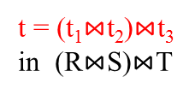
Improving logic plan via logic laws
Commutative operator: R * S = S * R
Associative operator: (R * S) * T = R * (S * T)
∩, ⋃,×,⨝: both commutative and associative (but not ⨝_{D} and ‒);
Proof for $⋈$: (R$⋈$S)$⋈$T = R$⋈$(S$⋈$T)
t = (t₁$⋈$t₂)$⋈$t₃
in (R$⋈$S)$⋈$T

Slide 7


Improving logic plan via logic laws
Commutative operator: R * S = S * R
Associative operator: (R * S) * T = R * (S * T)
∩, ⋃,×,⨝: both commutative and associative (but not ⨝_{D} and ‒);
Proof for $⋈$: (R$⋈$S)$⋈$T = R$⋈$(S$⋈$T)
t = (t₁$⋈$t₂)$⋈$t₃
in (R$⋈$S)$⋈$T
t₃ in T
t₁$⋈$t₂ in R$⋈$S

Slide 8
Improving logic plan via logic laws
Commutative operator: R * S = S * R
Associative operator: (R * S) * T = R * (S * T)
∩, ⋃,×,⨝: both commutative and associative (but not ⨝_{D} and ‒);
Proof for $⋈$: (R$⋈$S)$⋈$T = R$⋈$(S$⋈$T)
t = (t₁$⋈$t₂)$⋈$t₃
in (R$⋈$S)$⋈$T
A
t₃ in T
A
t₁$⋈$t₂ in R$⋈$S
A

Slide 9

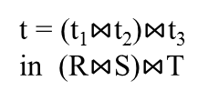
Improving logic plan via logic laws
Commutative operator: R * S = S * R
Associative operator: (R * S) * T = R * (S * T)
∩, ⋃,×,⨝: both commutative and associative (but not ⨝_{D} and ‒);
Proof for $⋈$: (R$⋈$S)$⋈$T = R$⋈$(S$⋈$T)
t = (t₁$⋈$t₂)$⋈$t₃
in (R$⋈$S)$⋈$T
A
t₃ in T
A
t₁$⋈$t₂ in R$⋈$S
A

Slide 10
Improving logic plan via logic laws
Commutative operator: R * S = S * R
Associative operator: (R * S) * T = R * (S * T)
∩, ⋃,×,⨝: both commutative and associative (but not ⨝_{D} and ‒);
Proof for $⋈$: (R$⋈$S)$⋈$T = R$⋈$(S$⋈$T)
t = (t₁$⋈$t₂)$⋈$t₃
in (R$⋈$S)$⋈$T
A
t₃ in T
A
t₁$⋈$t₂ in R$⋈$S
A
t₁ in R
t₂ in S

Slide 11

Improving logic plan via logic laws
Commutative operator: R * S = S * R
Associative operator: (R * S) * T = R * (S * T)
∩, ⋃,×,⨝: both commutative and associative (but not ⨝_{D} and ‒);
Proof for $⋈$: (R$⋈$S)$⋈$T = R$⋈$(S$⋈$T)
t = (t₁$⋈$t₂)$⋈$t₃
in (R$⋈$S)$⋈$T
A
t₃ in T
A
t₁$⋈$t₂ in R$⋈$S
B
A
t₁ in R
B
A₁
t₂ in S
B
A₂

Slide 12

Improving logic plan via logic laws
Commutative operator: R * S = S * R
Associative operator: (R * S) * T = R * (S * T)
∩, ⋃,×,⨝: both commutative and associative (but not ⨝_{D} and ‒);
Proof for $⋈$: (R$⋈$S)$⋈$T = R$⋈$(S$⋈$T)
t = (t₁$⋈$t₂)$⋈$t₃
in (R$⋈$S)$⋈$T
A
t₃ in T
A
t₁$⋈$t₂ in R$⋈$S
B
A
t₁ in R
B
A₁
A
t₃ in T
t₂ in S
B
A₂
B
A₂
t₂ in S

Slide 13

Improving logic plan via logic laws
Commutative operator: R * S = S * R
Associative operator: (R * S) * T = R * (S * T)
∩, ⋃,×,⨝: both commutative and associative (but not ⨝_{D} and ‒);
Proof for $⋈$: (R$⋈$S)$⋈$T = R$⋈$(S$⋈$T)
t = (t₁$⋈$t₂)$⋈$t₃
in (R$⋈$S)$⋈$T
A
t₃ in T
A
t₁$⋈$t₂ in R$⋈$S
A
A₂
t₂$⋈$t₃ in S$⋈$T
B
B
A₁
t₁ in R
B
A₁
A
t₃ in T
t₂ in S
B
A₂
B
A₂
t₂ in S

Slide 14

Improving logic plan via logic laws
Commutative operator: R * S = S * R
Associative operator: (R * S) * T = R * (S * T)
∩, ⋃,×,⨝: both commutative and associative (but not ⨝_{D} and ‒);
Proof for $⋈$: (R$⋈$S)$⋈$T = R$⋈$(S$⋈$T)
t = (t₁$⋈$t₂)$⋈$t₃
in (R$⋈$S)$⋈$T
A
t₃ in T
A
B
A₁
t₁ in R
t₁$⋈$t₂ in R$⋈$S
A
A₂
t₂$⋈$t₃ in S$⋈$T
B
B
A₁
t₁ in R
B
A₁
A
t₃ in T
t₂ in S
B
A₂
B
A₂
t₂ in S

Slide 15
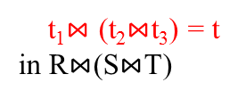
Improving logic plan via logic laws
Commutative operator: R * S = S * R
Associative operator: (R * S) * T = R * (S * T)
∩, ⋃,×,⨝: both commutative and associative (but not ⨝_{D} and ‒);
Proof for $⋈$: (R$⋈$S)$⋈$T = R$⋈$(S$⋈$T)
t = (t₁$⋈$t₂)$⋈$t₃
in (R$⋈$S)$⋈$T
t₁$⋈$ (t₂$⋈$t₃) = t
in R$⋈$(S$⋈$T)
A
A
A
t₃ in T
A
B
A₁
t₁ in R
t₁$⋈$t₂ in R$⋈$S
A
A₂
t₂$⋈$t₃ in S$⋈$T
B
B
A₁
t₁ in R
B
A₁
A
t₃ in T
t₂ in S
B
A₂
B
A₂
t₂ in S

Slide 16
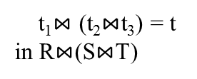
Improving logic plan via logic laws
Commutative operator: R * S = S * R
Associative operator: (R * S) * T = R * (S * T)
∩, ⋃,×,⨝: both commutative and associative (but not ⨝_{D} and ‒);
Proof for $⋈$: (R$⋈$S)$⋈$T = R$⋈$(S$⋈$T)
t = (t₁$⋈$t₂)$⋈$t₃
in (R$⋈$S)$⋈$T
t₁$⋈$ (t₂$⋈$t₃) = t
in R$⋈$(S$⋈$T)
A
A
A
t₃ in T
A
B
A₁
t₁ in R
t₁$⋈$t₂ in R$⋈$S
A
A₂
t₂$⋈$t₃ in S$⋈$T
B
B
A₁
t₁ in R
B
A₁
A
t₃ in T
t₂ in S
B
A₂
B
A₂
t₂ in S
to prove the other direction

Slide 17
Improving logic plan via logic laws
Commutative operator: R * S = S * R
Associative operator: (R * S) * T = R * (S * T)
∩, ⋃,×,⨝: both commutative and associative (but not ⨝_{D} and ‒);
Group each commutative and associative binary operator into a “group”.

Slide 18
Improving logic plan via logic laws
Commutative operator: R * S = S * R
Associative operator: (R * S) * T = R * (S * T)
∩, ⋃,×,⨝: both commutative and associative (but not ⨝_{D} and ‒);
Group each commutative and associative binary operator into a “group”.
C
D
E
A
B
C
D
E
A
B

Slide 19
Improving logic plan via logic laws
Major Steps:
Move selections σ so they can be applied early (σ reduces table size);
Combine cross product × with selections σ to make natural joins ⨝ and theta joins ⨝_{C}
(⨝ has more efficient algorithms);
3. group commutative and associative binary
operations (e.g., ∩, ⋃, ⨝) (for later opt.);
4. May consider other operations (e.g., π, δ, τ, γ)

Slide 20
Query Optimization
An input database program P
Prepare a collection C of efficient algorithms for operations in relational algebra;
parser
View processing,
Semantic checking
parse tree
preprocessing
parse tree
parse tree-lqp convertor
logic query plan
push selections,
group joins
apply logic laws
logic query plan
Optimization via logic and size
reduce the size of
intermediate results
logic query plan
Lqp-pqp convertor
take care of issues in optimization and security.
physical query plan
Optimization via algorithms and cost
choices of algorithms,
data structures, and
computational modes
Machine executable code

Slide 21
Improving logic plan via logic laws
Limits for applying pure logic laws
δ
δ
δ
σ
S
σ
S
R
R
Which one should be used?

Slide 22
Improving logic plan via logic laws
Limits for applying pure logic laws
could be small if R and
S have few matching
tuples
δ
δ
δ
could be large if R
and S have many
matching tuples
σ
S
σ
S
R
R
Which one should be used?

Slide 23
Improving logic plan via logic laws
Limits for applying pure logic laws
could be significantly
smaller if there are
many duplicates
could be small if R and
S have few matching
tuples
δ
δ
δ
could be large if R
and S have many
matching tuples
σ
S
σ
S
R
R
could be insignificant if
there are few duplicates
Which one should be used?

Slide 24
Query Optimization
An input database program P
Prepare a collection C of efficient algorithms for operations in relational algebra;
parser
View processing,
Semantic checking
parse tree
preprocessing
parse tree
parse tree-lqp convertor
logic query plan
push selections,
group joins
apply logic laws
logic query plan
Optimization via logic and size
reduce the size of
intermediate results
logic query plan
Lqp-pqp convertor
take care of issues in optimization and security.
physical query plan
Optimization via algorithms and cost
choices of algorithms,
data structures, and
computational modes
Machine executable code

Slide 25
Query Optimization
An input database program P
Prepare a collection C of efficient algorithms for operations in relational algebra;
parser
View processing,
Semantic checking
parse tree
preprocessing
parse tree
parse tree-lqp convertor
logic query plan
push selections,
group joins
apply logic laws
logic query plan
Optimization via logic and size
reduce the size of
intermediate results
logic query plan
Lqp-pqp convertor
take care of issues in optimization and security.
physical query plan
Optimization via algorithms and cost
choices of algorithms,
data structures, and
computational modes
Machine executable code

Slide 26
Improving logic plan via relation size
Major Steps:

Slide 27
Improving logic plan via relation size
Major Steps:
Collect size parameters for stored relations:

Slide 28
Improving logic plan via relation size
Major Steps:
Collect size parameters for stored relations: T(R), B(R), V(R,A) (the # of different values on attribute A)

Slide 29
Improving logic plan via relation size
Major Steps:
Collect size parameters for stored relations: T(R), B(R), V(R,A) (the # of different values on attribute A)
Set up estimation rules for size parameters on relational algebraic operators;

Slide 30
Improving logic plan via relation size
Major Steps:
Collect size parameters for stored relations: T(R), B(R), V(R,A) (the # of different values on attribute A)
Set up estimation rules for size parameters on relational algebraic operators;
Using logic laws to convert a logic query into the one that minimizes the (estimated) sizes of intermediate relations.

Slide 31
Improving logic plan via relation size
Major Steps:
Collect size parameters for stored relations: T(R), B(R), V(R,A) (the # of different values on attribute A)
Set up estimation rules for size parameters on relational algebraic operators;
Using logic laws to convert a logic query into the one that minimizes the (estimated) sizes of intermediate relations.
δ
500
150
1500
δ
δ
R
S
R
S
5000
2000
5000
2000

Slide 32
Improving logic plan via relation size
Major Steps:
Collect size parameters for stored relations: T(R), B(R), V(R,A) (the # of different values on attribute A)
Set up estimation rules for size parameters on relational algebraic operators;
Using logic laws to convert a logic query into the one that minimizes the (estimated) sizes of intermediate relations.
δ
500
150
1500
δ
δ
R
S
R
S
5000
2000
5000
2000

Slide 33
Improving logic plan via relation size
Major Steps:
Collect size parameters for stored relations: T(R), B(R), V(R,A) (the # of different values on attribute A)
Set up estimation rules for size parameters on relational algebraic operators;
Using logic laws to convert a logic query into the one that minimizes the (estimated) sizes of intermediate relations.
δ
500
150
1500
δ
δ
√
R
S
R
S
5000
2000
5000
2000

Slide 34
Improving logic plan via relation size
Major Steps:
Collect size parameters for stored relations: T(R), B(R), V(R,A) (the # of different values on attribute A)
Set up estimation rules for size parameters on relational algebraic operators;
Using logic laws to convert a logic query into the one that minimizes the (estimated) sizes of intermediate relations.
δ
500
150
1500
δ
δ
√
R
S
R
S
5000
2000
5000
2000

Slide 35
Estimating size parameters (T,B,V)
The values T(R), B(R), V(R,A) for a stored relation R can be obtained by statistic analysis (and recorded with the relation)

Slide 36
Estimating size parameters (T,B,V)
The values T(R), B(R), V(R,A) for a stored relation R can be obtained by statistic analysis (and recorded with the relation)
How do we know the values for intermediate relations?

Slide 37
Estimating size parameters (T,B,V)
The values T(R), B(R), V(R,A) for a stored relation R can be obtained by statistic analysis (and recorded with the relation)
How do we know the values for intermediate relations?
Suppose we know
T(R), B(R), V(R,A), T(S), B(S), V(S,D)

Slide 38
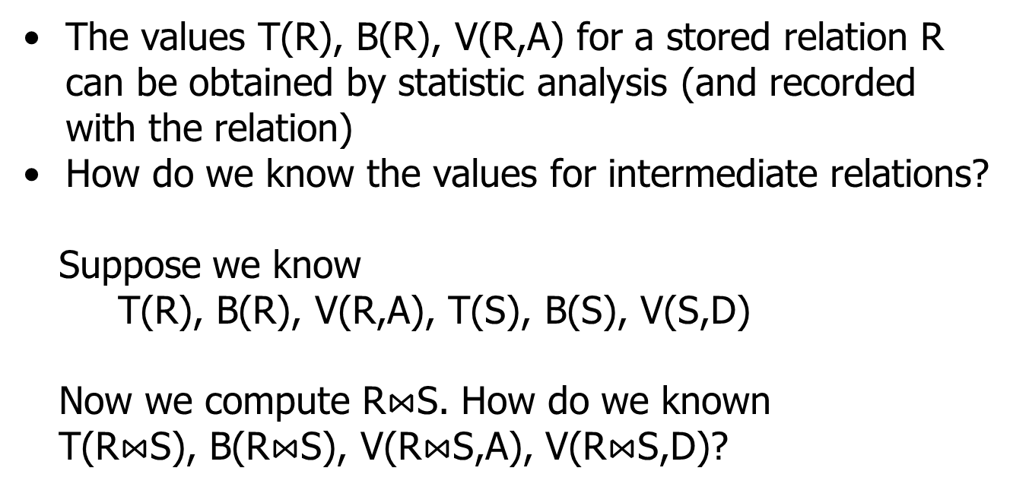
Estimating size parameters (T,B,V)
The values T(R), B(R), V(R,A) for a stored relation R can be obtained by statistic analysis (and recorded with the relation)
How do we know the values for intermediate relations?
Suppose we know
T(R), B(R), V(R,A), T(S), B(S), V(S,D)
Now we compute R$⋈$S. How do we known
T(R$⋈$S), B(R$⋈$S), V(R$⋈$S,A), V(R$⋈$S,D)?

Slide 39
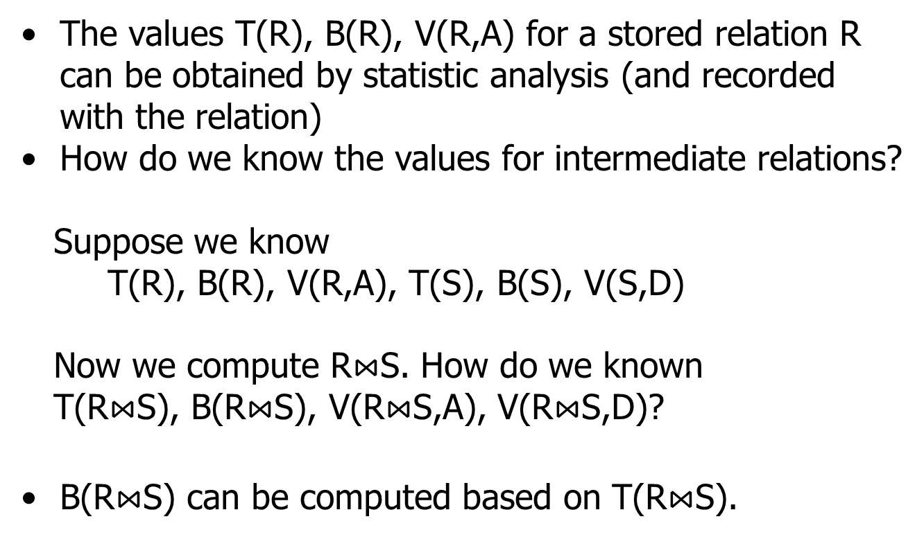
Estimating size parameters (T,B,V)
The values T(R), B(R), V(R,A) for a stored relation R can be obtained by statistic analysis (and recorded with the relation)
How do we know the values for intermediate relations?
Suppose we know
T(R), B(R), V(R,A), T(S), B(S), V(S,D)
Now we compute R$⋈$S. How do we known
T(R$⋈$S), B(R$⋈$S), V(R$⋈$S,A), V(R$⋈$S,D)?
B(R$⋈$S) can be computed based on T(R$⋈$S).

Slide 40
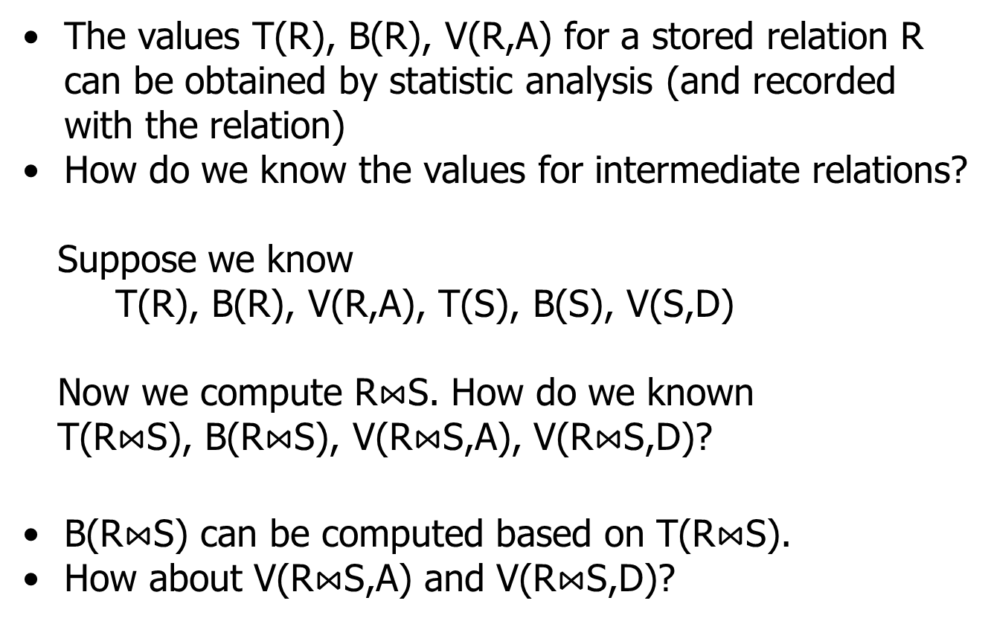
Estimating size parameters (T,B,V)
The values T(R), B(R), V(R,A) for a stored relation R can be obtained by statistic analysis (and recorded with the relation)
How do we know the values for intermediate relations?
Suppose we know
T(R), B(R), V(R,A), T(S), B(S), V(S,D)
Now we compute R$⋈$S. How do we known
T(R$⋈$S), B(R$⋈$S), V(R$⋈$S,A), V(R$⋈$S,D)?
B(R$⋈$S) can be computed based on T(R$⋈$S).
How about V(R$⋈$S,A) and V(R$⋈$S,D)?

Slide 41
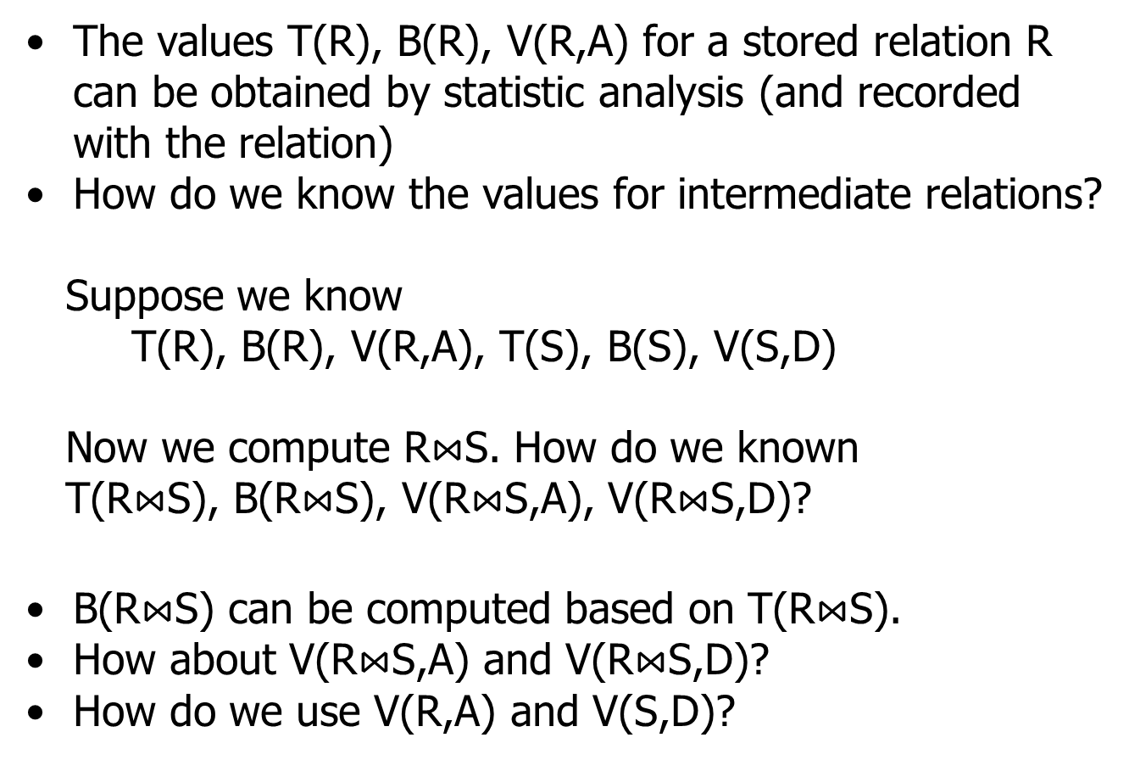
Estimating size parameters (T,B,V)
The values T(R), B(R), V(R,A) for a stored relation R can be obtained by statistic analysis (and recorded with the relation)
How do we know the values for intermediate relations?
Suppose we know
T(R), B(R), V(R,A), T(S), B(S), V(S,D)
Now we compute R$⋈$S. How do we known
T(R$⋈$S), B(R$⋈$S), V(R$⋈$S,A), V(R$⋈$S,D)?
B(R$⋈$S) can be computed based on T(R$⋈$S).
How about V(R$⋈$S,A) and V(R$⋈$S,D)?
How do we use V(R,A) and V(S,D)?

Slide 42
Estimating size parameters (T,B,V)

Slide 43
Estimating size parameters (T,B,V)
π, τ,×:

Slide 44
Estimating size parameters (T,B,V)
π, τ,×: size parameters can be calculated precisely

Slide 45
Estimating size parameters (T,B,V)
π, τ,×: size parameters can be calculated precisely
δ : T(δ(S)) = min{ T(S)/2, Π_{A}V(R,A) }

Slide 46
Estimating size parameters (T,B,V)
π, τ,×: size parameters can be calculated precisely
δ : T(δ(S)) = min{ T(S)/2, Π_{A}V(R,A) }
In average, there are
(probably) about two
copies of each tuple(?)
T(δ(S)) = T(S)/2 (?)

Slide 47
Estimating size parameters (T,B,V)
π, τ,×: size parameters can be calculated precisely
δ : T(δ(S)) = min{ T(S)/2, Π_{A}V(R,A) }
In average, there are
(probably) about two
copies of each tuple(?)
T(δ(R)) = T(R)/2 (?)

Slide 48
Estimating size parameters (T,B,V)
π, τ,×: size parameters can be calculated precisely
δ : T(δ(S)) = min{ T(S)/2, Π_{A}V(R,A) }
In average, there are
(probably) about two
copies of each tuple(?)
T(δ(R)) = T(R)/2 (?)
(Probably) every combination of different attribute values make a tuple(?)
T(δ(S)) = Π_{A}V(R,A) (?)
(this number could be larger than T(S)!)

Slide 49
Estimating size parameters (T,B,V)
π, τ,×: size parameters can be calculated precisely
δ : T(δ(S)) = min{ T(S)/2, Π_{A}V(R,A) }
In average, there are
(probably) about two
copies of each tuple(?)
T(δ(R)) = T(R)/2 (?)
(Probably) every combination of different attribute values make a tuple(?)
T(δ(R)) = ∏_{A}V(R,A) (?)
(this number could be larger than T(S)!)

Slide 50
Estimating size parameters (T,B,V)
π, τ,×: size parameters can be calculated precisely
δ : T(δ(S)) = min{ T(S)/2, Π_{A}V(R,A) }
In average, there are
(probably) about two
copies of each tuple(?)
T(δ(R)) = T(R)/2 (?)
(Probably) every combination of different attribute values make a tuple(?)
T(δ(R)) = ∏_{A}V(R,A) (?)
(this number could be larger than T(R)!)

Slide 51
Estimating size parameters (T,B,V)
π, τ,×: size parameters can be calculated precisely
δ : T(δ(R)) = min{ T(R)/2, ∏_{A}V(R,A) }
In average, there are
(probably) about two
copies of each tuple(?)
T(δ(R)) = T(R)/2 (?)
(Probably) every combination of different attribute values make a tuple(?)
T(δ(R)) = ∏_{A}V(R,A) (?)
(this number could be larger than T(R)!)

Slide 52
Estimating size parameters (T,B,V)
π, τ,×: size parameters can be calculated precisely
δ : T(δ(R)) = min{ T(R)/2, ∏_{A}V(R,A) }
γ : T(γ(S)) = min{ T(S)/2, Π_{grouping A}V(R,A) }

Slide 53
Estimating size parameters (T,B,V)
π, τ,×: size parameters can be calculated precisely
δ : T(δ(R)) = min{ T(R)/2, ∏_{A}V(R,A) }
γ : T(γ(S)) = min{ T(S)/2, Π_{grouping A}V(R,A) }
Strategies similar to that of δ

Slide 54
Estimating size parameters (T,B,V)
π, τ,×: size parameters can be calculated precisely
δ : T(δ(R)) = min{ T(R)/2, ∏_{A}V(R,A) }
γ : T(γ(S)) = min{ T(S)/2, Π_{grouping A}V(R,A) }
In average, there are
(probably) about two
tuples that agree on the grouping attributes T(γ(R)) = T(R)/2 (?)
(Probably) every combination of different values of the grouping attributes make a tuple(?)
T(γ(R)) = ∏_{grouping A}V(R,A) (?)
(this number could be larger than T(R)!)
Strategies similar to that of δ

Slide 55
Estimating size parameters (T,B,V)
π, τ,×: size parameters can be calculated precisely
δ : T(δ(R)) = min{ T(R)/2, ∏_{A}V(R,A) }
γ : T(γ(R)) = min{ T(R)/2, ∏_{grouping A}V(R,A) }
In average, there are
(probably) about two
tuples that agree on the grouping attributes T(γ(R)) = T(R)/2 (?)
(Probably) every combination of different values of the grouping attributes make a tuple(?)
T(γ(R)) = ∏_{grouping A}V(R,A) (?)
(this number could be larger than T(R)!)
Strategies similar to that of δ

