Slide 1
CSCE-411
Design and Analysis of Algorithms
Spring 2025
Instructor: Jianer Chen
Office: PETR 428
Phone: 845-4259
Email: chen@cse.tamu.edu
Notes 39: Dealing with NP -hardness

Slide 2
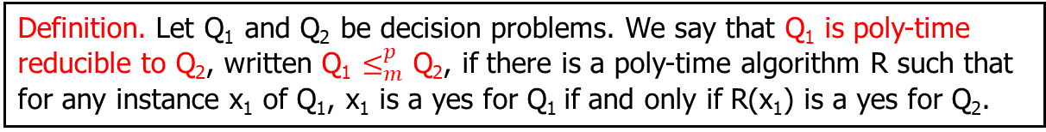
NP-Completeness Theory
Definition. A problem is in P if it can be solved in polynomial time.
Definition. A problem Q is in NP if Q is a decision problem and there is an algorithm A_{Q} such that for any instance x of Q:
If x is a yes-instance, then there is a y such that A_{Q}(x, y) = 1;
If x is a no-instance, then for all y, A_{Q}(x, y) = 0;
A_{Q}(x, y) runs in time polynomial in |x|.
Definition. Let Q₁ and Q₂ be decision problems. We say that Q₁ is poly-time reducible to Q₂, written Q₁ $≤_{m}^{p}$ Q₂, if there is a poly-time algorithm R such that for any instance x₁ of Q₁, x₁ is a yes for Q₁ if and only if R(x₁) is a yes for Q₂.
Definition. (1) A problem Q is NP–hard if for every problem Q’ in NP, Q’ $≤_{m}^{p}$ Q. (2) A problem Q is NP–complete if it is in NP and NP–hard.
NP–hard problems are hard.
Cook Theorem. SAT is NP–complete.
Lemma. If Q₁ $≤_{m}^{p}$ Q₂, and Q₁ is NP–hard, then Q₂ is NP–hard.

Slide 3
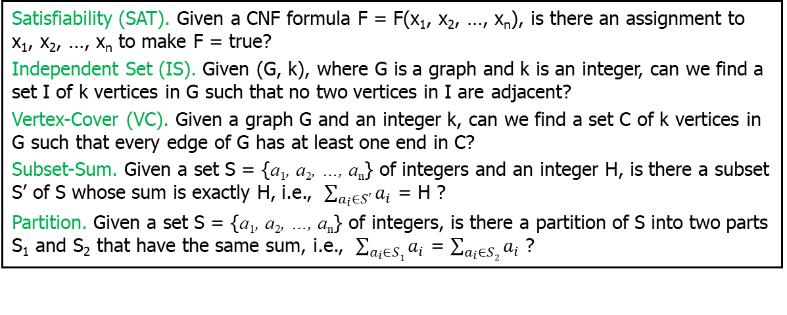
NP-Completeness Theory
A general procedure to prove NP–hardness of a problem Q₂:
(1) Start with a known NP–hard problem Q₁; (2) Show Q₁ $≤_{m}^{p}$ Q₂.
We have five NP–complete problems: SAT, IS, VC, Subset-Sum, and Partition.
Satisfiability (SAT). Given a CNF formula F = F(x₁, x₂, …, x_{n}), is there an assignment to x₁, x₂, …, x_{n} to make F = true?
Independent Set (IS). Given (G, k), where G is a graph and k is an integer, can we find a set I of k vertices in G such that no two vertices in I are adjacent?
Vertex-Cover (VC). Given a graph G and an integer k, can we find a set C of k vertices in G such that every edge of G has at least one end in C?
Subset-Sum. Given a set S = {a₁, a₂, …, a_{n}} of integers and an integer H, is there a subset S’ of S whose sum is exactly H, i.e., $\sum_{a_{i}∈S′}{a_{i}}$ = H ?
Partition. Given a set S = {a₁, a₂, …, a_{n}} of integers, is there a partition of S into two parts S₁ and S₂ that have the same sum, i.e., $\sum_{a_{i}∈S1}{a_{i}}$ = $\sum_{a_{i}∈S2}{a_{i}}$ ?
Using this technique, thousands of NP–hard problems have been proved. Under the belief P ≠ NP, none of these problems can be solved efficiently.
This provides a guideline for practical computation: For a problem Q on which you have tried very hard for an efficient algorithm but failed, you may consider to prove that Q is NP–hard (so you can stop working on efficient algorithms for Q)

Slide 4
Dealing with NP-hard Problems
If a problem Q is NP–hard, then we (believe that we) cannot solve it precisely in polynomial time.

Slide 5
Dealing with NP-hard Problems
If a problem Q is NP–hard, then we (believe that we) cannot solve it precisely in polynomial time.
However, there are many NP–hard problems of practical importance. We have to solve these problems somehow.

Slide 6
Dealing with NP-hard Problems
If a problem Q is NP–hard, then we (believe that we) cannot solve it precisely in polynomial time.
However, there are many NP–hard problems of practical importance. We have to solve these problems somehow.
(Popular) approaches proposed include parameterized algorithms, approximation algorithms, and randomized algorithms.

Slide 7
Dealing with NP-hard Problems
If a problem Q is NP–hard, then we (believe that we) cannot solve it precisely in polynomial time.
However, there are many NP–hard problems of practical importance. We have to solve these problems somehow.
(Popular) approaches proposed include parameterized algorithms, approximation algorithms, and randomized algorithms.
We will use the following problems to illustrate the techniques
Definition. Let G be a graph. A vertex cover C of G is a set of vertices such that every edge of G has at least one end in C.

Slide 8
Dealing with NP-hard Problems
If a problem Q is NP–hard, then we (believe that we) cannot solve it precisely in polynomial time.
However, there are many NP–hard problems of practical importance. We have to solve these problems somehow.
(Popular) approaches proposed include parameterized algorithms, approximation algorithms, and randomized algorithms.
We will use the following problems to illustrate the techniques
Definition. Let G be a graph. A vertex cover C of G is a set of vertices such that every edge of G has at least one end in C.
Vertex-Cover (VC). Given (G, k), where G is a graph and an integer k, is there a vertex cover of k vertices in G?
Min Vertex-Cover (min-VC). Given a graph G, construct a vertex cover of the minimum size in G.

Slide 9
Dealing with NP-hard Problems
If a problem Q is NP–hard, then we (believe that we) cannot solve it precisely in polynomial time.
However, there are many NP–hard problems of practical importance. We have to solve these problems somehow.
(Popular) approaches proposed include parameterized algorithms, approximation algorithms, and randomized algorithms.
We will use the following problems to illustrate the techniques
Definition. Let G be a graph. A vertex cover C of G is a set of vertices such that every edge of G has at least one end in C.
Vertex-Cover (VC). Given (G, k), where G is a graph and an integer k, is there a vertex cover of k vertices in G?
Min Vertex-Cover (min-VC). Given a graph G, construct a vertex cover of the minimum size in G.
Remark. VC is NP-complete. Min-VC is at least as hard as VC

Slide 10
Dealing with NP-hard Problems
Paramterized Algorithms

Slide 11
Dealing with NP-hard Problems
Paramterized Algorithms
Vertex-Cover (VC). Given (G, k), where G is a graph and an integer k, is there a vertex cover of k vertices in G?
Motivation. In practice, the parameter k can be very small.

Slide 12
Dealing with NP-hard Problems
Paramterized Algorithms
Vertex-Cover (VC). Given (G, k), where G is a graph and an integer k, is there a vertex cover of k vertices in G?
Motivation. In practice, the parameter k can be very small.
PVC(G, k)
1. if (k < 0)
return (false);
2. if (G has no edges)
return (true);
3. pick any edge e = [u, v];
4. t₁ = PVC(G-u, k-1);
t₂ = PVC(G-v, k-1);
5. return (t₁˅ t₂).

Slide 13
Dealing with NP-hard Problems
Paramterized Algorithms
Vertex-Cover (VC). Given (G, k), where G is a graph and an integer k, is there a vertex cover of k vertices in G?
Motivation. In practice, the parameter k can be very small.
PVC(G, k)
1. if (k < 0)
return (false);
2. if (G has no edges)
return (true);
3. pick any edge e = [u, v];
4. t₁ = PVC(G-u, k-1);
t₂ = PVC(G-v, k-1);
5. return (t₁˅ t₂).
(G, k)
pick an edge [u, v]
(G-u, k-1)
(G-v, k-1)
pick an edge
pick an edge
(⁕, k-2)
(⁕, k-2)
(⁕, k-2)
(⁕, k-2)

Slide 14
Dealing with NP-hard Problems
Paramterized Algorithms
Vertex-Cover (VC). Given (G, k), where G is a graph and an integer k, is there a vertex cover of k vertices in G?
Motivation. In practice, the parameter k can be very small.
PVC(G, k)
1. if (k < 0)
return (false);
2. if (G has no edges)
return (true);
3. pick any edge e = [u, v];
4. t₁ = PVC(G-u, k-1);
t₂ = PVC(G-v, k-1);
5. return (t₁˅ t₂).
(G, k)
pick an edge [u, v]
(G-u, k-1)
(G-v, k-1)
pick an edge
pick an edge
(⁕, k-2)
(⁕, k-2)
(⁕, k-2)
(⁕, k-2)
(⁕, 0)
(⁕, 2)
(⁕, -1)
(⁕, -1)

Slide 15
Dealing with NP-hard Problems
Paramterized Algorithms
Vertex-Cover (VC). Given (G, k), where G is a graph and an integer k, is there a vertex cover of k vertices in G?
Motivation. In practice, the parameter k can be very small.
PVC(G, k)
1. if (k < 0)
return (false);
2. if (G has no edges)
return (true);
3. pick any edge e = [u, v];
4. t₁ = PVC(G-u, k-1);
t₂ = PVC(G-v, k-1);
5. return (t₁˅ t₂).
(G, k)
pick an edge [u, v]
(G-u, k-1)
(G-v, k-1)
k+1
pick an edge
pick an edge
(⁕, k-2)
(⁕, k-2)
(⁕, k-2)
(⁕, k-2)
(⁕, 0)
(⁕, 2)
(⁕, -1)
(⁕, -1)
2^{k+1} leaves

Slide 16
Dealing with NP-hard Problems
Paramterized Algorithms
Vertex-Cover (VC). Given (G, k), where G is a graph and an integer k, is there a vertex cover of k vertices in G?
Motivation. In practice, the parameter k can be very small.
PVC(G, k)
1. if (k < 0)
return (false);
2. if (G has no edges)
return (true);
3. pick any edge e = [u, v];
4. t₁ = PVC(G-u, k-1);
t₂ = PVC(G-v, k-1);
5. return (t₁˅ t₂).
(G, k)
pick an edge [u, v]
(G-u, k-1)
(G-v, k-1)
k+1
pick an edge
pick an edge
(⁕, k-2)
(⁕, k-2)
(⁕, k-2)
(⁕, k-2)
(⁕, 0)
(⁕, 2)
Time = O(2^{k} n²)
(⁕, -1)
(⁕, -1)
2^{k+1} leaves

Slide 17
Dealing with NP-hard Problems
Paramterized Algorithms
Vertex-Cover (VC). Given (G, k), where G is a graph and an integer k, is there a vertex cover of k vertices in G?
Motivation. In practice, the parameter k can be very small.
PVC(G, k)
1. if (k < 0)
return (false);
2. if (G has no edges)
return (true);
3. pick any edge e = [u, v];
4. t₁ = PVC(G-u, k-1);
t₂ = PVC(G-v, k-1);
5. return (t₁˅ t₂).
(G, k)
pick an edge [u, v]
(G-u, k-1)
(G-v, k-1)
k+1
pick an edge
pick an edge
(⁕, k-2)
(⁕, k-2)
(⁕, k-2)
(⁕, k-2)
(⁕, 0)
(⁕, 2)
Time = O(2^{k} n²)
Theorem. The Vertex Cover problem can be solved in time O(2^{k}n²)
(⁕, -1)
(⁕, -1)
2^{k+1} leaves

Slide 18
Dealing with NP-hard Problems
Paramterized Algorithms
Vertex-Cover (VC). Given (G, k), where G is a graph and an integer k, is there a vertex cover of k vertices in G?
Motivation. In practice, the parameter k can be very small.
Parameterized algorithms have been a very active research area. For hundreds of NP-hard problems, parameterized algorithms have been developed that are efficient (or effective) when the parameter value k is small. This provides a (practical) way for solving NP-hard problems in the real world of computing.
PVC(G, k)
1. if (k < 0)
return (false);
2. if (G has no edges)
return (true);
3. pick any edge e = [u, v];
4. t₁ = PVC(G-u, k-1);
t₂ = PVC(G-v, k-1);
5. return (t₁˅ t₂).
Time = O(2^{k} n²)
Theorem. The Vertex Cover problem can be solved in time O(2^{k}n²)

Slide 19
Dealing with NP-hard Problems
Paramterized Algorithms
Vertex-Cover (VC). Given (G, k), where G is a graph and an integer k, is there a vertex cover of k vertices in G?
Motivation. In practice, the parameter k can be very small.
Parameterized algorithms have been a very active research area. For hundreds of NP-hard problems, parameterized algorithms have been developed that are efficient (or effective) when the parameter value k is small. This provides a (practical) way for solving NP-hard problems in the real world of computing.
PVC(G, k)
1. if (k < 0)
return (false);
2. if (G has no edges)
return (true);
3. pick any edge e = [u, v];
4. t₁ = PVC(G-u, k-1);
t₂ = PVC(G-v, k-1);
5. return (t₁˅ t₂).
However, not all NP-hard problems have efficient parameterized algorithms. For example, it is unlikely that the Independent Set (IS) problem (given a graph G and k, decide if G has an independent set of k vertices) has a parameterized algorithm of running time O(c^{k}∙poly(n)) for any constant c.
Time = O(2^{k} n²)
Theorem. The Vertex Cover problem can be solved in time O(2^{k}n²)

Slide 20
Dealing with NP-hard Problems
Approximation Algorithms

Slide 21
Dealing with NP-hard Problems
Approximation Algorithms
Min Vertex-Cover (min-VC). Given a graph G, construct a vertex cover of the minimum size in G.
Motivation. Even not the minimum, a small vertex cover may serve well enough for practical purposes.

Slide 22
Dealing with NP-hard Problems
Approximation Algorithms
Min Vertex-Cover (min-VC). Given a graph G, construct a vertex cover of the minimum size in G.
Motivation. Even not the minimum, a small vertex cover may serve well enough for practical purposes.
ApxVC(G)
1. M = Φ;
2. for (each edge e = [u, v])
if (M + e is a matching)
M = M + e;
3. let C be the end-vertices
of the edges in M;
4. return (C).

Slide 23
Dealing with NP-hard Problems
Approximation Algorithms
Min Vertex-Cover (min-VC). Given a graph G, construct a vertex cover of the minimum size in G.
Motivation. Even not the minimum, a small vertex cover may serve well enough for practical purposes.
Time = O(n+m)
ApxVC(G)
1. M = Φ;
2. for (each edge e = [u, v])
if (M + e is a matching)
M = M + e;
3. let C be the end-vertices
of the edges in M;
4. return (C).

Slide 24
Dealing with NP-hard Problems
Approximation Algorithms
Min Vertex-Cover (min-VC). Given a graph G, construct a vertex cover of the minimum size in G.
Motivation. Even not the minimum, a small vertex cover may serve well enough for practical purposes.
Facts.
Time = O(n+m)
ApxVC(G)
1. M = Φ;
2. for (each edge e = [u, v])
if (M + e is a matching)
M = M + e;
3. let C be the end-vertices
of the edges in M;
4. return (C).
M is a maximal matching in G, i.e., you cannot add edges to M to make a larger matching;

Slide 25
Dealing with NP-hard Problems
Approximation Algorithms
Min Vertex-Cover (min-VC). Given a graph G, construct a vertex cover of the minimum size in G.
Motivation. Even not the minimum, a small vertex cover may serve well enough for practical purposes.
Facts.
Time = O(n+m)
ApxVC(G)
1. M = Φ;
2. for (each edge e = [u, v])
if (M + e is a matching)
M = M + e;
3. let C be the end-vertices
of the edges in M;
4. return (C).
M is a maximal matching in G, i.e., you cannot add edges to M to make a larger matching;
Thus, the set C of end-vertices of edges in M makes a vertex cover;

Slide 26
Dealing with NP-hard Problems
Approximation Algorithms
Min Vertex-Cover (min-VC). Given a graph G, construct a vertex cover of the minimum size in G.
Motivation. Even not the minimum, a small vertex cover may serve well enough for practical purposes.
Facts.
Time = O(n+m)
ApxVC(G)
1. M = Φ;
2. for (each edge e = [u, v])
if (M + e is a matching)
M = M + e;
3. let C be the end-vertices
of the edges in M;
4. return (C).
M is a maximal matching in G, i.e., you cannot add edges to M to make a larger matching;
Thus, the set C of end-vertices of edges in M makes a vertex cover;
Every vertex cover has at least |M| vertices;

Slide 27
Dealing with NP-hard Problems
Approximation Algorithms
Min Vertex-Cover (min-VC). Given a graph G, construct a vertex cover of the minimum size in G.
Motivation. Even not the minimum, a small vertex cover may serve well enough for practical purposes.
Facts.
Time = O(n+m)
ApxVC(G)
1. M = Φ;
2. for (each edge e = [u, v])
if (M + e is a matching)
M = M + e;
3. let C be the end-vertices
of the edges in M;
4. return (C).
M is a maximal matching in G, i.e., you cannot add edges to M to make a larger matching;
Thus, the set C of end-vertices of edges in M makes a vertex cover;
Every vertex cover has at least |M| vertices;
The size of C is at most twice of that of a minimum vertex cover.

Slide 28
Dealing with NP-hard Problems
Approximation Algorithms
Min Vertex-Cover (min-VC). Given a graph G, construct a vertex cover of the minimum size in G.
Motivation. Even not the minimum, a small vertex cover may serve well enough for practical purposes.
Facts.
Time = O(n+m)
ApxVC(G)
1. M = Φ;
2. for (each edge e = [u, v])
if (M + e is a matching)
M = M + e;
3. let C be the end-vertices
of the edges in M;
4. return (C).
M is a maximal matching in G, i.e., you cannot add edges to M to make a larger matching;
Thus, the set C of end-vertices of edges in M makes a vertex cover;
Every vertex cover has at least |M| vertices;
The size of C is at most twice of that of a minimum vertex cover.
5. Apx ratio = apx-solution / opt-solution

Slide 29
Dealing with NP-hard Problems
Approximation Algorithms
Min Vertex-Cover (min-VC). Given a graph G, construct a vertex cover of the minimum size in G.
Motivation. Even not the minimum, a small vertex cover may serve well enough for practical purposes.
Facts.
Time = O(n+m)
ApxVC(G)
1. M = Φ;
2. for (each edge e = [u, v])
if (M + e is a matching)
M = M + e;
3. let C be the end-vertices
of the edges in M;
4. return (C).
M is a maximal matching in G, i.e., you cannot add edges to M to make a larger matching;
Thus, the set C of end-vertices of edges in M makes a vertex cover;
Every vertex cover has at least |M| vertices;
The size of C is at most twice of that of a minimum vertex cover.
Theorem. The Min-VC problem has a linear-time approximation algorithm with apx ratio 2.
5. Apx ratio = apx-solution / opt-solution

Slide 30
Dealing with NP-hard Problems
Approximation Algorithms
Min Vertex-Cover (min-VC). Given a graph G, construct a vertex cover of the minimum size in G.
Motivation. Even not the minimum, a small vertex cover may serve well enough for practical purposes.
Time = O(n+m)
Approximation algorithms make another active research area. For hundreds of NP-hard problems, efficient approximation algorithms have been developed with small approximation ratios. This provides another practical way for solving NP-hard problems in the real world of computing.
ApxVC(G)
1. M = Φ;
2. for (each edge e = [u, v])
if (M + e is a matching)
M = M + e;
3. let C be the end-vertices
of the edges in M;
4. return (C).
Theorem. The Min-VC problem has a linear-time approximation algorithm with apx ratio 2.

Slide 31
Dealing with NP-hard Problems
Approximation Algorithms
Min Vertex-Cover (min-VC). Given a graph G, construct a vertex cover of the minimum size in G.
Motivation. Even not the minimum, a small vertex cover may serve well enough for practical purposes.
Time = O(n+m)
Approximation algorithms make another active research area. For hundreds of NP-hard problems, efficient approximation algorithms have been developed with small approximation ratios. This provides another practical way for solving NP-hard problems in the real world of computing.
ApxVC(G)
1. M = Φ;
2. for (each edge e = [u, v])
if (M + e is a matching)
M = M + e;
3. let C be the end-vertices
of the edges in M;
4. return (C).
However, not all NP-hard problems have efficient approximation algorithms with small apx ratios. For example, it is unlikely that the Independent Set (IS) problem (finding a largest independent set in a given graph) has a polynomial-time algorithm of apx ratio C for any constant C.
Theorem. The Min-VC problem has a linear-time approximation algorithm with apx ratio 2.

Slide 32
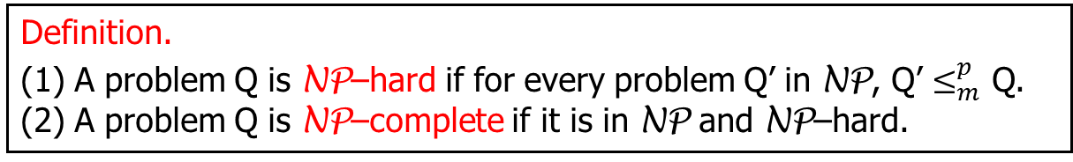
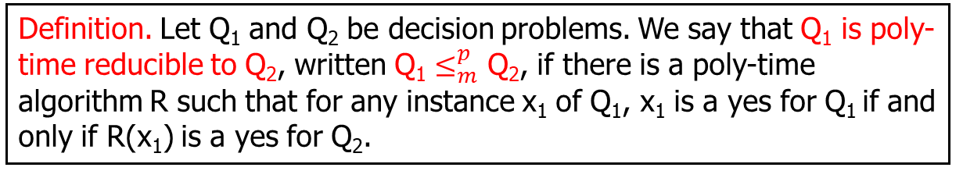
NP-Completeness Theory
Definition. A problem is in P if it can be solved in polynomial time.
Definition. A problem Q is in NP if Q is a decision problem and there is an algorithm A_{Q} such that for any instance x of Q:
If x is a yes-instance, then there is a y such that A_{Q}(x, y) = 1;
If x is a no-instance, then for all y, A_{Q}(x, y) = 0;
A_{Q}(x, y) runs in time polynomial in |x|.
Definition. Let Q₁ and Q₂ be decision problems. We say that Q₁ is poly-time reducible to Q₂, written Q₁ $≤_{m}^{p}$ Q₂, if there is a poly-time algorithm R such that for any instance x₁ of Q₁, x₁ is a yes for Q₁ if and only if R(x₁) is a yes for Q₂.
Definition.
(1) A problem Q is NP–hard if for every problem Q’ in NP, Q’ $≤_{m}^{p}$ Q. (2) A problem Q is NP–complete if it is in NP and NP–hard.
Lemma. If Q₁ $≤_{m}^{p}$ Q₂, and Q₁ is NP–hard, then Q₂ is NP–hard.

Slide 33
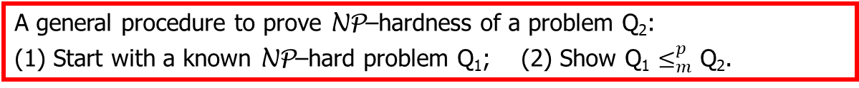
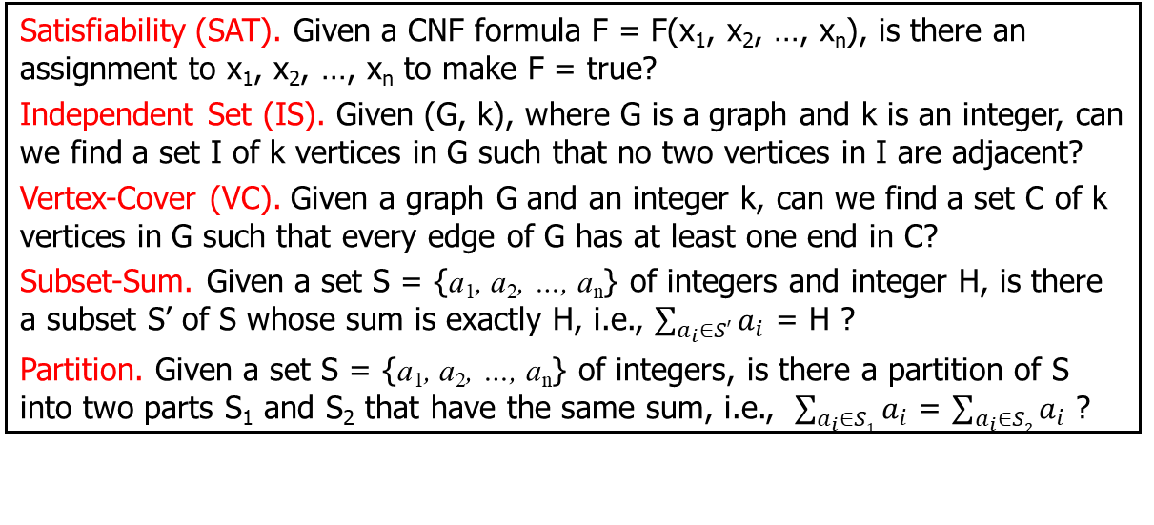
NP-Completeness Theory
NP–complete problems:
Satisfiability (SAT). Given a CNF formula F = F(x₁, x₂, …, x_{n}), is there an assignment to x₁, x₂, …, x_{n} to make F = true?
Independent Set (IS). Given (G, k), where G is a graph and k is an integer, can we find a set I of k vertices in G such that no two vertices in I are adjacent?
Vertex-Cover (VC). Given a graph G and an integer k, can we find a set C of k vertices in G such that every edge of G has at least one end in C?
Subset-Sum. Given a set S = {a₁, a₂, …, a_{n}} of integers and integer H, is there a subset S’ of S whose sum is exactly H, i.e., $\sum_{a_{i}∈S′}{a_{i}}$ = H ?
Partition. Given a set S = {a₁, a₂, …, a_{n}} of integers, is there a partition of S into two parts S₁ and S₂ that have the same sum, i.e., $\sum_{a_{i}∈S1}{a_{i}}$ = $\sum_{a_{i}∈S2}{a_{i}}$ ?
A general procedure to prove NP–hardness of a problem Q₂:
(1) Start with a known NP–hard problem Q₁; (2) Show Q₁ $≤_{m}^{p}$ Q₂.
Dealing with NP-hard problems:
Parameterized Algorithms: solving NP-hard problems in time f(k)∙poly(n), which is efficient enough when the parameter k is small.
Approximation Algorithms: polynomial time algorithms that construct “good enough” (maybe not optimal) solutions for NP-hard problems.

