Slide 1
CSCE-411
Design and Analysis of Algorithms
Spring 2025
Instructor: Jianer Chen
Office: PETR 428
Phone: 845-4259
Email: chen@cse.tamu.edu
Notes 36: NP-hardness and NP-completeness

Slide 2
NP-Completeness Theory
Definition. A problem is in P if it can be solved in polynomial time.
Definition. A problem Q is in NP if Q is a decision problem and there is an algorithm A_{Q} such that for any instance x of Q:
If x is a yes-instance, then there is a y such that A_{Q}(x, y) = 1;
If x is a no-instance, then for all y, A_{Q}(x, y) = 0;
A_{Q}(x, y) runs in time polynomial in |x|.

Slide 3
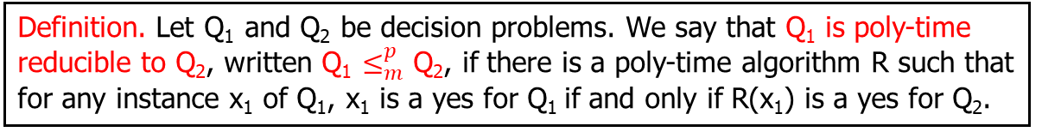
NP-Completeness Theory
How do we identify hard problems in NP ?
Find a way to compare the difficulties of problems.
Definition. Let Q₁ and Q₂ be decision problems. We say that Q₁ is poly-time reducible to Q₂, written Q₁ $≤_{m}^{p}$ Q₂, if there is a poly-time algorithm R such that for any instance x₁ of Q₁, x₁ is a yes for Q₁ if and only if R(x₁) is a yes for Q₂.
Q₁
R
Q₂
yes
yes
no
no

Slide 4
NP-Completeness Theory
How do we identify hard problems in NP ?
Find a way to compare the difficulties of problems.
Definition. Let Q₁ and Q₂ be decision problems. We say that Q₁ is poly-time reducible to Q₂, written Q₁ $≤_{m}^{p}$ Q₂, if there is a poly-time algorithm R such that for any instance x₁ of Q₁, x₁ is a yes for Q₁ if and only if R(x₁) is a yes for Q₂.
Roughly, if Q₁ $≤_{m}^{p}$ Q₂, then Q₁ is not harder than Q₂.

Slide 5
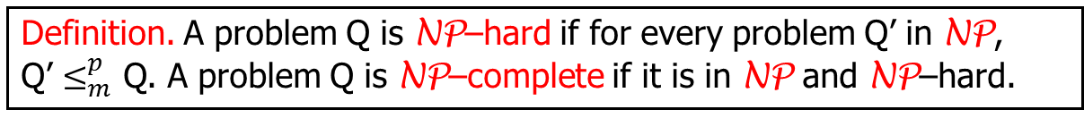
NP-Completeness Theory
How do we identify hard problems in NP ?
Find a way to compare the difficulties of problems.
Definition. Let Q₁ and Q₂ be decision problems. We say that Q₁ is poly-time reducible to Q₂, written Q₁ $≤_{m}^{p}$ Q₂, if there is a poly-time algorithm R such that for any instance x₁ of Q₁, x₁ is a yes for Q₁ if and only if R(x₁) is a yes for Q₂.
Roughly, if Q₁ $≤_{m}^{p}$ Q₂, then Q₁ is not harder than Q₂.
2. Identify hard problem in NP.
Definition. A problem Q is NP–hard if for every problem Q’ in NP, Q’ $≤_{m}^{p}$ Q. A problem Q is NP–complete if it is in NP and NP–hard.

Slide 6
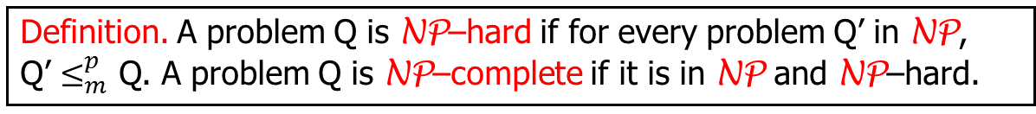
NP-Completeness Theory
How do we identify hard problems in NP ?
Find a way to compare the difficulties of problems.
Definition. Let Q₁ and Q₂ be decision problems. We say that Q₁ is poly-time reducible to Q₂, written Q₁ $≤_{m}^{p}$ Q₂, if there is a poly-time algorithm R such that for any instance x₁ of Q₁, x₁ is a yes for Q₁ if and only if R(x₁) is a yes for Q₂.
Roughly, if Q₁ $≤_{m}^{p}$ Q₂, then Q₁ is not harder than Q₂.
2. Identify hard problem in NP.
Definition. A problem Q is NP–hard if for every problem Q’ in NP, Q’ $≤_{m}^{p}$ Q. A problem Q is NP–complete if it is in NP and NP–hard.
No problem in NP is harder than NP-hard problems.
NP-complete problems are the hardest problems in NP.

Slide 7
NP-Completeness Theory
How do we identify hard problems in NP ?
Find a way to compare the difficulties of problems.
Definition. Let Q₁ and Q₂ be decision problems. We say that Q₁ is poly-time reducible to Q₂, written Q₁ $≤_{m}^{p}$ Q₂, if there is a poly-time algorithm R such that for any instance x₁ of Q₁, x₁ is a yes for Q₁ if and only if R(x₁) is a yes for Q₂.
Roughly, if Q₁ $≤_{m}^{p}$ Q₂, then Q₁ is not harder than Q₂.
2. Identify hard problem in NP.
Definition. A problem Q is NP–hard if for every problem Q’ in NP, Q’ $≤_{m}^{p}$ Q. A problem Q is NP–complete if it is in NP and NP–hard.
No problem in NP is harder than NP-hard problems.
NP-complete problems are the hardest problems in NP.
3. Identify the first hard problem in NP.
Cook Theorem. SAT is NP–complete.
Satisfiability (SAT). Given a CNF formula F = F(x₁, x₂, …, x_{n}), is there an assignment to x₁, x₂, …, x_{n} that makes F = true?

Slide 8
NP-Completeness Theory
How do we identify hard problems in NP ?
Find a way to compare the difficulties of problems.
Definition. Let Q₁ and Q₂ be decision problems. We say that Q₁ is poly-time reducible to Q₂, written Q₁ $≤_{m}^{p}$ Q₂, if there is a poly-time algorithm R such that for any instance x₁ of Q₁, x₁ is a yes for Q₁ if and only if R(x₁) is a yes for Q₂.
Roughly, if Q₁ $≤_{m}^{p}$ Q₂, then Q₁ is not harder than Q₂.
2. Identify hard problem in NP.
Definition. A problem Q is NP–hard if for every problem Q’ in NP, Q’ $≤_{m}^{p}$ Q. A problem Q is NP–complete if it is in NP and NP–hard.
No problem in NP is harder than NP-hard problems.
NP-complete problems are the hardest problems in NP.
3. Identify the first hard problem in NP.
Cook Theorem. SAT is NP–complete.
Thus, no problem in NP is harder than SAT. SAT is the hardest in NP.
Satisfiability (SAT). Given a CNF formula F = F(x₁, x₂, …, x_{n}), is there an assignment to x₁, x₂, …, x_{n} that makes F = true?

Slide 9


NP-Completeness Theory
How do we identify hard problems in NP ?
Definition. Let Q₁ and Q₂ be decision problems. We say that Q₁ is poly-time reducible to Q₂, written Q₁ $≤_{m}^{p}$ Q₂, if there is a poly-time algorithm R such that for any instance x₁ of Q₁, x₁ is a yes for Q₁ if and only if R(x₁) is a yes for Q₂.
Definition. A problem Q is NP–hard if for every problem Q’ in NP, Q’ $≤_{m}^{p}$ Q. A problem Q is NP–complete if it is in NP and NP–hard.
Cook Theorem. SAT is NP–complete.
NP–hard problems are hard.

Slide 10
NP-Completeness Theory
How do we identify hard problems in NP ?
Definition. Let Q₁ and Q₂ be decision problems. We say that Q₁ is poly-time reducible to Q₂, written Q₁ $≤_{m}^{p}$ Q₂, if there is a poly-time algorithm R such that for any instance x₁ of Q₁, x₁ is a yes for Q₁ if and only if R(x₁) is a yes for Q₂.
Definition. A problem Q is NP–hard if for every problem Q’ in NP, Q’ $≤_{m}^{p}$ Q. A problem Q is NP–complete if it is in NP and NP–hard.
Cook Theorem. SAT is NP–complete.
NP–hard problems are hard.
Recall:
Lemma. Suppose Q₁ $≤_{m}^{p}$ Q₂, and Q₂ is in P, then so is Q₁.

Slide 11
NP-Completeness Theory
How do we identify hard problems in NP ?
Definition. Let Q₁ and Q₂ be decision problems. We say that Q₁ is poly-time reducible to Q₂, written Q₁ $≤_{m}^{p}$ Q₂, if there is a poly-time algorithm R such that for any instance x₁ of Q₁, x₁ is a yes for Q₁ if and only if R(x₁) is a yes for Q₂.
Definition. A problem Q is NP–hard if for every problem Q’ in NP, Q’ $≤_{m}^{p}$ Q. A problem Q is NP–complete if it is in NP and NP–hard.
Cook Theorem. SAT is NP–complete.
NP–hard problems are hard.
Recall:
Lemma. Suppose Q₁ $≤_{m}^{p}$ Q₂, and Q₂ is in P, then so is Q₁.
Thus, if an NP–hard problem Q is in P, i.e., if Q can be solved in poly-time, then P = NP. If we believe P ≠ NP, then NP–hard problems cannot be solved in poly-time, i.e., they are hard.

Slide 12
NP-Completeness Theory
How do we identify hard problems in NP ?
Definition. Let Q₁ and Q₂ be decision problems. We say that Q₁ is poly-time reducible to Q₂, written Q₁ $≤_{m}^{p}$ Q₂, if there is a poly-time algorithm R such that for any instance x₁ of Q₁, x₁ is a yes for Q₁ if and only if R(x₁) is a yes for Q₂.
Definition. A problem Q is NP–hard if for every problem Q’ in NP, Q’ $≤_{m}^{p}$ Q. A problem Q is NP–complete if it is in NP and NP–hard.
Cook Theorem. SAT is NP–complete.
NP–hard problems are hard.
Using poly-time reductions to find other NP–hard problems.

Slide 13
NP-Completeness Theory
How do we identify hard problems in NP ?
Definition. Let Q₁ and Q₂ be decision problems. We say that Q₁ is poly-time reducible to Q₂, written Q₁ $≤_{m}^{p}$ Q₂, if there is a poly-time algorithm R such that for any instance x₁ of Q₁, x₁ is a yes for Q₁ if and only if R(x₁) is a yes for Q₂.
Definition. A problem Q is NP–hard if for every problem Q’ in NP, Q’ $≤_{m}^{p}$ Q. A problem Q is NP–complete if it is in NP and NP–hard.
Cook Theorem. SAT is NP–complete.
NP–hard problems are hard.
Using poly-time reductions to find other NP–hard problems.
Lemma. If Q₁ $≤_{m}^{p}$ Q₂, and Q₁ is NP–hard, then Q₂ is NP–hard.

Slide 14
NP-Completeness Theory
How do we identify hard problems in NP ?
Definition. Let Q₁ and Q₂ be decision problems. We say that Q₁ is poly-time reducible to Q₂, written Q₁ $≤_{m}^{p}$ Q₂, if there is a poly-time algorithm R such that for any instance x₁ of Q₁, x₁ is a yes for Q₁ if and only if R(x₁) is a yes for Q₂.
Definition. A problem Q is NP–hard if for every problem Q’ in NP, Q’ $≤_{m}^{p}$ Q. A problem Q is NP–complete if it is in NP and NP–hard.
Cook Theorem. SAT is NP–complete.
NP–hard problems are hard.
Using poly-time reductions to find other NP–hard problems.
Lemma. If Q₁ $≤_{m}^{p}$ Q₂, and Q₁ is NP–hard, then Q₂ is NP–hard.
Proof.

Slide 15
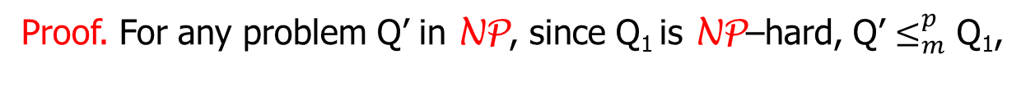
NP-Completeness Theory
How do we identify hard problems in NP ?
Definition. Let Q₁ and Q₂ be decision problems. We say that Q₁ is poly-time reducible to Q₂, written Q₁ $≤_{m}^{p}$ Q₂, if there is a poly-time algorithm R such that for any instance x₁ of Q₁, x₁ is a yes for Q₁ if and only if R(x₁) is a yes for Q₂.
Definition. A problem Q is NP–hard if for every problem Q’ in NP, Q’ $≤_{m}^{p}$ Q. A problem Q is NP–complete if it is in NP and NP–hard.
Cook Theorem. SAT is NP–complete.
NP–hard problems are hard.
Using poly-time reductions to find other NP–hard problems.
Lemma. If Q₁ $≤_{m}^{p}$ Q₂, and Q₁ is NP–hard, then Q₂ is NP–hard.
Proof. For any problem Q’ in NP, since Q₁ is NP–hard, Q’ $≤_{m}^{p}$ Q₁,

Slide 16
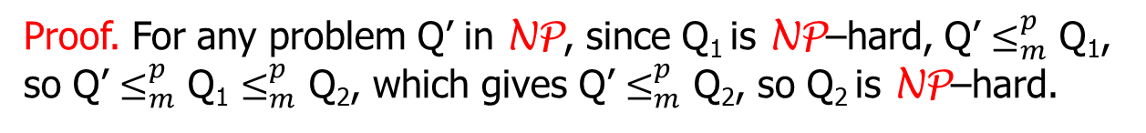
NP-Completeness Theory
How do we identify hard problems in NP ?
Definition. Let Q₁ and Q₂ be decision problems. We say that Q₁ is poly-time reducible to Q₂, written Q₁ $≤_{m}^{p}$ Q₂, if there is a poly-time algorithm R such that for any instance x₁ of Q₁, x₁ is a yes for Q₁ if and only if R(x₁) is a yes for Q₂.
Definition. A problem Q is NP–hard if for every problem Q’ in NP, Q’ $≤_{m}^{p}$ Q. A problem Q is NP–complete if it is in NP and NP–hard.
Cook Theorem. SAT is NP–complete.
NP–hard problems are hard.
Using poly-time reductions to find other NP–hard problems.
Lemma. If Q₁ $≤_{m}^{p}$ Q₂, and Q₁ is NP–hard, then Q₂ is NP–hard.
Proof. For any problem Q’ in NP, since Q₁ is NP–hard, Q’ $≤_{m}^{p}$ Q₁, so Q’ $≤_{m}^{p}$ Q₁ $≤_{m}^{p}$ Q₂, which gives Q’ $≤_{m}^{p}$ Q₂, so Q₂ is NP–hard.

Slide 17
NP-Completeness Theory
How do we identify hard problems in NP ?
Definition. Let Q₁ and Q₂ be decision problems. We say that Q₁ is poly-time reducible to Q₂, written Q₁ $≤_{m}^{p}$ Q₂, if there is a poly-time algorithm R such that for any instance x₁ of Q₁, x₁ is a yes for Q₁ if and only if R(x₁) is a yes for Q₂.
Definition. A problem Q is NP–hard if for every problem Q’ in NP, Q’ $≤_{m}^{p}$ Q. A problem Q is NP–complete if it is in NP and NP–hard.
Cook Theorem. SAT is NP–complete.
NP–hard problems are hard.
Using poly-time reductions to find other NP–hard problems.
Lemma. If Q₁ $≤_{m}^{p}$ Q₂, and Q₁ is NP–hard, then Q₂ is NP–hard.
Proof. For any problem Q’ in NP, since Q₁ is NP–hard, Q’ $≤_{m}^{p}$ Q₁, so Q’ $≤_{m}^{p}$ Q₁ $≤_{m}^{p}$ Q₂, which gives Q’ $≤_{m}^{p}$ Q₂, so Q₂ is NP–hard.
R’
R
Q’ Q₁ Q₂
x R’(x) R(R’(x))

Slide 18
NP-Completeness Theory
How do we identify hard problems in NP ?
Definition. Let Q₁ and Q₂ be decision problems. We say that Q₁ is poly-time reducible to Q₂, written Q₁ $≤_{m}^{p}$ Q₂, if there is a poly-time algorithm R such that for any instance x₁ of Q₁, x₁ is a yes for Q₁ if and only if R(x₁) is a yes for Q₂.
Definition. A problem Q is NP–hard if for every problem Q’ in NP, Q’ $≤_{m}^{p}$ Q. A problem Q is NP–complete if it is in NP and NP–hard.
Cook Theorem. SAT is NP–complete.
NP–hard problems are hard.
Using poly-time reductions to find other NP–hard problems.
Lemma. If Q₁ $≤_{m}^{p}$ Q₂, and Q₁ is NP–hard, then Q₂ is NP–hard.

Slide 19
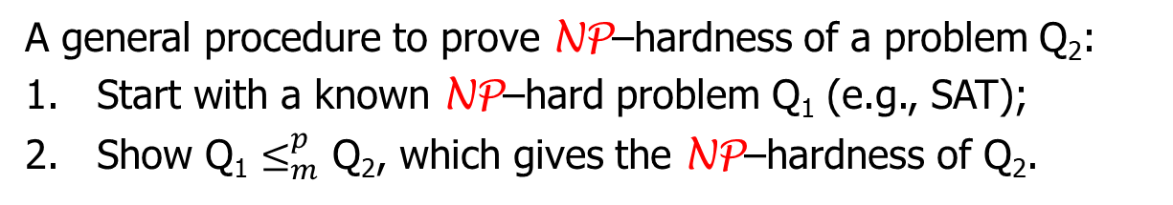
NP-Completeness Theory
How do we identify hard problems in NP ?
Definition. Let Q₁ and Q₂ be decision problems. We say that Q₁ is poly-time reducible to Q₂, written Q₁ $≤_{m}^{p}$ Q₂, if there is a poly-time algorithm R such that for any instance x₁ of Q₁, x₁ is a yes for Q₁ if and only if R(x₁) is a yes for Q₂.
Definition. A problem Q is NP–hard if for every problem Q’ in NP, Q’ $≤_{m}^{p}$ Q. A problem Q is NP–complete if it is in NP and NP–hard.
Cook Theorem. SAT is NP–complete.
NP–hard problems are hard.
Using poly-time reductions to find other NP–hard problems.
Lemma. If Q₁ $≤_{m}^{p}$ Q₂, and Q₁ is NP–hard, then Q₂ is NP–hard.
A general procedure to prove NP–hardness of a problem Q₂:
Start with a known NP–hard problem Q₁ (e.g., SAT);
Show Q₁ $≤_{m}^{p}$ Q₂, which gives the NP–hardness of Q₂.

Slide 20
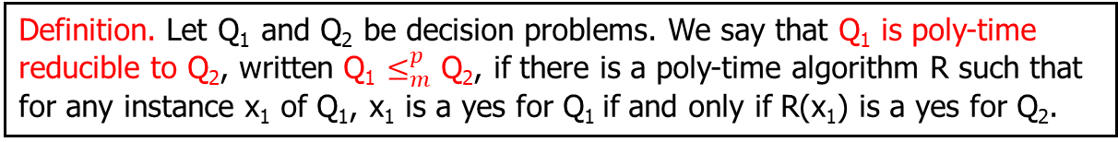
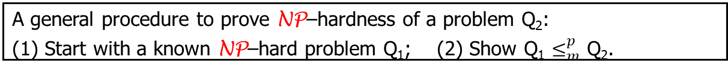
NP-Completeness Theory
Definition. A problem is in P if it can be solved in polynomial time.
Definition. A problem Q is in NP if Q is a decision problem and there is an algorithm A_{Q} such that for any instance x of Q:
If x is a yes-instance, then there is a y such that A_{Q}(x, y) = 1;
If x is a no-instance, then for all y, A_{Q}(x, y) = 0;
A_{Q}(x, y) runs in time polynomial in |x|.
Definition. Let Q₁ and Q₂ be decision problems. We say that Q₁ is poly-time reducible to Q₂, written Q₁ $≤_{m}^{p}$ Q₂, if there is a poly-time algorithm R such that for any instance x₁ of Q₁, x₁ is a yes for Q₁ if and only if R(x₁) is a yes for Q₂.
Definition. (1) A problem Q is NP–hard if for every problem Q’ in NP, Q’ $≤_{m}^{p}$ Q. (2) A problem Q is NP–complete if it is in NP and NP–hard.
Cook Theorem. SAT is NP–complete.
NP–hard problems are hard.
Lemma. If Q₁ $≤_{m}^{p}$ Q₂, and Q₁ is NP–hard, then Q₂ is NP–hard.
A general procedure to prove NP–hardness of a problem Q₂:
(1) Start with a known NP–hard problem Q₁; (2) Show Q₁ $≤_{m}^{p}$ Q₂.

Slide 21
NP-Completeness Theory
A general procedure to prove NP–hardness of a problem Q₂:
(1) Start with a known NP–hard problem Q₁; (2) Show Q₁ $≤_{m}^{p}$ Q₂.

Slide 22
NP-Completeness Theory
A general procedure to prove NP–hardness of a problem Q₂:
(1) Start with a known NP–hard problem Q₁; (2) Show Q₁ $≤_{m}^{p}$ Q₂.
Example 1. Independent-Set is NP–complete.
Independent Set (IS). Given (G, k), where G is a graph and k is an integer, can we find a set I of k vertices in G such that no two vertices in I are adjacent?
Satisfiability (SAT). Given a CNF formula F = F(x₁, x₂, …, x_{n}), is there an assignment to x₁, x₂, …, x_{n} to make F = true?

Slide 23

NP-Completeness Theory
A general procedure to prove NP–hardness of a problem Q₂:
(1) Start with a known NP–hard problem Q₁; (2) Show Q₁ $≤_{m}^{p}$ Q₂.
Example 1. Independent-Set is NP–complete.
Independent Set (IS). Given (G, k), where G is a graph and k is an integer, can we find a set I of k vertices in G such that no two vertices in I are adjacent?
Satisfiability (SAT). Given a CNF formula F = F(x₁, x₂, …, x_{n}), is there an assignment to x₁, x₂, …, x_{n} to make F = true?
We show:
SAT
$≤_{m}^{p}$
IS

Slide 24
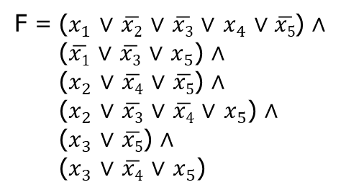
NP-Completeness Theory
A general procedure to prove NP–hardness of a problem Q₂:
(1) Start with a known NP–hard problem Q₁; (2) Show Q₁ $≤_{m}^{p}$ Q₂.
Example 1. Independent-Set is NP–complete.
Independent Set (IS). Given (G, k), where G is a graph and k is an integer, can we find a set I of k vertices in G such that no two vertices in I are adjacent?
Satisfiability (SAT). Given a CNF formula F = F(x₁, x₂, …, x_{n}), is there an assignment to x₁, x₂, …, x_{n} to make F = true?
We show:
SAT
$≤_{m}^{p}$
IS
F = ($x_{1}$ $∨$ $\overline{x2}$ $∨$ $\overline{x3}$ $∨$ $x_{4}$ $∨\overline{x5}$) $∧$
($\overline{x1}$ $∨$ $\overline{x3}$ $∨$ $x_{5}$) $∧$
($x_{2}$ $∨$ $\overline{x4}$ $∨$ $\overline{x5}$) $∧$
($x_{2}$ $∨$ $\overline{x3}$ $∨$ $\overline{x4}$ $∨$ $x_{5}$) $∧$
($x_{3}$ $∨$ $\overline{x5}$) $∧$
($x_{3}$ $∨$ $\overline{x4}$ $∨$ $x_{5}$)

Slide 25
















NP-Completeness Theory
A general procedure to prove NP–hardness of a problem Q₂:
(1) Start with a known NP–hard problem Q₁; (2) Show Q₁ $≤_{m}^{p}$ Q₂.
Example 1. Independent-Set is NP–complete.
Independent Set (IS). Given (G, k), where G is a graph and k is an integer, can we find a set I of k vertices in G such that no two vertices in I are adjacent?
Satisfiability (SAT). Given a CNF formula F = F(x₁, x₂, …, x_{n}), is there an assignment to x₁, x₂, …, x_{n} to make F = true?
We show:
SAT
$≤_{m}^{p}$
IS
$$\overline{x1}$$
$x_{2}$
$$\overline{x3}$$
F = ($x_{1}$ $∨$ $\overline{x2}$ $∨$ $\overline{x3}$ $∨$ $x_{4}$ $∨\overline{x5}$) $∧$
($\overline{x1}$ $∨$ $\overline{x3}$ $∨$ $x_{5}$) $∧$
($x_{2}$ $∨$ $\overline{x4}$ $∨$ $\overline{x5}$) $∧$
($x_{2}$ $∨$ $\overline{x3}$ $∨$ $\overline{x4}$ $∨$ $x_{5}$) $∧$
($x_{3}$ $∨$ $\overline{x5}$) $∧$
($x_{3}$ $∨$ $\overline{x4}$ $∨$ $x_{5}$)
$x_{1}$
$x_{5}$
$$\overline{x3}$$
$$\overline{x5}$$
$$\overline{x2}$$
$x_{2}$
$x_{5}$
$$\overline{x4}$$
$$\overline{x5}$$
$$\overline{x4}$$
$x_{3}$
$x_{4}$
$x_{3}$
$$\overline{x3}$$
$$\overline{x5}$$
$x_{5}$
$$\overline{x4}$$

Slide 26
NP-Completeness Theory
A general procedure to prove NP–hardness of a problem Q₂:
(1) Start with a known NP–hard problem Q₁; (2) Show Q₁ $≤_{m}^{p}$ Q₂.
Example 1. Independent-Set is NP–complete.
Independent Set (IS). Given (G, k), where G is a graph and k is an integer, can we find a set I of k vertices in G such that no two vertices in I are adjacent?
Satisfiability (SAT). Given a CNF formula F = F(x₁, x₂, …, x_{n}), is there an assignment to x₁, x₂, …, x_{n} to make F = true?
We show:
SAT
$≤_{m}^{p}$
IS
$$\overline{x1}$$
$x_{2}$
$$\overline{x3}$$
F = ($x_{1}$ $∨$ $\overline{x2}$ $∨$ $\overline{x3}$ $∨$ $x_{4}$ $∨\overline{x5}$) $∧$
($\overline{x1}$ $∨$ $\overline{x3}$ $∨$ $x_{5}$) $∧$
($x_{2}$ $∨$ $\overline{x4}$ $∨$ $\overline{x5}$) $∧$
($x_{2}$ $∨$ $\overline{x3}$ $∨$ $\overline{x4}$ $∨$ $x_{5}$) $∧$
($x_{3}$ $∨$ $\overline{x5}$) $∧$
($x_{3}$ $∨$ $\overline{x4}$ $∨$ $x_{5}$)
$x_{1}$
$x_{5}$
$$\overline{x3}$$
$$\overline{x5}$$
$$\overline{x2}$$
$x_{2}$
$x_{5}$
$$\overline{x4}$$
$$\overline{x5}$$
$$\overline{x4}$$
$x_{3}$
$x_{4}$
$x_{3}$
$$\overline{x3}$$
$$\overline{x5}$$
$x_{5}$
$$\overline{x4}$$
(G, 6)

