Slide 1
CSCE-411
Design and Analysis of Algorithms
Spring 2025
Instructor: Jianer Chen
Office: PETR 428
Phone: 845-4259
Email: chen@cse.tamu.edu
Notes 35: Polynomial-time reduction and Cook Theorem

Slide 2
NP-Completeness Theory
A theory for realizing computational difficulties, i.e., infeasibility, of problems (in particular, those encountered in practice.)

Slide 3
NP-Completeness Theory
A theory for realizing computational difficulties, i.e., infeasibility, of problems (in particular, those encountered in practice.)
If a problem Q can be solved in polynomial time, i.e., in time O(n^{c}) for a constant c, then we consider Q feasible.
Let P to be the class of all problems solvable in polynomial time.

Slide 4
NP-Completeness Theory
A theory for realizing computational difficulties, i.e., infeasibility, of problems (in particular, those encountered in practice.)
If a problem Q can be solved in polynomial time, i.e., in time O(n^{c}) for a constant c, then we consider Q feasible.
Let P to be the class of all problems solvable in polynomial time.
Examples. All problems we have studied in this class are in P.
Sorting: O(n log n) = O(n²)
Longest Common Subsequence: O(n²)
Many graph problems solvable based on DFS and BFS: O(m+n) = O(L)
Single Source Shortest Path:
Dijktra: O(n²) or O(m log n) = O(n³), Bellman-Ford: O(nm) = O(n³)
All-Pairs Shortest Path:
Floyd-Warshall: O(n³), Johnson: O(nm log n) = O(n⁴)
Minimum Spanning Tree: O(n²) or O(m log n) = O(n³),
Bipartite Graph Matching: O(nm) = O(n³),

Slide 5
NP-Completeness Theory
Definition. A problem is in P if it can be solved in polynomial time.
Definition. A problem Q is in NP if Q is a decision problem and there is an algorithm A_{Q} such that for any instance x of Q:
If x is a yes-instance, then there is a y such that A_{Q}(x, y) = 1;
If x is a no-instance, then for all y, A_{Q}(x, y) = 0;
A_{Q}(x, y) runs in time polynomial in |x|.

Slide 6
NP-Completeness Theory
Definition. A problem is in P if it can be solved in polynomial time.
Definition. A problem Q is in NP if Q is a decision problem and there is an algorithm A_{Q} such that for any instance x of Q:
If x is a yes-instance, then there is a y such that A_{Q}(x, y) = 1;
If x is a no-instance, then for all y, A_{Q}(x, y) = 0;
A_{Q}(x, y) runs in time polynomial in |x|.
Discussions.
In general, decision problems and their corresponding optimization problems have similar complexity, i.e., either both solvable in poly-time or both not. Thus, we will focus on decision problems.

Slide 7
NP-Completeness Theory
Definition. A problem is in P if it can be solved in polynomial time.
Definition. A problem Q is in NP if Q is a decision problem and there is an algorithm A_{Q} such that for any instance x of Q:
If x is a yes-instance, then there is a y such that A_{Q}(x, y) = 1;
If x is a no-instance, then for all y, A_{Q}(x, y) = 0;
A_{Q}(x, y) runs in time polynomial in |x|.
Discussions.
In general, decision problems and their corresponding optimization problems have similar complexity, i.e., either both solvable in poly-time or both not. Thus, we will focus on decision problems.
Independent Set (IS). Given a graph G and an integer k, can we find a set I of k vertices in G such that no two vertices in I are adjacent?
Max Independent Set (MaxIS). Given a graph G, construct a largest independent set.

Slide 8
NP-Completeness Theory
Definition. A problem is in P if it can be solved in polynomial time.
Definition. A problem Q is in NP if Q is a decision problem and there is an algorithm A_{Q} such that for any instance x of Q:
If x is a yes-instance, then there is a y such that A_{Q}(x, y) = 1;
If x is a no-instance, then for all y, A_{Q}(x, y) = 0;
A_{Q}(x, y) runs in time polynomial in |x|.
Discussions.
In general, decision problems and their corresponding optimization problems have similar complexity, i.e., either both solvable in poly-time or both not. Thus, we will focus on decision problems.
Independent Set (IS). Given a graph G and an integer k, can we find a set I of k vertices in G such that no two vertices in I are adjacent?
Max Independent Set (MaxIS). Given a graph G, construct a largest independent set.
If MaxIS is solvable in time O(n^{c}), then so is IS.

Slide 9
NP-Completeness Theory
Definition. A problem is in P if it can be solved in polynomial time.
Definition. A problem Q is in NP if Q is a decision problem and there is an algorithm A_{Q} such that for any instance x of Q:
If x is a yes-instance, then there is a y such that A_{Q}(x, y) = 1;
If x is a no-instance, then for all y, A_{Q}(x, y) = 0;
A_{Q}(x, y) runs in time polynomial in |x|.
Discussions.
In general, decision problems and their corresponding optimization problems have similar complexity, i.e., either both solvable in poly-time or both not. Thus, we will focus on decision problems.
Independent Set (IS). Given a graph G and an integer k, can we find a set I of k vertices in G such that no two vertices in I are adjacent?
Max Independent Set (MaxIS). Given a graph G, construct a largest independent set.
If MaxIS is solvable in time O(n^{c}), then so is IS.
If IS is solvable in time O(n^{c}), then we have an algorithm max-size(G) that finds the size of max IS in time O(n^{c+1}).

Slide 10
NP-Completeness Theory
Definition. A problem is in P if it can be solved in polynomial time.
Definition. A problem Q is in NP if Q is a decision problem and there is an algorithm A_{Q} such that for any instance x of Q:
If x is a yes-instance, then there is a y such that A_{Q}(x, y) = 1;
If x is a no-instance, then for all y, A_{Q}(x, y) = 0;
A_{Q}(x, y) runs in time polynomial in |x|.
Discussions.
In general, decision problems and their corresponding optimization problems have similar complexity, i.e., either both solvable in poly-time or both not. Thus, we will focus on decision problems.
Time = O(n^{c+3})
Independent Set (IS). Given a graph G and an integer k, can we find a set I of k vertices in G such that no two vertices in I are adjacent?
Max Independent Set (MaxIS). Given a graph G, construct a largest independent set.
If MaxIS is solvable in time O(n^{c}), then so is IS.
MaxIS(G)
1. let k = max-size(G);
2. I = Φ;
3. for (h = k; h > 0; h--)
find a vertex v such that
max-size(G-N(v)) = h-1;
I = I + v;
G = G – N(v);
4. return(I).
If IS is solvable in time O(n^{c}), then we have an algorithm max-size(G) that finds the size of max IS in time O(n^{c+1}).

Slide 11
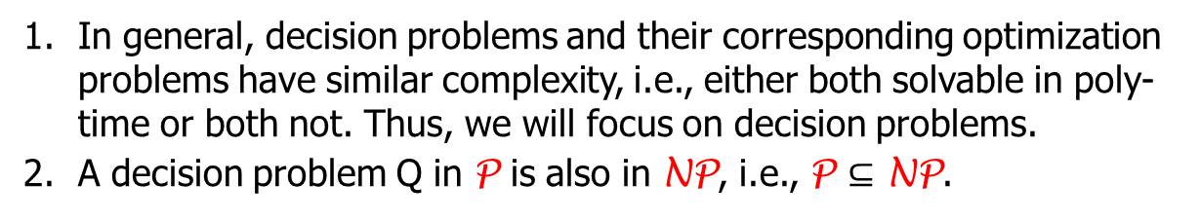
NP-Completeness Theory
Definition. A problem is in P if it can be solved in polynomial time.
Definition. A problem Q is in NP if Q is a decision problem and there is an algorithm A_{Q} such that for any instance x of Q:
If x is a yes-instance, then there is a y such that A_{Q}(x, y) = 1;
If x is a no-instance, then for all y, A_{Q}(x, y) = 0;
A_{Q}(x, y) runs in time polynomial in |x|.
Discussions.
In general, decision problems and their corresponding optimization problems have similar complexity, i.e., either both solvable in poly-time or both not. Thus, we will focus on decision problems.
A decision problem Q in P is also in NP, i.e., P $⊆$ NP.

Slide 12
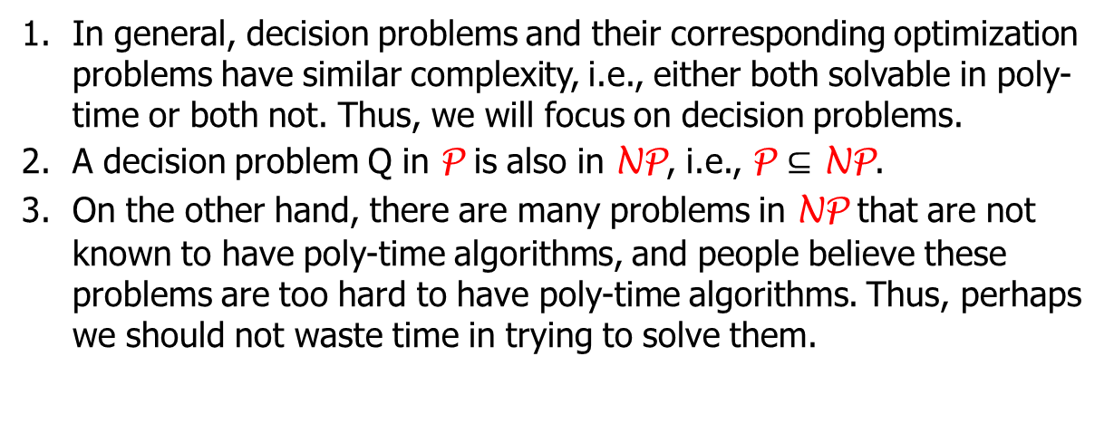
NP-Completeness Theory
Definition. A problem is in P if it can be solved in polynomial time.
Definition. A problem Q is in NP if Q is a decision problem and there is an algorithm A_{Q} such that for any instance x of Q:
If x is a yes-instance, then there is a y such that A_{Q}(x, y) = 1;
If x is a no-instance, then for all y, A_{Q}(x, y) = 0;
A_{Q}(x, y) runs in time polynomial in |x|.
Discussions.
In general, decision problems and their corresponding optimization problems have similar complexity, i.e., either both solvable in poly-time or both not. Thus, we will focus on decision problems.
A decision problem Q in P is also in NP, i.e., P $⊆$ NP.
On the other hand, there are many problems in NP that are not known to have poly-time algorithms, and people believe these problems are too hard to have poly-time algorithms. Thus, perhaps we should not waste time in trying to solve them.

Slide 13
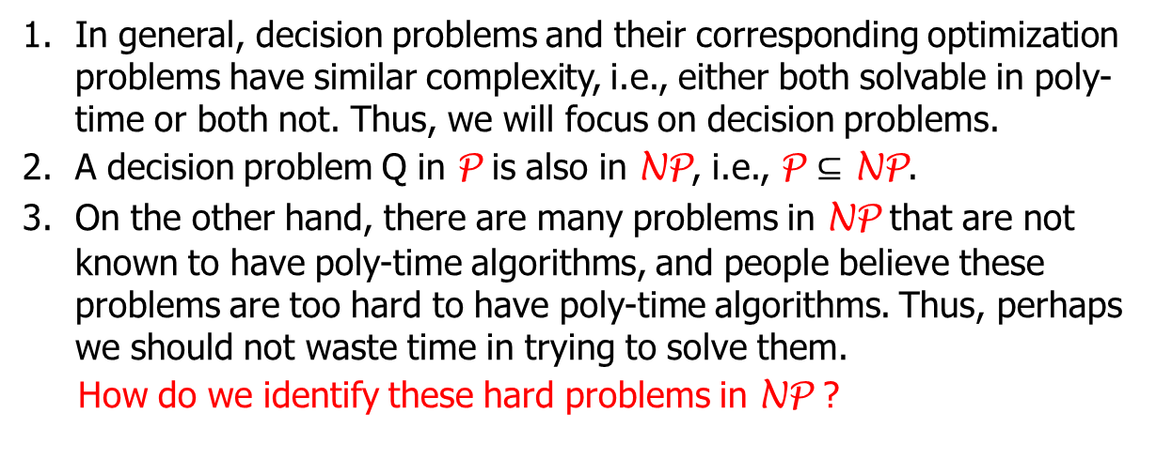
NP-Completeness Theory
Definition. A problem is in P if it can be solved in polynomial time.
Definition. A problem Q is in NP if Q is a decision problem and there is an algorithm A_{Q} such that for any instance x of Q:
If x is a yes-instance, then there is a y such that A_{Q}(x, y) = 1;
If x is a no-instance, then for all y, A_{Q}(x, y) = 0;
A_{Q}(x, y) runs in time polynomial in |x|.
Discussions.
In general, decision problems and their corresponding optimization problems have similar complexity, i.e., either both solvable in poly-time or both not. Thus, we will focus on decision problems.
A decision problem Q in P is also in NP, i.e., P $⊆$ NP.
On the other hand, there are many problems in NP that are not known to have poly-time algorithms, and people believe these problems are too hard to have poly-time algorithms. Thus, perhaps we should not waste time in trying to solve them.
How do we identify these hard problems in NP ?

Slide 14
NP-Completeness Theory
How do we identify hard problems in NP ?

Slide 15
NP-Completeness Theory
How do we identify hard problems in NP ?
Find a way to compare the difficulties of problems.

Slide 16
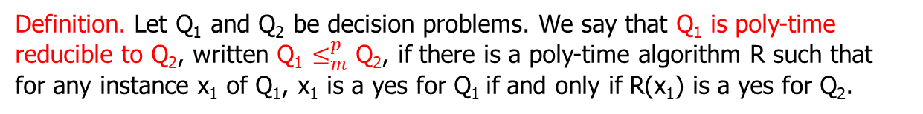
NP-Completeness Theory
How do we identify hard problems in NP ?
Find a way to compare the difficulties of problems.
Definition. Let Q₁ and Q₂ be decision problems. We say that Q₁ is poly-time reducible to Q₂, written Q₁ $≤_{m}^{p}$ Q₂, if there is a poly-time algorithm R such that for any instance x₁ of Q₁, x₁ is a yes for Q₁ if and only if R(x₁) is a yes for Q₂.
Q₁
R
Q₂
yes
yes
no
no

Slide 17
NP-Completeness Theory
How do we identify hard problems in NP ?
Find a way to compare the difficulties of problems.
Definition. Let Q₁ and Q₂ be decision problems. We say that Q₁ is poly-time reducible to Q₂, written Q₁ $≤_{m}^{p}$ Q₂, if there is a poly-time algorithm R such that for any instance x₁ of Q₁, x₁ is a yes for Q₁ if and only if R(x₁) is a yes for Q₂.
Q₁
R
Q₂
yes
yes
no
no
Lemma. Suppose Q₁ $≤_{m}^{p}$ Q₂, and Q₂ is in P, then so is Q₁.

Slide 18

NP-Completeness Theory
How do we identify hard problems in NP ?
Find a way to compare the difficulties of problems.
Definition. Let Q₁ and Q₂ be decision problems. We say that Q₁ is poly-time reducible to Q₂, written Q₁ $≤_{m}^{p}$ Q₂, if there is a poly-time algorithm R such that for any instance x₁ of Q₁, x₁ is a yes for Q₁ if and only if R(x₁) is a yes for Q₂.
Q₁
R
Q₂
yes
yes
no
no
Lemma. Suppose Q₁ $≤_{m}^{p}$ Q₂, and Q₂ is in P, then so is Q₁.
Q₁ $≤_{m}^{p}$ Q₂
x₁ R(x₁)
R
yes/no
yes/no

Slide 19
NP-Completeness Theory
How do we identify hard problems in NP ?
Find a way to compare the difficulties of problems.
Definition. Let Q₁ and Q₂ be decision problems. We say that Q₁ is poly-time reducible to Q₂, written Q₁ $≤_{m}^{p}$ Q₂, if there is a poly-time algorithm R such that for any instance x₁ of Q₁, x₁ is a yes for Q₁ if and only if R(x₁) is a yes for Q₂.
Q₁
R
Q₂
yes
yes
no
no
Lemma. Suppose Q₁ $≤_{m}^{p}$ Q₂, and Q₂ is in P, then so is Q₁.
Thus, if Q₂ is easy, then Q₁ is easy (equivalently, if Q₁ is hard, then Q₂ is hard).

Slide 20
NP-Completeness Theory
How do we identify hard problems in NP ?
Find a way to compare the difficulties of problems.
Definition. Let Q₁ and Q₂ be decision problems. We say that Q₁ is poly-time reducible to Q₂, written Q₁ $≤_{m}^{p}$ Q₂, if there is a poly-time algorithm R such that for any instance x₁ of Q₁, x₁ is a yes for Q₁ if and only if R(x₁) is a yes for Q₂.
Q₁
R
Q₂
yes
yes
no
no
Lemma. Suppose Q₁ $≤_{m}^{p}$ Q₂, and Q₂ is in P, then so is Q₁.
Thus, if Q₂ is easy, then Q₁ is easy (equivalently, if Q₁ is hard, then Q₂ is hard).
Roughly, if Q₁ $≤_{m}^{p}$ Q₂, then Q₁ is not harder than Q₂.

Slide 21
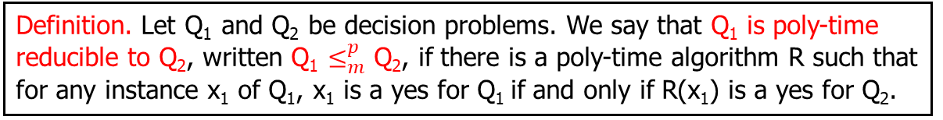
NP-Completeness Theory
How do we identify hard problems in NP ?
Find a way to compare the difficulties of problems.
Definition. Let Q₁ and Q₂ be decision problems. We say that Q₁ is poly-time reducible to Q₂, written Q₁ $≤_{m}^{p}$ Q₂, if there is a poly-time algorithm R such that for any instance x₁ of Q₁, x₁ is a yes for Q₁ if and only if R(x₁) is a yes for Q₂.

Slide 22
NP-Completeness Theory
How do we identify hard problems in NP ?
Find a way to compare the difficulties of problems.
Definition. Let Q₁ and Q₂ be decision problems. We say that Q₁ is poly-time reducible to Q₂, written Q₁ $≤_{m}^{p}$ Q₂, if there is a poly-time algorithm R such that for any instance x₁ of Q₁, x₁ is a yes for Q₁ if and only if R(x₁) is a yes for Q₂.
2. Identify the first hard problem in NP.

Slide 23
NP-Completeness Theory
How do we identify hard problems in NP ?
Find a way to compare the difficulties of problems.
Definition. Let Q₁ and Q₂ be decision problems. We say that Q₁ is poly-time reducible to Q₂, written Q₁ $≤_{m}^{p}$ Q₂, if there is a poly-time algorithm R such that for any instance x₁ of Q₁, x₁ is a yes for Q₁ if and only if R(x₁) is a yes for Q₂.
2. Identify the first hard problem in NP.
Cook Theorem. For every problem Q in NP, Q $≤_{m}^{p}$ SAT.
Satisfiability (SAT). Given a CNF formula F = F(x₁, x₂, …, x_{n}), is there an assignment to x₁, x₂, …, x_{n} that makes F = true?

Slide 24
NP-Completeness Theory
How do we identify hard problems in NP ?
Find a way to compare the difficulties of problems.
Definition. Let Q₁ and Q₂ be decision problems. We say that Q₁ is poly-time reducible to Q₂, written Q₁ $≤_{m}^{p}$ Q₂, if there is a poly-time algorithm R such that for any instance x₁ of Q₁, x₁ is a yes for Q₁ if and only if R(x₁) is a yes for Q₂.
2. Identify the first hard problem in NP.
Cook Theorem. For every problem Q in NP, Q $≤_{m}^{p}$ SAT.
Thus, no problem in NP is harder than SAT. SAT is the hardest in NP.
Satisfiability (SAT). Given a CNF formula F = F(x₁, x₂, …, x_{n}), is there an assignment to x₁, x₂, …, x_{n} that makes F = true?

Slide 25
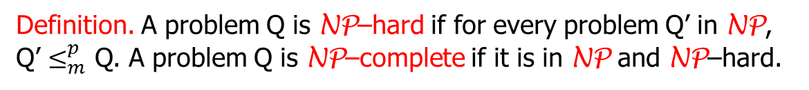
NP-Completeness Theory
How do we identify hard problems in NP ?
Find a way to compare the difficulties of problems.
Definition. Let Q₁ and Q₂ be decision problems. We say that Q₁ is poly-time reducible to Q₂, written Q₁ $≤_{m}^{p}$ Q₂, if there is a poly-time algorithm R such that for any instance x₁ of Q₁, x₁ is a yes for Q₁ if and only if R(x₁) is a yes for Q₂.
2. Identify the first hard problem in NP.
Cook Theorem. For every problem Q in NP, Q $≤_{m}^{p}$ SAT.
Thus, no problem in NP is harder than SAT. SAT is the hardest in NP.
Definition. A problem Q is NP–hard if for every problem Q’ in NP, Q’ $≤_{m}^{p}$ Q. A problem Q is NP–complete if it is in NP and NP–hard.
Satisfiability (SAT). Given a CNF formula F = F(x₁, x₂, …, x_{n}), is there an assignment to x₁, x₂, …, x_{n} that makes F = true?

Slide 26
NP-Completeness Theory
How do we identify hard problems in NP ?
Find a way to compare the difficulties of problems.
Definition. Let Q₁ and Q₂ be decision problems. We say that Q₁ is poly-time reducible to Q₂, written Q₁ $≤_{m}^{p}$ Q₂, if there is a poly-time algorithm R such that for any instance x₁ of Q₁, x₁ is a yes for Q₁ if and only if R(x₁) is a yes for Q₂.
2. Identify the first hard problem in NP.
Cook Theorem. SAT is NP–complete.
Thus, no problem in NP is harder than SAT. SAT is the hardest in NP.
Definition. A problem Q is NP–hard if for every problem Q’ in NP, Q’ $≤_{m}^{p}$ Q. A problem Q is NP–complete if it is in NP and NP–hard.
Satisfiability (SAT). Given a CNF formula F = F(x₁, x₂, …, x_{n}), is there an assignment to x₁, x₂, …, x_{n} that makes F = true?

