Slide 1
CSCE-411
Design and Analysis of Algorithms
Spring 2025
Instructor: Jianer Chen
Office: PETR 428
Phone: 845-4259
Email: chen@cse.tamu.edu
Notes 11: Graph algorithms

Slide 2
Dynamic Programming
Problem LCS. Given two sequences X[1..n] and Y[1..m], find the longest common subsequence LCS(X[1..n], Y[1..m]) of X and Y.
LCS(X[1..n], Y[1..m]) =
LCS(X[1..n-1], Y[1..m-1])◦X[n], if X[n] = Y[m];
Longer(LCS(X[1..n-1], Y[1..m]), LCS(X[1..n], Y[1..m-1])) if X[n] ≠ Y[m].
Time = O(nm)
Dyn-LCS(X[1..n], Y[1..m])
\\ array C[0..n,0..m] records the length
\\ of LCS(X[1..i],Y[1..j]) for all i, j.
1. for (i=0; i<=n; i++)
C[i,0] = 0;
2. for (j=0; j<=m; j++)
C[0,j] = 0;
3. for (i=1; i<=n; i++)
for (j=1; j<=m; j++)
if (X[i]==Y[j])
C[i,j] = C[i-1,j-1]+1;
else if (C[i-1,j] > C[i,j-1])
C[i,j] = C[i-1,j];
else C[i,j] = C[i,j-1].
Print-LCS(C[0..n,0..m])
\\ use array C[0..n,0..m] to print LCS
1. i=n; j=m;
2. while (i>0 & j>0)
if (X[i]==Y[j])
print(X[i]); i = i – 1; j = j – 1;
else if (C[i-1,j] == C[i,j])
i = i – 1;
else j = j – 1.
Main
1. Dyn-LCS(X[1..n], Y[1..m]);
2. Print-LCS(C[0..n,0..m]);
3. reverse the sequence of step 2 and output.
Dynamic programming algorithm for Longest-Common-Subsequence

Slide 3
Dynamic Programming (DP)
Remarks.
DP is also based on the divide-and-conquer technique.
LCS(X[1..n], Y[1..m]) =
LCS(X[1..n-1], Y[1..m-1])◦X[n], if X[n] = Y[m];
Longer(LCS(X[1..n-1], Y[1..m]), LCS(X[1..n], Y[1..m-1])) if X[n] ≠ Y[m].

Slide 4
Dynamic Programming (DP)
Remarks.
DP is also based on the divide-and-conquer technique.
DP becomes effective when the results of some small instances are needed many times.
Rec-LCS(i, j)
\\ compute LCS for X[1..i] and Y[1..j]
1. if (i<=0 or j<=0)
return(empty sequence);
2. if (X[i] == Y[j])
return(Rec-LCS(i-1, j-1)◦X[i]);
else
S1 = Rec-LCS(i-1,j);
S2 = Rec-LCS(i,j-1);
if (|S1| > |S2|) return(S1);
else return(S2).
Rec-LCS(7,5)
Rec-LCS(6,5)
Rec-LCS(7,4)
Rec-LCS(5,5)
Rec-LCS(6,4)
Rec-LCS(6,4)
Rec-LCS(7,3)
R-LCS(4,5)
R-LCS(5,4)
R-LCS(5,4)
R-LCS(6,3)
R-LCS(5,4)
R-LCS(6,3)
R-LCS(6,3)
R-LCS(7,2)
The recursive algorithm Rec-LCS(n, n) has a recurrence relation T(n) ≤ 2T(n-1)+O(1), which, in the worst case, gives T(n) = O(2^{n}) (compared with O(n²) using DP).

Slide 5
Dynamic Programming (DP)
Remarks.
DP is also based on the divide-and-conquer technique.
DP becomes effective when the results of some small instances are needed many times.
If the result of each small instance is used only once, DP will not help. We can use the recursive algorithm
M-Sort(A[1..16])
M-Sort(A[1..8])
M-Sort(A[9..16])
M-Sort(A[1..4])
M-Sort(A[5..8])
M-Sort(A[9..12])
MSort(A[13..16])
M-Sort(A[1..2]}
M-Sort(A[3..4]}
M-Sort(A[5..6]}
M-Sort(A[7..8]}
M-Sort(A[9..10]}
M-Sort(A[11..12]}
M-Sort(A[13..14]}
M-Sort(A[15..16]}

Slide 6
Dynamic Programming (DP)
Remarks.
DP is also based on the divide-and-conquer technique.
DP becomes effective when the results of some small instances are needed many times.
If the result of each small instance is used only once, DP will not help. We can use the recursive algorithm
Solving a problem using dynamic programming:

Slide 7
Dynamic Programming (DP)
Remarks.
DP is also based on the divide-and-conquer technique.
DP becomes effective when the results of some small instances are needed many times.
If the result of each small instance is used only once, DP will not help. We can use the recursive algorithm
Solving a problem using dynamic programming:
Write a recursion where the solution of a large instance is obtained from that of smaller instances.
LCS(X[1..n], Y[1..m]) =
LCS(X[1..n-1], Y[1..m-1])◦X[n], if X[n] = Y[m];
Longer(LCS(X[1..n-1], Y[1..m]), LCS(X[1..n], Y[1..m-1])) if X[n] ≠ Y[m].

Slide 8
Dynamic Programming (DP)
Remarks.
DP is also based on the divide-and-conquer technique.
DP becomes effective when the results of some small instances are needed many times.
If the result of each small instance is used only once, DP will not help. We can use the recursive algorithm
Solving a problem using dynamic programming:
Write a recursion where the solution of a large instance is obtained from that of smaller instances.
Check if a solution to a small instance is used many times in the recursion. (If not, do not use DP).

Slide 9
Dynamic Programming (DP)
Remarks.
DP is also based on the divide-and-conquer technique.
DP becomes effective when the results of some small instances are needed many times.
If the result of each small instance is used only once, DP will not help. We can use the recursive algorithm
Solving a problem using dynamic programming:
Dyn-LCS(X[1..n], Y[1..m])
\\ array C[0..n,0..m] records the length
\\ of LCS(X[1..i],Y[1..j]) for all i, j.
1. for (i=0; i<=n; i++)
C[i,0] = 0;
2. for (j=0; j<=m; j++)
C[0,j] = 0;
3. for (i=1; i<=n; i++)
for (j=1; j<=m; j++)
if (X[i]==Y[j])
C[i,j] = C[i-1,j-1]+1;
else if (C[i-1,j] > C[i,j-1])
C[i,j] = C[i-1,j];
else C[i,j] = C[i,j-1].`
Write a recursion where the solution of a large instance is obtained from that of smaller instances.
Check if a solution to a small instance is used many times in the recursion. (If not, do not use DP).
Start from the smallest instances and compute and save their solutions, then compute the solutions for larger instances based on the recursion using the saved solutions to smaller instances.

Slide 10
Graph Algorithms

Slide 11
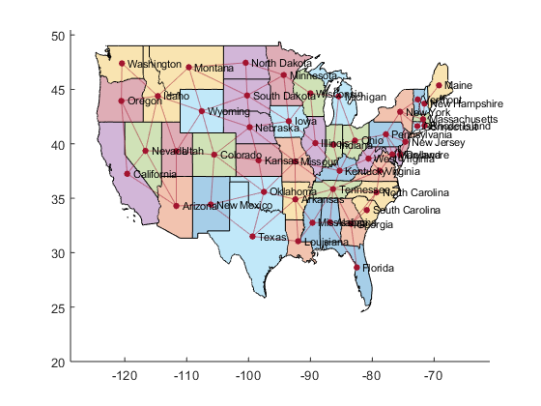
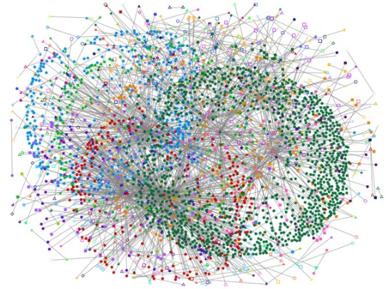


Graph Algorithms
Graphs are everywhere
map
neural network
social network
transportation network

Slide 12
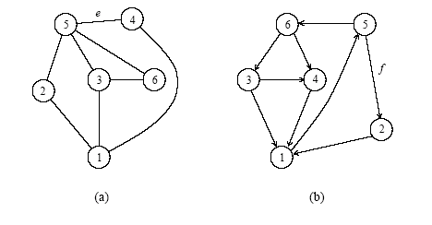
Definitions
An undirected graph G is a pair (V,E), where V is a finite set of points called vertices and E is a finite set of edges. Each edge e in E is an unordered pair [u, v] of vertices.
undirected graph
directed graph

Slide 13
Definitions
An undirected graph G is a pair (V,E), where V is a finite set of points called vertices and E is a finite set of edges. Each edge e in E is an unordered pair [u, v] of vertices.
In a directed graph, an edge (or arc) e is an ordered pair [u, v] of vertices, where v is the head and u is the tail of the edge.
undirected graph
directed graph

Slide 14
Definitions
A path P(v₀, v_{k}) from a vertex v₀ to a vertex v_{k} is a sequence {v₀, v₁, v₂, …, v_{k}} of vertices, where [v_{i-1}, v_{i}] are edges in G for i = 1, 2,…, k. The path P(v₀, v_{k}) is a cycle if v₀ = v_{k}. The path P(v₀, v_{k}) is simple if all vertices are distinct. The length of a path is defined as the number of edges in the path.

Slide 15
Definitions
A path P(v₀, v_{k}) from a vertex v₀ to a vertex v_{k} is a sequence {v₀, v₁, v₂, …, v_{k}} of vertices, where [v_{i-1}, v_{i}] are edges in G for i = 1, 2,…, k. The path P(v₀, v_{k}) is a cycle if v₀ = v_{k}. The path P(v₀, v_{k}) is simple if all vertices are distinct. The length of a path is defined as the number of edges in the path.
An undirected graph is connected if every pair of vertices is connected by a path.

Slide 16
Definitions
A path P(v₀, v_{k}) from a vertex v₀ to a vertex v_{k} is a sequence {v₀, v₁, v₂, …, v_{k}} of vertices, where [v_{i-1}, v_{i}] are edges in G for i = 1, 2,…, k. The path P(v₀, v_{k}) is a cycle if v₀ = v_{k}. The path P(v₀, v_{k}) is simple if all vertices are distinct. The length of a path is defined as the number of edges in the path.
An undirected graph is connected if every pair of vertices is connected by a path.
A forest is an acyclic graph (i.e., a graph without simple cycles). A tree is a connected acyclic graph. A tree of n vertices has n-1 edges.

Slide 17
Definitions
A path P(v₀, v_{k}) from a vertex v₀ to a vertex v_{k} is a sequence {v₀, v₁, v₂, …, v_{k}} of vertices, where [v_{i-1}, v_{i}] are edges in G for i = 1, 2,…, k. The path P(v₀, v_{k}) is a cycle if v₀ = v_{k}. The path P(v₀, v_{k}) is simple if all vertices are distinct. The length of a path is defined as the number of edges in the path.
An undirected graph is connected if every pair of vertices is connected by a path.
A forest is an acyclic graph (i.e., a graph without simple cycles). A tree is a connected acyclic graph. A tree of n vertices has n-1 edges.
A graph that has weights associated with each edge is called a weighted graph.

Slide 18
Graph Representations
Graphs can be given by adjacency matrix or adjacency list.

Slide 19
Graph Representations
Graphs can be given by adjacency matrix or adjacency list.
The adjacency matrix of a graph has value a_{i,j} = 1 if vertices i and j share an edge; 0 otherwise. For a weighted graph, a_{i,j} = w_{i,j}, the weight of the edge.

Slide 20
Graph Representations
Graphs can be given by adjacency matrix or adjacency list.
The adjacency matrix of a graph has value a_{i,j} = 1 if vertices i and j share an edge; 0 otherwise. For a weighted graph, a_{i,j} = w_{i,j}, the weight of the edge.
1
2
3
4
5

Slide 21
Graph Representations
Graphs can be given by adjacency matrix or adjacency list.
The adjacency matrix of a graph has value a_{i,j} = 1 if vertices i and j share an edge; 0 otherwise. For a weighted graph, a_{i,j} = w_{i,j}, the weight of the edge.
adjacency matrix
1
0 | 1 | 0 | 0 | 0
1 | 0 | 1 | 0 | 1
0 | 1 | 0 | 0 | 1
0 | 0 | 0 | 0 | 1
0 | 1 | 1 | 1 | 0
2
3
A =
4
5

Slide 22
Graph Representations
Graphs can be given by adjacency matrix or adjacency list.
The adjacency matrix of a graph has value a_{i,j} = 1 if vertices i and j share an edge; 0 otherwise. For a weighted graph, a_{i,j} = w_{i,j}, the weight of the edge.
The adjacency list of a graph G = (V,E) is an array Adj[1..|V|] of lists, where Adj[v] is a list of all vertices adjacent to vertex v.
adjacency matrix
1
0 | 1 | 0 | 0 | 0
1 | 0 | 1 | 0 | 1
0 | 1 | 0 | 0 | 1
0 | 0 | 0 | 0 | 1
0 | 1 | 1 | 1 | 0
2
3
A =
4
5

Slide 23
Graph Representations
Graphs can be given by adjacency matrix or adjacency list.
The adjacency matrix of a graph has value a_{i,j} = 1 if vertices i and j share an edge; 0 otherwise. For a weighted graph, a_{i,j} = w_{i,j}, the weight of the edge.
The adjacency list of a graph G = (V,E) is an array Adj[1..|V|] of lists, where Adj[v] is a list of all vertices adjacent to vertex v.
adjacency matrix
adjacency list
1
0 | 1 | 0 | 0 | 0
1 | 0 | 1 | 0 | 1
0 | 1 | 0 | 0 | 1
0 | 0 | 0 | 0 | 1
0 | 1 | 1 | 1 | 0
1
2
3
4
5
2 | •
2
3
1
5
3 | •
A =
2
5 | •
5 | •
4
5
3
2
4 | •

Slide 24
Graph Representations
Graphs can be given by adjacency matrix or adjacency list.
The adjacency matrix of a graph has value a_{i,j} = 1 if vertices i and j share an edge; 0 otherwise. For a weighted graph, a_{i,j} = w_{i,j}, the weight of the edge.
The adjacency list of a graph G = (V,E) is an array Adj[1..|V|] of lists, where Adj[v] is a list of all vertices adjacent to vertex v.
adjacency matrix
adjacency list
Data structure for adjacency matrix:
int A[1..n, 1..n];
\\ for unweighted graphs
float A[1..n, 1..n]
\\ for weighted graphs
1
0 | 1 | 0 | 0 | 0
1 | 0 | 1 | 0 | 1
0 | 1 | 0 | 0 | 1
0 | 0 | 0 | 0 | 1
0 | 1 | 1 | 1 | 0
1
2
3
4
5
2 | •
2
3
1
5
3 | •
A =
2
5 | •
5 | •
4
5
3
2
4 | •

Slide 25
Graph Representations
Graphs can be given by adjacency matrix or adjacency list.
The adjacency matrix of a graph has value a_{i,j} = 1 if vertices i and j share an edge; 0 otherwise. For a weighted graph, a_{i,j} = w_{i,j}, the weight of the edge.
The adjacency list of a graph G = (V,E) is an array Adj[1..|V|] of lists, where Adj[v] is a list of all vertices adjacent to vertex v.
adjacency matrix
adjacency list
Data structure for adjacency list:
struct node
{
int vertex;
float weight;
node *next;
}
node *Adj[1..n];
1
0 | 1 | 0 | 0 | 0
1 | 0 | 1 | 0 | 1
0 | 1 | 0 | 0 | 1
0 | 0 | 0 | 0 | 1
0 | 1 | 1 | 1 | 0
1
2
3
4
5
2 | •
2
3
1
5
3 | •
A =
2
5 | •
5 | •
4
5
3
2
4 | •

Slide 26
Graph Representations
Graphs can be given by adjacency matrix or adjacency list.
The adjacency matrix of a graph has value a_{i,j} = 1 if vertices i and j share an edge; 0 otherwise. For a weighted graph, a_{i,j} = w_{i,j}, the weight of the edge.
The adjacency list of a graph G = (V,E) is an array Adj[1..|V|] of lists, where Adj[v] is a list of all vertices adjacent to vertex v.
adjacency matrix
adjacency list
Data structure for adjacency list:
struct node
{
int vertex;
float weight;
node *next;
}
node *Adj[1..n];
1
0 | 1 | 0 | 0 | 0
1 | 0 | 1 | 0 | 1
0 | 1 | 0 | 0 | 1
0 | 0 | 0 | 0 | 1
0 | 1 | 1 | 1 | 0
1
2
3
4
5
2 | •
2
3
for weighted graph
1
5
3 | •
A =
2
5 | •
5 | •
4
5
3
2
4 | •

Slide 27
Graph Representations
Graphs can be given by adjacency matrix or adjacency list.
The adjacency matrix of a graph has value a_{i,j} = 1 if vertices i and j share an edge; 0 otherwise. For a weighted graph, a_{i,j} = w_{i,j}, the weight of the edge.
The adjacency list of a graph G = (V,E) is an array Adj[1..|V|] of lists, where Adj[v] is a list of all vertices adjacent to vertex v.
adjacency matrix
adjacency list
1
0 | 1 | 0 | 0 | 0
1 | 0 | 1 | 0 | 1
0 | 1 | 0 | 0 | 1
0 | 0 | 0 | 0 | 1
0 | 1 | 1 | 1 | 0
1
2
3
4
5
2 | •
2
3
1
5
3 | •
A =
2
5 | •
5 | •
4
5
3
2
4 | •
For graphs with n nodes and m edges, adjacency matrices take Θ(n²) space and adjacency list takes Θ(m) space.

