Slide 1
The Arts of Satisfiability:
Algorithms and Complexity
Jianer Chen
Computer Science and Engineering
Texas A&M University
(October 14, 2019)

Slide 2
The Satisfiability Problem (SAT)
Given a CNF formula F, decide if there is an assignment to F that makes F = 1?

Slide 3
The Satisfiability Problem (SAT)
Given a CNF formula F, decide if there is an assignment to F that makes F = 1?
(x₁∨¬x₂∨¬x₃∨x₄)∧(x₂∨¬x₅∨x₃)∧( x₆∨x₅)∧(¬x₆∨x₂∨¬x₁)

Slide 4
The Satisfiability Problem (SAT)
Given a CNF formula F, decide if there is an assignment to F that makes F = 1?
(x₁∨¬x₂∨¬x₃∨x₄)∧(x₂∨¬x₅∨x₃)∧( x₆∨x₅)∧(¬x₆∨x₂∨¬x₁)
x₁ = 1, x₂ = 1, x₃ = 1, x₄ = 0, x₅ = 0, x₆ = 1

Slide 5
The Satisfiability Problem (SAT)
Given a CNF formula F, decide if there is an assignment to F that makes F = 1?
(x₁∨¬x₂∨¬x₃∨x₄)∧(x₂∨¬x₅∨x₃)∧( x₆∨x₅)∧(¬x₆∨x₂∨¬x₁)
x₁ = 1, x₂ = 1, x₃ = 1, x₄ = 0, x₅ = 0, x₆ = 1

Slide 6
The Satisfiability Problem (SAT)
Given a CNF formula F, decide if there is an assignment to F that makes F = 1?
(x₁∨¬x₂∨¬x₃∨x₄)∧(x₂∨¬x₅∨x₃)∧( x₆∨x₅)∧(¬x₆∨x₂∨¬x₁)
x₁ = 1, x₂ = 1, x₃ = 1, x₄ = 0, x₅ = 0, x₆ = 1
An example of an unsatisfiable formula
(x₁∨x₂)∧(¬x₁∨x₂)∧( x₁∨¬x₂)∧(¬x₁∨¬x₂)

Slide 7
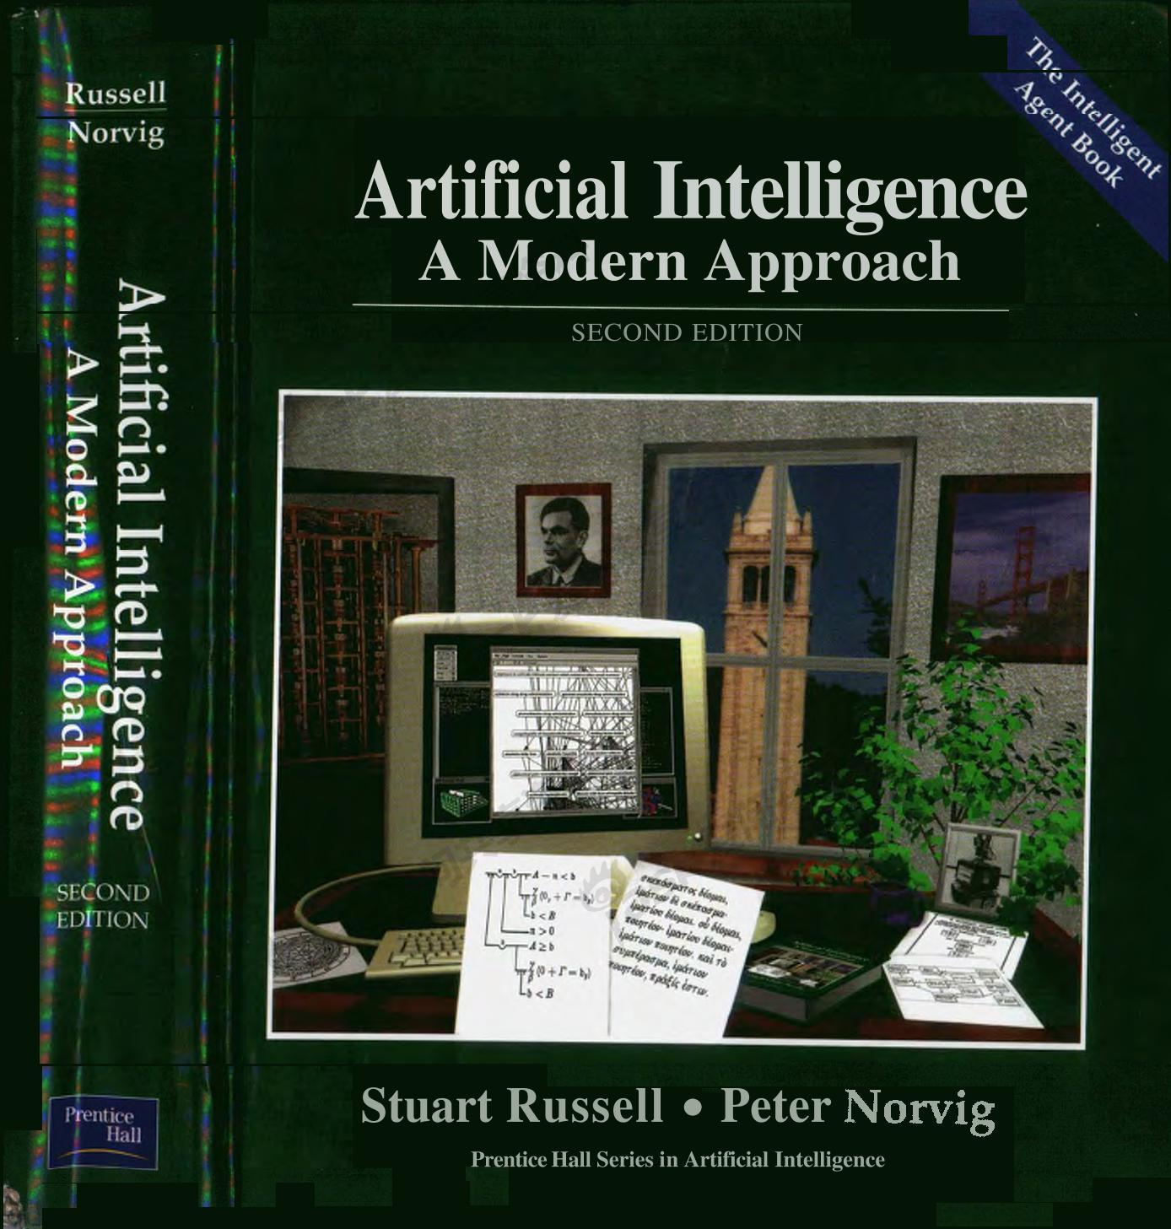
SAT in AI

Slide 8
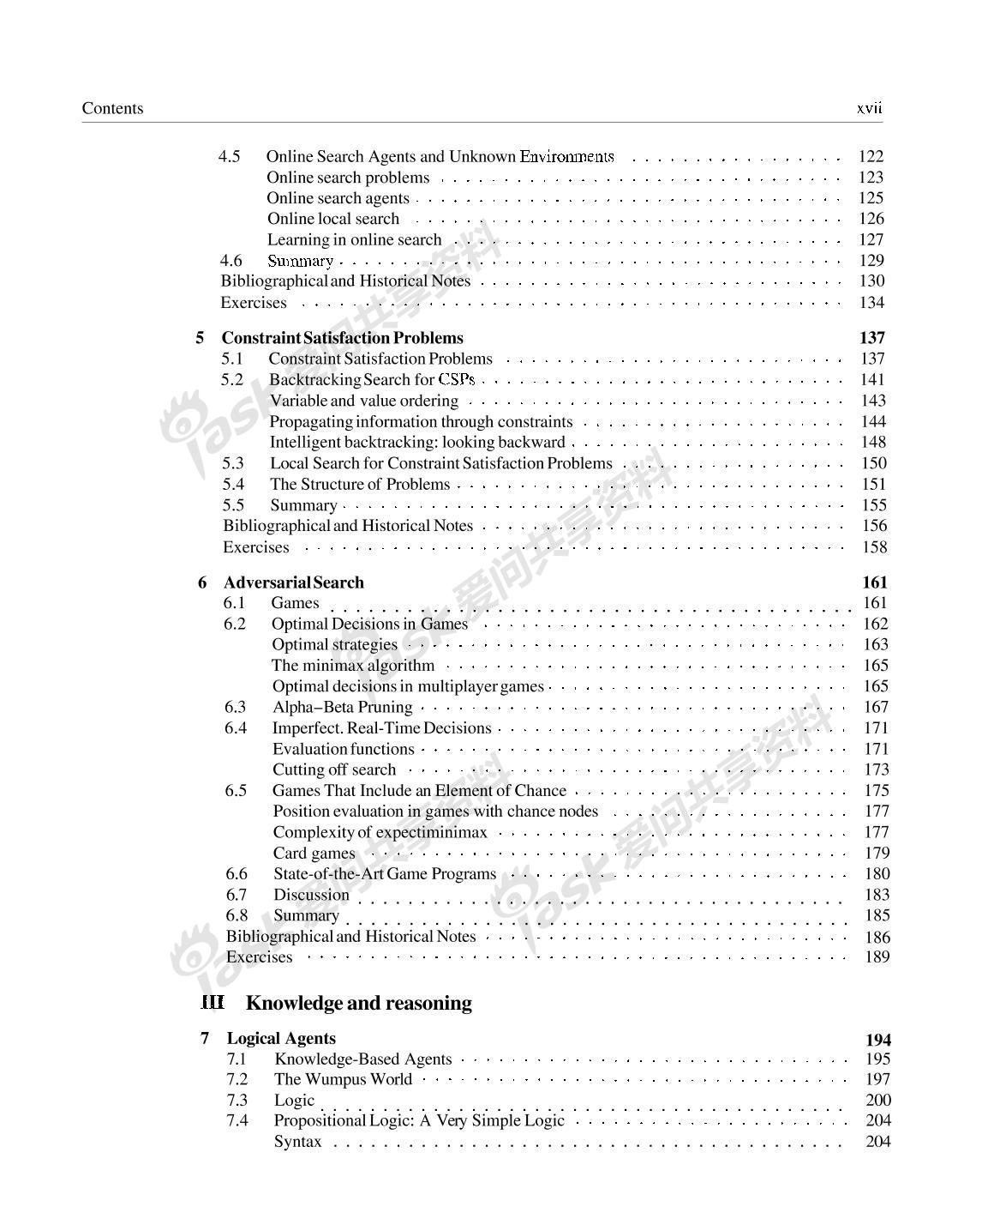
SAT in AI

Slide 9
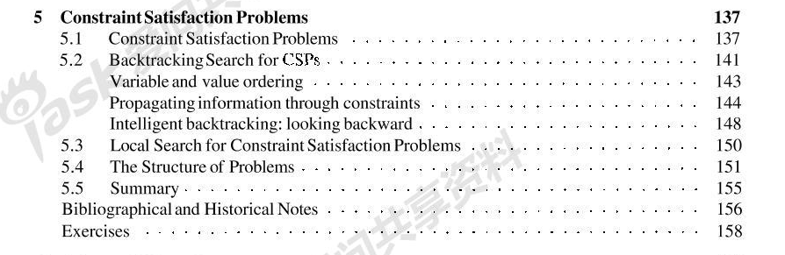
SAT in AI

Slide 10
SAT in AI
Satisfiability stands at the crossroads of logic, graph theory, computer science, computer engineering, and operations research. Thus, many problems originating in one of these fields typically have multiple translations to SAT and there exist many mathematical tools available to the SAT solver to assist in solving them with improved performance.
Handbook of Satisfiability (2009)

Slide 11
The Satisfiability Problem (SAT)
Closely related to Hilbert’s 10th problem [Davis-Putnam’60]
The most important problem in computer science
The first NP-complete problem [Cook’71, Karp’72]
The central problem in the research in algorithms and complexity theory
Many applications

Slide 12
SAT: Algorithms
Given a CNF formula F = C₁∧ …∧C_{m} on n variables x₁, …, x_{n}, decide if there is an assignment to x₁, …, x_{n} that makes F = 1?
F = (x₁∨¬x₂∨¬x₃∨x₄)∧(x₂∨¬x₅∨x₃)∧( x₆∨x₅)∧(¬x₆∨x₂∨¬x₁)

Slide 13
SAT: Algorithms
Given a CNF formula F = C₁∧ …∧C_{m} on n variables x₁, …, x_{n}, decide if there is an assignment to x₁, …, x_{n} that makes F = 1?
Parameters for measuring the complexity of SAT algorithms:
n: the number of variables
m: the number of clauses
L: the length of the input
F = (x₁∨¬x₂∨¬x₃∨x₄)∧(x₂∨¬x₅∨x₃)∧( x₆∨x₅)∧(¬x₆∨x₂∨¬x₁)

Slide 14
SAT: Algorithms
Given a CNF formula F = C₁∧ …∧C_{m} on n variables x₁, …, x_{n}, decide if there is an assignment to x₁, …, x_{n} that makes F = 1?
Parameters for measuring the complexity of SAT algorithms:
best algorithm
n: the number of variables
m: the number of clauses O*(1.234^{m}) [Yamamoto 2005]
L: the length of the input O*(1.066^{L}) [Chen-Liu 2009]
F = (x₁∨¬x₂∨¬x₃∨x₄)∧(x₂∨¬x₅∨x₃)∧( x₆∨x₅)∧(¬x₆∨x₂∨¬x₁)

Slide 15
SAT: Algorithms
Given a CNF formula F = C₁∧ …∧C_{m} on n variables x₁, …, x_{n}, decide if there is an assignment to x₁, …, x_{n} that makes F = 1?
Parameters for measuring the complexity of SAT algorithms:
best algorithm
n: the number of variables
m: the number of clauses O*(1.234^{m}) [Yamamoto 2005]
L: the length of the input O*(1.066^{L}) [Chen-Liu 2009]
F = (x₁∨¬x₂∨¬x₃∨x₄)∧(x₂∨¬x₅∨x₃)∧( x₆∨x₅)∧(¬x₆∨x₂∨¬x₁)

Slide 16
SAT: Algorithms
Given a CNF formula F = C₁∧ …∧C_{m} on n variables x₁, …, x_{n}, decide if there is an assignment to x₁, …, x_{n} that makes F = 1?

Slide 17
SAT: Algorithms
Given a CNF formula F = C₁∧ …∧C_{m} on n variables x₁, …, x_{n}, decide if there is an assignment to x₁, …, x_{n} that makes F = 1?
Algorithm 1.
1. for each assignment σ to x₁, …, x_{n} do
compute the value of F on σ (x₁), …, σ (x_{n});
if F = 1 under the assignment σ then return (‘yes’); stop;
2. return (‘no’)

Slide 18
SAT: Algorithms
Given a CNF formula F = C₁∧ …∧C_{m} on n variables x₁, …, x_{n}, decide if there is an assignment to x₁, …, x_{n} that makes F = 1?
Algorithm 1.
1. for each assignment σ to x₁, …, x_{n} do
compute the value of F on σ (x₁), …, σ (x_{n});
if F = 1 under the assignment σ then return (‘yes’); stop;
2. return (‘no’)
time complexity: O(2^{n}nm)= O*(2^{n})

Slide 19
SAT: Algorithms
Given a CNF formula F = C₁∧ …∧C_{m} on n variables x₁, …, x_{n}, decide if there is an assignment to x₁, …, x_{n} that makes F = 1?
Algorithm 1.
1. for each assignment σ to x₁, …, x_{n} do
compute the value of F on σ (x₁), …, σ (x_{n});
if F = 1 under the assignment σ then return (‘yes’); stop;
2. return (‘no’)
time complexity: O(2^{n}nm)= O*(2^{n})
A better algorithm?

Slide 20
SAT: Algorithms
Given a CNF formula F = C₁∧ …∧C_{m} on n variables x₁, …, x_{n}, decide if there is an assignment to x₁, …, x_{n} that makes F = 1?
Algorithm 1.
1. for each assignment σ to x₁, …, x_{n} do
compute the value of F on σ (x₁), …, σ (x_{n});
if F = 1 under the assignment σ then return (‘yes’); stop;
2. return (‘no’)
time complexity: O(2^{n}nm)= O*(2^{n})
A better algorithm?
No better algorithm!

Slide 21
SAT: Algorithms
Open Problem: is there an algorithm of time complexity O*(c^{n}) for SAT, where c is a constant less than 2 (e.g., O*(1.99^{n}) )?

Slide 22
SAT: Algorithms
Open Problem: is there an algorithm of time complexity O*(c^{n}) for SAT, where c is a constant less than 2 (e.g., O*(1.99^{n}) )?
No progress in the past 20 years.

Slide 23
SAT: Algorithms
Open Problem: is there an algorithm of time complexity O*(c^{n}) for SAT, where c is a constant less than 2 (e.g., O*(1.99^{n}) )?
No progress in the past 20 years.
Strong Exponential Time Hypothesis (SETH):
no such algorithm exists.

Slide 24
SAT: Algorithms
So, what do we do?

Slide 25
SAT: Algorithms
So, what do we do?
3-SAT:
Given a CNF formula F = C₁∧ …∧C_{m} on n variables x₁, …, x_{n}, where each C_{i} has at most 3 literals, decide if there is an assignment to x₁, …, x_{n} that makes F = 1?

Slide 26
SAT: Algorithms
So, what do we do?
3-SAT:
Given a CNF formula F = C₁∧ …∧C_{m} on n variables x₁, …, x_{n}, where each C_{i} has at most 3 literals, decide if there is an assignment to x₁, …, x_{n} that makes F = 1?
(x₁∨¬x₂∨x₃)∧(x₂∨x₅∨¬x₃)∧(¬x₄∨x₅)∧(x₄∨¬x₂∨x₁)

Slide 27
SAT: Algorithms
So, what do we do?
3-SAT:
Given a CNF formula F = C₁∧ …∧C_{m} on n variables x₁, …, x_{n}, where each C_{i} has at most 3 literals, decide if there is an assignment to x₁, …, x_{n} that makes F = 1?
General SAT can be reduced to 3-SAT.
(x₁∨¬x₂∨x₃)∧(x₂∨x₅∨¬x₃)∧(¬x₄∨x₅)∧(x₄∨¬x₂∨x₁)

Slide 28
3-SAT: Algorithms

Slide 29
3-SAT: Algorithms
An algorithm for 3-SAT
Algorithm-3SAT-I(F) [Monien-Speckenmeyer’ 85]
1. if there is no 3-clauses then solve the problem directly, stop;
2. pick a 3-clause (l₁∨l₂∨l₃);
3. recursively call
Algorithm-3SAT-I(F[l₁= 1]);
Algorithm-3SAT-I(F[l₁= 0; l₂= 1]);
Algorithm-3SAT-I(F[l₁= 0; l₂= 0; l₃= 1]);
4. return (“yes”) if and only if at least one of the above return “yes”).

Slide 30
3-SAT: Algorithms
An algorithm for 3-SAT
Algorithm-3SAT-I(F) [Monien-Speckenmeyer’ 85]
1. if there is no 3-clauses then solve the problem directly, stop;
2. pick a 3-clause (l₁∨l₂∨l₃);
3. recursively call
Algorithm-3SAT-I(F[l₁= 1]);
Algorithm-3SAT-I(F[l₁= 0; l₂= 1]);
Algorithm-3SAT-I(F[l₁= 0; l₂= 0; l₃= 1]);
4. return (“yes”) if and only if at least one of the above return “yes”).
Time complexity T(n) on n variables?

Slide 31
3-SAT: Algorithms
An algorithm for 3-SAT
Algorithm-3SAT-I(F) [Monien-Speckenmeyer’ 85]
1. if there is no 3-clauses then solve the problem directly, stop;
2. pick a 3-clause (l₁∨l₂∨l₃);
3. recursively call
Algorithm-3SAT-I(F[l₁= 1]);
Algorithm-3SAT-I(F[l₁= 0; l₂= 1]);
Algorithm-3SAT-I(F[l₁= 0; l₂= 0; l₃= 1]);
4. return (“yes”) if and only if at least one of the above return “yes”).
Time complexity T(n) on n variables?
T(n) = T(n-1) + T(n-2) + T(n-3) ⇒ T(n) = O*(1.84^{n})

Slide 32
3-SAT: Algorithms
An algorithm for 3-SAT
Algorithm-3SAT-I(F) [Monien-Speckenmeyer’ 85]
1. if there is no 3-clauses then solve the problem directly, stop;
2. pick a 3-clause (l₁∨l₂∨l₃);
3. recursively call
Algorithm-3SAT-I(F[l₁= 1]);
Algorithm-3SAT-I(F[l₁= 0; l₂= 1]);
Algorithm-3SAT-I(F[l₁= 0; l₂= 0; l₃= 1]);
4. return (“yes”) if and only if at least one of the above return “yes”).
Time complexity T(n) on n variables?
T(n) = T(n-1) + T(n-2) + T(n-3) ⇒ T(n) = O*(1.84^{n})
Better than O*(2^{n})!

Slide 33
3-SAT: Algorithms
Schöning’s algorithm [Schöning’99]

Slide 34
3-SAT: Algorithms
Schöning’s algorithm [Schöning’99]
Schoning-Algorithm-3SAT(F)
1. repeat (4/3)^{n} times
1.1 randomly pick an assignment σ;
1.2 if σ satisfies F then return (“yes”); stop;
1.3 else \\ F is not satisfied by σ
randomly pick a clause (l₁∨l₂∨l₃) not satisfied by σ;
randomly pick one of l₁, l₂, l₃ and flip it;
1.4 repeat steps1.2-1.3 n times;
2. return (“no”).

Slide 35
3-SAT: Algorithms
Schöning’s algorithm [Schöning’99]
Schoning-Algorithm-3SAT(F)
1. repeat (4/3)^{n} times
1.1 randomly pick an assignment σ;
1.2 if σ satisfies F then return (“yes”); stop;
1.3 else \\ F is not satisfied by σ
randomly pick a clause (l₁∨l₂∨l₃) not satisfied by σ;
randomly pick one of l₁, l₂, l₃ and flip it;
1.4 repeat steps1.2-1.3 n times;
2. return (“no”).
Time complexity of Schöning’s algorithm: T(n) = O*((4/3)^{n})

Slide 36
3-SAT: Algorithms
Schöning’s algorithm [Schöning’99]
Schoning-Algorithm-3SAT(F)
1. repeat (4/3)^{n} times
1.1 randomly pick an assignment σ;
1.2 if σ satisfies F then return (“yes”); stop;
1.3 else \\ F is not satisfied by σ
randomly pick a clause (l₁∨l₂∨l₃) not satisfied by σ;
randomly pick one of l₁, l₂, l₃ and flip it;
1.4 repeat steps1.2-1.3 n times;
2. return (“no”).
Time complexity of Schöning’s algorithm: T(n) = O*((4/3)^{n})
O*(1.334^{n}) [99], O*(1.324^{n}) [04], O*(1.323^{n}) [05], O*(1.322^{n}) [10], O*(1.321^{n}) [11], ……

Slide 37
3-SAT: Algorithms
Schöning’s algorithm [Schöning’99]
Schoning-Algorithm-3SAT(F)
1. repeat (4/3)^{n} times
1.1 randomly pick an assignment σ;
1.2 if σ satisfies F then return (“yes”); stop;
1.3 else \\ F is not satisfied by σ
randomly pick a clause (l₁∨l₂∨l₃) not satisfied by σ;
randomly pick one of l₁, l₂, l₃ and flip it;
1.4 repeat steps1.2-1.3 n times;
2. return (“no”).
Time complexity of Schöning’s algorithm: T(n) = O*((4/3)^{n})
O*(1.334^{n}) [99], O*(1.324^{n}) [04], O*(1.323^{n}) [05], O*(1.322^{n}) [10], O*(1.321^{n}) [11], ……
Currently the best algorithm for 3-SAT: O*(1.308^{n}) [Hertli’11]

Slide 38
3-SAT: Algorithms
Schöning’s algorithm [Schöning’99]
Schoning-Algorithm-3SAT(F)
1. repeat (4/3)^{n} times
1.1 randomly pick an assignment σ;
1.2 if σ satisfies F then return (“yes”); stop;
1.3 else \\ F is not satisfied by σ
randomly pick a clause (l₁∨l₂∨l₃) not satisfied by σ;
randomly pick one of l₁, l₂, l₃ and flip it;
1.4 repeat steps1.2-1.3 n times;
2. return (“no”).
Time complexity of Schöning’s algorithm: T(n) = O*((4/3)^{n})
O*(1.334^{n}) [99], O*(1.324^{n}) [04], O*(1.323^{n}) [05], O*(1.322^{n}) [10], O*(1.321^{n}) [11], ……
Currently the best algorithm for 3-SAT: O*(1.308^{n}) [Hertli’11]
????? 1.308^{n} → 1.305^{n} → 1.250^{n} → 1.201^{n} → 1.199^{n} → 1.151^{n} → 1.001^{n} ?????

Slide 39
3-SAT: Algorithms
Open Problem: for 3-SAT, is it possible to develop algorithms of time complexity O*((1+δ)^{n}) , for an arbitrary constant δ>0?

Slide 40
3-SAT: Algorithms
Open Problem: for 3-SAT, is it possible to develop algorithms of time complexity O*((1+δ)^{n}) , for an arbitrary constant δ>0?
Exponential Time Hypothesis (ETH):
there is no subexponential time algorithm,
i.e., there is a constant c > 0 such that all 3-SAT
algorithms take time at least O*((1+c)^{n}) .

Slide 41
The Max-SAT problem

Slide 42
The Max-SAT problem
Given a CNF formula F, find an assignment to F that satisfies the largest number of clauses in F.

Slide 43
The Max-SAT problem
Given a CNF formula F, find an assignment to F that satisfies the largest number of clauses in F.
F = (x₁∨x₂)∧(x₁∨¬x₂)∧(¬x₁∨x₂)∧(¬x₁∨¬x₂)

Slide 44
The Max-SAT problem
Given a CNF formula F, find an assignment to F that satisfies the largest number of clauses in F.
F = (x₁∨x₂)∧(x₁∨¬x₂)∧(¬x₁∨x₂)∧(¬x₁∨¬x₂)
x₁ = 1, x₂ = 1, x₃ = 0, x₄ = 1,

Slide 45
The Max-SAT problem
Given a CNF formula F, find an assignment to F that satisfies the largest number of clauses in F.
F = (x₁∨x₂)∧(x₁∨¬x₂)∧(¬x₁∨x₂)∧(¬x₁∨¬x₂)
x₁ = 1, x₂ = 1, x₃ = 0, x₄ = 1,

Slide 46
The Max-SAT problem
Given a CNF formula F, find an assignment to F that satisfies the largest number of clauses in F.
F = (x₁∨x₂)∧(x₁∨¬x₂)∧(¬x₁∨x₂)∧(¬x₁∨¬x₂)
x₁ = 1, x₂ = 1, x₃ = 0, x₄ = 1,
An optimization version of the SAT problem

Slide 47
The Max-SAT problem
Given a CNF formula F, find an assignment to F that satisfies the largest number of clauses in F.
F = (x₁∨x₂)∧(x₁∨¬x₂)∧(¬x₁∨x₂)∧(¬x₁∨¬x₂)
x₁ = 1, x₂ = 1, x₃ = 0, x₄ = 1,
An optimization version of the SAT problem
A fundamental problem in computational optimization

Slide 48


The Max-SAT problem
Algorithms for Maximum Satisfiability
with Applications to AI
Fahiem Bacchus¹ Matti Jarvisalo²
¹ University of Toronto
Canada
² University of Helsinki
Finland
February 13, 2016 AAAI-16, Phoenix, AZ, USA

Slide 49
The Max-SAT problem
Given a CNF formula F, find an assignment to F that satisfies the largest number of clauses in F.
Approaches to solving Max-SAT:
(polynomial-time) approximation algorithms,
exact algorithms, parameterized algorithms,
heuristic algorithms, …

Slide 50
Approximation algorithms for Max-SAT
Johnson’s algorithm [Johnson’74]
Johnson-Algorithm(F = C₁∧ …∧C_{m} )
1. for i = 1 to m do wt(C_{i}) = (½)^{|Ci|};
2. L = {C₁, …, C_{m}};
3. for i = 1 to n do
let P be the clauses in L that contain x_{i};
let N be the clauses in L that contain ¬x_{i};
if wt(P) > wt(N) then x_{i} = 1; remove P from L;
for each C_{h} in N do wt(C_{h}) = 2*wt(C_{h});
else x_{i} = 0; remove N from L;
for each C_{h} in P do wt(C_{h}) = 2*wt(C_{h});

Slide 51
Approximation algorithms for Max-SAT
Johnson’s algorithm [Johnson’74]
Johnson-Algorithm(F = C₁∧ …∧C_{m} )
1. for i = 1 to m do wt(C_{i}) = (½)^{|Ci|};
2. L = {C₁, …, C_{m}};
3. for i = 1 to n do
let P be the clauses in L that contain x_{i};
let N be the clauses in L that contain ¬x_{i};
if wt(P) > wt(N) then x_{i} = 1; remove P from L;
for each C_{h} in N do wt(C_{h}) = 2*wt(C_{h});
else x_{i} = 0; remove N from L;
for each C_{h} in P do wt(C_{h}) = 2*wt(C_{h});
Theorem [Johnson’74] Johnson’s algorithm has an
approximation ratio (= max/apx) ≤ 2.

Slide 52
Approximation algorithms for Max-SAT
Johnson’s algorithm [Johnson’74]
Johnson-Algorithm(F = C₁∧ …∧C_{m} )
1. for i = 1 to m do wt(C_{i}) = (½)^{|Ci|};
2. L = {C₁, …, C_{m}};
3. for i = 1 to n do
let P be the clauses in L that contain x_{i};
let N be the clauses in L that contain ¬x_{i};
if wt(P) > wt(N) then x_{i} = 1; remove P from L;
for each C_{h} in N do wt(C_{h}) = 2*wt(C_{h});
else x_{i} = 0; remove N from L;
for each C_{h} in P do wt(C_{h}) = 2*wt(C_{h});
Theorem [Johnson’74] Johnson’s algorithm has an
approximation ratio (= max/apx) ≤ 2.
Theorem [Chen-Friesen-Zheng’99] Johnson’s algorithm has
an approximation ratio 3/2, which is tight.

Slide 53
Approximation algorithms for Max-SAT
Authors Ratio Year
Johnson 2 1974
Hansen-Jaumard < 2 ? 1990

Slide 54
Approximation algorithms for Max-SAT
Authors Ratio Year
Johnson 2 1974
Hansen-Jaumard < 2 ? 1990
Chen-Friesen-Zheng 1.5 1999

Slide 55
Approximation algorithms for Max-SAT
Authors Ratio Year
Johnson 2 1974
Hansen-Jaumard < 2 ? 1990
Chen-Friesen-Zheng 1.5 1999
Yannakakis 4/3 1994
Goemans-Williams 4/3 1994
Karloff-Zwick 8/7? 1997

Slide 56
Approximation algorithms for Max-SAT
Authors Ratio Year
Johnson 2 1974
Hansen-Jaumard < 2 ? 1990
Chen-Friesen-Zheng 1.5 1999
Yannakakis 4/3 1994
Goemans-Williams 4/3 1994
Karloff-Zwick 8/7? 1997
Hastad ≥ 8/7 1997
[Godel Prize 2011]

Slide 57
Parameterized algorithms for Max-SAT
Given a CNF formula F and an integer k, is there an assignment that satisfies at least k clauses in F?

Slide 58
Parameterized algorithms for Max-SAT
Given a CNF formula F and an integer k, is there an assignment that satisfies at least k clauses in F?
Simple-Algorithm(F, k) [Mahajan-Raman’99]
1. pick a variable x in F;
2. case 1. only x or only ¬x appears in F
assign the value v of x directly, recursively work on F[x=v];
case 2. each of x and ¬x appears exactly once in F
apply Davis-Putnam’s resolution;
case 3. otherwise
recursively work on F[x=0] and F[x=1];

Slide 59
Parameterized algorithms for Max-SAT
Given a CNF formula F and an integer k, is there an assignment that satisfies at least k clauses in F?
Simple-Algorithm(F, k) [Mahajan-Raman’99]
1. pick a variable x in F;
2. case 1. only x or only ¬x appears in F
assign the value v of x directly, recursively work on F[x=v];
case 2. each of x and ¬x appears exactly once in F
apply Davis-Putnam’s resolution;
case 3. otherwise
recursively work on F[x=0] and F[x=1];
Time complexity on instance (F, k)?

Slide 60
Parameterized algorithms for Max-SAT
Given a CNF formula F and an integer k, is there an assignment that satisfies at least k clauses in F?
Simple-Algorithm(F, k) [Mahajan-Raman’99]
1. pick a variable x in F;
2. case 1. only x or only ¬x appears in F
assign the value v of x directly, recursively work on F[x=v];
case 2. each of x and ¬x appears exactly once in F
apply Davis-Putnam’s resolution;
case 3. otherwise
recursively work on F[x=0] and F[x=1];
Time complexity on instance (F, k)?
T(k) = T(k-1) + T(k-2) ⇒ T(k) = O*(1.618^{k})

Slide 61
Parameterized algorithms for Max-SAT
Authors Complexity Year
Mahajan-Raman O*(1.618^{k}) 1999
Niedermeier-Rossmanith O*(1.400^{k}) 2000
Bansal-Raman O*(1.381^{k}) 1999
Chen-Kanj O*(1.370^{k}) 2004
Bliznets-Golovnev O*(1.358^{k}) 2012*
* Best paper award at IPEC 2012

Slide 62
Parameterized algorithms for Max-SAT
Exponential Time Hypothesis (ETH):
There is a constant c > 1 such that Max3SAT cannot be solved in time O*(c^{n}).
Strong Exponential Time Hypothesis (SETH): There is no constant c < 2 such that MaxSAT can be solved in time O*(c^{n}).

Slide 63
Parameterized algorithms for Max-SAT
Exponential Time Hypothesis (ETH):
There is a constant c > 1 such that Max3SAT cannot be solved in time O*(c^{n}).
Strong Exponential Time Hypothesis (SETH): There is no constant c < 2 such that MaxSAT can be solved in time O*(c^{n}).
ETH and SETH show, to some extent, a popular opinion that branch-and-search is perhaps unavoidable in solving the SAT and Max-SAT problems.

Slide 64
Resolution Principle
There is a well-known (and powerful) technique on SAT that is not based on branch-and-search.
Resolvent: if (x∨C) and (¬x∨D) are clauses in F, then the clause (C∨D) is a resolvent on the variable x in F.
Resolution DP_{x}(F): the formula whose clauses are obtained by first removing from F all clauses containing x and ¬x then adding all resolvents on x in F.
Davis-Putnam.
A CNF formula F is satisfiable if and only if the resolution DP_{x}(F) on any variable x is satisfiable.

Slide 65

Resolution Principle

Slide 66
Resolution Principle
DPx(F) = F₁ ˄
C₁D₁ ˄ … ˄ C₁D_{t} ˄
……
C_{s}D₁ ˄ … ˄ C_{s}D_{t}

Slide 67

Resolution Principle
opt(DPx(F)) can be significantly larger than opt(F);
opt(DPx(F)) depends not only on opt(F), but also on the structures of C₁, … C_{s}, D₁, …D_{t}
DPx(F) = F₁ ˄
C₁D₁ ˄ … ˄ C₁D_{t} ˄
……
C_{s}D₁ ˄ … ˄ C_{s}D_{t}

Slide 68
Resolution Principle
An “Ideally Imagined” MaxSAT Algorithm.
repeat
resolution; \\ eliminate a variable
kernelization; \\ keep the size small

Slide 69
Resolution Principle
An “Ideally Imagined” MaxSAT Algorithm.
repeat
resolution; \\ eliminate a variable
kernelization; \\ keep the size small
However, it is difficult to control the value opt(DP_{x}(F))

Slide 70
On Variables of small degree
Xu-Chen-Wang (TCS 2018)
An O*(1.194^{k})-time parameterized algorithm for MaxSAT on deg-3 CNF formulas → improving previous best upper bound O*(1.2721^{k})
An O*(1.237^{n})-time exact algorithm for MaxSAT on deg-3 CNF formulas → improving previous best upper bound O*(1.26^{n})

Slide 71
On Variables of small degree
Chen-Xu-Wang (WADS 2018)
An O*(1.325^{k})-time parameterized algorithm for MaxSAT → improving previous best upper bound O*(1.358^{k})
Xu, Chen, et al. (IJCAI 2019)
An O*(1.2981^{m})-time exact algorithm for MaxSAT → improving previous best upper bound O*(1.325^{m})

Slide 72
Heuristic algorithms for SAT/MaxSAT
Heuristic algorithms solve SAT/MaxSAT practically, but either do not guarantee the correctness or do not guarantee efficiency.

Slide 73
Heuristic algorithms for SAT/MaxSAT
Heuristic algorithms solve SAT/MaxSAT practically, but either do not guarantee the correctness or do not guarantee efficiency.
A large collection of SAT/MaxSAT Solvers

Slide 74
Heuristic algorithms for SAT/MaxSAT
Heuristic algorithms solve SAT/MaxSAT practically, but either do not guarantee the correctness or do not guarantee efficiency.
A large collection of SAT/MaxSAT Solvers
Solving most practical SAT instances efficiently

Slide 75
Heuristic algorithms for SAT/MaxSAT
Heuristic algorithms solve SAT/MaxSAT practically, but either do not guarantee the correctness or do not guarantee efficiency.
A large collection of SAT/MaxSAT Solvers
Solving most practical SAT instances efficiently
Can solve instances of millions of variables and clauses;

Slide 76
Heuristic algorithms for SAT/MaxSAT
Heuristic algorithms solve SAT/MaxSAT practically, but either do not guarantee the correctness or do not guarantee efficiency.
A large collection of SAT/MaxSAT Solvers
Solving most practical SAT instances efficiently
Can solve instances of millions of variables and clauses;
Progress in SAT Solvers in the past 20 years
From 100 variables, 200 constraints (early 90s)
Up to > 10,000,000 variables and > 50,000,000 clauses.

Slide 77
Heuristic algorithms for SAT/MaxSAT
Heuristic algorithms solve SAT/MaxSAT practically, but either do not guarantee the correctness or do not guarantee efficiency.
A large collection of SAT/MaxSAT Solvers
Solving most practical SAT instances efficiently
Can solve instances of millions of variables and clauses;
Annual conference for SAT/MaxSAT:
The International Conference on Theory and applications of Satisfiability Testing (SAT), 1996-2024
The Conference on Evaluation of Max-SAT Solvers (Max-SAT), 2006-2024

Slide 78
Go SAT!

