Slide 1
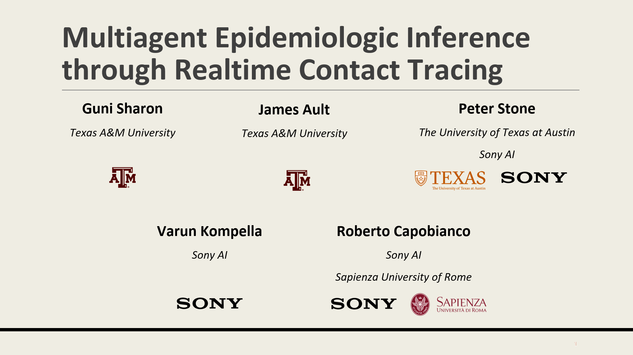





Multiagent Epidemiologic Inference through Realtime Contact Tracing
Guni Sharon
Texas A&M University
James Ault
Texas A&M University
Peter Stone
The University of Texas at Austin
Sony AI
Varun Kompella
Sony AI
Roberto Capobianco
Sony AI
Sapienza University of Rome

Slide 2



Who is most likely to be infected?
Thicker arrow → longer exposure
Notes:
2 households
Use arrows to display contacts
1 has friends that live somewhere else

Slide 3


Who is most likely to be infected?
Thicker arrow → longer exposure
No Symptoms
Symptomatic
C
A
B
Notes:
4 report symptomatic
Test 1

Slide 4


Who is most likely to be infected?
Thicker arrow → longer exposure
No Symptoms
Symptomatic
Confirmed Infection
C
A
B
Notes:
Suppose person A and B live in the same household, then person B gets a positive test
Person 3 has reported to have symptoms, while no others in their household have
All of person 2’s recent contacts have reported symptoms as well
We have only a single test to give, who should get it?
Following Grushka’s, person 3, as they have both had exposure to a positive case and reported symptoms
Intuitively however we see that person 2 is more likely to have been infected, they’re in the same house!
Now scale this outside of the simple case of a household, into offices and schools where the decision is less clear
This is what we hoped to capture in this work

Slide 5
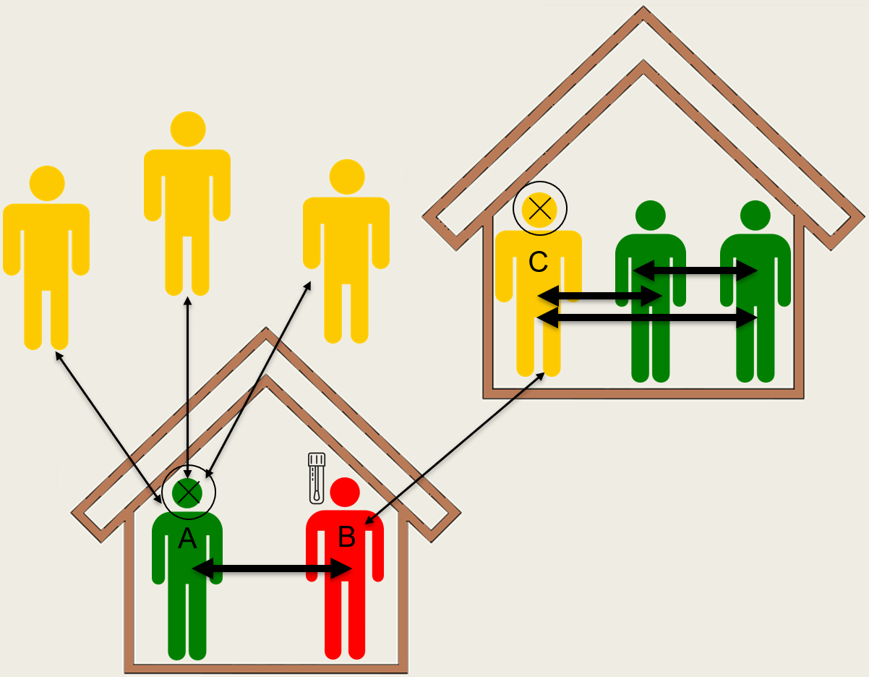
Previous work
4
4
4
2
5
5
Grushka et al Method
  Correlation to positive COVID-19 test
    Positive tested
    Exposure & symptomatic
    Exposure
    Symptomatic
    Non-symptomatic
More information
  False positive/negative test rates
  Probability of transmission between contacts
  Symptomatic rate
Higher Infection Likelihood
3
1

Slide 6
Motivation
Reduce contagious disease spread
Limited testing
Limited quarantine
Contact data via mobile devices (usually partial)
  Armenia, Ecuador, Israel, Russia, South Korea, Taiwan, Vietnam, etc.
Our long-term goal: Optimized policy to assign test and quarantine orders
This paper: identify most likely infected individuals
Notes:
Various countries have used mobile devices to collect data
Can not test entire population every day
A complete lockdown might be effective, but comes with extreme cost
Objective to offer a better way to allocate test and quarantine

Slide 7
Our Approach
Hidden Markov model
Update probabilities daily:
  test outcomes
  reported symptoms
  recorded contact
  recovery rate
Markov property via compressed contact history
Test and quarantine the highest probability individuals

Slide 8



Hidden Markov Model Definition
State – Infection probabilities
Initial Distribution – Initial disease prevalence
Transitions
Emissions
  Test results
    False positive
    False negative
  Reported symptoms
    False symptomatic rate
    Asymptomatic rate
  Recorded contacts
    Probability of infection from contact
% | % | % | % | % | % | %
Recovery Rate

Slide 9
Assumptions
Recovery Rate Exists
Infection events are mutually exclusive over days
Probability any individual was sick and has recovered is near zero
Daily a priori infection probability is equal in past days
Notes:
Evidence that assumption 1 doesn’t hold in the covid pandemic
Assumption 3 obviously is untrue outside of initial stages of a pandemic
However prediction is more important in the initial stages as well

Slide 10
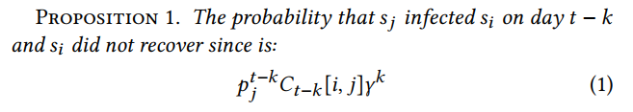
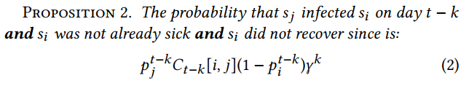
Infection Probability from Contact
Recovery probability over k days
Probability person j was infected on day t-k
Probability person i and person j were in contact on day t-k
Probability person i was not already sick on day t-k
Assumption 2: Infection events are mutually exclusive over days
Notes:
Assumption 1: there is a constant per day recovery rate

Slide 11



Infection Probability from Contact
Using proposition 2 and the probability that no mutually exclusive events happening:
  Prop. 3: the probability that an individual is currently sick
k days in the past
Prop. 2
Lemma 1:
All contacts of i
Substitute w/ lemma 1 and distribute:
  Prop. 4: the probability that an individual is sick in the next time step
Double-decayed contact matrix
Triple-decayed contact matrix
Notes:
Assuming that infection events are mutually exclusive over days, gives us proposition 3, 1 – sum of event probabilities
Lemma 1, prob. K days in past is product of current and recovery probability
Full proof in the paper
Take k to be 1, can be computed with 2 contact matricies

Slide 12
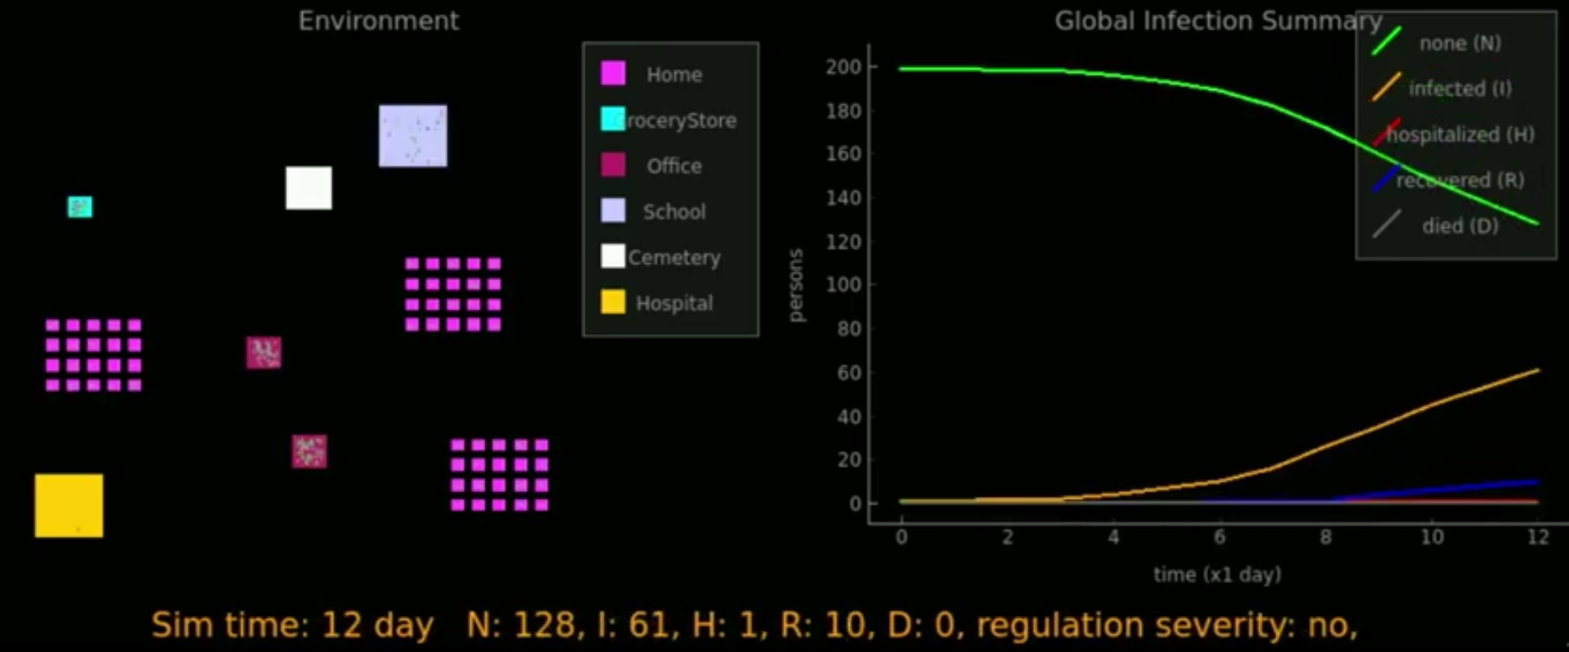
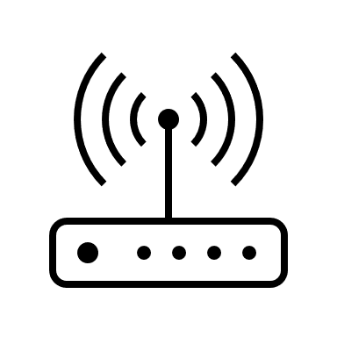



Empirical Evaluation via Simulation
Microscopic pandemic simulator with individual contact tracing
Full Tracing
Half Tracing
Passive Tracing : Contact from home/work/school address
github.com/SonyAI/PandemicSimulator
Notes:
Simulator developed by Sony AI and UT Austin, which is now publicly available
Necessary because existing simulators don’t have the resolution to track individuals in the population
3 people work here
A visitor
Full trace: we know full contact information, length of contact
Half: still know the 2 participants did not contact,
Passive: we only know that these 4 work together and had some chance of contact

Slide 13
Empirical Evaluation via Simulation
Microscopic pandemic simulator with individual contact tracing
Full Tracing
Half Tracing
Passive Tracing : Contact from home/work/school address
github.com/SonyAI/PandemicSimulator
Notes:
lose most of the contact information, only have full information between participants
grey lines use estimate of location contact rate
No longer know visitor was ever there, no recorded contact

Slide 14

Empirical Evaluation via Simulation
Microscopic pandemic simulator with individual contact tracing
Full Tracing
Half Tracing
Passive Tracing : Contact from home/work/school address
github.com/SonyAI/PandemicSimulator
Notes:
Only have the estimated contact rate
Visitor unknown

Slide 15
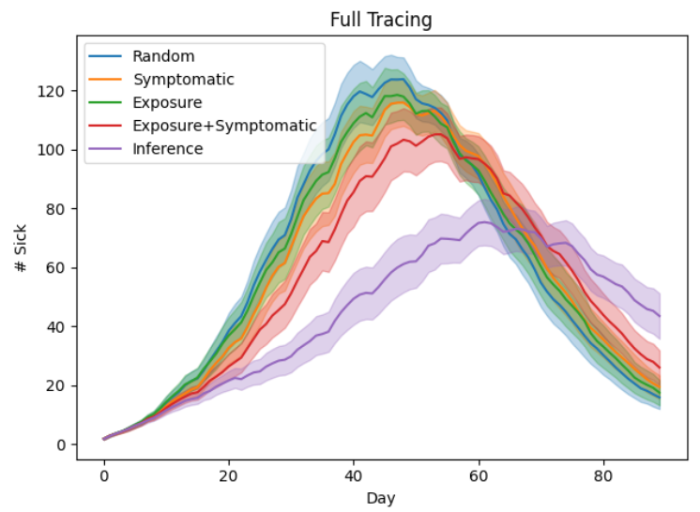
Empirical Evaluation via Simulation
Full Tracing: Entire population participates
95% confidence interval over 60 random trials shaded
1% tested, 2% quarantine cap
1,000-person population
Notes:
Quick explanation of each baseline

Slide 16
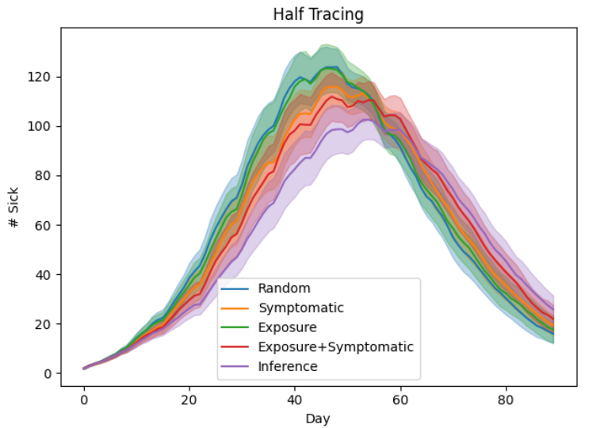
Empirical Evaluation via Simulation
Half Tracing: Only 50% of the population participates
Far less than 50% of contacts are recorded

Slide 17
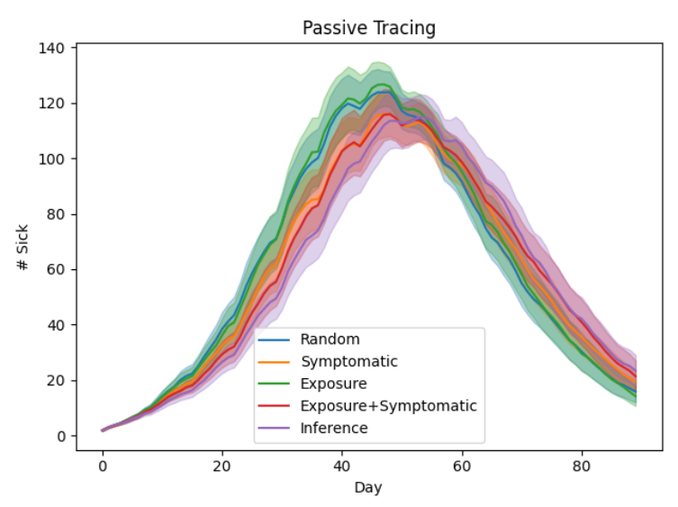
Empirical Evaluation via Simulation
Passive Tracing: No active participants
Assumes work/home/school known
Contact rates for each estimated
Notes:
Not particularly compelling, however with updates and calibration of the simulator to match real world data..

Slide 18
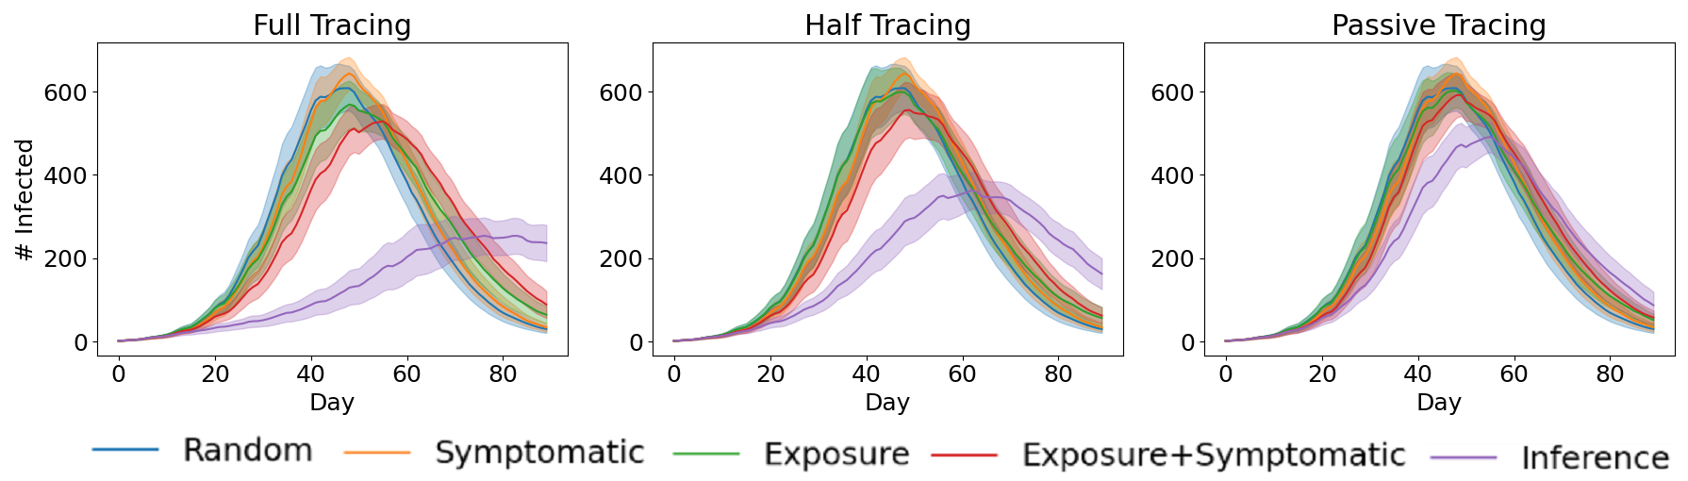
Updated Simulation
Calibrated to Sweden’s hospitalization data
4,000-person population
Continues to achieve better outcomes than baselines
Significant advantage also in Passive Tracing!
Notes:
Preview/unpublished results
Sim went through improvements/calibration

Slide 19
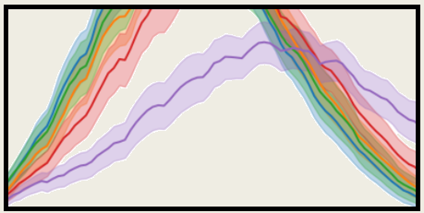
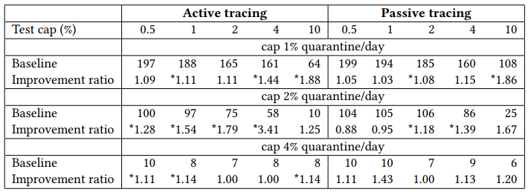
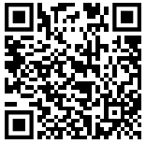
Conclusion
Guni Sharon
James Ault
Peter Stone
Varun Kompella
Roberto Capobianco
Lower peak infections
Full participation > Half > Passive
Advantage up to 3.41
Heavy quarantine (4%/day) reduces testing need
Check out the paper!
Notes:
Asterisk denotes statistically significant results
If you have some time left, describe future work

