Slide 1

CSCE-642 Reinforcement Learning
Chapter 9: On-policy Prediction with Approximation
Instructor: Guni Sharon

Slide 2
CSCE-689, Reinforcement Learning
Stateless decision process
Monte-Carlo
Policy gradient
Actor-critic
Markov decision process
Temporal difference
Function approximators
Solving MDPs (offline)
Dynamic programming
Tabular methods
Deep RL

Slide 3


Generalizing value-based learning
Tabular Learning keeps a table of all state values
In realistic situations, we cannot possibly learn about every single state!
  Too many states to visit them all during training
  Too many states to hold a value table in memory
Instead, we want to generalize:
  Train on a small number of states from experience
  Generalize that experience to new, similar situations
  This is a fundamental idea in machine learning

Slide 4
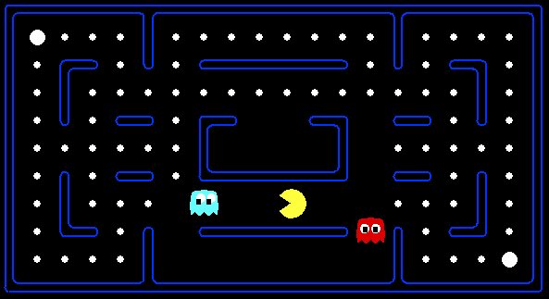



Example: Pacman
Let’s say we discover through experience that this state is bad:
In naïve tabular-learning, we know nothing about this state:
Or even this one!
Demo
Notes:
python pacman.py -p PacmanQAgent -x 50 -n 60 -l mediumGrid

Slide 5
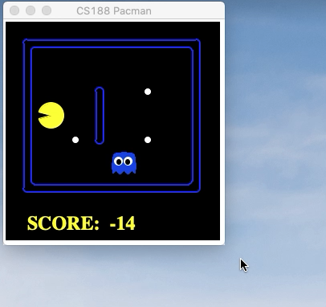
Naïve Q-learning
After 50 training episodes

Slide 6




Learn an approximation function
Learn
Predict
Generalize
$$\hat{v}\left(s;θ\right)→ℝ$$
$$\hat{v}\left(s:θ\right)$$
$$\hat{v}\left(s:θ\right)$$
Demo: python3 pacman.py -p PacmanQAgent -x 50 -n 60 -l mediumGrid ; python3 pacman.py -p ApproximateQAgent -a extractor=SimpleExtractor -x 50 -n 60 -l mediumGrid ; python3 pacman.py -p ApproximateQAgent -n 10 -l smallClassic -a numTraining=10 -a extractor=SimpleExtractor

Slide 7
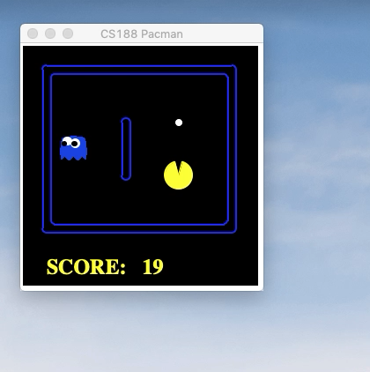
Q-learning with function approximator

Slide 8
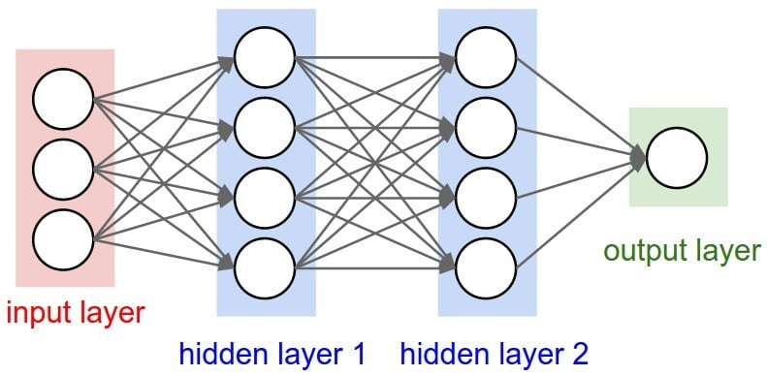


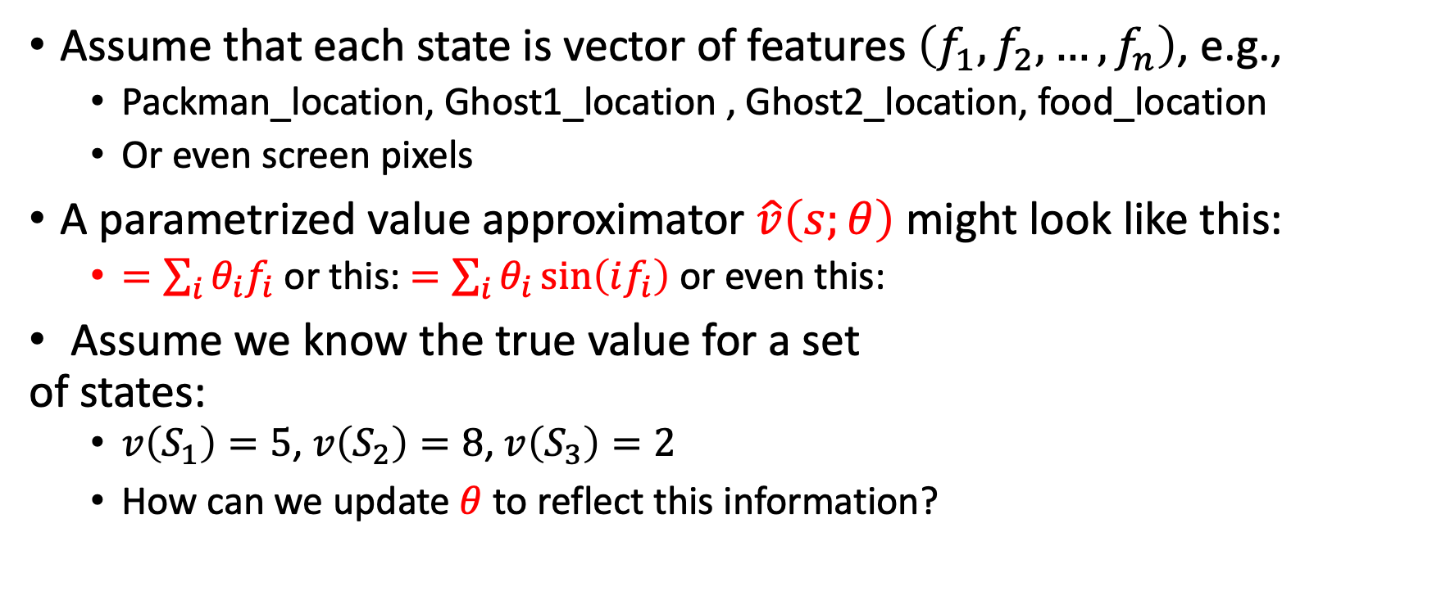





Parametrized function approximator
Assume that each state is vector of features $\left(f_{1},f_{2},…,f_{n}\right)$, e.g.,
  Packman_location, Ghost1_location , Ghost2_location, food_location
  Or even screen pixels
A parametrized value approximator $\hat{v}\left(s;θ\right)$ might look like this:
  $=\sum_{i}{θ_{i}f_{i}}$ or this: $=\sum_{i}{θ_{i}\sin\left(if_{i}\right)}$ or even this:
Assume we know the true value for a set
of states:
  $v\left(S_{1}\right)=5$, $v\left(S_{2}\right)=8$, $v\left(S_{3}\right)=2$
  How can we update $θ$ to reflect this information?
$$θ_{1−12}$$
$$θ_{13−28}$$
$$θ_{29−32}$$
$$f_{1}$$
$$f_{2}$$
$$\hat{v}$$
$$f_{3}$$

Slide 9
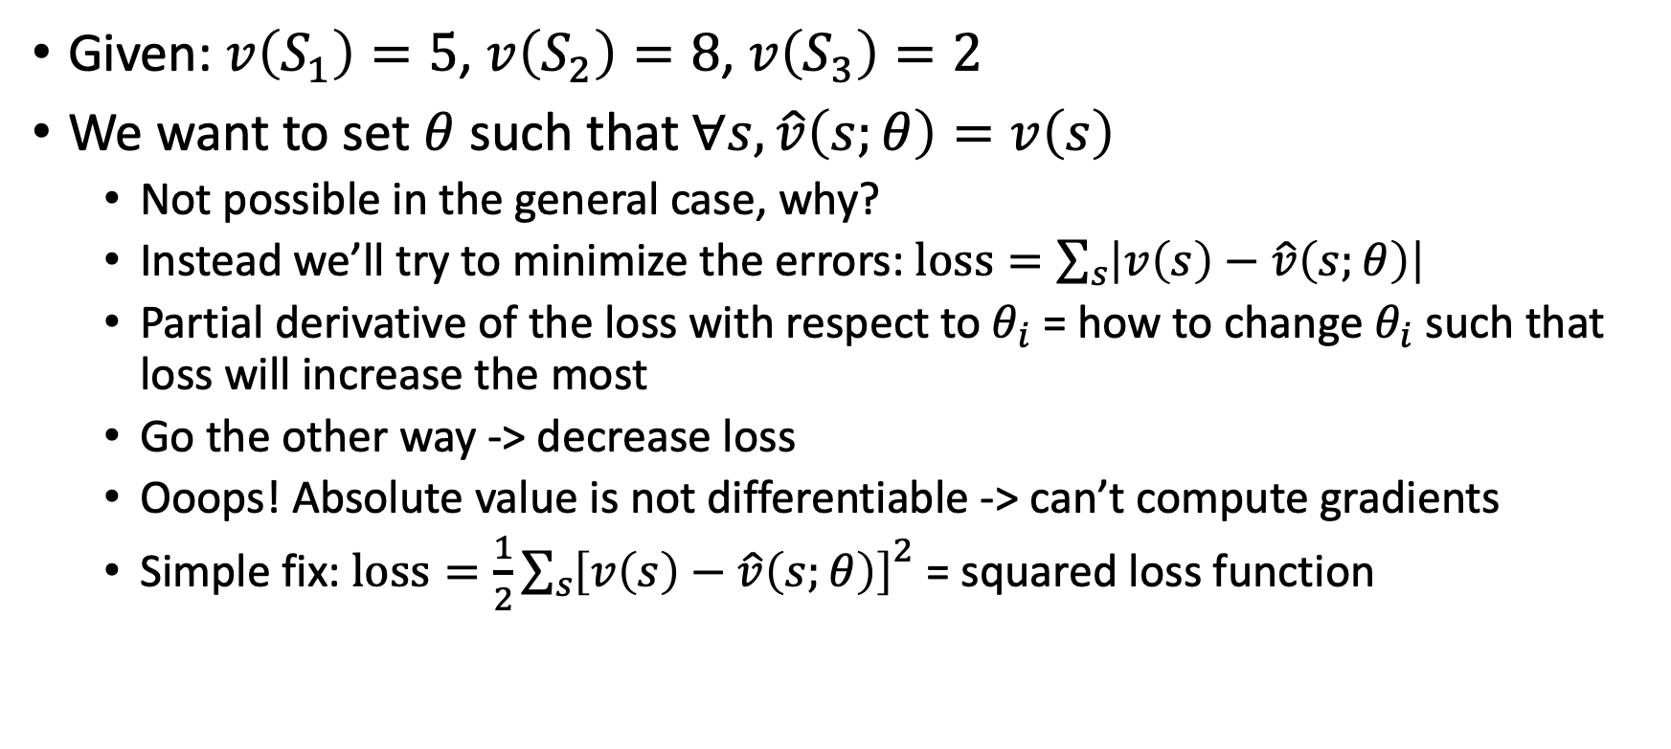
Gradient Decent
Given: $v\left(S_{1}\right)=5$, $v\left(S_{2}\right)=8$, $v\left(S_{3}\right)=2$
We want to set $θ$ such that $∀s, \hat{v}\left(s;θ\right)=v\left(s\right)$
  Not possible in the general case, why?
  Instead we’ll try to minimize the errors: $loss=\sum_{s}{\left|v\left(s\right)−\hat{v}\left(s;θ\right)\right|}$
  Partial derivative of the loss with respect to $θ_{i}$= how to change $θ_{i}$ such that loss will increase the most
  Go the other way -> decrease loss
  Ooops! Absolute value is not differentiable -> can’t compute gradients
  Simple fix: $loss=\frac{1}{2}{\sum_{s}{\left[v\left(s\right)−\hat{v}\left(s;θ\right)\right]}}^{2}$ = squared loss function

Slide 10
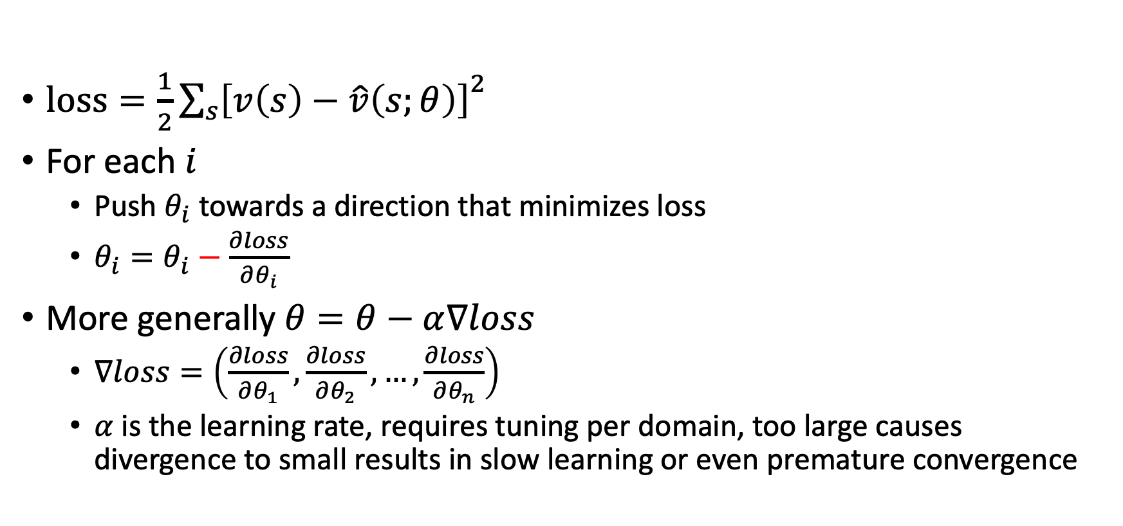
Gradient Decent
$loss=\frac{1}{2}{\sum_{s}{\left[v\left(s\right)−\hat{v}\left(s;θ\right)\right]}}^{2}$
For each $i$
  Push $θ_{i}$ towards a direction that minimizes loss
  $θ_{i}=θ_{i}−\frac{∂loss}{∂θ_{i}}$
More generally $θ=θ−α∇loss$
  $∇loss=\left(\frac{∂loss}{∂θ_{1}},\frac{∂loss}{∂θ_{2}},…,\frac{∂loss}{∂θ_{n}}\right)$
  $α$ is the learning rate, requires tuning per domain, too large causes divergence to small results in slow learning or even premature convergence

Slide 11
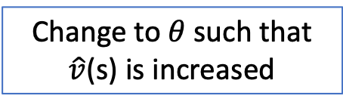
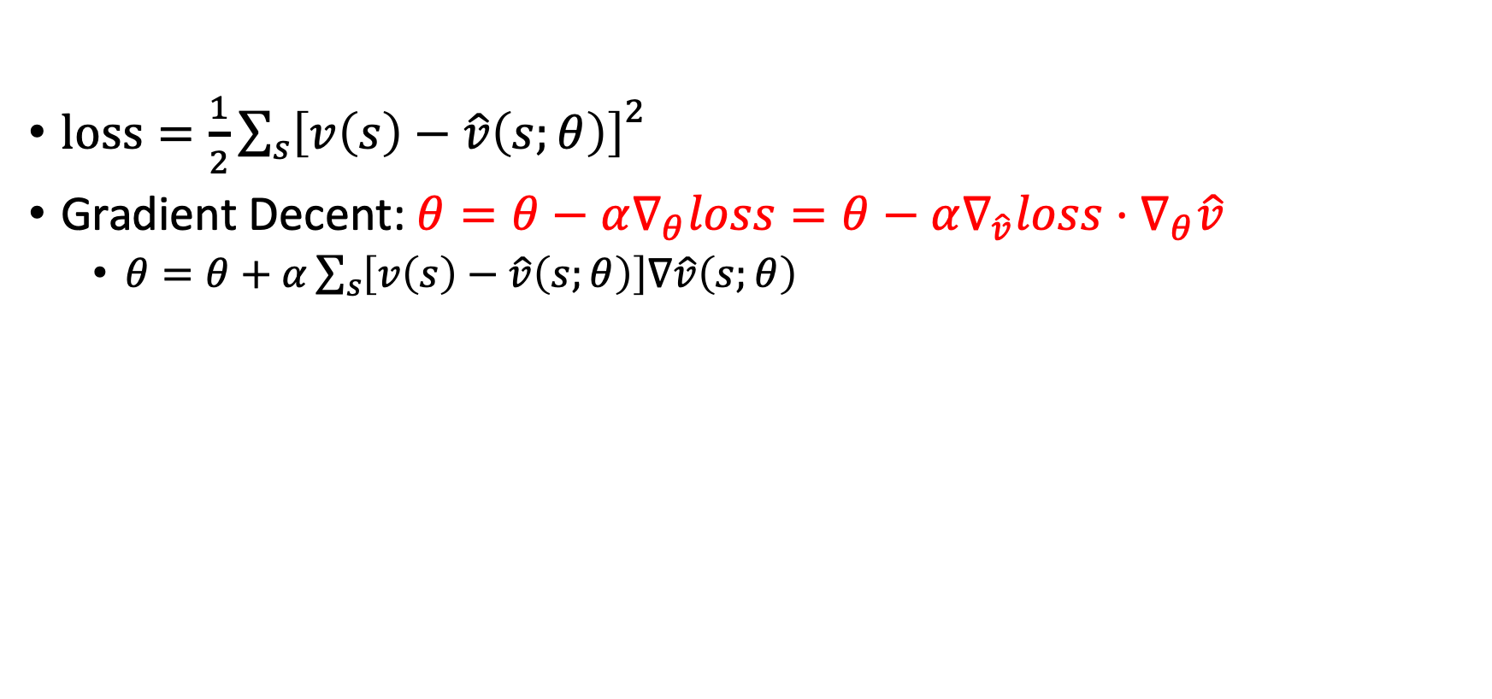
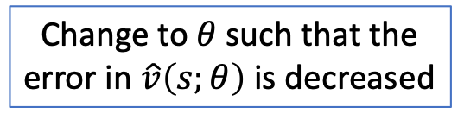

Gradient Decent
Chain rule
$loss=\frac{1}{2}{\sum_{s}{\left[v\left(s\right)−\hat{v}\left(s;θ\right)\right]}}^{2}$
Gradient Decent: $θ=θ−α∇_{θ}loss=θ−α∇_{\hat{v}}loss⋅∇_{θ}\hat{v}$
  $θ=θ+α\sum_{s}{\left[v\left(s\right)−\hat{v}\left(s;θ\right)\right]∇\hat{v}\left(s;θ\right)}$
The error in $\hat{v}\left(s;θ\right)$
Change to $θ$ such that $\hat{v}$(s) is increased
Change to $θ$ such that the error in $\hat{v}\left(s;θ\right)$ is decreased

Slide 12
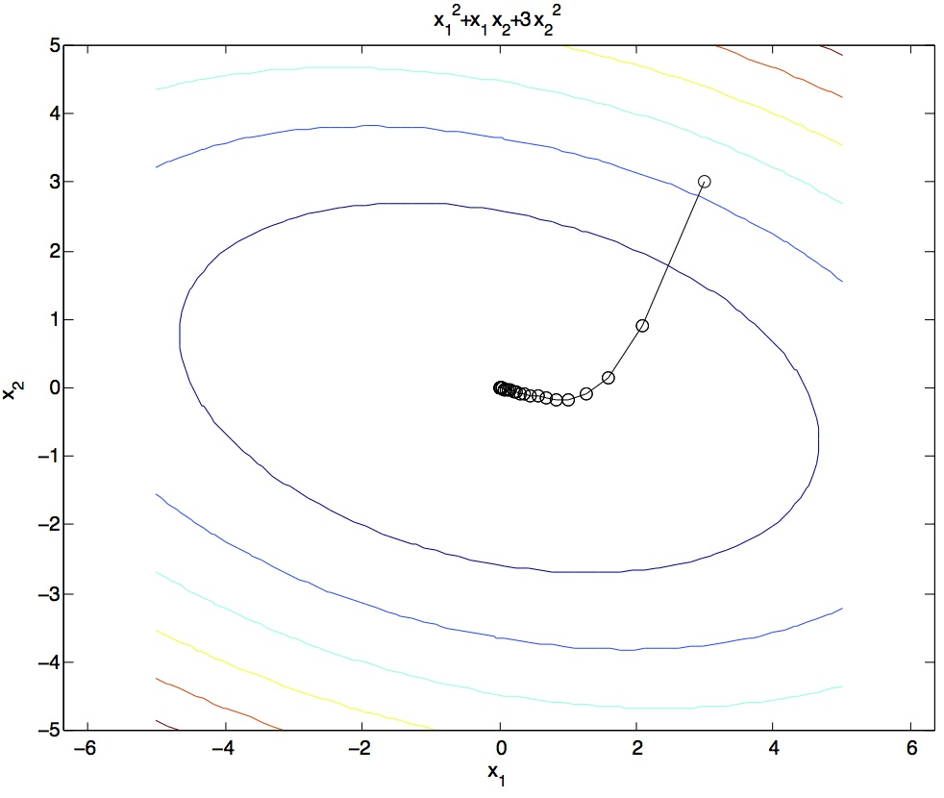
Gradient Descent
Idea:
  Start somewhere
  Repeat: Take a step in the (-) gradient direction
Figure source: Mathworks

Slide 13
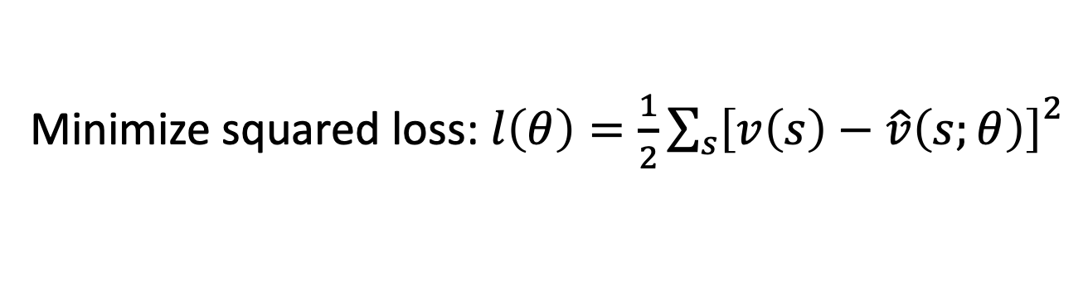
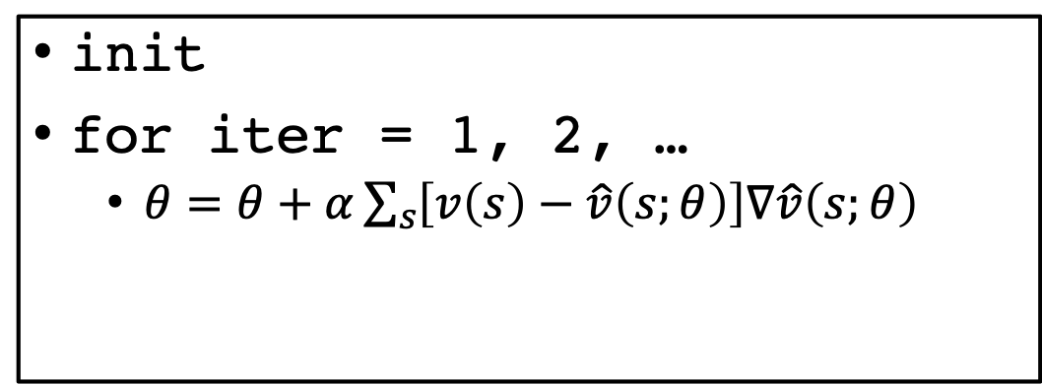
Batch Gradient Decent
Minimize squared loss: $l\left(θ\right)=\frac{1}{2}{\sum_{s}{\left[v\left(s\right)−\hat{v}\left(s;θ\right)\right]}}^{2}$
init
for iter = 1, 2, …
  $θ=θ+α\sum_{s}{\left[v\left(s\right)−\hat{v}\left(s;θ\right)\right]∇\hat{v}\left(s;θ\right)}$

Slide 14
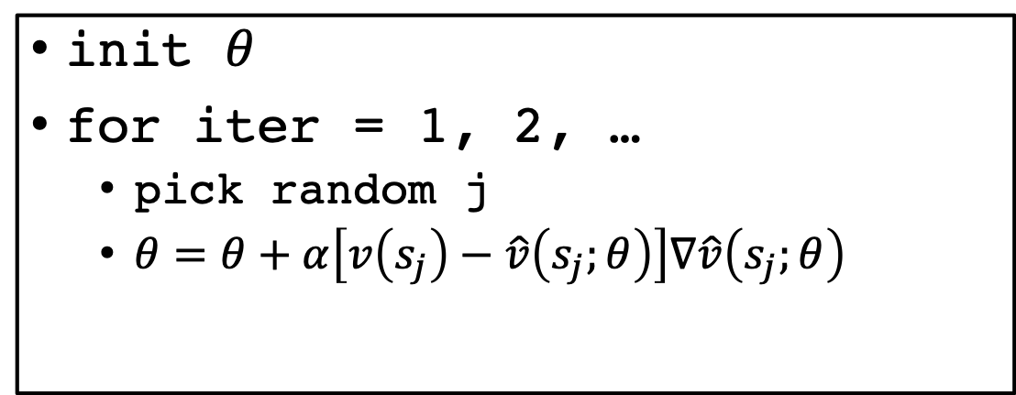
Stochastic Gradient Decent (SGD)
Minimize squared loss: $l\left(θ\right)=\frac{1}{2}{\sum_{s}{\left[v\left(s\right)−\hat{v}\left(s;θ\right)\right]}}^{2}$
Observation: once gradient on one training example has been computed, might as well incorporate before computing next one
init $θ$
for iter = 1, 2, …
  pick random j
  $θ=θ+α\left[v\left(s_{j}\right)−\hat{v}\left(s_{j};θ\right)\right]∇\hat{v}\left(s_{j};θ\right)$

Slide 15
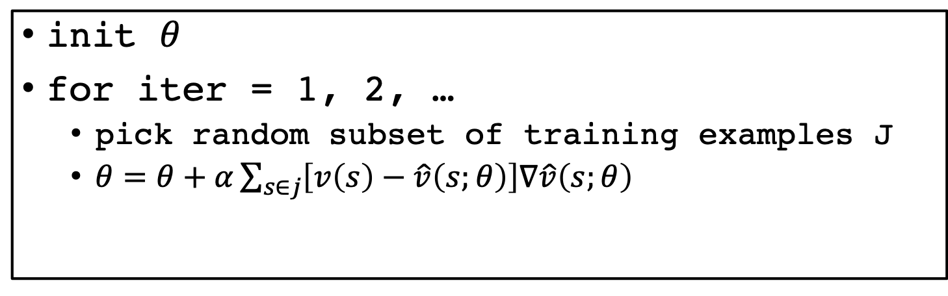
Mini-Batch Gradient Decent
Minimize squared loss: $l\left(θ\right)=\frac{1}{2}{\sum_{s}{\left[v\left(s\right)−\hat{v}\left(s;θ\right)\right]}}^{2}$
Observation: gradient over small set of training examples (=mini-batch) can be computed in parallel, might as well do that instead of a single one
init $θ$
for iter = 1, 2, …
  pick random subset of training examples J
  $θ=θ+α\sum_{s∈j}{\left[v\left(s\right)−\hat{v}\left(s;θ\right)\right]∇\hat{v}\left(s;θ\right)}$

Slide 16
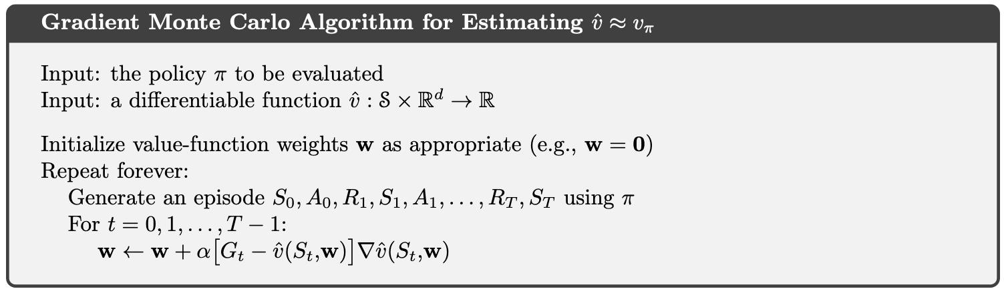
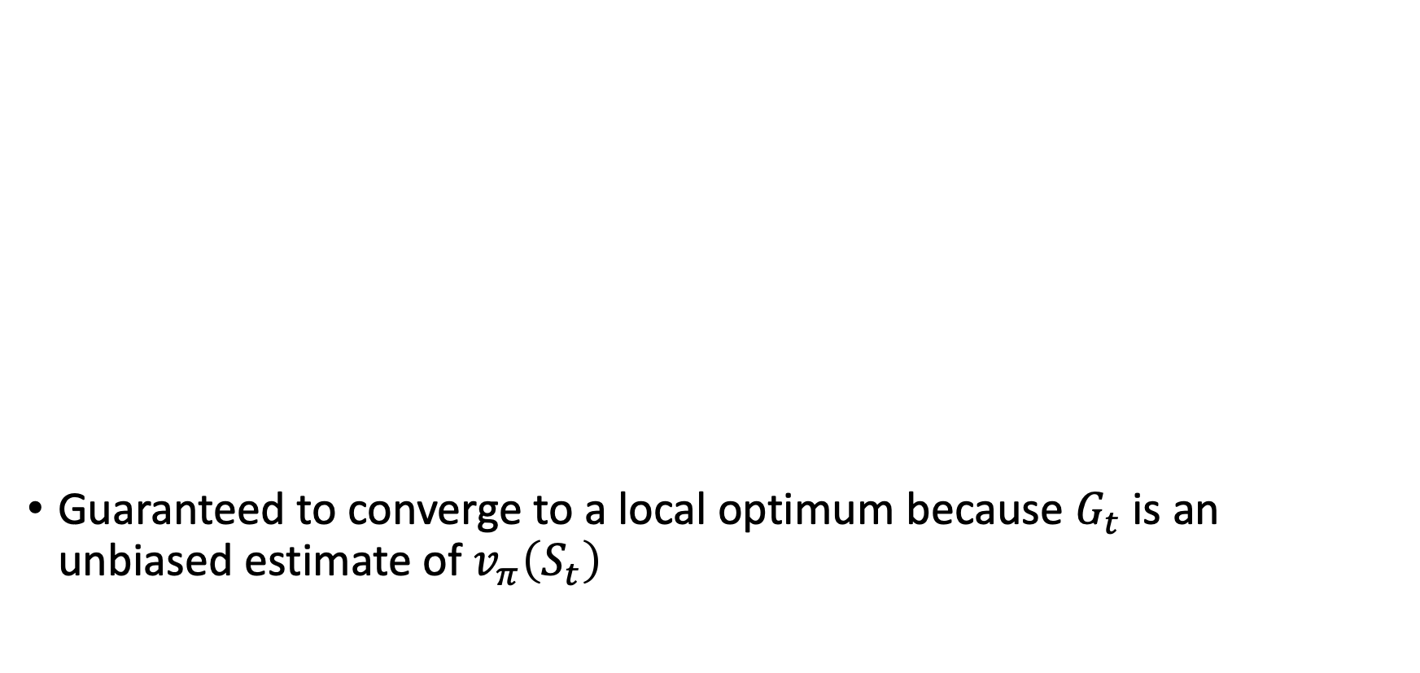
SGD for Monte Carlo estimation
Guaranteed to converge to a local optimum because $G_{t}$ is an unbiased estimate of $v_{π}\left(S_{t}\right)$
w are the tunable parameters of the value approximation function

Slide 17
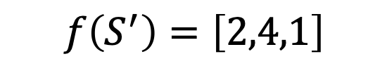

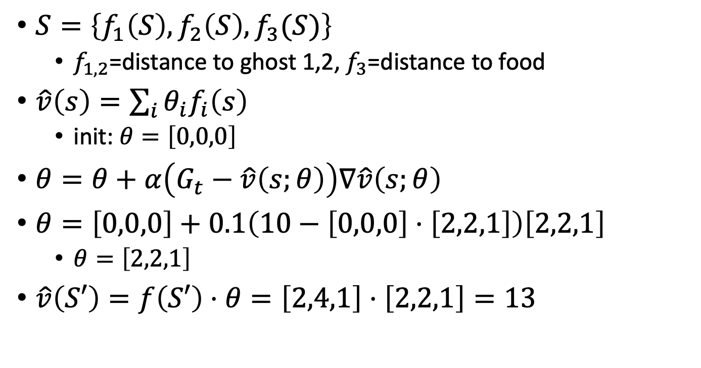
Example
$$f\left(S\right)=\left[2,2,1\right]$$
$$f\left(S^{′}\right)=\left[2,4,1\right]$$
$S=\left\{f_{1}\left(S\right),f_{2}\left(S\right),f_{3}(S)\right\}$
  $f_{1,2}$=distance to ghost 1,2, $f_{3}$=distance to food
$\hat{v}\left(s\right)=\sum_{i}{θ_{i}f_{i}\left(s\right)}$
  init: $θ=\left[0,0,0\right]$
$θ=θ+α\left(G_{t}−\hat{v}\left(s;θ\right)\right)∇\hat{v}\left(s;θ\right)$
$θ=\left[0,0,0\right]+0.1\left(10−\left[0,0,0\right]⋅\left[2,2,1\right]\right)\left[2,2,1\right]$
  $θ=\left[2,2,1\right]$
$\hat{v}\left(S′\right)=f\left(S′\right)⋅θ=\left[2,4,1\right]⋅\left[2,2,1\right]=13$
10

Slide 18

Side note
Should we care about on-policy value approximation?
  Once the policy changes the approximated values become irrelevant
Yes! This will be useful for Actor-Critic methods which will be discussed later

Slide 19
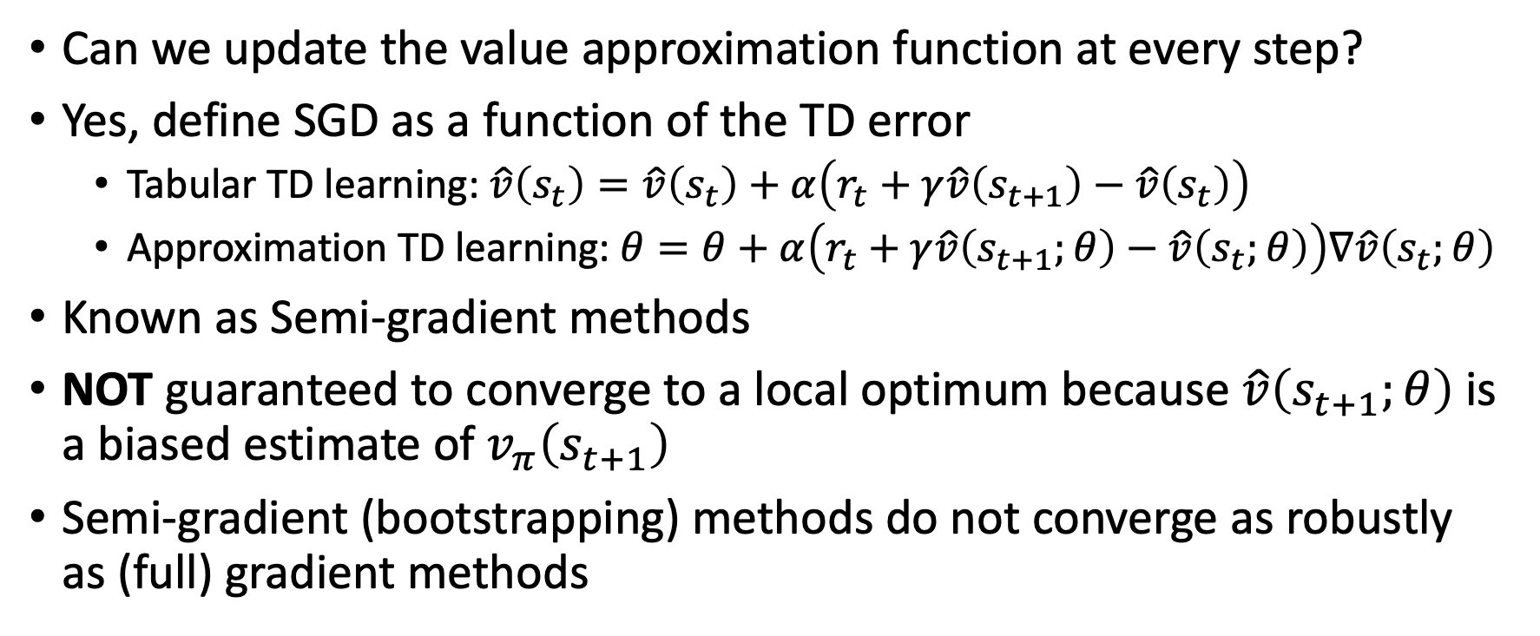
Learning approximation with bootstrapping
Can we update the value approximation function at every step?
Yes, define SGD as a function of the TD error
  Tabular TD learning: $\hat{v}\left(s_{t}\right)=\hat{v}\left(s_{t}\right)+α\left(r_{t}+γ\hat{v}\left(s_{t+1}\right)−\hat{v}\left(s_{t}\right)\right)$
  Approximation TD learning: $θ=θ+α\left(r_{t}+γ\hat{v}\left(s_{t+1};θ\right)−\hat{v}\left(s_{t};θ\right)\right)∇\hat{v}\left(s_{t};θ\right)$
Known as Semi-gradient methods
NOT guaranteed to converge to a local optimum because $\hat{v}\left(s_{t+1};θ\right)$ is a biased estimate of $v_{π}\left(s_{t+1}\right)$
Semi-gradient (bootstrapping) methods do not converge as robustly as (full) gradient methods

Slide 20
Semi-gradient methods
They do converge reliably in important cases such as the linear approximation case
They offer important advantages that make them often clearly preferred
They typically enable significantly faster learning, as we have seen in Chapters 6 and 7
They enable learning to be continual and online, without waiting for the end of an episode
This enables them to be used on continuing problems and provides computational advantages

Slide 21
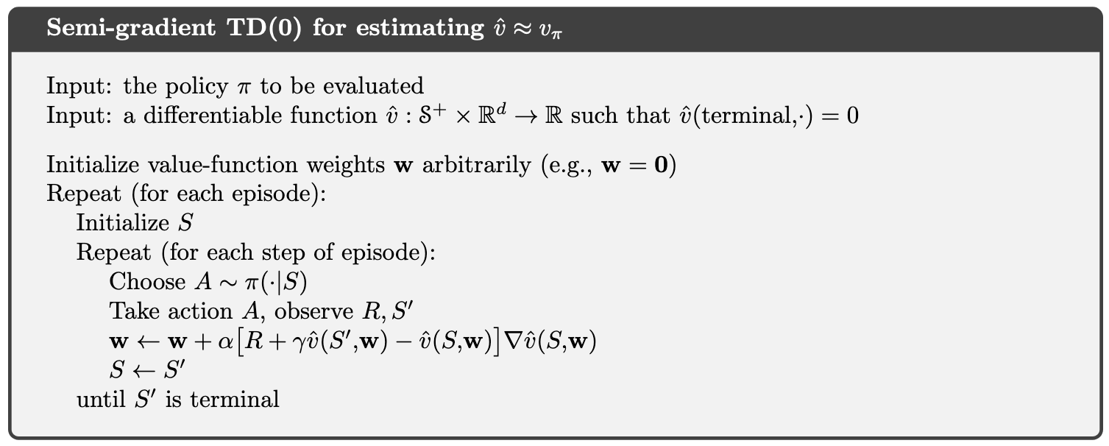
Semi-gradient TD(0)
What’s the difference from the tabular case?

Slide 22

Semi-gradient TD(0)
What’s the difference from the tabular case?
$$\hat{v}\left(S\right)=\hat{v}\left(S\right)+α\left[R+γ\hat{v}\left(S′\right)−\hat{v}\left(S\right)\right]$$

Slide 23


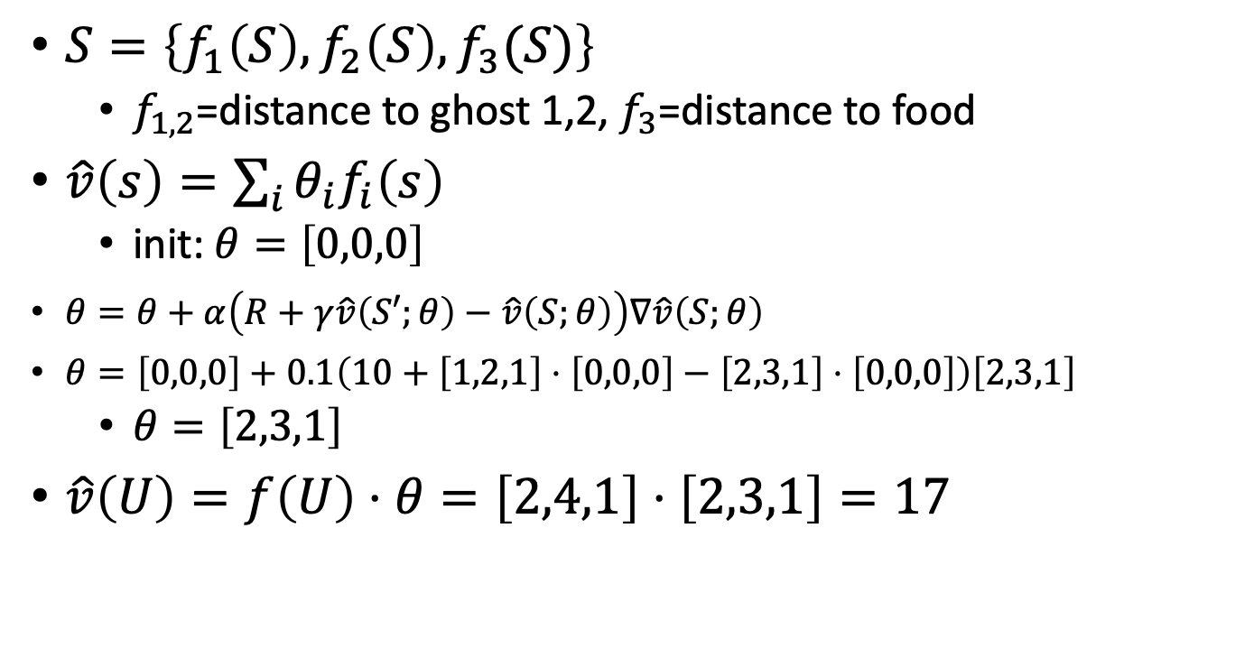


Example
$$f\left(U\right)=\left[2,4,1\right]$$
$$f\left(S\right)=\left[2,3,1\right]$$
$S=\left\{f_{1}\left(S\right),f_{2}\left(S\right),f_{3}(S)\right\}$
  $f_{1,2}$=distance to ghost 1,2, $f_{3}$=distance to food
$\hat{v}\left(s\right)=\sum_{i}{θ_{i}f_{i}\left(s\right)}$
  init: $θ=\left[0,0,0\right]$
$θ=θ+α\left(R+γ\hat{v}\left(S′;θ\right)−\hat{v}\left(S;θ\right)\right)∇\hat{v}\left(S;θ\right)$
$θ=\left[0,0,0\right]+0.1\left(10+\left[1,2,1\right]⋅\left[0,0,0\right]−\left[2,3,1\right]⋅\left[0,0,0\right]\right)\left[2,3,1\right]$
  $θ=\left[2,3,1\right]$
$\hat{v}\left(U\right)=f\left(U\right)⋅θ=\left[2,4,1\right]⋅\left[2,3,1\right]=17$
$$R=+10$$
$$f\left(S′\right)=\left[1,2,1\right]$$

Slide 24
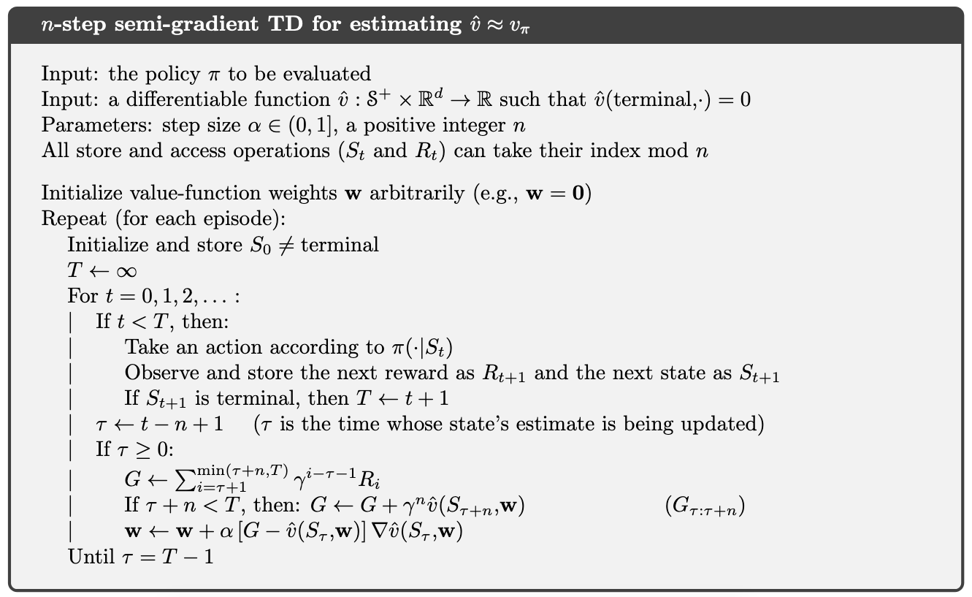
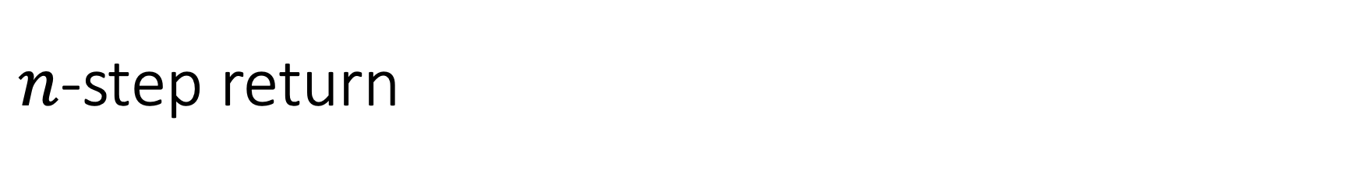
$n$-step return
Again, only a simple modification over the tabular setting

Slide 25
$n$-step return
Again, only a simple modification over the tabular setting
Weight update instead of tabular entry update

Slide 26
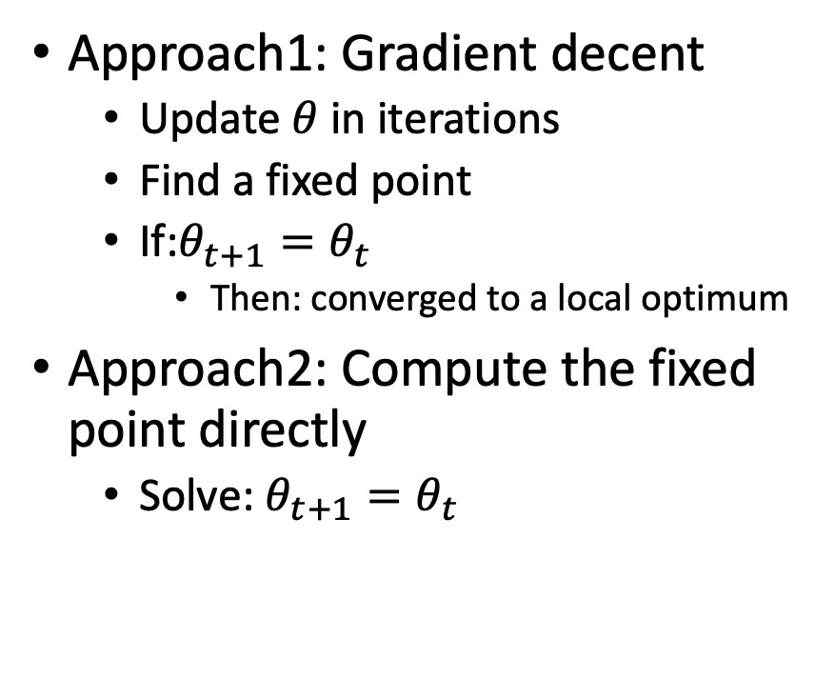
Another optimization approach
Approach1: Gradient decent
  Update $θ$ in iterations
  Find a fixed point
  If:$θ_{t+1}=θ_{t}$
    Then: converged to a local optimum
Approach2: Compute the fixed point directly
  Solve: $θ_{t+1}=θ_{t}$

Slide 27
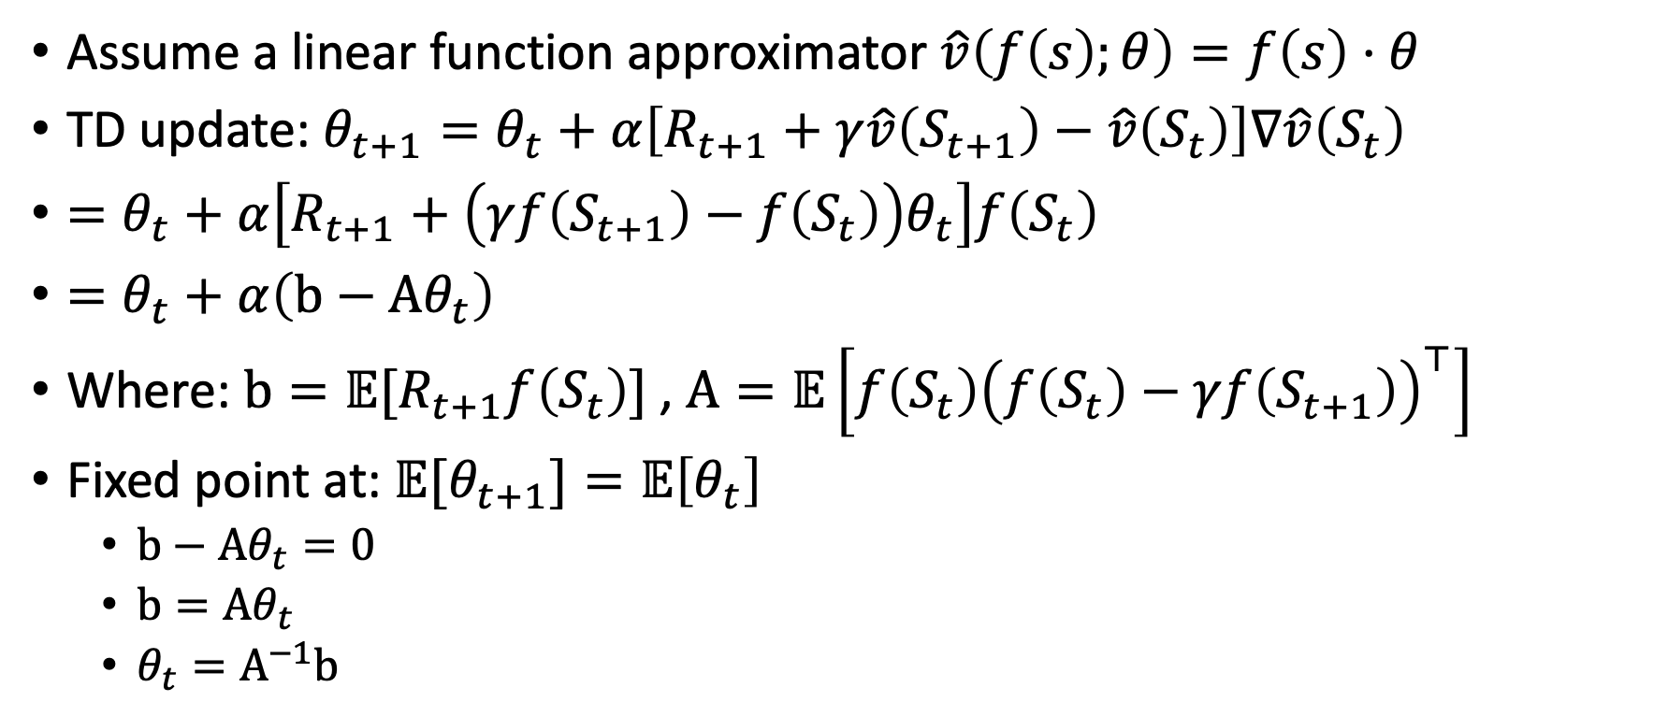


Compute fixed point over $θ$
Assume a linear function approximator $\hat{v}\left(f\left(s\right);θ\right)=f\left(s\right)⋅θ$
TD update: $θ_{t+1}=θ_{t}+α\left[R_{t+1}+γ\hat{v}\left(S_{t+1}\right)−\hat{v}\left(S_{t}\right)\right]∇\hat{v}\left(S_{t}\right)$
$=θ_{t}+α\left[R_{t+1}+\left(γf\left(S_{t+1}\right)−f\left(S_{t}\right)\right)θ_{t}\right]f\left(S_{t}\right)$
$=θ_{t}+α\left(b−Aθ_{t}\right)$
Where: $b={𝔼[R}_{t+1}f\left(S_{t}\right)]$, $A=𝔼\left[f\left(S_{t}\right){\left(f\left(S_{t}\right)−γf\left(S_{t+1}\right)\right)}^{⊤}\right]$
Fixed point at: $𝔼{[θ}_{t+1}]=𝔼\left[θ_{t}\right]$
  $b−Aθ_{t}=0$
  $b=Aθ_{t}$
  $θ_{t}=A^{−1}b$
$$f\left(S_{t}\right)$$
For a linear approximator
Vector
Matrix
TD-error = 0

Slide 28
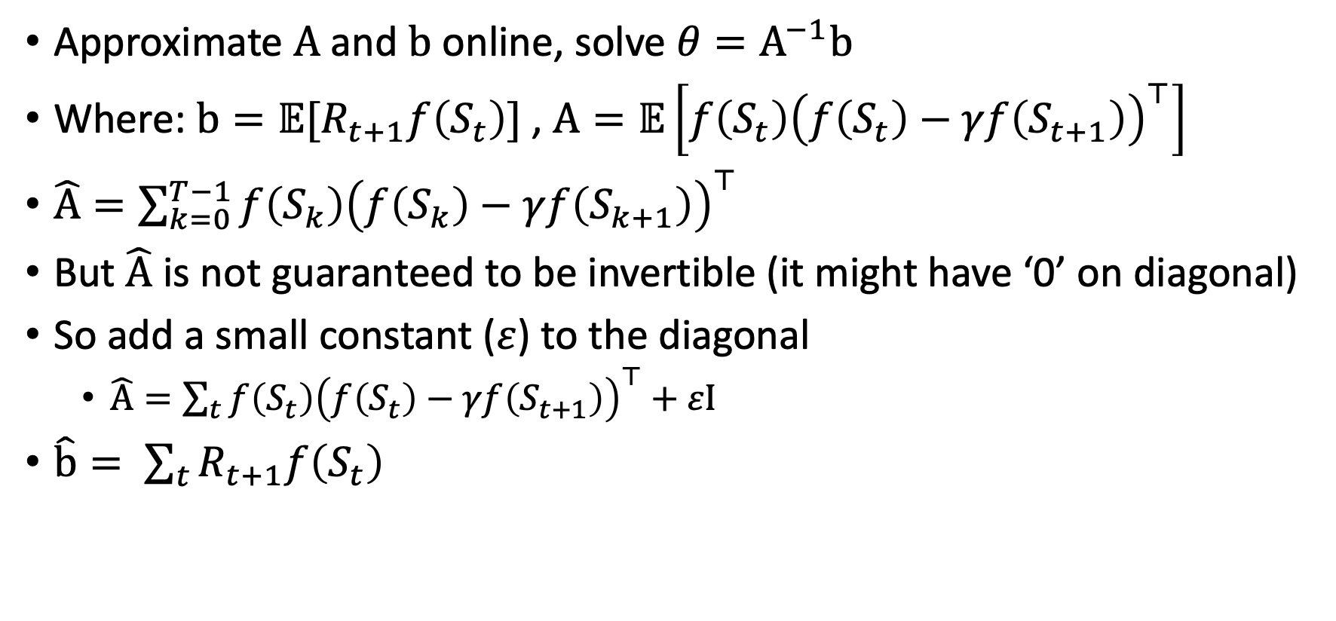
Least squares TD
Approximate $A$ and $b$ online, solve $θ=A^{−1}b$
Where: $b={𝔼[R}_{t+1}f\left(S_{t}\right)]$, $A=𝔼\left[f\left(S_{t}\right){\left(f\left(S_{t}\right)−γf\left(S_{t+1}\right)\right)}^{⊤}\right]$
$\hat{A}=\sum_{k=0}^{T−1}{f\left(S_{k}\right){\left(f\left(S_{k}\right)−γf\left(S_{k+1}\right)\right)}^{⊤}}$
But $\hat{A}$ is not guaranteed to be invertible (it might have ‘0’ on diagonal)
So add a small constant ($ε$) to the diagonal
  $\hat{A}=\sum_{t}{f\left(S_{t}\right){\left(f\left(S_{t}\right)−γf\left(S_{t+1}\right)\right)}^{⊤}}+εI$
$\hat{b}= \sum_{t}{R_{t+1}f\left(S_{t}\right)}$

Slide 29
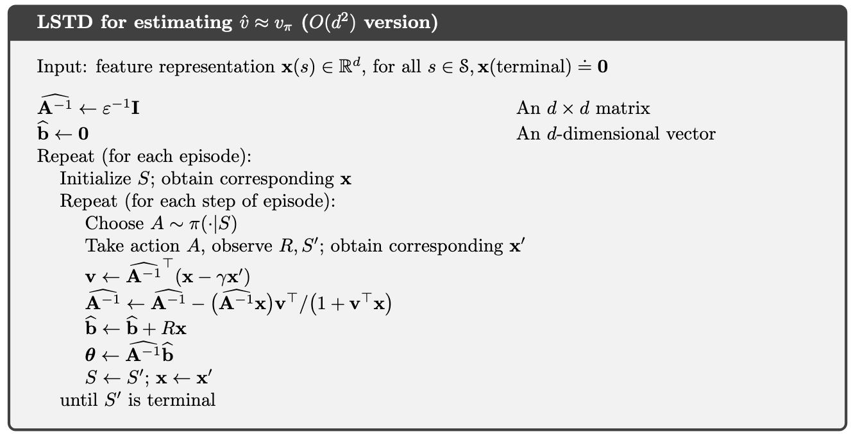
Least squares TD
Store the inverse of A instead of A

Slide 30
Least squares TD
Incremental updates (no need to store all previous transitions)

Slide 31
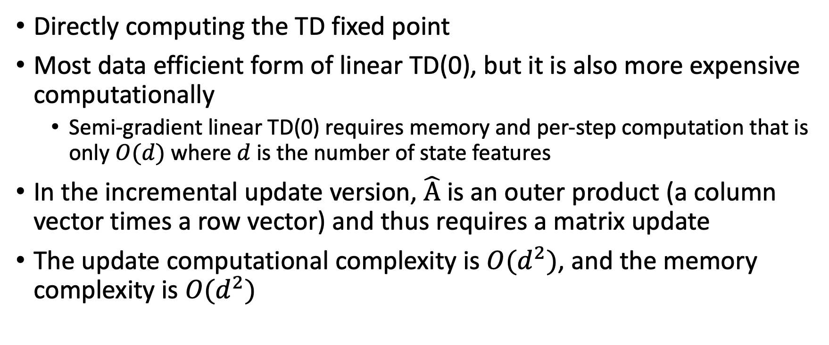
Least squares TD
Directly computing the TD fixed point
Most data efficient form of linear TD(0), but it is also more expensive computationally
  Semi-gradient linear TD(0) requires memory and per-step computation that is only $O(d)$ where $d$ is the number of state features
In the incremental update version, $\hat{A}$ is an outer product (a column vector times a row vector) and thus requires a matrix update
The update computational complexity is $O(d^{2})$, and the memory complexity is $O(d^{2})$

Slide 32

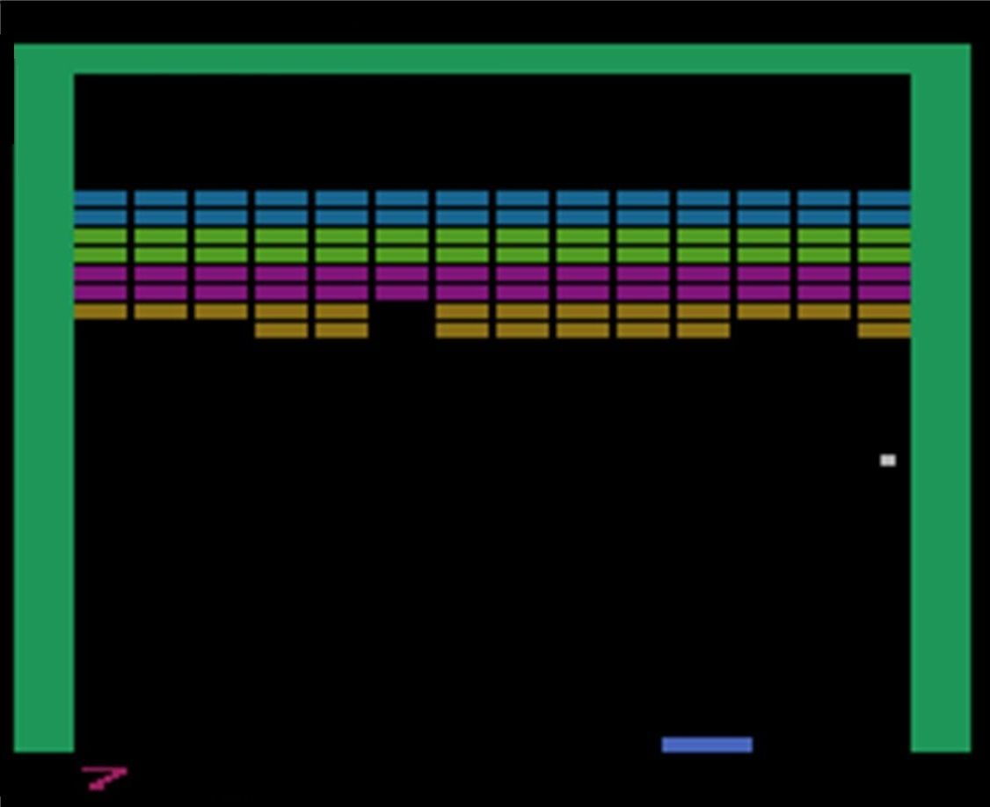

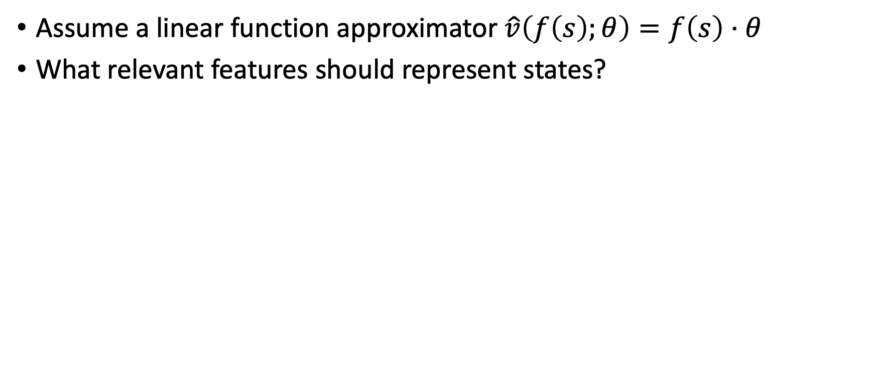
Feature selection
Assume a linear function approximator $\hat{v}\left(f\left(s\right);θ\right)=f\left(s\right)⋅θ$
What relevant features should represent states?
Features are domain depended
requiring expert knowledge

Slide 33
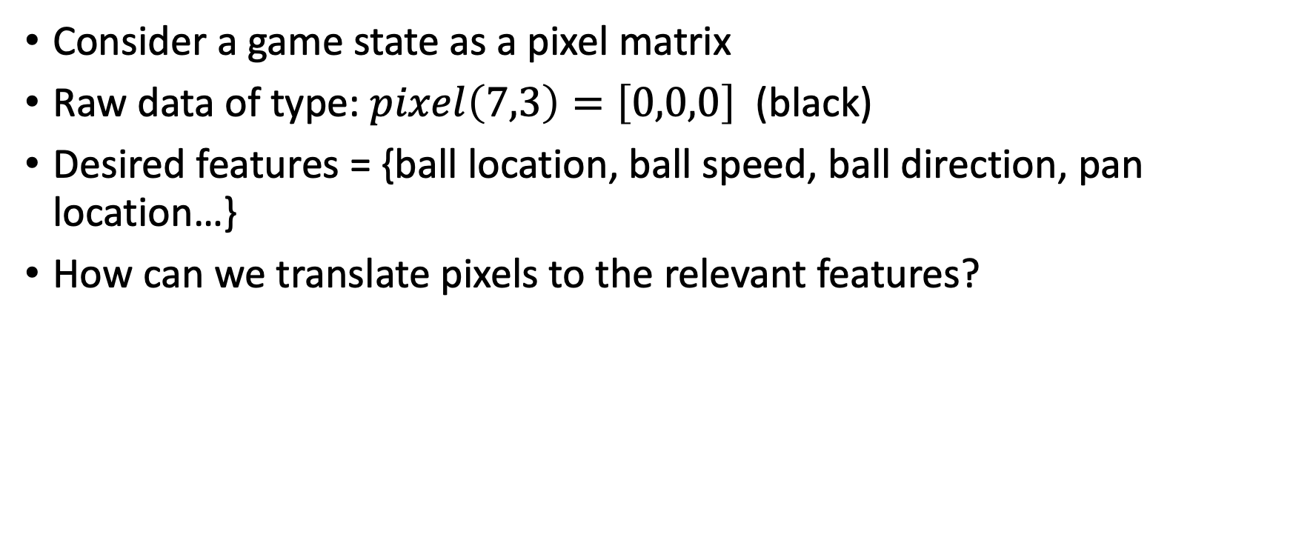
Automatic features extraction
Consider a game state as a pixel matrix
Raw data of type: $pixel\left(7,3\right)=\left[0,0,0\right]$ (black)
Desired features = {ball location, ball speed, ball direction, pan location…}
How can we translate pixels to the relevant features?

Slide 34
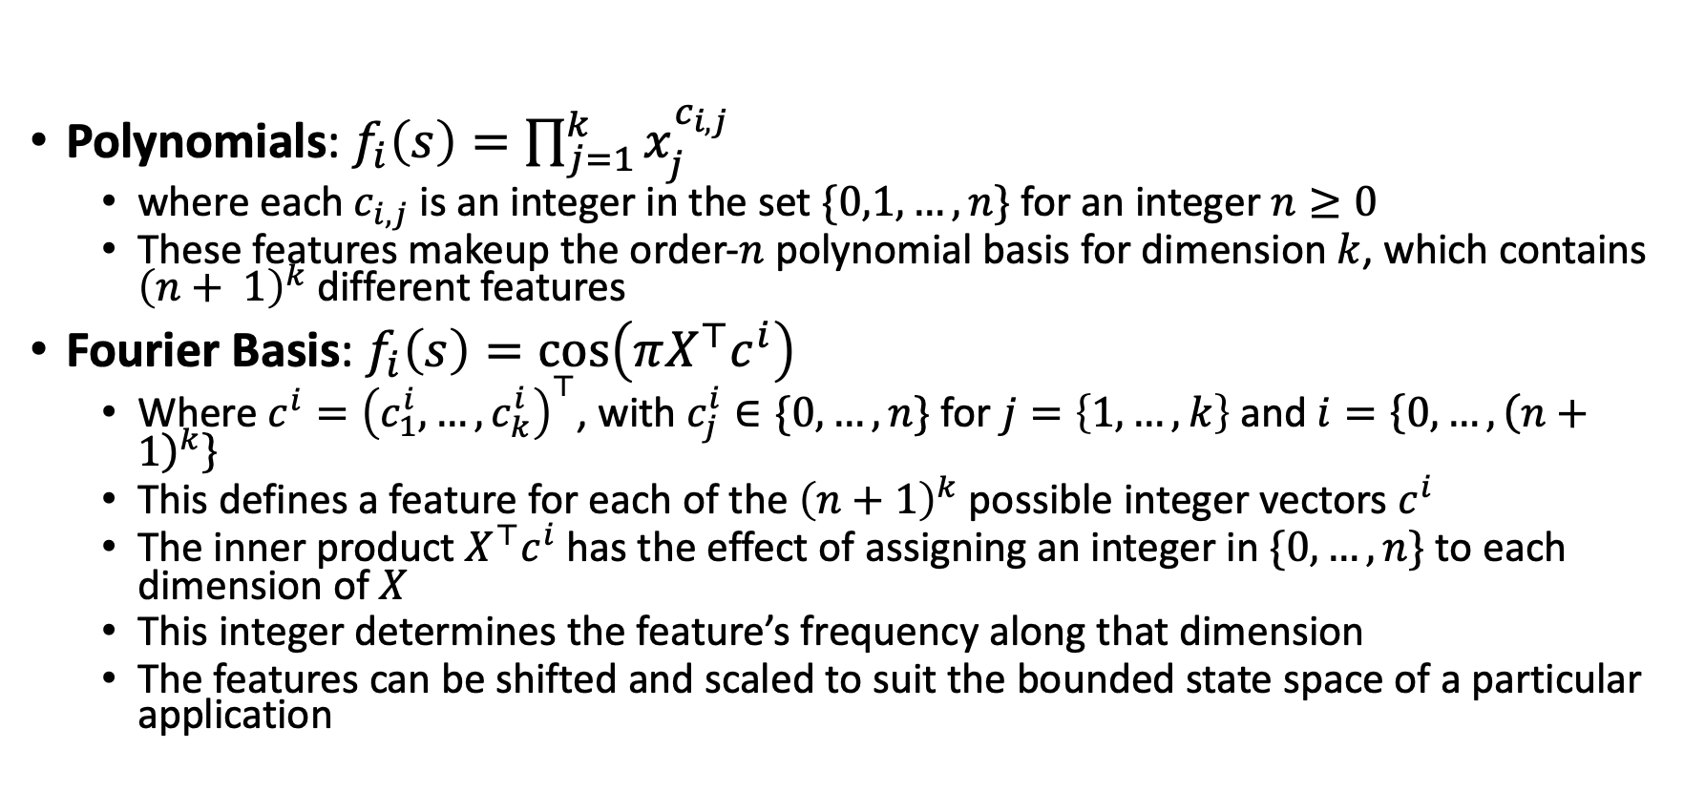
Automatic features extraction for linear approximator
Polynomials: $f_{i}\left(s\right)=\prod_{j=1}^{k}{x_{j}^{c_{i,j}}}$
  where each $c_{i,j}$ is an integer in the set $\{0,1,…,n\}$for an integer $n≥0$
  These features makeup the order-$n$ polynomial basis for dimension $k$, which contains ${\left(n+ 1\right)}^{k}$different features
Fourier Basis: $f_{i}\left(s\right)=\cos\left(πX^{⊤}c^{i}\right)$
  Where $c^{i}={\left(c_{1}^{i},…,c_{k}^{i}\right)}^{⊤}$, with $c_{j}^{i}∈\{0, …,n\}$ for $j=\left\{1,…,k\right\}$ and $i=\left\{0,…,{\left(n+1\right)}^{k}\right\}$
  This defines a feature for each of the ${\left(n+1\right)}^{k}$ possible integer vectors $c^{i}$
  The inner product $X^{⊤}c^{i}$ has the effect of assigning an integer in $\{0,…,n\}$to each dimension of $X$
  This integer determines the feature’s frequency along that dimension
  The features can be shifted and scaled to suit the bounded state space of a particular application

Slide 35
Automatic features extraction for linear approximator
Other approaches include: Coarse Coding, Tile Coding, Radial Basis Functions (See chapter 9.5 in textbook)
Each of these approaches defines a set of features, some useful yet most are not
  E.g., is there a polynomial/Fourier function that translates pixels to pan location?
  Probably but it’s a needle in a (combinatorial) haystack
Can we do better (generically)
  Yes, using deep neural networks…

Slide 36
What did we learn?
Reinforcement learning must generalize on observed experience if it is to be applicable to real world domains
We can use parameterized function approximation to represent our knowledge about the domain state/action values
Use stochastic gradient descend to update the tunable parameters such that the observed (TD, rollout) error is reduced
When using a linear approximator, the Least squares TD method provides the most sample efficient approximation

Slide 37
What next?
Lecture: Deep Neural Networks as function approximators
Assignments:
  Value Iteration, by September-23, EOD
  Asynchronous Value Iteration, by September-23, EOD
  Policy Iteration, by September-23, EOD
  Monte-Carlo Control by September-30, EOD
  Monte-Carlo Control with Importance Sampling by September-30, EOD
  Tabular Q-Learning, by Oct. 7, EOD
  SARSA, by Oct. 7, EOD
  Q-Learning with Approximation, by Oct. 14, EOD
Quiz (on Canvas):
  n-step Bootstrapping, by Sep. 23, EOD
  Value approximation, by Sep. 30, EOD
Project:
  Project proposal, by Sep. 30 EOD

