Slide 1

CSCE-642 Reinforcement Learning
Chapter 8: Planning and learning
Instructor: Guni Sharon

Slide 2
TODOs:
Quizzes:
  Monte-Carlo Control, by Sunday, Sep24, EOD
  TD learning, by Thursday Sep. 28, EOD
  n-step Bootstrapping, by Thursday Sep. 28, EOD
Assignments:
  Value Iteration, by Monday, September-25, EOD
  Asynchronous Value Iteration, by Monday, September-25, EOD
  Policy Iteration, by Monday, September-25, EOD
  Monte-Carlo Control, Monday, Oct 2, EOD
  Monte-Carlo Control with Importance Sampling, Monday, Oct 2, EOD
  Tabular Q-Learning, by Monday Oct. 9, EOD
  SARSA, by Monday Oct. 9, EOD
Project:
  Project proposal, by Monday, October 2 EOD

Slide 3
Solving MDPs so far…
Dynamic programming
Off policy
local learning, propagating values from neighbors
assumes the model is known
Monte-Carlo
On-policy (though important sampling can be used)
Requires a full episode to train on
Model free
Must online solvers be Model free?
TD Learning
Off policy
local learning, propagating values from neighbors
Slow value propagation
Model free
n-step TD Learning
On-policy (though important sampling can be used)
local learning (flexible locality)
Model free

Slide 4
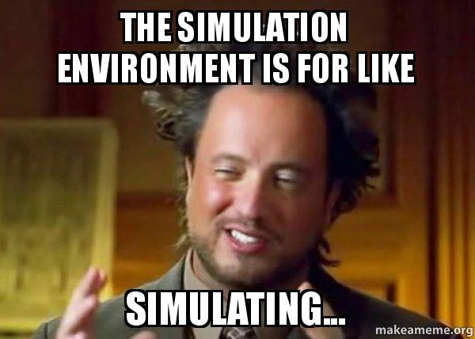
The value of a model
Having a model is useful
  We can simulate episodes cheaply
  Compute optimal policy offline (no growing pains)
Sounds great! We should use Model-based approaches
For most practical applications, the model is unknown
Can we learn the model (transition and reward functions)?
  Sure, we just need to observe enough relevant transitions

Slide 5
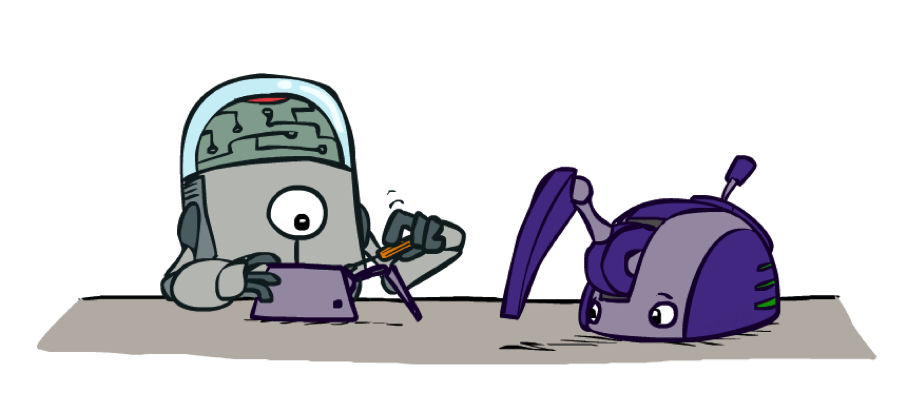
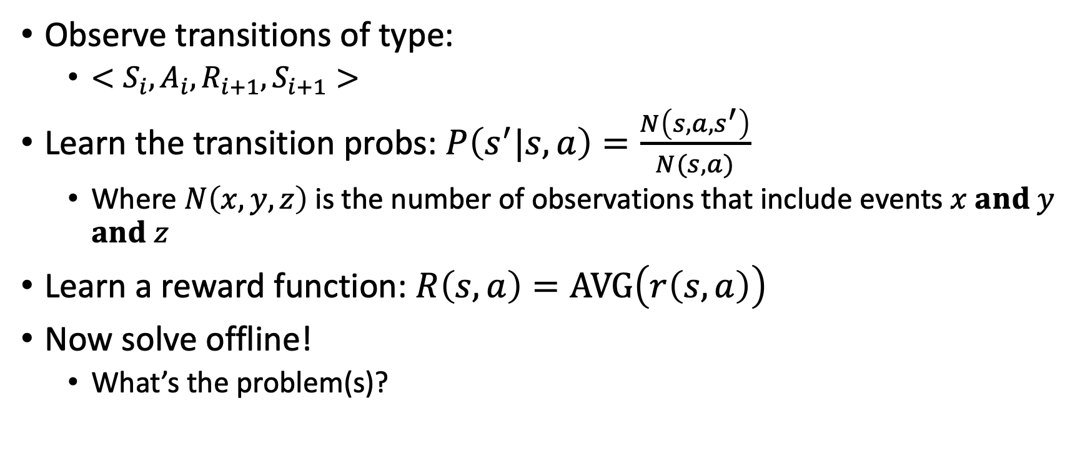
Build a model
Observe transitions of type:
  $<S_{i},A_{i}, R_{i+1},S_{i+1}>$
Learn the transition probs: $P\left(s^{′}|s,a\right)=\frac{N\left(s,a,s^{′}\right)}{N(s,a)}$
  Where $N\left(x,y,z\right)$ is the number of observations that include events $x and y$ $and z$
Learn a reward function: $R\left(s,a\right)=AVG\left(r\left(s,a\right)\right)$
Now solve offline!
  What’s the problem(s)?
Unbiased estimations

Slide 6


Learning a model
A model allows offline planning
Learning a model is done online
How many samples are required to learn an accurate model?
  Can be arbitrarily large
How many samples are required to learn a useful model?
  Depends on the model and reward distribution
  E.g., what’s the expected reward from buying a Powerball ticket
Eventually, a model is just a model

Slide 7

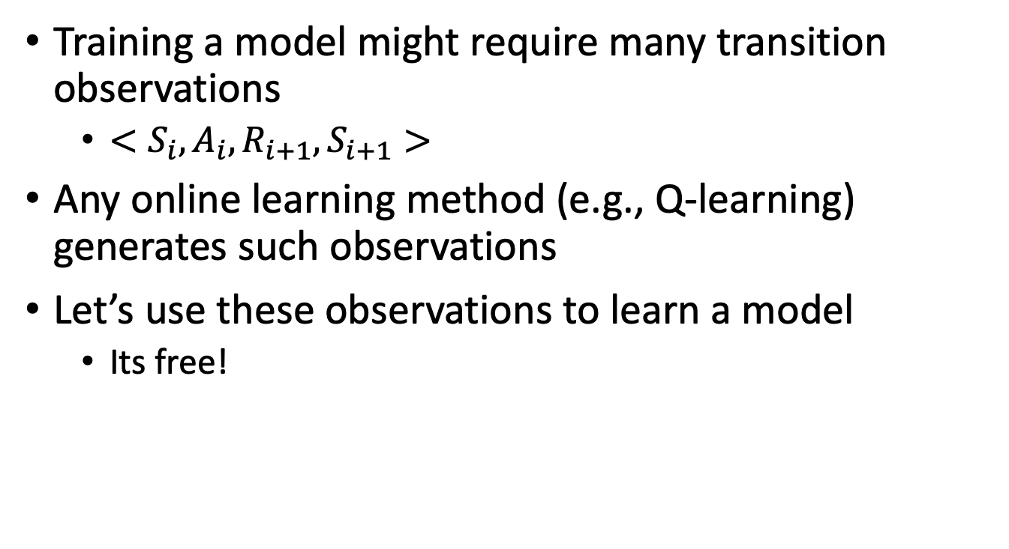
Can we train models for free?
Training a model might require many transition observations
  $<S_{i},A_{i}, R_{i+1},S_{i+1}>$
Any online learning method (e.g., Q-learning) generates such observations
Let’s use these observations to learn a model
  Its free!

Slide 8
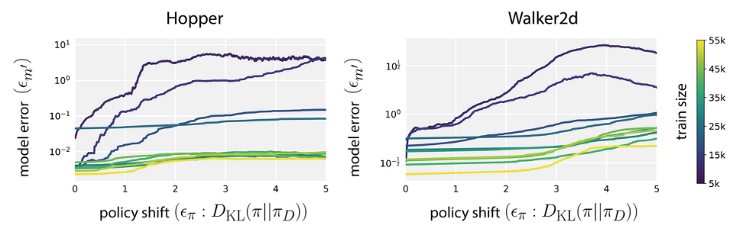
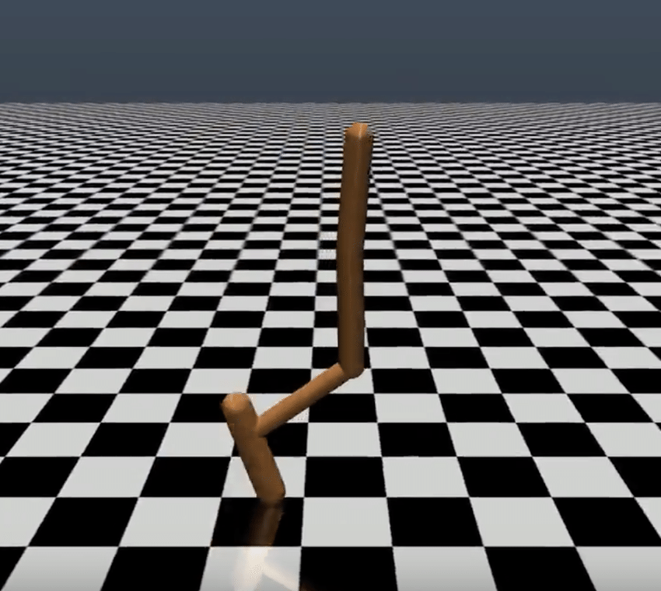
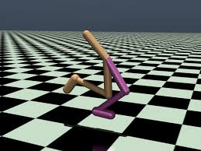
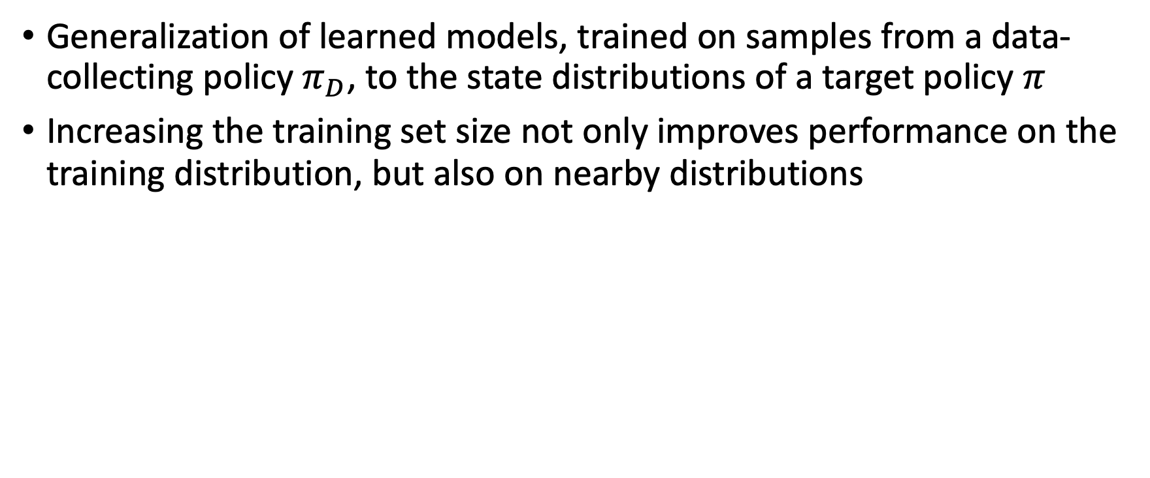
Off-policy learning with approx. model
Generalization of learned models, trained on samples from a data-collecting policy $π_{D}$, to the state distributions of a target policy $π$
Increasing the training set size not only improves performance on the training distribution, but also on nearby distributions
Results by Sergey Levin

Slide 9
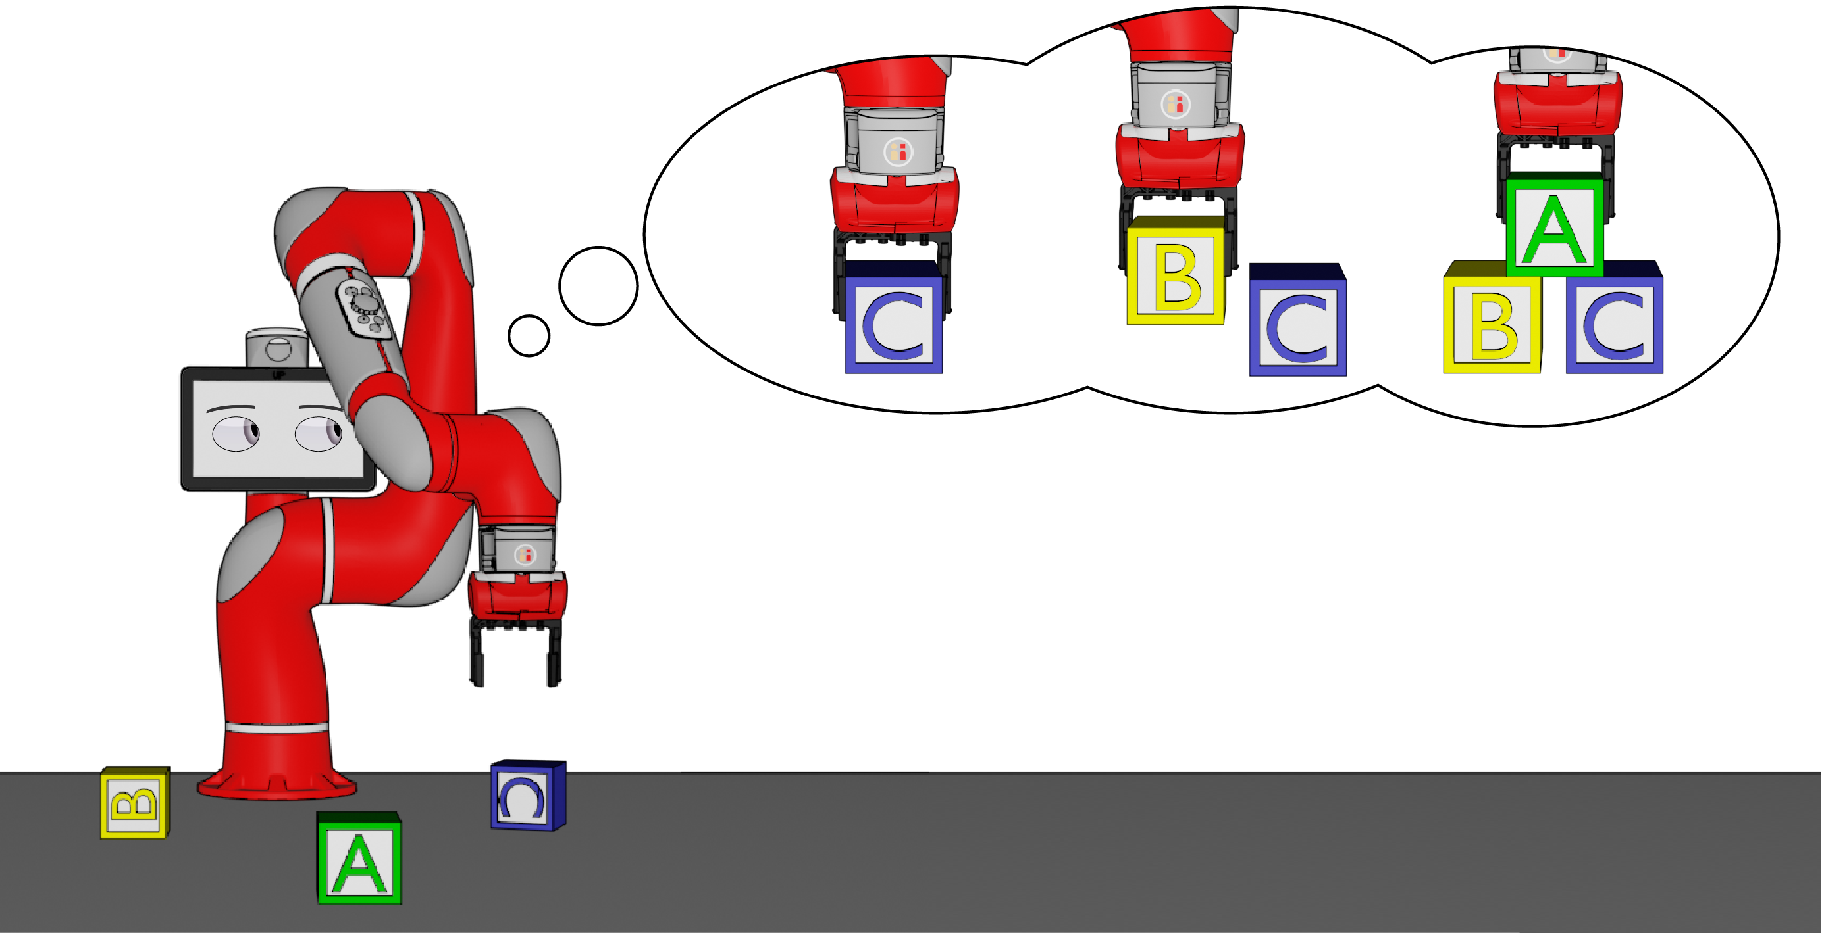
Relaying on past experience is dangerous
In practice many (on-policy) algorithms re-use trajectories from old policies for improved sample-efficiency
  Introduces off-policy learning errors
A model allows us to cheaply draw on-policy (simulated) trajectories
Sample efficient + no need for off-policy training

Slide 10
Model approx. looks promising
Not so fast…
The results suggest that a single-step predictive accuracy of a learned model can be reliable under policy shift
The catch is that most model-based algorithms rely on models for much more than a single-step
When predictions are strung together, small errors compound over the prediction horizon

Slide 11

Error accumulation
A 450-step action sequence rolled out under a learned probabilistic model
Depicting the mean prediction and one standard deviation away from the mean colored regions
The growing uncertainty and deterioration of a recognizable sinusoidal motion underscore accumulation of model errors
Demo by Sergey Levin

Slide 12
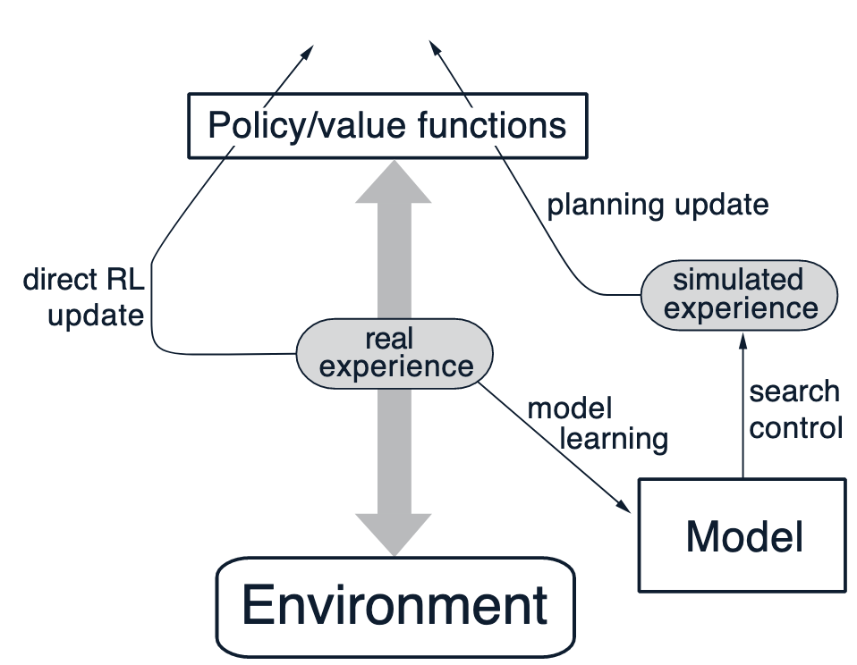
Experience from simulation
Observations from the real world might be costly and dangerous
If we have a model, we can generate simulated observations
Simulated observations are faster, cheaper, and safer to obtain
Use the simulated experience to train the policy with any online method
Be careful: Modeling errors can cause diverging TD updates

Slide 13
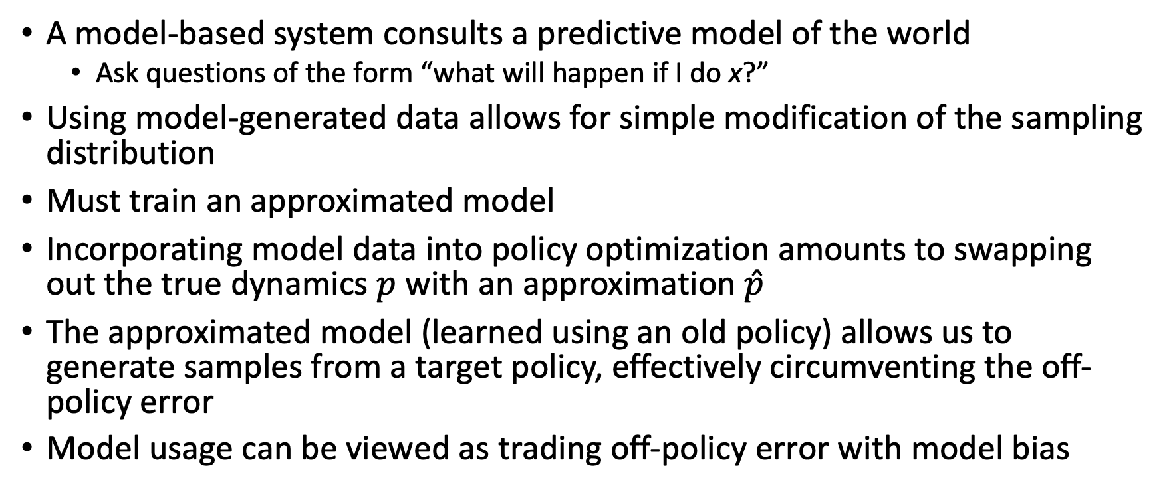
Combining model-based and model-free
A model-based system consults a predictive model of the world
  Ask questions of the form “what will happen if I do x?”
Using model-generated data allows for simple modification of the sampling distribution
Must train an approximated model
Incorporating model data into policy optimization amounts to swapping out the true dynamics $p$ with an approximation $\hat{p}$
The approximated model (learned using an old policy) allows us to generate samples from a target policy, effectively circumventing the off-policy error
Model usage can be viewed as trading off-policy error with model bias

Slide 14
Simulated trajectory (rollout) length
There is a tension involving the model rollout length
The model serves to reduce off-policy error over entire episodes
However, increasing the rollout length also brings about increased discrepancy proportional to the model error
Predictive models can generalize well enough for the incurred model bias to be worth the reduction in off-policy error, but
Compounding errors make long-horizon model rollouts unreliable

Slide 15
So, what should we do?
We observe that a one step rollout is mostly accurate
A simple recipe is to use the model only to perform short rollouts from previously encountered (real) states instead of full-length rollouts from the initial state distribution
This is the main idea behind the Dyna-Q algorithm

Slide 16
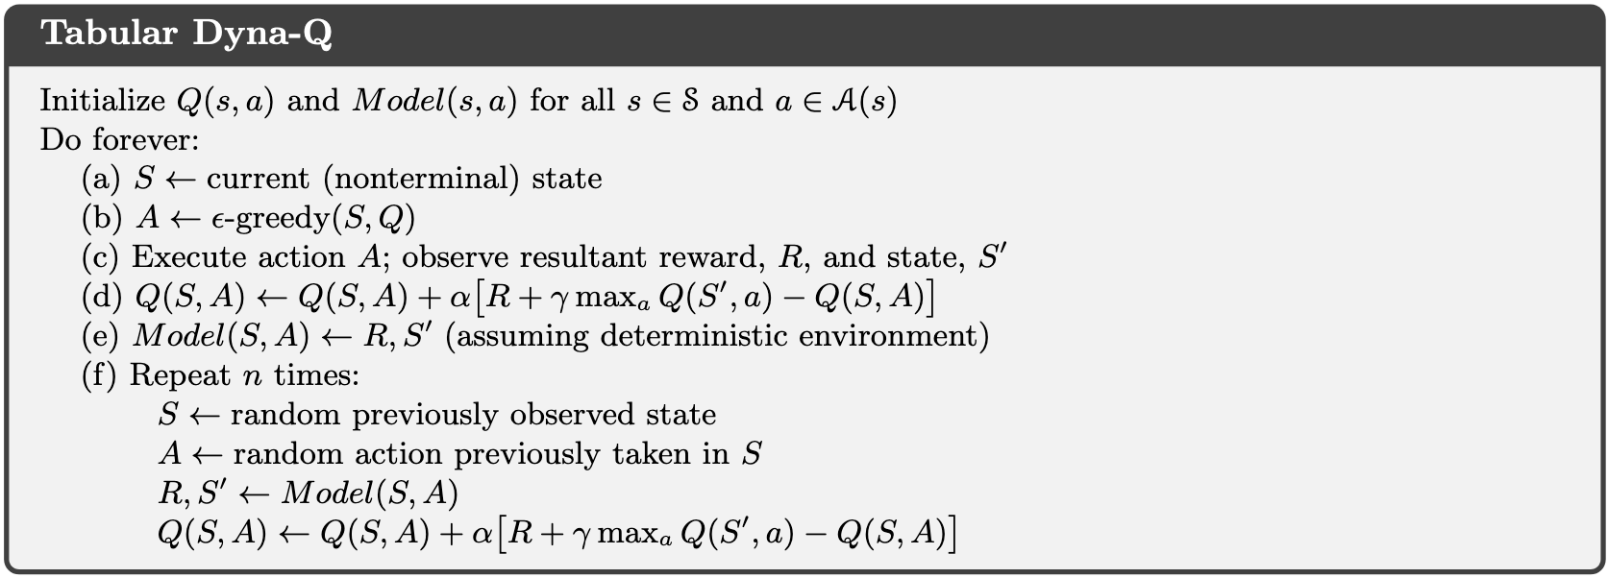
Dyna-Q
Q-learning

Slide 17
Dyna-Q
Update model

Slide 18
Dyna-Q
Simulate transitions and perform Q-learning

Slide 19
Dyna-Q
Why simulate only previously observed (S,A)?
*Else we don’t have a reliable approximation

Slide 20
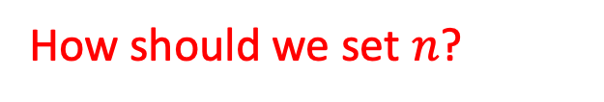
Dyna-Q
How should we set $n$?
*take into account model accuracy and cost of real vs simulated transition

Slide 21
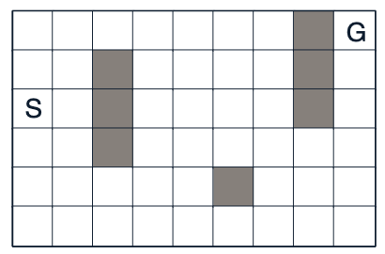
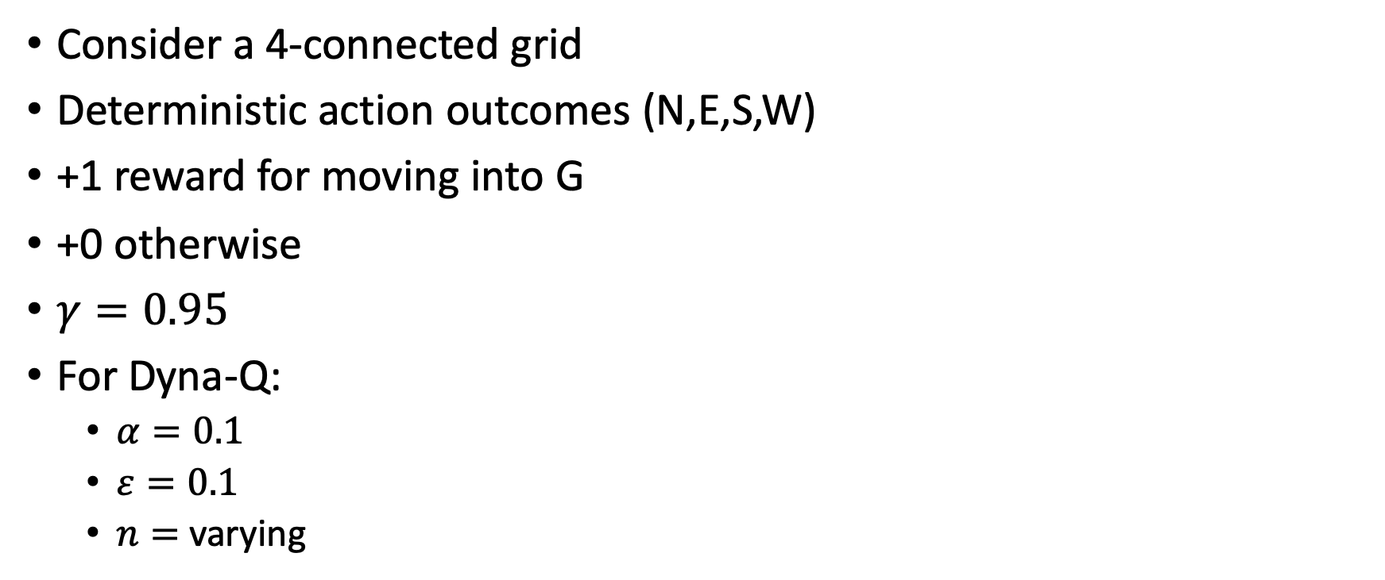
Dyna-Q example
Consider a 4-connected grid
Deterministic action outcomes (N,E,S,W)
+1 reward for moving into G
+0 otherwise
$γ=0.95$
For Dyna-Q:
  $α=0.1$
  $ε=0.1$
  $n=$ varying

Slide 22
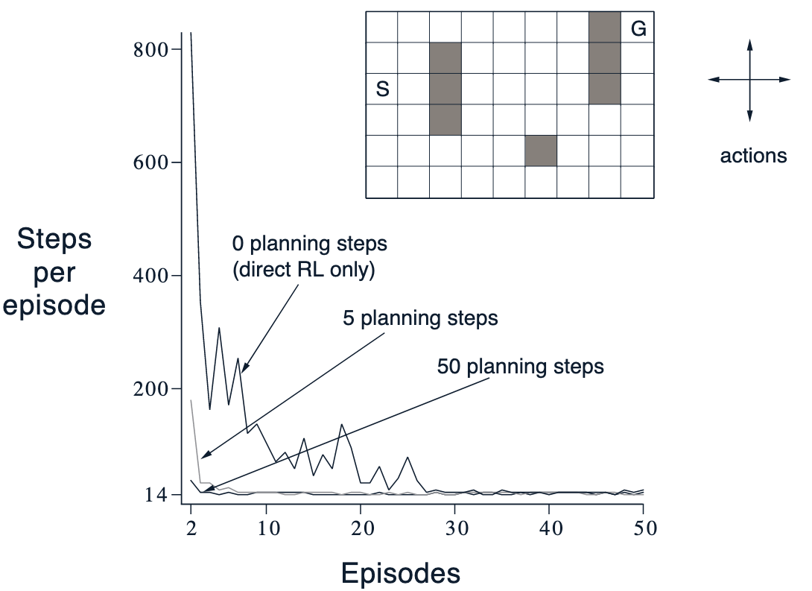
Dyna-Q example
How accurate is the learned model?
What would happen if the model wasn’t accurate?
What’s more common in stochastic environments?
What can we do about it?
  Constantly explore!
  See Dyna-Q+
    (Ch. 8.3 in the textbook)

Slide 23
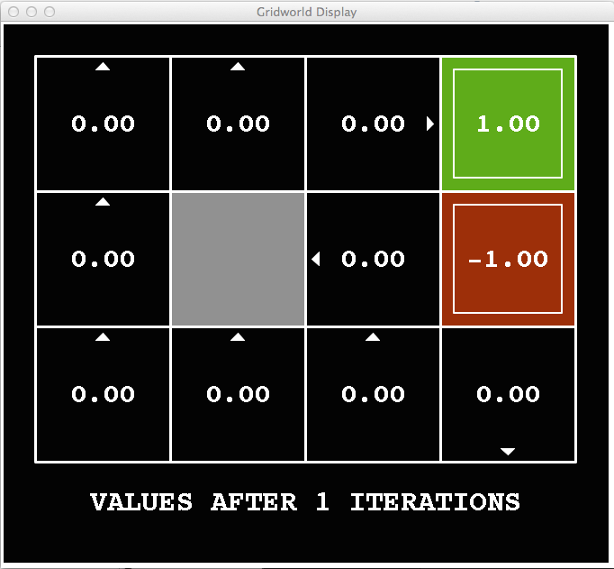
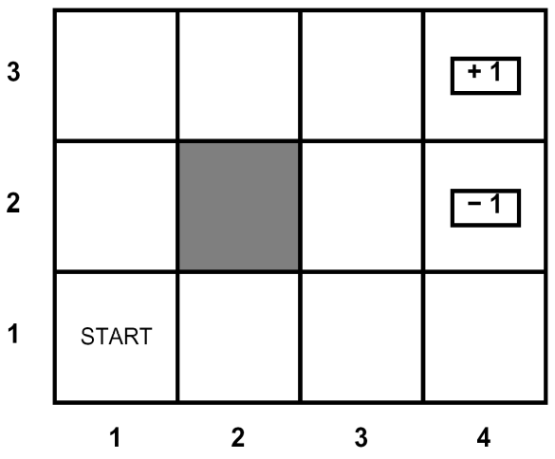
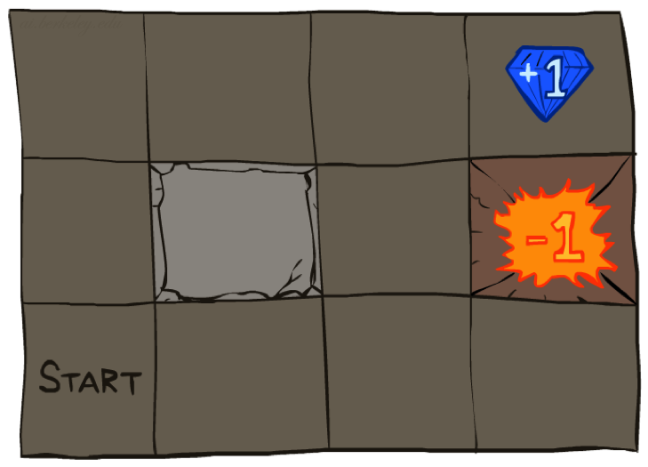




Simulating what matters
Do some (S,A) pairs matter more than others?

Slide 24
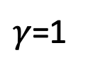
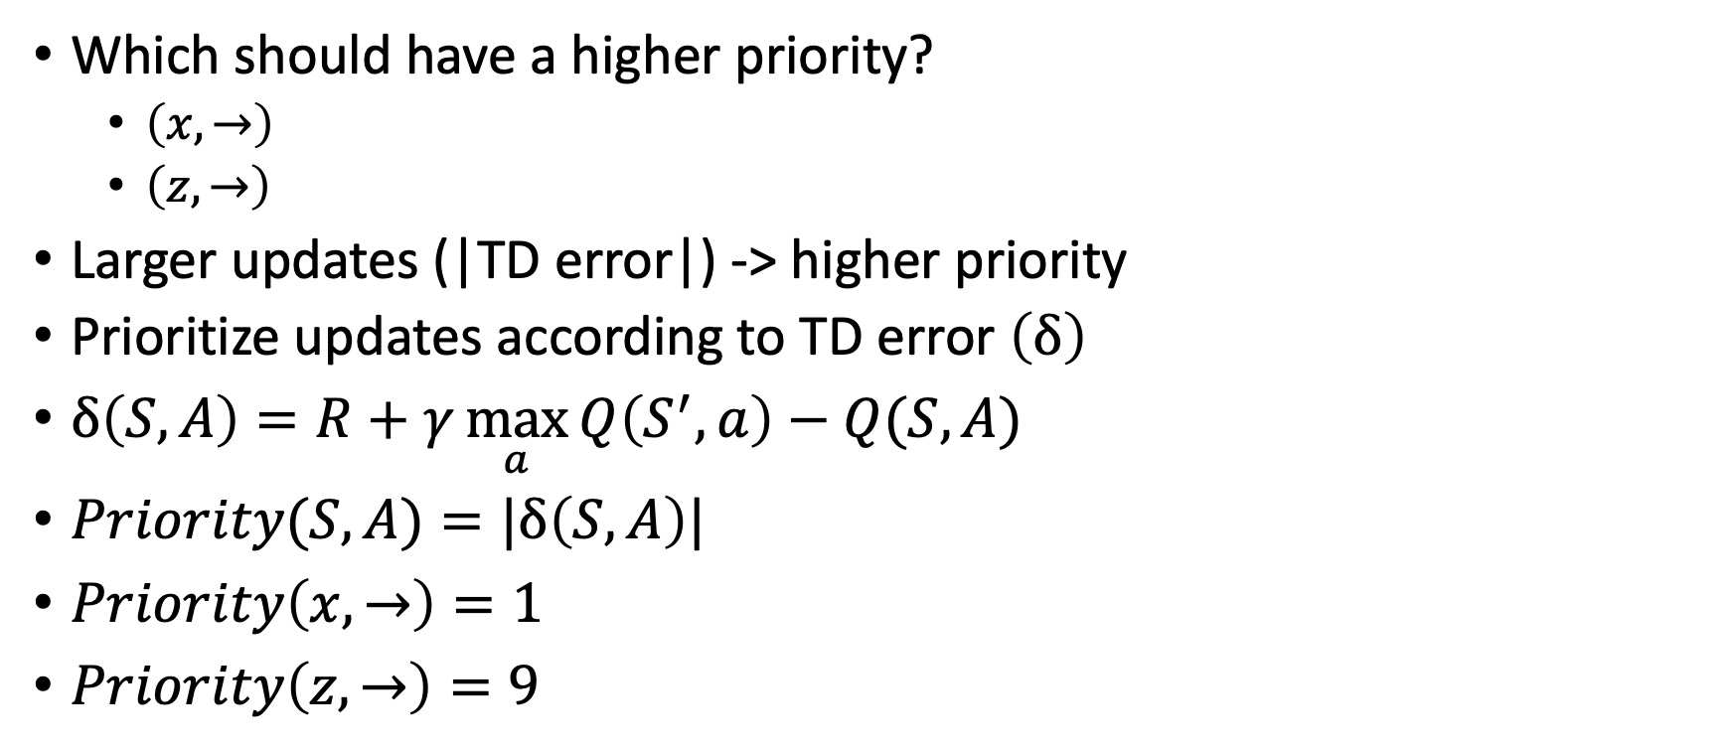
Prioritizing experience
Which should have a higher priority?
  $\left(x,→\right)$
  $\left(z,→\right)$
Larger updates (|TD error|) -> higher priority
Prioritize updates according to TD error $\left(δ\right)$
$δ\left(S,A\right)=R+γ\max_{a}{Q\left(S^{′},a\right)}−Q(S,A)$
$Priority(S,A)=|δ\left(S,A\right)|$
$Priority\left(x,→\right)=1$
$Priority\left(z,→\right)=9$
$γ$=1
x
y
10
1
10
z
w
0
1
10

Slide 25
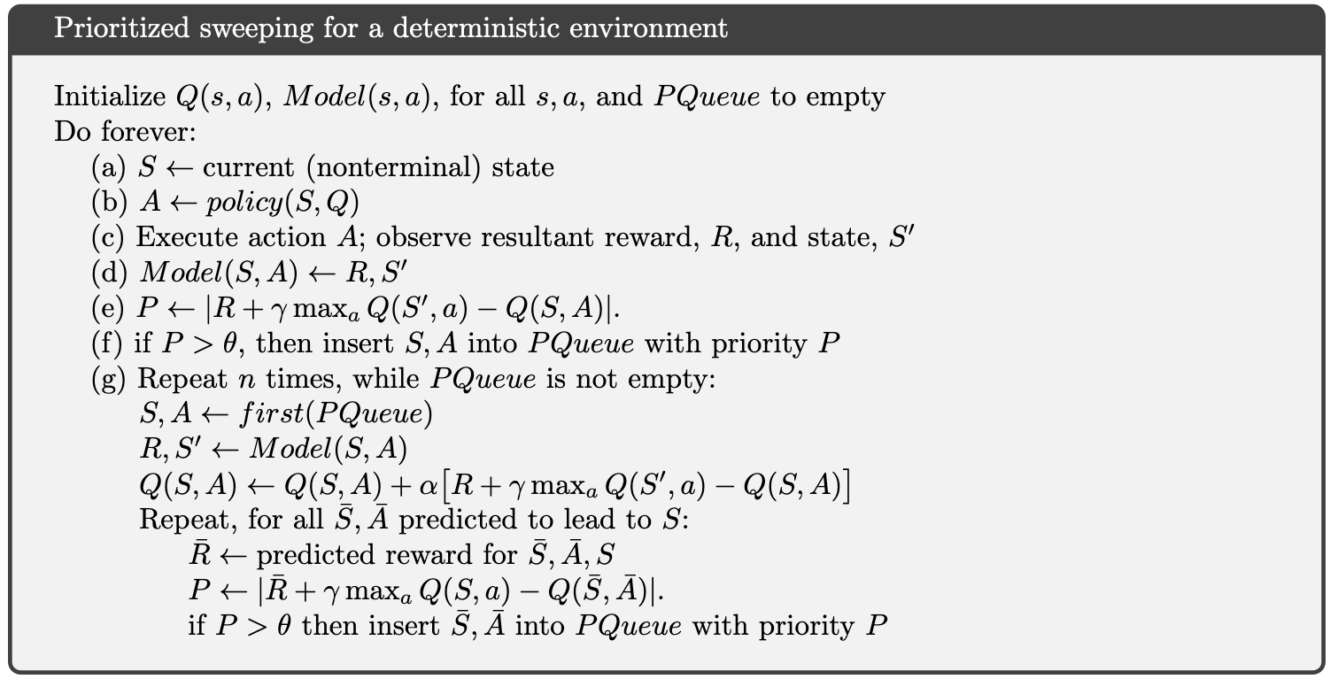
Prioritized sweeping
Store each observed transition in reply buffer with the affiliated priority

Slide 26
Prioritized sweeping
Get max priority transition and update the relevant Q value

Slide 27
Prioritized sweeping
Once S was updated check if and by how much all predecessor states need to be updated. Insert relevant transitions to reply buffer with the relevant priority

Slide 28
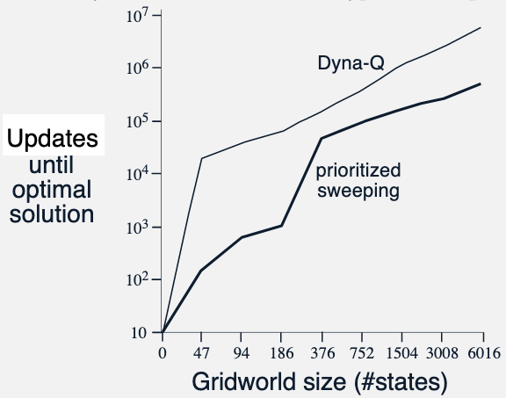
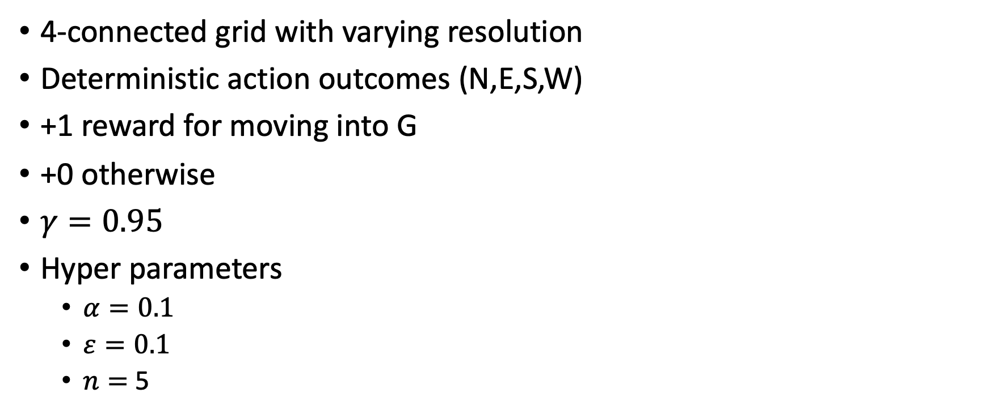
Prioritized sweeping
4-connected grid with varying resolution
Deterministic action outcomes (N,E,S,W)
+1 reward for moving into G
+0 otherwise
$γ=0.95$
Hyper parameters
  $α=0.1$
  $ε=0.1$
  $n=$ 5

Slide 29
Stochastic environments
What adjustments are required for a stochastic environment?

Slide 30
Stochastic environments
Model will now return a distribution over S’ and R

Slide 31
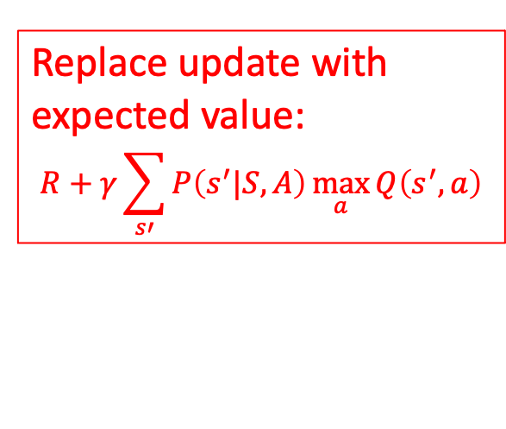
Stochastic environments
Replace update with expected value:
$$R+γ\sum_{s′}{P\left(s^{′}|S,A\right)}\max_{a}{Q\left(s^{′},a\right)}$$

Slide 32
What did we learn?
Learning an approx. model alongside any online algorithm is free
The approx. model can be used to speed up state or action value learning -- especially for sparse reward settings and off-policy learning
On the other hand, errors in the approx. model can lead to inaccurate updates
Longer rollouts lead to faster learning but result in large prediction errors
When setting the n hyper parameter in Dyna-Q, take into account model accuracy and cost of real vs simulated transition

Slide 33
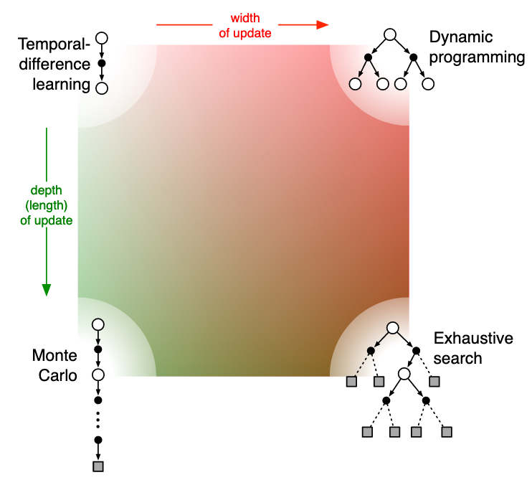
Summary of tabular learning approaches
Dynamic programing
  Model based
  Offline
Exhaustive search (Expectimax)
  Model based
  Offline
  NP-C
Temporal difference
  Model free
  Online
  Off policy
  Slow value propagation (low variance)
Monte Carlo
  Model free
  Online
  On policy
  Fast value propagation (high variance)

Slide 34
Important concepts
Definition of return (discounted sum of rewards)
  Is the task episodic or continuing, discounted or not
Action (q) vs. State (v) value
  What kind of values should be estimated? If only state values are estimated, then either a model or a separate policy (as in actor–critic methods) is required for action selection
Action selection/exploration
  How are actions selected to ensure a suitable trade-off between exploration and exploitation? We have considered several approaches: ε-greedy, optimistic initialization of values, softmax, and upper confidence bound

Slide 35
Important concepts
Synchronous vs. asynchronous
  Are the updates for all states performed simultaneously or one by one in some order?
Real vs. simulated
  Should one update be based on real experience or simulated experience? If both, how much of each?
Location of updates
  What states or state–action pairs should be updated? Model-free methods can choose only among the states and state–action pairs actually encountered

Slide 36
What next?
Lecture: On-policy Prediction with Approximation
Project:
  Finalize your project proposal, due Sep 30

