Slide 1

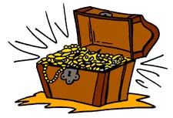
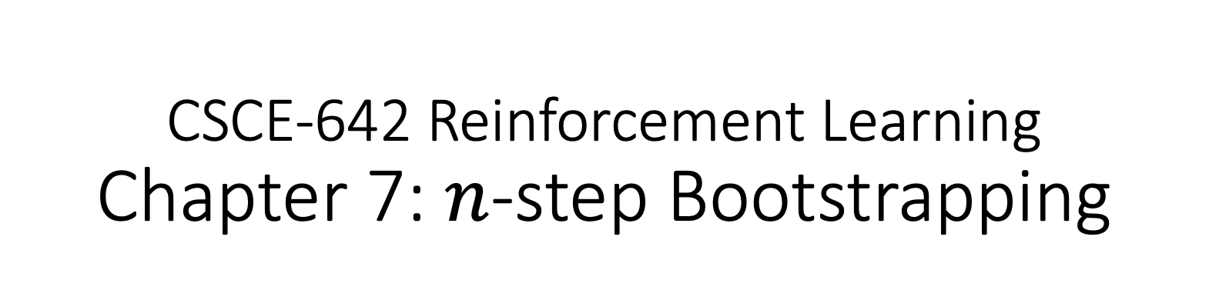
CSCE-642 Reinforcement Learning
Chapter 7: $n$-step Bootstrapping
Instructor: Guni Sharon

Slide 2
TODOs:
Quizzes:
  Quiz3 Monte-Carlo Control Sep 16, EOD
  Quiz4 TD-learning by Sep. 18, EOD
Assignments:
  Value Iteration, by September-23, EOD
  Asynchronous Value Iteration, by September-23, EOD
  Policy Iteration, by September-23, EOD
  Monte-Carlo Control by September-30, EOD
  Monte-Carlo Control with Importance Sampling by September-30, EOD
  Tabular Q-Learning, by Oct. 7, EOD
  SARSA, by Oct. 7, EOD
Project:
  Start writing, submit by Sep. 30

Slide 3
CSCE-689, Reinforcement Learning
Stateless decision process
Monte-Carlo
Policy gradient
Actor-critic
Markov decision process
Temporal difference
Function approximators
Solving MDPs (offline)
Dynamic programming
Tabular methods
Deep RL

Slide 4


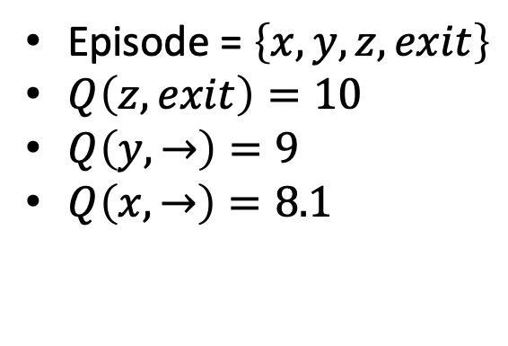
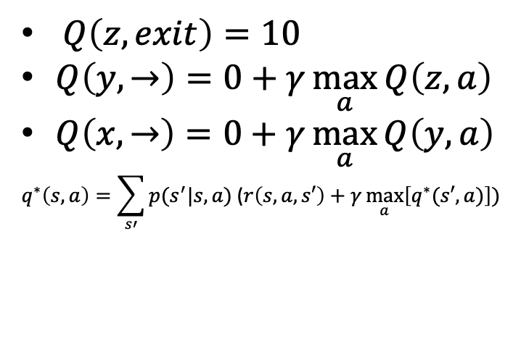

Solving MDPs so far
Dynamic programming
Off policy
local learning, propagating values from neighbors (Bootstrapping)
Model based
Monte-Carlo
On-policy (though important sampling can be used)
Requires a full episode to train on
Model free, online learning
$$γ=0.9$$
$Q\left(z,exit\right)=10$
$Q\left(y,→\right)=0+γ\max_{a}{Q\left(z,a\right)}$
$Q\left(x,→\right)=0+γ\max_{a}{Q\left(y,a\right)}$
$$q^{∗}\left(s,a\right)=\sum_{s′}{p(s^{′}|s,a)\text{ (}r\left(s,a,s′\right)}+γ\max_{a}\left[q^{∗}(s′,a)\right])$$
Episode = $\left\{x,y,z,exit\right\}$
$Q\left(z,exit\right)=10$
$Q\left(y,→\right)=9$
$Q\left(x,→\right)=8.1$
-100
+10
w | x | y | z

Slide 5
Fuse DP and MC
Dynamic programming
Off policy
local learning, propagating values from neighbors (Bootstrapping)
Model based
Monte-Carlo
On-policy (though important sampling can be used)
Requires a full episode to train on
Model free, online learning
TD Learning
Off policy
local learning, propagating values from neighbors (Bootsraping)
Model free, online learning

Slide 6
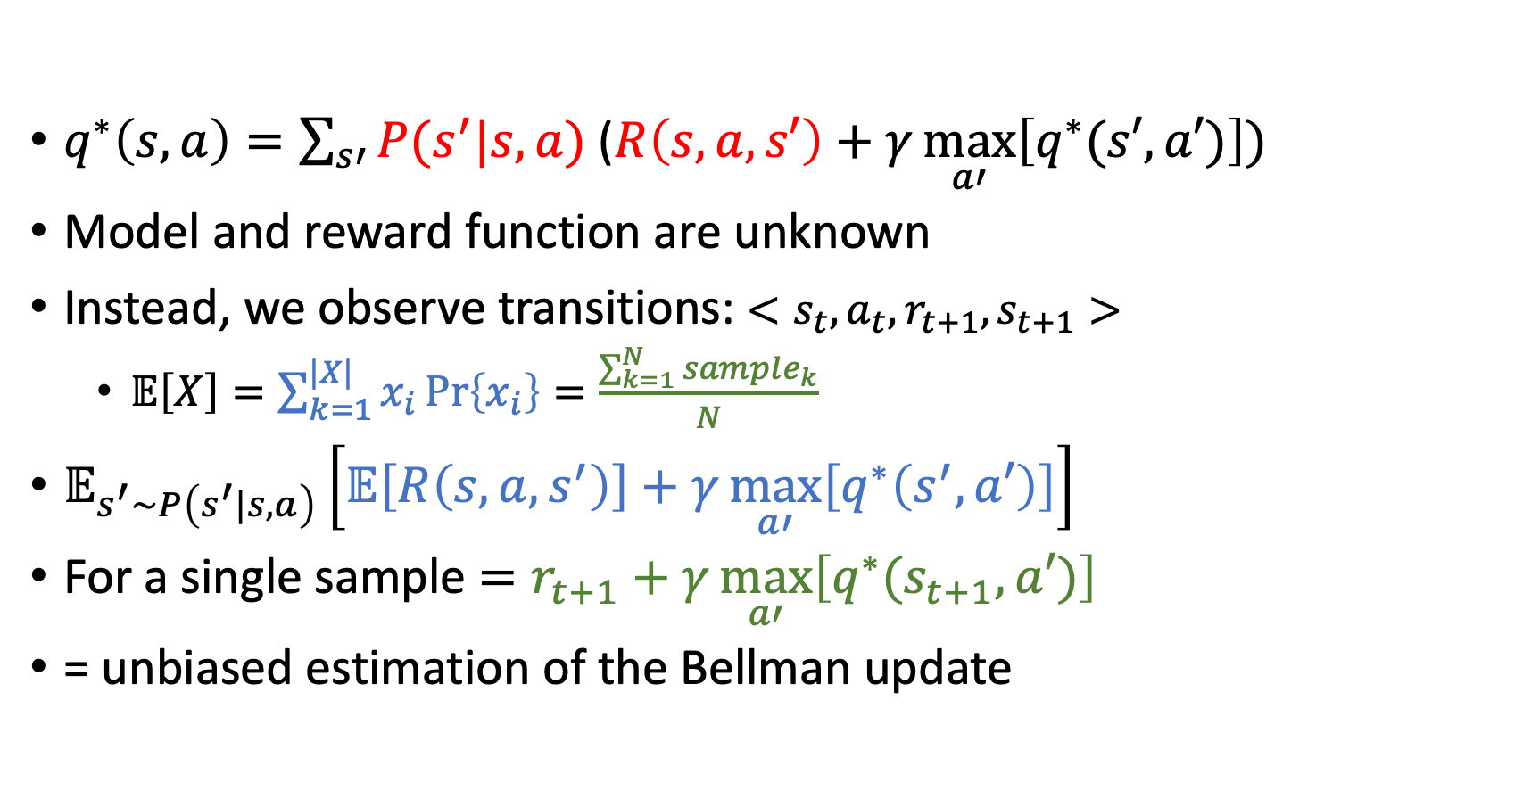
Online Bellman update
$q^{∗}\left(s,a\right)=\sum_{s′}{P(s^{′}|s,a) \text{(}R\left(s,a,s′\right)}+γ\max_{a′}\left[q^{∗}(s′,a′)\right])$
Model and reward function are unknown
Instead, we observe transitions: $<s_{t},a_{t},r_{t+1},s_{t+1}>$
  $𝔼\left[X\right]=\sum_{k=1}^{|X|}{x_{i}\operatorname{Pr}\left\{x_{i}\right\}}=\frac{\sum_{k=1}^{N}{sample_{k}}}{N}$
$𝔼_{s^{′}\sim P\left(s^{′}|s,a\right)}\left[𝔼\left[R\left(s,a,s^{′}\right)\right]+γ\max_{a′}\left[q^{∗}\left(s^{′},a′\right)\right]\right]$
For a single sample $=r_{t+1}+γ\max_{a′}\left[q^{∗}(s_{t+1},a′)\right]$
= unbiased estimation of the Bellman update

Slide 7
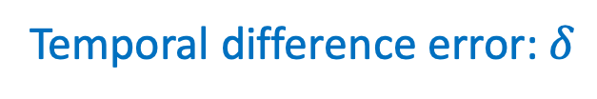
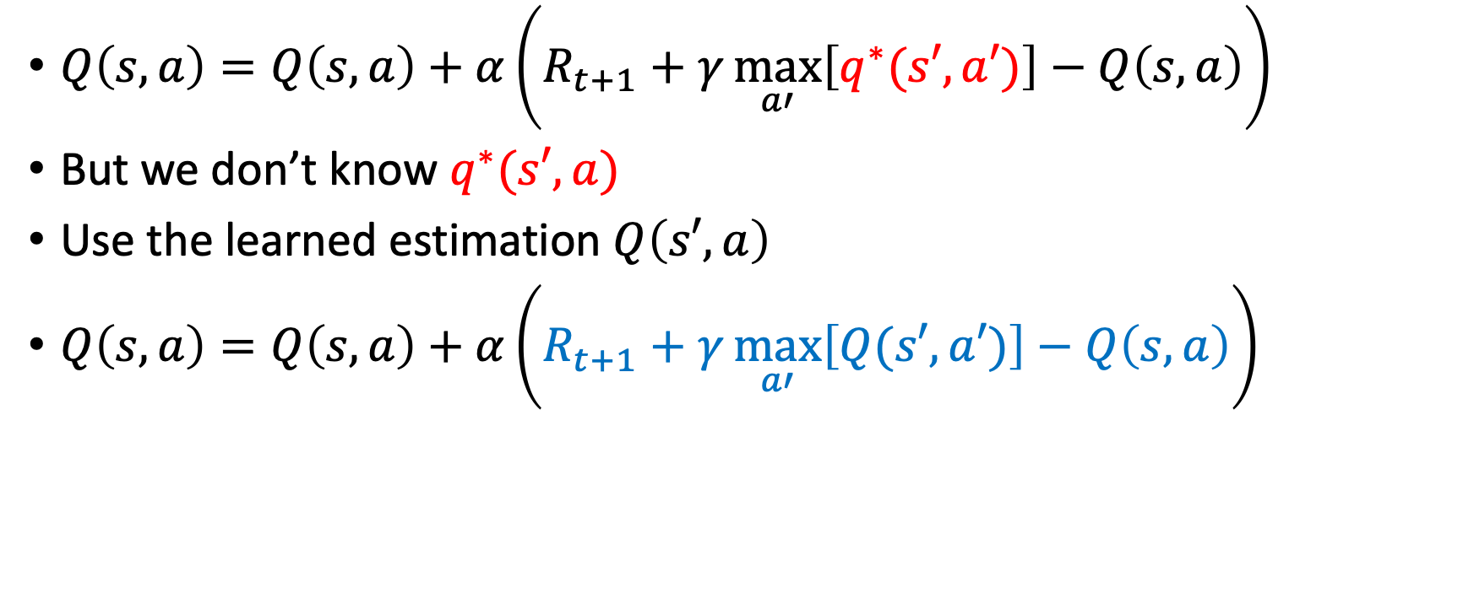
Temporal difference learning
$Q\left(s,a\right)=Q\left(s,a\right)+α\left(R_{t+1}+γ\max_{a′}\left[q^{∗}(s′,a′)\right]−Q\left(s,a\right)\right)$
But we don’t know $q^{∗}(s′,a)$
Use the learned estimation $Q\left(s′,a\right)$
$Q\left(s,a\right)=Q\left(s,a\right)+α\left(R_{t+1}+γ\max_{a′}\left[Q(s′,a′)\right]−Q\left(s,a\right)\right)$
Temporal difference error: $δ$
Introduces a maximization bias!

Slide 8
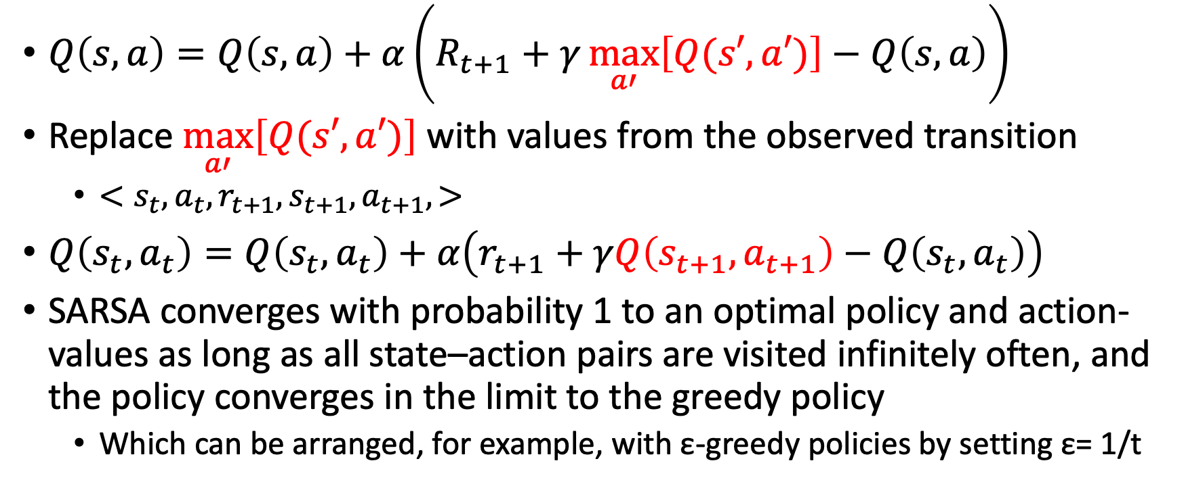
SARSA: On-policy TD Control
$Q\left(s,a\right)=Q\left(s,a\right)+α\left(R_{t+1}+γ\max_{a′}\left[Q(s′,a′)\right]−Q\left(s,a\right)\right)$
Replace $\max_{a′}\left[Q(s′,a′)\right]$ with values from the observed transition
  $<s_{t},a_{t},r_{t+1},s_{t+1}, a_{t+1}, >$
$Q\left(s_{t},a_{t}\right)=Q\left(s_{t},a_{t}\right)+α\left(r_{t+1}+γQ\left(s_{t+1},a_{t+1}\right)−Q\left(s_{t},a_{t}\right)\right)$
SARSA converges with probability 1 to an optimal policy and action-values as long as all state–action pairs are visited infinitely often, and the policy converges in the limit to the greedy policy
  Which can be arranged, for example, with ε-greedy policies by setting ε= 1/t

Slide 9
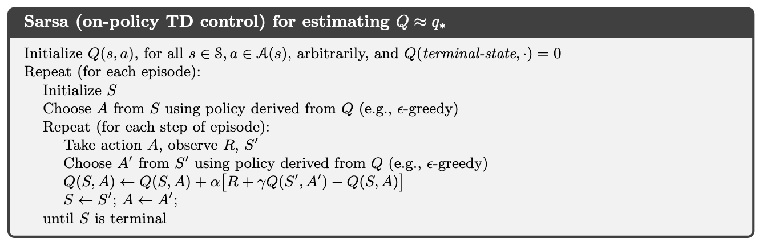
SARSA: On-policy TD Control

Slide 10
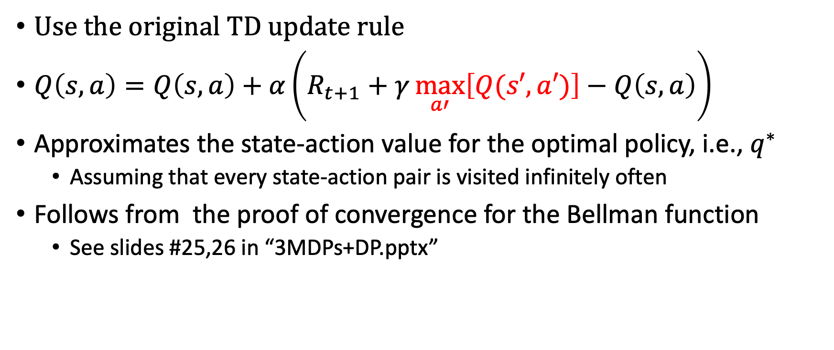
Q-learning: Off-policy TD Control
Use the original TD update rule
$Q\left(s,a\right)=Q\left(s,a\right)+α\left(R_{t+1}+γ\max_{a′}\left[Q(s′,a′)\right]−Q\left(s,a\right)\right)$
Approximates the state-action value for the optimal policy, i.e., $q^{∗}$
  Assuming that every state-action pair is visited infinitely often
Follows from the proof of convergence for the Bellman function
  See slides #25,26 in “3MDPs+DP.pptx”

Slide 11
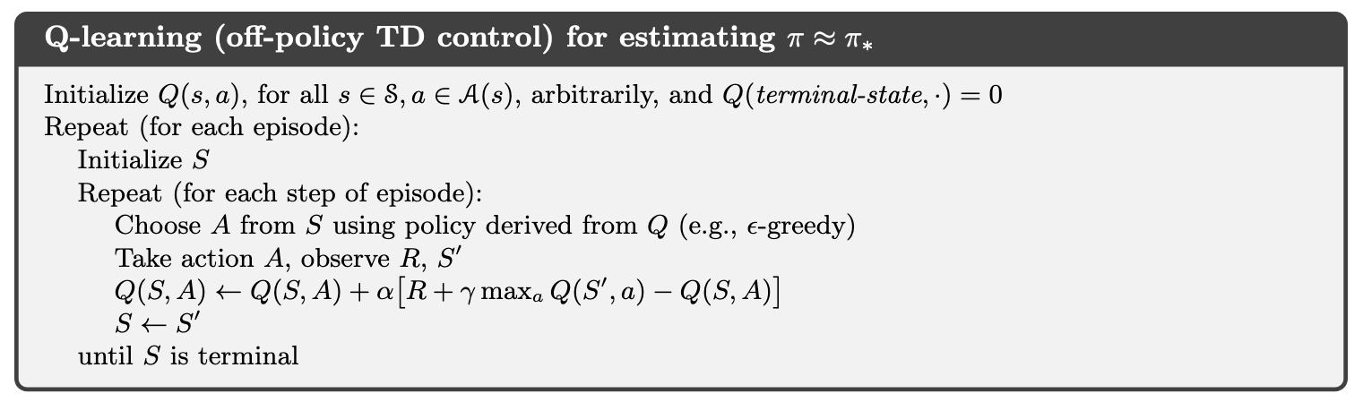
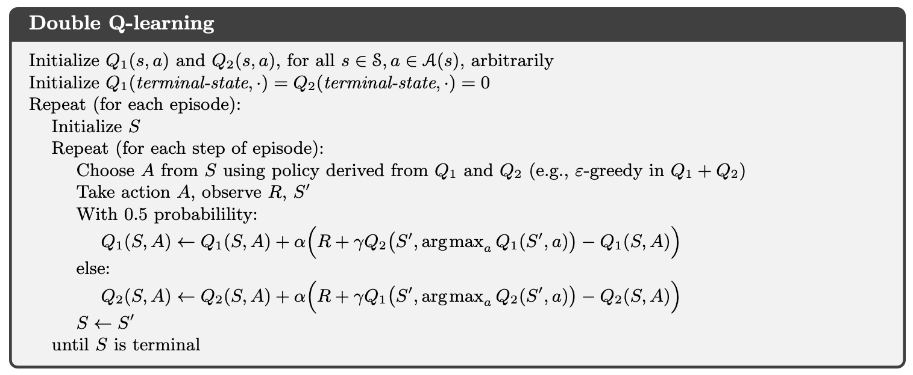
Q-learning: Off-policy TD Control

Slide 12
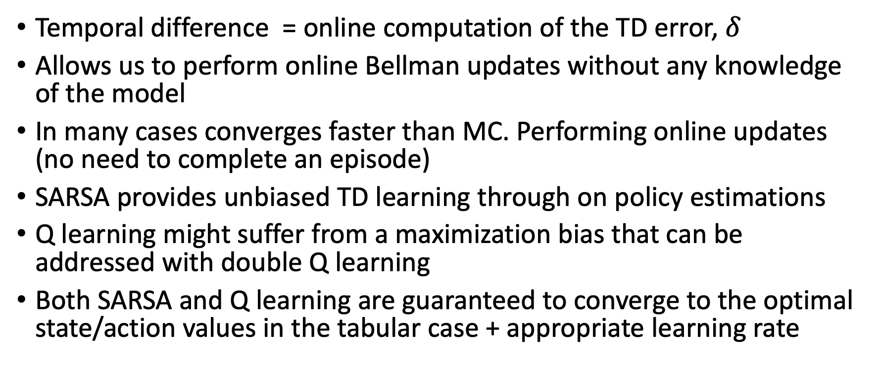
TD learning
Temporal difference = online computation of the TD error, $δ$
Allows us to perform online Bellman updates without any knowledge of the model
In many cases converges faster than MC. Performing online updates (no need to complete an episode)
SARSA provides unbiased TD learning through on policy estimations
Q learning might suffer from a maximization bias that can be addressed with double Q learning
Both SARSA and Q learning are guaranteed to converge to the optimal state/action values in the tabular case + appropriate learning rate

Slide 13
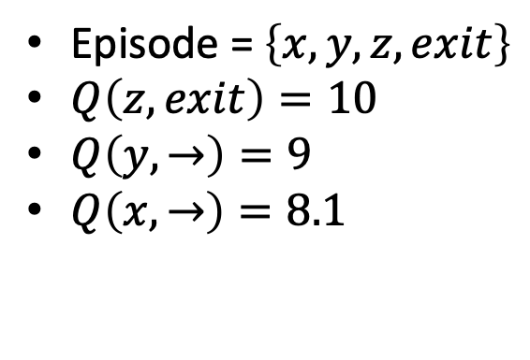
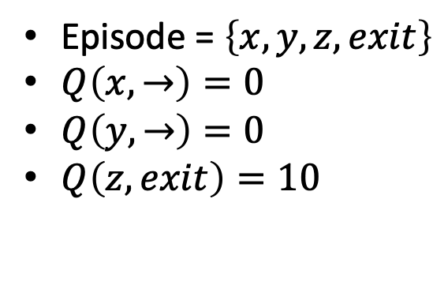

Model free RL so far
Monte-Carlo
On-policy (but important sampling can be used)
Requires a full episode to train on
Noisy learning (high variance)
Efficient value propagation
Temporal-Difference learning
Off policy
Local learning, propagating values from neighbors (Bootsraping)
slow value propagation
Episode = $\left\{x,y,z,exit\right\}$
$Q\left(z,exit\right)=10$
$Q\left(y,→\right)=9$
$Q\left(x,→\right)=8.1$
$$γ=0.9$$
Episode = $\left\{x,y,z,exit\right\}$
$Q\left(x,→\right)=0$
$Q\left(y,→\right)=0$
$Q\left(z,exit\right)=10$
-100
+10
w | x | y | z

Slide 14
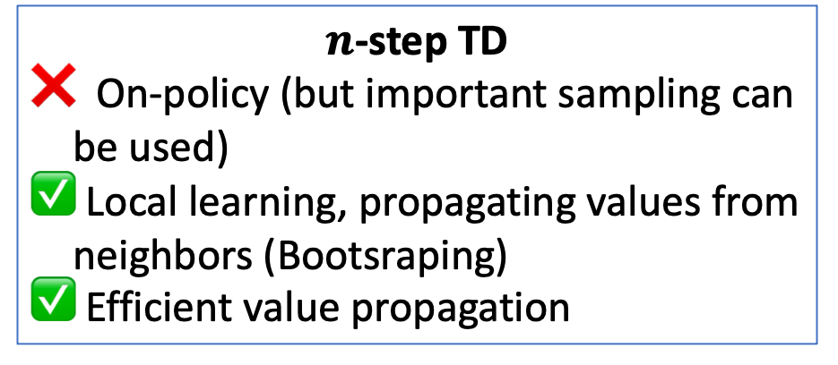
MC and TD(0) are two extremes of the same continuum
Monte-Carlo
On-policy (but important sampling can be used)
Requires a full episode to train on
Noisy learning (high variance)
Efficient value propagation
Temporal-Difference learning
Off policy
Local learning, propagating values from neighbors (Bootsraping)
slow value propagation
$n$-step TD
On-policy (but important sampling can be used)
Local learning, propagating values from neighbors (Bootsraping)
Efficient value propagation

Slide 15
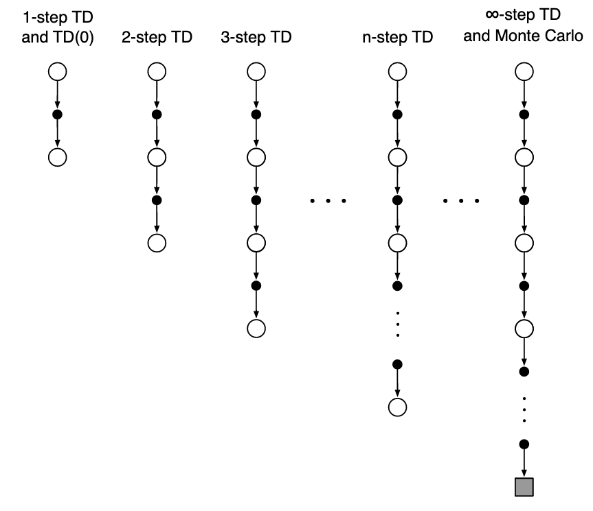
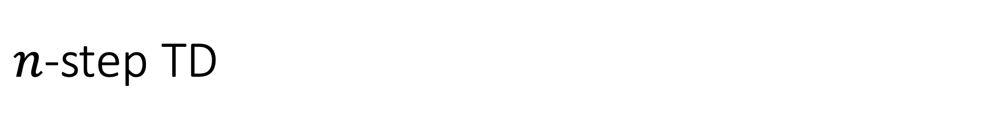
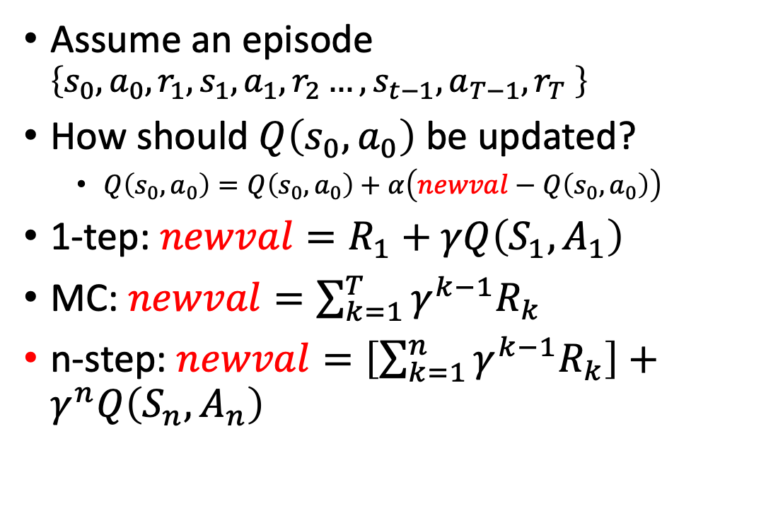
$n$-step TD
Assume an episode $\left\{s_{0},a_{0},r_{1},s_{1}, a_{1},r_{2}…,{s_{t−1},a}_{T−1},r_{T} \right\}$
How should $Q\left(s_{0},a_{0}\right)$ be updated?
  $Q\left(s_{0},a_{0}\right)=Q\left(s_{0},a_{0}\right)+α\left(newval−Q\left(s_{0},a_{0}\right)\right)$
1-tep: $newval=R_{1}+γQ\left(S_{1},A_{1}\right)$
MC: $newval=\sum_{k=1}^{T}{{γ^{k−1}R}_{k}}$
n-step: $newval=\left[\sum_{k=1}^{n}{{γ^{k−1}R}_{k}}\right]+γ^{n}Q\left(S_{n},A_{n}\right)$

Slide 16
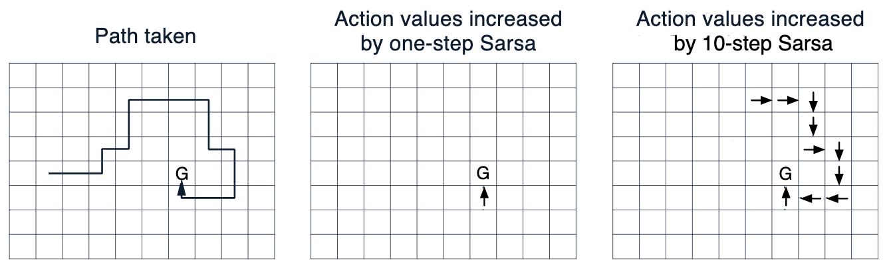
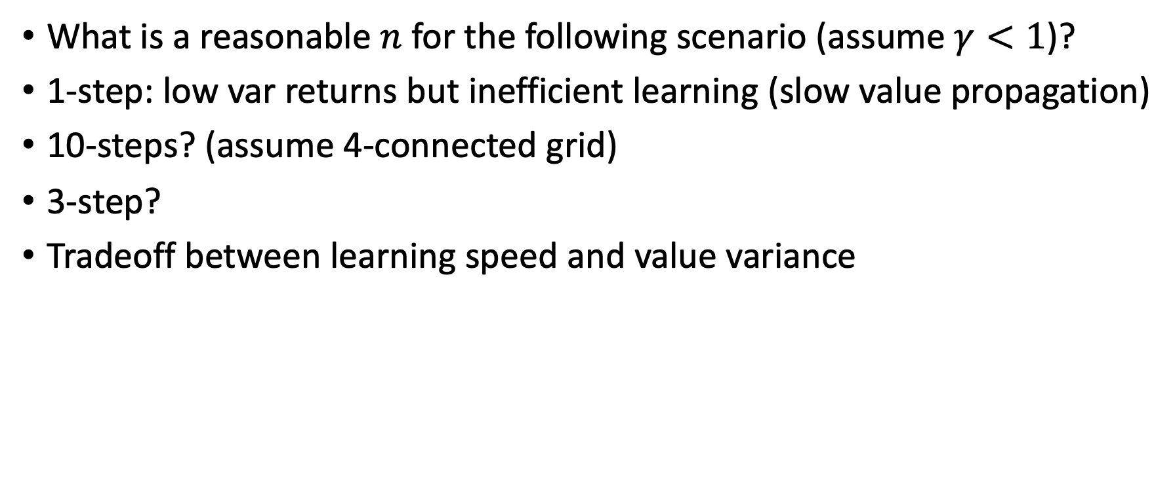
$n$-step TD
What is a reasonable $n$ for the following scenario (assume $γ<1$)?
1-step: low var returns but inefficient learning (slow value propagation)
10-steps? (assume 4-connected grid)
3-step?
Tradeoff between learning speed and value variance

Slide 17
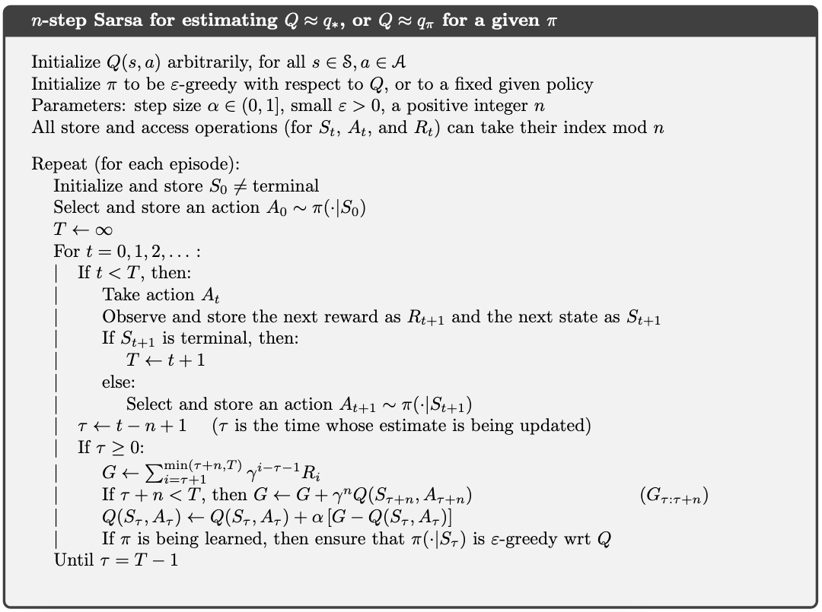
n-step SARSA

Slide 18
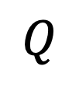

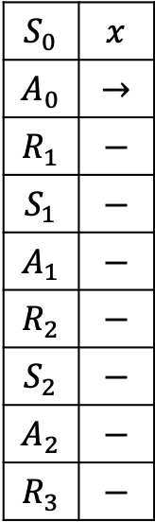
n-step SARSA
$$S_{0}$$ | $$x$$
$$A_{0}$$ | $$→$$
$$R_{1}$$ | $$−$$
$$S_{1}$$ | $$−$$
$$A_{1}$$ | $$−$$
$$R_{2}$$ | $$−$$
$$S_{2}$$ | $$−$$
$$A_{2}$$ | $$−$$
$$R_{3}$$ | $$−$$
n=2
$$Q$$
0 | 0,0 | 0,0 | 0
w | x | y | z
$$γ=0.9$$
-100
+10
w | x | y | z

Slide 19
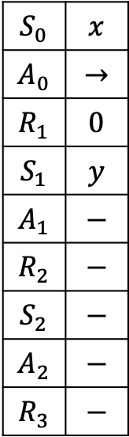
n-step SARSA
$$S_{0}$$ | $$x$$
$$A_{0}$$ | $$→$$
$$R_{1}$$ | $$0$$
$$S_{1}$$ | $$y$$
$$A_{1}$$ | $$−$$
$$R_{2}$$ | $$−$$
$$S_{2}$$ | $$−$$
$$A_{2}$$ | $$−$$
$$R_{3}$$ | $$−$$
n=2
$$Q$$
0 | 0,0 | 0,0 | 0
w | x | y | z
$$γ=0.9$$
-100
+10
w | x | y | z

Slide 20
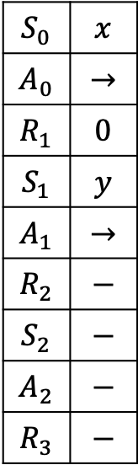
n-step SARSA
$$S_{0}$$ | $$x$$
$$A_{0}$$ | $$→$$
$$R_{1}$$ | $$0$$
$$S_{1}$$ | $$y$$
$$A_{1}$$ | $$→$$
$$R_{2}$$ | $$−$$
$$S_{2}$$ | $$−$$
$$A_{2}$$ | $$−$$
$$R_{3}$$ | $$−$$
n=2
$$Q$$
0 | 0,0 | 0,0 | 0
w | x | y | z
$$γ=0.9$$
-100
+10
w | x | y | z

Slide 21

n-step SARSA
$$S_{0}$$ | $$x$$
$$A_{0}$$ | $$→$$
$$R_{1}$$ | $$0$$
$$S_{1}$$ | $$y$$
$$A_{1}$$ | $$→$$
$$R_{2}$$ | $$−$$
$$S_{2}$$ | $$−$$
$$A_{2}$$ | $$−$$
$$R_{3}$$ | $$−$$
n=2
$$τ=−1$$
$$Q$$
0 | 0,0 | 0,0 | 0
w | x | y | z
$$γ=0.9$$
-100
+10
w | x | y | z

Slide 22
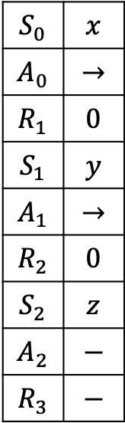
n-step SARSA
$$S_{0}$$ | $$x$$
$$A_{0}$$ | $$→$$
$$R_{1}$$ | $$0$$
$$S_{1}$$ | $$y$$
$$A_{1}$$ | $$→$$
$$R_{2}$$ | $$0$$
$$S_{2}$$ | $$z$$
$$A_{2}$$ | $$−$$
$$R_{3}$$ | $$−$$
n=2
$$τ=−1$$
$$Q$$
0 | 0,0 | 0,0 | 0
w | x | y | z
$$γ=0.9$$
-100
+10
w | x | y | z

Slide 23
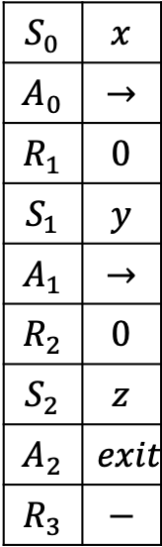
n-step SARSA
$$S_{0}$$ | $$x$$
$$A_{0}$$ | $$→$$
$$R_{1}$$ | $$0$$
$$S_{1}$$ | $$y$$
$$A_{1}$$ | $$→$$
$$R_{2}$$ | $$0$$
$$S_{2}$$ | $$z$$
$$A_{2}$$ | $$exit$$
$$R_{3}$$ | $$−$$
n=2
$$τ=−1$$
$$Q$$
0 | 0,0 | 0,0 | 0
w | x | y | z
$$γ=0.9$$
-100
+10
w | x | y | z

Slide 24

n-step SARSA
$$S_{0}$$ | $$x$$
$$A_{0}$$ | $$→$$
$$R_{1}$$ | $$0$$
$$S_{1}$$ | $$y$$
$$A_{1}$$ | $$→$$
$$R_{2}$$ | $$0$$
$$S_{2}$$ | $$z$$
$$A_{2}$$ | $$exit$$
$$R_{3}$$ | $$−$$
n=2
$$τ=0$$
$$Q$$
0 | 0,0 | 0,0 | 0
w | x | y | z
$$γ=0.9$$
-100
+10
w | x | y | z

Slide 25
n-step SARSA
$$S_{0}$$ | $$x$$
$$A_{0}$$ | $$→$$
$$R_{1}$$ | $$0$$
$$S_{1}$$ | $$y$$
$$A_{1}$$ | $$→$$
$$R_{2}$$ | $$0$$
$$S_{2}$$ | $$z$$
$$A_{2}$$ | $$exit$$
$$R_{3}$$ | $$−$$
n=2
$$τ=0$$
$$Q$$
0 | 0,0 | 0,0 | 0
w | x | y | z
$$γ=0.9$$
-100
+10
w | x | y | z

Slide 26
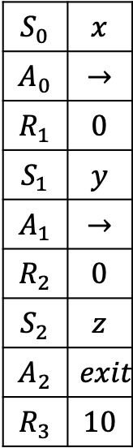
n-step SARSA
$$S_{0}$$ | $$x$$
$$A_{0}$$ | $$→$$
$$R_{1}$$ | $$0$$
$$S_{1}$$ | $$y$$
$$A_{1}$$ | $$→$$
$$R_{2}$$ | $$0$$
$$S_{2}$$ | $$z$$
$$A_{2}$$ | $$exit$$
$$R_{3}$$ | $$10$$
n=2
$$τ=0$$
$$Q$$
0 | 0,0 | 0,0 | 0
w | x | y | z
$$γ=0.9$$
-100
+10
w | x | y | z

Slide 27
n-step SARSA
$$S_{0}$$ | $$x$$
$$A_{0}$$ | $$→$$
$$R_{1}$$ | $$0$$
$$S_{1}$$ | $$y$$
$$A_{1}$$ | $$→$$
$$R_{2}$$ | $$0$$
$$S_{2}$$ | $$z$$
$$A_{2}$$ | $$exit$$
$$R_{3}$$ | $$10$$
n=2
$$τ=0$$
$$Q$$
0 | 0,0 | 0,0 | 0
w | x | y | z
$$γ=0.9$$
-100
+10
w | x | y | z

Slide 28

n-step SARSA
$$S_{0}$$ | $$x$$
$$A_{0}$$ | $$→$$
$$R_{1}$$ | $$0$$
$$S_{1}$$ | $$y$$
$$A_{1}$$ | $$→$$
$$R_{2}$$ | $$0$$
$$S_{2}$$ | $$z$$
$$A_{2}$$ | $$exit$$
$$R_{3}$$ | $$10$$
n=2
$$τ=1$$
$$Q$$
0 | 0,0 | 0,0 | 0
w | x | y | z
$$γ=0.9$$
-100
+10
w | x | y | z

Slide 29
n-step SARSA
$$S_{0}$$ | $$x$$
$$A_{0}$$ | $$→$$
$$R_{1}$$ | $$0$$
$$S_{1}$$ | $$y$$
$$A_{1}$$ | $$→$$
$$R_{2}$$ | $$0$$
$$S_{2}$$ | $$z$$
$$A_{2}$$ | $$exit$$
$$R_{3}$$ | $$10$$
n=2
$$τ=1$$
$$Q$$
0 | 0,0 | 0,0 | 0
w | x | y | z
$$γ=0.9$$
= 9
-100
+10
w | x | y | z

Slide 30
n-step SARSA
$$S_{0}$$ | $$x$$
$$A_{0}$$ | $$→$$
$$R_{1}$$ | $$0$$
$$S_{1}$$ | $$y$$
$$A_{1}$$ | $$→$$
$$R_{2}$$ | $$0$$
$$S_{2}$$ | $$z$$
$$A_{2}$$ | $$exit$$
$$R_{3}$$ | $$10$$
n=2
$$τ=1$$
$$Q$$
0 | 0,0 | 0,9 | 0
w | x | y | z
$$γ=0.9$$
= 9
-100
+10
w | x | y | z

Slide 31
n-step SARSA
$$S_{0}$$ | $$x$$
$$A_{0}$$ | $$→$$
$$R_{1}$$ | $$0$$
$$S_{1}$$ | $$y$$
$$A_{1}$$ | $$→$$
$$R_{2}$$ | $$0$$
$$S_{2}$$ | $$z$$
$$A_{2}$$ | $$exit$$
$$R_{3}$$ | $$10$$
n=2
$$τ=1$$
$$Q$$
0 | 0,0 | 0,9 | 0
w | x | y | z
False
$$γ=0.9$$
-100
+10
w | x | y | z

Slide 32
n-step SARSA
$$S_{0}$$ | $$x$$
$$A_{0}$$ | $$→$$
$$R_{1}$$ | $$0$$
$$S_{1}$$ | $$y$$
$$A_{1}$$ | $$→$$
$$R_{2}$$ | $$0$$
$$S_{2}$$ | $$z$$
$$A_{2}$$ | $$exit$$
$$R_{3}$$ | $$10$$
n=2
$$τ=1$$
$$Q$$
0 | 0,0 | 0,9 | 0
w | x | y | z
$$γ=0.9$$
= 10
-100
+10
w | x | y | z

Slide 33
n-step SARSA
$$S_{0}$$ | $$x$$
$$A_{0}$$ | $$→$$
$$R_{1}$$ | $$0$$
$$S_{1}$$ | $$y$$
$$A_{1}$$ | $$→$$
$$R_{2}$$ | $$0$$
$$S_{2}$$ | $$z$$
$$A_{2}$$ | $$exit$$
$$R_{3}$$ | $$10$$
n=2
$$τ=1$$
$$Q$$
0 | 0,0 | 0,9 | 10
w | x | y | z
$$γ=0.9$$
= 10
-100
+10
w | x | y | z

Slide 34
n-step SARSA
$$S_{0}$$ | $$x$$
$$A_{0}$$ | $$→$$
$$R_{1}$$ | $$0$$
$$S_{1}$$ | $$y$$
$$A_{1}$$ | $$→$$
$$R_{2}$$ | $$0$$
$$S_{2}$$ | $$z$$
$$A_{2}$$ | $$exit$$
$$R_{3}$$ | $$10$$
n=2
$$τ=1$$
$$Q$$
0 | 0,0 | 0,9 | 10
w | x | y | z
$$γ=0.9$$
-100
+10
w | x | y | z

Slide 35
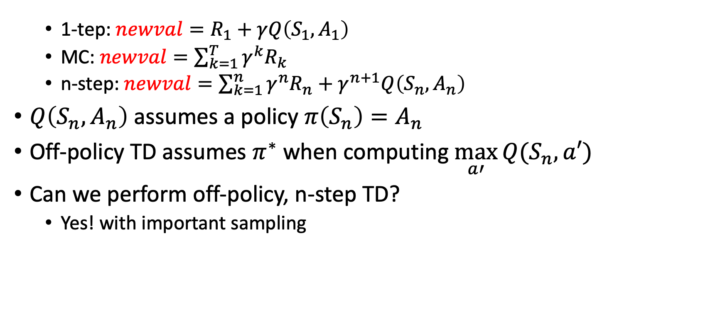
n-step TD is on-policy
  1-tep: $newval=R_{1}+γQ\left(S_{1},A_{1}\right)$
  MC: $newval=\sum_{k=1}^{T}{{γ^{k}R}_{k}}$
  n-step: $newval=\sum_{k=1}^{n}{{γ^{n}R}_{n}}+γ^{n+1}Q\left(S_{n},A_{n}\right)$
$Q\left(S_{n},A_{n}\right)$ assumes a policy $π\left(S_{n}\right)=A_{n}$
Off-policy TD assumes $π^{∗}$ when computing $\max_{a′}{Q(S_{n},a′)}$
Can we perform off-policy, n-step TD?
  Yes! with important sampling

Slide 36
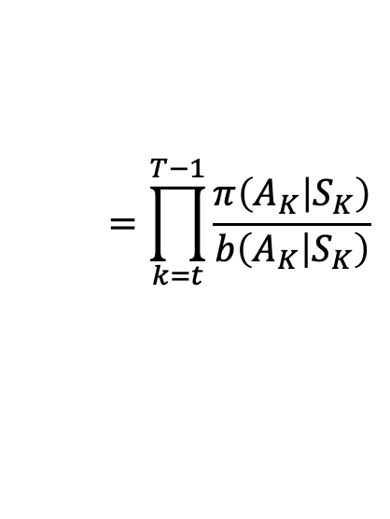
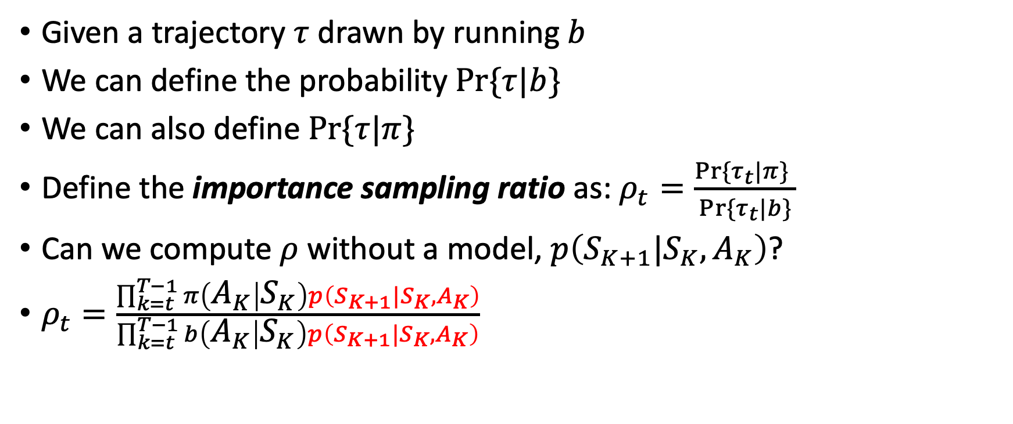
Importance sampling reminder
Given a trajectory $τ$ drawn by running $b$
We can define the probability $Pr⁡\{τ|b\}$
We can also define $Pr⁡\{τ|π\}$
Define the importance sampling ratio as: $ρ_{t}=\frac{Pr⁡\{τ_{t}|π\} }{Pr⁡\{τ_{t}|b\}}$
Can we compute $ρ$ without a model, $p\left(S_{K+1}|S_{K},A_{K}\right)$?
$ρ_{t}=\frac{\prod_{k=t}^{T−1}{π\left(A_{K} | S_{K}\right)p\left(S_{K+1}|S_{K},A_{K}\right)}}{\prod_{k=t}^{T−1}{b\left(A_{K} | S_{K}\right)p\left(S_{K+1}|S_{K},A_{K}\right)}}$
$$=\prod_{k=t}^{T−1}{\frac{π\left(A_{K} | S_{K}\right)}{b\left(A_{K} | S_{K}\right)}}$$
YES!

Slide 37
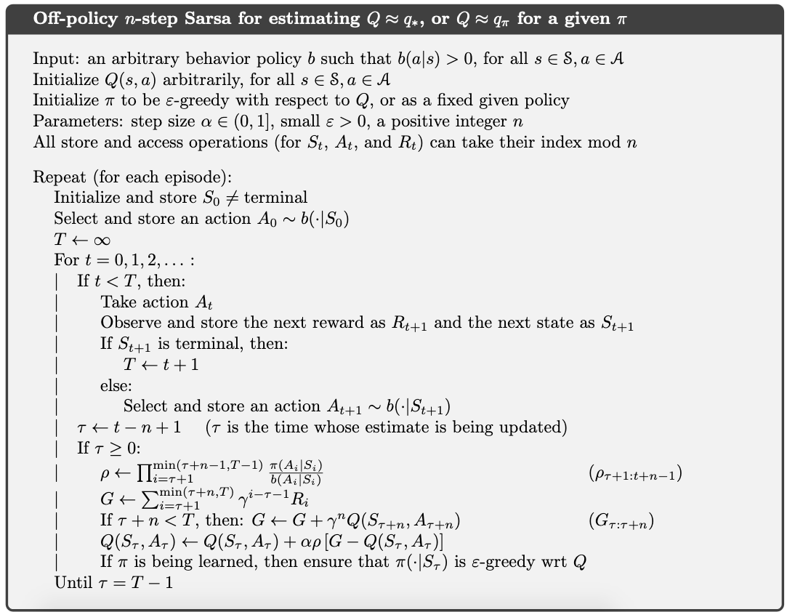
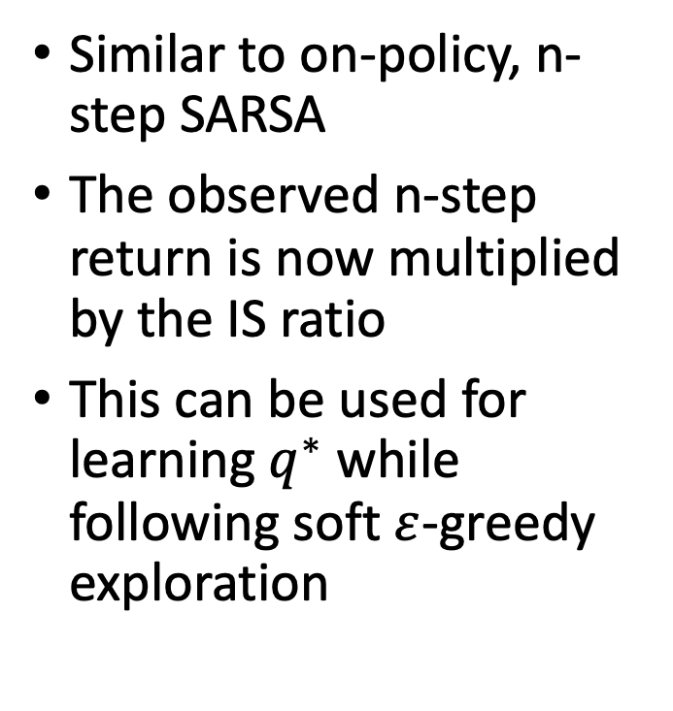
n-step SARSA + IS
Similar to on-policy, n-step SARSA
The observed n-step return is now multiplied by the IS ratio
This can be used for learning $q^{∗}$ while following soft $ε$-greedy exploration

Slide 38
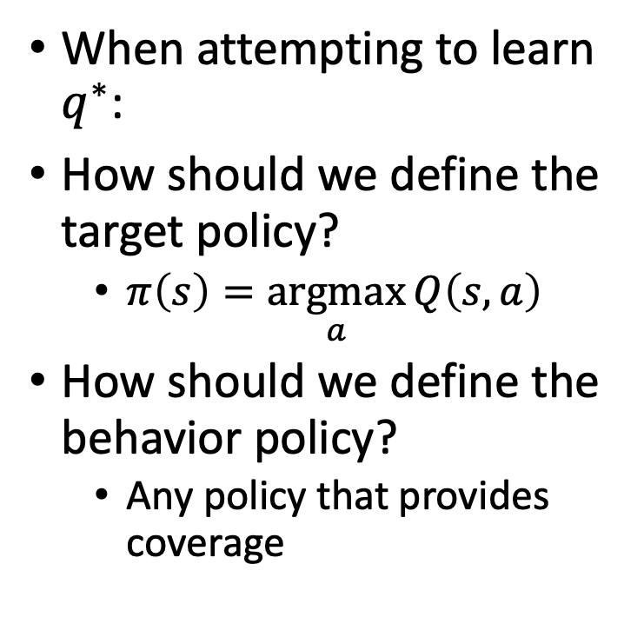
n-step SARSA + IS
When attempting to learn $q^{∗}$:
How should we define the target policy?
  $π\left(s\right)=\underset{a}{argmax}{Q\left(s,a\right)}$
How should we define the behavior policy?
  Any policy that provides coverage

Slide 39
What did we learn?
TD learning results in slow propagation of future rewards across the state space
  Especially problematic in sparse reward settings
MC, on the other hand, suffers from high variance in observed returns
  Especially problematic in stochastic environments and long episodes
TD learning with n-step return gaps these two extremes
  The best n is domain specific and is usually chosen empirically
  Careful! Like MC, it is off-policy (use IS when needed)

Slide 40
What next?
Lecture: Model-based RL (as opposed to model-free RL)
Quiz (on Canvas):
  n-step Bootstrapping
  By Sep. 23, EoD
Project:
  Start writing the project proposal document (due Sep. 30)

