Slide 1

CSCE-642 Reinforcement Learning
Chapter 6: Temporal-Difference Learning
Instructor: Guni Sharon

Slide 2
CSCE-689, Reinforcement Learning
Stateless decision process
Monte-Carlo
Policy gradient
Actor-critic
Markov decision process
Temporal difference
Function approximators
Solving MDPs (offline)
Dynamic programming
Tabular methods
Deep RL

Slide 3



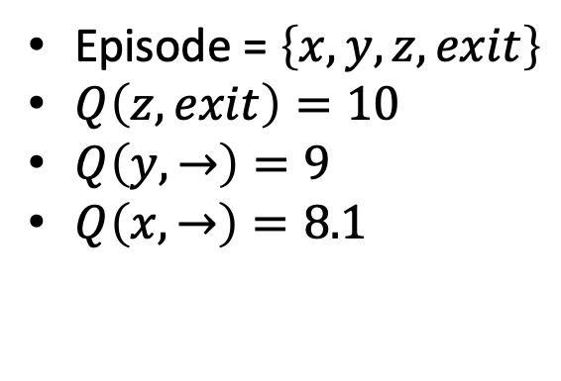
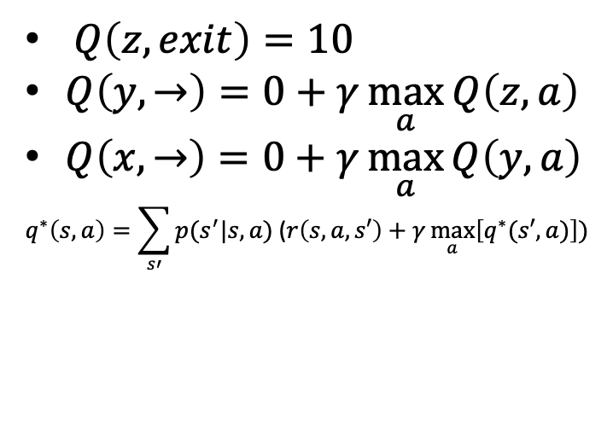

Solving MDPs so far
Dynamic programming
Off policy
local learning, propagating values from neighbors (Bootstrapping)
Model based
Monte-Carlo
On-policy (though important sampling can be used)
Requires a full episode to train on
Model free, online learning
$$γ=0.9$$
$Q\left(z,exit\right)=10$
$Q\left(y,→\right)=0+γ\max_{a}{Q\left(z,a\right)}$
$Q\left(x,→\right)=0+γ\max_{a}{Q\left(y,a\right)}$
$$q^{∗}\left(s,a\right)=\sum_{s′}{p(s^{′}|s,a)\text{ (}r\left(s,a,s′\right)}+γ\max_{a}\left[q^{∗}(s′,a)\right])$$
Episode = $\left\{x,y,z,exit\right\}$
$Q\left(z,exit\right)=10$
$Q\left(y,→\right)=9$
$Q\left(x,→\right)=8.1$
-100
+10
w | x | y | z

Slide 4
Fuse DP and MC
Dynamic programming
Off policy
local learning, propagating values from neighbors (Bootstrapping)
Model based
Monte-Carlo
On-policy (though important sampling can be used)
Requires a full episode to train on
Model free, online learning
TD Learning
Off policy
local learning, propagating values from neighbors (Bootsraping)
Model free, online learning

Slide 5
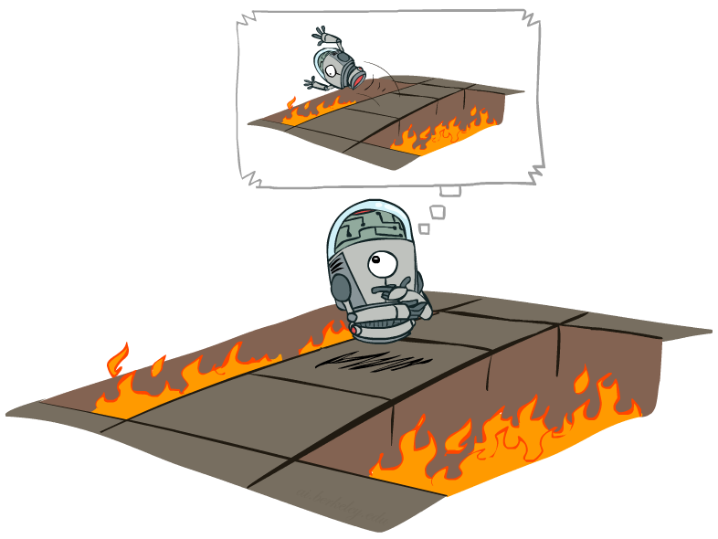
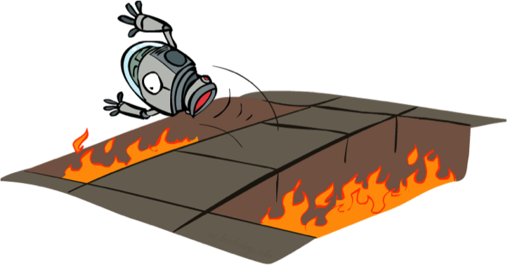
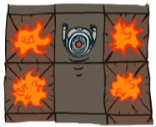
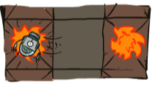



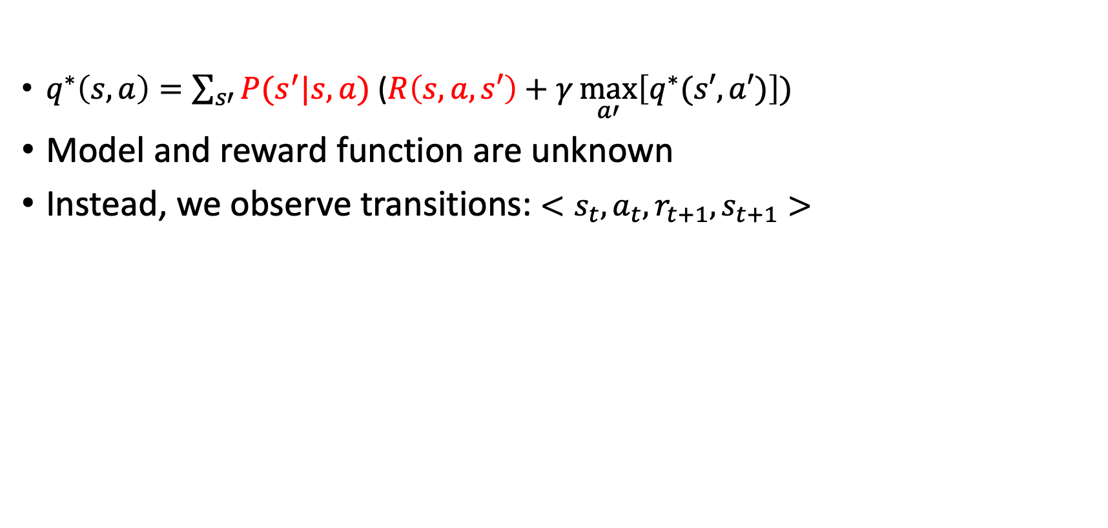
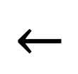
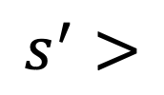

Online Bellman update
$q^{∗}\left(s,a\right)=\sum_{s′}{P(s^{′}|s,a) \text{(}R\left(s,a,s′\right)}+γ\max_{a′}\left[q^{∗}(s′,a′)\right])$
Model and reward function are unknown
Instead, we observe transitions: $<s_{t},a_{t},r_{t+1},s_{t+1}>$
Offline Solution
$$<s$$
$$a$$
$$r$$
$$s^{′}>$$
$$←$$
$$−100$$
Online Learning

Slide 6
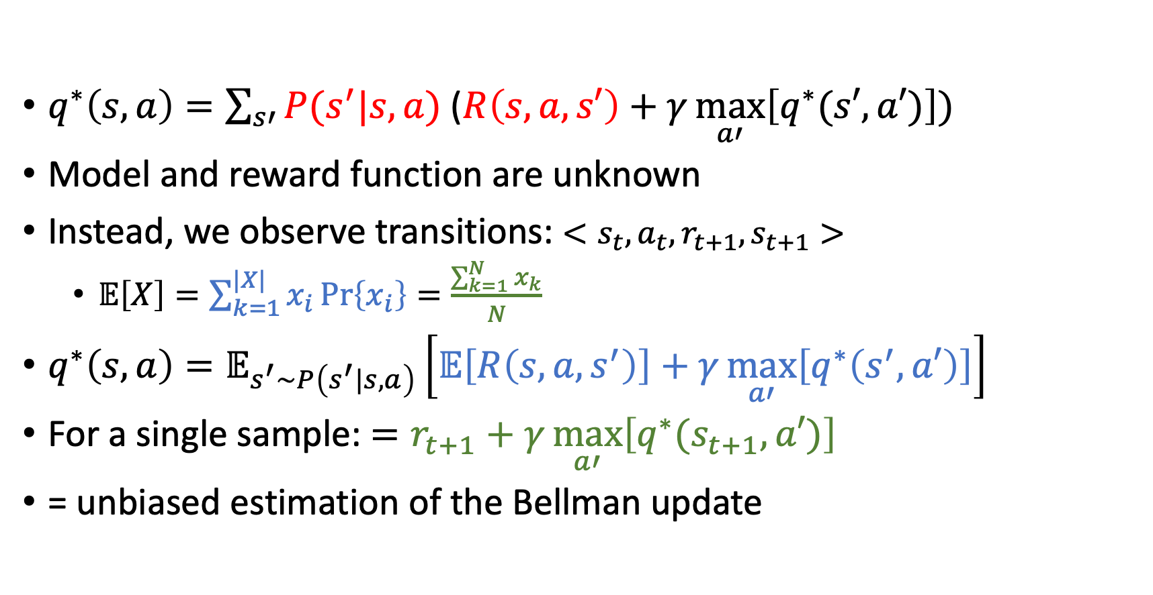
Online Bellman update
$q^{∗}\left(s,a\right)=\sum_{s′}{P(s^{′}|s,a) \text{(}R\left(s,a,s′\right)}+γ\max_{a′}\left[q^{∗}(s′,a′)\right])$
Model and reward function are unknown
Instead, we observe transitions: $<s_{t},a_{t},r_{t+1},s_{t+1}>$
  $𝔼\left[X\right]=\sum_{k=1}^{|X|}{x_{i}\operatorname{Pr}\left\{x_{i}\right\}}=\frac{\sum_{k=1}^{N}{x_{k}}}{N}$
$q^{∗}\left(s,a\right)=𝔼_{s^{′}\sim P\left(s^{′}|s,a\right)}\left[𝔼\left[R\left(s,a,s^{′}\right)\right]+γ\max_{a′}\left[q^{∗}\left(s^{′},a′\right)\right]\right]$
For a single sample: $=r_{t+1}+γ\max_{a′}\left[q^{∗}(s_{t+1},a′)\right]$
= unbiased estimation of the Bellman update

Slide 7
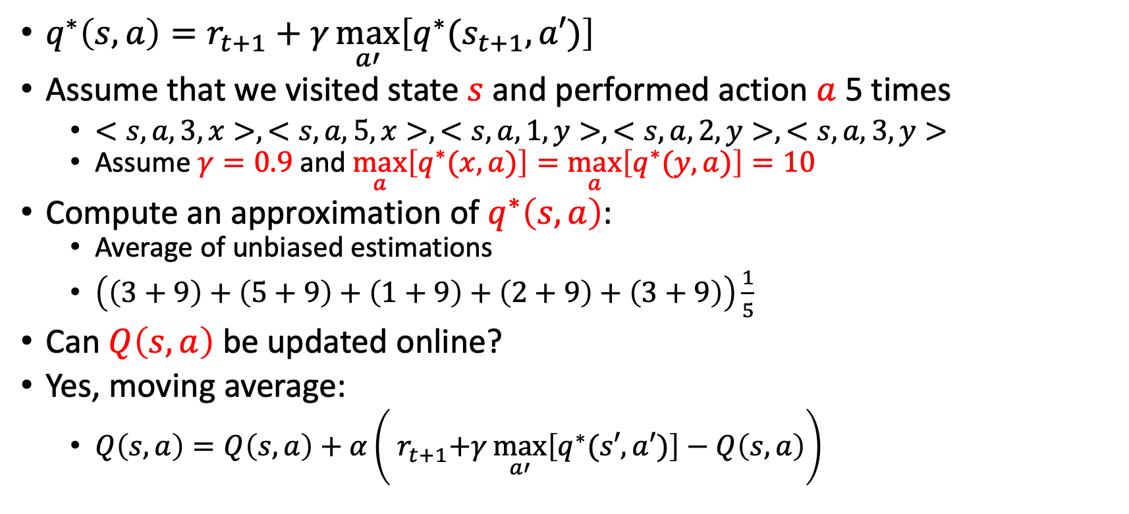
Online Bellman update
$q^{∗}\left(s,a\right)=r_{t+1}+γ\max_{a′}\left[q^{∗}(s_{t+1},a′)\right]$
Assume that we visited state $s$ and performed action $a$ 5 times
  $<s,a,3,x>, <s,a,5,x>,<s,a,1,y>,<s,a,2,y>,<s,a,3,y>$
  Assume $γ=0.9$ and $\max_{a}\left[q^{∗}(x,a)\right]=\max_{a}\left[q^{∗}(y,a)\right]=10$
Compute an approximation of $q^{∗}\left(s,a\right)$:
  Average of unbiased estimations
  $\left(\left(3+9\right)+\left(5+9\right)+\left(1+9\right)+\left(2+9\right)+\left(3+9\right)\right)\frac{1}{5}$
Can $Q\left(s,a\right)$ be updated online?
Yes, moving average:
  $Q\left(s,a\right)=Q\left(s,a\right)+α\left({ r}_{t+1}+γ\max_{a′}\left[q^{∗}(s′,a′)\right]−Q\left(s,a\right)\right)$

Slide 8
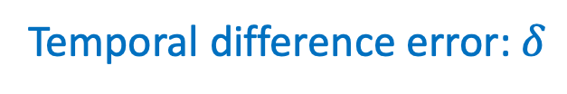
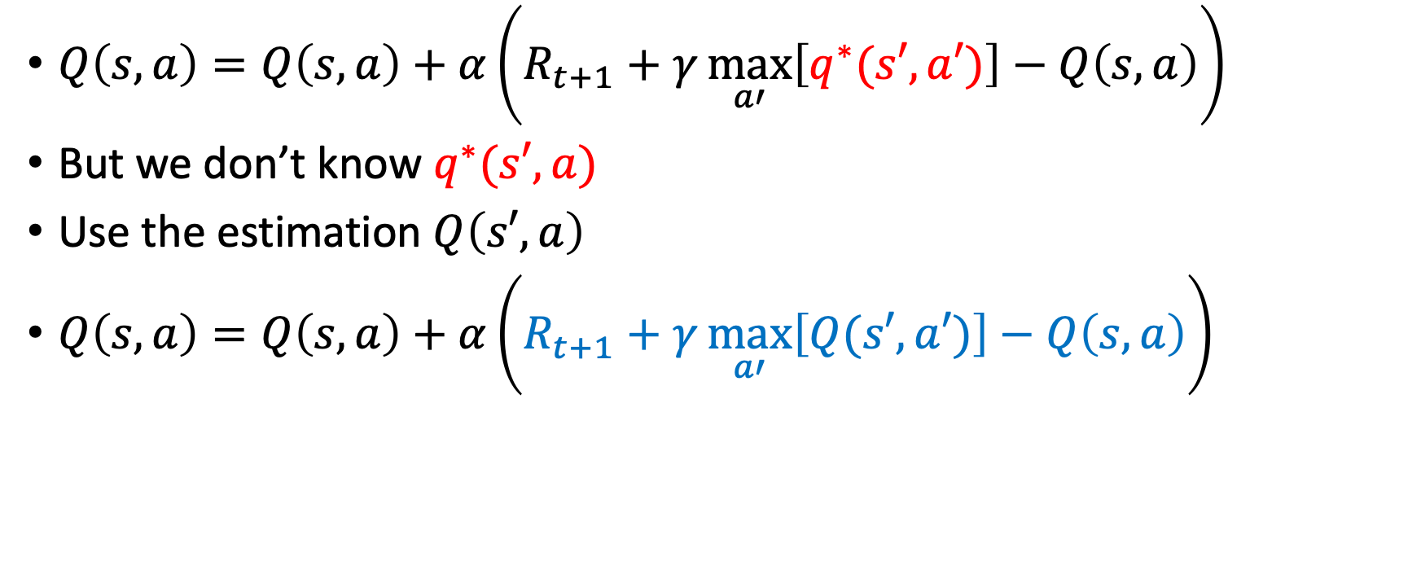
Temporal difference learning
$Q\left(s,a\right)=Q\left(s,a\right)+α\left(R_{t+1}+γ\max_{a′}\left[q^{∗}(s′,a′)\right]−Q\left(s,a\right)\right)$
But we don’t know $q^{∗}(s′,a)$
Use the estimation $Q\left(s′,a\right)$
$Q\left(s,a\right)=Q\left(s,a\right)+α\left(R_{t+1}+γ\max_{a′}\left[Q(s′,a′)\right]−Q\left(s,a\right)\right)$
Temporal difference error: $δ$

Slide 9
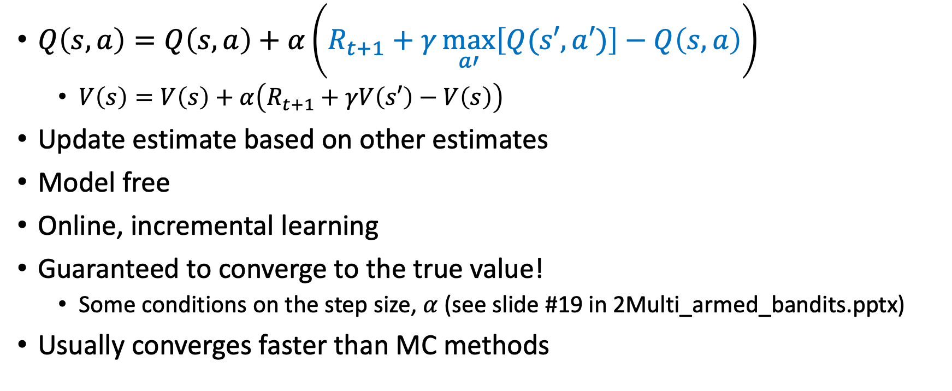
Temporal difference learning
$Q\left(s,a\right)=Q\left(s,a\right)+α\left(R_{t+1}+γ\max_{a′}\left[Q(s′,a′)\right]−Q\left(s,a\right)\right)$
  $V\left(s\right)=V\left(s\right)+α\left(R_{t+1}+γV\left(s′\right)−V\left(s\right)\right)$
Update estimate based on other estimates
Model free
Online, incremental learning
Guaranteed to converge to the true value!
  Some conditions on the step size, $α$ (see slide #19 in 2Multi_armed_bandits.pptx)
Usually converges faster than MC methods

Slide 10
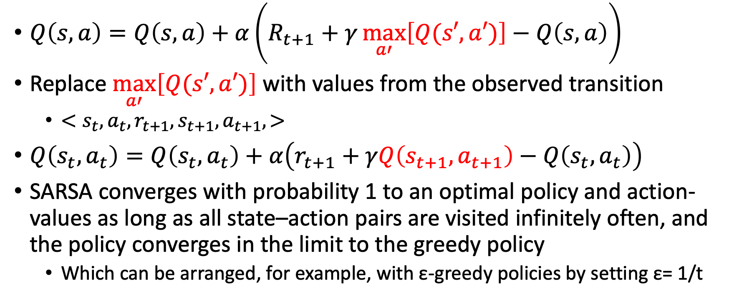
SARSA: On-policy TD Control
$Q\left(s,a\right)=Q\left(s,a\right)+α\left(R_{t+1}+γ\max_{a′}\left[Q(s′,a′)\right]−Q\left(s,a\right)\right)$
Replace $\max_{a′}\left[Q(s′,a′)\right]$ with values from the observed transition
  $<s_{t},a_{t},r_{t+1},s_{t+1}, a_{t+1}, >$
$Q\left(s_{t},a_{t}\right)=Q\left(s_{t},a_{t}\right)+α\left(r_{t+1}+γQ\left(s_{t+1},a_{t+1}\right)−Q\left(s_{t},a_{t}\right)\right)$
SARSA converges with probability 1 to an optimal policy and action-values as long as all state–action pairs are visited infinitely often, and the policy converges in the limit to the greedy policy
  Which can be arranged, for example, with ε-greedy policies by setting ε= 1/t

Slide 11
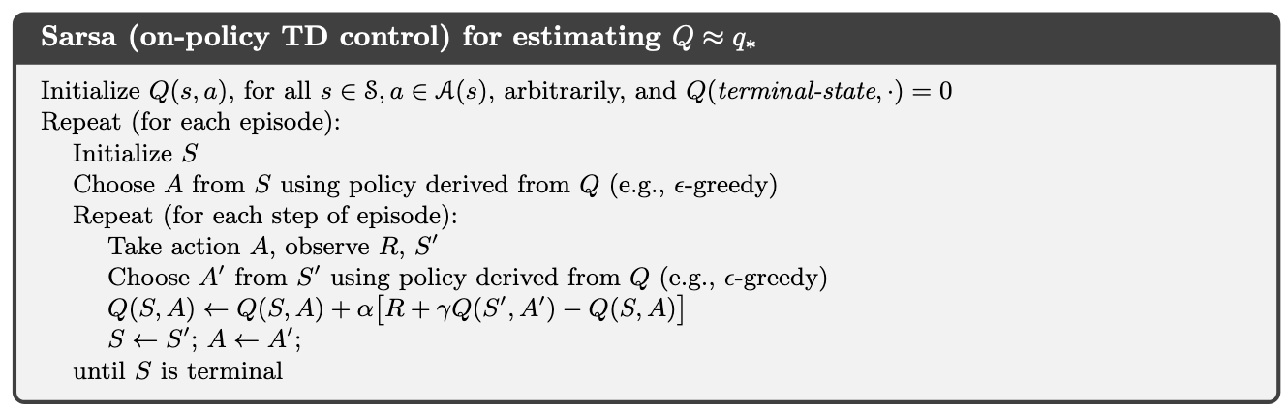

SARSA: On-policy TD Control
$$γ=0.9$$
-100
+10
w | x | y | z

Slide 12
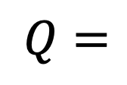
SARSA: On-policy TD Control
$$γ=0.9$$
-100
+10
w | x | y | z
$$Q=$$
0 | 0,0 | 0,0 | 0
w | x | y | z

Slide 13
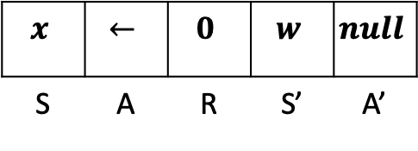
SARSA: On-policy TD Control
$$γ=0.9$$
-100
+10
w | x | y | z
$$x$$ | $$←$$ | $$0$$ | $$w$$ | $$null$$
S | A | R | S’ | A’
$$Q=$$
0 | 0,0 | 0,0 | 0
w | x | y | z

Slide 14
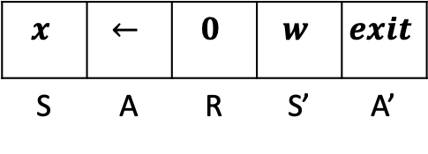
SARSA: On-policy TD Control
$$γ=0.9$$
-100
+10
w | x | y | z
$$x$$ | $$←$$ | $$0$$ | $$w$$ | $$exit$$
S | A | R | S’ | A’
$$Q=$$
0 | 0,0 | 0,0 | 0
w | x | y | z

Slide 15
SARSA: On-policy TD Control
$$γ=0.9$$
-100
+10
w | x | y | z
$$x$$ | $$←$$ | $$0$$ | $$w$$ | $$exit$$
S | A | R | S’ | A’
$$Q=$$
0 | 0,0 | 0,0 | 0
w | x | y | z

Slide 16
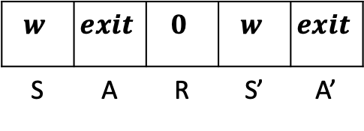
SARSA: On-policy TD Control
$$γ=0.9$$
-100
+10
w | x | y | z
$$w$$ | $$exit$$ | $$0$$ | $$w$$ | $$exit$$
S | A | R | S’ | A’
$$Q=$$
0 | 0,0 | 0,0 | 0
w | x | y | z

Slide 17
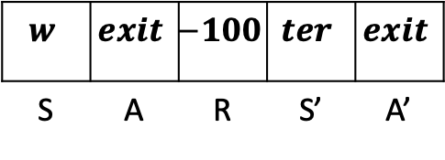
SARSA: On-policy TD Control
$$γ=0.9$$
-100
+10
w | x | y | z
$$w$$ | $$exit$$ | $$−100$$ | $$ter$$ | $$exit$$
S | A | R | S’ | A’
$$Q=$$
0 | 0,0 | 0,0 | 0
w | x | y | z

Slide 18
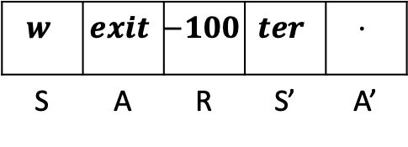
SARSA: On-policy TD Control
$$γ=0.9$$
-100
+10
w | x | y | z
$$w$$ | $$exit$$ | $$−100$$ | $$ter$$ | $$⋅$$
S | A | R | S’ | A’
$$Q=$$
-100 | 0,0 | 0,0 | 0
w | x | y | z

Slide 19
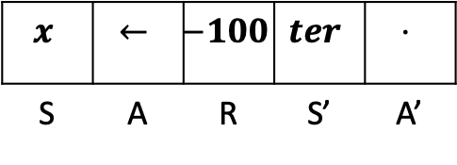
SARSA: On-policy TD Control
$$γ=0.9$$
-100
+10
w | x | y | z
$$x$$ | $$←$$ | $$−100$$ | $$ter$$ | $$⋅$$
S | A | R | S’ | A’
$$Q=$$
-100 | 0,0 | 0,0 | 0
w | x | y | z

Slide 20
SARSA: On-policy TD Control
$$γ=0.9$$
-100
+10
w | x | y | z
$$x$$ | $$←$$ | $$0$$ | $$w$$ | $$exit$$
S | A | R | S’ | A’
$$Q=$$
-100 | 0,0 | 0,0 | 0
w | x | y | z

Slide 21
SARSA: On-policy TD Control
$$γ=0.9$$
-100
+10
w | x | y | z
$$x$$ | $$←$$ | $$0$$ | $$w$$ | $$exit$$
S | A | R | S’ | A’
$$Q=$$
-100 | -90,0 | 0,0 | 0
w | x | y | z

Slide 22
SARSA: On-policy TD Control
And so on…
$$γ=0.9$$
-100
+10
w | x | y | z
$$w$$ | $$exit$$ | $$0$$ | $$w$$ | $$exit$$
S | A | R | S’ | A’
$$Q=$$
-100 | -90,0 | 0,0 | 0
w | x | y | z

Slide 23
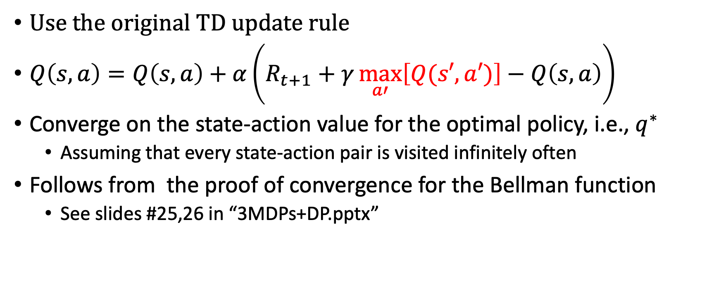
Q-learning: Off-policy TD Control
Use the original TD update rule
$Q\left(s,a\right)=Q\left(s,a\right)+α\left(R_{t+1}+γ\max_{a′}\left[Q(s′,a′)\right]−Q\left(s,a\right)\right)$
Converge on the state-action value for the optimal policy, i.e., $q^{∗}$
  Assuming that every state-action pair is visited infinitely often
Follows from the proof of convergence for the Bellman function
  See slides #25,26 in “3MDPs+DP.pptx”

Slide 24
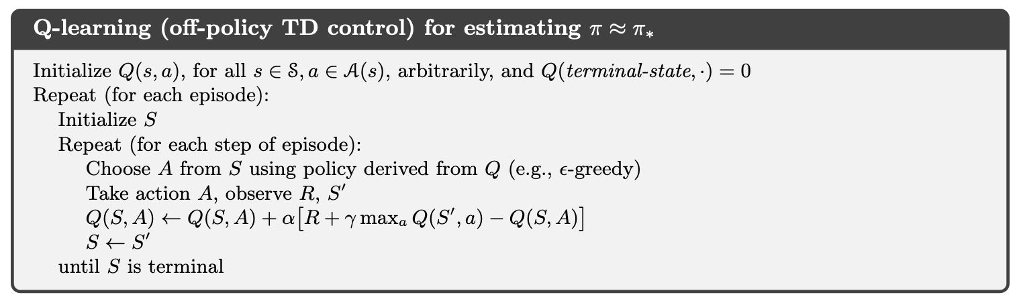
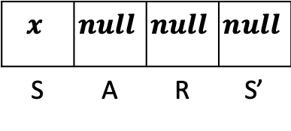
Q-learning: Off-policy TD Control
$$γ=0.9$$
+10
-100
w | x | y | z
$$x$$ | $$null$$ | $$null$$ | $$null$$
S | A | R | S’
$$Q=$$
0 | 0,0 | 0,0 | 0
w | x | y | z

Slide 25
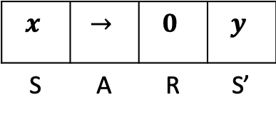
Q-learning: Off-policy TD Control
$$γ=0.9$$
+10
-100
w | x | y | z
$$x$$ | $$→$$ | $$0$$ | $$y$$
S | A | R | S’
$$Q=$$
0 | 0,0 | 0,0 | 0
w | x | y | z

Slide 26
Q-learning: Off-policy TD Control
$$γ=0.9$$
+10
-100
w | x | y | z
$$x$$ | $$→$$ | $$0$$ | $$y$$
S | A | R | S’
$$Q=$$
0 | 0,0 | 0,0 | 0
w | x | y | z

Slide 27
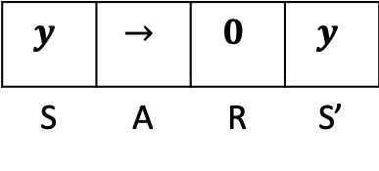
Q-learning: Off-policy TD Control
$$γ=0.9$$
+10
-100
w | x | y | z
$$y$$ | $$→$$ | $$0$$ | $$y$$
S | A | R | S’
$$Q=$$
0 | 0,0 | 0,0 | 0
w | x | y | z

Slide 28
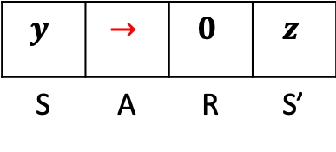
Q-learning: Off-policy TD Control
$$γ=0.9$$
+10
-100
w | x | y | z
$$y$$ | $$→$$ | $$0$$ | $$z$$
S | A | R | S’
$$Q=$$
0 | 0,0 | 0,0 | 0
w | x | y | z

Slide 29
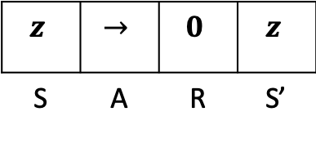
Q-learning: Off-policy TD Control
$$γ=0.9$$
+10
-100
w | x | y | z
$$z$$ | $$→$$ | $$0$$ | $$z$$
S | A | R | S’
$$Q=$$
0 | 0,0 | 0,0 | 0
w | x | y | z

Slide 30
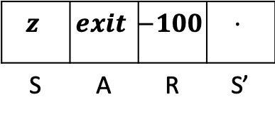
Q-learning: Off-policy TD Control
$$γ=0.9$$
+10
-100
w | x | y | z
$$z$$ | $$exit$$ | $$−100$$ | $$⋅$$
S | A | R | S’
$$Q=$$
0 | 0,0 | 0,0 | 0
w | x | y | z

Slide 31
Q-learning: Off-policy TD Control
$$γ=0.9$$
+10
-100
w | x | y | z
$$z$$ | $$exit$$ | $$−100$$ | $$⋅$$
S | A | R | S’
$$Q=$$
0 | 0,0 | 0,0 | -100
w | x | y | z

Slide 32
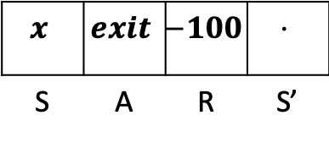
Q-learning: Off-policy TD Control
$$γ=0.9$$
+10
-100
w | x | y | z
$$x$$ | $$exit$$ | $$−100$$ | $$⋅$$
S | A | R | S’
$$Q=$$
0 | 0,0 | 0,0 | -100
w | x | y | z

Slide 33
Q-learning: Off-policy TD Control
$$γ=0.9$$
+10
-100
w | x | y | z
$$x$$ | $$→$$ | $$0$$ | $$y$$
S | A | R | S’
$$Q=$$
0 | 0,0 | 0,0 | -100
w | x | y | z

Slide 34
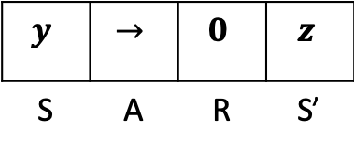
Q-learning: Off-policy TD Control
$$γ=0.9$$
+10
-100
w | x | y | z
$$y$$ | $$→$$ | $$0$$ | $$z$$
S | A | R | S’
$$Q=$$
0 | 0,0 | 0,0 | -100
w | x | y | z

Slide 35
Q-learning: Off-policy TD Control
$$γ=0.9$$
+10
-100
w | x | y | z
$$y$$ | $$→$$ | $$0$$ | $$z$$
S | A | R | S’
$$Q=$$
0 | 0,0 | 0,-90 | -100
w | x | y | z

Slide 36
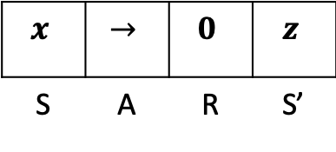
Q-learning: Off-policy TD Control
$$γ=0.9$$
+10
-100
w | x | y | z
$$x$$ | $$→$$ | $$0$$ | $$z$$
S | A | R | S’
$$Q=$$
0 | 0,0 | 0,-90 | -100
w | x | y | z

Slide 37
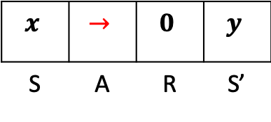
Q-learning: Off-policy TD Control
$$γ=0.9$$
+10
-100
w | x | y | z
$$x$$ | $$→$$ | $$0$$ | $$y$$
S | A | R | S’
$$Q=$$
0 | 0,0 | 0,-90 | -100
w | x | y | z

Slide 38
Q-learning: Off-policy TD Control
$$γ=0.9$$
+10
-100
w | x | y | z
$$x$$ | $$→$$ | $$0$$ | $$y$$
S | A | R | S’
$$Q=$$
0 | 0,0 | 0,-90 | -100
w | x | y | z

Slide 39
Q-learning: Off-policy TD Control
And so on…
$$γ=0.9$$
+10
-100
w | x | y | z
$$x$$ | $$→$$ | $$0$$ | $$y$$
S | A | R | S’
$$Q=$$
0 | 0,0 | 0,-90 | -100
w | x | y | z

Slide 40
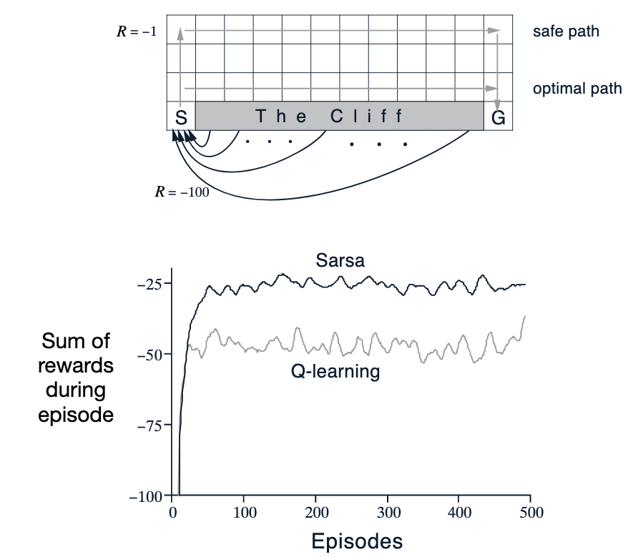
SARSA vs Q-learning
4-connected gridworld
Reward = -1 for all transitions except those into the region marked “The Cliff”

Slide 41
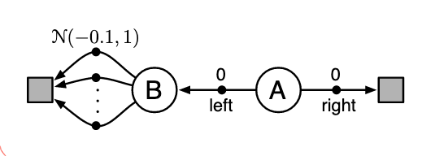
Maximization bias in Q-learning
Consider an MDP with two non-terminal states A and B
Episodes start in A with a choice between two actions, left and right
The right action transitions immediately to the terminal state with a reward and return of zero
The left action transitions to B, also with a reward of zero
From B there are many possible actions all of which cause immediate termination with a reward drawn from a normal distribution with mean −0.1 and variance 1.0
Thus, the expected return for any trajectory starting with left is −0.1, and thus taking left in state A is a mistake

Slide 42
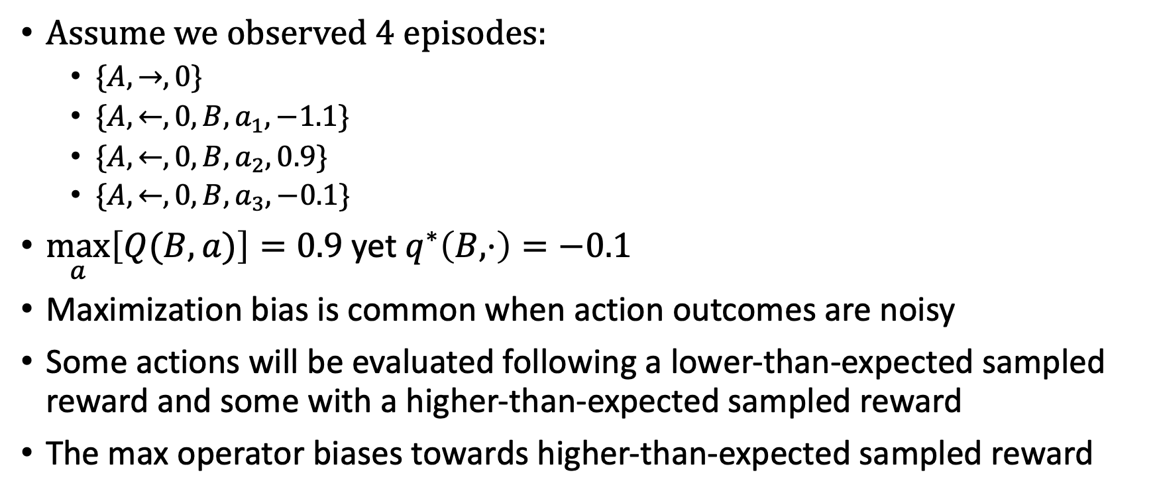
Maximization bias in Q-learning
Assume we observed 4 episodes:
  $\{A,→,0\}$
  $\{A,←,0,B,a_{1}, −1.1\}$
  $\{A,←,0,B,a_{2}, 0.9\}$
  $\{A,←,0,B,a_{3}, −0.1\}$
$\max_{a}\left[Q(B,a)\right]=0.9$ yet $q^{∗}\left(B,⋅\right)=−0.1$
Maximization bias is common when action outcomes are noisy
Some actions will be evaluated following a lower-than-expected sampled reward and some with a higher-than-expected sampled reward
The max operator biases towards higher-than-expected sampled reward

Slide 43

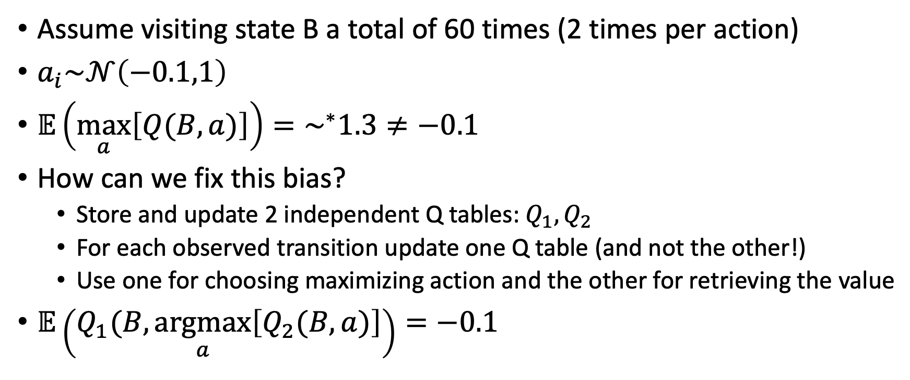



Double Q-learning
Assume visiting state B a total of 60 times (2 times per action)
$a_{i}\sim 𝒩\left(−0.1,1\right)$
$𝔼\left(\max_{a}\left[Q(B,a)\right]\right)=\sim ^{∗}1.3≠−0.1$
How can we fix this bias?
  Store and update 2 independent Q tables: $Q_{1}, Q_{2}$
  For each observed transition update one Q table (and not the other!)
  Use one for choosing maximizing action and the other for retrieving the value
$𝔼\left(Q_{1}(B,\underset{a}{argmax}\left[Q_{2}(B,a)\right]\right)=−0.1$
$$a_{1}$$
$$a_{2}$$
B
.
.
.
$$a_{30}$$
$∗$ evaluated through simulation

Slide 44
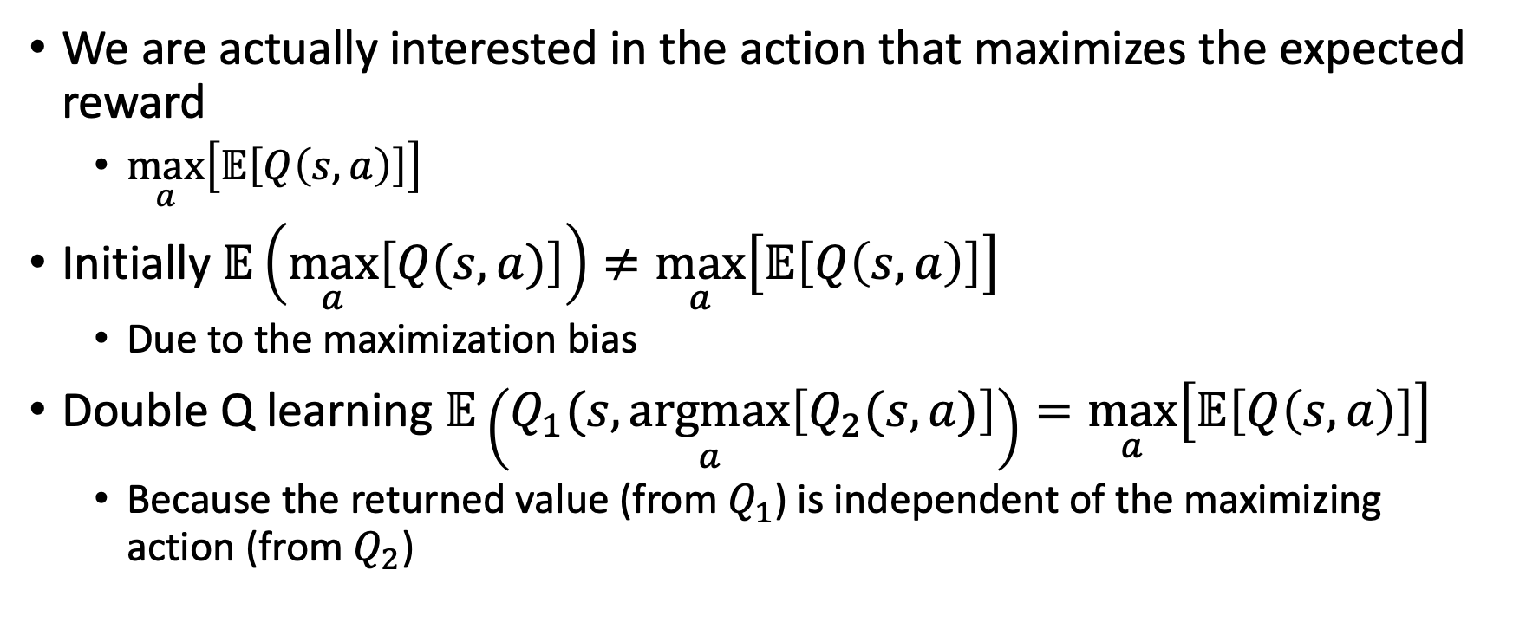
Double Q learning is unbiased
We are actually interested in the action that maximizes the expected reward
  $\max_{a}\left[𝔼\left[Q\left(s,a\right)\right]\right]$
Initially $𝔼\left(\max_{a}\left[Q(s,a)\right]\right)≠\max_{a}\left[𝔼\left[Q\left(s,a\right)\right]\right]$
  Due to the maximization bias
Double Q learning $𝔼\left(Q_{1}(s,\underset{a}{argmax}\left[Q_{2}(s,a)\right]\right)=\max_{a}\left[𝔼\left[Q\left(s,a\right)\right]\right]$
  Because the returned value (from $Q_{1}$) is independent of the maximizing action (from $Q_{2}$)

Slide 45
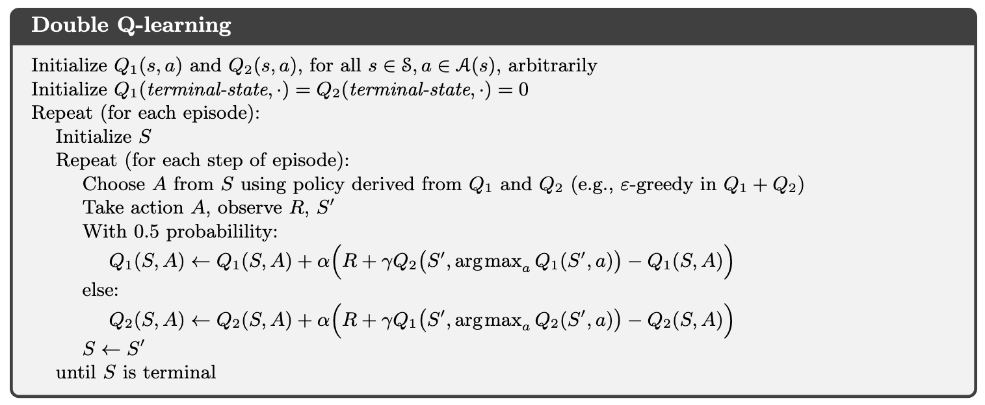
Double Q-learning

Slide 46
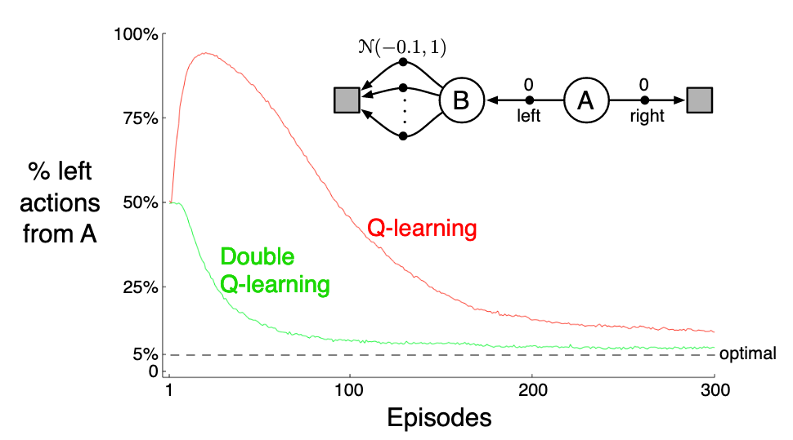
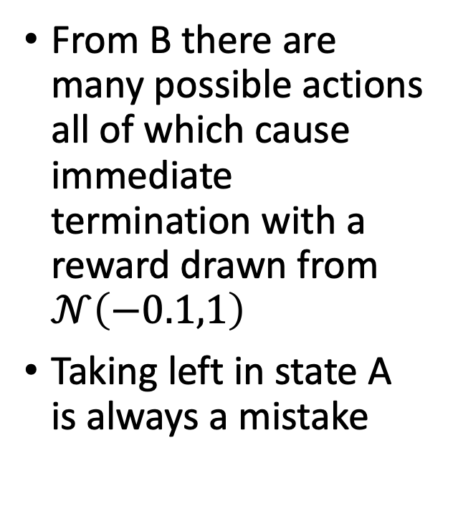
Double Q-learning
From B there are many possible actions all of which cause immediate termination with a reward drawn from $𝒩\left(−0.1,1\right)$
Taking left in state A is always a mistake

Slide 47
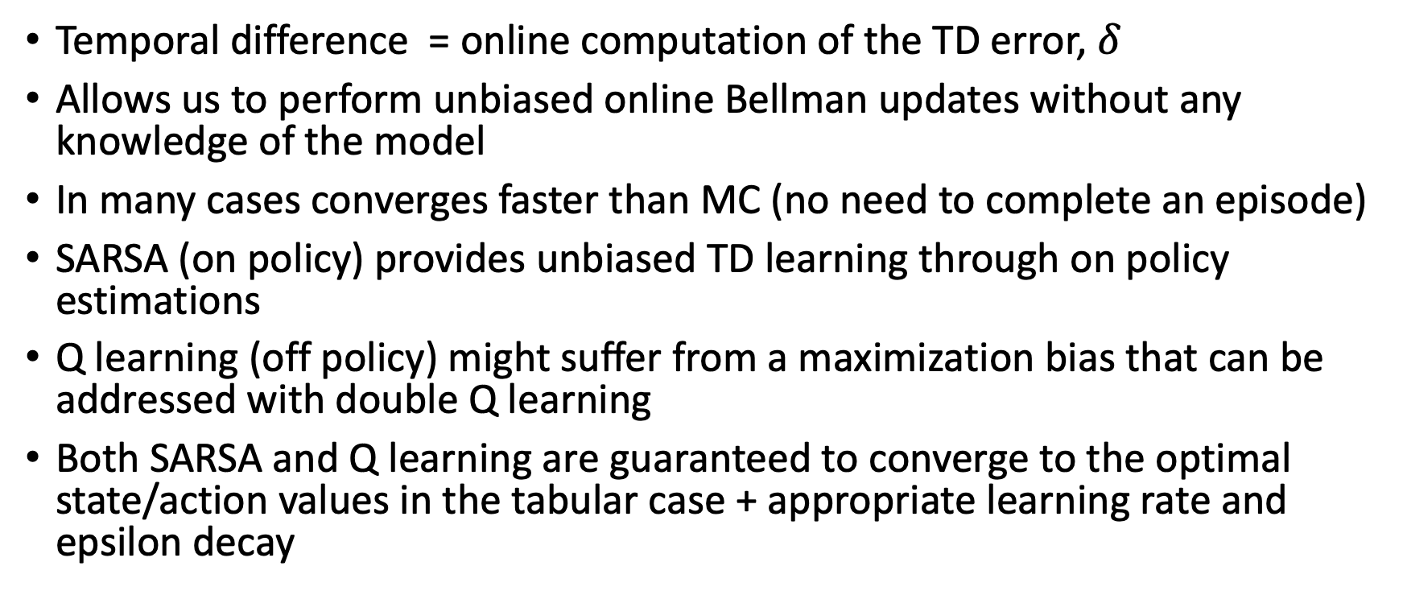
What did we learn?
Temporal difference = online computation of the TD error, $δ$
Allows us to perform unbiased online Bellman updates without any knowledge of the model
In many cases converges faster than MC (no need to complete an episode)
SARSA (on policy) provides unbiased TD learning through on policy estimations
Q learning (off policy) might suffer from a maximization bias that can be addressed with double Q learning
Both SARSA and Q learning are guaranteed to converge to the optimal state/action values in the tabular case + appropriate learning rate and epsilon decay

Slide 48
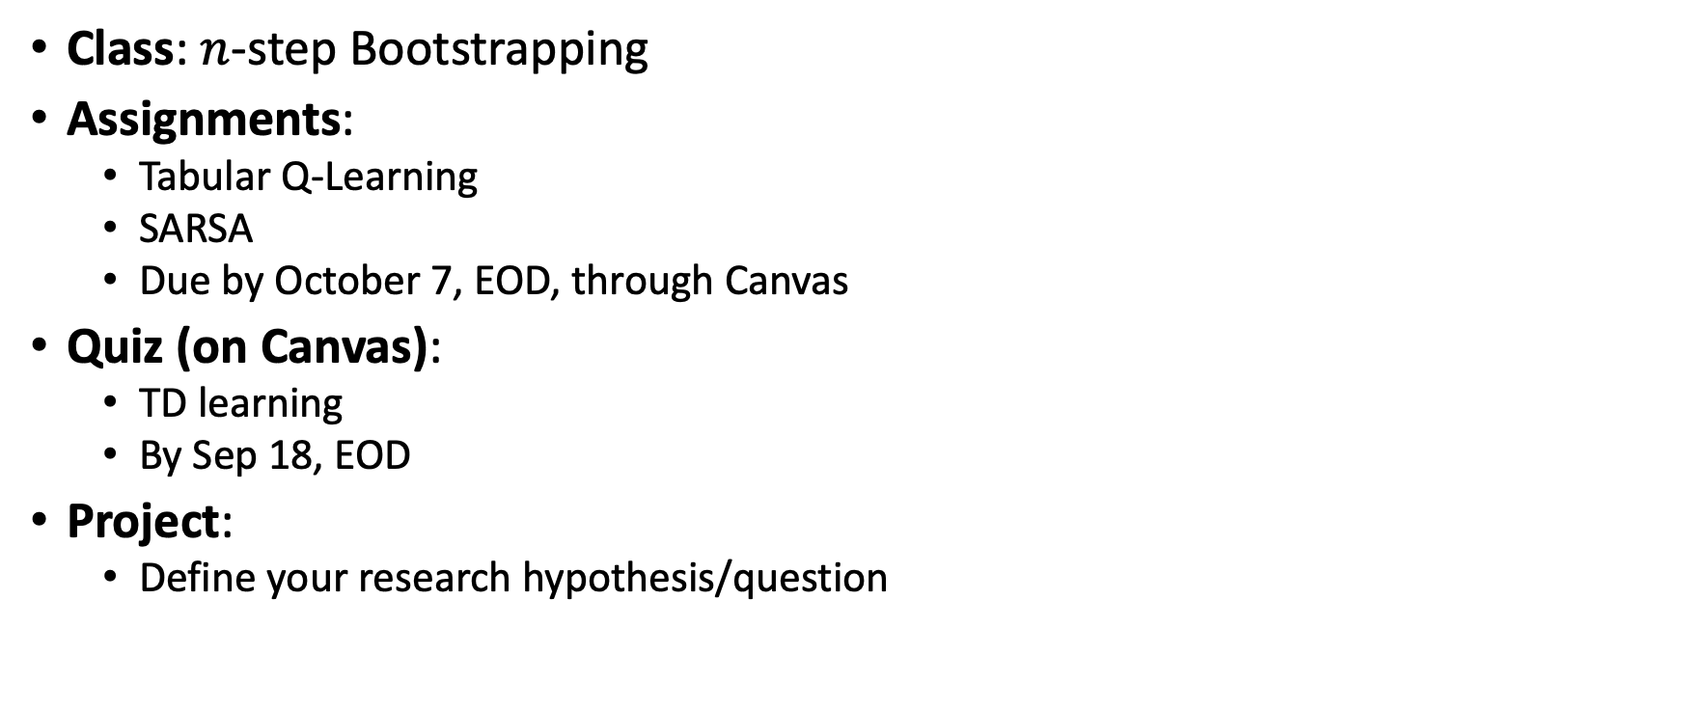
What next?
Class: $n$-step Bootstrapping
Assignments:
  Tabular Q-Learning
  SARSA
  Due by October 7, EOD, through Canvas
Quiz (on Canvas):
  TD learning
  By Sep 18, EOD
Project:
  Define your research hypothesis/question

