Slide 1
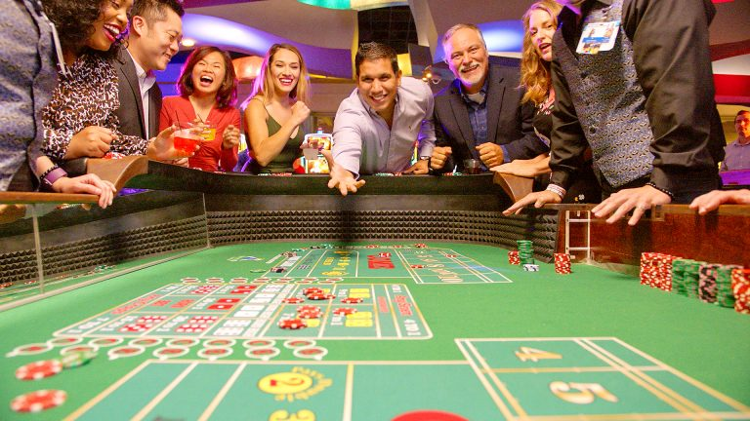
CSCE-642 Reinforcement Learning
Chapter 5: Monte Carlo Methods
Instructor: Guni Sharon

Slide 2
CSCE-689, Reinforcement Learning
Stateless decision process
Monte-Carlo
Policy gradient
Actor-critic
Markov decision process
Temporal difference
Function approximators
Solving MDPs (offline)
Dynamic programming
Tabular methods
Deep RL

Slide 3
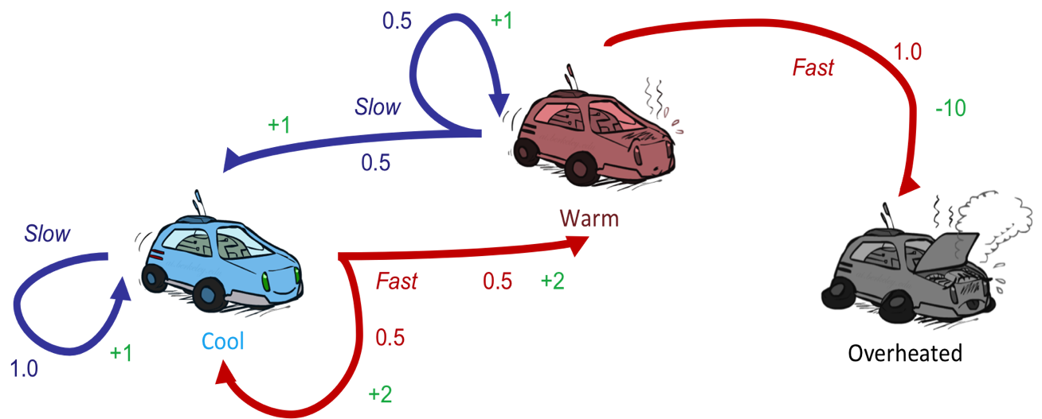
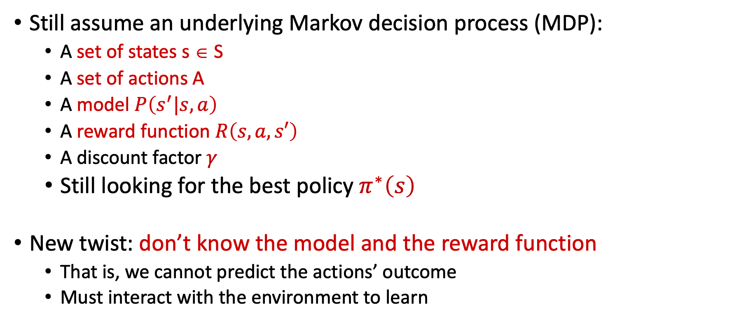
Reinforcement Learning
Still assume an underlying Markov decision process (MDP):
  A set of states s ∈ S
  A set of actions A
  A model $P\left(s^{′}|s,a\right)$
  A reward function $R\left(s,a,s′\right)$
  A discount factor $γ$
  Still looking for the best policy $π^{∗}\left(s\right)$
New twist: don’t know the model and the reward function
  That is, we cannot predict the actions’ outcome
  Must interact with the environment to learn

Slide 4
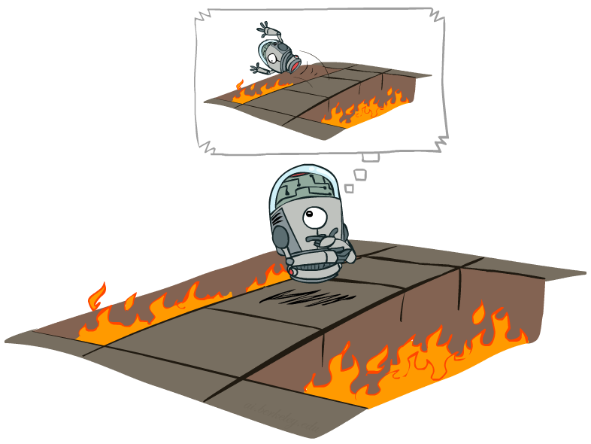
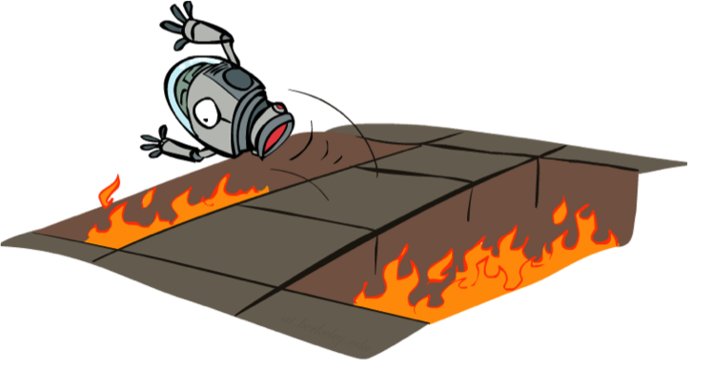
Offline vs. Online (RL)
Offline Optimization
Online Learning

Slide 5
Monte-Carlo Methods
Monte Carlo methods are a broad class of computational algorithms that rely on repeated random sampling to obtain numerical results
The underlying concept is to obtain unbiased samples from a complex/unknown distribution through a random process
They are often used in physical and mathematical problems and are most useful when it is difficult or impossible to compute a solution analytically
  Weather prediction
  Computational biology
  Computer graphics
  Finance and business
  Sport game prediction

Slide 6
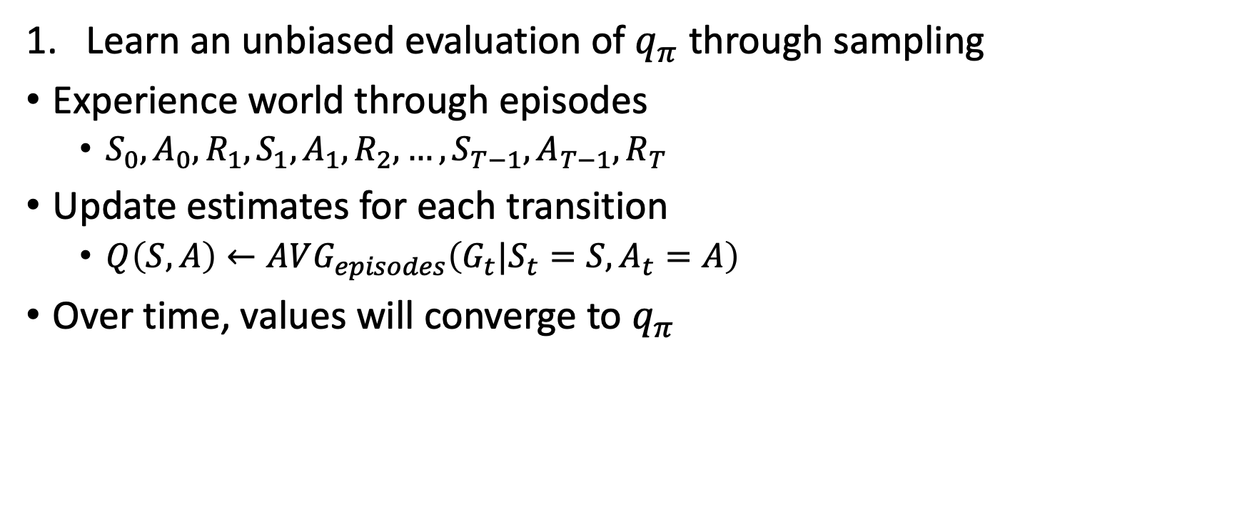
Value-based learning via Monte-Carlo
s
a
Learn an unbiased evaluation of $q_{π}$ through sampling
Experience world through episodes
  $S_{0},A_{0},R_{1},S_{1},A_{1},R_{2},…,S_{T−1},A_{T−1},R_{T}$
Update estimates for each transition
  $Q\left(S,A\right)←AVG_{episodes}\left(G_{t}|S_{t}=S,A_{t}=A\right)$
Over time, values will converge to $q_{π}$
s, a
r
s’
a’
s’, a’
s’’

Slide 7
Example: MC Evaluation
Input Policy π
Observed Episodes (Training)
Output Values
Episode 1
Episode 2
 | A
B | C | D
 | E
 | A
B | C | D
 | E
B, east, C, -1
C, east, D, -1
D, exit, , +10
B, east, C, -1
C, east, D, -1
D, exit, , +10
-10
+8
+4
+10
Episode 3
Episode 4
-2
E, north, C, -1
C, east, D, -1
D, exit, , +10
E, north, C, -1
C, east, A, -1
A, exit, , -10
Assume: γ = 1

Slide 8
Problems with MC Evaluation
What’s good about direct evaluation?
  It’s easy to understand
  It doesn’t require any knowledge of the model
  It converges to the true expected values
What’s bad about it?
  It wastes information about transition probabilities
  Each state must be learned separately
  So, it takes a long time to learn
Output Values
 | A
B | C | D
 | E
-10
+8
+4
+10
-2
If B and E both go to C with the same probability, how can their values be different?

Slide 9







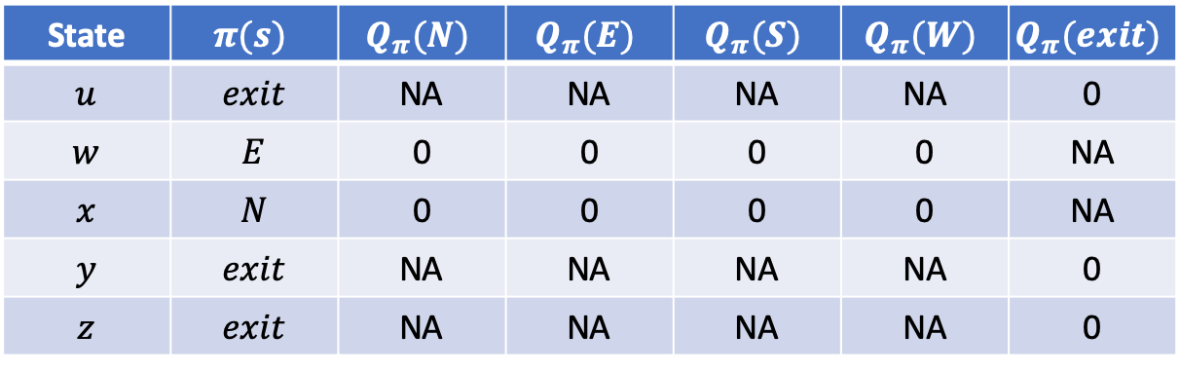
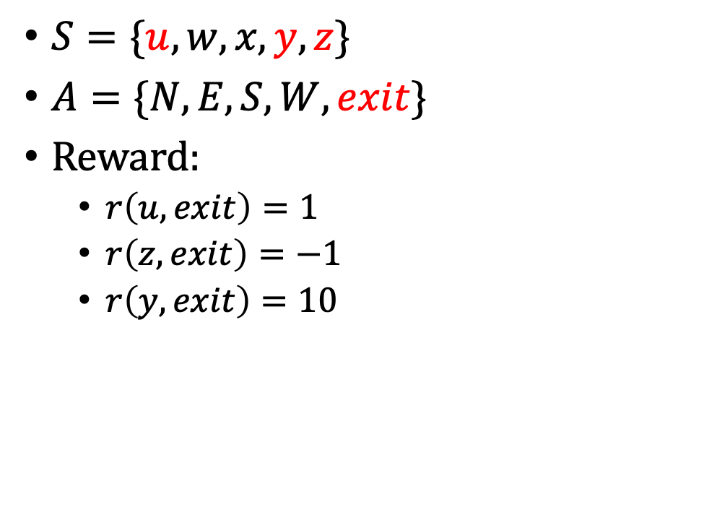





Greedy MC
$$z$$
$S=\{u,w,x,y,z\}$
$A=\{N,E,S,W,exit\}$
Reward:
  $r\left(u,exit\right)=1$
  $r\left(z,exit\right)=−1$
  $r\left(y,exit\right)=10$
-1
$$u$$
$$w$$
$$y$$
+1
+10
$$x$$
State | $$π(s)$$ | $$Q_{π}(N)$$ | $$Q_{π}(E)$$ | $$Q_{π}(S)$$ | $$Q_{π}(W)$$ | $$Q_{π}(exit)$$
$$u$$ | $$exit$$ | NA | NA | NA | NA | 0
$$w$$ | $$E$$ | 0 | 0 | 0 | 0 | NA
$$x$$ | $$N$$ | 0 | 0 | 0 | 0 | NA
$$y$$ | $$exit$$ | NA | NA | NA | NA | 0
$$z$$ | $$exit$$ | NA | NA | NA | NA | 0
$$−1$$
$$−1$$
$$−1$$

Slide 10

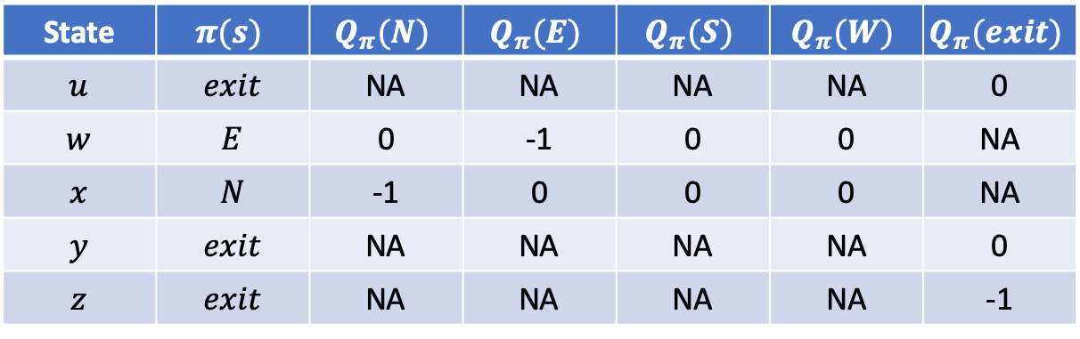



Greedy MC
$$z$$
$S=\{u,w,x,y,z\}$
$A=\{N,E,S,W,exit\}$
Reward:
  $r\left(u,exit\right)=1$
  $r\left(z,exit\right)=−1$
  $r\left(y,exit\right)=10$
-1
$$u$$
$$w$$
$$y$$
+1
+10
$$x$$
State | $$π(s)$$ | $$Q_{π}(N)$$ | $$Q_{π}(E)$$ | $$Q_{π}(S)$$ | $$Q_{π}(W)$$ | $$Q_{π}(exit)$$
$$u$$ | $$exit$$ | NA | NA | NA | NA | 0
$$w$$ | $$E$$ | 0 | -1 | 0 | 0 | NA
$$x$$ | $$N$$ | -1 | 0 | 0 | 0 | NA
$$y$$ | $$exit$$ | NA | NA | NA | NA | 0
$$z$$ | $$exit$$ | NA | NA | NA | NA | -1
$$1$$
$$W$$
$$1$$
$$E$$

Slide 11
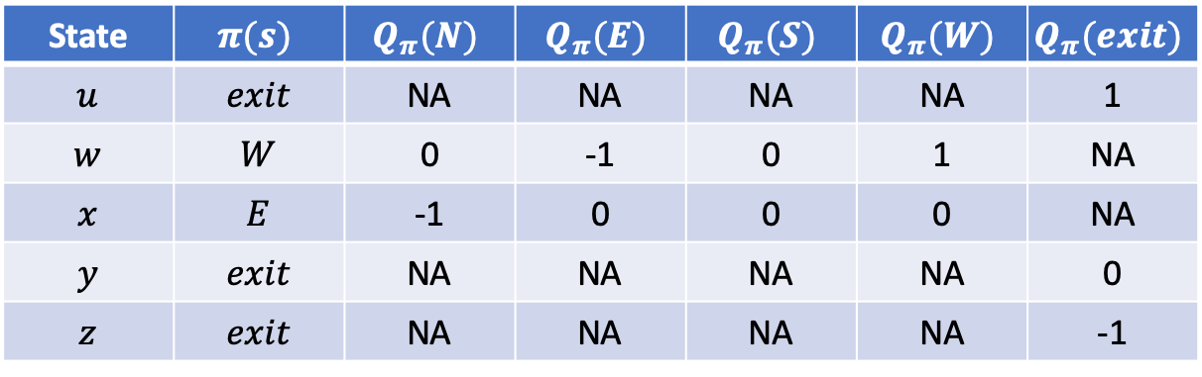
Greedy MC
$$z$$
$S=\{u,w,x,y,z\}$
$A=\{N,E,S,W,exit\}$
Reward:
  $r\left(u,exit\right)=1$
  $r\left(z,exit\right)=−1$
  $r\left(y,exit\right)=10$
-1
$$u$$
$$w$$
$$y$$
+1
+10
$$x$$
State | $$π(s)$$ | $$Q_{π}(N)$$ | $$Q_{π}(E)$$ | $$Q_{π}(S)$$ | $$Q_{π}(W)$$ | $$Q_{π}(exit)$$
$$u$$ | $$exit$$ | NA | NA | NA | NA | 1
$$w$$ | $$W$$ | 0 | -1 | 0 | 1 | NA
$$x$$ | $$E$$ | -1 | 0 | 0 | 0 | NA
$$y$$ | $$exit$$ | NA | NA | NA | NA | 0
$$z$$ | $$exit$$ | NA | NA | NA | NA | -1
We converged on a local optimum!

Slide 12
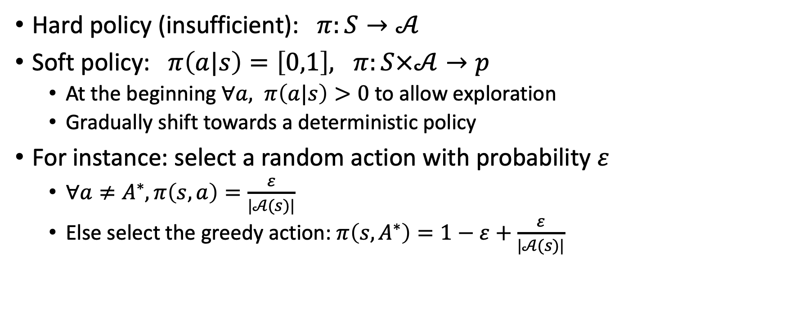
Must explore!
Hard policy (insufficient): $π:S→𝒜$
Soft policy: $π\left(a|s\right)=\left[0,1\right], π:S×𝒜→p$
  At the beginning $∀a, π\left(a|s\right)>0$ to allow exploration
  Gradually shift towards a deterministic policy
For instance: select a random action with probability $ε$
  $∀a≠A^{∗}, π\left(s,a\right)=\frac{ε}{|𝒜(s)|}$
  Else select the greedy action: $π\left(s,A^{∗}\right)=1−ε+\frac{ε}{|𝒜(s)|}$

Slide 13
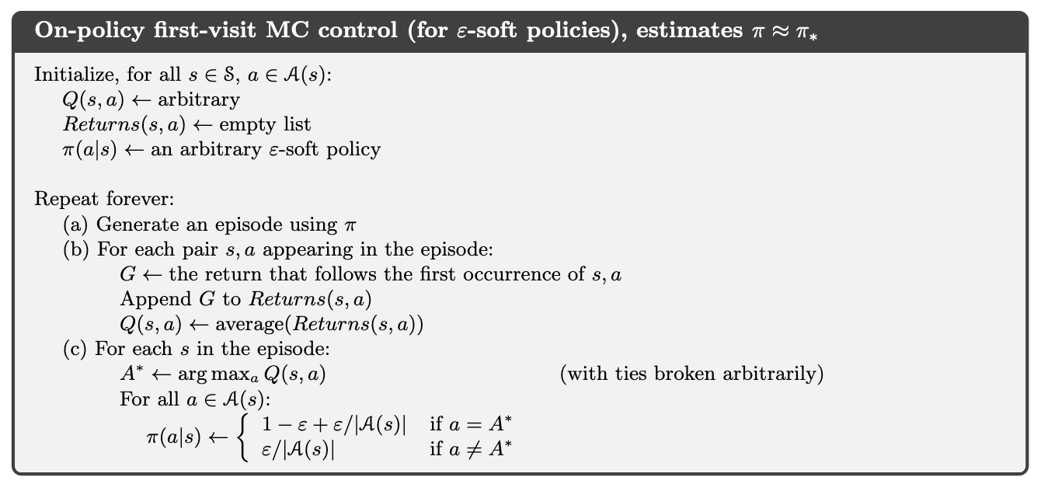
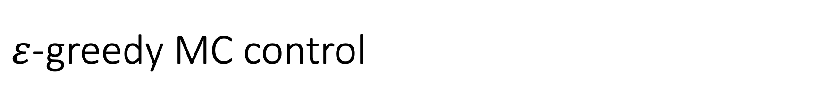
$ε$-greedy MC control

Slide 14


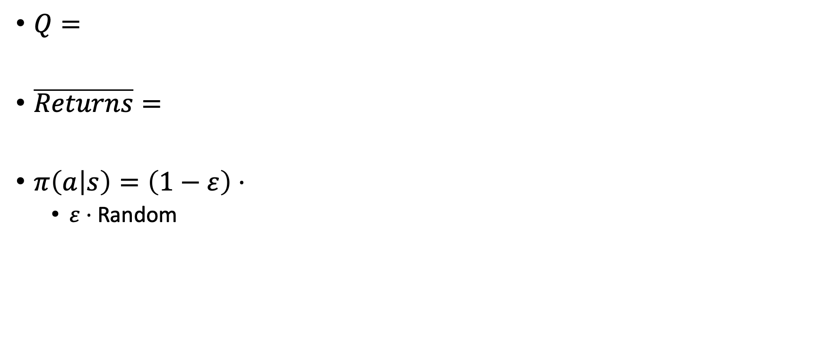
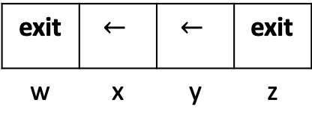
MC control - example
$$γ=0.9$$
-100
+10
w | x | y | z
5 | 4,3 | 2,1 | 0
w | x | y | z
$Q=$
$\overline{Returns}=$
$π\left(a | s\right)=\left(1−ε\right)⋅$
  $ε⋅$ Random
- | -,- | -,- | -
w | x | y | z
exit | $$←$$ | $$←$$ | exit
w | x | y | z

Slide 15
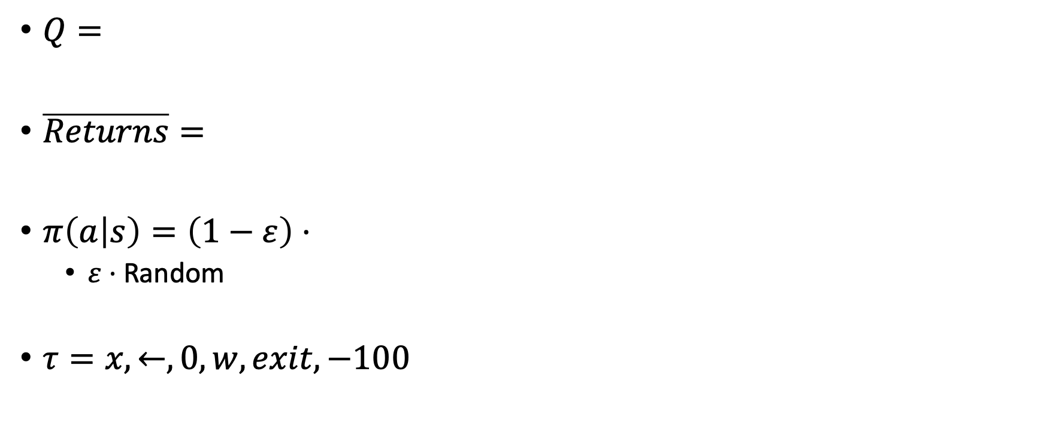
MC control - example
$$γ=0.9$$
-100
+10
w | x | y | z
5 | 4,3 | 2,1 | 0
w | x | y | z
$Q=$
$\overline{Returns}=$
$π\left(a | s\right)=\left(1−ε\right)⋅$
  $ε⋅$ Random
$τ=x,←,0,w,exit,−100$
- | -,- | -,- | -
w | x | y | z
exit | $$←$$ | $$←$$ | exit
w | x | y | z

Slide 16
MC control - example
$$γ=0.9$$
-100
+10
w | x | y | z
5 | 4,3 | 2,1 | 0
w | x | y | z
$Q=$
$\overline{Returns}=$
$π\left(a | s\right)=\left(1−ε\right)⋅$
  $ε⋅$ Random
$τ=x,←,0,w,exit,−100$
-100 | -90,0 | -,- | -
w | x | y | z
exit | $$←$$ | $$←$$ | exit
w | x | y | z

Slide 17
MC control - example
$$γ=0.9$$
-100
+10
w | x | y | z
-100 | -90,3 | 2,1 | 0
w | x | y | z
$Q=$
$\overline{Returns}=$
$π\left(a | s\right)=\left(1−ε\right)⋅$
  $ε⋅$ Random
$τ=x,←,0,w,exit,−100$
-100 | -90,0 | -,- | -
w | x | y | z
exit | $$←$$ | $$←$$ | exit
w | x | y | z

Slide 18
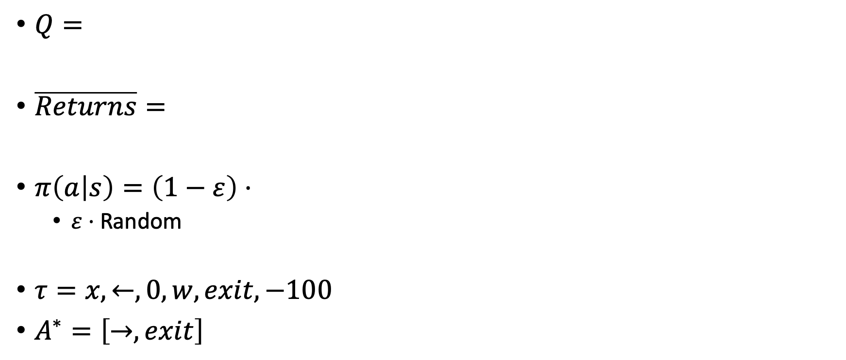
MC control - example
$$γ=0.9$$
-100
+10
w | x | y | z
-100 | -90,3 | 2,1 | 0
w | x | y | z
$Q=$
$\overline{Returns}=$
$π\left(a | s\right)=\left(1−ε\right)⋅$
  $ε⋅$ Random
$τ=x,←,0,w,exit,−100$
$A^{∗}=\left[→,exit\right]$
-100 | -90,0 | -,- | -
w | x | y | z
exit | $$←$$ | $$←$$ | exit
w | x | y | z

Slide 19
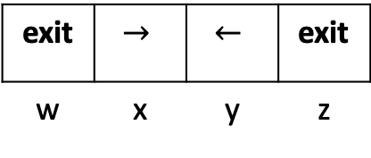
MC control - example
$$γ=0.9$$
-100
+10
w | x | y | z
-100 | -90,3 | 2,1 | 0
w | x | y | z
$Q=$
$\overline{Returns}=$
$π\left(a | s\right)=\left(1−ε\right)⋅$
  $ε⋅$ Random
$τ=x,←,0,w,exit,−100$
$A^{∗}=\left[→,exit\right]$
-100 | -90,0 | -,- | -
w | x | y | z
exit | $$→$$ | $$←$$ | exit
w | x | y | z

Slide 20
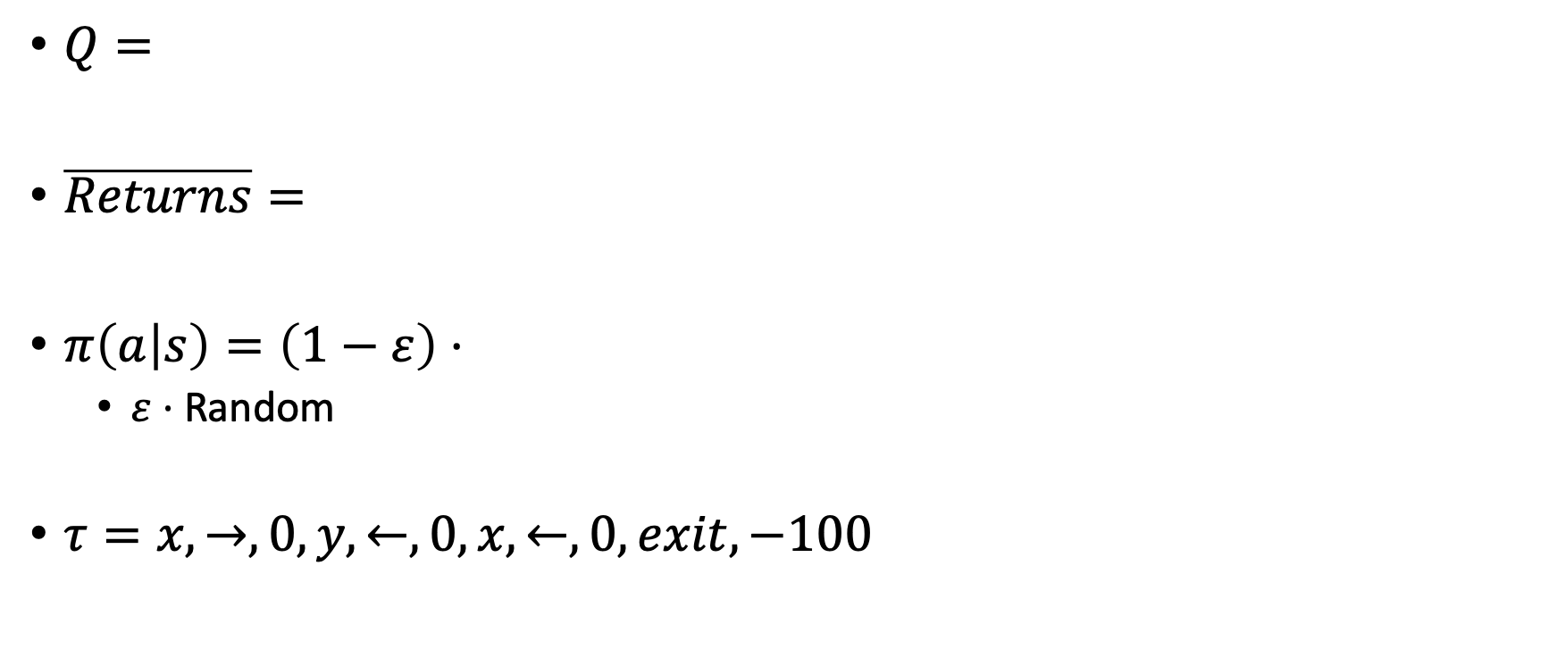
MC control - example
$$γ=0.9$$
-100
+10
w | x | y | z
-100 | -90,3 | 2,1 | 0
w | x | y | z
$Q=$
$\overline{Returns}=$
$π\left(a | s\right)=\left(1−ε\right)⋅$
  $ε⋅$ Random
$τ=x,→,0,y,←,0,x,←,0,exit,−100$
-100 | -90,0 | -,- | -
w | x | y | z
exit | $$→$$ | $$←$$ | exit
w | x | y | z

Slide 21
MC control - example
$$γ=0.9$$
-100
+10
w | x | y | z
-100 | -90,-72.9 | -81,1 | 0
w | x | y | z
$Q=$
$\overline{Returns}=$
$π\left(a | s\right)=\left(1−ε\right)⋅$
  $ε⋅$ Random
$τ=x,→,0,y,←,0,x,←,0,exit,−100$
-100 | -90,-72.9 | -81,- | -
w | x | y | z
exit | $$→$$ | $$←$$ | exit
w | x | y | z

Slide 22
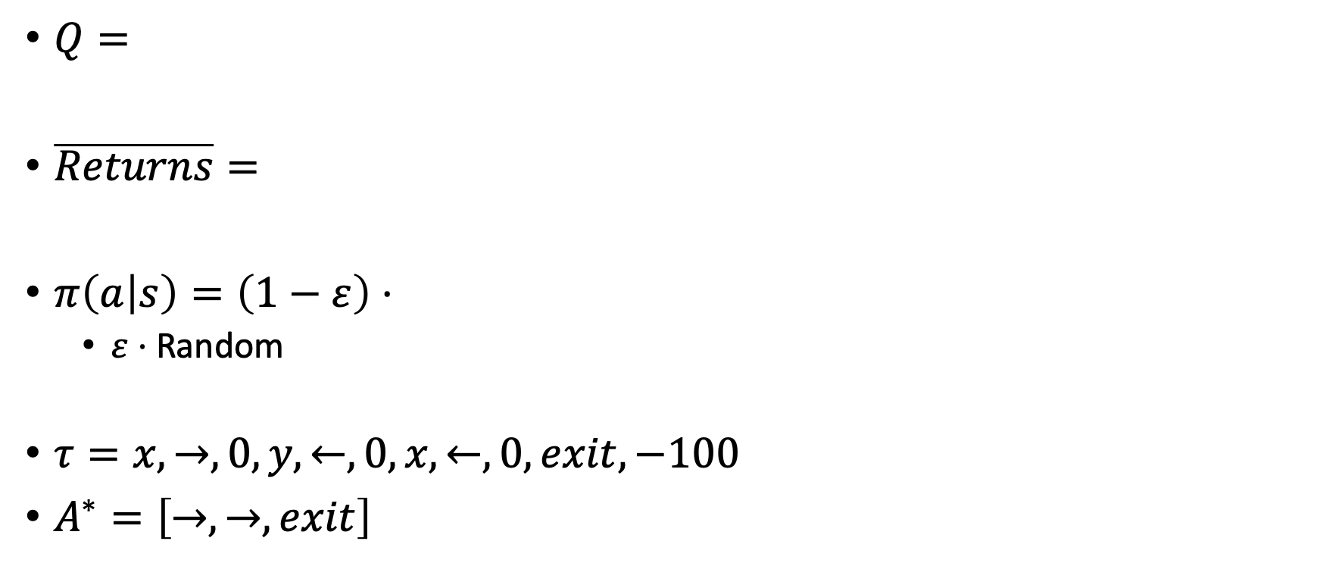
MC control - example
$$γ=0.9$$
-100
+10
w | x | y | z
-100 | -90,-72.9 | -81,1 | 0
w | x | y | z
$Q=$
$\overline{Returns}=$
$π\left(a | s\right)=\left(1−ε\right)⋅$
  $ε⋅$ Random
$τ=x,→,0,y,←,0,x,←,0,exit,−100$
$A^{∗}=\left[→,→,exit\right]$
-100 | -90,-72.9 | -81,- | -
w | x | y | z
exit | $$→$$ | $$←$$ | exit
w | x | y | z

Slide 23
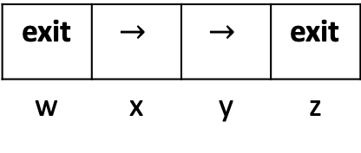
MC control - example
$$γ=0.9$$
-100
+10
w | x | y | z
-100 | -90,-72.9 | -81,1 | 0
w | x | y | z
$Q=$
$\overline{Returns}=$
$π\left(a | s\right)=\left(1−ε\right)⋅$
  $ε⋅$ Random
$τ=x,→,0,y,←,0,x,←,0,exit,−100$
$A^{∗}=\left[→,→,exit\right]$
-100 | -90,-72.9 | -81,- | -
w | x | y | z
exit | $$→$$ | $$→$$ | exit
w | x | y | z

Slide 24

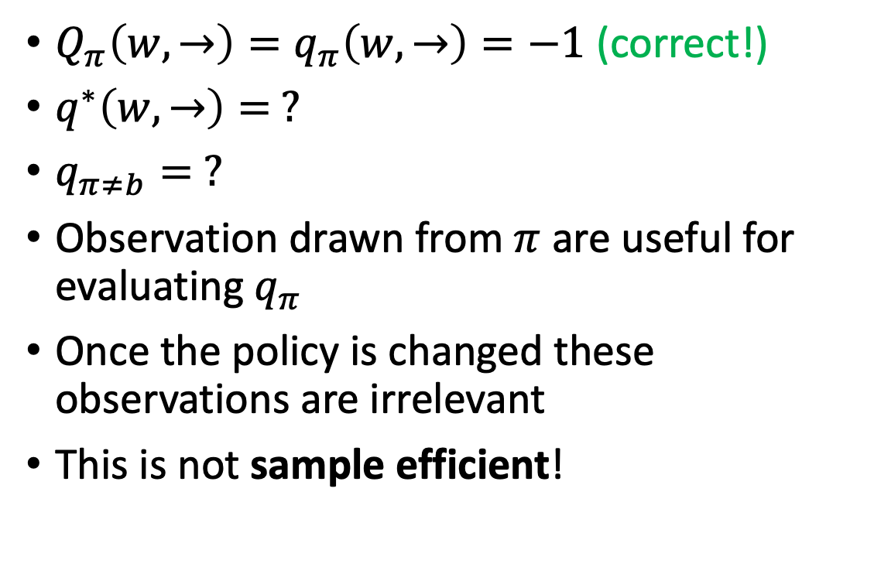
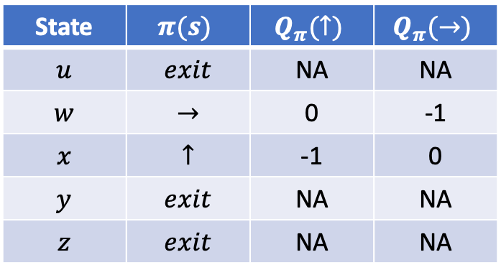


On-policy learning
Estimation
True value
$$z$$
$Q_{π}\left(w,→\right)=q_{π}\left(w,→\right)=−1$ (correct!)
$q^{∗}\left(w,→\right)= ?$
$q_{π≠b}= ?$
Observation drawn from $π$ are useful for evaluating $q_{π}$
Once the policy is changed these observations are irrelevant
This is not sample efficient!
-1
$$u$$
$$w$$
$$y$$
+1
+10
State | $$π(s)$$ | $$Q_{π}(↑)$$ | $$Q_{π}(→)$$
$$u$$ | $$exit$$ | NA | NA
$$w$$ | $$→$$ | 0 | -1
$$x$$ | $$↑$$ | -1 | 0
$$y$$ | $$exit$$ | NA | NA
$$z$$ | $$exit$$ | NA | NA

Slide 25
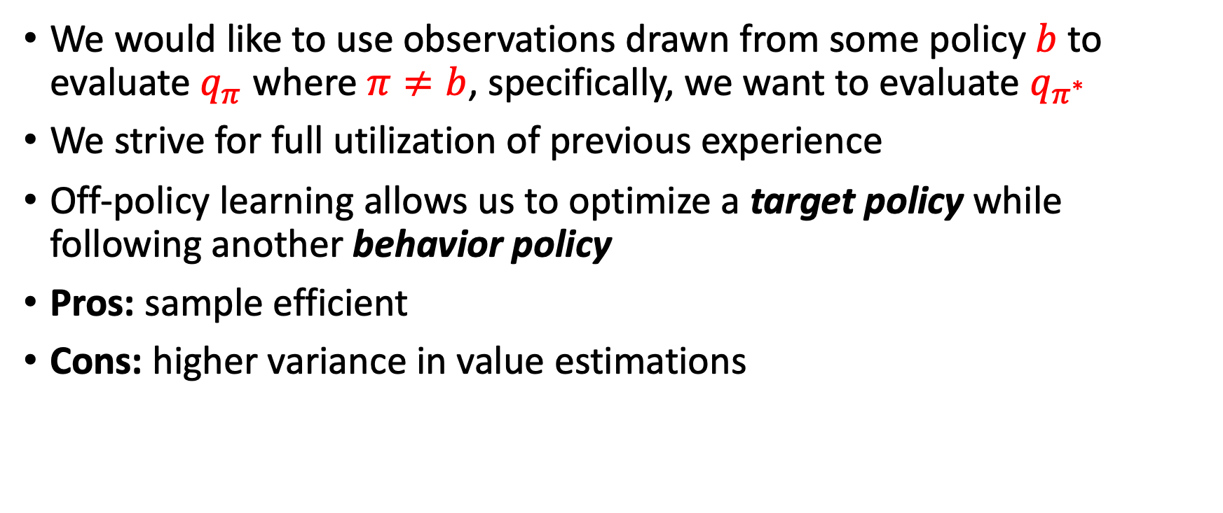
Off-policy learning
We would like to use observations drawn from some policy $b$ to evaluate $q_{π}$ where $π≠b$, specifically, we want to evaluate $q_{π^{∗}}$
We strive for full utilization of previous experience
Off-policy learning allows us to optimize a target policy while following another behavior policy
Pros: sample efficient
Cons: higher variance in value estimations

Slide 26
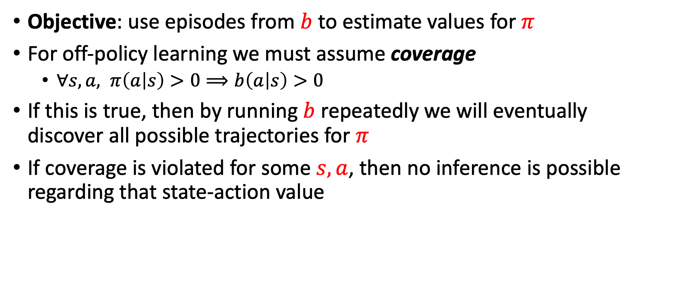
Off-policy learning conditions
Objective: use episodes from $b$ to estimate values for $π$
For off-policy learning we must assume coverage
  $∀s,a, π\left(a | s\right)>0⟹b\left(a | s\right)>0$
If this is true, then by running $b$ repeatedly we will eventually discover all possible trajectories for $π$
If coverage is violated for some $s,a$, then no inference is possible regarding that state-action value

Slide 27
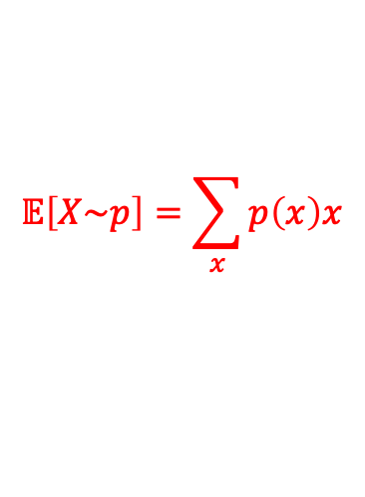
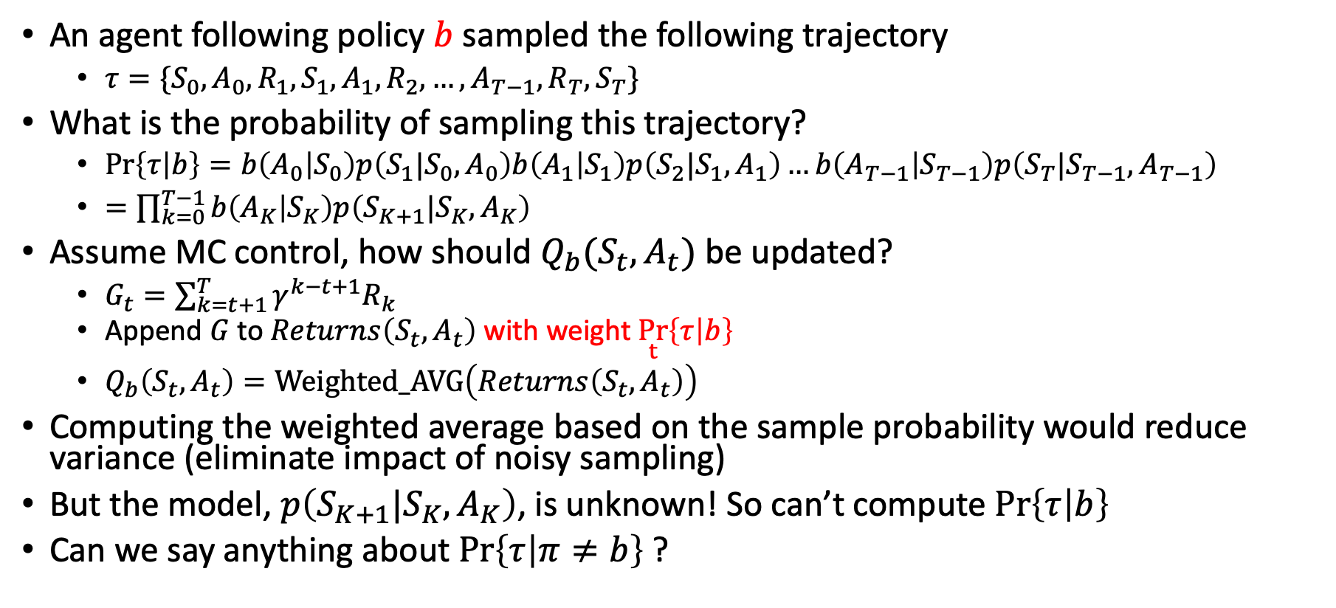
Trajectory probability
An agent following policy $b$ sampled the following trajectory
  $τ=\{S_{0},A_{0},R_{1},S_{1},A_{1},R_{2},…,A_{T−1},R_{T},S_{T}\}$
What is the probability of sampling this trajectory?
  $\operatorname{Pr}\left\{τ | b\right\}=b\left(A_{0} | S_{0}\right)p\left(S_{1}|S_{0},A_{0}\right)b\left(A_{1} | S_{1}\right)p\left(S_{2}|S_{1},A_{1}\right)…b\left(A_{T−1} | S_{T−1}\right)p\left(S_{T}|S_{T−1},A_{T−1}\right)$
  $=\prod_{k=0}^{T−1}{b\left(A_{K} | S_{K}\right)p\left(S_{K+1}|S_{K},A_{K}\right)}$
Assume MC control, how should $Q_{b}(S_{t},A_{t})$ be updated?
  $G_{t}=\sum_{k=t+1}^{T}{γ^{k−t+1}R_{k}}$
  Append $G$ to $Returns\left(S_{t},A_{t}\right)$ with weight $\underset{t}{Pr}\left\{τ | b\right\}$
  $Q_{b}\left(S_{t},A_{t}\right)=Weighted_AVG\left(Returns\left(S_{t},A_{t}\right)\right)$
Computing the weighted average based on the sample probability would reduce variance (eliminate impact of noisy sampling)
But the model, $p\left(S_{K+1}|S_{K},A_{K}\right)$, is unknown! So can’t compute $\operatorname{Pr}\left\{τ | b\right\}$
Can we say anything about $\operatorname{Pr}\left\{τ | π≠b\right\}$ ?
$$𝔼\left[X\sim p\right]=\sum_{x}{p\left(x\right)x}$$

Slide 28
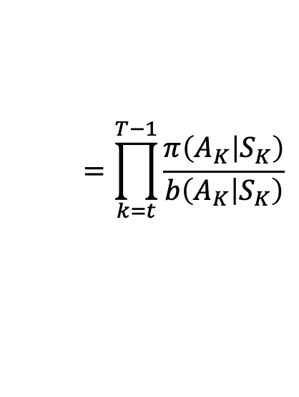
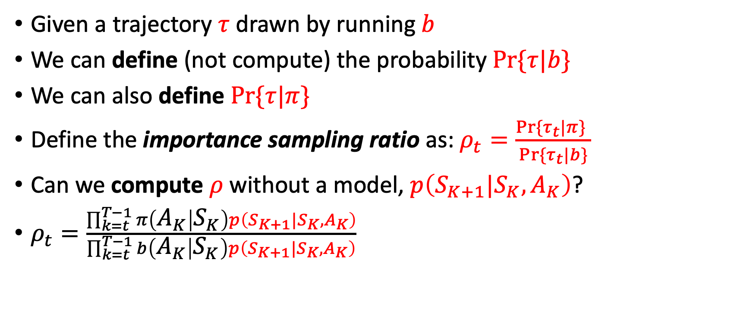
Importance sampling
Given a trajectory $τ$ drawn by running $b$
We can define (not compute) the probability $Pr⁡\{τ|b\}$
We can also define $Pr⁡\{τ|π\}$
Define the importance sampling ratio as: $ρ_{t}=\frac{Pr⁡\{τ_{t}|π\} }{Pr⁡\{τ_{t}|b\}}$
Can we compute $ρ$ without a model, $p\left(S_{K+1}|S_{K},A_{K}\right)$?
$ρ_{t}=\frac{\prod_{k=t}^{T−1}{π\left(A_{K} | S_{K}\right)p\left(S_{K+1}|S_{K},A_{K}\right)}}{\prod_{k=t}^{T−1}{b\left(A_{K} | S_{K}\right)p\left(S_{K+1}|S_{K},A_{K}\right)}}$
$$=\prod_{k=t}^{T−1}{\frac{π\left(A_{K} | S_{K}\right)}{b\left(A_{K} | S_{K}\right)}}$$
YES!

Slide 29
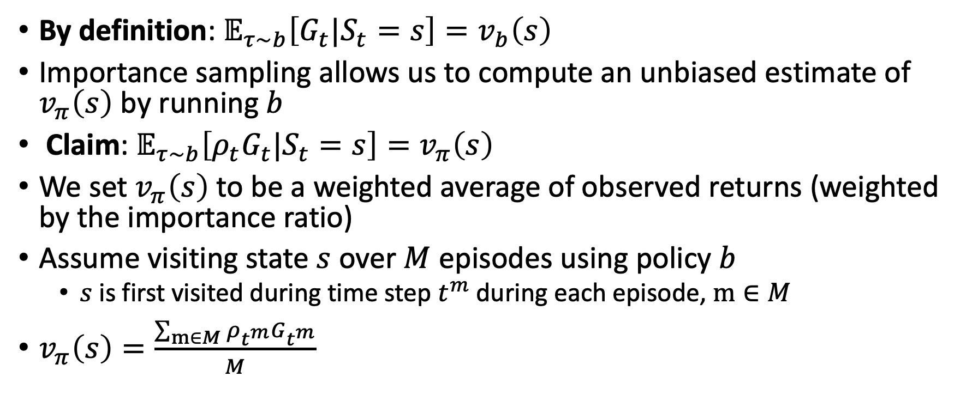
Importance sampling
By definition: $𝔼_{τ\sim b}\left[G_{t}|S_{t}=s\right]=v_{b}\left(s\right)$
Importance sampling allows us to compute an unbiased estimate of $v_{π}\left(s\right)$ by running $b$
Claim: $𝔼_{τ\sim b}\left[ρ_{t}G_{t}|S_{t}=s\right]=v_{π}\left(s\right)$
We set $v_{π}\left(s\right)$ to be a weighted average of observed returns (weighted by the importance ratio)
Assume visiting state $s$ over $M$ episodes using policy $b$
  $s$ is first visited during time step $t^{m}$ during each episode, $m∈M$
$v_{π}\left(s\right)=\frac{\sum_{m∈M}{ρ_{t^{m}}}G_{t^{m}}}{M}$

Slide 30
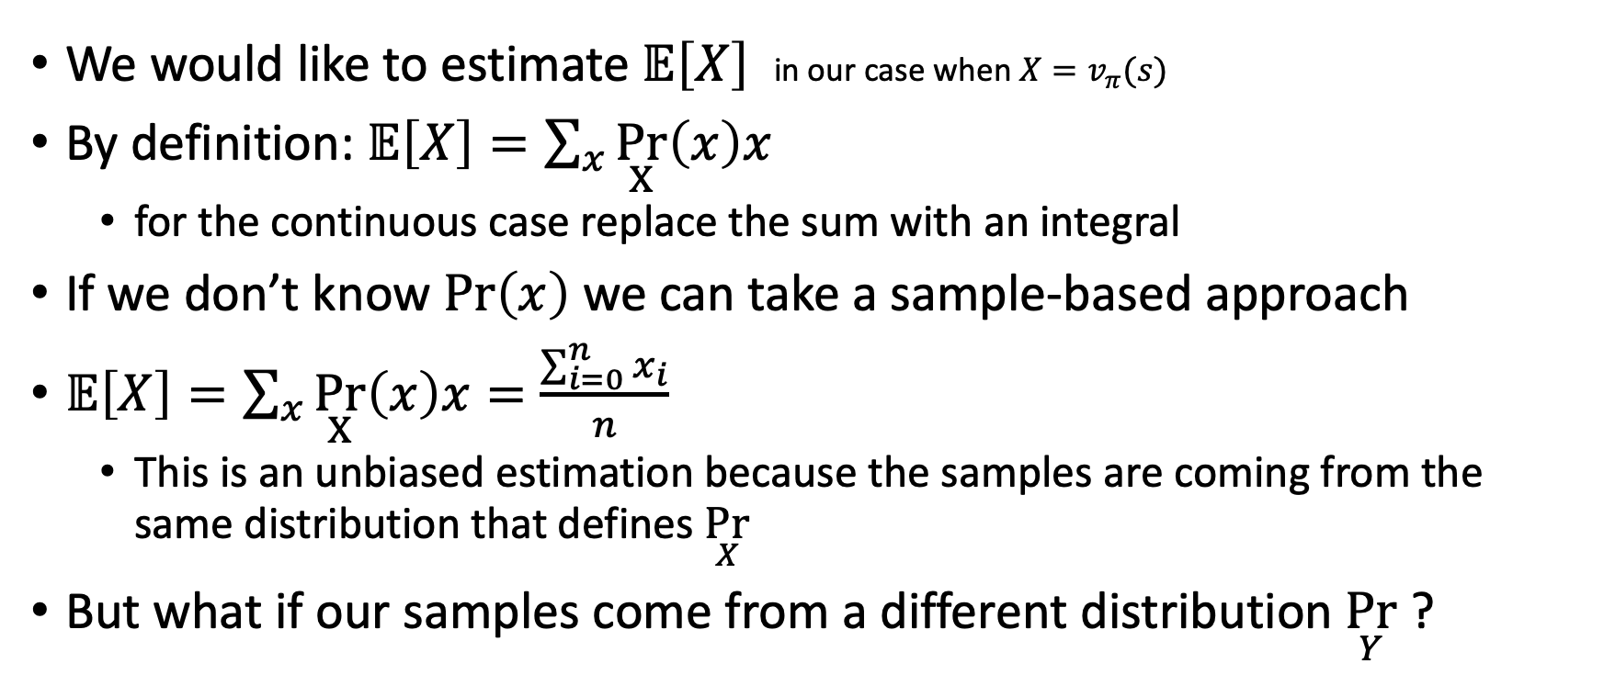
Importance sampling: proof
We would like to estimate $𝔼\left[X\right]$ in our case when ${X=v}_{π}(s)$
By definition: $𝔼\left[X\right]=\sum_{x}{\underset{X}{Pr}\left(x\right)x}$
  for the continuous case replace the sum with an integral
If we don’t know $\operatorname{Pr}\left(x\right)$ we can take a sample-based approach
$𝔼\left[X\right]=\sum_{x}{\underset{X}{Pr}\left(x\right)x}=\frac{\sum_{i=0}^{n}{x_{i}}}{n}$
  This is an unbiased estimation because the samples are coming from the same distribution that defines $\underset{X}{Pr}$
But what if our samples come from a different distribution $\underset{Y}{Pr}$ ?

Slide 31
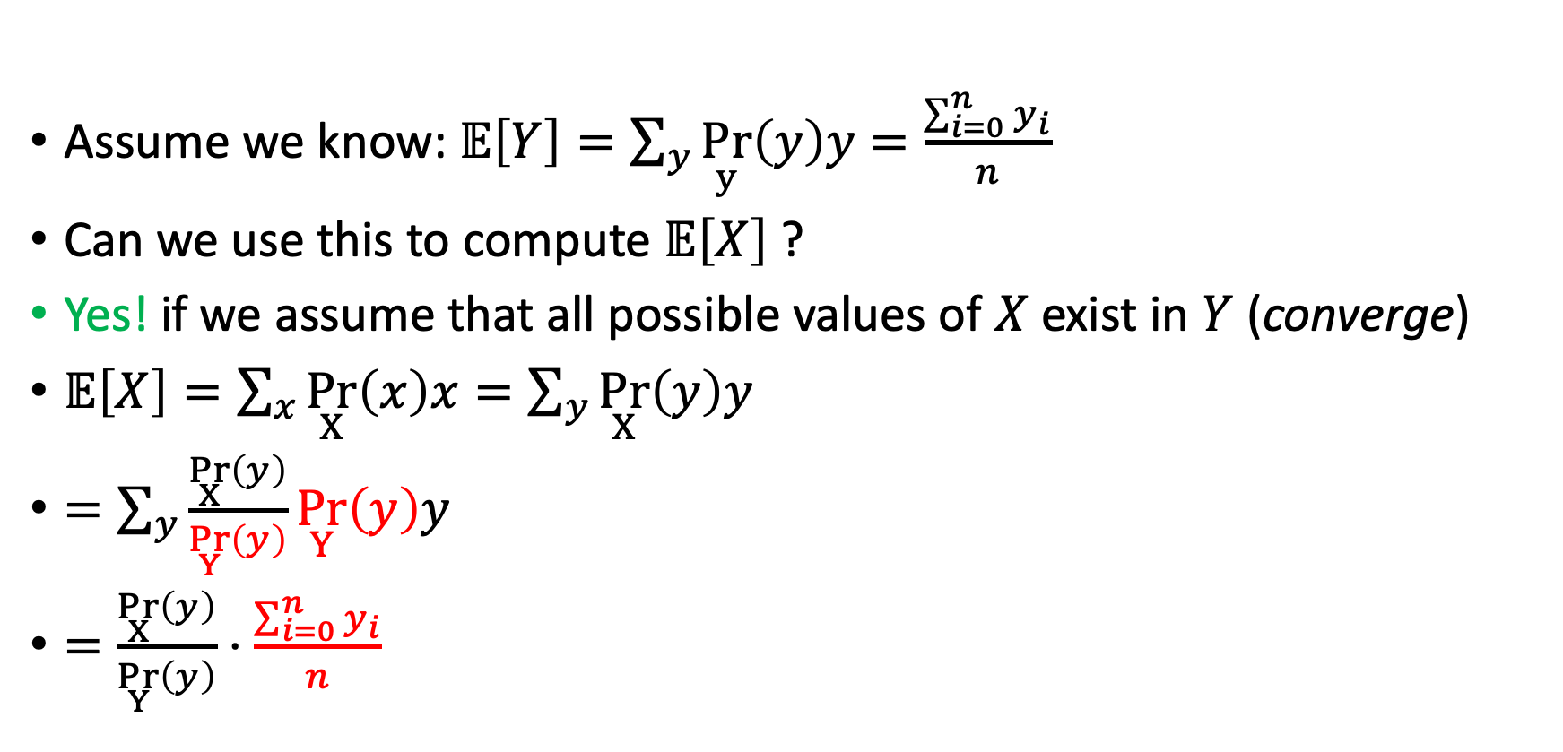
Importance sampling: proof
Assume we know: $𝔼\left[Y\right]=\sum_{y}{\underset{y}{Pr}\left(y\right)y}=\frac{\sum_{i=0}^{n}{y_{i}}}{n}$
Can we use this to compute $𝔼\left[X\right]$ ?
Yes! if we assume that all possible values of $X$ exist in $Y$ (converge)
$𝔼\left[X\right]=\sum_{x}{\underset{X}{Pr}\left(x\right)x}=\sum_{y}{\underset{X}{Pr}\left(y\right)y}$
$=\sum_{y}{\frac{\underset{X}{Pr}\left(y\right)}{\underset{Y}{Pr}\left(y\right)}{\underset{Y}{Pr}\left(y\right)y}}$
$=\frac{\underset{X}{Pr}\left(y\right)}{\underset{Y}{Pr}\left(y\right)}⋅\frac{\sum_{i=0}^{n}{y_{i}}}{n}$
Importance ratio

Slide 32


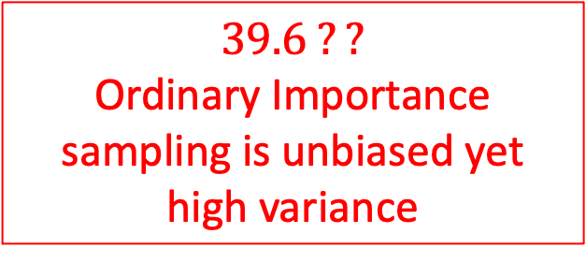
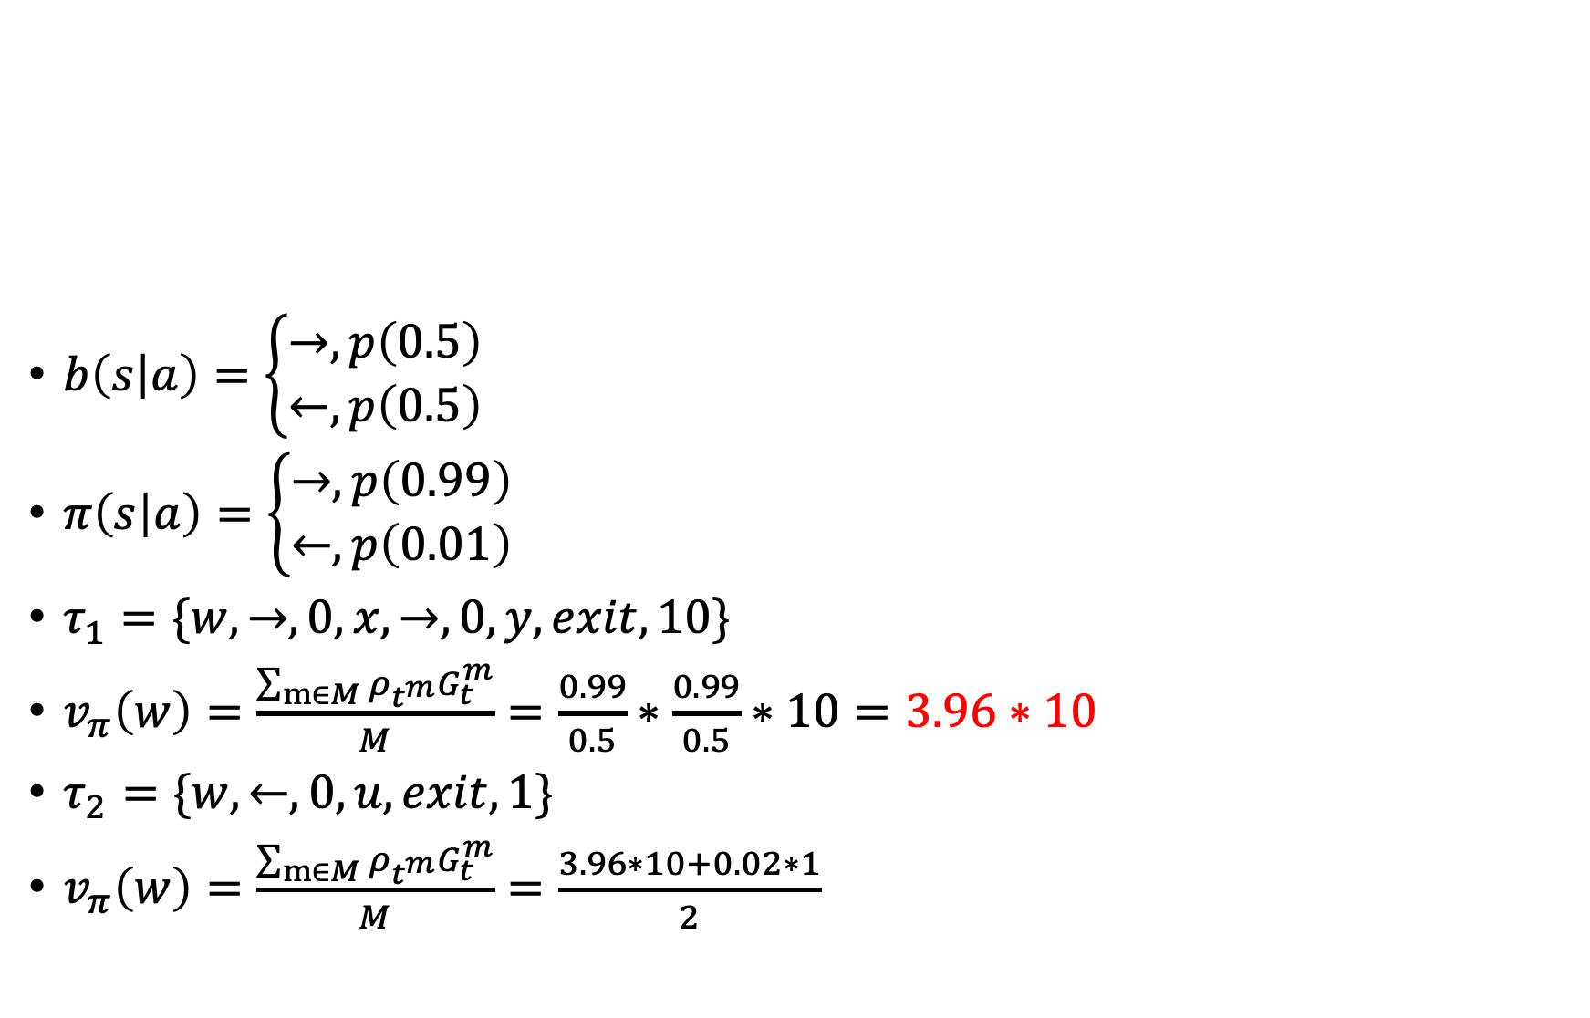



(ordinary) Importance sampling - example
$b\left(s | a\right)=\left\{\begin{aligned}→, p\left(0.5\right) \\ ←, p\left(0.5\right)\end{aligned}\right.$
$π\left(s | a\right)=\left\{\begin{aligned}→, p\left(0.99\right) \\ ←, p\left(0.01\right)\end{aligned}\right.$
$τ_{1}=\{w,→,0,x,→,0,y,exit,10\}$
$v_{π}\left(w\right)=\frac{\sum_{m∈M}{ρ_{t^{m}}}G_{t}^{m}}{M}=\frac{0.99}{0.5}∗\frac{0.99}{0.5}∗10=3.96∗10$
$τ_{2}=\{w,←,0,u,exit,1\}$
$v_{π}\left(w\right)=\frac{\sum_{m∈M}{ρ_{t^{m}}}G_{t}^{m}}{M}=\frac{3.96∗10+0.02∗1}{2}$
$$z$$
-1
$$u$$
$$w$$
$$y$$
+1
+10
$$x$$
$$39.6 ??$$
Ordinary Importance sampling is unbiased yet high variance

Slide 33
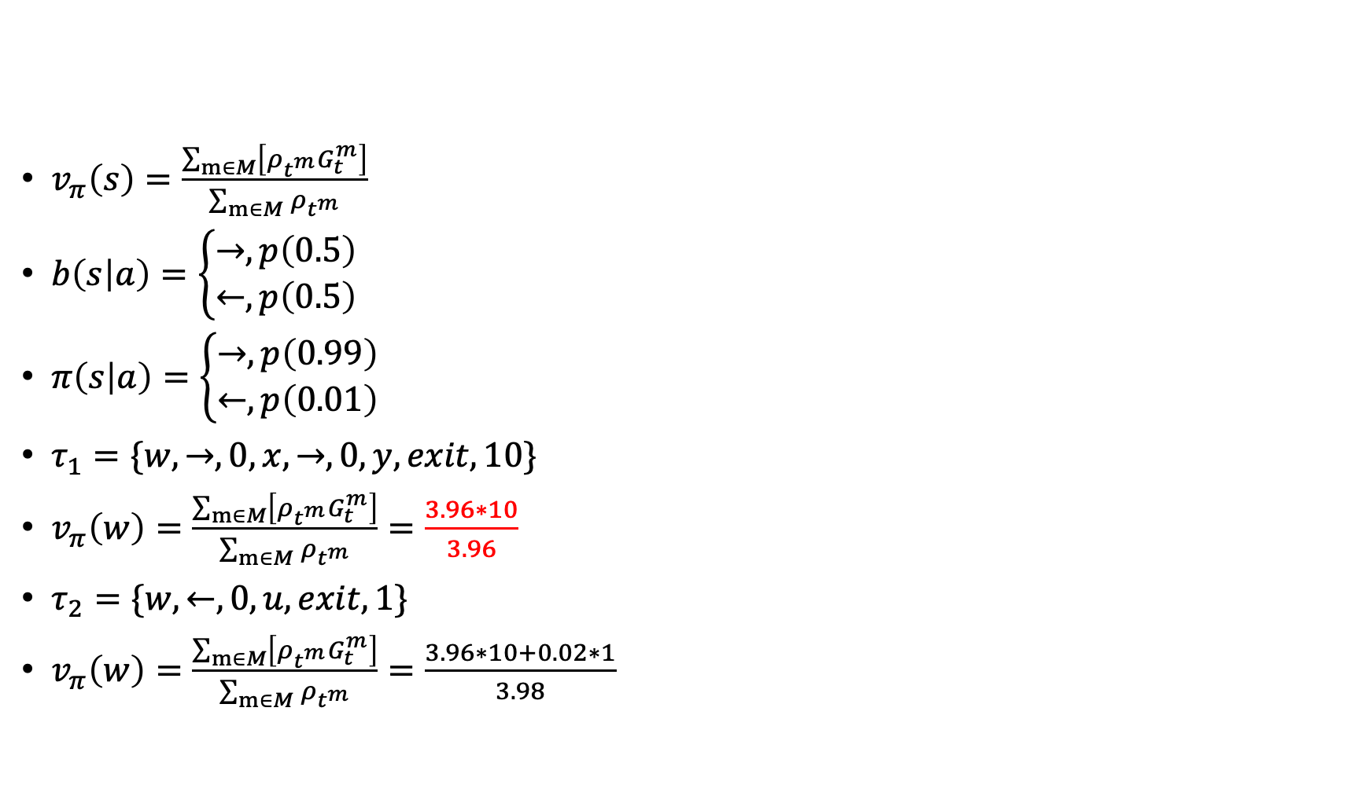
Weighted importance sampling
Trick: normalize by the sum of importance ratios
$v_{π}\left(s\right)=\frac{\sum_{m∈M}{\left[{ρ_{t^{m}}G}_{t}^{m}\right]}}{\sum_{m∈M}{ρ_{t^{m}}}}$
$b\left(s | a\right)=\left\{\begin{aligned}→, p\left(0.5\right) \\ ←, p\left(0.5\right)\end{aligned}\right.$
$π\left(s | a\right)=\left\{\begin{aligned}→, p\left(0.99\right) \\ ←, p\left(0.01\right)\end{aligned}\right.$
$τ_{1}=\{w,→,0,x,→,0,y,exit,10\}$
$v_{π}\left(w\right)=\frac{\sum_{m∈M}{\left[{ρ_{t^{m}}G}_{t}^{m}\right]}}{\sum_{m∈M}{ρ_{t^{m}}}}=\frac{3.96∗10}{3.96}$
$τ_{2}=\{w,←,0,u,exit,1\}$
$v_{π}\left(w\right)=\frac{\sum_{m∈M}{\left[{ρ_{t^{m}}G}_{t}^{m}\right]}}{\sum_{m∈M}{ρ_{t^{m}}}}=\frac{3.96∗10+0.02∗1}{3.98}$
$$z$$
-1
$$u$$
$$w$$
$$y$$
+1
+10
$$x$$
Ordinary Importance sampling is unbiased while the weighted version is biased (initially). Ordinary Importance sampling results in high variance while the weighted version has a bounded variance

Slide 34
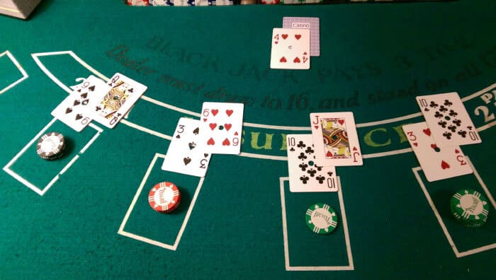
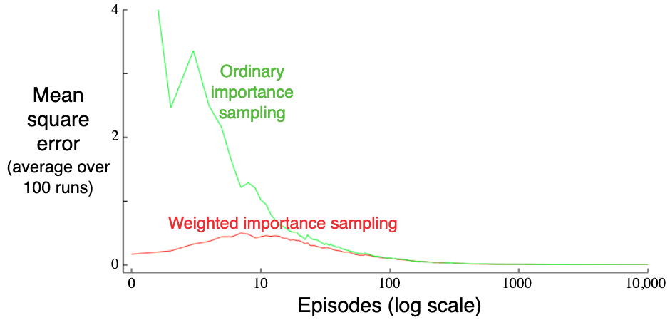
Ordinary vs weighted importance sampling
Estimating a black-jack state
Target policy: hit on 19 or below
Behavior policy: random (uniform)
Both approaches converge to the true value
weighted importance sampling is much better initially

Slide 35
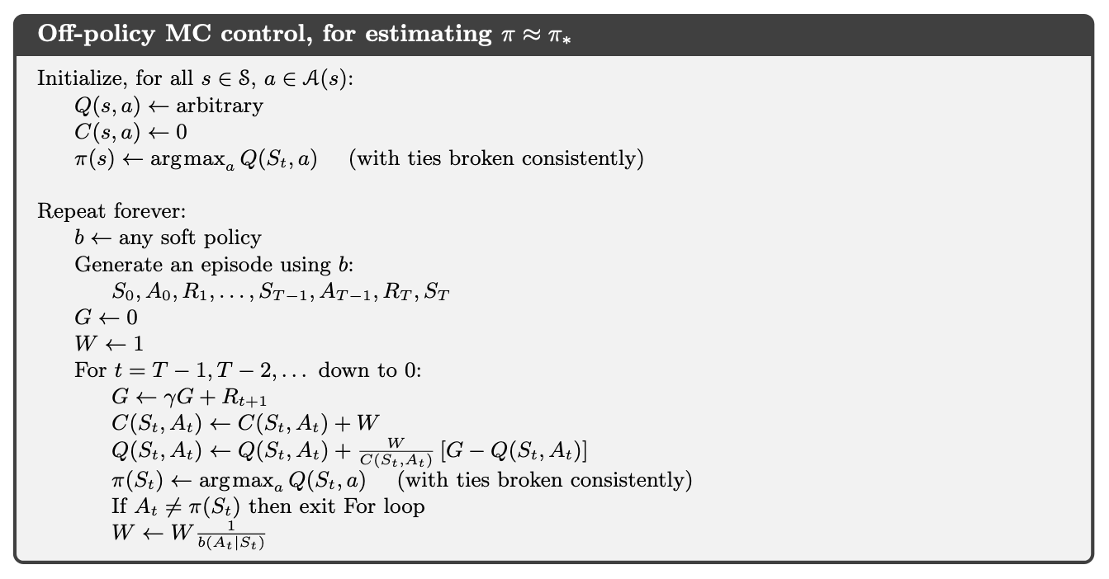
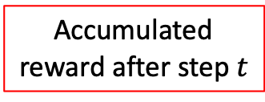
MC control + importance sampling
Accumulated reward after step $t$

Slide 36
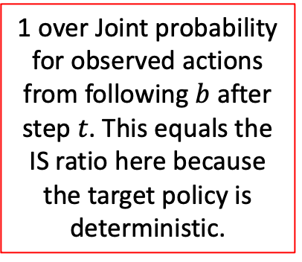
MC control + importance sampling
1 over Joint probability for observed actions from following $b$ after step $t$. This equals the IS ratio here because the target policy is deterministic.

Slide 37
MC control + importance sampling
Going back in time

Slide 38
MC control + importance sampling
Discount future rewards and add immediate reward

Slide 39
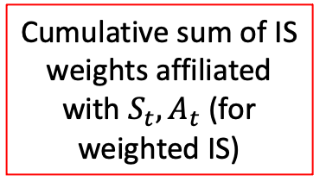
MC control + importance sampling
Cumulative sum of IS weights affiliated with $S_{t},A_{t}$ (for weighted IS)

Slide 40
MC control + importance sampling
Incremental update of Q values (waited moving average)

Slide 41
MC control + importance sampling
Update target policy (greedy)

Slide 42
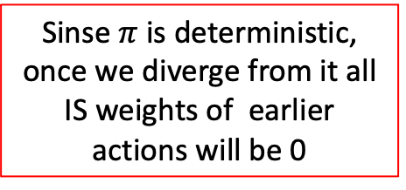
MC control + importance sampling
Sinse $π$ is deterministic, once we diverge from it all IS weights of earlier actions will be 0

Slide 43
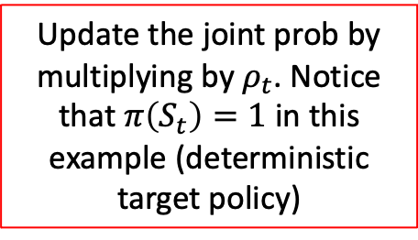
MC control + importance sampling
Update the joint prob by multiplying by $ρ_{t}$. Notice that $π\left(S_{t}\right)=1$ in this example (deterministic target policy)

Slide 44

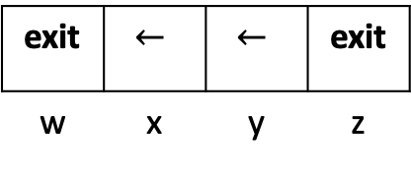
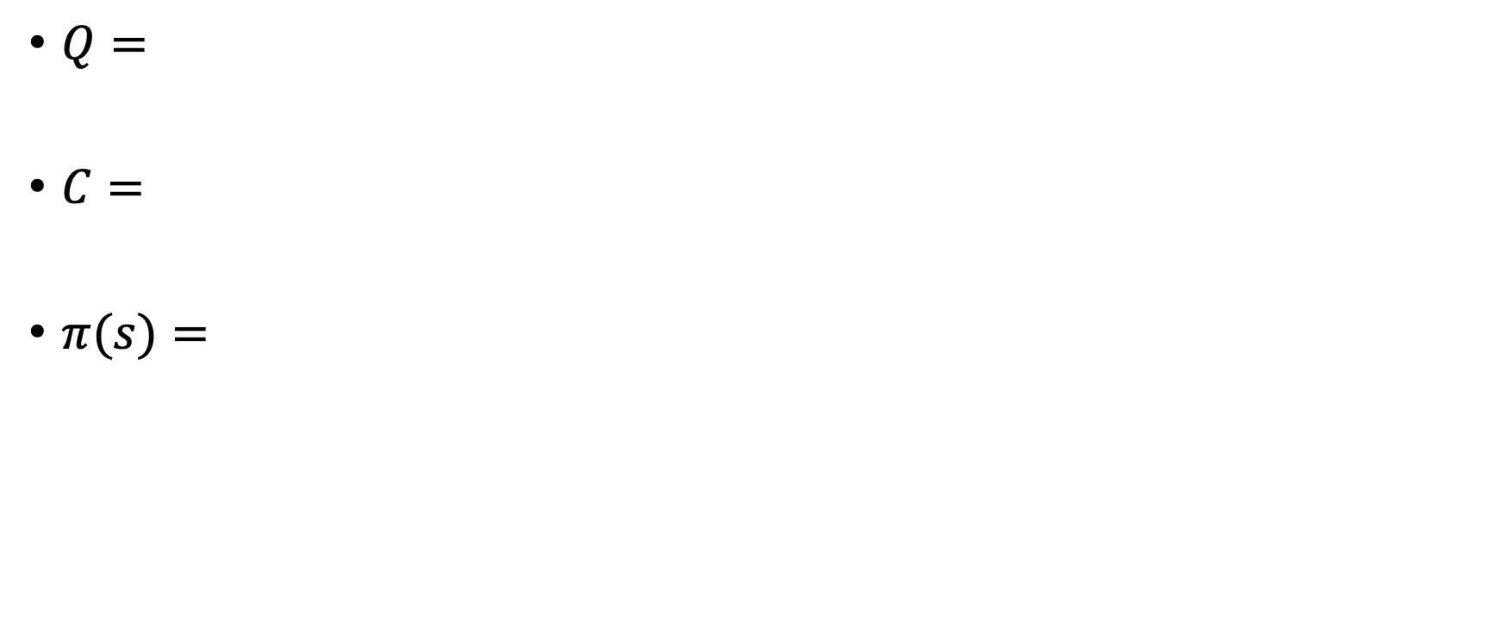
MC control + IS example
$$γ=0.9$$
-100
+10
w | x | y | z
- | 4,3 | 2,1 | -
w | x | y | z
$Q=$
$C=$
$π(s)=$
- | 0,0 | 0,0 | -
w | x | y | z
exit | $$←$$ | $$←$$ | exit
w | x | y | z

Slide 45
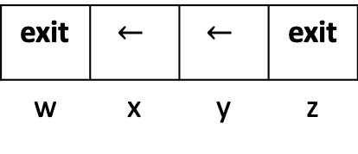
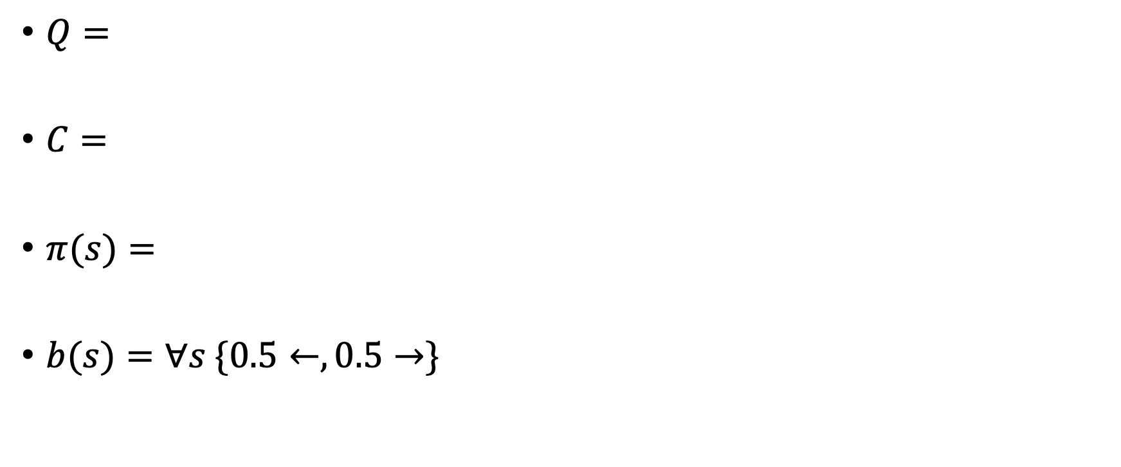
MC control + IS example
$$γ=0.9$$
-100
+10
w | x | y | z
- | 4,3 | 2,1 | -
w | x | y | z
$Q=$
$C=$
$π(s)=$
$b(s)=∀s \{0.5←, 0.5→\}$
- | 0,0 | 0,0 | -
w | x | y | z
exit | $$←$$ | $$←$$ | exit
w | x | y | z

Slide 46
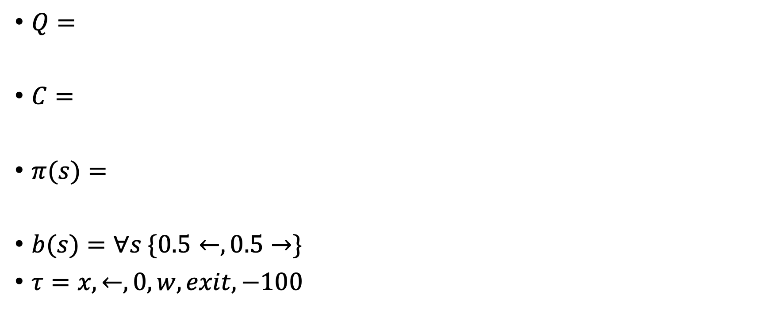
MC control + IS example
$$γ=0.9$$
-100
+10
w | x | y | z
5 | 4,3 | 2,1 | 5
w | x | y | z
$Q=$
$C=$
$π(s)=$
$b(s)=∀s \{0.5←, 0.5→\}$
$τ=x,←,0,w,exit,−100$
0 | 0,0 | 0,0 | 0
w | x | y | z
exit | $$←$$ | $$←$$ | exit
w | x | y | z

Slide 47
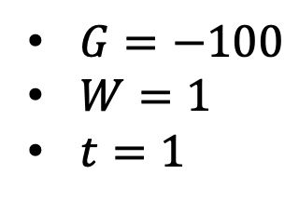
MC control + IS example
$$γ=0.9$$
-100
+10
w | x | y | z
5 | 4,3 | 2,1 | 5
w | x | y | z
$G=−100$
$W=1$
$t=1$
$Q=$
$C=$
$π(s)=$
$b(s)=∀s \{0.5←, 0.5→\}$
$τ=x,←,0,w,exit,−100$
0 | 0,0 | 0,0 | 0
w | x | y | z
exit | $$←$$ | $$←$$ | exit
w | x | y | z

Slide 48
MC control + IS example
$$γ=0.9$$
-100
+10
w | x | y | z
5 | 4,3 | 2,1 | 5
w | x | y | z
$G=−100$
$W=1$
$t=1$
$Q=$
$C=$
$π(s)=$
$b(s)=∀s \{0.5←, 0.5→\}$
$τ=x,←,0,w,exit,−100$
1 | 0,0 | 0,0 | 0
w | x | y | z
exit | $$←$$ | $$←$$ | exit
w | x | y | z

Slide 49
MC control + IS example
$$γ=0.9$$
-100
+10
w | x | y | z
-100 | 4,3 | 2,1 | 5
w | x | y | z
$G=−100$
$W=1$
$t=1$
$Q=$
$C=$
$π(s)=$
$b(s)=∀s \{0.5←, 0.5→\}$
$τ=x,←,0,w,exit,−100$
1 | 0,0 | 0,0 | 0
w | x | y | z
exit | $$←$$ | $$←$$ | exit
w | x | y | z

Slide 50
MC control + IS example
$$γ=0.9$$
-100
+10
w | x | y | z
-100 | 4,3 | 2,1 | 5
w | x | y | z
$G=−100$
$W=1$
$t=1$
$Q=$
$C=$
$π(s)=$
$b(s)=∀s \{0.5←, 0.5→\}$
$τ=x,←,0,w,exit,−100$
1 | 0,0 | 0,0 | 0
w | x | y | z
exit | $$←$$ | $$←$$ | exit
w | x | y | z

Slide 51
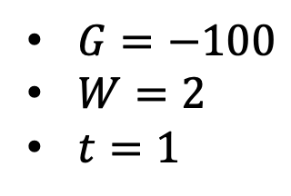
MC control + IS example
$$γ=0.9$$
-100
+10
w | x | y | z
-100 | 4,3 | 2,1 | 5
w | x | y | z
$G=−100$
$W=2$
$t=1$
$Q=$
$C=$
$π(s)=$
$b(s)=∀s \{0.5←, 0.5→\}$
$τ=x,←,0,w,exit,−100$
1 | 0,0 | 0,0 | 0
w | x | y | z
exit | $$←$$ | $$←$$ | exit
w | x | y | z

Slide 52

MC control + IS example
$$γ=0.9$$
-100
+10
w | x | y | z
-100 | 4,3 | 2,1 | 5
w | x | y | z
$G=−90$
$W=2$
$t=0$
$Q=$
$C=$
$π(s)=$
$b(s)=∀s \{0.5←, 0.5→\}$
$τ=x,←,0,w,exit,−100$
1 | 0,0 | 0,0 | 0
w | x | y | z
exit | $$←$$ | $$←$$ | exit
w | x | y | z

Slide 53
MC control + IS example
$$γ=0.9$$
-100
+10
w | x | y | z
-100 | 4,3 | 2,1 | 5
w | x | y | z
$G=−90$
$W=2$
$t=0$
$Q=$
$C=$
$π(s)=$
$b(s)=∀s \{0.5←, 0.5→\}$
$τ=x,←,0,w,exit,−100$
1 | 2,0 | 0,0 | 0
w | x | y | z
exit | $$←$$ | $$←$$ | exit
w | x | y | z

Slide 54
MC control + IS example
$$γ=0.9$$
-100
+10
w | x | y | z
-100 | -90,3 | 2,1 | 5
w | x | y | z
$G=−90$
$W=2$
$t=0$
$Q=$
$C=$
$π(s)=$
$b(s)=∀s \{0.5←, 0.5→\}$
$τ=x,←,0,w,exit,−100$
1 | 2,0 | 0,0 | 0
w | x | y | z
exit | $$←$$ | $$←$$ | exit
w | x | y | z

Slide 55

MC control + IS example
$$γ=0.9$$
-100
+10
w | x | y | z
-100 | -90,3 | 2,1 | 5
w | x | y | z
$G=−90$
$W=2$
$t=0$
$Q=$
$C=$
$π(s)=$
$b(s)=∀s \{0.5←, 0.5→\}$
$τ=x,←,0,w,exit,−100$
1 | 2,0 | 0,0 | 0
w | x | y | z
exit | $$→$$ | $$←$$ | exit
w | x | y | z

Slide 56
MC control + IS example
$$γ=0.9$$
-100
+10
w | x | y | z
-100 | -90,3 | 2,1 | 5
w | x | y | z
$G=−90$
$W=2$
$t=0$
$Q=$
$C=$
$π(s)=$
$b(s)=∀s \{0.5←, 0.5→\}$
$τ=x,←,0,w,exit,−100$
1 | 2,0 | 0,0 | 0
w | x | y | z
exit | $$→$$ | $$←$$ | exit
w | x | y | z

Slide 57

MC control + IS example
$$γ=0.9$$
-100
+10
w | x | y | z
-100 | -90,3 | 2,1 | 5
w | x | y | z
$G=−90$
$W=2$
$t=0$
$Q=$
$C=$
$π(s)=$
$b(s)=∀s \{0.5←, 0.5→\}$
$τ=x,→,0,y,→0,z,exit,10$
1 | 2,0 | 0,0 | 0
w | x | y | z
exit | $$→$$ | $$←$$ | exit
w | x | y | z

Slide 58

MC control + IS example
$$γ=0.9$$
-100
+10
w | x | y | z
-100 | -90,3 | 2,1 | 5
w | x | y | z
$G=10$
$W=1$
$t=2$
$Q=$
$C=$
$π(s)=$
$b(s)=∀s \{0.5←, 0.5→\}$
$τ=x,→,0,y,→0,z,exit,10$
1 | 2,0 | 0,0 | 0
w | x | y | z
exit | $$→$$ | $$←$$ | exit
w | x | y | z

Slide 59
MC control + IS example
$$γ=0.9$$
-100
+10
w | x | y | z
-100 | -90,3 | 2,1 | 5
w | x | y | z
$G=10$
$W=1$
$t=2$
$Q=$
$C=$
$π(s)=$
$b(s)=∀s \{0.5←, 0.5→\}$
$τ=x,→,0,y,→0,z,exit,10$
1 | 2,0 | 0,0 | 1
w | x | y | z
exit | $$→$$ | $$←$$ | exit
w | x | y | z

Slide 60
MC control + IS example
$$γ=0.9$$
-100
+10
w | x | y | z
-100 | -90,3 | 2,1 | 10
w | x | y | z
$G=10$
$W=1$
$t=2$
$Q=$
$C=$
$π(s)=$
$b(s)=∀s \{0.5←, 0.5→\}$
$τ=x,→,0,y,→0,z,exit,10$
1 | 2,0 | 0,0 | 1
w | x | y | z
exit | $$→$$ | $$←$$ | exit
w | x | y | z

Slide 61
MC control + IS example
$$γ=0.9$$
-100
+10
w | x | y | z
-100 | -90,3 | 2,1 | 10
w | x | y | z
$G=10$
$W=1$
$t=2$
$Q=$
$C=$
$π(s)=$
$b(s)=∀s \{0.5←, 0.5→\}$
$τ=x,→,0,y,→0,z,exit,10$
1 | 2,0 | 0,0 | 1
w | x | y | z
exit | $$→$$ | $$←$$ | exit
w | x | y | z

Slide 62

MC control + IS example
$$γ=0.9$$
-100
+10
w | x | y | z
-100 | -90,3 | 2,1 | 10
w | x | y | z
$G=10$
$W=2$
$t=2$
$Q=$
$C=$
$π(s)=$
$b(s)=∀s \{0.5←, 0.5→\}$
$τ=x,→,0,y,→0,z,exit,10$
1 | 2,0 | 0,0 | 1
w | x | y | z
exit | $$→$$ | $$←$$ | exit
w | x | y | z

Slide 63

MC control + IS example
$$γ=0.9$$
-100
+10
w | x | y | z
-100 | -90,3 | 2,1 | 10
w | x | y | z
$G=9$
$W=2$
$t=1$
$Q=$
$C=$
$π(s)=$
$b(s)=∀s \{0.5←, 0.5→\}$
$τ=x,→,0,y,→0,z,exit,10$
1 | 2,0 | 0,0 | 1
w | x | y | z
exit | $$→$$ | $$←$$ | exit
w | x | y | z

Slide 64
MC control + IS example
$$γ=0.9$$
-100
+10
w | x | y | z
-100 | -90,3 | 2,1 | 10
w | x | y | z
$G=9$
$W=2$
$t=1$
$Q=$
$C=$
$π(s)=$
$b(s)=∀s \{0.5←, 0.5→\}$
$τ=x,→,0,y,→0,z,exit,10$
1 | 2,0 | 0,2 | 1
w | x | y | z
exit | $$→$$ | $$←$$ | exit
w | x | y | z

Slide 65
MC control + IS example
$$γ=0.9$$
-100
+10
w | x | y | z
-100 | -90,3 | 2,9 | 10
w | x | y | z
$G=9$
$W=2$
$t=1$
$Q=$
$C=$
$π(s)=$
$b(s)=∀s \{0.5←, 0.5→\}$
$τ=x,→,0,y,→0,z,exit,10$
1 | 2,0 | 0,2 | 1
w | x | y | z
exit | $$→$$ | $$←$$ | exit
w | x | y | z

Slide 66

MC control + IS example
$$γ=0.9$$
-100
+10
w | x | y | z
-100 | -90,3 | 2,9 | 10
w | x | y | z
$G=9$
$W=2$
$t=1$
$Q=$
$C=$
$π(s)=$
$b(s)=∀s \{0.5←, 0.5→\}$
$τ=x,→,0,y,→0,z,exit,10$
1 | 2,0 | 0,2 | 1
w | x | y | z
exit | $$→$$ | $$→$$ | exit
w | x | y | z

Slide 67

MC control + IS example
$$γ=0.9$$
-100
+10
w | x | y | z
-100 | -90,3 | 2,9 | 10
w | x | y | z
$G=9$
$W=4$
$t=1$
$Q=$
$C=$
$π(s)=$
$b(s)=∀s \{0.5←, 0.5→\}$
$τ=x,→,0,y,→0,z,exit,10$
1 | 2,0 | 0,2 | 1
w | x | y | z
exit | $$→$$ | $$→$$ | exit
w | x | y | z

Slide 68

MC control + IS example
$$γ=0.9$$
-100
+10
w | x | y | z
-100 | -90,3 | 2,9 | 10
w | x | y | z
$G=8.1$
$W=4$
$t=0$
$Q=$
$C=$
$π(s)=$
$b(s)=∀s \{0.5←, 0.5→\}$
$τ=x,→,0,y,→0,z,exit,10$
1 | 2,0 | 0,2 | 1
w | x | y | z
exit | $$→$$ | $$→$$ | exit
w | x | y | z

Slide 69
MC control + IS example
$$γ=0.9$$
-100
+10
w | x | y | z
-100 | -90,3 | 2,9 | 10
w | x | y | z
$G=8.1$
$W=4$
$t=0$
$Q=$
$C=$
$π(s)=$
$b(s)=∀s \{0.5←, 0.5→\}$
$τ=x,→,0,y,→0,z,exit,10$
1 | 2,4 | 0,2 | 1
w | x | y | z
exit | $$→$$ | $$→$$ | exit
w | x | y | z

Slide 70
MC control + IS example
$$γ=0.9$$
-100
+10
w | x | y | z
-100 | -90,8.1 | 2,9 | 10
w | x | y | z
$G=8.1$
$W=4$
$t=0$
$Q=$
$C=$
$π(s)=$
$b(s)=∀s \{0.5←, 0.5→\}$
$τ=x,→,0,y,→0,z,exit,10$
1 | 2,4 | 0,2 | 1
w | x | y | z
exit | $$→$$ | $$→$$ | exit
w | x | y | z

Slide 71

MC control + IS example
$$γ=0.9$$
-100
+10
w | x | y | z
-100 | -90,8.1 | 2,9 | 10
w | x | y | z
$G=8.1$
$W=8$
$t=0$
$Q=$
$C=$
$π(s)=$
$b(s)=∀s \{0.5←, 0.5→\}$
$τ=x,→,0,y,→0,z,exit,10$
1 | 2,4 | 0,2 | 1
w | x | y | z
exit | $$→$$ | $$→$$ | exit
w | x | y | z

Slide 72
MC control + IS example
$$γ=0.9$$
-100
+10
w | x | y | z
-100 | -90,8.1 | 2,9 | 10
w | x | y | z
$G=8.1$
$W=8$
$t=0$
$Q=$
$C=$
$π(s)=$
$b(s)=∀s \{0.5←, 0.5→\}$
$τ=x,→,0,y,→0,z,exit,10$
1 | 2,4 | 0,2 | 1
w | x | y | z
exit | $$→$$ | $$→$$ | exit
w | x | y | z

Slide 73

What did we learn?
Online evaluation through the Monte-Carlo approach
  Update V or Q estimations based on observed returns
On policy Monte-Carlo control
  Beware of local optimum. Must explore!
  Consider using a soft policy $π(a|s)$
  Assign soft policy values that mimic an $ε$-greedy strategy
  On policy learning is not sample efficient!
Off policy Monte-Carlo control
  Define target policy (e.g., $\arg{\max_{a}{Q\left(S_{t},a\right)}}$) that can be different than the behavior policy
  Utilize weighted importance sampling to train a target policy
  $v_{π}\left(s\right)=\frac{\sum_{m∈M}{\left[{ρ_{t^{m}}G}_{t}^{m}\right]}}{\sum_{m∈M}{ρ_{t^{m}}}}$

Slide 74
What next?
Lecture: Temporal Difference Learning
Assignments:
  Monte-Carlo Control
  Monte-Carlo Control with Importance Sampling
  Due by Monday, Sep-30, EOD
Quiz (on Canvas):
  Monte-Carlo Control
  By Monday Sep-16, EOD
Project:
  Converge on your project’s topic and scope

