Slide 1
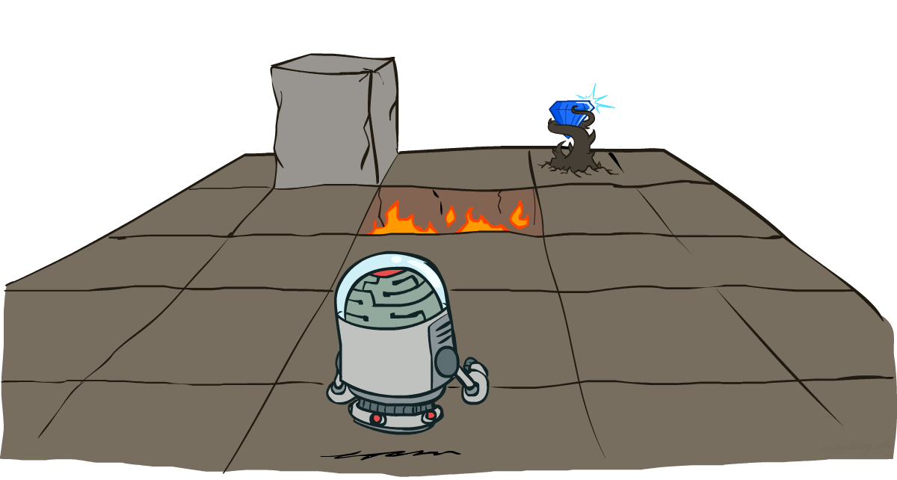
CSCE642 Reinforcement Learning
Chapter 3,4: Markov Decision Processes and dynamic programming
Instructor: Guni Sharon

Slide 2
Today
Class:
  Markov Decision Processes
Assignments:
  Quiz Multi Armed Bandits on Canvas by Sunday, September 3, EOD.
  Go over tutorials
    Linear algebra
    Basic probability
    Python
    Numpy
    Gym (OpenAI)
Project:
  Go over the project description and timeline
  Find a partner (a relevant discussion board is available on Campuswire)

Slide 3
CSCE-689, Reinforcement Learning
Stateless decision process
Monte-Carlo
Policy gradient
Actor-critic
Markov decision process
Temporal difference
Function approximators
Solving MDPs
Dynamic programming
Tabular methods
Deep RL

Slide 4
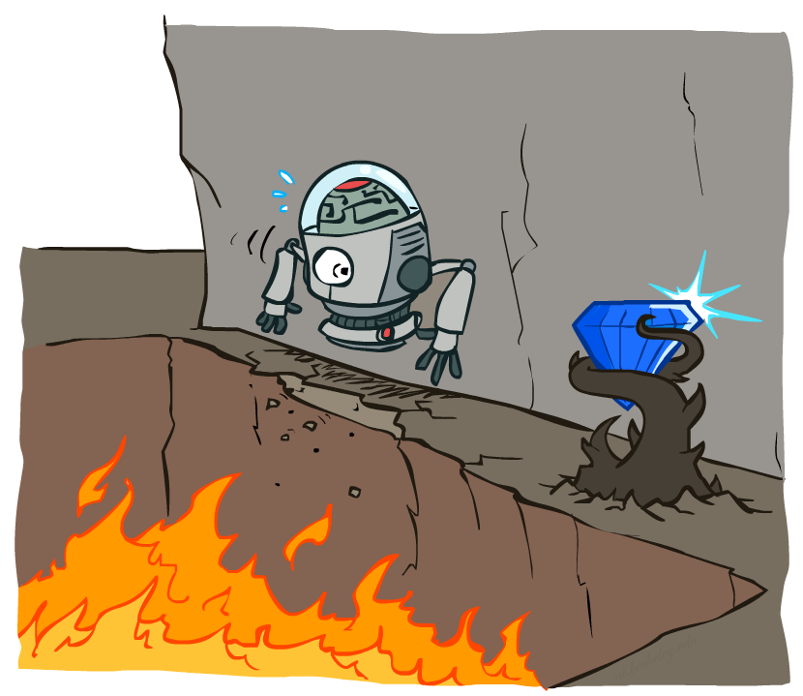
Introducing states
Multi-armed bandit
  (Action -> reward) -> (action -> reward) …
Markov Decision Processes
  Agent acts in an environment
  The environment includes a set of possible states
  At each state, a different set of actions might be applicable
  Each state, action pair have a different expected outcome (reward and next state)
  [State -> action -> reward -> state] -> action -> reward …

Slide 5
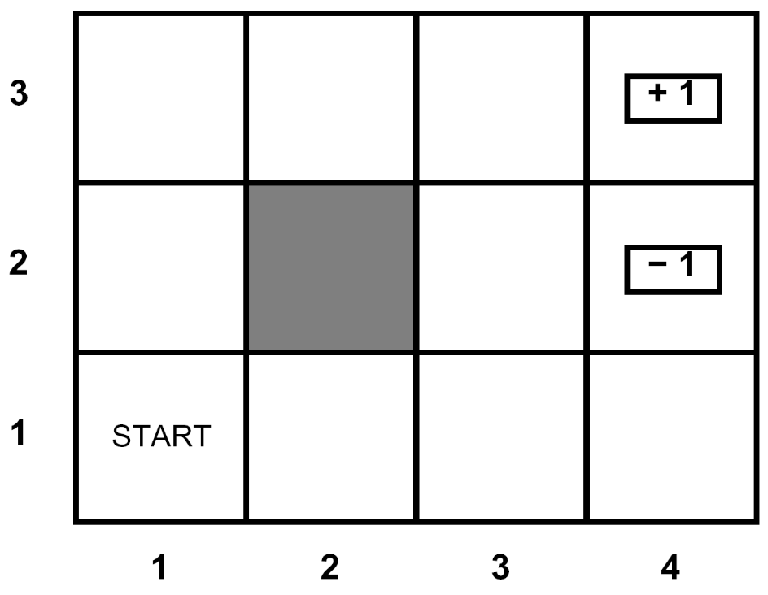
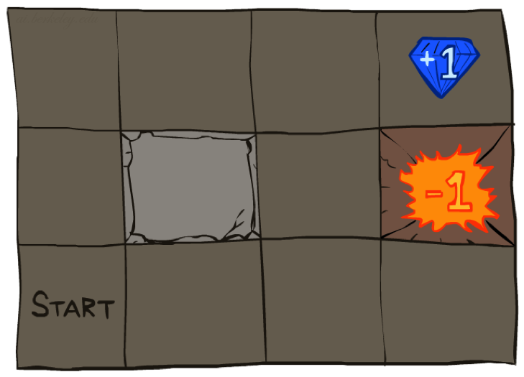




Example: Grid World
A maze-like problem
  The agent lives in a grid
  Walls block the agent’s path
Noisy movement: actions do not always go as planned
  80% of the time, the action North takes the agent North
  (if there is no wall there)
  10% of the time, North takes the agent West; 10% East
  If there is a wall in the direction the agent would have taken, the agent stays put
The agent receives rewards each time step
  -0.1 per step (battery loss)
  +1 if arriving at (4,3) and -1 for arriving at (4,2)
Objective: maximize accumulated rewards
Notes:
[cut demo of moving around in grid world program]

Slide 6
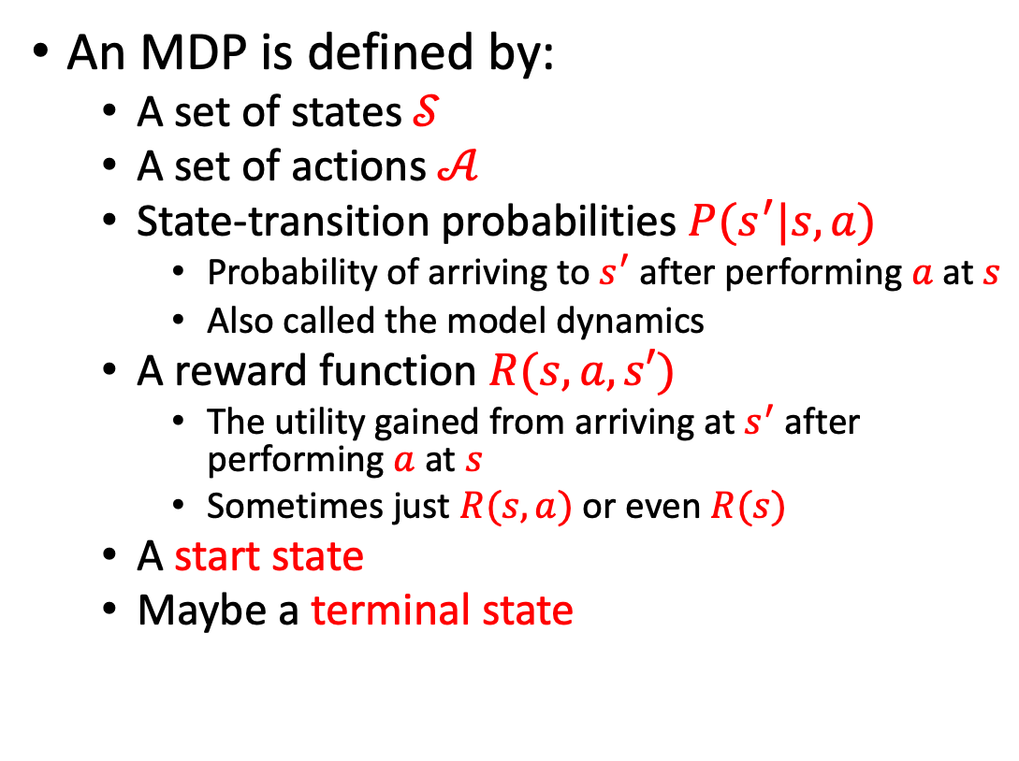
Markov Decision Processes
An MDP is defined by:
  A set of states $𝒮$
  A set of actions $𝒜$
  State-transition probabilities $P(s^{′}|s,a)$
    Probability of arriving to $s^{′}$ after performing $a$ at $s$
    Also called the model dynamics
  A reward function $R(s,a,s′)$
    The utility gained from arriving at $s^{′}$ after performing $a$ at $s$
    Sometimes just $R(s,a)$ or even $R(s)$
  A start state
  Maybe a terminal state
Notes:
In search problems: did not talk about actions, but about successor functions --- now the information inside the successor function is unpacked into actions, transitions and reward
Write out S, A, example entry in T, entry in R
Reward function different from the book : R(s,a,s’)
In book simpler for equations, but not useful for the projects.
Need to modify expectimax a tiny little bit to account for rewards along the way, but that’s something you should be able to do, and so you can already solve MDP’s (not in most efficient way)

Slide 7
Today
We will assume that the MDP model is known
  The distribution over outcomes (reward and next state) for each state and action
Not a practical assumption but it will help us get started
Assuming the same for the bandits problem directly implies the optimal policy
Why is this not the case for MDPs?

Slide 8
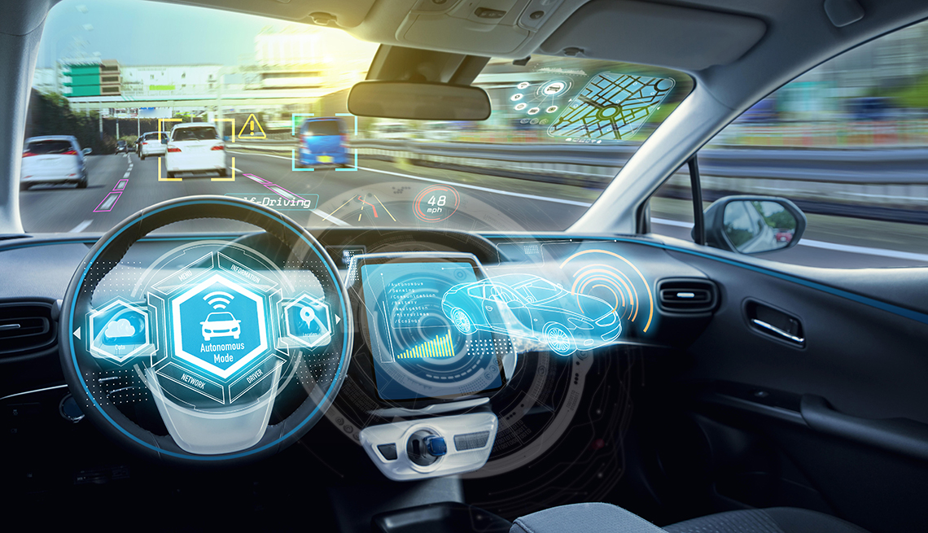
MDP formalization - Autonomous driving [“Learning to Drive in a Day”, Kendall et. al., 2018]
State:
  image from front camera
Actions:
  Steering from [-1,1], acceleration from [0,1], brake from [0,1]
Reward:
  Drive off road = -10
  Hit a person = -1000
  Drive at speed limit = +2
  Align with lane = +4
  Run a stop sign = -5
  Erratic driving= -3
  …
State-transition probabilities:
  defined by stochasticity in action outcomes and other actuators

Slide 9
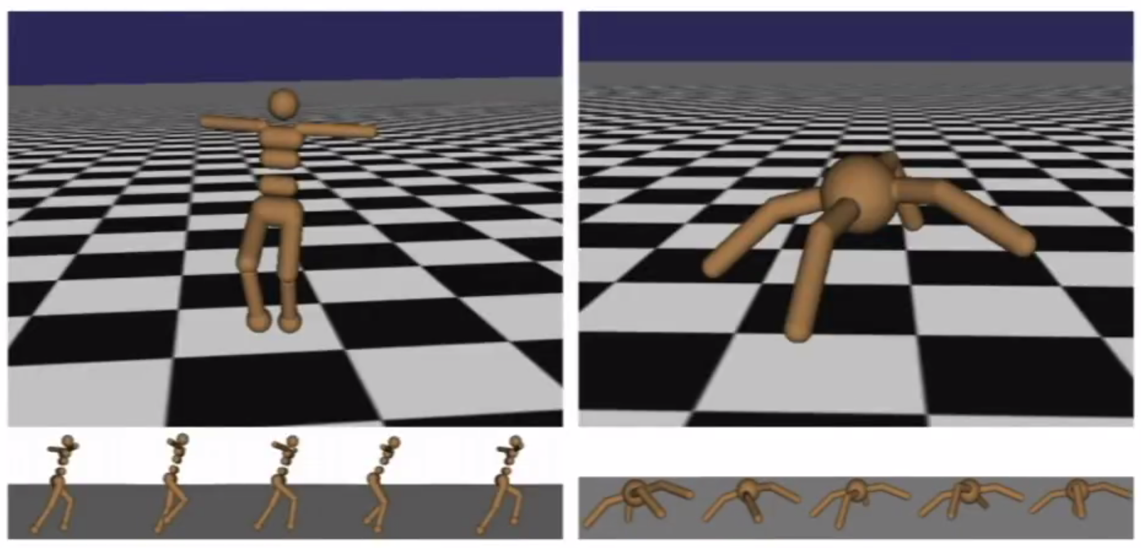
MDP formalization - Robot locomotion [“Policy gradient reinforcement learning for fast quadrupedal locomotion”, Kohl & Stone, 2004]
State:
  angle and position of joints, obstacles/pits
Actions:
  torques applied to joints
Reward:
  forward speed
State-transition probabilities:
  defined by stochasticity in action outcomes and obstacles

Slide 10
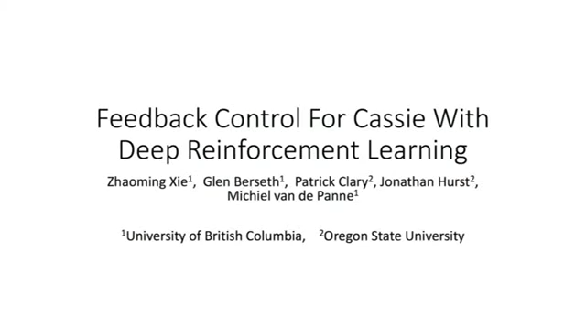
Robot locomotion

Slide 11

MDP formalization – Video games [“Playing Atari with deep reinforcement learning”, Mnih et al., 2013]
State:
  raw pixels
Actions:
  game controls
Reward:
  change in score
State-transition probabilities:
  defined by stochasticity in game evolution
Is this decision process Markovian?
No. History dictates the ball’s velocity vector which matters for optimal action selection.
Solution (Mnih et al.): a state includes the 4 last frames

Slide 12


Slide 13
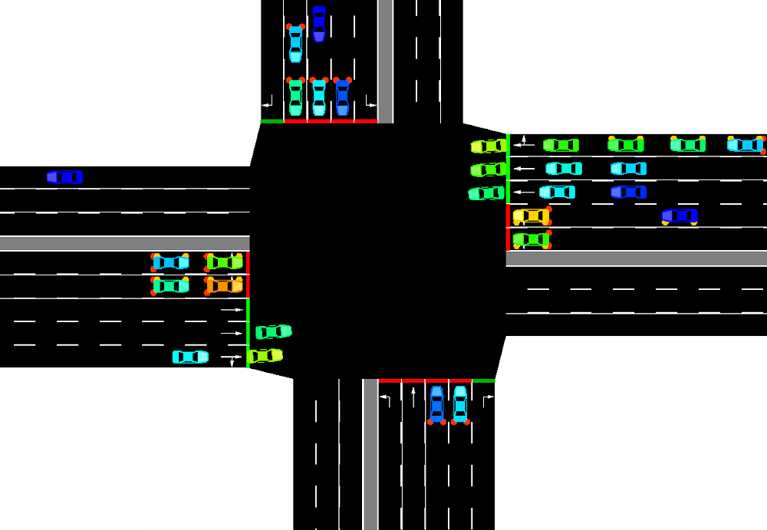
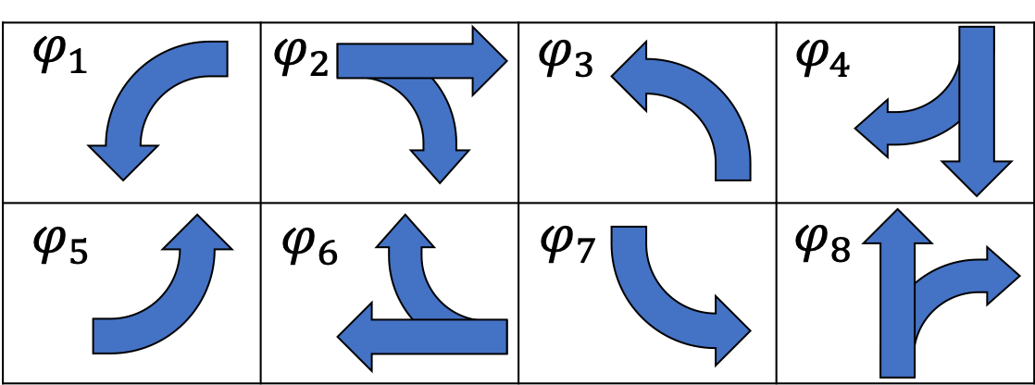
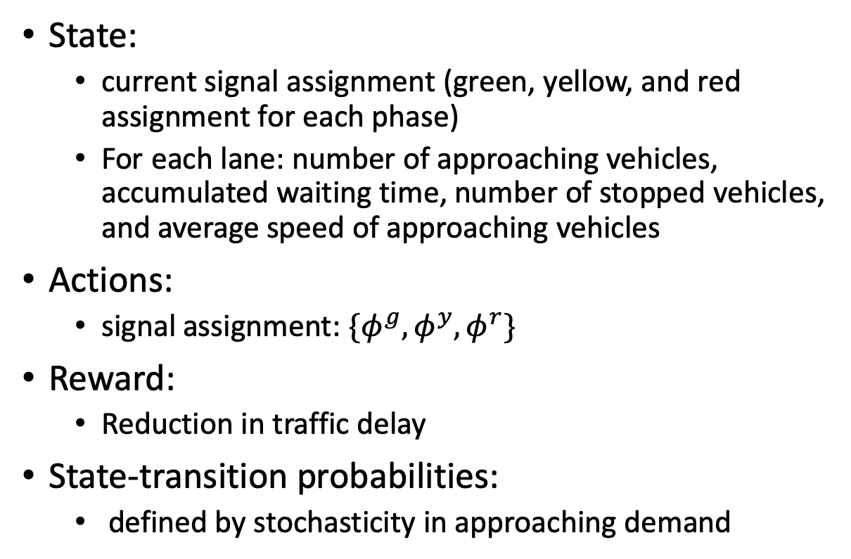
MDP formalization - Traffic signal control [“Learning an Interpretable Traffic Signal Control Policy”, Ault et al., 2020]
State:
  current signal assignment (green, yellow, and red assignment for each phase)
  For each lane: number of approaching vehicles, accumulated waiting time, number of stopped vehicles, and average speed of approaching vehicles
Actions:
  signal assignment: $\{φ^{g},φ^{y},φ^{r}\}$
Reward:
  Reduction in traffic delay
State-transition probabilities:
  defined by stochasticity in approaching demand

Slide 14
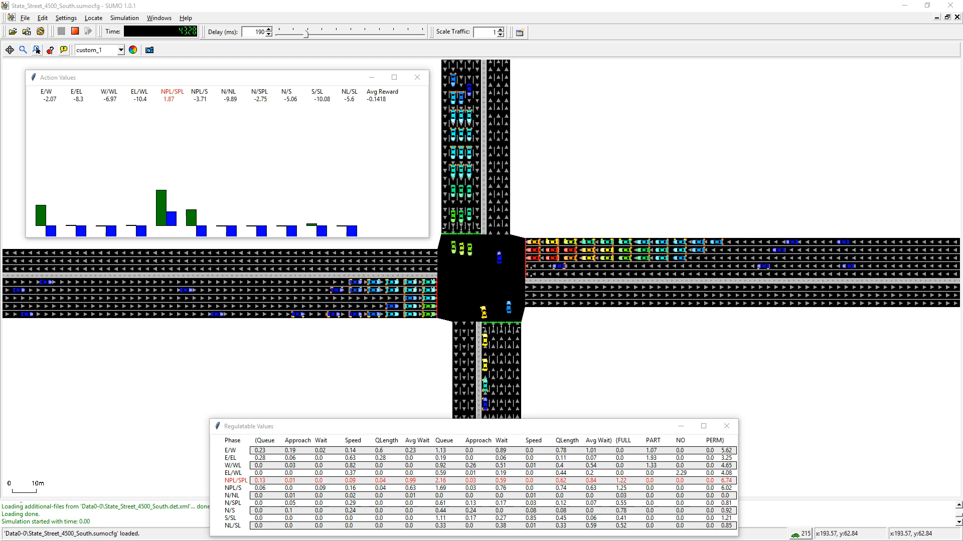
Initial performance

Slide 15
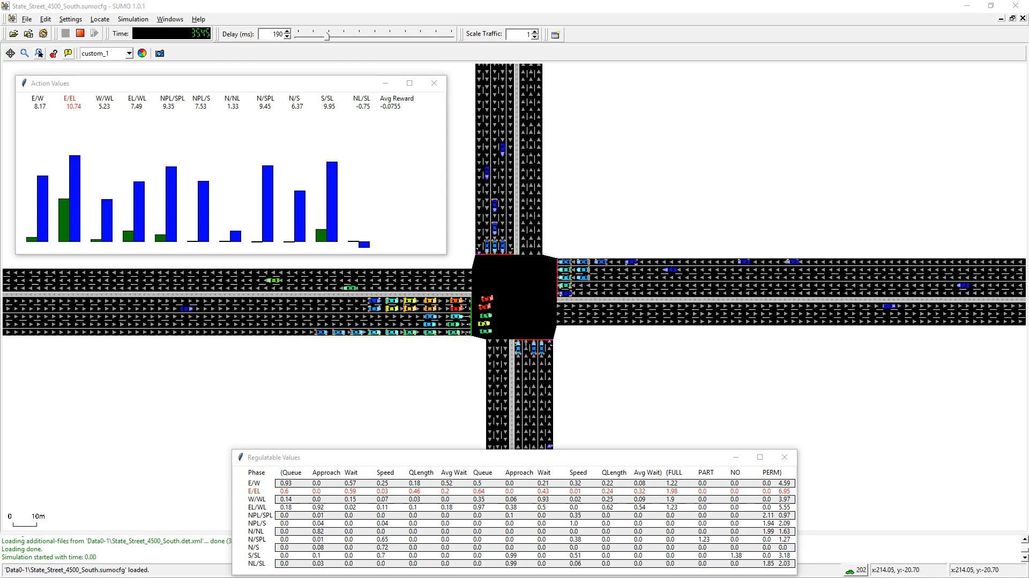
After 20 simulated days

Slide 16

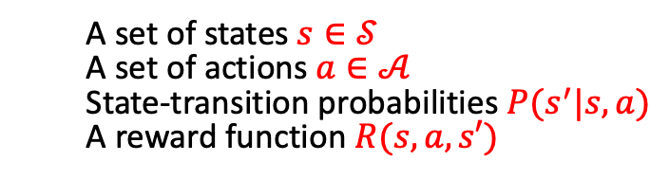



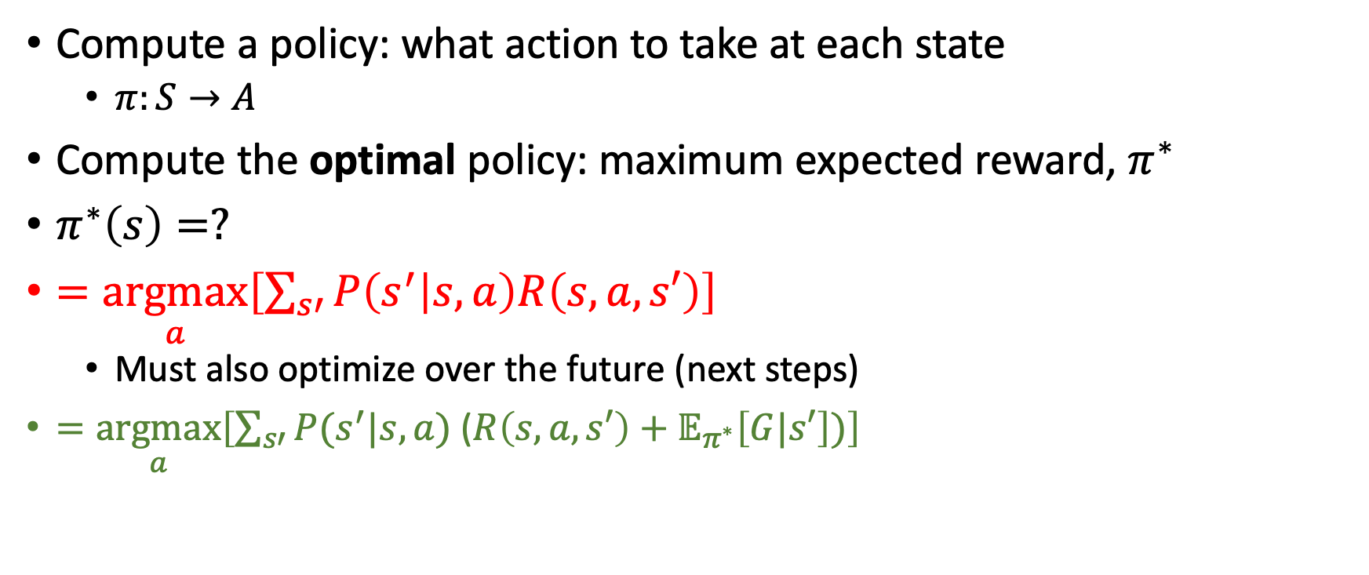







MDP - Objective
  A set of states $s∈𝒮$
  A set of actions $a∈𝒜$
  State-transition probabilities $P(s^{′}|s,a)$
  A reward function $R(s,a,s′)$
Compute a policy: what action to take at each state
  $π:S→A$
Compute the optimal policy: maximum expected reward, $π^{∗}$
$π^{∗}\left(s\right)=?$
$=\underset{a}{argmax}\left[\sum_{s′}{P\left(s^{′} | s,a\right)R\left(s,a,s′\right)}\right]$
  Must also optimize over the future (next steps)
$=\underset{a}{argmax}\left[\sum_{s′}{P(s^{′}|s,a) \text{(}R\left(s,a,s′\right)}+𝔼_{π^{∗}}\left[G|s′\right])\right]$
$$s$$
$$a_{1}$$
$$a_{2}$$
$$a_{3}$$
$$v^{∗}\left(s′\right)$$
$$s_{1}^{′}$$
$$s_{2}^{′}$$
$$s_{3}^{′}$$
$$s_{4}^{′}$$
$$s_{5}^{′}$$
$$s_{6}^{′}$$

Slide 17
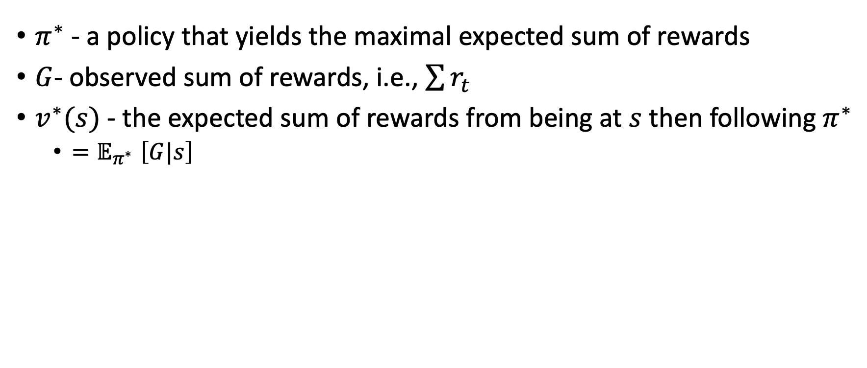
Notation
$π^{∗}$ - a policy that yields the maximal expected sum of rewards
$G$- observed sum of rewards, i.e., $\sum{r_{t}}$
$v^{∗}(s)$- the expected sum of rewards from being at $s$ then following $π^{∗}$
  ${=𝔼}_{π^{∗}}\left[G|s\right]$

Slide 18
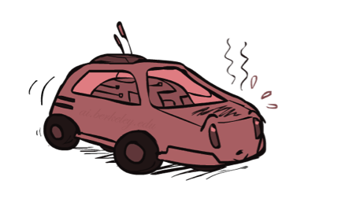
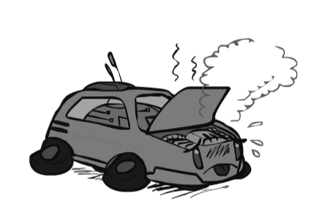

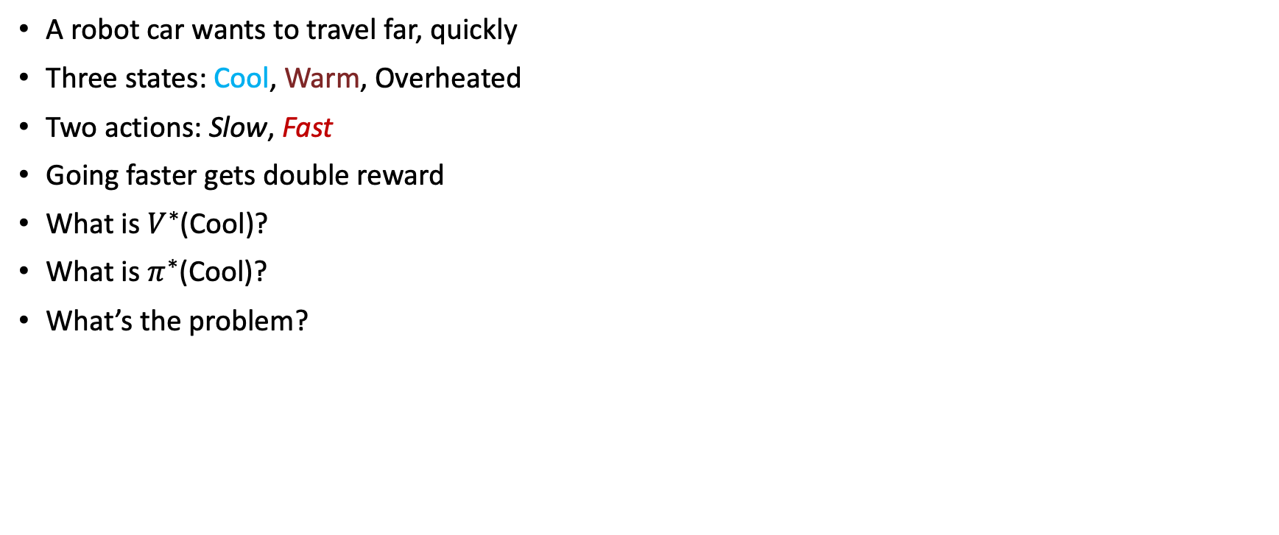
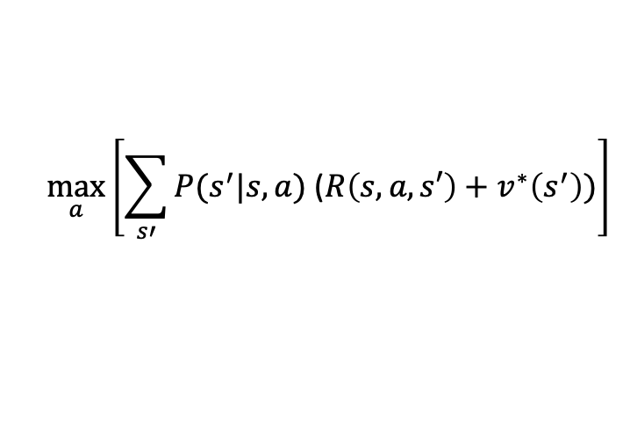
Race car example
$$\max_{a}\left[\sum_{s′}{P(s^{′}|s,a)\text{ (}R\left(s,a,s′\right)}+v^{∗}\left(s^{′}\right))\right]$$
A robot car wants to travel far, quickly
Three states: Cool, Warm, Overheated
Two actions: Slow, Fast
Going faster gets double reward
What is $V^{∗}$(Cool)?
What is $π^{∗}$(Cool)?
What’s the problem?
0.5
+1
1.0
Fast
Slow
-10
+1
0.5
Warm
Slow
Fast
0.5
+2
Cool
0.5
Overheated
1.0
+1
+2

Slide 19

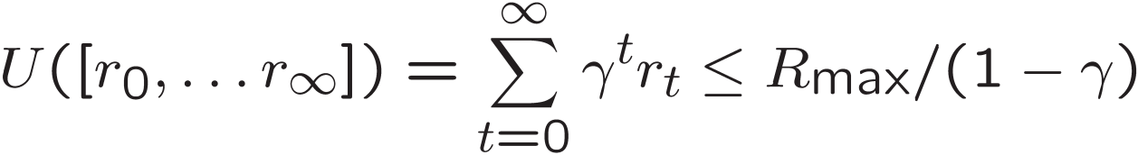
Infinite Utilities?!
Problem: What if the game lasts forever? Do we get infinite rewards?
Solutions:
  Finite horizon: (similar to depth-limited search)
    Terminate episodes after a fixed T steps (e.g. life)
    Gives nonstationary policies (π depends on time left)
  Discounting: use 0 < γ < 1
    Smaller γ means smaller “horizon” – shorter term focus

Slide 20
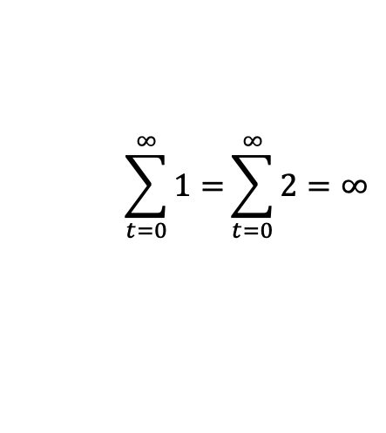
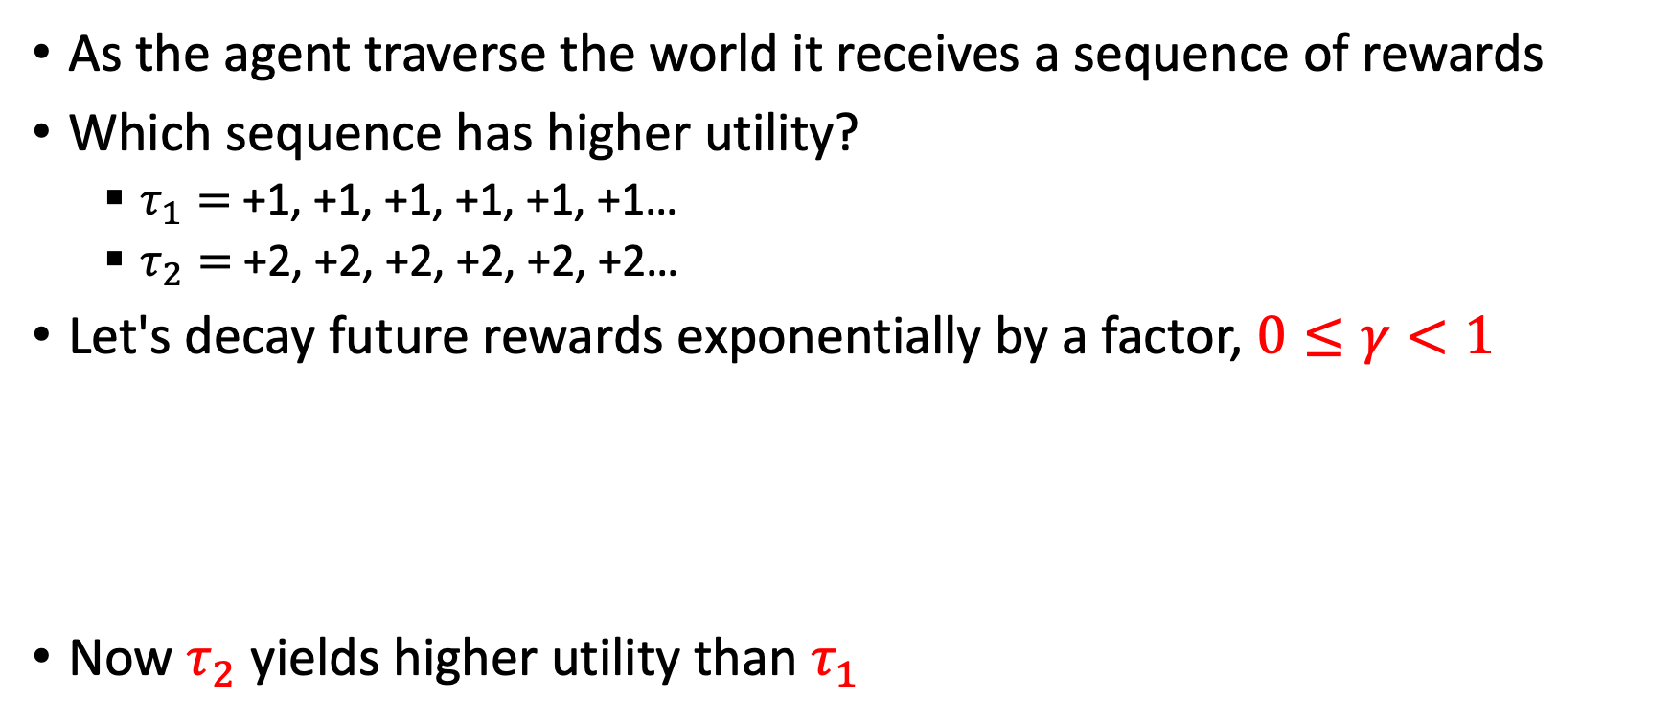
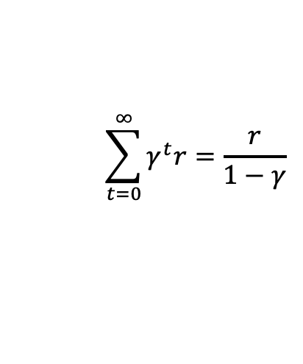
Discount factor
As the agent traverse the world it receives a sequence of rewards
Which sequence has higher utility?
  $τ_{1}=$+1, +1, +1, +1, +1, +1…
  $τ_{2}=$+2, +2, +2, +2, +2, +2…
Let's decay future rewards exponentially by a factor, $0≤γ<1$
Now $τ_{2}$ yields higher utility than $τ_{1}$
$$\sum_{t=0}^{∞}{1=}\sum_{t=0}^{∞}{2}=∞$$
$$\sum_{t=0}^{∞}{γ^{t}r=\frac{r}{1−γ}}$$
Geometric series

Slide 21

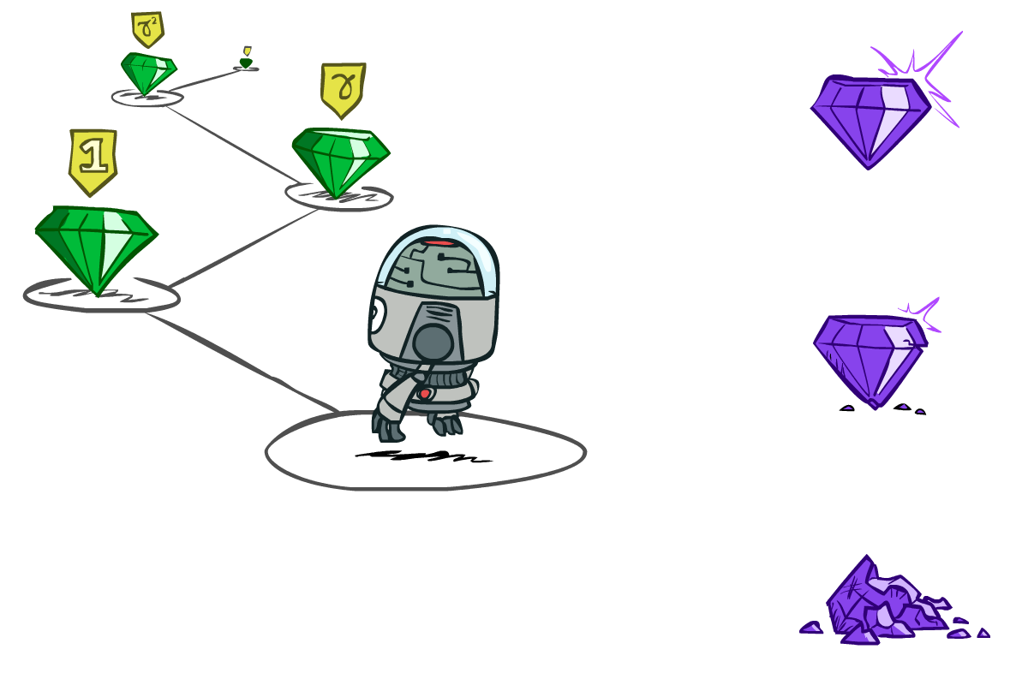

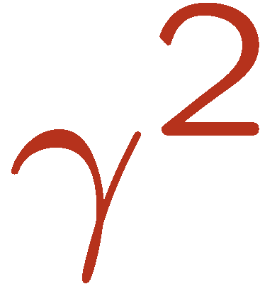

Discounting
It’s reasonable to maximize the sum of rewards
It’s also reasonable to prefer rewards now to rewards later
Discount factor: values of rewards decay exponentially
Worth Now
Worth Next Step
Worth In Two Steps

Slide 22

Discounting
How to discount?
  Each time we descend a level, we multiply by the discount once
Why discount?
  Sooner rewards probably do have higher utility than later rewards
  Also helps our algorithms converge
Example: discount of 0.5
  G(r=[1,2,3]) = 1*1 + 0.5*2 + 0.25*3
  G([1,2,3]) < G([3,2,1])
Notes:
Rewards in the future (deeper in the tree) matter less
Interesting: running expectimax, if having to truncate the search, then not losing much; e.g., less then \gamma^d / (1-\gamma)

Slide 23
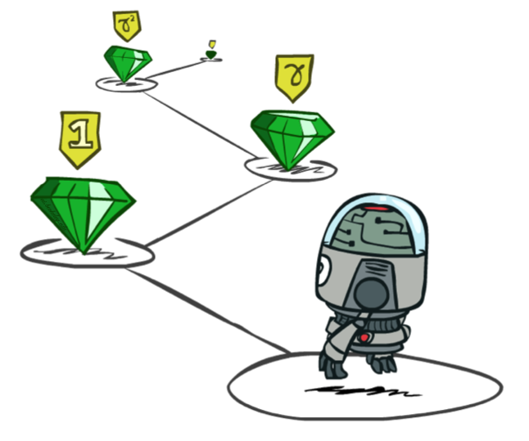


Quiz: Discounting
Given grid world:
  Actions: East, West, and Exit (‘Exit’ only available in terminal states: a, e)
  Rewards are given only after an exit action
  Transitions: deterministic
Quiz 1: For γ = 1, what is the optimal policy?
Quiz 2: For γ = 0.1, what is the optimal policy?
Quiz 3: For which γ are West and East equally good when in state d?

Slide 24
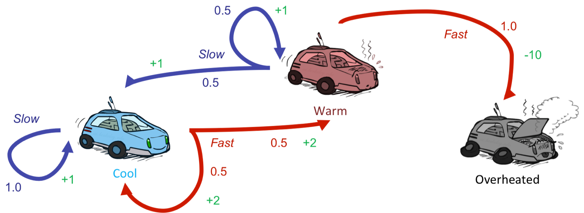
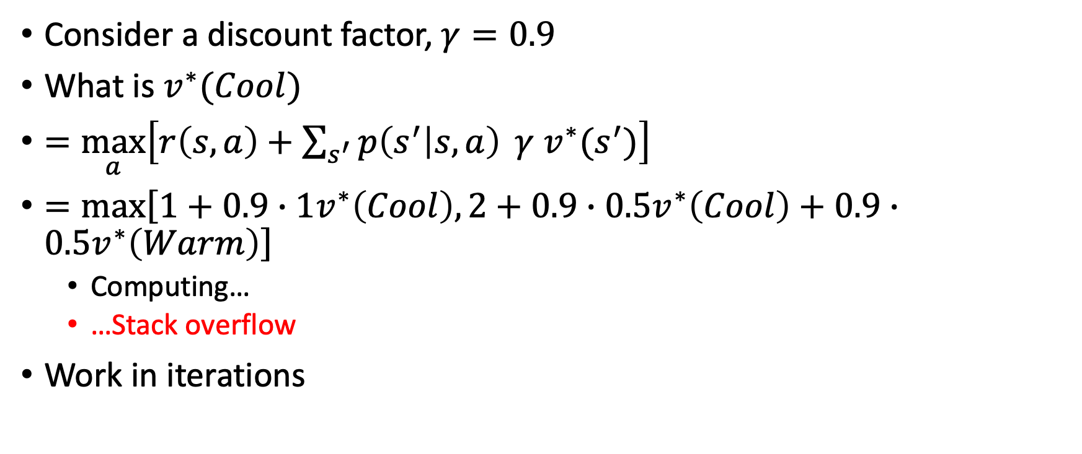
Race car example
Consider a discount factor, $γ=0.9$
What is $v^{∗}(Cool)$
$=\max_{a}\left[r\left(s,a\right)+\sum_{s^{′}}{p\left(s^{′} | s,a\right) }{γ v}^{∗}(s^{′})\right]$
$=\max\left[1+{0.9∙1v}^{∗}\left(Cool\right),2+0.9∙0.5v^{∗}\left(Cool\right)+0.9∙0.5v^{∗}\left(Warm\right)\right]$
  Computing…
  …Stack overflow
Work in iterations

Slide 25
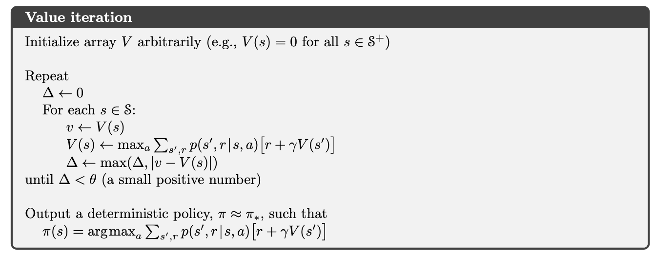
Value iteration

Slide 26

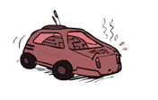
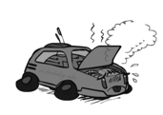
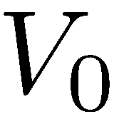
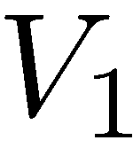
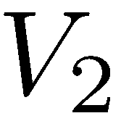
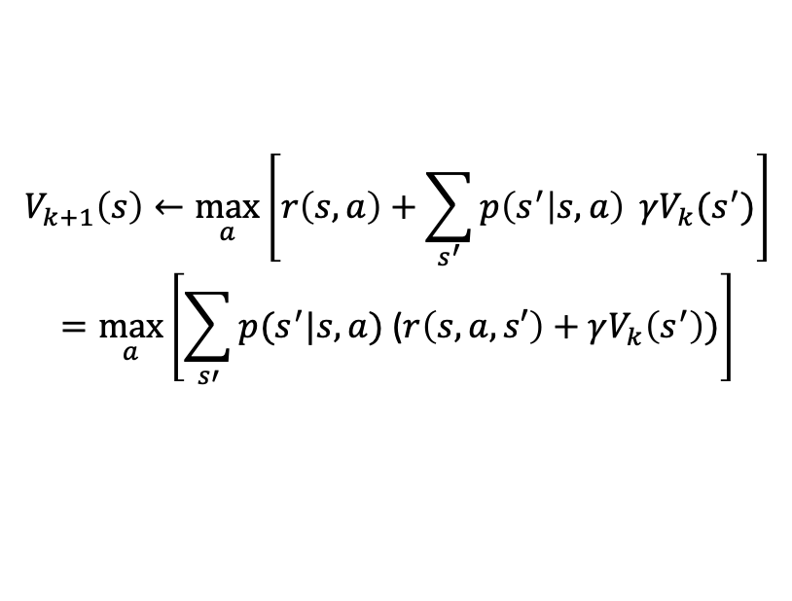

Value Iteration
0 0 0
$$γ=0.9$$
2 1 0
Bellman operator
3.35 2.35 0
$$V_{k+1}\left(s\right)←\max_{a}\left[r\left(s,a\right)+\sum_{s^{′}}{p\left(s^{′} | s,a\right) }γV_{k}(s^{′})\right]$$
$$=\max_{a}\left[\sum_{s′}{p(s^{′}|s,a)\text{ (}r\left(s,a,s′\right)}+γV_{k}\left(s^{′}\right))\right]$$

Slide 27
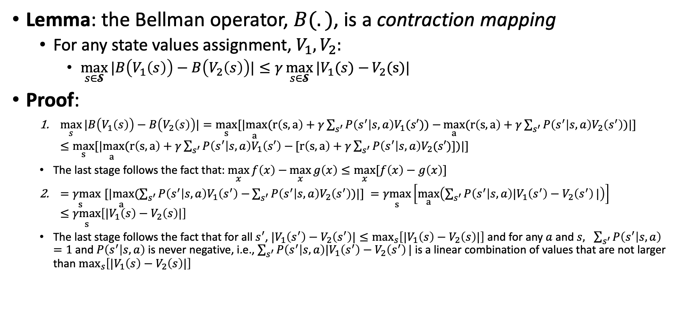
Value iteration – convergence
Lemma: the Bellman operator, $B(.)$, is a contraction mapping
  For any state values assignment, $V_{1}, V_{2}:$
    $\max_{s∈𝓢}{|B\left(V_{1}\left(s\right)\right)−}$ $B\left(V_{2}\left(s\right)\right)|≤γ\max_{s∈𝓢}{|V_{1}(s)−}V_{2}(\text{s}\text{)}|$
Proof:
  $\max_{s}{|B\left(V_{1}\left(s\right)\right)−}$ $B\left(V_{2}\left(s\right)\right)|=\max_{s}[\underset{a}{|max}(r\left(s,a\right)+γ\sum_{s^{′}}{P\left(s^{′} | s,a\right)V_{1}(s′))−}\max_{a}(r\left(s,a\right)+γ\sum_{s^{′}}{P\left(s^{′} | s,a\right)V_{2}\left(s^{′}\right))|] }≤\max_{s}[\underset{a}{|max}(r\left(s,a\right)+γ\sum_{s^{′}}{P\left(s^{′} | s,a\right)V_{1}\left(s′\right)−}[r\left(s,a\right)+γ\sum_{s^{′}}{P\left(s^{′} | s,a\right)V_{2}(s′)])|] }$
  The last stage follows the fact that: $\max_{x}{f\left(x\right)−}\max_{x}{g\left(x\right)≤\max_{x}{[f\left(x\right)−g\left(x\right)]}}$
  $\underset{s}{=γmax}[\underset{a}{|max}(\sum_{s^{′}}{P\left(s^{′} | s,a\right)V_{1}\left(s^{′}\right)−}\sum_{s^{′}}{P\left(s^{′} | s,a\right)V_{2}\left(s^{′}\right))|] }=\underset{s}{γmax}\left[\max_{a}\left(\sum_{s^{′}}{P\left(s^{′} | s,a\right){|V}_{1}\left(s^{′}\right)−V_{2}\left(s^{′}\right)}|\right)\right]≤\underset{s}{γmax}\left[{|V}_{1}\left(s\right)−V_{2}\left(s\right)|\right]$
  The last stage follows the fact that for all $s^{′}$, ${{|V}_{1}\left(s^{′}\right)−V_{2}\left(s^{′}\right)|≤max}_{s}\left[{|V}_{1}\left(s\right)−V_{2}\left(s\right)|\right]$ and for any $a$ and $s, \sum_{s^{′}}{P\left(s^{′} | s,a\right)}=1$and $P\left(s^{′} | s,a\right)$ is never negative, i.e., $\sum_{s^{′}}{P\left(s^{′} | s,a\right){|V}_{1}\left(s^{′}\right)−V_{2}\left(s^{′}\right)}|$ is a linear combination of values that are not larger than $\max_{s}\left[{|V}_{1}\left(s\right)−V_{2}\left(s\right)|\right]$

Slide 28
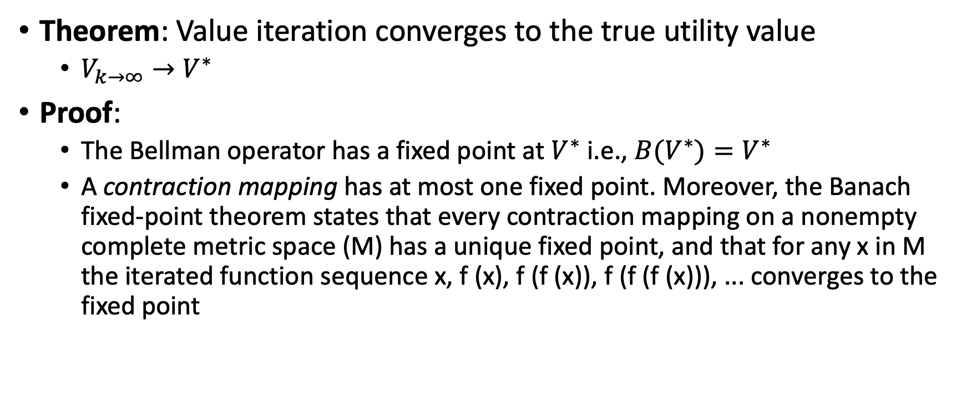
Value iteration – convergence
Theorem: Value iteration converges to the true utility value
  $V_{k→∞}→V^{∗}$
Proof:
  The Bellman operator has a fixed point at $V^{∗}$ i.e., $B(V^{∗})=V^{∗}$
  A contraction mapping has at most one fixed point. Moreover, the Banach fixed-point theorem states that every contraction mapping on a nonempty complete metric space (M) has a unique fixed point, and that for any x in M the iterated function sequence x, f (x), f (f (x)), f (f (f (x))), ... converges to the fixed point

Slide 29
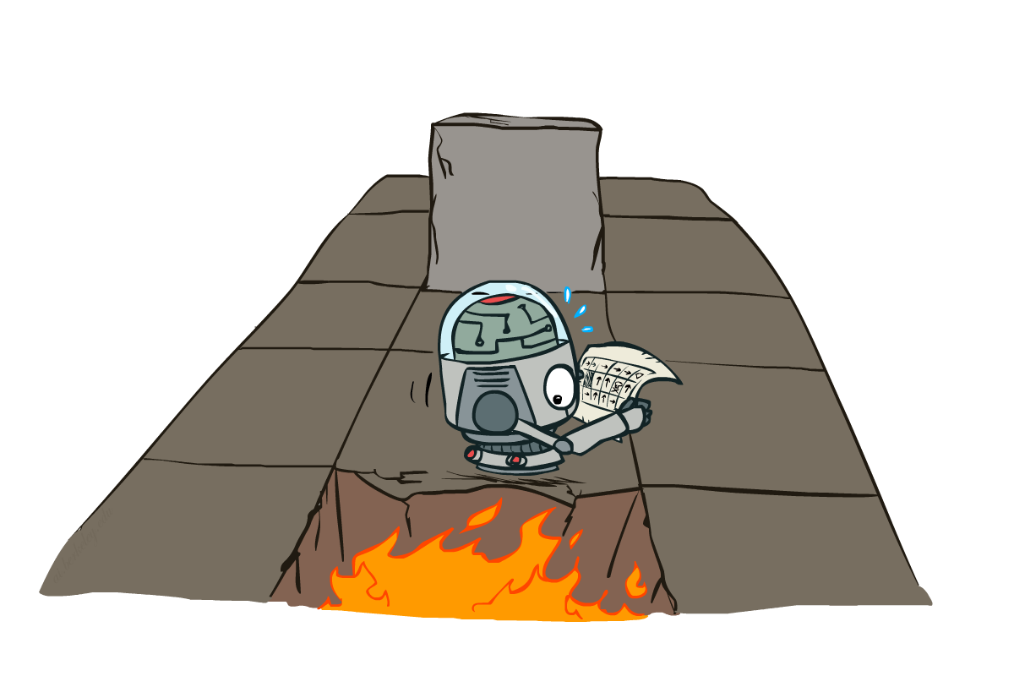
Example: Grid World
A maze-like problem
  The agent lives in a grid
  Walls block the agent’s path
Noisy movement: actions do not always go as planned
  80% of the time, the action North takes the agent North
  10% of the time, North takes the agent West; 10% East
  If there is a wall in the direction the agent would have taken, the agent stays put
The agent receives rewards each time step
  Small negative reward each step (battery drain)
  Big rewards come at the end (good or bad)
Goal: maximize sum of (discounted) rewards
Notes:
[cut demo of moving around in grid world program]

Slide 30
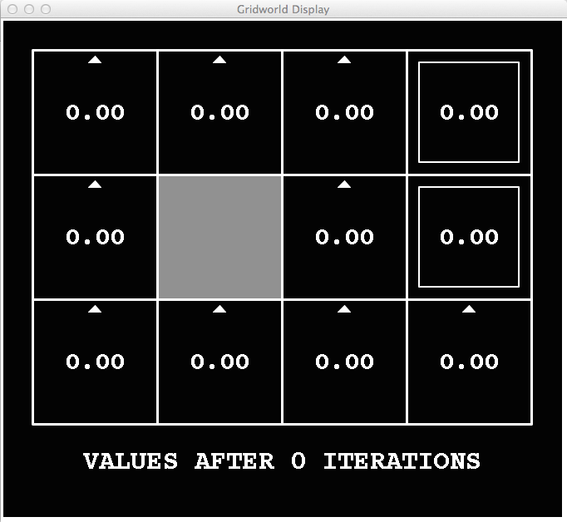
k=0
Noise = 0.2
Discount = 0.9
Living reward = 0
Notes:
Assuming zero living reward

Slide 31
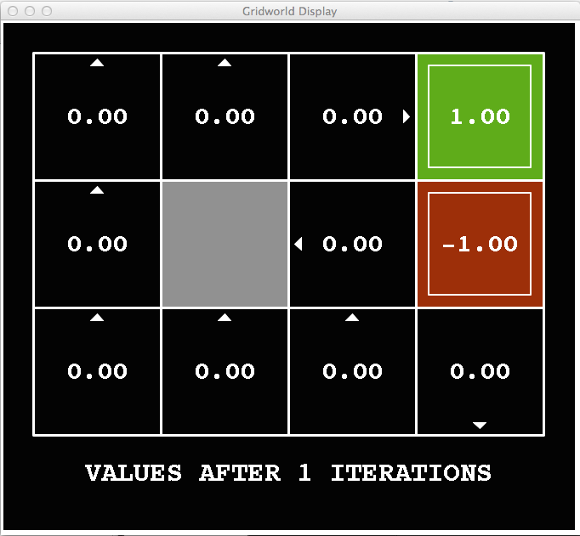
k=1
Noise = 0.2
Discount = 0.9
Living reward = 0
Notes:
Assuming zero living reward

Slide 32
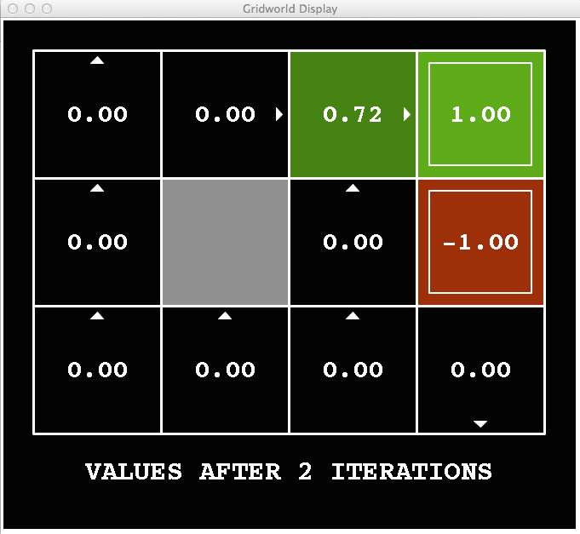
k=2
Noise = 0.2
Discount = 0.9
Living reward = 0
Notes:
Assuming zero living reward

Slide 33
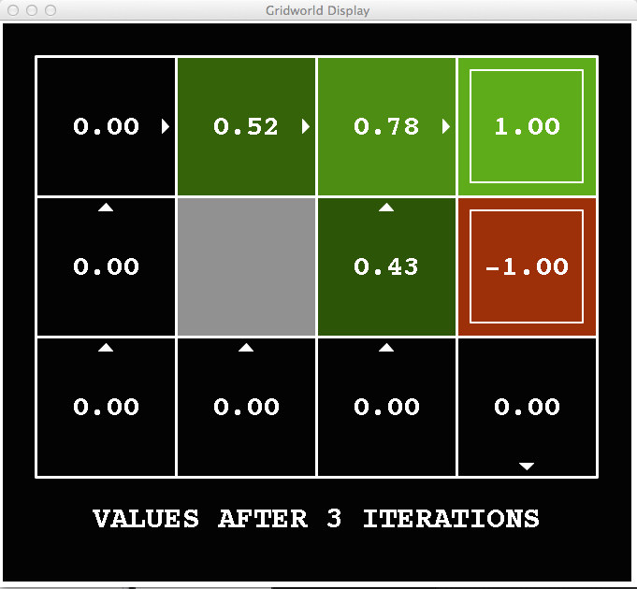
k=3
Noise = 0.2
Discount = 0.9
Living reward = 0
Notes:
Assuming zero living reward

Slide 34
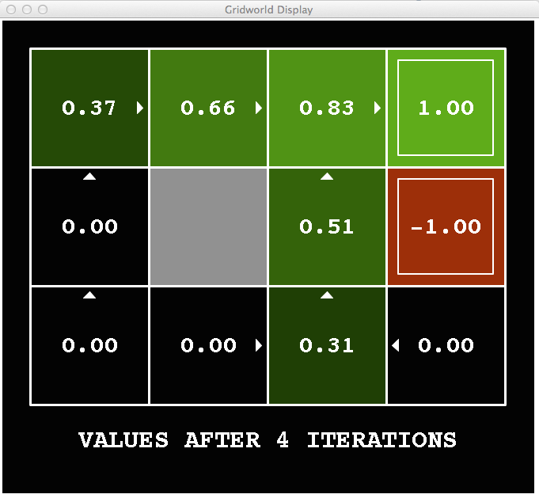
k=4
Noise = 0.2
Discount = 0.9
Living reward = 0
Notes:
Assuming zero living reward

Slide 35
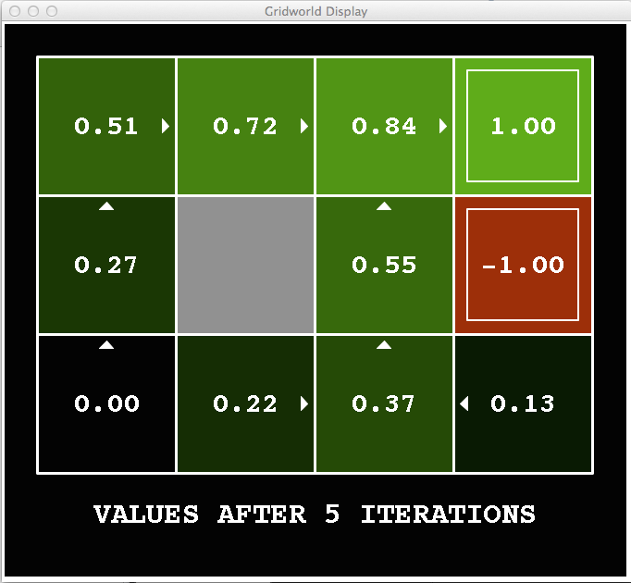
k=5
Noise = 0.2
Discount = 0.9
Living reward = 0
Notes:
Assuming zero living reward

Slide 36
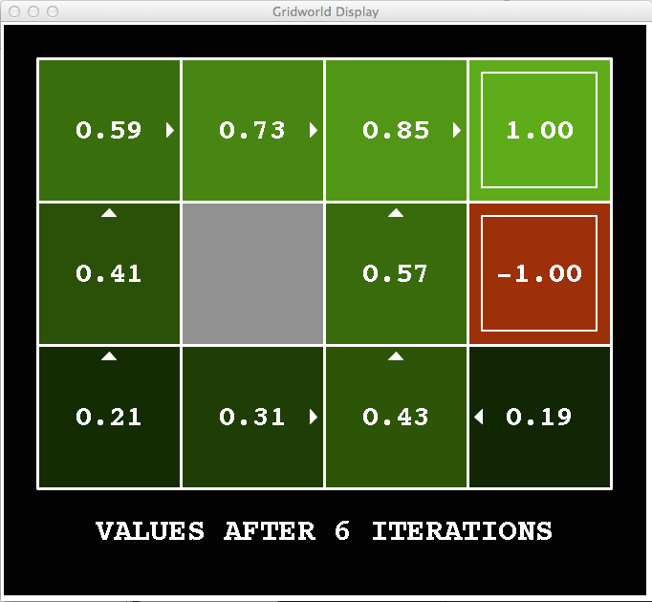
k=6
Noise = 0.2
Discount = 0.9
Living reward = 0
Notes:
Assuming zero living reward

Slide 37
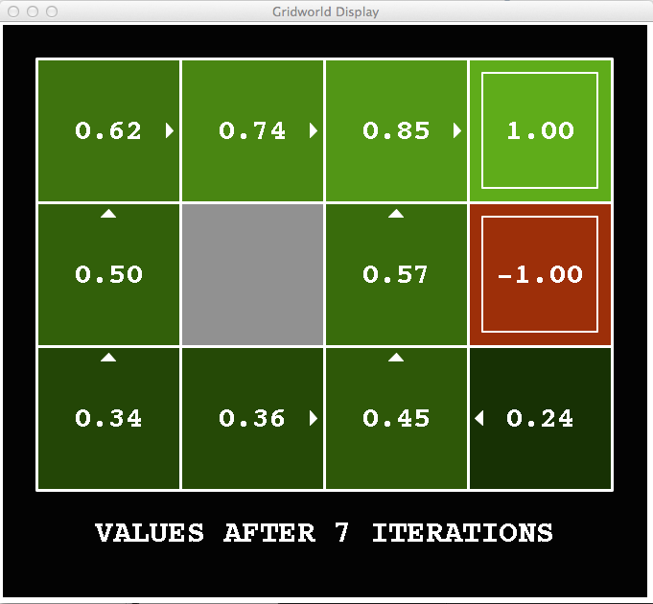
k=7
Noise = 0.2
Discount = 0.9
Living reward = 0
Notes:
Assuming zero living reward

Slide 38
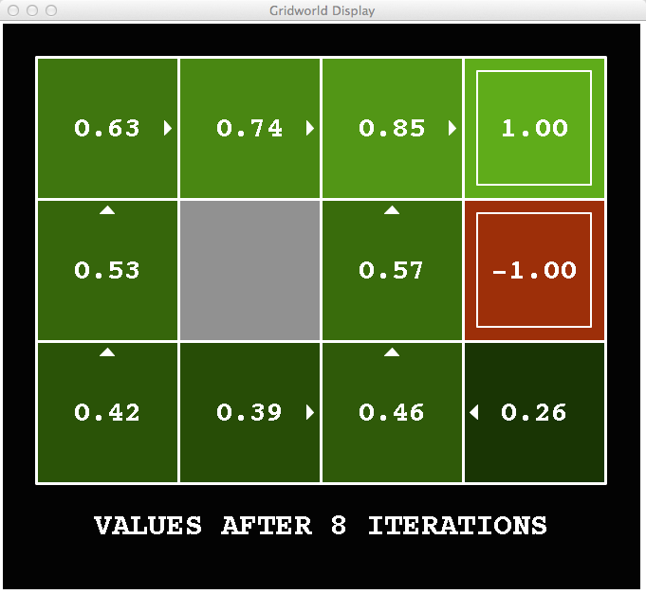
k=8
Noise = 0.2
Discount = 0.9
Living reward = 0
Notes:
Assuming zero living reward

Slide 39
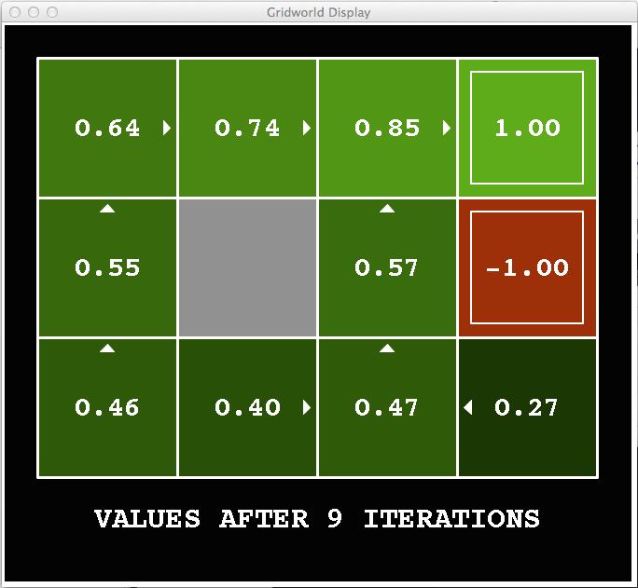
k=9
Noise = 0.2
Discount = 0.9
Living reward = 0
Notes:
Assuming zero living reward

Slide 40

k=10
Noise = 0.2
Discount = 0.9
Living reward = 0
Notes:
Assuming zero living reward

Slide 41

k=11
Noise = 0.2
Discount = 0.9
Living reward = 0
Notes:
Assuming zero living reward

Slide 42
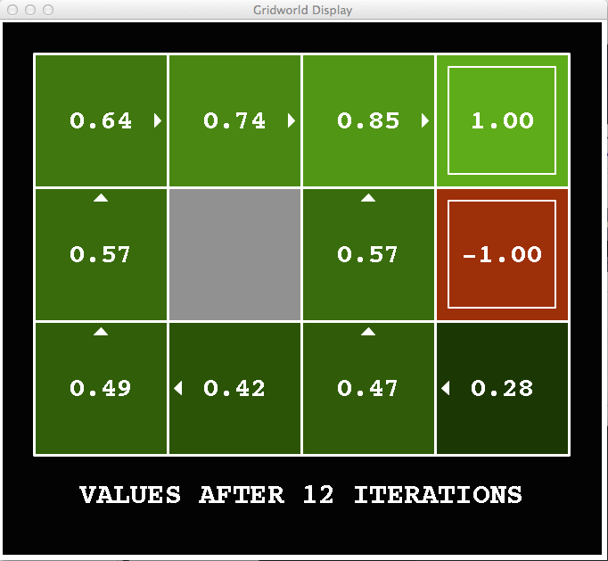
k=12
Noise = 0.2
Discount = 0.9
Living reward = 0
Notes:
Assuming zero living reward

Slide 43

k=100
Noise = 0.2
Discount = 0.9
Living reward = 0
Notes:
Assuming zero living reward

Slide 44

Drawbacks of Value Iteration
Value iteration repeats the Bellman updates:
$V_{k+1}\left(s\right)←\max_{a}\left[R\left(s,a\right)+\sum_{s^{′}}{P\left(s^{′} | s,a\right) }γV_{k}(s^{′})\right]$
$$=\max_{a}\left[\sum_{s′}{P(s^{′}|s,a)\text{ (}R\left(s,a,s′\right)}+γV_{k}\left(s^{′}\right))\right]$$
Issue 1: It’s slow – O(S²A) per iteration
  Do we really need to update every state at every iteration?
Issue 2: A policy cannot be easily extracted
  Policy extraction requires another O(S²A)
Issue 3: The policy often converges long before the values
  Can we identify when the policy converged?
Issue 4: requires knowing the model, $P(s^{′}|s,a)$, and the reward function, $R\left(s,a\right)$
Issue 5: requires discrete (finite) set of actions
Issue 6: infeasible in large state spaces
Notes:
Demo steps through value iteration; snapshots of values shown on next slides.

Slide 45

Solutions (briefly, more later…)
Issue 1: It’s slow – O(S²A) per iteration
  Asynchronous value iteration
Issue 2: A policy cannot be easily extracted
  Learn $q$ (action) values
Issue 3: The policy often converges long before the values
  Policy-based methods
Issue 4: requires knowing the model and the reward function
  Reinforcement learning
Issue 5: requires discrete (finite) set of actions
  Policy gradient methods
Issue 6: infeasible for large (or continues) state spaces
  Function approximators

Slide 46

Issue 1: It’s slow – $O(S2A)$per iteration
Asynchronous value iteration
In value iteration, we update every state in each iteration
  Actually, any sequences of Bellman updates will converge if every state is visited infinitely often regardless of the visitation order
Idea: prioritize states whose value we expect to change significantly

Slide 47



Asynchronous Value Iteration
Which states should be prioritized for an update?
A single update per iteration
$$SDS\left(s\right)=\left\{s^{′}:∃a, p\left(s|s^{′},a\right)>0\right\}$$
For the home assignment set:
$$H\left(s\right)=\left|V\left(s\right)−\max_{a}\left\{R\left(s,a\right)+γ\sum_{s^{′}}{\operatorname{Pr}\left(s^{′}|s,a\right)V\left(s′\right)}\right\}\right|$$

Slide 48


Double the work?
For the home assignment set:
$$H\left(s^{}\right)=\left|V\left(s\right)−\max_{a}\left\{R\left(s^{},a\right)+γ\sum_{s^{′}}{\operatorname{Pr}\left(s^{′}|s^{},a\right)V\left(s′\right)}\right\}\right|$$
Computing priority is similar to updating the state value (computational effort)
Why double work?
  If we computed the priority, we can go ahead and update the value for free
Notice that we don’t need to update the priorities for the entire state space
For many of the states the priority doesn’t change following an updated value for a single state $s$
Only states $s’$ with $\sum_{a}{p\left(s|s′,a\right)}>0$ might be updated

Slide 49

Issue 2: A policy cannot be easily extracted
Given state values, what is the appropriate policy?
  $π\left(s\right)←\underset{a}{argmax}\left[R\left(s,a\right)+\sum_{s^{′}}{P\left(s^{′} | s,a\right) }γV_{k}(s^{′})\right]$
  Requires another full value sweep: $O(S2A)$
  Assumes known model
Learn $q$ (action) values instead
$Q^{∗}(s,a)$- the expected sum of rewards from being at $s$, taking action $a$ and then following $π^{∗}$

Slide 50


Q-learning
$Q^{∗}(s,a)$- the expected sum of rewards from being at $s$, taking action $a$ and then following $π^{∗}$
$π^{∗}\left(s\right)←\underset{a}{argmax}\left[Q^{∗}(s,a)\right]$
Can we learn Q values with dynamic programming?
  Yes, similar to value iteration

Slide 51

Q-learning with value iteration
$V^{∗}\left(s\right)≔\max_{a}\left[\sum_{s′}{P(s^{′}|s,a)\text{ (}R\left(s,a,s′\right)}+γV^{∗}\left(s^{′}\right))\right]$
$V^{∗}\left(s\right)≔\max_{a}\left[Q^{∗}(s,a)\right]$
$Q^{∗}\left(s,a\right)≔\sum_{s′}{P(s^{′}|s,a)\text{ (}R\left(s,a,s′\right)}+γV^{∗}\left(s^{′}\right))$
$Q^{∗}\left(s,a\right)=\sum_{s′}{P(s^{′}|s,a)\text{ (}R\left(s,a,s′\right)}+γ\max_{a}\left[Q^{∗}(s′,a)\right])$
Solve iteratively
  $Q_{k+1}\left(s,a\right)=\sum_{s′}{P(s^{′}|s,a)\text{ (}R\left(s,a,s′\right)}+γ\max_{a}\left[Q_{k}(s′,a)\right])$
  Can also use Asynchronous learning

Slide 52

Issue 3: The policy often converges long before the values
Value iteration converges to the true utility value: $V_{k→∞}→V^{∗}$
$V^{∗}$ implies the optimal policy: $π^{∗}$
Can we converge directly on $π^{∗}$?
  Improve the policy in iteration until reaching the optimal one

Slide 53


Policy Iteration
Compute $V_{π}$: calculate state value for some fixed policy (not necessarily the optimal values, $V_{π}≠V^{∗}$)
Update $π$: update policy using one-step look-ahead with the resulting (non optimal) values
Repeat until policy converges
  (optimal values and policy)
Guaranteed converges to $π^{∗}$
  $∀s, V_{k>0}\left(s\right)≤V_{k+1}\left(s\right)$ i.e., $π_{i}$ improves monotonically with i
  A fixed point, $∀s, V_{k}\left(s\right)=V_{k+1}\left(s\right)$, implies $π^{∗}$

Slide 54

Policy Evaluation
Why is calculating $V_{π}$ easier that calculating $V^{∗}$?
  Turns non-linear Bellman equations into linear equations
$v^{∗}(s)=\max_{a}\left[\sum_{s′}{P(s^{′}|s,a)\text{ (}R\left(s,a,s′\right)}+γv^{∗}\left(s^{′}\right))\right]$
$v_{π}(s)=\sum_{s′}{P(s^{′}|s,π(s))\text{ (}R\left(s,π(s),s′\right)}+γv^{∗}\left(s^{′}\right))$
Solve a set of linear equations in $O(S^{2})$
  Solve with Numpy (numpy.linalg.solve)
  Required for your home assignment
  See: https://numpy.org/doc/stable/reference/generated/numpy.linalg.solve.html#numpy.linalg.solve

Slide 55


Policy value as a Linear program
$v_{11}=0.8⋅\left(−0.1+0.95⋅v_{12}\right)$+0.1 $⋅\left(−0.1+0.95⋅v_{21}\right)\text{+0.1} ⋅\left(−0.1+0.95⋅v_{11}\right)$
$v_{12}=0.8⋅\left(−0.1+0.95⋅v_{13}\right)\text{+0.}\text{2} ⋅\left(−0.1+0.95⋅v_{12}\right)$
…
$v_{42}=−1$
$v_{43}=1$
Notes:
[cut demo of moving around in grid world program]

Slide 56


Policy iteration
0.7
0.8
0.9
0.7
0.6
0.4
0.6
0.5

Slide 57
Comparison
Both value iteration and policy iteration compute the same thing (optimal state values)
In value iteration:
  Every iteration updates both the values and (implicitly) the policy
  We don’t track the policy, but taking the max over actions implicitly defines it
In policy iteration:
  We do several passes that update utilities for fixed policies (each pass is fast because we consider only one action, not all of them)
  After the policy is evaluated, a new policy is chosen (slow like a value iteration pass)
  The new policy will be better (or we’re done)

Slide 58



Issue 4: requires knowing the model and the reward function
We will explore online learning (reinforcement learning) approaches
How can we learn the model and reward function from interactions?
Do we even need to learn them? Can we learn $V^{∗},Q^{∗}$ without a model?
Can we do without $V^{∗},Q^{∗}$ ? Can we run policy iteration without a model?
Offline optimization
Online Learning

Slide 59
Issue 5: requires discrete (finite) set of actions
We will explore policy gradient approaches that are suitable for continuous actions, e.g., throttle and steering for a vehicle
Can such approaches be relevant for discrete action spaces?
  Yes! We can always define a continues action space as a distribution over the discreate actions (e.g., using the softmax function)
Can we combine value-based approaches and policy gradient approaches and get the best of both?
  Yes! Actor-critic methods

Slide 60
Issue 6: infeasible in large (or continues) state spaces
Most real-life problems contain very large state spaces (practically infinite)
It is infeasible to learn and store a value for every state
Moreover, doing so is not useful as the chance of encountering a state more than once is very small
We will learn to generalize our learning to apply to unseen states
We will use value function approximators that can generalize the acquired knowledge and provide a value to any state (even if it was not previously seen)

Slide 61

Notation
$π^{∗}$ - a policy that that yields the maximal expected sum of rewards
$V^{∗}(s)$- the expected sum of rewards from being at $s$ then following $π^{∗}$
$V_{π}(s)$- the expected sum of rewards from being at $s$ then following $π$
$Q^{∗}(s,a)$- the expected sum of rewards from being at $s$, taking action $a$ and then following $π^{∗}$
$Q_{π}(s,a)$- the expected sum of rewards from being at $s$, taking action $a$ and then following $π$
$G_{t}$ - observed sum of rewards following time $t$, i.e., $\sum_{k=t}^{T}{r_{k}}$

Slide 62

What did we learn?
MDP = States, Actions, Reward function, Transition probabilities
Meaningful policy evaluation requires a discount factor, finite planning horizon, or terminal states
Knowing the MDP model allows us to compute the optimal policy offline (through VI or PI)
PI is usually faster to converge due to simplified bellman updates (eliminating the $\max_{a}⁡$ operator)
A known model is not a practical assumption and is not commonly assumed in RL
  We will drop this assumption in the next lecture

Slide 63
What next?
Class: Monte-Carlo RL algorithms
Assignments:
  Value Iteration
  Asynchronous Value Iteration
  Policy Iteration
  Due by Monday, September-23, EOD.
Quiz (on Canvas):
  Dynamic programming – by Tuesday, Sep-9, EOD
Project:
  Find a partner
  Converge on the project’s topic
  Define the relevant MDP

