Slide 1
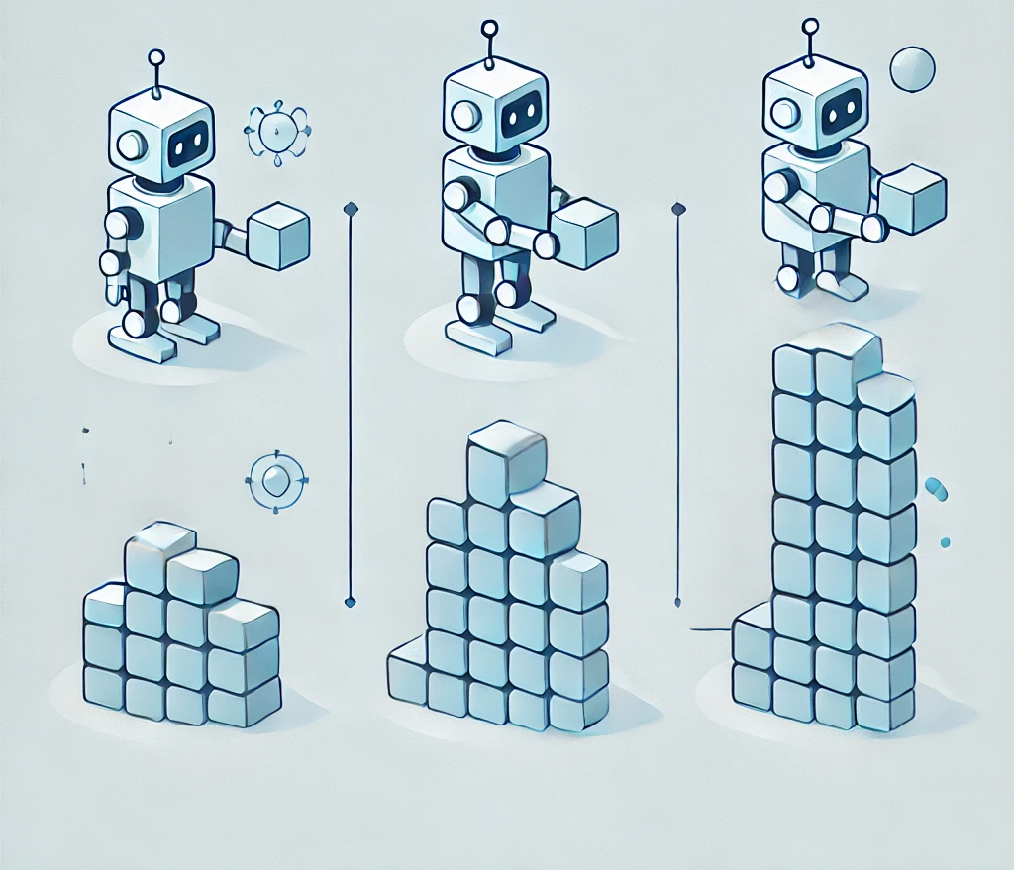
Curriculum Learning
CSCE-642 Reinforcement Learning
Vaibhav Bajaj

Slide 2
Outline
Background:
  Introduction to Curriculum Learning (CL)
  Examples of Traditional CL Approaches
  Pros and Cons of CL
Automated Curriculum Leaning:
  Automated CL Strategies
  Theoretical Guarantees
Evaluation Metrics

Slide 3
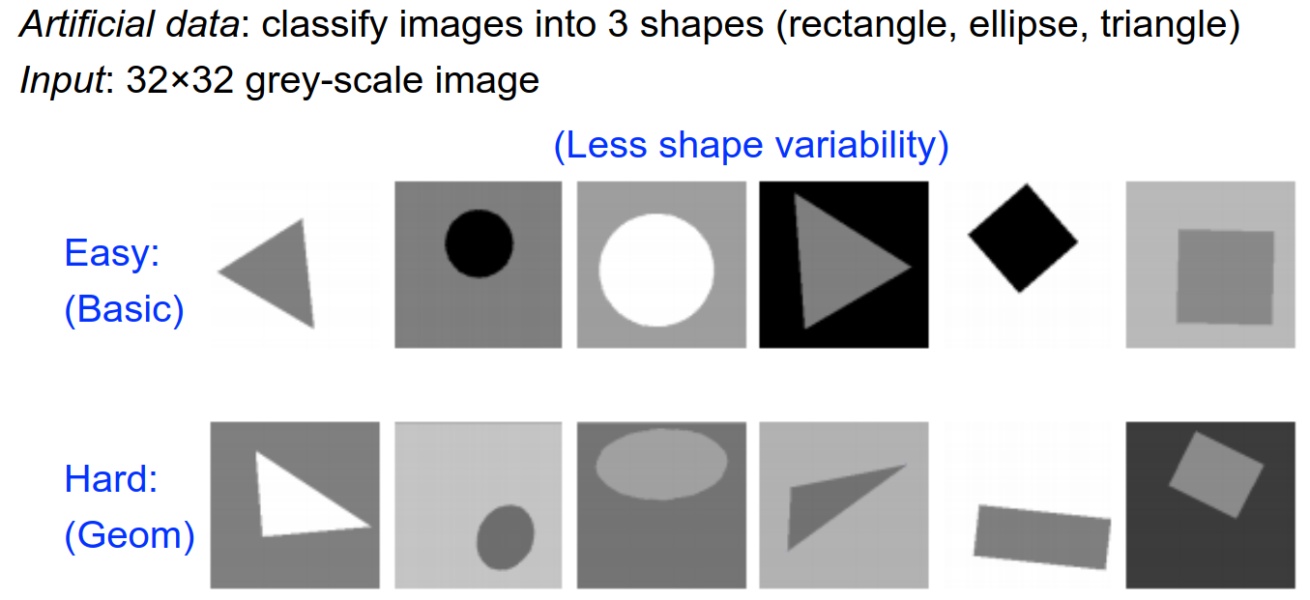
Curriculum Learning
Introduced by (Bengio et al., 2009) as a concept in machine learning aimed at improving performance, initially applied in supervised learning.

Slide 4
Curriculum Learning
Motivation: Mimics human learning by starting with "easy" examples and progressively moving to more challenging ones.
Key Insight: Proper sequencing of training data can lead to faster convergence and better generalization compared to traditional training methods with randomly ordered data

Slide 5
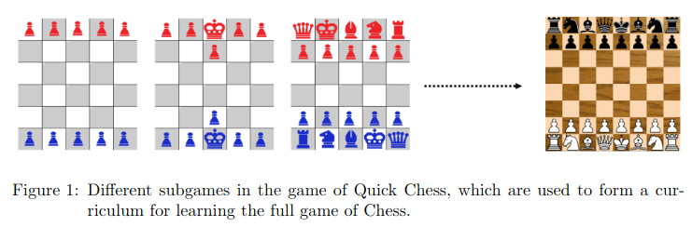
Curriculum Learning in Reinforcement Learning
RL’s unique challenges:
  Exploration-exploitation tradeoff.
  No direct supervision (rewards are sparse and delayed).
  Stochastic environments and non-stationary policies.
In RL, CL often involves sequencing tasks or adjusting environment complexity to scaffold learning.

Slide 6
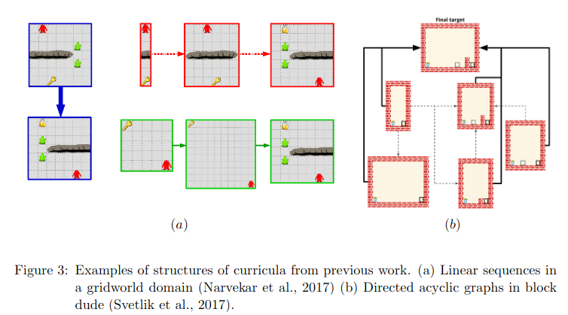
Curriculum: Sequential or DAG
Complex task →Sequence of simpler, learnable tasks.
Reusability: Different curriculums can have common source-tasks

Slide 7
How is CL Different from Other Learning Paradigms?
Transfer Learning (TL) vs CL:
  TL: one-step transfer of knowledge between a source and target task.
  CL: designing a sequence of source tasks, progressively increasing in complexity
Multi-Task RL & Lifelong Learning vs CL:
  Multi-Task objective: optimize performance across multiple tasks simultaneously or continuously over time (generalization over progression).
  CL: improve final performance or accelerate learning speed in a specific target task.

Slide 8
Traditional Approaches to Curriculum Design
Manual Design:
  Experts manually define task sequences
  Example: Gradually increasing obstacle density in navigation tasks.
Heuristic-Based Curriculum Learning (Semi-Automated):
  Uses predefined difficulty metrics to adjust task progression.
  Examples:
    Reward Shaping: Modifies rewards to guide learning.
    Goal-Conditioned RL: Varies goal complexity.

Slide 9
Source Task Creation for Curriculum Learning (Narvekar et al., 2016)
Objective:
  Automate the creation of source tasks to design effective curricula for reinforcement learning (RL).
Key Contributions:
  Source-Task Creation: Proposed techniques to generate source tasks by modifying domain parameters.
  Personalized Curricula: Emphasized tailoring tasks to an agent's current abilities for efficient learning.
Results:
  Demonstrated improved learning speed and performance in multi-agent RL domains.

Slide 10
Autonomous Task Sequencing for Customized Curriculum Design in Reinforcement Learning (Narvekar et.al, 2017)
Objective:
  Generate an optimal ordering of source tasks to design a customized curriculum for RL.
Key Contributions:
  Formulated curriculum creation as a Markov Decision Process (MDP).
  Developed a Monte Carlo approximation method to solve the MDP and determine the optimal task sequence.
Drawback:
  Computational Complexity: The recursive decomposition of complex tasks and reliance on Monte Carlo approximation methods can be resource-intensive, limiting scalability in large and complex domains.

Slide 11
Automated Curriculum Learning Strategies
Task Generation Methods: These methods focus on creating new tasks or environments to facilitate learning. They can be further divided into:
  Teacher-Student Frameworks: A 'teacher' module generates tasks tailored to the 'student' agent's current capabilities.
  Self-Play Mechanisms: Agents generate tasks by competing against themselves, progressively increasing task difficulty.

Slide 12
Teacher algorithms for curriculum learning of Deep
RL in continuously parameterized environments (Portelas et al., 2020)
Objective:
  Develop teacher algorithms to guide RL agents in acquiring skills through adaptive learning curricula across diverse environments.
Key Insights:
  Curriculum Generation: Teacher algorithm samples parameters for procedural environment generation
  Learning Progress Maximization: Frames sampling as a continuous bandit task to maximize the student’s learning progress.
  ALP-GMM Algorithm: Uses a Gaussian Mixture Model (GMM) to model learning progress and guide environment sampling.

Slide 13
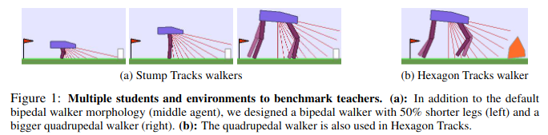
Teacher algorithms for curriculum learning of Deep
RL in continuously parameterized environments (Portelas et al., 2020)
Results:
  Personalized Curricula: ALP-GMM tailors learning sequences to DRL agents, enabling skill acquisition in diverse, complex environments.

Slide 14

Self-Play: Multi-Agent Hide-&-Seek

Slide 15
Automated Curriculum Learning Strategies
Task Sequencing Methods: These strategies determine the order in which tasks are presented to the agent. They include:
  Learning Progress-Based Sequencing: Tasks are ordered based on the agent's performance improvements.
  Difficulty-Based Sequencing: Tasks are arranged from easy to hard, often using predefined difficulty metrics.

Slide 16
Automatic Curriculum Graph Generation for RL Agents (Svetlik et al. 2017)
Objective:
  Develop an automated method to generate RL curricula by sequencing tasks using descriptors and transfer potential to enhance learning efficiency.
Key Insights:
  Curriculum as a DAG: Representing curricula as directed acyclic graphs enables flexible and efficient task progression.
  Transfer Potential Metric: Evaluates knowledge transfer benefits between tasks to guide sequencing.
  Task Grouping and Sequencing: Algorithms for task elimination, grouping, and intra- and inter-group transfers construct the curriculum graph
Results:
  Automated Curriculum Design: The method eliminates the need for manual task sequencing by domain experts

Slide 17
Automated Curriculum Learning Strategies
Domain Randomization:
  This approach involves varying environmental parameters to expose the agent to a wide range of scenarios, enhancing generalization.
  Often used in sim-to-real transfer tasks.

Slide 18
Accelerating Robot Learning of Contact-Rich Manipulations: A Curriculum Learning Study (Beltran-Hernandez et al., 2022)
Objective:
  Enhance robot learning for contact-rich manipulation tasks by combining CL with domain randomization (DR).
Key Insights:
  Curriculum Design: Uses domain randomization to incrementally increase task difficulty by varying parameters such as tolerances and object dynamics.
  Progressive Learning: Starts with simple tasks to build foundational skills.
  Robust Generalization: Ensures policies handle diverse real-world uncertainties.
Results:
  High Success Rates: 86% success in industrial insertion tasks (significant improvement)

Slide 19
Automated Curriculum Learning Strategies
Goal-conditioned RL: the agent's objective is to achieve dynamically generated goals, which serve as milestones in the learning process.
Goals can be:
  Intrinsic Goals: Generated based on the agent's current state or performance, encouraging exploration and self-improvement.
  Extrinsic Goals: Predefined by the environment or task designer, often tied to specific learning objectives.

Slide 20
Hindsight Experience Replay (HER) (Andrychowicz et al., 2017)
Objective:
  Improve RL efficiency in goal-based environments with sparse rewards.
Key Insights:
  Hindsight Relabeling: Reframes failed episodes as successes for achieved goals, extracting learning signals from failures.
  Sample Efficiency: Enables learning from all episodes using off-policy RL, improving efficiency in sparse reward settings.
Results:
  Robotic Tasks: HER enabled successful training for pushing, sliding, and pick-and-place with binary rewards.
  Real-World Transfer: Policies trained in simulation were effectively deployed on physical robots.

Slide 21
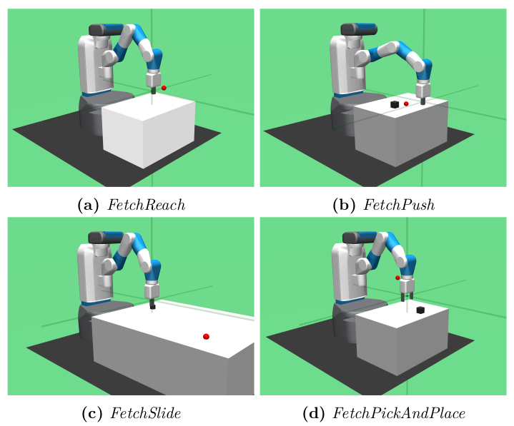
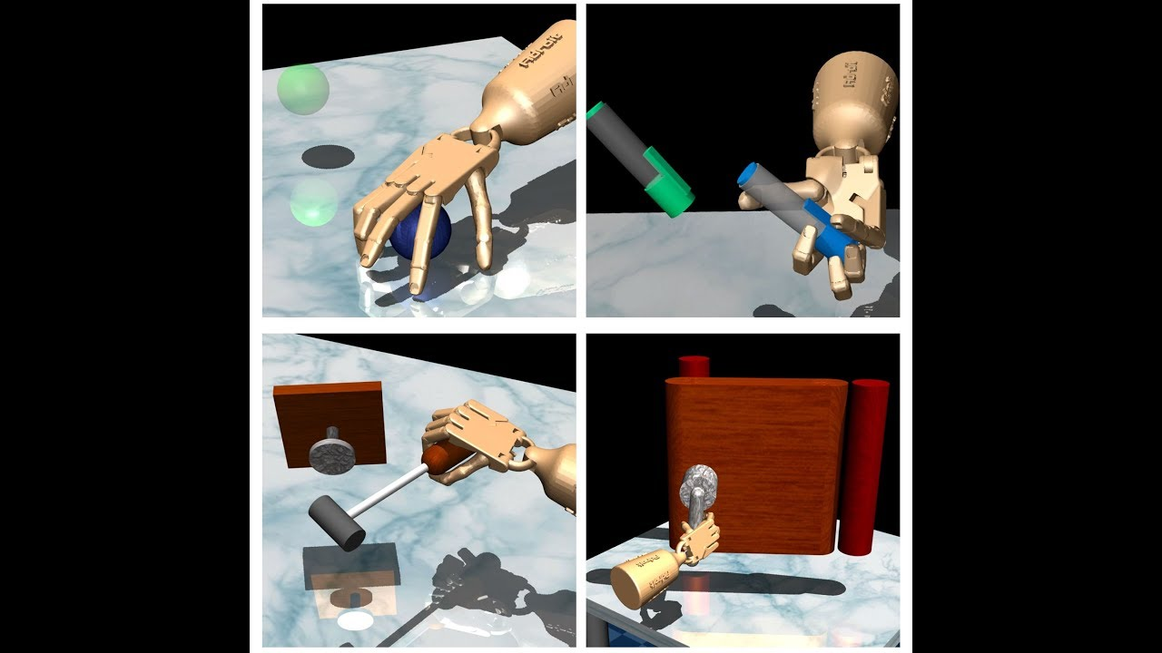
Goal-Based Environments

Slide 22
Limited Optimality Guarantees:
Heuristic Nature: Many curriculum learning approaches rely on heuristics or predefined rules, which may not guarantee optimal task sequences.
Limited Theoretical Foundations: Few methods provide theoretical guarantees on convergence or optimality of the learned policy.
Exploration vs. Exploitation Trade-off: Balancing task difficulty progression often lacks formal guarantees for achieving globally optimal solutions.

Slide 23
Task Phasing: Automated Curriculum Learning from Demonstrations (Bajaj et al., 2023)
Imitate sub-optimal demonstrator
Learn optimal target policy
π_{D}
π*_{RL}
T_{S}
T_{β}
T_{F}
0.0
β
1.0
Task Continuum
Imitation Learning
Reinforcement Learning
Temporal Phasing
Reward Phasing

Slide 24
Convergence Guarantees
Convergence on the optimal policy, π_{f}*, for the target task:
  The guarantee asserts that if the optimal policies of tasks within a task continuum are continuous, then by making sufficiently small transitions along the continuum, trust-region methods can ensure convergence to the optimal policy for each task, including the target task.
  This is achieved by leveraging the smoothness of the policy landscape, and trust-region optimization guarantees to progressively guide the agent through the task sequence.

Slide 25
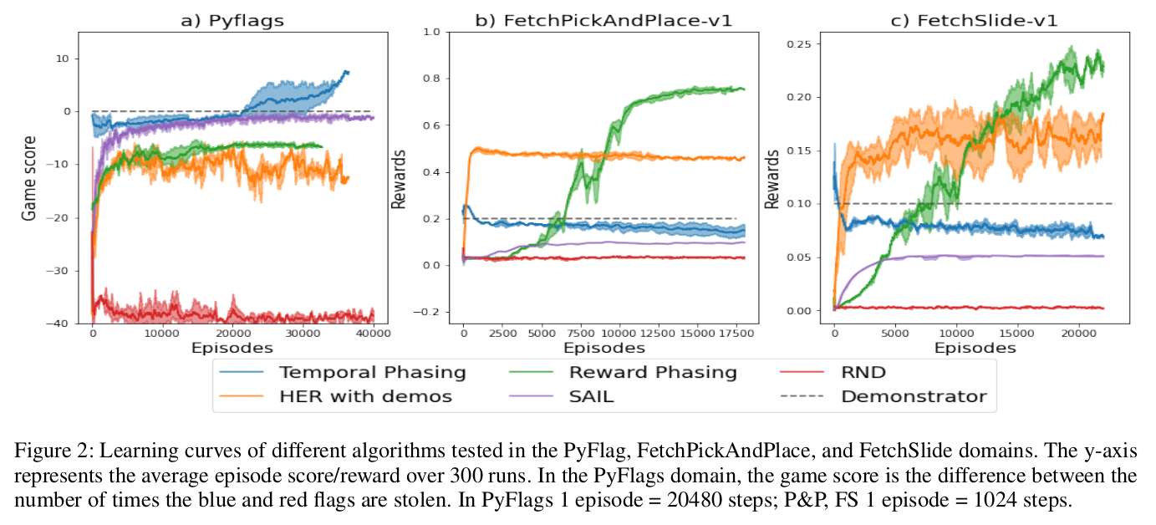
Experiments

Slide 26
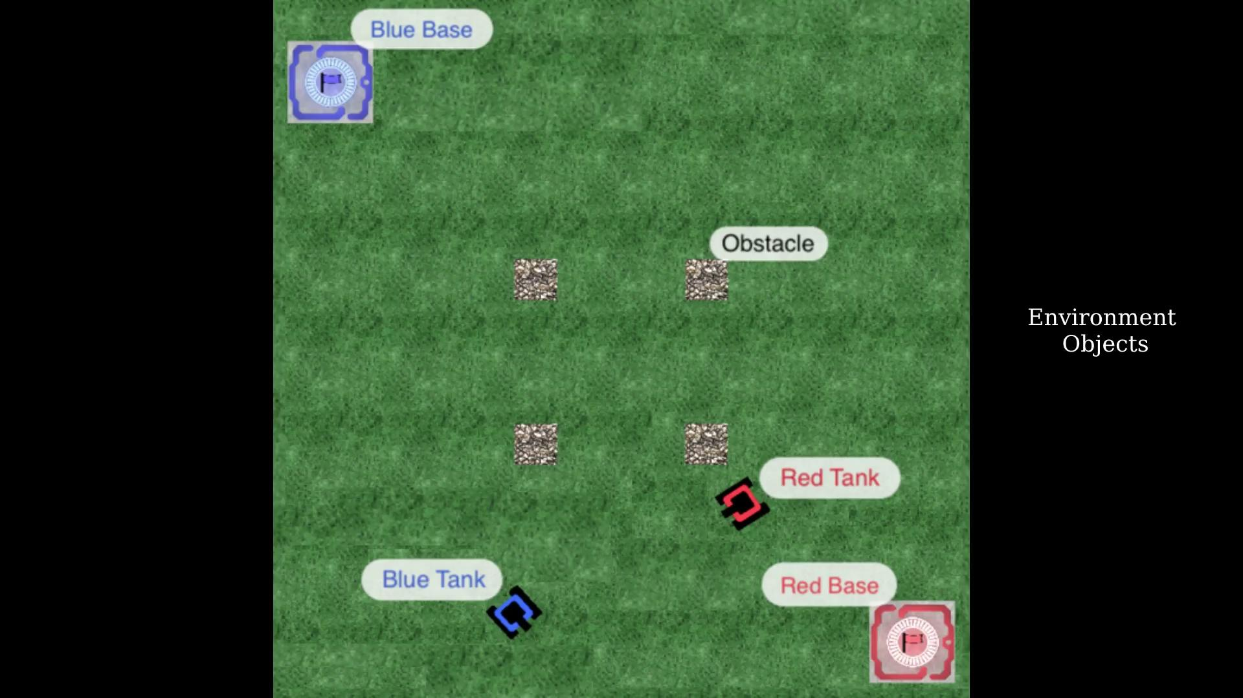
Pyflags- Capture the Flag

Slide 27
CL Evaluation Metrics
Learning Speed:
  Measures the time or number of iterations required for the agent to achieve a specified performance level.
Final Performance:
  Evaluates the agent's ability to solve the target task after training with the curriculum.
  Example: Success rate, cumulative rewards, or task completion time.

Slide 28
CL Evaluation Metrics
Transfer Efficiency:
  Assesses the benefits of the curriculum in transferring knowledge from source tasks to the target task.
  Example: Comparing target task performance with and without the curriculum.
Robustness and Generalization:
  Tests the agent's performance across diverse and unseen environments.
  Example: Generalization gap or success rates in new scenarios.

Slide 29
CL Evaluation Metrics
Stability:
  Measures how consistently the curriculum improves learning across different agents or environments.
  Example: Variance in performance metrics across multiple training runs.
Curriculum Efficiency:
  Evaluates the computational cost or resource usage of curriculum generation.
  Example: Time taken to design and execute the curriculum compared to traditional training.

Slide 30
Summary
Background:
  What is CL? A strategy to improve RL performance by sequencing tasks for better learning speed and final outcomes.
  Traditional Approaches: Manual design and heuristic-based methods, focusing on predefined task sequencing.
Pros and Cons:
  Pros: Accelerates learning, improves target task performance, enables skill acquisition Cons: Lacks optimality guarantees, computationally expensive, and agent-specific tuning required.

Slide 31
Summary
Automated Curriculum Learning:
  Strategies: Includes task sequencing, goal generation, teacher-student frameworks, and domain randomization.
Theoretical Guarantees:
  Limited, with most approaches lacking formal convergence or optimality assurances.
Evaluation Metrics:
  Learning speed, final performance, transfer efficiency, robustness, and curriculum efficiency.

