Slide 1
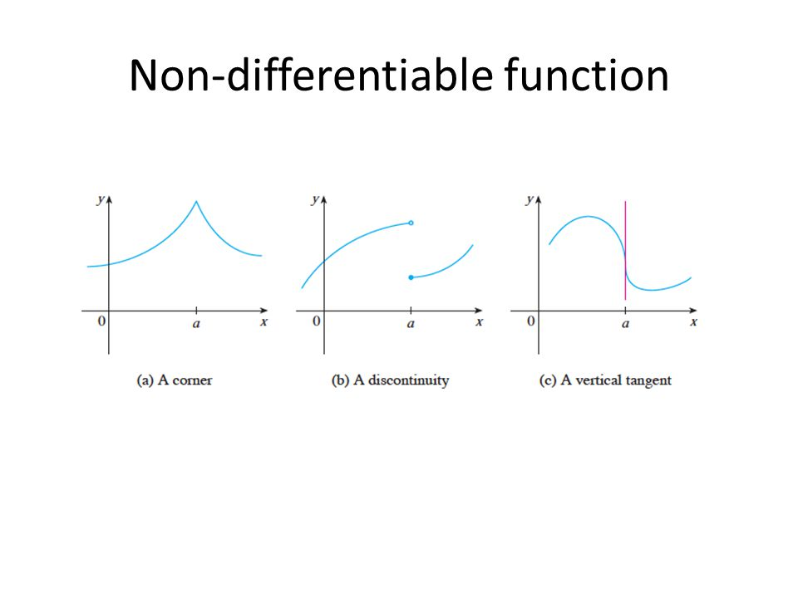
CSCE-642 Reinforcement Learning
Derivative Free Methods
Instructor: Guni Sharon

Slide 2
Final report
Please limit to 6 pages
Be concise and on-point
Follow a clear narrative

Slide 3
Solver classes
TD learning
Policy tuning
Gradient free
Policy gradient
Policy iteration
Value based
Today:
Policy tuning without a differentiable policy
Also known as gradient free methods
Actor-critic
Q-learning

Slide 4

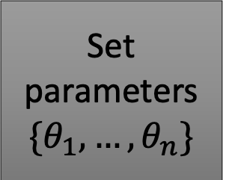
Online parameter tuning
Set parameters
$${\{θ}_{1}, …,θ_{n}\}$$
Gradient approximation -
Finite Difference Policy Gradient Decent
[Kohl and Stone, 2004]
Evolution strategy –
covariance matrix adaptation
[Hansen and Ostermeier, 1996]
Gaussian processes
Evaluate performance
Act

Slide 5
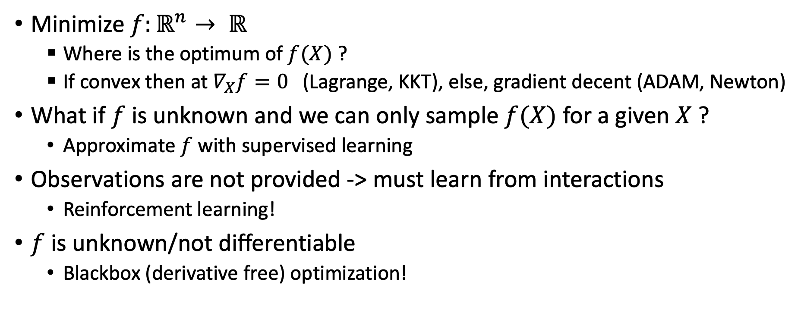
Online parameter tuning
Minimize $f:ℝ^{n}→ ℝ$
  Where is the optimum of $f(X)$ ?
  If convex then at $∇_{X}f=0$ (Lagrange, KKT), else, gradient decent (ADAM, Newton)
What if $f$ is unknown and we can only sample $f(X)$ for a given $X$ ?
  Approximate $f$ with supervised learning
Observations are not provided -> must learn from interactions
  Reinforcement learning!
$f$ is unknown/not differentiable
  Blackbox (derivative free) optimization!

Slide 6
Examples
Comparison between popular genetic algorithm (GA)-based tool and covariance matrix adaptation – evolutionary strategy (CMA-ES) for optimizing indoor daylight
Manal Anis, Sumedh Pendurkar, Yun Kyu Yi, and Guni Sharon
In Proceedings of Building Simulation 2023: 18th Conference of IBPSA, 2023
Bilevel Entropy based Mechanism Design for Balancing Meta in Video Games.
Sumedh Pendurkar, Chris Chow, Luo Jie, and Guni Sharon
In Proceedings of the 22th International Conference on Autonomous Agents and MultiAgent Systems (AAMAS), 2023

Slide 7
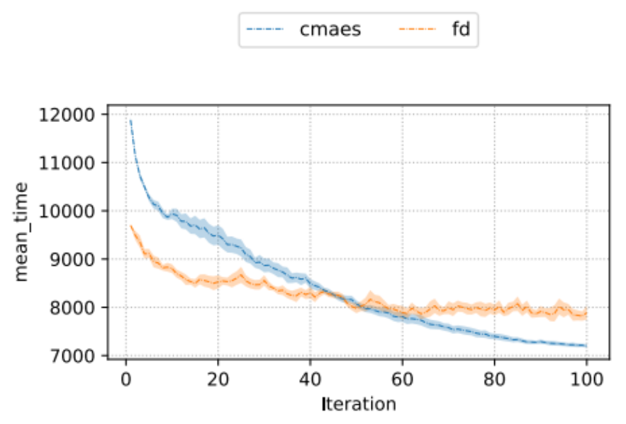
Blackbox optimization
Challenges:
  Compute the optimum of an unknown function via samples
  Sample efficiency: minimize the number of samples along the training process
  minimize cumulative regret (for online optimization)
Cost

Slide 8
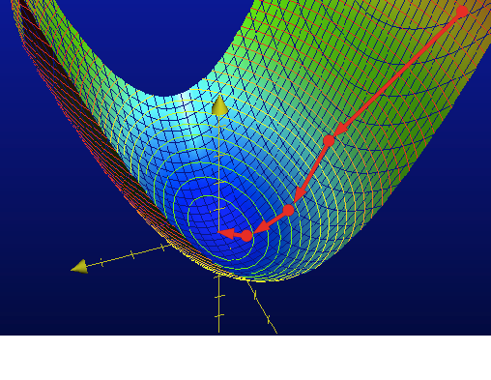
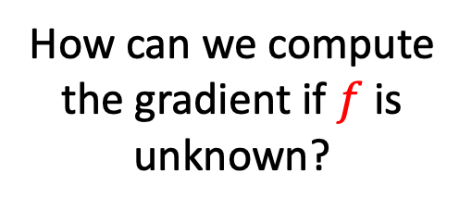
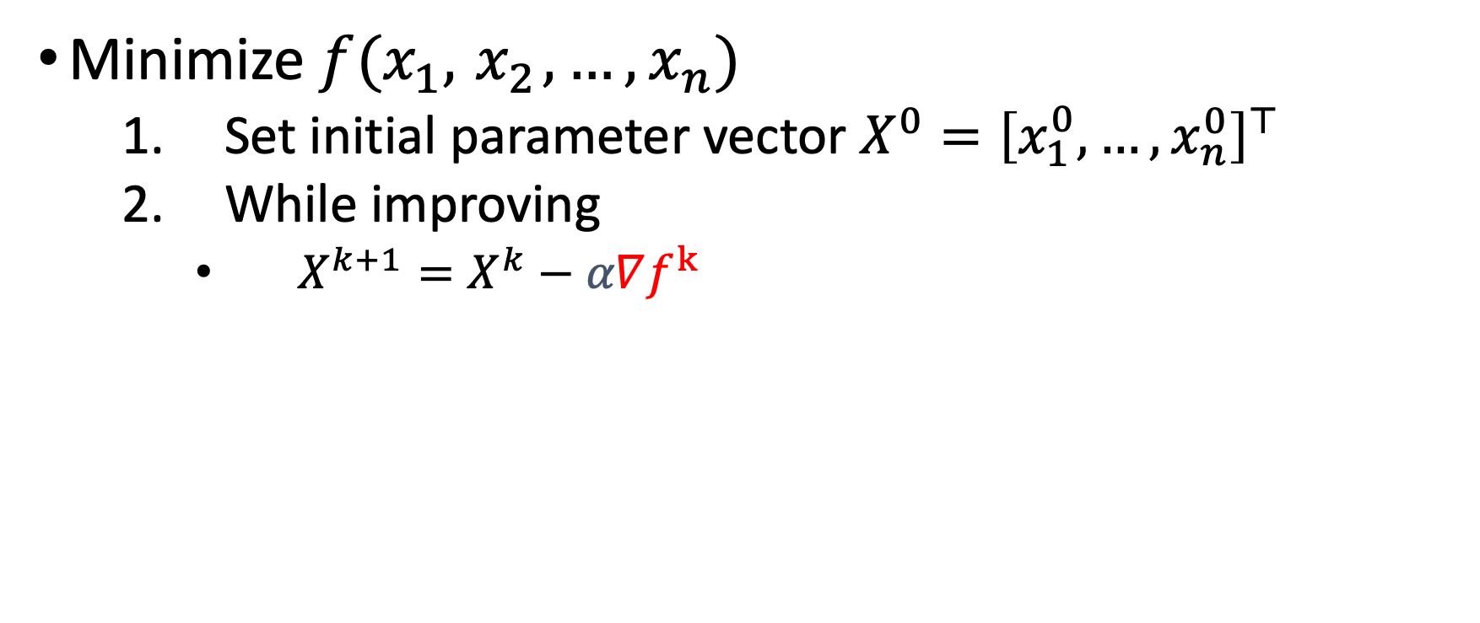
1. Gradient Descent
Minimize $f(x_{1},{ x}_{2},…, x_{n})$
  Set initial parameter vector $X^{0}={\left[x_{1}^{0}, …,x_{n}^{0}\right]}^{⊤}$
  While improving
    $X^{k+1}=X^{k}−α∇f^{k}$
?
How can we compute the gradient if $f$ is unknown?

Slide 9
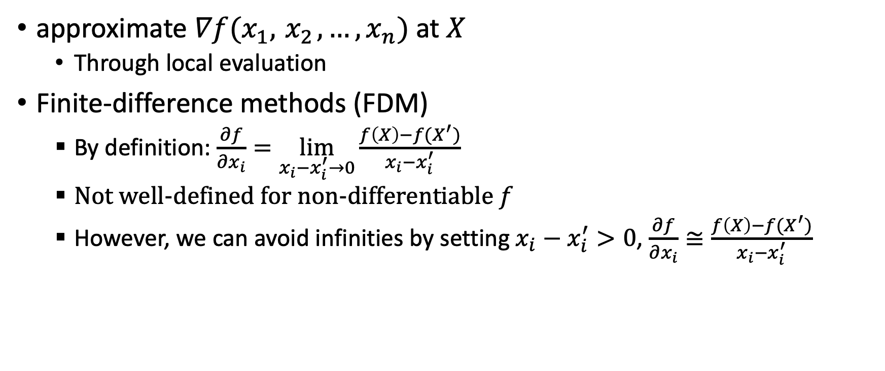
Empirical gradient
approximate $∇f(x_{1},{ x}_{2},…, x_{n})$ at $X$
  Through local evaluation
Finite-difference methods (FDM)
  By definition: $\frac{∂f}{∂x_{i}}=\lim_{x_{i}−x_{i}^{′}→0}\frac{f\left(X\right)−f(X^{′})}{x_{i}−x_{i}^{′}}$
  Not well-defined for non-differentiable $f$
  However, we can avoid infinities by setting $x_{i}−x_{i}^{′}>0$, $\frac{∂f}{∂x_{i}}≅\frac{f\left(X\right)−f(X^{′})}{x_{i}−x_{i}^{′}}$

Slide 10
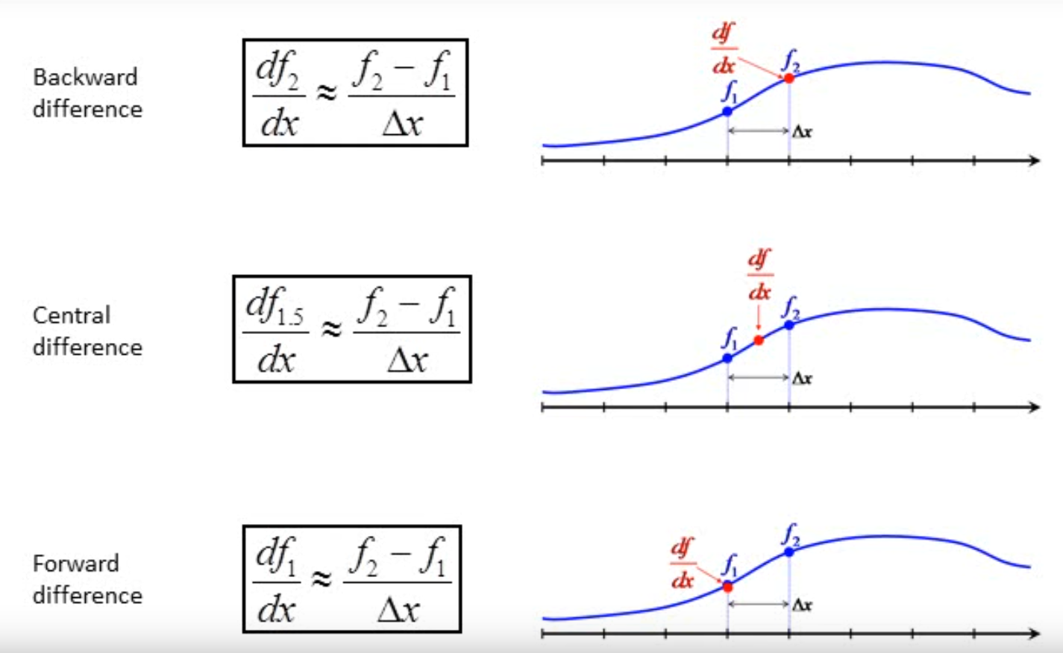
Finite difference approach
Biased towards the rear
Unbiased
X2 samples
Biased towards the front

Slide 11
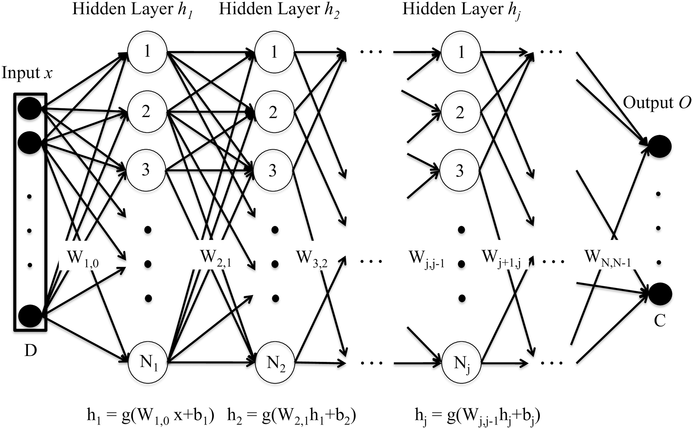
High dimensionality
Approximate the gradient of a DNN with 1M parameters
Requires 2M observations!
  Not practical
A stochastic approach is required

Slide 12
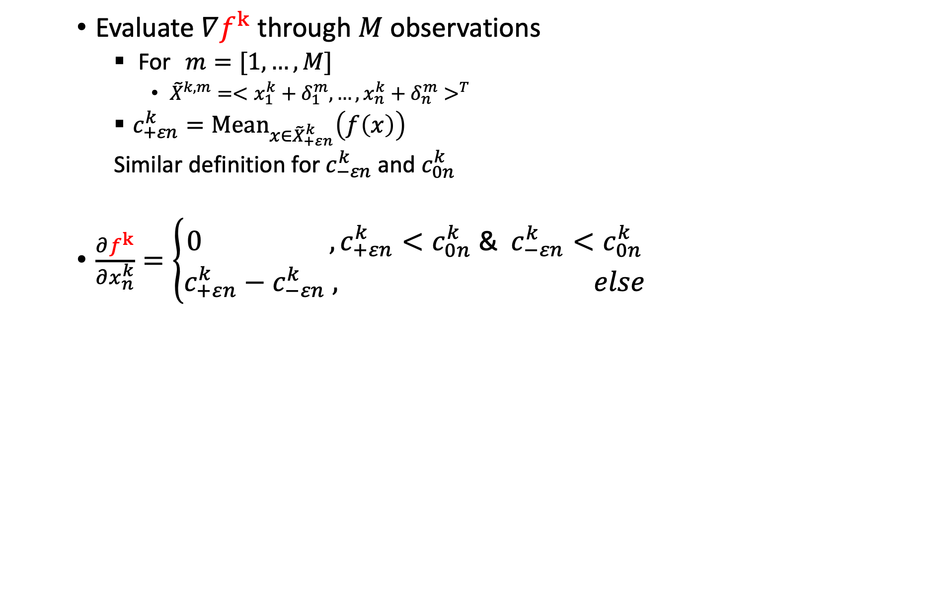
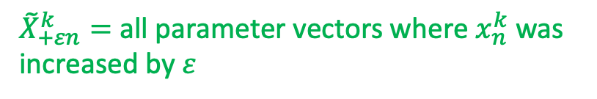

Finite Difference Policy Gradient
(Kohl and Stone, 2004)
Evaluate $∇f^{k}$ through $M$ observations
  For $m=[1,…,M$]
    ${\tilde{X}}^{k,m}=<{x_{1}^{k}+δ_{1}^{m}, …,x_{n}^{k}+δ_{n}^{m}>}^{T}$
  $c_{+εn}^{k}={Mean}_{x∈{\tilde{X}}_{+εn}^{k}}\left(f\left(x\right)\right)$
  Similar definition for $c_{−εn}^{k}$ and $c_{0n}^{k}$
$\frac{∂f^{k}}{∂x_{n}^{k}}=\left\{\begin{aligned}0{ , c}_{+εn}^{k}<c_{0n}^{k} \text{&} { c}_{−εn}^{k}<c_{0n}^{k} \\ c_{+εn}^{k}−&c_{−εn}^{k} , else\end{aligned}\right.$
$$δ_{n}^{m}=Rand(−ε,0,ε)$$
${\tilde{X}}_{+εn}^{k}=$ all parameter vectors where $x_{n}^{k}$ was increased by $ε$

Slide 13
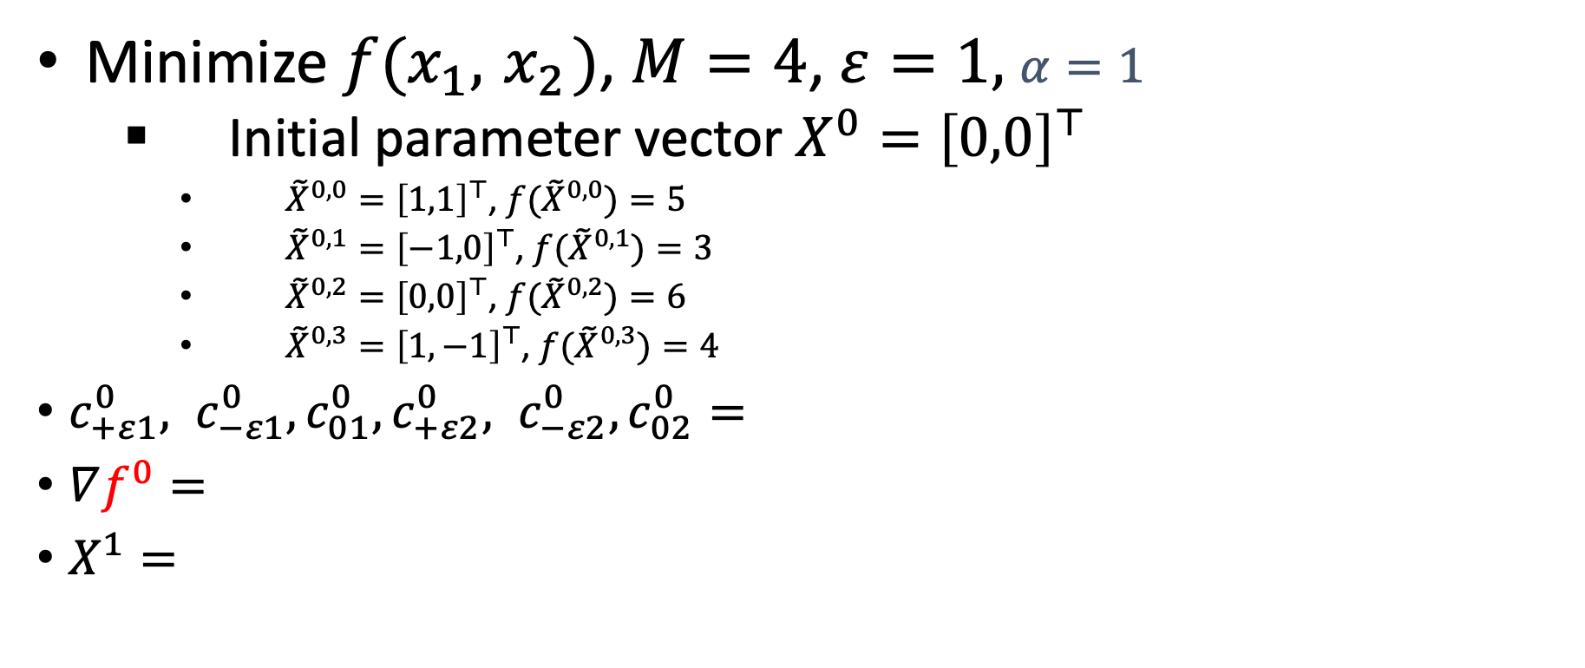
Example
    Minimize $f(x_{1},{ x}_{2})$, $M=4$, $ε=1,$ $α=1$
  Initial parameter vector $X^{0}={\left[0,0\right]}^{⊤}$
    ${\tilde{X}}^{0,0}={\left[1,1\right]}^{⊤}$, ${f(\tilde{X}}^{0,0})=5$
    ${\tilde{X}}^{0,1}={\left[−1,0\right]}^{⊤}$, ${f(\tilde{X}}^{0,1})=3$
    ${\tilde{X}}^{0,2}={\left[0,0\right]}^{⊤}$, ${f(\tilde{X}}^{0,2})=6$
    ${\tilde{X}}^{0,3}={\left[1,−1\right]}^{⊤}$, ${f(\tilde{X}}^{0,3})=4$
$c_{+ε1}^{0}, c_{−ε1}^{0},c_{01}^{0},c_{+ε2}^{0}, c_{−ε2}^{0},c_{02}^{0}=$
$∇f^{0}=$
$X^{1}=$

Slide 14
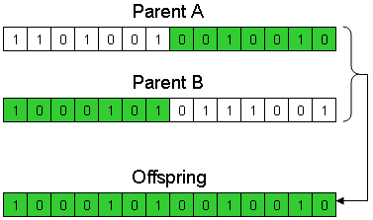
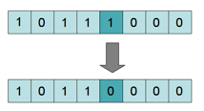
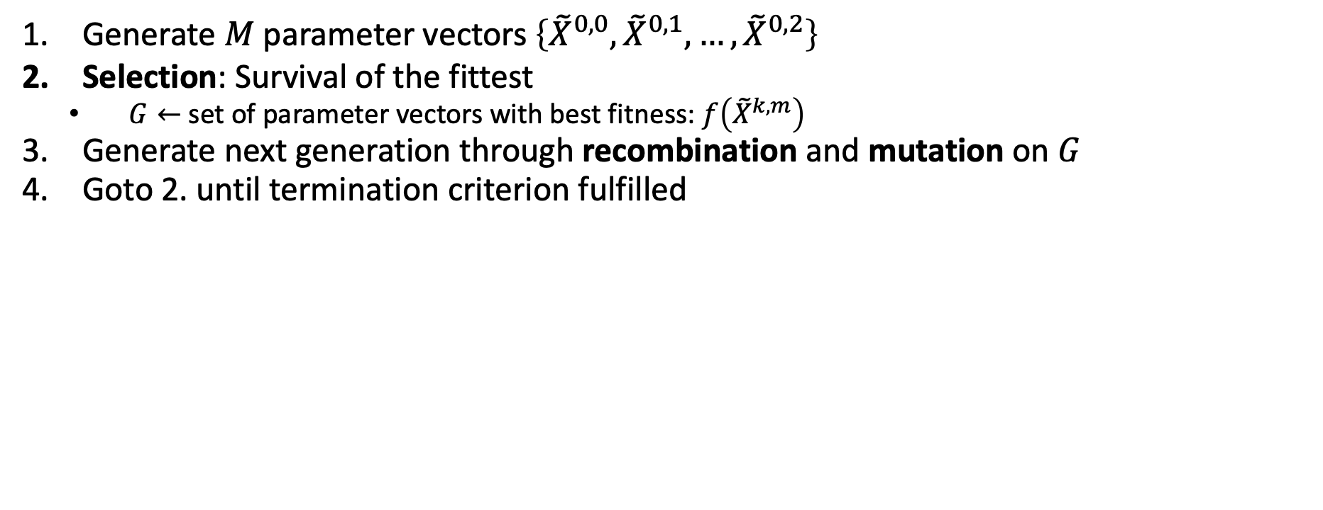
Genetic Algorithm
Might apply to the unification of current and former generations
  Generate $M$ parameter vectors $\left\{{\tilde{X}}^{0,0},{\tilde{X}}^{0,1},…,{\tilde{X}}^{0,2}\right\}$
  Selection: Survival of the fittest
    $G←$ set of parameter vectors with best fitness: $f\left({\tilde{X}}^{k,m}\right)$
  Generate next generation through recombination and mutation on $G$
  Goto 2. until termination criterion fulfilled
Recombination
How many parents?
How many offsprings?
Crossover technique?
Mutation technique?
Continuous space?
Mutation

Slide 15
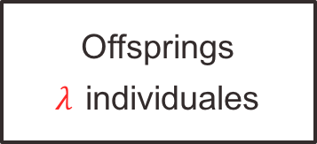
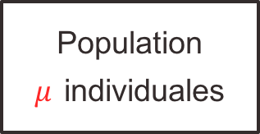
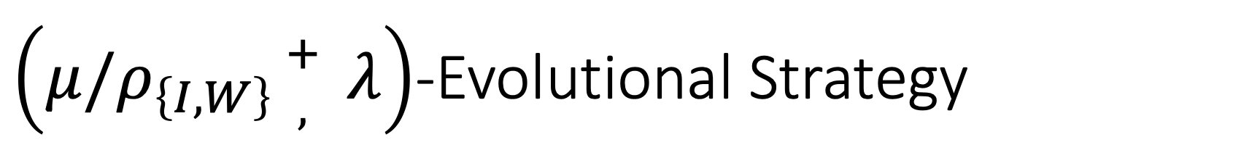
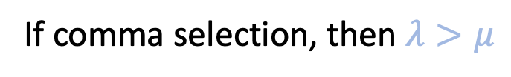
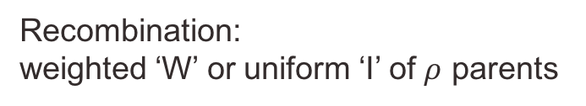
$\left(μ/ρ_{\left\{I,W\right\}}{+ \atop ,} λ\right)$-Evolutional Strategy
Recombination:
weighted ‘W’ or uniform ‘I’ of $ρ$ parents
Init population
Population
$μ$ individuales
Offsprings
$λ$ individuales
*Selection from current generation ’,’ or current $∪$ previous ‘+’
If comma selection, then $λ>μ$
*While the ‘,’ selection is recommended for unbounded search spaces (Schwefel, 1987), the ‘+’ selection should be used in discrete finite size search spaces, e.g., in combinatorial optimization problems (Herdy, 1990; Beyer, 1992).

Slide 16
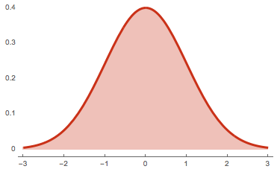
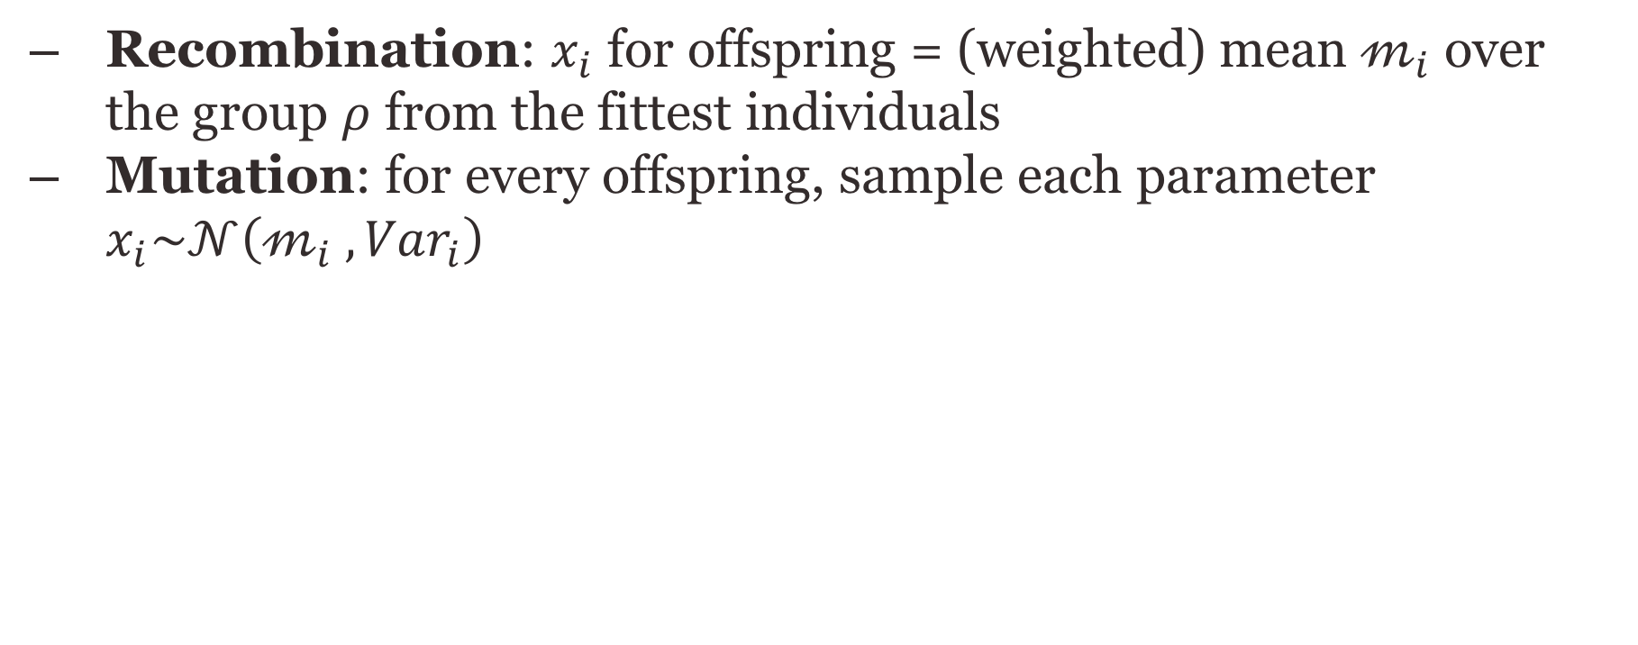
Continuous space
  Recombination: $x_{i}$ for offspring = (weighted) mean $𝓂_{i}$ over the group $ρ$ from the fittest individuals
  Mutation: for every offspring, sample each parameter $x_{i}\sim 𝒩\left(𝓂_{i} , {Var}_{i}\right)$
Recombination
Mutation

Slide 17
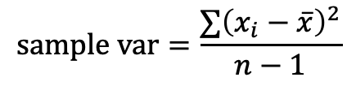
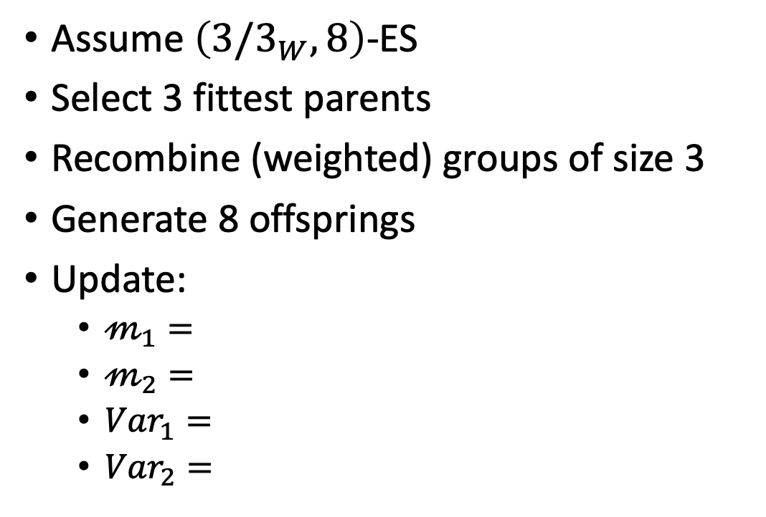
Recombination
Assume $\left(3/3_{W}, 8\right)$-ES
Select 3 fittest parents
Recombine (weighted) groups of size 3
Generate 8 offsprings
Update:
  $𝓂_{1}=$
  $𝓂_{2}=$
  ${Var}_{1}=$
  ${Var}_{2}=$
9
1
7
(1,1)
5
1
(0,0)
2
6
(-1,-1)
8
$$sample var=\frac{∑{\left(x_{i}−\overline{x}\right)}^{2}}{n−1}$$

Slide 18
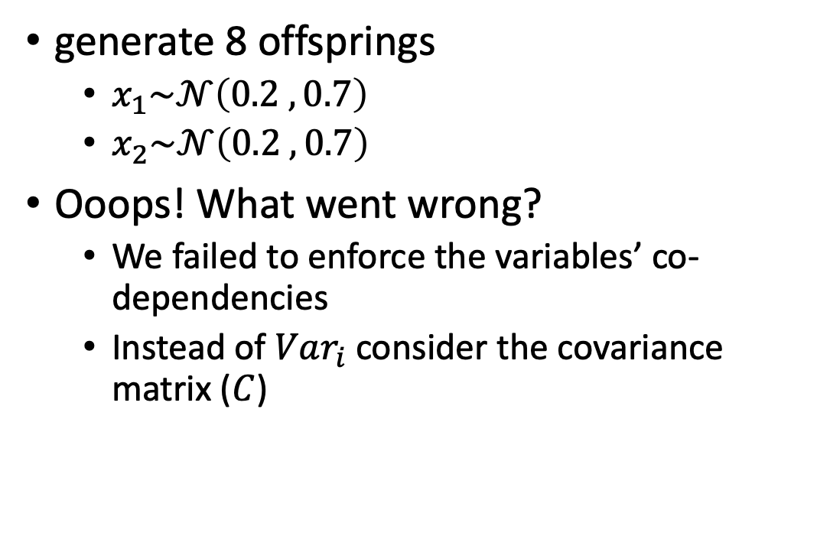
Mutation
generate 8 offsprings
  $x_{1}\sim 𝒩\left(0.2 , 0.7\right)$
  $x_{2}\sim 𝒩\left(0.2 , 0.7\right)$
Ooops! What went wrong?
  We failed to enforce the variables’ co-dependencies
  Instead of $Var_{i}$ consider the covariance matrix ($C$)
7
1
9
(0.2,0.2)
5
1
8
2
6

Slide 19
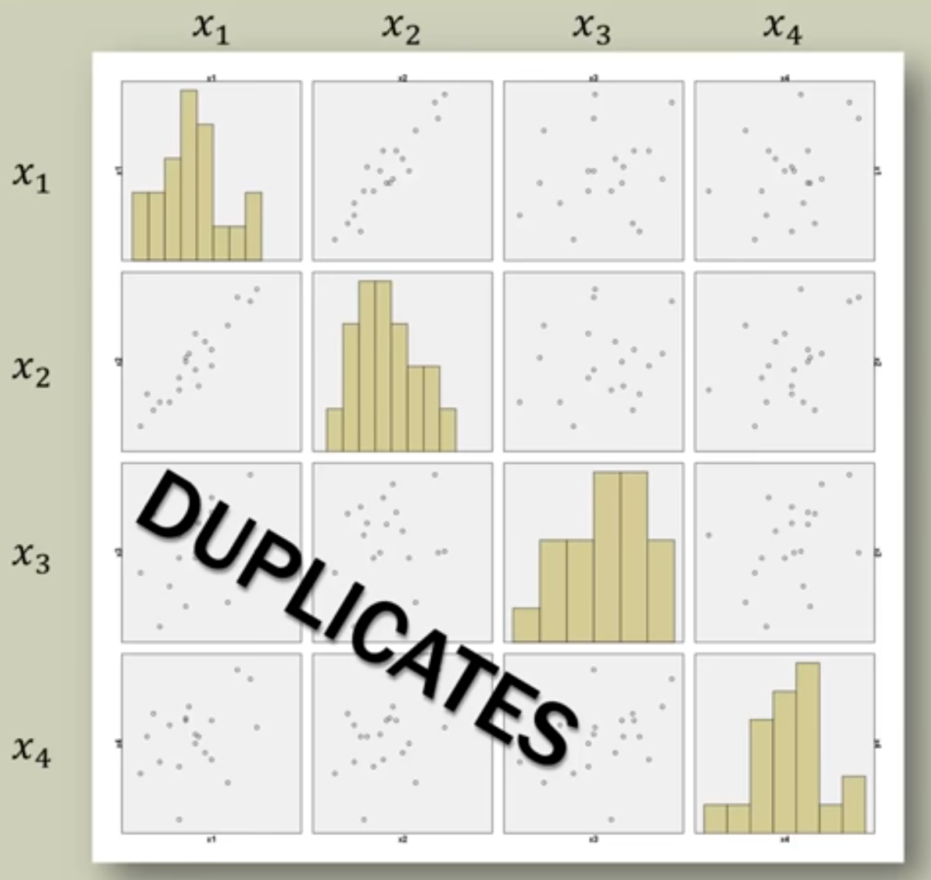
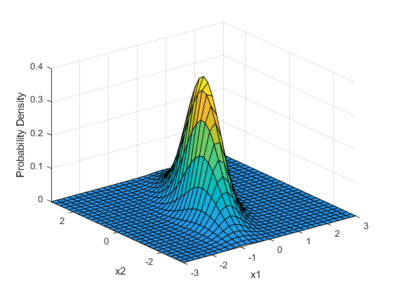
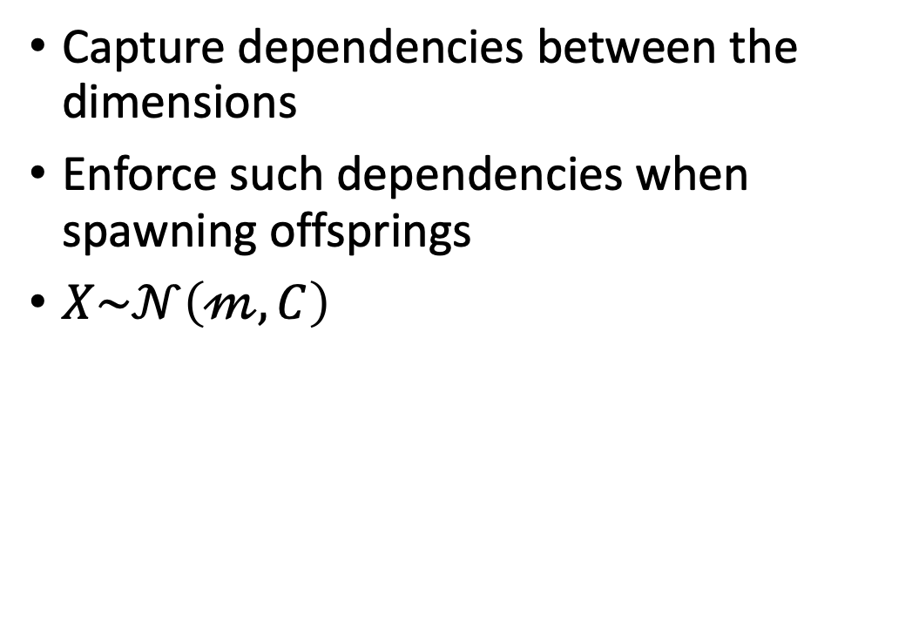
Covariance matrix
Capture dependencies between the dimensions
Enforce such dependencies when spawning offsprings
$X\sim 𝒩\left(𝓂, C\right)$

Slide 20
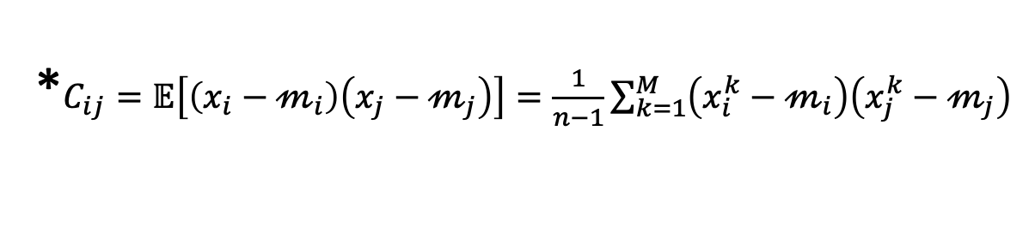
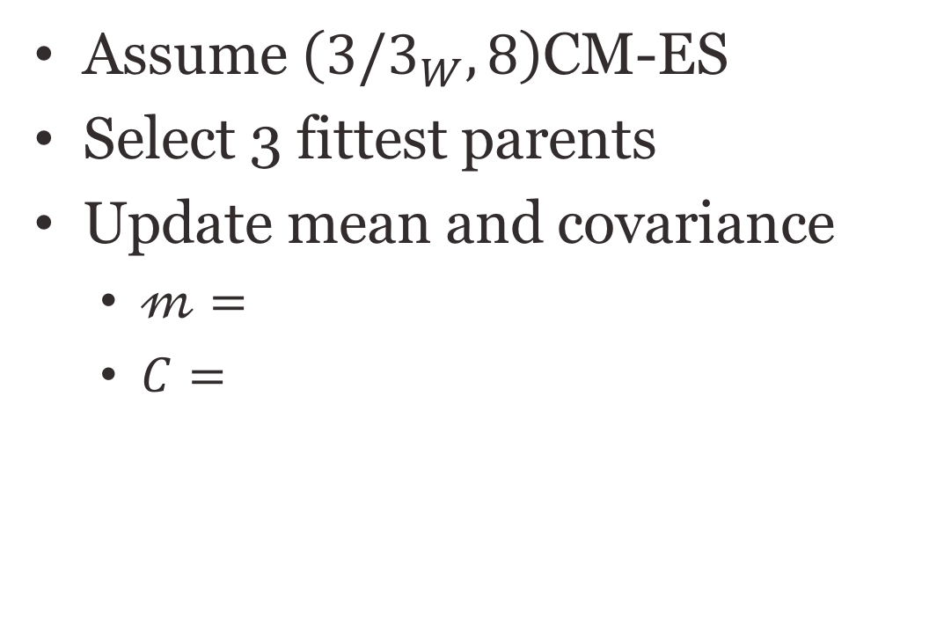
Lets try again…
Assume $\left(3/3_{W}, 8\right)$CM-ES
Select 3 fittest parents
Update mean and covariance
  $𝓂=$
  $C=$
9
1
7
(1,1)
5
1
(0,0)
2
6
(-1,-1)
8
*$C_{ij}=𝔼\left[\left(x_{i}−𝓂_{i}\right)\left(x_{j}−𝓂_{j}\right)\right]=\frac{1}{n−1}\sum_{k=1}^{M}{\left(x_{i }^{k}−𝓂_{i}\right)\left(x_{j }^{k}−𝓂_{j}\right)}$

Slide 21
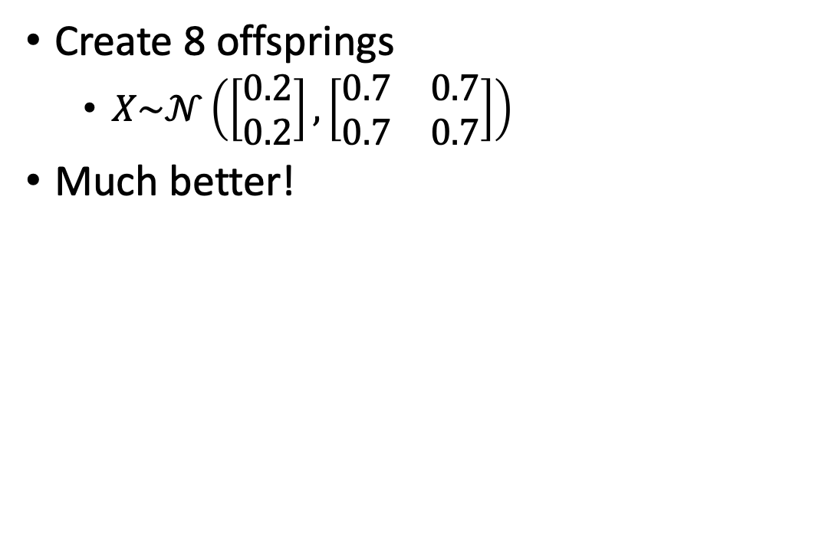
Mutation
Create 8 offsprings
  $X\sim 𝒩\left(\left[\begin{matrix}0.2 \\ 0.2\end{matrix}\right], \left[\begin{matrix}0.7 & 0.7 \\ 0.7 & 0.7\end{matrix}\right]\right)$
Much better!
1
1
1
(0.2,0.2)
1
3
2
2
2

Slide 22
Step-size control
For updating the mean and covariance matrix between generations
Step size too large
Reasonable step size
Step size too
small
if several updates go to the same/similar direction the step-size is increased
We've seen this before (momentum)

Slide 23
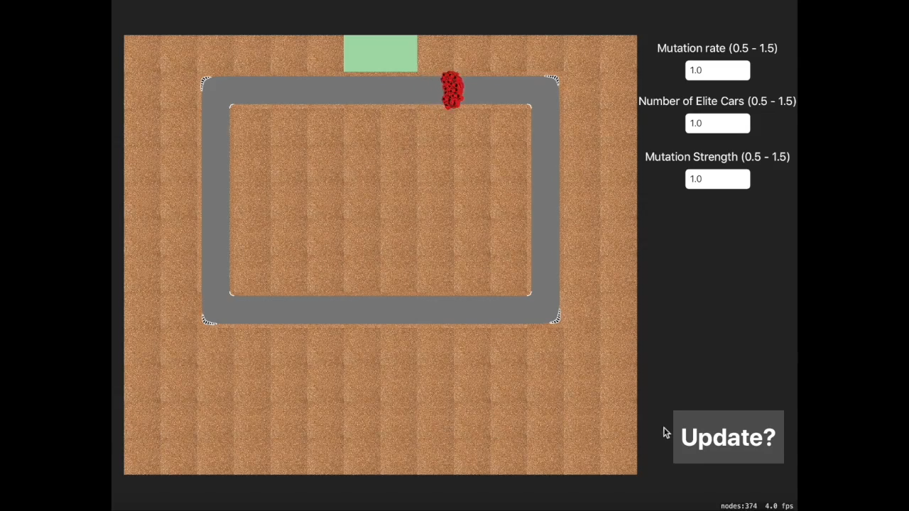
Video CMA-ES

Slide 24
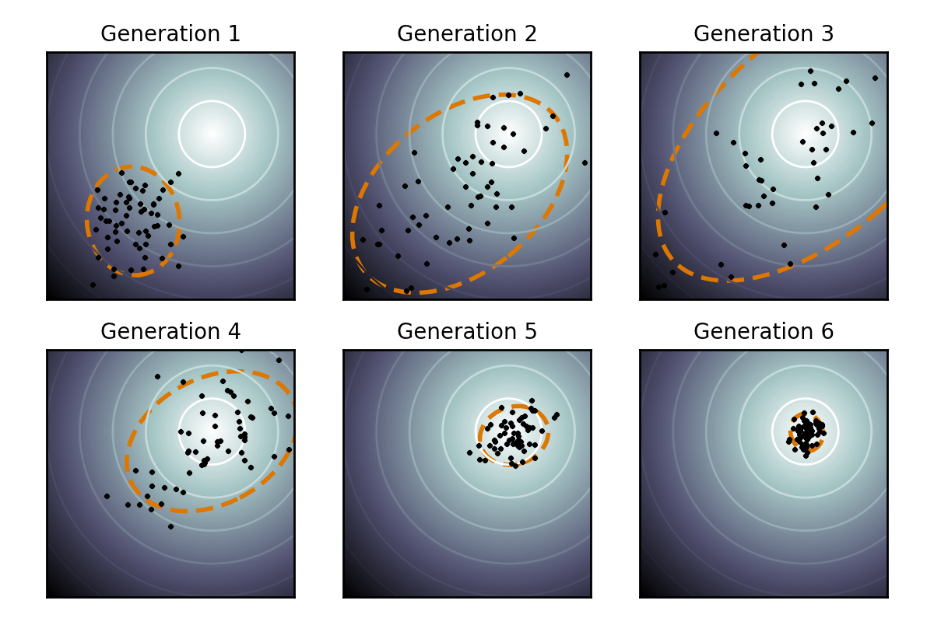
Online parameter tuning
Finite difference
  Less exploration
  Safer
  Harder to escape a local minima
CMA-ES
  More exploration
  Less safe
  Easier to escape a local minima
Iteration
Iteration
Iteration
Iteration
Iteration
Iteration

Slide 25
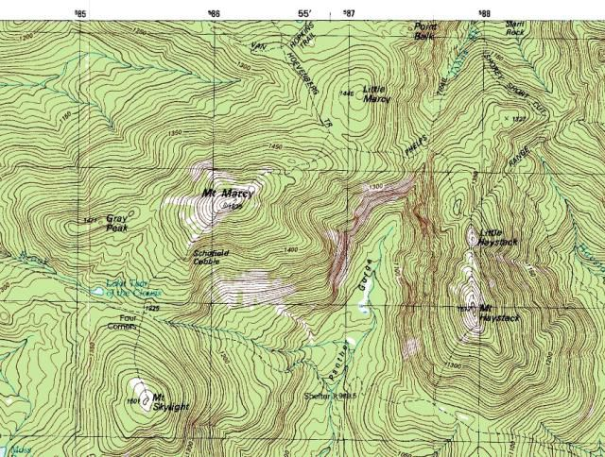




Looking for gold
Daniel Krige - South African mining engineer, 1960
Find the point richest in gold
Sampling the soil is expensive
Given current samples
  Where should the next sample be taken from?

Slide 26
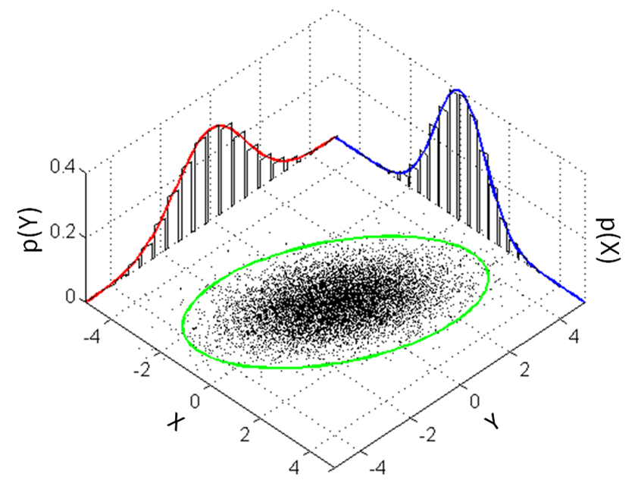
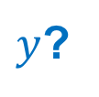
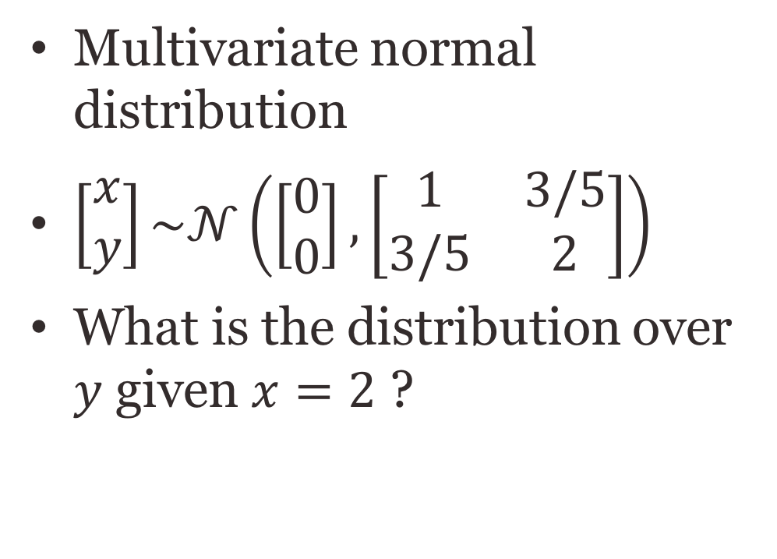
Conditional distribution
Multivariate normal distribution
$\left[\begin{matrix}x \\ y\end{matrix}\right]\sim 𝒩\left(\left[\begin{matrix}0 \\ 0\end{matrix}\right], \left[\begin{matrix}1 & 3/5 \\ 3/5 & 2\end{matrix}\right]\right)$
What is the distribution over $y$ given $x=2$ ?
$y$?
3-Sigma bound

Slide 27
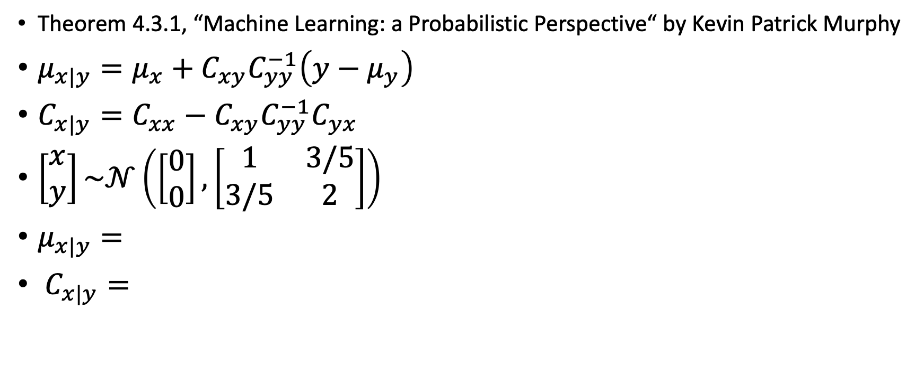
Posterior conditionals of an MVN
Theorem 4.3.1, “Machine Learning: a Probabilistic Perspective“ by Kevin Patrick Murphy
$μ_{x|y}=μ_{x}+C_{xy}C_{yy}^{−1}\left(y−μ_{y}\right)$
$C_{x|y}=C_{xx}−C_{xy}C_{yy}^{−1}C_{yx}$
$\left[\begin{matrix}x \\ y\end{matrix}\right]\sim 𝒩\left(\left[\begin{matrix}0 \\ 0\end{matrix}\right], \left[\begin{matrix}1 & 3/5 \\ 3/5 & 2\end{matrix}\right]\right)$
$μ_{x|y}=$
$C_{x|y}=$
In the example x and y are a single parameter but they can represent high-dimensional vectors (the general case). Hence the matrix notation.

Slide 28


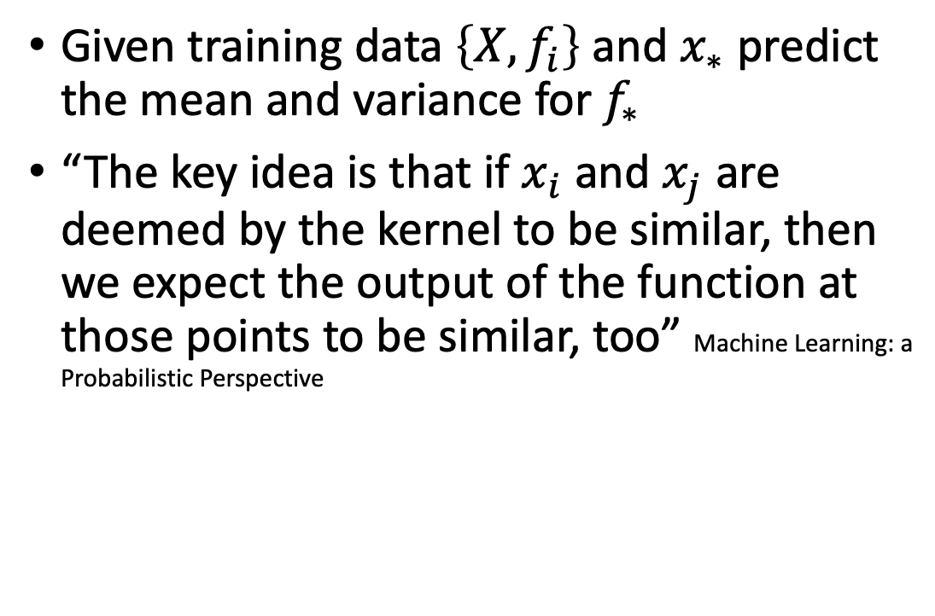




Gaussian Prediction
$$f(x)$$
Given training data $\left\{X,f_{i}\right\}$ and $x_{∗}$ predict the mean and variance for $f_{∗}$
“The key idea is that if $x_{i}$ and $x_{j}$ are deemed by the kernel to be similar, then we expect the output of the function at those points to be similar, too” Machine Learning: a Probabilistic Perspective
$$x_{3}$$
$$x_{∗}$$
$$x$$
$$x_{2}$$
$$x_{1}$$

Slide 29
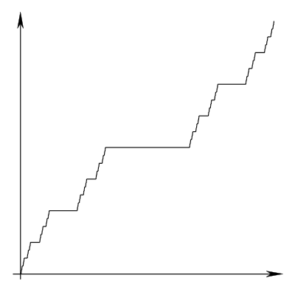
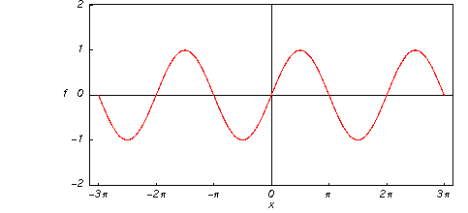
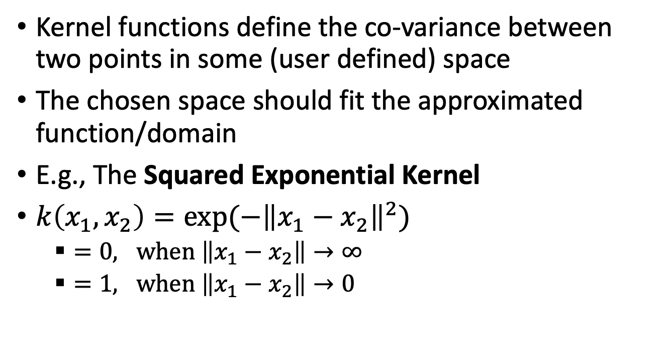
Kernels
Kernel functions define the co-variance between two points in some (user defined) space
The chosen space should fit the approximated function/domain
E.g., The Squared Exponential Kernel
$k\left(x_{1},x_{2}\right)=exp⁡(−{\left\|x_{1}−x_{2}\right\|}^{2})$
  $=0, when \left\|x_{1}−x_{2}\right\|→∞$
  $=1, when \left\|x_{1}−x_{2}\right\|→0$

Slide 30



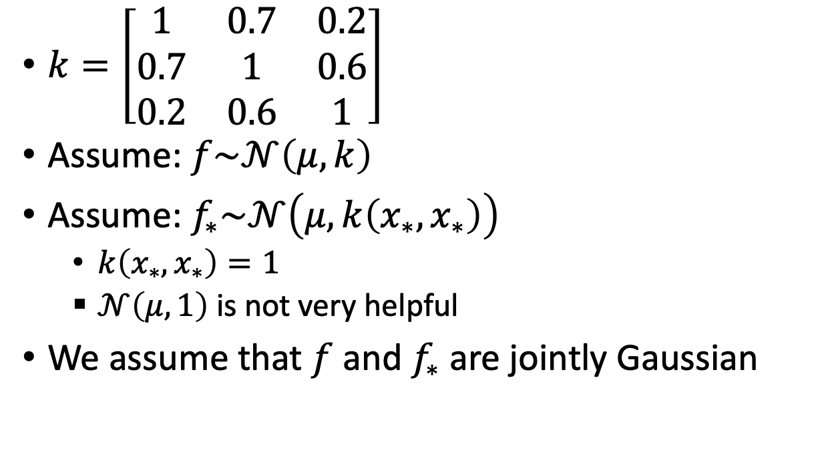

Gaussian Prediction
$$f(x)$$
$k=\left[\begin{matrix}1 & 0.7 & 0.2 \\ 0.7 & 1 & 0.6 \\ 0.2 & 0.6 & 1\end{matrix}\right]$
Assume: $f\sim 𝒩\left(μ,k\right)$
Assume: $f_{∗}\sim 𝒩\left(μ,k\left(x_{∗},x_{∗}\right)\right)$
  $k\left(x_{∗},x_{∗}\right)=1$
  $𝒩\left(μ,1\right)$ is not very helpful
We assume that $f$ and $f_{∗}$ are jointly Gaussian
$$x_{3}$$
$$x_{∗}$$
$$x$$
$$x_{2}$$
$$x_{1}$$

Slide 31



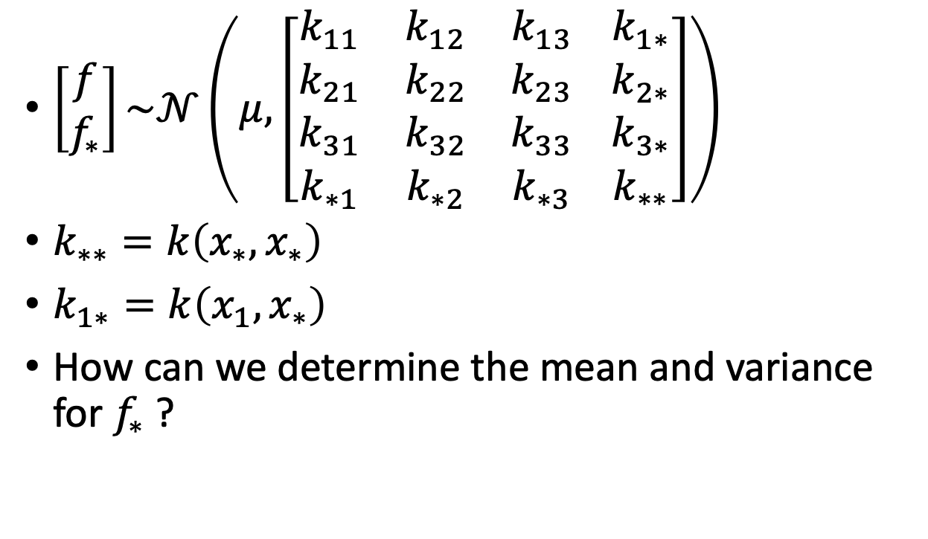
Gaussian Process
$$f(x)$$
$\left[\begin{matrix}f \\ f_{∗}\end{matrix}\right]\sim 𝒩\left(μ, \left[\begin{matrix}k_{11} & k_{12} & k_{13} \\ k_{21} & k_{22} & k_{23} \\ \begin{matrix}k_{31} \\ k_{∗1}\end{matrix} & \begin{matrix}k_{32} \\ k_{∗2}\end{matrix} & \begin{matrix}k_{33} \\ k_{∗3}\end{matrix}\end{matrix} \begin{matrix}k_{1∗} \\ k_{2∗} \\ \begin{matrix}k_{3∗} \\ k_{∗∗}\end{matrix}\end{matrix}\right]\right)$
$k_{∗∗}=k\left(x_{∗},x_{∗}\right)$
$k_{1∗}=k\left(x_{1},x_{∗}\right)$
How can we determine the mean and variance for $f_{∗}$ ?
$$x_{3}$$
$$x_{∗}$$
$$x$$
$$k$$
$$k_{∗}$$
$$k_{∗∗}$$
$$x_{2}$$
$$x_{1}$$

Slide 32
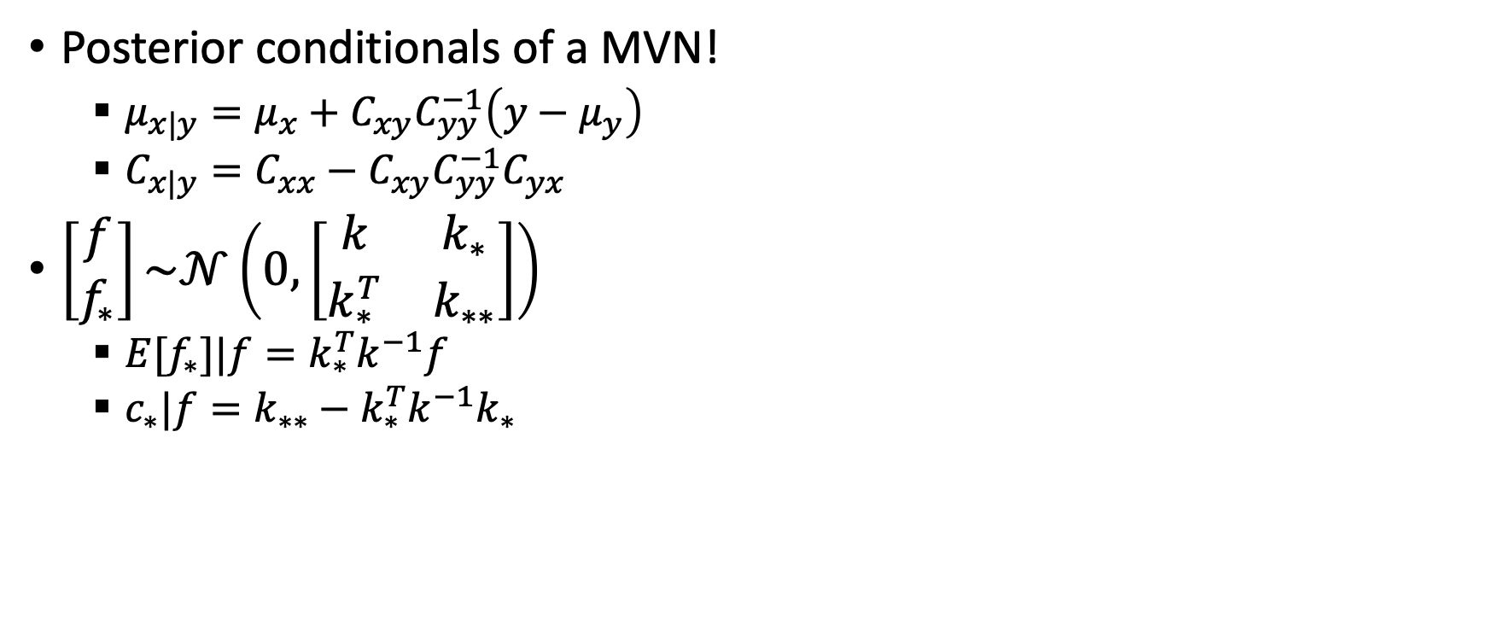
Gaussian Process
$$f(x)$$
Posterior conditionals of a MVN!
  $μ_{x|y}=μ_{x}+C_{xy}C_{yy}^{−1}\left(y−μ_{y}\right)$
  $C_{x|y}=C_{xx}−C_{xy}C_{yy}^{−1}C_{yx}$
$\left[\begin{matrix}f \\ f_{∗}\end{matrix}\right]\sim 𝒩\left(0, \left[\begin{matrix}k & k_{∗} \\ k_{∗}^{T} & k_{∗∗}\end{matrix}\right]\right)$
  ${E[f}_{∗}]|f=k_{∗}^{T}k^{−1}f$
  $c_{∗}|f=k_{∗∗}−k_{∗}^{T}k^{−1}k_{∗}$
$$x_{3}$$
$$x_{∗}$$
$$x$$
$$x_{2}$$
$$x_{1}$$

Slide 33
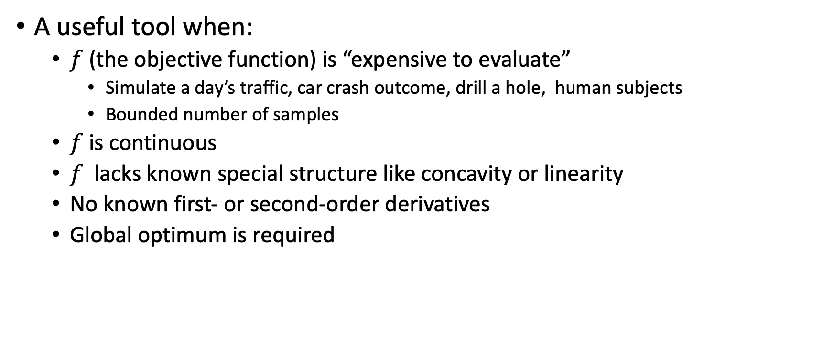
Bayesian optimization
A useful tool when:
  $f$ (the objective function) is “expensive to evaluate”
    Simulate a day’s traffic, car crash outcome, drill a hole, human subjects
    Bounded number of samples
  $f$is continuous
  $f$ lacks known special structure like concavity or linearity
  No known first- or second-order derivatives
  Global optimum is required

Slide 34
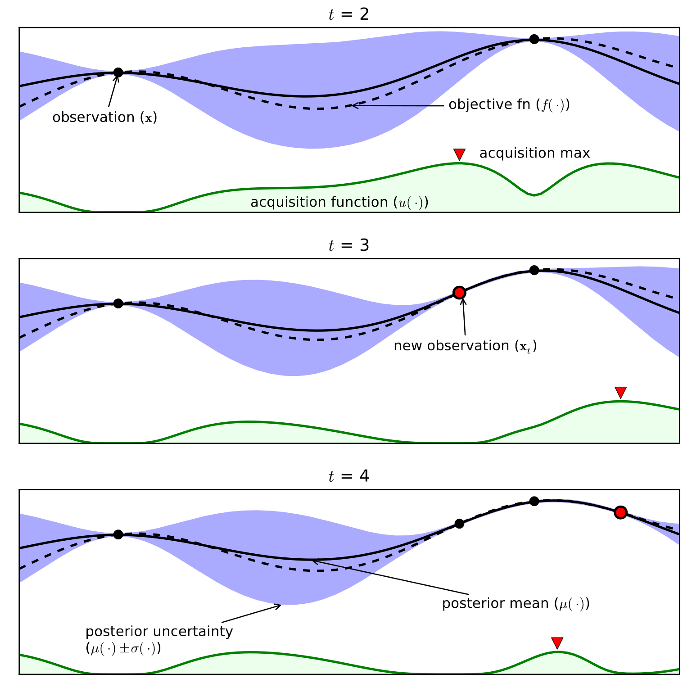
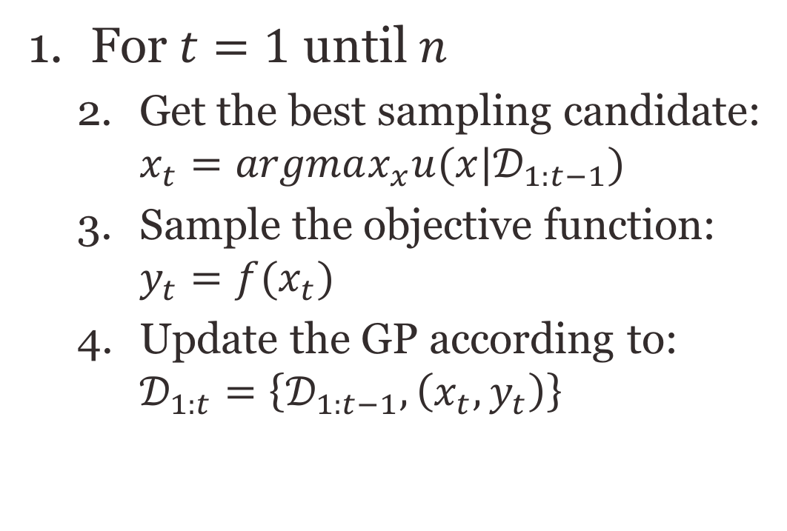
Bayesian optimization
For $t=1$ until $n$
  Get the best sampling candidate: $x_{t}=argmax_{x}u(x|𝒟_{1:t−1})$
  Sample the objective function: $y_{t}=f(x_{t})$
  Update the GP according to: $𝒟_{1:t}=\left\{𝒟_{1:t−1}, \left(x_{t},y_{t}\right)\right\}$

Slide 35
Bayesian optimization
For $t=1$ until $n$
  Get the best sampling candidate: $x_{t}=argmax_{x}u(x|𝒟_{1:t−1})$
  Sample the objective function: $y_{t}=f(x_{t})$
  Update the GP according to: $𝒟_{1:t}=\left\{𝒟_{1:t−1}, \left(x_{t},y_{t}\right)\right\}$

Slide 36
Bayesian optimization
For $t=1$ until $n$
  Get the best sampling candidate: $x_{t}=argmax_{x}u(x|𝒟_{1:t−1})$
  Sample the objective function: $y_{t}=f(x_{t})$
  Update the GP according to: $𝒟_{1:t}=\left\{𝒟_{1:t−1}, \left(x_{t},y_{t}\right)\right\}$

Slide 37
Acquisition function
Exploit: prefer the points with high expected mean value
Explore: prefer the points with high variance
The acquisition function balances between the two
  Probability of Improvement
  Expected Improvement
  Gaussian Process Upper Confidence Bound (GP-UCB)
  Thompson sampling

Slide 38
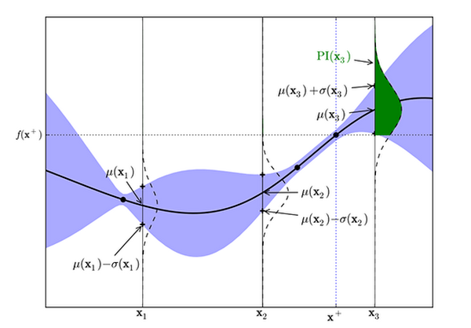

Probability of Improvement [Kushner, 1964]
$PI\left(x_{∗}\right)=P\left(f\left(x_{∗}\right)>μ^{+}+ξ\right)=Φ\left(\frac{μ_{∗}−μ^{+}−ξ}{Var_{∗}}\right)$
  $Φ$ is the normal CDF
The probability that $x_{∗}$ is better than the best known point ($μ^{+}$)
$ξ$ is required so to bias against previously observed points
PI is very useful if the maximal $f$ value is known a priory

Slide 39

Expected Improvement [Mockus 1978]
$x_{∗}=argmax_{x}𝔼(\max\left\{0,f_{n+1}\left(x\right)−f^{max}\right\}|𝒟_{n})$
  $f^{max}=\max\left(μ^{+}+ξ\right)$
If 𝑋 is a random variable whose cumulative distribution function admits a density 𝑓(𝑥) then: 𝔼(𝑥)=∫𝑥𝑓(𝑥)𝑑𝑥
$EI\left(x_{∗}\right)=\left\{\begin{matrix}\left(μ_{∗}−μ^{+}−ξ\right)Φ\left(Z\right)+Var_{∗}φ(Z) & Var_{∗}>0 \\ 0 & Var_{∗}=0\end{matrix}\right.$
  $Z=\frac{μ_{∗}−μ^{+}−ξ}{Var_{∗}}$
  $φ$ is the normal PDF

Slide 40

GP-UCB [Srinivas et al. 2010]
$GPUCB\left(x_{∗}\right)=μ_{∗}+\sqrt{vβ_{t}}Var_{∗}$
Linear combination of the mean and variance
Setting $v=1$ and $β_{t}=2\log\left(\frac{t^{d/2+2}π^{2}}{3δ}\right)$ leads to no regret: $\lim_{T→∞}{\frac{R_{T}}{T}=0}$
  $R_{T}=r\left(x_{1}\right)+…+r\left(x_{T}\right)$
  $r\left(x\right)=f\left(x^{∗}\right)−f\left(x\right)$

Slide 41

Acquisition functions
PI: Probability improvement
EI: Expected improvement
GP-UCB: Gaussian process upper confidence bound

Slide 42

Acquisition functions

Slide 43


Thompson Sampling
Sample a function from the Gaussian Process
The function is sampled as a set of $f_{∗}$ values from the distribution $\left[\begin{matrix}f \\ f_{∗}\end{matrix}\right]\sim 𝒩\left(\begin{matrix}μ \\ μ_{∗}\end{matrix}, \left[\begin{matrix}k & k_{∗} \\ k_{∗}^{T} & k_{∗∗}\end{matrix}\right]\right)$ given $f$
Chosen point is the optimum of the sampled function

Slide 44

Branch and bound approach
A general approach in planning and scheduling
If best > upper bound then prune

Slide 45
Extra reading
https://www.youtube.com/watch?v=SQtOI9jsrJ0&list=PLCJPYIcPhgPAiiBjjVxi5St_lC_cXHFCK&index=9
https://www.youtube.com/watch?v=4vGiHC35j9s

Slide 46
What next?
Lecture: Curriculum Learning
Assignments:
  DDPG, by No. 25, EoD
Quiz (on Canvas):
  Imitation Learning, by Nov 25, EoD
Project:
  Final Report, by Dec. 2, EoD

