Slide 1
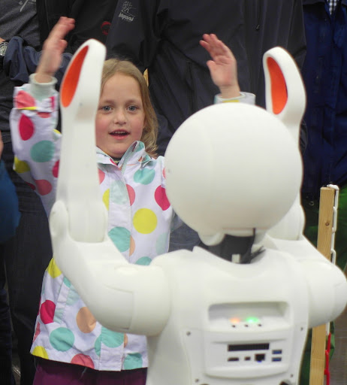
CSCE-642 Reinforcement Learning
Imitation Learning
Instructor: Guni Sharon
Based on slides by: Yisong Yue and Hoang M. Le

Slide 2
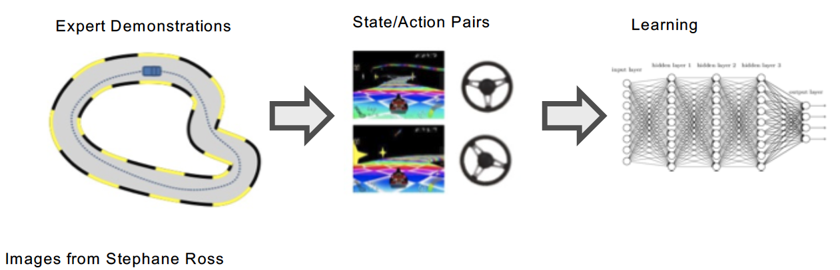
Imitation Learning in a Nutshell
Given: demonstrations or a demonstrator (interactive)
Goal: train a policy to imitate the demonstrator

Slide 3
Ingredients of Imitation Learning
Demonstration or demonstrator
Environment / Simulator
Policy Class
vs
Loss function
Learning algorithm

Slide 4
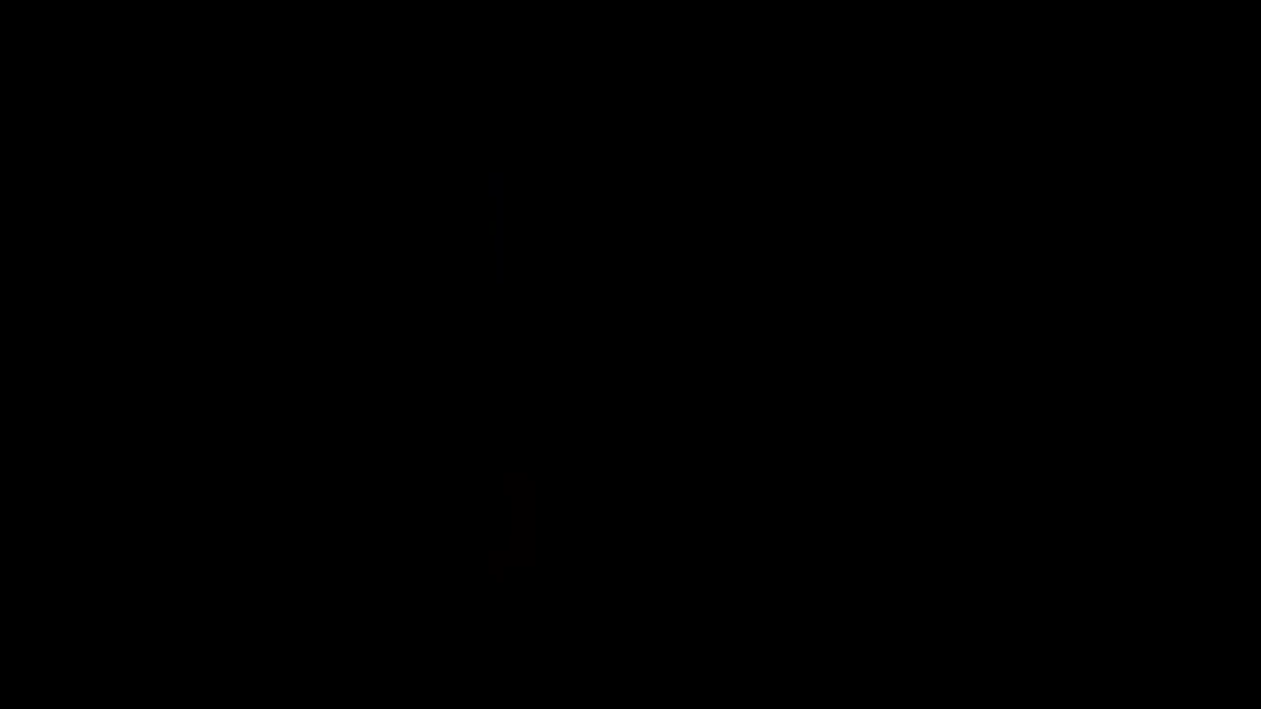

Slide 5
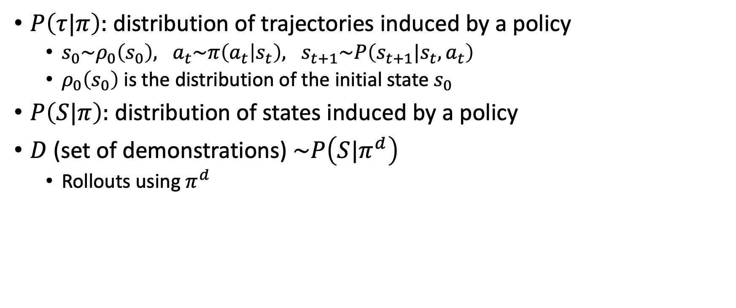
Notation
$P\left(τ|π\right):$ distribution of trajectories induced by a policy
  $s_{0}\sim ρ_{0}\left(s_{0}\right), a_{t}\sim π\left(a_{t} | s_{t}\right), s_{t+1}\sim P\left(s_{t+1}|s_{t},a_{t}\right)$
  $ρ_{0}\left(s_{0}\right)$ is the distribution of the initial state $s_{0}$
$P\left(S|π\right):$ distribution of states induced by a policy
$D$ (set of demonstrations) $\sim P\left(S|π^{d}\right)$
  Rollouts using $π^{d}$

Slide 6
Imitation Learning Algorithms
Behavioral Cloning
  Learn to do exactly what the demonstrator showed you
Direct (interactive) Imitation Learning
  Solicit the demonstrator for new (relevant) examples as you learn
Inverse RL
  Learn the demonstrator’s objective (its reward function)
  Train a policy that optimizes the same objective
Generative adversarial
  Learn to act indistinguishably from the demonstrator

Slide 7
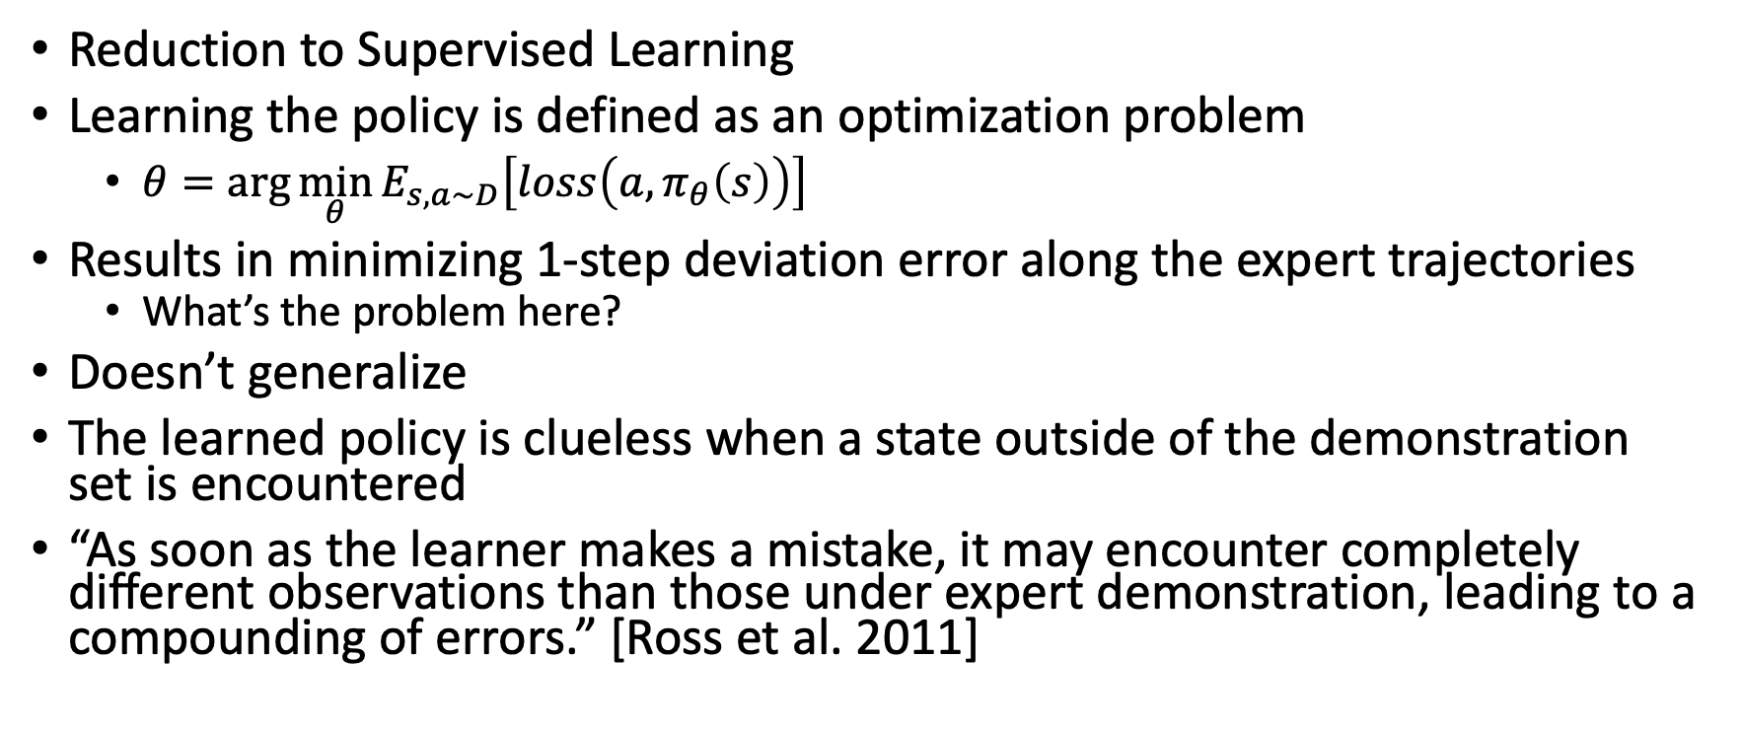
Behavioral Cloning
Reduction to Supervised Learning
Learning the policy is defined as an optimization problem
  $θ=\arg{\min_{θ}{E_{s,a\sim D}\left[loss\left(a,π_{θ}\left(s\right)\right)\right]}}$
Results in minimizing 1-step deviation error along the expert trajectories
  What’s the problem here?
Doesn’t generalize
The learned policy is clueless when a state outside of the demonstration set is encountered
“As soon as the learner makes a mistake, it may encounter completely different observations than those under expert demonstration, leading to a compounding of errors.” [Ross et al. 2011]

Slide 8
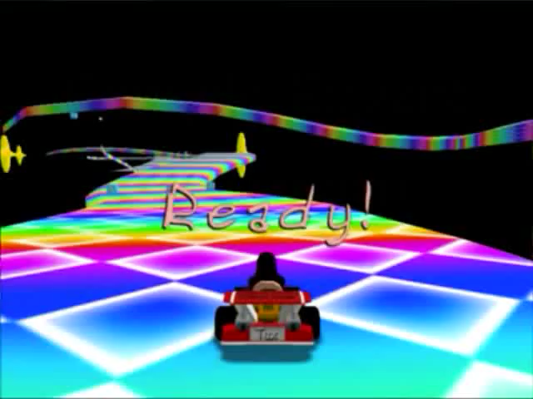
Video from Stephane Ross

Slide 9
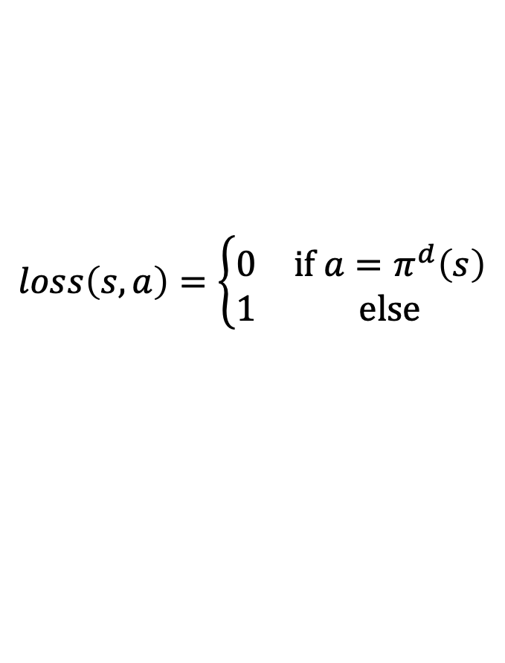
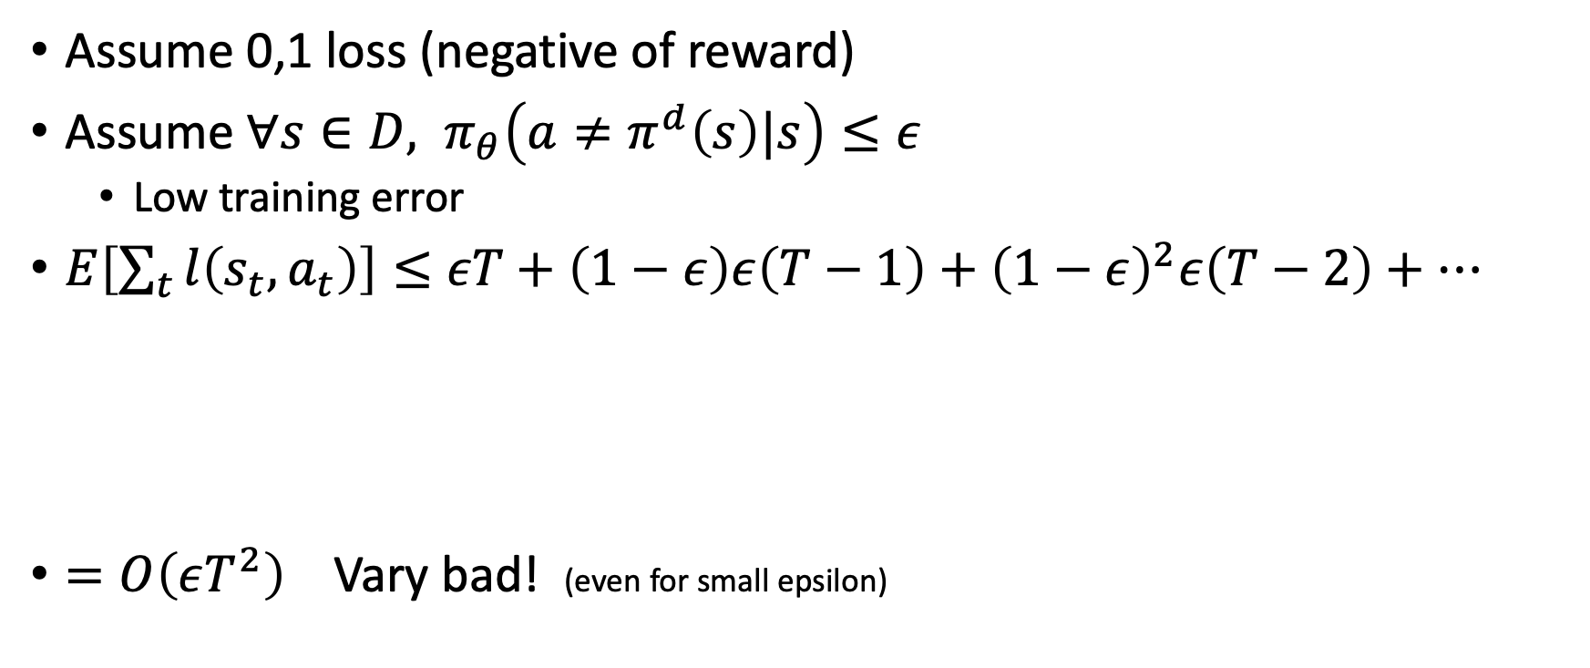
Worst case analysis
$$loss\left(s,a\right)=\left\{\begin{matrix}0 & if a=π^{d}\left(s\right) \\ 1 & else\end{matrix}\right.$$
Assume 0,1 loss (negative of reward)
Assume $∀s∈D, π_{θ}\left(a≠π^{d}\left(s\right)|s\right)≤ε$
  Low training error
$E\left[\sum_{t}{l\left(s_{t},a_{t}\right)}\right]≤εT+\left(1−ε\right)ε\left(T−1\right)+{\left(1−ε\right)}^{2}ε\left(T−2\right)+…$
$=O\left(εT^{2}\right)$ Vary bad! (even for small epsilon)
Made a mistake on step 1 -> unknown terrain -> continue to make mistakes until the end
Made a mistake on step 2 -> unknown terrain -> continue to make mistakes until the end

Slide 10
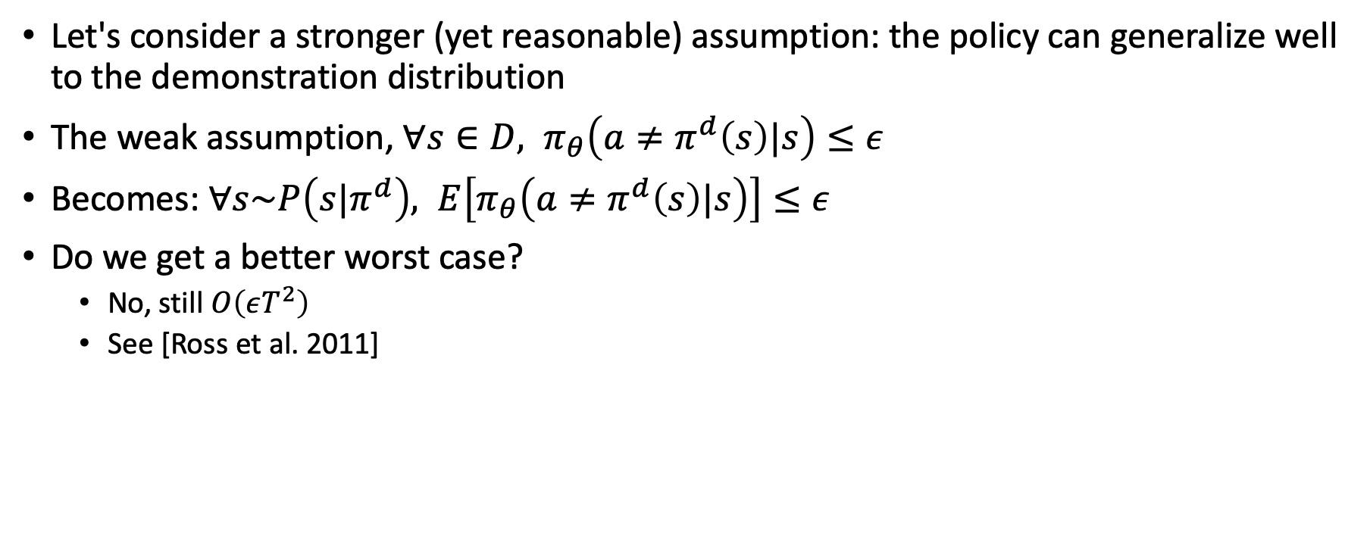
Worst case analysis
Let's consider a stronger (yet reasonable) assumption: the policy can generalize well to the demonstration distribution
The weak assumption, $∀s∈D, π_{θ}\left(a≠π^{d}\left(s\right)|s\right)≤ε$
Becomes: $∀s\sim P\left(s|π^{d}\right), E\left[π_{θ}\left(a≠π^{d}\left(s\right)|s\right)\right]≤ε$
Do we get a better worst case?
  No, still $O\left(εT^{2}\right)$
  See [Ross et al. 2011]

Slide 11
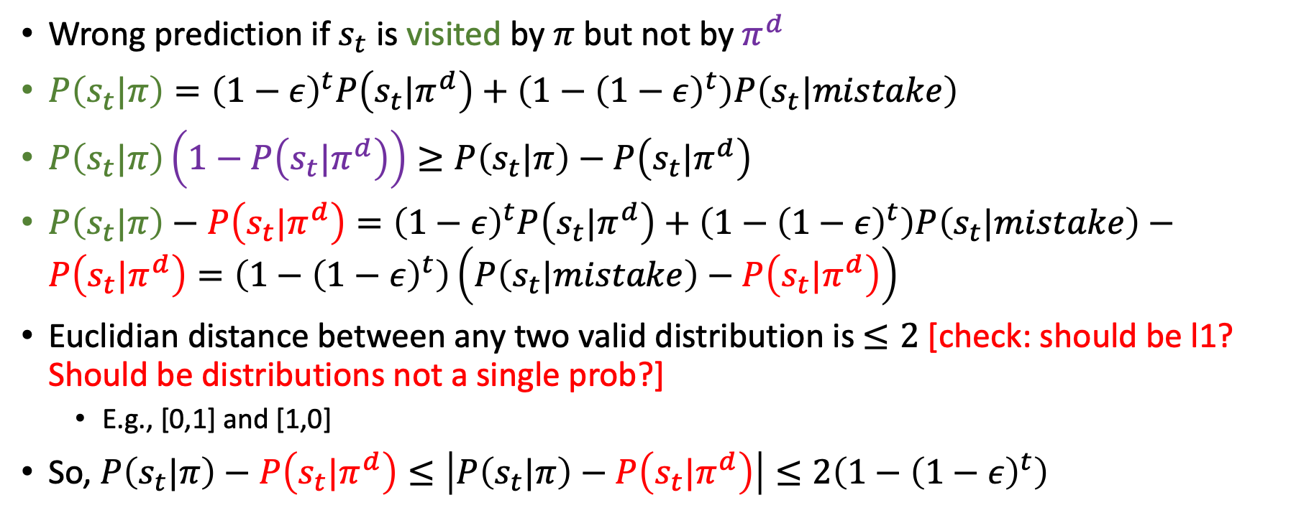
Worst case analysis
Wrong prediction if $s_{t}$ is visited by $π$ but not by $π^{d}$
$P\left(s_{t}|π\right)={\left(1−ε\right)}^{t}P\left(s_{t}|π^{d}\right)+\left(1−{\left(1−ε\right)}^{t}\right)P\left(s_{t}|mistake\right)$
$P\left(s_{t}|π\right)\left(1−P\left(s_{t}|π^{d}\right)\right)≥P\left(s_{t}|π\right)−P\left(s_{t}|π^{d}\right)$
$P\left(s_{t}|π\right)−P\left(s_{t}|π^{d}\right)={\left(1−ε\right)}^{t}P\left(s_{t}|π^{d}\right)+\left(1−{\left(1−ε\right)}^{t}\right)P\left(s_{t}|mistake\right)−P\left(s_{t}|π^{d}\right)=\left(1−{\left(1−ε\right)}^{t}\right)\left(P\left(s_{t}|mistake\right)−P\left(s_{t}|π^{d}\right)\right)$
Euclidian distance between any two valid distribution is $≤2$ [check: should be l1? Should be distributions not a single prob?]
  E.g., [0,1] and [1,0]
So, $P\left(s_{t}|π\right)−P\left(s_{t}|π^{d}\right)≤\left|P\left(s_{t}|π\right)−P\left(s_{t}|π^{d}\right)\right|≤2\left(1−{\left(1−ε\right)}^{t}\right)$
Following the demonstrator all the way to t + arriving to s_t by mistake

Slide 12


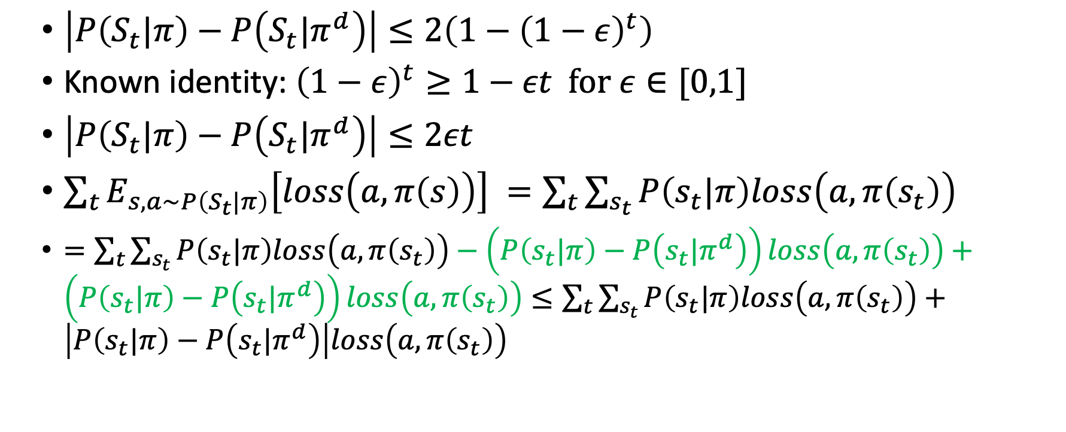
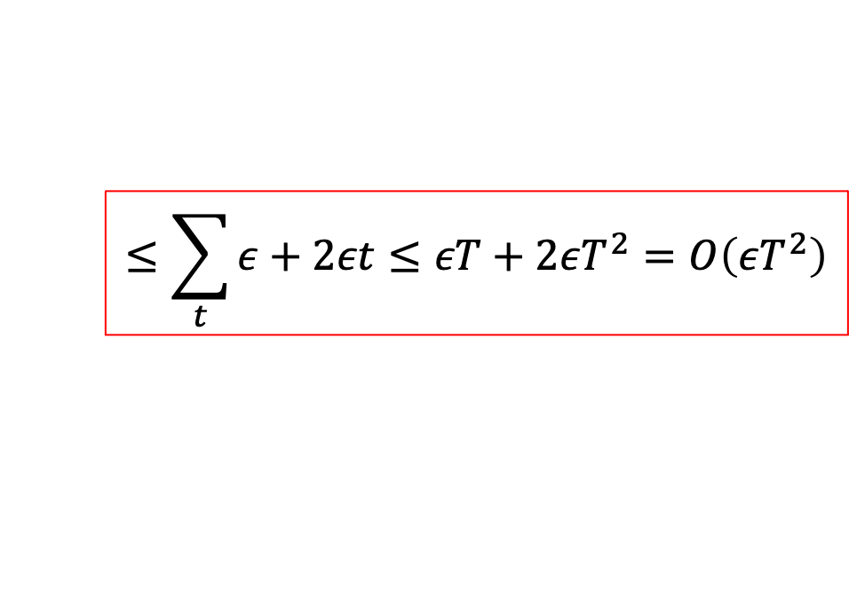

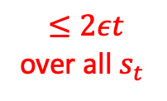
Worst case analysis
$\left|P\left(S_{t}|π\right)−P\left(S_{t}|π^{d}\right)\right|≤2\left(1−{\left(1−ε\right)}^{t}\right)$
Known identity: ${\left(1−ε\right)}^{t}≥1−εt for ε∈[0,1]$
$\left|P\left(S_{t}|π\right)−P\left(S_{t}|π^{d}\right)\right|≤2εt$
$\sum_{t}{E_{s,a\sim P\left(S_{t}|π\right)}\left[loss\left(a,π\left(s\right)\right)\right] =\sum_{t}{\sum_{s_{t}}{P\left(s_{t}|π\right)loss\left(a,π\left(s_{t}\right)\right)}}}$
$=\sum_{t}{\sum_{s_{t}}{P\left(s_{t}|π\right)loss\left(a,π\left(s_{t}\right)\right)}}−\left(P\left(s_{t}|π\right)−P\left(s_{t}|π^{d}\right)\right)loss\left(a,π\left(s_{t}\right)\right)+\left(P\left(s_{t}|π\right)−P\left(s_{t}|π^{d}\right)\right)loss\left(a,π\left(s_{t}\right)\right)≤\sum_{t}{\sum_{s_{t}}{P\left(s_{t}|π\right)loss\left(a,π\left(s_{t}\right)\right)}}+\left|P\left(s_{t}|π\right)−P\left(s_{t}|π^{d}\right)\right|loss\left(a,π\left(s_{t}\right)\right)$
Definition of expected value
$$≤$$
$$≤ε$$
$$≤2εt$$
over all $s_{t}$
$$[0,1]$$
$$≤\sum_{t}{ε+2εt≤εT+2εT^{2}=O\left(εT^{2}\right)}$$

Slide 13
When to use Behavioral Cloning?
Advantages
  Simple
  Simple
  Efficient
Use When:
  1-step deviations not too bad
  Learning reactive behaviors
  Expert trajectories “cover” state space
Disadvantages
  Distribution mismatch between training and testing
  No long-term planning
Don’t Use When:
  1-step deviations can lead to catastrophic error
  Optimizing long-term objective (at least not without a stronger model)

Slide 14
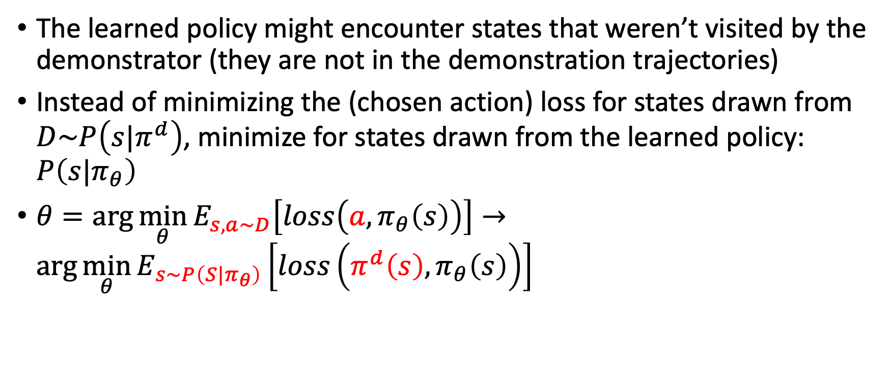
(robust) Imitation Learning
The learned policy might encounter states that weren’t visited by the demonstrator (they are not in the demonstration trajectories)
Instead of minimizing the (chosen action) loss for states drawn from $D\sim P\left(s|π^{d}\right)$, minimize for states drawn from the learned policy: $P\left(s|π_{θ}\right)$
$θ=\arg{\min_{θ}{E_{s,a\sim D}\left[loss\left(a,π_{θ}\left(s\right)\right)\right]}}→\arg{\min_{θ}{E_{s\sim P\left(S|π_{θ}\right)}\left[loss\left(π^{d}\left(s\right),π_{θ}\left(s\right)\right)\right]}}$

Slide 15
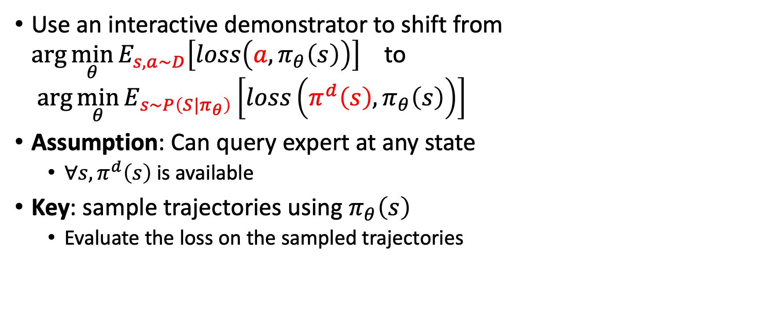
Interactive IL
Use an interactive demonstrator to shift from $\arg{\min_{θ}{E_{s,a\sim D}\left[loss\left(a,π_{θ}\left(s\right)\right)\right]}}$ to $\arg{\min_{θ}{E_{s\sim P\left(S|π_{θ}\right)}\left[loss\left(π^{d}\left(s\right),π_{θ}\left(s\right)\right)\right]}}$
Assumption: Can query expert at any state
  $∀s, π^{d}\left(s\right)$ is available
Key: sample trajectories using $π_{θ}\left(s\right)$
  Evaluate the loss on the sampled trajectories

Slide 16

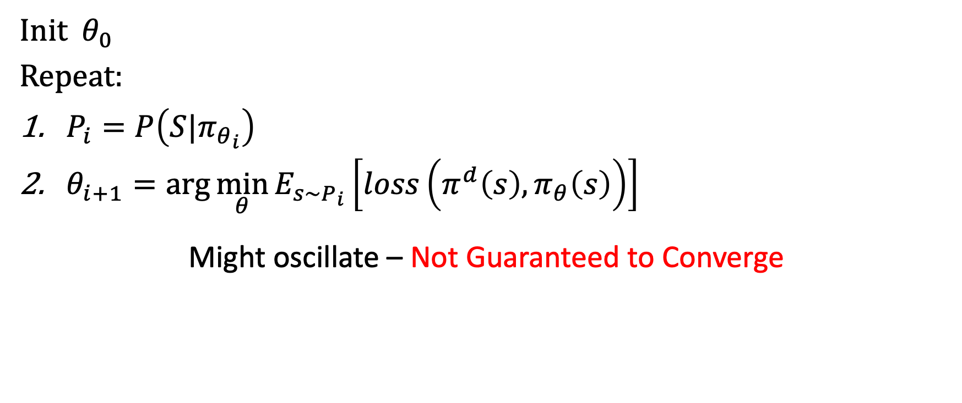
Alternating Optimization (Naïve Attempt)
Init $θ_{0}$
Repeat:
$P_{i}=P\left(S|π_{θ_{i}}\right)$
$θ_{i+1}=\arg{\min_{θ}{E_{s\sim P_{i}}\left[loss\left(π^{d}\left(s\right),π_{θ}\left(s\right)\right)\right]}}$
Might oscillate – Not Guaranteed to Converge
More to the right
How can we address this issue?
More to the left

Slide 17
Data Aggregation (DAgger) [Ross et al. 2011]
“DAGGER proceeds by collecting a dataset at each iteration under the current policy and trains the next policy under the aggregate of all collected datasets”
“trains a deterministic policy that achieves good performance guarantees under its induced distribution of states”
“collecting a dataset at each iteration under the current policy and trains the next policy under the aggregate of all collected datasets”

Slide 18
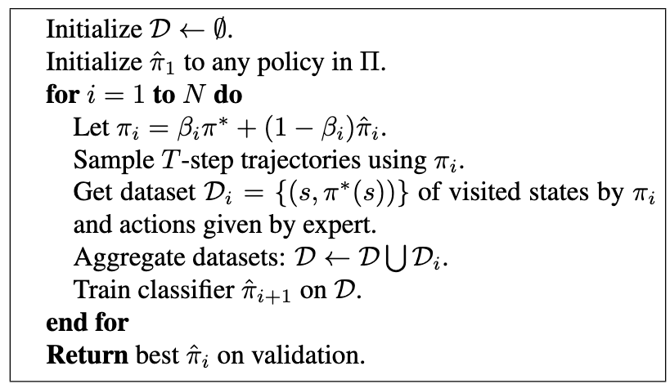
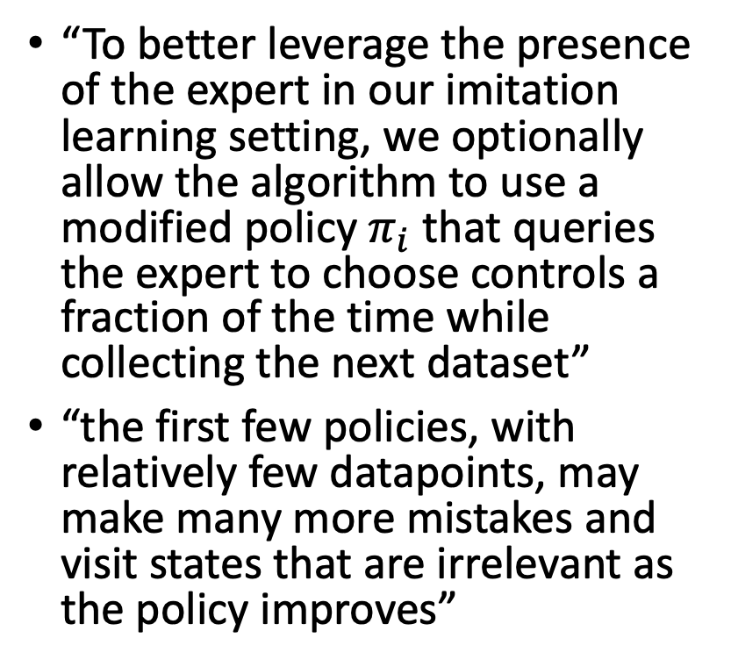
Data Aggregation (DAgger) [Ross et al. 2011]
“To better leverage the presence of the expert in our imitation learning setting, we optionally allow the algorithm to use a modified policy $π_{i}$ that queries the expert to choose controls a fraction of the time while collecting the next dataset”
“the first few policies, with relatively few datapoints, may make many more mistakes and visit states that are irrelevant as the policy improves”

Slide 19
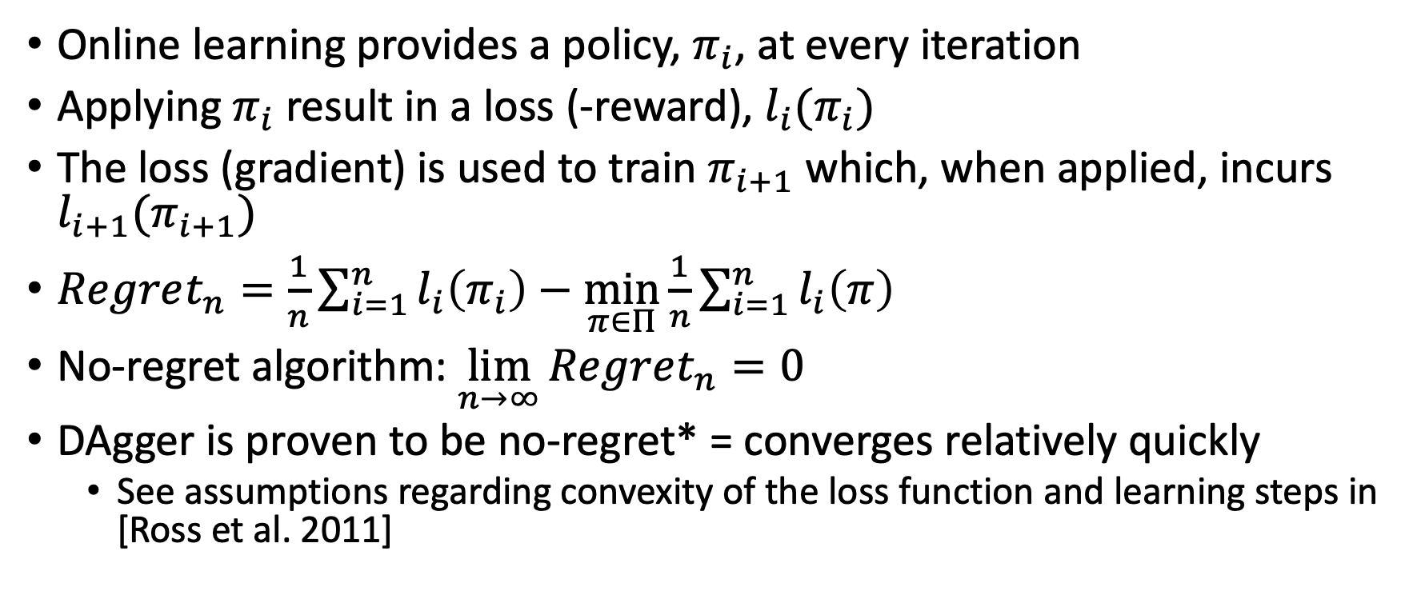
No-regret algorithm
Online learning provides a policy, $π_{i}$, at every iteration
Applying $π_{i}$ result in a loss (-reward), $l_{i}(π_{i})$
The loss (gradient) is used to train $π_{i+1}$ which, when applied, incurs $l_{i+1}(π_{i+1})$
$Regret_{n}=\frac{1}{n}\sum_{i=1}^{n}{l_{i}\left(π_{i}\right)}−\min_{π∈Π}{\frac{1}{n}\sum_{i=1}^{n}{l_{i}\left(π\right)}}$
No-regret algorithm: $\lim_{n→∞}{Regret_{n}=0}$
DAgger is proven to be no-regret* = converges relatively quickly
  See assumptions regarding convexity of the loss function and learning steps in [Ross et al. 2011]

Slide 20
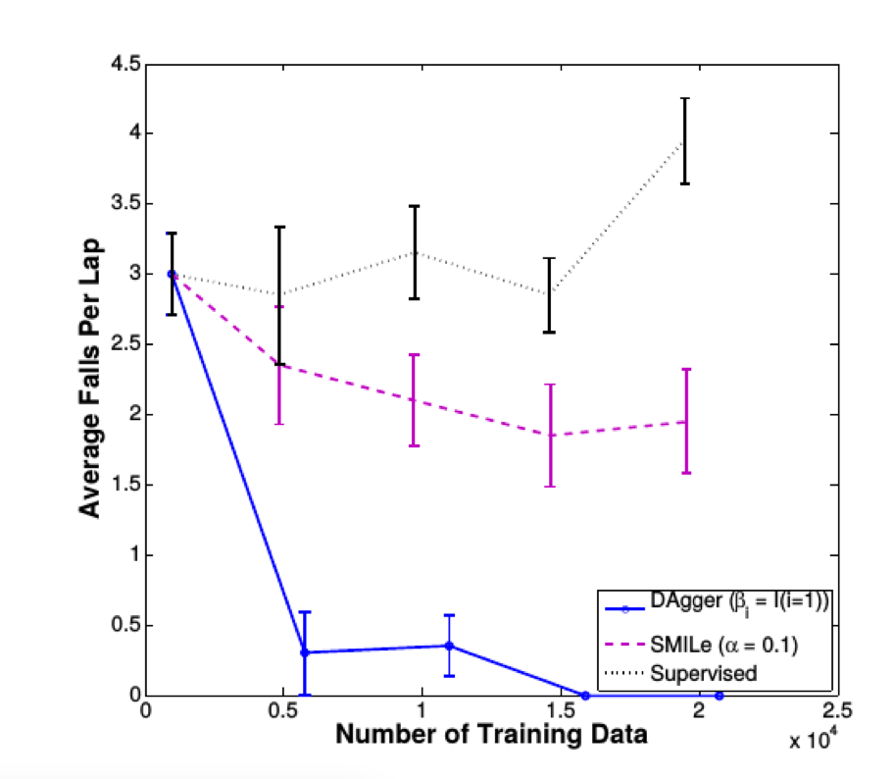
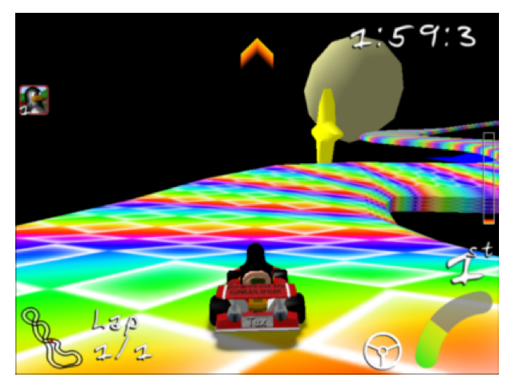
Results

Slide 21
Inverse RL
What if we don’t have an interactive demonstrator?
  We only have access to an offline set of demonstrated trajectories
Behavioral cloning is not robust
  Suffers from overfitting
  We know what to do in observed states but can’t generalize well to other states
How can we learn to mimic the demonstrator in a general way?
  Learn the demonstrator’s objective (reward) function
  Apply RL

Slide 22

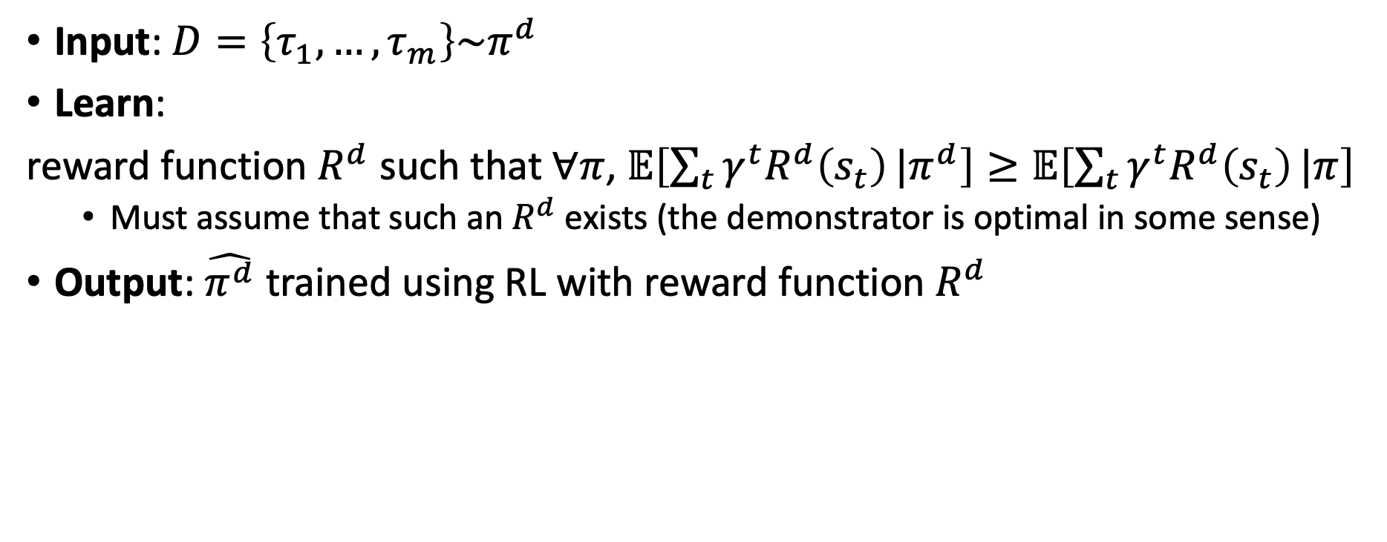
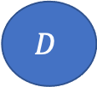
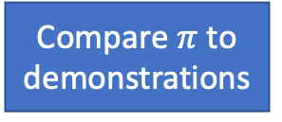
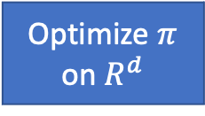
Inverse RL
Input: $D=\left\{τ_{1},…,τ_{m}\right\}\sim π^{d}$
Learn:
reward function $R^{d}$ such that $∀π$, $𝔼\left[\sum_{t}{γ^{t}R^{d}\left(s_{t}\right)}|π^{d}\right]≥𝔼\left[\sum_{t}{γ^{t}R^{d}\left(s_{t}\right)}|π\right]$
  Must assume that such an $R^{d}$ exists (the demonstrator is optimal in some sense)
Output: $\hat{π^{d}}$ trained using RL with reward function $R^{d}$
$$D$$
Update $R^{d}$
Compare $π$ to demonstrations
Optimize $π$ on $R^{d}$

Slide 23
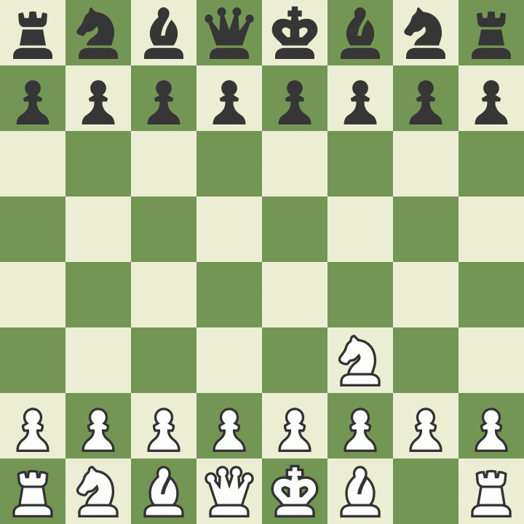
Fitted reward is ambiguous
With no knowledge of chess rules
What reward function results in the white player policy?
For most observations of behavior there are many fitting reward functions. The set of solutions often contains many degenerate solutions, e.g., assigning zero reward to all states

Slide 24
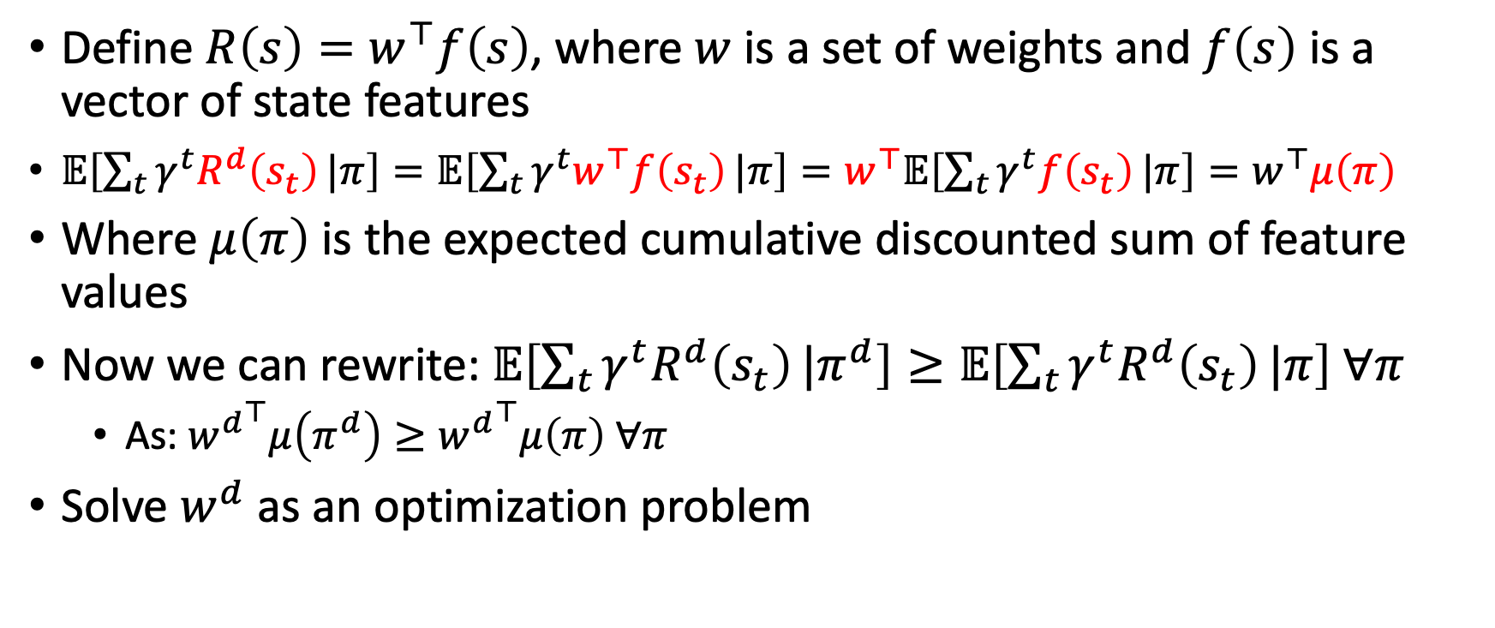
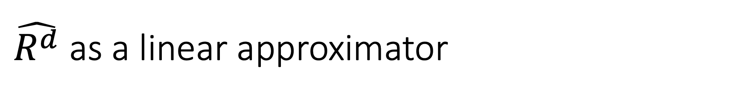
$\hat{R^{d}}$ as a linear approximator
Define $R\left(s\right)=w^{⊤}f\left(s\right)$, where $w$ is a set of weights and $f\left(s\right)$ is a vector of state features
$𝔼\left[\sum_{t}{γ^{t}R^{d}\left(s_{t}\right)}|π\right]=𝔼\left[\sum_{t}{γ^{t}w^{⊤}f\left(s_{t}\right)}|π\right]=w^{⊤}𝔼\left[\sum_{t}{γ^{t}f\left(s_{t}\right)}|π\right]=w^{⊤}μ\left(π\right)$
Where $μ\left(π\right)$ is the expected cumulative discounted sum of feature values
Now we can rewrite: $𝔼\left[\sum_{t}{γ^{t}R^{d}\left(s_{t}\right)}|π^{d}\right]≥𝔼\left[\sum_{t}{γ^{t}R^{d}\left(s_{t}\right)}|π\right] ∀π$
  As: ${w^{d}}^{⊤}μ\left(π^{d}\right)≥{w^{d}}^{⊤}μ\left(π\right) ∀π$
Solve $w^{d}$ as an optimization problem

Slide 25
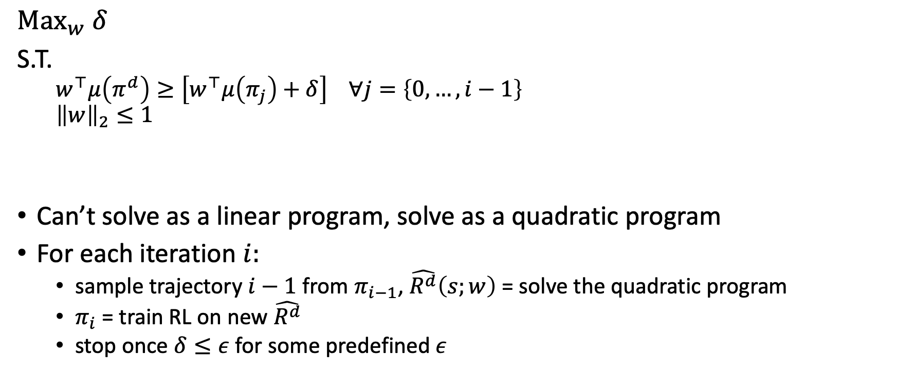
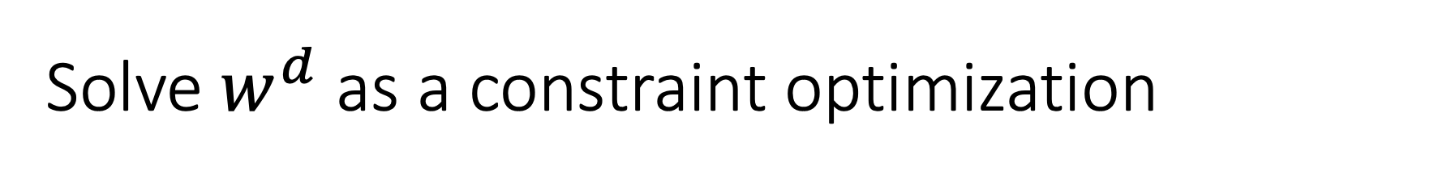
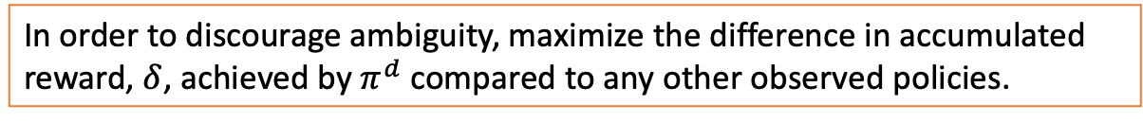
Solve $w^{d}$ as a constraint optimization
Abbeel & Ng, ICML ‘04
$${Max}_{w} δ$$
S.T.
  $$w^{⊤}μ\left(π^{d}\right)≥\left[w^{⊤}μ\left(π_{j}\right)+δ\right] ∀j=\left\{0,…,i−1\right\}$$
  $${\left\|w\right\|}_{2}≤1$$
Can’t solve as a linear program, solve as a quadratic program
For each iteration $i:$
  sample trajectory $i−1$ from $π_{i−1}$, $\hat{R^{d}}\left(s;w\right)$ = solve the quadratic program
  $π_{i}$ = train RL on new $\hat{R^{d}}$
  stop once $δ≤ε$ for some predefined $ε$
In order to discourage ambiguity, maximize the difference in accumulated reward, $δ$, achieved by $π^{d}$ compared to any other observed policies.
When assuming that all state features are valued from the range [0,1], bounding ${\left\|w\right\|}_{2}≤1$ ensures that the rewards are bounded by 1 (Important for theoretical guarantees).
Non-linear constraint

Slide 26
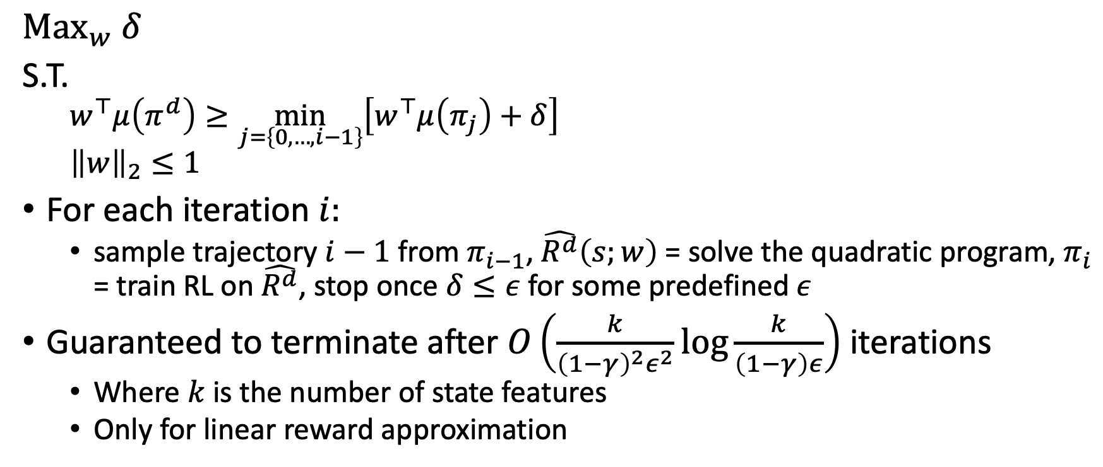
Solve $w^{d}$ as a constraint optimization
Abbeel & Ng, ICML ‘04
$${Max}_{w} δ$$
S.T.
  $$w^{⊤}μ\left(π^{d}\right)≥\min_{j=\left\{0,…,i−1\right\}}\left[w^{⊤}μ\left(π_{j}\right)+δ\right]$$
  $${\left\|w\right\|}_{2}≤1$$
For each iteration $i:$
  sample trajectory $i−1$ from $π_{i−1}$, $\hat{R^{d}}\left(s;w\right)$ = solve the quadratic program, $π_{i}$ = train RL on $\hat{R^{d}}$, stop once $δ≤ε$ for some predefined $ε$
Guaranteed to terminate after $O\left(\frac{k}{{\left(1−γ\right)}^{2}ε^{2}}\log{\frac{k}{\left(1−γ\right)ε}}\right)$ iterations
  Where $k$ is the number of state features
  Only for linear reward approximation

Slide 27
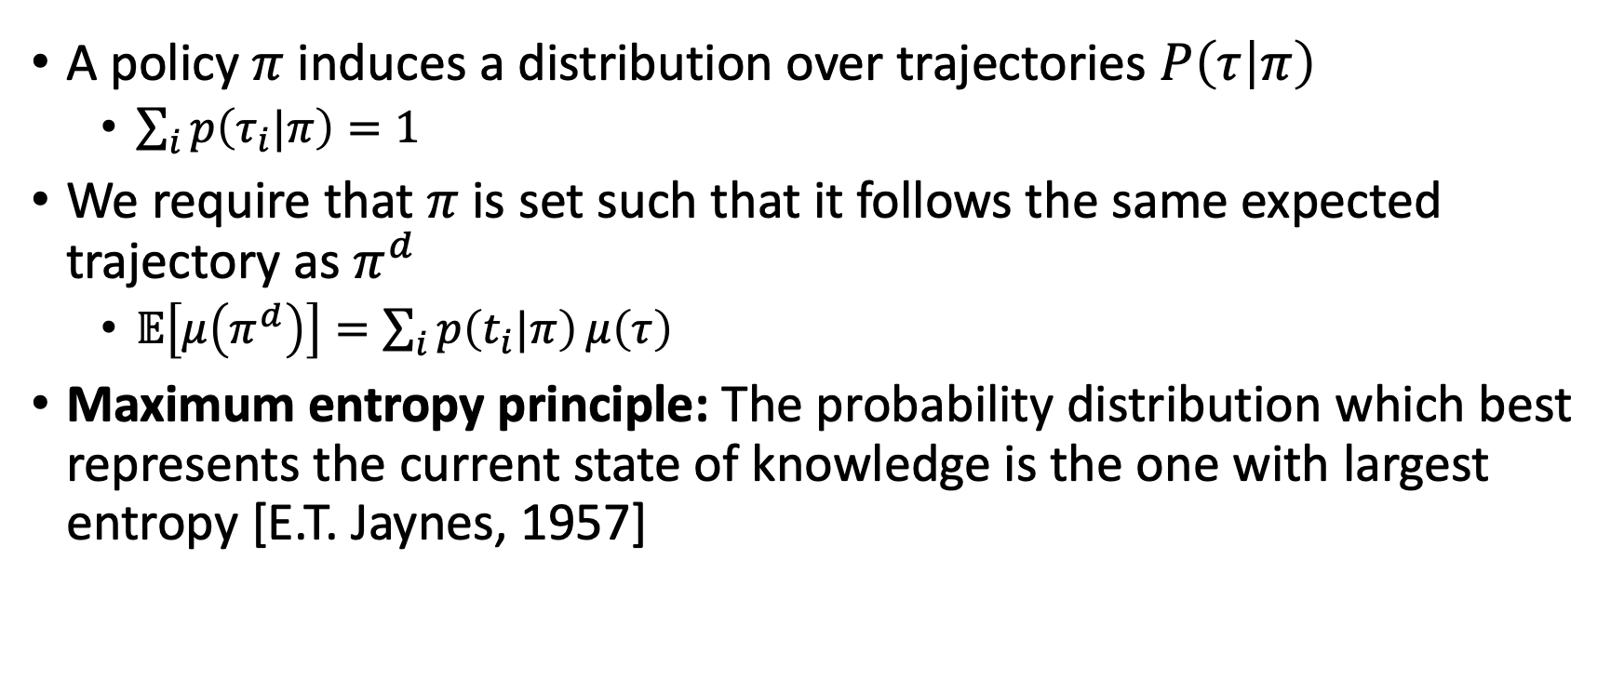
MaxEnt approach
A policy $π$ induces a distribution over trajectories $P\left(τ | π\right)$
  $\sum_{i}{p\left(τ_{i}|π\right)}=1$
We require that $π$ is set such that it follows the same expected trajectory as $π^{d}$
  $𝔼\left[μ\left(π^{d}\right)\right]=\sum_{i}{p\left(t_{i}|π\right)}μ\left(τ\right)$
Maximum entropy principle: The probability distribution which best represents the current state of knowledge is the one with largest entropy [E.T. Jaynes, 1957]

Slide 28
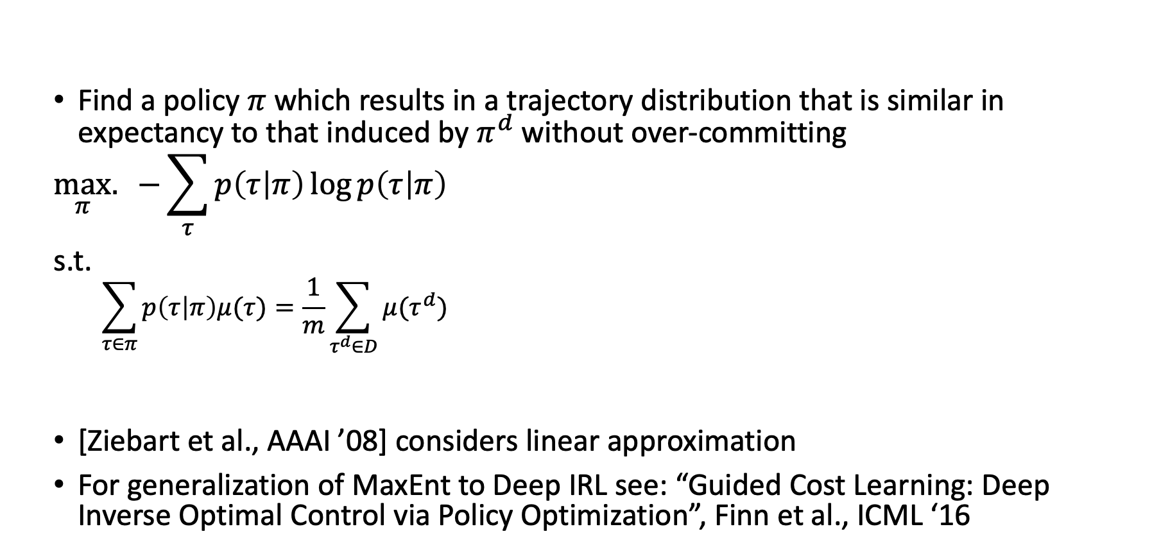
MaxEnt approach [Ziebart et al., AAAI ’08]
Find a policy $π$ which results in a trajectory distribution that is similar in expectancy to that induced by $π^{d}$ without over-committing
$$\max_{π}.{−\sum_{τ}{p\left(τ | π\right)\log{p\left(τ | π\right)}}}$$
s.t.
  $$\sum_{τ∈π}{p\left(τ | π\right)μ(τ)}=\frac{1}{m}\sum_{τ^{d}∈D}{μ(τ^{d})}$$
[Ziebart et al., AAAI ’08] considers linear approximation
For generalization of MaxEnt to Deep IRL see: “Guided Cost Learning: Deep Inverse Optimal Control via Policy Optimization”, Finn et al., ICML ‘16
Visited states distribution in demonstrations

Slide 29
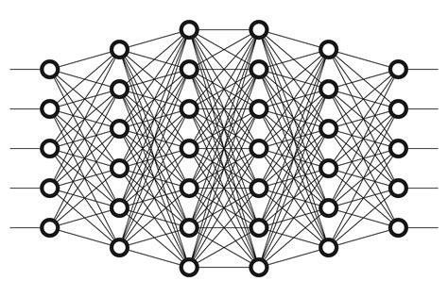




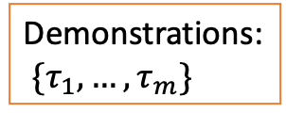

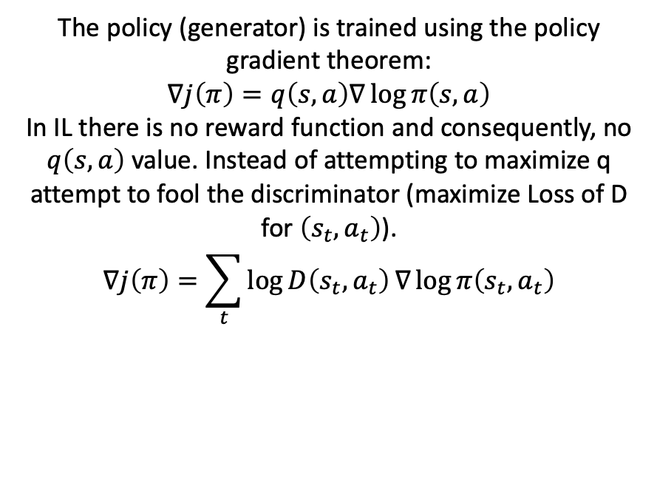
Generative Adversarial Imitation Learning
[Ho & Ermon, NeurIPS 2016]
Discriminator is trained to output 0 if input state-action is by the demonstrator else 1
Loss = log loss
Demonstrations:
$\{τ_{1},…,τ_{m}\}$
Discriminator ($D$)
$$τ$$
Environment
The policy (generator) is trained using the policy gradient theorem:
$$∇j\left(π\right)=q\left(s,a\right)∇\log{π\left(s,a\right)}$$
In IL there is no reward function and consequently, no $q\left(s,a\right)$ value. Instead of attempting to maximize q attempt to fool the discriminator (maximize Loss of D for $\left(s_{t},a_{t}\right)$).
$$∇j\left(π\right)=\sum_{t}{\log{D\left(s_{t},a_{t}\right)}∇\log{π\left(s_{t},a_{t}\right)}}$$
$$a_{t}$$
$$s_{t}$$
Generator ($π$)

Slide 30
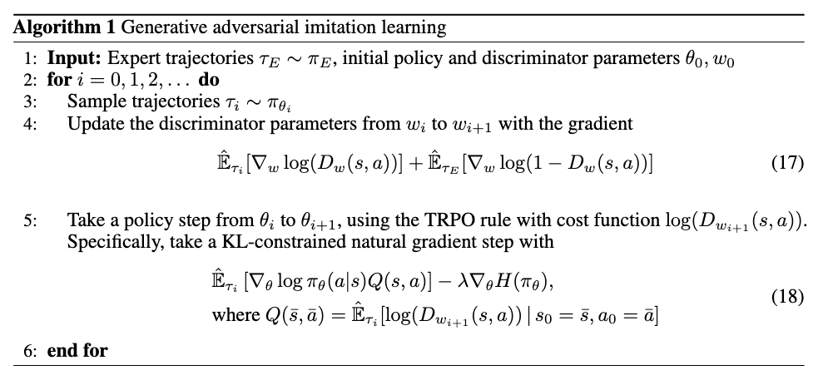
Generative Adversarial Imitation Learning
[Ho & Ermon, NeurIPS 2016]
Training the discriminator
Training the policy
Note: H here is not for entropy. It is the Hessian matrix -- the original GAIL paper used TRPO (natural gradient).
Note: the Q value is not the action value but the discriminator’s loss

Slide 31
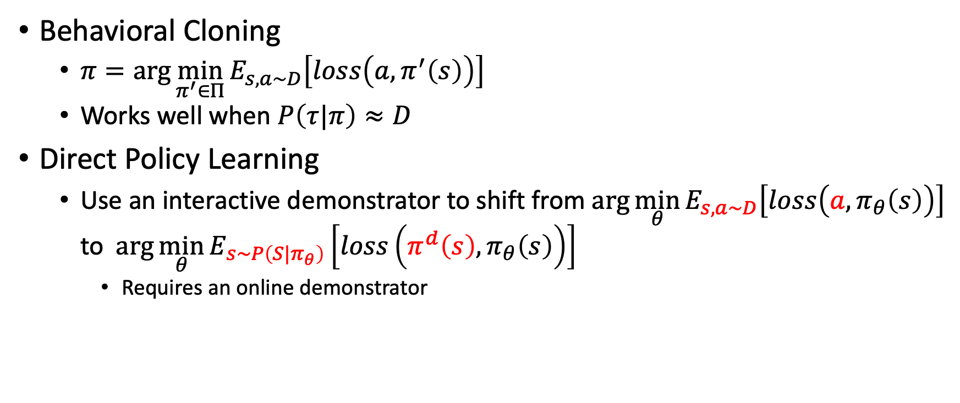
Summary: Types of Imitation Learning
Behavioral Cloning
  $π=\arg{\min_{π^{′}∈Π}{E_{s,a\sim D}\left[loss\left(a,π^{′}\left(s\right)\right)\right]}}$
  Works well when $P\left(τ|π\right)≈D$
Direct Policy Learning
  Use an interactive demonstrator to shift from $\arg{\min_{θ}{E_{s,a\sim D}\left[loss\left(a,π_{θ}\left(s\right)\right)\right]}}$ to $\arg{\min_{θ}{E_{s\sim P\left(S|π_{θ}\right)}\left[loss\left(π^{d}\left(s\right),π_{θ}\left(s\right)\right)\right]}}$
    Requires an online demonstrator

Slide 32
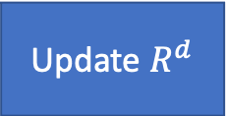
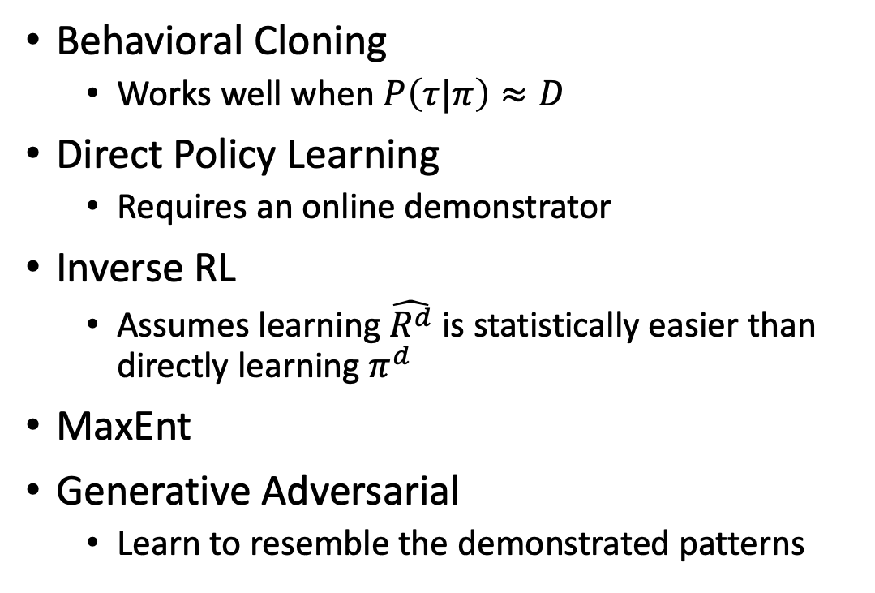
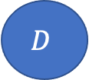
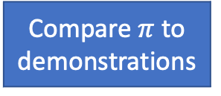
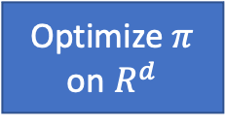
Summary: Types of Imitation Learning
Behavioral Cloning
  Works well when $P\left(τ|π\right)≈D$
Direct Policy Learning
  Requires an online demonstrator
Inverse RL
  Assumes learning $\hat{R^{d}}$ is statistically easier than directly learning $π^{d}$
MaxEnt
Generative Adversarial
  Learn to resemble the demonstrated patterns
$$D$$
Update $R^{d}$
Compare $π$ to demonstrations
Optimize $π$ on $R^{d}$

Slide 33
Summary: Types of Imitation Learning
 | Direct policy learning | Learn the reward function | Access to environment | Interactive demonstrator | Pre-collected demonstration
Behavioral cloning | ✅ | ❌ | ❌ | ❌ | ✅
Interactive IL | ✅ | ❌ | ✅ | ✅ | Optional
Inverse RL | ❌ | ✅ | ✅ | ❌ | ✅
Generative Adversarial | ❌ | ❌ | ✅ | ❌ | ✅

Slide 34
Extra reading
https://sites.google.com/view/icml2018-imitation-learning/
https://arxiv.org/pdf/1011.0686.pdf
https://ai.stanford.edu/~ang/papers/icml04-apprentice.pdf
https://people.eecs.berkeley.edu/~pabbeel/cs287-fa12/slides/inverseRL.pdf
https://arxiv.org/pdf/1606.03476.pdf
https://arxiv.org/pdf/1710.11248.pdf

Slide 35
What next?
Lecture: Transfer learning
Assignments:
  DDPG, by No. 25, EoD
  A2C, by Nov. 18, EoD
Quiz (on Canvas):
  Imitation Learning, by Nov 25, EoD
Project:
  Final Report, by Dec. 2, EoD

Slide 36
Course evaluation
Course evaluations through AEFIS (https://tamu.aefis.net/)
  The preferred browsers are Chrome and Firefox
Your constructive feedback helps improving the course
  Lectures
  Assignments
  Quizzes
  Research project

