Slide 1

CSCE-642 Reinforcement Learning
Soft Actor-Critic
Instructor: Guni Sharon

Slide 2
CSCE-689, Reinforcement Learning
Stateless decision process
Monte-Carlo
Policy gradient
Actor-critic
Markov decision process
Temporal difference
Function approximators
Solving MDPs (offline)
Dynamic programming
Tabular methods
Deep RL

Slide 3
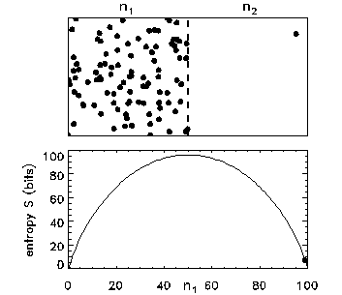
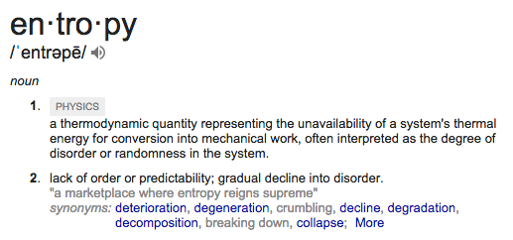
Entropy

Slide 4
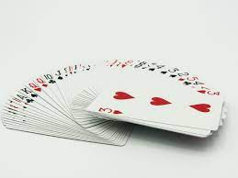
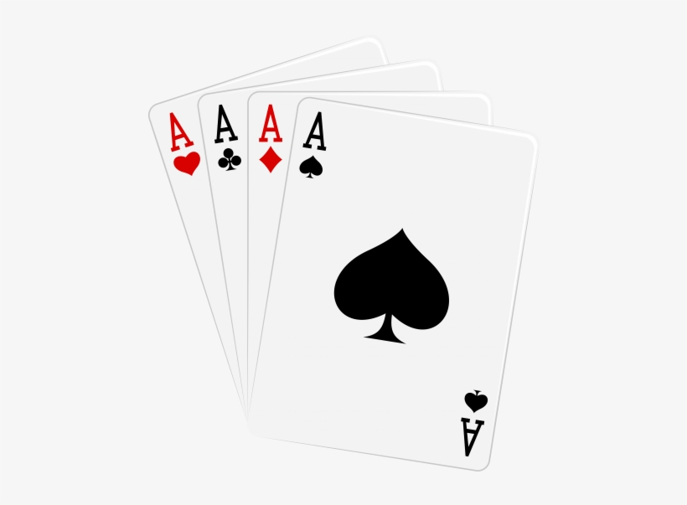


Disorder is the most probable state
What is the probability of getting a specific order of cards after shuffling a deck?
  1 over all possible configurations (52!)
    52!=80,658,175,170,943,878,571,660,636, 856,403,766,975,289,505,440, 883,277,824,000,000,000,000
What is the probability of getting a configuration where cards are ordered based on value?
  Number of configurations where cards are ordered over (52!)
Why is it not probable to shuffle cards and get ordered values?

Slide 5
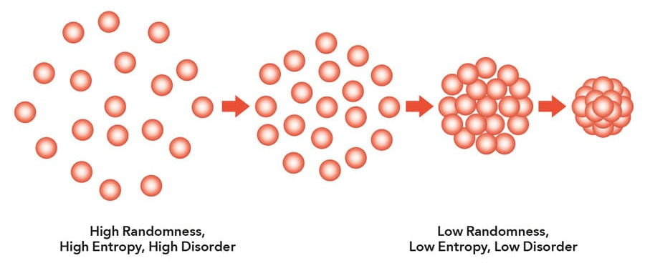
Entropy
The 2nd law of thermodynamics states that the total entropy of an isolated system can never decrease over time. Isolated systems spontaneously evolve towards thermodynamic equilibrium, i.e., the state with maximum entropy
How much information is required to represent each state?

Slide 6
Entropy in Information Theory
Information answers questions
  The more uncertain about the answer initially, the more information in the answer
  Scale: bits
    Answer to Boolean question with prior <1/2, 1/2>?
    Answer to 4-way question with prior <1/4, 1/4, 1/4, 1/4>?
    Answer to 4-way question with prior <0, 0, 0, 1>?
    Answer to 3-way question with prior <1/3, 1/3, 1/3>?
    Answer to 3-way question with prior <1/2, 1/4, 1/4>?
High entropy p-way question:
  A uniform distribution with probability 1/p
  Requires O(log₂ 1/p) bits
1 bit
2 bits
0 bits
1+0.667x1=1.667 bits
1+0.5x1=1.5 bits

Slide 7
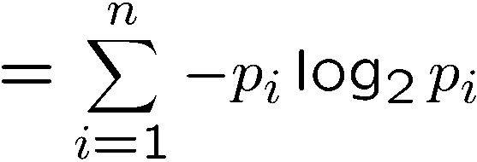
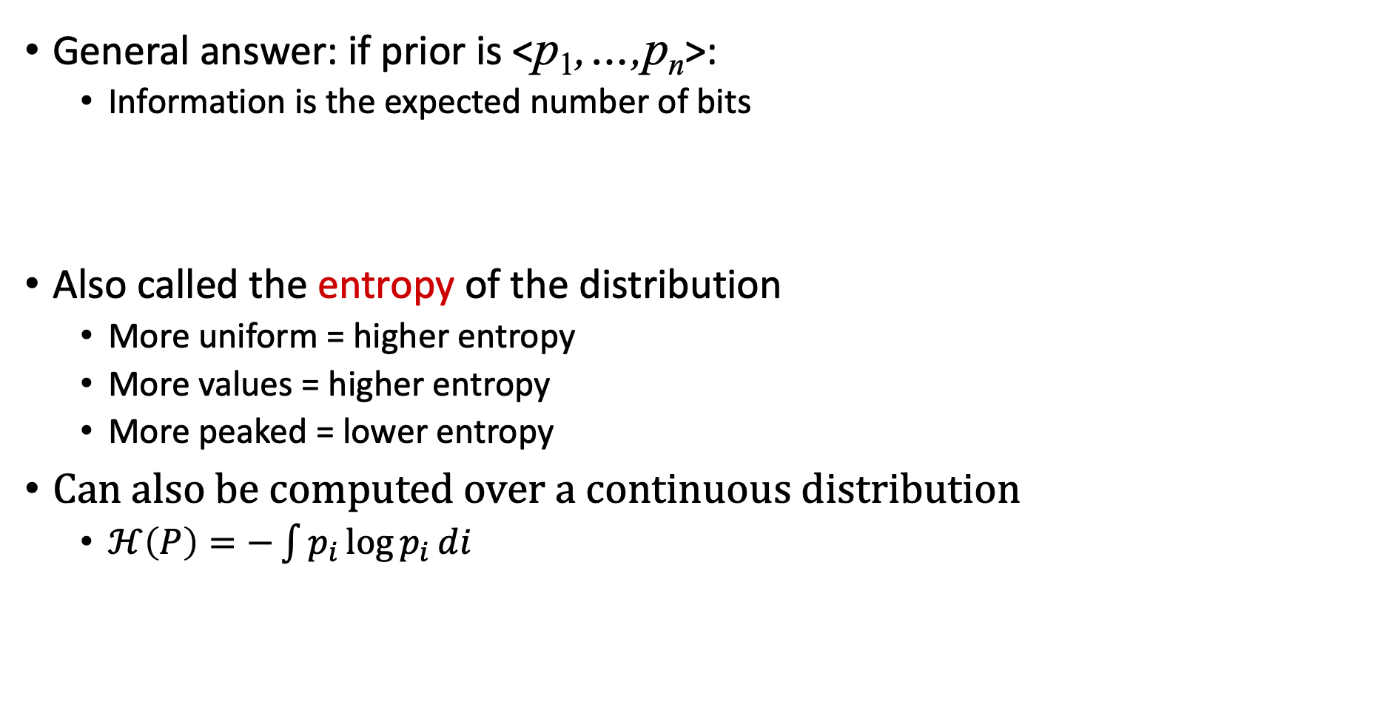
Entropy
General answer: if prior is <p₁,…,p_{n}>:
  Information is the expected number of bits
Also called the entropy of the distribution
  More uniform = higher entropy
  More values = higher entropy
  More peaked = lower entropy
Can also be computed over a continuous distribution
  $ℋ\left(P\right)=−\int{p_{i}\log{p_{i}}}ⅆi$
1 bit
0 bits
0.5 bit

Slide 8
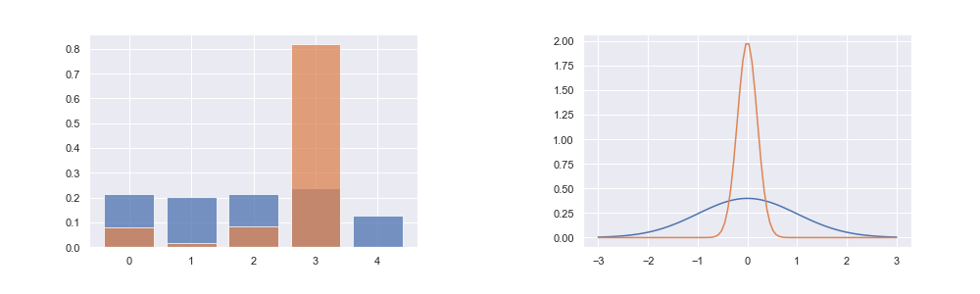
Entropy
Categorical (left), and Gaussian (Right) distributions. Orange shows low-entropy distributions, while blue shows high-entropy distributions.
Picture credit: Arthur Juliani

Slide 9
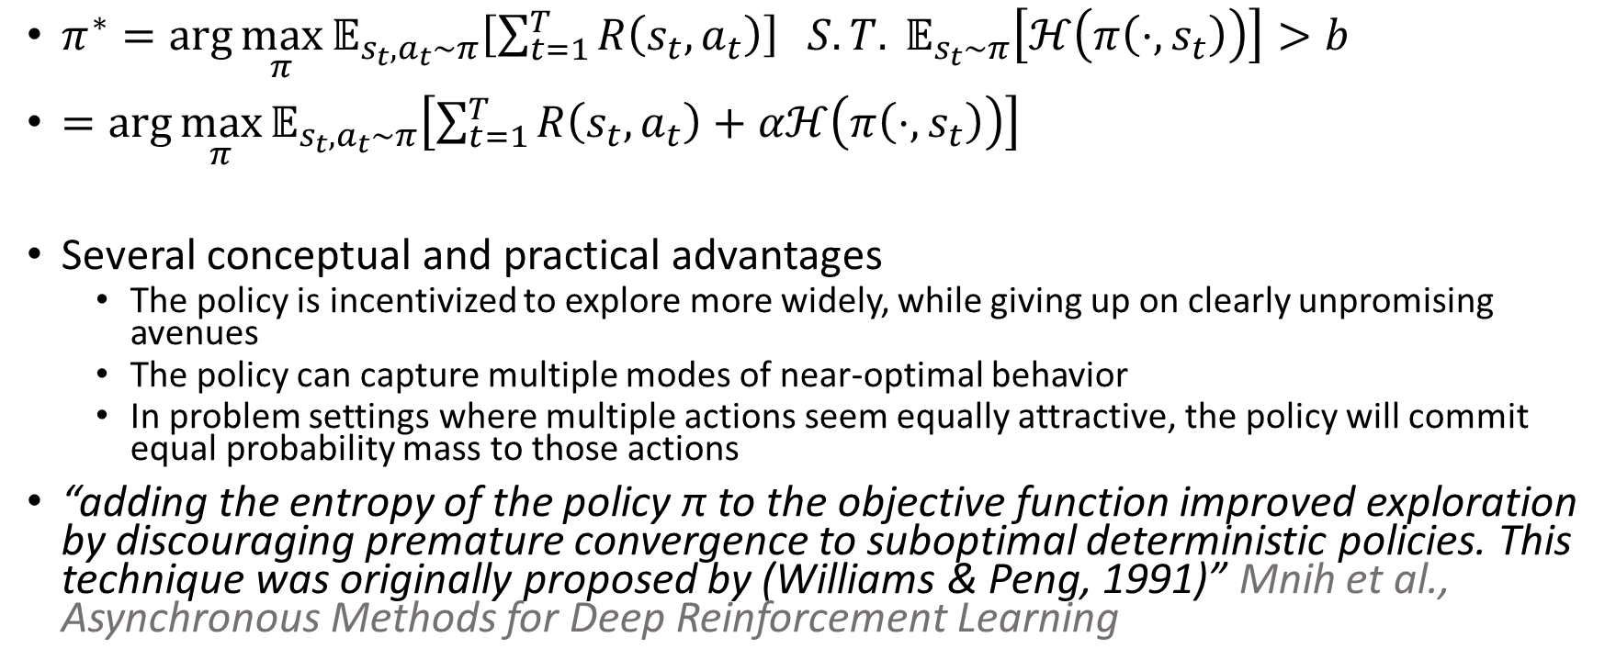
Maximum Entropy RL objective
$π^{∗}=\arg{\max_{π}{𝔼_{s_{t},a_{t}∼π}\left[\sum_{t=1}^{T}{R\left(s_{t},a_{t}\right)}\right]}} S.T. 𝔼_{s_{t}∼π}\left[ℋ\left(π\left(⋅,s_{t}\right)\right)\right]>b$
$=\arg{\max_{π}{𝔼_{s_{t},a_{t}∼π}\left[\sum_{t=1}^{T}{R\left(s_{t},a_{t}\right)+αℋ\left(π\left(⋅,s_{t}\right)\right)}\right]}}$
Several conceptual and practical advantages
  The policy is incentivized to explore more widely, while giving up on clearly unpromising avenues
  The policy can capture multiple modes of near-optimal behavior
  In problem settings where multiple actions seem equally attractive, the policy will commit equal probability mass to those actions
“adding the entropy of the policy π to the objective function improved exploration by discouraging premature convergence to suboptimal deterministic policies. This technique was originally proposed by (Williams & Peng, 1991)” Mnih et al., Asynchronous Methods for Deep Reinforcement Learning

Slide 10
Soft Actor Critic [https://arxiv.org/pdf/1812.05905.pdf]
Defines an off-policy actor-critic algorithm based on the maximum entropy principal
Attempts to address two major challenges in model-free deep RL: high sample complexity and brittleness to hyperparameters
The actor aims to simultaneously maximize expected return and policy entropy; that is, to succeed at the task while acting as randomly as possible
An actor-critic architecture with separate policy and value function networks
Off-policy formulation that enables reuse of previously collected data for efficiency
Policy entropy maximization to encourage stability and exploration

Slide 11
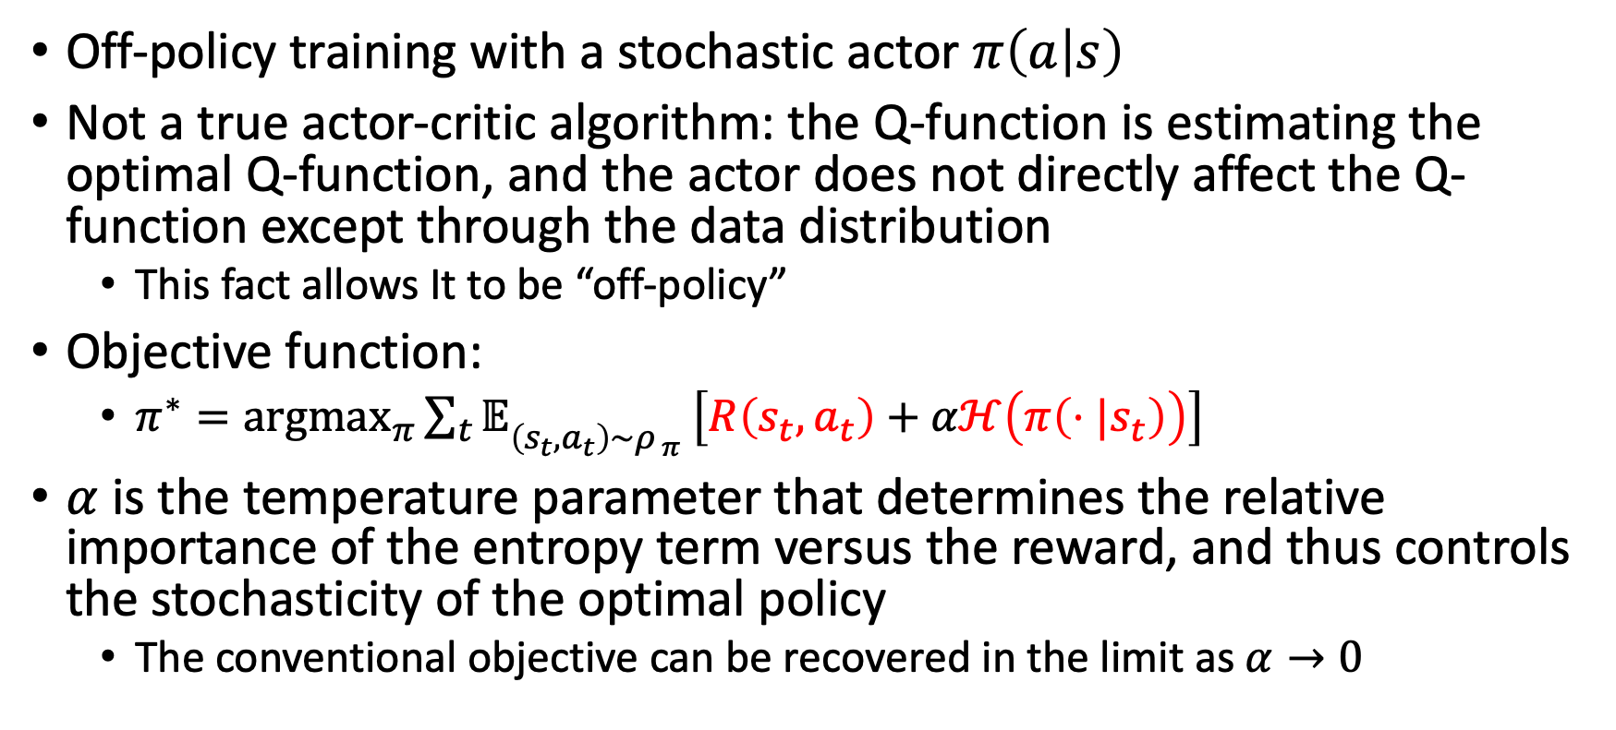
Soft policy iteration
Off-policy training with a stochastic actor $π\left(a | s\right)$
Not a true actor-critic algorithm: the Q-function is estimating the optimal Q-function, and the actor does not directly affect the Q-function except through the data distribution
  This fact allows It to be “off-policy”
Objective function:
  ${π^{∗}=argmax_{π}\sum_{t}{𝔼}}_{\left(s_{t},a_{t}\right)\sim ρ_{ π}}\left[R\left(s_{t},a_{t}\right)+αℋ\left(π\left(⋅|s_{t}\right)\right)\right]$
$α$ is the temperature parameter that determines the relative importance of the entropy term versus the reward, and thus controls the stochasticity of the optimal policy
  The conventional objective can be recovered in the limit as $α→0$

Slide 12
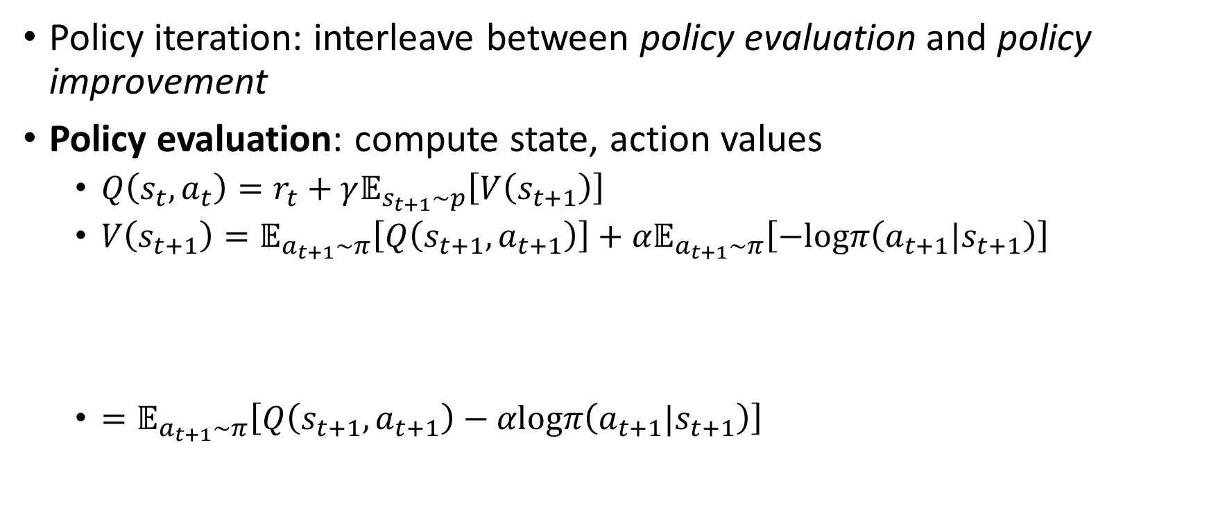
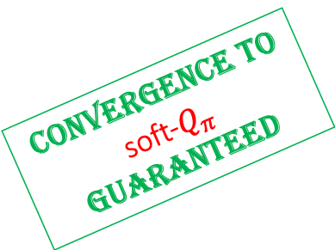
Soft policy iteration
Policy iteration: interleave between policy evaluation and policy improvement
Policy evaluation: compute state, action values
  $Q\left(s_{t},a_{t}\right)=r_{t}+γ𝔼_{s_{t+1}\sim p}\left[V\left(s_{t+1}\right)\right]$
  $V\left(s_{t+1}\right)=𝔼_{a_{t+1}\sim π}\left[Q\left(s_{t+1},a_{t+1}\right)\right]+{α𝔼}_{a_{t+1}\sim π}\left[−logπ\left(a_{t+1}|s_{t+1}\right)\right]$
  $=𝔼_{a_{t+1}\sim π}\left[Q\left(s_{t+1},a_{t+1}\right)−αlogπ\left(a_{t+1}|s_{t+1}\right)\right]$
Convergence to soft-$Q_{π}$ guaranteed
Entropy
*for the tabular case and assuming all state-action pairs are visited infinitely often

Slide 13
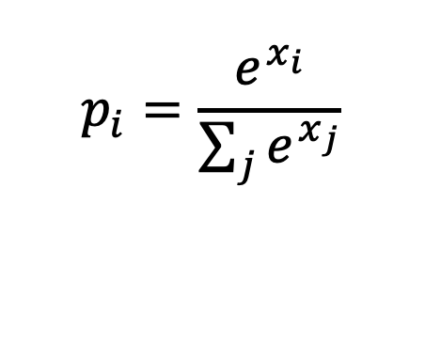
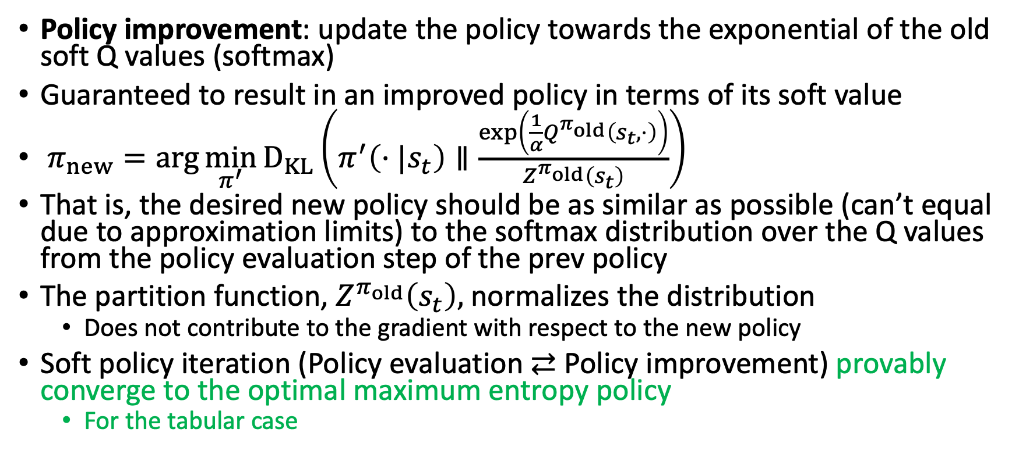
Soft policy iteration
$$p_{i}=\frac{e^{x_{i}}}{\sum_{j}{e^{x_{j}}}}$$
Softmax:
Policy improvement: update the policy towards the exponential of the old soft Q values (softmax)
Guaranteed to result in an improved policy in terms of its soft value
$π_{new}=\arg{\min_{π^{′}}{D_{KL}}\left(π^{′}\left(⋅|s_{t}\right)∥\frac{\exp\left(\frac{1}{α}Q^{π_{old}}\left(s_{t}, ⋅\right)\right)}{Z^{π_{old}}\left(s_{t}\right)}\right)}$
That is, the desired new policy should be as similar as possible (can’t equal due to approximation limits) to the softmax distribution over the Q values from the policy evaluation step of the prev policy
The partition function, $Z^{π_{old}}\left(s_{t}\right),$ normalizes the distribution
  Does not contribute to the gradient with respect to the new policy
Soft policy iteration (Policy evaluation $⇄$ Policy improvement) provably converge to the optimal maximum entropy policy
  For the tabular case

Slide 14
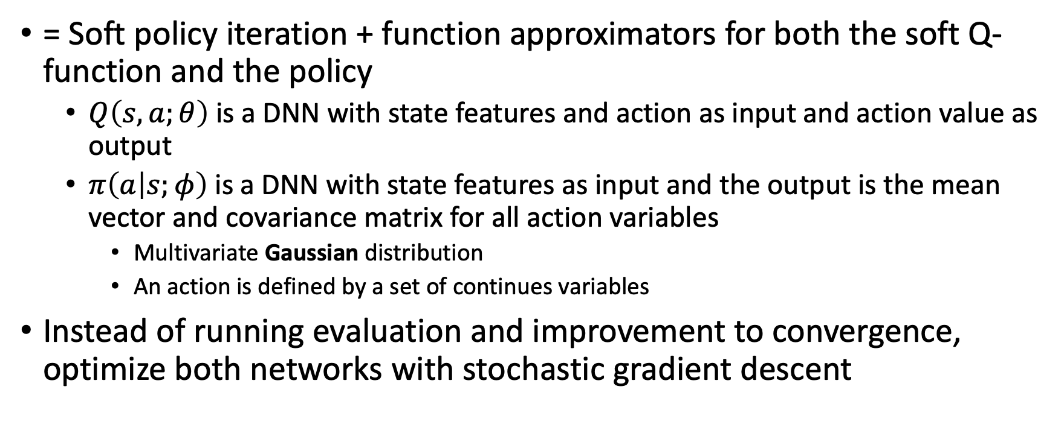
Soft Actor Critic
= Soft policy iteration + function approximators for both the soft Q-function and the policy
  $Q\left(s,a;θ\right)$ is a DNN with state features and action as input and action value as output
  $π\left(a | s;φ\right)$ is a DNN with state features as input and the output is the mean vector and covariance matrix for all action variables
    Multivariate Gaussian distribution
    An action is defined by a set of continues variables
Instead of running evaluation and improvement to convergence, optimize both networks with stochastic gradient descent

Slide 15
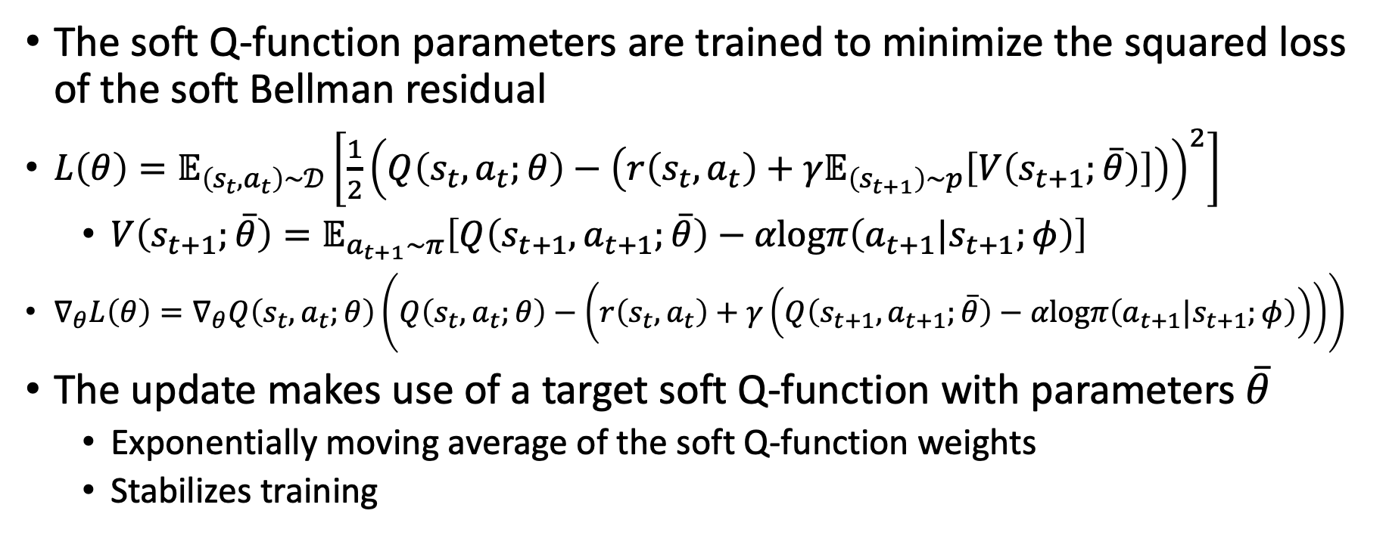
Soft Critic
The soft Q-function parameters are trained to minimize the squared loss of the soft Bellman residual
$L\left(θ\right)=𝔼_{\left(s_{t},a_{t}\right)\sim 𝒟}\left[\frac{1}{2}{\left(Q\left(s_{t},a_{t};θ\right)−\left(r\left(s_{t},a_{t}\right)+γ𝔼_{\left(s_{t+1}\right)\sim p}\left[V\left(s_{t+1};\overline{θ}\right)\right]\right)\right)}^{2}\right]$
  $V\left(s_{t+1};\overline{θ}\right)=𝔼_{a_{t+1}\sim π}\left[Q\left(s_{t+1},a_{t+1};\overline{θ}\right)−αlogπ\left(a_{t+1}|s_{t+1};φ\right)\right]$
$∇_{θ}L\left(θ\right)=∇_{θ}Q\left(s_{t},a_{t};θ\right)\left(Q\left(s_{t},a_{t};θ\right)−\left(r\left(s_{t},a_{t}\right)+γ\left(Q\left(s_{t+1},a_{t+1};\overline{θ}\right)−αlogπ\left(a_{t+1}|s_{t+1};φ\right)\right)\right)\right)$
The update makes use of a target soft Q-function with parameters $\overline{θ}$
  Exponentially moving average of the soft Q-function weights
  Stabilizes training

Slide 16
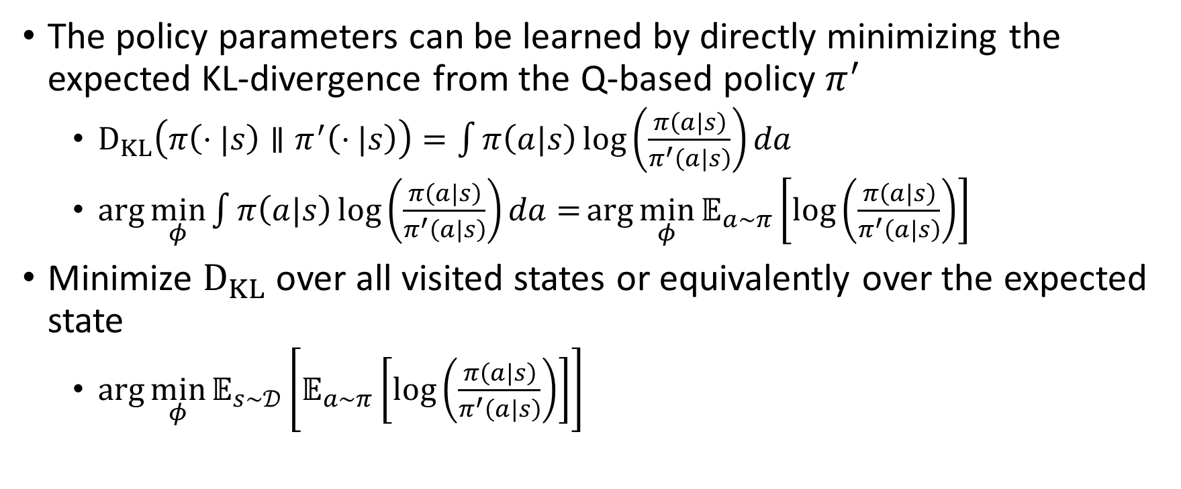

Soft actor
The policy parameters can be learned by directly minimizing the expected KL-divergence from the Q-based policy $π^{′}$
  $D_{KL}\left(π\left(⋅|s\right)∥π^{′}\left(⋅|s\right)\right)=\int{π\left(a|s\right)\log\left(\frac{π\left(a|s\right)}{π^{′}\left(a|s\right)}\right)}da$
  $\arg{\min_{φ}{\int{π\left(a|s\right)\log\left(\frac{π\left(a|s\right)}{π^{′}\left(a|s\right)}\right)}da=}}\arg{\min_{φ}{𝔼_{a\sim π}}}\left[\log\left(\frac{π\left(a|s\right)}{π^{′}\left(a|s\right)}\right)\right]$
Minimize $D_{KL}$ over all visited states or equivalently over the expected state
  $\arg{\min_{φ}{𝔼_{s\sim 𝒟}}}\left[𝔼_{a\sim π}\left[\log\left(\frac{π\left(a|s\right)}{π^{′}\left(a|s\right)}\right)\right]\right]$
$$p(a)$$

Slide 17
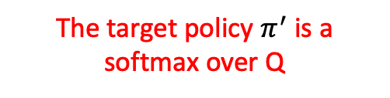
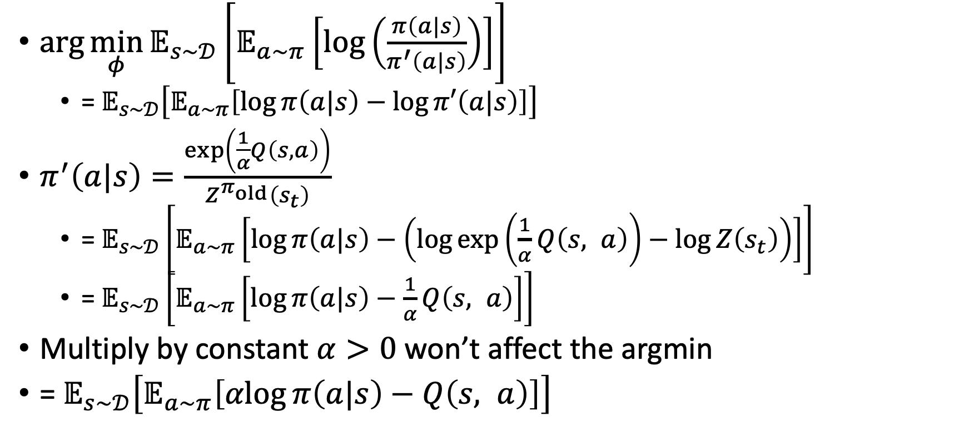
Actor training
The target policy $π^{′}$ is a softmax over Q
$\arg{\min_{φ}{𝔼_{s\sim 𝒟}}}\left[𝔼_{a\sim π}\left[\log\left(\frac{π\left(a|s\right)}{π^{′}\left(a|s\right)}\right)\right]\right]$
  = $𝔼_{s\sim 𝒟}\left[𝔼_{a\sim π}\left[\log{π\left(a|s\right)}−\log{π′\left(a|s\right)}\right]\right]$
$π^{′}\left(a|s\right)=\frac{\exp\left(\frac{1}{α}Q\left(s, a\right)\right)}{Z^{π_{old}}\left(s_{t}\right)}$
  = $𝔼_{s\sim 𝒟}\left[𝔼_{a\sim π}\left[\log{π\left(a|s\right)}−\left(\log{\exp\left(\frac{1}{α}Q\left(s, a\right)\right)}−\log{Z\left(s_{t}\right)}\right)\right]\right]$
  = $𝔼_{s\sim 𝒟}\left[𝔼_{a\sim π}\left[\log{π\left(a|s\right)}−\frac{1}{α}Q\left(s, a\right)\right]\right]$
Multiply by constant $α>0$ won’t affect the argmin
= $𝔼_{s\sim 𝒟}\left[𝔼_{a\sim π}\left[αlog{π\left(a|s\right)}−Q\left(s, a\right)\right]\right]$
The constant log-partition function can be ignored with no impact on the argmin

Slide 18
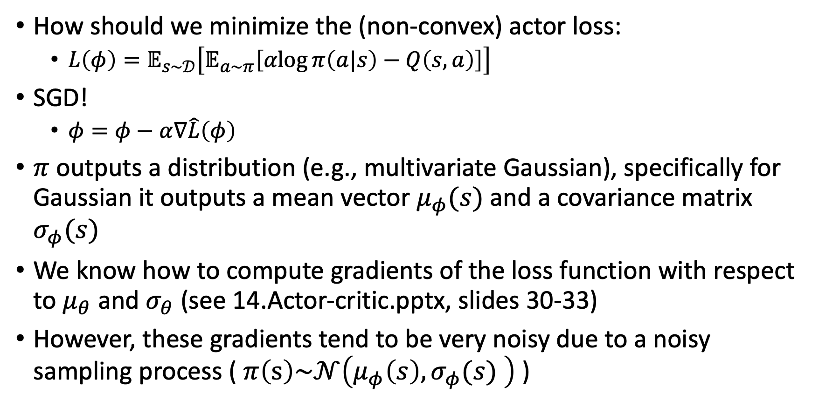
Actor training
How should we minimize the (non-convex) actor loss:
  $L\left(φ\right)=𝔼_{s\sim 𝒟}\left[𝔼_{a\sim π}\left[αlog{π\left(a|s\right)}−Q\left(s, a\right)\right]\right]$
SGD!
  $φ=φ−α∇\hat{L}\left(φ\right)$
$π$ outputs a distribution (e.g., multivariate Gaussian), specifically for Gaussian it outputs a mean vector $μ_{φ}(s)$ and a covariance matrix $σ_{φ}(s)$
We know how to compute gradients of the loss function with respect to $μ_{θ}$ and $σ_{θ}$ (see 14.Actor-critic.pptx, slides 30-33)
However, these gradients tend to be very noisy due to a noisy sampling process ( $π\left(s\right)\sim 𝒩\left(μ_{φ}\left(s\right),σ_{φ}(s) \right)$ )

Slide 19
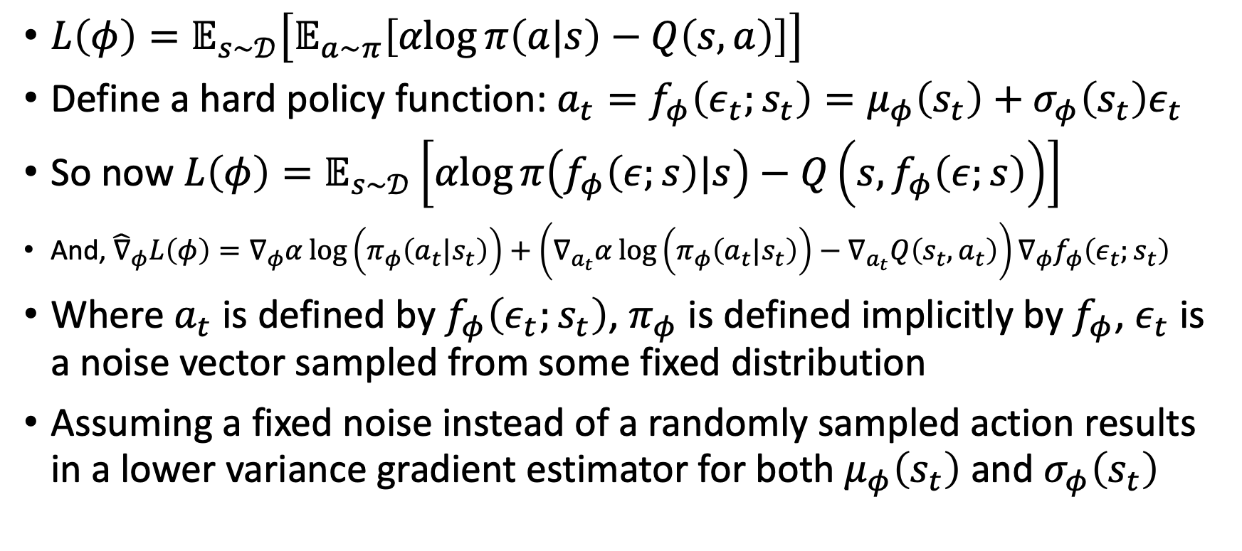
Reparameterization trick
$L\left(φ\right)=𝔼_{s\sim 𝒟}\left[𝔼_{a\sim π}\left[αlog{π\left(a|s\right)}−Q\left(s, a\right)\right]\right]$
Define a hard policy function: $a_{t}=f_{φ}\left(ε_{t};s_{t}\right)=μ_{φ}\left(s_{t}\right)+σ_{φ}\left(s_{t}\right)ε_{t}$
So now $L\left(φ\right)=𝔼_{s\sim 𝒟}\left[αlog{π\left(f_{φ}\left(ε;s\right)|s\right)}−Q\left(s,f_{φ}\left(ε;s\right)\right)\right]$
And, ${\hat{∇}}_{φ}L\left(φ\right)=∇_{φ}α\log\left(π_{φ}\left(a_{t}|s_{t}\right)\right)+\left(∇_{a_{t}}α\log\left(π_{φ}\left(a_{t}|s_{t}\right)\right)−∇_{a_{t}}Q\left(s_{t},a_{t}\right)\right)∇_{φ}f_{φ}\left(ε_{t};s_{t}\right)$
Where $a_{t}$ is defined by $f_{φ}\left(ε_{t};s_{t}\right)$, $π_{φ}$ is defined implicitly by $f_{φ}$, $ε_{t}$ is a noise vector sampled from some fixed distribution
Assuming a fixed noise instead of a randomly sampled action results in a lower variance gradient estimator for both $μ_{φ}\left(s_{t}\right)$ and $σ_{φ}\left(s_{t}\right)$

Slide 20
Training a VAE
*Sidenote regarding the Reparameterization trick*
Reconstruction loss
Regularization term
$l\left(x\right)={\left(x−x^{′}\right)}^{2}+KL\left(𝒩\left(μ_{x},σ_{x}\right),𝒩\left(0,I\right)\right)$
  Differentiable loss function
Backprop!
Derivative of sampling????
$$\frac{∂μ,σ}{∂loss}$$
$$\frac{∂z}{∂loss}$$
$$\frac{∂d}{∂loss}$$
$$\frac{∂x′}{∂loss}$$
?
$$x$$
Encoder
$$e$$
$$μ$$
decoder
$$d$$
$$x′$$
$$\sim 𝒩$$
$$z$$
$$σ$$

Slide 21
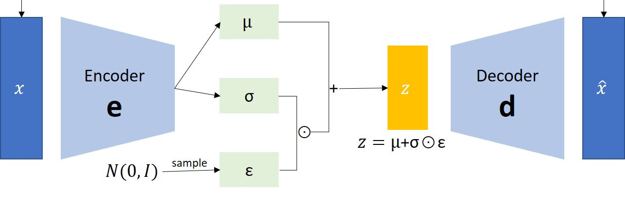
Reparameterization trick
*Sidenote regarding the Reparameterization trick*
We cannot backpropagate through a sampling operation so we define a random noise input variable while keeping mu and sigma as constants

Slide 22
Generating new data
*Sidenote regarding the Reparameterization trick*
Once we trained mu, sigma, and the decoder, we can create new samples of x
Simply sample noise from $𝒩\left(0,I\right)$ to get a fabricated $x$

Slide 23
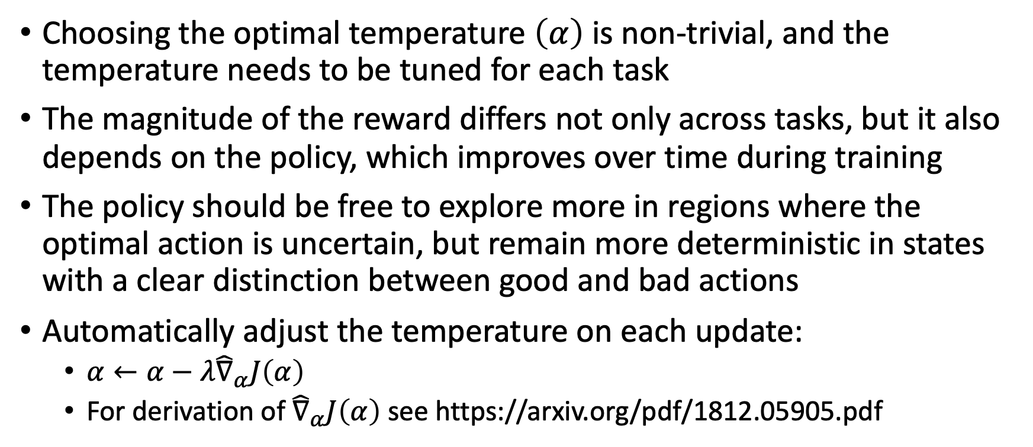
Auto entropy weight adjustment
Choosing the optimal temperature $\left(α\right)$ is non-trivial, and the temperature needs to be tuned for each task
The magnitude of the reward differs not only across tasks, but it also depends on the policy, which improves over time during training
The policy should be free to explore more in regions where the optimal action is uncertain, but remain more deterministic in states with a clear distinction between good and bad actions
Automatically adjust the temperature on each update:
  $α←α−λ{\hat{∇}}_{α}J\left(α\right)$
  For derivation of ${\hat{∇}}_{α}J\left(α\right)$ see https://arxiv.org/pdf/1812.05905.pdf

Slide 24
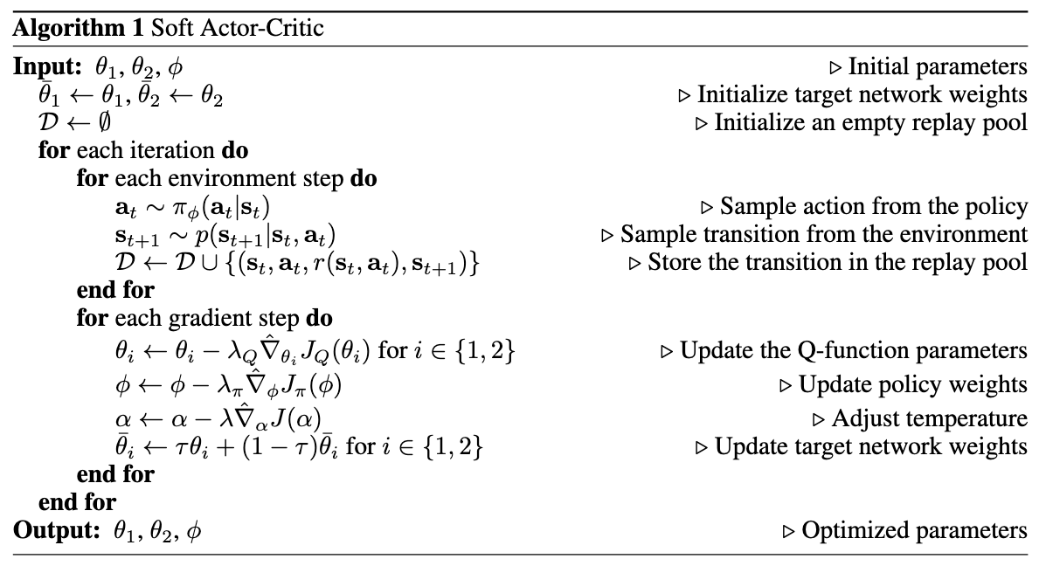

Slide 25
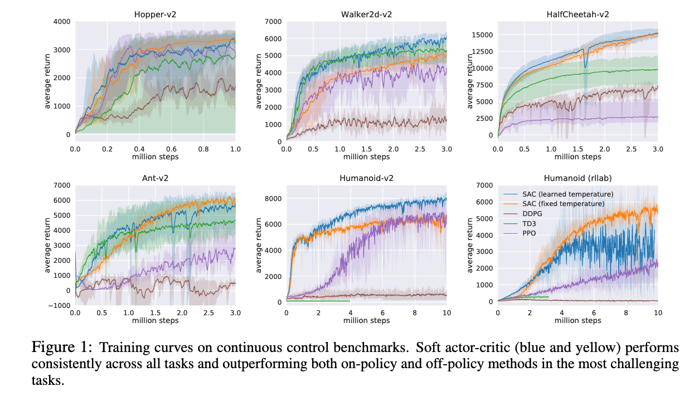

Slide 26
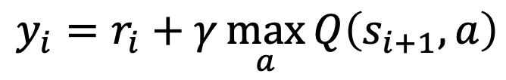






Generalizing DQN to continuous actions
Train with squared TD loss
DQN for discrete action space:
Q-net
$$q_{a1}$$
$$S$$
$$…$$
$$π\left(s\right)=\arg_{a}{\max{Q(s,a)}}$$
$$q_{an}$$
$$L\left(s,a\right)={\left(q−y\right)}^{2}$$
$$y_{i}=r_{i}+γ\max_{a}{Q\left(s_{i+1},a\right)}$$
How can we define a Q net for continues actions?

Slide 27

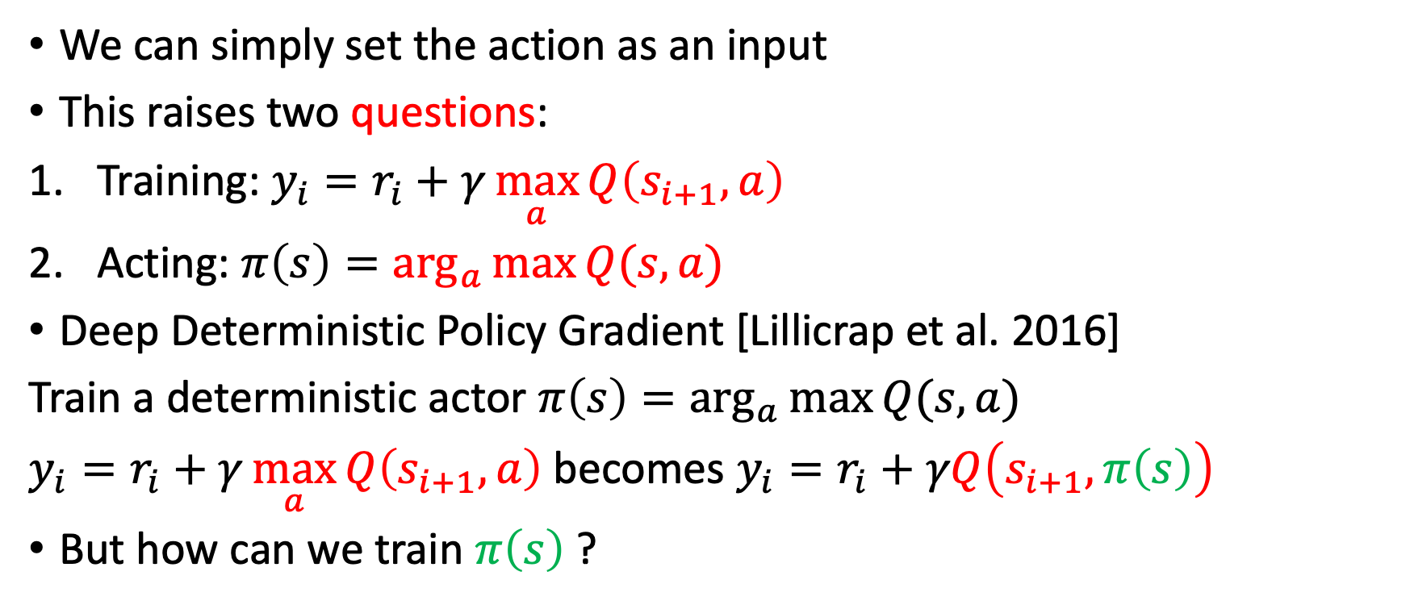


Q net for continues actions
We can simply set the action as an input
This raises two questions:
Training: $y_{i}=r_{i}+γ\max_{a}{Q\left(s_{i+1},a\right)}$
Acting: $π\left(s\right)=\arg_{a}{\max{Q(s,a)}}$
Deep Deterministic Policy Gradient [Lillicrap et al. 2016]
Train a deterministic actor $π\left(s\right)=\arg_{a}{\max{Q(s,a)}}$
$y_{i}=r_{i}+γ\max_{a}{Q\left(s_{i+1},a\right)}$ becomes $y_{i}=r_{i}+γQ\left(s_{i+1},π\left(s\right)\right)$
But how can we train $π\left(s\right)$ ?
Q-net
$$S$$
$$q$$
$$A$$

Slide 28
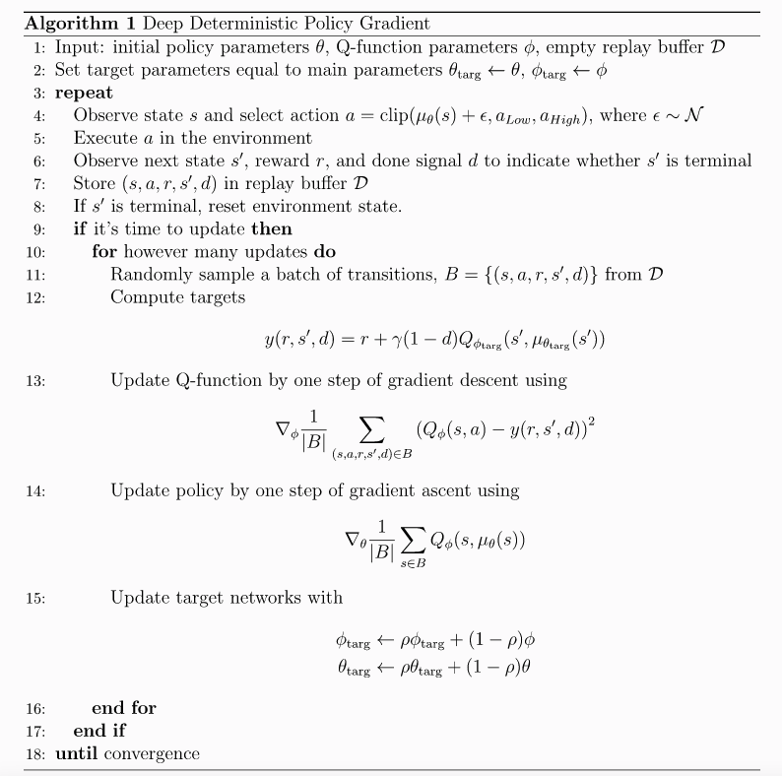

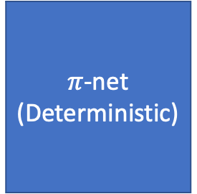

Deep Deterministic Policy Gradient
Train with squared TD loss
Q-net
$$S$$
$$q$$
$$A$$
Train policy?
$π$-net
(Deterministic)
$$S$$
$$A$$

Slide 29
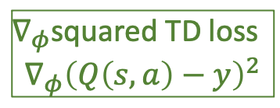
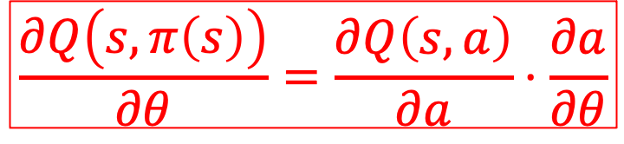

Deep Deterministic Policy Gradient
$∇_{φ}$squared TD loss
$$∇_{φ}{\left(Q\left(s,a\right)−y\right)}^{2}$$
Q-net
$$S$$
$$q$$
$$A$$
$$∇_{a}q\left(s,a\right)$$
$π$-net
(Deterministic)
$$S$$
$$A$$
$$\frac{∂Q\left(s,π\left(s\right)\right)}{∂θ}=\frac{∂Q\left(s,a\right)}{∂a}⋅\frac{∂a}{∂θ}$$

Slide 30

Deep Deterministic Policy Gradient
Q-net
$∇_{φ}$squared TD loss
$$S$$
$$q$$
$$A$$
Add random exploration by sampling a Gaussian with mean=the deterministic action
$$∇_{a}q\left(s,a\right)$$
$π$-net
(Deterministic)
$$S$$
$$A$$
$$\frac{∂Q\left(s,π\left(s\right)\right)}{∂θ}=\frac{∂Q\left(s,a\right)}{∂a}⋅\frac{∂a}{∂θ}$$

Slide 31
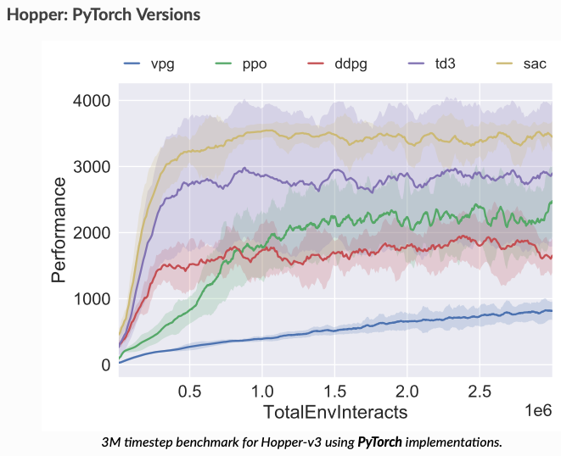
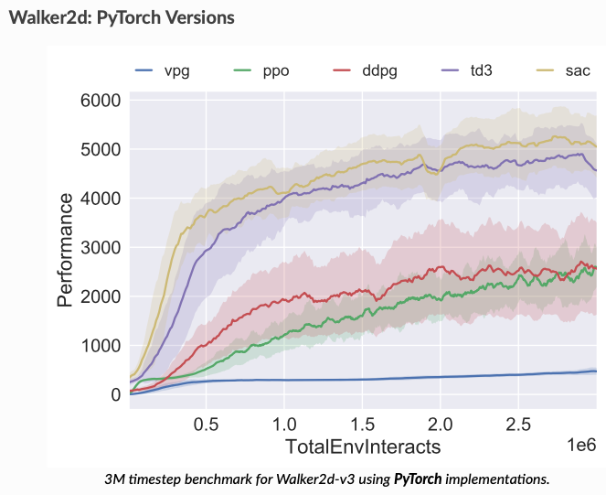
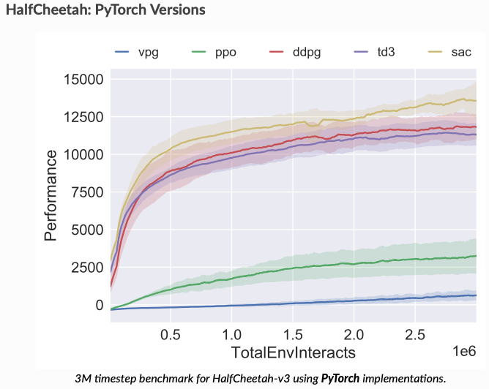
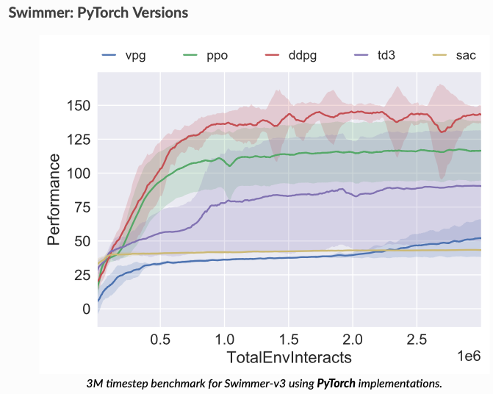
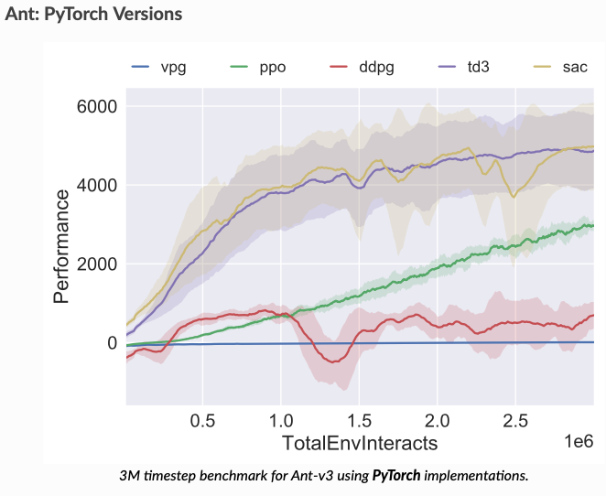
Results (from https://spinningup.openai.com/en/latest/spinningup/bench.html)

Slide 32
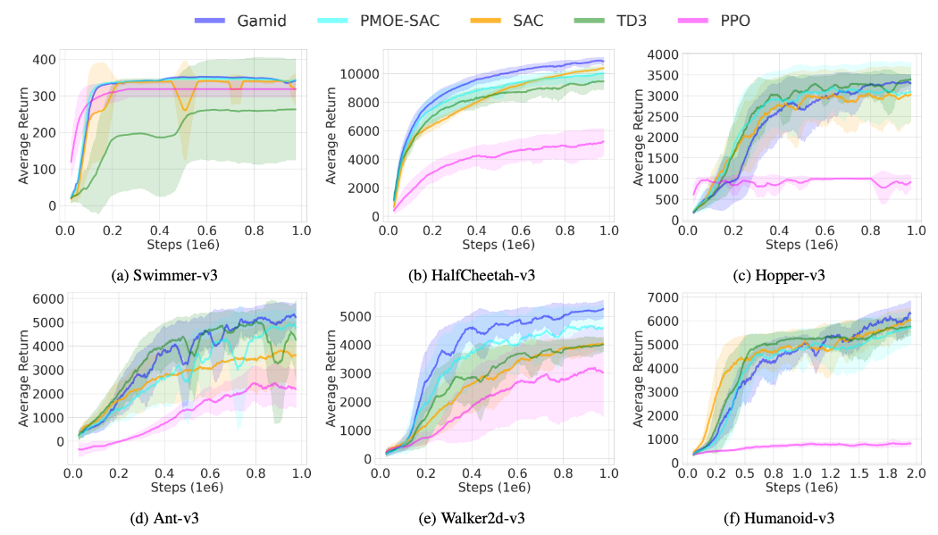
Gaussian Mixture Deterministic Policy Gradient

Slide 33
What did we learn (SAC)?
Higher entropy for a policy -> more exploration
More exploration -> higher chances of overcoming local optima
It is worthwhile to encourage the policy to be of high entropy even at the cost of lower expected return
Sampling a soft policy for an action results in a noisy gradient estimate
  Instead, sample noise from a fixed distribution as input for a hard policy

Slide 34
What did we learn (DDPG)?
Generalizing DQN to continuous action space is challenging
Can’t enumerate over all possible actions so can’t compute argmax_a
DDPG: “train a deterministic policy that approximates argmax_a”
Train the deterministic policy using gradient ascend with respect to the approximated Q output

Slide 35
Extra reading
https://arxiv.org/pdf/1812.05905.pdf
https://spinningup.openai.com/en/latest/algorithms/sac.html
https://towardsdatascience.com/soft-actor-critic-demystified-b8427df61665
https://arxiv.org/pdf/1312.6114.pdf - Reparameterization trick

Slide 36
What next?
Lecture: Transfer learning
Assignments:
  DDPG, by No. 25, EoD
  A2C, by Nov. 18, EoD
  REINFORCE, by Nov. 11, EOD
Quiz (on Canvas):
  Soft Actor-Critic, by Nov. 13, EoD
Project:
  Final Project, by Dec. 2, EoD

