Slide 1

CSCE-642 Reinforcement Learning
Trust Regions
Instructor: Guni Sharon
Based on slides by: Pascal Poupart and John Schulman

Slide 2
CSCE-689, Reinforcement Learning
Stateless decision process
Monte-Carlo
Policy gradient
Actor-critic
Markov decision process
Temporal difference
Function approximators
Solving MDPs (offline)
Dynamic programming
Tabular methods
Deep RL

Slide 3
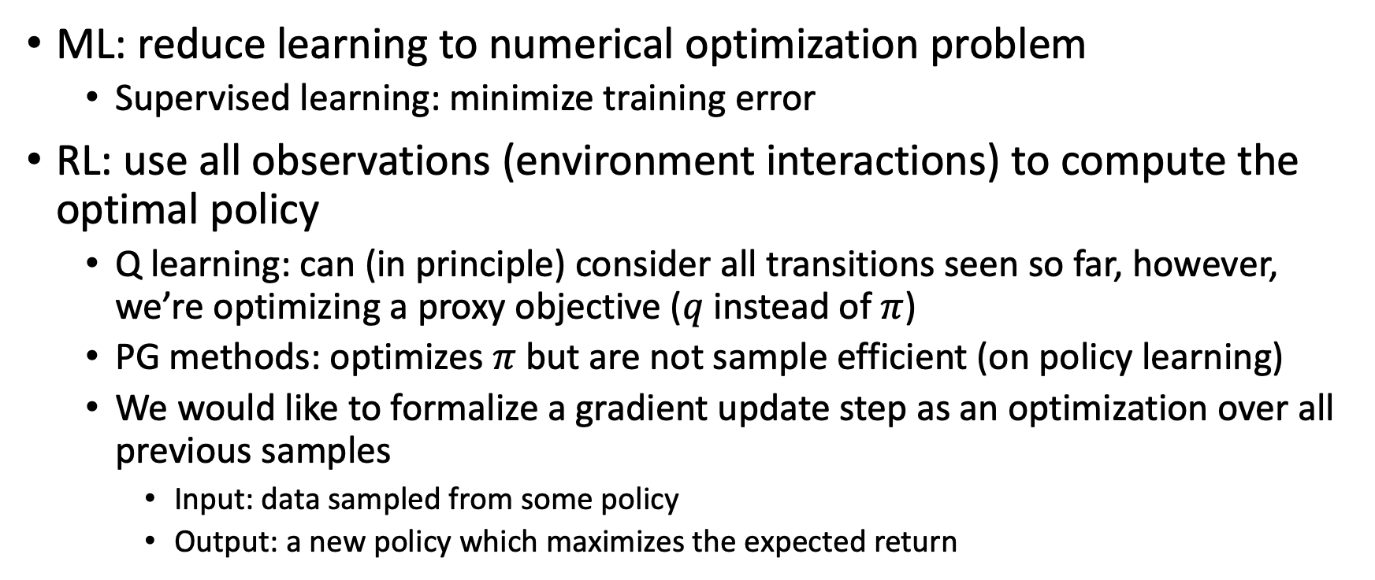
RL as an optimization problem
ML: reduce learning to numerical optimization problem
  Supervised learning: minimize training error
RL: use all observations (environment interactions) to compute the optimal policy
  Q learning: can (in principle) consider all transitions seen so far, however, we’re optimizing a proxy objective ($q$ instead of $π$)
  PG methods: optimizes $π$ but are not sample efficient (on policy learning)
  We would like to formalize a gradient update step as an optimization over all previous samples
    Input: data sampled from some policy
    Output: a new policy which maximizes the expected return

Slide 4
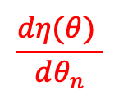





Limitations of “vanilla” PG methods
Hard to choose step size
  Input data is nonstationary due to changing policy: state and reward distributions are non-stationary
  Bad step size is more damaging than in supervised learning, since it affects the trajectory distribution
    Step too far -> bad policy
    Next batch: collected under bad policy
    Can’t recover – collapse in performance
Sample efficiency
  Only one gradient step per environment sample
    Need to better utilize previous experience
  Dependent on scaling of coordinates
    Uses the same learning rate for all states and all tunable parameters
$$J(θ)$$
$$\frac{dη(θ) }{dθ_{n}}$$
$$θ_{n+1}?$$
$$θ$$
$$θ_{n}$$

Slide 5
Find the optimal point
PG: Line search methods (e.g., gradient ascend/decent)
  Find direction of improvement
  Select step length
Today: Trust region methods
  Select a trust region radius (analog to max step length)
  Find optimal point within trust region

Slide 6
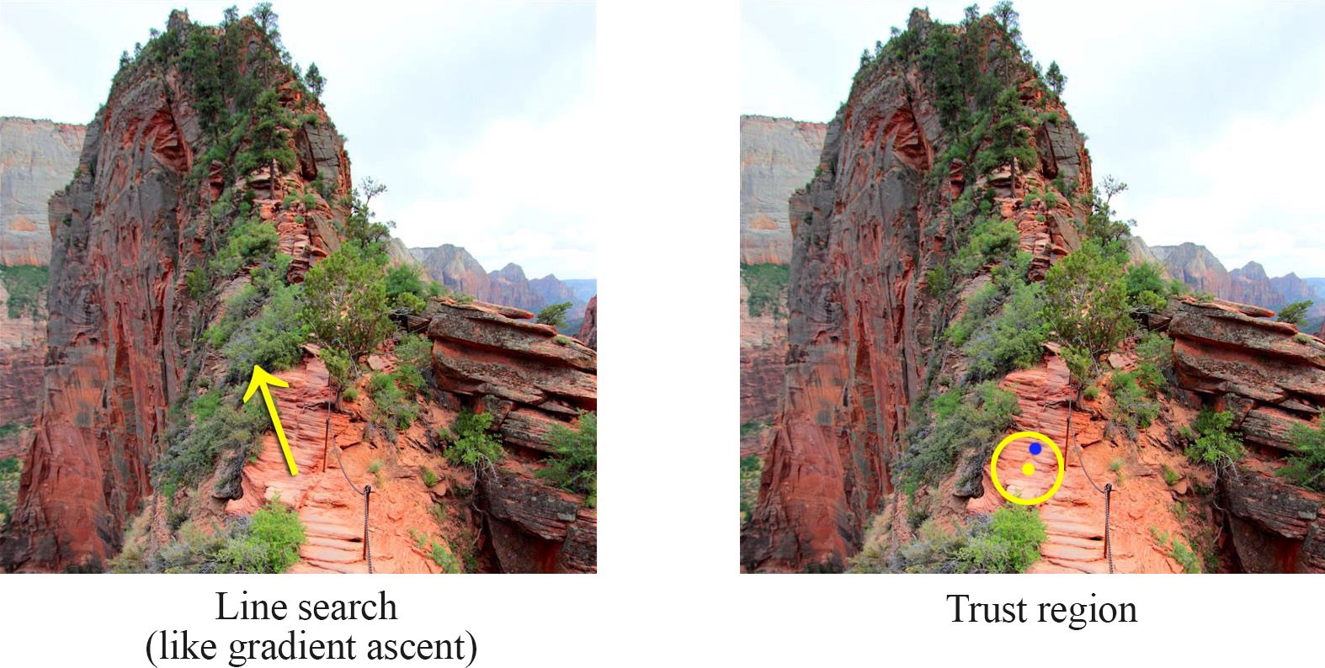

Slide 7
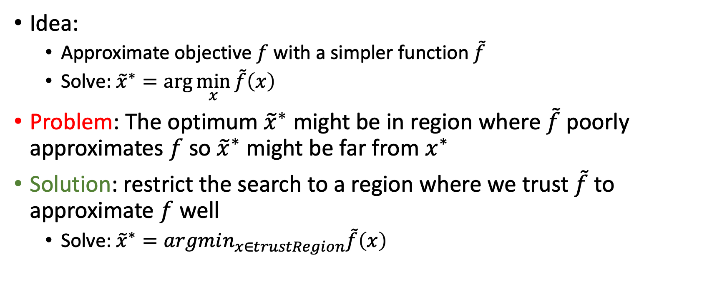
Trust region methods
Idea:
  Approximate objective $f$ with a simpler function $\tilde{f}$
  Solve: ${\tilde{x}}^{∗}=\arg{\min_{x}{\tilde{f}\left(x\right)}}$
Problem: The optimum ${\tilde{x}}^{∗}$ might be in region where $\tilde{f}$ poorly approximates $f$ so ${\tilde{x}}^{∗}$ might be far from $x^{∗}$
Solution: restrict the search to a region where we trust $\tilde{f}$ to approximate $f$ well
  Solve: ${\tilde{x}}^{∗}=argmin_{x∈trustRegion}\tilde{f}\left(x\right)$

Slide 8
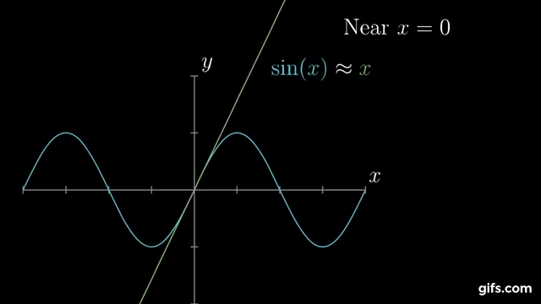
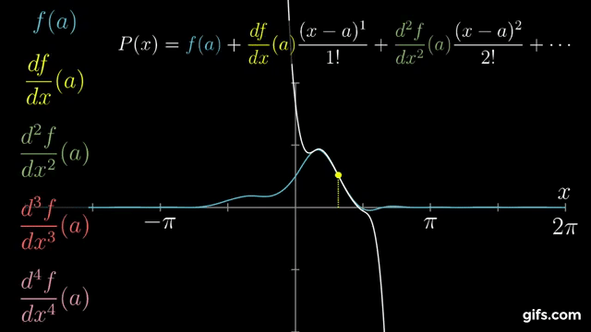
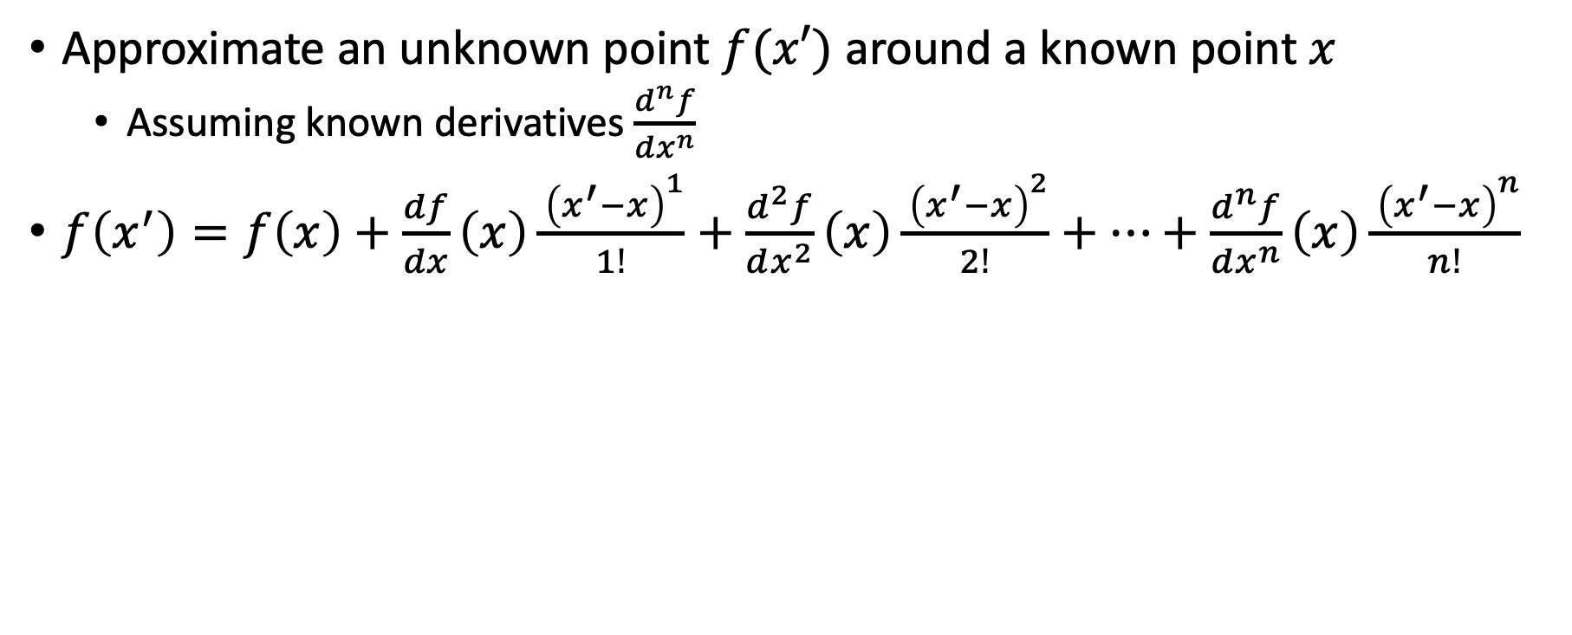
Taylor series for approximation
Approximate an unknown point $f(x′)$ around a known point $x$
  Assuming known derivatives $\frac{d^{n}f}{dx^{n}}$
$f\left(x^{′}\right)=f\left(x\right)+\frac{df}{dx}\left(x\right)\frac{{ \left(x^{′}−x\right)}^{1}}{1!}+\frac{d^{2}f}{dx^{2}}\left(x\right)\frac{{ \left(x^{′}−x\right)}^{2}}{2!}+…+\frac{d^{n}f}{dx^{n}}\left(x\right)\frac{{ \left(x^{′}−x\right)}^{n}}{n!}$
3Blue1Brown by Grant Sanderson

Slide 9
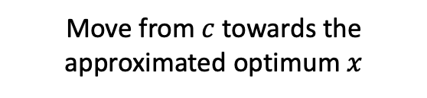
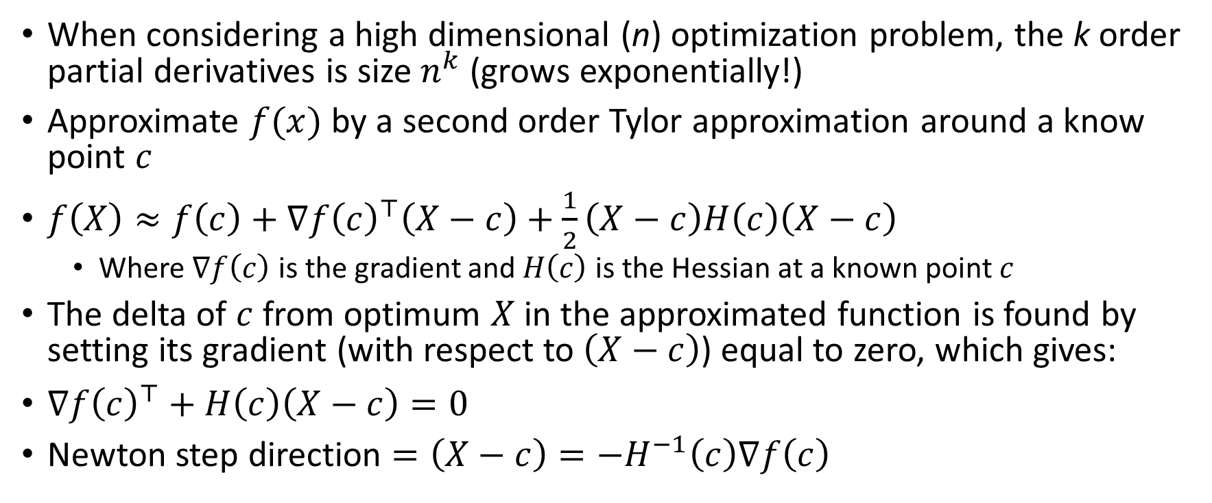
Newton's method
When considering a high dimensional (n) optimization problem, the k order partial derivatives is size $n^{k}$ (grows exponentially!)
Approximate $f(x)$ by a second order Tylor approximation around a know point $c$
$f\left(X\right)≈f\left(c\right)+∇f{\left(c\right)}^{⊤}\left(X−c\right)+\frac{1}{2}\left(X−c\right)H\left(c\right)\left(X−c\right)$
  Where $∇f\left(c\right)$ is the gradient and $H\left(c\right)$ is the Hessian at a known point $c$
The delta of $c$ from optimum $X$ in the approximated function is found by setting its gradient (with respect to $\left(X−c\right)$) equal to zero, which gives:
$∇f{\left(c\right)}^{⊤}+H\left(c\right)\left(X−c\right)=0$
Newton step direction $=\left(X−c\right)=−H^{−1}\left(c\right)∇f\left(c\right)$
Move from $c$ towards the approximated optimum $x$

Slide 10
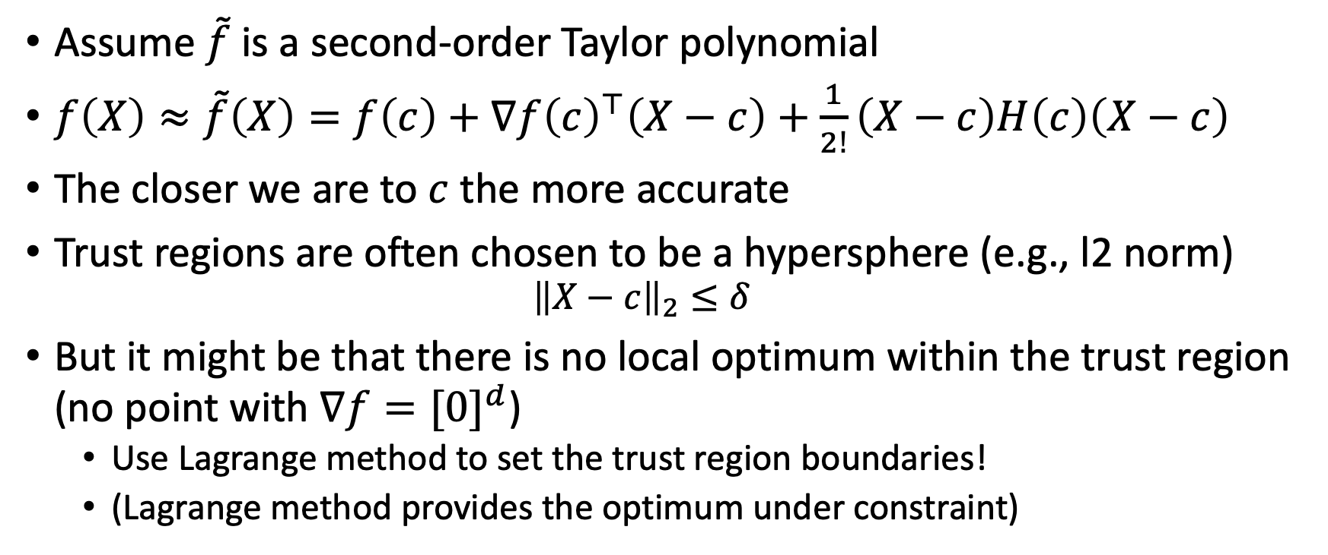
Add a trust region
Assume $\tilde{f}$ is a second-order Taylor polynomial
$f\left(X\right)≈\tilde{f}\left(X\right)=f\left(c\right)+∇f{\left(c\right)}^{⊤}\left(X−c\right)+\frac{1}{2!}\left(X−c\right)H\left(c\right)\left(X−c\right)$
The closer we are to $c$ the more accurate
Trust regions are often chosen to be a hypersphere (e.g., l2 norm)
  $${\left\|X−c\right\|}_{2}≤δ$$
But it might be that there is no local optimum within the trust region (no point with $∇f={[0]}^{d}$)
  Use Lagrange method to set the trust region boundaries!
  (Lagrange method provides the optimum under constraint)

Slide 11
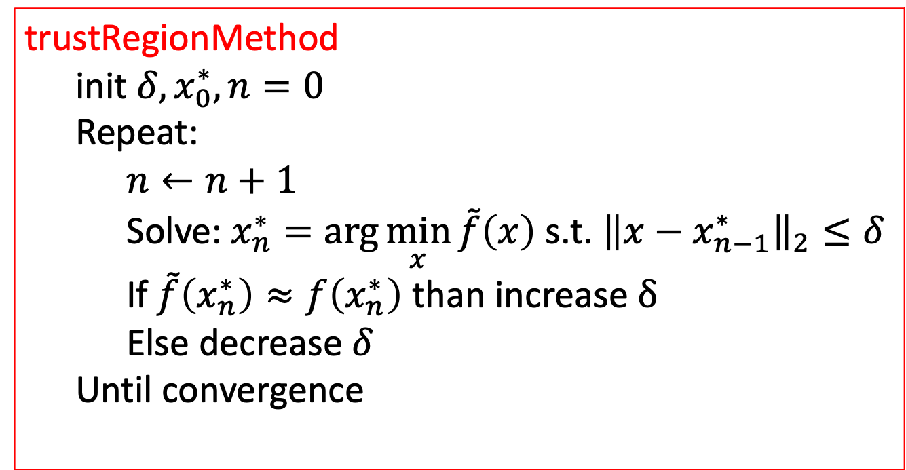
Generic algorithm
trustRegionMethod
  init $δ,x_{0}^{∗},n=0$
  Repeat:
    $$n←n+1$$
    Solve: $x_{n}^{∗}=\arg{\min_{x}{\tilde{f}\left(x\right)}}$ s.t. ${\left\|x−x_{n−1}^{∗}\right\|}_{2}≤δ$
    If $\tilde{f}\left(x_{n}^{∗}\right)≈f\left(x_{n}^{∗}\right)$ than increase $δ$
    Else decrease $δ$
  Until convergence

Slide 12
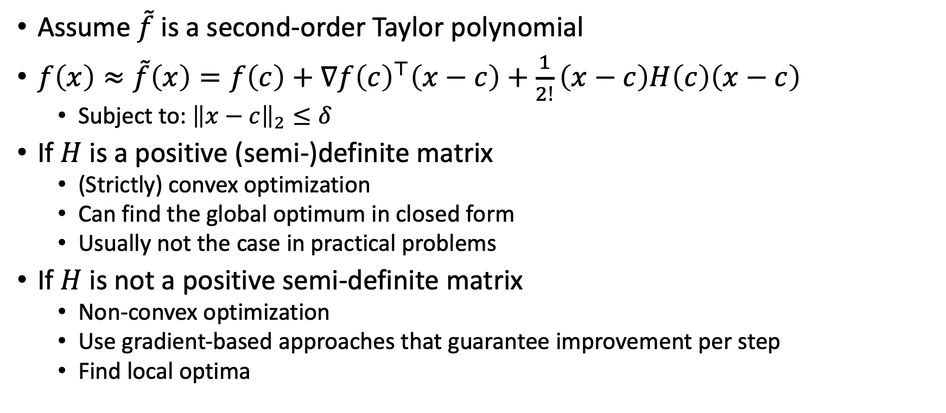
Finding the optimal point
Assume $\tilde{f}$ is a second-order Taylor polynomial
$f\left(x\right)≈\tilde{f}\left(x\right)=f\left(c\right)+∇f{\left(c\right)}^{⊤}\left(x−c\right)+\frac{1}{2!}\left(x−c\right)H\left(c\right)\left(x−c\right)$
  Subject to: ${\left\|x−c\right\|}_{2}≤δ$
If $H$ is a positive (semi-)definite matrix
  (Strictly) convex optimization
  Can find the global optimum in closed form
  Usually not the case in practical problems
If $H$ is not a positive semi-definite matrix
  Non-convex optimization
  Use gradient-based approaches that guarantee improvement per step
  Find local optima

Slide 13
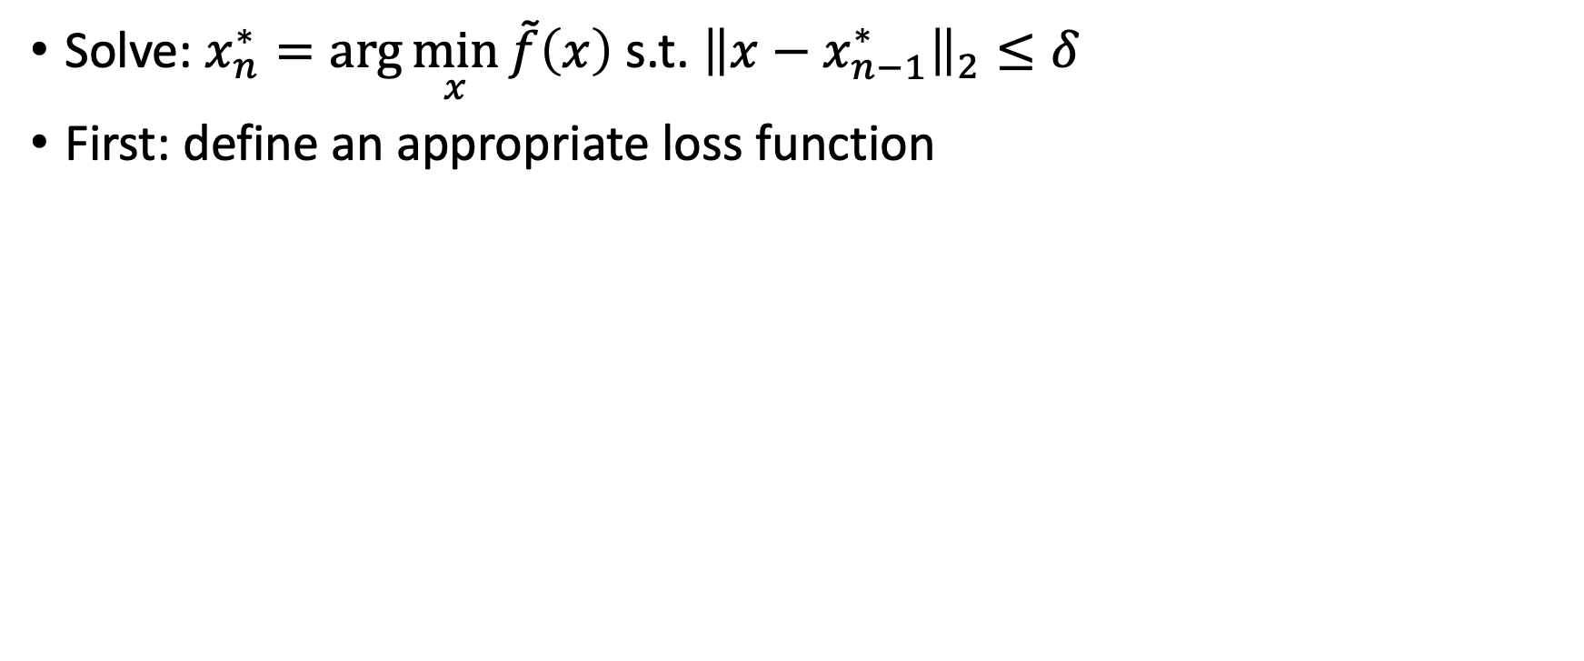
Non-convex optimization
Solve: $x_{n}^{∗}=\arg{\min_{x}{\tilde{f}\left(x\right)}}$ s.t. ${\left\|x−x_{n−1}^{∗}\right\|}_{2}≤δ$
First: define an appropriate loss function

Slide 14

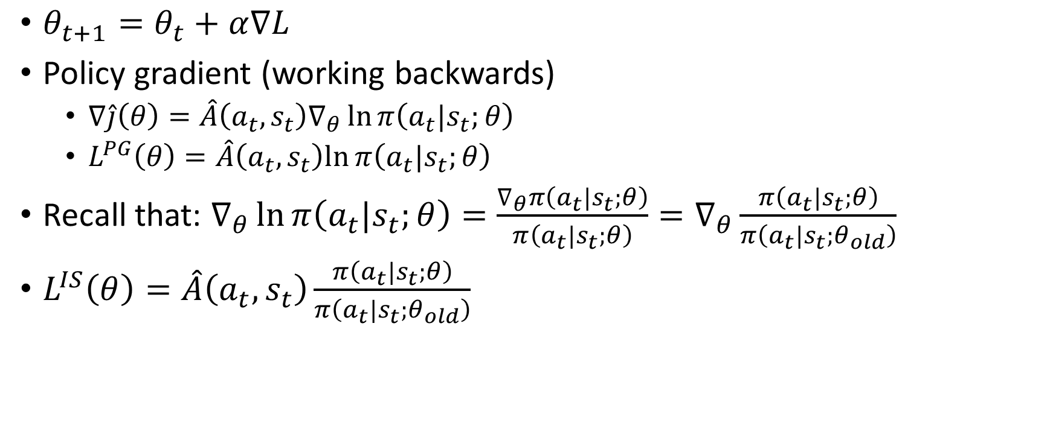
What loss do we minimize in PG?
$θ_{t+1}=θ_{t}+α∇L$
Policy gradient (working backwards)
  $∇\hat{j}\left(θ\right)=\hat{A}\left(a_{t},s_{t}\right)∇_{θ}\ln{π\left(a_{t}|s_{t};θ\right)}$
  $L^{PG}\left(θ\right)=\hat{A}\left(a_{t},s_{t}\right)ln{π\left(a_{t}|s_{t};θ\right)}$
Recall that: $∇_{θ}\ln{π\left(a_{t}|s_{t};θ\right)}=\frac{∇_{θ}π\left(a_{t}|s_{t};θ\right)}{π\left(a_{t}|s_{t};θ\right)}=∇_{θ}\frac{π\left(a_{t}|s_{t};θ\right)}{π\left(a_{t}|s_{t};θ_{old}\right)}$
$L^{IS}\left(θ\right)=\hat{A}\left(a_{t},s_{t}\right){\frac{π\left(a_{t}|s_{t};θ\right)}{π\left(a_{t}|s_{t};θ_{old}\right)}}$
$π\left(a_{t}|s_{t};θ_{old}\right)$ is a constant
Important sampling ratio (see slide 28 from “4.Monte-Carlo”)

Slide 15
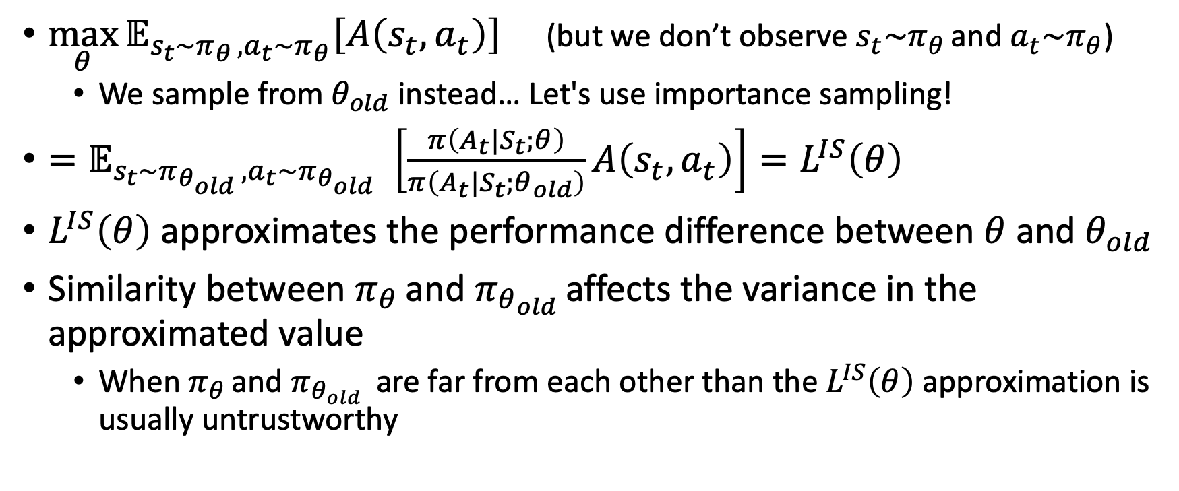
What do we actually want to optimize in PG?
$\max_{θ}{𝔼_{s_{t}\sim π_{θ },a_{t}\sim π_{θ}}\left[A\left(s_{t},a_{t}\right)\right]}$ (but we don’t observe $s_{t}\sim π_{θ }$and $a_{t}\sim π_{θ}$)
  We sample from $θ_{old}$ instead… Let's use importance sampling!
${=𝔼}_{s_{t}\sim π_{θ_{old} },a_{t}\sim π_{θ_{old} }}\left[\frac{π\left(A_{t}|S_{t};θ\right)}{π\left(A_{t}|S_{t};θ_{old}\right)}A\left(s_{t},a_{t}\right)\right]=L^{IS}\left(θ\right)$
$L^{IS}\left(θ\right)$ approximates the performance difference between $θ$ and $θ_{old}$
Similarity between $π_{θ }$and $π_{θ_{old} }$affects the variance in the approximated value
  When $π_{θ }$and $π_{θ_{old} }$ are far from each other than the $L^{IS}\left(θ\right)$ approximation is usually untrustworthy

Slide 16
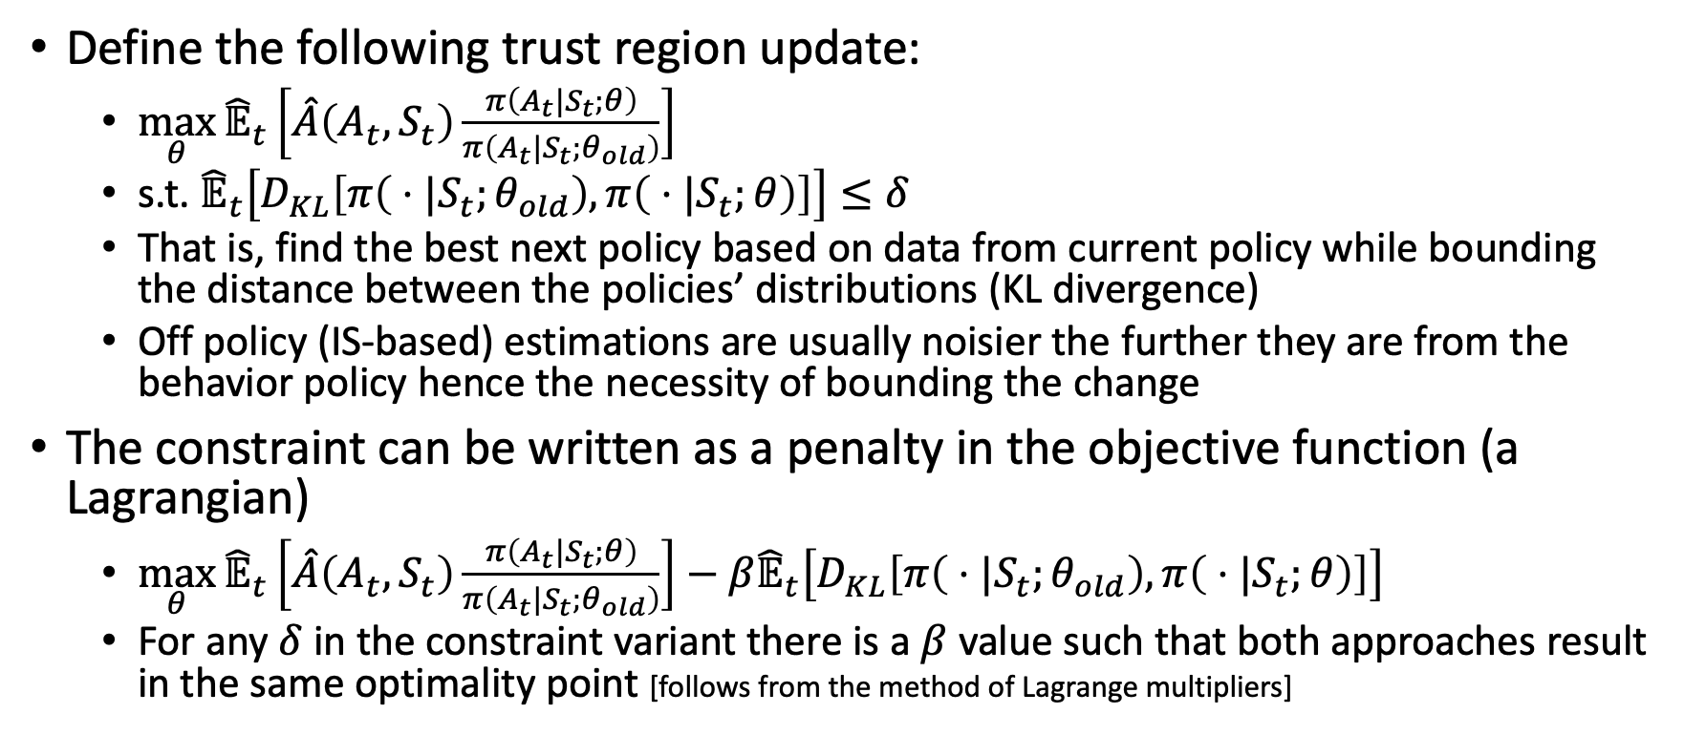
Trust Region Policy Optimization
Define the following trust region update:
  $\max_{θ}{{\hat{𝔼}}_{t}}\left[\hat{A}\left(A_{t},S_{t}\right)\frac{π\left(A_{t}|S_{t};θ\right)}{π\left(A_{t}|S_{t};θ_{old}\right)}\right]$
  s.t. ${\hat{𝔼}}_{t}\left[D_{KL}\left[π\left( ⋅|S_{t};θ_{old}\right),π\left( ⋅|S_{t};θ\right)\right]\right]≤δ$
  That is, find the best next policy based on data from current policy while bounding the distance between the policies’ distributions (KL divergence)
  Off policy (IS-based) estimations are usually noisier the further they are from the behavior policy hence the necessity of bounding the change
The constraint can be written as a penalty in the objective function (a Lagrangian)
  $\max_{θ}{{\hat{𝔼}}_{t}}\left[\hat{A}\left(A_{t},S_{t}\right)\frac{π\left(A_{t}|S_{t};θ\right)}{π\left(A_{t}|S_{t};θ_{old}\right)}\right]−β{\hat{𝔼}}_{t}\left[D_{KL}\left[π\left( ⋅|S_{t};θ_{old}\right),π\left( ⋅|S_{t};θ\right)\right]\right]$
  For any $δ$ in the constraint variant there is a $β$ value such that both approaches result in the same optimality point [follows from the method of Lagrange multipliers]

Slide 17
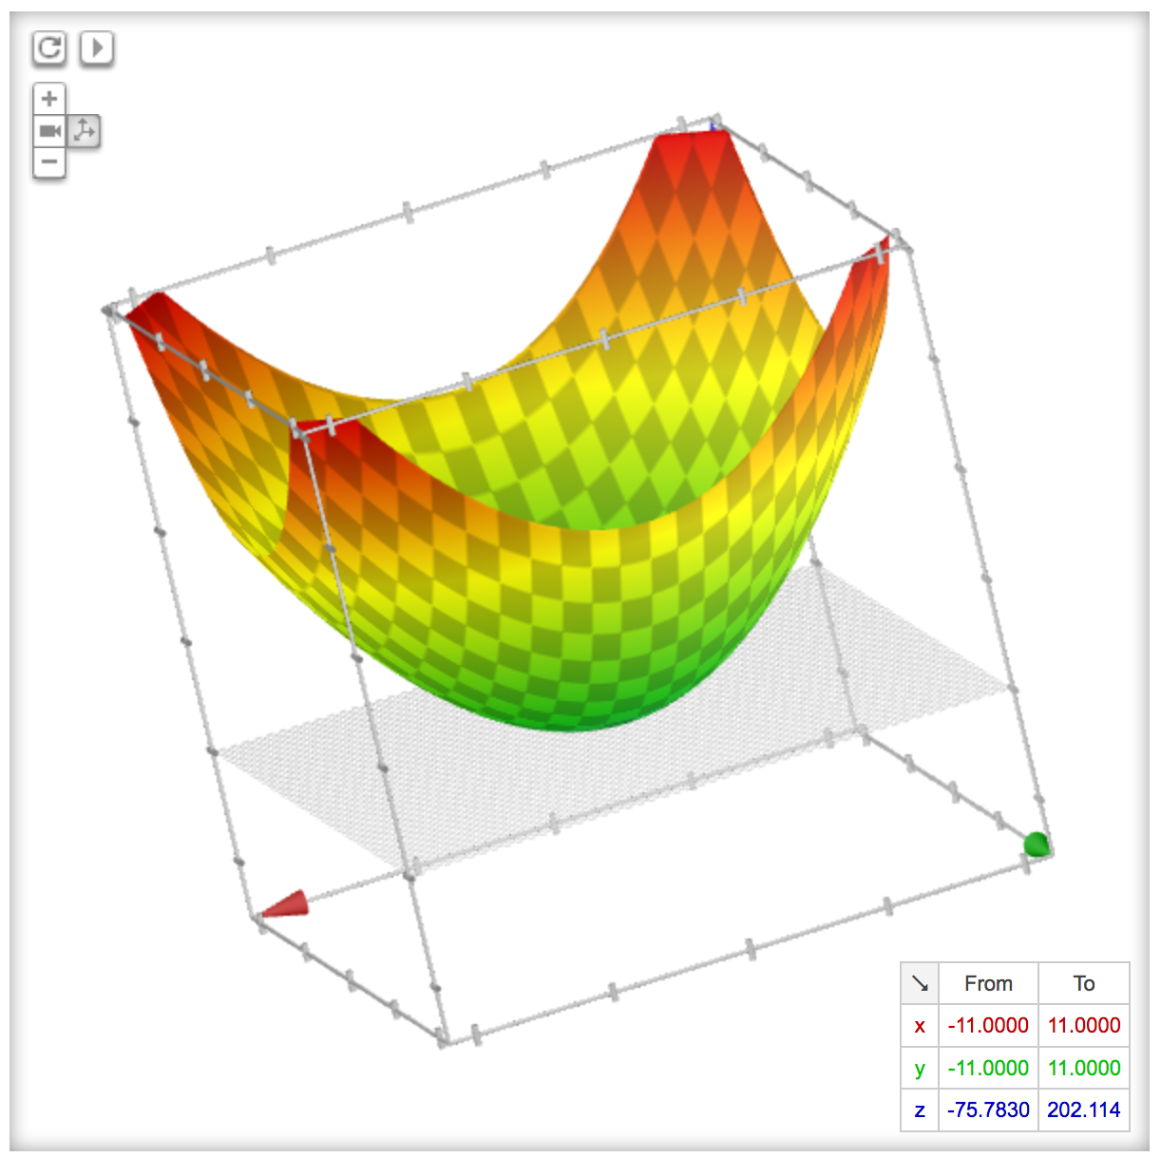
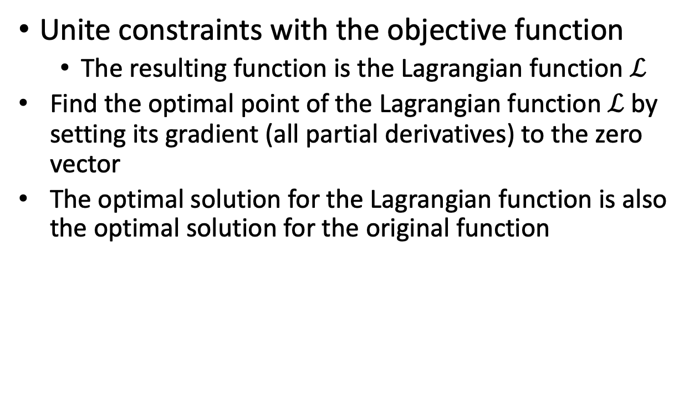
Method of Lagrange multipliers
Unite constraints with the objective function
  The resulting function is the Lagrangian function $ℒ$
  Find the optimal point of the Lagrangian function $ℒ$ by setting its gradient (all partial derivatives) to the zero vector
  The optimal solution for the Lagrangian function is also the optimal solution for the original function

Slide 18
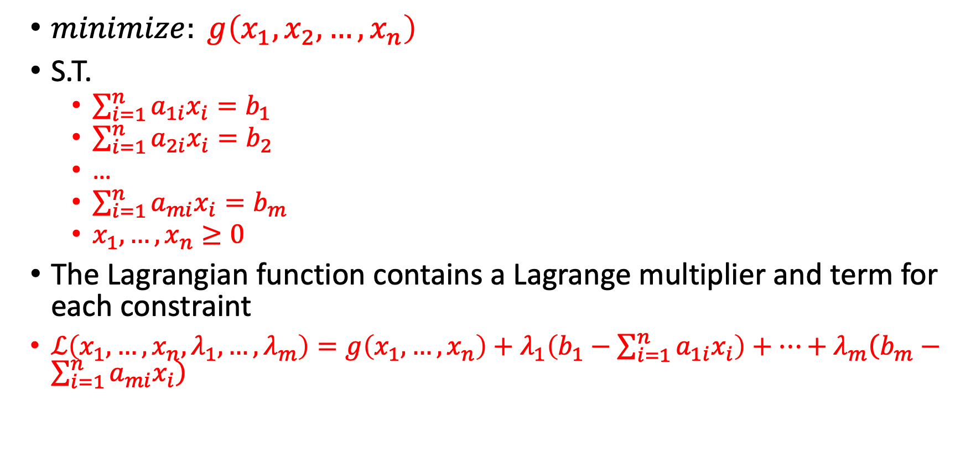
Method of Lagrange multipliers
$minimize: g\left(x_{1},x_{2},…,x_{n}\right)$
S.T.
  $\sum_{i=1}^{n}{a_{1i}x_{i}}=b_{1}$
  $\sum_{i=1}^{n}{a_{2i}x_{i}}=b_{2}$
  …
  $\sum_{i=1}^{n}{a_{mi}x_{i}}=b_{m}$
  $x_{1},…,x_{n}≥0$
The Lagrangian function contains a Lagrange multiplier and term for each constraint
$ℒ\left(x_{1},…,x_{n},λ_{1},…,λ_{m}\right)=g\left(x_{1},…,x_{n}\right)+λ_{1}\left(b_{1}−\sum_{i=1}^{n}{a_{1i}x_{i}}\right)+…+λ_{m}\left(b_{m}−\sum_{i=1}^{n}{a_{mi}x_{i}}\right)$

Slide 19
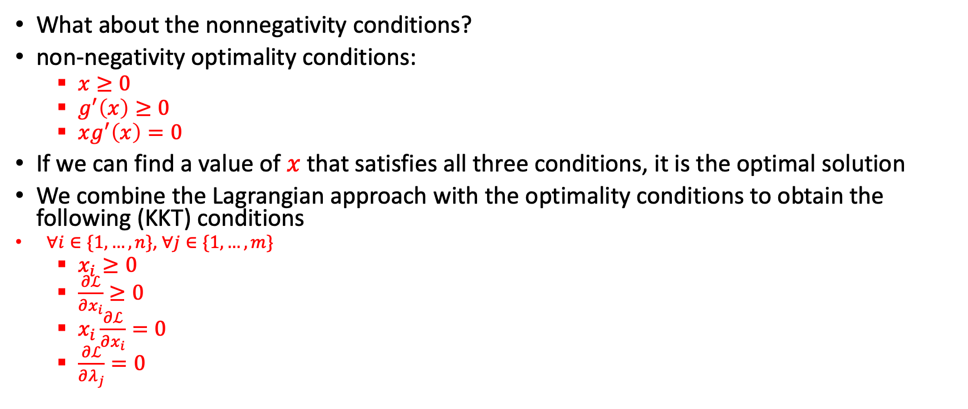
Method of Lagrange multipliers
What about the nonnegativity conditions?
non-negativity optimality conditions:
  $x≥0$
  $g^{′}\left(x\right)≥0$
  $xg^{′}\left(x\right)=0$
If we can find a value of $x$ that satisfies all three conditions, it is the optimal solution
We combine the Lagrangian approach with the optimality conditions to obtain the following (KKT) conditions
    $∀i∈\{1,…,n\}$, $∀j∈\{1,…,m\}$
  $x_{i}≥0$
  $\frac{∂ℒ}{∂x_{i}}≥0$
  $x_{i}\frac{∂ℒ}{∂x_{i}}=0$
  $\frac{∂ℒ}{∂λ_{j}}=0$
Either x is in a local optimum (g’(x)=0), or x equals the boundary condition (x=0)

Slide 20



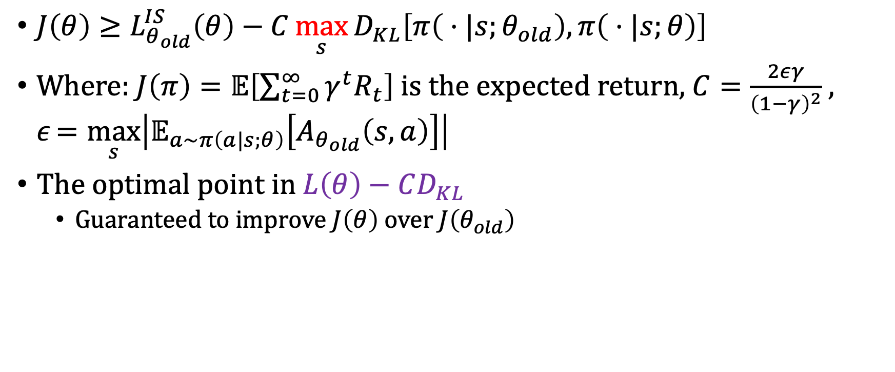




Monotonic improvement results
$J\left(θ\right)≥L_{θ_{old}}^{IS}\left(θ\right)−C\max_{s}{D_{KL}\left[π\left( ⋅|s;θ_{old}\right),π\left( ⋅|s;θ\right)\right]}$
Where: $J\left(π\right)=𝔼\left[\sum_{t=0}^{∞}{γ^{t}R_{t}}\right]$ is the expected return, $C=\frac{2εγ}{{\left(1−γ\right)}^{2}}$, $ε=\max_{s}\left|𝔼_{a\sim π\left(a|s;θ\right)}\left[A_{θ_{old}}\left(s,a\right)\right]\right|$
The optimal point in $L\left(θ\right)−CD_{KL}$
  Guaranteed to improve $J\left(θ\right)$ over $J\left(θ_{old}\right)$
$$J(θ)$$
$$L\left(θ\right)$$
Note that the original paper considers costs instead of rewards so \ge becomes \le
$$L\left(θ\right)−CD_{KL}$$
$$θ$$
$$θ_{n}$$
Schulman, John, et al. "Trust region policy optimization." International conference on machine learning. 2015.
$$θ_{n+1}$$

Slide 21
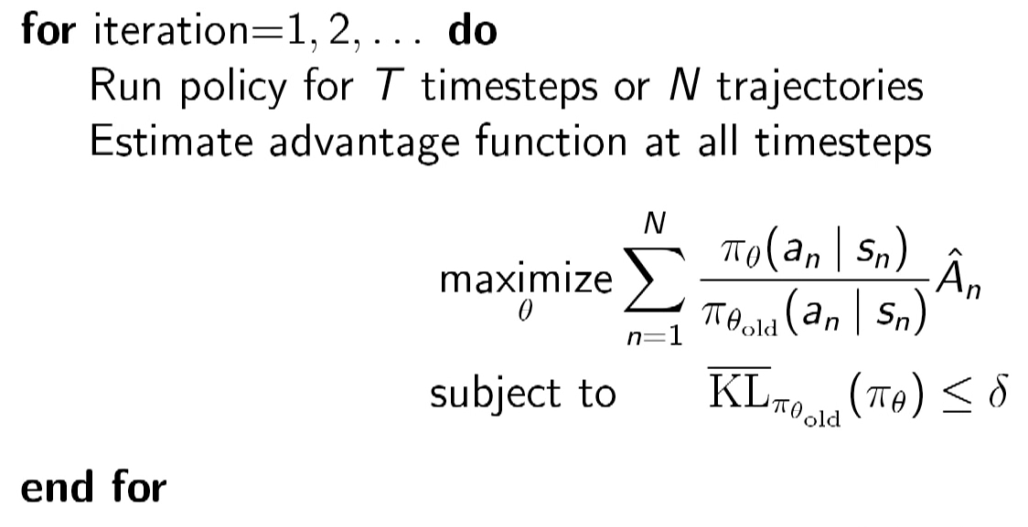
TRPO algorithm
Take the mean or the max?
The monotonic improvement guarantees hold only for max but in practice mean works better (max is too conservative)

Slide 22
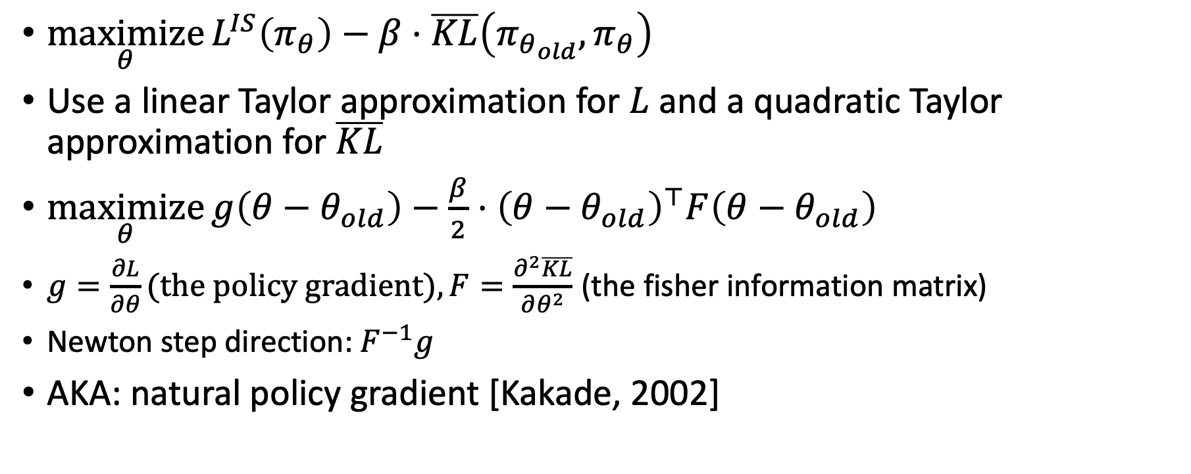
Solving KL penalized problem
$\underset{θ}{maximize}{L^{IS}\left(π_{θ}\right)−β⋅\overline{KL}\left(π_{θ_{old}}, π_{θ}\right)}$
Use a linear Taylor approximation for $L$ and a quadratic Taylor approximation for $\overline{KL}$
$\underset{θ}{maximize}{g\left(θ−θ_{old}\right)−\frac{β}{2}⋅{\left(θ−θ_{old}\right)}^{⊤}F\left(θ−θ_{old}\right)}$
$g=\frac{∂L}{∂θ}\text{(}\text{the} \text{policy} \text{gradient}\text{)}, F=\frac{∂^{2}\overline{KL}}{∂θ^{2}}$ (the fisher information matrix)
Newton step direction: $F^{−1}g$
AKA: natural policy gradient [Kakade, 2002]

Slide 23
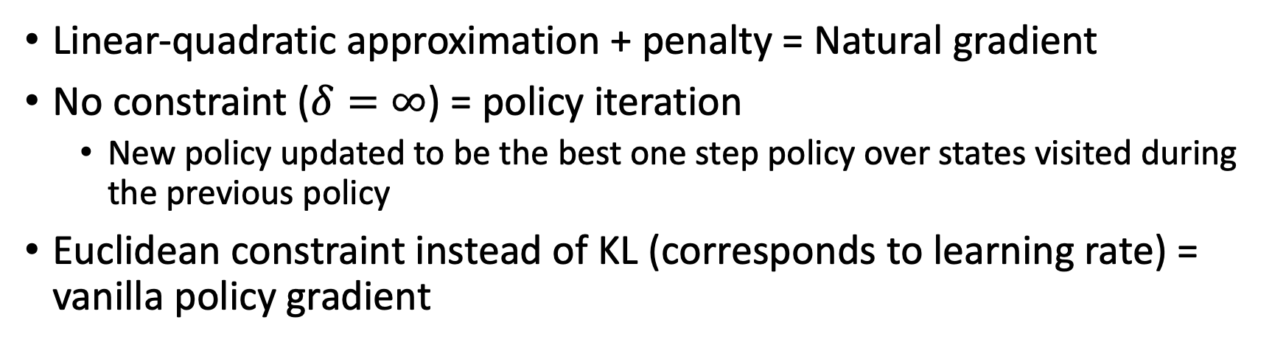
TRPO as a general PG algorithm
Linear-quadratic approximation + penalty = Natural gradient
No constraint ($δ=∞$) = policy iteration
  New policy updated to be the best one step policy over states visited during the previous policy
Euclidean constraint instead of KL (corresponds to learning rate) = vanilla policy gradient

Slide 24
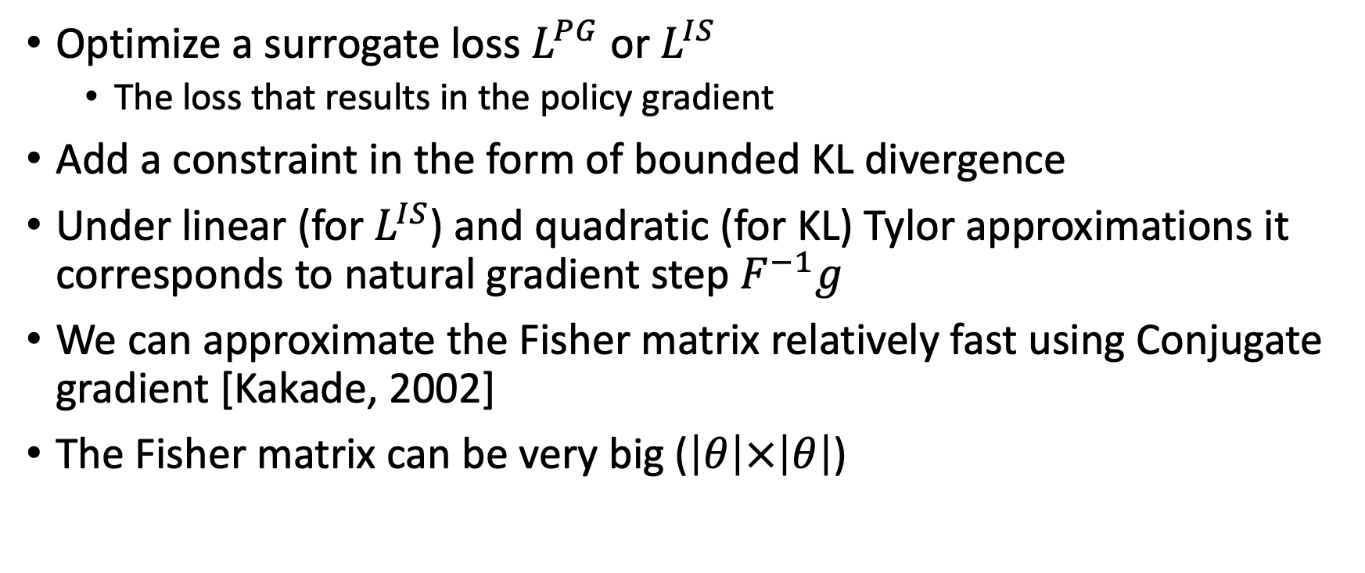
Review
Optimize a surrogate loss $L^{PG}$ or $L^{IS}$
  The loss that results in the policy gradient
Add a constraint in the form of bounded KL divergence
Under linear (for $L^{IS}$) and quadratic (for KL) Tylor approximations it corresponds to natural gradient step $F^{−1}g$
We can approximate the Fisher matrix relatively fast using Conjugate gradient [Kakade, 2002]
The Fisher matrix can be very big ($\left|θ\right|×\left|θ\right|$)

Slide 25
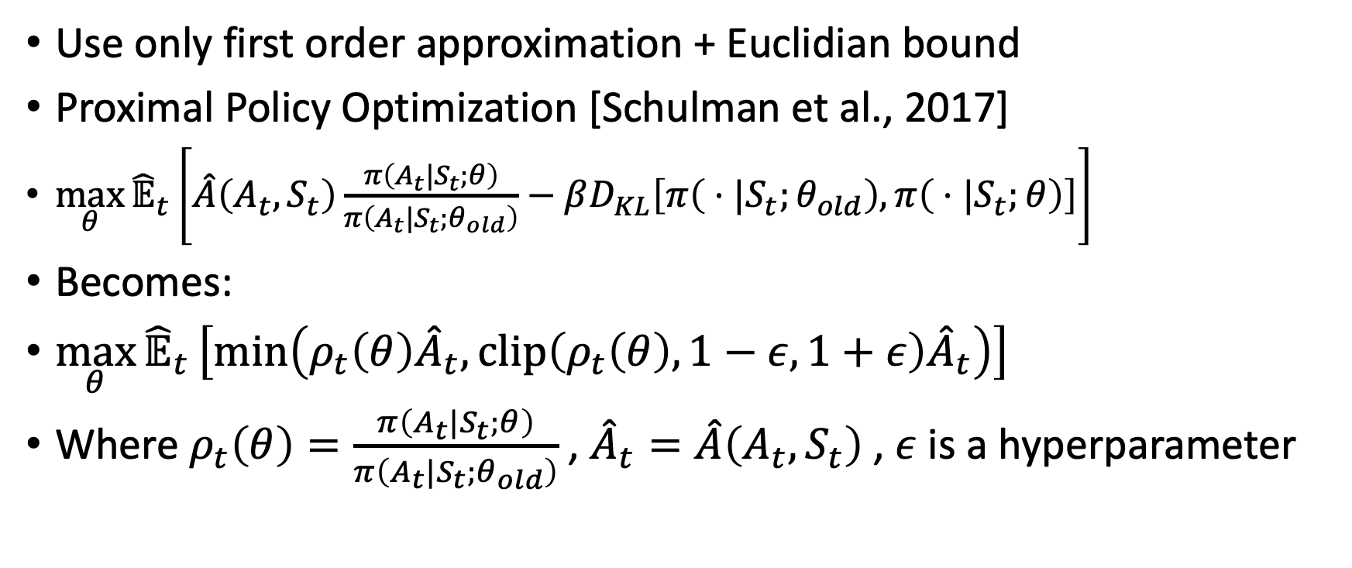
Avoiding the Fisher matrix computation
Use only first order approximation + Euclidian bound
Proximal Policy Optimization [Schulman et al., 2017]
$\max_{θ}{{\hat{𝔼}}_{t}}\left[\hat{A}\left(A_{t},S_{t}\right)\frac{π\left(A_{t}|S_{t};θ\right)}{π\left(A_{t}|S_{t};θ_{old}\right)}−βD_{KL}\left[π\left( ⋅|S_{t};θ_{old}\right),π\left( ⋅|S_{t};θ\right)\right]\right]$
Becomes:
$\max_{θ}{{\hat{𝔼}}_{t}}\left[\min\left(ρ_{t}\left(θ\right){\hat{A}}_{t}, clip\left(ρ_{t}\left(θ\right),1−ε,1+ε\right){\hat{A}}_{t}\right)\right]$
Where $ρ_{t}\left(θ\right)=\frac{π\left(A_{t}|S_{t};θ\right)}{π\left(A_{t}|S_{t};θ_{old}\right)}$ , ${\hat{A}}_{t}=\hat{A}\left(A_{t},S_{t}\right)$ , $ε$ is a hyperparameter

Slide 26
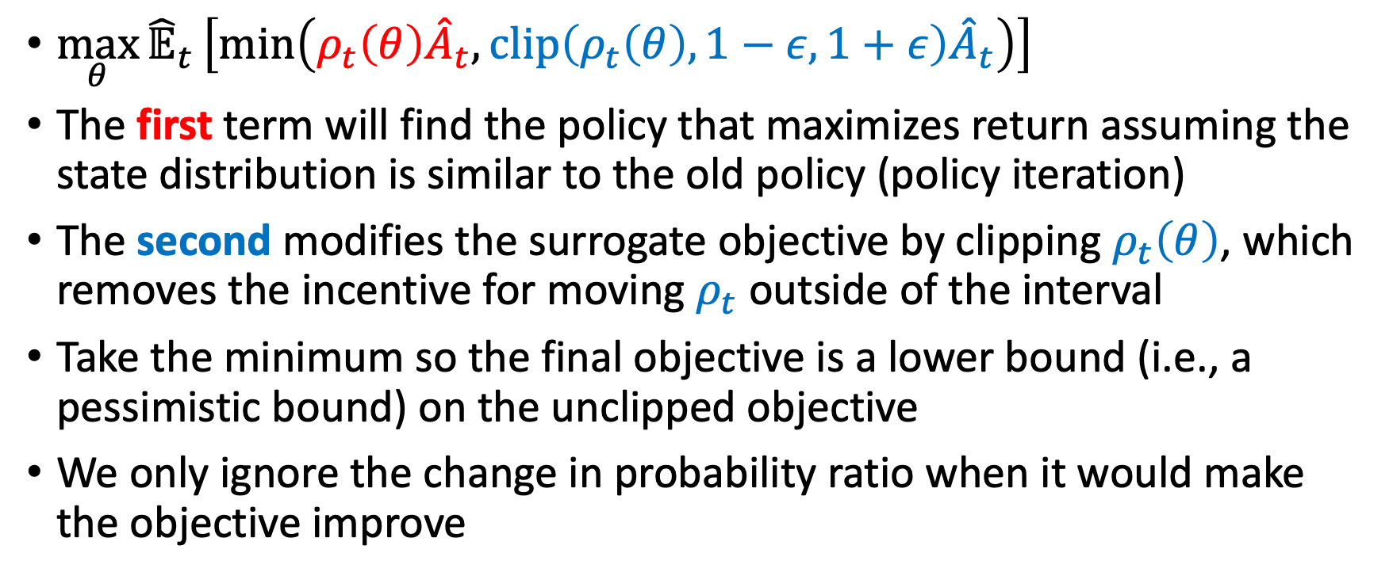
Proximal Policy Optimization [Schulman et al., 2017]
$\max_{θ}{{\hat{𝔼}}_{t}}\left[\min\left(ρ_{t}\left(θ\right){\hat{A}}_{t}, clip\left(ρ_{t}\left(θ\right),1−ε,1+ε\right){\hat{A}}_{t}\right)\right]$
The first term will find the policy that maximizes return assuming the state distribution is similar to the old policy (policy iteration)
The second modifies the surrogate objective by clipping $ρ_{t}\left(θ\right)$, which removes the incentive for moving $ρ_{t}$ outside of the interval
Take the minimum so the final objective is a lower bound (i.e., a pessimistic bound) on the unclipped objective
We only ignore the change in probability ratio when it would make the objective improve

Slide 27
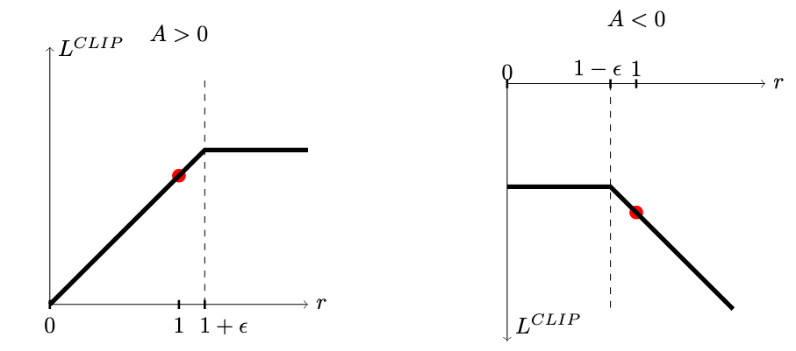

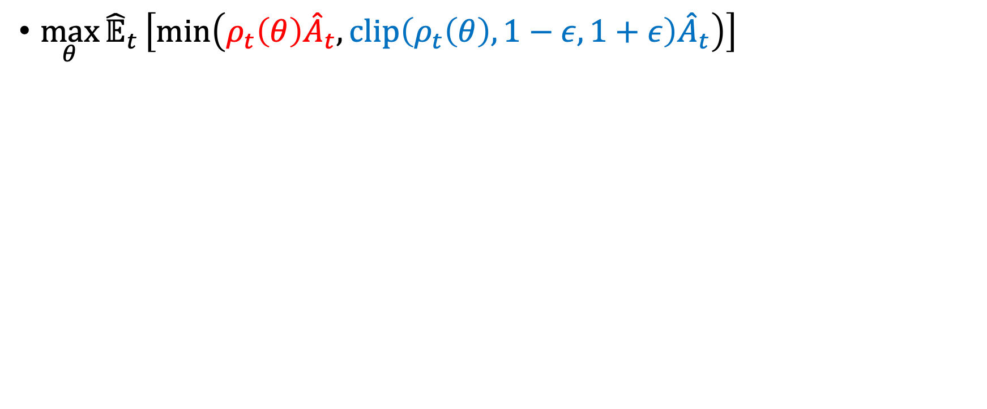
Proximal Policy Optimization [Schulman et al., 2017]
$\max_{θ}{{\hat{𝔼}}_{t}}\left[\min\left(ρ_{t}\left(θ\right){\hat{A}}_{t}, clip\left(ρ_{t}\left(θ\right),1−ε,1+ε\right){\hat{A}}_{t}\right)\right]$
$$ρ$$
$$ρ$$

Slide 28
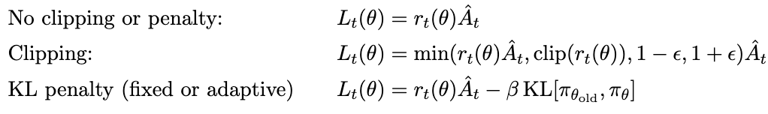
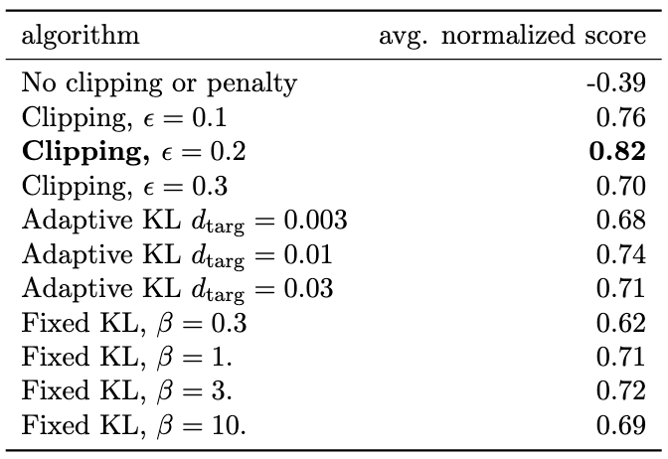
Results
Results from continuous control benchmark. Average normalized scores (over 21 runs of the algorithm, on 7 environments) for each algorithm / hyperparameter setting .

Slide 29
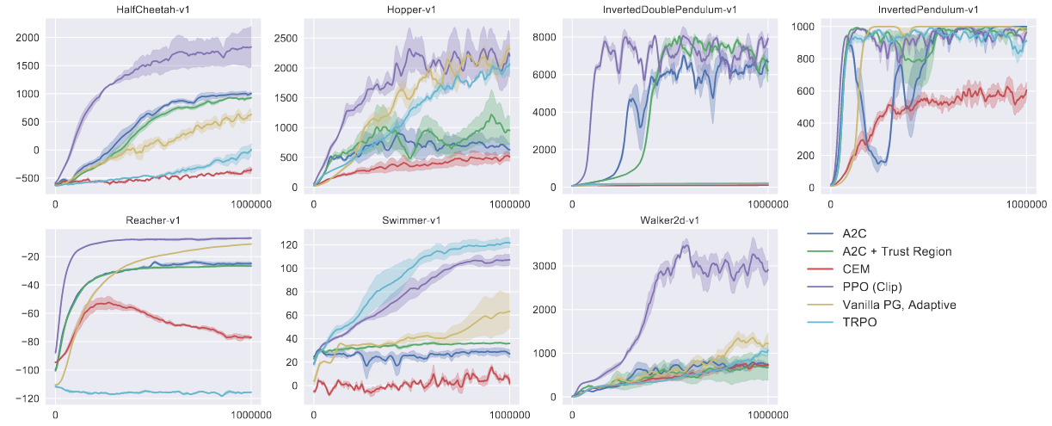
RESULTS 2
Comparison on several MuJoCo environments, training for one million time steps

Slide 30
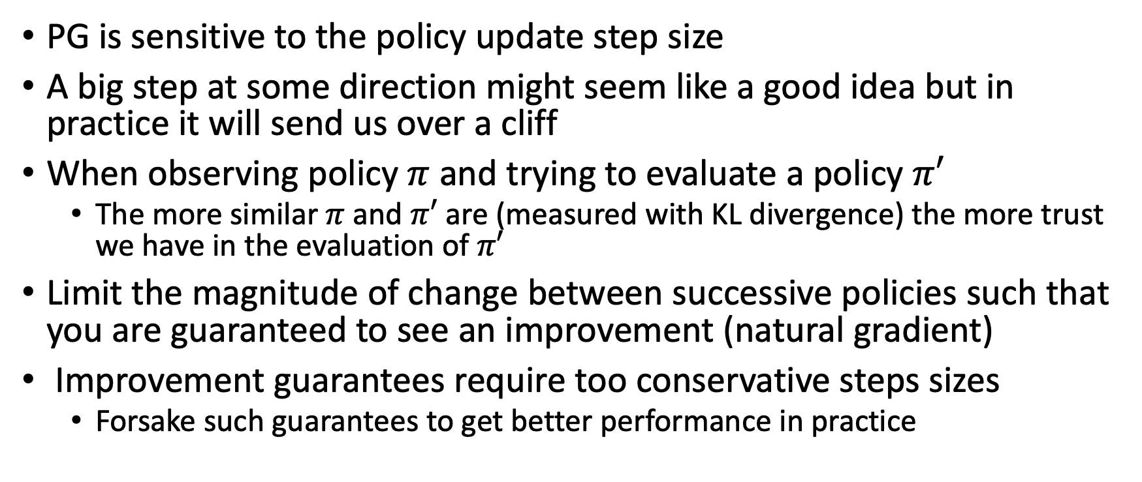
What did we learn?
PG is sensitive to the policy update step size
A big step at some direction might seem like a good idea but in practice it will send us over a cliff
When observing policy $π$ and trying to evaluate a policy $π′$
  The more similar $π$ and $π′$ are (measured with KL divergence) the more trust we have in the evaluation of $π′$
Limit the magnitude of change between successive policies such that you are guaranteed to see an improvement (natural gradient)
Improvement guarantees require too conservative steps sizes
  Forsake such guarantees to get better performance in practice

Slide 31
What next?
Lecture: Soft Actor-Critic
Assignments:
  A2C, by Nov. 18, EoD
  REINFORCE, by Nov. 11, EOD
  Deep Q-Learning, by Nov. 4, EOD
Quiz (on Canvas):
Project:
  Literature survey by Nov. 4, EOD

