Slide 1

CSCE-642 Reinforcement Learning
Chapter 13.5: Actor-Critic
Instructor: Guni Sharon

Slide 2
CSCE-642, Reinforcement Learning
Stateless decision process
Monte-Carlo
Policy gradient
Actor-critic
Markov decision process
Temporal difference
Function approximators
Solving MDPs (offline)
Dynamic programming
Tabular methods
Deep RL

Slide 3
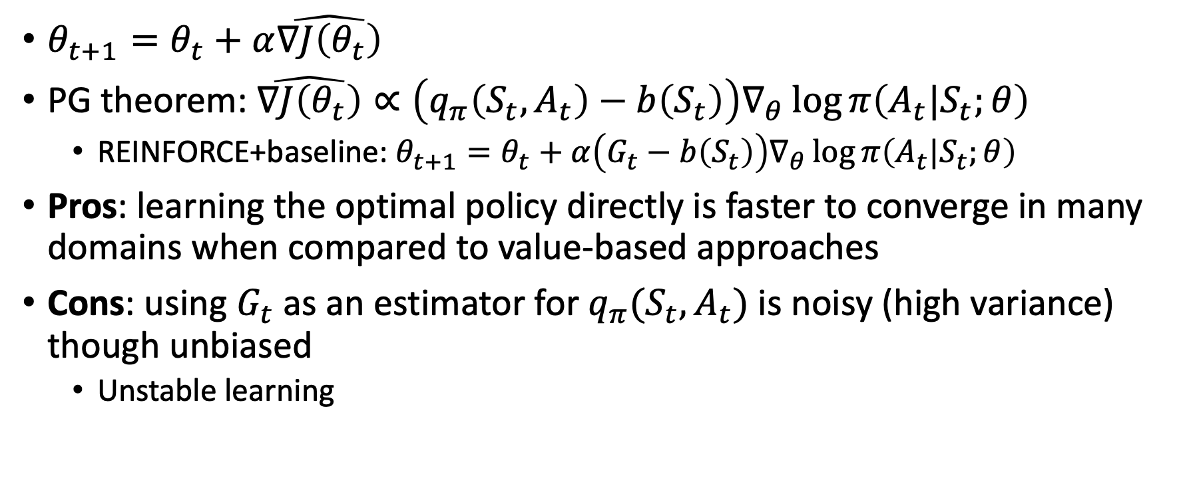
Policy Gradient
$θ_{t+1}=θ_{t}+α\hat{∇J\left(θ_{t}\right)}$
PG theorem: $\hat{∇J\left(θ_{t}\right)}∝\left(q_{π}\left(S_{t},A_{t}\right)−b\left(S_{t}\right)\right)∇_{θ}\log{π\left(A_{t}|S_{t};θ\right)}$
  REINFORCE+baseline: $θ_{t+1}=θ_{t}+α\left(G_{t}−b\left(S_{t}\right)\right)∇_{θ}\log{π\left(A_{t}|S_{t};θ\right)}$
Pros: learning the optimal policy directly is faster to converge in many domains when compared to value-based approaches
Cons: using $G_{t}$ as an estimator for $q_{π}(S_{t},A_{t})$ is noisy (high variance) though unbiased
  Unstable learning

Slide 4
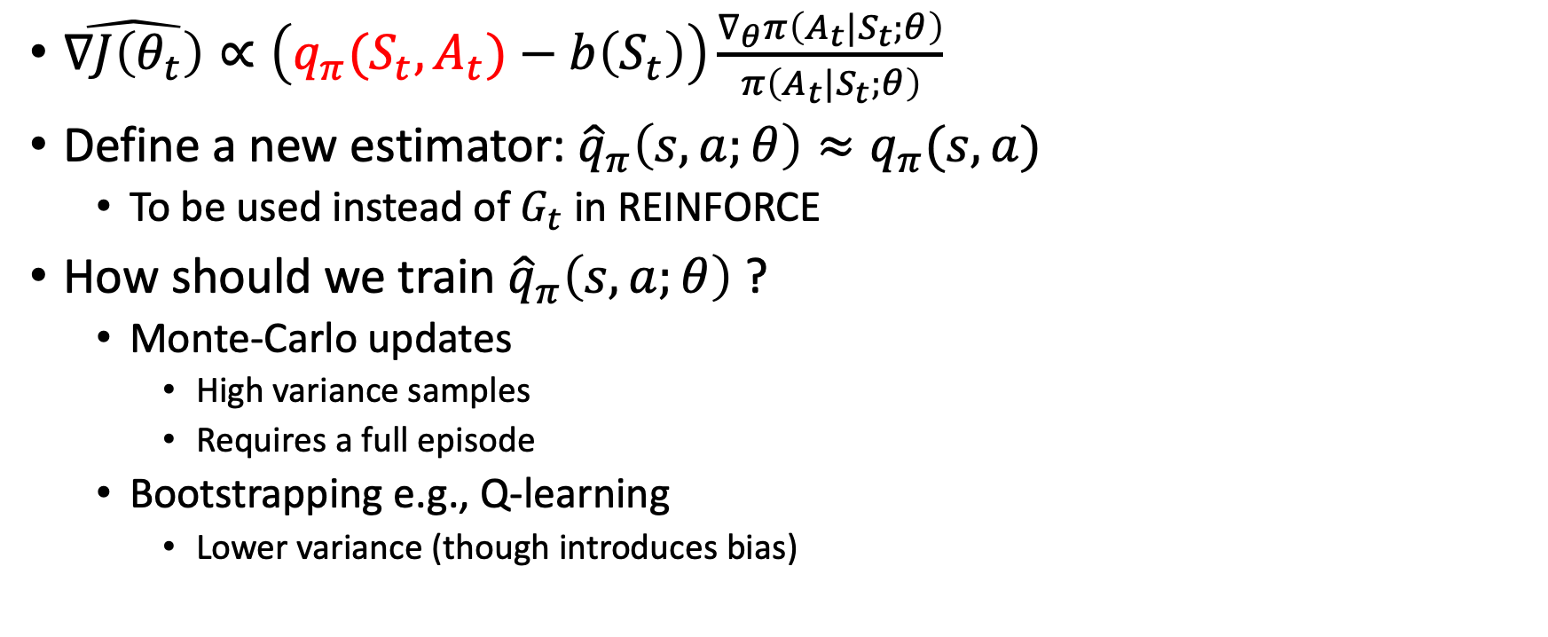
Add a critic
$\hat{∇J\left(θ_{t}\right)}∝\left(q_{π}(S_{t},A_{t})−b\left(S_{t}\right)\right)\frac{∇_{θ}π\left(A_{t}|S_{t};θ\right)}{π\left(A_{t}|S_{t};θ\right)}$
Define a new estimator: ${{\hat{q}}_{π}\left(s,a;θ\right)≈q}_{π}(s,a)$
  To be used instead of $G_{t}$ in REINFORCE
How should we train ${\hat{q}}_{π}\left(s,a;θ\right)$ ?
  Monte-Carlo updates
    High variance samples
    Requires a full episode
  Bootstrapping e.g., Q-learning
    Lower variance (though introduces bias)

Slide 5
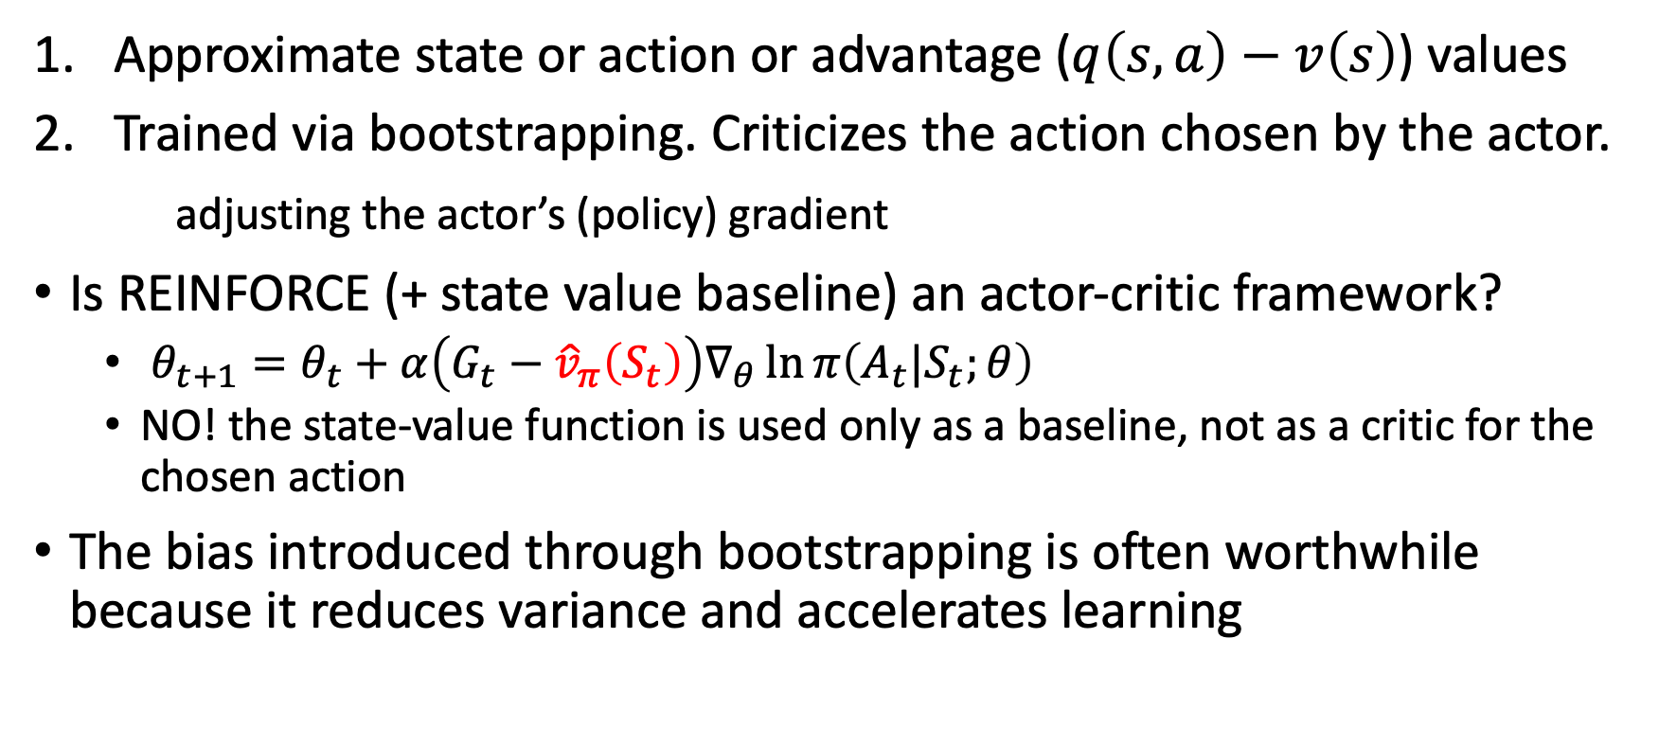
Critic’s duties
Approximate state or action or advantage ($q\left(s,a\right)−v\left(s\right)$) values
Trained via bootstrapping. Criticizes the action chosen by the actor.
adjusting the actor’s (policy) gradient
Is REINFORCE (+ state value baseline) an actor-critic framework?
  $θ_{t+1}=θ_{t}+α\left(G_{t}−{\hat{v}}_{π}\left(S_{t}\right)\right)∇_{θ}\ln{π\left(A_{t}|S_{t};θ\right)}$
  NO! the state-value function is used only as a baseline, not as a critic for the chosen action
The bias introduced through bootstrapping is often worthwhile because it reduces variance and accelerates learning

Slide 6
Benefits from a critic
REINFORCE with baseline is unbiased* and will converge asymptotically to a local optimum
  * when b is not a function of a
  Like all Monte-Carlo methods it tends to learn slowly (produce estimates of high variance)
  Not suitable for online or for continuing problems
Temporal-difference methods can eliminate these inconveniences
In order to gain the TD advantages in the case of policy gradient methods we use actor–critic methods

Slide 7
Actor+critic
Actor-critic algorithms are a derivative of policy iteration, which alternates between policy evaluation—computing the value function for a policy—and policy improvement—using the value function to obtain a better policy
In large-scale reinforcement learning problems, it is typically impractical to run either of these steps to convergence, and instead the value function and policy are optimized jointly
The policy is referred to as the actor, and the value function as the critic

Slide 8
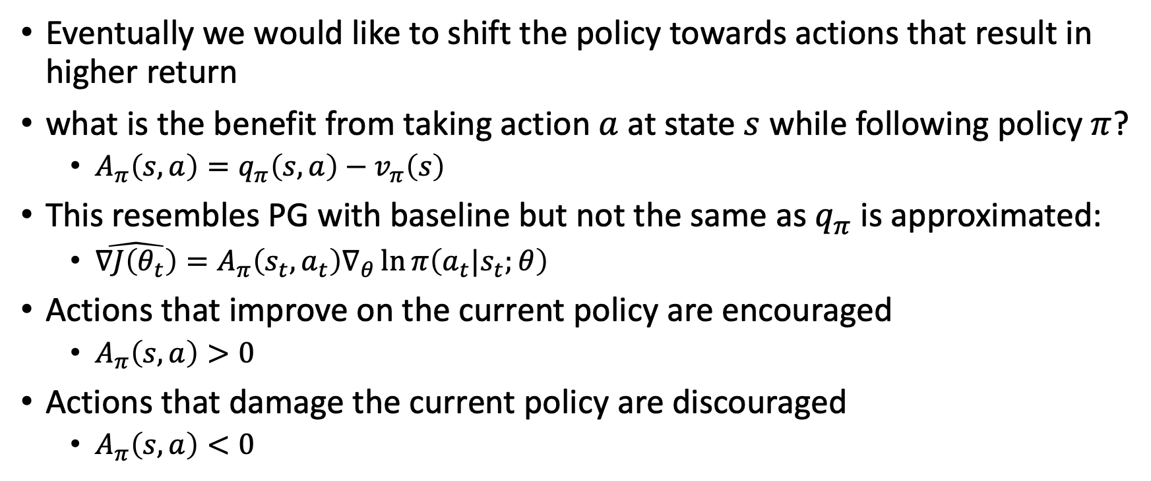
Advantage function
Eventually we would like to shift the policy towards actions that result in higher return
what is the benefit from taking action $a$ at state $s$ while following policy $π$?
  $A_{π}\left(s,a\right)=q_{π}\left(s,a\right)−v_{π}\left(s\right)$
This resembles PG with baseline but not the same as $q_{π}$ is approximated:
  $\hat{∇J\left(θ_{t}\right)}=A_{π}\left(s_{t},a_{t}\right)∇_{θ}\ln{π\left(a_{t}|s_{t};θ\right)}$
Actions that improve on the current policy are encouraged
  $A_{π}\left(s,a\right)>0$
Actions that damage the current policy are discouraged
  $A_{π}\left(s,a\right)<0$

Slide 9
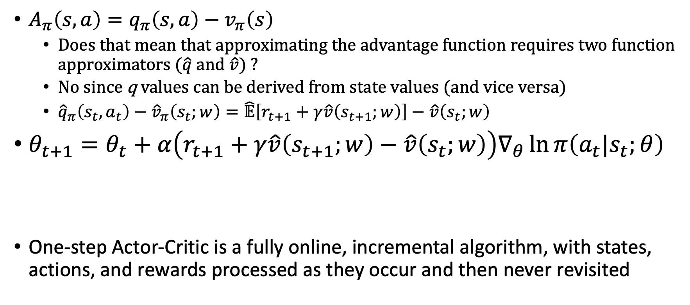
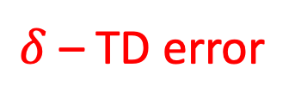
One-step actor-critic
$A_{π}\left(s,a\right)=q_{π}\left(s,a\right)−v_{π}\left(s\right)$
  Does that mean that approximating the advantage function requires two function approximators ($\hat{q}$ and $\hat{v}$) ?
  No since q values can be derived from state values (and vice versa)
  ${\hat{q}}_{π}\left(s_{t},a_{t}\right)−{\hat{v}}_{π}\left(s_{t};w\right)=\hat{𝔼}\left[r_{t+1}+γ\hat{v}\left(s_{t+1};w\right)\right]−\hat{v}\left(s_{t};w\right)$
$θ_{t+1}=θ_{t}+α\left(r_{t+1}+γ\hat{v}\left(s_{t+1};w\right)−\hat{v}\left(s_{t};w\right)\right)∇_{θ}\ln{π\left(a_{t}|s_{t};θ\right)}$
One-step Actor-Critic is a fully online, incremental algorithm, with states, actions, and rewards processed as they occur and then never revisited
$δ$ – TD error

Slide 10
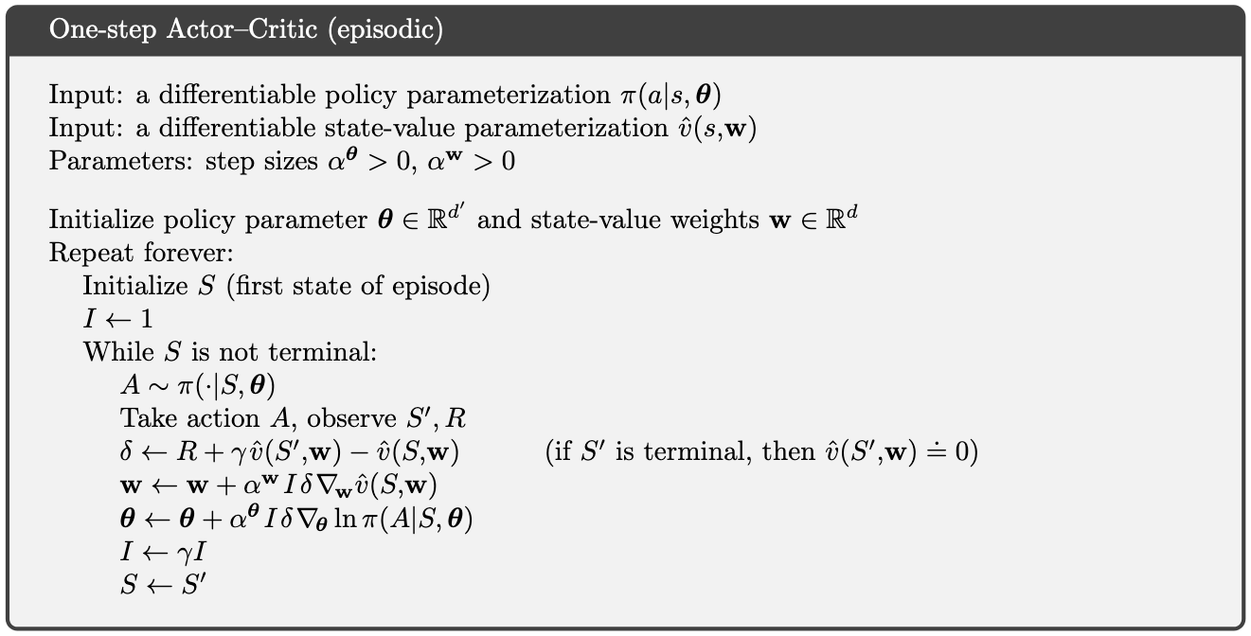
Keep track of accumulated discount

Slide 11
Follow the current policy

Slide 12
Compute the TD error

Slide 13
Update the critic without the accumulated discount. (The discount factor is included in the TD error)

Slide 14
Update the actor with discounting. Early actions matter more.

Slide 15
Update accumulated discount and progress to the next state

Slide 16
disregard I in your implementation (it’s not needed in practice)

Slide 17
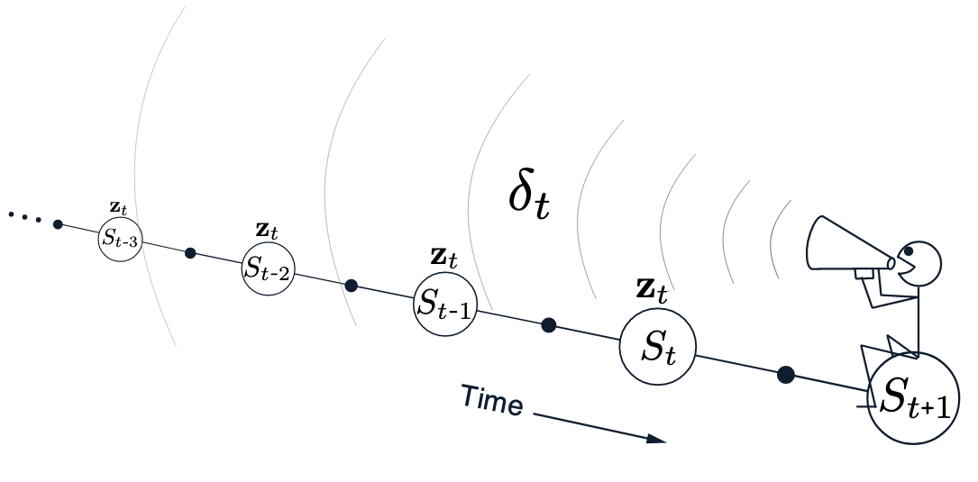
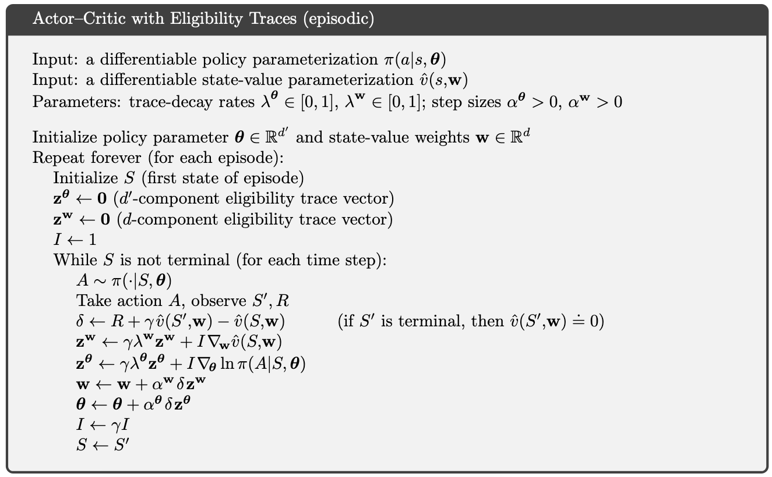
Add eligibility traces
Gradient eligibility per tunable parameter for both the actor and the critic approximators

Slide 18
Asynchronous Methods for Deep Reinforcement Learning [Mnih et al. 2016]
The sequence of observed data encountered by an online RL agent is non-stationary, and online RL updates are strongly correlated
Experience replay memory mitigates this issue by reducing non-stationarity and decorrelating updates
But, uses more memory and computation per “real” interaction
Requires off-policy learning algorithms that can update from data generated by an older policy
We want a deep RL mechanism that can decorrelate updates and can work with on-policy algorithms and is memory and computationally efficient

Slide 19
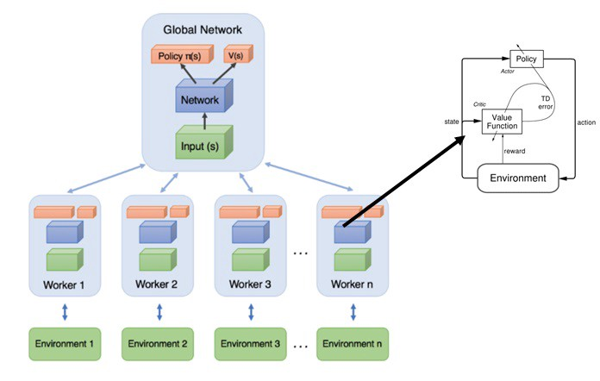
Asynchronized updates
Asynchronously execute multiple agents in parallel, on multiple instances of the environment
At any given time-step the parallel agents will be experiencing a variety of different states
  Decorrelated samples
Enables a spectrum of on-policy RL algorithms (SARSA, n-step bootstrapping, PG, …) to use DNN
Efficient utilization of a standard multi-core CPU

Slide 20
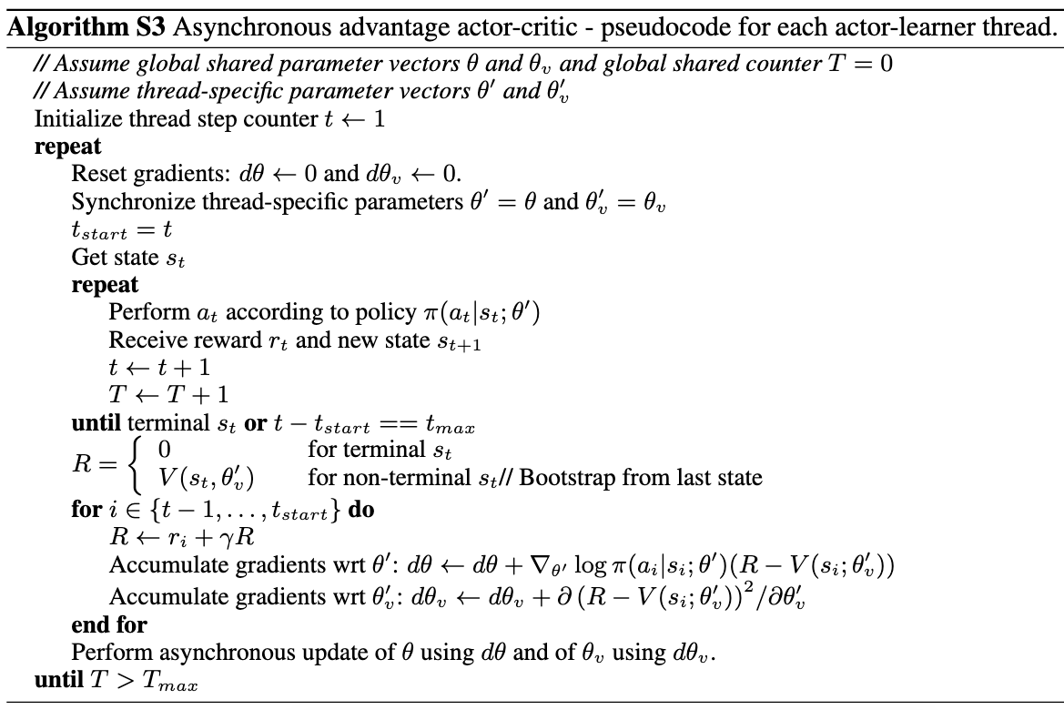

Slide 21
Make a copy of the current global actor and critic

Slide 22
Compute the n-step return

Slide 23
Update thread specific gradients. For the actor, using the PG theorem. For the critic, using squared loss

Slide 24
Update the global actor and critic based on the accumulated thread specific gradients

Slide 25
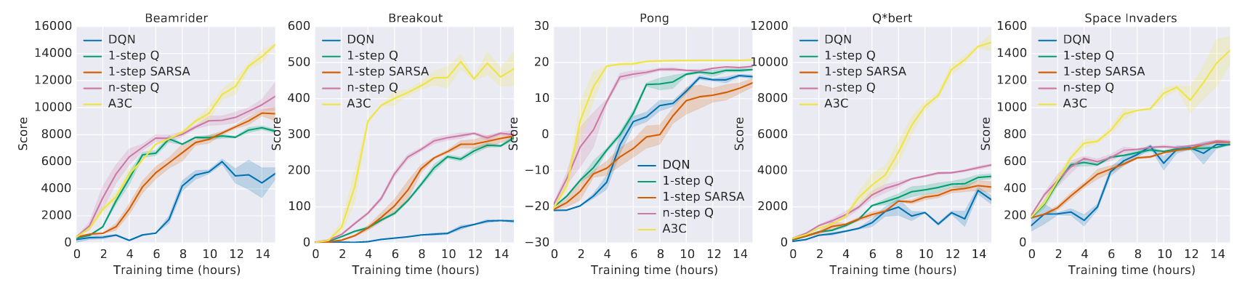
Asynchronized advantage actor-critic (A3C)
Training time (wall clock) comparison for DQN and asynchronous algorithms on Atari 2600 games averaged over 5 runs
DQN results for different seeds on Nvidia K40 GPU. asynchronous methods results from best 5 of 50 workers using 16 CPU cores

Slide 26
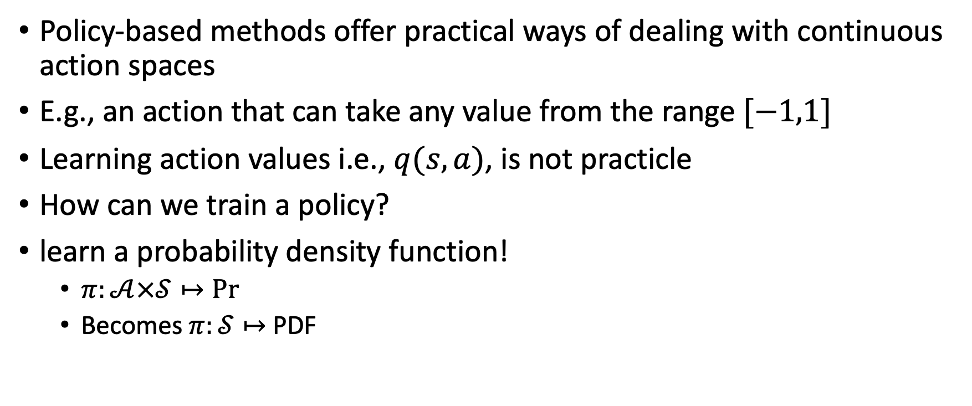
Continuous actions
Policy-based methods offer practical ways of dealing with continuous action spaces
E.g., an action that can take any value from the range $[−1,1]$
Learning action values i.e., $q(s,a)$, is not practicle
How can we train a policy?
learn a probability density function!
  $π:𝒜×𝒮↦\operatorname{Pr}{}$
  Becomes $π:𝒮↦$ PDF

Slide 27
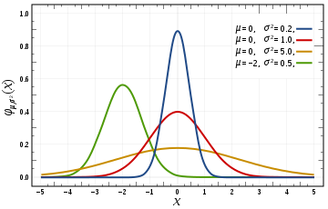
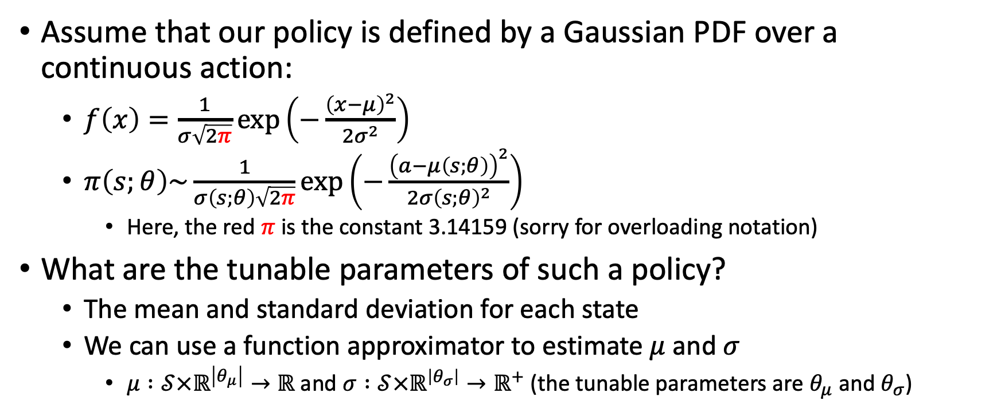
Continuous actions
Assume that our policy is defined by a Gaussian PDF over a continuous action:
  $f\left(x\right)=\frac{1}{σ\sqrt{2π}}\exp\left(−\frac{{\left(x−μ\right)}^{2}}{2σ^{2}}\right)$
  $π\left(s;θ\right)\sim \frac{1}{σ\left(s;θ\right)\sqrt{2π}}\exp\left(−\frac{{\left(a−μ\left(s;θ\right)\right)}^{2}}{2{σ\left(s;θ\right)}^{2}}\right)$
    Here, the red $π$ is the constant 3.14159 (sorry for overloading notation)
What are the tunable parameters of such a policy?
  The mean and standard deviation for each state
  We can use a function approximator to estimate $μ$ and $σ$
    $μ :𝒮×ℝ^{\left|θ_{μ}\right|}→ℝ$ and $σ :𝒮×ℝ^{\left|θ_{σ}\right|}→ℝ^{+}$ (the tunable parameters are $θ_{μ}$ and $θ_{σ}$)

Slide 28
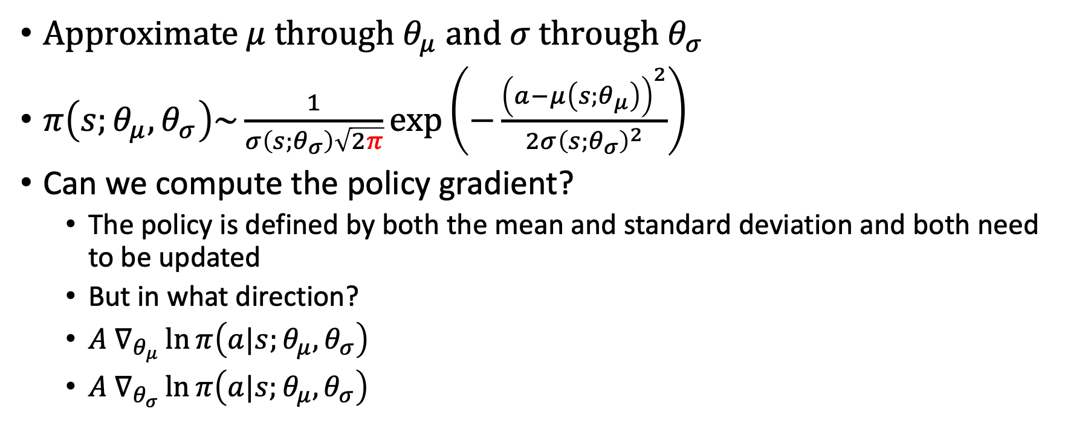
Updating the PDF
Approximate $μ$ through $θ_{μ}$ and $σ$ through $θ_{σ}$
$π\left(s;θ_{μ},θ_{σ}\right)\sim \frac{1}{σ\left(s;θ_{σ}\right)\sqrt{2π}}\exp\left(−\frac{{\left(a−μ\left(s;θ_{μ}\right)\right)}^{2}}{2{σ\left(s;θ_{σ}\right)}^{2}}\right)$
Can we compute the policy gradient?
  The policy is defined by both the mean and standard deviation and both need to be updated
  But in what direction?
  $A{ ∇}_{θ_{μ}}\ln{π\left(a|s;θ_{μ},θ_{σ}\right)}$
  $A ∇_{θ_{σ}}\ln{π\left(a|s;θ_{μ},θ_{σ}\right)}$
?

Slide 29
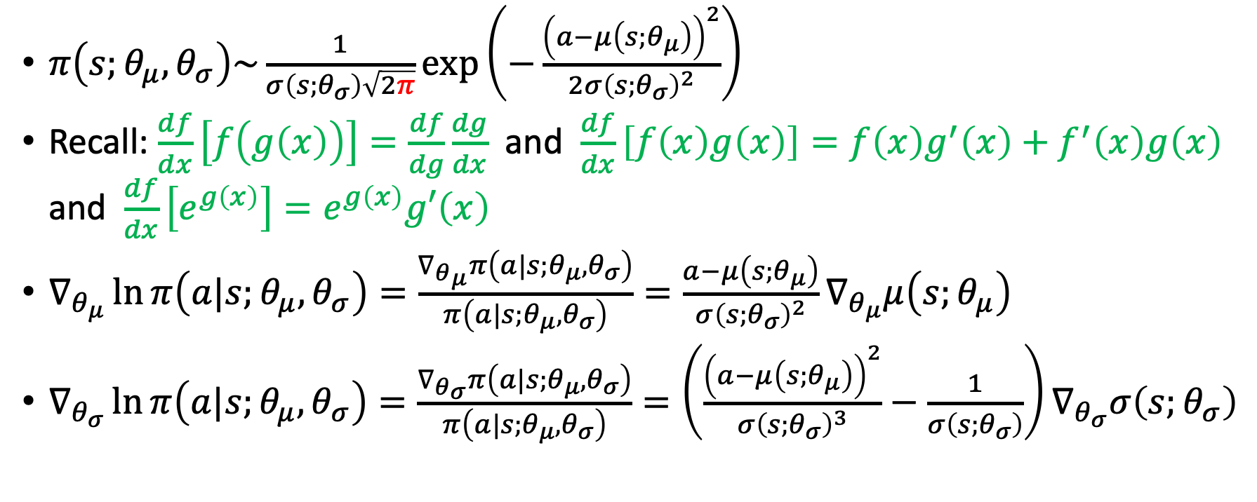
Gaussian gradient
$π\left(s;θ_{μ},θ_{σ}\right)\sim \frac{1}{σ\left(s;θ_{σ}\right)\sqrt{2π}}\exp\left(−\frac{{\left(a−μ\left(s;θ_{μ}\right)\right)}^{2}}{2{σ\left(s;θ_{σ}\right)}^{2}}\right)$
Recall: $\frac{df}{dx}\left[f\left(g\left(x\right)\right)\right]=\frac{df}{dg}\frac{dg}{dx}$ and $\frac{df}{dx}\left[f\left(x\right)g\left(x\right)\right]=f\left(x\right)g^{′}\left(x\right)+f^{′}\left(x\right)g\left(x\right)$ and $\frac{df}{dx}\left[e^{g\left(x\right)}\right]=e^{g\left(x\right)}g′\left(x\right)$
$∇_{θ_{μ}}\ln{π\left(a|s;θ_{μ},θ_{σ}\right)}=\frac{∇_{θ_{μ}}π\left(a|s;θ_{μ},θ_{σ}\right)}{π\left(a|s;θ_{μ},θ_{σ}\right)}=\frac{a−μ\left(s;θ_{μ}\right)}{{σ\left(s;θ_{σ}\right)}^{2}}∇_{θ_{μ}}μ\left(s;θ_{μ}\right)$
$∇_{θ_{σ}}\ln{π\left(a|s;θ_{μ},θ_{σ}\right)}=\frac{∇_{θ_{σ}}π\left(a|s;θ_{μ},θ_{σ}\right)}{π\left(a|s;θ_{μ},θ_{σ}\right)}=\left(\frac{{\left(a−μ\left(s;θ_{μ}\right)\right)}^{2}}{{σ\left(s;θ_{σ}\right)}^{3}}−\frac{1}{σ\left(s;θ_{σ}\right)}\right)∇_{θ_{σ}}σ\left(s;θ_{σ}\right)$

Slide 30
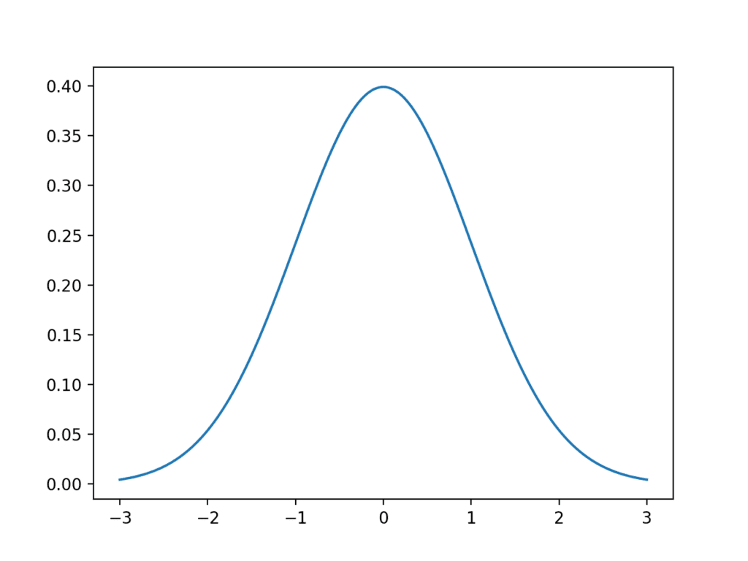
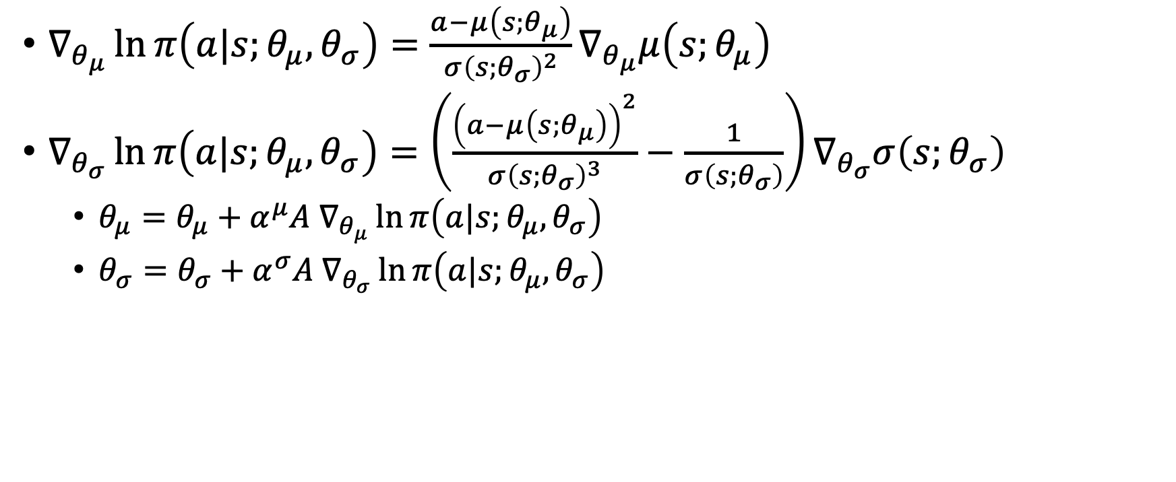
Gaussian PG
$∇_{θ_{μ}}\ln{π\left(a|s;θ_{μ},θ_{σ}\right)}=\frac{a−μ\left(s;θ_{μ}\right)}{{σ\left(s;θ_{σ}\right)}^{2}}∇_{θ_{μ}}μ\left(s;θ_{μ}\right)$
$∇_{θ_{σ}}\ln{π\left(a|s;θ_{μ},θ_{σ}\right)}=\left(\frac{{\left(a−μ\left(s;θ_{μ}\right)\right)}^{2}}{{σ\left(s;θ_{σ}\right)}^{3}}−\frac{1}{σ\left(s;θ_{σ}\right)}\right)∇_{θ_{σ}}σ\left(s;θ_{σ}\right)$
  $θ_{μ}=θ_{μ}+α^{μ}A{ ∇}_{θ_{μ}}\ln{π\left(a|s;θ_{μ},θ_{σ}\right)}$
  $θ_{σ}=θ_{σ}+α^{σ}A ∇_{θ_{σ}}\ln{π\left(a|s;θ_{μ},θ_{σ}\right)}$

Slide 31
Gaussian PG
$∇_{θ_{μ}}\ln{π\left(a|s;θ_{μ},θ_{σ}\right)}=\frac{a−μ\left(s;θ_{μ}\right)}{{σ\left(s;θ_{σ}\right)}^{2}}∇_{θ_{μ}}μ\left(s;θ_{μ}\right)$
$∇_{θ_{σ}}\ln{π\left(a|s;θ_{μ},θ_{σ}\right)}=\left(\frac{{\left(a−μ\left(s;θ_{μ}\right)\right)}^{2}}{{σ\left(s;θ_{σ}\right)}^{3}}−\frac{1}{σ\left(s;θ_{σ}\right)}\right)∇_{θ_{σ}}σ\left(s;θ_{σ}\right)$
  $θ_{μ}=θ_{μ}+α^{μ}A{ ∇}_{θ_{μ}}\ln{π\left(a|s;θ_{μ},θ_{σ}\right)}$
  $θ_{σ}=θ_{σ}+α^{σ}A ∇_{θ_{σ}}\ln{π\left(a|s;θ_{μ},θ_{σ}\right)}$
This sampled action yielded a positive advantage?

Slide 32
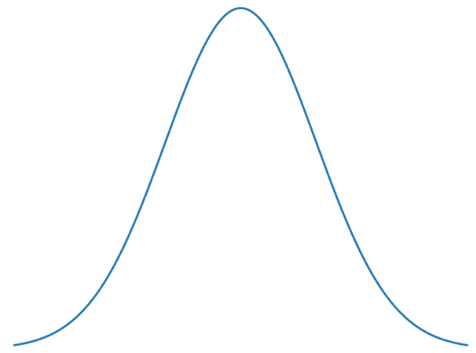
Gaussian PG
$∇_{θ_{μ}}\ln{π\left(a|s;θ_{μ},θ_{σ}\right)}=\frac{a−μ\left(s;θ_{μ}\right)}{{σ\left(s;θ_{σ}\right)}^{2}}∇_{θ_{μ}}μ\left(s;θ_{μ}\right)$
$∇_{θ_{σ}}\ln{π\left(a|s;θ_{μ},θ_{σ}\right)}=\left(\frac{{\left(a−μ\left(s;θ_{μ}\right)\right)}^{2}}{{σ\left(s;θ_{σ}\right)}^{3}}−\frac{1}{σ\left(s;θ_{σ}\right)}\right)∇_{θ_{σ}}σ\left(s;θ_{σ}\right)$
  $θ_{μ}=θ_{μ}+α^{μ}A{ ∇}_{θ_{μ}}\ln{π\left(a|s;θ_{μ},θ_{σ}\right)}$
  $θ_{σ}=θ_{σ}+α^{σ}A ∇_{θ_{σ}}\ln{π\left(a|s;θ_{μ},θ_{σ}\right)}$
Increase sigma and reduce mu

Slide 33
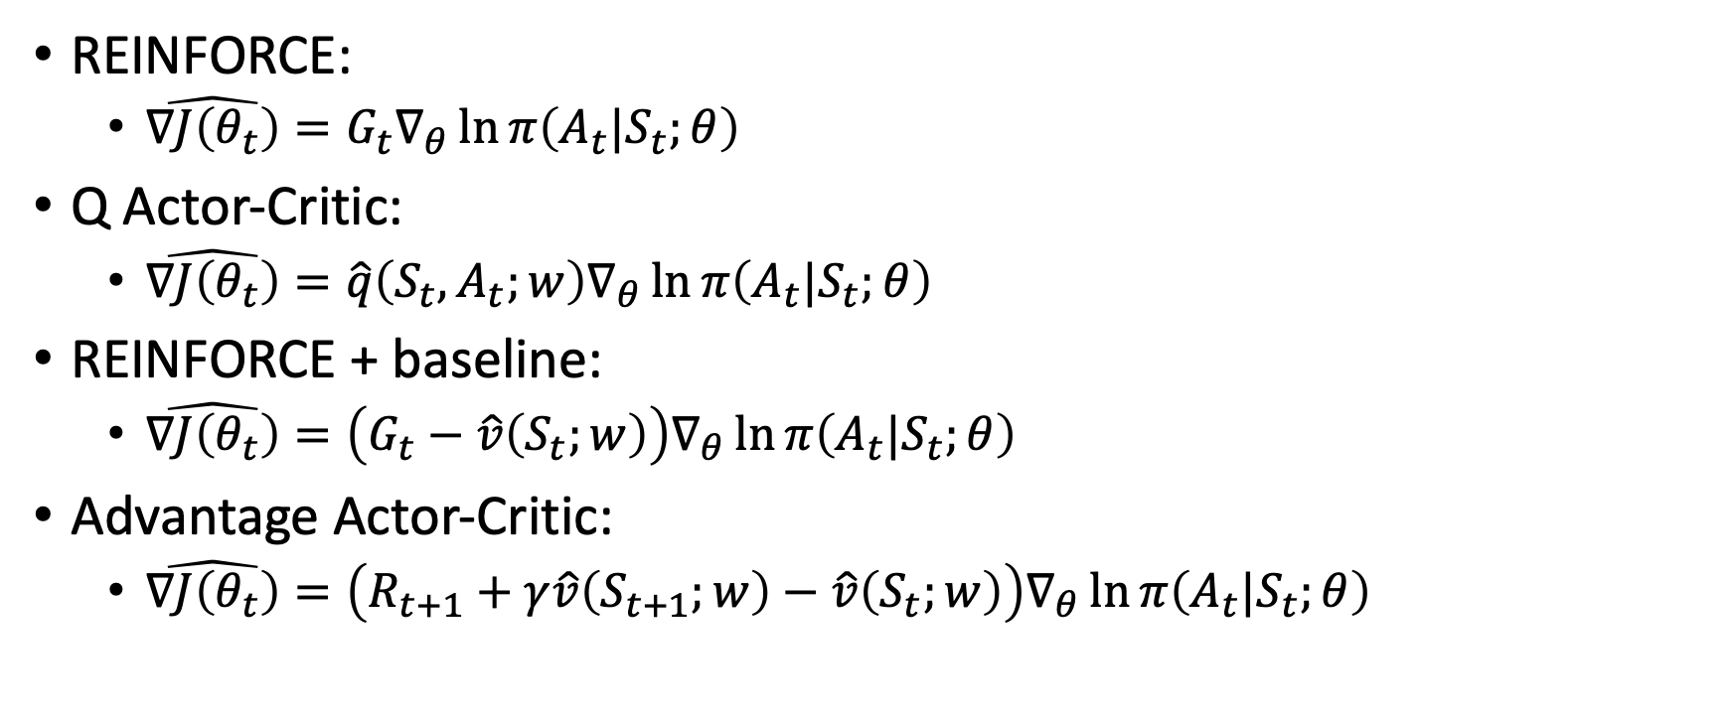
What did we learn?
REINFORCE:
  $\hat{∇J\left(θ_{t}\right)}=G_{t}∇_{θ}\ln{π\left(A_{t}|S_{t};θ\right)}$
Q Actor-Critic:
  $\hat{∇J\left(θ_{t}\right)}=\hat{q}\left(S_{t},A_{t};w\right)∇_{θ}\ln{π\left(A_{t}|S_{t};θ\right)}$
REINFORCE + baseline:
  $\hat{∇J\left(θ_{t}\right)}=\left(G_{t}−\hat{v}\left(S_{t};w\right)\right)∇_{θ}\ln{π\left(A_{t}|S_{t};θ\right)}$
Advantage Actor-Critic:
  $\hat{∇J\left(θ_{t}\right)}=\left(R_{t+1}+γ\hat{v}\left(S_{t+1};w\right)−\hat{v}\left(S_{t};w\right)\right)∇_{θ}\ln{π\left(A_{t}|S_{t};θ\right)}$

Slide 34
What next?
Lecture: Trust regions
Assignments:
  A2C, by Nov. 18, EoD
  REINFORCE, by Nov. 11, EOD
  Deep Q-Learning, by Nov. 4, EOD
Quiz (on Canvas):
  Policy Gradient, by Oct. 30, EOD
  Deep Q-Learning, by Oct. 28, EOD
Project:
  Literature survey, by Nov. 4, EOD

