Slide 1
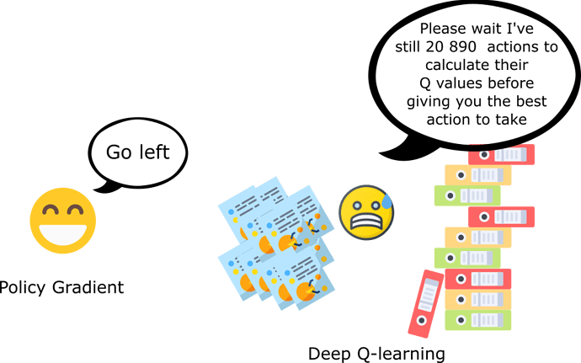
CSCE-642 Reinforcement Learning
Chapter 13: Policy Gradient
Instructor: Guni Sharon

Slide 2
CSCE-689, Reinforcement Learning
Stateless decision process
Monte-Carlo
Policy gradient
Actor-critic
Markov decision process
Temporal difference
Function approximators
Solving MDPs (offline)
Dynamic programming
Tabular methods
Deep RL

Slide 3
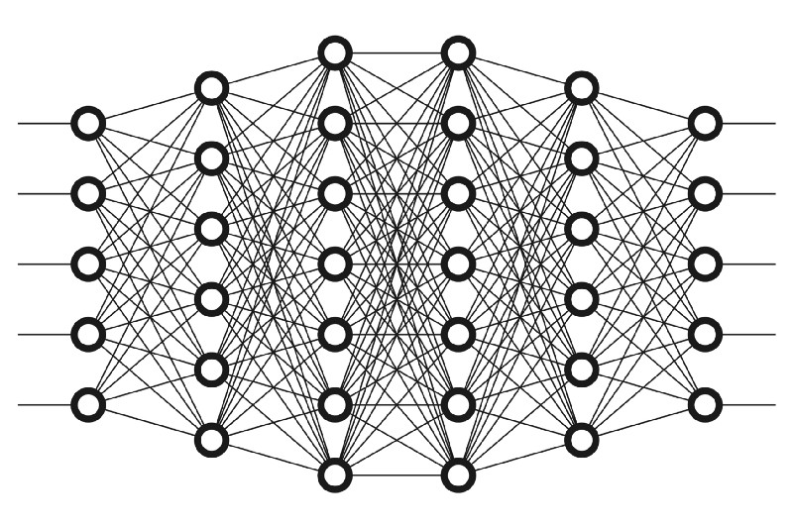







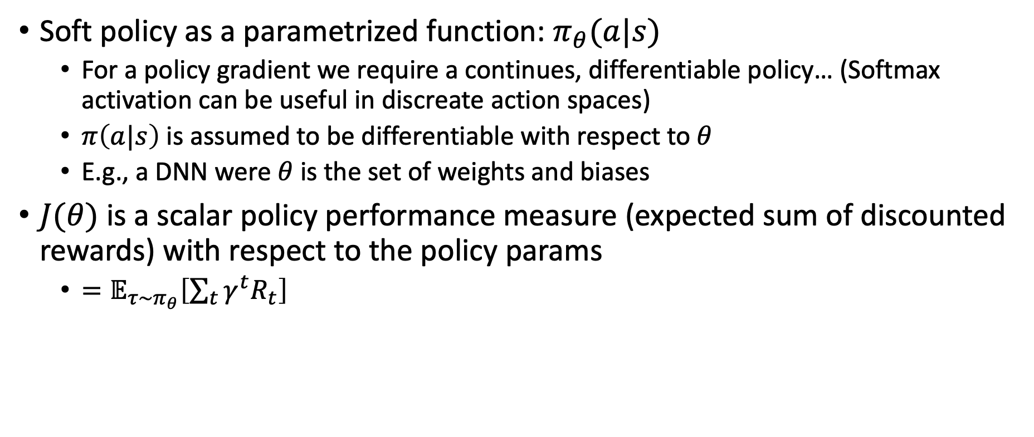



Notation
Soft policy as a parametrized function: $π_{θ}(a|s)$
  For a policy gradient we require a continues, differentiable policy… (Softmax activation can be useful in discreate action spaces)
  $π\left(a|s\right)$ is assumed to be differentiable with respect to $θ$
  E.g., a DNN were $θ$ is the set of weights and biases
$J(θ)$ is a scalar policy performance measure (expected sum of discounted rewards) with respect to the policy params
  $=𝔼_{τ∼π_{θ}}\left[\sum_{t}{γ^{t}R_{t}}\right]$
$$s_{1}$$
$${P(a}_{1})$$
$$s_{2}$$
$${P(a}_{2})$$
$$s_{3}$$
$${P(a}_{3})$$
$$s_{4}$$
$${P(a}_{4})$$
$$s_{n}$$
$${P(a}_{m})$$

Slide 4
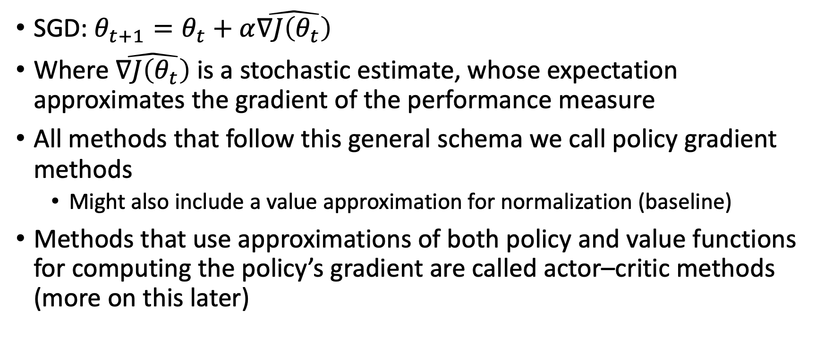
Improving the policy
SGD: $θ_{t+1}=θ_{t}+α\hat{∇J\left(θ_{t}\right)}$
Where $\hat{∇J\left(θ_{t}\right)}$ is a stochastic estimate, whose expectation approximates the gradient of the performance measure
All methods that follow this general schema we call policy gradient methods
  Might also include a value approximation for normalization (baseline)
Methods that use approximations of both policy and value functions for computing the policy’s gradient are called actor–critic methods (more on this later)

Slide 5
Advantages of PG
The policy convergence over time as opposed to an epsilon-greedy value-based approach
Naturally applies to continues action space as opposed to a Q-learning approach
In many domains the policy is a simpler function to approximate
  Though this is not always the case
Choice of policy parameterization is sometimes a good way of injecting prior knowledge
  E.g., initial cycle assignment for a signal controller
Can converge on stochastic optimal policies, as opposed to value-based approaches
  Useful in games with imperfect information where the optimal play is often inherently random, e.g., bluffing in Poker

Slide 6
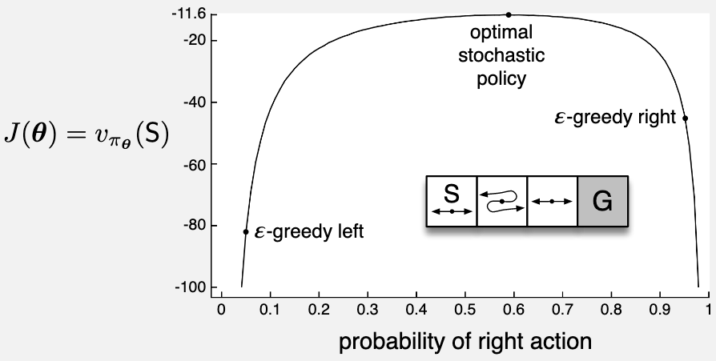


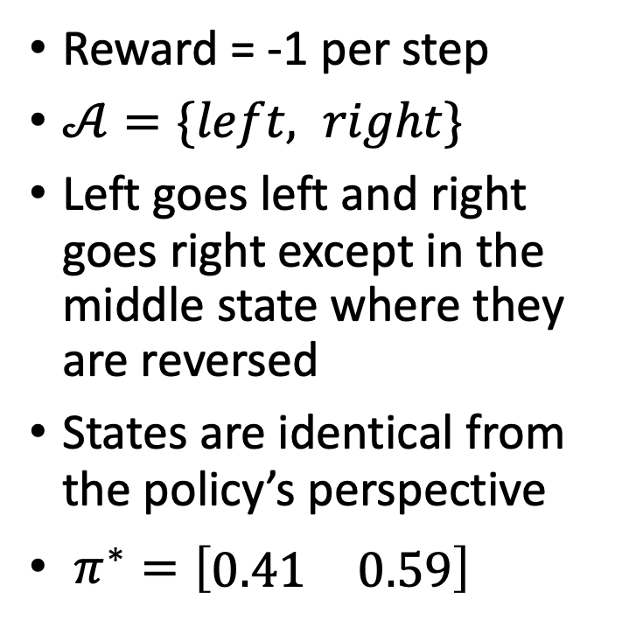
Stochastic policy
Reward = -1 per step
$𝒜=\{left, right\}$
Left goes left and right goes right except in the middle state where they are reversed
States are identical from the policy’s perspective
$π^{∗}={\left[\begin{matrix}0.41 & 0.59\end{matrix}\right]}^{}$
$$0.1$$
$$0.1$$

Slide 7
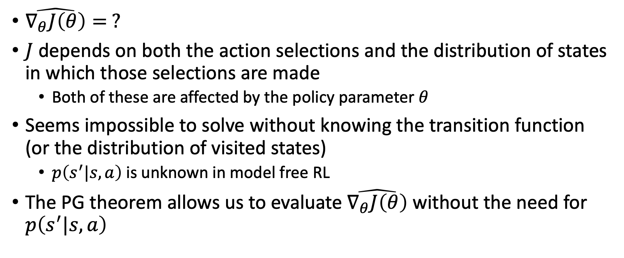
Estimating the policy gradient
$\hat{∇_{θ}J\left(θ\right)}= ?$
$J$ depends on both the action selections and the distribution of states in which those selections are made
  Both of these are affected by the policy parameter $θ$
Seems impossible to solve without knowing the transition function (or the distribution of visited states)
  $p\left(s^{′}|s,a\right)$ is unknown in model free RL
The PG theorem allows us to evaluate $\hat{∇_{θ}J\left(θ\right)}$ without the need for $p\left(s^{′}|s,a\right)$

Slide 8
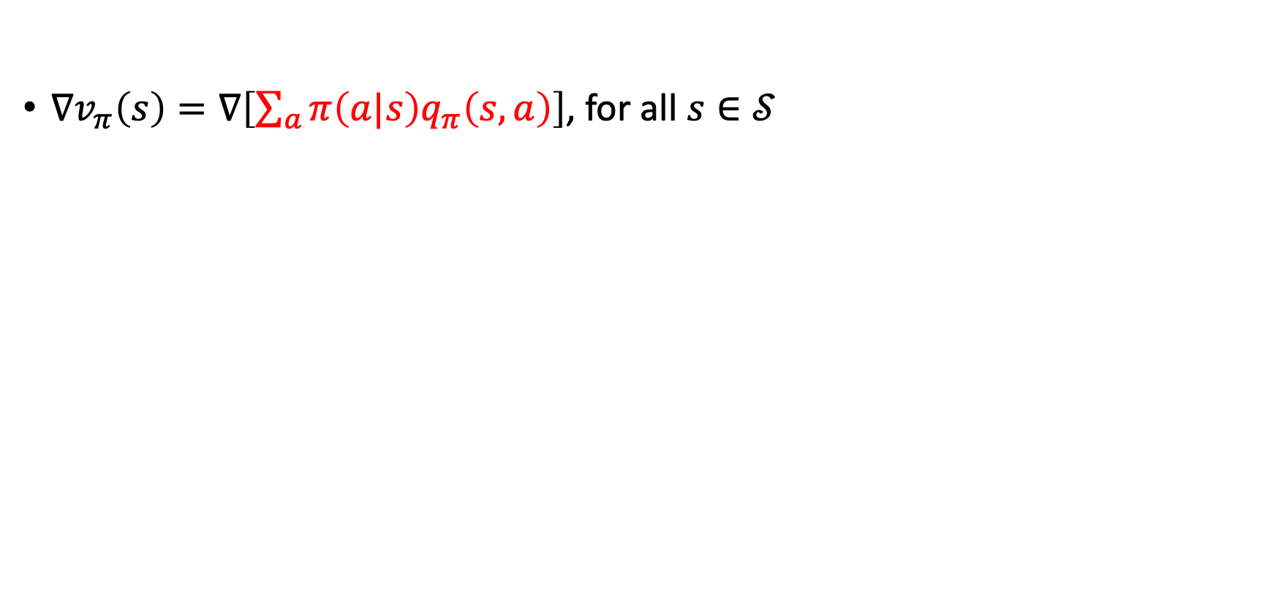
Policy Gradient Theorem
$$∇_{θ}J\left(θ\right)=∇v_{π}\left(s_{0}\right)∇_{θ}π$$
$∇v_{π}\left(s\right)=∇\left[\sum_{a}{π\left(a|s\right)q_{π}\left(s,a\right)}\right]$, for all $s∈𝒮$

Slide 9
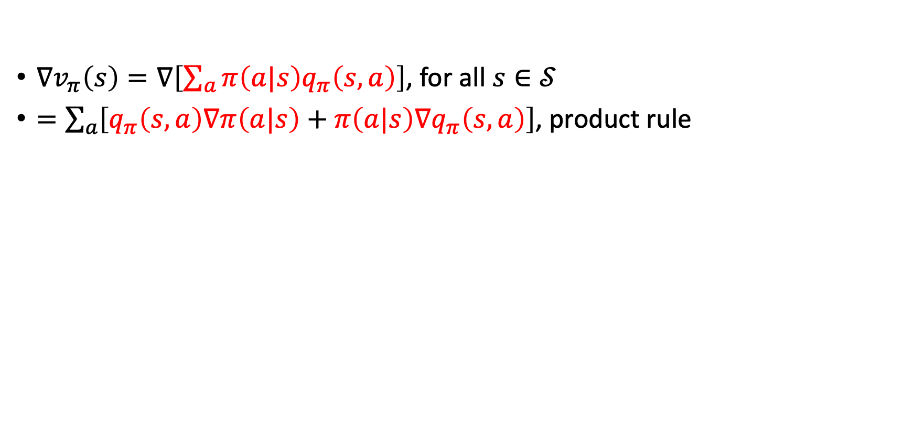
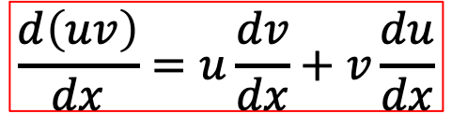
Policy Gradient Theorem
$∇v_{π}\left(s\right)=∇\left[\sum_{a}{π\left(a|s\right)q_{π}\left(s,a\right)}\right]$, for all $s∈𝒮$
$=\sum_{a}{\left[q_{π}\left(s,a\right)∇π\left(a|s\right)+π\left(a|s\right)∇q_{π}\left(s,a\right)\right]}$, product rule
$$\frac{d\left(uv\right)}{dx}=u\frac{dv}{dx}+v\frac{du}{dx}$$

Slide 10
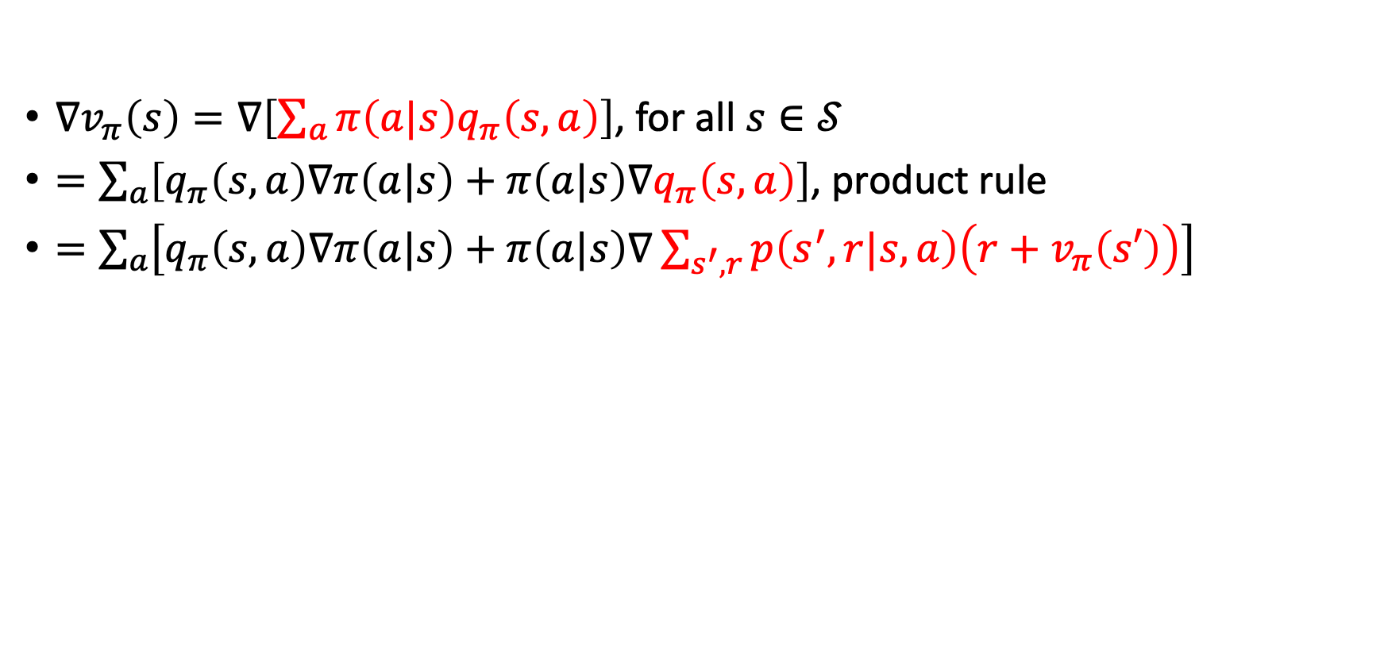
Policy Gradient Theorem
$∇v_{π}\left(s\right)=∇\left[\sum_{a}{π\left(a|s\right)q_{π}\left(s,a\right)}\right]$, for all $s∈𝒮$
$=\sum_{a}{\left[q_{π}\left(s,a\right)∇π\left(a|s\right)+π\left(a|s\right)∇q_{π}\left(s,a\right)\right]}$, product rule
$=\sum_{a}{\left[q_{π}\left(s,a\right)∇π\left(a|s\right)+π\left(a|s\right)∇\sum_{s^{′},r}{p\left(s^{′},r|s,a\right)\left(r+v_{π}\left(s′\right)\right)}\right]}$

Slide 11
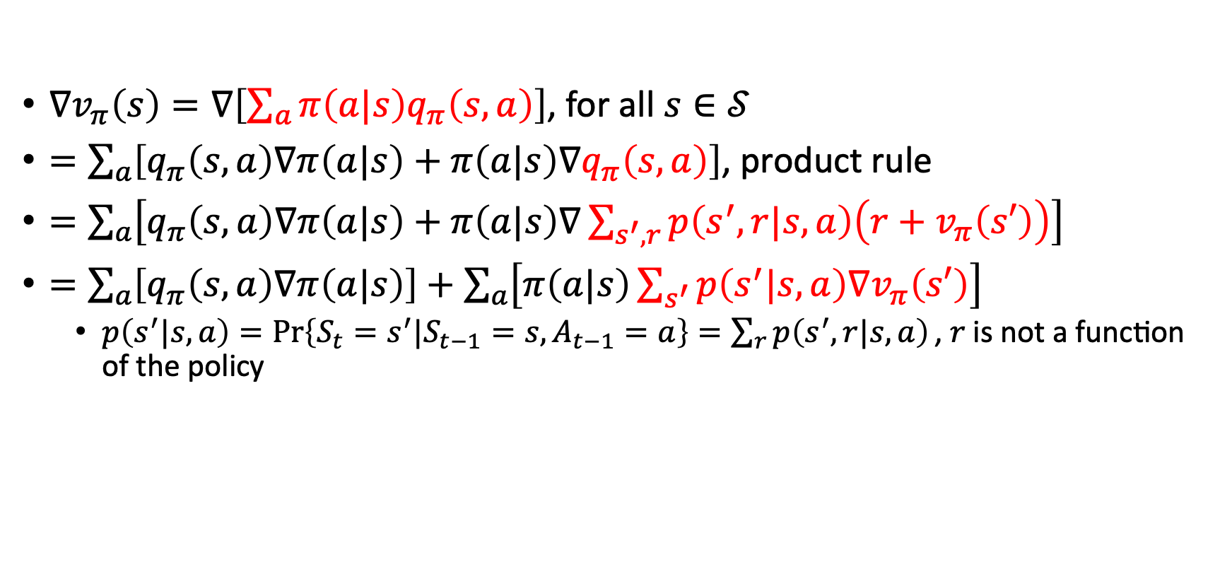
Policy Gradient Theorem
$∇v_{π}\left(s\right)=∇\left[\sum_{a}{π\left(a|s\right)q_{π}\left(s,a\right)}\right]$, for all $s∈𝒮$
$=\sum_{a}{\left[q_{π}\left(s,a\right)∇π\left(a|s\right)+π\left(a|s\right)∇q_{π}\left(s,a\right)\right]}$, product rule
$=\sum_{a}{\left[q_{π}\left(s,a\right)∇π\left(a|s\right)+π\left(a|s\right)∇\sum_{s^{′},r}{p\left(s^{′},r|s,a\right)\left(r+v_{π}\left(s′\right)\right)}\right]}$
$=\sum_{a}{\left[q_{π}\left(s,a\right)∇π\left(a|s\right)\right]+\sum_{a}{\left[π\left(a|s\right)\sum_{s^{′}}{p\left(s^{′}|s,a\right)∇v_{π}\left(s′\right)}\right]}}$
  $p\left(s^{′}|s,a\right)=\operatorname{Pr}\left\{S_{t}=s^{′}|S_{t−1}=s,A_{t−1}=a\right\}=\sum_{r}{p\left(s^{′},r|s,a\right)}\text{, }r \text{is} \text{not} \text{a} \text{function} \text{of} \text{the} \text{policy}$

Slide 12
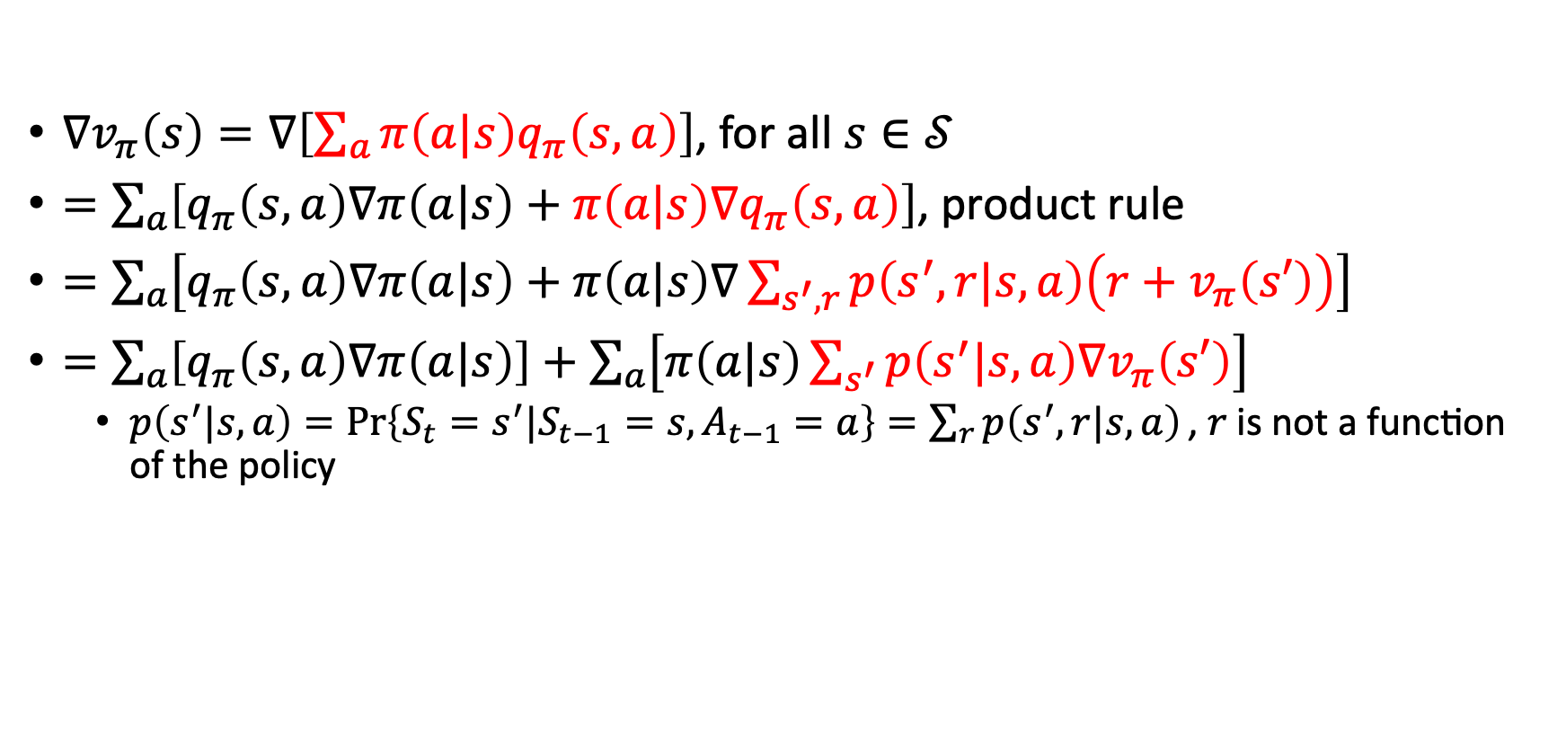
Policy Gradient Theorem
$∇v_{π}\left(s\right)=∇\left[\sum_{a}{π\left(a|s\right)q_{π}\left(s,a\right)}\right]$, for all $s∈𝒮$
$=\sum_{a}{\left[q_{π}\left(s,a\right)∇π\left(a|s\right)+π\left(a|s\right)∇q_{π}\left(s,a\right)\right]}$, product rule
$=\sum_{a}{\left[q_{π}\left(s,a\right)∇π\left(a|s\right)+π\left(a|s\right)∇\sum_{s^{′},r}{p\left(s^{′},r|s,a\right)\left(r+v_{π}\left(s′\right)\right)}\right]}$
$=\sum_{a}{\left[q_{π}\left(s,a\right)∇π\left(a|s\right)\right]+\sum_{a}{\left[π\left(a|s\right)\sum_{s^{′}}{p\left(s^{′}|s,a\right)∇v_{π}\left(s′\right)}\right]}}$
  $p\left(s^{′}|s,a\right)=\operatorname{Pr}\left\{S_{t}=s^{′}|S_{t−1}=s,A_{t−1}=a\right\}=\sum_{r}{p\left(s^{′},r|s,a\right)}\text{, }r \text{is} \text{not} \text{a} \text{function} \text{of} \text{the} \text{policy}$

Slide 13
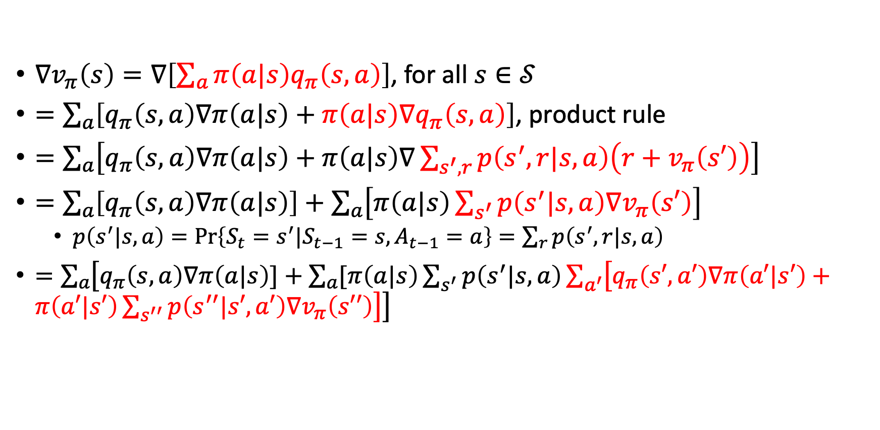
Policy Gradient Theorem
$∇v_{π}\left(s\right)=∇\left[\sum_{a}{π\left(a|s\right)q_{π}\left(s,a\right)}\right]$, for all $s∈𝒮$
$=\sum_{a}{\left[q_{π}\left(s,a\right)∇π\left(a|s\right)+π\left(a|s\right)∇q_{π}\left(s,a\right)\right]}$, product rule
$=\sum_{a}{\left[q_{π}\left(s,a\right)∇π\left(a|s\right)+π\left(a|s\right)∇\sum_{s^{′},r}{p\left(s^{′},r|s,a\right)\left(r+v_{π}\left(s′\right)\right)}\right]}$
$=\sum_{a}{\left[q_{π}\left(s,a\right)∇π\left(a|s\right)\right]+\sum_{a}{\left[π\left(a|s\right)\sum_{s^{′}}{p\left(s^{′}|s,a\right)∇v_{π}\left(s′\right)}\right]}}$
  $p\left(s^{′}|s,a\right)=\operatorname{Pr}\left\{S_{t}=s^{′}|S_{t−1}=s,A_{t−1}=a\right\}=\sum_{r}{p\left(s^{′},r|s,a\right)}$
$=\sum_{a}{\left[q_{π}\left(s,a\right)∇π\left(a|s\right)]+\sum_{a}{[π\left(a|s\right)\sum_{s^{′}}{p\left(s^{′}|s,a\right)\sum_{a^{′}}{\left[q_{π}\left(s′,a′\right)∇π\left(a′|s′\right)+π\left(a′|s′\right)\sum_{s^{′′}}{p\left(s^{′′}|s′,a′\right)∇v_{π}\left(s′′\right)}\right]}}}\right]}$

Slide 14
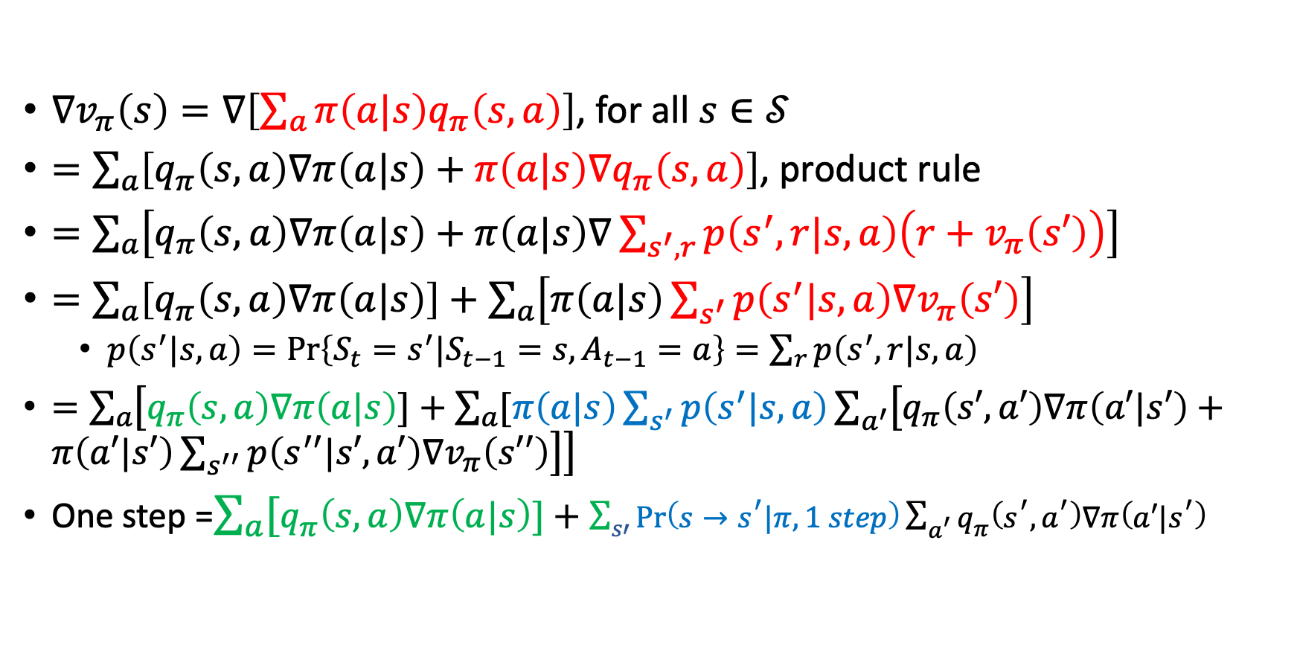
Policy Gradient Theorem
$∇v_{π}\left(s\right)=∇\left[\sum_{a}{π\left(a|s\right)q_{π}\left(s,a\right)}\right]$, for all $s∈𝒮$
$=\sum_{a}{\left[q_{π}\left(s,a\right)∇π\left(a|s\right)+π\left(a|s\right)∇q_{π}\left(s,a\right)\right]}$, product rule
$=\sum_{a}{\left[q_{π}\left(s,a\right)∇π\left(a|s\right)+π\left(a|s\right)∇\sum_{s^{′},r}{p\left(s^{′},r|s,a\right)\left(r+v_{π}\left(s′\right)\right)}\right]}$
$=\sum_{a}{\left[q_{π}\left(s,a\right)∇π\left(a|s\right)\right]+\sum_{a}{\left[π\left(a|s\right)\sum_{s^{′}}{p\left(s^{′}|s,a\right)∇v_{π}\left(s′\right)}\right]}}$
  $p\left(s^{′}|s,a\right)=\operatorname{Pr}\left\{S_{t}=s^{′}|S_{t−1}=s,A_{t−1}=a\right\}=\sum_{r}{p\left(s^{′},r|s,a\right)}$
$=\sum_{a}{\left[q_{π}\left(s,a\right)∇π\left(a|s\right)]+\sum_{a}{[π\left(a|s\right)\sum_{s^{′}}{p\left(s^{′}|s,a\right)\sum_{a^{′}}{\left[q_{π}\left(s′,a′\right)∇π\left(a′|s′\right)+π\left(a′|s′\right)\sum_{s^{′′}}{p\left(s^{′′}|s′,a′\right)∇v_{π}\left(s′′\right)}\right]}}}\right]}$
One step =$\sum_{a}{[q_{π}\left(s,a\right)∇π\left(a|s\right)]+\sum_{s′}{\operatorname{Pr}\left(s→s^{′}|π,1 step\right)\sum_{a^{′}}{q_{π}\left(s^{′},a^{′}\right)∇π\left(a′|s^{′}\right)}}}$

Slide 15
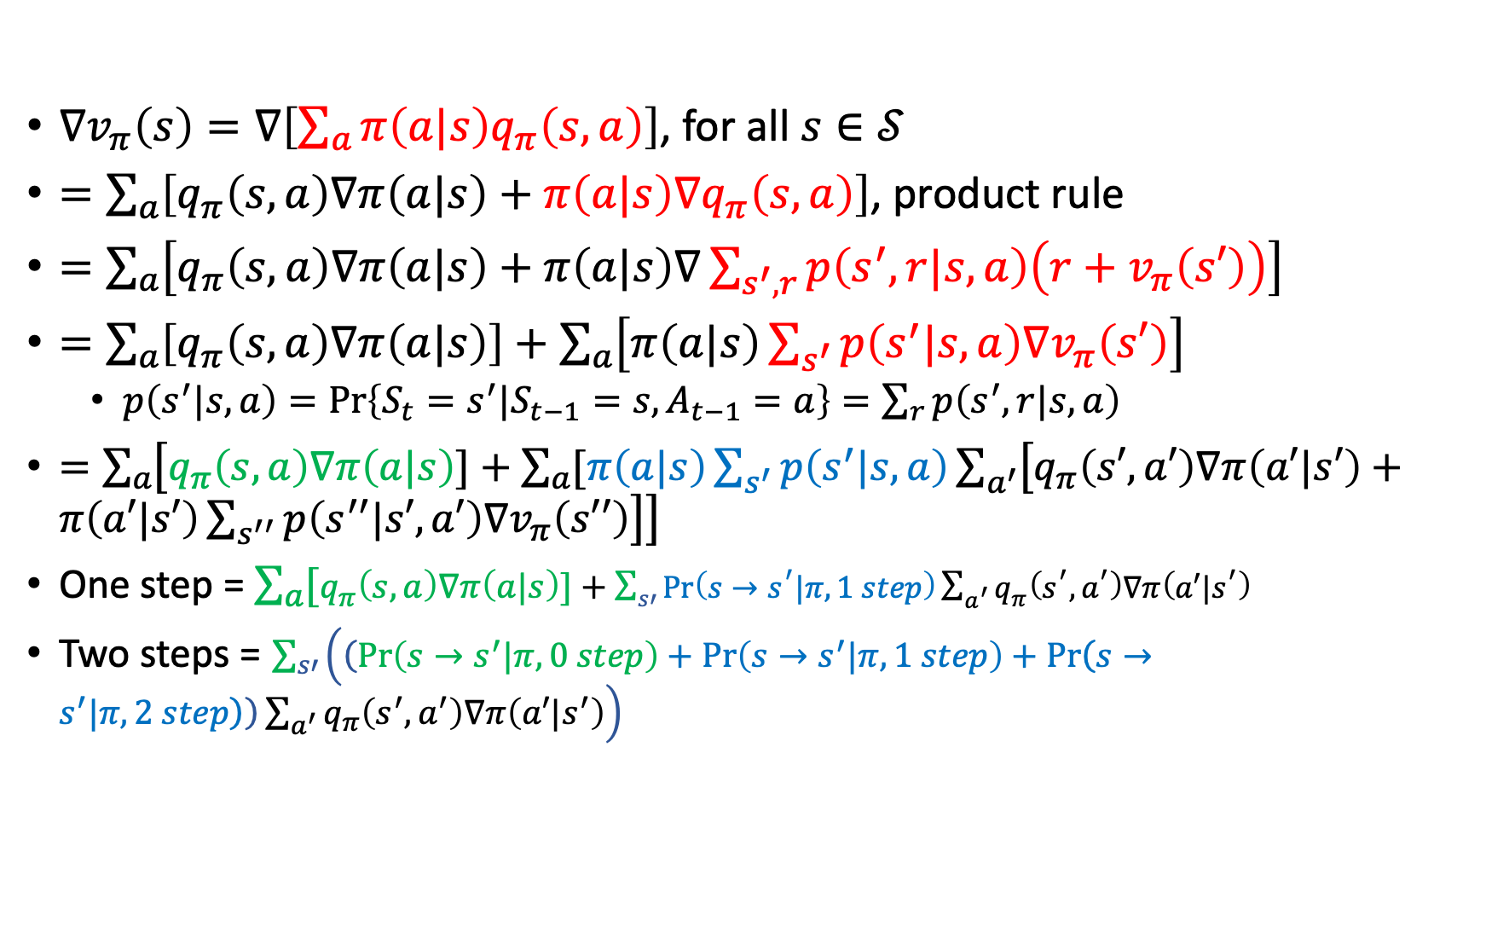
Policy Gradient Theorem
$∇v_{π}\left(s\right)=∇\left[\sum_{a}{π\left(a|s\right)q_{π}\left(s,a\right)}\right]$, for all $s∈𝒮$
$=\sum_{a}{\left[q_{π}\left(s,a\right)∇π\left(a|s\right)+π\left(a|s\right)∇q_{π}\left(s,a\right)\right]}$, product rule
$=\sum_{a}{\left[q_{π}\left(s,a\right)∇π\left(a|s\right)+π\left(a|s\right)∇\sum_{s^{′},r}{p\left(s^{′},r|s,a\right)\left(r+v_{π}\left(s′\right)\right)}\right]}$
$=\sum_{a}{\left[q_{π}\left(s,a\right)∇π\left(a|s\right)\right]+\sum_{a}{\left[π\left(a|s\right)\sum_{s^{′}}{p\left(s^{′}|s,a\right)∇v_{π}\left(s′\right)}\right]}}$
  $p\left(s^{′}|s,a\right)=\operatorname{Pr}\left\{S_{t}=s^{′}|S_{t−1}=s,A_{t−1}=a\right\}=\sum_{r}{p\left(s^{′},r|s,a\right)}$
$=\sum_{a}{\left[q_{π}\left(s,a\right)∇π\left(a|s\right)]+\sum_{a}{[π\left(a|s\right)\sum_{s^{′}}{p\left(s^{′}|s,a\right)\sum_{a^{′}}{\left[q_{π}\left(s′,a′\right)∇π\left(a′|s′\right)+π\left(a′|s′\right)\sum_{s^{′′}}{p\left(s^{′′}|s′,a′\right)∇v_{π}\left(s′′\right)}\right]}}}\right]}$
One step = $\sum_{a}{[q_{π}\left(s,a\right)∇π\left(a|s\right)]+\sum_{s′}{\operatorname{Pr}\left(s→s^{′}|π,1 step\right)\sum_{a^{′}}{q_{π}\left(s^{′},a^{′}\right)∇π\left(a′|s^{′}\right)}}}$
Two steps = $\sum_{s′}{\left(\left(\operatorname{Pr}\left(s→s^{′}|π, 0 step\right)+\operatorname{Pr}\left(s→s^{′}|π, 1 step\right)+\operatorname{Pr}\left(s→s^{′}|π,2 step\right)\right)\sum_{a^{′}}{q_{π}\left(s^{′},a^{′}\right)∇π\left(a′|s^{′}\right)}\right)}$

Slide 16
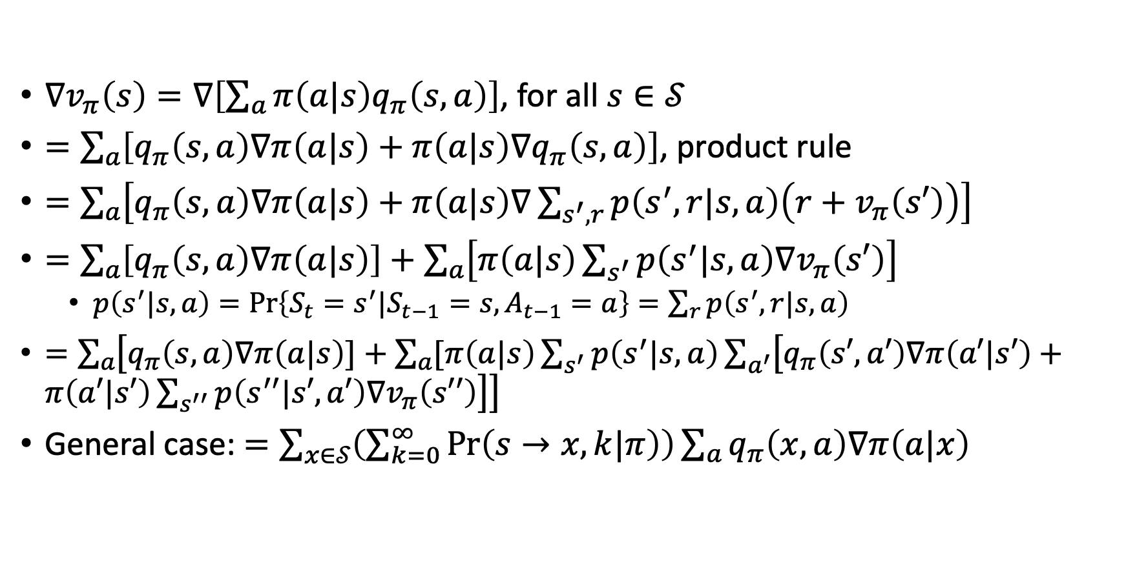
Policy Gradient Theorem
$∇v_{π}\left(s\right)=∇\left[\sum_{a}{π\left(a|s\right)q_{π}\left(s,a\right)}\right]$, for all $s∈𝒮$
$=\sum_{a}{\left[q_{π}\left(s,a\right)∇π\left(a|s\right)+π\left(a|s\right)∇q_{π}\left(s,a\right)\right]}$, product rule
$=\sum_{a}{\left[q_{π}\left(s,a\right)∇π\left(a|s\right)+π\left(a|s\right)∇\sum_{s^{′},r}{p\left(s^{′},r|s,a\right)\left(r+v_{π}\left(s′\right)\right)}\right]}$
$=\sum_{a}{\left[q_{π}\left(s,a\right)∇π\left(a|s\right)\right]+\sum_{a}{\left[π\left(a|s\right)\sum_{s^{′}}{p\left(s^{′}|s,a\right)∇v_{π}\left(s′\right)}\right]}}$
  $p\left(s^{′}|s,a\right)=\operatorname{Pr}\left\{S_{t}=s^{′}|S_{t−1}=s,A_{t−1}=a\right\}=\sum_{r}{p\left(s^{′},r|s,a\right)}$
$=\sum_{a}{\left[q_{π}\left(s,a\right)∇π\left(a|s\right)]+\sum_{a}{[π\left(a|s\right)\sum_{s^{′}}{p\left(s^{′}|s,a\right)\sum_{a^{′}}{\left[q_{π}\left(s′,a′\right)∇π\left(a′|s′\right)+π\left(a′|s′\right)\sum_{s^{′′}}{p\left(s^{′′}|s′,a′\right)∇v_{π}\left(s′′\right)}\right]}}}\right]}$
General case: $=\sum_{x∈𝒮}{\left(\sum_{k=0}^{∞}{\operatorname{Pr}\left(s→x,k|π\right)}\right)}\sum_{a}{q_{π}\left(x,a\right)∇π\left(a|x\right)}$
Update the policy so it will lead us (with high likelihood) to the best k-reachable state (maximal state value)
Number of steps

Slide 17
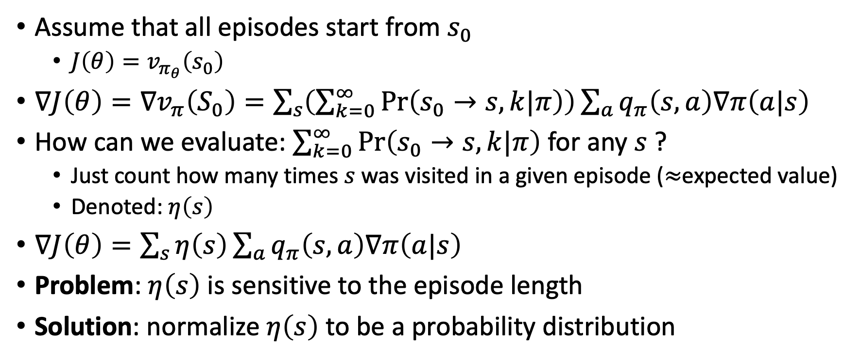
Policy Gradient Theorem
Assume that all episodes start from $s_{0}$
  $J\left(θ\right)=v_{π_{θ}}\left(s_{0}\right)$
$∇J\left(θ\right)=∇v_{π}\left(S_{0}\right)=\sum_{s}{\left(\sum_{k=0}^{∞}{\operatorname{Pr}\left(s_{0}→s,k|π\right)}\right)}\sum_{a}{q_{π}\left(s,a\right)∇π\left(a|s\right)}$
How can we evaluate: $\sum_{k=0}^{∞}{\operatorname{Pr}\left(s_{0}→s,k|π\right)}$ for any $s$ ?
  Just count how many times $s$ was visited in a given episode ($≈$expected value)
  Denoted: $η\left(s\right)$
$∇J\left(θ\right)=\sum_{s}{η\left(s\right)}\sum_{a}{q_{π}\left(s,a\right)∇π\left(a|s\right)}$
Problem: $η\left(s\right)$ is sensitive to the episode length
Solution: normalize $η\left(s\right)$ to be a probability distribution

Slide 18
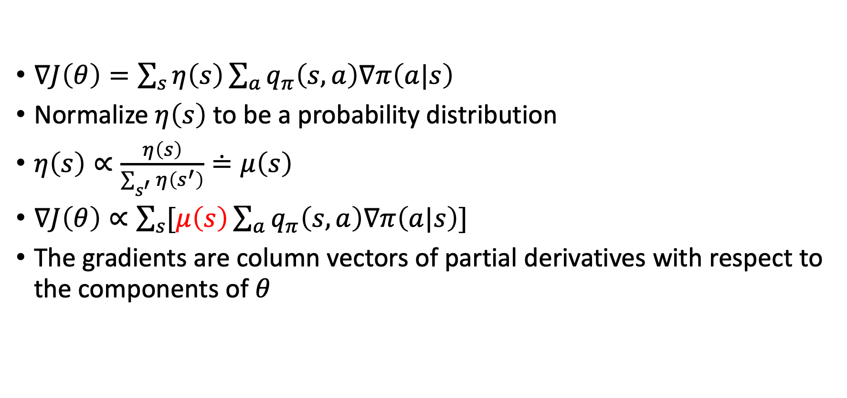
Policy Gradient Theorem
$∇J\left(θ\right)=\sum_{s}{η\left(s\right)}\sum_{a}{q_{π}\left(s,a\right)∇π\left(a|s\right)}$
Normalize $η\left(s\right)$ to be a probability distribution
$η\left(s\right)∝\frac{η\left(s\right)}{\sum_{s^{′}}{η\left(s^{′}\right)}}≐μ\left(s\right)$
$∇J\left(θ\right)∝\sum_{s}{[μ\left(s\right)}\sum_{a}{q_{π}\left(s,a\right)∇π\left(a|s\right)]}$
The gradients are column vectors of partial derivatives with respect to the components of $θ$

Slide 19
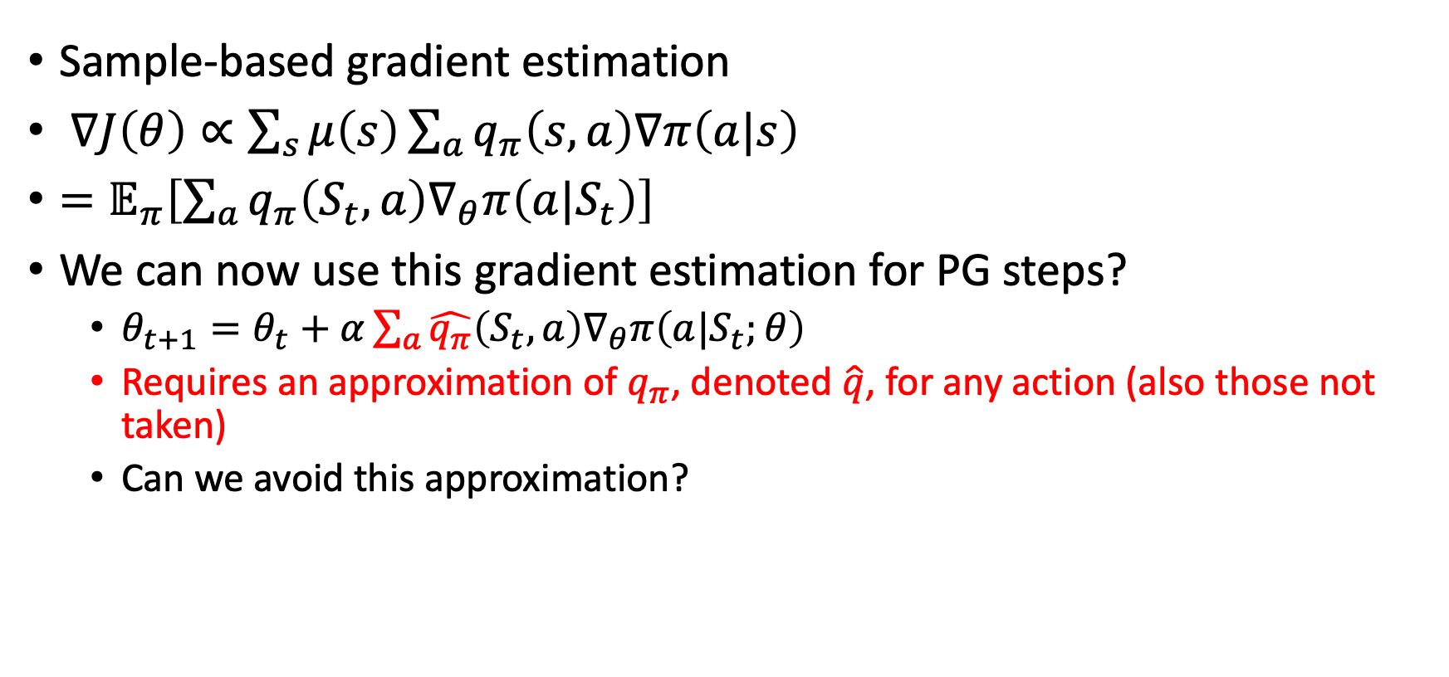
Monte-Carlo Policy Gradient
Sample-based gradient estimation
$∇J\left(θ\right)∝\sum_{s}{μ\left(s\right)}\sum_{a}{q_{π}\left(s,a\right)∇π\left(a|s\right)}$
$=𝔼_{π}\left[\sum_{a}{q_{π}\left(S_{t},a\right)∇_{θ}π\left(a|S_{t}\right)}\right]$
We can now use this gradient estimation for PG steps?
  $θ_{t+1}=θ_{t}+α\sum_{a}{\hat{q_{π}}\left(S_{t},a\right)∇_{θ}π\left(a|S_{t};θ\right)}$
  Requires an approximation of $q_{π}$, denoted $\hat{q}$, for any action (also those not taken)
  Can we avoid this approximation?

Slide 20
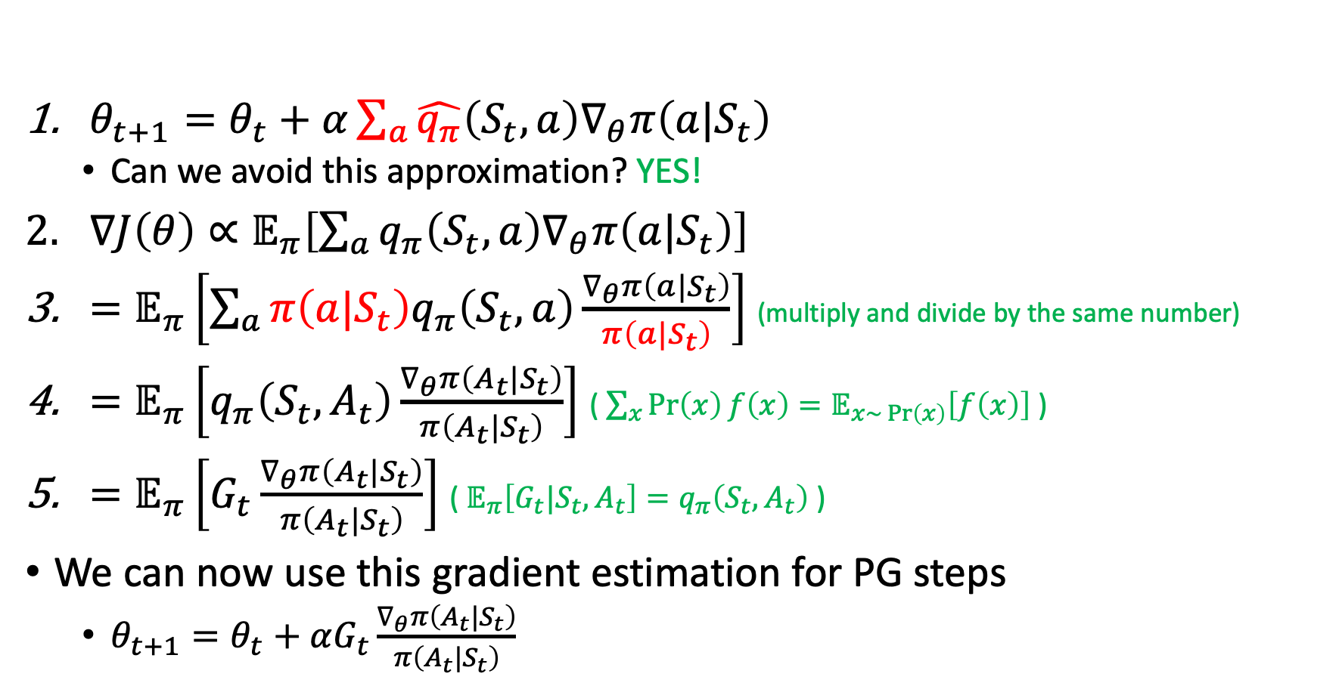
REINFORCE [Williams, 1992]
$θ_{t+1}=θ_{t}+α\sum_{a}{\hat{q_{π}}\left(S_{t},a\right)∇_{θ}π\left(a|S_{t}\right)}$
  Can we avoid this approximation? YES!
$∇J\left(θ\right)∝𝔼_{π}\left[\sum_{a}{q_{π}\left(S_{t},a\right)∇_{θ}π\left(a|S_{t}\right)}\right]$
$=𝔼_{π}\left[\sum_{a}{π\left(a|S_{t}\right)q_{π}\left(S_{t},a\right)\frac{∇_{θ}π\left(a|S_{t}\right)}{π\left(a|S_{t}\right)}}\right]$ (multiply and divide by the same number)
$=𝔼_{π}\left[q_{π}\left(S_{t},A_{t}\right)\frac{∇_{θ}π\left(A_{t}|S_{t}\right)}{π\left(A_{t}|S_{t}\right)}\right]$ ($\sum_{x}{\operatorname{Pr}\left(x\right)}f\left(x\right)=𝔼_{x\sim \operatorname{Pr}\left(x\right)}\left[f\left(x\right)\right]$ )
$=𝔼_{π}\left[G_{t}\frac{∇_{θ}π\left(A_{t}|S_{t}\right)}{π\left(A_{t}|S_{t}\right)}\right]$ ( $𝔼_{π}\left[G_{t}|S_{t},A_{t}\right]=q_{π}\left(S_{t},A_{t}\right)$ )
We can now use this gradient estimation for PG steps
  $θ_{t+1}=θ_{t}+αG_{t}\frac{∇_{θ}π\left(A_{t}|S_{t}\right)}{π\left(A_{t}|S_{t}\right)}$

Slide 21
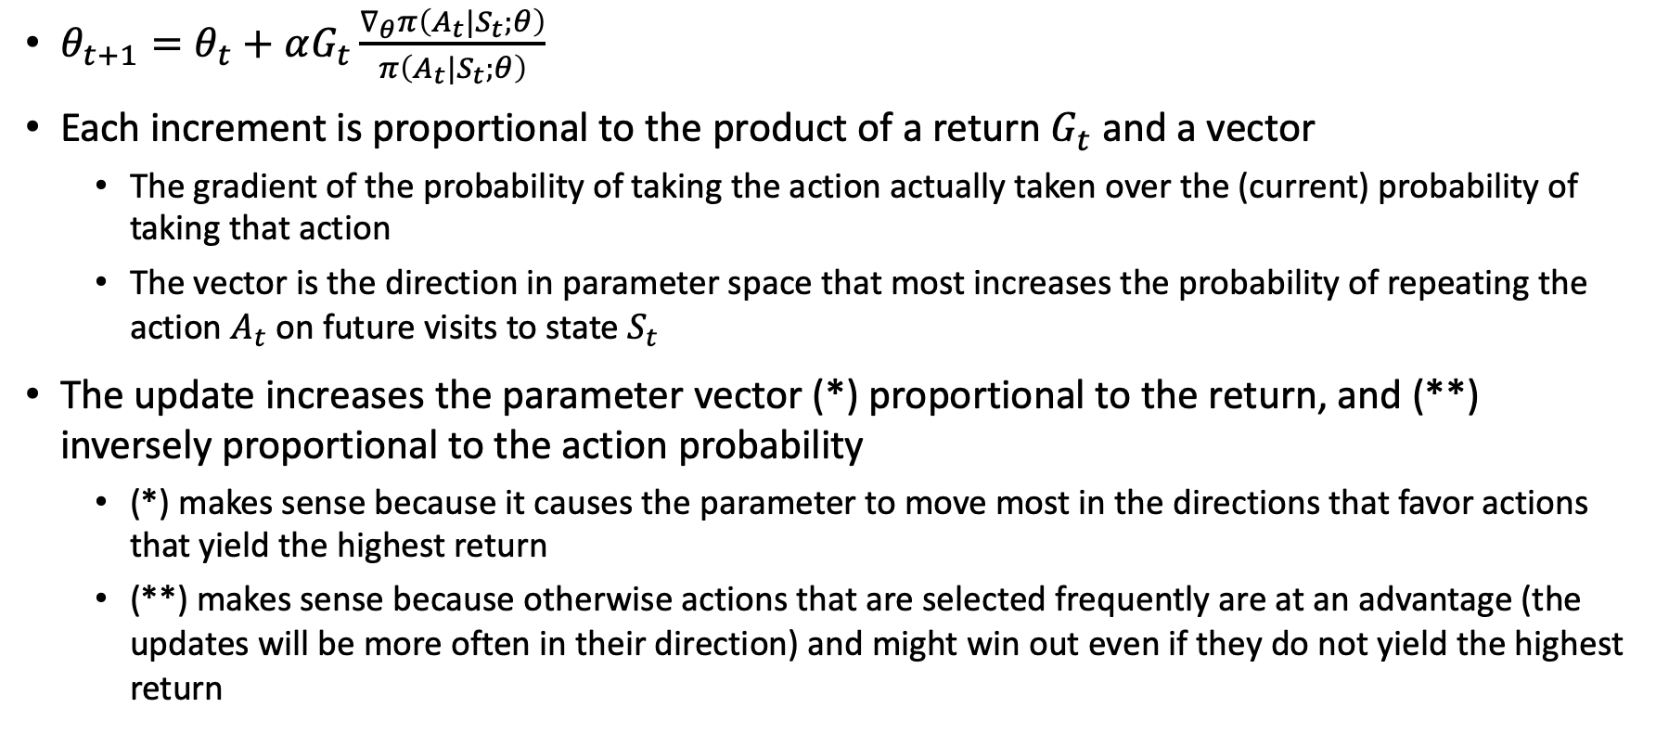
REINFORCE [Williams, 1992]
$θ_{t+1}=θ_{t}+αG_{t}\frac{∇_{θ}π\left(A_{t}|S_{t};θ\right)}{π\left(A_{t}|S_{t};θ\right)}$
Each increment is proportional to the product of a return $G_{t}$ and a vector
  The gradient of the probability of taking the action actually taken over the (current) probability of taking that action
  The vector is the direction in parameter space that most increases the probability of repeating the action $A_{t}$ on future visits to state $S_{t}$
The update increases the parameter vector (*) proportional to the return, and (**) inversely proportional to the action probability
  (*) makes sense because it causes the parameter to move most in the directions that favor actions that yield the highest return
  (**) makes sense because otherwise actions that are selected frequently are at an advantage (the updates will be more often in their direction) and might win out even if they do not yield the highest return

Slide 22
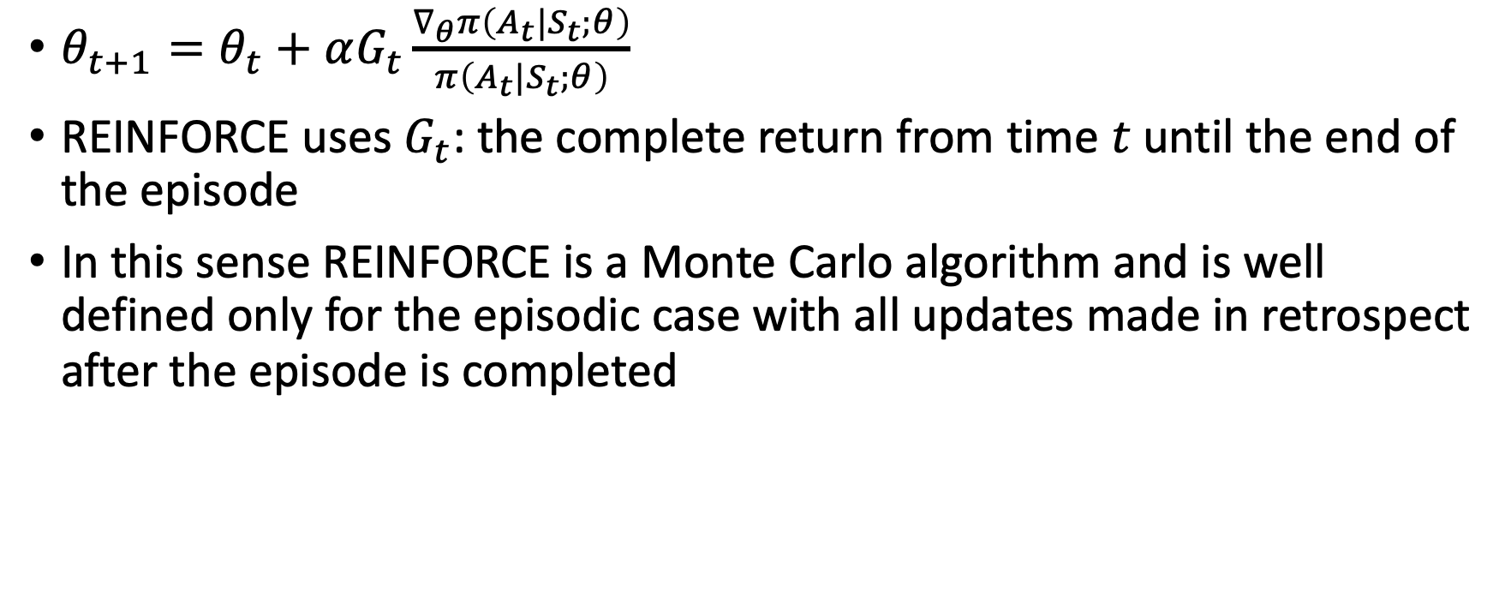
REINFORCE [Williams, 1992]
$θ_{t+1}=θ_{t}+αG_{t}\frac{∇_{θ}π\left(A_{t}|S_{t};θ\right)}{π\left(A_{t}|S_{t};θ\right)}$
REINFORCE uses $G_{t}$: the complete return from time $t$ until the end of the episode
In this sense REINFORCE is a Monte Carlo algorithm and is well defined only for the episodic case with all updates made in retrospect after the episode is completed

Slide 23
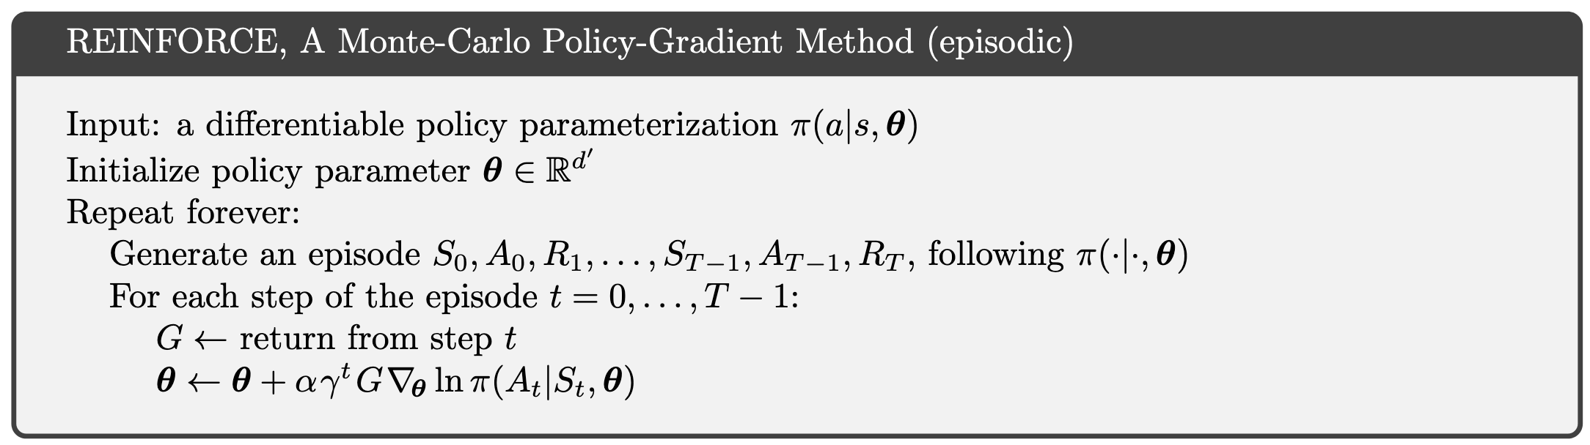
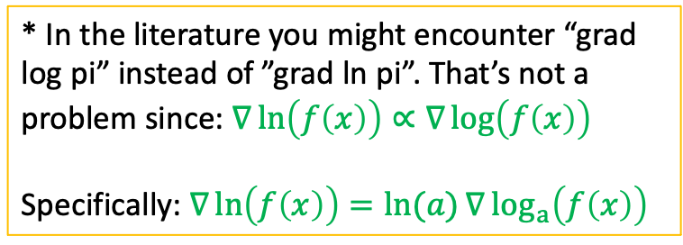
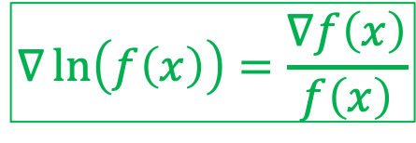
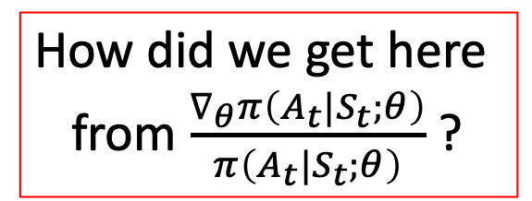
REINFORCE [Williams, 1992]
* In the literature you might encounter “grad log pi” instead of ”grad ln pi”. That’s not a problem since: $∇\ln\left(f\left(x\right)\right)∝∇\log\left(f\left(x\right)\right)$
Specifically: $∇\ln\left(f\left(x\right)\right)=\ln{(a)}∇\log_{a}\left(f\left(x\right)\right)$
How did we get here
from $\frac{∇_{θ}π\left(A_{t}|S_{t};θ\right)}{π\left(A_{t}|S_{t};θ\right)}$ ?
$$∇\ln\left(f\left(x\right)\right)=\frac{∇f\left(x\right)}{f\left(x\right)}$$

Slide 24
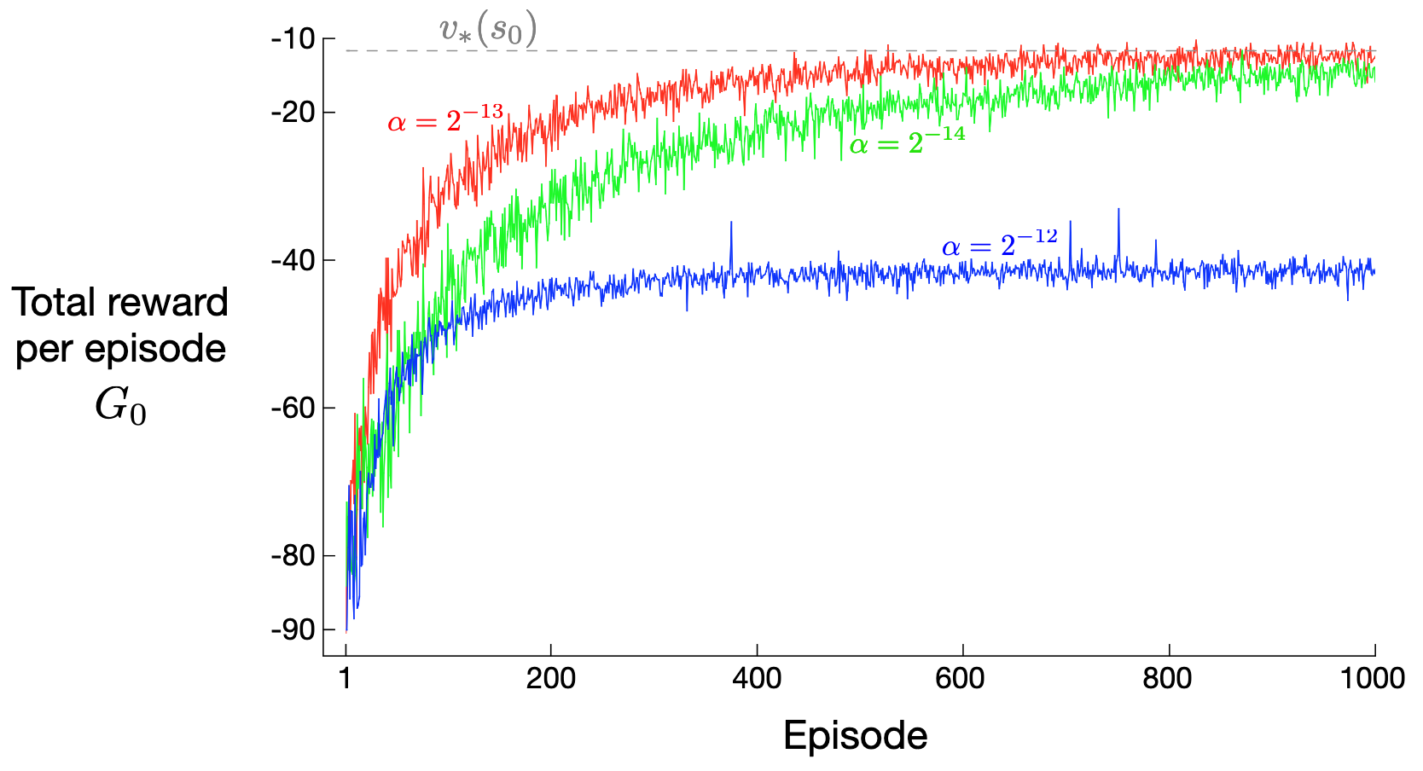
REINFORCE [Williams, 1992]
The crazy corridor domain
With the right step size, the total reward per episode approaches the optimal value of the start state
Guaranteed to converge to a local optimum under standard stochastic approximation conditions for decaying α

Slide 25
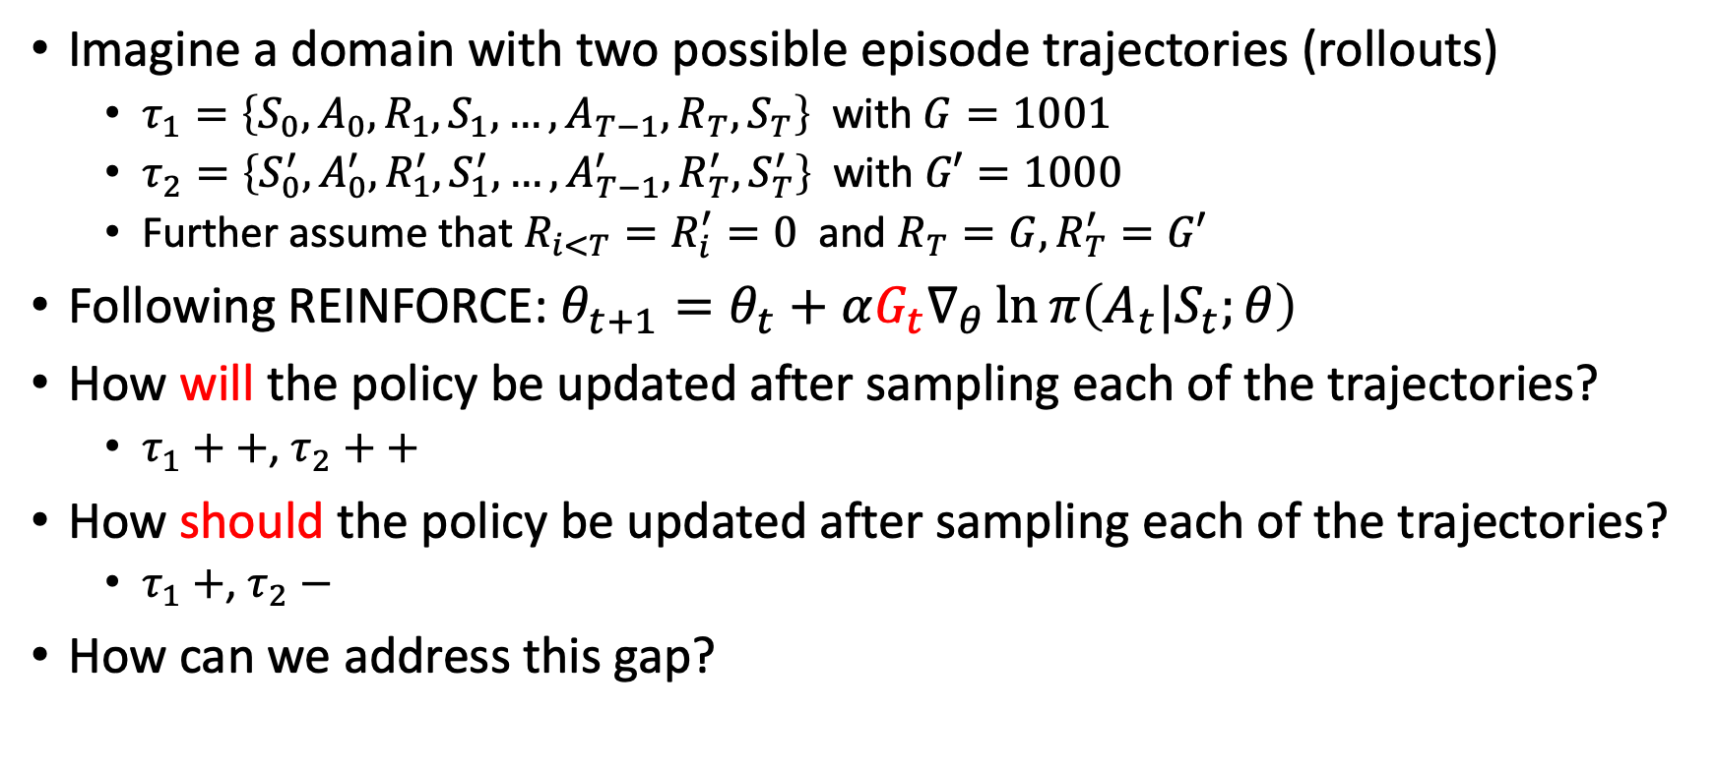
Calibrating REINFORCE
Imagine a domain with two possible episode trajectories (rollouts)
  $τ_{1}=\left\{S_{0},A_{0},R_{1},S_{1},…,A_{T−1},R_{T},S_{T}\right\}$ with $G=1001$
  $τ_{2}=\left\{S_{0}^{′},A_{0}^{′},R_{1}^{′},S_{1}^{′},…,A_{T−1}^{′},R_{T}^{′},S_{T}^{′}\right\}$ with $G′=1000$
  Further assume that $R_{i<T}=R_{i}^{′}=0$ and $R_{T}=G,R_{T}^{′}=G′$
Following REINFORCE: $θ_{t+1}=θ_{t}+αG_{t}∇_{θ}\ln{π\left(A_{t}|S_{t};θ\right)}$
How will the policy be updated after sampling each of the trajectories?
  $τ_{1}++$, $τ_{2}++$
How should the policy be updated after sampling each of the trajectories?
  $τ_{1}+$, $τ_{2}−$
How can we address this gap?

Slide 26
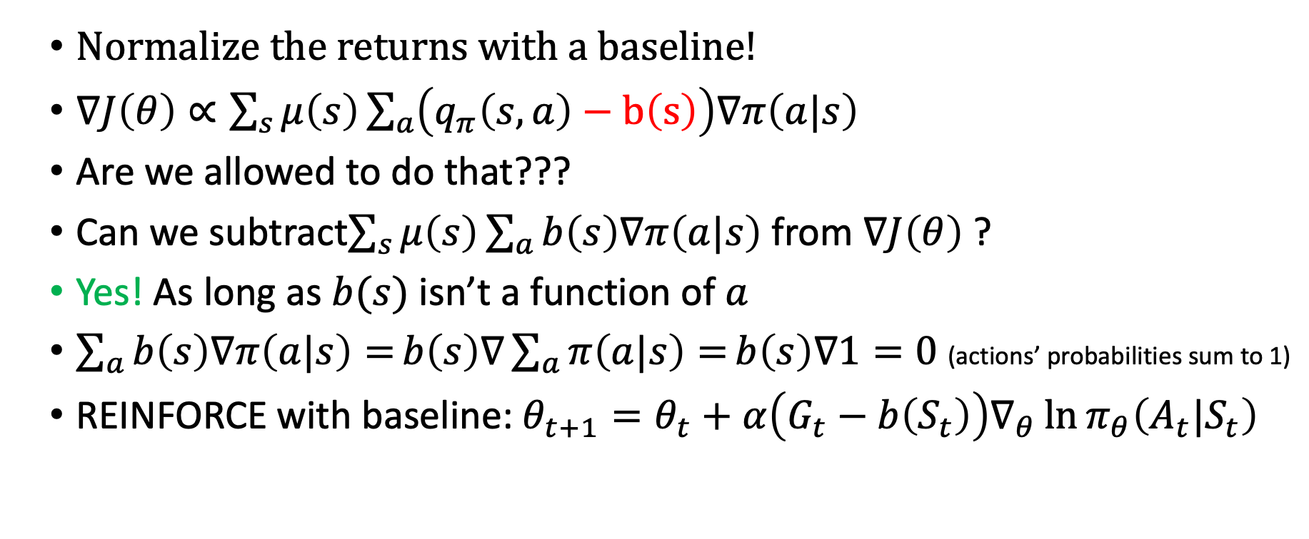
PG with baseline
Normalize the returns with a baseline!
$∇J\left(θ\right)∝\sum_{s}{μ\left(s\right)}\sum_{a}{\left(q_{π}\left(s,a\right)−b\left(s\right)\right)∇π\left(a|s\right)}$
Are we allowed to do that???
Can we subtract$\sum_{s}{μ\left(s\right)}\sum_{a}{b\left(s\right)∇π\left(a|s\right)}$ from $∇J\left(θ\right)$ ?
Yes! As long as $b(s)$ isn’t a function of $a$
$\sum_{a}{b\left(s\right)∇π\left(a|s\right)=}b\left(s\right)∇\sum_{a}{π\left(a|s\right)=}b\left(s\right)∇1=0$ (actions’ probabilities sum to 1)
REINFORCE with baseline: $θ_{t+1}=θ_{t}+α\left(G_{t}−b\left(S_{t}\right)\right)∇_{θ}\ln{π_{θ}\left(A_{t}|S_{t}\right)}$

Slide 27
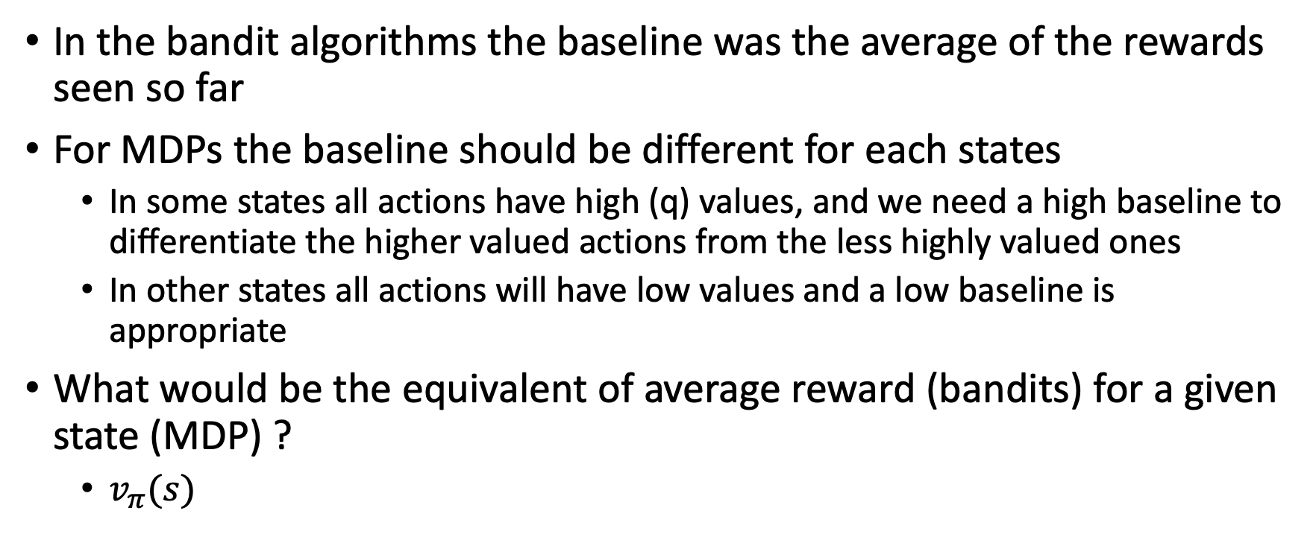
PG with baseline
In the bandit algorithms the baseline was the average of the rewards seen so far
For MDPs the baseline should be different for each states
  In some states all actions have high (q) values, and we need a high baseline to differentiate the higher valued actions from the less highly valued ones
  In other states all actions will have low values and a low baseline is appropriate
What would be the equivalent of average reward (bandits) for a given state (MDP) ?
  $v_{π}(s)$

Slide 28
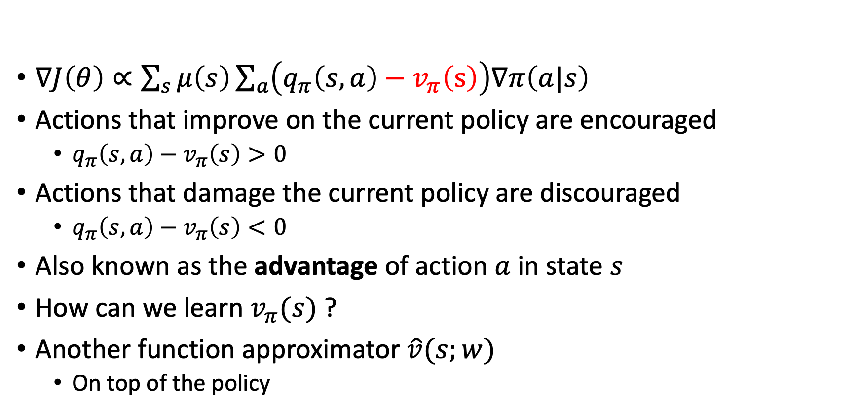
PG with baseline
$∇J\left(θ\right)∝\sum_{s}{μ\left(s\right)}\sum_{a}{\left(q_{π}\left(s,a\right)−v_{π}\left(s\right)\right)∇π\left(a|s\right)}$
Actions that improve on the current policy are encouraged
  $q_{π}\left(s,a\right)−v_{π}\left(s\right)>0$
Actions that damage the current policy are discouraged
  $q_{π}\left(s,a\right)−v_{π}\left(s\right)<0$
Also known as the advantage of action $a$ in state $s$
How can we learn $v_{π}(s)$ ?
Another function approximator $\hat{v}(s;w)$
  On top of the policy

Slide 29
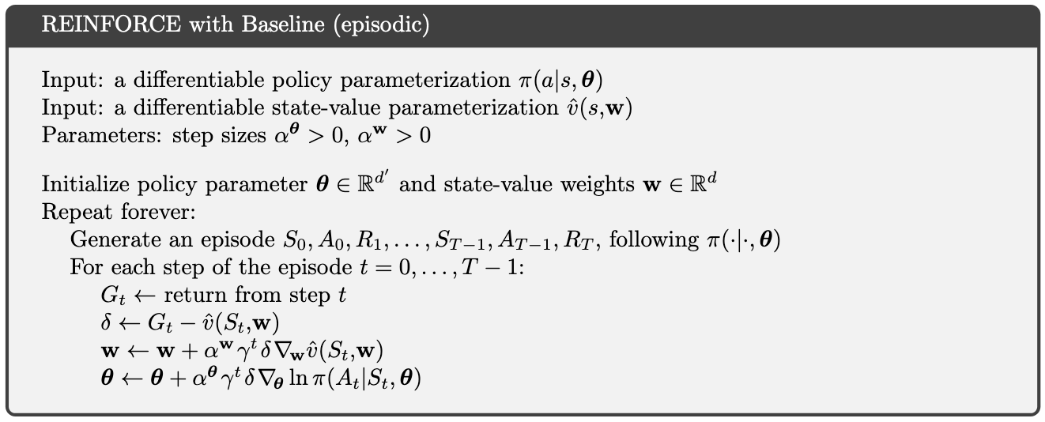
REINFORCE with baseline
Each approximator has its unique learning rate

Slide 30
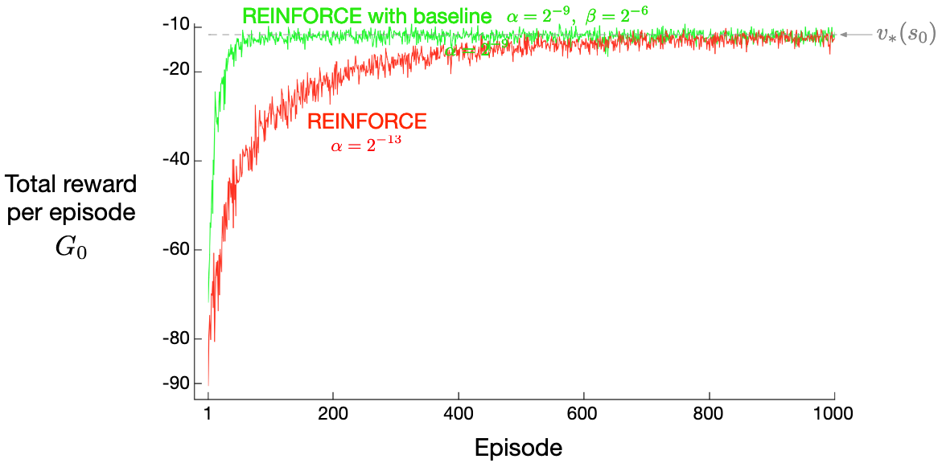
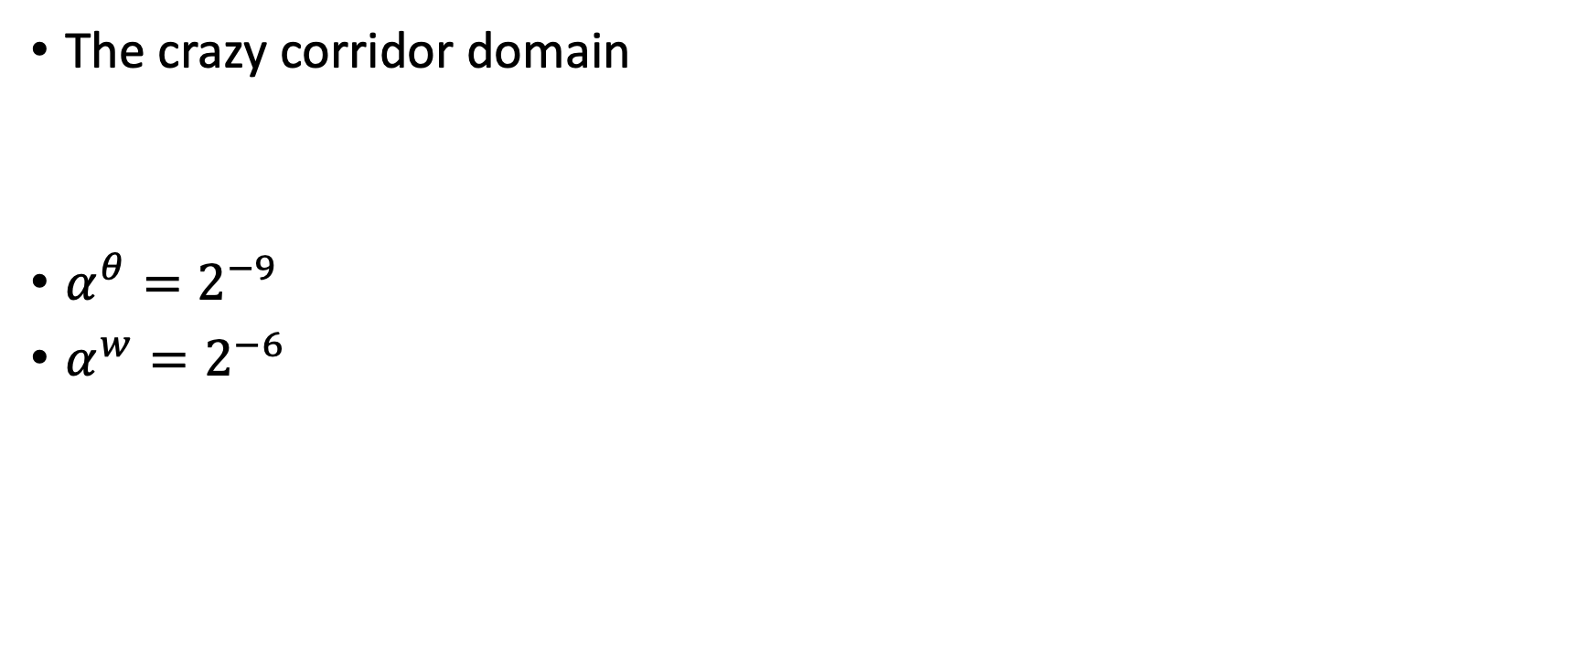
REINFORCE with baseline
The crazy corridor domain
$α^{θ}=2^{−9}$
$α^{w}=2^{−6}$

Slide 31
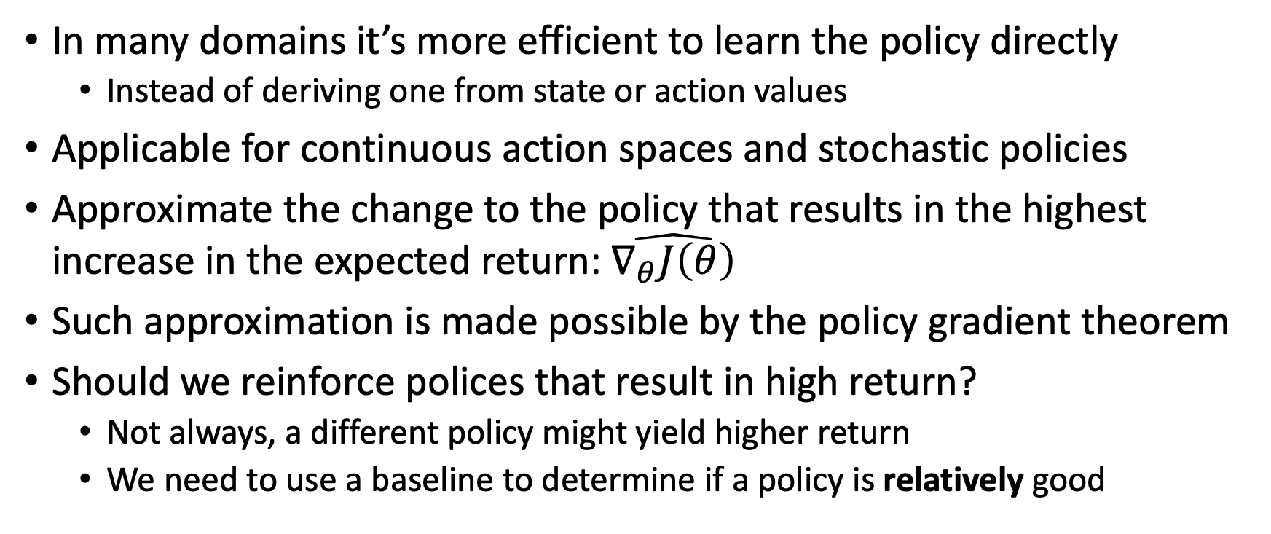
What did we learn?
In many domains it’s more efficient to learn the policy directly
  Instead of deriving one from state or action values
Applicable for continuous action spaces and stochastic policies
Approximate the change to the policy that results in the highest increase in the expected return: $\hat{∇_{θ}J\left(θ\right)}$
Such approximation is made possible by the policy gradient theorem
Should we reinforce polices that result in high return?
  Not always, a different policy might yield higher return
  We need to use a baseline to determine if a policy is relatively good

Slide 32
What next?
Lecture: Actor-Critic
Assignments:
  REINFORCE, by Nov. 11, EOD
  Deep Q-Learning, by Nov. 4, EOD
Quiz (on Canvas):
  Policy Gradient, by Oct. 30, EOD
  Deep Q-Learning, by Oct. 28, EOD
Project:
  Literature survey, by Nov. 4, EOD

