Slide 1

CSCE-642 Reinforcement Learning
Deep Q-learning
Instructor: Guni Sharon

Slide 2
Successfully address the deadly triad
Danger of instability and divergence arises whenever we combine all of the following three elements
Function approximation: A powerful, scalable way of generalizing from a state space much larger than the memory and computational resources
Bootstrapping: Update targets that include existing estimates (as in dynamic programming or TD methods) rather than relying exclusively on actual rewards and complete returns (as in MC methods)
Off-policy training: Training on a distribution of transitions other than that produced by the target policy.
* Divergence can always occur if the learning rate is set too high

Slide 3
CSCE-689, Reinforcement Learning
Stateless decision process
Monte-Carlo
Policy gradient
Actor-critic
Markov decision process
Temporal difference
Function approximators
Solving MDPs (offline)
Dynamic programming
Tabular methods
Deep RL

Slide 4
Mnih et al. 2015
First deep learning algorithm to successfully learn control policies directly from high-dimensional sensory input using RL
The algorithm is a convolutional neural network, trained with a variant of Q-learning
Input is raw pixels and output is an action-value function estimating future rewards
Surpassed a human expert on various Atari video games

Slide 5
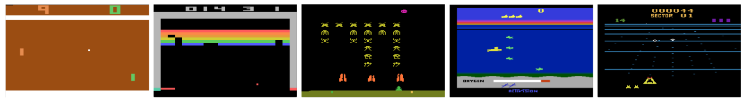
The age of deep learning
Previous models relied on hand-crafted features combined with linear value functions
  The performance of such systems heavily relies on the quality of the feature representation
Advances in deep learning have made it possible to automatically extract high-level features from raw sensory data

Slide 6
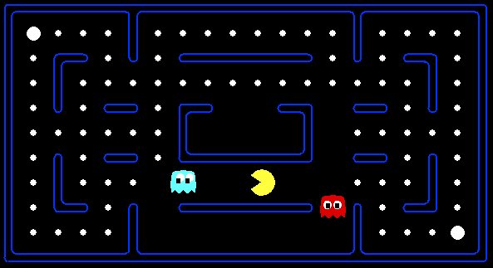



Example: Pacman
Let’s say we discover through experience that this state is bad:
In naïve q-learning, we know nothing about this state:
Or even this one!
We must generalize our knowledge!
Notes:
python pacman.py -p PacmanQAgent -x 50 -n 60 -l mediumGrid

Slide 7
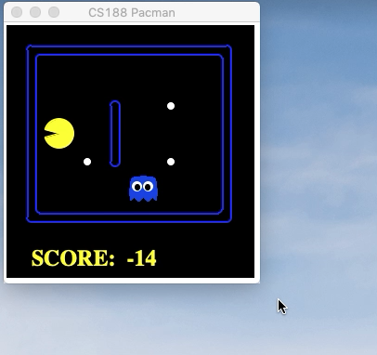
Naïve Q-learning
After 50 training episodes

Slide 8
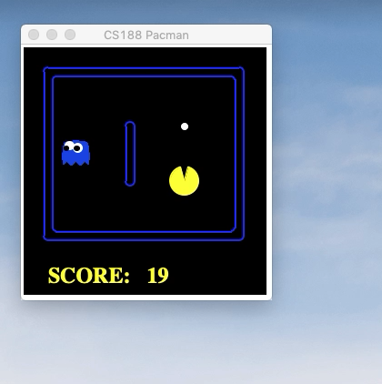
Generalize Q-learning with function approximator

Slide 9
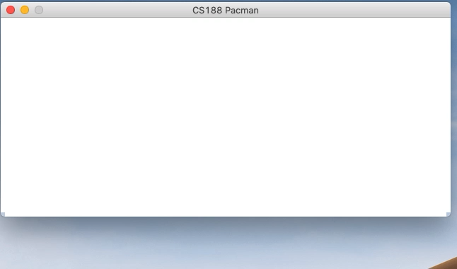
Generalizing knowledge results in efficient learning
E.g., learn to avoid the ghosts

Slide 10
Generalizing with Deep learning
Supervised: Require large amounts of hand-labelled training data
  RL on the other hand, learns from a scalar reward signal that is frequently sparse, noisy, and delayed
Supervised: Assume the data samples are independent
  In RL one typically encounters sequences of highly correlated state
Supervised: Assume a fixed underlying distribution
  In RL the data distribution changes as the algorithm learns new behaviors
DQN was first to demonstrate that a convolutional neural network can overcome these challenges to learn successful control policies from raw video data in complex RL environments

Slide 11
Deep Q learning [Mnih et al. 2015]
Trains a generic neural network-based agent that successfully learns to operate in many diverse domains
The network is not provided with any domain-specific information or hand-designed features
Must learn from nothing but the raw input (pixels), the reward, terminal signals, and the set of possible actions

Slide 12
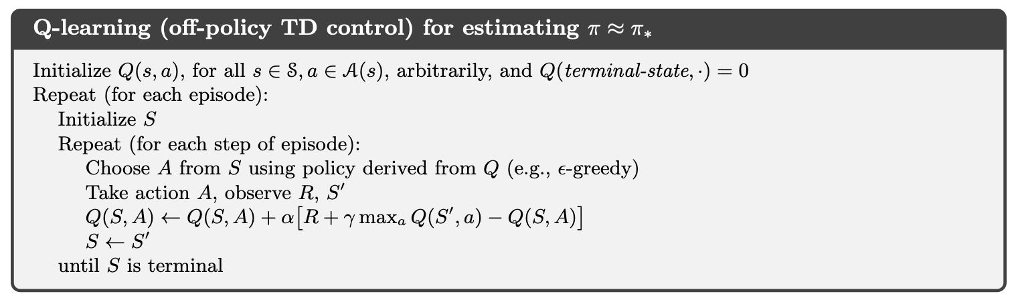

Original Q-learning
What’s the problem with using DNNs in Basic Q-learning?
Train on correlated (successive states) samples
Train on sparse data, i.e., only a small portion of the state space
Policy change -> sample distribution shifts
$$θ=θ+α\left(R+γ\max_{a}{\hat{Q}\left(S′,a;θ\right)}−\hat{Q}\left(S,A;θ\right)\right)∇_{θ}\hat{Q}\left(S,A;θ\right)$$

Slide 13
Deep Q learning [Mnih et al. 2015]
DQN addresses problems of correlated data and non-stationary distributions
  Use an experience replay mechanism
  Randomly samples and trains on previous transitions
  Results in a smoother training distribution over many past behaviors

Slide 14
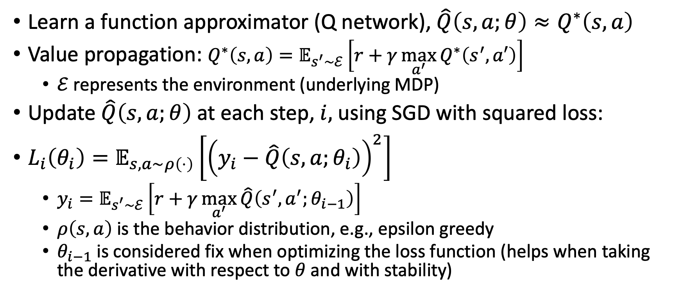
Deep Q learning [Mnih et al. 2015]
Learn a function approximator (Q network), ${\hat{Q}\left(s,a;θ\right)≈Q}^{∗}\left(s,a\right)$
Value propagation: $Q^{∗}\left(s,a\right)=𝔼_{s^{′}\sim ℰ}\left[r+γ\max_{a^{′}}{Q^{∗}\left(s^{′},a′\right)}\right]$
  $ℰ$ represents the environment (underlying MDP)
Update $\hat{Q}\left(s,a;θ\right)$ at each step, $i,$ using SGD with squared loss:
$L_{i}\left(θ_{i}\right)=𝔼_{s,a\sim ρ\left(⋅\right)}\left[{\left(y_{i}−\hat{Q}\left(s,a;θ_{i}\right)\right)}^{2}\right]$
  $y_{i}=𝔼_{s^{′}\sim ℰ}\left[r+γ\max_{a^{′}}{\hat{Q}\left(s^{′},a^{′};θ_{i−1}\right)}\right]$
  $ρ\left(s,a\right)$ is the behavior distribution, e.g., epsilon greedy
  $θ_{i−1}$ is considered fix when optimizing the loss function (helps when taking the derivative with respect to $θ$ and with stability)

Slide 15
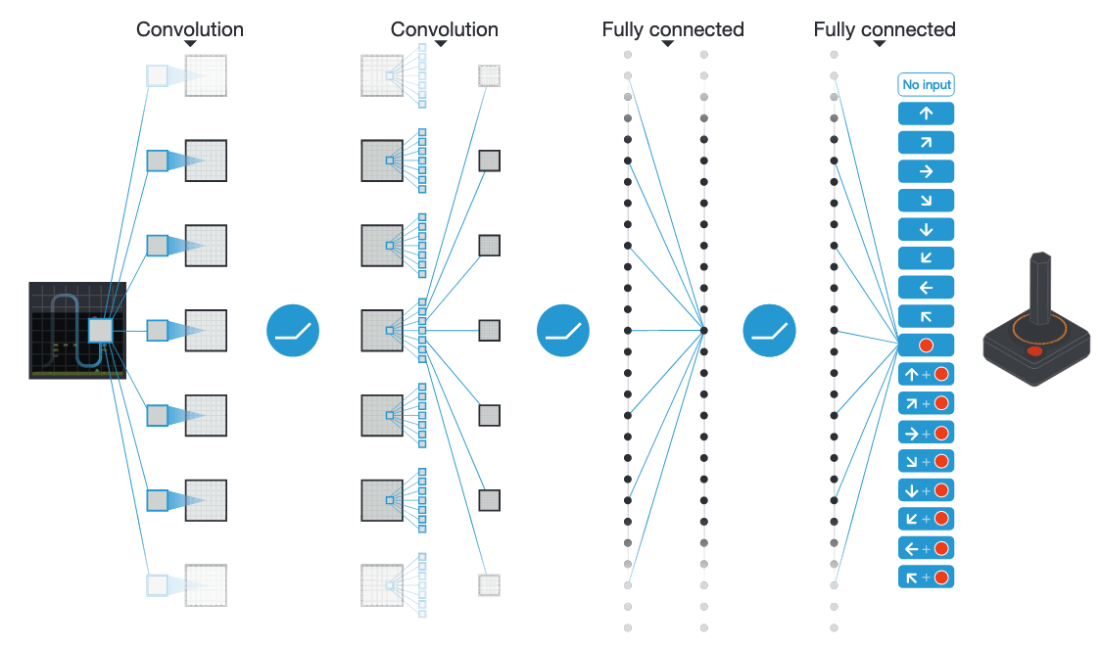
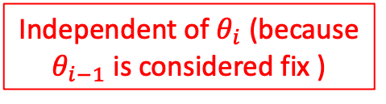
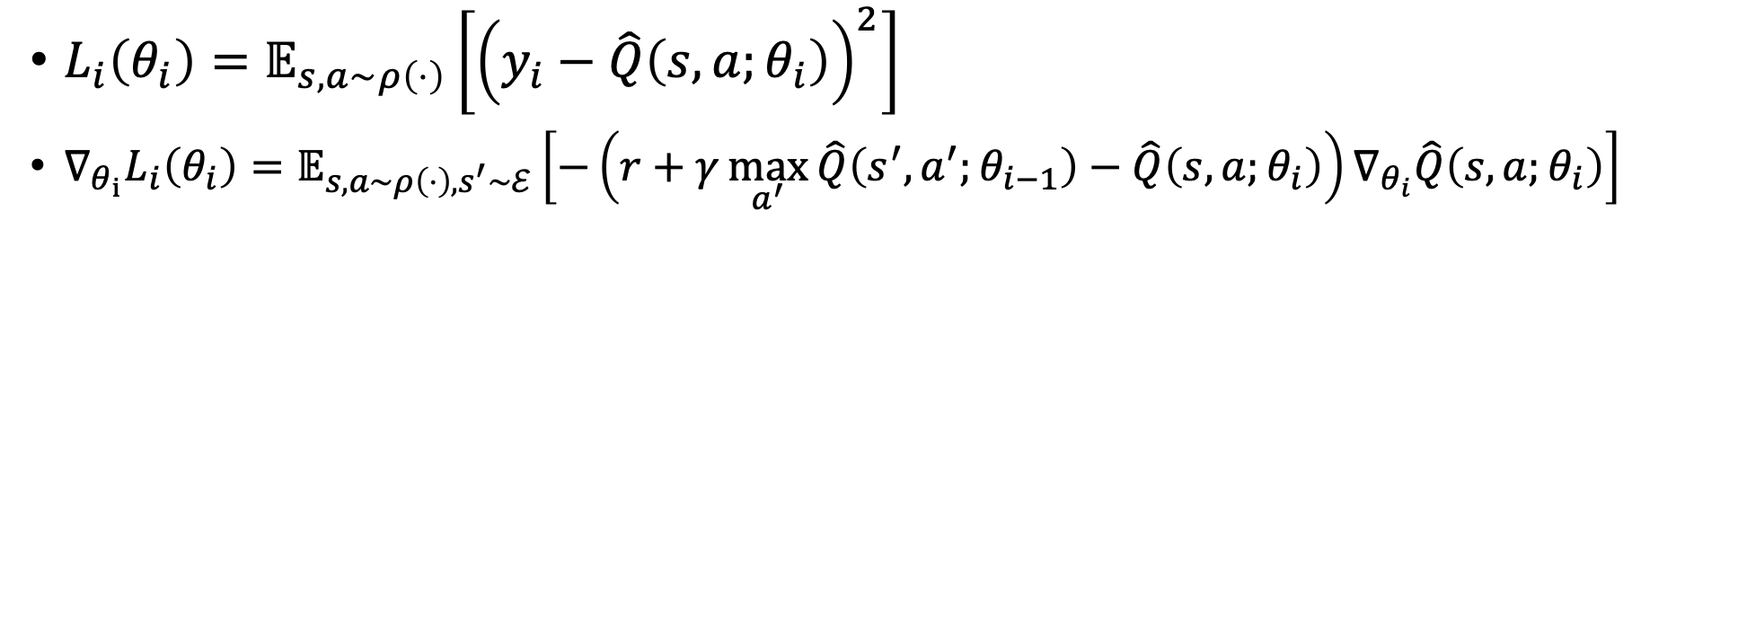
Deep Q learning [Mnih et al. 2015]
Independent of $θ_{i}$ (because $θ_{i−1}$ is considered fix )
$L_{i}\left(θ_{i}\right)=𝔼_{s,a\sim ρ\left(⋅\right)}\left[{\left(y_{i}−\hat{Q}\left(s,a;θ_{i}\right)\right)}^{2}\right]$
${∇_{θ_{i}}L}_{i}\left(θ_{i}\right)=𝔼_{s,a\sim ρ\left(⋅\right),s^{′}\sim ℰ}\left[−\left(r+γ\max_{a^{′}}{\hat{Q}\left(s^{′},a^{′};θ_{i−1}\right)−\hat{Q}\left(s,a;θ_{i}\right)}\right)∇_{θ_{i}}\hat{Q}\left(s,a;θ_{i}\right)\right]$

Slide 16
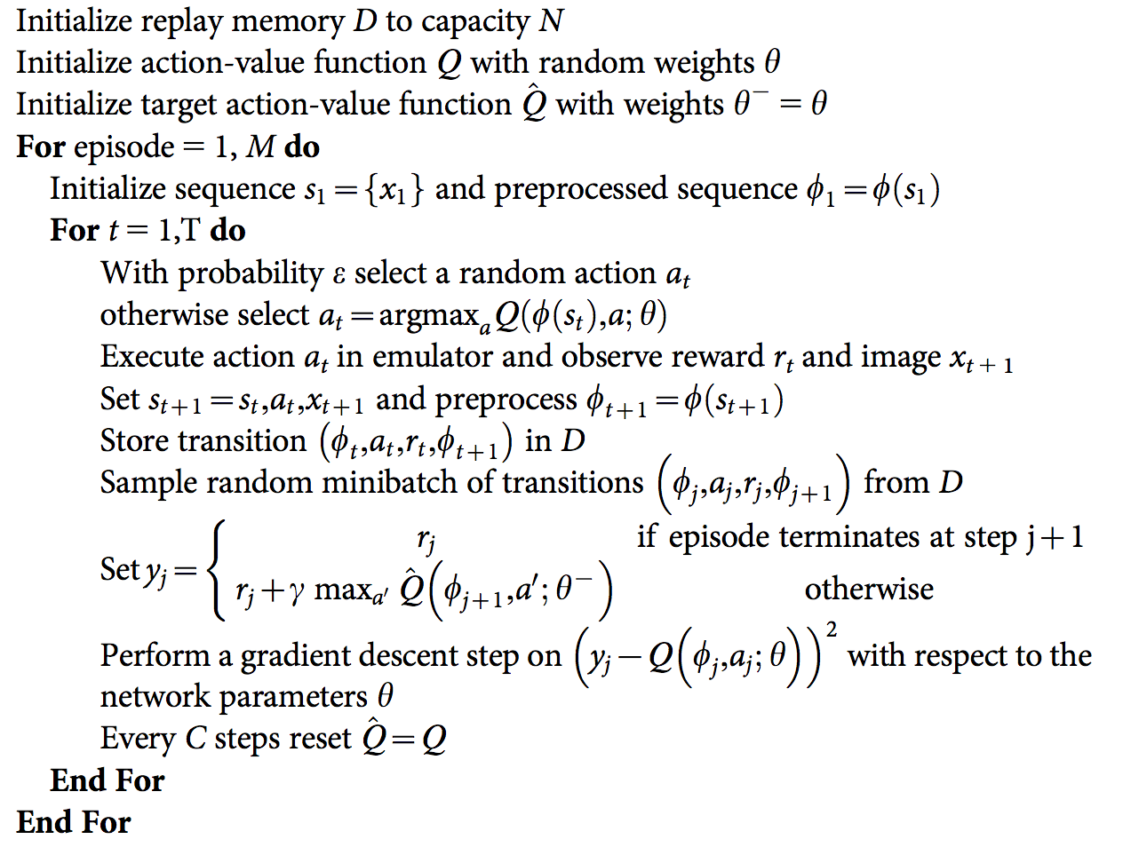
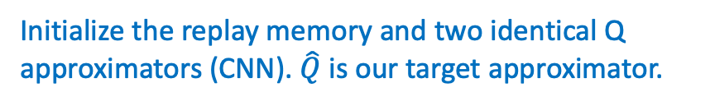
Q-learning with experience replay
Initialize the replay memory and two identical Q approximators (CNN). $\hat{Q}$ is our target approximator.

Slide 17
Q-learning with experience replay
Play m episodes (full games)

Slide 18
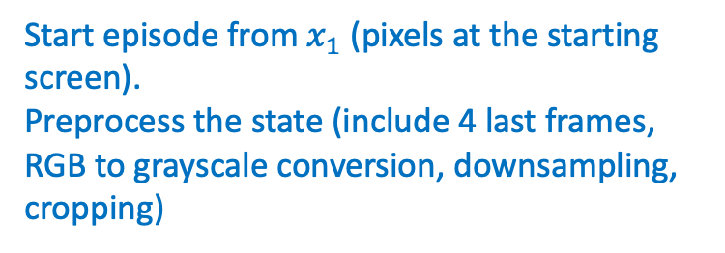
Q-learning with experience replay
Start episode from $x_{1}$ (pixels at the starting screen).
Preprocess the state (include 4 last frames, RGB to grayscale conversion, downsampling, cropping)

Slide 19
Q-learning with experience replay
For each time step during the episode

Slide 20
Q-learning with experience replay
With small probability select a random action (explore), otherwise select the, currently known, best action (exploit).

Slide 21
Q-learning with experience replay
Execute the chosen action and store the (processed) observed transition in the replay memory

Slide 22
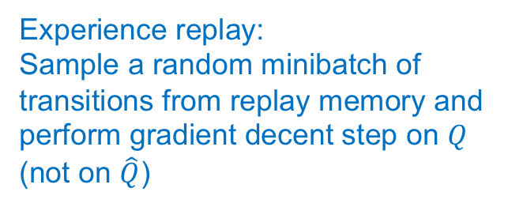
Q-learning with experience replay
Experience replay:
Sample a random minibatch of transitions from replay memory and perform gradient decent step on $Q$ (not on $\hat{Q}$)

Slide 23
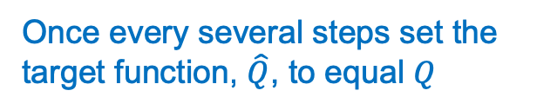
Q-learning with experience replay
Once every several steps set the target function, $\hat{Q}$, to equal $Q$

Slide 24
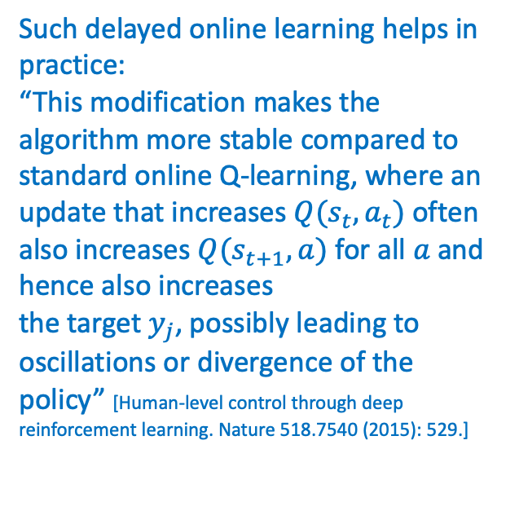
Q-learning with experience replay
Such delayed online learning helps in practice:
“This modification makes the
algorithm more stable compared to standard online Q-learning, where an update that increases $Q(s_{t},a_{t})$ often also increases $Q(s_{t+1},a)$ for all $a$ and hence also increases
the target $y_{j}$, possibly leading to oscillations or divergence of the policy” [Human-level control through deep reinforcement learning. Nature 518.7540 (2015): 529.]

Slide 25
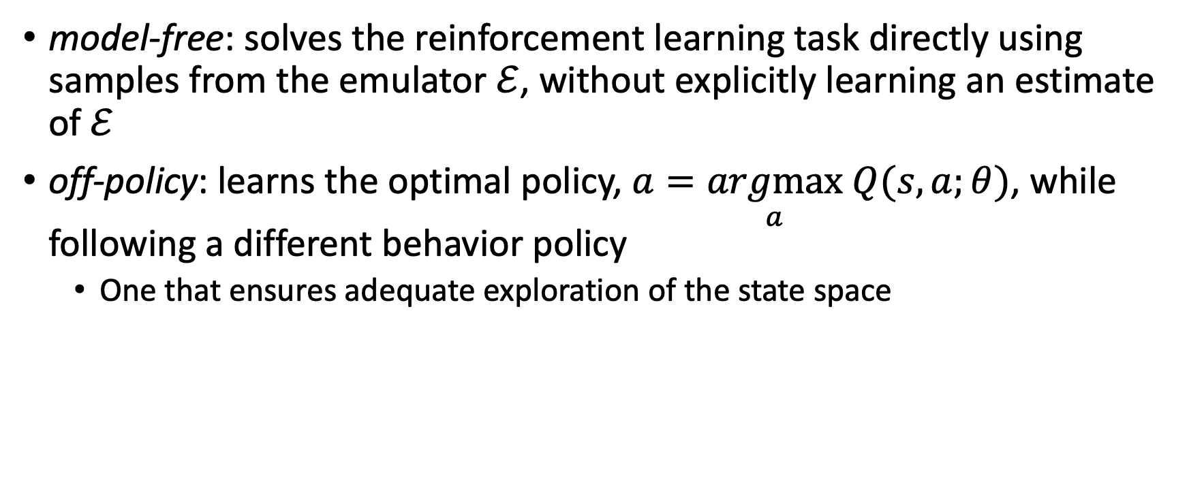
Deep Q learning
model-free: solves the reinforcement learning task directly using samples from the emulator $ℰ$, without explicitly learning an estimate of $ℰ$
off-policy: learns the optimal policy, $a=\underset{a}{argmax} Q(s,a;θ)$, while following a different behavior policy
  One that ensures adequate exploration of the state space

Slide 26
Experience replay
Utilizing experience replay has several advantages
  Each step of experience is potentially used in many weight updates, which allows for greater data efficiency
  Learning directly from consecutive samples is inefficient, due to the strong correlations between the samples; randomizing the samples breaks these correlations and therefore reduces the variance of the updates
  The behavior distribution is averaged over many of its previous states, smoothing out learning and avoiding oscillations or divergence in the parameters
Note that when learning by experience replay, it is necessary to learn off-policy (because our current parameters are different to those used to generate the sample), which motivates the choice of Q-learning

Slide 27
Experience replay
DQN only stores the last N experience tuples in the replay memory
  Old transitions are overwritten
Samples uniformly at random from the buffer when performing updates
Is there room for improvement?
  Important transitions?
    Prioritized replay
  Prioritize deletions from the replay memory
  see prioritized experience reply, https://arxiv.org/abs/1511.05952

Slide 28
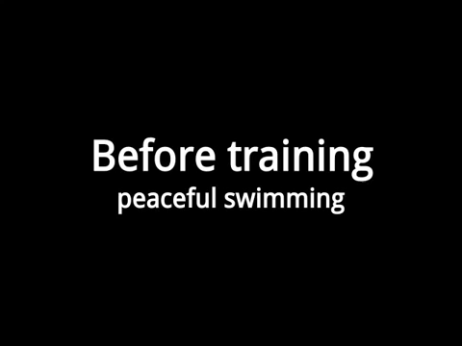

Slide 29
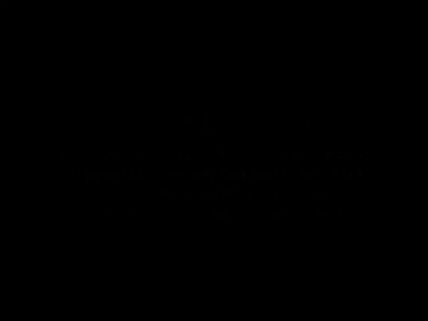

Slide 30
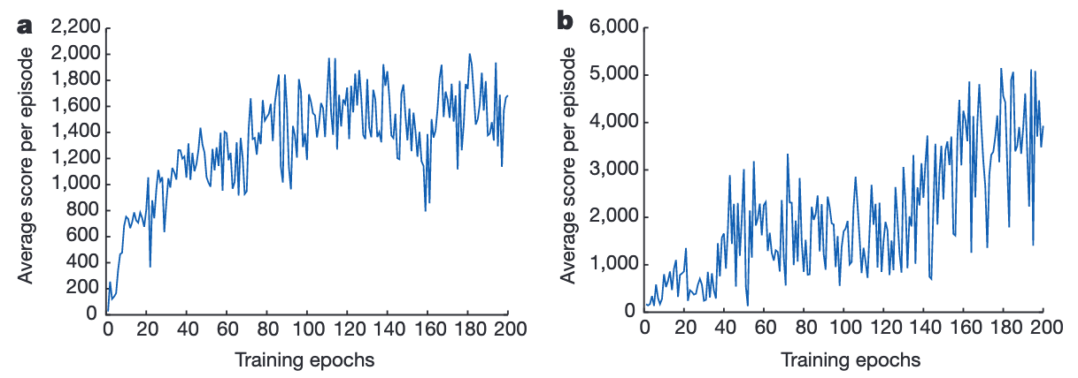
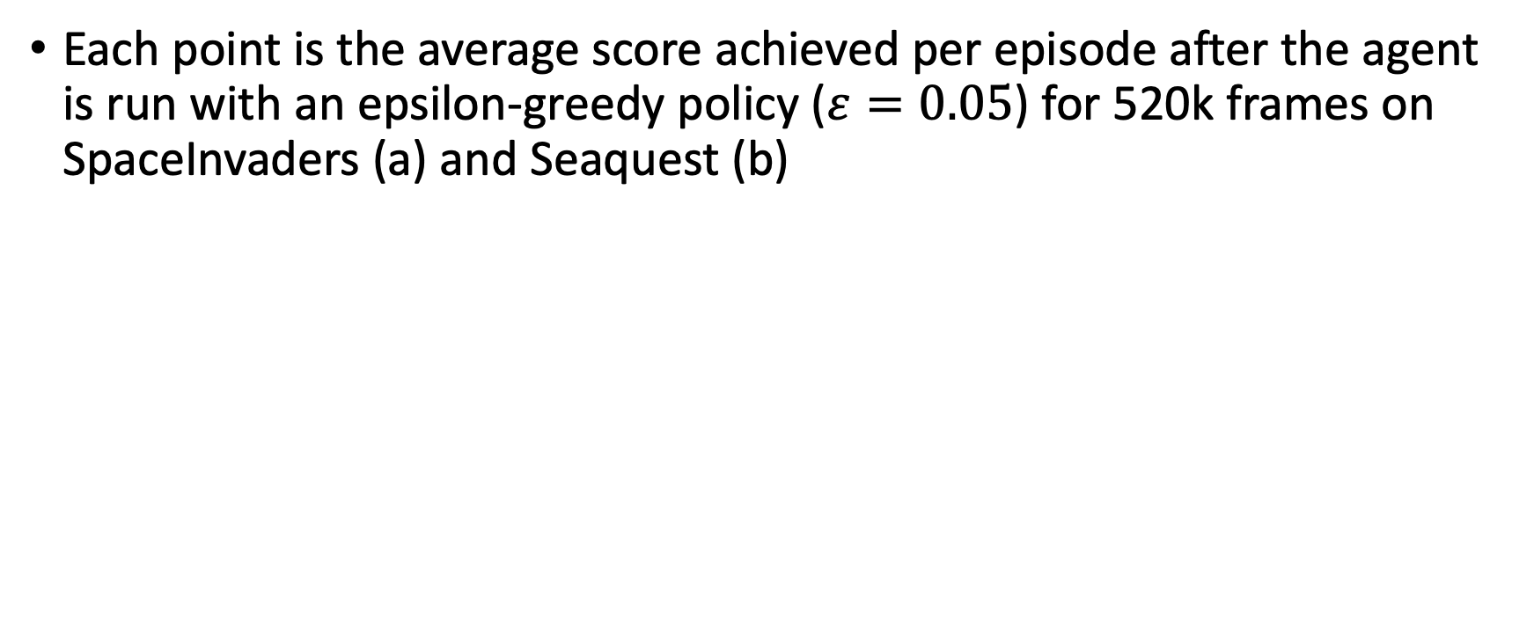
Results: DQN
Each point is the average score achieved per episode after the agent is run with an epsilon-greedy policy ($ε=0.05$) for 520k frames on SpaceInvaders (a) and Seaquest (b)

Slide 31
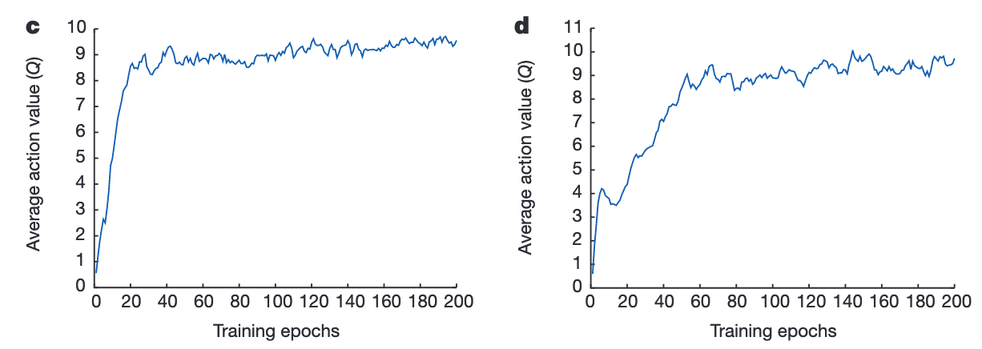
Results: DQN
Average predicted action-value on a held-out set of states on Space Invaders (c) and Seaquest (d)

Slide 32
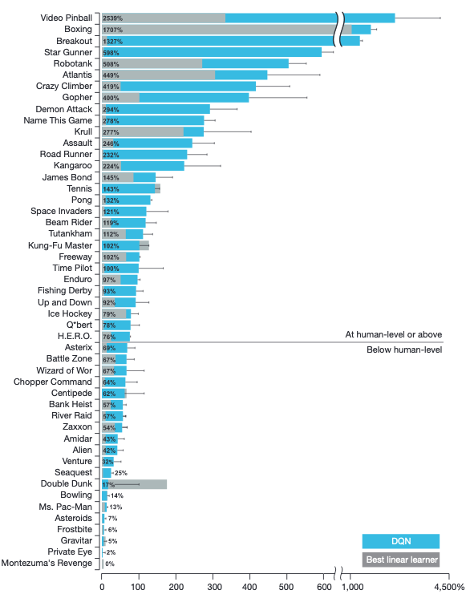
Normalized between a professional human games tester (100%) and random play (0%)
  The normalized performance of DQN is: 100x(DQN score-random play score)/(human score-random play score)

Slide 33
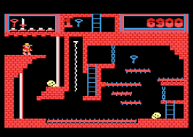
Montezuma revenge
Long-term planning
Sparse rewards

Slide 34
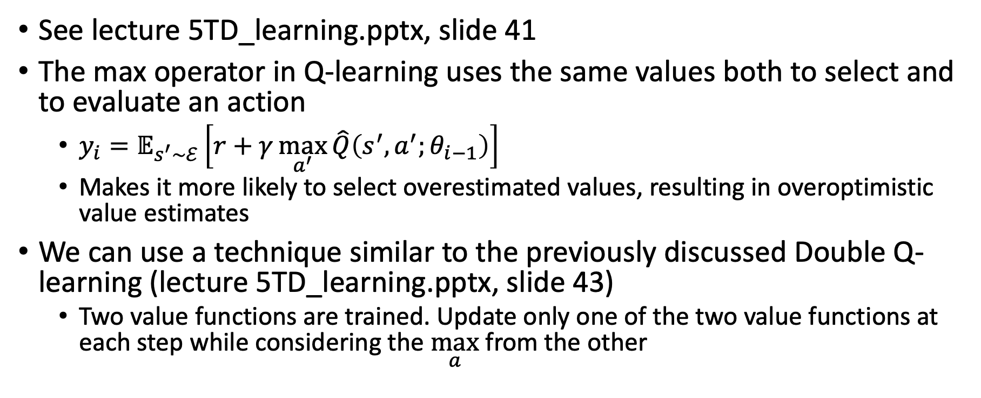
Maximization bias
See lecture 5TD_learning.pptx, slide 41
The max operator in Q-learning uses the same values both to select and to evaluate an action
  $y_{i}=𝔼_{s^{′}\sim ℰ}\left[r+γ\max_{a^{′}}{\hat{Q}\left(s^{′},a^{′};θ_{i−1}\right)}\right]$
  Makes it more likely to select overestimated values, resulting in overoptimistic value estimates
We can use a technique similar to the previously discussed Double Q-learning (lecture 5TD_learning.pptx, slide 43)
  Two value functions are trained. Update only one of the two value functions at each step while considering the $\max_{a}$ from the other

Slide 35
Double Deep Q networks (DDQN)
We have two available Q networks. Let's use them for double learning

Slide 36

Double Deep Q networks (DDQN)
We have two available Q networks. Let's use them for double learning
$$r_{j}+γ\hat{Q}\left(φ_{j+1},\arg{\max_{a^{′}}{Q\left(φ_{j+1},a^{′};θ\right),θ^{−}}}\right)$$

Slide 37
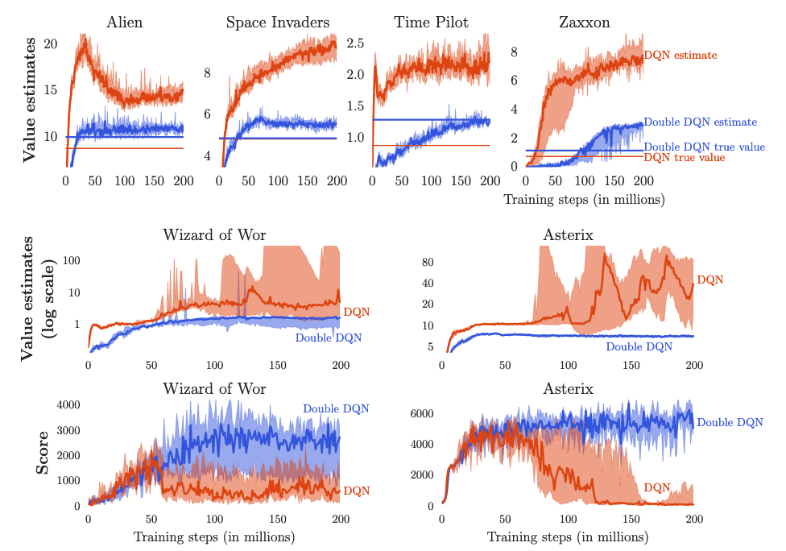
Hasselt et al. 2015
The straight horizontal orange (for DQN) and blue (for Double DQN) lines in the top row are computed by running the corresponding agents after learning concluded, and averaging the actual discounted return obtained from each visited state. These straight lines would match the learning curves at the right side of the plots if there is no bias.

Slide 38
What did we learn?
Using deep neural networks as function approximators in RL is tricky
  Sparse samples
  Correlated samples
  Evolving policy (nonstationary sample distribution)
DQN attempts to address these issues
  Reuse previous transitions (reply memory)
  Randomly sample previous transitions to break correlation
  Use off-policy, TD(0) learning to allow convergence to the true target values (Q*)
    No guarantees for non-linear (DNN) approximators

Slide 39
What next?
Lecture: Policy Gradient
Assignments:
  Deep Q-Learning, by Monday Nov. 4, EOD
Quiz (on Canvas):
  Deep Q-Learning, by Oct. 28, EOD
  Eligibility Traces, by Oct. 21, EOD
Project:
  Literature survey, by Monday, November 4 EOD

