Slide 1

CSCE-642 Reinforcement Learning
Ch 12: Eligibility Traces
Instructor: Guni Sharon

Slide 2
CSCE-689, Reinforcement Learning
Stateless decision process
Monte-Carlo
Policy gradient
Actor-critic
Markov decision process
Temporal difference
Function approximators
Solving MDPs (offline)
Dynamic programming
Tabular methods
Deep RL

Slide 3
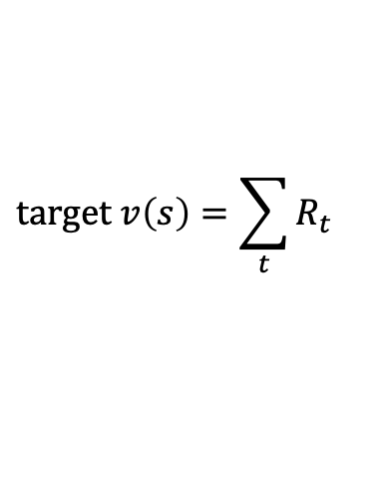

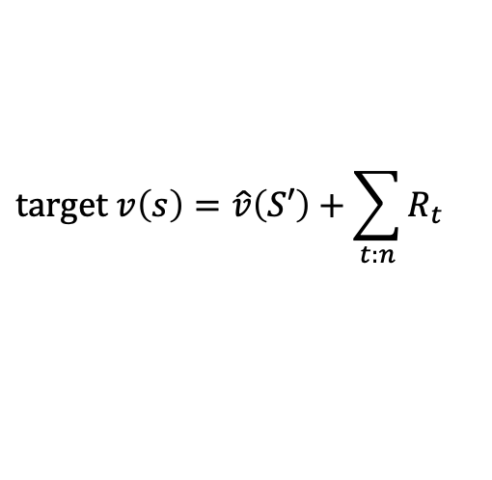
So far…
TD(0) – propagate state/action values from immediate neighbor/s
  Q-learning, SARSA
  Biased samples
Monte Carlo TD(1) - update state/action value according to return from a full episode
  High variance samples
  On policy
Combine the two to balance bias and variance
  n-step return
$$target v\left(s\right)=R+\hat{v}\left(S′\right)$$
S
S’
$$target v\left(s\right)=\sum_{t}{R_{t}}$$
S
$$target v\left(s\right)=\hat{v}\left(S′\right)+\sum_{t:n}{R_{t}}$$
S
S’

Slide 4

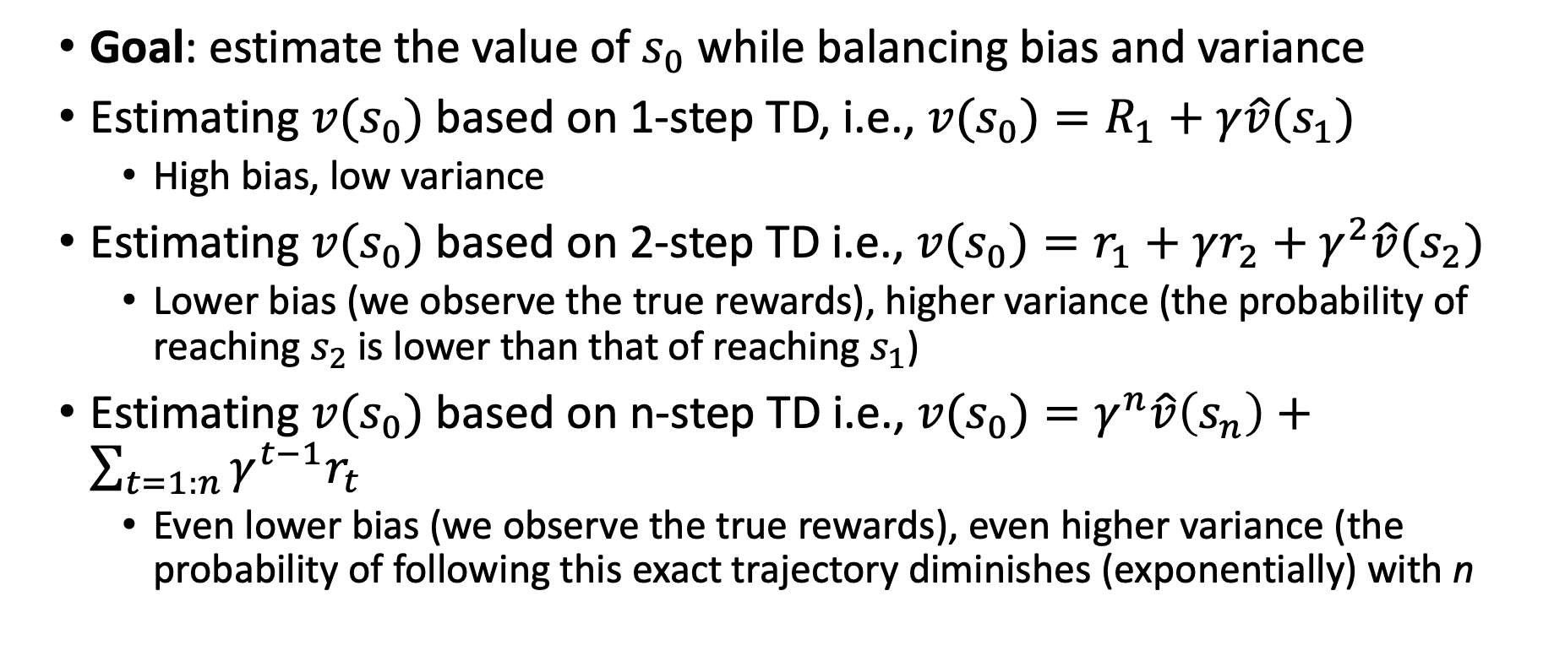



n-step return intuition
$$s_{0}$$
$$s_{1}$$
$$s_{2}$$
$$s_{n}$$
Goal: estimate the value of $s_{0}$ while balancing bias and variance
Estimating ${v(s}_{0})$ based on 1-step TD, i.e., ${v(s}_{0})=R_{1}+{γ\hat{v}(s}_{1})$
  High bias, low variance
Estimating ${v(s}_{0})$ based on 2-step TD i.e., ${v(s}_{0})=r_{1}+γr_{2}+γ^{2}{\hat{v}(s}_{2})$
  Lower bias (we observe the true rewards), higher variance (the probability of reaching $s_{2}$ is lower than that of reaching $s_{1}$)
Estimating ${v(s}_{0})$ based on n-step TD i.e., ${v(s}_{0})=γ^{n}\hat{v}\left(s_{n}\right)+\sum_{t=1:n}{γ^{t−1}r_{t}}$
  Even lower bias (we observe the true rewards), even higher variance (the probability of following this exact trajectory diminishes (exponentially) with n

Slide 5





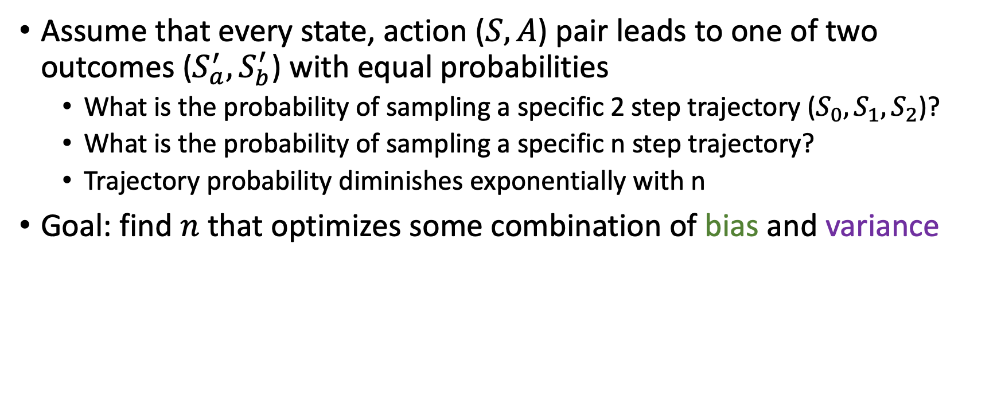





n-step return intuition
$$s_{a}$$
$$s_{a}$$
$$s_{b}$$
$$s_{a}$$
$$s_{b}$$
$$s_{a}$$
$$s_{b}$$
$$s_{a}$$
$$s_{b}$$
Assume that every state, action ($S,A$) pair leads to one of two outcomes ($S_{a}^{′},S_{b}^{′}$) with equal probabilities
  What is the probability of sampling a specific 2 step trajectory ($S_{0},S_{1},S_{2}$)?
  What is the probability of sampling a specific n step trajectory?
  Trajectory probability diminishes exponentially with n
Goal: find $n$ that optimizes some combination of bias and variance
$$n$$

Slide 6
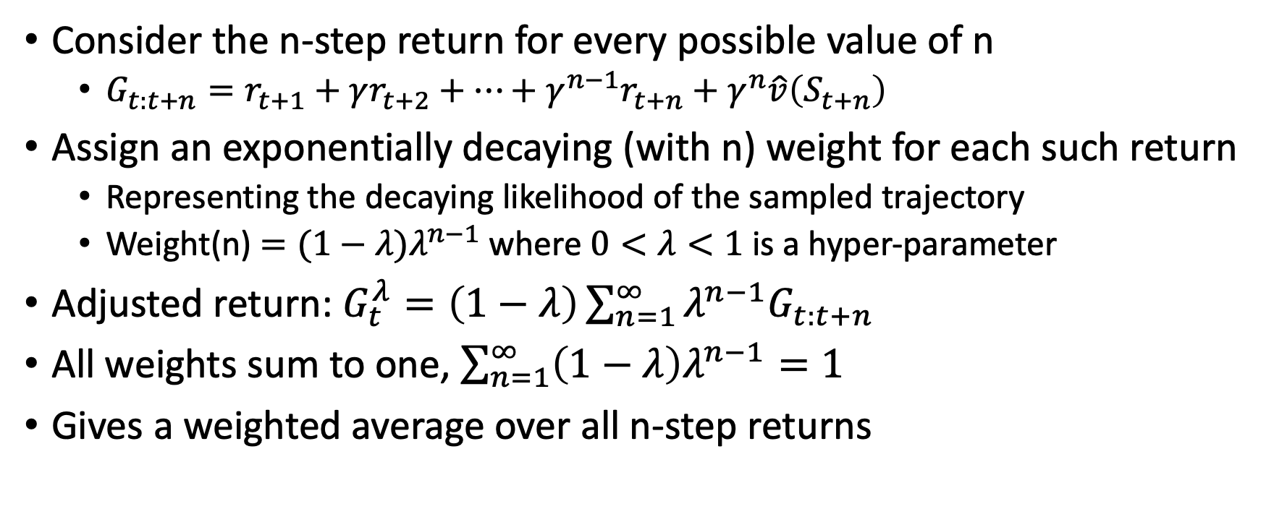
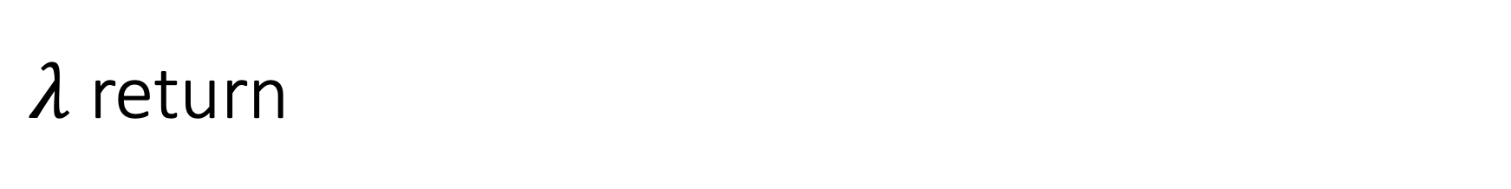
$λ$ return
$$s_{0}$$
$$s_{1}$$
$$s_{2}$$
$$s_{n}$$
Consider the n-step return for every possible value of n
  $G_{t:t+n}=r_{t+1}+γr_{t+2}+…+γ^{n−1}r_{t+n}+γ^{n}\hat{v}\left(S_{t+n}\right)$
Assign an exponentially decaying (with n) weight for each such return
  Representing the decaying likelihood of the sampled trajectory
  Weight(n) $=(1−λ)λ^{n−1}$ where $0<λ<1$ is a hyper-parameter
Adjusted return: $G_{t}^{λ}=\left(1−λ\right)\sum_{n=1}^{∞}{λ^{n−1}G_{t:t+n}}$
All weights sum to one, $\sum_{n=1}^{∞}{\left(1−λ\right)λ^{n−1}=1}$
Gives a weighted average over all n-step returns

Slide 7
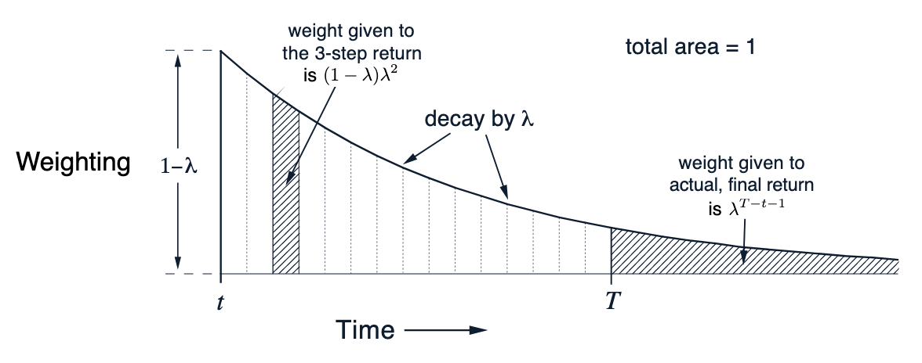
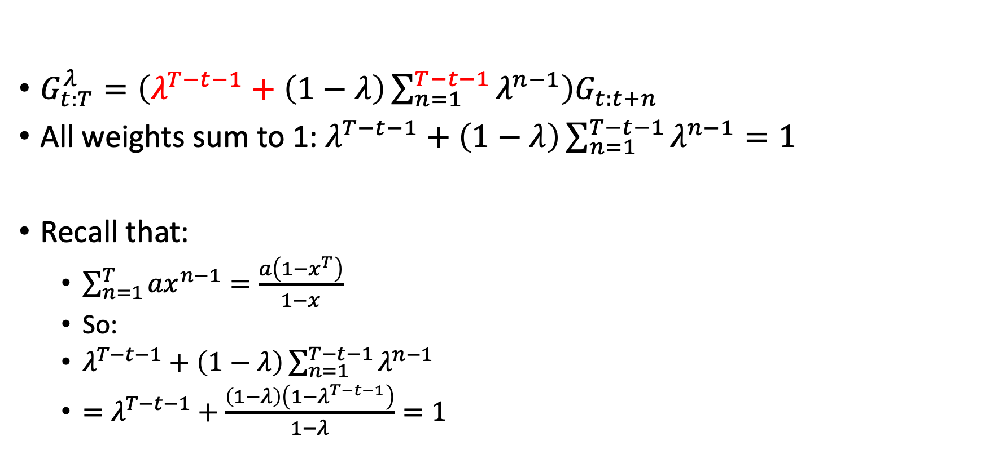
Bounded horizon (T) adjustments
$G_{t:T}^{λ}=\left(λ^{T−t−1}+\left(1−λ\right)\sum_{n=1}^{T−t−1}{λ^{n−1}}\right)G_{t:t+n}$
All weights sum to 1: $λ^{T−t−1}+\left(1−λ\right)\sum_{n=1}^{T−t−1}{λ^{n−1}}=1$
Recall that:
  $\sum_{n=1}^{T}{{ax}^{n−1}=\frac{a\left(1−x^{T}\right)}{1−x}}$
  So:
  $λ^{T−t−1}+\left(1−λ\right)\sum_{n=1}^{T−t−1}{λ^{n−1}}$
  $=λ^{T−t−1}+\frac{\left(1−λ\right)\left(1−λ^{T−t−1}\right)}{1−λ}=1$

Slide 8
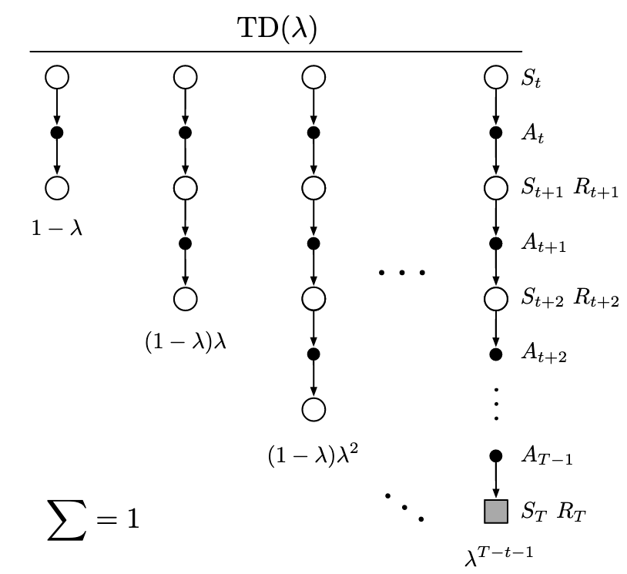
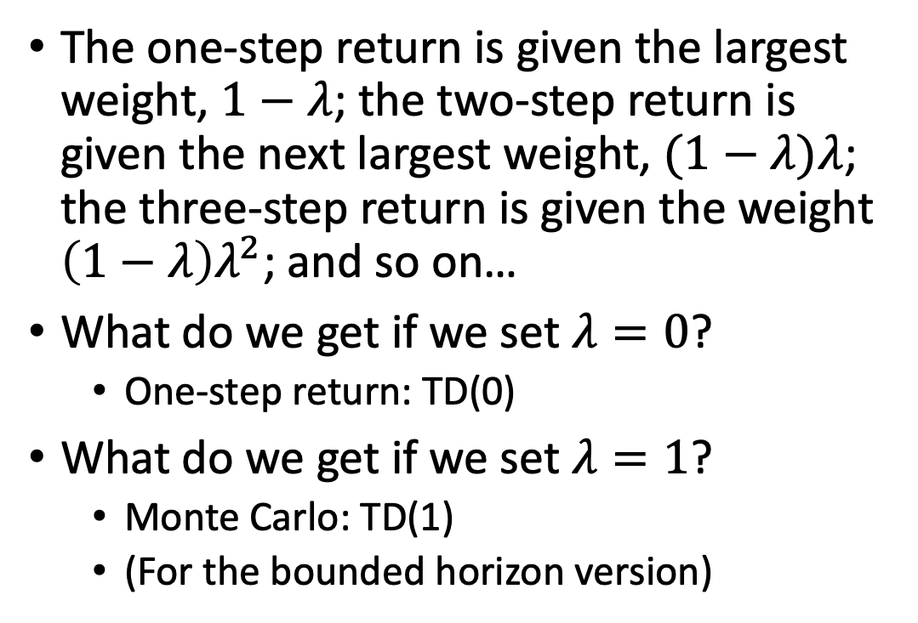
$λ$ return
The one-step return is given the largest weight, $1−λ$; the two-step return is given the next largest weight, $(1−λ)λ$; the three-step return is given the weight $\left(1−λ\right)λ^{2}$; and so on…
What do we get if we set $λ=0$?
  One-step return: TD(0)
What do we get if we set $λ=1$?
  Monte Carlo: TD(1)
  (For the bounded horizon version)

Slide 9
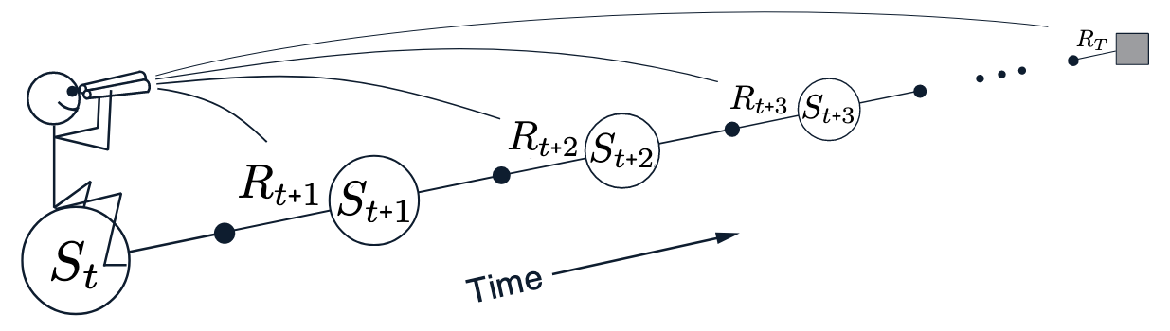
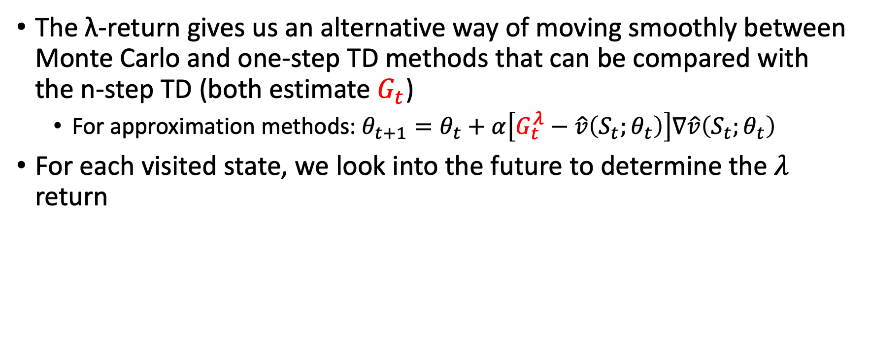
$λ$ return
The λ-return gives us an alternative way of moving smoothly between Monte Carlo and one-step TD methods that can be compared with the n-step TD (both estimate $G_{t}$)
  For approximation methods: $θ_{t+1}=θ_{t}+α\left[G_{t}^{λ}−\hat{v}\left(S_{t};θ_{t}\right)\right]∇\hat{v}\left(S_{t};θ_{t}\right)$
For each visited state, we look into the future to determine the $λ$ return

Slide 10
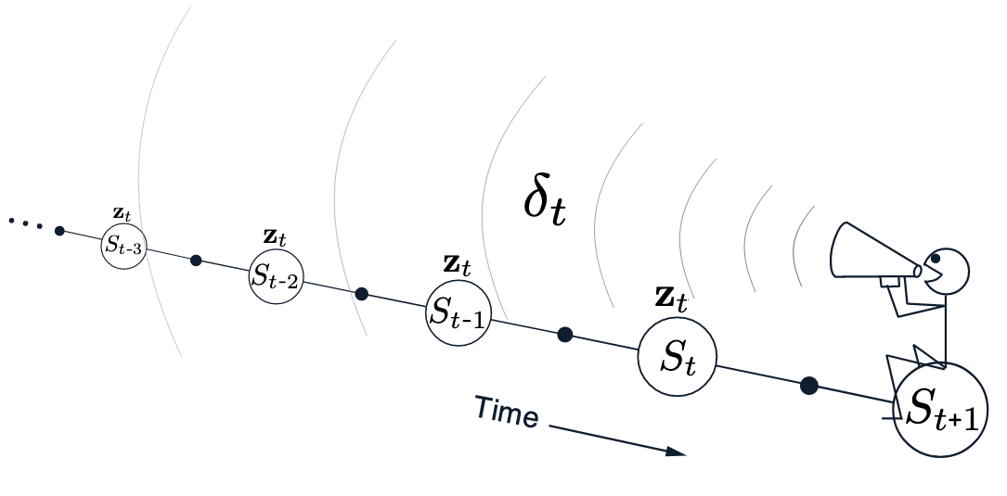
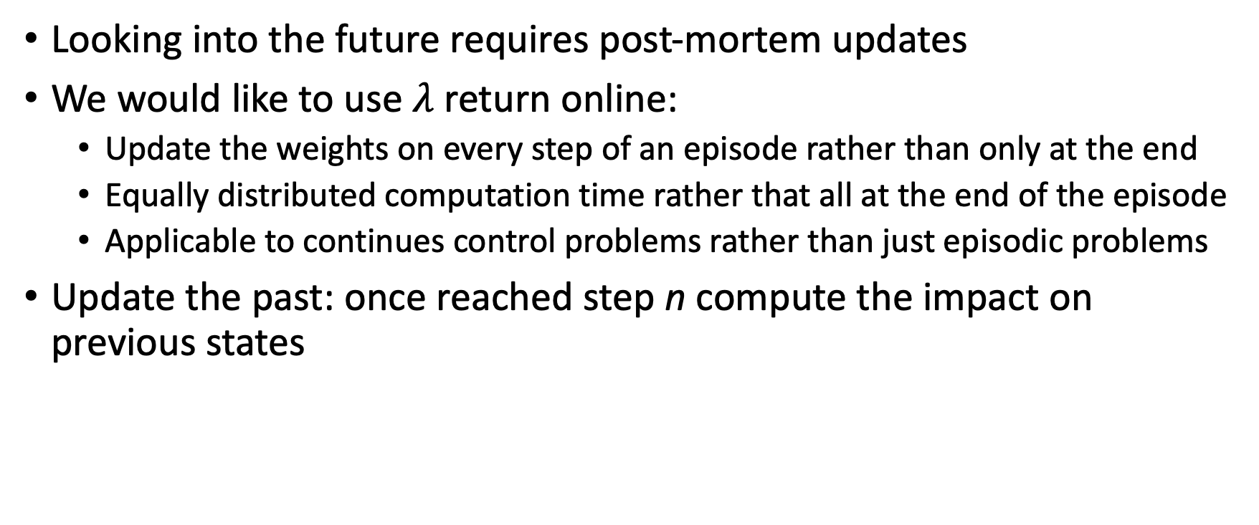
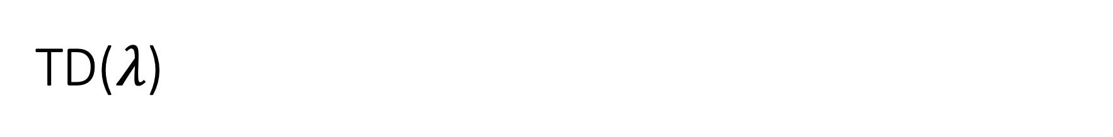
TD($λ$)
Looking into the future requires post-mortem updates
We would like to use $λ$ return online:
  Update the weights on every step of an episode rather than only at the end
  Equally distributed computation time rather that all at the end of the episode
  Applicable to continues control problems rather than just episodic problems
Update the past: once reached step n compute the impact on previous states

Slide 11
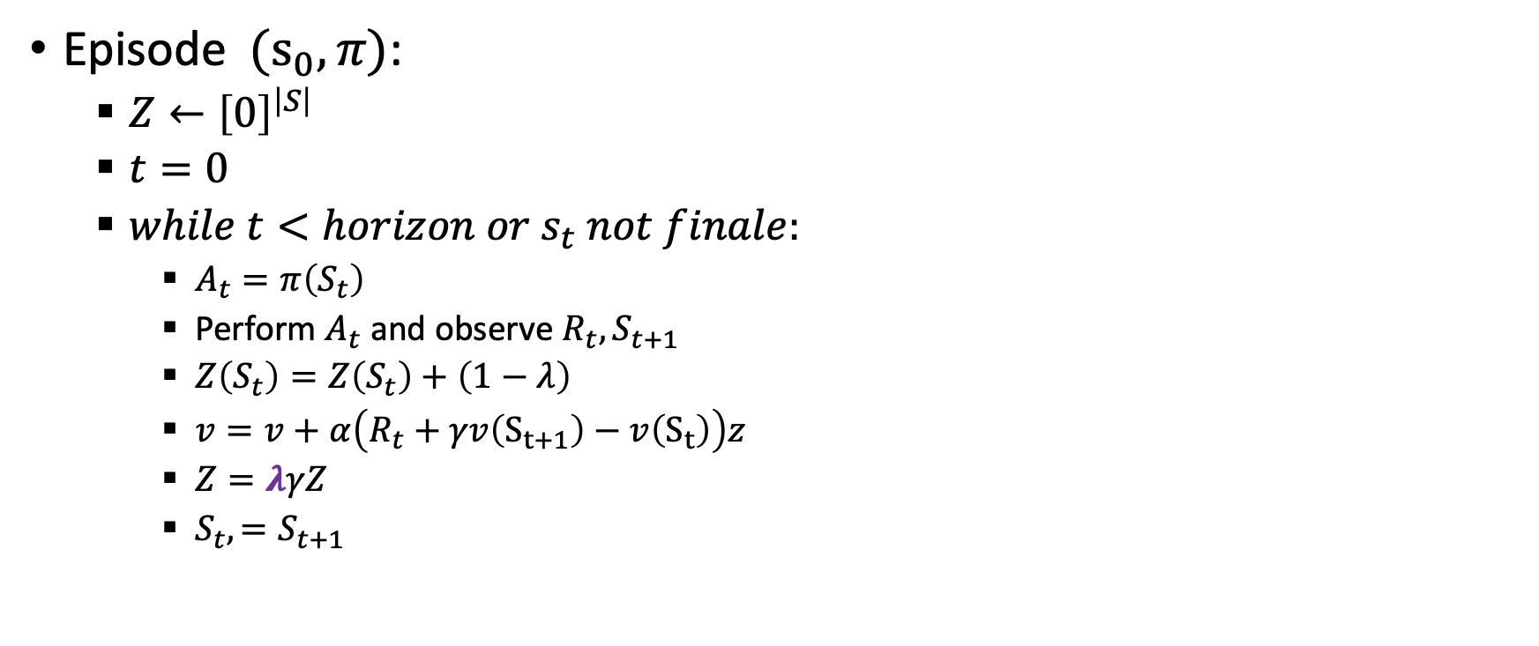

Tabular TD$\left(λ\right)$ for estimating $v_{π}$
Episode $(s_{0},π)$:
  $Z←{\left[0\right]}^{\left|S\right|}$
  $t=0$
  $while t<horizon or s_{t} not finale:$
    $A_{t}=π\left(S_{t}\right)$
    Perform $A_{t}$ and observe ${R_{t}, S}_{t+1}$
    $Z\left(S_{t}\right)=Z\left(S_{t}\right)+\left(1−λ\right)$
    $v=v+α\left(R_{t}+γv\left(S_{t+1}\right)−v\left(S_{t}\right)\right)z$
    $Z=λγZ$
    ${S_{t},=S}_{t+1}$
The eligibility to learn from the last action
In many implementations this will be replaced with 1: no problem as this is a constant that can be seen as part of the learning rate 𝛼 (the weights won’t sum to 1 though)

Slide 12

Tabular TD$\left(λ\right)$ for estimating $v_{π}$
Episode $(s_{0},π)$:
  $Z←{\left[0\right]}^{\left|S\right|}$
  $t=0$
  $while t<horizon or s_{t} not finale:$
    $A_{t}=π\left(S_{t}\right)$
    Perform $A_{t}$ and observe ${R_{t}, S}_{t+1}$
    $Z\left(S_{t}\right)=Z\left(S_{t}\right)+\left(1−λ\right)$
    $v=v+α\left(R_{t}+γv\left(S_{t+1}\right)−v\left(S_{t}\right)\right)z$
    $Z=λγZ$
    ${S_{t},=S}_{t+1}$
Update all states based on their current eligibility (vector notation)
The eligibility to learn from the last action
In many implementations this will be replaced with 1: no problem as this is a constant that can be seen as part of the learning rate 𝛼 (the weights won’t sum to 1 though)
The TD error ($δ$)
The eligibility vector for this update

Slide 13
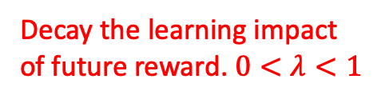
Tabular TD$\left(λ\right)$ for estimating $v_{π}$
Episode $(s_{0},π)$:
  $Z←{\left[0\right]}^{\left|S\right|}$
  $t=0$
  $while t<horizon or s_{t} not finale:$
    $A_{t}=π\left(S_{t}\right)$
    Perform $A_{t}$ and observe ${R_{t}, S}_{t+1}$
    $Z\left(S_{t}\right)=Z\left(S_{t}\right)+\left(1−λ\right)$
    $v=v+α\left(R_{t}+γv\left(S_{t+1}\right)−v\left(S_{t}\right)\right)z$
    $Z=λγZ$
    ${S_{t},=S}_{t+1}$
Update all states based on their current eligibility (vector notation)
The eligibility to learn from the last action
In many implementations this will be replaced with 1: no problem as this is a constant that can be seen as part of the learning rate 𝛼 (the weights won’t sum to 1 though)
Decay the learning impact of future reward. $0<λ<1$
The eligibility vector for this update
The TD error ($δ$)

Slide 14
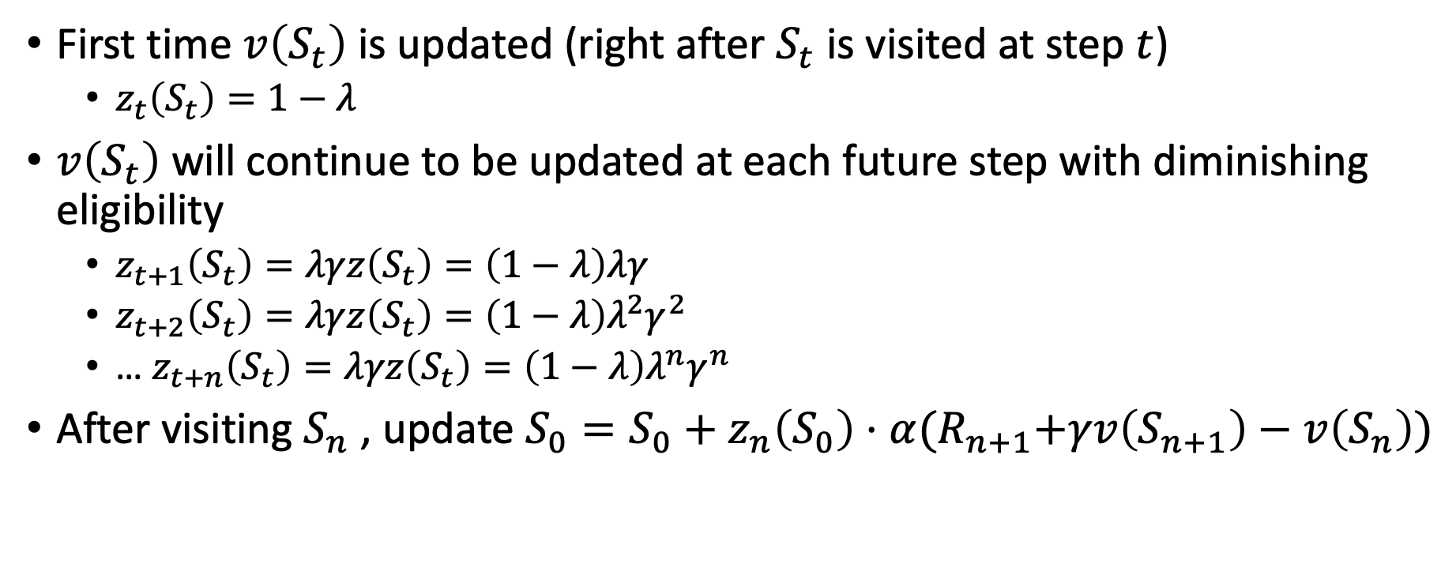
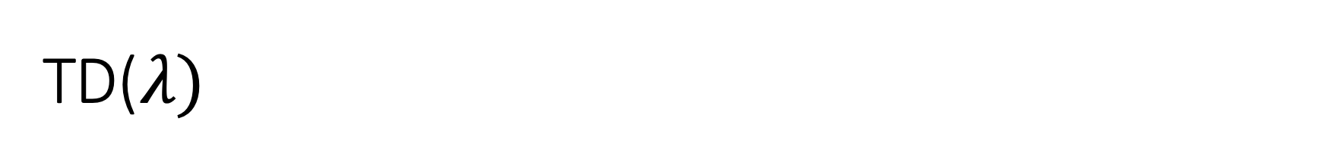
TD($λ)$
First time $v\left(S_{t}\right)$ is updated (right after $S_{t}$ is visited at step $t$)
  $z_{t}\left(S_{t}\right)=1−λ$
$v\left(S_{t}\right)$ will continue to be updated at each future step with diminishing eligibility
  $z_{t+1}\left(S_{t}\right)=λγz\left(S_{t}\right)=\left(1−λ\right)λγ$
  $z_{t+2}\left(S_{t}\right)=λγz\left(S_{t}\right)=\left(1−λ\right)λ^{2}γ^{2}$
  … $z_{t+n}\left(S_{t}\right)=λγz\left(S_{t}\right)=\left(1−λ\right)λ^{n}γ^{n}$
After visiting $S_{n}$ , update $S_{0}=S_{0}+z_{n}\left(S_{0}\right)⋅α{(R}_{n+1}+γv\left(S_{n+1}\right)−v\left(S_{n}\right))$
$$s_{0}$$
$$s_{1}$$
$$s_{2}$$
$$s_{n}$$

Slide 15
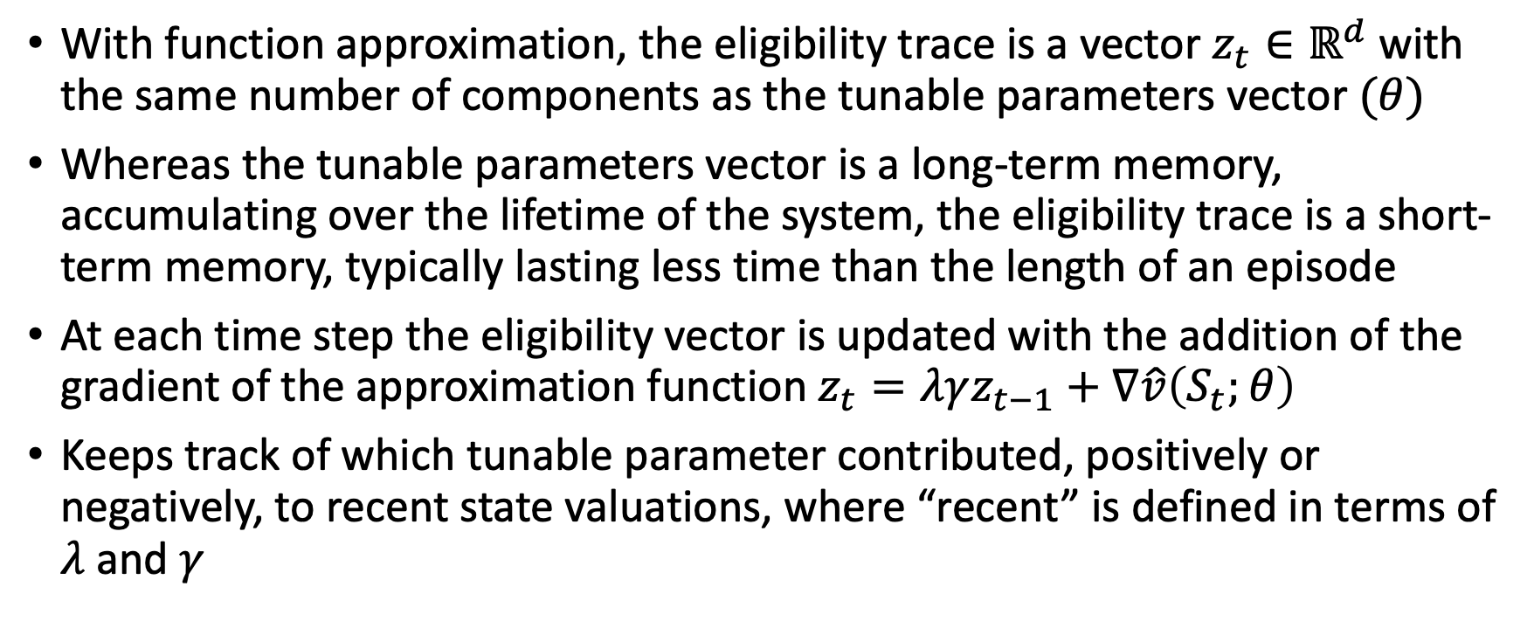
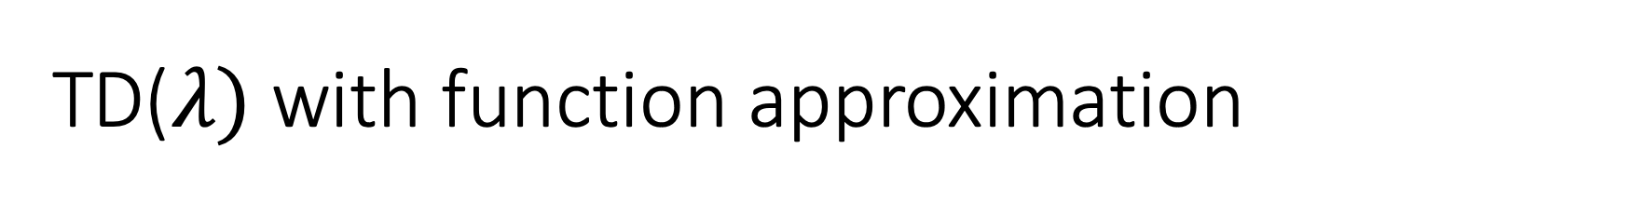
TD($λ)$ with function approximation
With function approximation, the eligibility trace is a vector $z_{t}∈ℝ^{d}$with the same number of components as the tunable parameters vector $(θ)$
Whereas the tunable parameters vector is a long-term memory, accumulating over the lifetime of the system, the eligibility trace is a short-term memory, typically lasting less time than the length of an episode
At each time step the eligibility vector is updated with the addition of the gradient of the approximation function $z_{t}=λγz_{t−1}+∇\hat{v}\left(S_{t};θ\right)$
Keeps track of which tunable parameter contributed, positively or negatively, to recent state valuations, where “recent” is defined in terms of $λ$ and $γ$

Slide 16
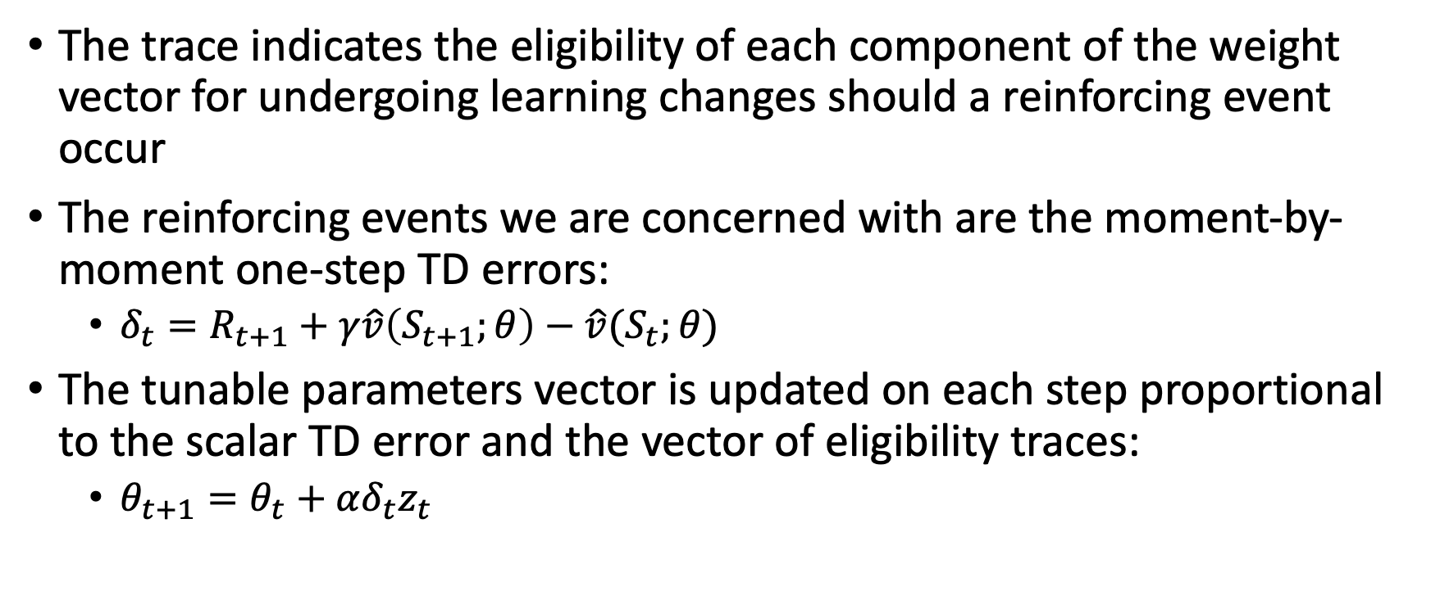
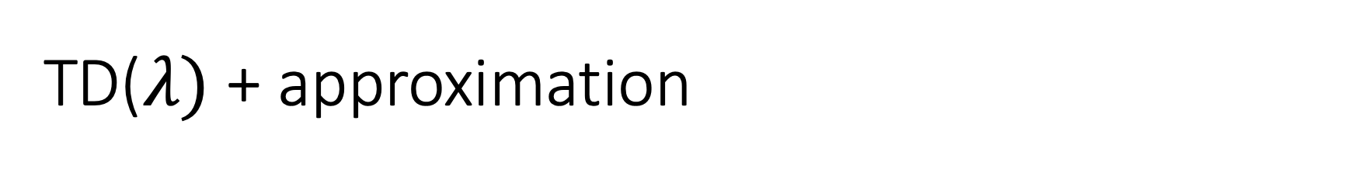
TD($λ)$ + approximation
The trace indicates the eligibility of each component of the weight vector for undergoing learning changes should a reinforcing event occur
The reinforcing events we are concerned with are the moment-by-moment one-step TD errors:
  $δ_{t}=R_{t+1}+γ\hat{v}\left(S_{t+1};θ\right)−\hat{v}(S_{t};θ)$
The tunable parameters vector is updated on each step proportional to the scalar TD error and the vector of eligibility traces:
  $θ_{t+1}=θ_{t}+αδ_{t}z_{t}$

Slide 17
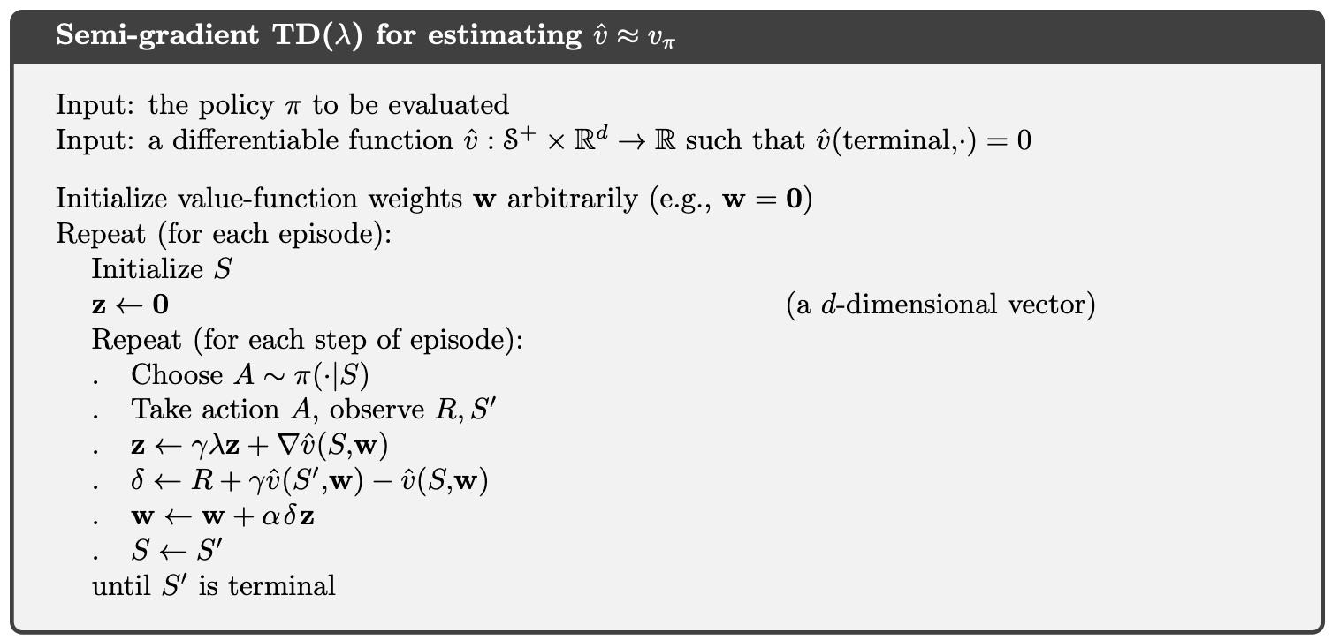
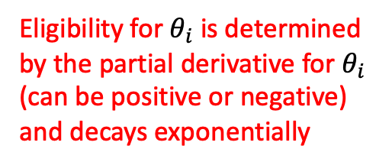
Eligibility for $θ_{i}$ is determined by the partial derivative for $θ_{i}$ (can be positive or negative) and decays exponentially

Slide 18


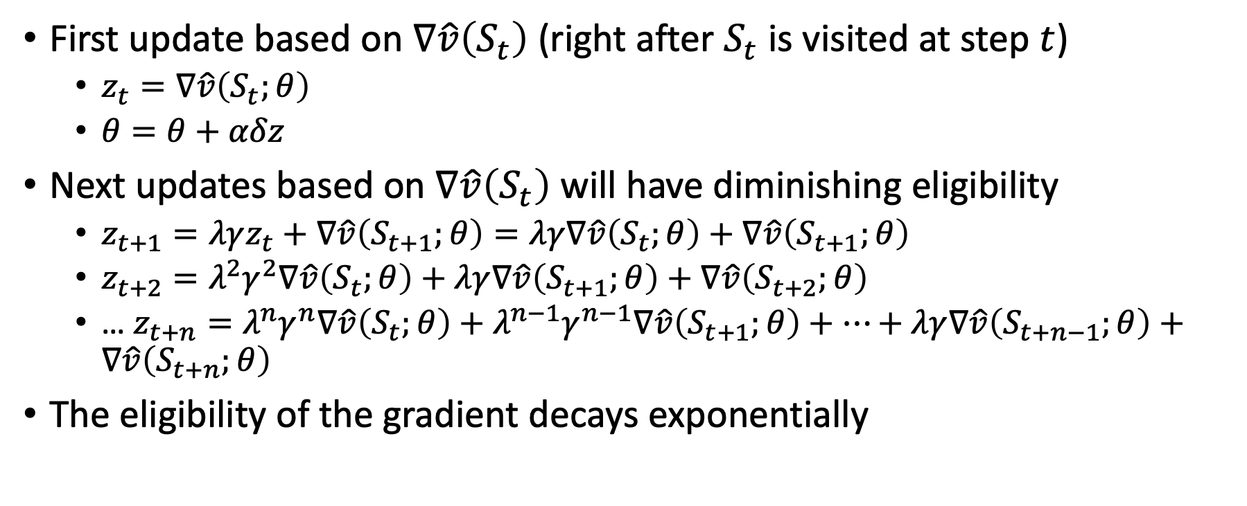








Semi-gradient TD$(λ)$
First update based on $∇\hat{v}\left(S_{t}\right)$ (right after $S_{t}$ is visited at step $t$)
  $z_{t}=∇\hat{v}\left(S_{t};θ\right)$
  $θ=θ+αδz$
Next updates based on $∇\hat{v}\left(S_{t}\right)$ will have diminishing eligibility
  $z_{t+1}=λγz_{t}+∇\hat{v}\left(S_{t+1};θ\right)=λγ∇\hat{v}\left(S_{t};θ\right)+∇\hat{v}\left(S_{t+1};θ\right)$
  $z_{t+2}=λ^{2}γ^{2}∇\hat{v}\left(S_{t};θ\right)+λγ∇\hat{v}\left(S_{t+1};θ\right)+∇\hat{v}\left(S_{t+2};θ\right)$
  … $z_{t+n}=λ^{n}γ^{n}∇\hat{v}\left(S_{t};θ\right)+λ^{n−1}γ^{n−1}∇\hat{v}\left(S_{t+1};θ\right)+…+λγ∇\hat{v}\left(S_{t+n−1};θ\right)+∇\hat{v}\left(S_{t+n};θ\right)$
The eligibility of the gradient decays exponentially
$$∇_{4}$$
$$∇_{3}$$
$$∇_{2}$$
$$∇_{1}$$
$$z_{4}$$
$$+$$
$$=$$
$$s_{0}$$
$$s_{1}$$
$$s_{2}$$
$$s_{n}$$
$$+$$
$$+$$

Slide 19
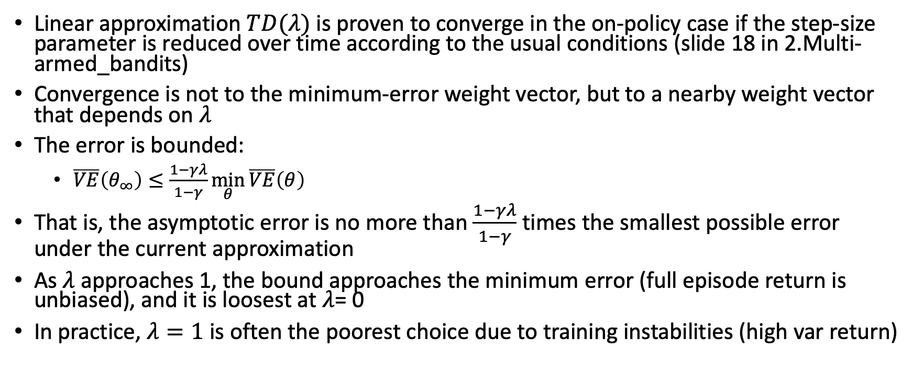
Theoretical properties
Linear approximation $TD(λ)$is proven to converge in the on-policy case if the step-size parameter is reduced over time according to the usual conditions (slide 18 in 2.Multi-armed_bandits)
Convergence is not to the minimum-error weight vector, but to a nearby weight vector that depends on $λ$
The error is bounded:
  $\overline{VE}\left(θ_{∞}\right)≤\frac{1−γλ}{1−γ}\min_{θ}{\overline{VE}\left(θ\right)}$
That is, the asymptotic error is no more than $\frac{1−γλ}{1−γ}$ times the smallest possible error under the current approximation
As $λ$ approaches 1, the bound approaches the minimum error (full episode return is unbiased), and it is loosest at $λ$= 0
In practice, $λ=1$is often the poorest choice due to training instabilities (high var return)

Slide 20
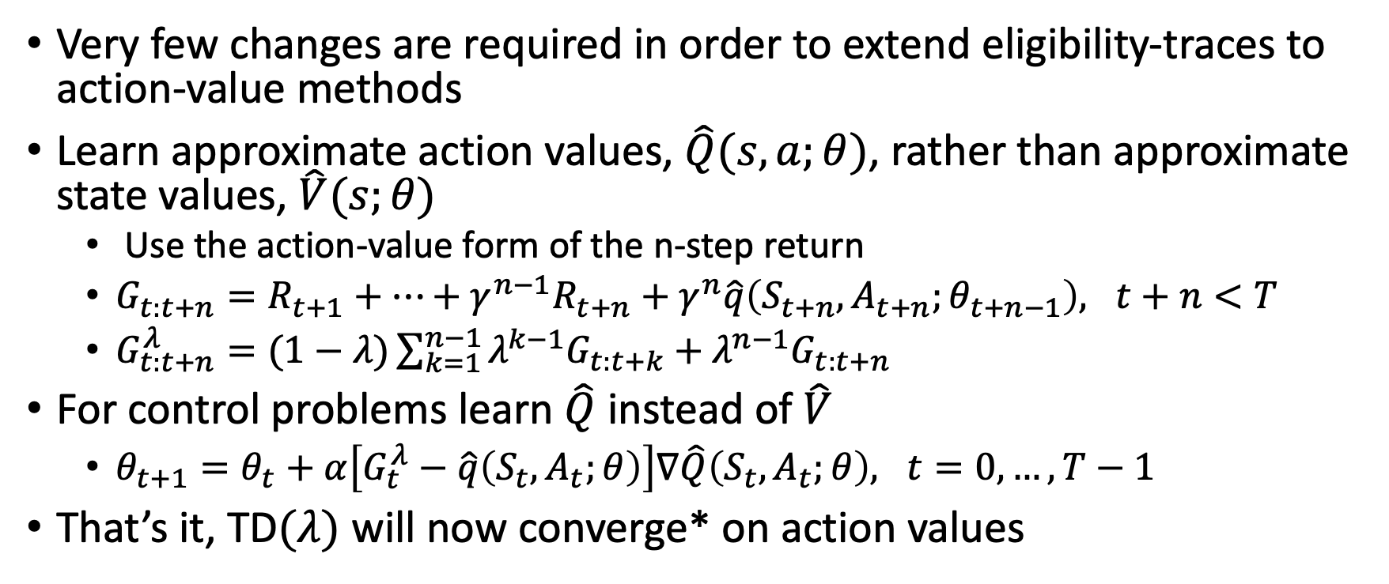
Learning action values
Very few changes are required in order to extend eligibility-traces to action-value methods
Learn approximate action values, $\hat{Q}(s,a;θ)$, rather than approximate state values, $\hat{V}(s;θ)$
  Use the action-value form of the n-step return
  $G_{t:t+n}=R_{t+1}+…+γ^{n−1}R_{t+n}+γ^{n}\hat{q}\left(S_{t+n},A_{t+n};θ_{t+n−1}\right), t+n<T$
  $G_{t:t+n}^{λ}=(1−λ)\sum_{k=1}^{n−1}{λ^{k−1}G_{t:t+k}+λ^{n−1}G_{t:t+n}}$
For control problems learn $\hat{Q}$ instead of $\hat{V}$
  $θ_{t+1}=θ_{t}+α\left[G_{t}^{λ}−\hat{q}\left(S_{t},A_{t};θ\right)\right]∇\hat{Q}\left(S_{t},A_{t};θ\right), t=0,…,T−1$
That’s it, TD$(λ)$ will now converge* on action values

Slide 21
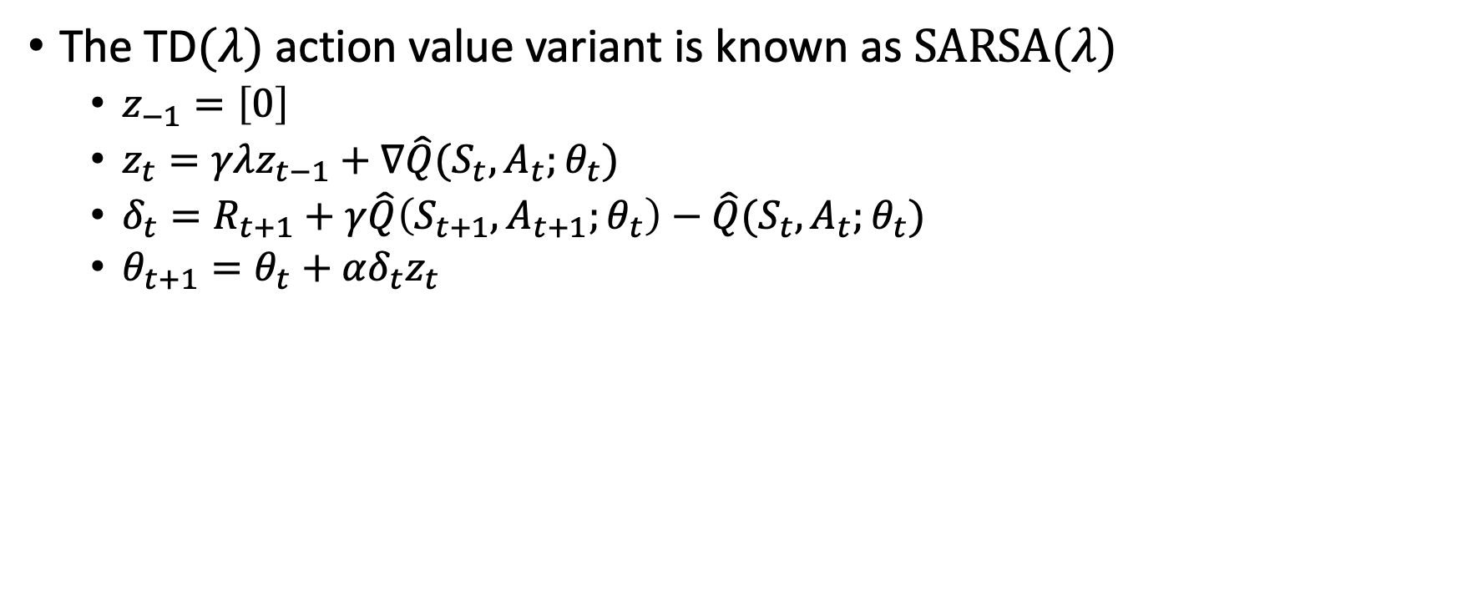

Sarsa$(λ)$
The TD$(λ)$ action value variant is known as $SARSA(λ)$
  $z_{−1}=\left[0\right]$
  $z_{t}=γλz_{t−1}+∇\hat{Q}(S_{t},A_{t};θ_{t})$
  $δ_{t}=R_{t+1}+γ\hat{Q}\left(S_{t+1},A_{t+1};θ_{t}\right)−\hat{Q}(S_{t},A_{t};θ_{t})$
  $θ_{t+1}=θ_{t}+αδ_{t}z_{t}$

Slide 22
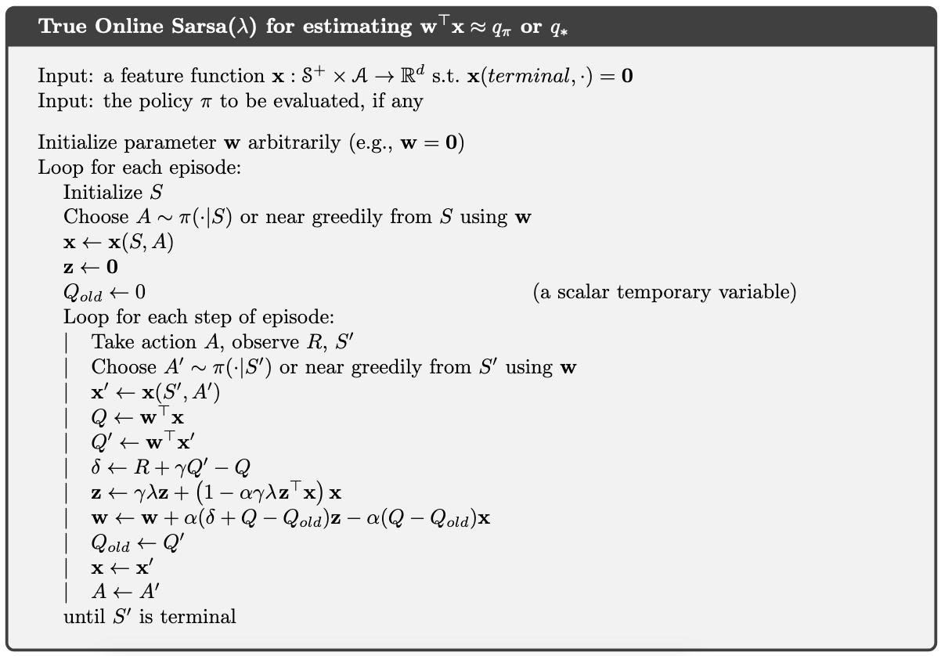
Online SARSA with Linear approximator

Slide 23
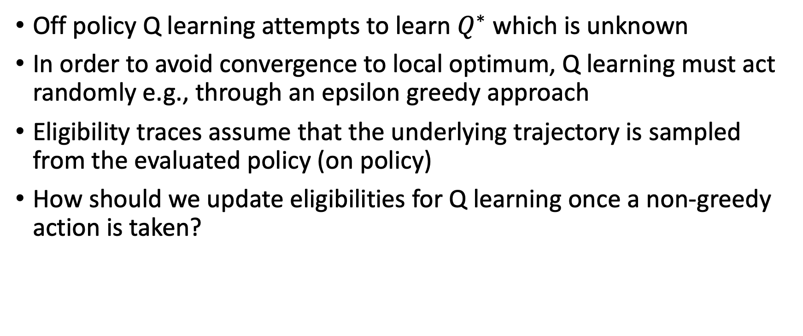
Q learning with eligibility traces
Off policy Q learning attempts to learn $Q^{∗}$ which is unknown
In order to avoid convergence to local optimum, Q learning must act randomly e.g., through an epsilon greedy approach
Eligibility traces assume that the underlying trajectory is sampled from the evaluated policy (on policy)
How should we update eligibilities for Q learning once a non-greedy action is taken?

Slide 24
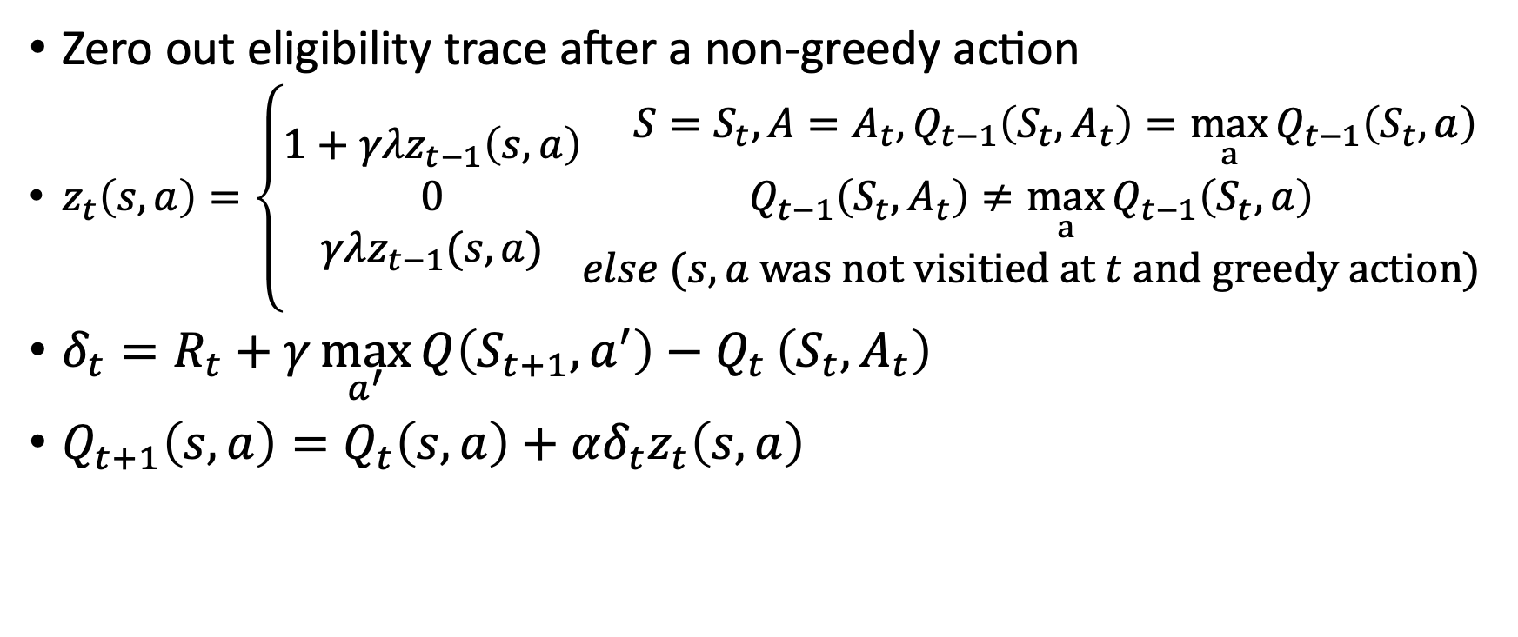

Watkins’s $Q(λ)$
Zero out eligibility trace after a non-greedy action
$z_{t}\left(s,a\right)=\left\{\begin{matrix}1+γλz_{t−1}\left(s,a\right) \\ 0 \\ γλz_{t−1}(s,a)\end{matrix}\begin{aligned} S=S_{t},A=A_{t}, Q_{t−1}\left(S_{t},A_{t}\right)=\max_{a}{Q_{t−1}\left(S_{t},a\right)} \\ Q_{t−1}\left(S_{t},A_{t}\right)≠\max_{a}{Q_{t−1}\left(S_{t},a\right)} \\ else (s,a was not visitied at t and greedy action)\end{aligned}\right.$
$δ_{t}=R_{t}+γ\max_{a^{′}}{Q\left(S_{t+1},a^{′}\right)−Q_{t}}\left(S_{t},A_{t}\right)$
$Q_{t+1}\left(s,a\right)=Q_{t}\left(s,a\right)+αδ_{t}z_{t}\left(s,a\right)$

Slide 25
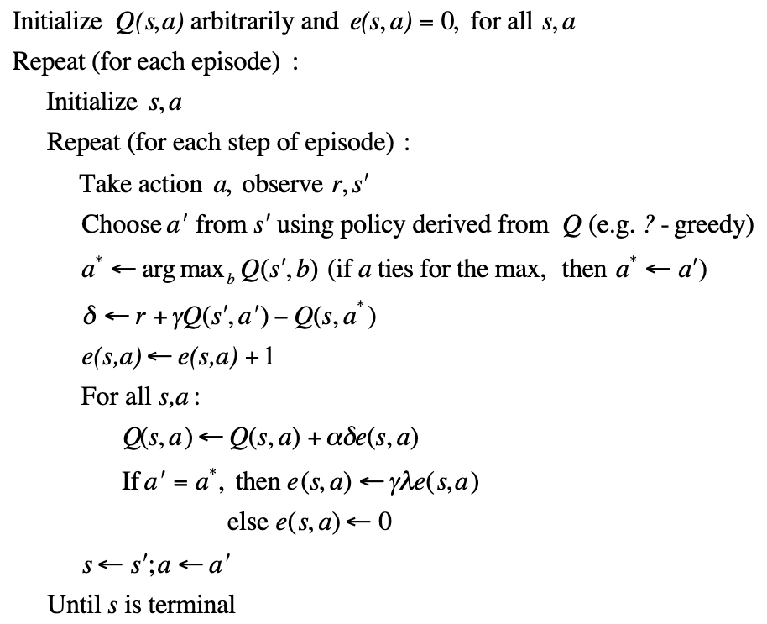

Watkins’s $Q(λ)$ – tabular version

Slide 26
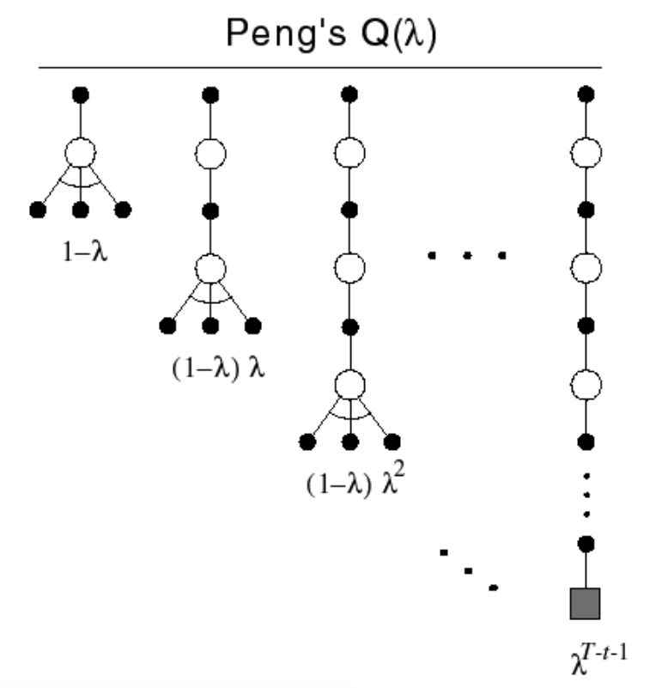

Peng’s $Q(λ)$
Disadvantage of Watkins’s method
  The eligibility trace will be “cut” (zeroed out) frequently resulting in little advantage to traces
Peng:
  Backup max action except at end
  Never cut traces
  Disadvantage: Complicated to implement

Slide 27
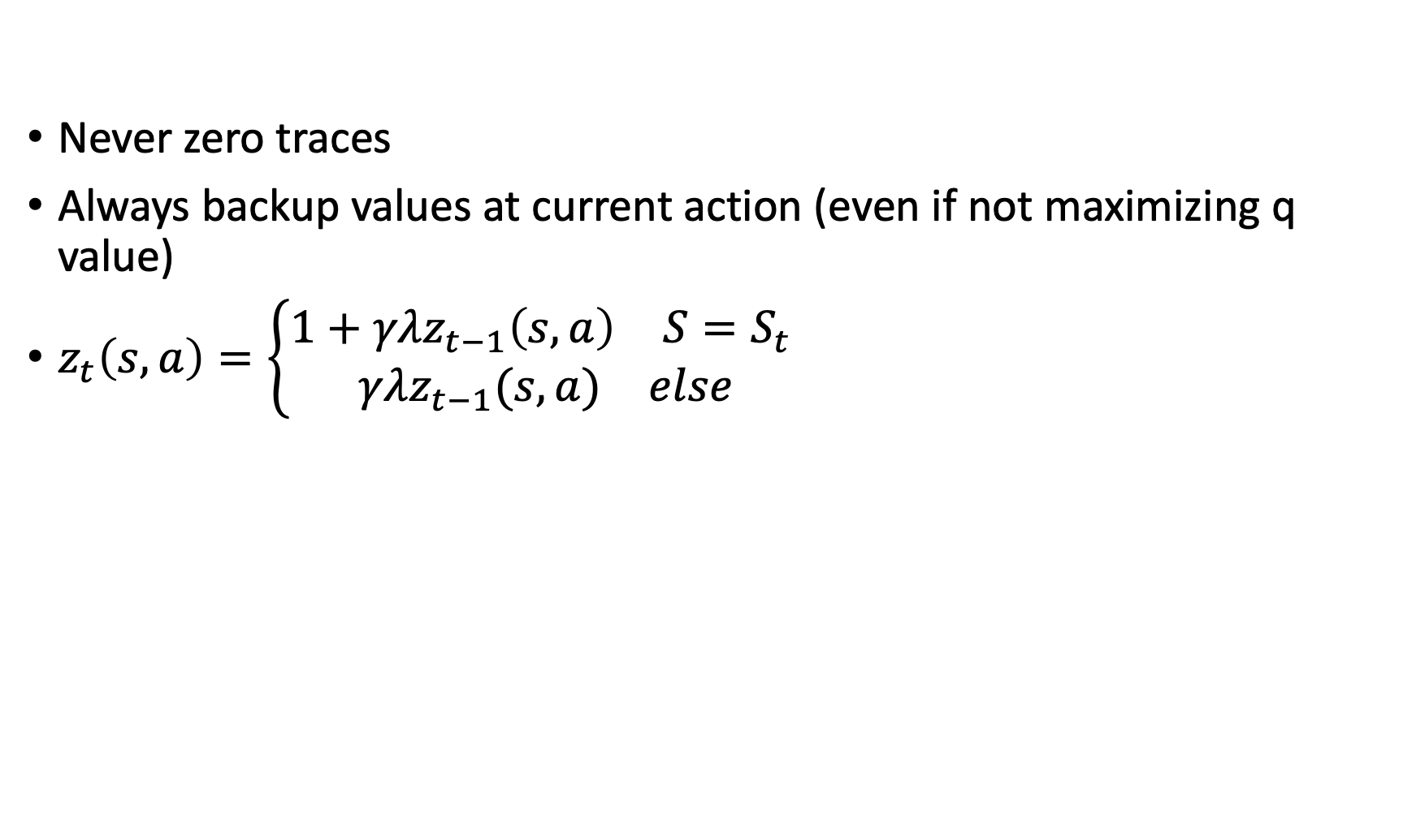

Naïve $Q(λ)$
Never zero traces
Always backup values at current action (even if not maximizing q value)
$z_{t}\left(s,a\right)=\left\{\begin{aligned}\begin{matrix}1+γλz_{t−1}\left(s,a\right) & S=S_{t} \end{matrix} \\ \begin{matrix}γλz_{t−1}(s,a) & else\end{matrix}\end{aligned}\right.$

Slide 28

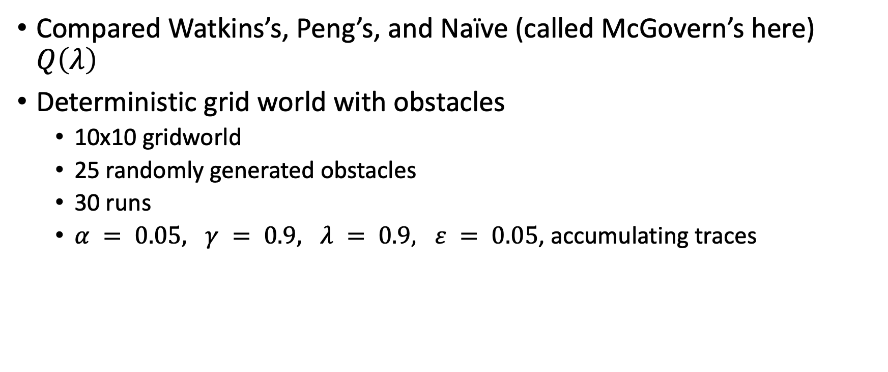
Comparing the three approaches
Compared Watkins’s, Peng’s, and Naïve (called McGovern’s here) $Q\left(λ\right)$
Deterministic grid world with obstacles
  10x10 gridworld
  25 randomly generated obstacles
  30 runs
  $α = 0.05, γ = 0.9, λ = 0.9, ε = 0.05$, accumulating traces
  *See McGovern and Sutton (1997). Towards a Better $Q(λ)$ for other tasks and results (stochastic tasks, continuing tasks, etc)

Slide 29
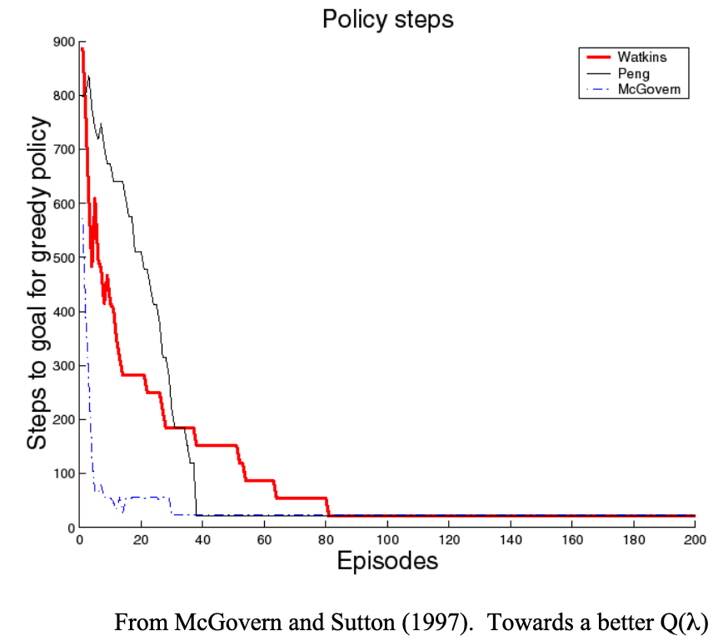

Slide 30
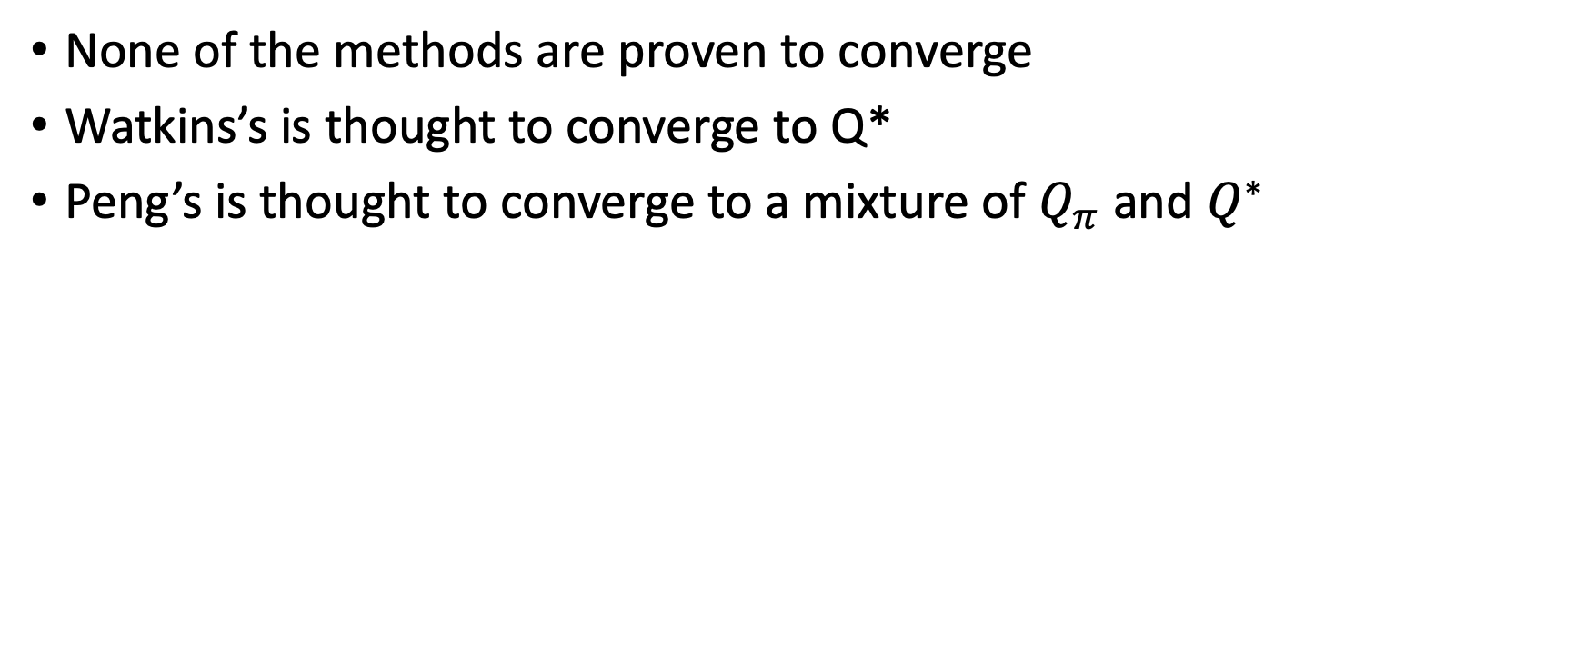

Convergence for $Q(λ)$
None of the methods are proven to converge
Watkins’s is thought to converge to Q*
Peng’s is thought to converge to a mixture of $Q_{π}$ and $Q^{∗}$

Slide 31
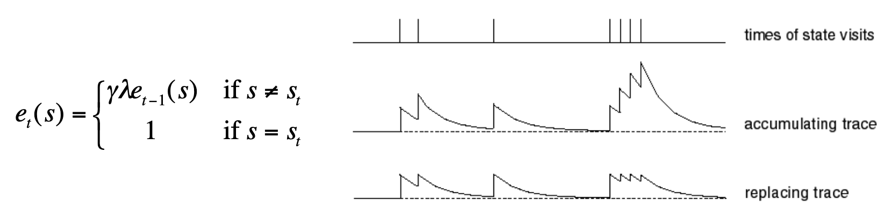
Replacing traces
Using accumulating traces, frequently visited states can have eligibilities greater than 1
This can be a problem for convergence
Replacing traces: Instead of adding 1 when you visit a state, set that trace to 1

Slide 32
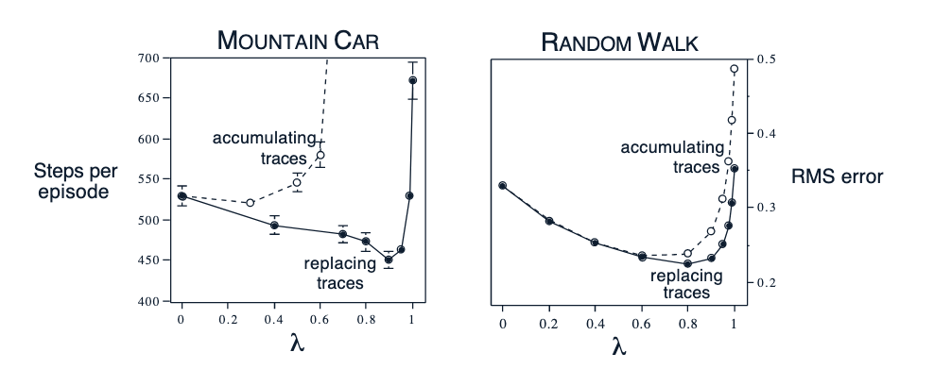
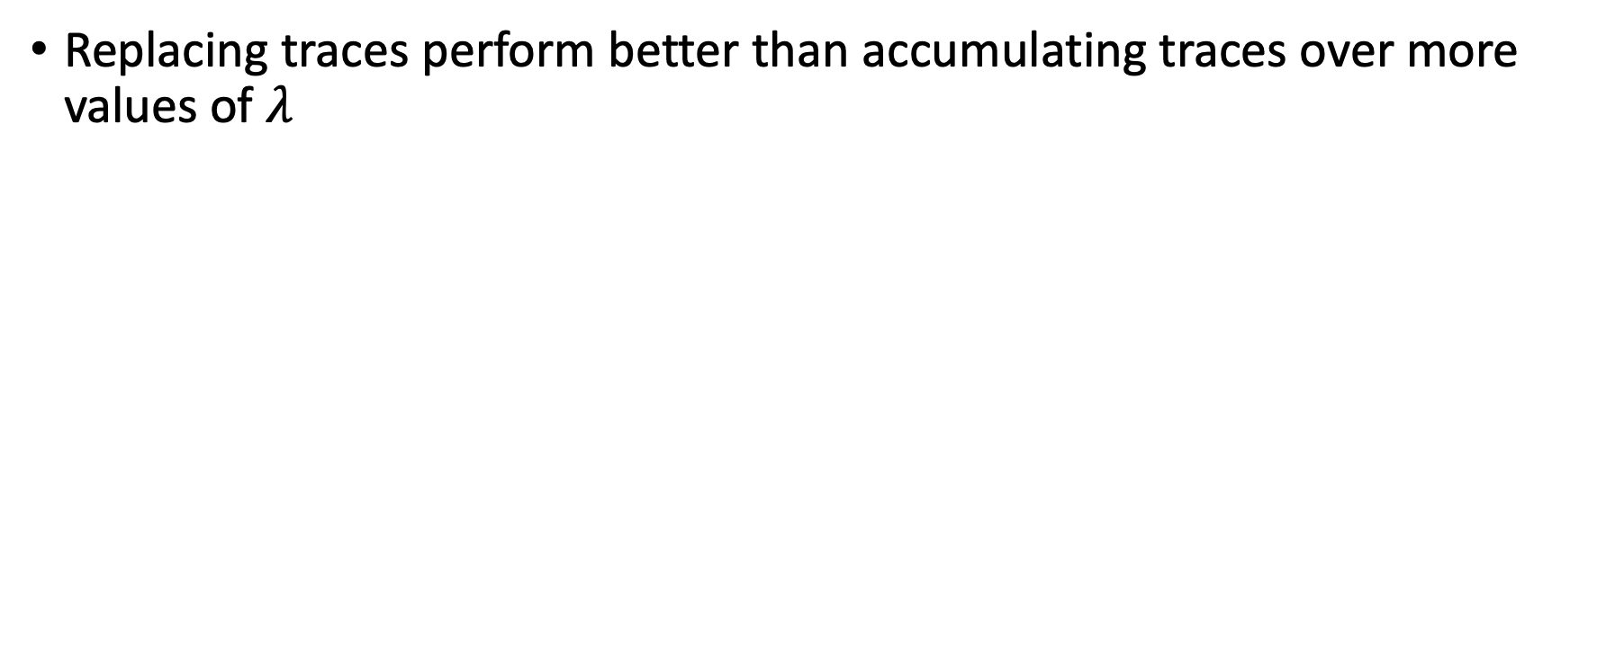
Replacing traces
Replacing traces perform better than accumulating traces over more values of $λ$
root-mean-square

Slide 33
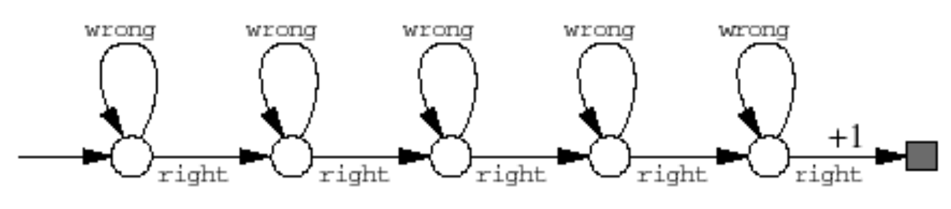
Why Replacing Traces?
What will happen in the following domain if accumulated traces is used?
Will the learning be meaningful?

Slide 34
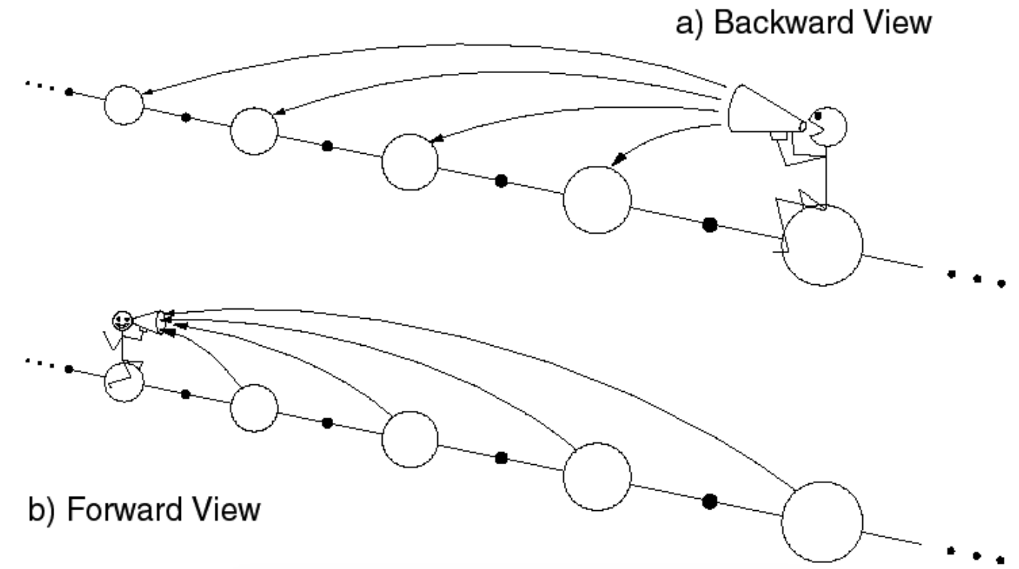
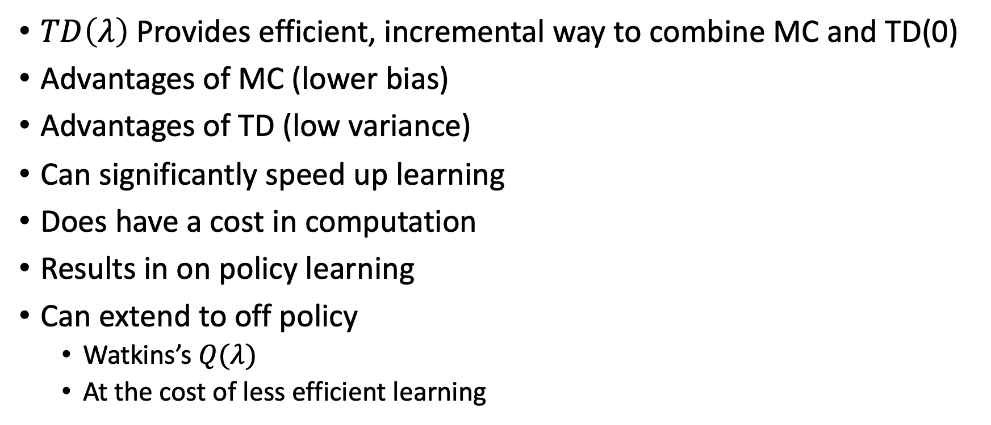
What did we learn?
$TD\left(λ\right)$Provides efficient, incremental way to combine MC and TD(0)
Advantages of MC (lower bias)
Advantages of TD (low variance)
Can significantly speed up learning
Does have a cost in computation
Results in on policy learning
Can extend to off policy
  Watkins’s $Q(λ)$
  At the cost of less efficient learning

Slide 35
What next?
Lecture: Deep Q-Learning
Assignments:
  Q-Learning with Approximation, Oct. 14, EOD
Quiz (on Canvas):
  Eligibility traces, Oct 21, EoD
Project:
  Literature survey, by Monday, November 4 EOD

