Slide 1

CSCE-642 Reinforcement Learning
Ch10,11: Control with Approximation
Instructor: Guni Sharon

Slide 2
CSCE-689, Reinforcement Learning
Stateless decision process
Monte-Carlo
Policy gradient
Actor-critic
Markov decision process
Temporal difference
Function approximators
Solving MDPs (offline)
Dynamic programming
Tabular methods
Deep RL

Slide 3
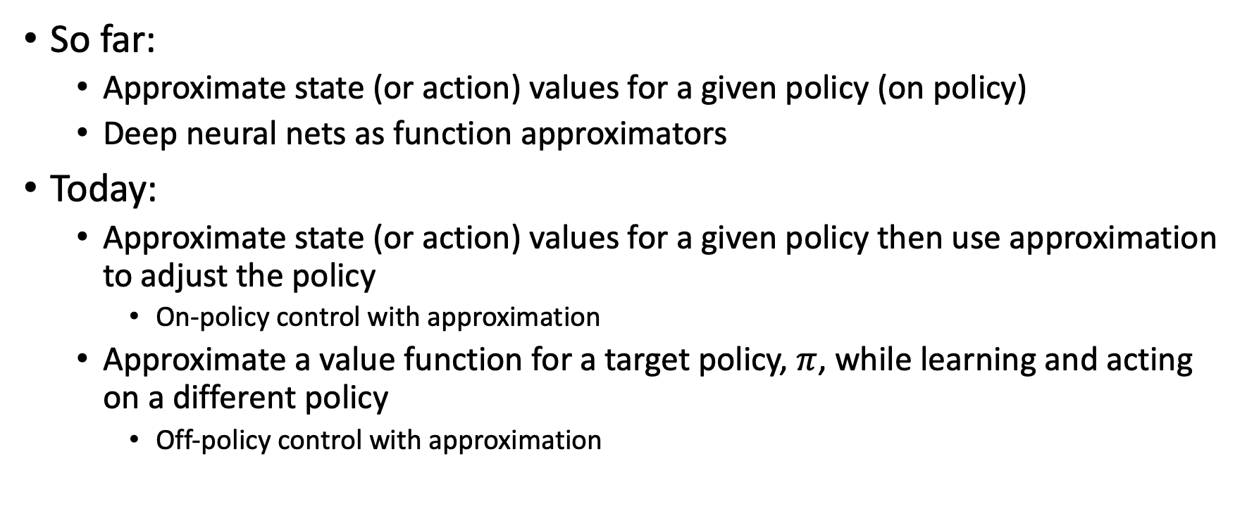
Function Approximation in RL
So far:
  Approximate state (or action) values for a given policy (on policy)
  Deep neural nets as function approximators
Today:
  Approximate state (or action) values for a given policy then use approximation to adjust the policy
    On-policy control with approximation
  Approximate a value function for a target policy, $π$, while learning and acting on a different policy
    Off-policy control with approximation

Slide 4

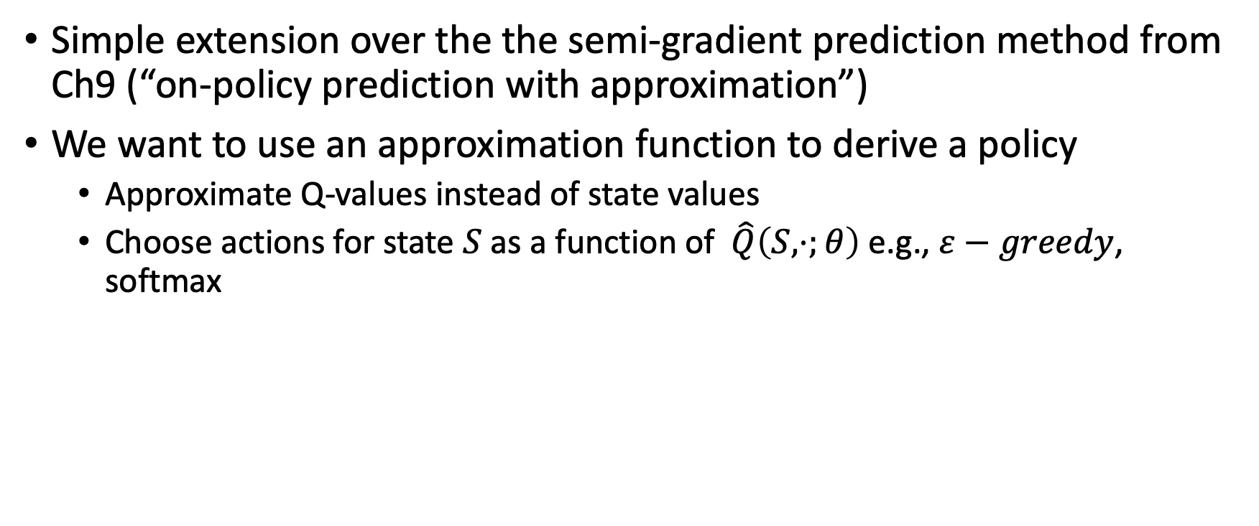
On policy, episodic Semi-gradient control
Simple extension over the the semi-gradient prediction method from Ch9 (“on-policy prediction with approximation”)
We want to use an approximation function to derive a policy
  Approximate Q-values instead of state values
  Choose actions for state $S$ as a function of $\hat{Q}\left(S,⋅;θ\right)$ e.g., $ε−greedy$, softmax

Slide 5
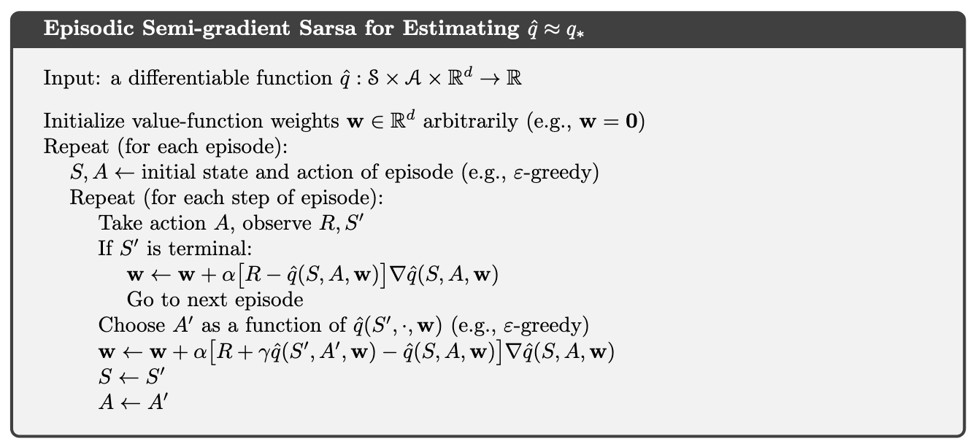
Gradient assuming squared loss of the TD-error

Slide 6
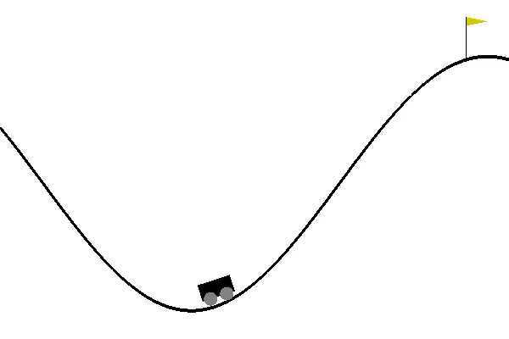
Mountain car example
Gravity is stronger than the car’s engine
  Even at full throttle the car cannot accelerate up the steep slope
Solution: first move away from the goal and up the opposite slope on the left
  Then, by applying full throttle the car can build up enough inertia to carry it up the steep slope
Things have to get worse in a sense (further from the goal) before they can get better
Reward: −1 on all time steps until the car moves past its goal position
Actions: full throttle forward, full throttle reverse, and zero throttle

Slide 7
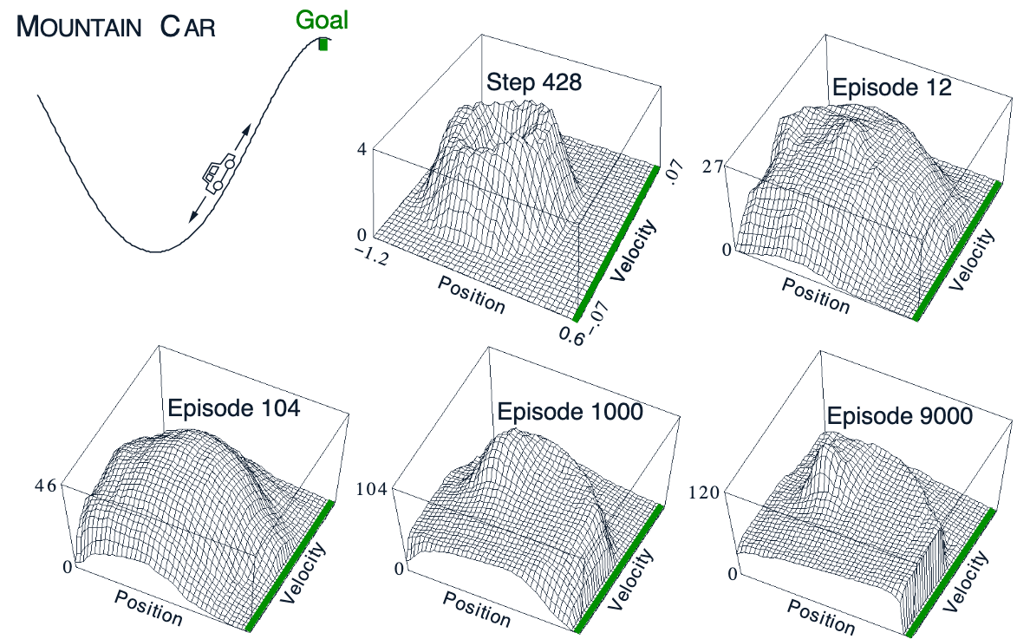
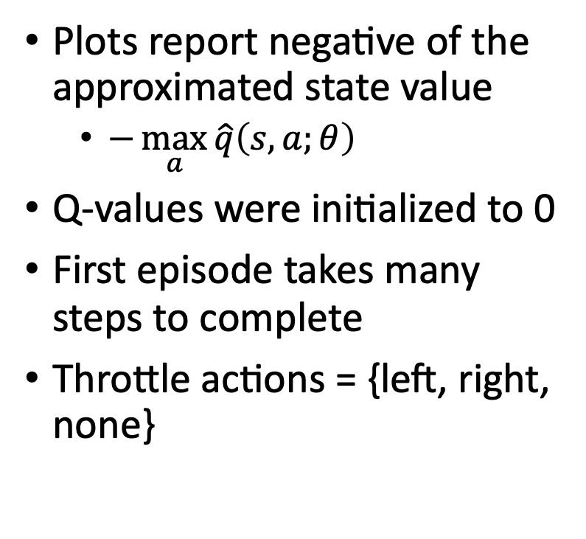
Semi –gradient SARSA with coarse coding approximation
Plots report negative of the approximated state value
  $−\max_{a}{\hat{q}\left(s,a;θ\right)}$
Q-values were initialized to 0
First episode takes many steps to complete
Throttle actions = {left, right, none}

Slide 8
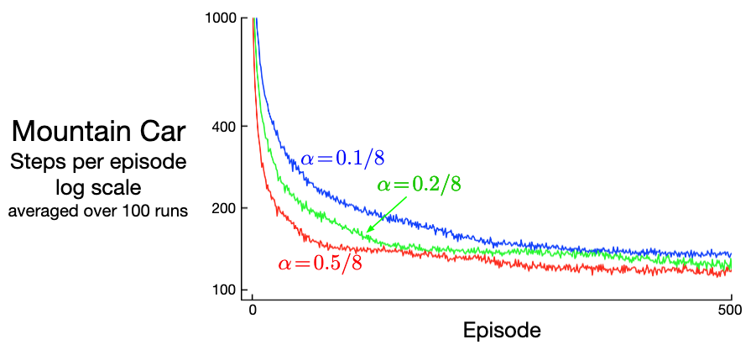
Semi –gradient SARSA with approximation
The policy converges faster than the Q-values
How can we speed up the Q-values propagation?

Slide 9
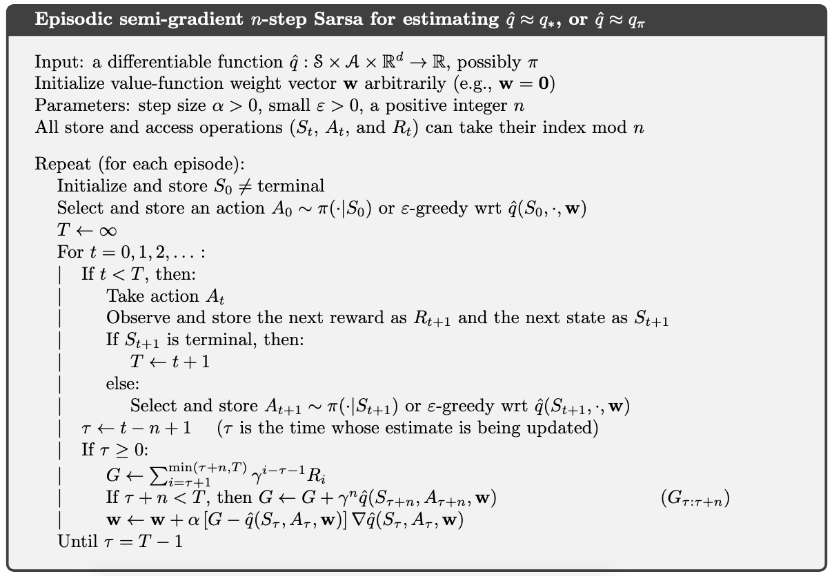
Semi-gradient n-step SARSA with approximation
We can use the n-step return as the target value to speed up on-policy Q learning propagation

Slide 10
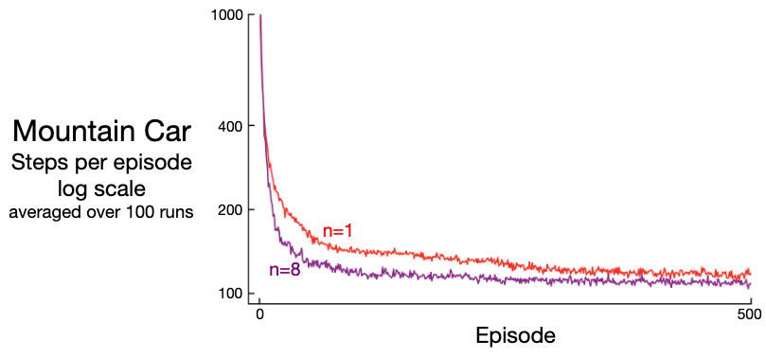
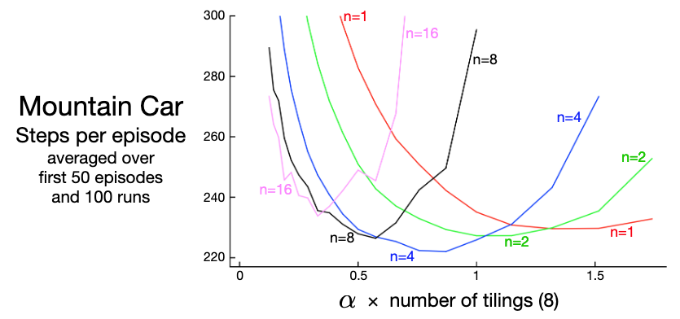
n-step SARSA with approximation
One-step vs multi-step performance of n-step semi-gradient Sarsa on the Mountain Car task
Effect of α and n on early performance of n-step semi-gradient Sarsa
An intermediate level of bootstrapping (n= 4) performed best

Slide 11
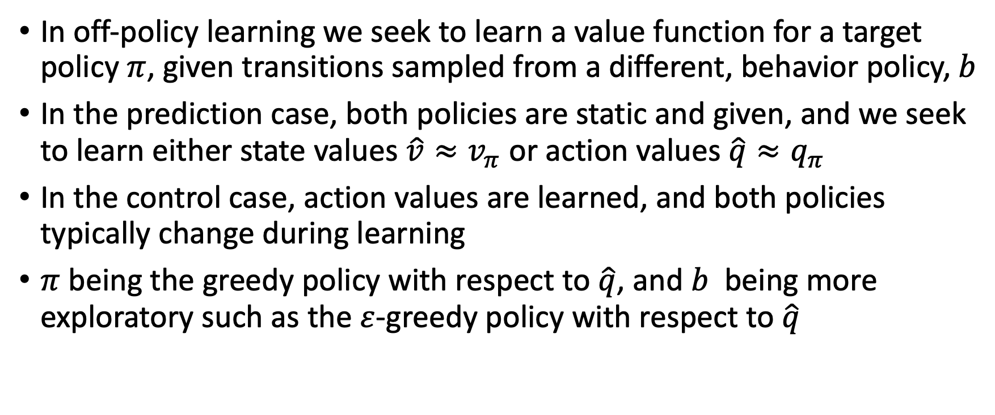
Off-policy control with approximation
In off-policy learning we seek to learn a value function for a target policy $π$, given transitions sampled from a different, behavior policy, $b$
In the prediction case, both policies are static and given, and we seek to learn either state values $\hat{v}≈v_{π}$ or action values $\hat{q}≈q_{π}$
In the control case, action values are learned, and both policies typically change during learning
$π$ being the greedy policy with respect to $\hat{q}$, and $b$ being more exploratory such as the $ε$-greedy policy with respect to $\hat{q}$

Slide 12
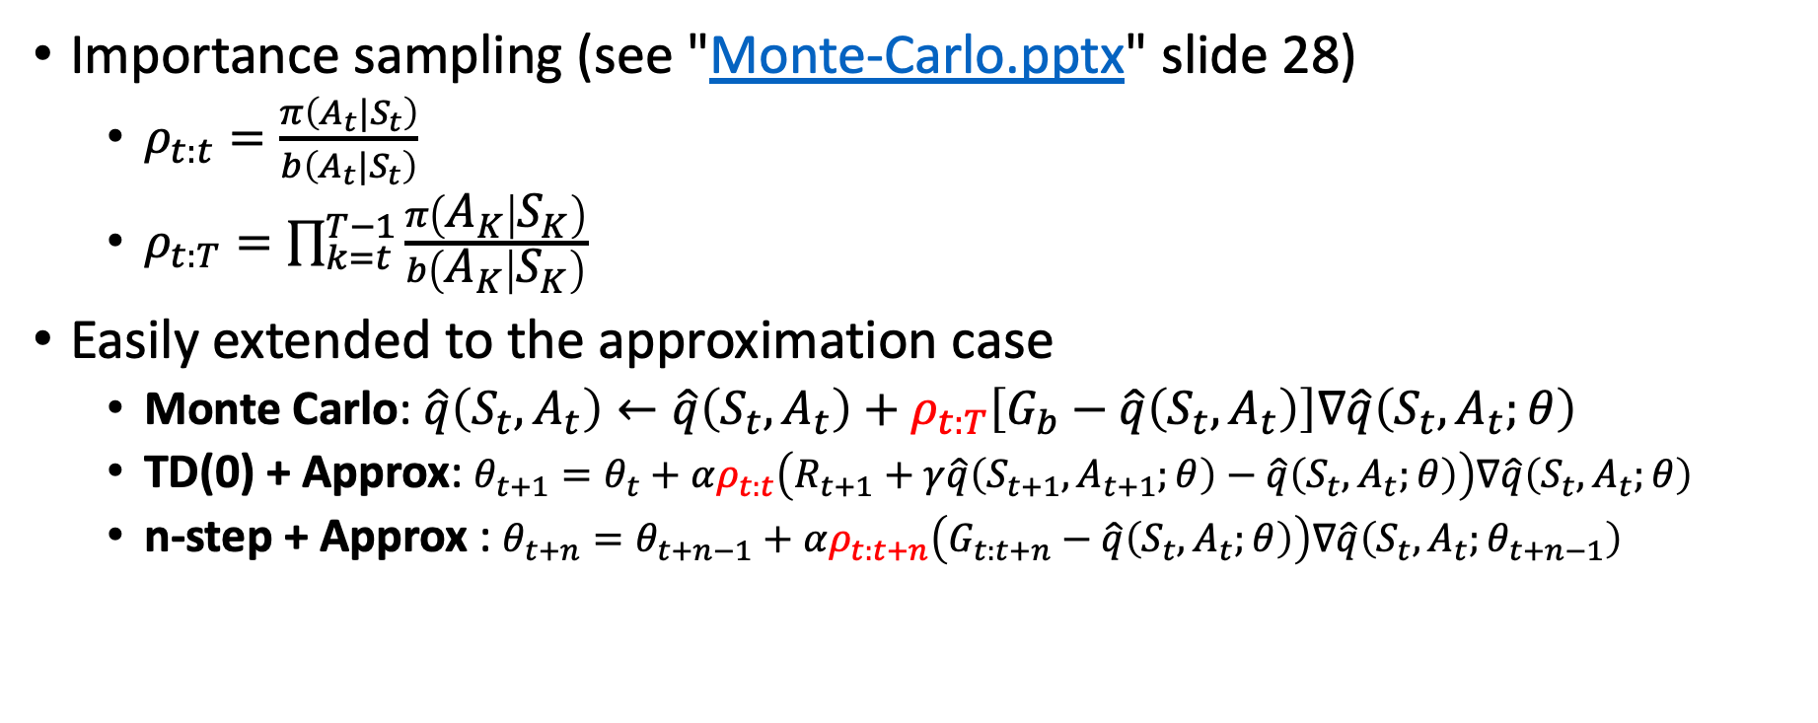
Importance sampling
Importance sampling (see "Monte-Carlo.pptx" slide 28)
  $ρ_{t:t}=\frac{π\left(A_{t}|S_{t}\right)}{b\left(A_{t}|S_{t}\right)}$
  $ρ_{t:T}=\prod_{k=t}^{T−1}{\frac{π\left(A_{K} | S_{K}\right)}{b\left(A_{K} | S_{K}\right)}}$
Easily extended to the approximation case
  Monte Carlo: $\hat{q}\left(S_{t},A_{t}\right)←\hat{q}\left(S_{t},A_{t}\right)+ρ_{t:T}\left[G_{b}−\hat{q}\left(S_{t},A_{t}\right)\right]∇\hat{q}\left(S_{t},A_{t};θ\right)$
  TD(0) + Approx: $θ_{t+1}=θ_{t}+αρ_{t:t}\left(R_{t+1}+γ\hat{q}\left(S_{t+1},A_{t+1};θ\right)−\hat{q}\left(S_{t},A_{t};θ\right)\right)∇\hat{q}\left(S_{t},A_{t};θ\right)$
  n-step + Approx : $θ_{t+n}=θ_{t+n−1}+αρ_{t:t+n}\left(G_{t:t+n}−\hat{q}\left(S_{t},A_{t};θ\right)\right)∇\hat{q}\left(S_{t},A_{t};θ_{t+n−1}\right)$

Slide 13
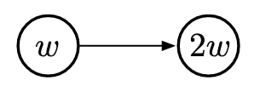
Off-policy divergence
With function approximation, the distribution of updates does not match the on-policy distribution
  Updating one state might affect the value of many others
  Semi-gradient and other simple algorithms are unstable and often diverge
E.g., consider two states and a value approximator with one tunable parameter
Updating the value for the left state would also increase the value of the right state, which will increase the value in the left state…

Slide 14
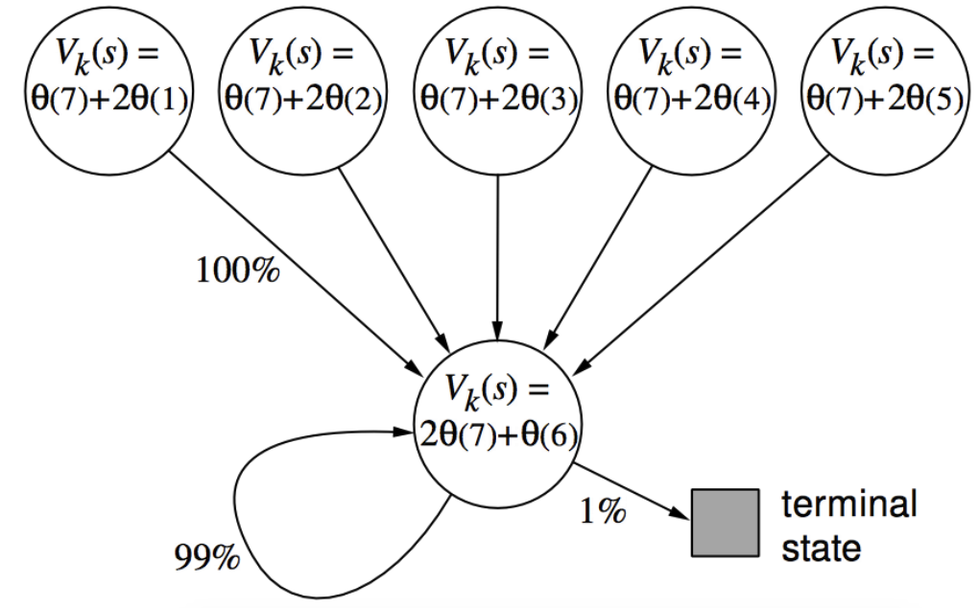
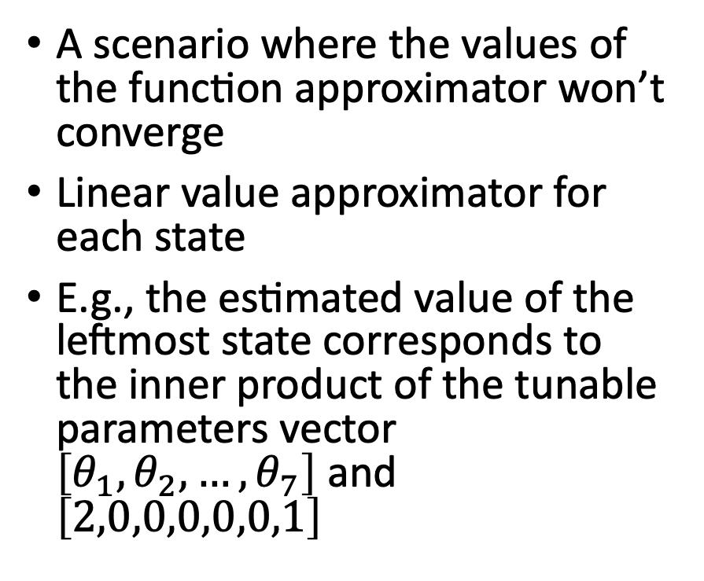
Baird’s counterexample
A scenario where the values of the function approximator won’t converge
Linear value approximator for each state
E.g., the estimated value of the leftmost state corresponds to the inner product of the tunable parameters vector $\left[θ_{1},θ_{2},…,θ_{7}\right]$ and $\left[2,0,0,0,0,0,1\right]$

Slide 15
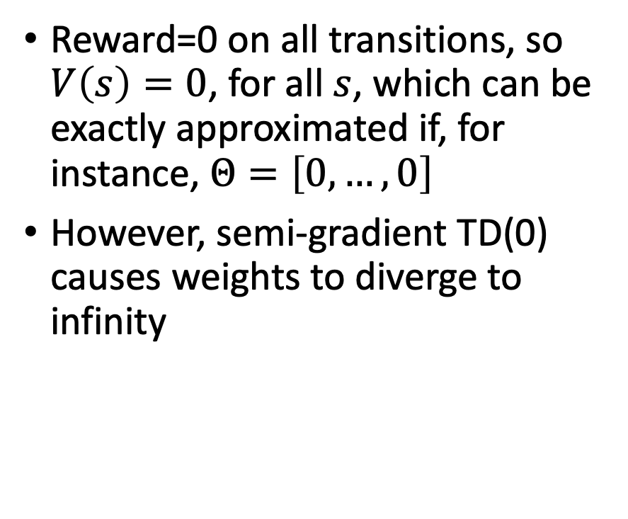
Baird’s counterexample
Reward=0 on all transitions, so $V\left(s\right)=0$, for all $s$, which can be exactly approximated if, for instance, $Θ=\left[0,…,0\right]$
However, semi-gradient TD(0) causes weights to diverge to infinity

Slide 16
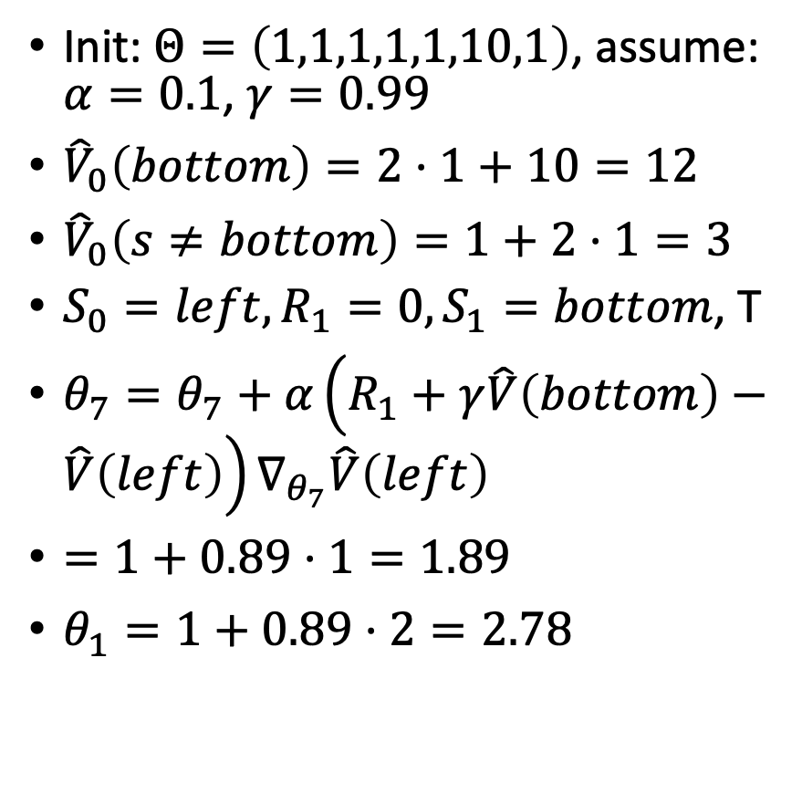
Baird’s counterexample
Init: $Θ=\left(1,1,1,1,1,10,1\right)$, assume: $α=0.1$, $γ=0.99$
${\hat{V}}_{0}\left(bottom\right)=2⋅1+10=12$
${\hat{V}}_{0}\left(s≠bottom\right)=1+2⋅1=3$
$S_{0}=left, R_{1}=0, S_{1}=bottom$, T
$θ_{7}=θ_{7}+α\left(R_{1}+γ\hat{V}\left(bottom\right)−\hat{V}\left(left\right)\right)∇_{θ_{7}}\hat{V}\left(left\right)$
$=1+0.89⋅1=1.89$
$θ_{1}=1+0.89⋅2=2.78$

Slide 17
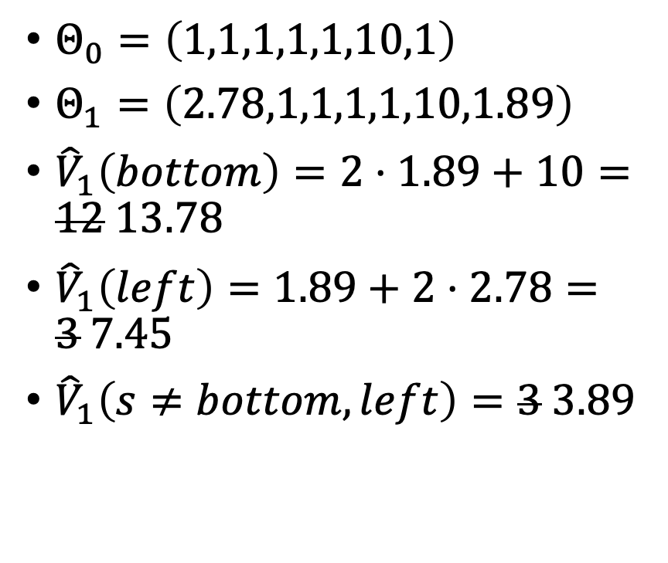
Baird’s counterexample
$Θ_{0}=\left(1,1,1,1,1,10,1\right)$
$Θ_{1}=\left(2.78,1,1,1,1,10,1.89\right)$
${\hat{V}}_{1}\left(bottom\right)=2⋅1.89+10=12 13.78$
${\hat{V}}_{1}\left(left\right)=1.89+2⋅2.78=3 7.45$
${\hat{V}}_{1}\left(s≠bottom, left\right)=3 3.89$

Slide 18
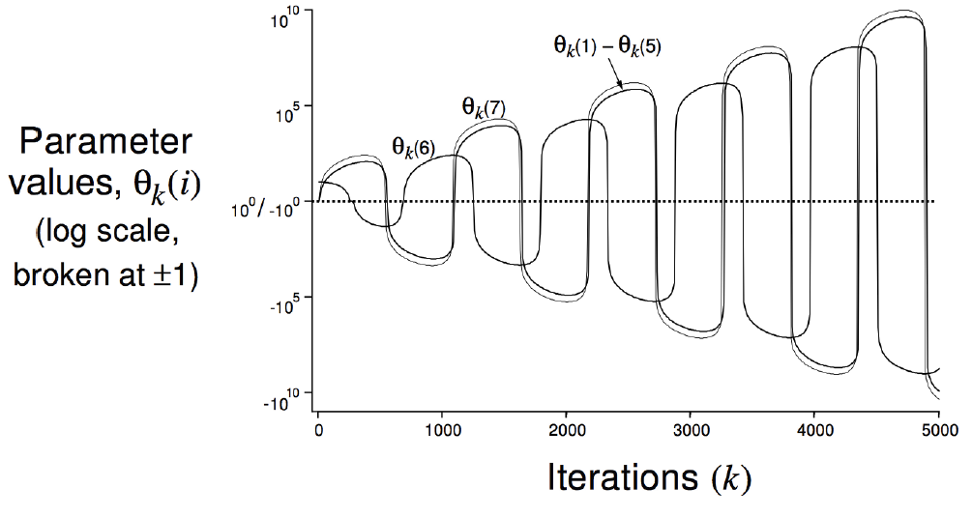
Baird’s counterexample

Slide 19
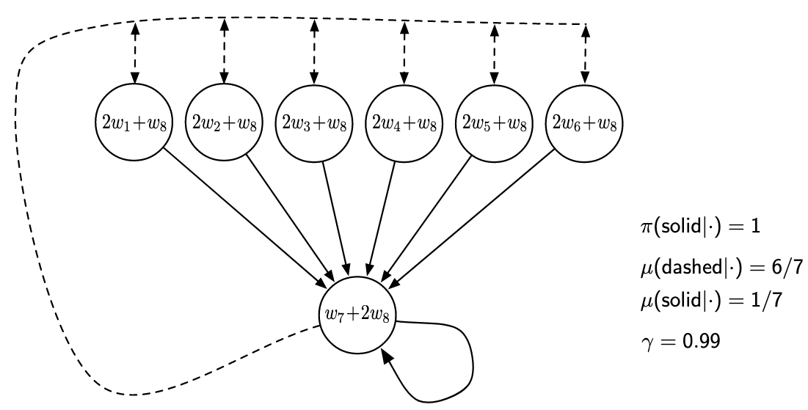
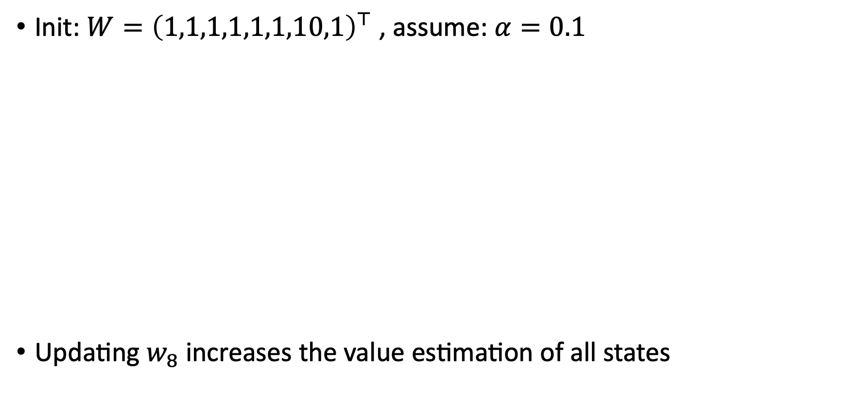
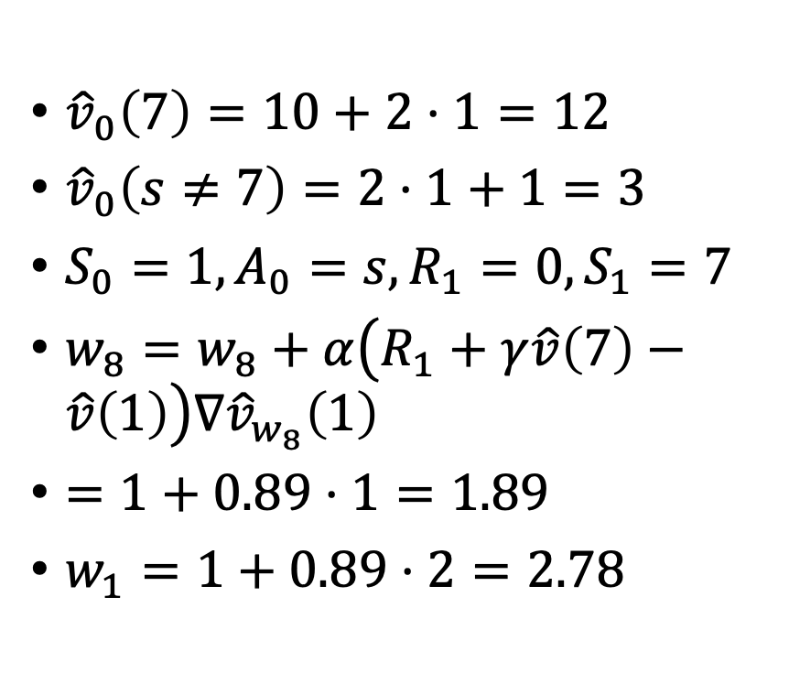
Baird’s counterexample
Init: $W={\left(1,1,1,1,1,1,10,1\right)}^{⊤}$ , assume: $α=0.1$
Updating $w_{8}$ increases the value estimation of all states
${\hat{v}}_{0}\left(7\right)=10+2⋅1=12$
${\hat{v}}_{0}\left(s≠7\right)=2⋅1+1=3$
$S_{0}=1, A_{0}=s, R_{1}=0, S_{1}=7$
$w_{8}=w_{8}+α\left(R_{1}+γ\hat{v}\left(7\right)−\hat{v}\left(1\right)\right)∇{\hat{v}}_{w_{8}}\left(1\right)$
$=1+0.89⋅1=1.89$
$w_{1}=1+0.89⋅2=2.78$

Slide 20
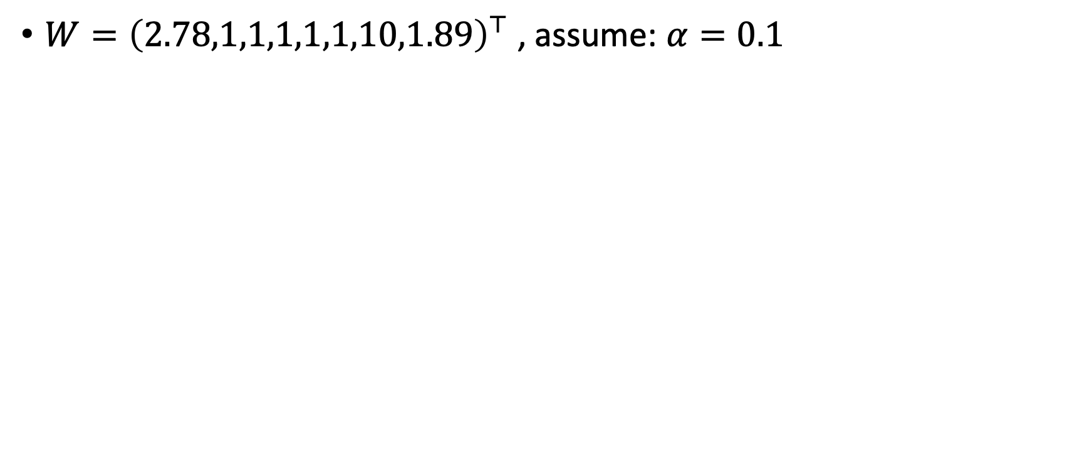
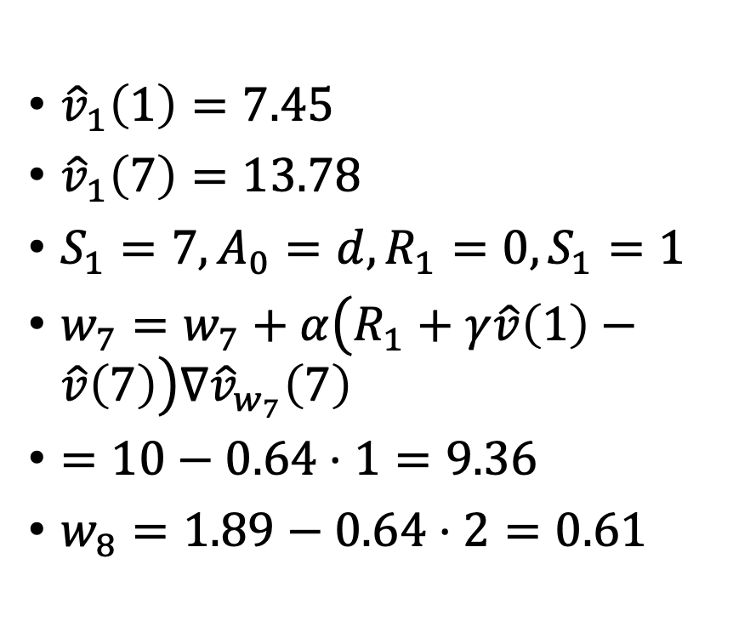
Baird’s counterexample
$W={\left(2.78,1,1,1,1,1,10,1.89\right)}^{⊤}$ , assume: $α=0.1$
${\hat{v}}_{1}\left(1\right)=7.45$
${\hat{v}}_{1}\left(7\right)=13.78$
$S_{1}=7, A_{0}=d, R_{1}=0, S_{1}=1$
$w_{7}=w_{7}+α\left(R_{1}+γ\hat{v}\left(1\right)−\hat{v}\left(7\right)\right)∇{\hat{v}}_{w_{7}}\left(7\right)$
$=10−0.64⋅1=9.36$
$w_{8}=1.89−0.64⋅2=0.61$

Slide 21
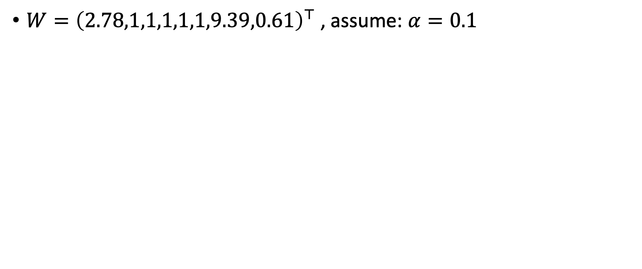
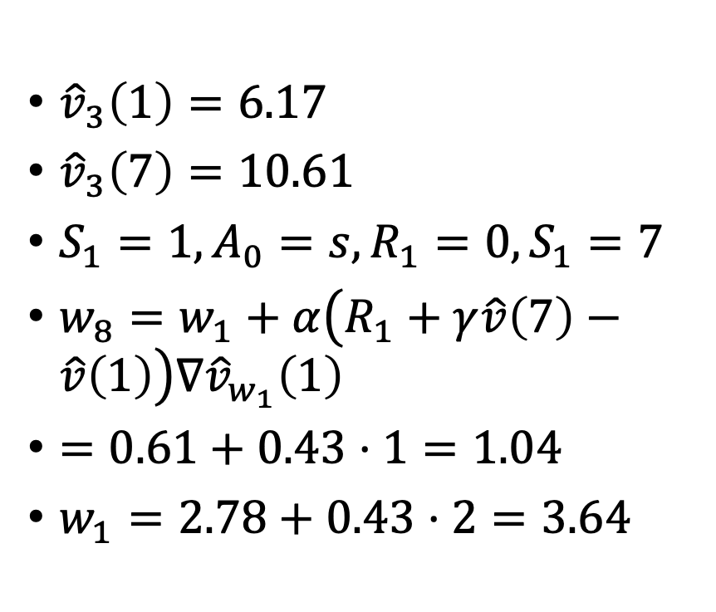
Baird’s counterexample
$W={\left(2.78,1,1,1,1,1,9.39,0.61\right)}^{⊤}$ , assume: $α=0.1$
${\hat{v}}_{3}\left(1\right)=6.17$
${\hat{v}}_{3}\left(7\right)=10.61$
$S_{1}=1, A_{0}=s, R_{1}=0, S_{1}=7$
$w_{8}=w_{1}+α\left(R_{1}+γ\hat{v}\left(7\right)−\hat{v}\left(1\right)\right)∇{\hat{v}}_{w_{1}}\left(1\right)$
$=0.61+0.43⋅1=1.04$
$w_{1}=2.78+0.43⋅2=3.64$

Slide 22
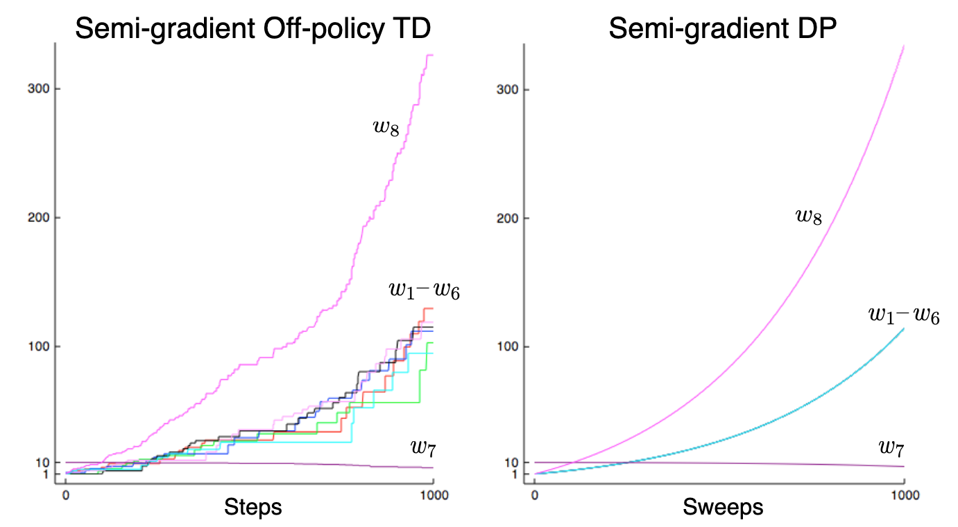
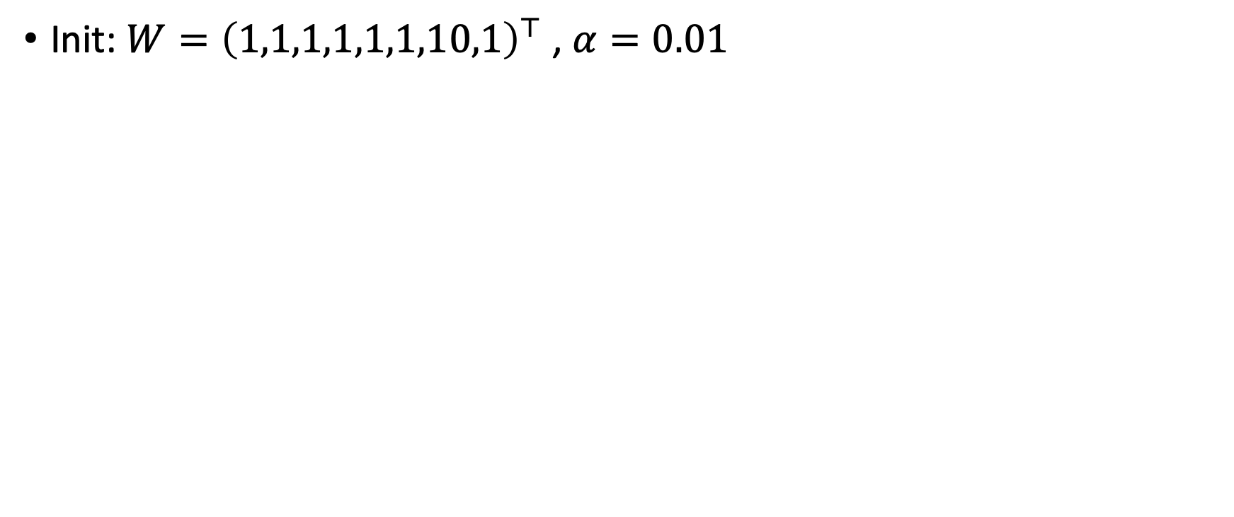
Baird’s counterexample
Init: $W={\left(1,1,1,1,1,1,10,1\right)}^{⊤}$ , $α=0.01$

Slide 23
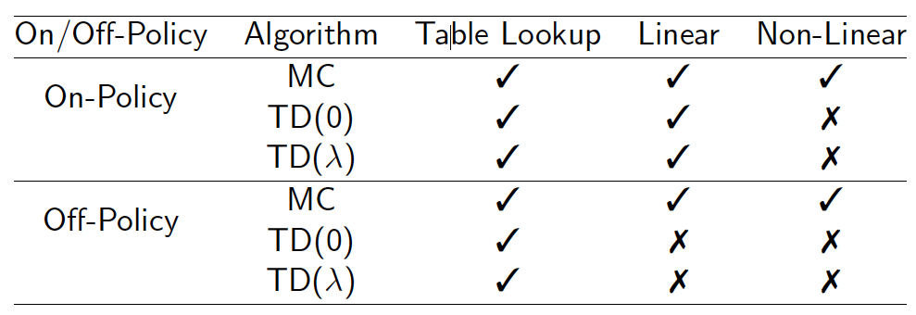
Convergence guarantees - prediction
For now think of this as n-step TD

Slide 24
Convergence guarantees - control
Algorithm | Table Lookup | Linear | Non-Linear
Monte-Carlo Control | ✔️ | (✔️) | ✖️
Sarsa | ✔️ | (✔️) | ✖️
Q-learning | ✔️ | ✖️ | ✖️
(✔️) chatters around the optimal value function

Slide 25
The deadly triad
Danger of instability and divergence arises whenever we combine all of the following three elements
Function approximation: A powerful, scalable way of generalizing from a state space much larger than the memory and computational resources
Bootstrapping: Update targets that include existing estimates (as in dynamic programming or TD methods) rather than relying exclusively on actual rewards and complete returns (as in MC methods)
Off-policy training: Training on a distribution of transitions other than that produced by the target policy.
* Divergence can always occur if the learning rate is set too high

Slide 26
Avoiding instability and divergence
Avoid the use of a function approximator
We need methods that scale to large problems and to great expressive power
State aggregation or nonparametric methods whose complexity grows with data are too weak or too expensive
Least-squares methods such as LSTD are of quadratic complexity and are therefore too expensive for large problems

Slide 27
Avoiding instability and divergence
Avoid bootstrapping
Monte Carlo (non-bootstrapping) methods require storing all transitions leading to the final return and weights are updated only once the final return is obtained
With bootstrapping, data can be dealt with when and where it is generated, then need never be used again
The savings in communication and memory made possible by bootstrapping are great
Bootstrapping often results in faster learning because it allows learning to take advantage of the state property
Often bootstrapping greatly increases efficiency. It is an ability that we would very much like to keep in our toolkit

Slide 28
Avoiding instability and divergence
Avoid off-policy learning
On-policy methods are often adequate. For model-free reinforcement learning, one can simply use SARSA rather than Q-learning
Off-policy methods free behavior from the target policy. This could be considered an appealing convenience but not a necessity
However, off-policy learning is essential to other anticipated use cases, cases that we have not yet mentioned but are important to the larger goal of creating a powerful intelligent agent
In these use cases, the agent learns not just a single value function and single policy, but large numbers of them in parallel
Moreover, in many control problems, the policy (actor) evolves over time. Once the policy changes, all our previous experience becomes off-policy.

Slide 29
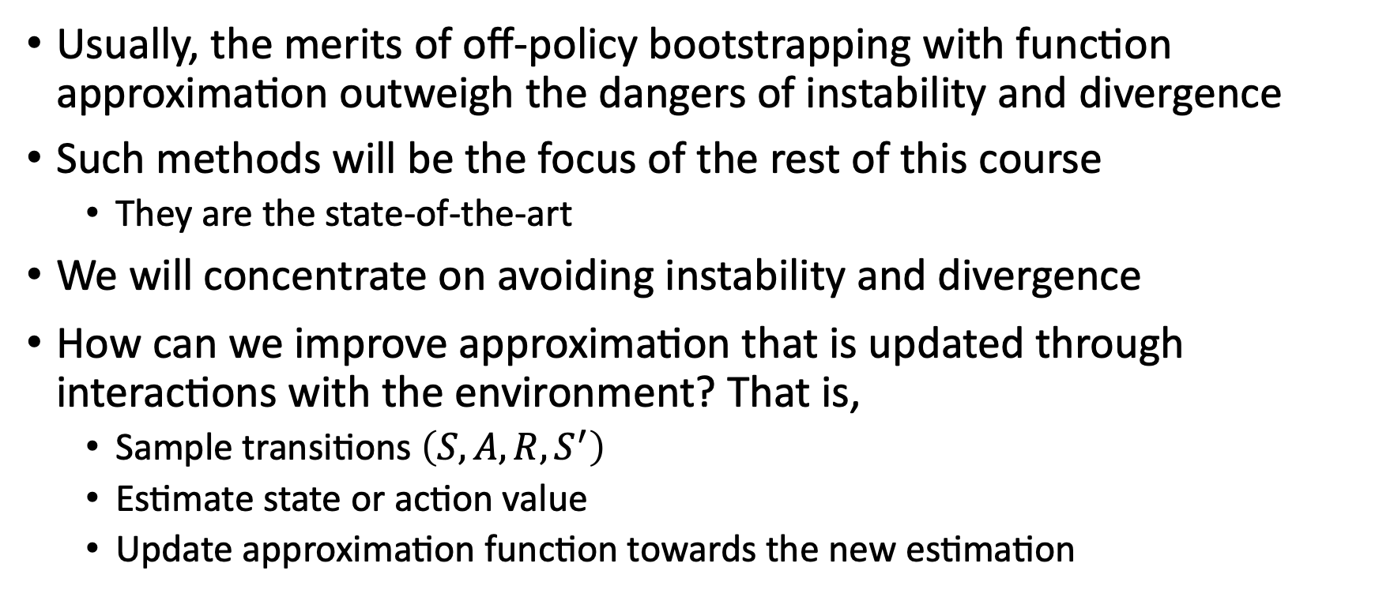
Improving the approximation
Usually, the merits of off-policy bootstrapping with function approximation outweigh the dangers of instability and divergence
Such methods will be the focus of the rest of this course
  They are the state-of-the-art
We will concentrate on avoiding instability and divergence
How can we improve approximation that is updated through interactions with the environment? That is,
  Sample transitions $\left(S,A,R,S^{′}\right)$
  Estimate state or action value
  Update approximation function towards the new estimation

Slide 30
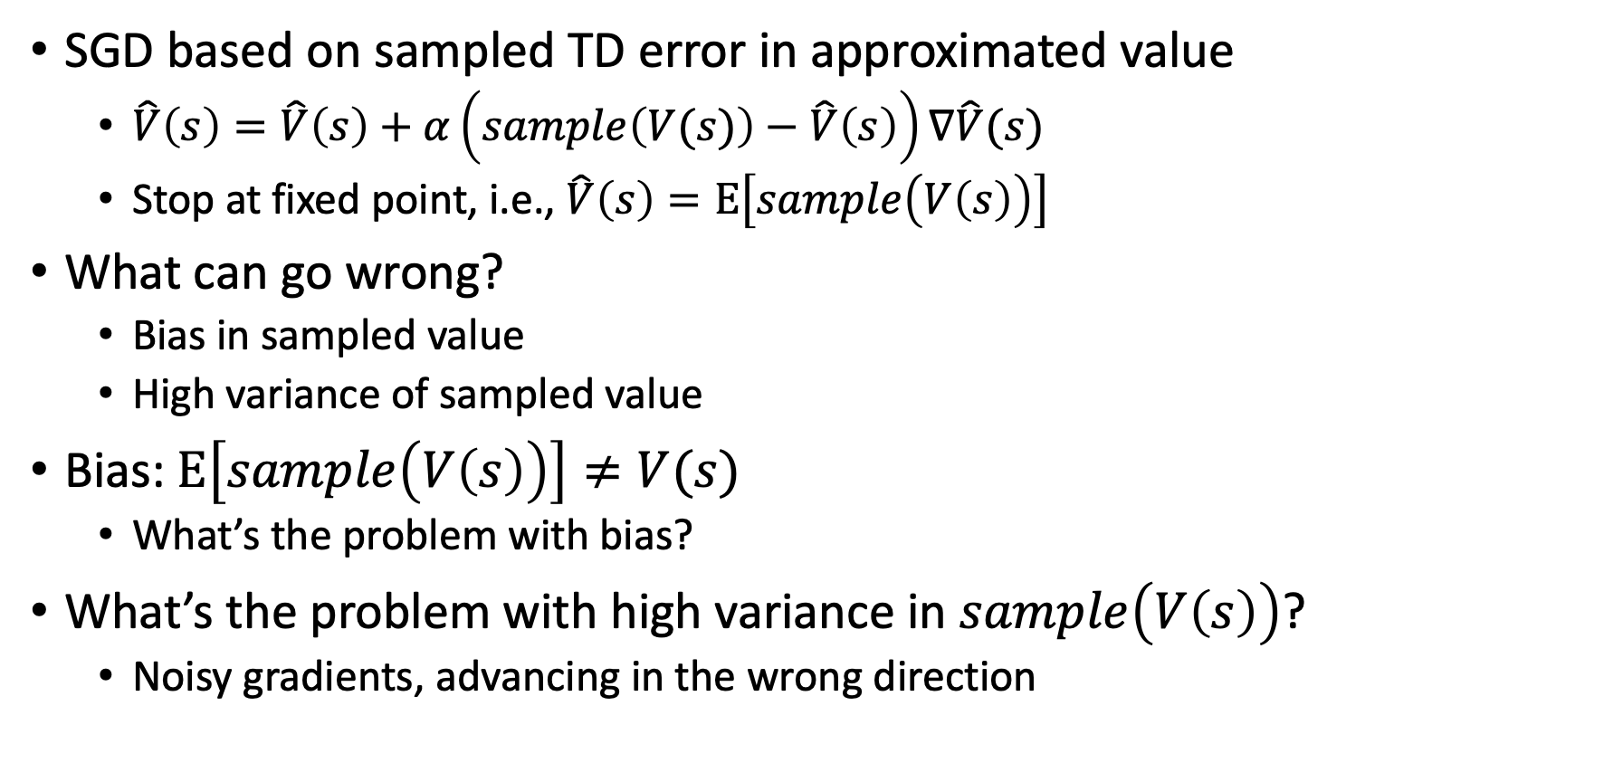
Improving the approximation
SGD based on sampled TD error in approximated value
  $\hat{V}\left(s\right)=\hat{V}\left(s\right)+α\left(sample\left(V(s)\right)−\hat{V}\left(s\right)\right)∇\hat{V}(s)$
  Stop at fixed point, i.e., $\hat{V}\left(s\right)=E\left[sample\left(V\left(s\right)\right)\right]$
What can go wrong?
  Bias in sampled value
  High variance of sampled value
Bias: $E\left[sample\left(V\left(s\right)\right)\right]≠V(s)$
  What’s the problem with bias?
What’s the problem with high variance in $sample\left(V\left(s\right)\right)$?
  Noisy gradients, advancing in the wrong direction

Slide 31

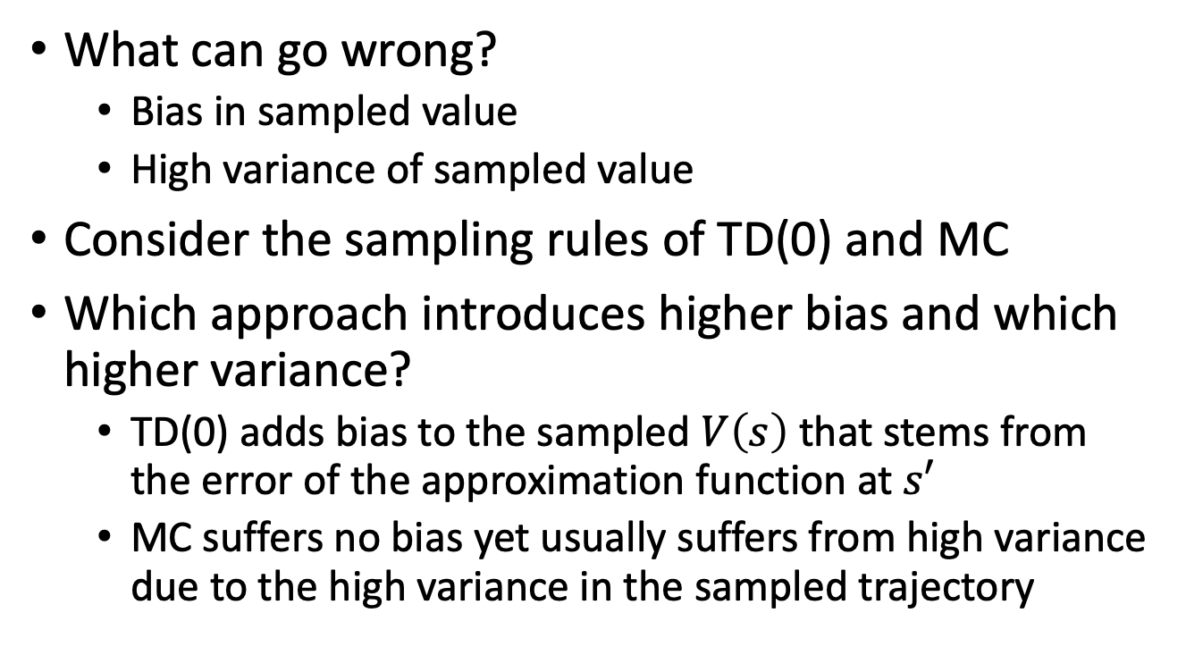
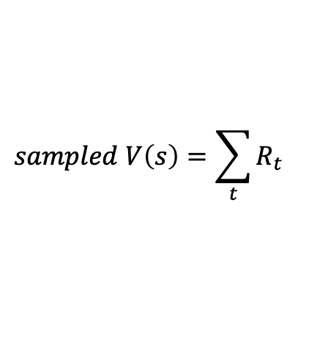
Improving the approximation
What can go wrong?
  Bias in sampled value
  High variance of sampled value
Consider the sampling rules of TD(0) and MC
Which approach introduces higher bias and which higher variance?
  TD(0) adds bias to the sampled $V\left(s\right)$ that stems from the error of the approximation function at $s′$
  MC suffers no bias yet usually suffers from high variance due to the high variance in the sampled trajectory
$$sampled V\left(s\right)=R+\hat{V}\left(S′\right)$$
S
S’
$$sampled V\left(s\right)=\sum_{t}{R_{t}}$$
S

Slide 32
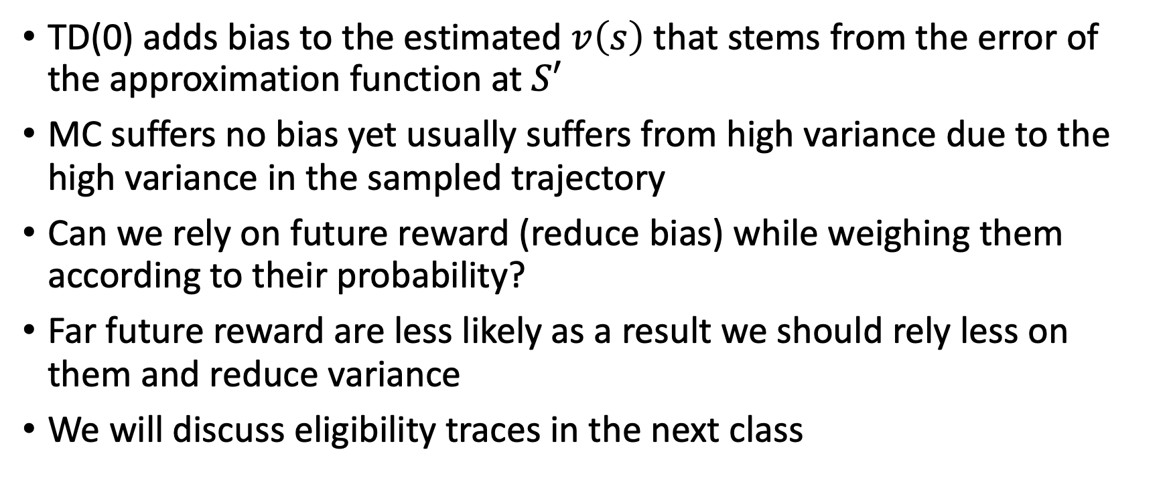
Improving the approximation
TD(0) adds bias to the estimated $v\left(s\right)$ that stems from the error of the approximation function at $S′$
MC suffers no bias yet usually suffers from high variance due to the high variance in the sampled trajectory
Can we rely on future reward (reduce bias) while weighing them according to their probability?
Far future reward are less likely as a result we should rely less on them and reduce variance
We will discuss eligibility traces in the next class

Slide 33
What did we learn?
We can rely on an approximation function for estimating both state/action values and for defining a policy (control with approximation)
No convergence guarantees (as opposed to the tabular setting)
Some guarantees are available for on-policy learning with linear approximator
Once we use bootstrapping approaches for off-policy learning with non-linear approximation no guarantees can be given regarding stability and divergence
So, should we forgo such methods?
  No! in practice they work best
  * requires hyperparameter tuning

Slide 34
What next?
Lecture: Ch 12-Eligibility Traces
Assignments:
  Tabular Q-Learning, by Oct. 9, EOD
  SARSA, by Monday Oct. 9, EOD
  Q-Learning with Approximation, by Oct. 14, EOD
Quiz (on Canvas):
  Deep Neural Nets, by Tuesday Oct. 9, EOD
Project:
  Literature survey, by Monday, November 4 EOD

