Slide 1
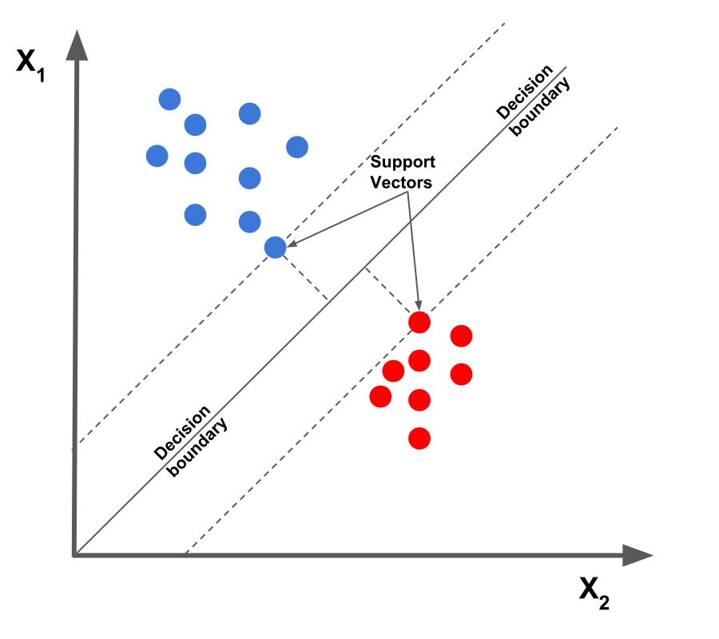
CSCE-633 Machine Learning
9. Support Vector Machine
Instructor: Guni Sharon

Slide 2
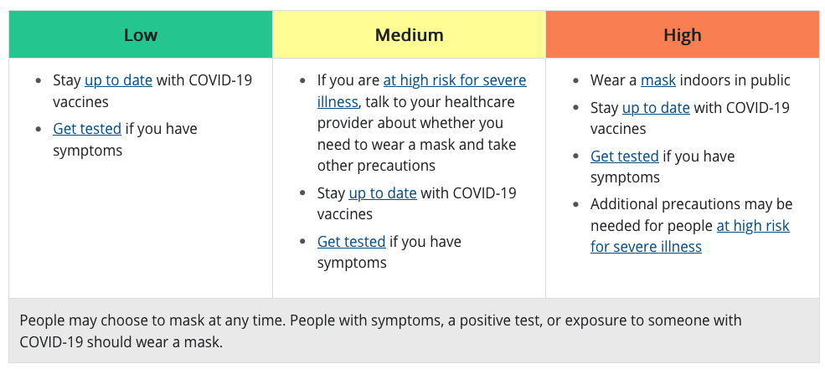
CDC: What Prevention Steps Should You Take Based on Your COVID-19 Community Level?
Notes:
https://www.cdc.gov/coronavirus/2019-ncov/your-health/covid-by-county.html

Slide 3
Announcements
Announcements
  Read the discussion board on Campuswire (class code: 8512)
  Midterm on Tuesday, April 12 during class
Due:
  Programming assignment 2: Linear and Logistic Regression, due by March-15

Slide 4
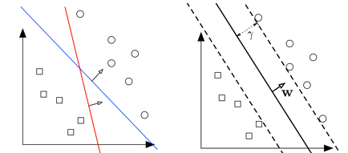
Support Vector Machine (SVM)
A linear classifier that improves on the Perceptron algorithm
The Perceptron guarantees that you find a hyperplane if it exists
The SVM finds the maximum margin separating hyperplane
The margin, $γ$, is the distance from the hyperplane (solid line) to the closest points in either class

Slide 5

Warning!
SVM is patented
Patent US 7.478,074 B2
Do not use (or state that you are using) without permission
https://www.businesswire.com/news/home/20200723005903/en/Health-Discovery-Corporation-Files-Infringement-Suit-Against-Intel-Corporation

Slide 6
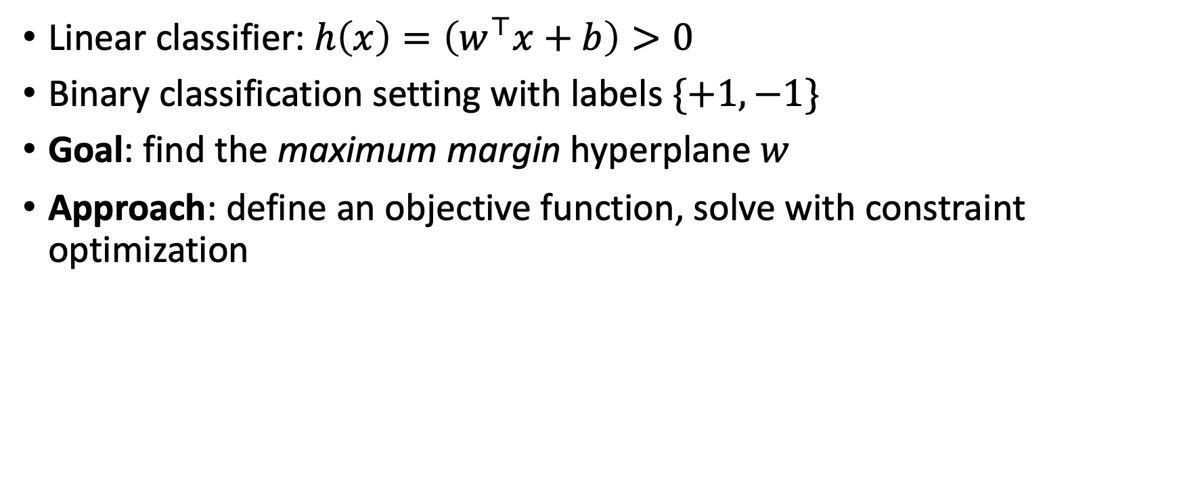
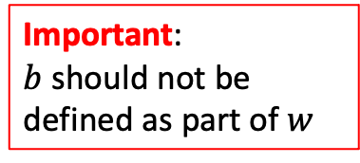
Setting
Important:
$b$ should not be defined as part of $w$
Linear classifier: $h\left(x\right)=\left(w^{⊤}x+b\right)>0$
Binary classification setting with labels $\{+1,−1\}$
Goal: find the maximum margin hyperplane $w$
Approach: define an objective function, solve with constraint optimization

Slide 7

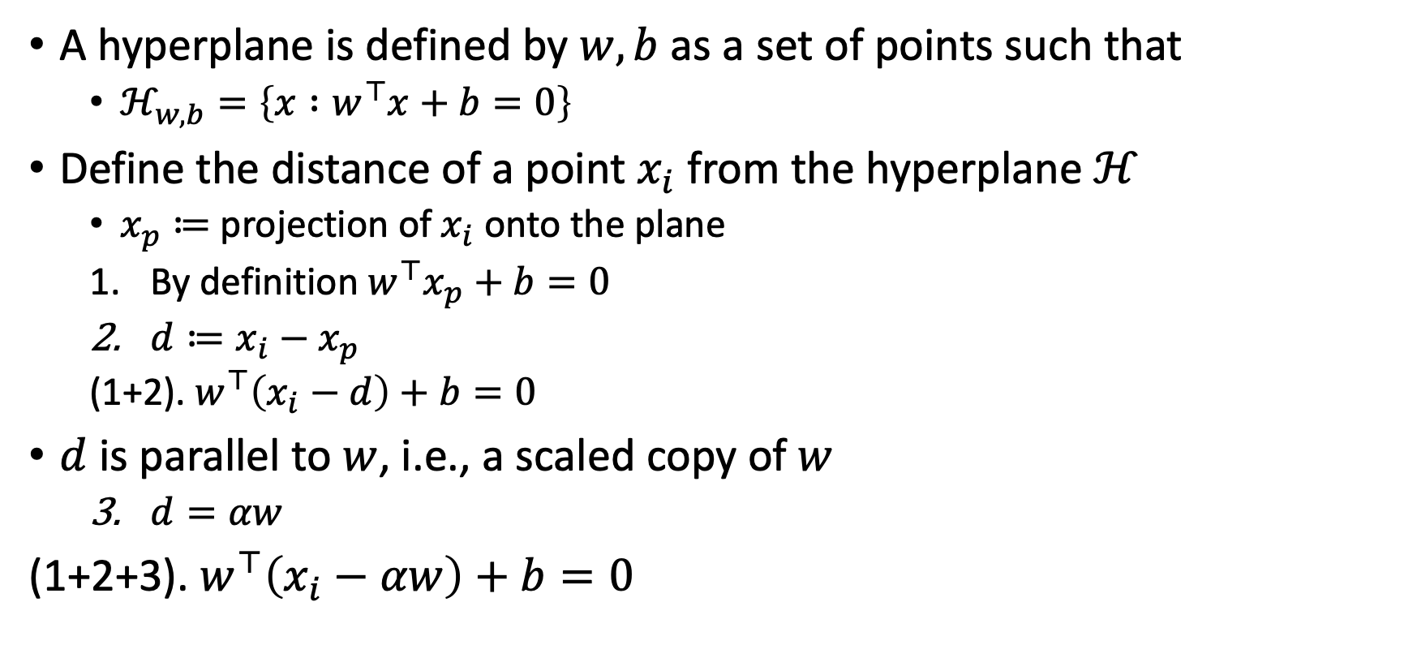



Distance to the hyperplane
A hyperplane is defined by $w,b$ as a set of points such that
  $ℋ_{w,b}=\left\{x :w^{⊤}x+b=0\right\}$
Define the distance of a point $x_{i}$ from the hyperplane $ℋ$
  $x_{p}≔$ projection of $x_{i}$ onto the plane
  By definition $w^{⊤}x_{p}+b=0$
  $d≔x_{i}−x_{p}$
  (1+2). $w^{⊤}\left(x_{i}−d\right)+b=0$
$d$ is parallel to $w$, i.e., a scaled copy of $w$
  $d=αw$
(1+2+3). $w^{⊤}\left(x_{i}−αw\right)+b=0$
$$x_{i}$$
$$d$$
$$x_{p}$$
$$w$$

Slide 8
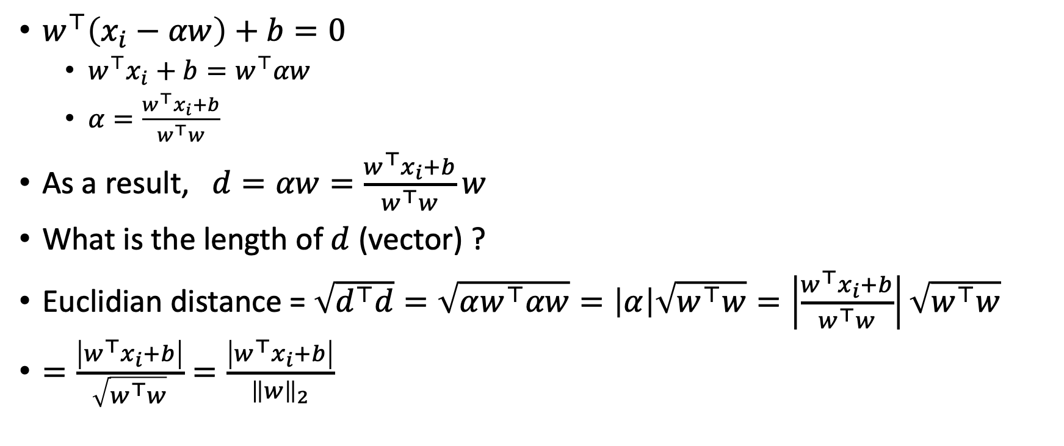
Distance to the hyperplane
$w^{⊤}\left(x_{i}−αw\right)+b=0$
  $w^{⊤}x_{i}+b=w^{⊤}αw$
  $α=\frac{w^{⊤}x_{i}+b}{w^{⊤}w}$
As a result, $d=αw=\frac{w^{⊤}x_{i}+b}{w^{⊤}w}w$
What is the length of $d$ (vector) ?
Euclidian distance = $\sqrt{d^{⊤}d}=\sqrt{αw^{⊤}αw}=\left|α\right|\sqrt{w^{⊤}w}=\left|\frac{w^{⊤}x_{i}+b}{w^{⊤}w}\right|\sqrt{w^{⊤}w}$
$=\frac{\left|w^{⊤}x_{i}+b\right|}{\sqrt{w^{⊤}w}}=\frac{\left|w^{⊤}x_{i}+b\right|}{{\left\|w\right\|}_{2}}$

Slide 9
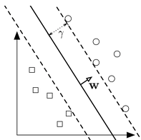
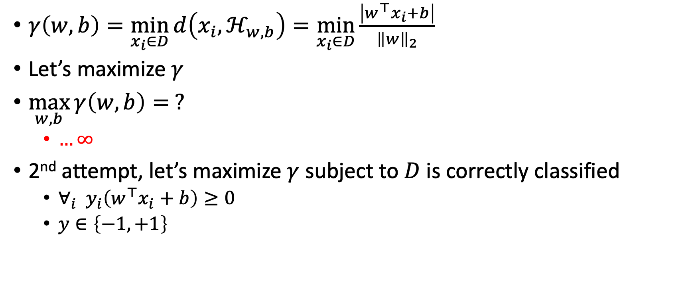
Maximum margin
$γ\left(w,b\right)=\min_{x_{i}∈D}{d\left(x_{i},ℋ_{w,b}\right)}=\min_{x_{i}∈D}{\frac{\left|w^{⊤}x_{i}+b\right|}{{\left\|w\right\|}_{2}}}$
Let’s maximize $γ$
$\max_{w,b}{γ\left(w,b\right)}= ?$
  $…∞$
2nd attempt, let’s maximize $γ$ subject to $D$ is correctly classified
  $∀_{i} y_{i}\left(w^{⊤}x_{i}+b\right)≥0$
  $y∈\left\{−1,+1\right\}$

Slide 10
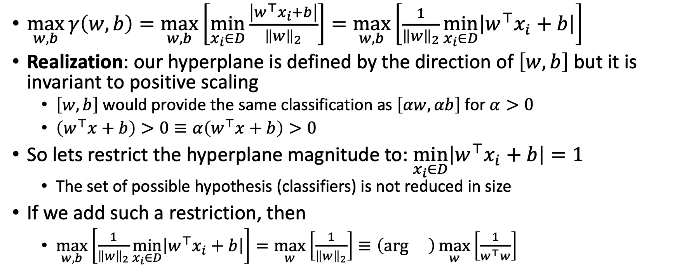
Max Margin Classifier
$\max_{w,b}{γ\left(w,b\right)}=\max_{w,b}\left[\min_{x_{i}∈D}{\frac{\left|w^{⊤}x_{i}+b\right|}{{\left\|w\right\|}_{2}}}\right]=\max_{w,b}\left[\frac{1}{{\left\|w\right\|}_{2}}\min_{x_{i}∈D}\left|w^{⊤}x_{i}+b\right|\right]$
Realization: our hyperplane is defined by the direction of $\left[w,b\right]$ but it is invariant to positive scaling
  $\left[w,b\right]$ would provide the same classification as $\left[αw,αb\right]$ for $α>0$
  $\left(w^{⊤}x+b\right)>0≡α\left(w^{⊤}x+b\right)>0$
So lets restrict the hyperplane magnitude to: $\min_{x_{i}∈D}\left|w^{⊤}x_{i}+b\right|=1$
  The set of possible hypothesis (classifiers) is not reduced in size
If we add such a restriction, then
  $\max_{w,b}\left[\frac{1}{{\left\|w\right\|}_{2}}\min_{x_{i}∈D}\left|w^{⊤}x_{i}+b\right|\right]=\max_{w}\left[\frac{1}{{\left\|w\right\|}_{2}}\right]≡\left(\arg{}\right)\max_{w}\left[\frac{1}{w^{⊤}w}\right]$

Slide 11
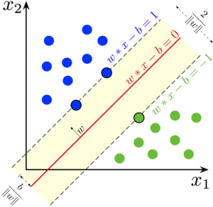
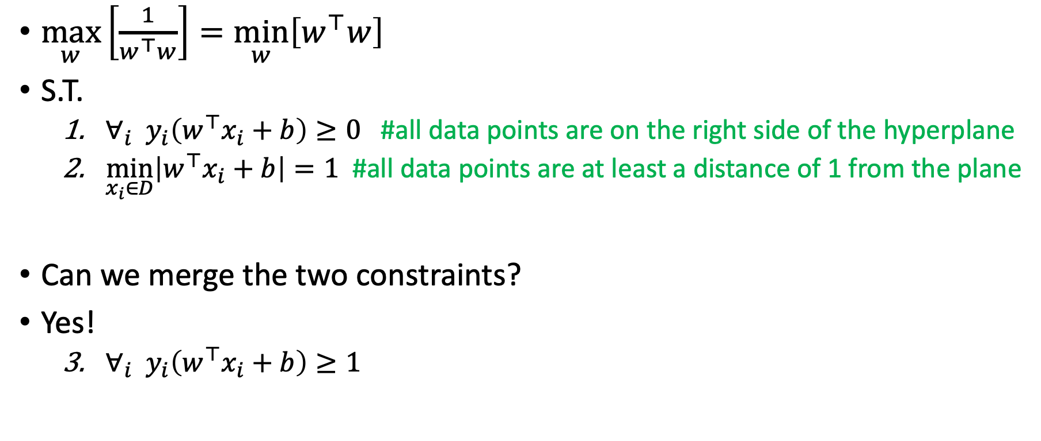
Max Margin Classifier
$\max_{w}\left[\frac{1}{w^{⊤}w}\right]=\min_{w}\left[w^{⊤}w\right]$
S.T.
  $∀_{i} y_{i}\left(w^{⊤}x_{i}+b\right)≥0$ #all data points are on the right side of the hyperplane
  $\min_{x_{i}∈D}\left|w^{⊤}x_{i}+b\right|=1$ #all data points are at least a distance of 1 from the plane
Can we merge the two constraints?
Yes!
  $∀_{i} y_{i}\left(w^{⊤}x_{i}+b\right)≥1$
Our previous simplifying condition

Slide 12
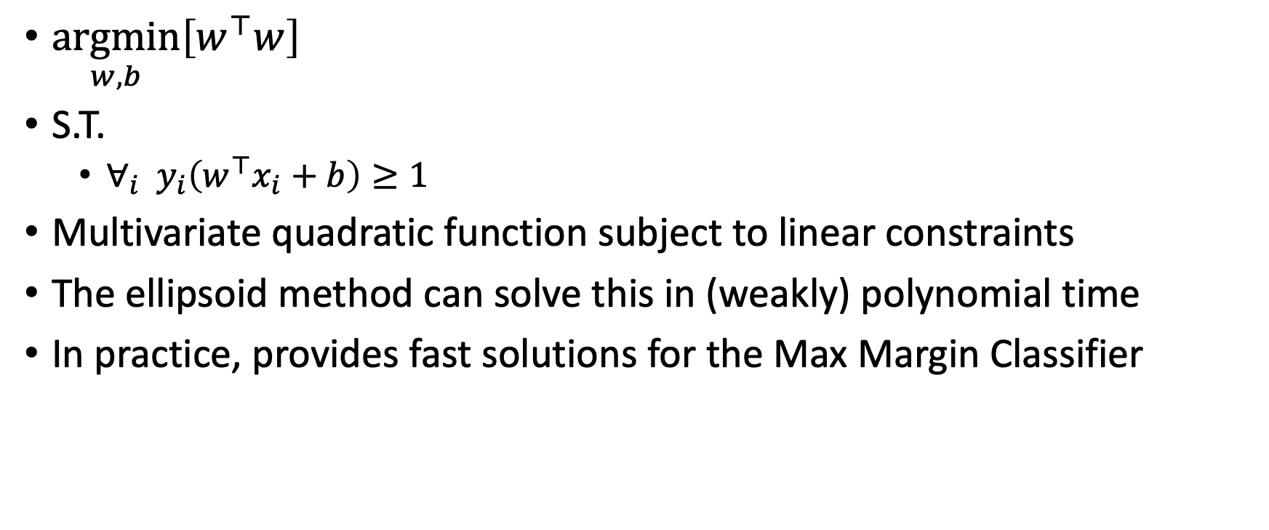
Quadratic programming
$\underset{w,b}{argmin}\left[w^{⊤}w\right]$
S.T.
  $∀_{i} y_{i}\left(w^{⊤}x_{i}+b\right)≥1$
Multivariate quadratic function subject to linear constraints
The ellipsoid method can solve this in (weakly) polynomial time
In practice, provides fast solutions for the Max Margin Classifier

Slide 13
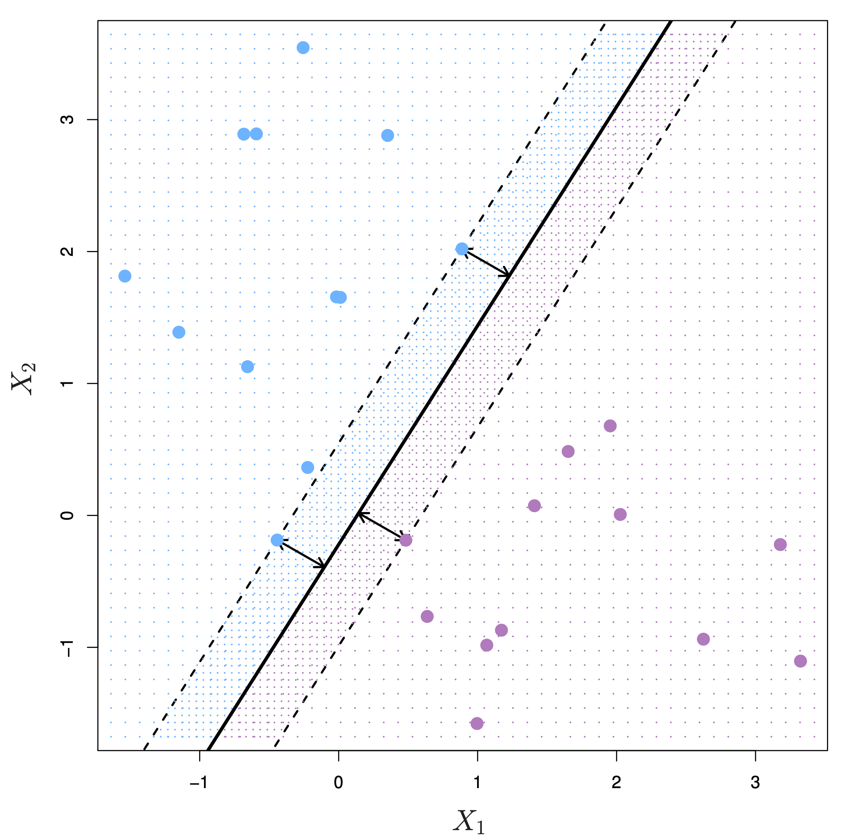
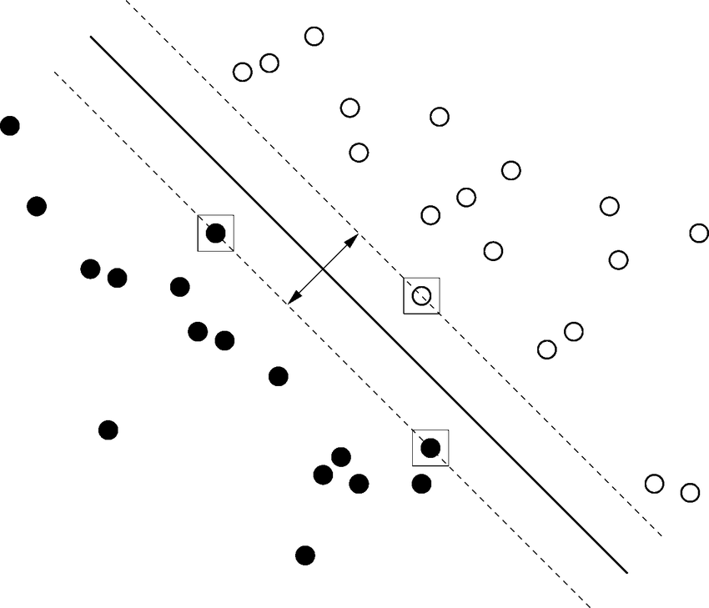
Max Margin Classifier = equal minimal distance from classes

Slide 14
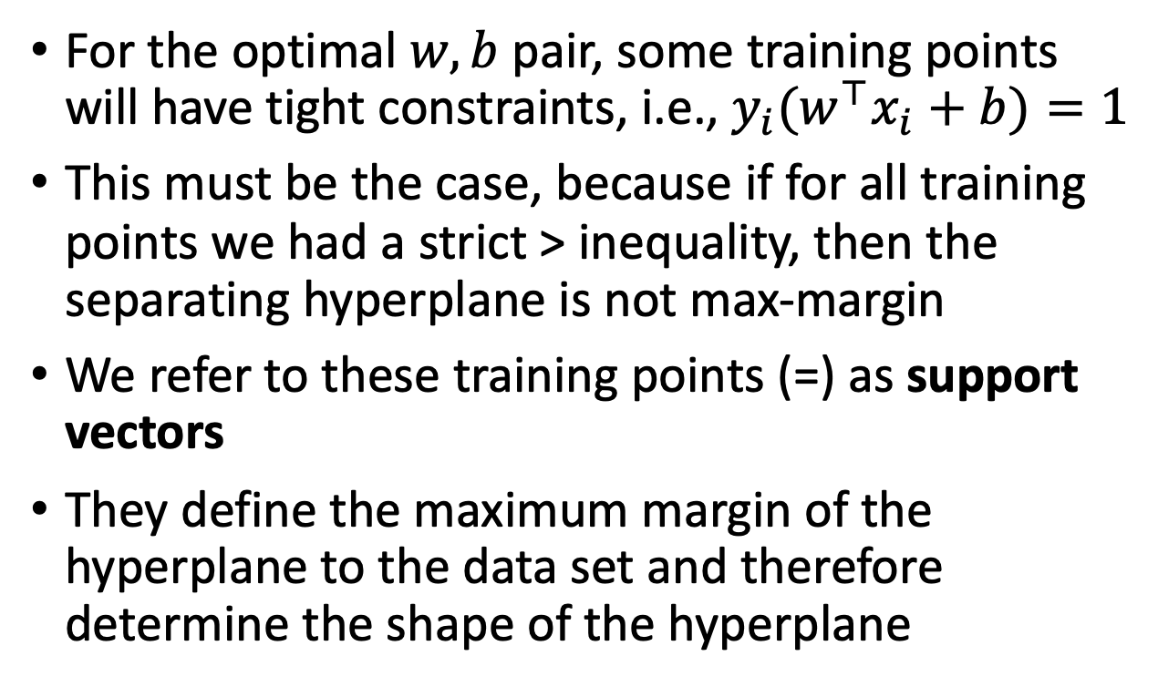
Support Vectors
For the optimal $w,b$ pair, some training points will have tight constraints, i.e., $y_{i}(w^{⊤}x_{i}+b)=1$
This must be the case, because if for all training points we had a strict > inequality, then the separating hyperplane is not max-margin
We refer to these training points (=) as support vectors
They define the maximum margin of the hyperplane to the data set and therefore determine the shape of the hyperplane

Slide 15
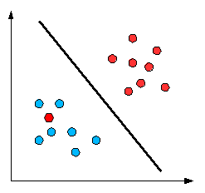
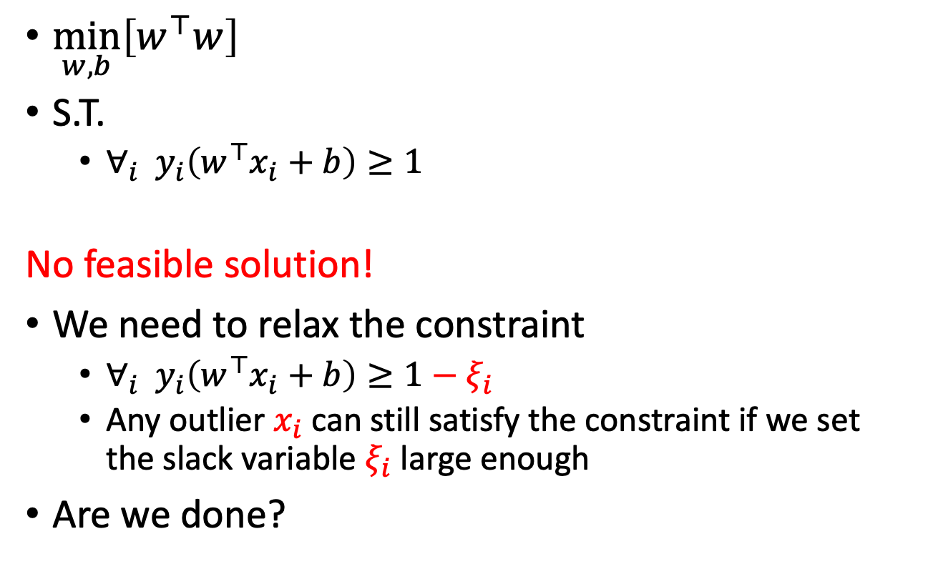

What if $D$ is not linearly separable?
$\min_{w,b}\left[w^{⊤}w\right]$
S.T.
  $∀_{i} y_{i}\left(w^{⊤}x_{i}+b\right)≥1$
No feasible solution!
We need to relax the constraint
  $∀_{i} y_{i}\left(w^{⊤}x_{i}+b\right)≥1−ξ_{i}$
  Any outlier $x_{i}$ can still satisfy the constraint if we set the slack variable $ξ_{i}$ large enough
Are we done?

Slide 16
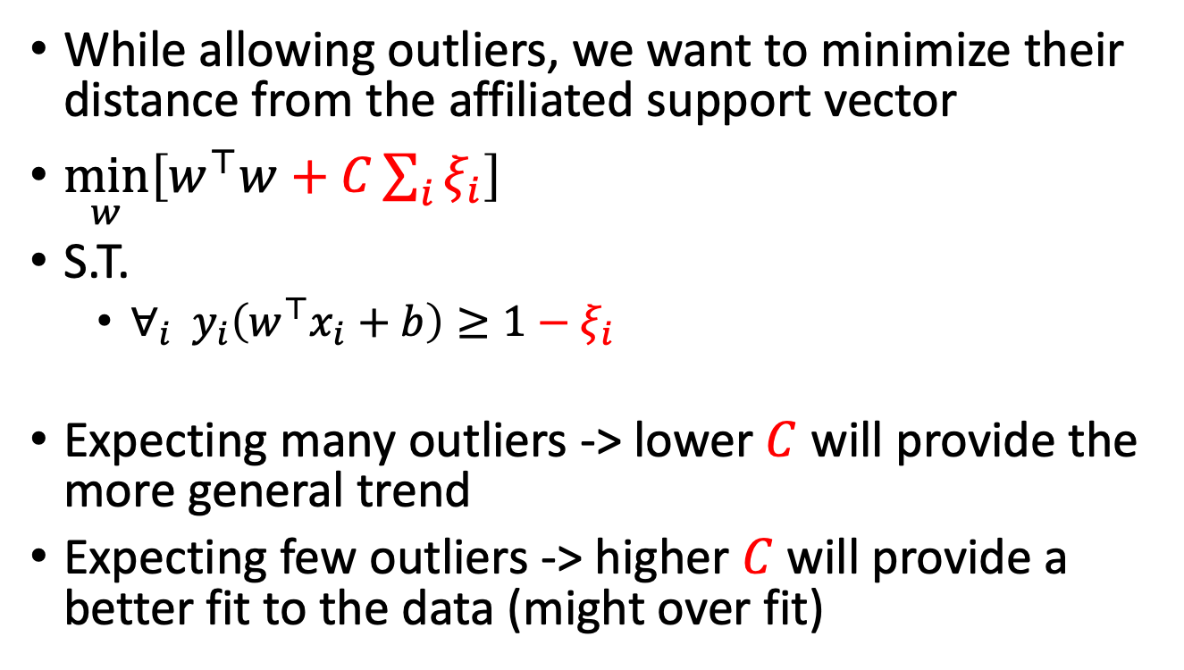

SVM with soft constraints
While allowing outliers, we want to minimize their distance from the affiliated support vector
$\min_{w}\left[w^{⊤}w+C\sum_{i}{ξ_{i}}\right]$
S.T.
  $∀_{i} y_{i}\left(w^{⊤}x_{i}+b\right)≥1−ξ_{i}$
Expecting many outliers -> lower $C$ will provide the more general trend
Expecting few outliers -> higher $C$ will provide a better fit to the data (might over fit)
$$ξ_{i}$$

Slide 17
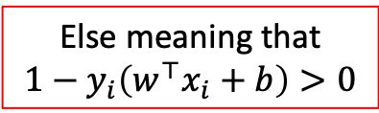
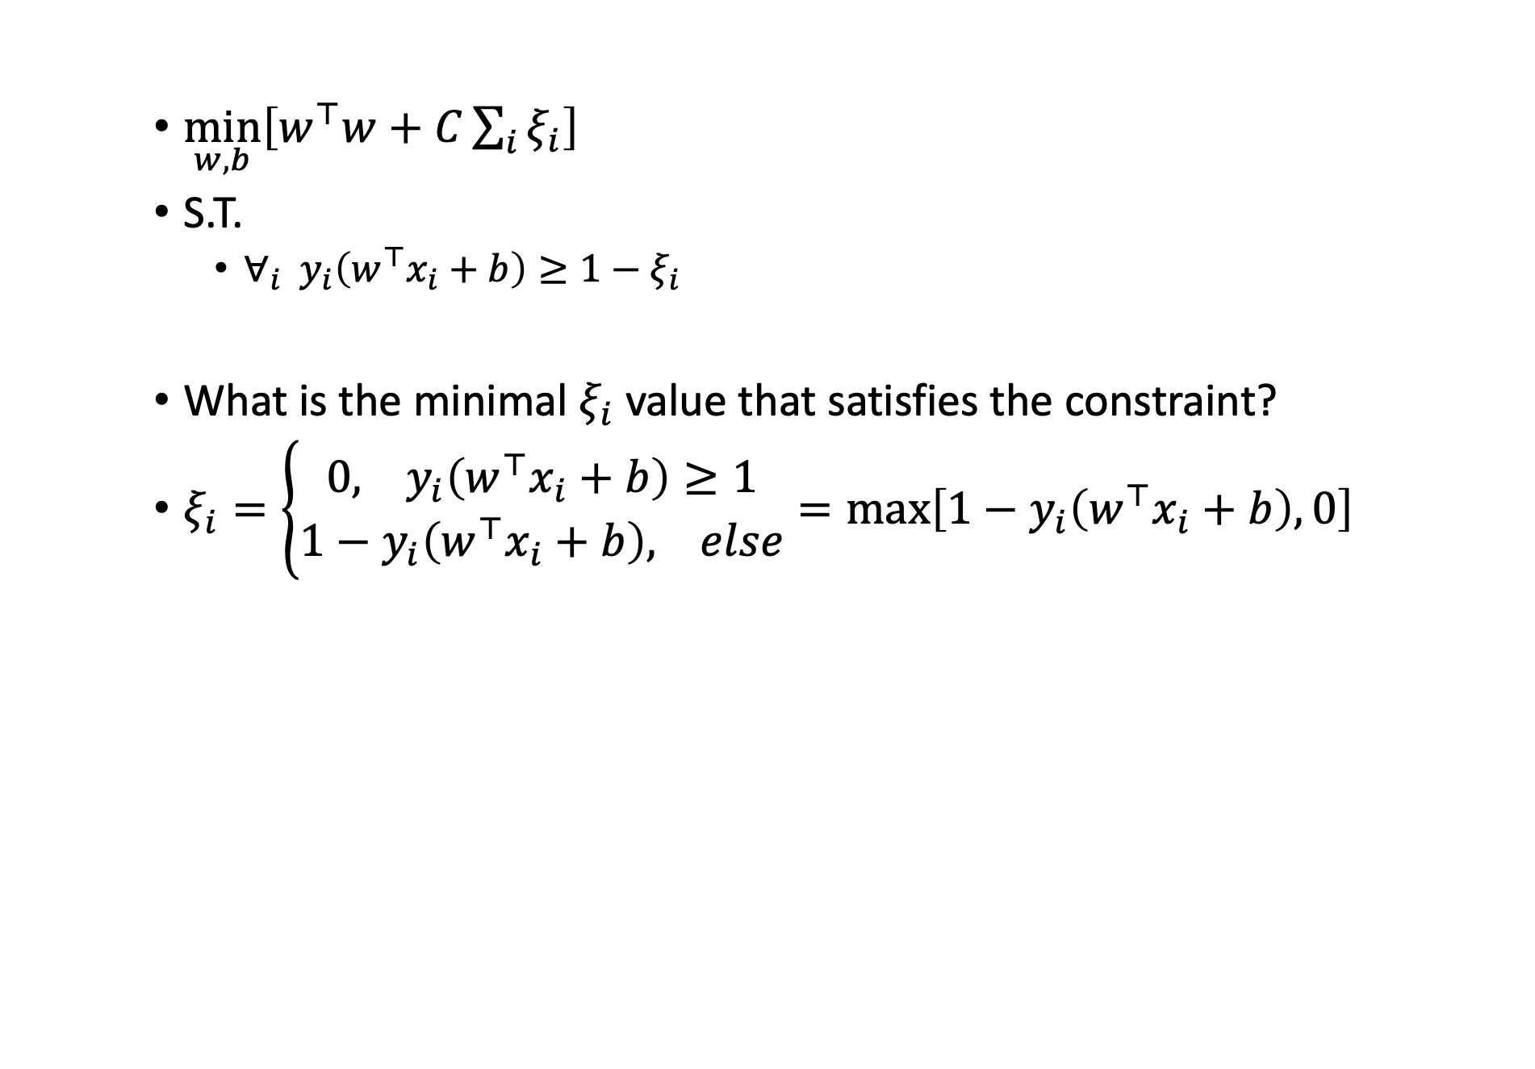
Solving SVM with soft constraints
$\min_{w,b}\left[w^{⊤}w+C\sum_{i}{ξ_{i}}\right]$
S.T.
  $∀_{i} y_{i}\left(w^{⊤}x_{i}+b\right)≥1−ξ_{i}$
What is the minimal $ξ_{i}$ value that satisfies the constraint?
$ξ_{i}=\left\{\begin{aligned}0, y_{i}\left(w^{⊤}x_{i}+b\right)≥1 \\ &1−y_{i}\left(w^{⊤}x_{i}+b\right), else\end{aligned}\right.=\max\left[1−y_{i}\left(w^{⊤}x_{i}+b\right),0\right]$
Else meaning that
$$1−y_{i}\left(w^{⊤}x_{i}+b\right)>0$$

Slide 18
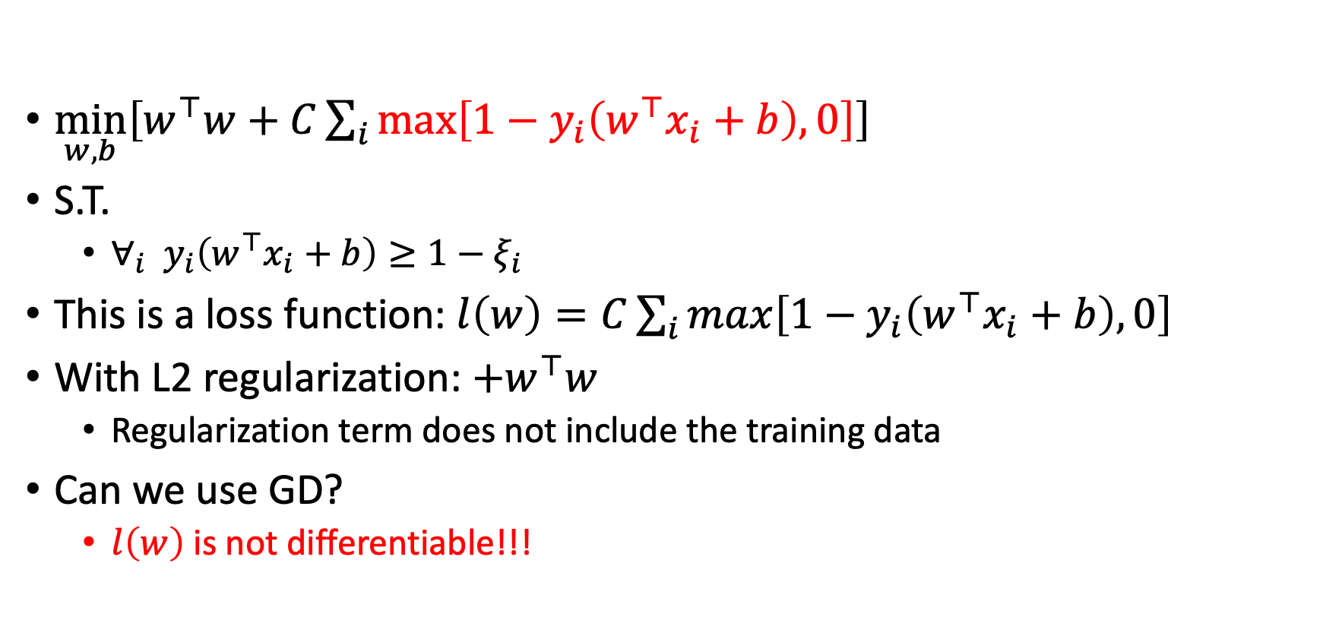
Solving SVM with soft constraints
$\min_{w,b}\left[w^{⊤}w+C\sum_{i}{\max\left[1−y_{i}\left(w^{⊤}x_{i}+b\right),0\right]}\right]$
S.T.
  $∀_{i} y_{i}\left(w^{⊤}x_{i}+b\right)≥1−ξ_{i}$
This is a loss function: $l\left(w\right)=C\sum_{i}{\max\left[1−y_{i}\left(w^{⊤}x_{i}+b\right),0\right]}$
With L2 regularization: $+w^{⊤}w$
  Regularization term does not include the training data
Can we use GD?
  $l\left(w\right)$is not differentiable!!!

Slide 19
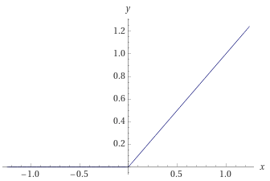
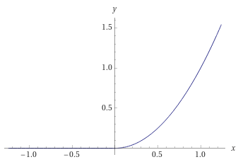
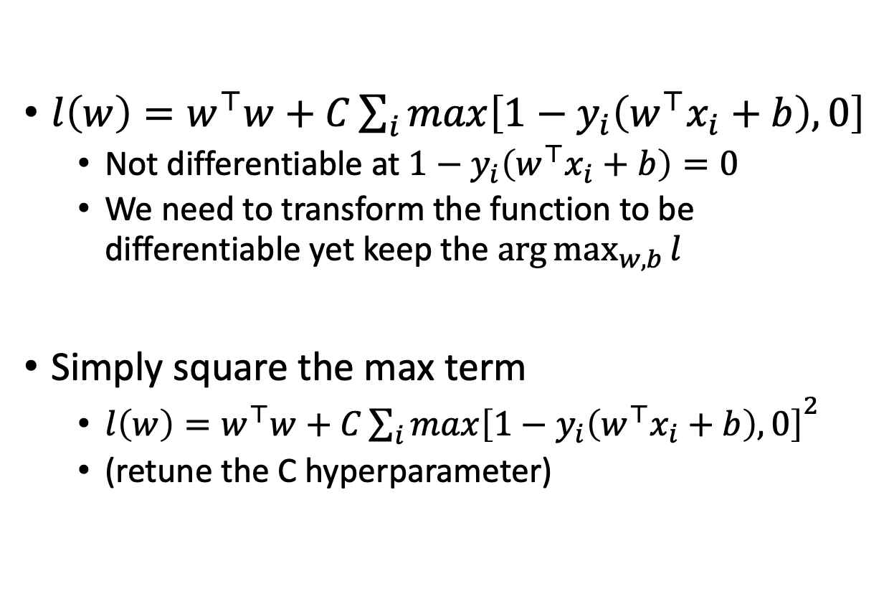
Differentiable loss
$l\left(w\right)=w^{⊤}w+C\sum_{i}{\max\left[1−y_{i}\left(w^{⊤}x_{i}+b\right),0\right]}$
  Not differentiable at $1−y_{i}\left(w^{⊤}x_{i}+b\right)=0$
  We need to transform the function to be differentiable yet keep the $\arg{\max_{w,b}{l}}$
Simply square the max term
  $l\left(w\right)=w^{⊤}w+C{\sum_{i}{\max\left[1−y_{i}\left(w^{⊤}x_{i}+b\right),0\right]}}^{2}$
  (retune the C hyperparameter)

Slide 20
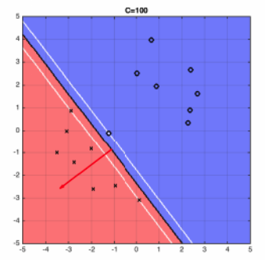

Impact of the $C$ value
High value (100)
More weight towards fitting the data
Less weight towards maximizing the support vectors margin
Examples by Kilian Weinberger

Slide 21
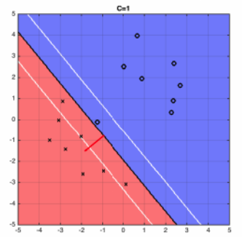
Impact of the $C$ value
Reduced value (1)
Reduced fitting (4 points are not supported)
Increased generality (support vectors margin)
Examples by Kilian Weinberger

Slide 22
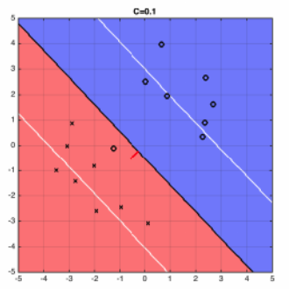
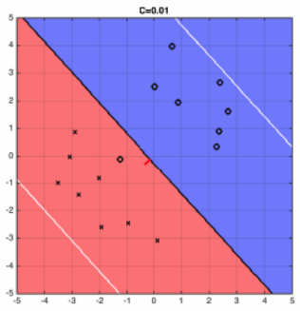
Impact of the $C$ value
Examples by Kilian Weinberger

Slide 23
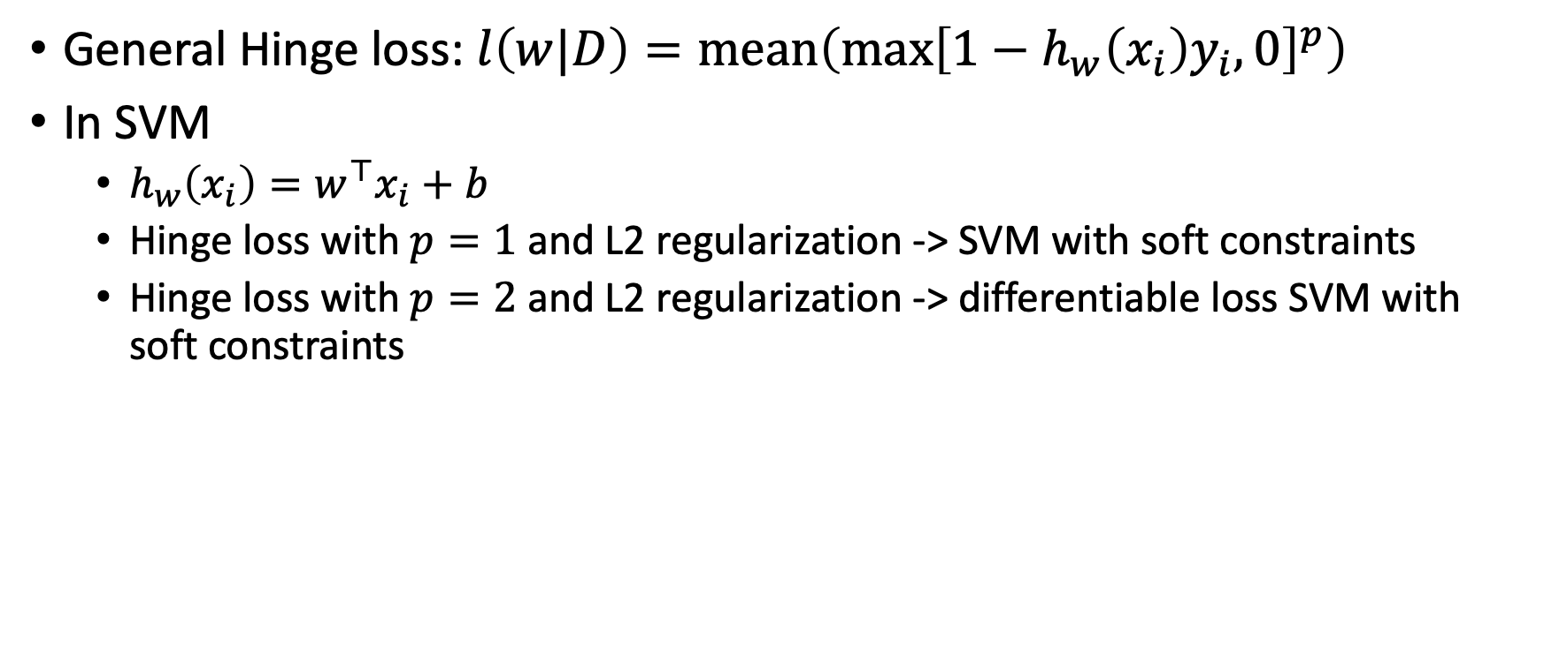
The Hinge loss function
General Hinge loss: $l\left(w|D\right)=mean\left(\max{{\left[1−h_{w}\left(x_{i}\right)y_{i},0\right]}^{p}}\right)$
In SVM
  $h_{w}\left(x_{i}\right)=w^{⊤}x_{i}+b$
  Hinge loss with $p=1$ and L2 regularization -> SVM with soft constraints
  Hinge loss with $p=2$ and L2 regularization -> differentiable loss SVM with soft constraints

Slide 24
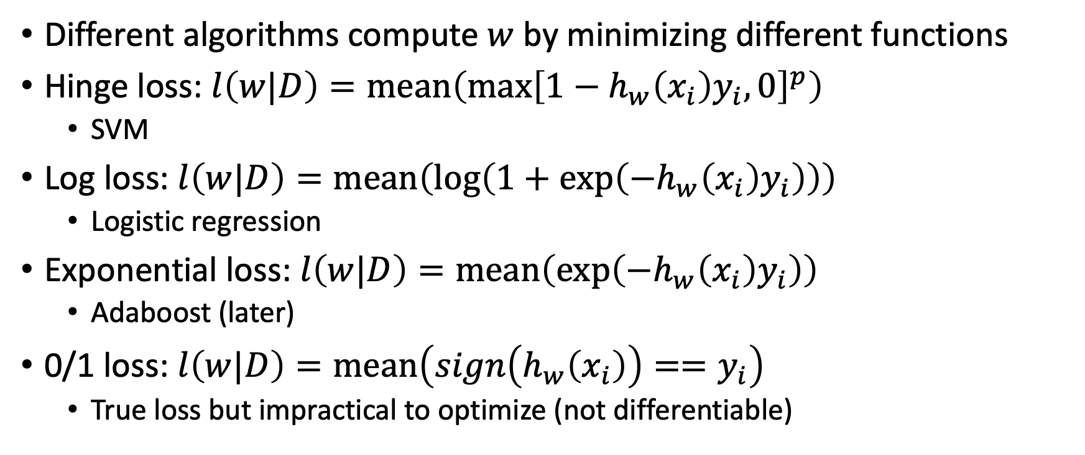
Classification loss functions so far
Different algorithms compute $w$ by minimizing different functions
Hinge loss: $l\left(w|D\right)=mean\left(\max{{\left[1−h_{w}\left(x_{i}\right)y_{i},0\right]}^{p}}\right)$
  SVM
Log loss: $l\left(w|D\right)=mean\left(\log\left(1+\exp\left(−h_{w}\left(x_{i}\right)y_{i}\right)\right)\right)$
  Logistic regression
Exponential loss: $l\left(w|D\right)=mean\left(\exp\left(−h_{w}\left(x_{i}\right)y_{i}\right)\right)$
  Adaboost (later)
0/1 loss: $l\left(w|D\right)=mean\left(sign\left(h_{w}\left(x_{i}\right)\right)==y_{i}\right)$
  True loss but impractical to optimize (not differentiable)

Slide 25
What did we learn?
SVM are linear classifiers that learn a maximal margin separating plane
  Solved with quadratic programing (wasn’t covered)
SVM are also applicable when the training data is not linearly separable
  Tradeoff between classification accuracy and margin size
  Requires tuning the hyperparameter C
  Solved with GD on the Hinge loss function

Slide 26
What next?
Class: Empirical Risk Minimization
Assignments:
  Programming assignment 2: Linear and Logistic Regression, due by March-15
Quizzes:
  Quiz 3: Naïve Bayes and SVM, finish by March-13

