Slide 1
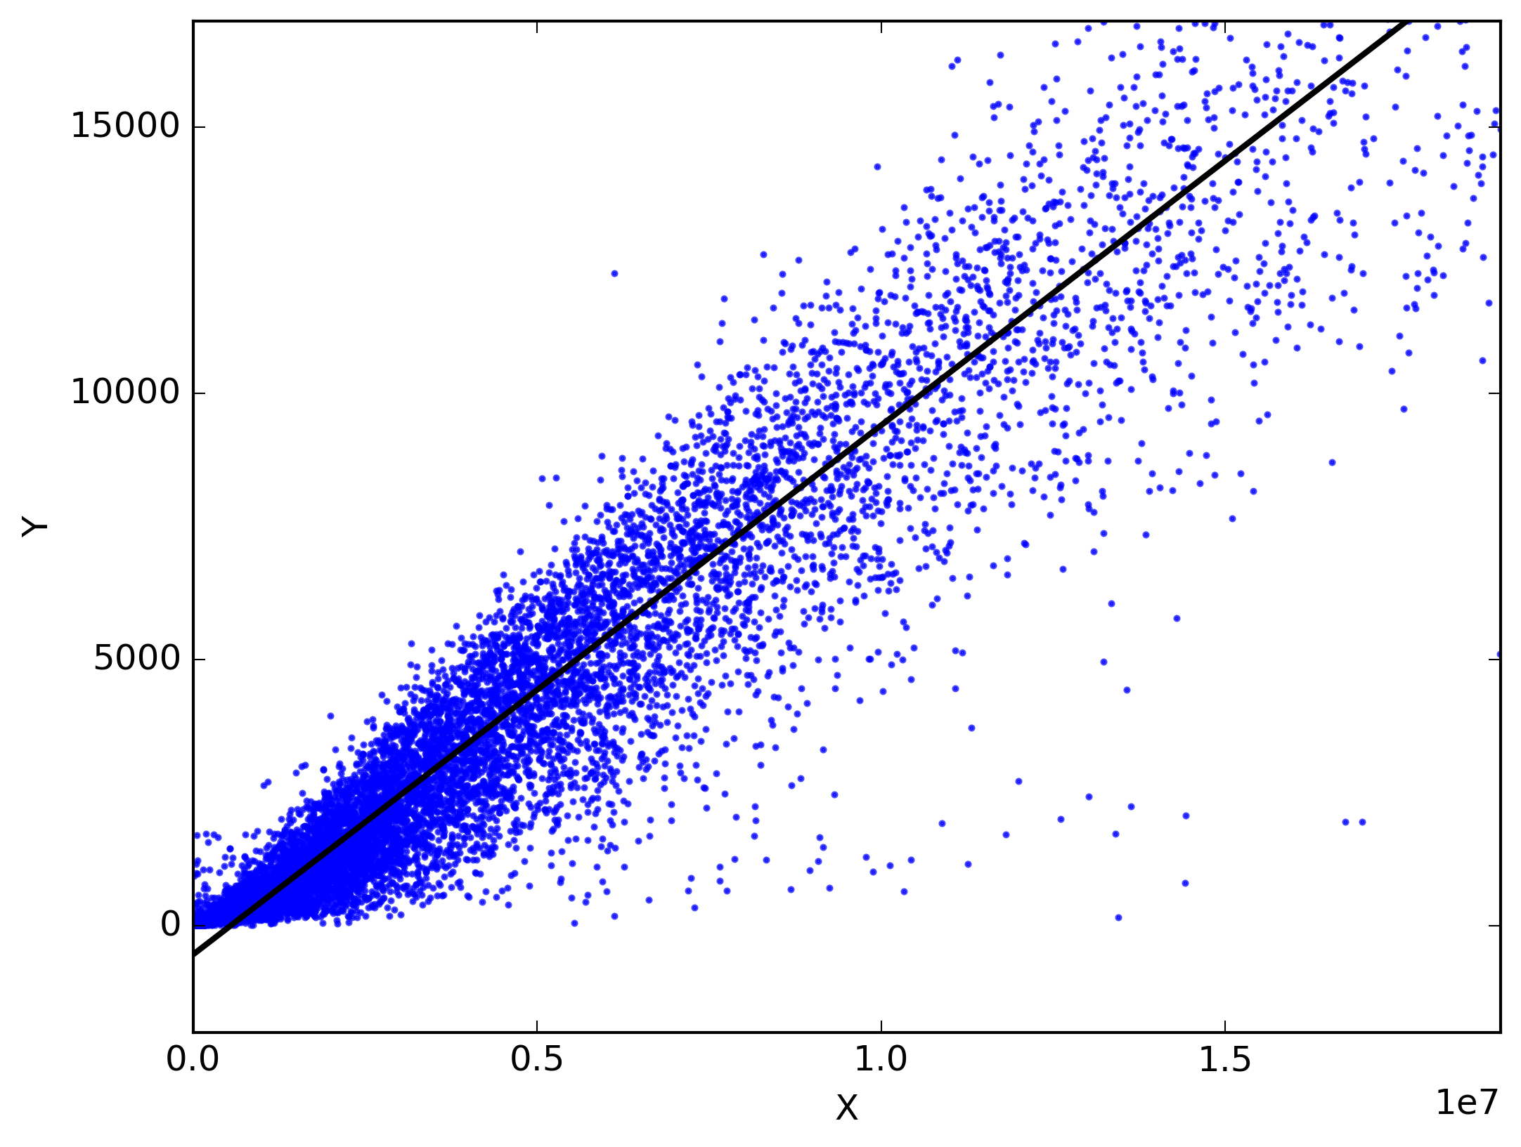
CSCE-633 Machine Learning
8. Linear regression
Instructor: Guni Sharon

Slide 2
Announcements
Announcements
  Midterm on Tuesday, April 12 during class
  Tuesday April 19 , 5 p.m., Last day drop courses with no penalty (Q-drop)
Overdue:
Due:
  Programming assignment 2: Linear and Logistic Regression, due by March-15

Slide 3
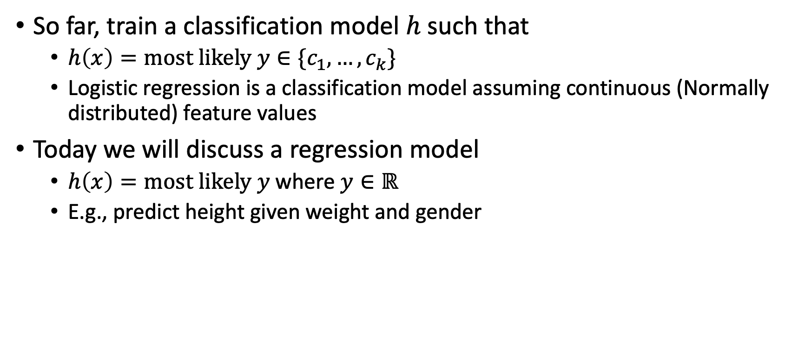
Classifiers vs regression models
So far, train a classification model $h$ such that
  $h\left(x\right)=most likely y∈\{c_{1},…,c_{k}\}$
  Logistic regression is a classification model assuming continuous (Normally distributed) feature values
Today we will discuss a regression model
  $h\left(x\right)=most likely y$where $y∈ℝ$
  E.g., predict height given weight and gender

Slide 4
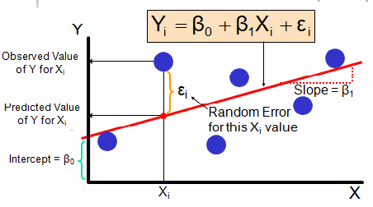
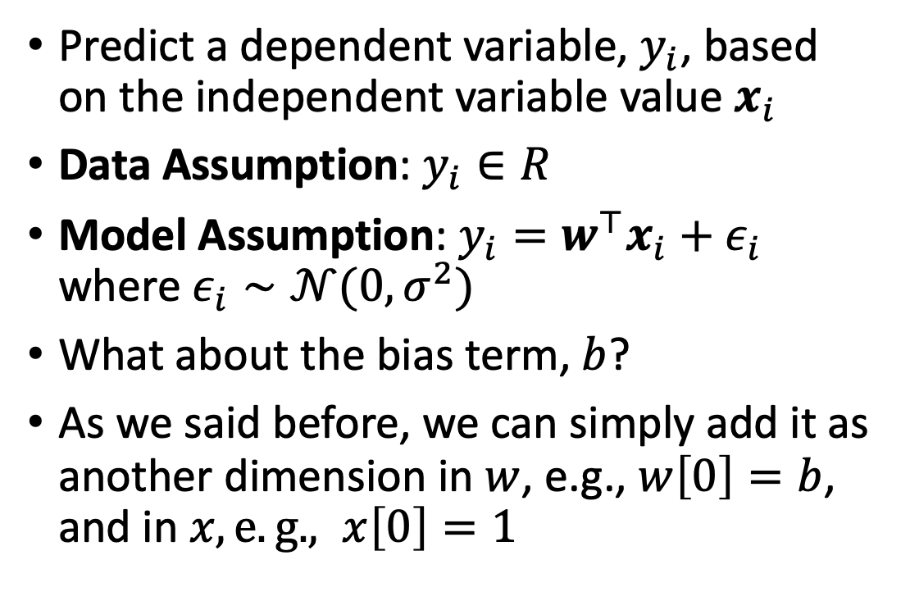
Linear regression
Predict a dependent variable, $y_{i}$, based on the independent variable value $x_{i}$
Data Assumption: $y_{i}∈R$
Model Assumption: $y_{i}=w^{⊤}x_{i}+ε_{i}$ where $ε_{i}∼𝒩(0,σ^{2})$
What about the bias term, $b$?
As we said before, we can simply add it as another dimension in $w$, e.g., $w\left[0\right]=b$, and in $x, e.g., x\left[0\right]=1$

Slide 5

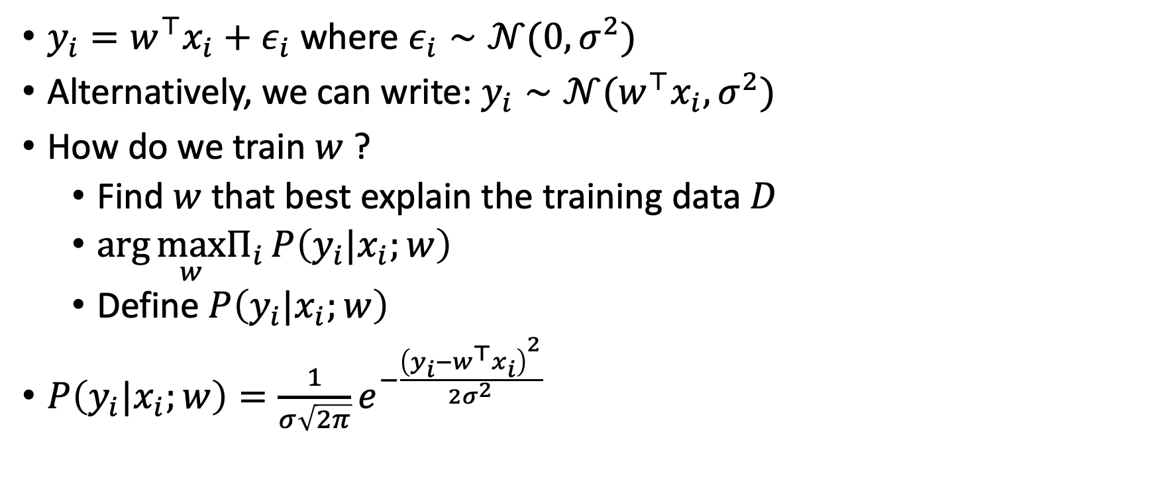
Linear regression
$y_{i}=w^{⊤}x_{i}+ε_{i}$ where $ε_{i}∼𝒩(0,σ^{2})$
Alternatively, we can write: $y_{i}∼𝒩(w^{⊤}x_{i},σ^{2})$
How do we train $w$ ?
  Find $w$ that best explain the training data $D$
  $\arg{\max_{w}Π_{i}{P\left(y_{i}|x_{i};w\right)}}$
  Define $P\left(y_{i}|x_{i};w\right)$
$P\left(y_{i}|x_{i};w\right)=\frac{1}{σ\sqrt{2π}}e^{−\frac{{\left(y_{i}−w^{⊤}x_{i}\right)}^{2}}{{2σ}^{2}}}$

Slide 6
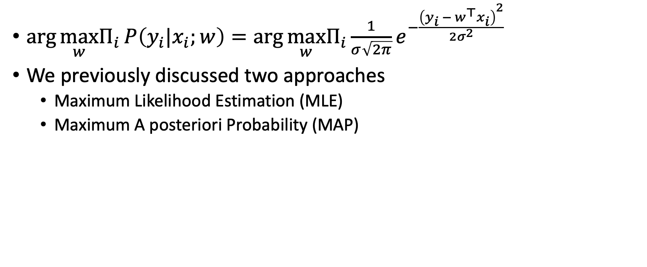
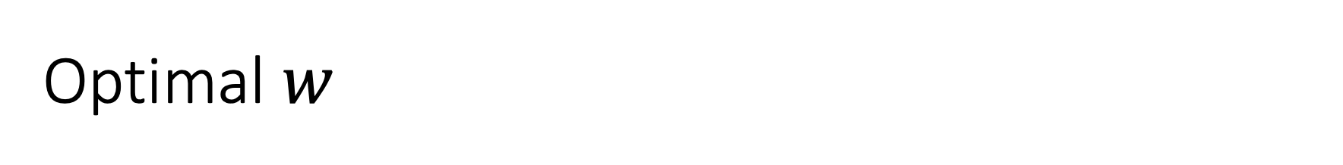
Optimal $w$
$\arg{\max_{w}Π_{i}{P\left(y_{i}|x_{i};w\right)}}=\arg{\max_{w}Π_{i}{\frac{1}{σ\sqrt{2π}}e^{−\frac{{\left(y_{i} − w^{⊤}x_{i}\right)}^{2}}{{2σ}^{2}}}}}$
We previously discussed two approaches
  Maximum Likelihood Estimation (MLE)
  Maximum A posteriori Probability (MAP)

Slide 7

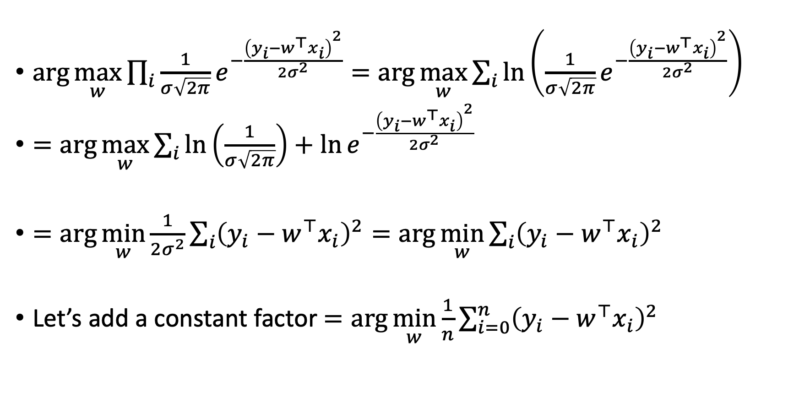

Maximum Likelihood Estimation (MLE)
$\arg{\max_{w}\prod_{i}{\frac{1}{σ\sqrt{2π}}e^{−\frac{{\left(y_{i}−w^{⊤}x_{i}\right)}^{2}}{{2σ}^{2}}}}}=\arg{\max_{w}\sum_{i}{\ln\left(\frac{1}{σ\sqrt{2π}}e^{−\frac{{\left(y_{i}−w^{⊤}x_{i}\right)}^{2}}{{2σ}^{2}}}\right)}}$
$=\arg{\max_{w}\sum_{i}{\ln\left(\frac{1}{σ\sqrt{2π}}\right)+\ln{e^{−\frac{{\left(y_{i}−w^{⊤}x_{i}\right)}^{2}}{{2σ}^{2}}}}}}$
$=\arg{\min_{w}\frac{1}{{2σ}^{2}}\sum_{i}{{\left(y_{i}−w^{⊤}x_{i}\right)}^{2}}}=\arg{\min_{w}\sum_{i}{{\left(y_{i}−w^{⊤}x_{i}\right)}^{2}}}$
Let’s add a constant factor $=\arg{\min_{w}\frac{1}{n}\sum_{i=0}^{n}{{\left(y_{i}−w^{⊤}x_{i}\right)}^{2}}}$
Constant w.r.t $w$
Constant w.r.t $w$
Mean Squared Error!

Slide 8
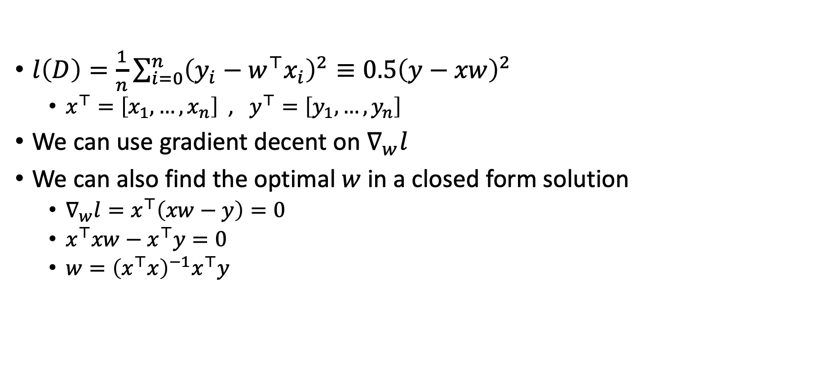
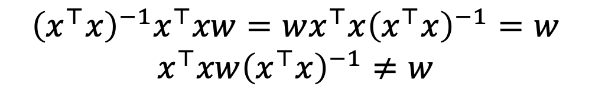
Ordinary Least Square Linear Regression
$l\left(D\right)=\frac{1}{n}\sum_{i=0}^{n}{{\left(y_{i}−w^{⊤}x_{i}\right)}^{2}}≡0.5{\left(y−xw\right)}^{2}$
  $x^{⊤}=\left[x_{1},…, x_{n}\right]$ , $y^{⊤}=\left[y_{1},…, y_{n}\right]$
We can use gradient decent on $∇_{w}l$
We can also find the optimal $w$ in a closed form solution
  $∇_{w}l=x^{⊤}\left(xw−y\right)=0$
  $x^{⊤}xw−x^{⊤}y=0$
  $w={\left(x^{⊤}x\right)}^{−1}x^{⊤}y$
$$≠x^{⊤}y{\left(x^{⊤}x\right)}^{−1}$$
$${\left(x^{⊤}x\right)}^{−1}x^{⊤}xw=wx^{⊤}x{\left(x^{⊤}x\right)}^{−1}=w$$
$$x^{⊤}xw{\left(x^{⊤}x\right)}^{−1}≠w$$
Demo…
Notes:
https://onecompiler.com/python
import numpy as np
import pandas as pd
from numpy.linalg import inv
from sklearn.datasets import load_boston
# A Dataset derived from information collected by the U.S. Census Service concerning housing in the area of Boston Mass.
# Predict house price based on 14 attributes:
# CRIM - per capita crime rate by town
# ZN - proportion of residential land zoned for lots over 25,000 sq.ft.
# INDUS - proportion of non-retail business acres per town.
# CHAS - Charles River dummy variable (1 if tract bounds river; 0 otherwise)
# NOX - nitric oxides concentration (parts per 10 million)
# RM - average number of rooms per dwelling
# AGE - proportion of owner-occupied units built prior to 1940
# DIS - weighted distances to five Boston employment centres
# RAD - index of accessibility to radial highways
# TAX - full-value property-tax rate per $10,000
# PTRATIO - pupil-teacher ratio by town
# B - 1000(Bk - 0.63)^2 where Bk is the proportion of blacks by town
# LSTAT - % lower status of the population
# MEDV - Median value of owner-occupied homes in $1000's
# load the boston data set
boston = load_boston()
# obtain the feature matrix as a numpy array
X = boston.data
# obtain the target variable as a numpy array
y = boston.target
# create vector of ones...
bias = np.ones(shape=y.shape)[..., None]
#...and add to feature matrix (uniform bias)
X = np.concatenate((bias, X), 1)
# calculate coefficients using closed-form solution
coeffs = inv(X.transpose().dot(X)).dot(X.transpose()).dot(y)
# extract the feature names of the boston data set and prepend the intercept
feature_names = np.insert(boston.feature_names, 0, ‘BIAS')
# collect results into a DataFrame for pretty printing
results = pd.DataFrame({'coeffs':coeffs}, index=feature_names)
print(results.round(2))

Slide 9
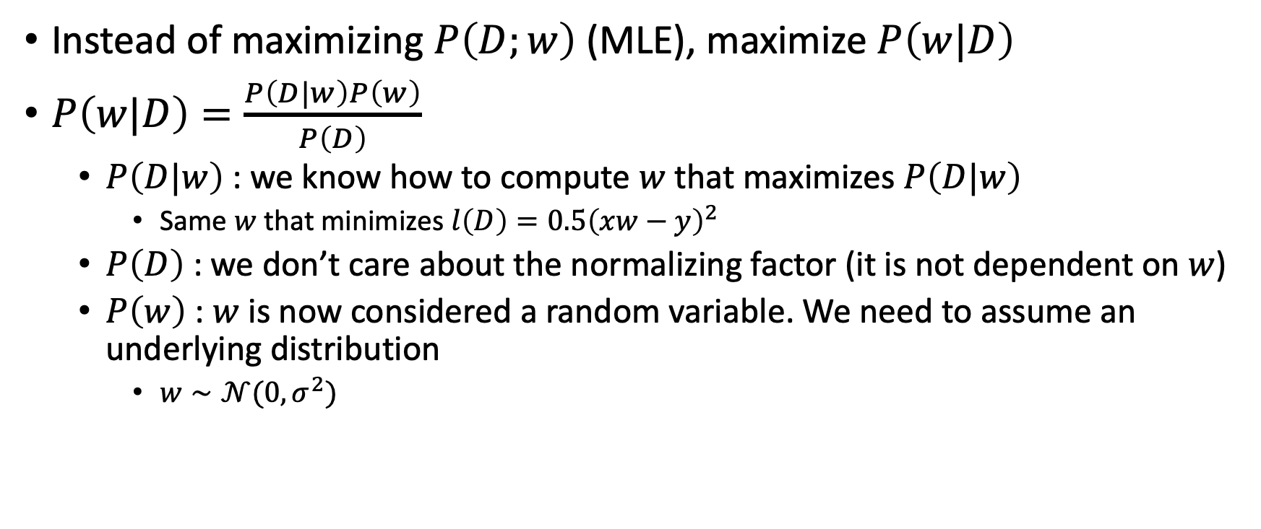
Maximum A posteriori Probability (MAP)
Instead of maximizing $P\left(D;w\right)$ (MLE), maximize $P\left(w|D\right)$
$P\left(w|D\right)=\frac{P\left(D|w\right)P\left(w\right)}{P\left(D\right)}$
  $P\left(D|w\right)$ : we know how to compute $w$ that maximizes $P\left(D|w\right)$
    Same $w$ that minimizes $l\left(D\right)=0.5{\left(xw−y\right)}^{2}$
  $P\left(D\right)$ : we don’t care about the normalizing factor (it is not dependent on $w$)
  $P\left(w\right)$ : $w$ is now considered a random variable. We need to assume an underlying distribution
    $w∼𝒩(0,σ^{2})$

Slide 10
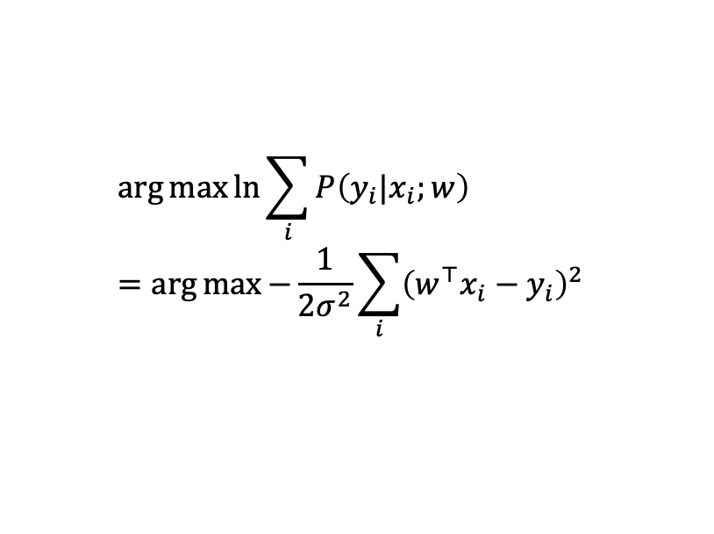
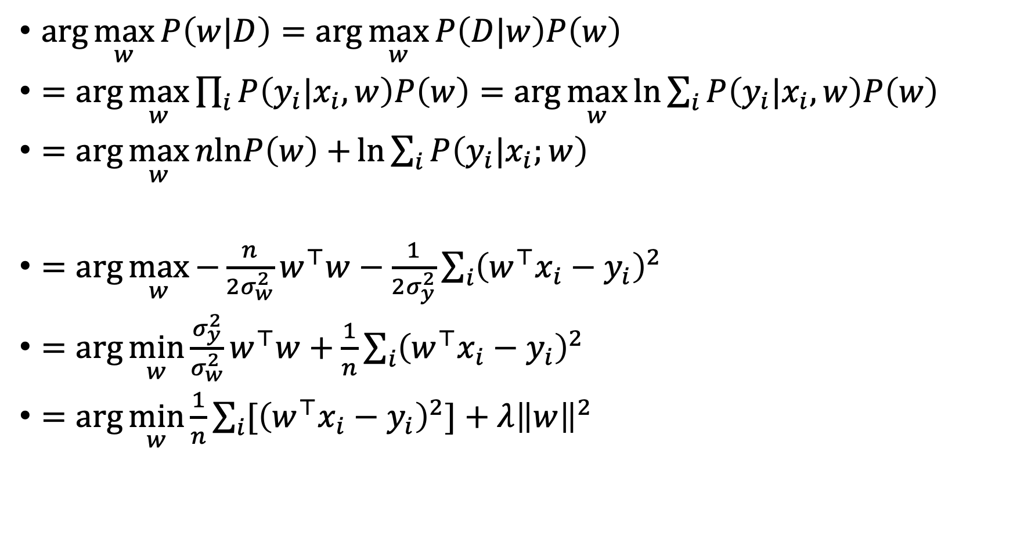
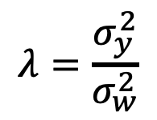

Ridge Regression
$\arg{\max_{w}{P\left(w|D\right)}}=\arg{\max_{w}{P\left(D|w\right)P\left(w\right)}}$
$=\arg{\max_{w}{\prod_{i}{P\left(y_{i}|x_{i},w\right)P\left(w\right)}}}=\arg{\max_{w}{\ln{\sum_{i}{P\left(y_{i}|x_{i},w\right)P\left(w\right)}} }}$
$=\arg{\max_{w}{nlnP\left(w\right)+{\ln{\sum_{i}{P\left(y_{i}|x_{i};w\right)}}} }}$
$=\arg{\max_{w}{−\frac{n}{{2σ}_{w}^{2}}w^{⊤}w−\frac{1}{{2σ}_{y}^{2}}\sum_{i}{{\left(w^{⊤}x_{i}−y_{i}\right)}^{2}}}}$
$=\arg{\min_{w}{\frac{σ_{y}^{2}}{σ_{w}^{2}}w^{⊤}w+\frac{1}{n}\sum_{i}{{\left(w^{⊤}x_{i}−y_{i}\right)}^{2}}}}$
$=\arg{\min_{w}{\frac{1}{n}\sum_{i}{{[\left(w^{⊤}x_{i}−y_{i}\right)}^{2}]}+λ{\left\|w\right\|}^{2}}}$
$$\arg{\max{\ln{\sum_{i}{P\left(y_{i}|x_{i};w\right)}}}}=\arg{\max{−\frac{1}{{2σ}^{2}}\sum_{i}{{\left(w^{⊤}x_{i}−y_{i}\right)}^{2}} }}$$
$$μ=0$$
$$λ=\frac{σ_{y}^{2}}{σ_{w}^{2}}$$

Slide 11
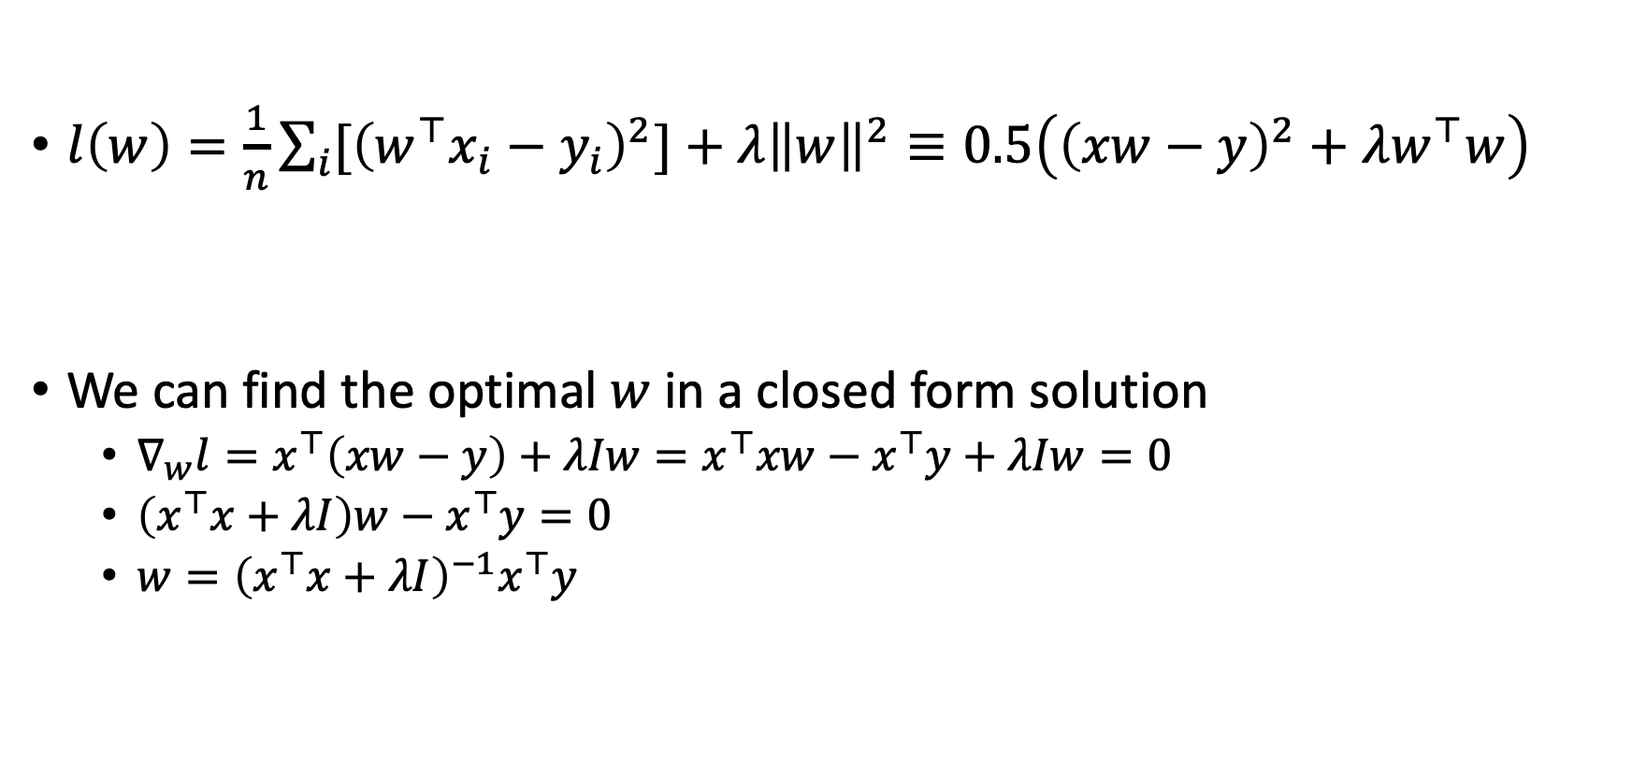
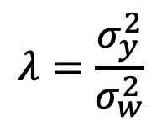
Ridge Regression
$l\left(w\right)=\frac{1}{n}\sum_{i}{{[\left(w^{⊤}x_{i}−y_{i}\right)}^{2}]}+λ{\left\|w\right\|}^{2}≡0.5\left({\left(xw−y\right)}^{2}+λw^{⊤}w\right)$
We can find the optimal $w$ in a closed form solution
  $∇_{w}l=x^{⊤}\left(xw−y\right)+λIw=x^{⊤}xw−x^{⊤}y+λIw=0$
  $\left(x^{⊤}x+λI\right)w−x^{⊤}y=0$
  $w={\left(x^{⊤}x+λI\right)}^{−1}x^{⊤}y$
$$λ=\frac{σ_{y}^{2}}{σ_{w}^{2}}$$
Demo…
Notes:
https://onecompiler.com/python
import numpy as np
import pandas as pd
from numpy.linalg import inv
from sklearn.datasets import load_boston
# A Dataset derived from information collected by the U.S. Census Service concerning housing in the area of Boston Mass.
# Predict house price based on 14 attributes:
# CRIM - per capita crime rate by town
# ZN - proportion of residential land zoned for lots over 25,000 sq.ft.
# INDUS - proportion of non-retail business acres per town.
# CHAS - Charles River dummy variable (1 if tract bounds river; 0 otherwise)
# NOX - nitric oxides concentration (parts per 10 million)
# RM - average number of rooms per dwelling
# AGE - proportion of owner-occupied units built prior to 1940
# DIS - weighted distances to five Boston employment centres
# RAD - index of accessibility to radial highways
# TAX - full-value property-tax rate per $10,000
# PTRATIO - pupil-teacher ratio by town
# B - 1000(Bk - 0.63)^2 where Bk is the proportion of blacks by town
# LSTAT - % lower status of the population
# MEDV - Median value of owner-occupied homes in $1000's
# load the boston data set
boston = load_boston()
# obtain the feature matrix as a numpy array
X = boston.data
# obtain the target variable as a numpy array
y = boston.target
# create vector of ones...
bias = np.ones(shape=y.shape)[..., None]
#...and add to feature matrix (uniform bias)
X = np.concatenate((bias, X), 1)
# calculate coefficients using closed-form solution
#coeffs = inv(X.transpose().dot(X)).dot(X.transpose()).dot(y)
n,m = X.shape
I = np.identity(m)
lambd = 0
coeffs = inv(X.transpose().dot(X) + lambd * I).dot(X.transpose()).dot(y)
# extract the feature names of the boston data set and prepend the intercept
feature_names = np.insert(boston.feature_names, 0, 'INT')
# collect results into a DataFrame for pretty printing
results = pd.DataFrame({'coeffs':coeffs}, index=feature_names)
print(results.round(2))

Slide 12
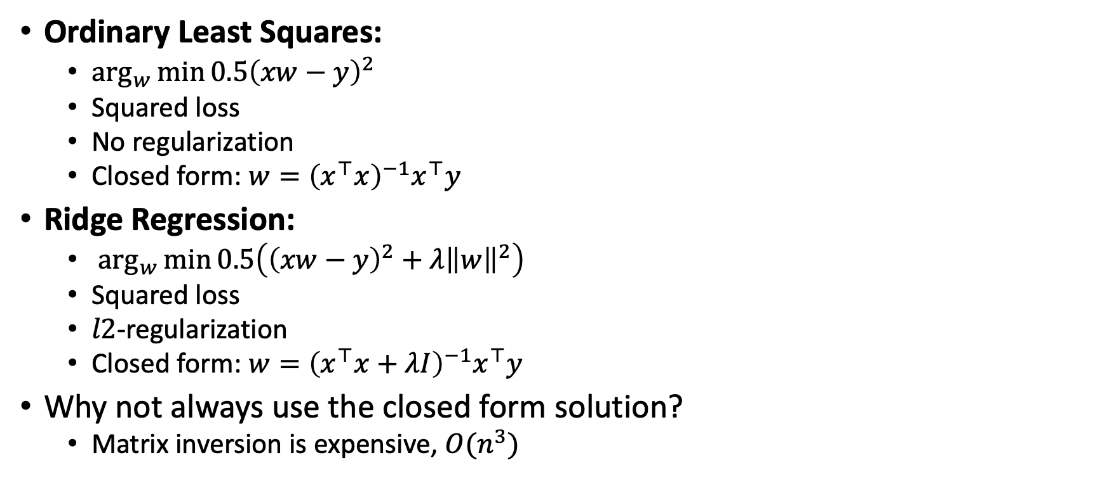
What did we learn?
Ordinary Least Squares:
  $\arg_{w}{\min{0.5{\left(xw−y\right)}^{2}}}$
  Squared loss
  No regularization
  Closed form: $w={\left(x^{⊤}x\right)}^{−1}x^{⊤}y$
Ridge Regression:
  $\arg_{w}{\min{0.5\left({\left(xw−y\right)}^{2}+λ{\left\|w\right\|}^{2}\right)}}$
  Squared loss
  $l2$-regularization
  Closed form: $w={\left(x^{⊤}x+λI\right)}^{−1}x^{⊤}y$
Why not always use the closed form solution?
  Matrix inversion is expensive, ${O(n}^{3})$

Slide 13
What next?
Class: Support Vector Machines
Assignments:
  Programming assignment 2: Linear and Logistic Regression, due by March-15

