Slide 1
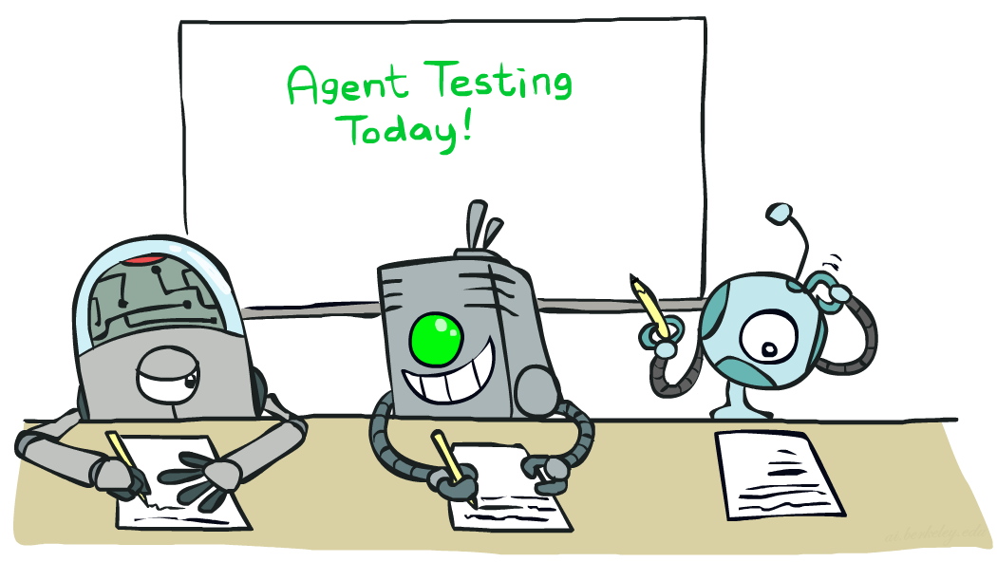
CSCE-633 Machine Learning
6. Naïve Bayes
Instructor: Guni Sharon
Based on slides by: Pieter Abbeel, Dan Klein

Slide 2
Announcements
Overdue:
  Programing assignment 1: Perceptron (due Feb 15)
Due:
  Written assignment 2: generative models (due Monday, Feb. 21)
  Quiz 2 (by Wednesday, Feb-23)

Slide 3
TAMIDS 2022 Data Science Student Competition
2022 TAMIDS Student Data Science Competition
EXPLORING THE NETWORKS OF TEXAS A&M’S RESEARCH
Further Information:
  https://tamids.tamu.edu/2022/01/23/2022-dscomp-call/
  Competitor Registrationhttps://forms.gle/QZwLxuWn3TD4utPw8
Undergraduate and Graduate Teams of 1-5 members will compete for prizes totaling more than $8,000
Extra course credit if you win places 1-3
Important Dates
  Feb 27: Competitor and Team Registration Deadline
  Mar 1: Technical Information Session, Data Release, Competition Start
  April 5: Submission Deadline
  April 19: Final Event, Prize Awards

Slide 4
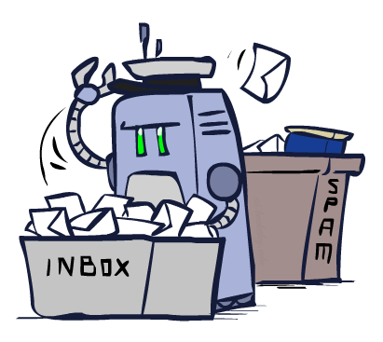
Classification

Slide 5
Example: Spam Filter
Input: character string
Output: spam/ham
Setup (supervised learning):
  Get a large collection of example emails, each labeled “spam” or “ham”
  Note: someone must hand label all this data!
  Want to learn to predict labels of new, future emails
Features: The attributes used to make the ham / spam decision
  Words: FREE!
  Text Patterns: $dd, CAPS
  Non-text: SenderInContacts, WidelyBroadcast
  …
Dear Sir.
First, I must solicit your confidence in this transaction, this is by virture of its nature as being utterly confidencial and top secret. …
TO BE REMOVED FROM FUTURE MAILINGS, SIMPLY REPLY TO THIS MESSAGE AND PUT "REMOVE" IN THE SUBJECT.
99 MILLION EMAIL ADDRESSES
FOR ONLY $99
Ok, Iknow this is blatantly OT but I'm beginning to go insane. Had an old Dell Dimension XPS sitting in the corner and decided to put it to use, I know it was working pre being stuck in the corner, but when I plugged it in, hit the power nothing happened.

Slide 6

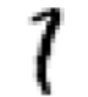



Example: Digit Recognition
Input: images / pixel grids
Output: a digit 0-9
Setup:
  Get a large collection of example images, each labeled with a digit
  Note: someone must hand label all this data!
  Want to learn to predict labels of new, future digit images
Features: The attributes used to make the digit decision
  Pixels: (6,8)=ON
  Features : NumComponents, AspectRatio, NumLoops, …
  Features should be increasingly induced rather than crafted
0
1
2
1
??

Slide 7
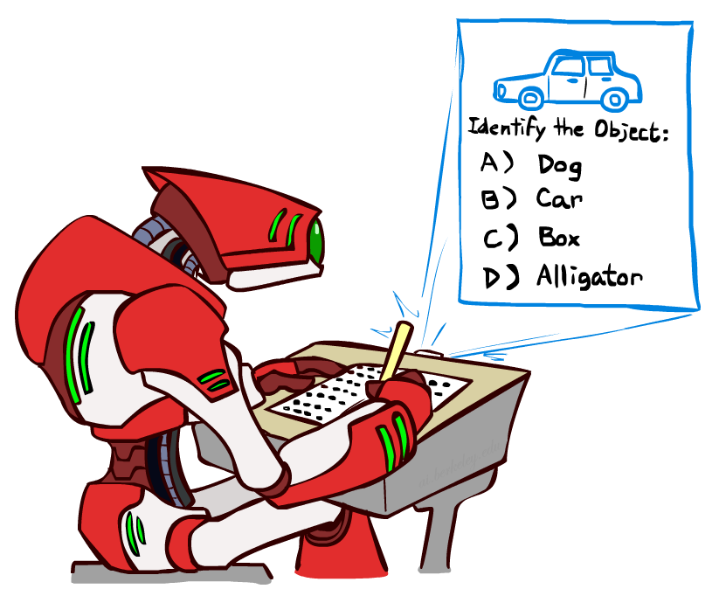
Other Classification Tasks
Classification: given inputs x, predict labels (classes) y
Examples:
  Medical diagnosis (input: symptoms,
  classes: diseases)
  Fraud detection (input: account activity,
  classes: fraud / valid)
  Automatic essay grading (input: document,
  classes: letter grade)
  Customer service email routing
  Review sentiment
  Language ID
  … many more
Classification is an important commercial technology!

Slide 8
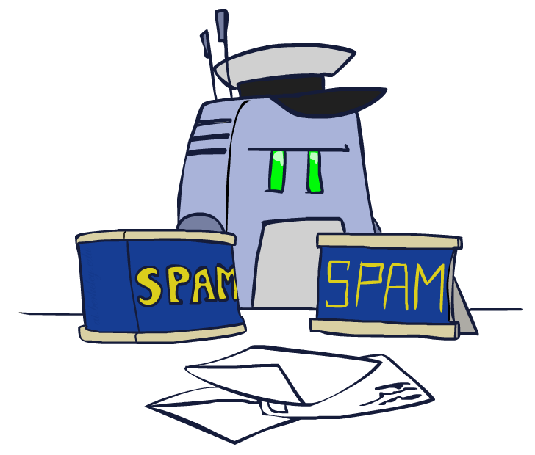
Model-Based (generative) Classification

Slide 9
Model-Based (generative) Classification
Model-based approach
  Build a model (e.g., Bayes’ net) where both the output label and input features are random variables
  Query for the distribution of the label conditioned on the features
Challenges
  What structure should the BN have?
  How should we learn its parameters?
    Maximum Likelihood Estimation
    Maximum A posteriori Probability

Slide 10
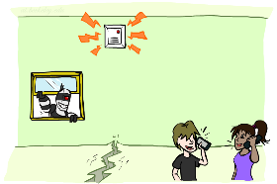
BN Example: Alarm Network
B | P(B)
+b | 0.001
-b | 0.999
E | P(E)
+e | 0.002
-e | 0.998
Burglary
Earthquake
Alarm
B | E | A | P(A|B,E)
+b | +e | +a | 0.95
+b | +e | -a | 0.05
+b | -e | +a | 0.94
+b | -e | -a | 0.06
-b | +e | +a | 0.29
-b | +e | -a | 0.71
-b | -e | +a | 0.001
-b | -e | -a | 0.999
John calls
Mary calls
A | J | P(J|A)
+a | +j | 0.9
+a | -j | 0.1
-a | +j | 0.05
-a | -j | 0.95
A | M | P(M|A)
+a | +m | 0.7
+a | -m | 0.3
-a | +m | 0.01
-a | -m | 0.99
Notes:
demo

Slide 11
BN dimensionality
What if all the variables are dependent?
  Requires a full joint conditional probability table (over all variables)
  Can’t store in memory
  Can’t perform meaningful learning (bound to overfit)
  Can’t perform learning at all (we will never see all features combinations)
Let’s make a simplifying assumption
  All variables are conditionally independent given the label

Slide 12


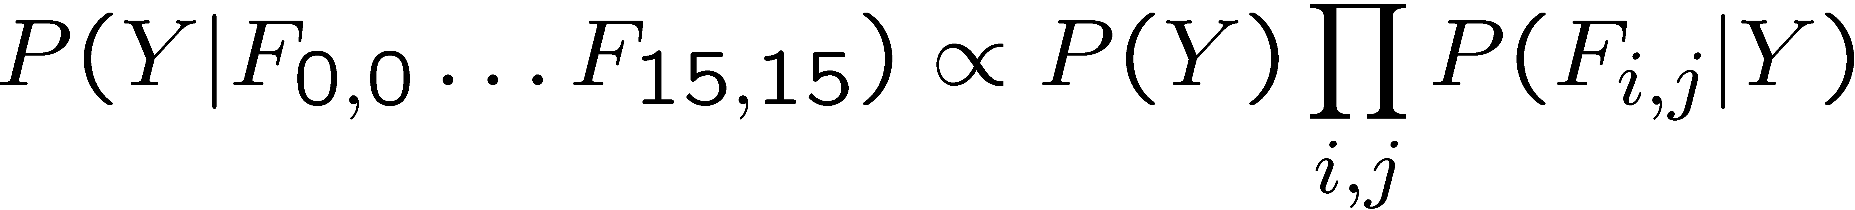
Naïve Bayes for Digits
Naïve Bayes: Assume all features are conditionally independent given the label
Simple digit recognition version:
  One feature (variable) F_{ij} for each grid position <i,j>
  Feature values are on / off
  = more or less than 0.5 black in underlying image
  Each input maps to a feature vector, e.g.
  Here: lots of features, each is binary valued
Naïve Bayes model:
What parameters do we need to learn?
Y
F₁
F₂
F_{n}
Definition of conditional prob (=P(y,x)/P(x)) using the Chain rule with cond independency assumptions (Fs given Y)

Slide 13

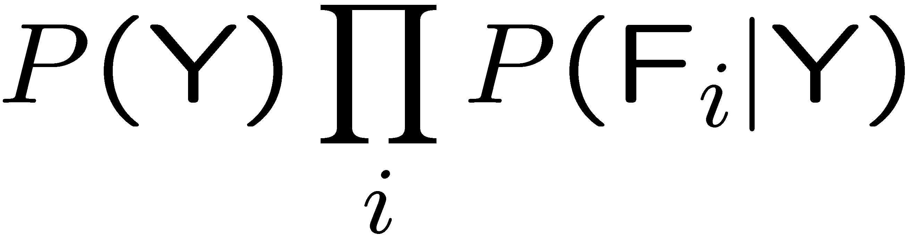
General Naïve Bayes
Y
A general Naive Bayes model:
Only need to learn the probability of each feature given the label
Total number of parameters is linear in n and |Y|
Model is very simplistic (overgeneralization), but often works anyway
|Y| parameters
F₁
F₂
F_{n}
|Y| x |F|^{n} possible observatios
n x |F| x |Y| parameters (for each F_i a CPT of size |Y|)

Slide 14
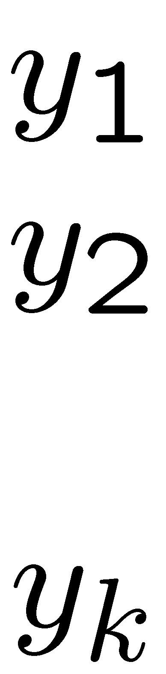
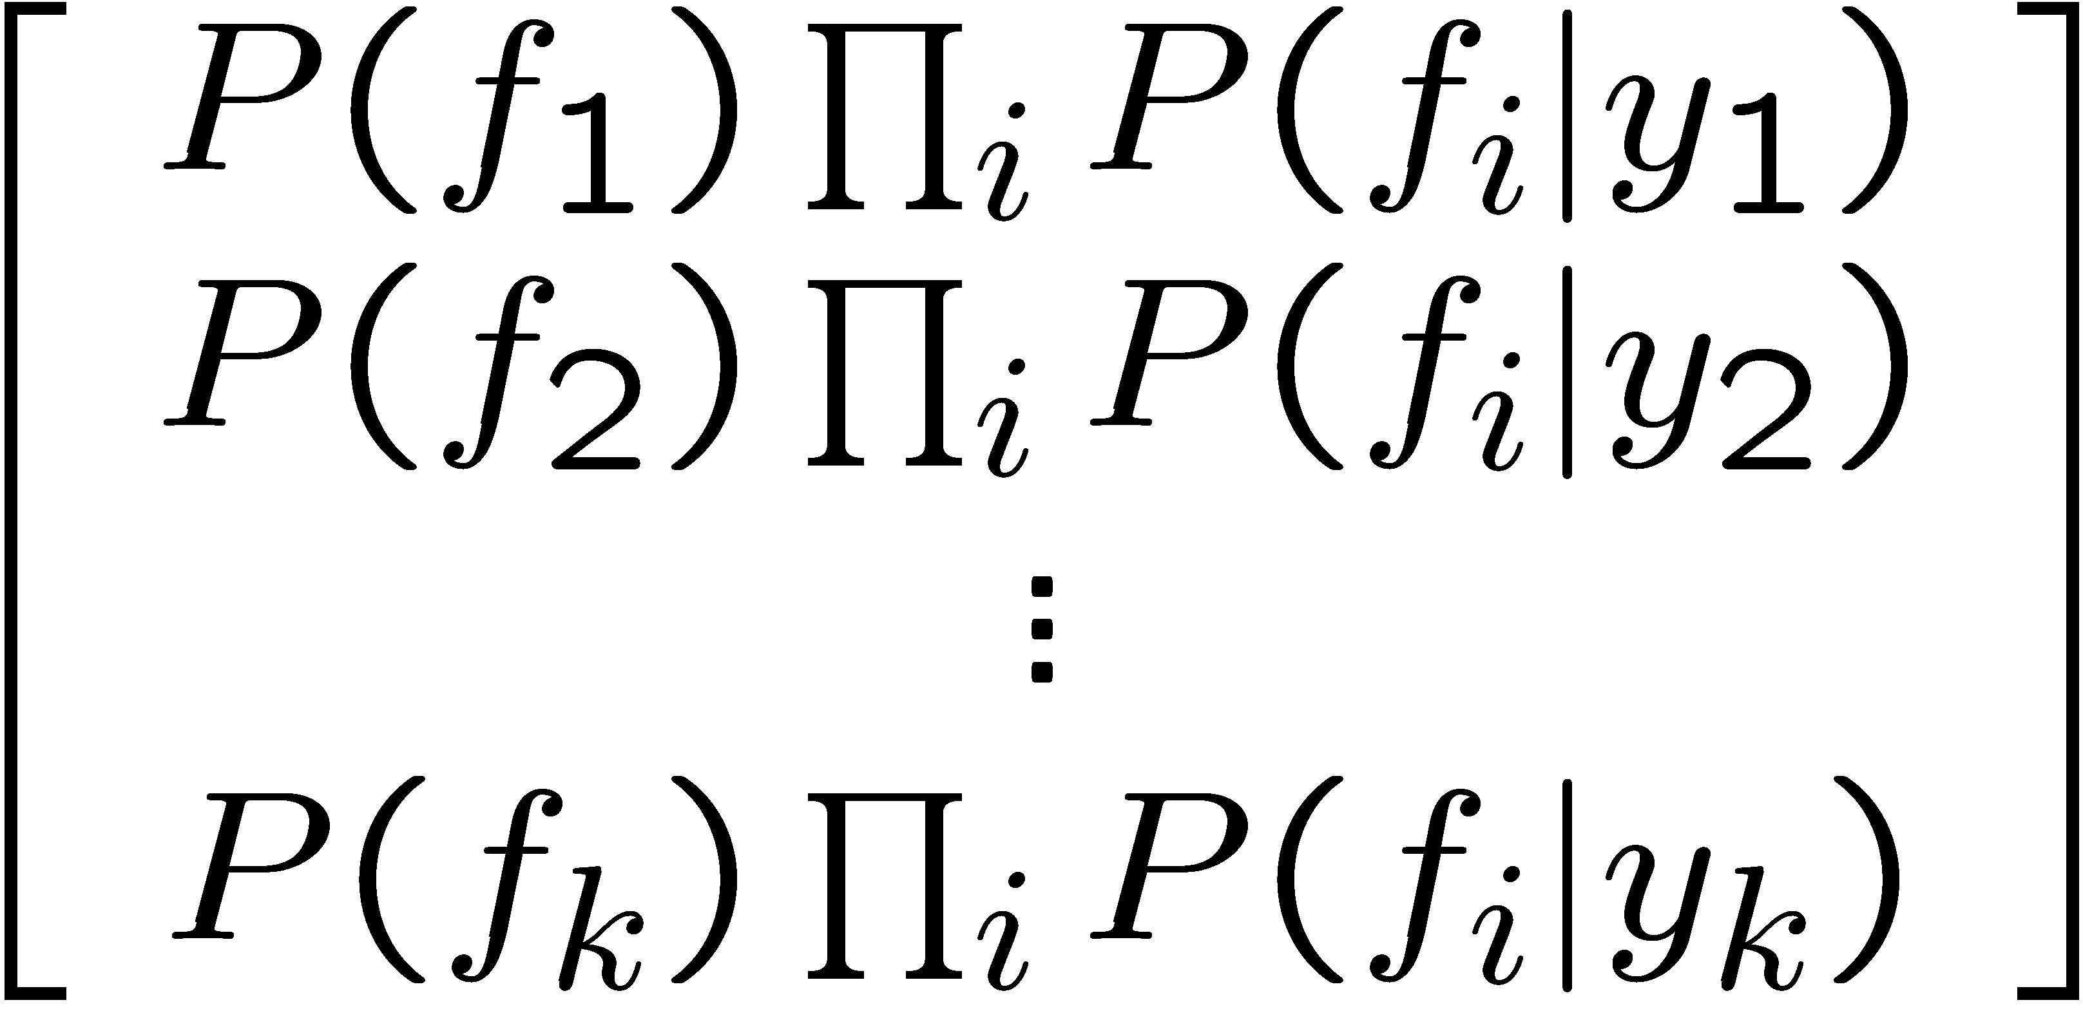

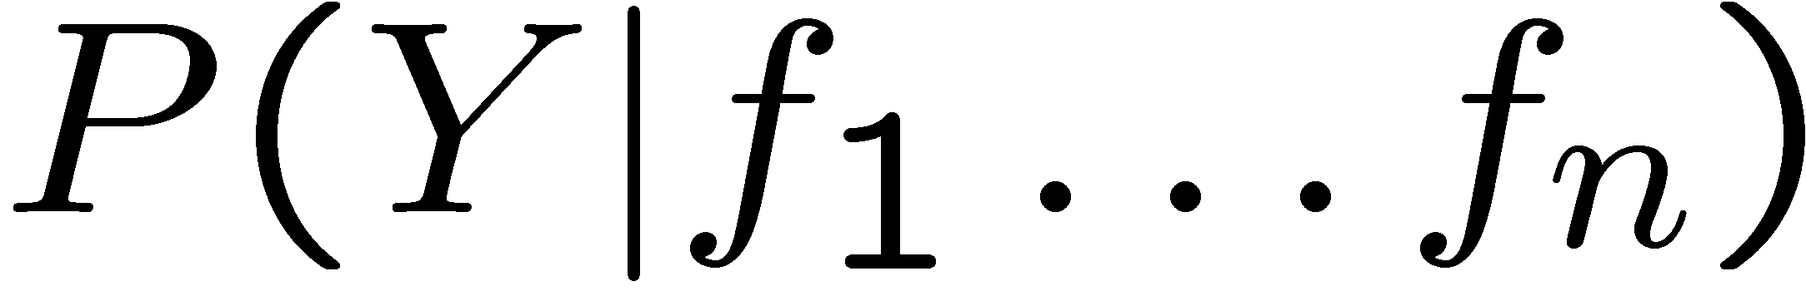
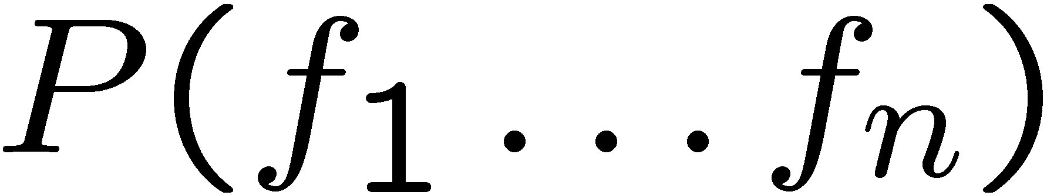
Inference for Naïve Bayes
Goal: compute posterior distribution over label variable Y
  Step 1: compute conditional probabilities using the chain rule
  Step 2: normalize
+

Slide 15
General Naïve Bayes
What do we need in order to use Naïve Bayes?
  Inference method (we just saw this part)
    Start with a bunch of probabilities: P(Y) and the P(F_{i}|Y) tables (CPT)
    Use standard inference to compute P(Y|F₁…F_{n})
  Estimates of local conditional probability tables
    P(Y), the prior over labels
    P(F_{i}|Y) for each feature (evidence variable)
    These probabilities are collectively called the parameters of the model and denoted by θ
    These typically come from training data counts (MLE, MAP)

Slide 16
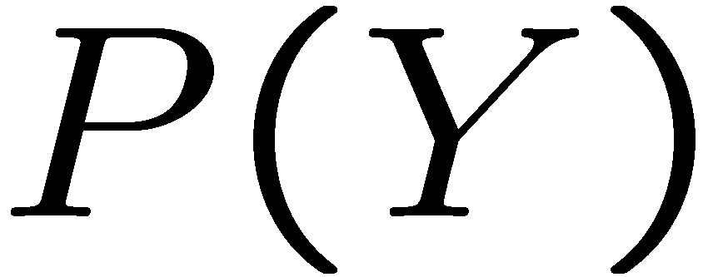


Example: Conditional Probabilities
1 | 0.1
2 | 0.1
3 | 0.1
4 | 0.1
5 | 0.1
6 | 0.1
7 | 0.1
8 | 0.1
9 | 0.1
0 | 0.1
1 | 0.01
2 | 0.05
3 | 0.05
4 | 0.30
5 | 0.80
6 | 0.90
7 | 0.05
8 | 0.60
9 | 0.50
0 | 0.80
1 | 0.05
2 | 0.01
3 | 0.90
4 | 0.80
5 | 0.90
6 | 0.90
7 | 0.25
8 | 0.85
9 | 0.60
0 | 0.80

Slide 17
A Spam Filter
Dear Sir.
First, I must solicit your confidence in this transaction, this is by virture of its nature as being utterly confidencial and top secret. …
Naïve Bayes spam filter
Data:
  Collection of emails, labeled spam or ham
  Note: someone has to hand label all this data!
  Split into training, held-out, test sets
Classifiers
  Learn on the training set
  (Tune it on a held-out set)
  Test it on new emails
TO BE REMOVED FROM FUTURE MAILINGS, SIMPLY REPLY TO THIS MESSAGE AND PUT "REMOVE" IN THE SUBJECT.
99 MILLION EMAIL ADDRESSES
FOR ONLY $99
Ok, Iknow this is blatantly OT but I'm beginning to go insane. Had an old Dell Dimension XPS sitting in the corner and decided to put it to use, I know it was working pre being stuck in the corner, but when I plugged it in, hit the power nothing happened.

Slide 18
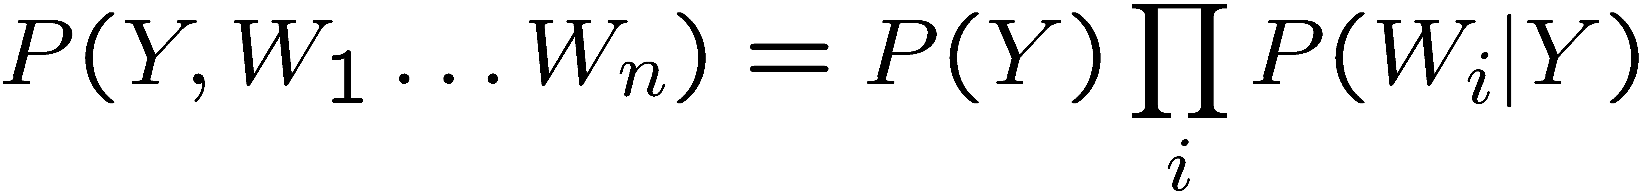
Naïve Bayes for Text
Bag-of-words Naïve Bayes:
  Features: W_{i} is the word at position i
  As before: predict label conditioned on feature variables (spam vs. ham)
  As before: assume features are conditionally independent given label
Generative model:
“Tied” distributions and bag-of-words
  Usually, each variable gets its own conditional probability distribution P(F|Y)
  In a bag-of-words model
    Each position is identically distributed
    All positions share the same conditional probs P(W|Y)
    Why make this assumption?
  Called “bag-of-words” because model is insensitive to word order or reordering
  A similar approach is used in Convolutional Neural Networks
Word at position i, not i^{th} word in the dictionary!

Slide 19

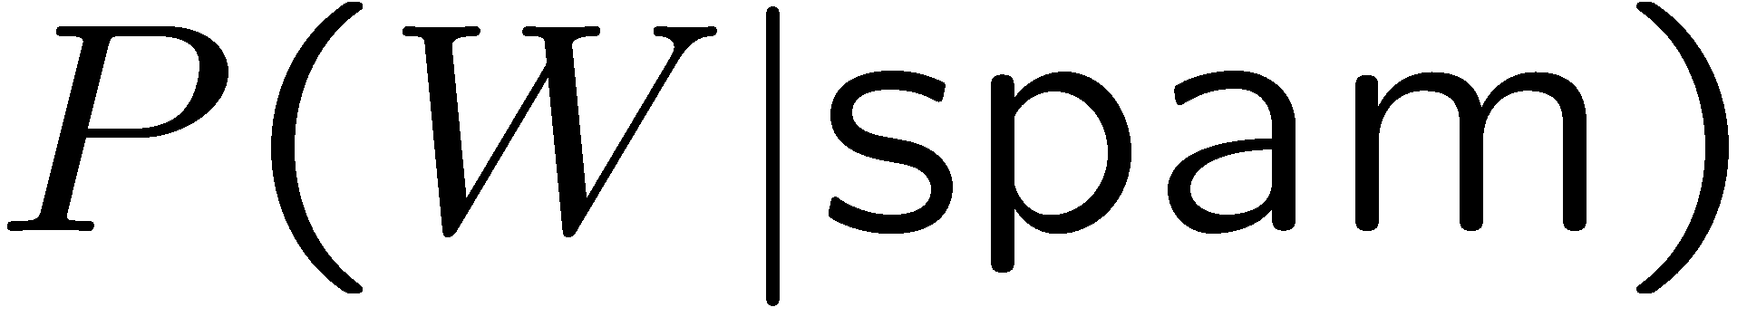
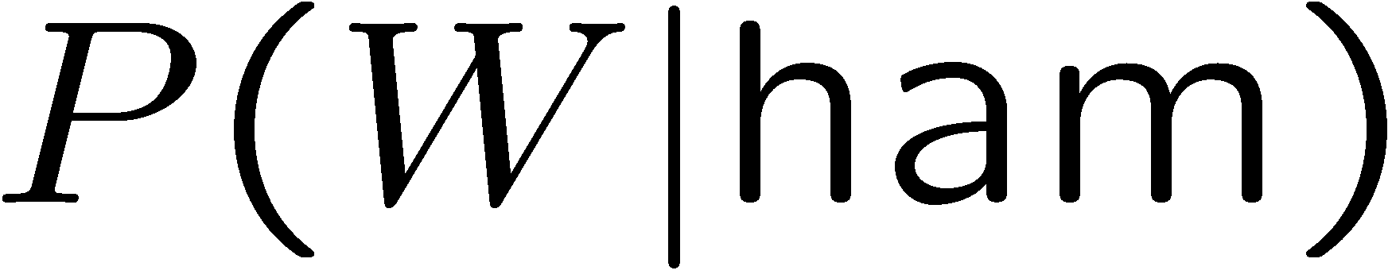
Example: Spam Filtering
Model:
What are the parameters?
Where do these tables come from?
ham : 0.66
spam: 0.33
the : 0.0156
to : 0.0153
and : 0.0115
of : 0.0095
you : 0.0093
a : 0.0086
with: 0.0080
from: 0.0075
...
the : 0.0210
to : 0.0133
of : 0.0119
2002: 0.0110
with: 0.0108
from: 0.0107
and : 0.0105
a : 0.0100
...

Slide 20
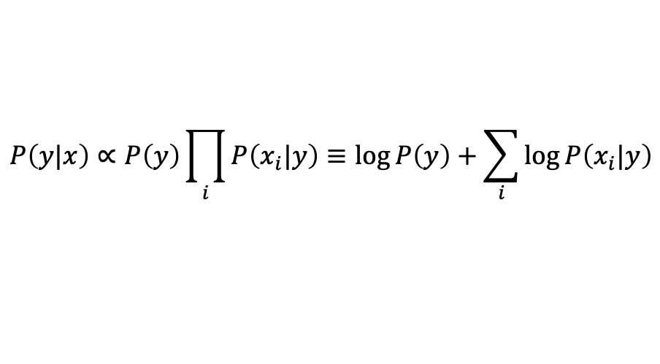
Spam Example
$$P\left(y|x\right)∝P\left(y\right)\prod_{i}{P\left(x_{i}|y\right)}≡\log{P\left(y\right)+\sum_{i}{\log{P\left(x_{i}|y\right)}}}$$
Word | P(w|spam) | P(w|ham) | Tot Spam | Tot Ham
(prior) | 0.33333 | 0.66666 | -1.1 | -0.4
Gary | 0.00002 | 0.00021 | -11.8 | -8.9
would | 0.00069 | 0.00084 | -19.1 | -16.0
you | 0.00881 | 0.00304 | -23.8 | -21.8
like | 0.00086 | 0.00083 | -30.9 | -28.9
to | 0.01517 | 0.01339 | -35.1 | -33.2
lose | 0.00008 | 0.00002 | -44.5 | -44.0
weight | 0.00016 | 0.00002 | -53.3 | -55.0
while | 0.00027 | 0.00027 | -61.5 | -63.2
you | 0.00881 | 0.00304 | -66.2 | -69.0
sleep | 0.00006 | 0.00001 | -76.0 | -80.5
P(spam | w) = 0.989

Slide 21
Generalization and Overfitting
Rare parameter values will overfit the training data!
  Just because we never saw a 3 with pixel (15,15) on during training doesn’t mean we won’t see it at test time
  Unlikely that every occurrence of “minute” is 100% spam
  Unlikely that every occurrence of “seriously” is 100% ham
  What about all the words that don’t occur in the training set at all?
  In general, we can’t go around giving unseen events zero probability
As an extreme case, imagine using the entire email as the only feature
  Would get the training data perfect
  Wouldn’t generalize at all
  Just making the bag-of-words assumption gives us some generalization, but isn’t enough
To generalize better: we need to smooth or regularize the estimates

Slide 22
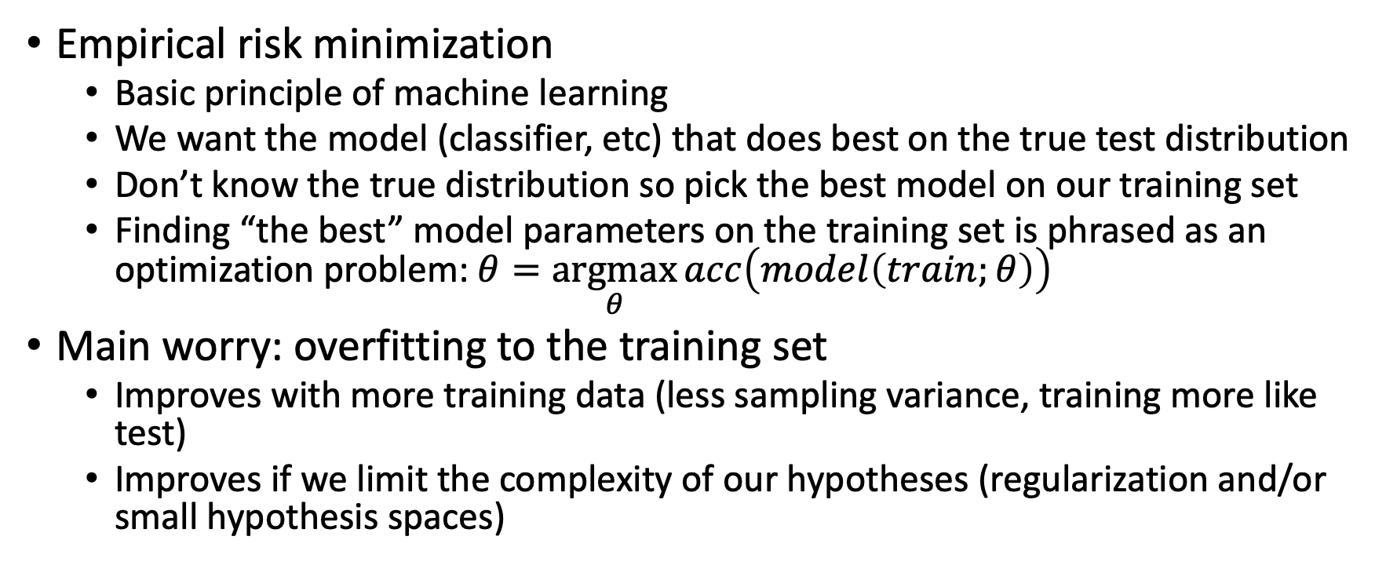
Empirical Risk Minimization
Empirical risk minimization
  Basic principle of machine learning
  We want the model (classifier, etc) that does best on the true test distribution
  Don’t know the true distribution so pick the best model on our training set
  Finding “the best” model parameters on the training set is phrased as an optimization problem: $θ=\underset{θ}{argmax}{acc\left(model\left(train;θ\right)\right)}$
Main worry: overfitting to the training set
  Improves with more training data (less sampling variance, training more like test)
  Improves if we limit the complexity of our hypotheses (regularization and/or small hypothesis spaces)

Slide 23
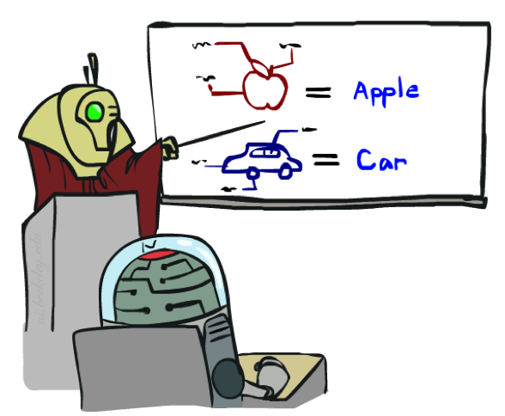
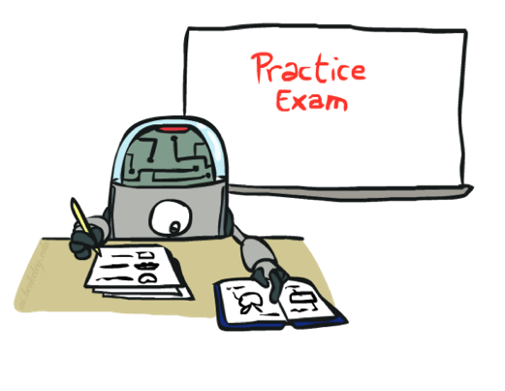
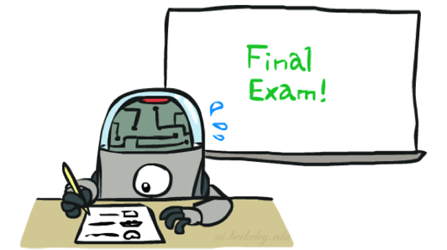
Important Concepts
Data: labeled instances (e.g. emails marked spam/ham)
  Training set
  Held out set
  Test set
Features: attribute values which characterize each x
Experimentation cycle
  Learn parameters (e.g. model probabilities) on training set
  (Tune hyperparameters on held-out set)
  Compute accuracy of test set
  Very important: never optimize parameters for the test set!
Evaluation (many metrics possible, e.g. accuracy)
  Accuracy: fraction of instances predicted correctly
Overfitting and generalization
  Want a classifier which does well on test data
  Overfitting: fitting the training data very closely, but not generalizing well
Training
Data
Held-Out
Data
Test
Data

Slide 24

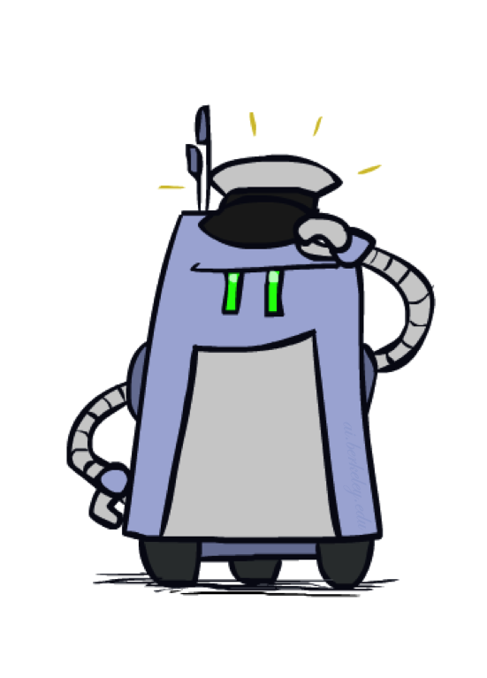
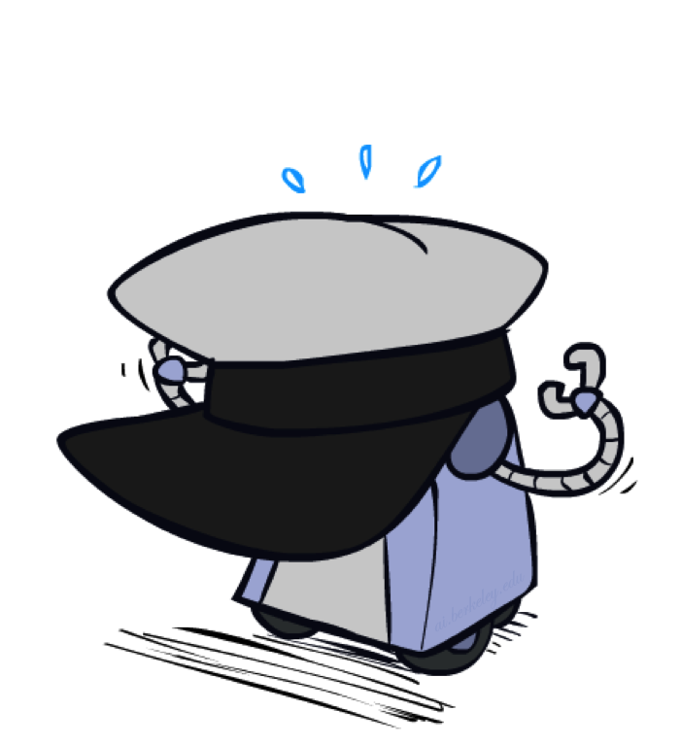
Generalization and Overfitting

Slide 25
Overfitting
30
25
20
Degree 15 polynomial
15
10
5
0
-5
-10
-15
0
2
4
6
8
10
12
14
16
18
20

Slide 26












Example: Overfitting
2 wins!!

Slide 27
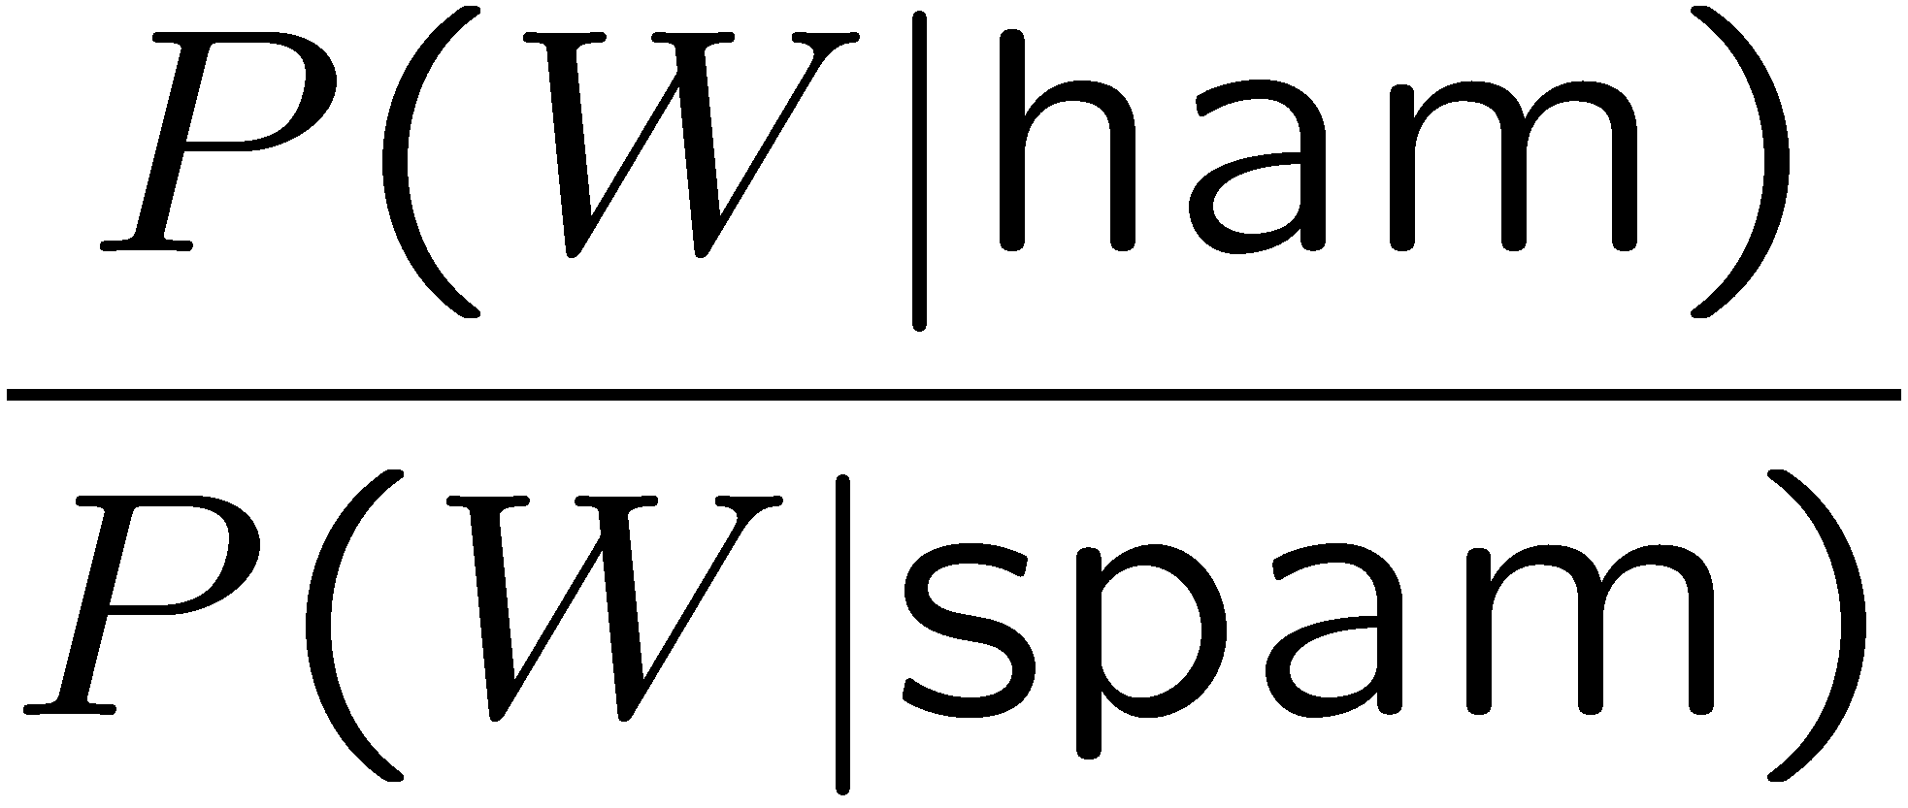
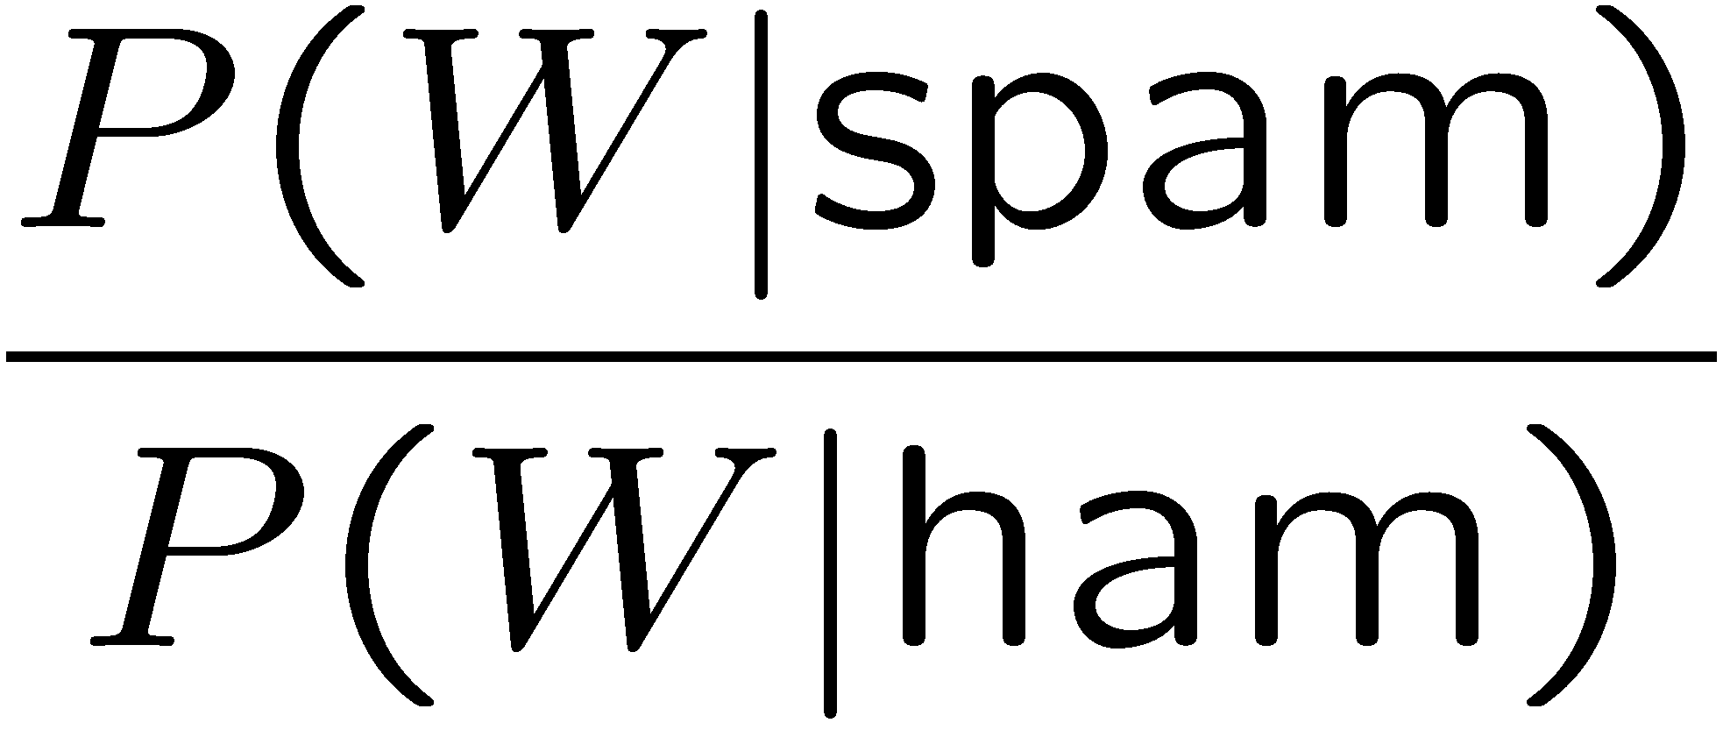
Example: Overfitting
Posteriors determined by relative probabilities (how much more likely is a word to appear in ‘spam’ relative to ‘ham’):
south-west : inf
nation : inf
morally : inf
nicely : inf
extent : inf
seriously : inf
...
screens : inf
minute : inf
guaranteed : inf
$205.00 : inf
delivery : inf
signature : inf
...
What went wrong here?

Slide 28
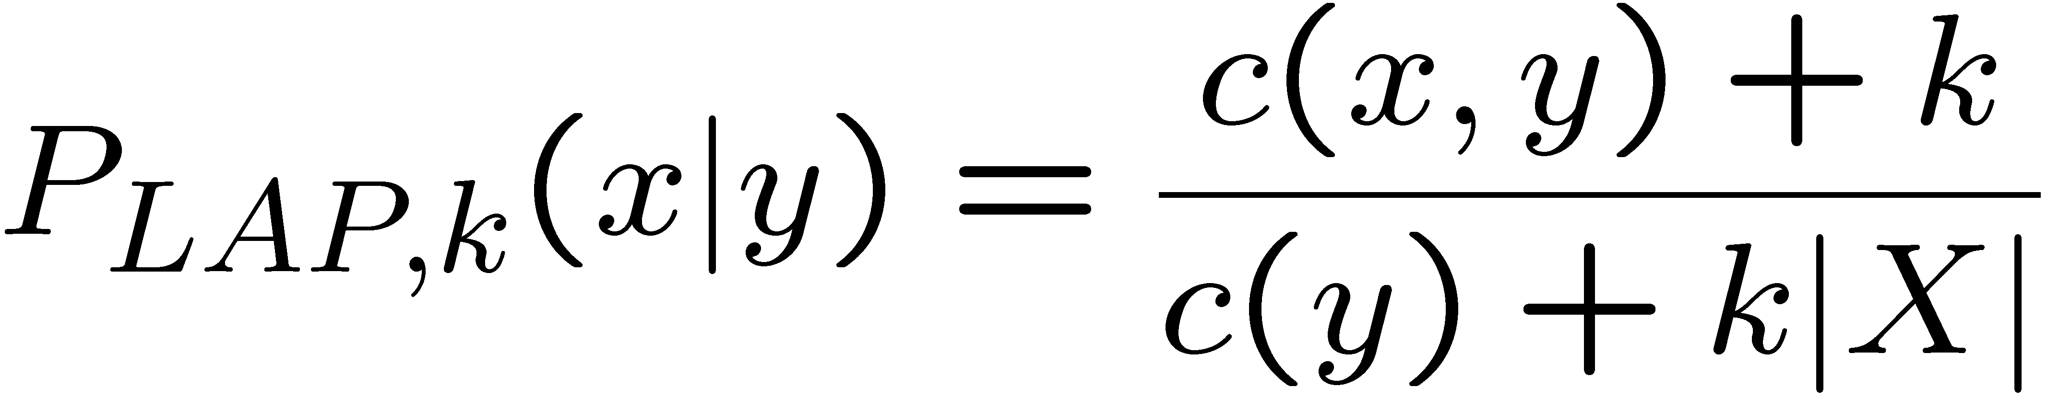
Smoothing
In practice, Laplace often performs poorly for P(X|Y):
  When |X| is very large
  When |Y| is very large
Another option: linear interpolation
  Also get the empirical P(X) from the data
  Make sure the estimate of P(X|Y) isn’t too different from the empirical P(X)
  What if α is 0? 1?

Slide 29
Real NB: Smoothing
For real classification problems, smoothing is critical
New odds ratios:
helvetica : 11.4
seems : 10.8
group : 10.2
ago : 8.4
areas : 8.3
...
verdana : 28.8
Credit : 28.4
ORDER : 27.2
<FONT> : 26.9
money : 26.5
...

Slide 30
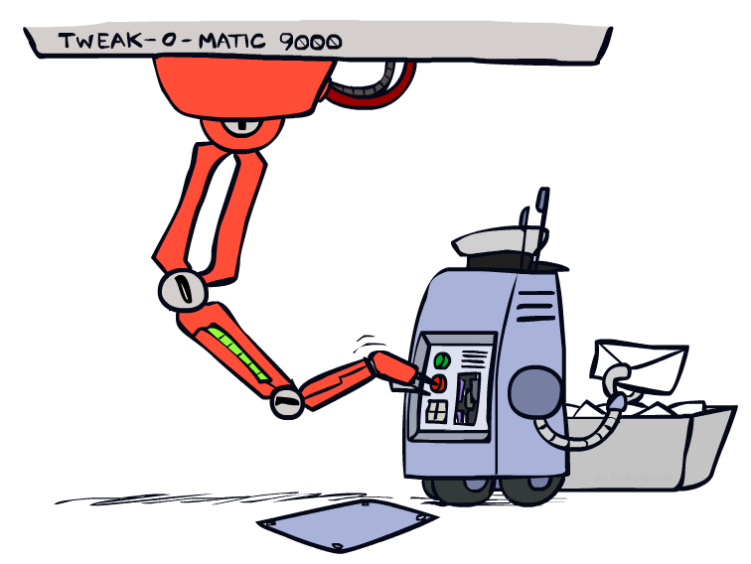
Tuning

Slide 31








Tuning on Held-Out Data
Now we’ve got two kinds of unknowns
  Parameters: the probabilities P(X|Y), P(Y)
  Hyperparameters: e.g., the amount / type of smoothing to do, k, α
What should we learn where?
  Learn parameters from training data
  Tune hyperparameters on different data
    Why?
  For each value of the hyperparameters, test on the held-out data
  Choose the best value and do a final test on the test data

Slide 32
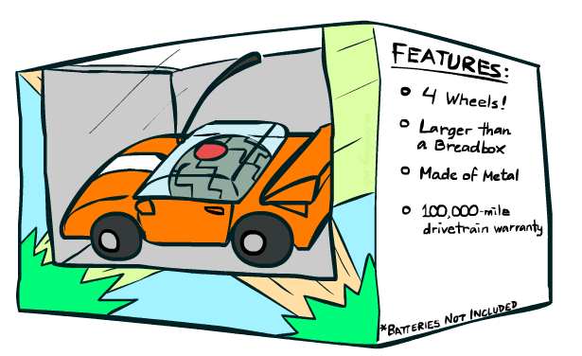
Features

Slide 33
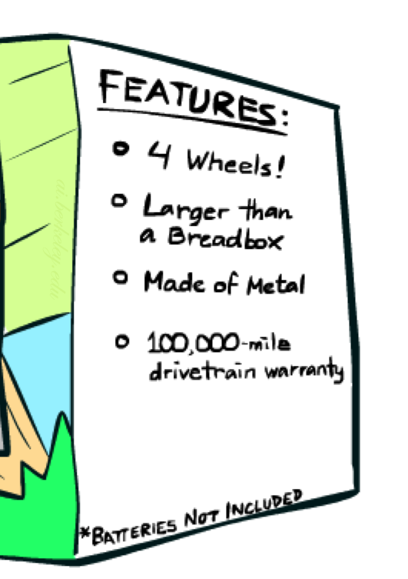
What if the optimal model is subpar
Need more features– words aren’t enough!
  Have you emailed the sender before?
  Have 1K other people just gotten the same email?
  Is the sending information consistent?
  Is the email in ALL CAPS?
  Do inline URLs point where they say they point?
  Does the email address you by (your) name?
Can add these information sources as new variables in the NB model
We’ll talk about classifiers which compute and add new features by transformations applied to the input features (Kernel trick), and, later, how to automatically derive useful features (deep neural networks)

Slide 34
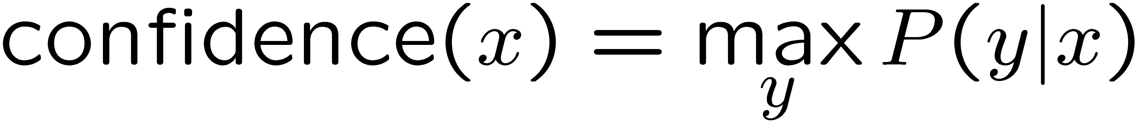
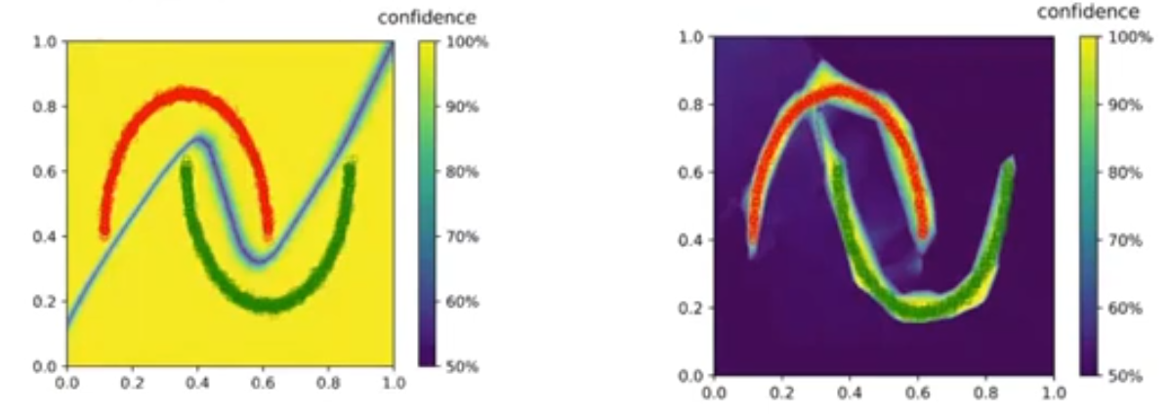
Confidences from a Classifier
The confidence of a probabilistic classifier:
  Posterior probability of the most probable label
  Represents how sure the classifier is of the classification
  Any probabilistic model will have confidences
  No guarantee that confidence is correct
Calibration
  Weak calibration: higher confidences mean higher accuracy
  Strong calibration: confidence predicts accuracy rate
  What’s the value in calibrating confidence?
Image: Ulas Bagci

Slide 35
Summary
Naïve Bayes assumes that all features are independent given the class label
A naïve Bayes model requires estimating P(Y) and P(f|Y) for every feature f
  Can be estimated from samples (MLE, MAP)
Smoothing the estimations is important in real-world systems (Laplace, linear interpolation)
Introduces hyper-parameters that should be tuned on a separate (validation) set
Classifier’s confidence is useful for safety critical systems

Slide 36
What next?
Class:
  Logistic Regression
Assignments:
  Written assignment 2: generative models (due Monday, Feb. 21)
Quizzes:
  Quiz 2 (by Wednesday, Feb-23)

