Slide 1
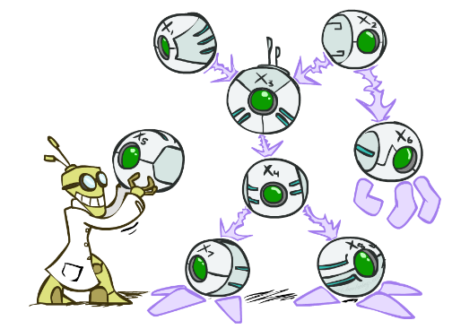
CSCE-633 Machine Learning
Bayes’ Nets
Instructor: Guni Sharon
Based on slides by: Pieter Abbeel, Dan Klein

Slide 2
Announcements
Due:
  Programing assignment 1: Perceptron (due today!)
  Written assignment 2: generative models (due Monday, Feb. 21)

Slide 3

Probabilistic Models
Models describe how (a portion of) the world works
Models are always simplifications
  May not account for every variable
  May not account for all interactions between variables
  “All models are wrong; but some are useful.”
  – George E. P. Box
What do we do with probabilistic models?
  We (or our agents) need to reason about unknown variables, given evidence
  Example: explanation (diagnostic reasoning)
  Example: prediction (causal reasoning)
  Example: value of information
Notes:
George Box: All models are wrong; some of them are useful

Slide 4
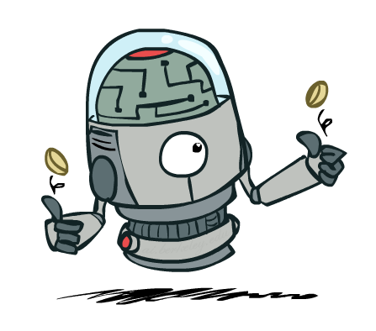
Independence

Slide 5

Independence
Two variables are independent if:
  This says that their joint distribution factors into a product of the two simpler distributions
  Another form:
  We write:
Independence is a simplifying modeling assumption
  Empirical joint distributions: at best “close” to independent
  What could we assume for {Weather, Traffic, Cavity, Toothache}?

Slide 6
Example: Independence?
T | P
hot | 0.5
cold | 0.5
T | W | P
hot | sun | 0.4
hot | rain | 0.1
cold | sun | 0.2
cold | rain | 0.3
T | W | P
hot | sun | 0.3
hot | rain | 0.2
cold | sun | 0.3
cold | rain | 0.2
X
Independent
W | P
sun | 0.6
rain | 0.4

Slide 7


Example: Independence
N fair, independent coin flips:
H | 0.5
T | 0.5
H | 0.5
T | 0.5
H | 0.5
T | 0.5

Slide 8
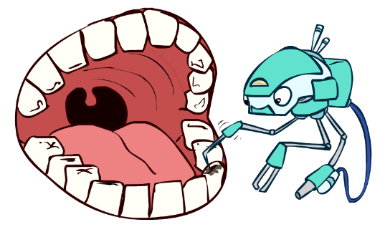
Conditional Independence
P(Toothache, Cavity, Catch)
If I have a cavity, the probability that the probe catches it doesn't depend on whether I have a toothache:
  P(+catch | +toothache, +cavity) = P(+catch | +cavity)
The same independence holds if I don’t have a cavity:
  P(+catch | +toothache, -cavity) = P(+catch| -cavity)
Catch is conditionally independent of Toothache given Cavity:
  P(Catch | Toothache, Cavity) = P(Catch | Cavity)
Equivalent statements:
  P(Toothache | Catch , Cavity) = P(Toothache | Cavity)
  P(Toothache, Catch | Cavity) = P(Toothache | Cavity) P(Catch | Cavity)
  One can be derived from the other

Slide 9

Conditional Independence
Unconditional (absolute) independence is very rare
Conditional independence is our most basic and robust form of knowledge about uncertain environments.
X is conditionally independent of Y given Z
if and only if:
or, equivalently, if and only if

Slide 10
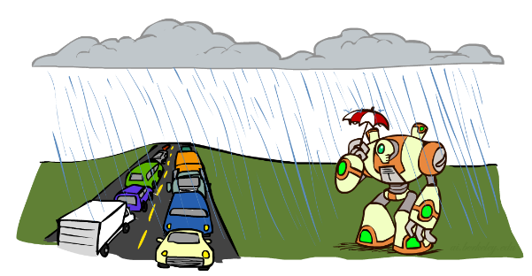
Conditional Independence
What about this domain:
  Traffic
  Umbrella
  Raining

Slide 11
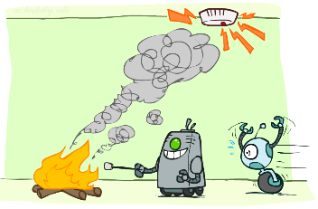
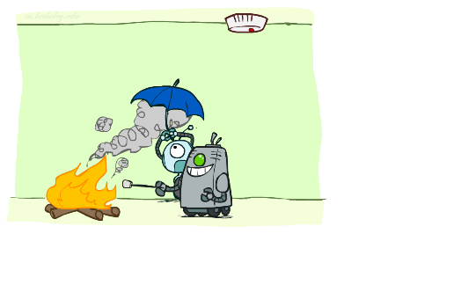
Conditional Independence
What about this domain:
  Fire
  Smoke
  Alarm

Slide 12

Conditional Independence and the Chain Rule
Chain rule:
Trivial decomposition:
With assumption of conditional independence:
Bayes’nets / graphical models exploit conditional independence assumptions

Slide 13
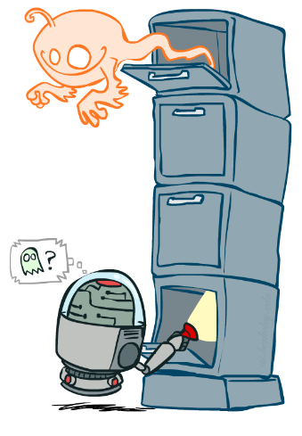
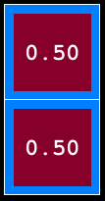
Ghostbusters Chain Rule
Each sensor depends only
on where the ghost is
That means, the two sensors (top sensor, bottom sensor) are conditionally independent, given the ghost position
T: Top sensor reading=red
B: Bottom sensor reading=red
G: Ghost at top
Givens:
P( +g ) = 0.5
P( -g ) = 0.5
P( +t | +g ) = 0.8
P( +t | -g ) = 0.4
P( +b | +g ) = 0.4
P( +b | -g ) = 0.8
Full joint distribution table
P(T,B,G) = P(G) P(T|G) P(B|G)
T | B | G | P(T,B,G)
+t | +b | +g | 0.16
+t | +b | -g | 0.16
+t | -b | +g | 0.24
+t | -b | -g | 0.04
-t | +b | +g | 0.04
-t | +b | -g | 0.24
-t | -b | +g | 0.06
-t | -b | -g | 0.06
Can be encoded with 3 smaller tables:
P(G)
P(T,G)
P(B,G)

Slide 14
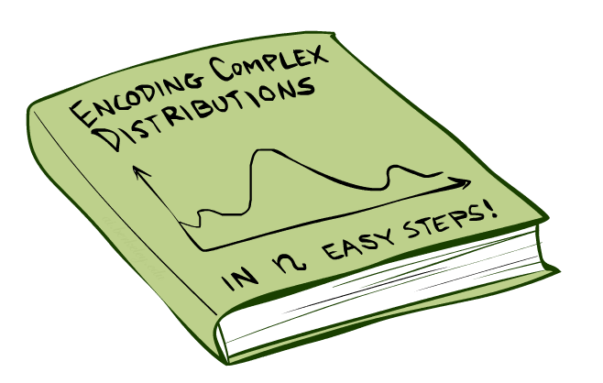
Bayes’Nets: Big Picture

Slide 15

Bayes’ Nets: Big Picture
Two problems with using full joint distribution tables as our probabilistic models:
  Unless there are only a few variables, the joint is WAY too big to represent explicitly (d^n)
  Hard to learn (estimate) anything empirically about more than a few variables at a time
Bayes’ nets: a technique for describing complex joint distributions (models) using simple, local distributions (conditional probabilities)
  Also called graphical models
  Describes how variables locally interact
  Local interactions chain together to give global, indirect interactions

Slide 16
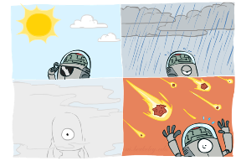
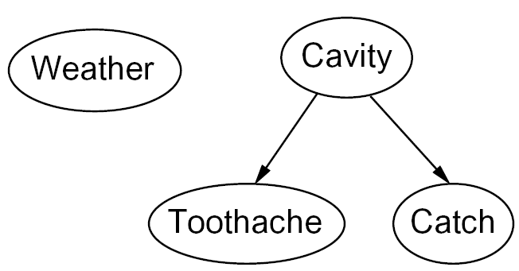

Graphical Model Notation
Nodes: variables (with domains)
  Can be assigned (observed) or unassigned (unobserved)
Arcs: interactions
  Indicate “direct influence” between variables
  Formally: encode conditional independence (more later)
For now: imagine that arrows mean direct causation (in general, they don’t!)

Slide 17

Example: Coin Flips
N independent coin flips
No interactions between variables: absolute independence
X₁
X₂
X_{n}

Slide 18
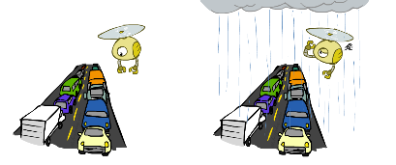
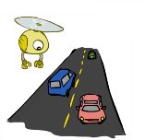
Example: Traffic
Model 2: rain causes traffic
Variables:
  R: It rains
  T: There is traffic
Model 1: independence
Why is an agent using model 2 better?
R
R
T
T

Slide 19
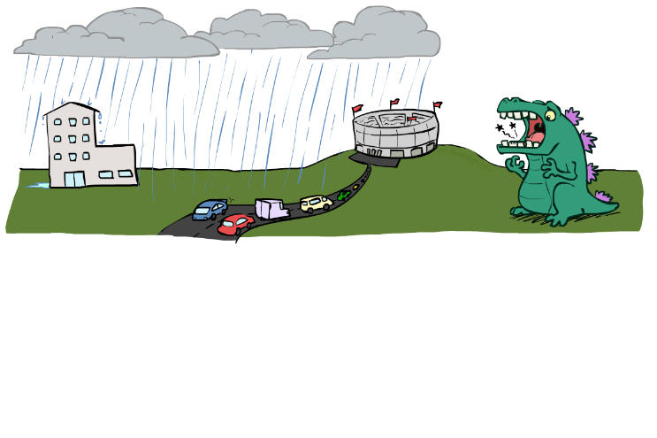
Example: Traffic II
Let’s build a causal graphical model!
Variables
  T: Traffic
  R: It rains
  L: Low pressure
  D: Roof drips
  B: Ballgame
  C: Cavity

Slide 20
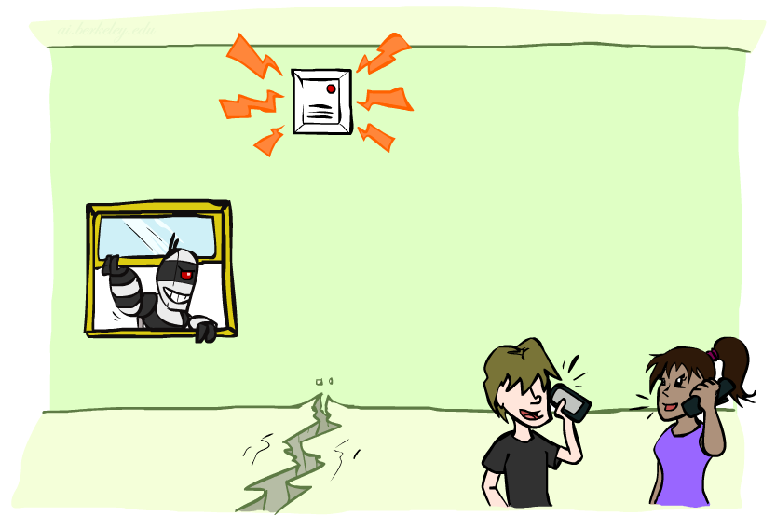
Example: Alarm Network
Variables
  B: Burglary
  A: Alarm goes off
  M: Mary calls
  J: John calls
  E: Earthquake!

Slide 21
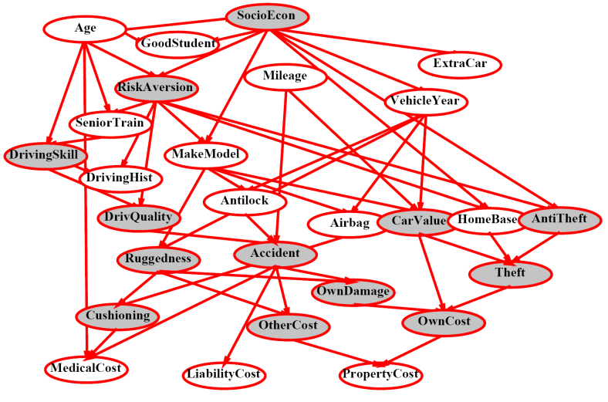
Example Bayes’ Net: Insurance (prediction)

Slide 22
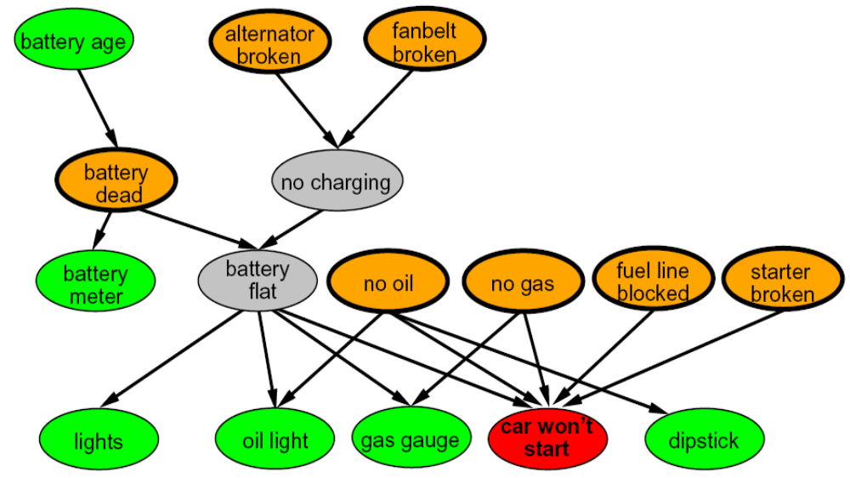
Example Bayes’ Net: Car (diagnosis)

Slide 23
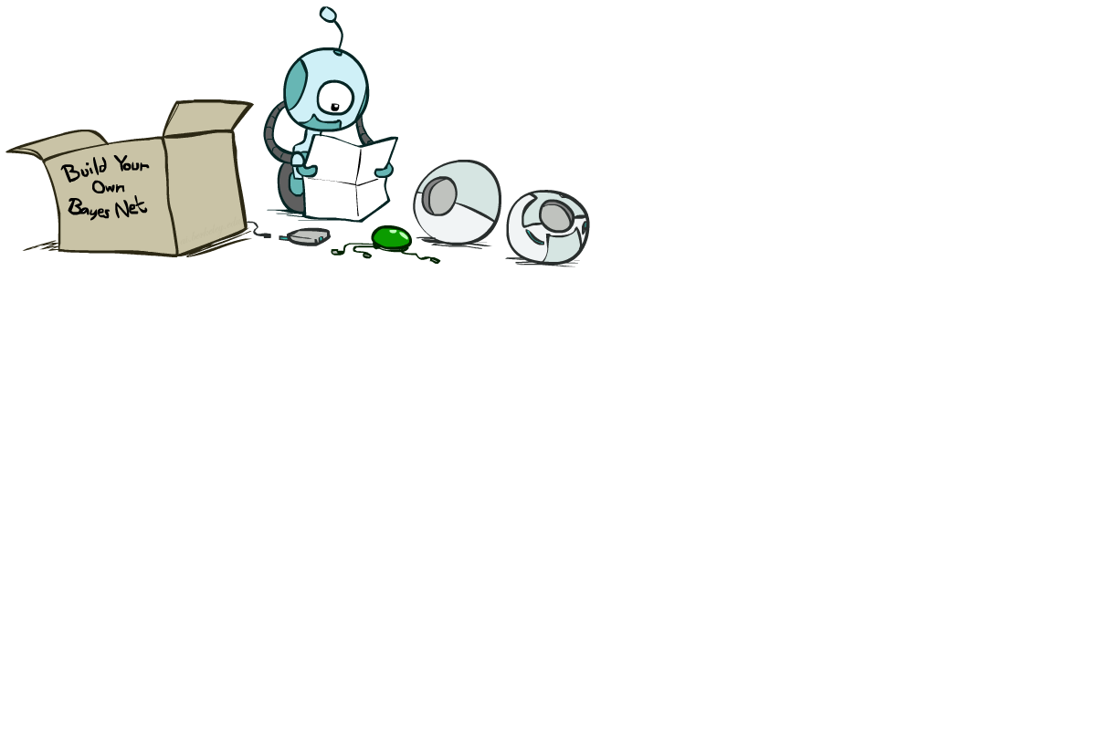
Bayes’ Net Semantics

Slide 24
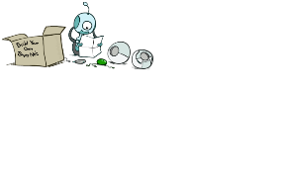


Bayes’ Net Semantics
A set of nodes, one per variable X
A directed, acyclic graph
A conditional distribution for each node
  A collection of distributions over X, one for each combination of parents’ values
  CPT: conditional probability table
  Description of a noisy “causal” process
A₁
A_{n}
X
A Bayes net = Topology (graph) + Local Conditional Probabilities

Slide 25


Probabilities in BNs
Bayes’ nets implicitly encode joint distributions
  As a product of local conditional distributions
  To see what probability a BN gives to a full assignment, multiply all the relevant conditionals together:
  Example:

Slide 26


Probabilities in BNs
Why are we guaranteed that setting
results in a proper joint distribution?
Chain rule (valid for all distributions):
Assume conditional independences:
→ Consequence:

Slide 27

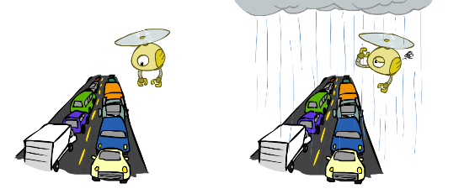

Example: Traffic
R
+r | 1/4
-r | 3/4
+r | +t | 3/4
 | -t | 1/4
T
-r | +t | 1/2
 | -t | 1/2
Notes:
demo

Slide 28
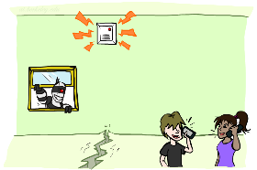
Example: Alarm Network
B | P(B)
+b | 0.001
-b | 0.999
E | P(E)
+e | 0.002
-e | 0.998
Burglary
Earthqk
Alarm
B | E | A | P(A|B,E)
+b | +e | +a | 0.95
+b | +e | -a | 0.05
+b | -e | +a | 0.94
+b | -e | -a | 0.06
-b | +e | +a | 0.29
-b | +e | -a | 0.71
-b | -e | +a | 0.001
-b | -e | -a | 0.999
John calls
Mary calls
A | J | P(J|A)
+a | +j | 0.9
+a | -j | 0.1
-a | +j | 0.05
-a | -j | 0.95
A | M | P(M|A)
+a | +m | 0.7
+a | -m | 0.3
-a | +m | 0.01
-a | -m | 0.99
Notes:
demo

Slide 29
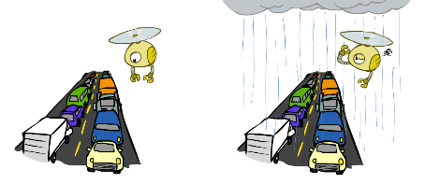

Example: Traffic
Causal direction
R
+r | 1/4
-r | 3/4
+r | +t | 3/16
+r | -t | 1/16
-r | +t | 6/16
-r | -t | 6/16
+r | +t | 3/4
 | -t | 1/4
T
-r | +t | 1/2
 | -t | 1/2

Slide 30
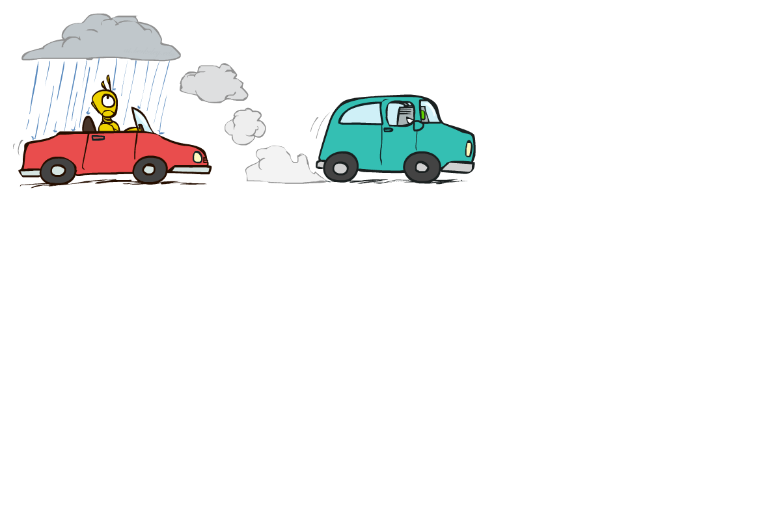

Example: Reverse Traffic
Reverse causality?
T
+t | 9/16
-t | 7/16
+r | +t | 3/16
+r | -t | 1/16
-r | +t | 6/16
-r | -t | 6/16
+t | +r | 1/3
 | -r | 2/3
R
-t | +r | 1/7
 | -r | 6/7

Slide 31
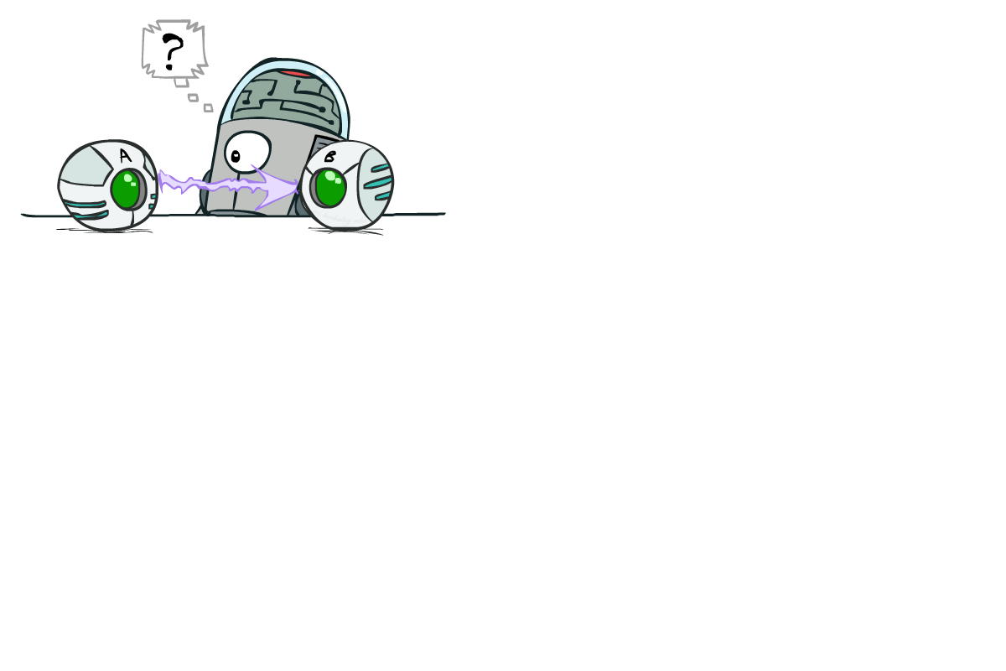
Causality?
When Bayes’ nets reflect the true causal patterns:
  Often simpler (nodes have fewer parents)
  Often easier to think about
  Often easier to elicit from experts
BNs need not actually be causal
  Sometimes no causal net exists over the domain (especially if variables are missing)
  E.g. consider the variables Traffic and roof Drips
  End up with arrows that reflect correlation, not causation
What do the arrows really mean?
  Topology may happen to encode causal structure
  Topology really encodes conditional independence

Slide 32

What did we learn?
Bayes’ nets encode a joint distribution through local CPTs
Assemble BNs using an intuitive notion of conditional independence
key idea: use causality to represent conditional independence
Main goal: answer queries about conditional probabilities

Slide 33
What next?
Class:
  Naïve Bayes
Assignments:
  Programing assignment 1: Perceptron (due today!)
  Written assignment 2: generative models (due Monday, Feb. 21)
Quizzes:
  Quiz 2 (by Monday, Feb-21)

