Slide 1
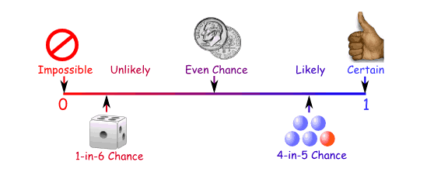
CSCE-633 Machine Learning
4. Inference from Probabilities
Instructor: Guni Sharon
Based on slides by: Pieter Abbeel, Dan Klein

Slide 2
Announcements
Overdue:
  Written assignment 1: K Nearest Neighbors + Linear algebra (due Tuesday, Feb 1)
  Quiz 1 published on Canvas (finish by Feb-7)
    hypotheses space size
    L1 and L2 loss
    KNN and Minkowski distance
Due:
  Programming assignment 1: Perceptron (due Tuesday, Feb-15)

Slide 3
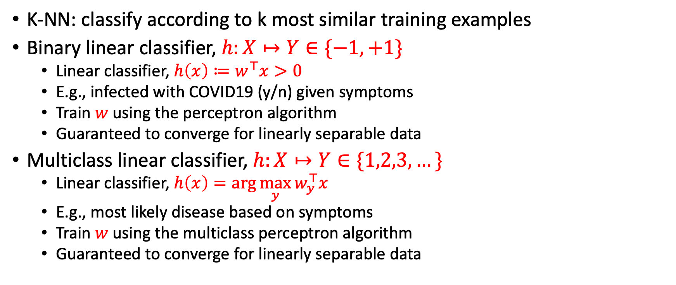
So far
K-NN: classify according to k most similar training examples
Binary linear classifier, $h:X↦Y∈\{−1,+1\}$
  Linear classifier, $h\left(x\right)≔w^{⊤}x>0$
  E.g., infected with COVID19 (y/n) given symptoms
  Train $w$ using the perceptron algorithm
  Guaranteed to converge for linearly separable data
Multiclass linear classifier, $h:X↦Y∈\{1,2,3,…\}$
  Linear classifier, $h\left(x\right)=\arg{\max_{y}{w_{y}^{⊤}x}}$
  E.g., most likely disease based on symptoms
  Train $w$ using the multiclass perceptron algorithm
  Guaranteed to converge for linearly separable data

Slide 4
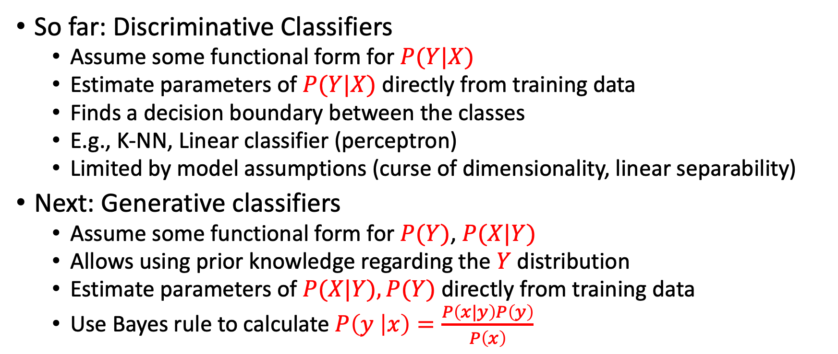
Generative vs Discriminative Models
So far: Discriminative Classifiers
  Assume some functional form for $P(Y|X)$
  Estimate parameters of $P(Y|X)$ directly from training data
  Finds a decision boundary between the classes
  E.g., K-NN, Linear classifier (perceptron)
  Limited by model assumptions (curse of dimensionality, linear separability)
Next: Generative classifiers
  Assume some functional form for $P(Y)$, $P(X|Y)$
  Allows using prior knowledge regarding the $Y$ distribution
  Estimate parameters of $P(X|Y), P(Y)$directly from training data
  Use Bayes rule to calculate $P\left(y | x\right)=\frac{P\left(x|y\right)P\left(y\right)}{P\left(x\right)}$

Slide 5
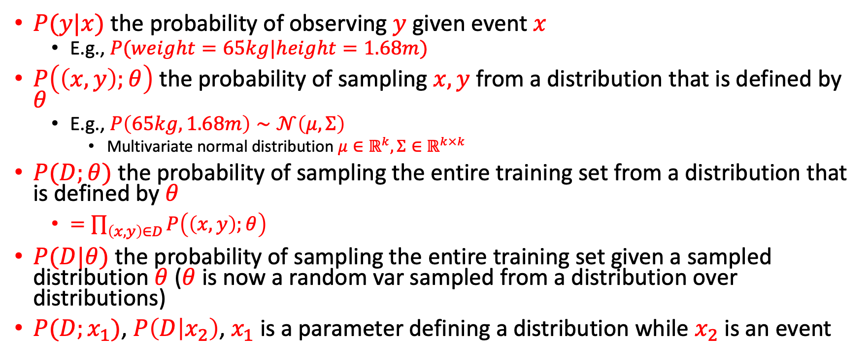
Notation
$P(y|x)$ the probability of observing $y$ given event $x$
  E.g., $P(weight=65kg|height=1.68m)$
$P\left(\left(x,y\right);θ\right)$ the probability of sampling $x,y$ from a distribution that is defined by $θ$
  E.g., $P\left(65kg,1.68m\right)∼𝒩\left(μ,Σ\right)$
    Multivariate normal distribution $μ∈ℝ^{k}, Σ∈ℝ^{k×k}$
$P(D;θ)$ the probability of sampling the entire training set from a distribution that is defined by $θ$
  $=\prod_{\left(x,y\right)∈D}{P\left(\left(x,y\right);θ\right)}$
$P(D|θ)$ the probability of sampling the entire training set given a sampled distribution $θ$ ($θ$is now a random var sampled from a distribution over distributions)
$P(D;x_{1})$, $P\left(D | x_{2}\right)$, $x_{1}$ is a parameter defining a distribution while $x_{2}$ is an event

Slide 6

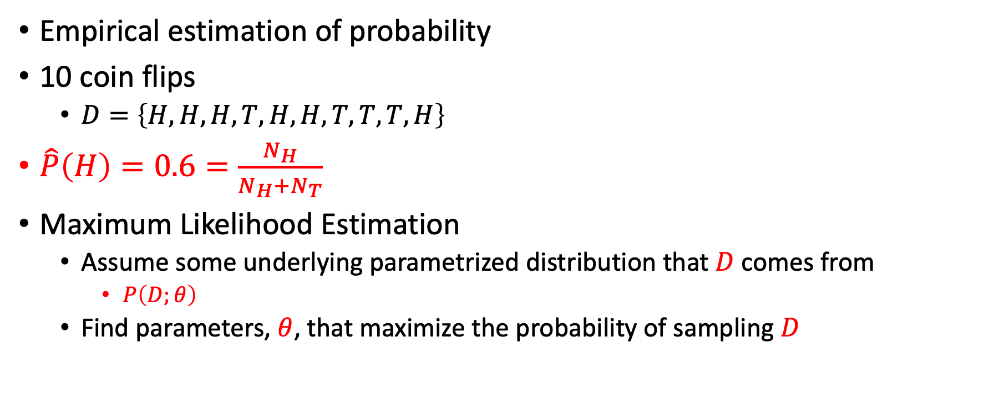
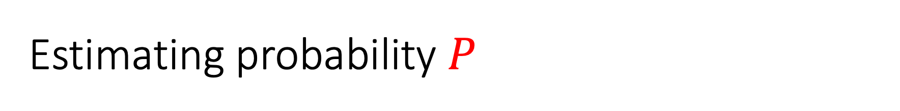
Estimating probability $P$
Empirical estimation of probability
10 coin flips
  $D=\left\{H,H,H,T,H,H,T,T,T,H\right\}$
$\hat{P}\left(H\right)=0.6=\frac{N_{H}}{N_{H}+N_{T}}$
Maximum Likelihood Estimation
  Assume some underlying parametrized distribution that $D$ comes from
    $P\left(D;θ\right)$
  Find parameters, $θ$, that maximize the probability of sampling $D$

Slide 7
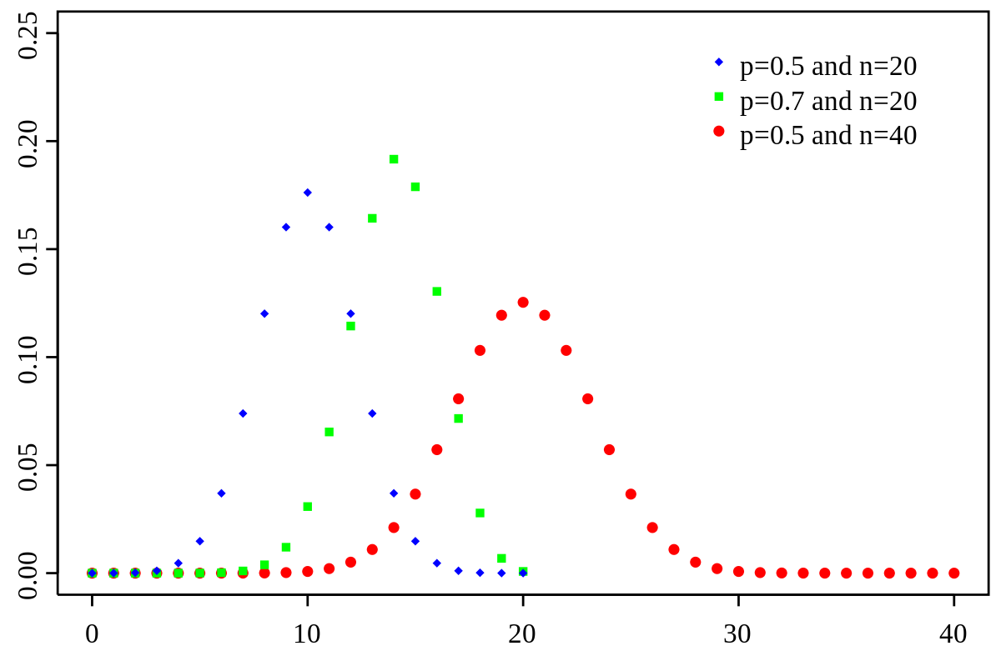
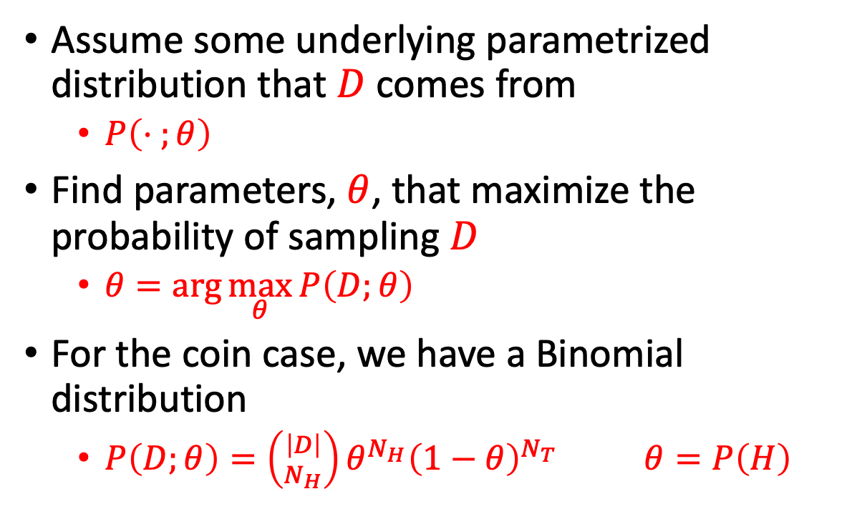
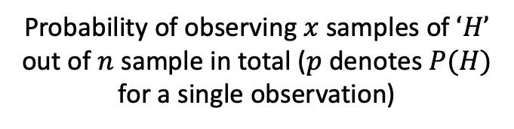

Estimating probability $P$
Probability of observing $x$ samples of $‘H’$ out of $n$ sample in total ($p$ denotes $P(H)$ for a single observation)
$$P\left(x\right)=\left({n \atop x}\right)p^{x}{\left(1−p\right)}^{n−x}$$
Assume some underlying parametrized distribution that $D$ comes from
  $P\left(⋅ ;θ\right)$
Find parameters, $θ$, that maximize the probability of sampling $D$
  $θ=\arg{\max_{θ}{P\left(D;θ\right)}}$
For the coin case, we have a Binomial distribution
  $P\left(D;θ\right)=\left({\left|D\right| \atop N_{H}}\right)θ^{N_{H}}{\left(1−θ\right)}^{N_{T}} θ=P\left(H\right)$

Slide 8
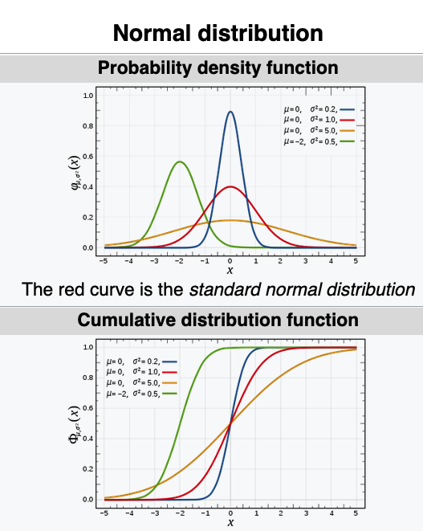
Sidestep: PDF
Probability density function (PDF)
Defines the probability that a random variable takes a value within a particular range
  Computed by the integral of the PDF over that range
  *Drawing a specific value has a prob=0
The PDF is nonnegative everywhere, and its integral (CDF) over the entire range is equal to 1

Slide 9
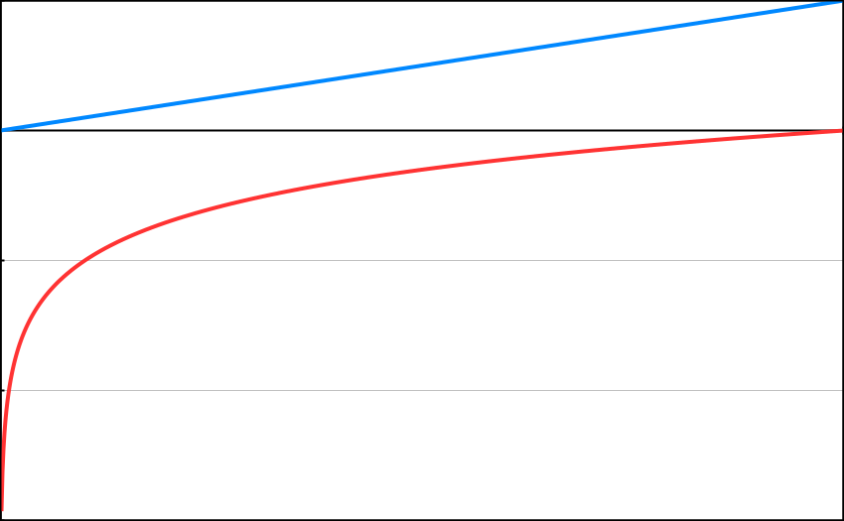



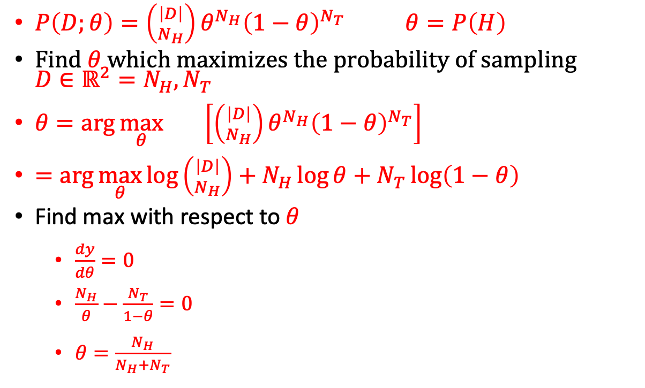
Estimating probability $P$
Log likelihood (important, pay attention):
MLE is invariant under this transformation
Common trick for breaking up a factored objective function
But log is not defined over negative values
  Probability can’t be negative
$P\left(D;θ\right)=\left({\left|D\right| \atop N_{H}}\right)θ^{N_{H}}{\left(1−θ\right)}^{N_{T}} θ=P\left(H\right)$
Find $θ$ which maximizes the probability of sampling ${D∈ℝ^{2}=N}_{H},N_{T}$
$θ=\arg{\max_{θ}\left[\left({\left|D\right| \atop N_{H}}\right)θ^{N_{H}}{\left(1−θ\right)}^{N_{T}}\right]}$
$=\arg{\max_{θ}{\log\left({\left|D\right| \atop N_{H}}\right)+N_{H}\log{θ+N_{T}\log\left(1−θ\right)}}}$
Find max with respect to $θ$
  $\frac{dy}{dθ}=0$
  $\frac{N_{H}}{θ}−\frac{N_{T}}{1−θ}=0$
  $θ=\frac{N_{H}}{N_{H}+N_{T}}$
$$log$$
  Log is monotonically increasing
$$f(x)$$
$$\log\left(f\left(x\right)\right)$$
$$f(x)$$

Slide 10

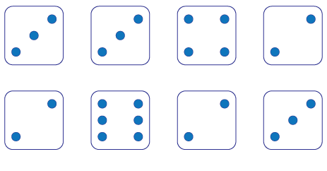
Unseen Events
MLE for P(outcome=5) ?

Slide 11
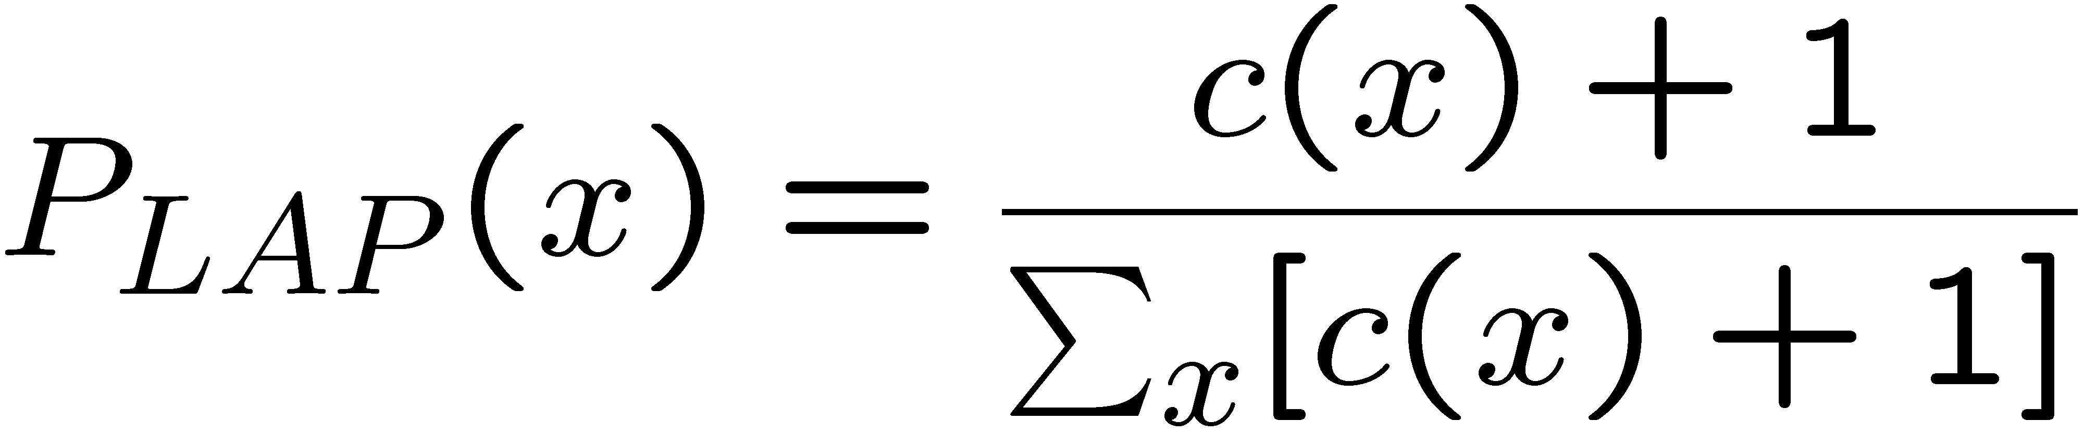
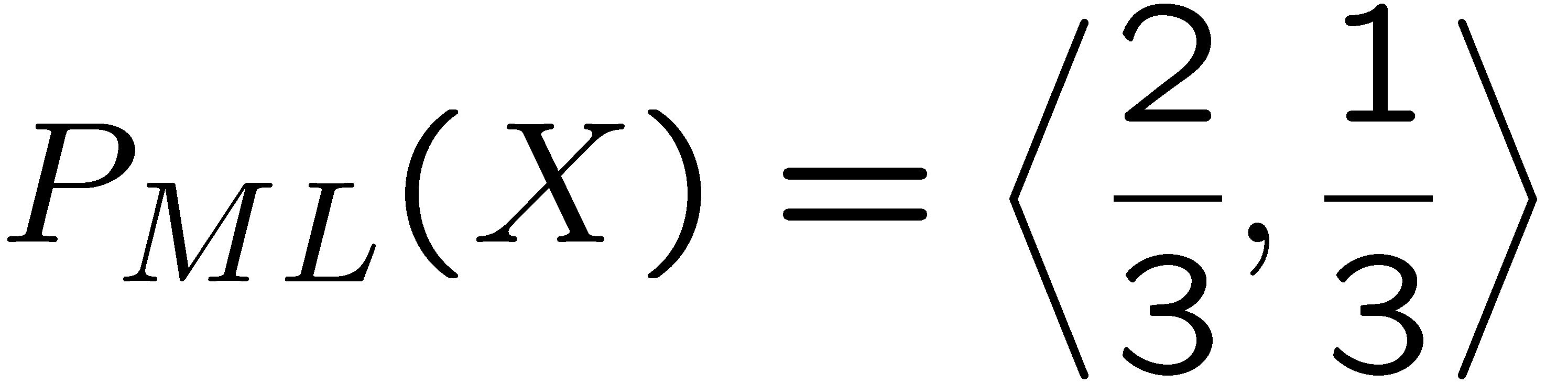
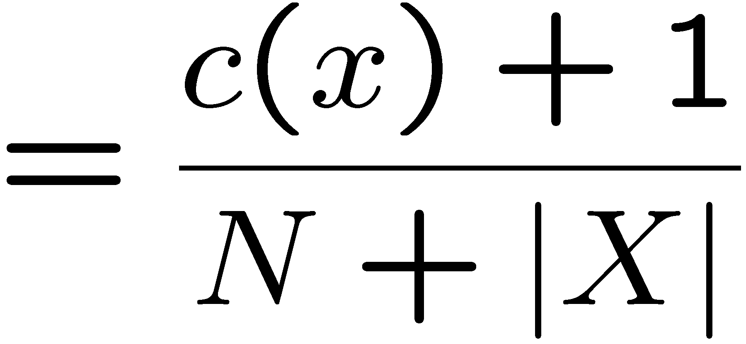
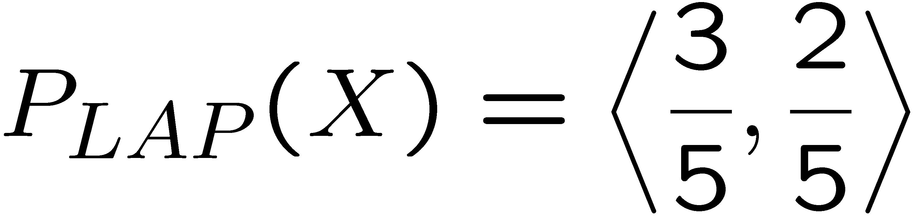
Laplace Smoothing
Estimate the probability of drawing ‘red’ given 3 observations
Laplace’s estimate:
  Pretend you saw every outcome once more than you actually did
r
r
b
r
r

Slide 12
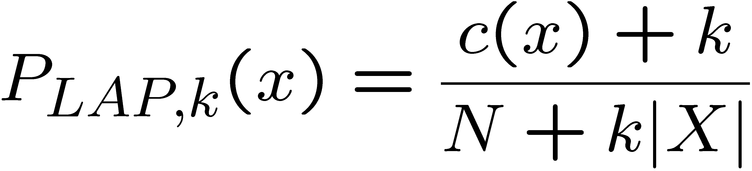
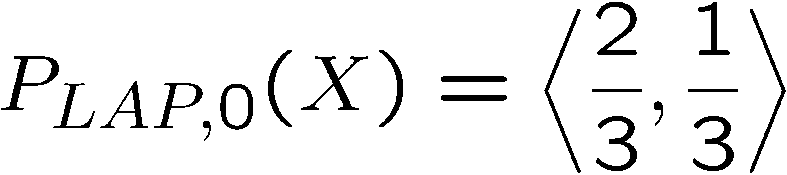
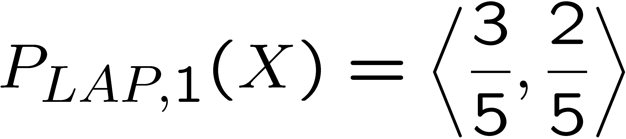
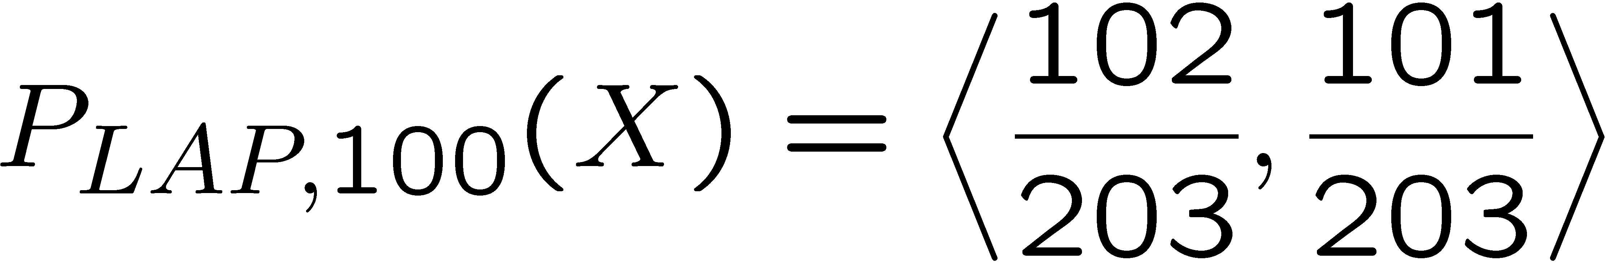
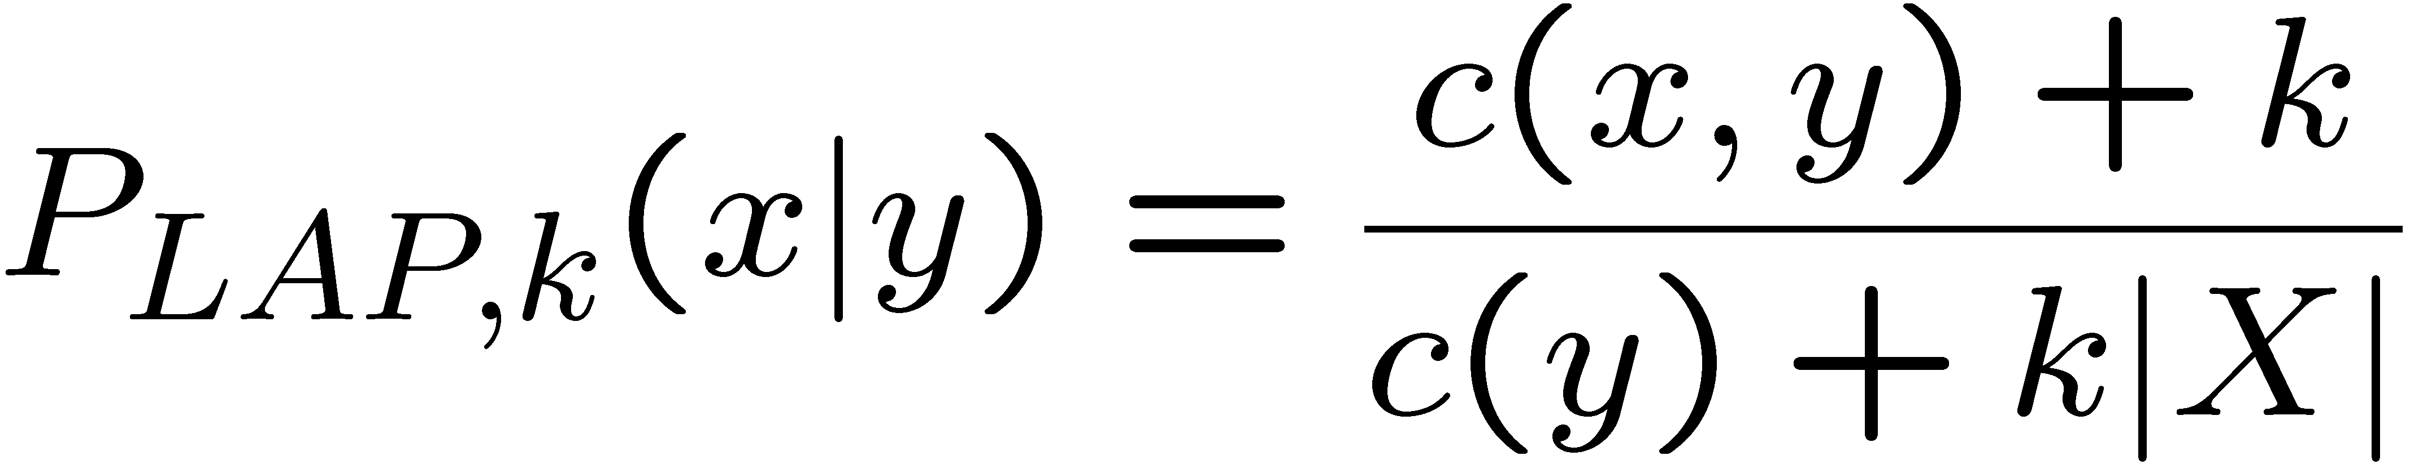
Laplace Smoothing
Laplace’s estimate (extended):
  Pretend you saw every outcome k extra times
  What’s Laplace with k = 0?
  k is the strength of the uniformity prior
Laplace for conditionals:
  Smooth each condition independently:
r
r
b

Slide 13
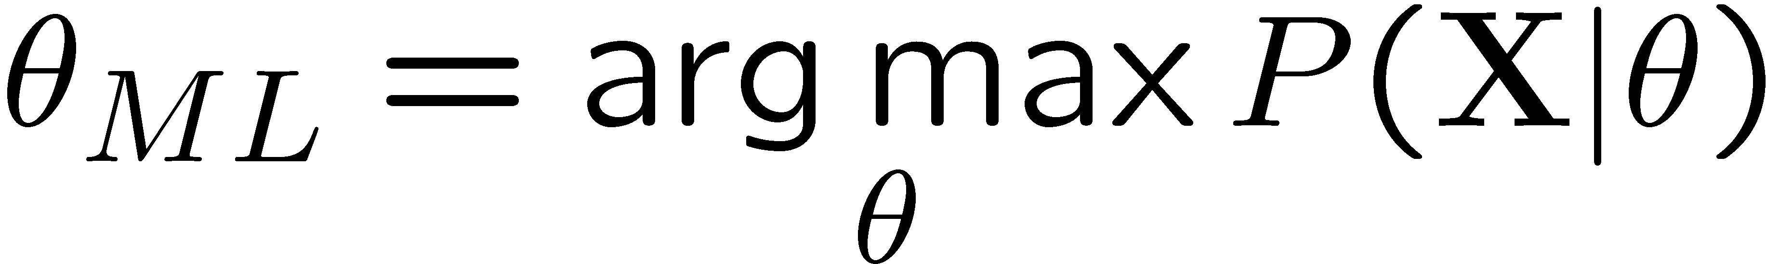
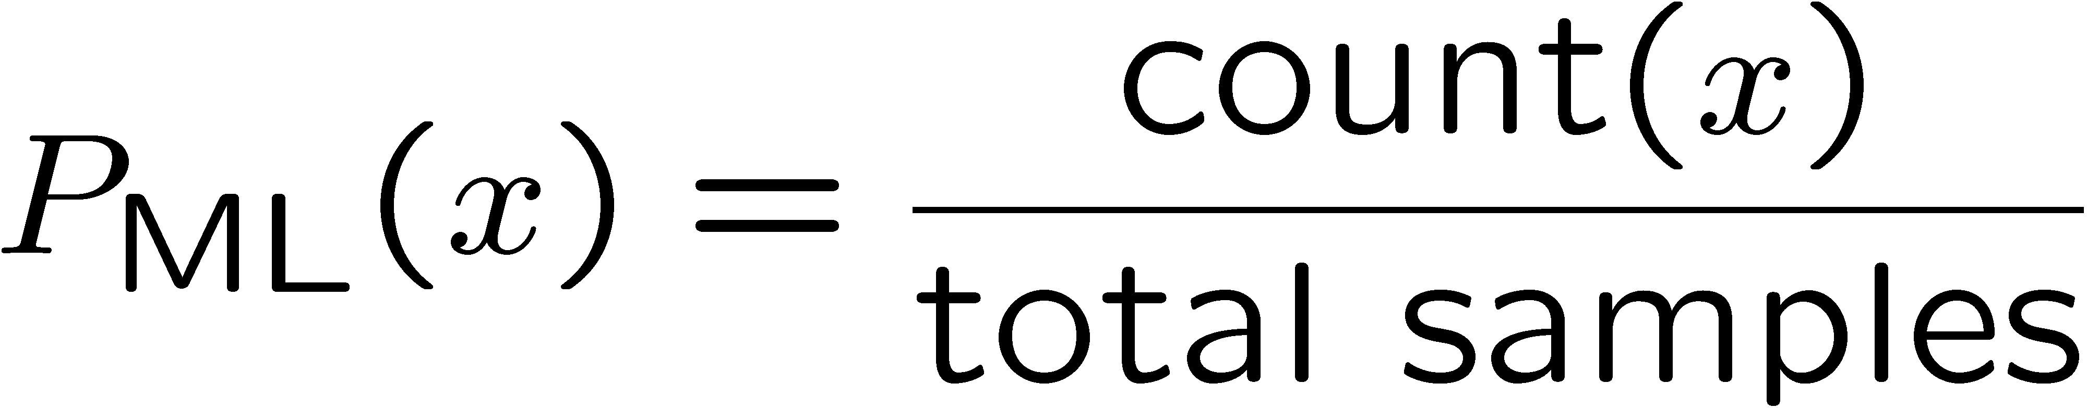
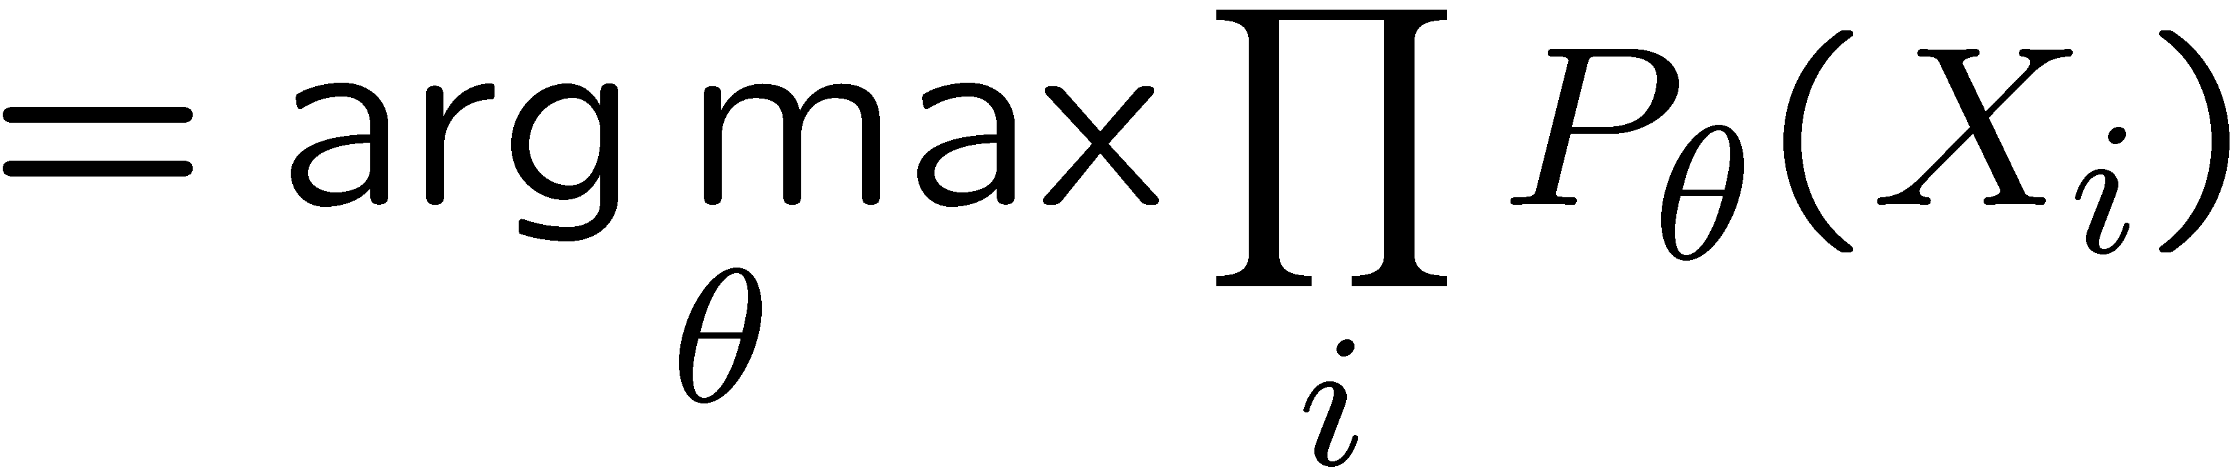
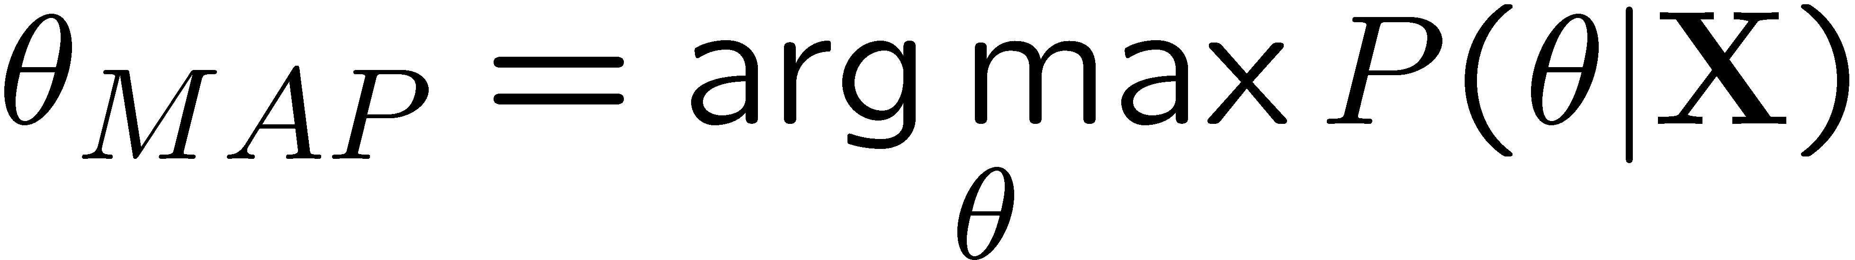
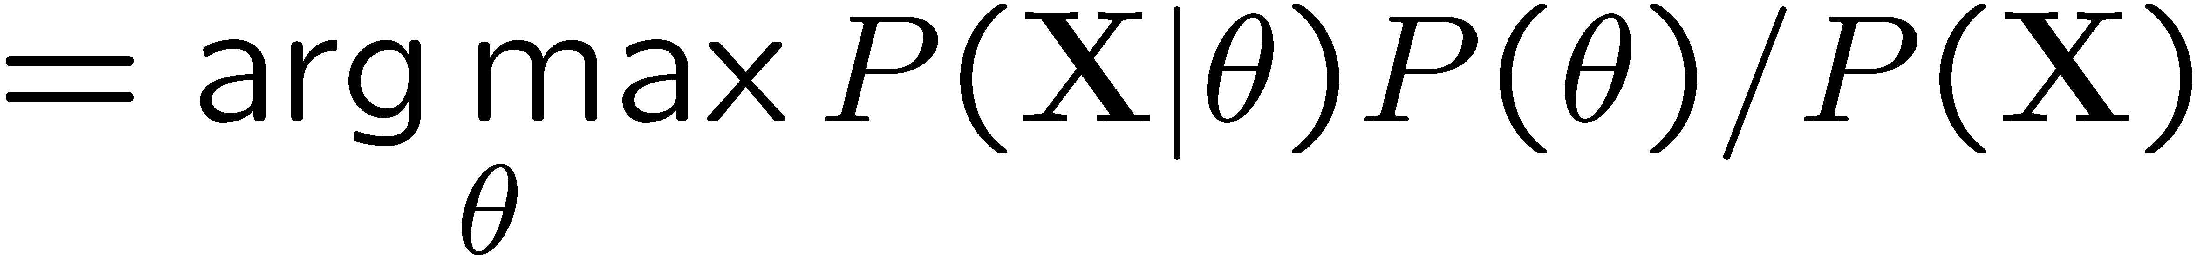
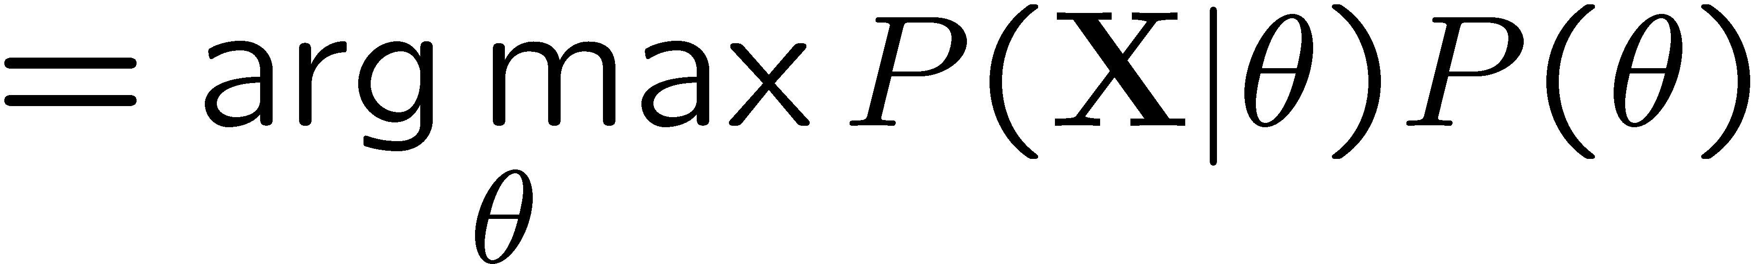
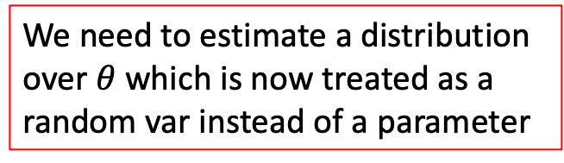
Maximum Likelihood?
Relative frequencies are the maximum likelihood estimates for a given data set
Another option is to consider the maximum a posteriori probability given the data
We need to estimate a distribution over $θ$ which is now treated as a random var instead of a parameter

Slide 14
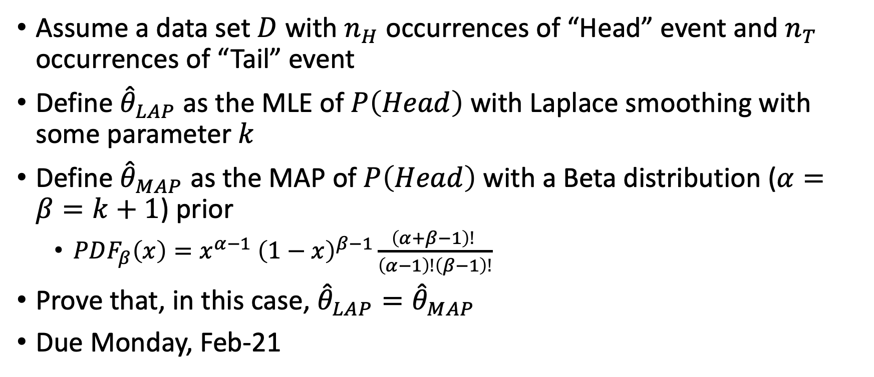
Written assignment 2: generative models
Assume a data set $D$ with $n_{H}$ occurrences of “Head” event and $n_{T}$ occurrences of “Tail” event
Define ${\hat{θ}}_{LAP}$ as the MLE of $P\left(Head\right)$ with Laplace smoothing with some parameter $k$
Define ${\hat{θ}}_{MAP}$ as the MAP of $P\left(Head\right)$ with a Beta distribution ($α=β=k+1$) prior
  $PDF_{β}\left(x\right)=x^{α−1} {\left(1−x\right)}^{β−1}\frac{\left(α+β−1\right)! }{\left(α−1\right)!\left(β−1\right)!}$
Prove that, in this case, ${\hat{θ}}_{LAP}={\hat{θ}}_{MAP}$
Due Monday, Feb-21
Normalizing constant

Slide 15
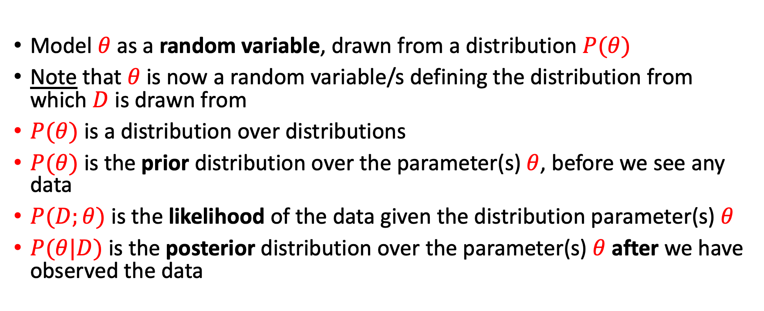
Maximum a posteriori probability
Model $θ$ as a random variable, drawn from a distribution $P(θ)$
Note that $θ$ is now a random variable/s defining the distribution from which $D$ is drawn from
$P(θ)$ is a distribution over distributions
$P(θ)$ is the prior distribution over the parameter(s) $θ$, before we see any data
$P(D;θ)$ is the likelihood of the data given the distribution parameter(s) $θ$
$P(θ|D)$is the posterior distribution over the parameter(s) $θ$ after we have observed the data

Slide 16
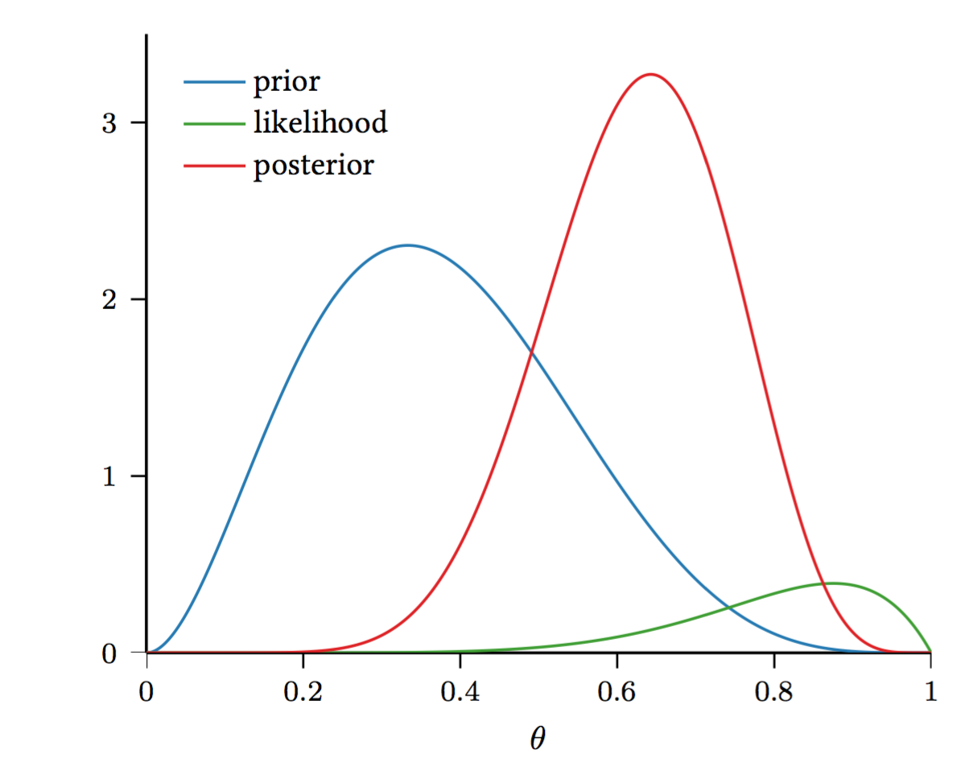
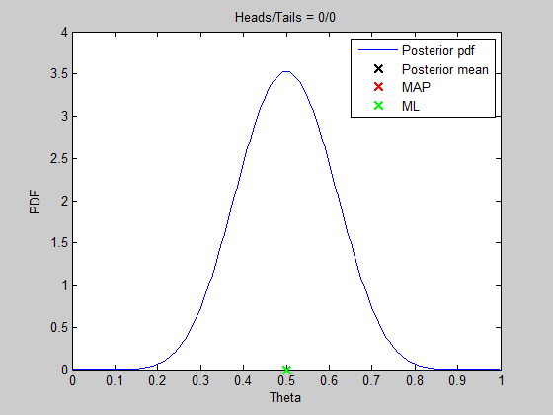



Maximum a posteriori probability
$$P(θ|D)$$
$P(θ)$
$P(D|θ)$

Slide 17
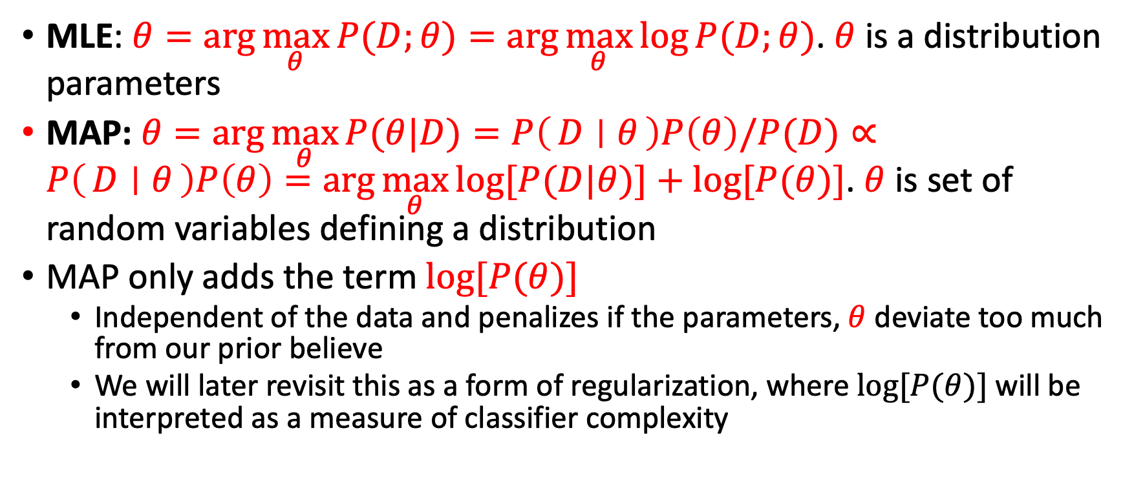
Empirical probability estimation summary
MLE: $θ=\arg{\max_{θ}{P(D;θ)}}=\arg{\max_{θ}{\log{P(D;θ)}}}$. $θ$ is a distribution parameters
MAP: $θ=\arg{\max_{θ}{P(θ|D)}}=P\left(D ∣ θ\right)P\left(θ\right)/P(D)∝P\left(D ∣ θ\right)P\left(θ\right)=\arg{\max_{θ}{log⁡[P(D|θ)]+log⁡[P(θ)]}}$. $θ$ is set of random variables defining a distribution
MAP only adds the term $log⁡[P(θ)]$
  Independent of the data and penalizes if the parameters, $θ$ deviate too much from our prior believe
  We will later revisit this as a form of regularization, where $log⁡[P(θ)]$will be interpreted as a measure of classifier complexity

Slide 18
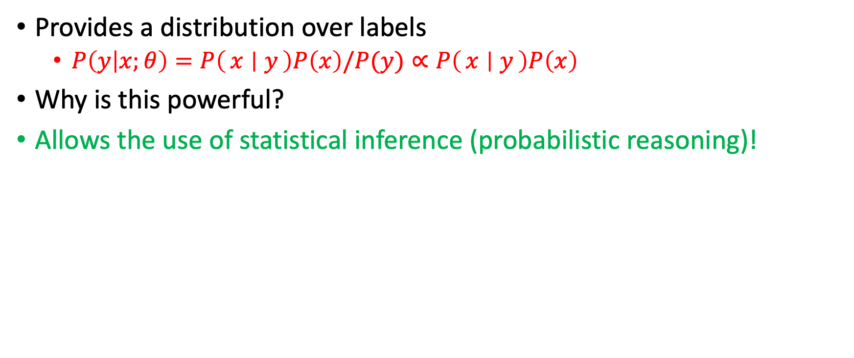
Generative model
Provides a distribution over labels
  $P\left(y | x;θ\right)=P\left(x ∣ y\right)P\left(x\right)/P(y)∝P\left(x ∣ y\right)P\left(x\right)$
Why is this powerful?
Allows the use of statistical inference (probabilistic reasoning)!

Slide 19
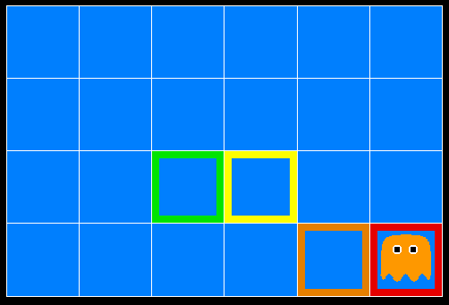
Inference from probabilities
A ghost is in the grid somewhere
Sensor readings tell how close a square is to the ghost
  On the ghost: red
  1 or 2 away: orange
  3 or 4 away: yellow
  5+ away: green
Sensors are noisy, but we know P(Color | Distance)
P(red | 3) | P(orange | 3) | P(yellow | 3) | P(green | 3)
0.05 | 0.15 | 0.5 | 0.3
[Demo: Ghostbuster – no probability (L12D1) ]

Slide 20

Video of Demo Ghostbuster – No probability

Slide 21
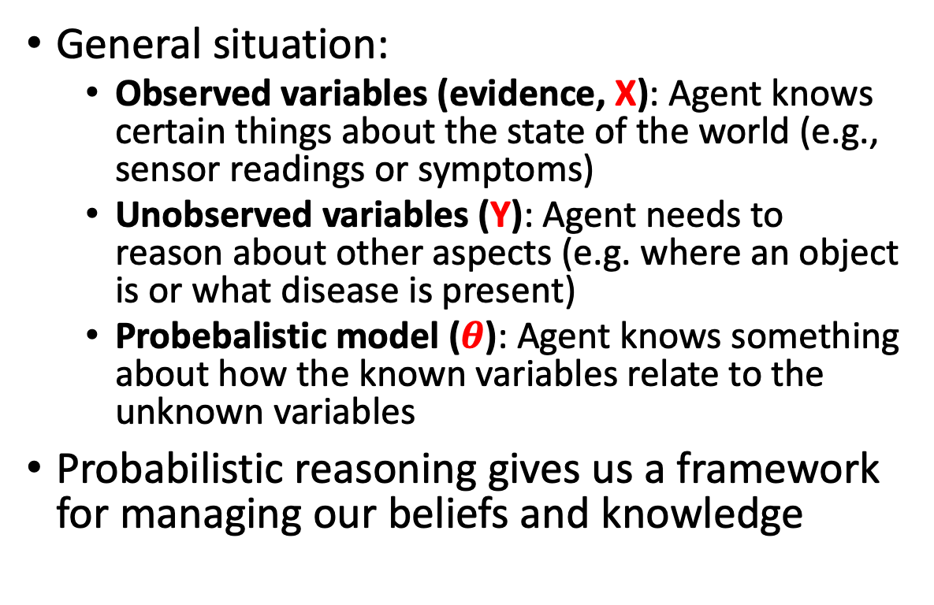
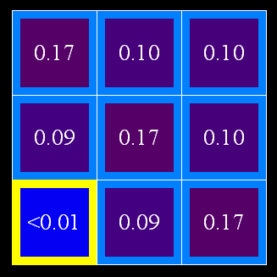
Uncertainty
General situation:
  Observed variables (evidence, X): Agent knows certain things about the state of the world (e.g., sensor readings or symptoms)
  Unobserved variables (Y): Agent needs to reason about other aspects (e.g. where an object is or what disease is present)
  Probebalistic model ($θ$): Agent knows something about how the known variables relate to the unknown variables
Probabilistic reasoning gives us a framework for managing our beliefs and knowledge

Slide 22
Random Variables
A random variable is some aspect of the world about which we (may) have uncertainty
  R = Is it raining?
  T = Is it hot or cold?
  D = How long will it take to drive to work?
  L = Where is the ghost?
We denote random variables with capital letters
Random variables have domains
  R in {true, false} (often write as {+r, -r})
  T in {hot, cold}
  D in [0, ∞)
  L in possible locations, maybe {(0,0), (0,1), …}

Slide 23
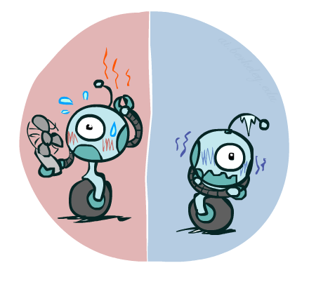

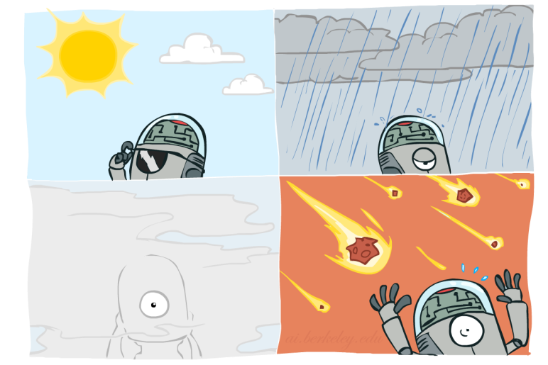

Probability Distributions
  Weather:
Associate a probability with each value
  Temperature:
W | P
sun | 0.6
rain | 0.1
fog | 0.3
meteor | 0.0
T | P
hot | 0.5
cold | 0.5

Slide 24


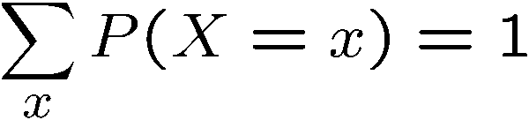
Probability Distributions
Random variables are affiliated with distributions
A distribution is a TABLE of probability per value
An outcome probability is a single number
Must have: and
Shorthand notation:
OK if all domain entries are unique
T | P
hot | 0.5
cold | 0.5
W | P
sun | 0.6
rain | 0.1
fog | 0.3
meteor | 0.0

Slide 25




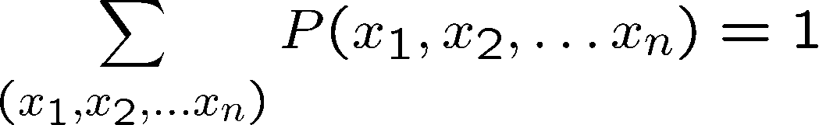
Joint Distributions
A joint distribution over a set of random variables:
specifies a real number for each assignment (or outcome):
  Must obey:
Size of distribution if n variables with domain sizes d?
  For all but the smallest distributions, impractical to write out!
T | W | P
hot | sun | 0.4
hot | rain | 0.1
cold | sun | 0.2
cold | rain | 0.3

Slide 26
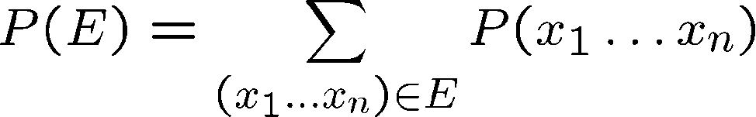
Events
An event is a set E of outcomes
From a joint distribution, we can calculate the probability of any event
  Probability that it’s hot AND sunny?
  Probability that it’s hot?
  Probability that it’s hot OR sunny?
Typically, the events we care about are partial assignments, like P(T=hot)
T | W | P
hot | sun | 0.4
hot | rain | 0.1
cold | sun | 0.2
cold | rain | 0.3

Slide 27

Quiz: Events
P(+x, +y) ?
P(+x) ?
P(-y OR +x) ?
X | Y | P
+x | +y | 0.2
+x | -y | 0.3
-x | +y | 0.4
-x | -y | 0.1

Slide 28
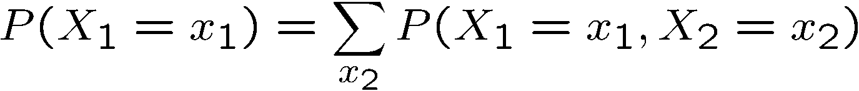
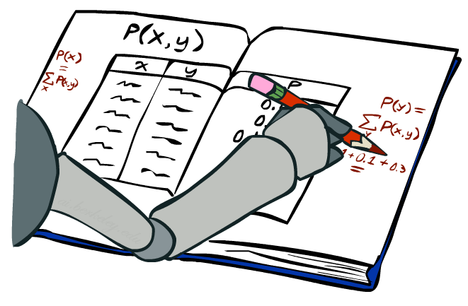
Marginal Distributions
Marginal distributions are sub-tables which eliminate variables
Marginalization (summing out): Combine collapsed rows by adding
T | P
hot | 0.5
cold | 0.5
T | W | P
hot | sun | 0.4
hot | rain | 0.1
cold | sun | 0.2
cold | rain | 0.3
W | P
sun | 0.6
rain | 0.4

Slide 29


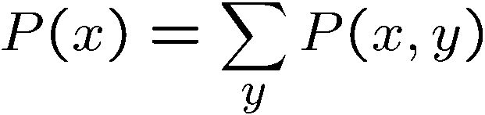

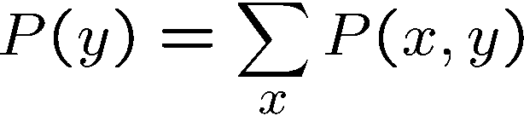
Quiz: Marginal Distributions
X | P
+x
-x
X | Y | P
+x | +y | 0.2
+x | -y | 0.3
-x | +y | 0.4
-x | -y | 0.1
Y | P
+y
-y

Slide 30
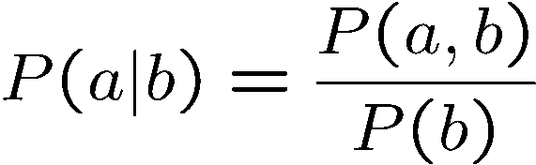
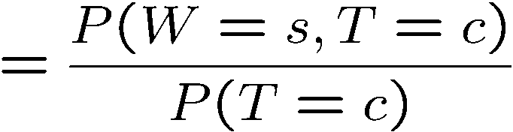
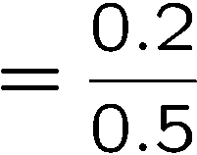



Conditional Probabilities
Derived from the joint probability
  The definition of a conditional probability
P(a,b)
P(a)
P(b)
T | W | P
hot | sun | 0.4
hot | rain | 0.1
cold | sun | 0.2
cold | rain | 0.3

Slide 31
Quiz: Conditional Probabilities
P(+x | +y) ?
P(-x | +y) ?
P(-y | +x) ?
X | Y | P
+x | +y | 0.2
+x | -y | 0.3
-x | +y | 0.4
-x | -y | 0.1

Slide 32



Conditional Distributions
Conditional distributions are probability distributions over some variables given fixed values of others
Conditional Distributions
Joint Distribution
W | P
sun | 0.8
rain | 0.2
T | W | P
hot | sun | 0.4
hot | rain | 0.1
cold | sun | 0.2
cold | rain | 0.3
W | P
sun | 0.4
rain | 0.6

Slide 33









Conditional Distributions
T | W | P
hot | sun | 0.4
hot | rain | 0.1
cold | sun | 0.2
cold | rain | 0.3
W | P
sun | 0.4
rain | 0.6

Slide 34








Normalization Trick
  SELECT the joint probabilities matching the evidence
  NORMALIZE the selection
  (make it sum to one)
T | W | P
hot | sun | 0.4
hot | rain | 0.1
cold | sun | 0.2
cold | rain | 0.3
T | W | P
cold | sun | 0.2
cold | rain | 0.3
W | P
sun | 0.4
rain | 0.6

Slide 35
To Normalize
(Dictionary) To bring or restore to a normal condition
Procedure:
  Step 1: Compute Z = sum over all entries
  Step 2: Divide every entry by Z
Example 1
All entries sum to ONE
Example 2
W | P
sun | 0.2
rain | 0.3
Normalize
W | P
sun | 0.4
rain | 0.6
T | W | P
hot | sun | 20
hot | rain | 5
cold | sun | 10
cold | rain | 15
T | W | P
hot | sun | 0.4
hot | rain | 0.1
cold | sun | 0.2
cold | rain | 0.3
Normalize
Z = 0.5
Z = 50

Slide 36

Quiz: Normalization Trick
P(X | Y=-y) ?
  SELECT the joint probabilities matching the evidence
  NORMALIZE the selection
  (make it sum to one)
X | Y | P
+x | +y | 0.2
+x | -y | 0.3
-x | +y | 0.4
-x | -y | 0.1
X | P
+x
-x
X | P
+x
-x

Slide 37

Probabilistic Inference
Probabilistic inference: compute a desired probability from other known probabilities (e.g. conditional from joint)
We generally compute conditional probabilities
  P(on time | no reported accidents) = 0.90
  These represent the agent’s beliefs given the evidence
Probabilities change with new evidence:
  P(on time | no accidents, 5 a.m.) = 0.95
  P(on time | no accidents, 5 a.m., raining) = 0.80
  Observing new evidence causes beliefs to be updated

Slide 38












Inference by Enumeration
* Works fine with multiple query variables, too
General case:
  Evidence variables:
  Query* variable:
  Hidden variables:
We want:
All variables
Step 1: Select the entries consistent with the evidence
Step 2: Sum out H to get joint of Query and evidence
Step 3: Normalize

Slide 39
Inference by Enumeration
P(W)?
P(W | winter)?
P(W | winter, hot)?
W | P
sun
rain
S | T | W | P
summer | hot | sun | 0.30
summer | hot | rain | 0.05
summer | cold | sun | 0.10
summer | cold | rain | 0.05
winter | hot | sun | 0.10
winter | hot | rain | 0.05
winter | cold | sun | 0.15
winter | cold | rain | 0.20
W | P
sun
rain
W | P
sun
rain

Slide 40
Inference by Enumeration
Obvious problems:
  Worst-case time complexity O(d^{n})
  Space complexity O(d^{n}) to store the joint distribution

Slide 41



The Product Rule
Compute the joint probability from the conditional

Slide 42


The Product Rule
Example:
D | W | P
wet | sun | 0.1
dry | sun | 0.9
wet | rain | 0.7
dry | rain | 0.3
D | W | P
wet | sun | 0.08
dry | sun | 0.72
wet | rain | 0.14
dry | rain | 0.06
R | P
sun | 0.8
rain | 0.2

Slide 43


The Chain Rule
More generally, we can always write any joint distribution as an incremental product of conditional distributions
Proof:
$$\prod_{i=1 to n}{\frac{P\left(x_{1},…,x_{i}\right)}{P\left(x_{1},…,x_{i−1}\right)}}=P\left(x_{1}\right)\frac{p\left(x_{1},x_{2}\right)}{P\left(x_{1}\right)}…\frac{p\left(x_{1},…,x_{n}\right)}{P\left(x_{1},…,x_{n−1}\right)}=p\left(x_{1},…,x_{n}\right)$$

Slide 44

Bayes’ Rule

Slide 45



Bayes’ Rule
Two ways to factor a joint distribution over two variables:
Dividing, we get:
Why is this at all helpful?
  Lets us build one conditional from its reverse
  Often one conditional is tricky but the other one is simple
  Foundation of many systems we’ll see later
In the running for most important AI equation!

Slide 46




Inference with Bayes’ Rule
Example: Diagnostic probability from causal probability:
Example:
  M: meningitis, S: stiff neck
  Note: posterior probability of meningitis still very small
  Note: you should still get stiff necks checked out!
Example
givens
=0.0079

Slide 47
Quiz: Bayes’ Rule
Given:
What is P(W | dry) ?
D | W | P
wet | sun | 0.1
dry | sun | 0.9
wet | rain | 0.7
dry | rain | 0.3
W | P
sun | 0.8
rain | 0.2
D | W | P
wet | sun | 0.08
dry | sun | 0.72
wet | rain | 0.14
dry | rain | 0.06
$$P\left(W | dry\right)=\frac{P\left(dry | W\right)}{P\left(dry\right)}P(W)$$
$$P\left(D,W\right)=P\left(D | W\right)P(W)$$
$$P\left(dry\right)=?$$
$$0.78$$

Slide 48


Ghostbusters, Revisited
Let’s say we have two distributions:
  Prior distribution over ghost location: P(G)
    Let’s say this is uniform
  Sensor reading model: P(R | G)
    Given: we know what our sensors do
    R = reading color measured at (1,1)
    E.g. P(R = yellow | G=(1,1)) = 0.1
We can calculate the posterior distribution P(G|r) over ghost locations given a reading using Bayes’ rule:
[Demo: Ghostbuster – with probability (L12D2) ]

Slide 49
Video of Demo Ghostbusters with Probability

Slide 50
What did we learn?
Generative vs Discriminative Models
MLE and MAP
Random variables and events
Maximum Likelihood and Maximum a posteriori estimates
Probability distribution
Joint distribution and marginal distribution
Conditional probabilities
Probabilistic inference
Bayes’ rule
Bayesian inference

Slide 51
What next?
Class:
  Bayesian networks
Assignments:
  Programing assignment 1: Perceptron (due Tuesday, Feb-15)
  Written assignment 2: generative models (due Monday, Feb. 21)
Quizzes:

