Slide 1
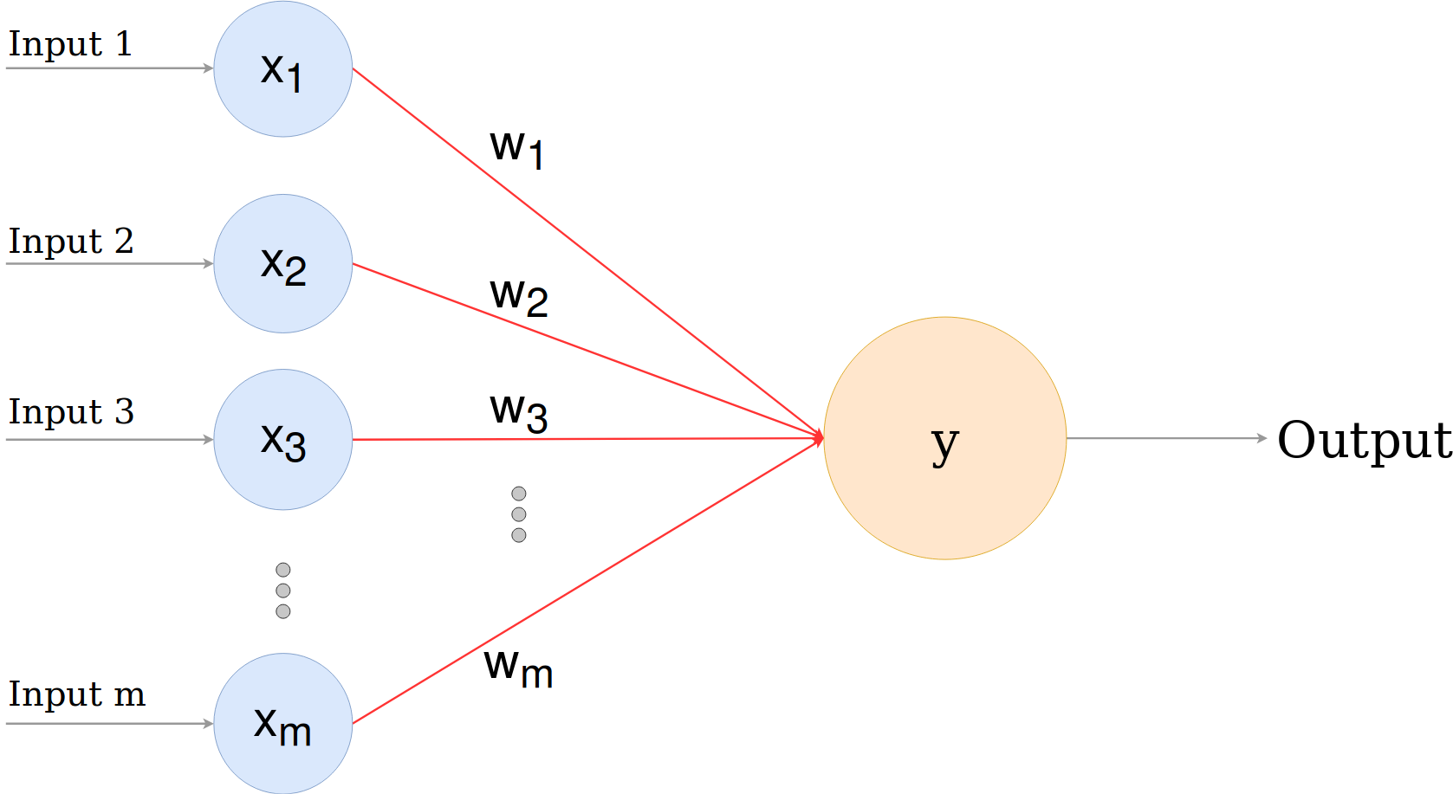
CSCE-421 Machine Learning
3. Perceptron
Instructor: Guni Sharon

Slide 2
Announcements
Late days
  No need to notify me or get permission for delayed submissions
  Use your available late days for justified purposes
  When uploading your submission to Canvas, state the number of late days you are using out of your remaining balance e.g., “using 2/6 late days”
Overdue:
  Programming assignment 0: Python Warmup (due Tuesday, Jan 25)
Due:
  Written assignment 1: K Nearest Neighbors + Linear algebra (due Tuesday, Feb 1)

Slide 3
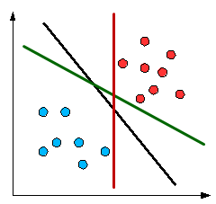
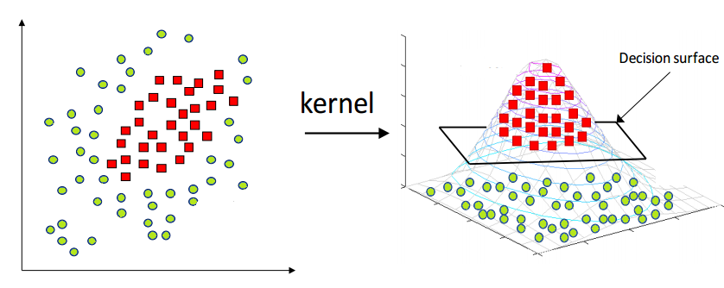
Linear classifier
Find a hyper-plane that separates the data
Requires our data to be linearly separable
Is that a reasonable assumption?
For high-dimensional data, Yes!
More dimensions result in increased separability
“any two finite sets of data with empty overlap in original input space will become linearly separable in an infinite dimensional feature space”
  Chen et al., 2007

Slide 4
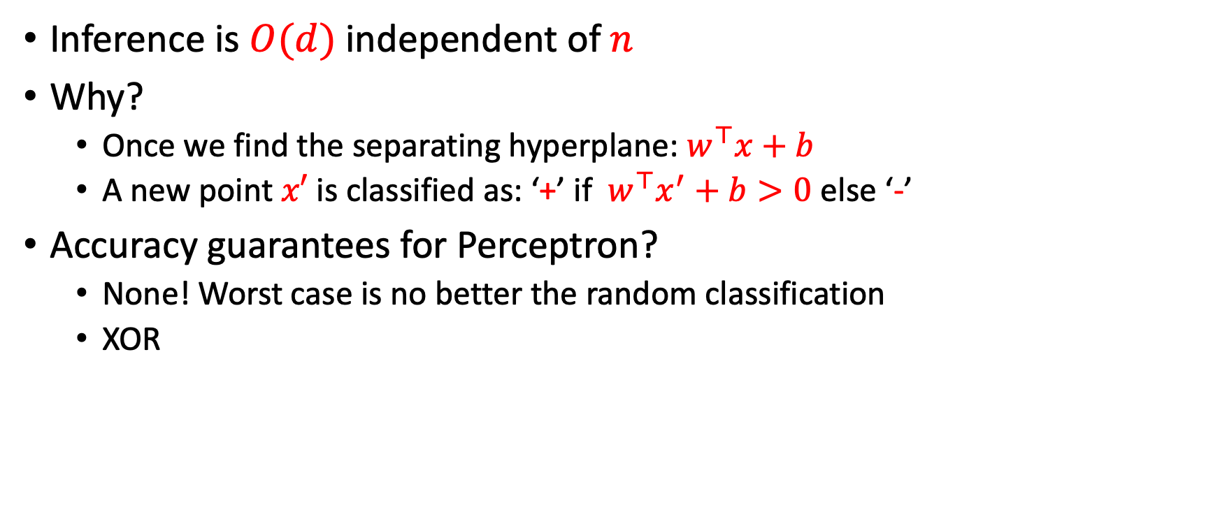
Linear classifier
Inference is $O(d)$independent of $n$
Why?
  Once we find the separating hyperplane: $w^{⊤}x+b$
  A new point $x′$ is classified as: ‘+’ if $w^{⊤}x^{′}+b>0$ else ‘-’
Accuracy guarantees for Perceptron?
  None! Worst case is no better the random classification
  XOR

Slide 5
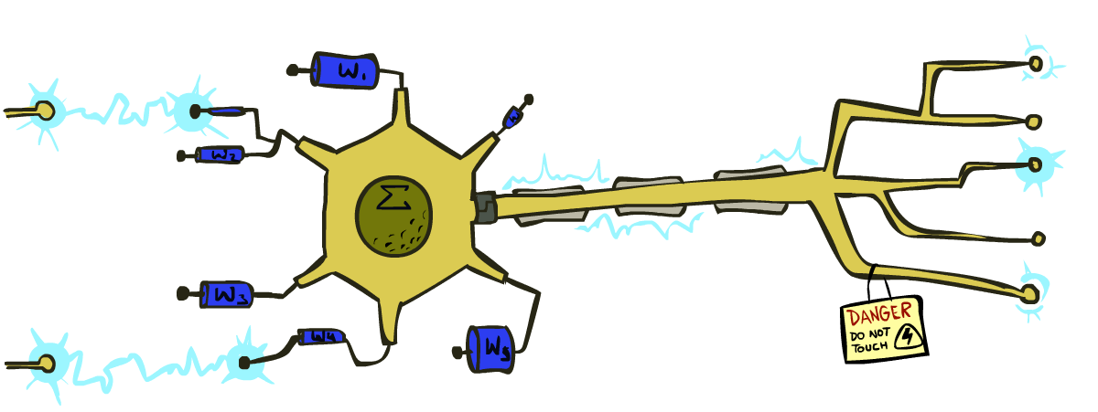
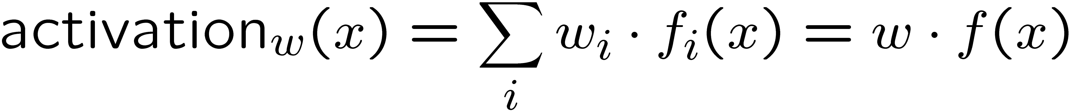
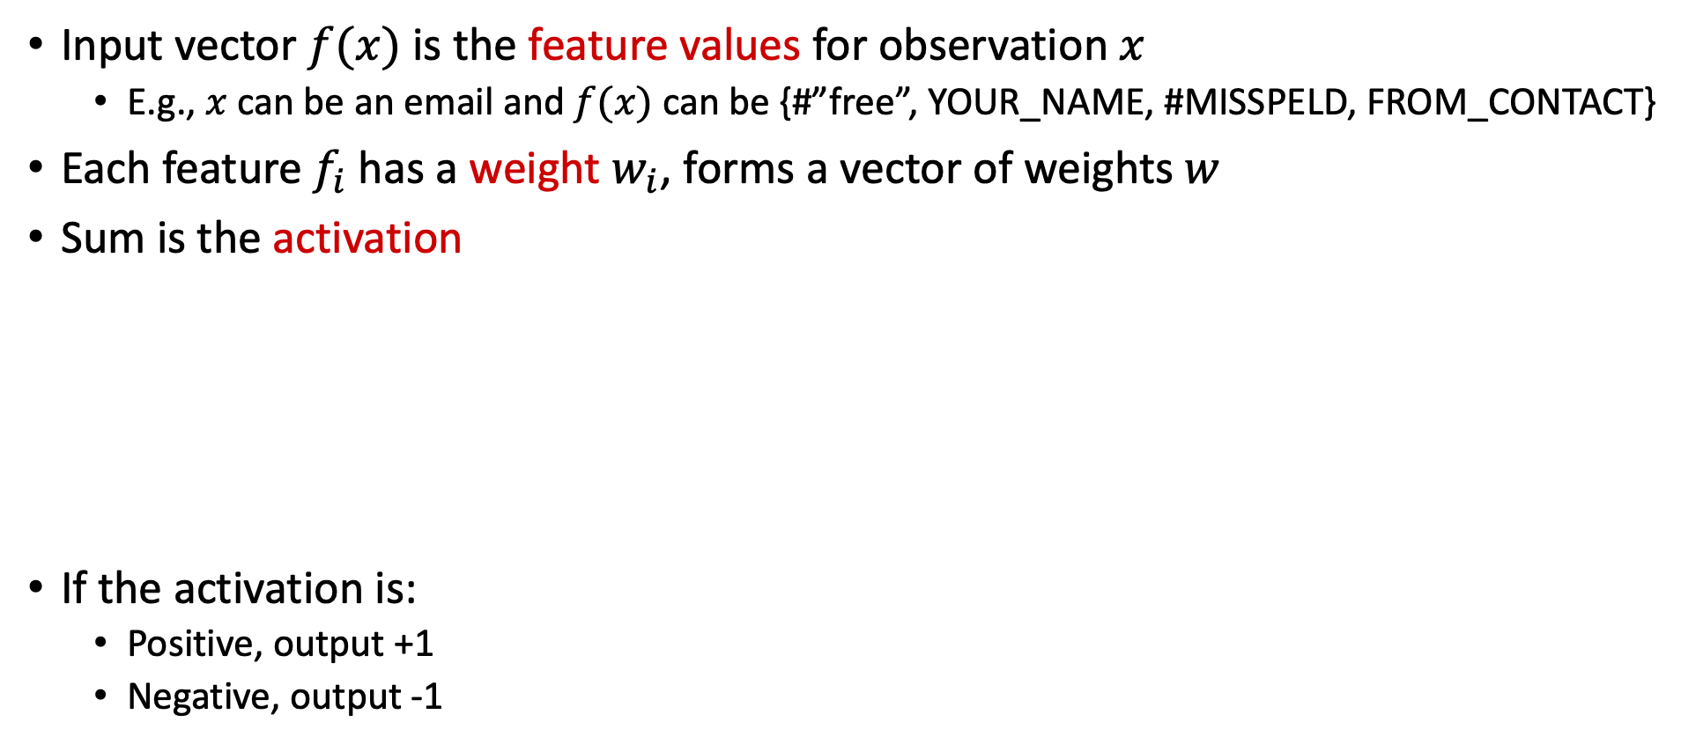
Linear Classifiers
Input vector $f(x)$ is the feature values for observation $x$
  E.g., $x$ can be an email and $f(x)$ can be {#”free”, YOUR_NAME, #MISSPELD, FROM_CONTACT}
Each feature $f_{i}$ has a weight $w_{i}$, forms a vector of weights $w$
Sum is the activation
If the activation is:
  Positive, output +1
  Negative, output -1
w₁
Σ
f₁
w₂
>0?
f₂
w₃
f₃

Slide 6

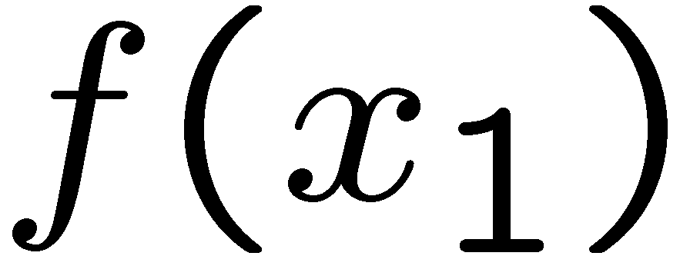
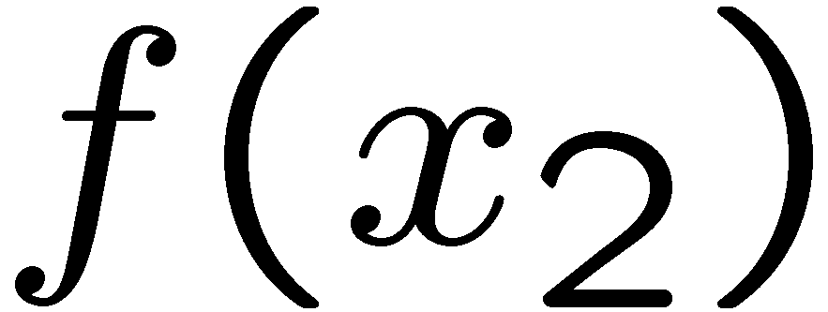
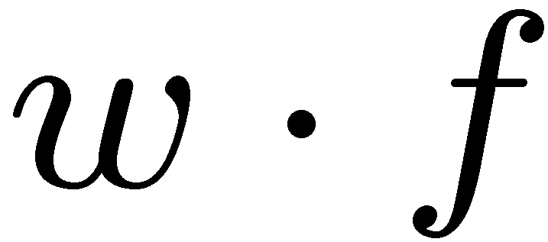
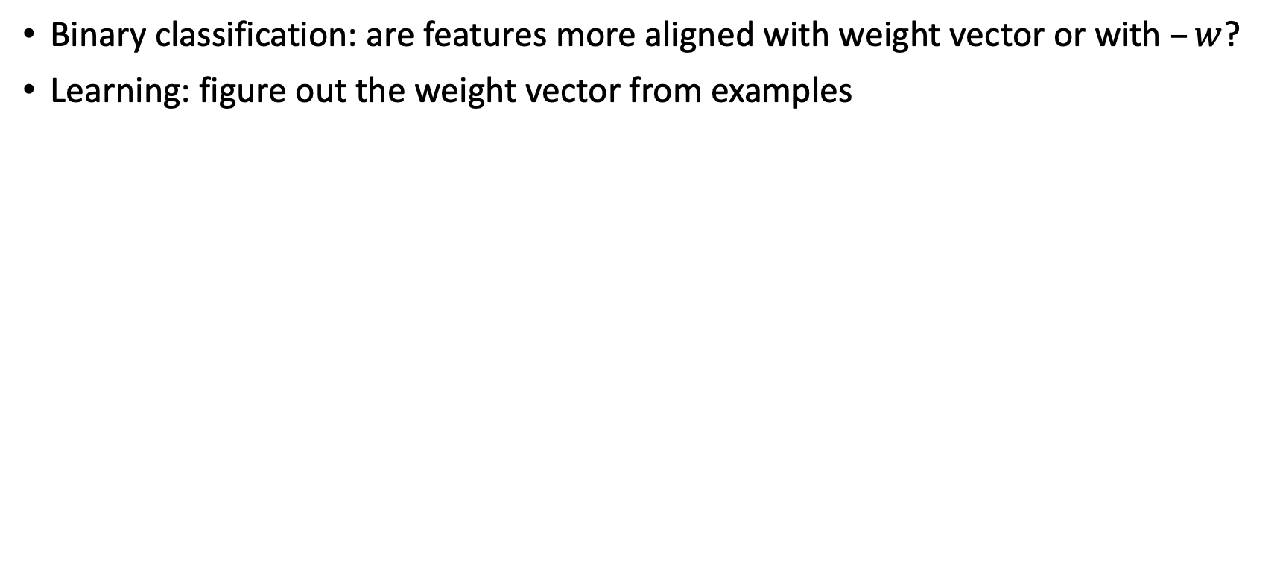
Weights
Binary classification: are features more aligned with weight vector or with $–w$?
Learning: figure out the weight vector from examples
# free : 4
YOUR_NAME :-1
MISSPELLED : 1
FROM_FRIEND :-3
...
# free : 2
YOUR_NAME : 0
MISSPELLED : 2
FROM_FRIEND : 0
...
# free : 0
YOUR_NAME : 1
MISSPELLED : 1
FROM_FRIEND : 1
...
Dot product positive means the positive class

Slide 7
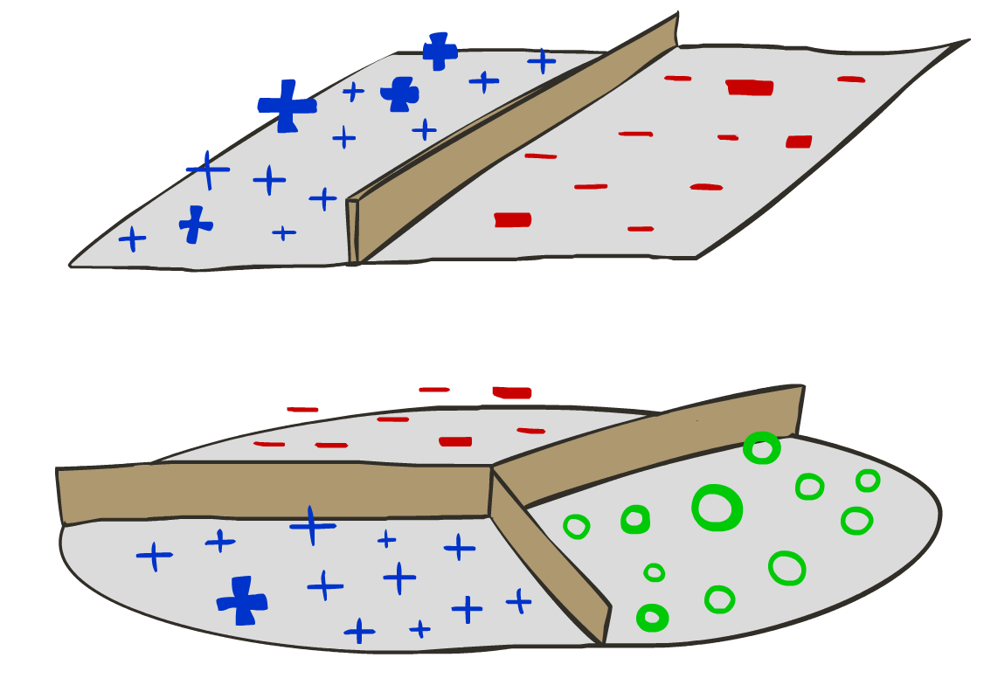
Decision Rules

Slide 8

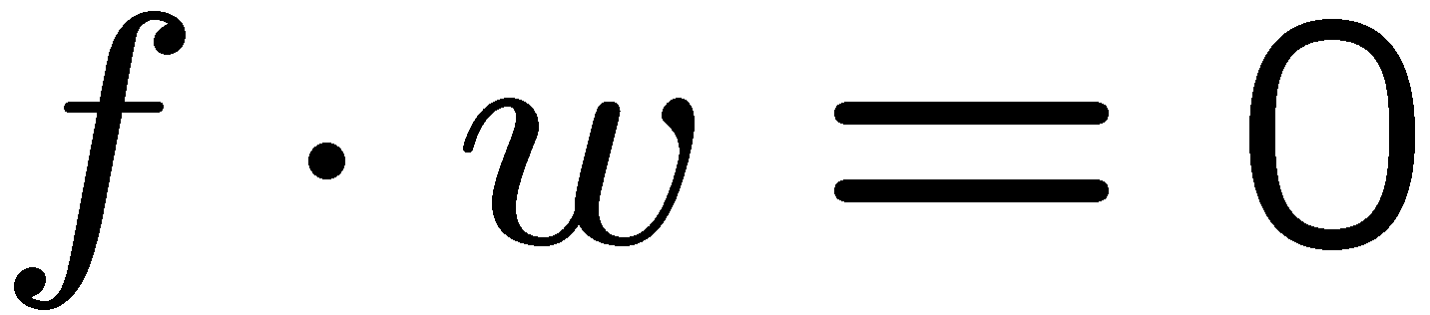
Binary Decision Rule
In the space of feature vectors
  Examples are points
  Any weight vector represents a hyperplane
  One side corresponds to Y=+1
  Other corresponds to Y=-1
money
2
+1 = SPAM
1
Weight vector
BIAS : -3
free : 4
money : 2
...
0
-1 = HAM
0
Bias
1
free

Slide 9

Weight Updates

Slide 10
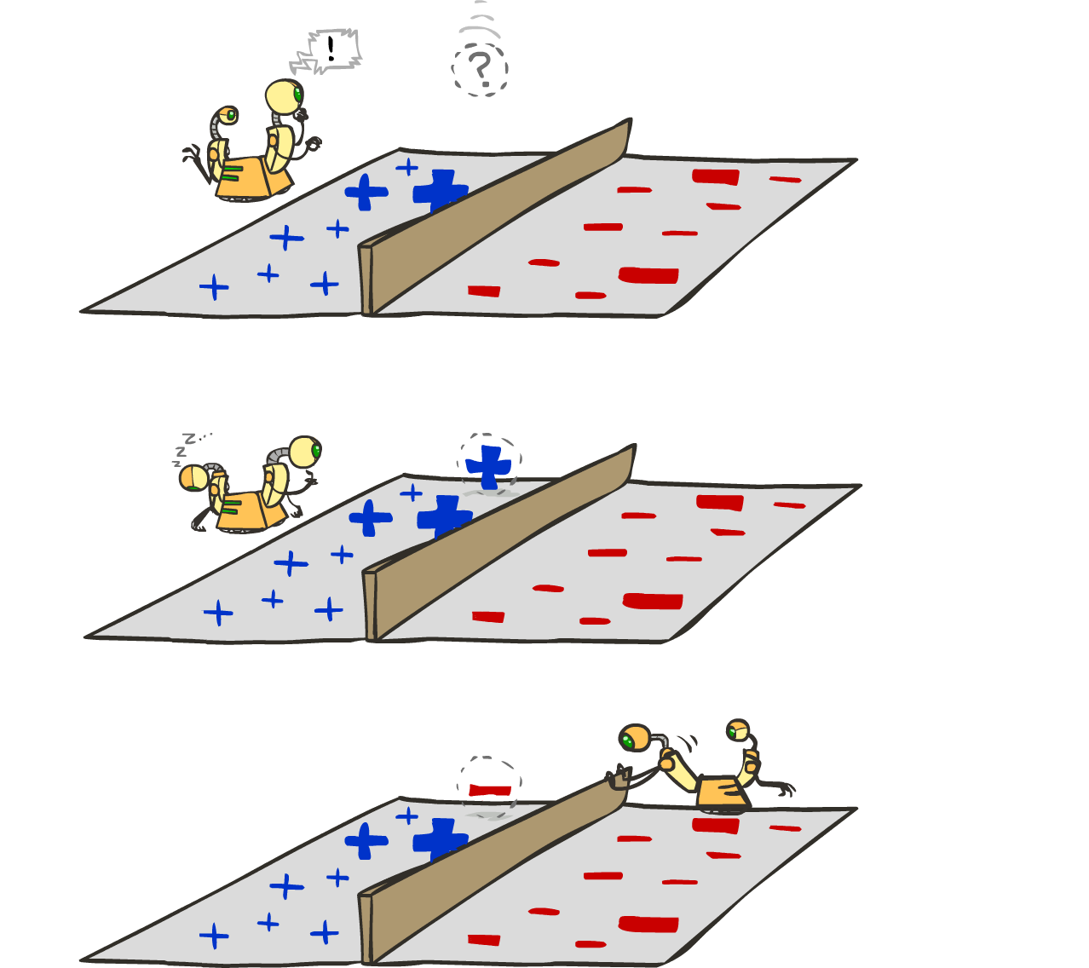
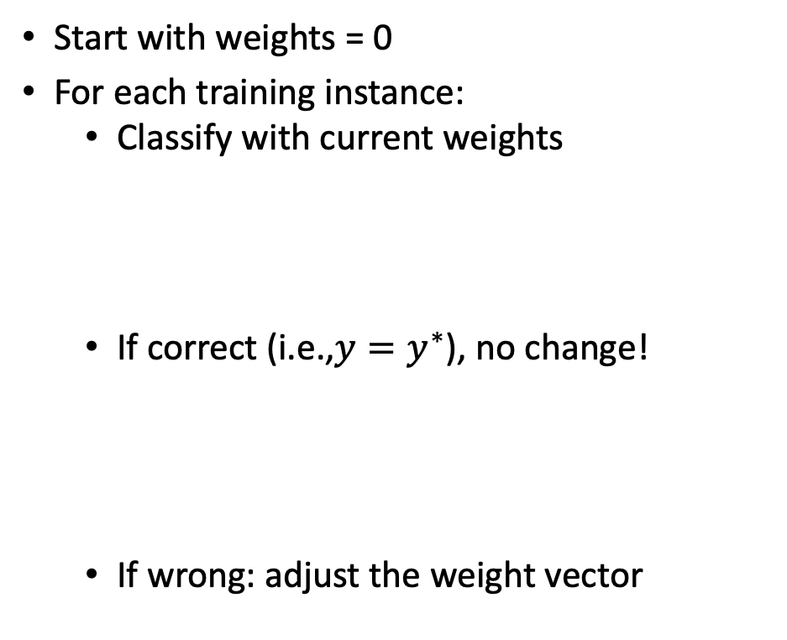
Learning: Binary Perceptron
Start with weights = 0
For each training instance:
  Classify with current weights
  If correct (i.e.,$y=y^{∗}$), no change!
  If wrong: adjust the weight vector
Notes:
http://isl.ira.uka.de/neuralNetCourse/2004/VL_11_5/Perceptron.html

Slide 11

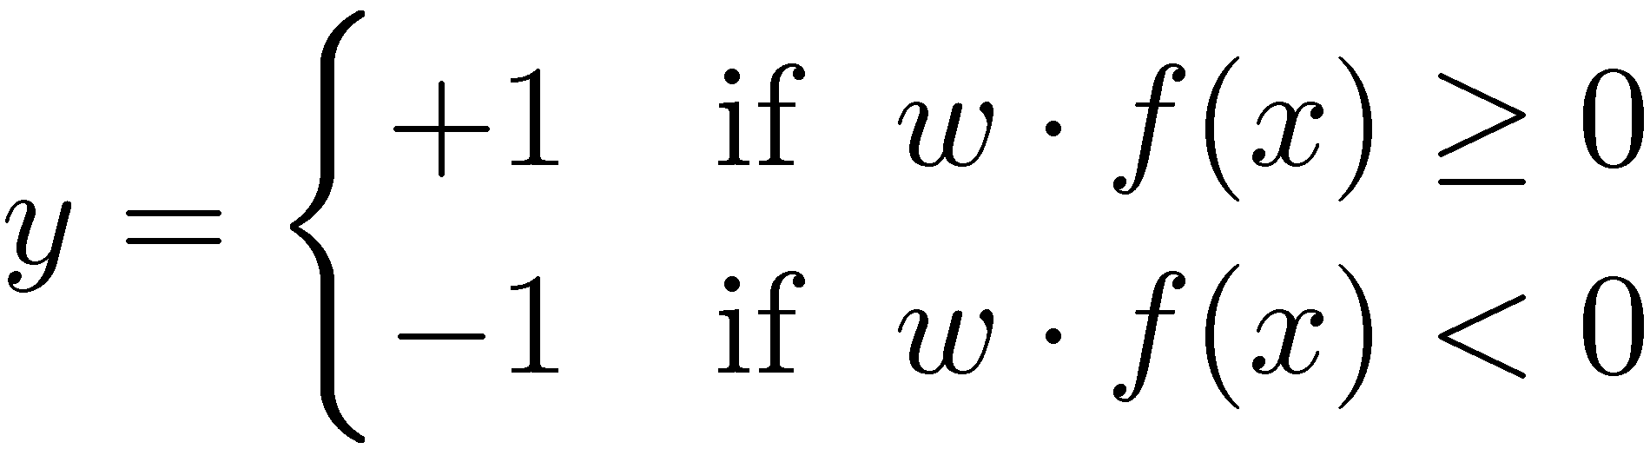

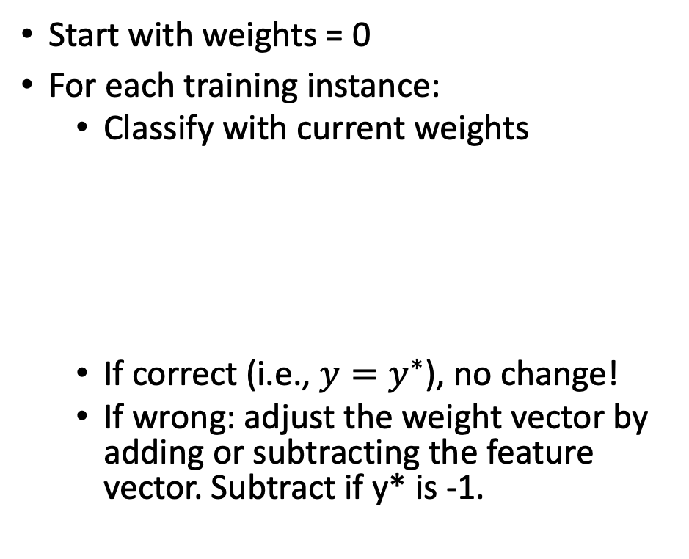
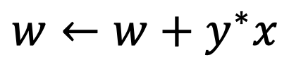
Learning: Binary Perceptron
Start with weights = 0
For each training instance:
  Classify with current weights
  If correct (i.e., $y=y^{∗}$), no change!
  If wrong: adjust the weight vector by adding or subtracting the feature vector. Subtract if y* is -1.
$$w←w+y^{∗}x$$
Notes:
http://isl.ira.uka.de/neuralNetCourse/2004/VL_11_5/Perceptron.html

Slide 12
Demo: Perceptron
https://lecture-demo.ira.uka.de/neural-network-demo/?preset=Rosenblatt%20Perceptron

Slide 13
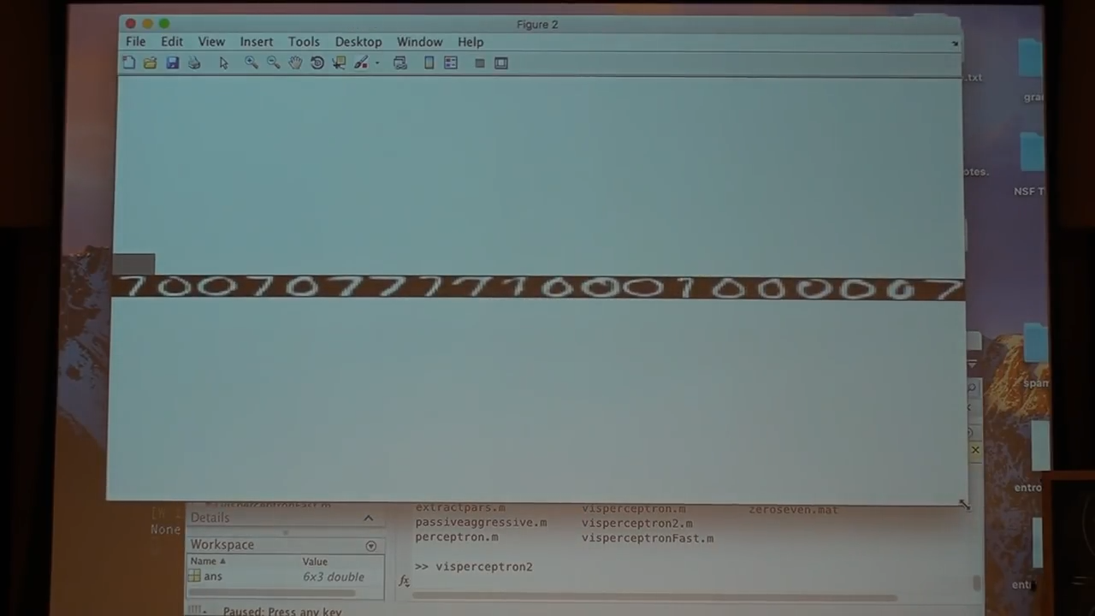
Demo by Kilian Weinberger

Slide 14

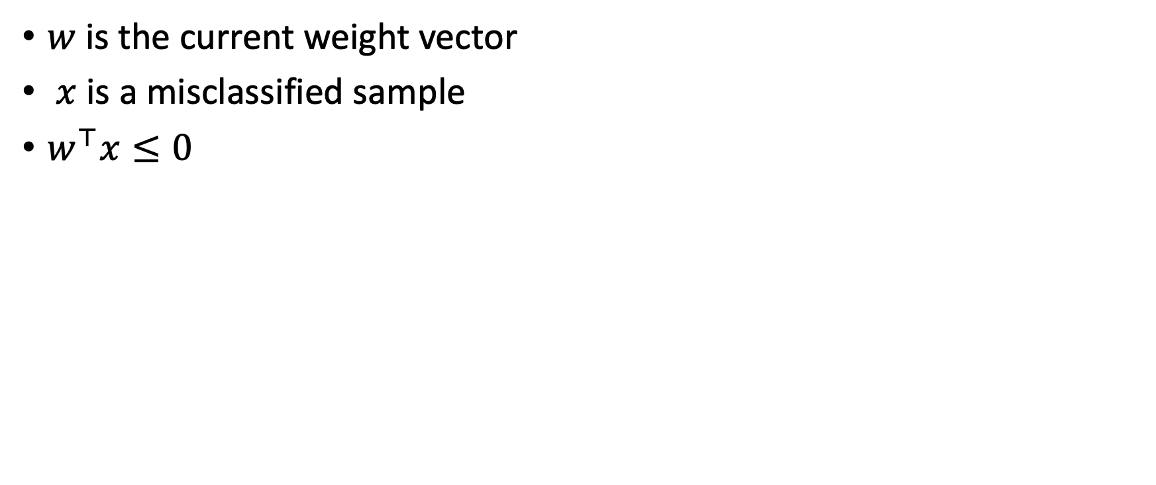

Perceptron update effectiveness
$w$ is the current weight vector
$x$ is a misclassified sample
$w^{⊤}x≤0$
$$w$$
$$x$$

Slide 15
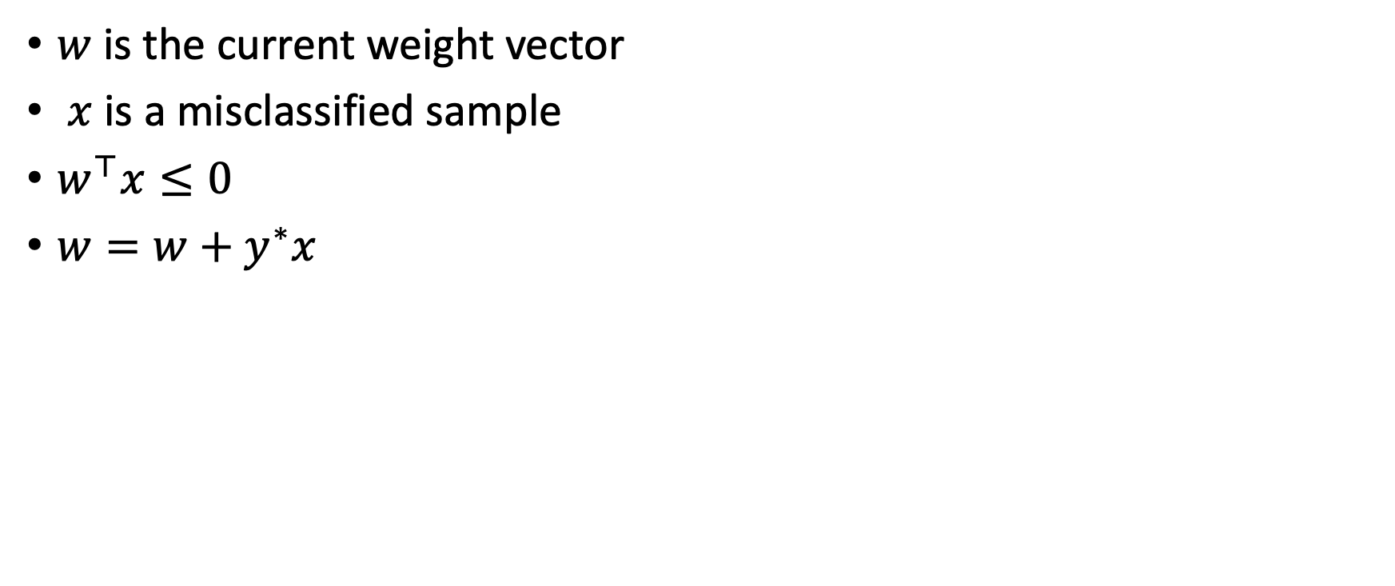

Perceptron update effectiveness
$w$ is the current weight vector
$x$ is a misclassified sample
$w^{⊤}x≤0$
$w=w+y^{∗}x$
$$w′$$
$$w$$
$$x$$

Slide 16
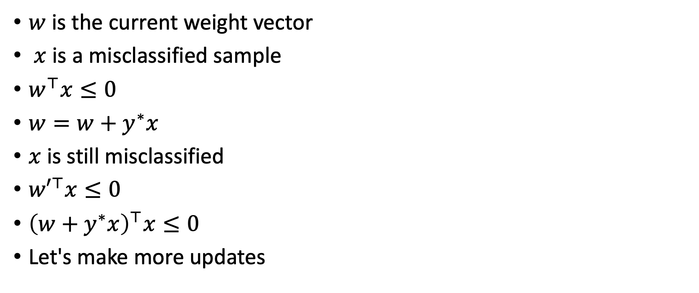
Perceptron update effectiveness
$w$ is the current weight vector
$x$ is a misclassified sample
$w^{⊤}x≤0$
$w=w+y^{∗}x$
$x$ is still misclassified
${w′}^{⊤}x≤0$
${\left(w+y^{∗}x\right)}^{⊤}x≤0$
Let's make more updates
$$w′$$
$$w$$
$$x$$

Slide 17

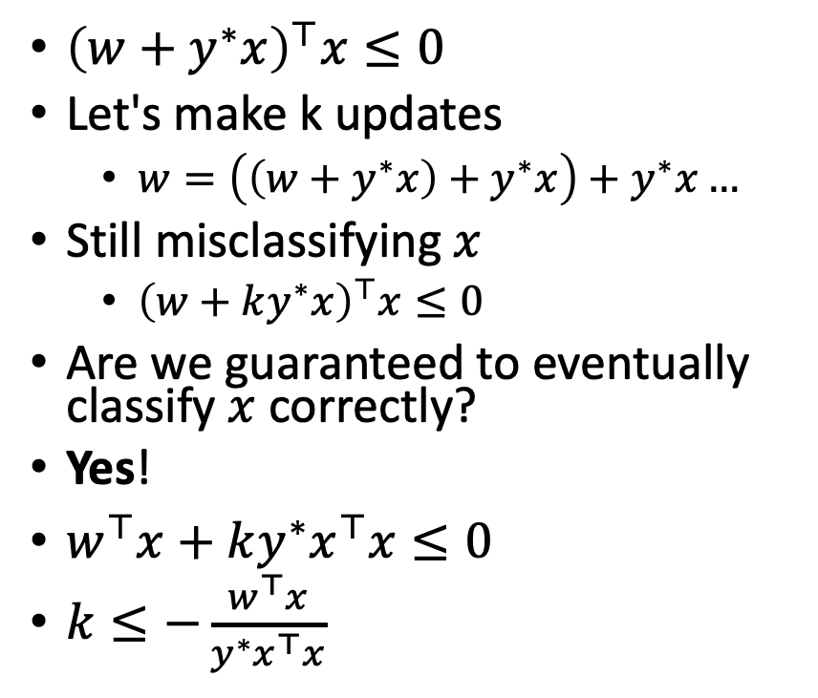


Perceptron update effectiveness
${\left(w+y^{∗}x\right)}^{⊤}x≤0$
Let's make k updates
  $w=\left(\left(w+y^{∗}x\right)+y^{∗}x\right)+y^{∗}x…$
Still misclassifying $x$
  ${\left(w+ky^{∗}x\right)}^{⊤}x≤0$
Are we guaranteed to eventually classify $x$ correctly?
Yes!
$w^{⊤}x+ky^{∗}x^{⊤}x≤0$
$k≤−\frac{w^{⊤}x}{y^{∗}x^{⊤}x}$
$$w^{3}$$
$$w^{2}$$
$$w^{1}$$
…
$$x$$
(A+B)^{T}=A^{T}+B^{T}

Slide 18
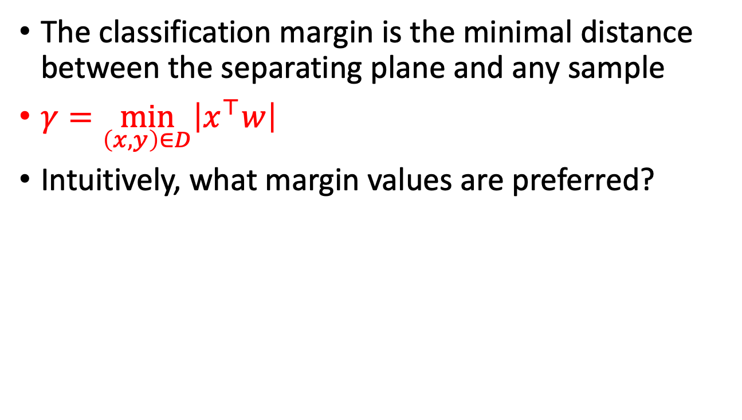



Classification margin
The classification margin is the minimal distance between the separating plane and any sample
$γ=\min_{\left(x,y\right)∈D}\left|x^{⊤}w\right|$
Intuitively, what margin values are preferred?
$γ$=1
$γ$=5
$γ$=1

Slide 19

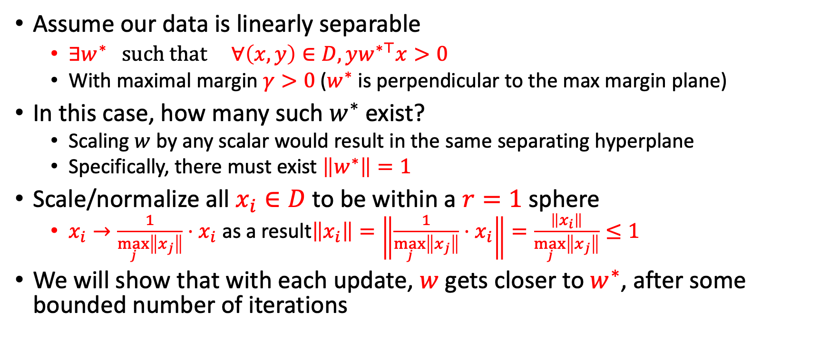
Perceptron proof of convergence
Assume our data is linearly separable
  $∃w^{∗} such that ∀\left(x,y\right)∈D, yw^{∗⊤}x>0$
  With maximal margin $γ>0$ ($w^{∗}$is perpendicular to the max margin plane)
In this case, how many such $w^{∗}$exist?
  Scaling $w$ by any scalar would result in the same separating hyperplane
  Specifically, there must exist $\left\|w^{∗}\right\|=1$
Scale/normalize all $x_{i}∈D$ to be within a $r=1$ sphere
  $x_{i}→\frac{1}{\max_{j}\left\|x_{j}\right\|}⋅x_{i}$ as a result$\left\|x_{i}\right\|=\left\|\frac{1}{\max_{j}\left\|x_{j}\right\|}⋅x_{i}\right\|=\frac{\left\|x_{i}\right\|}{\max_{j}\left\|x_{j}\right\|}≤1$
We will show that with each update, $w$ gets closer to $w^{∗}$, after some bounded number of iterations
$\left\|x\right\|$ is the L2 norm of a vector i.e., $\sqrt{x⋅x}≡\sqrt{x^{⊤}x}$

Slide 20
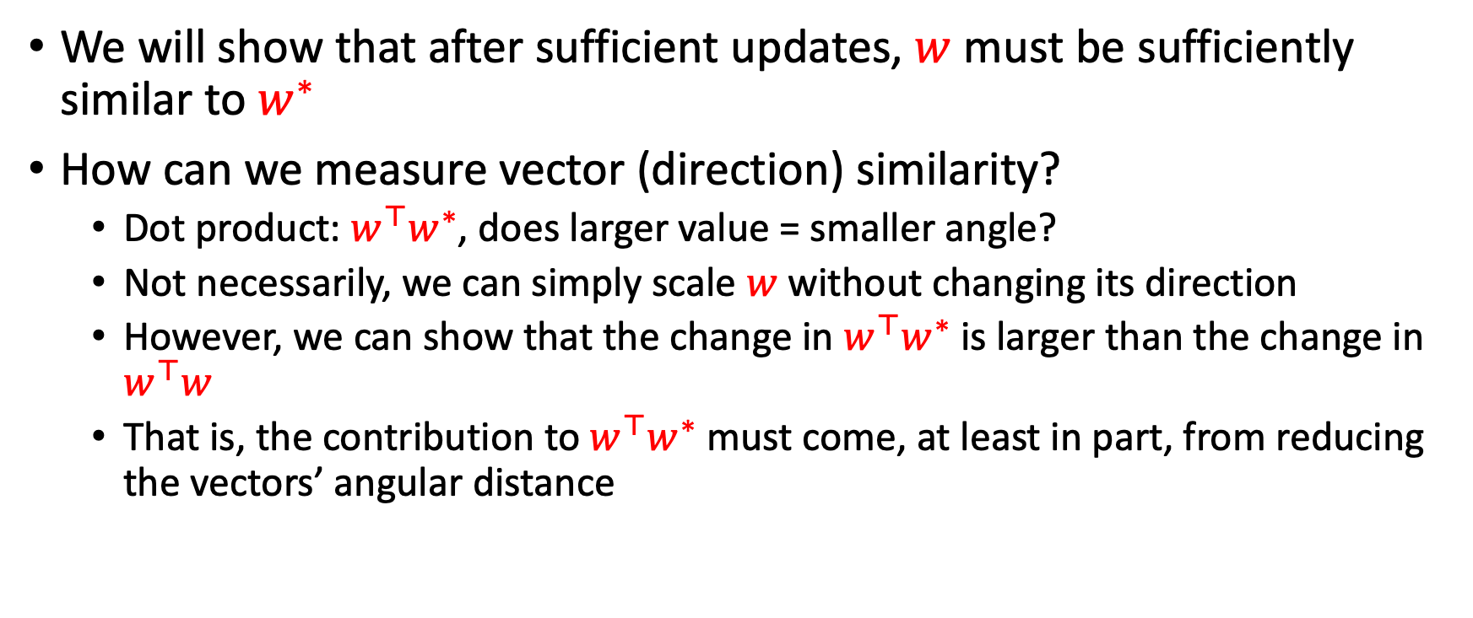
Proof of convergence
We will show that after sufficient updates, $w$ must be sufficiently similar to $w^{∗}$
How can we measure vector (direction) similarity?
  Dot product: $w^{⊤}w^{∗}$, does larger value = smaller angle?
  Not necessarily, we can simply scale $w$ without changing its direction
  However, we can show that the change in $w^{⊤}w^{∗}$ is larger than the change in $w^{⊤}w$
  That is, the contribution to $w^{⊤}w^{∗}$ must come, at least in part, from reducing the vectors’ angular distance

Slide 21
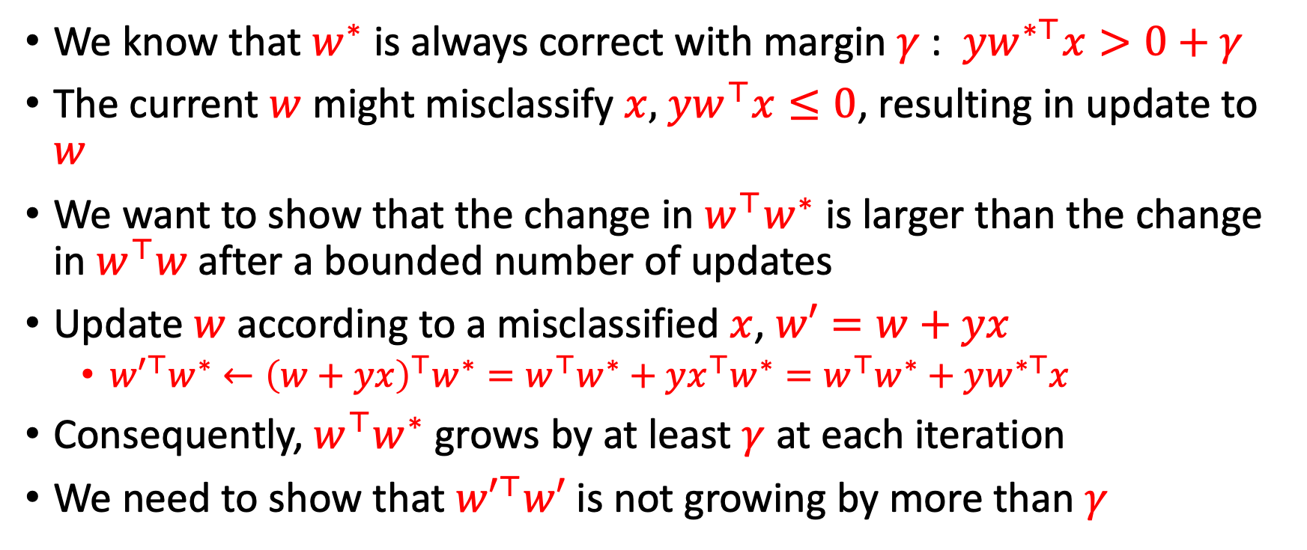
Proof of convergence
We know that $w^{∗}$ is always correct with margin $γ$: $yw^{∗⊤}x>0+γ$
The current $w$ might misclassify $x,$ $yw^{⊤}x≤0$, resulting in update to $w$
We want to show that the change in $w^{⊤}w^{∗}$ is larger than the change in $w^{⊤}w$after a bounded number of updates
Update $w$ according to a misclassified $x$, $w′=w+yx$
  ${w′}^{⊤}w^{∗}←{\left(w+yx\right)}^{⊤}w^{∗}=w^{⊤}w^{∗}+yx^{⊤}w^{∗}=w^{⊤}w^{∗}+yw^{∗⊤}x$
Consequently, $w^{⊤}w^{∗}$ grows by at least $γ$ at each iteration
We need to show that ${w′}^{⊤}w′$ is not growing by more than $γ$

Slide 22
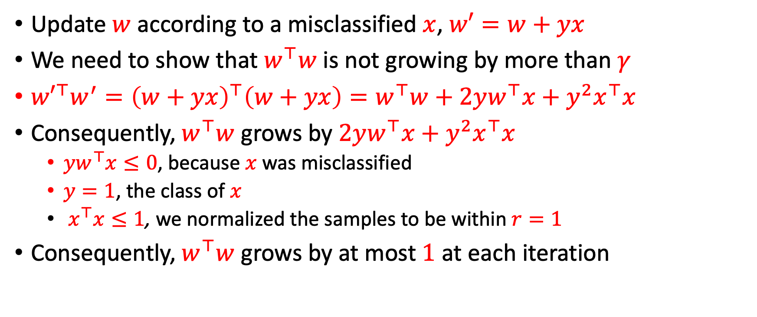
Proof of convergence
Update $w$ according to a misclassified $x$, $w′=w+yx$
We need to show that $w^{⊤}w$ is not growing by more than $γ$
${w′}^{⊤}w^{′}={\left(w+yx\right)}^{⊤}\left(w+yx\right)=w^{⊤}w+2yw^{⊤}x+y^{2}x^{⊤}x$
Consequently, $w^{⊤}w$ grows by $2yw^{⊤}x+y^{2}x^{⊤}x$
  $yw^{⊤}x≤0$, because $x$ was misclassified
  $y=1$, the class of $x$
  $x^{⊤}x≤1$, we normalized the samples to be within $r=1$
Consequently, $w^{⊤}w$ grows by at most $1$ at each iteration

Slide 23
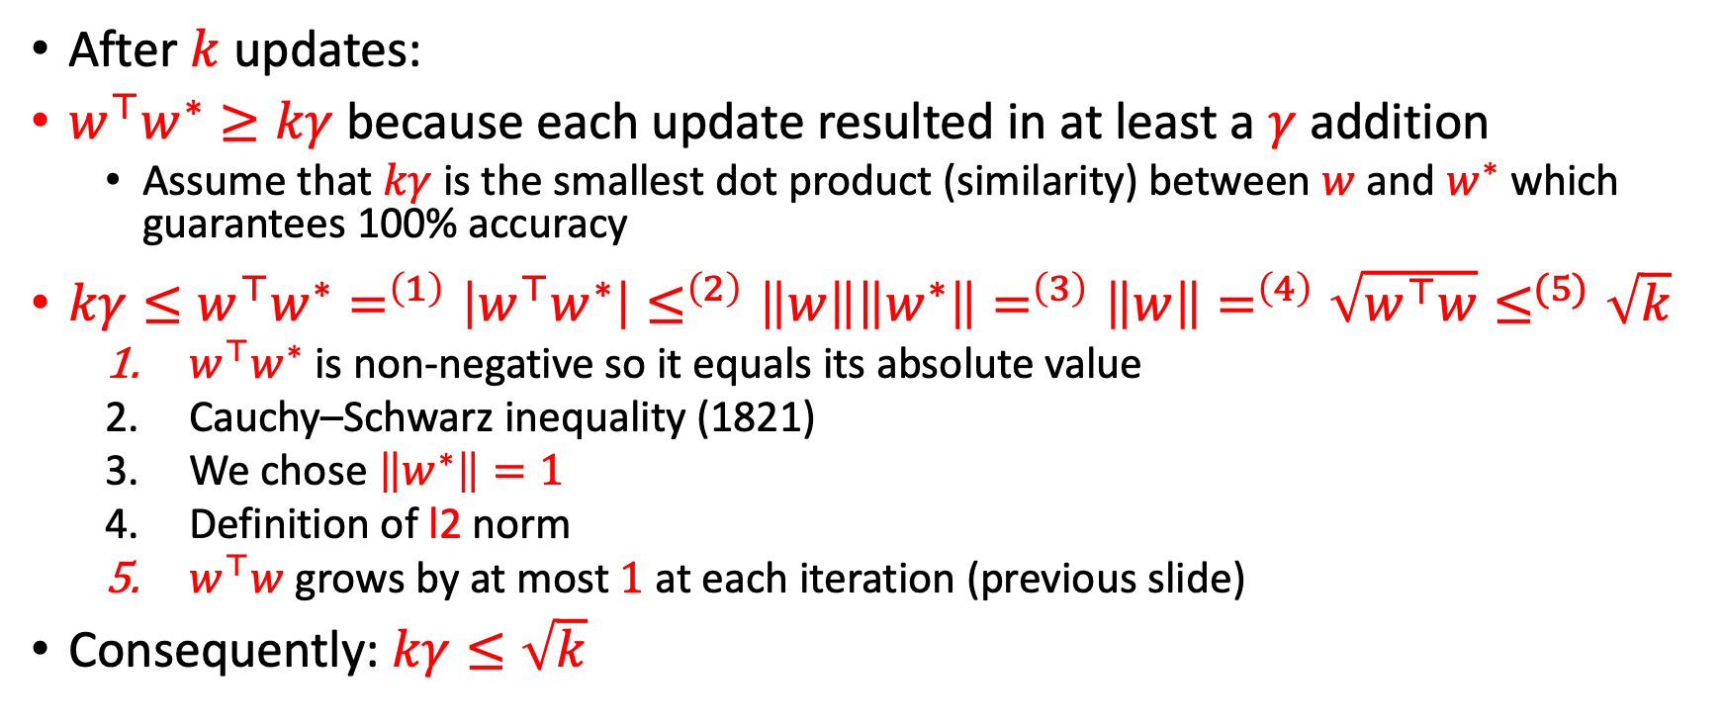
Proof of convergence
After $k$ updates:
$w^{⊤}w^{∗}≥kγ$ because each update resulted in at least a $γ$ addition
  Assume that $kγ$ is the smallest dot product (similarity) between $w$ and $w^{∗}$ which guarantees 100% accuracy
$kγ≤w^{⊤}w^{∗}=^{\left(1\right)}\left|w^{⊤}w^{∗}\right|≤^{\left(2\right)}\left\|w\right\|\left\|w^{∗}\right\|=^{\left(3\right)}\left\|w\right\|=^{\left(4\right)}\sqrt{w^{⊤}w}≤^{(5)}\sqrt{k}$
  $w^{⊤}w^{∗}$ is non-negative so it equals its absolute value
  Cauchy–Schwarz inequality (1821)
  We chose $\left\|w^{∗}\right\|=1$
  Definition of l2 norm
  $w^{⊤}w$ grows by at most $1$ at each iteration (previous slide)
Consequently: $kγ≤\sqrt{k}$

Slide 24
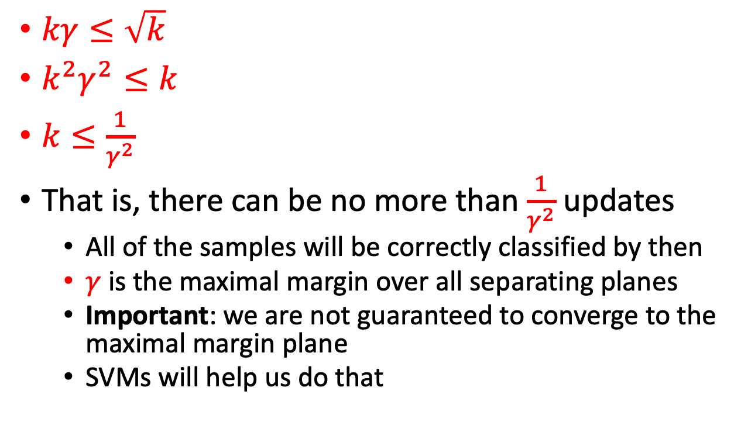
Proof of convergence
A
$kγ≤\sqrt{k}$
$k^{2}γ^{2}≤k$
$k≤\frac{1}{γ^{2}}$
That is, there can be no more than $\frac{1}{γ^{2}}$ updates
  All of the samples will be correctly classified by then
  $γ$ is the maximal margin over all separating planes
  Important: we are not guaranteed to converge to the maximal margin plane
  SVMs will help us do that
B

Slide 25
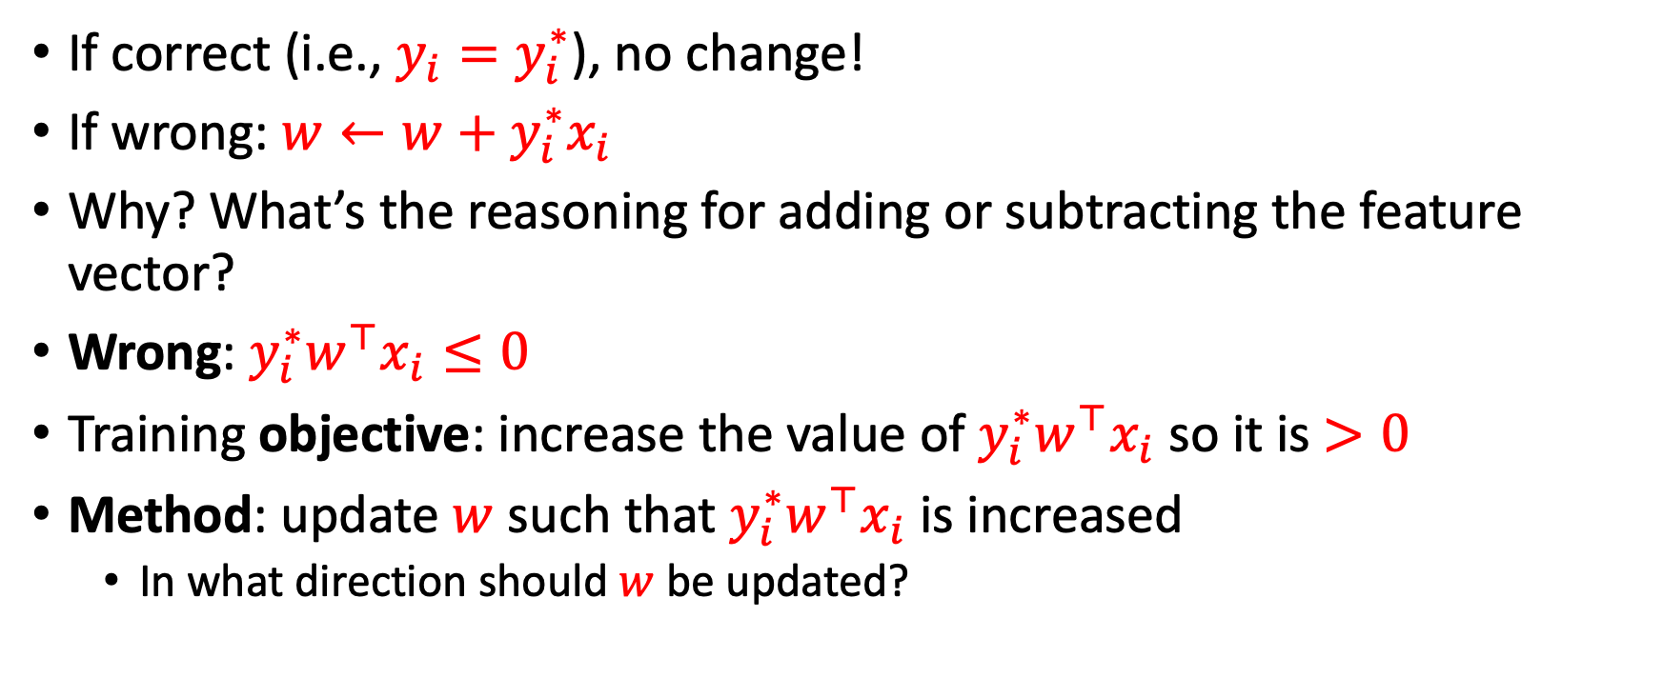
Rethinking the update rule
If correct (i.e., $y_{i}=y_{i}^{∗}$), no change!
If wrong: $w←w+y_{i}^{∗}x_{i}$
Why? What’s the reasoning for adding or subtracting the feature vector?
Wrong: $y_{i}^{∗}w^{⊤}x_{i}≤0$
Training objective: increase the value of $y_{i}^{∗}w^{⊤}x_{i}$ so it is $>0$
Method: update $w$ such that $y_{i}^{∗}w^{⊤}x_{i}$ is increased
  In what direction should $w$ be updated?

Slide 26
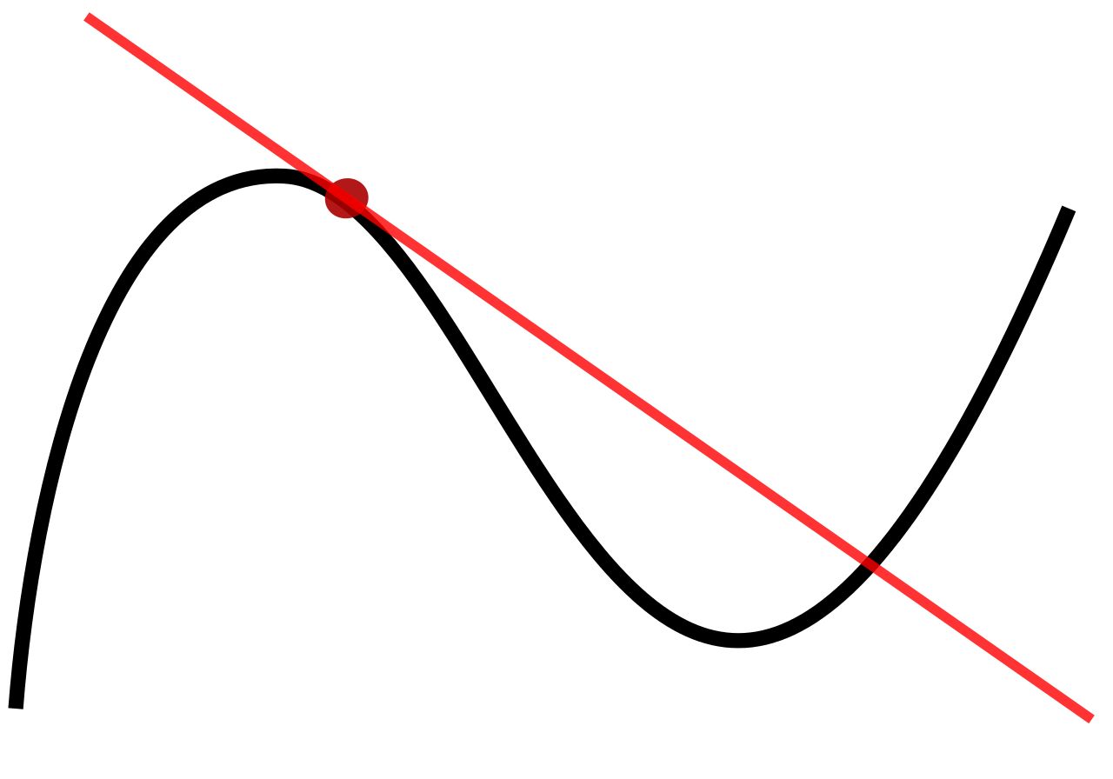
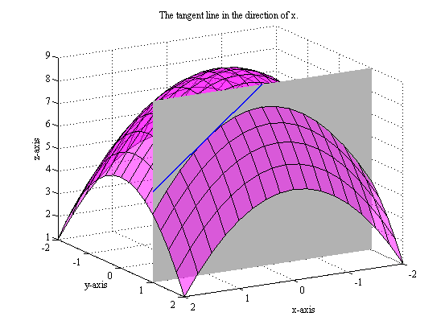
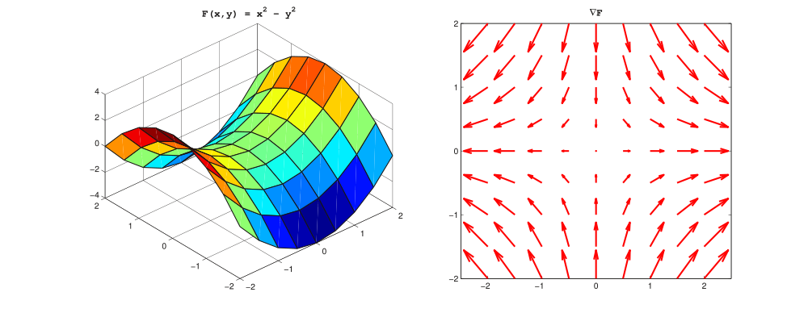
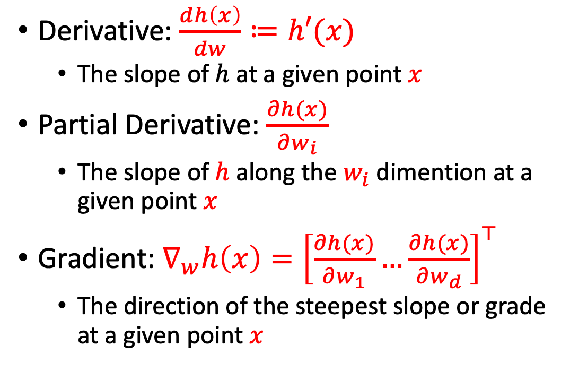
Gradient
Derivative: $\frac{dh\left(x\right)}{dw}≔h′(x)$
  The slope of $h$at a given point $x$
Partial Derivative: $\frac{∂h(x)}{∂w_{i}}$
  The slope of $h$along the $w_{i}$ dimention at a given point $x$
Gradient: $∇_{w}h\left(x\right)={\left[\frac{∂h(x)}{∂w_{1}}…\frac{∂h(x)}{∂w_{d}}\right]}^{⊤}$
  The direction of the steepest slope or grade at a given point $x$

Slide 27
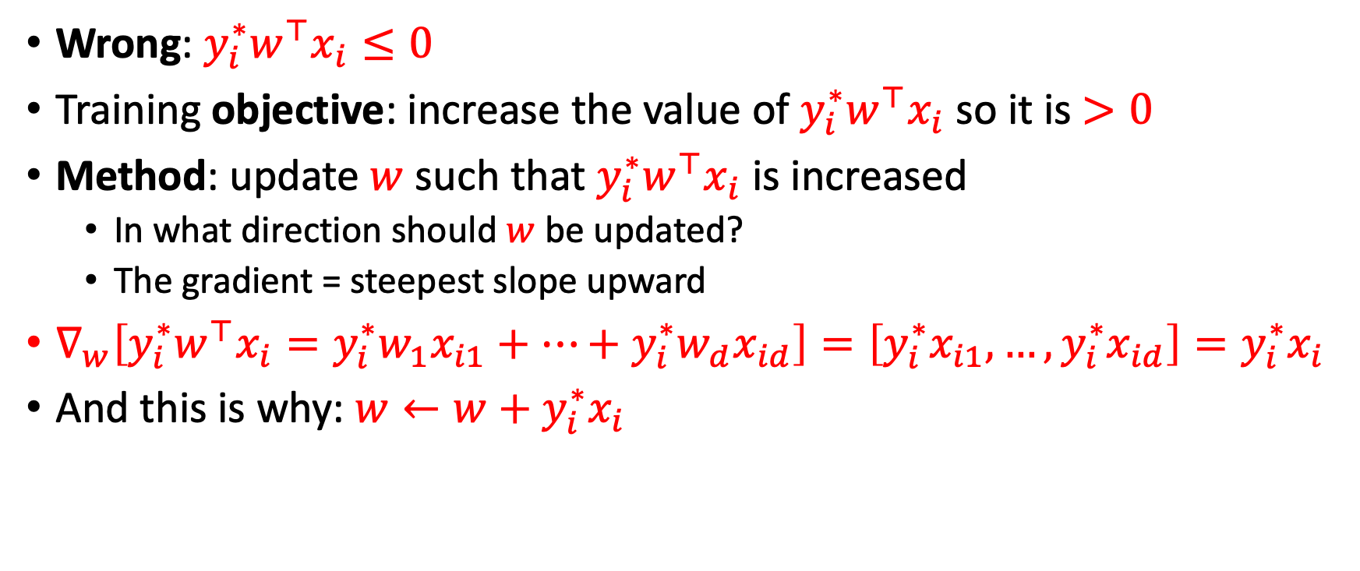
Rethinking the update rule
Wrong: $y_{i}^{∗}w^{⊤}x_{i}≤0$
Training objective: increase the value of $y_{i}^{∗}w^{⊤}x_{i}$ so it is $>0$
Method: update $w$ such that $y_{i}^{∗}w^{⊤}x_{i}$ is increased
  In what direction should $w$ be updated?
  The gradient = steepest slope upward
$∇_{w}\left[y_{i}^{∗}w^{⊤}x_{i}=y_{i}^{∗}w_{1}x_{i1}+…+y_{i}^{∗}w_{d}x_{id}\right]=\left[y_{i}^{∗}x_{i1},…,y_{i}^{∗}x_{id}\right]=y_{i}^{∗}x_{i}$
And this is why: $w←w+y_{i}^{∗}x_{i}$

Slide 28


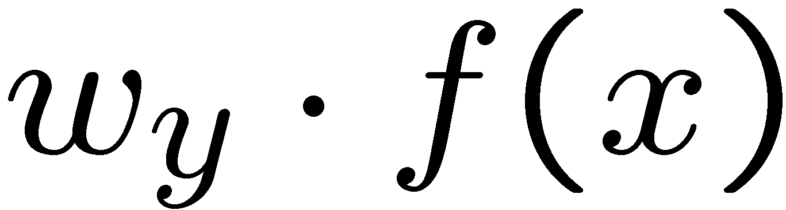

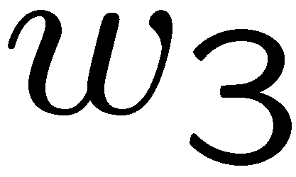
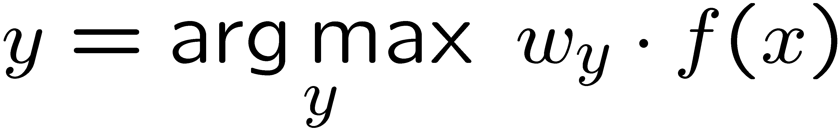
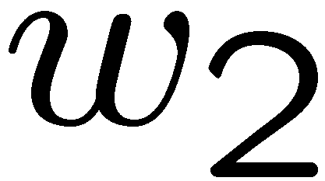
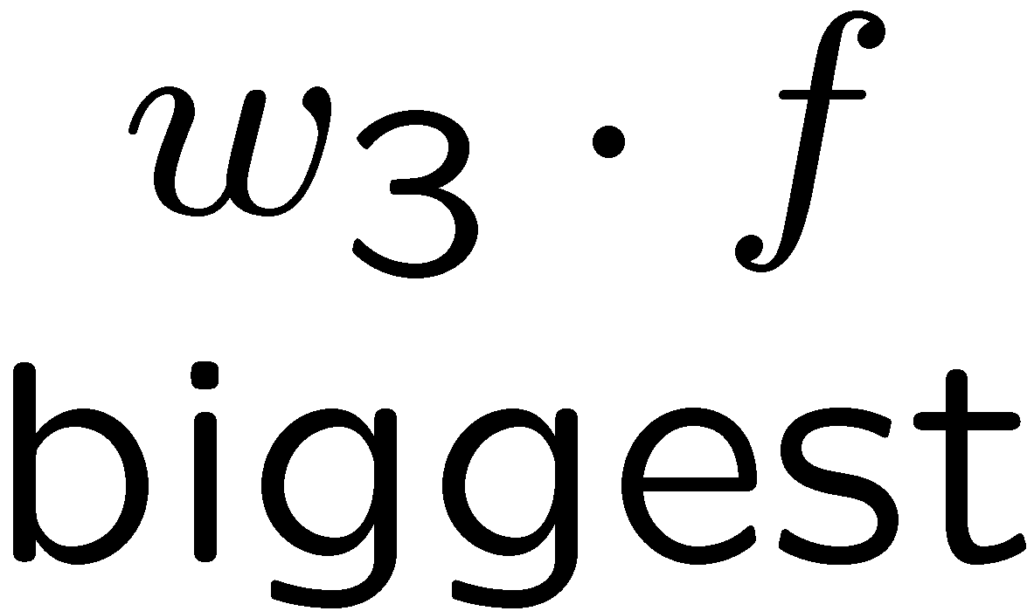
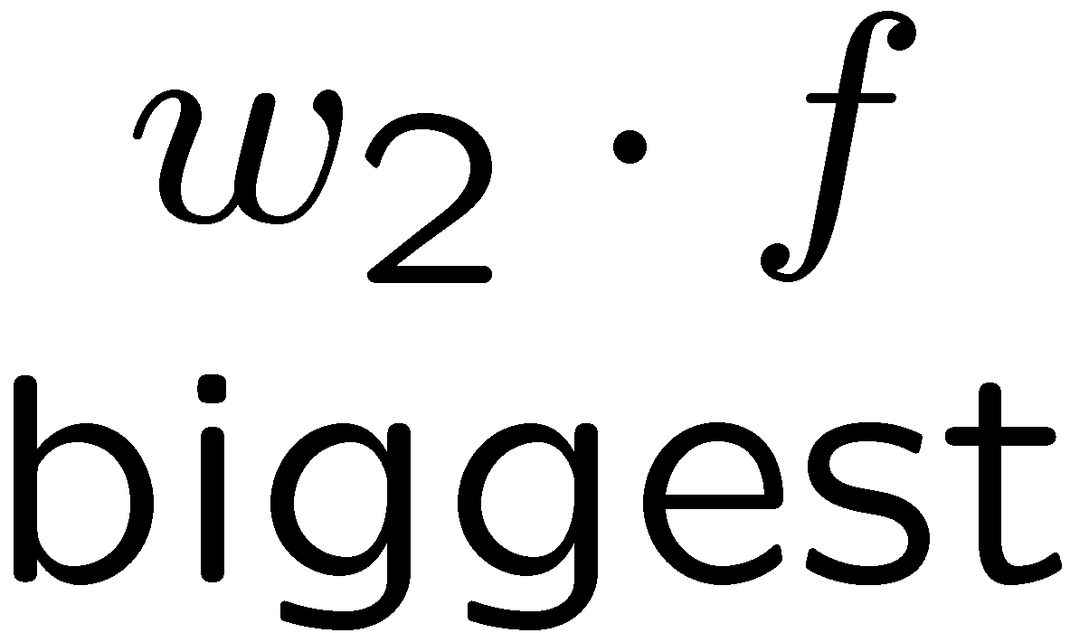
Multiclass Decision Rule
If we have multiple classes:
  A weight vector for each class:
  Score (activation) of a class y:
  Prediction highest score wins
Binary = multiclass where the negative class has weight zero

Slide 29

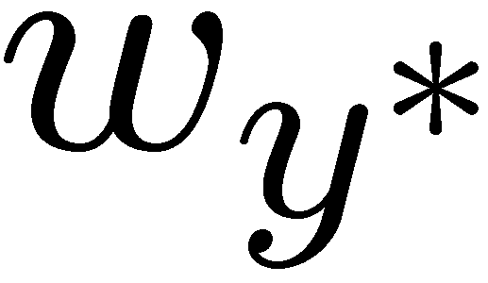

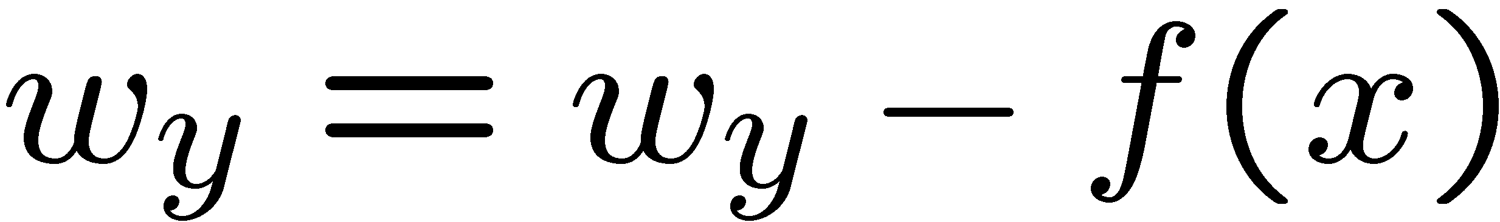
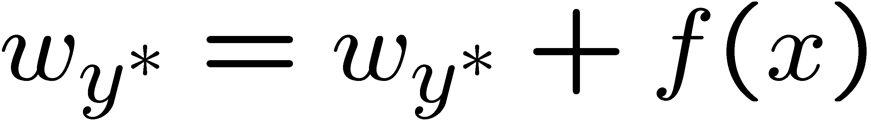
Learning: Multiclass Perceptron
Start with all weights = 0
Pick up training examples one by one
Predict with current weights
If correct, no change!
If wrong: lower score of wrong answer, raise score of right answer

Slide 30



Example: Multiclass Perceptron
Assume a training set (x,y) of 2 sentences:
  x1=“win the vote” y1=Politics
  x2=“win the election” y2=Politics
Assume a multiclass perceptron that considers the count of each word as the feature vector [#win, #game, #vote, #the]
win : 1
game : 0
vote : 0
the : 0
win : 0
game : 0
vote : 0
the : 0
win : 1
game : 0
vote : 1
the : 1

Slide 31
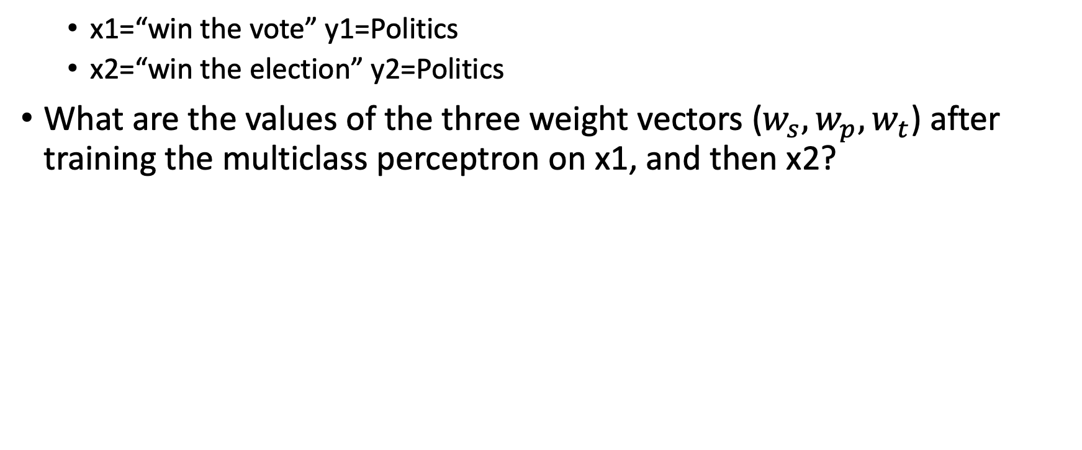
Example problem
  x1=“win the vote” y1=Politics
  x2=“win the election” y2=Politics
What are the values of the three weight vectors ($w_{s}, w_{p}, w_{t}$) after training the multiclass perceptron on x1, and then x2?
win : 1
game : 0
vote : 0
the : 0
win : 0
game : 0
vote : 0
the : 0
win : 1
game : 0
vote : 1
the : 1

Slide 32
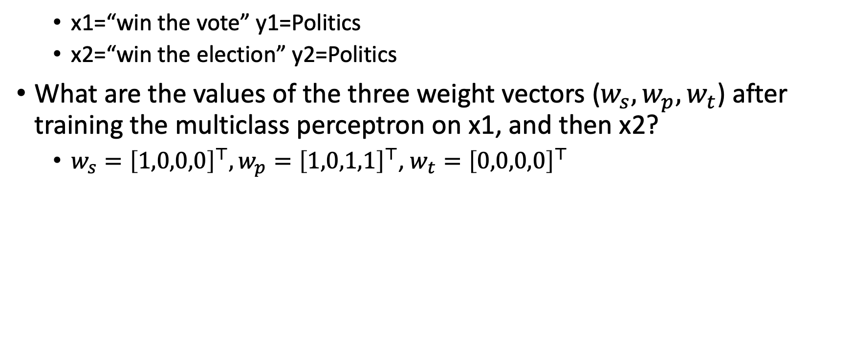
Example problem
  x1=“win the vote” y1=Politics
  x2=“win the election” y2=Politics
What are the values of the three weight vectors ($w_{s}, w_{p}, w_{t}$) after training the multiclass perceptron on x1, and then x2?
  $w_{s}={\left[1,0,0,0\right]}^{⊤},w_{p}={\left[1,0,1,1\right]}^{⊤}$, $w_{t}={\left[0,0,0,0\right]}^{⊤}$
win : 1
game : 0
vote : 0
the : 0
win : 0
game : 0
vote : 0
the : 0
win : 1
game : 0
vote : 1
the : 1

Slide 33
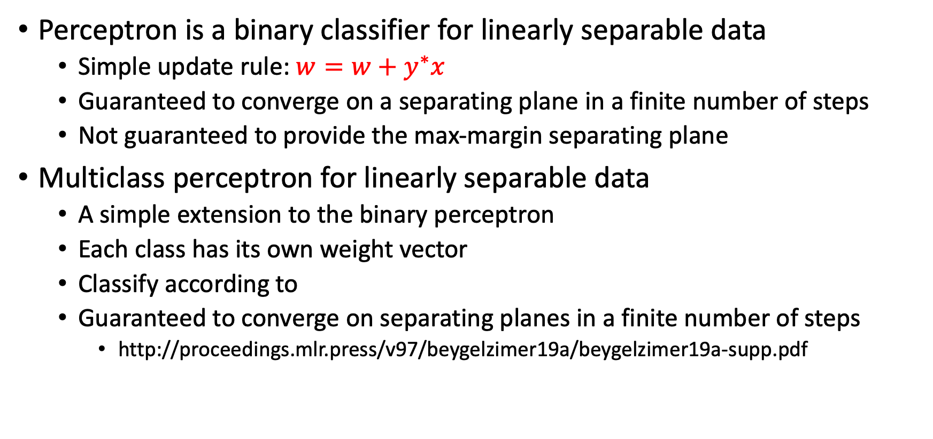
What did we learn?
Perceptron is a binary classifier for linearly separable data
  Simple update rule: $w=w+y^{∗}x$
  Guaranteed to converge on a separating plane in a finite number of steps
  Not guaranteed to provide the max-margin separating plane
Multiclass perceptron for linearly separable data
  A simple extension to the binary perceptron
  Each class has its own weight vector
  Classify according to
  Guaranteed to converge on separating planes in a finite number of steps
    http://proceedings.mlr.press/v97/beygelzimer19a/beygelzimer19a-supp.pdf

Slide 34
What next?
Class:
  Inference from probabilities
Assignments:
  Written assignment 1: K Nearest Neighbors + Linear algebra (due Tuesday, Feb 1)
  Programming assignment 1: Perceptron (due Tuesday, Feb-15)
Quizzes:
  Quiz 1 published on Canvas (finish by Feb-7)

