Slide 1
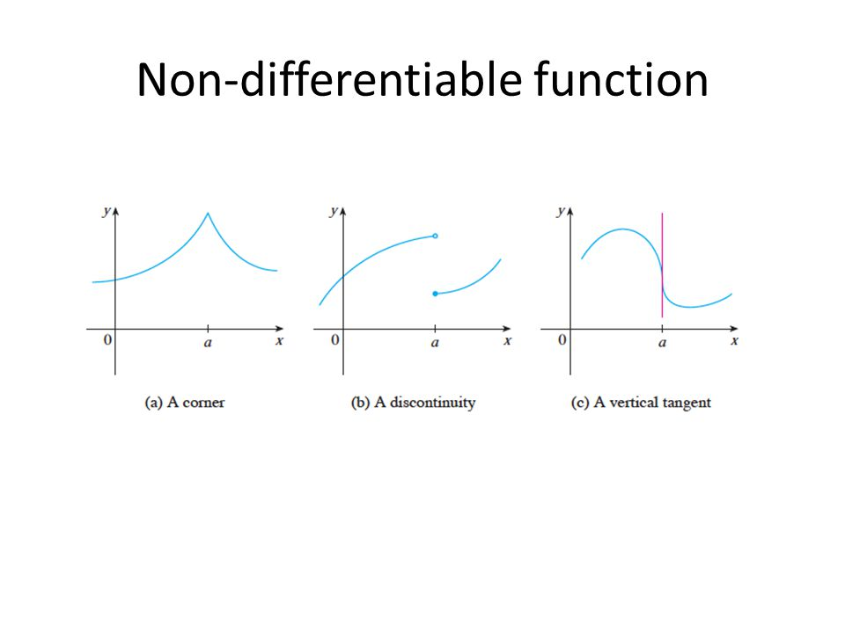
CSCE-633 ML
Derivative Free Methods
Instructor: Guni Sharon

Slide 2



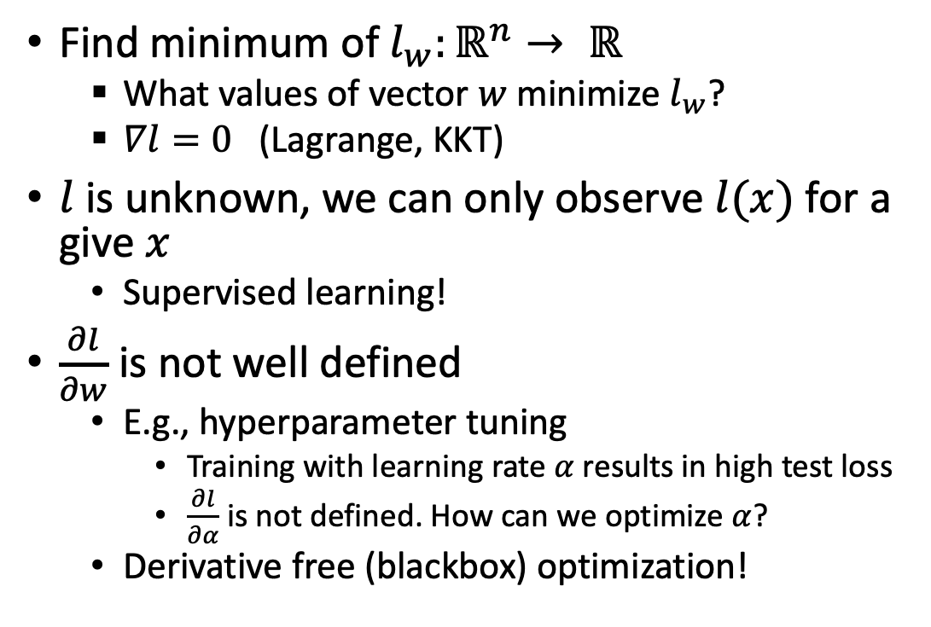
Online parameter tuning
Find minimum of $l_{w}:ℝ^{n}→ ℝ$
  What values of vector $w$ minimize $l_{w}$?
  $∇l=0$ (Lagrange, KKT)
$l$ is unknown, we can only observe $l(x)$ for a give $x$
  Supervised learning!
$\frac{∂l}{∂w}$ is not well defined
  E.g., hyperparameter tuning
    Training with learning rate $α$ results in high test loss
    $\frac{∂l}{∂α}$ is not defined. How can we optimize $α$?
  Derivative free (blackbox) optimization!
How can I do it better???

Slide 3
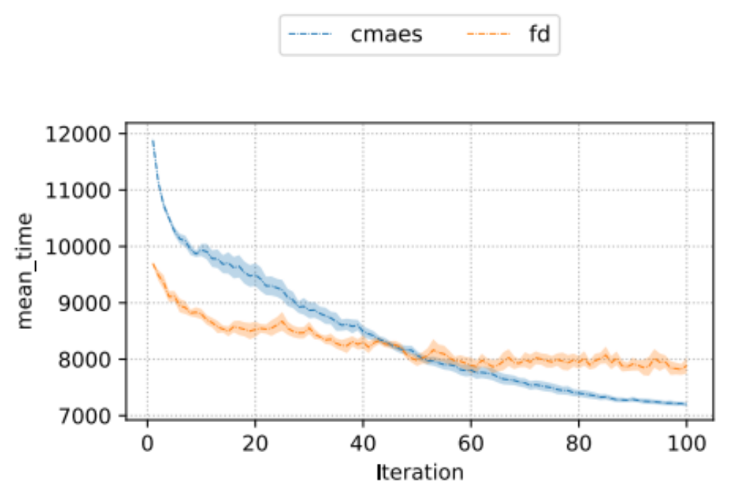
Blackbox optimization
Challenges:
  Find the optimal parameter assignment
  Sample efficiency: minimize the number of samples along the process
  minimize cumulative regret (for online optimization)
Cost

Slide 4
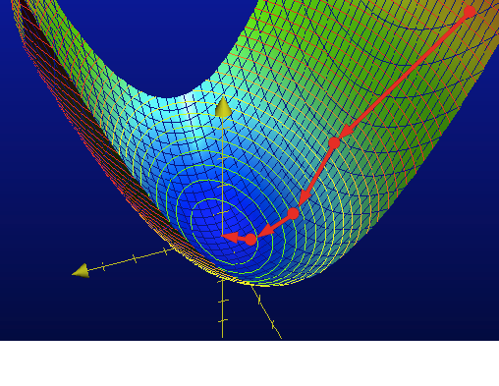
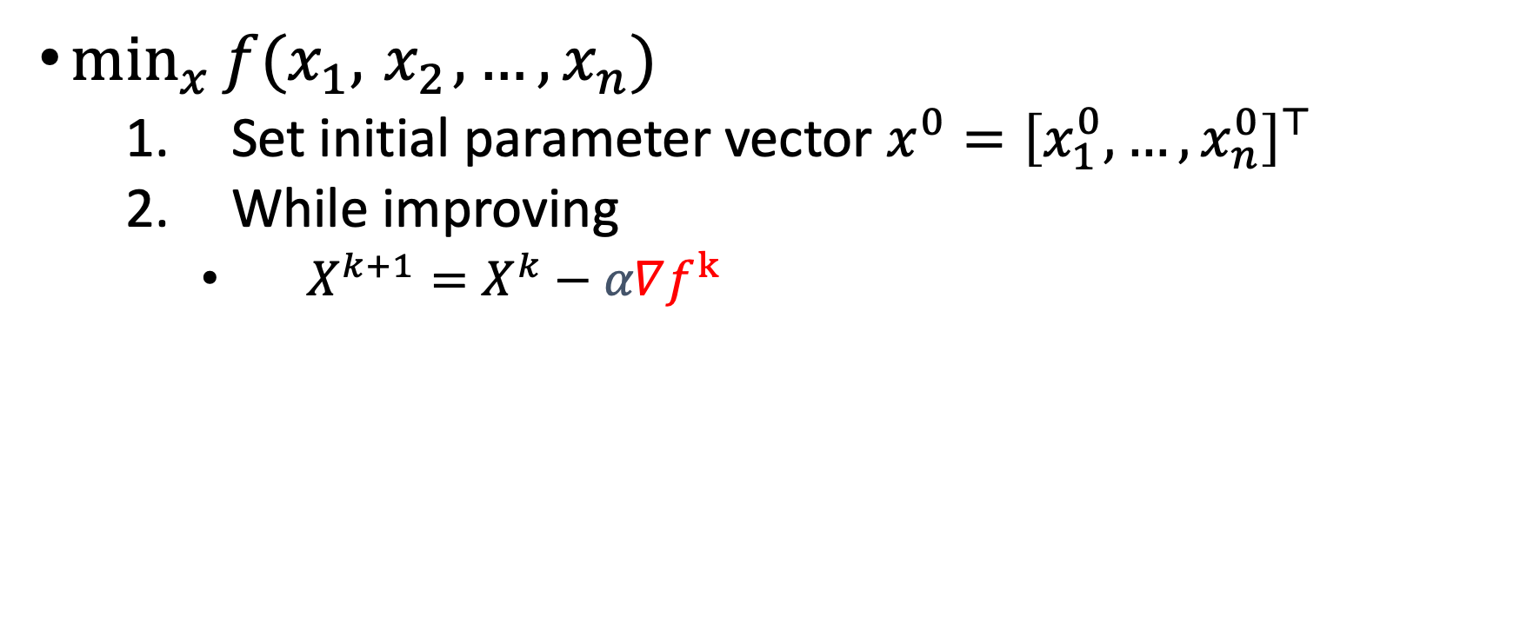
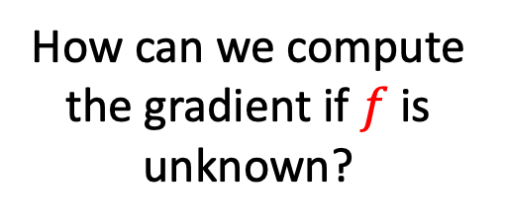
1. Gradient Descent
$\min_{x}{f(x_{1},{ x}_{2},…, x_{n})}$
  Set initial parameter vector $x^{0}={\left[x_{1}^{0}, …,x_{n}^{0}\right]}^{⊤}$
  While improving
    $X^{k+1}=X^{k}−α∇f^{k}$
?
How can we compute the gradient if $f$ is unknown?

Slide 5
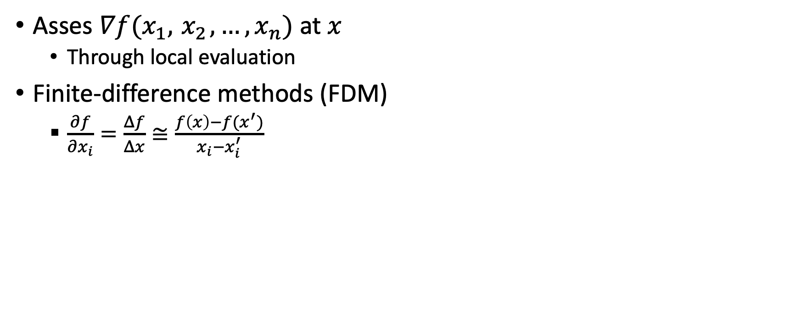
Empirical gradient
Asses $∇f(x_{1},{ x}_{2},…, x_{n})$ at $x$
  Through local evaluation
Finite-difference methods (FDM)
  $\frac{∂f}{∂x_{i}}=\frac{Δf}{Δx}≅\frac{f\left(x\right)−f(x^{′})}{x_{i}−x_{i}^{′}}$

Slide 6
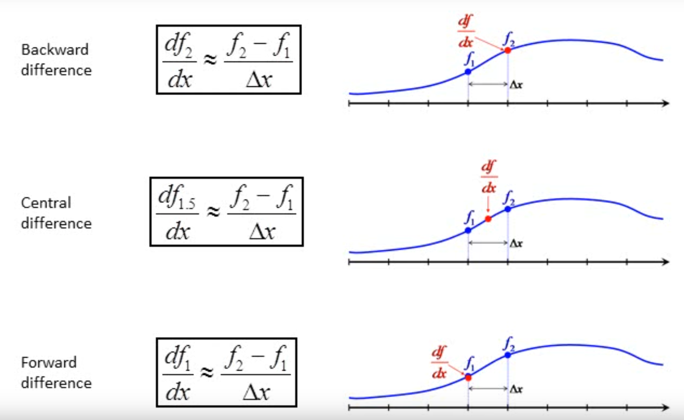
Finite difference approach
Biased towards the rear
Unbiased
X2 samples
Biased towards the front

Slide 7
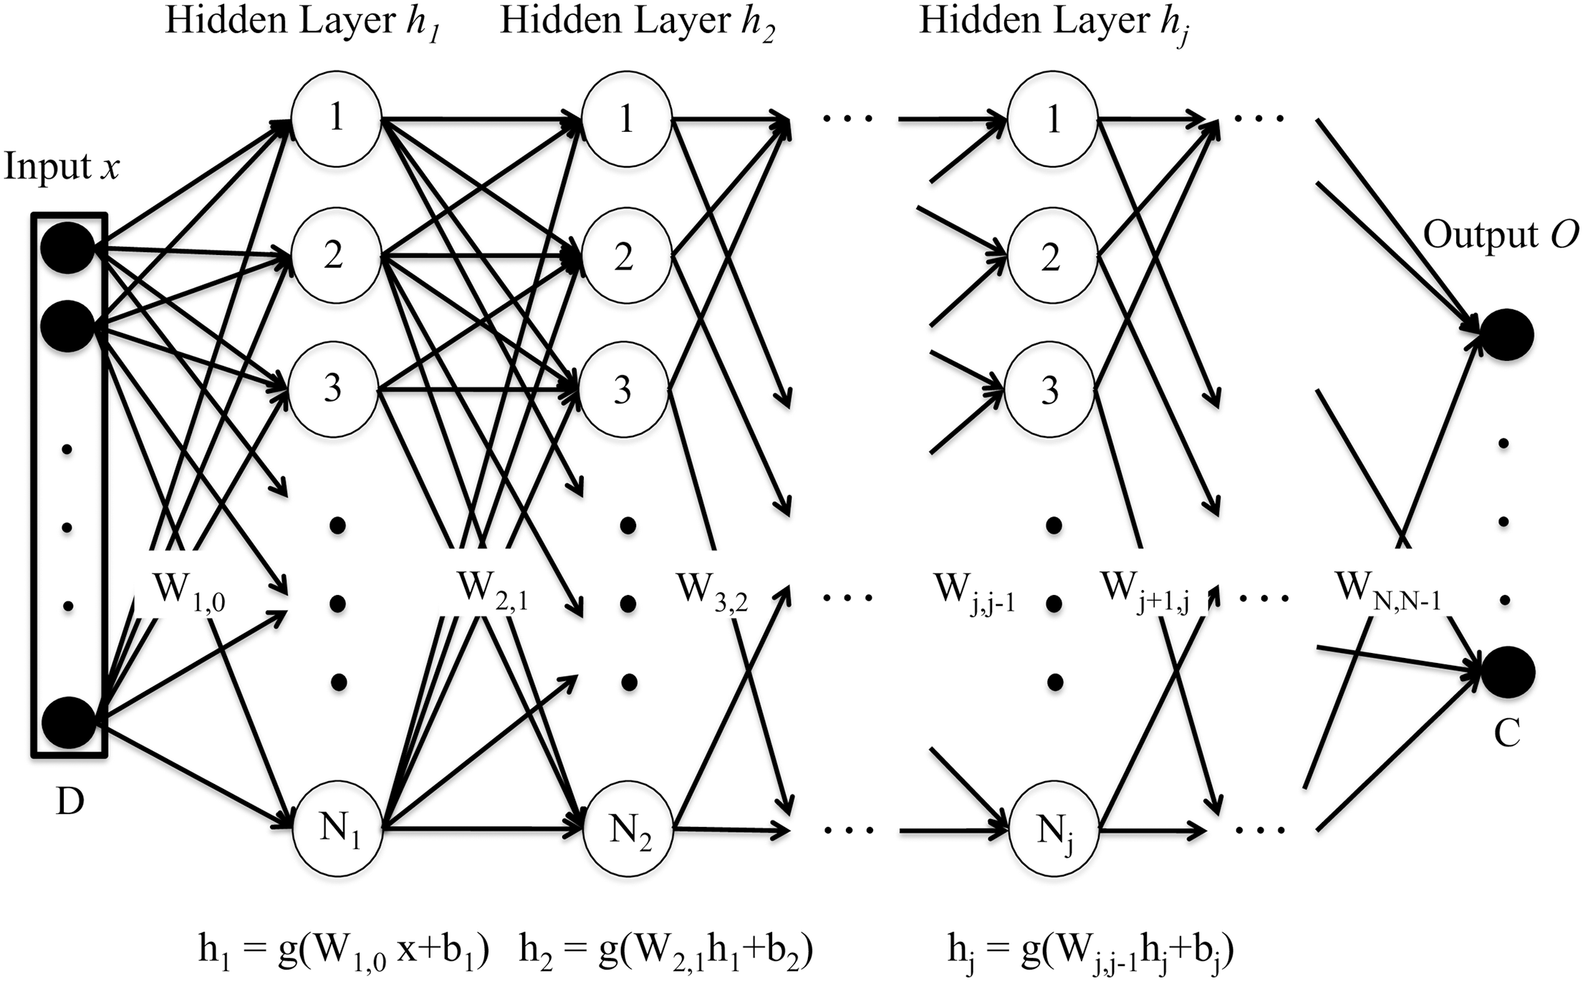
High dimensionality
Approximate the gradient of a DNN with 100k parameters
Requires 200k observations!
  2 per parameter
  Not practical for real-world applications
A stochastic approach is required

Slide 8

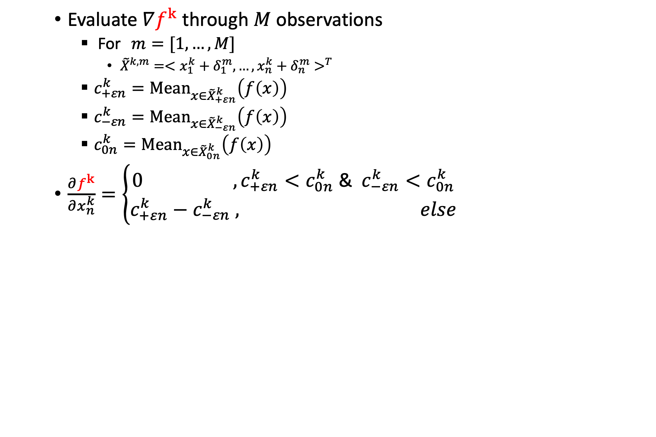
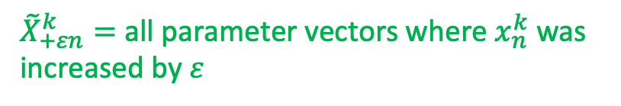
Policy Gradient Reinforcement Learning
(Kohl and Stone, 2004)
Evaluate $∇f^{k}$ through $M$ observations
  For $m=[1,…,M$]
    ${\tilde{X}}^{k,m}=<{x_{1}^{k}+δ_{1}^{m}, …,x_{n}^{k}+δ_{n}^{m}>}^{T}$
  $c_{+εn}^{k}={Mean}_{x∈{\tilde{X}}_{+εn}^{k}}\left(f\left(x\right)\right)$
  $c_{−εn}^{k}={Mean}_{x∈{\tilde{X}}_{−εn}^{k}}\left(f\left(x\right)\right)$
  $c_{0n}^{k}={Mean}_{x∈{\tilde{X}}_{0n}^{k}}\left(f\left(x\right)\right)$
$\frac{∂f^{k}}{∂x_{n}^{k}}=\left\{\begin{aligned}0{ , c}_{+εn}^{k}<c_{0n}^{k} \text{&} { c}_{−εn}^{k}<c_{0n}^{k} \\ c_{+εn}^{k}−&c_{−εn}^{k} , else\end{aligned}\right.$
$$δ_{n}^{m}=Rand(−ε,0,ε)$$
${\tilde{X}}_{+εn}^{k}=$ all parameter vectors where $x_{n}^{k}$ was increased by $ε$

Slide 9
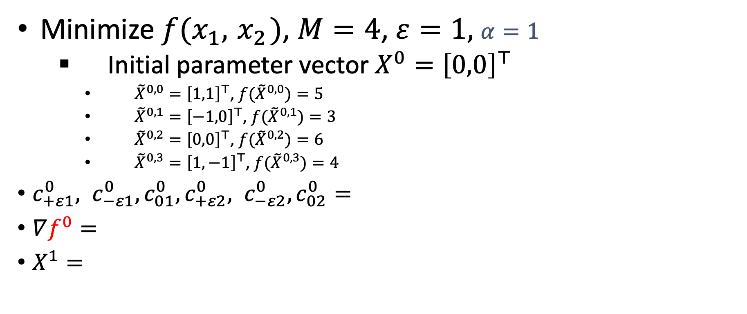
Example - PGRL
    Minimize $f(x_{1},{ x}_{2})$, $M=4$, $ε=1,$ $α=1$
  Initial parameter vector $X^{0}={\left[0,0\right]}^{⊤}$
    ${\tilde{X}}^{0,0}={\left[1,1\right]}^{⊤}$, ${f(\tilde{X}}^{0,0})=5$
    ${\tilde{X}}^{0,1}={\left[−1,0\right]}^{⊤}$, ${f(\tilde{X}}^{0,1})=3$
    ${\tilde{X}}^{0,2}={\left[0,0\right]}^{⊤}$, ${f(\tilde{X}}^{0,2})=6$
    ${\tilde{X}}^{0,3}={\left[1,−1\right]}^{⊤}$, ${f(\tilde{X}}^{0,3})=4$
$c_{+ε1}^{0}, c_{−ε1}^{0},c_{01}^{0},c_{+ε2}^{0}, c_{−ε2}^{0},c_{02}^{0}=$
$∇f^{0}=$
$X^{1}=$

Slide 10
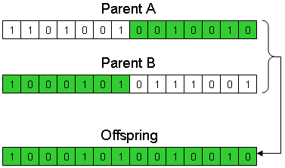
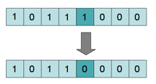
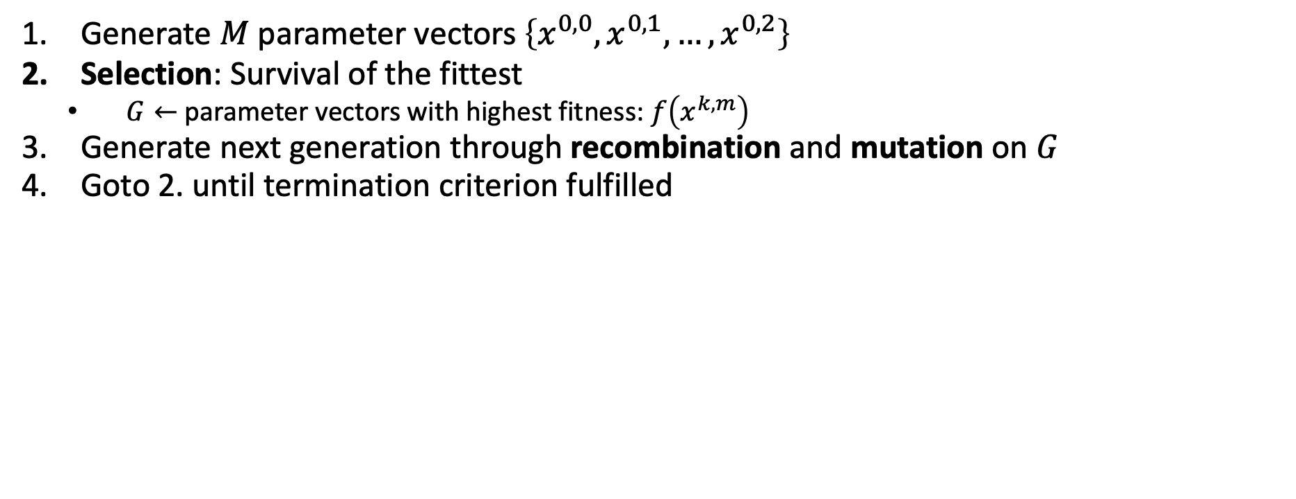
Genetic Algorithm
Might apply to the unification of current and former generations
  Generate $M$ parameter vectors $\left\{x^{0,0},x^{0,1},…,x^{0,2}\right\}$
  Selection: Survival of the fittest
    $G←$ parameter vectors with highest fitness: $f\left(x^{k,m}\right)$
  Generate next generation through recombination and mutation on $G$
  Goto 2. until termination criterion fulfilled
Recombination
How many parents?
How many offsprings?
Crossover technique?
Mutation technique?
Continuous space?
Mutation

Slide 11
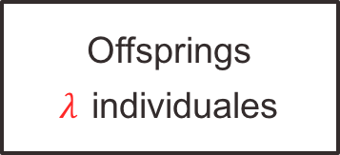
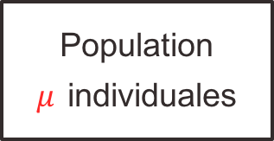
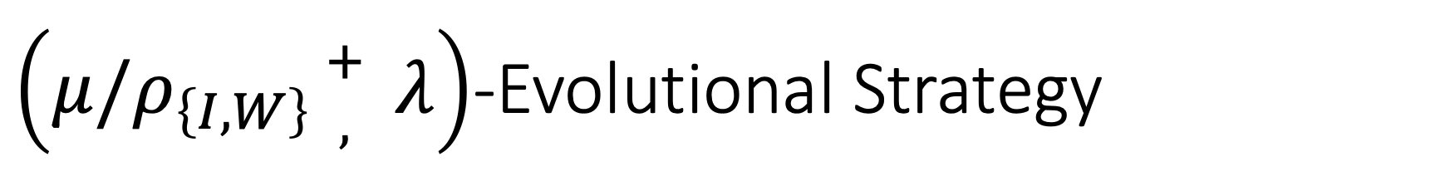
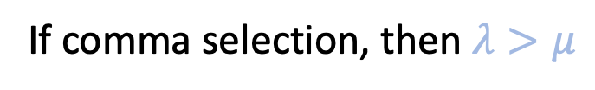
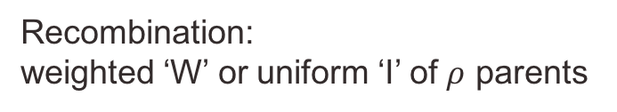
$\left(μ/ρ_{\left\{I,W\right\}}{+ \atop ,} λ\right)$-Evolutional Strategy
Recombination:
weighted ‘W’ or uniform ‘I’ of $ρ$ parents
Init parental population
Population
$μ$ individuales
Offsprings
$λ$ individuales
*Selection from current generation ’,’ or current $∪$ previous ‘+’
If comma selection, then $λ>μ$
*While the ‘,’ selection is recommended for unbounded search spaces (Schwefel, 1987), the ‘+’ selection should be used in discrete finite size search spaces, e.g., in combinatorial optimization problems (Herdy, 1990; Beyer, 1992).

Slide 12
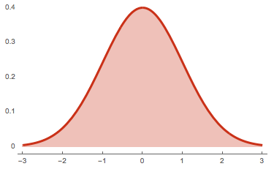
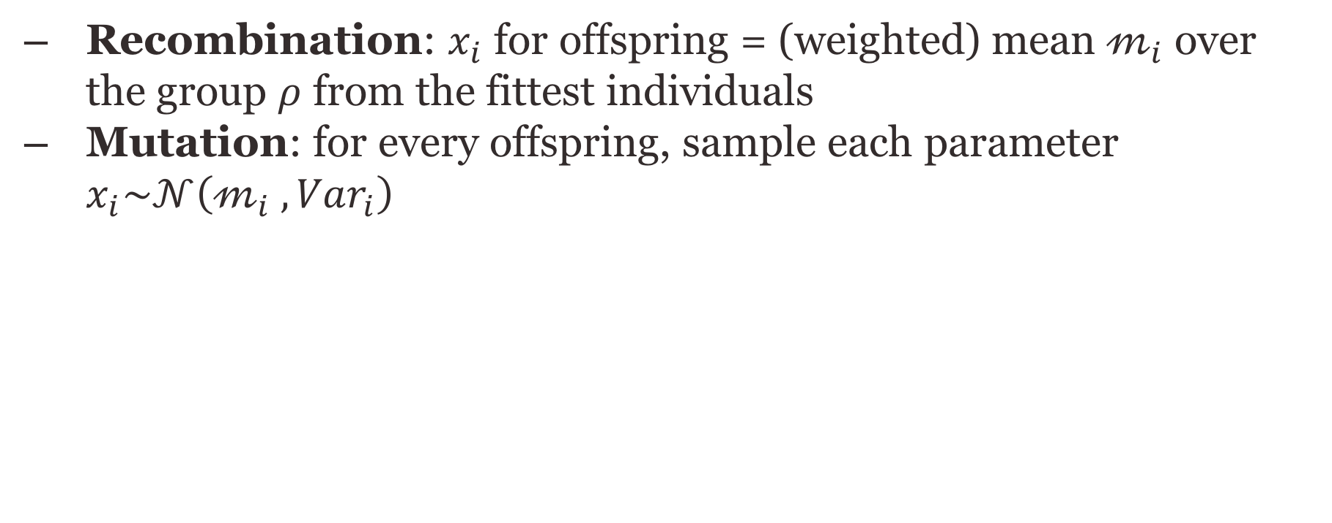
Continuous unbounded space
  Recombination: $x_{i}$ for offspring = (weighted) mean $𝓂_{i}$ over the group $ρ$ from the fittest individuals
  Mutation: for every offspring, sample each parameter $x_{i}\sim 𝒩\left(𝓂_{i} , {Var}_{i}\right)$
Recombination
Mutation

Slide 13
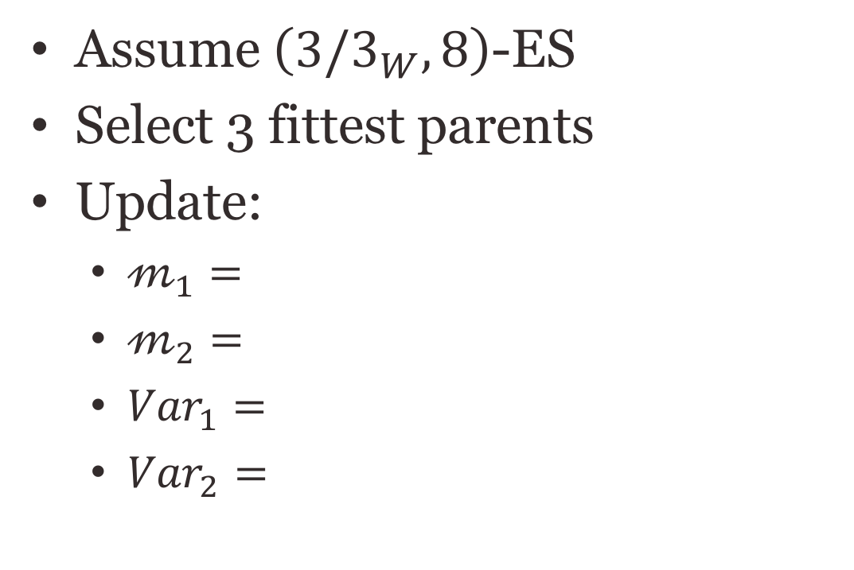
Recombination
Assume $\left(3/3_{W}, 8\right)$-ES
Select 3 fittest parents
Update:
  $𝓂_{1}=$
  $𝓂_{2}=$
  ${Var}_{1}=$
  ${Var}_{2}=$
9
1
7
(1,1)
5
1
(0,0)
2
6
(-1,-1)
8

Slide 14
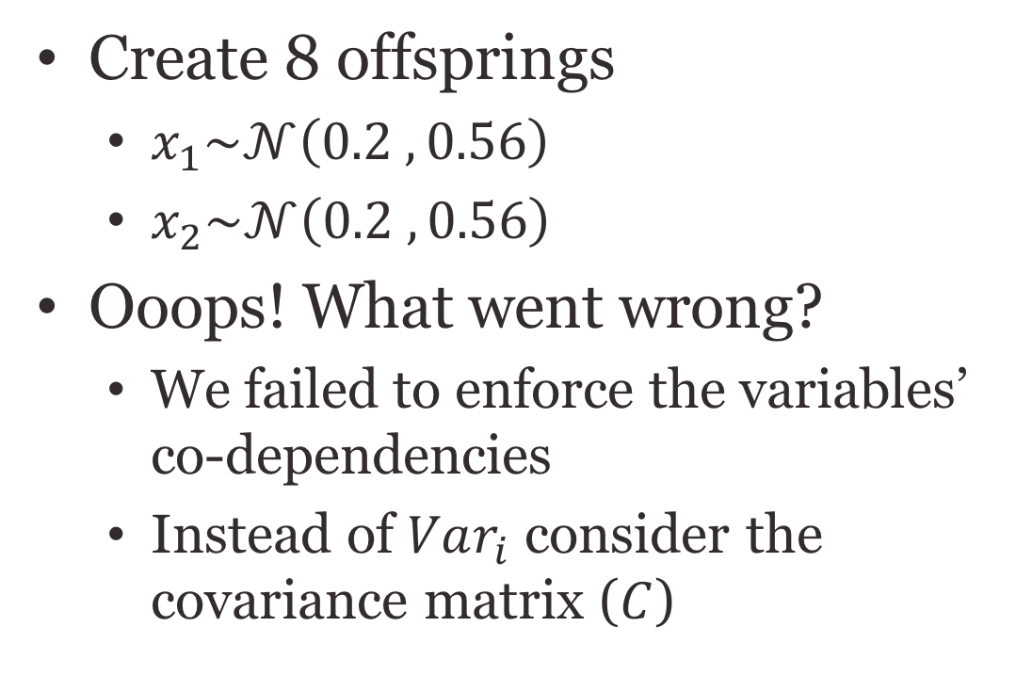
Mutation
Create 8 offsprings
  $x_{1}\sim 𝒩\left(0.2 , 0.56\right)$
  $x_{2}\sim 𝒩\left(0.2 , 0.56\right)$
Ooops! What went wrong?
  We failed to enforce the variables’ co-dependencies
  Instead of $Var_{i}$ consider the covariance matrix ($C$)
7
1
9
(0.2,0.2)
5
1
8
2
6

Slide 15
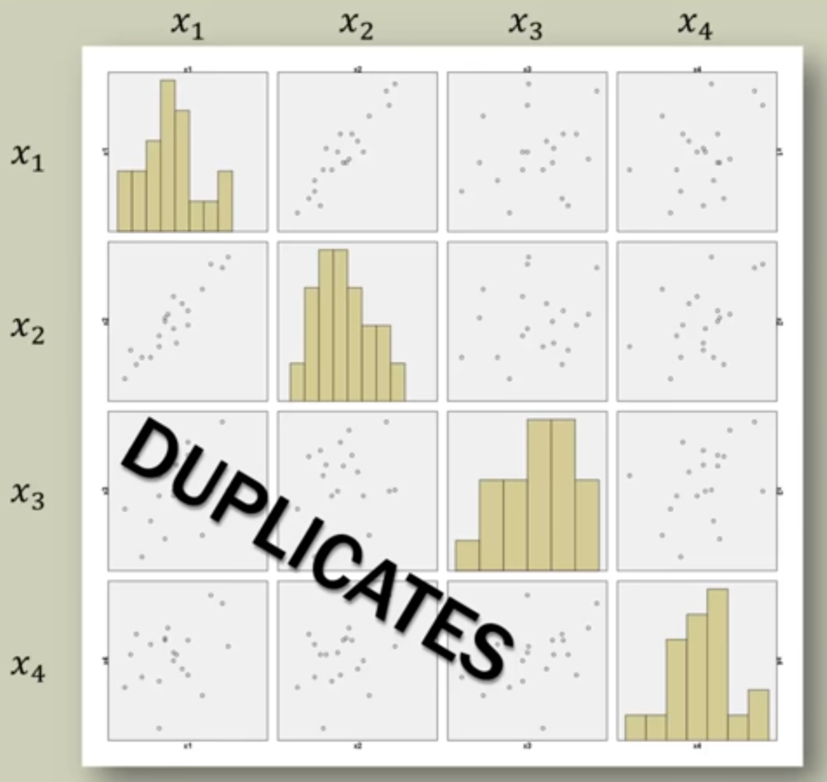
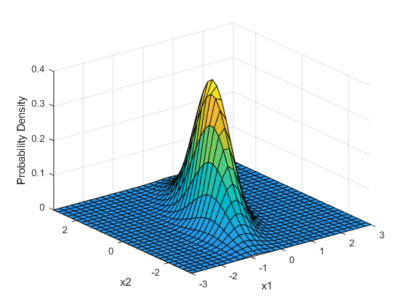
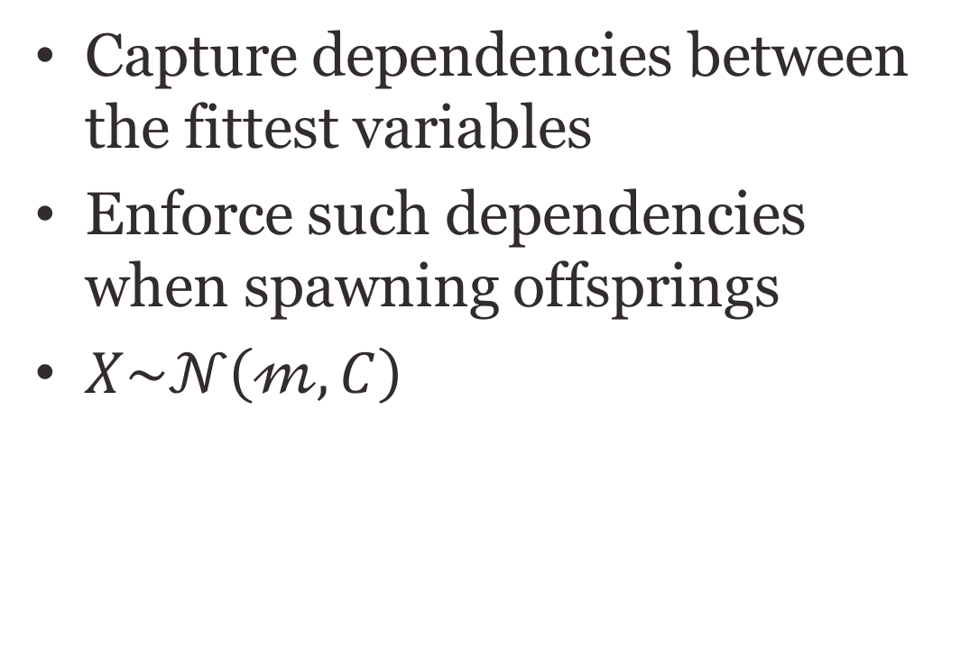
Covariance matrix
Capture dependencies between the fittest variables
Enforce such dependencies when spawning offsprings
$X\sim 𝒩\left(𝓂, C\right)$

Slide 16
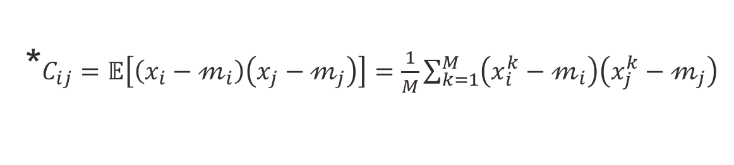
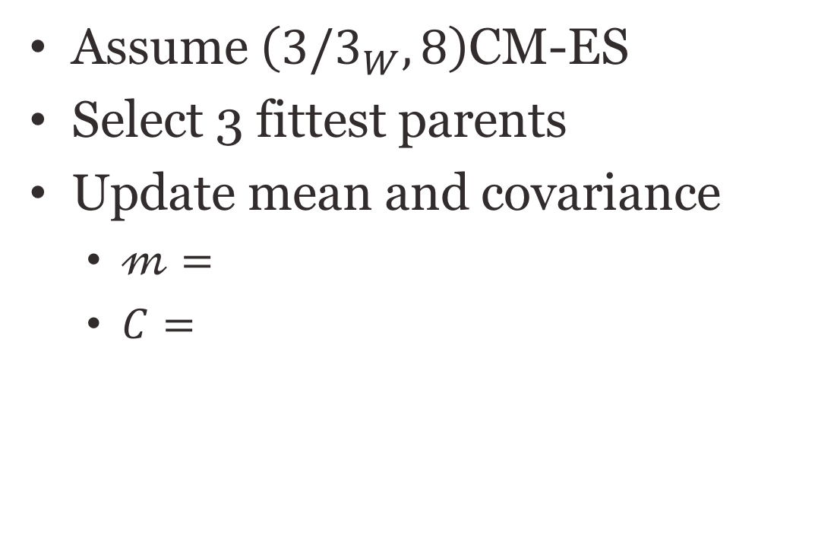
Lets try again…
Assume $\left(3/3_{W}, 8\right)$CM-ES
Select 3 fittest parents
Update mean and covariance
  $𝓂=$
  $C=$
9
1
7
(1,1)
5
1
(0,0)
2
6
(-1,-1)
8
Means are known a priori
*$C_{ij}=𝔼\left[\left(x_{i}−𝓂_{i}\right)\left(x_{j}−𝓂_{j}\right)\right]=\frac{1}{M}\sum_{k=1}^{M}{\left(x_{i }^{k}−𝓂_{i}\right)\left(x_{j }^{k}−𝓂_{j}\right)}$

Slide 17
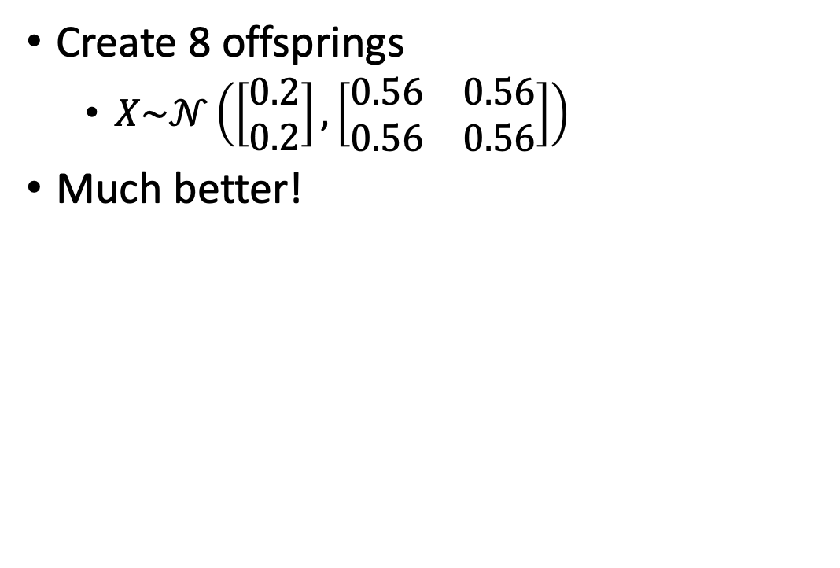
Mutation
Create 8 offsprings
  $X\sim 𝒩\left(\left[\begin{matrix}0.2 \\ 0.2\end{matrix}\right], \left[\begin{matrix}0.56 & 0.56 \\ 0.56 & 0.56\end{matrix}\right]\right)$
Much better!
1
1
1
(0.2,0.2)
1
3
2
2
2

Slide 18
Step-size control
For updating the mean and covariance matrix between generations
Step size too large
Reasonable step size
Step size too
small
if several updates go to the same/similar direction (if they have the same sign) the step-size is increased

Slide 19
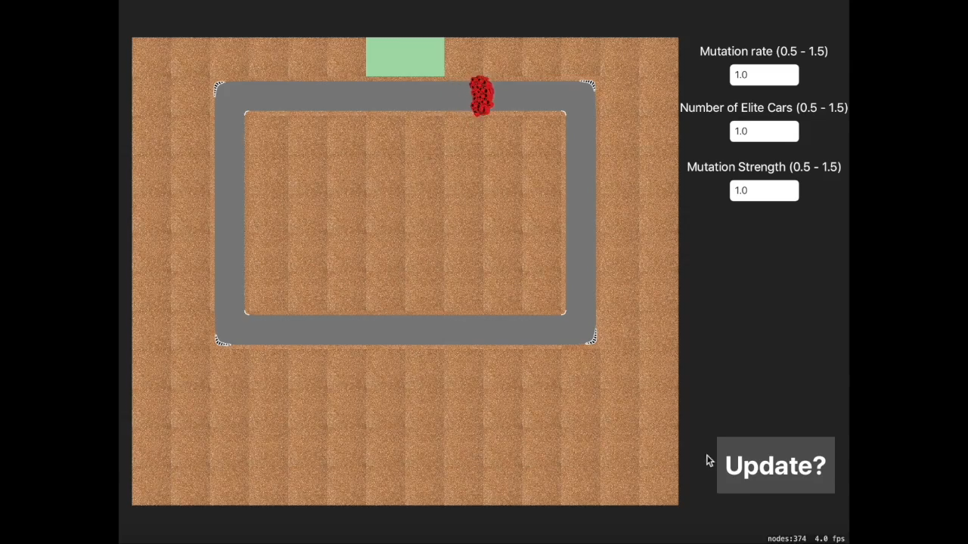
Video CMA-ES

Slide 20
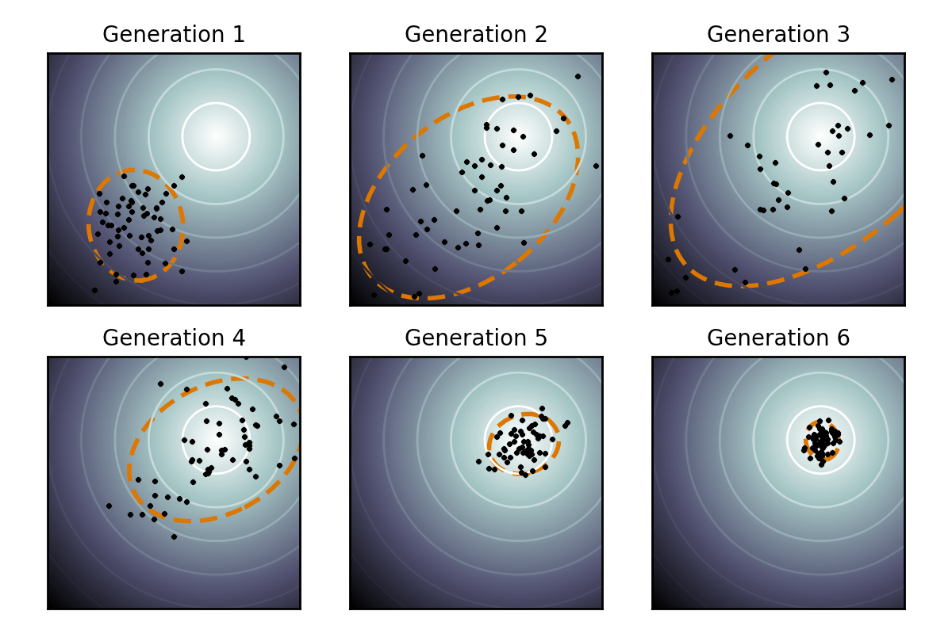
Online parameter tuning
Finite difference
  Less exploration
  Safer
  Harder to escape a local minima
CMA-ES
  More exploration
  Less safe
  Easier to escape a local minima
Iteration
Iteration
Iteration
Iteration
Iteration
Iteration

Slide 21
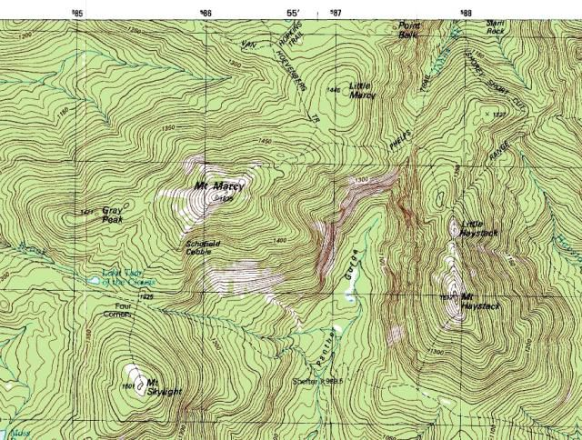




Looking for gold
Daniel Krige - South African mining engineer, 1960
Find the point richest in gold
Sampling the soil is expensive
Given current samples
  Where should the next sample be taken from?

Slide 22
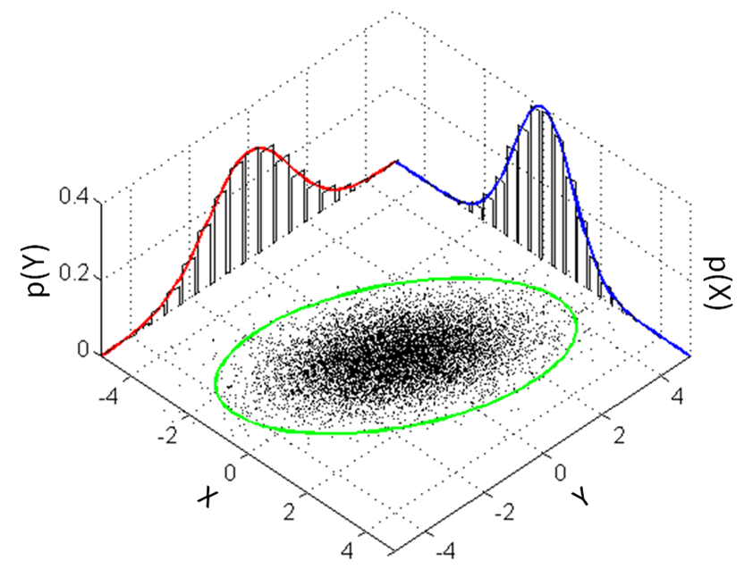
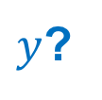
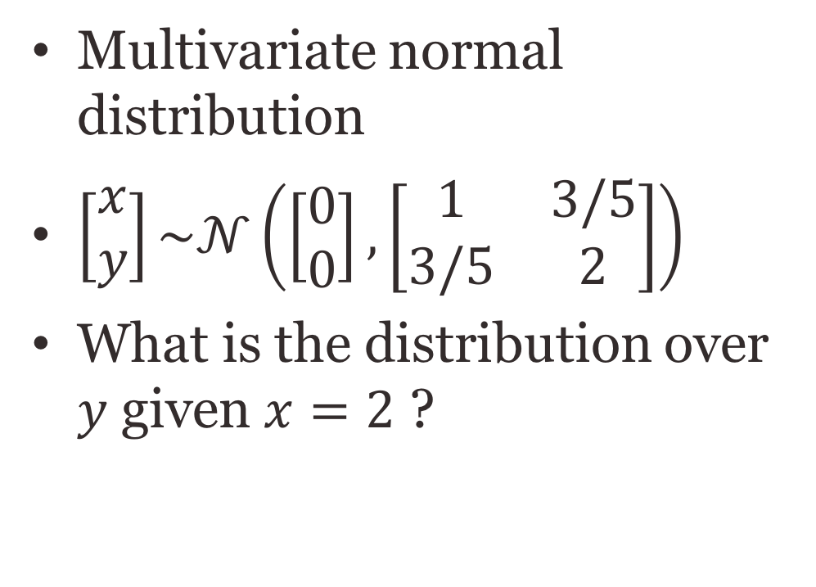
Conditional distribution
Multivariate normal distribution
$\left[\begin{matrix}x \\ y\end{matrix}\right]\sim 𝒩\left(\left[\begin{matrix}0 \\ 0\end{matrix}\right], \left[\begin{matrix}1 & 3/5 \\ 3/5 & 2\end{matrix}\right]\right)$
What is the distribution over $y$ given $x=2$ ?
$y$?
3-Sigma bound

Slide 23
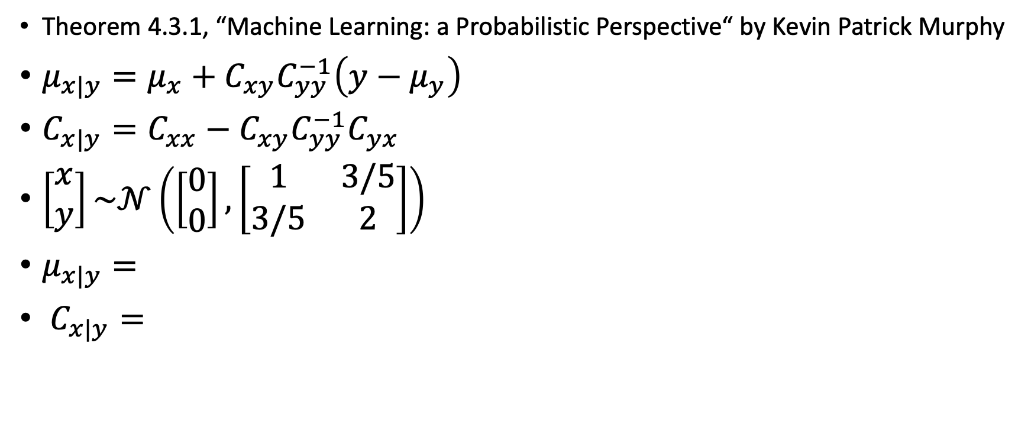
Posterior conditionals of an MVN
Theorem 4.3.1, “Machine Learning: a Probabilistic Perspective“ by Kevin Patrick Murphy
$μ_{x|y}=μ_{x}+C_{xy}C_{yy}^{−1}\left(y−μ_{y}\right)$
$C_{x|y}=C_{xx}−C_{xy}C_{yy}^{−1}C_{yx}$
$\left[\begin{matrix}x \\ y\end{matrix}\right]\sim 𝒩\left(\left[\begin{matrix}0 \\ 0\end{matrix}\right], \left[\begin{matrix}1 & 3/5 \\ 3/5 & 2\end{matrix}\right]\right)$
$μ_{x|y}=$
$C_{x|y}=$

Slide 24





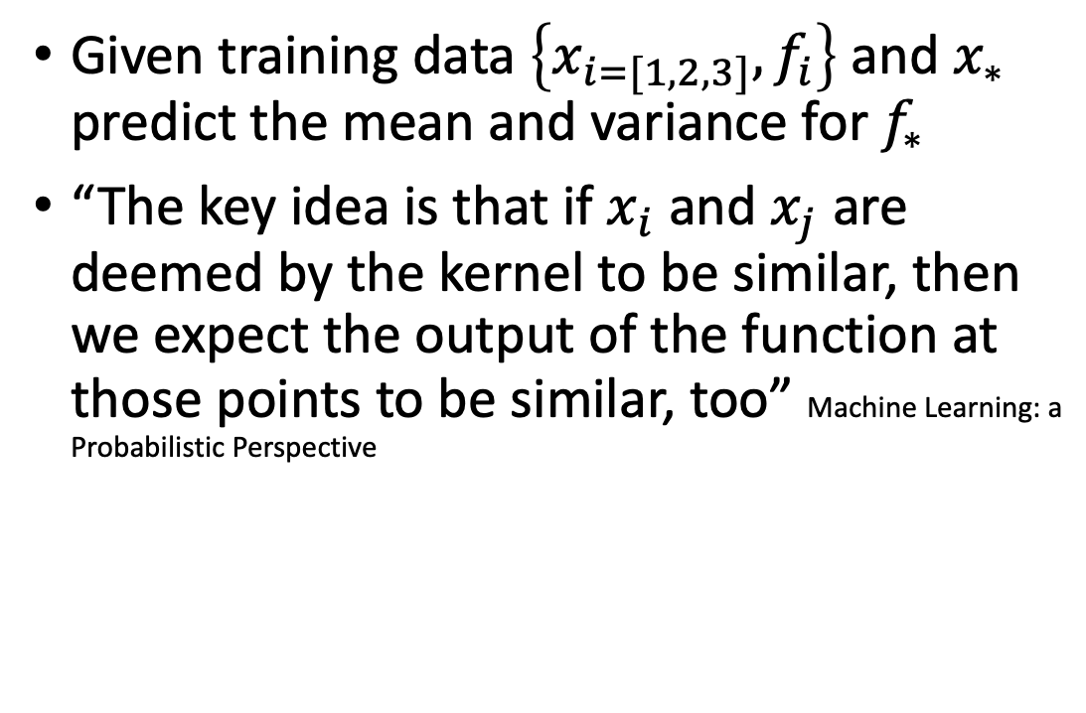

Gaussian Prediction
$$f(x)$$
Given training data $\left\{x_{i=[1,2,3]},f_{i}\right\}$ and $x_{∗}$ predict the mean and variance for $f_{∗}$
“The key idea is that if $x_{i}$ and $x_{j}$ are deemed by the kernel to be similar, then we expect the output of the function at those points to be similar, too” Machine Learning: a Probabilistic Perspective
$$x_{3}$$
$$x_{∗}$$
$$x$$
$$x_{2}$$
$$x_{1}$$

Slide 25
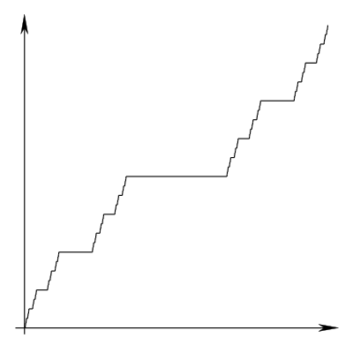
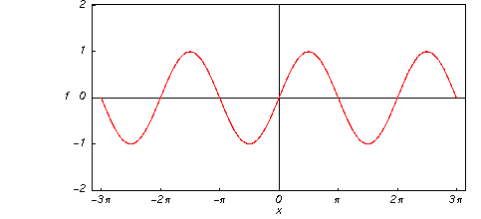
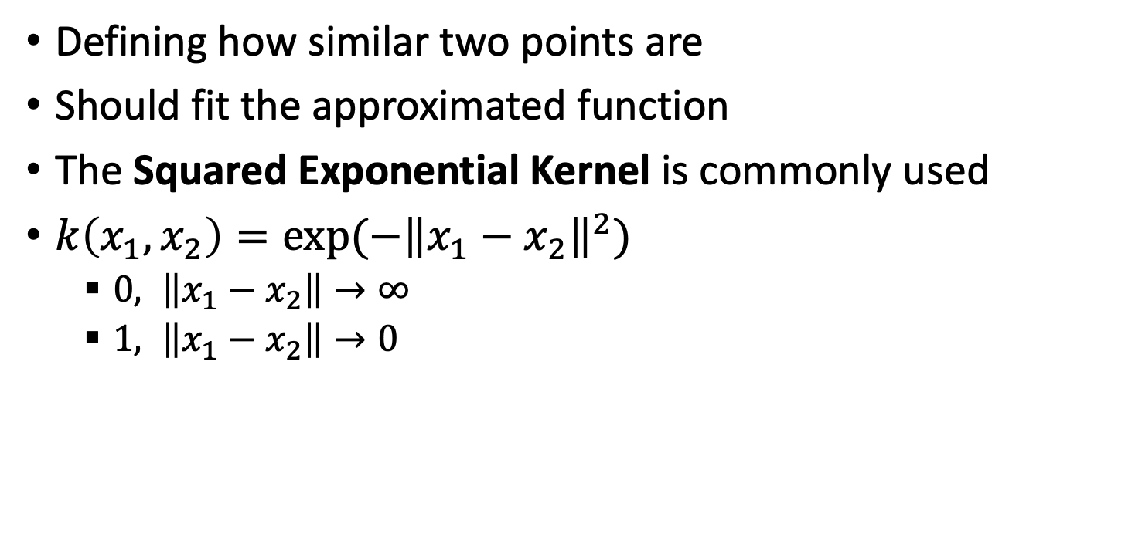
Kernels
Defining how similar two points are
Should fit the approximated function
The Squared Exponential Kernel is commonly used
$k\left(x_{1},x_{2}\right)=exp⁡(−{\left\|x_{1}−x_{2}\right\|}^{2})$
  $0, \left\|x_{1}−x_{2}\right\|→∞$
  $1, \left\|x_{1}−x_{2}\right\|→0$

Slide 26



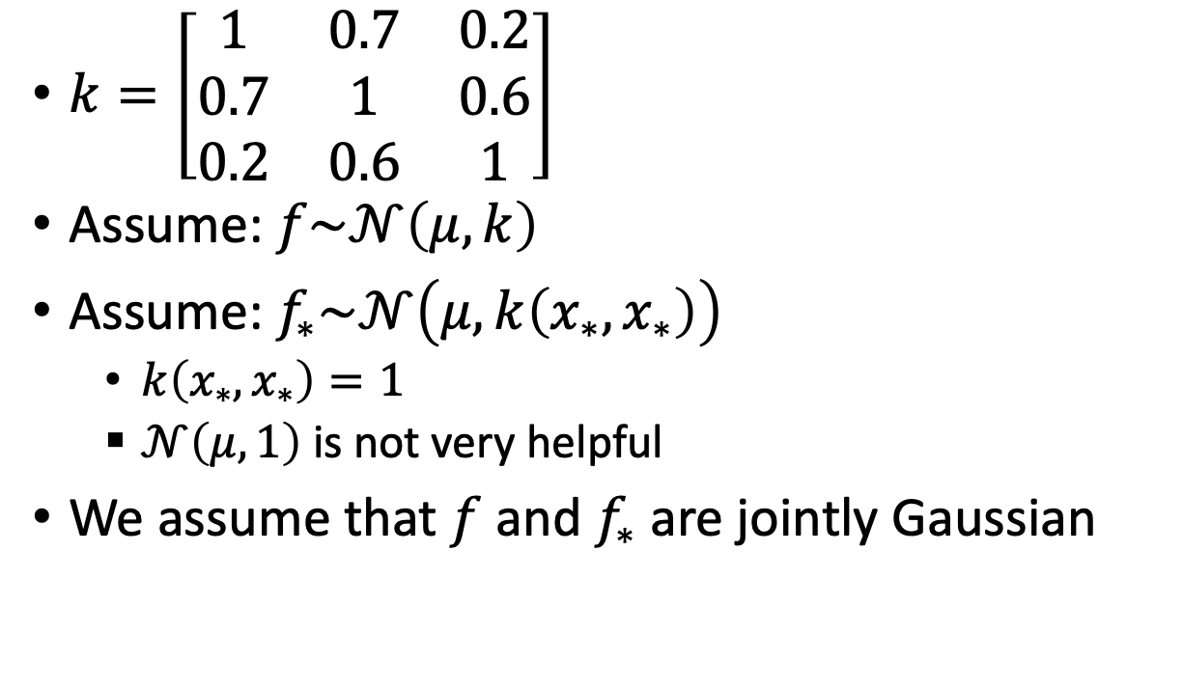

Gaussian Prediction
$$f(x)$$
$k=\left[\begin{matrix}1 & 0.7 & 0.2 \\ 0.7 & 1 & 0.6 \\ 0.2 & 0.6 & 1\end{matrix}\right]$
Assume: $f\sim 𝒩\left(μ,k\right)$
Assume: $f_{∗}\sim 𝒩\left(μ,k\left(x_{∗},x_{∗}\right)\right)$
  $k\left(x_{∗},x_{∗}\right)=1$
  $𝒩\left(μ,1\right)$ is not very helpful
We assume that $f$ and $f_{∗}$ are jointly Gaussian
$$x_{3}$$
$$x_{∗}$$
$$x$$
$$x_{2}$$
$$x_{1}$$

Slide 27



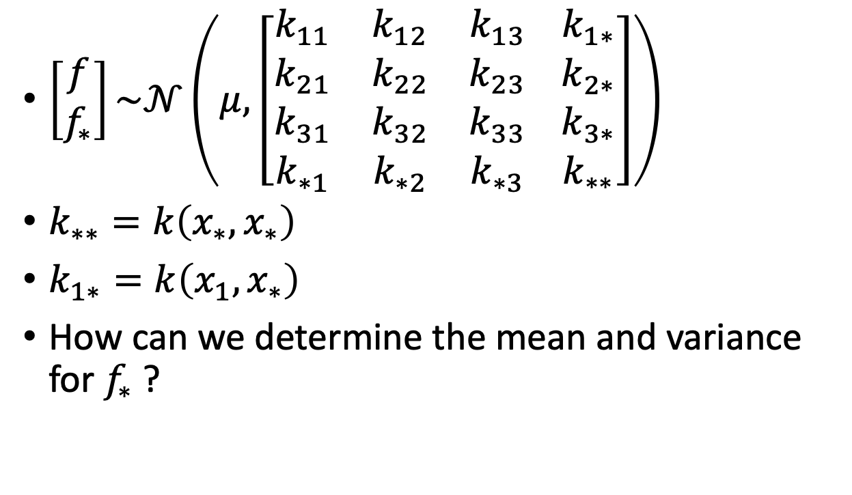
Gaussian Process
$$f(x)$$
$\left[\begin{matrix}f \\ f_{∗}\end{matrix}\right]\sim 𝒩\left(μ, \left[\begin{matrix}k_{11} & k_{12} & k_{13} \\ k_{21} & k_{22} & k_{23} \\ \begin{matrix}k_{31} \\ k_{∗1}\end{matrix} & \begin{matrix}k_{32} \\ k_{∗2}\end{matrix} & \begin{matrix}k_{33} \\ k_{∗3}\end{matrix}\end{matrix} \begin{matrix}k_{1∗} \\ k_{2∗} \\ \begin{matrix}k_{3∗} \\ k_{∗∗}\end{matrix}\end{matrix}\right]\right)$
$k_{∗∗}=k\left(x_{∗},x_{∗}\right)$
$k_{1∗}=k\left(x_{1},x_{∗}\right)$
How can we determine the mean and variance for $f_{∗}$ ?
$$x_{3}$$
$$x_{∗}$$
$$x$$
$$k$$
$$k_{∗}$$
$$k_{∗∗}$$
$$x_{2}$$
$$x_{1}$$

Slide 28
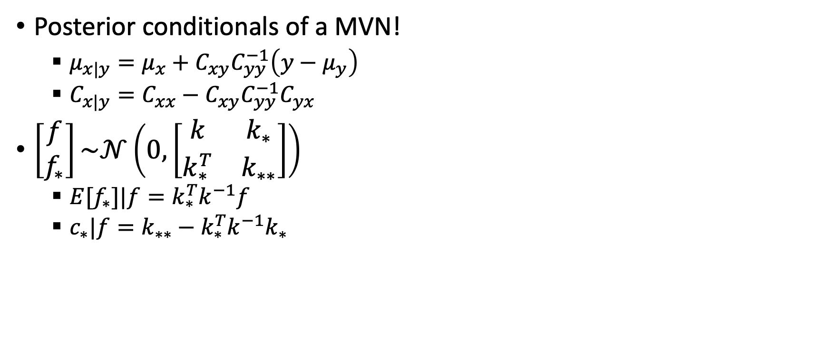
Gaussian Process
$$f(x)$$
Posterior conditionals of a MVN!
  $μ_{x|y}=μ_{x}+C_{xy}C_{yy}^{−1}\left(y−μ_{y}\right)$
  $C_{x|y}=C_{xx}−C_{xy}C_{yy}^{−1}C_{yx}$
$\left[\begin{matrix}f \\ f_{∗}\end{matrix}\right]\sim 𝒩\left(0, \left[\begin{matrix}k & k_{∗} \\ k_{∗}^{T} & k_{∗∗}\end{matrix}\right]\right)$
  ${E[f}_{∗}]|f=k_{∗}^{T}k^{−1}f$
  $c_{∗}|f=k_{∗∗}−k_{∗}^{T}k^{−1}k_{∗}$
$$x_{3}$$
$$x_{∗}$$
$$x$$
$$x_{2}$$
$$x_{1}$$

Slide 29
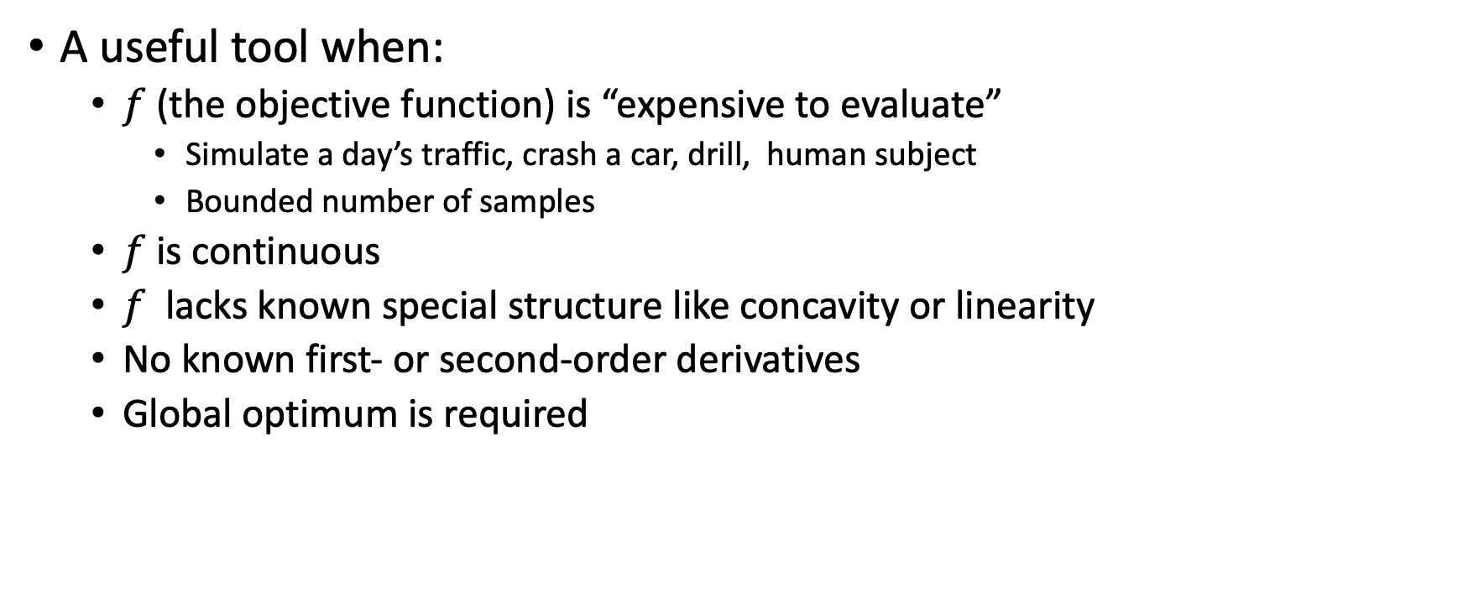
Bayesian optimization
A useful tool when:
  $f$ (the objective function) is “expensive to evaluate”
    Simulate a day’s traffic, crash a car, drill, human subject
    Bounded number of samples
  $f$is continuous
  $f$ lacks known special structure like concavity or linearity
  No known first- or second-order derivatives
  Global optimum is required

Slide 30
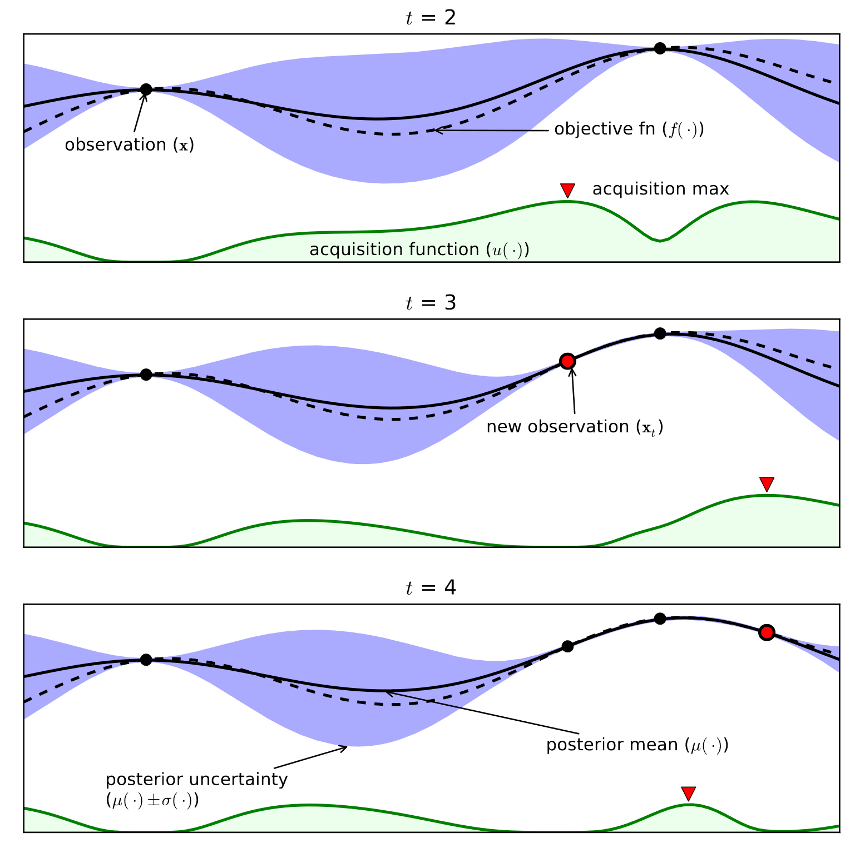
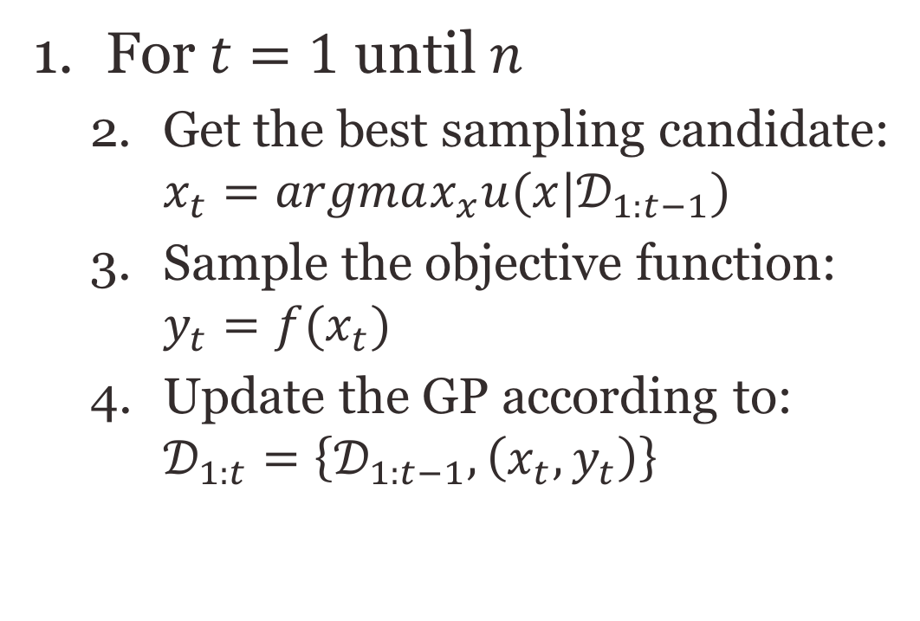
Bayesian optimization
For $t=1$ until $n$
  Get the best sampling candidate: $x_{t}=argmax_{x}u(x|𝒟_{1:t−1})$
  Sample the objective function: $y_{t}=f(x_{t})$
  Update the GP according to: $𝒟_{1:t}=\left\{𝒟_{1:t−1}, \left(x_{t},y_{t}\right)\right\}$

Slide 31
Bayesian optimization
For $t=1$ until $n$
  Get the best sampling candidate: $x_{t}=argmax_{x}u(x|𝒟_{1:t−1})$
  Sample the objective function: $y_{t}=f(x_{t})$
  Update the GP according to: $𝒟_{1:t}=\left\{𝒟_{1:t−1}, \left(x_{t},y_{t}\right)\right\}$

Slide 32
Bayesian optimization
For $t=1$ until $n$
  Get the best sampling candidate: $x_{t}=argmax_{x}u(x|𝒟_{1:t−1})$
  Sample the objective function: $y_{t}=f(x_{t})$
  Update the GP according to: $𝒟_{1:t}=\left\{𝒟_{1:t−1}, \left(x_{t},y_{t}\right)\right\}$

Slide 33
Acquisition function
Exploit: prefer the points with high expected mean value
Explore: prefer the points with high variance
The acquisition function balances between the two
  Probability of Improvement
  Expected Improvement
  Gaussian Process – Upper Confidence Bound (GP-UCB)
  Thompson sampling

Slide 34
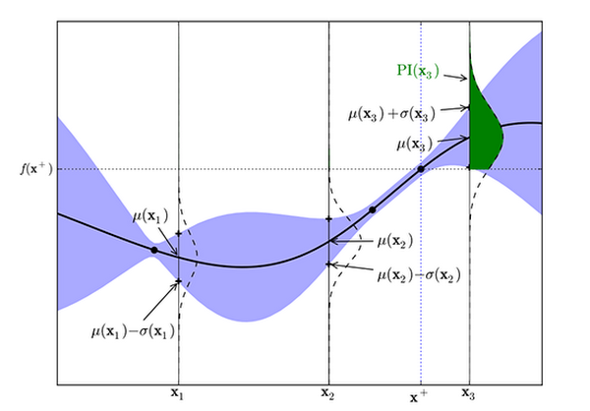
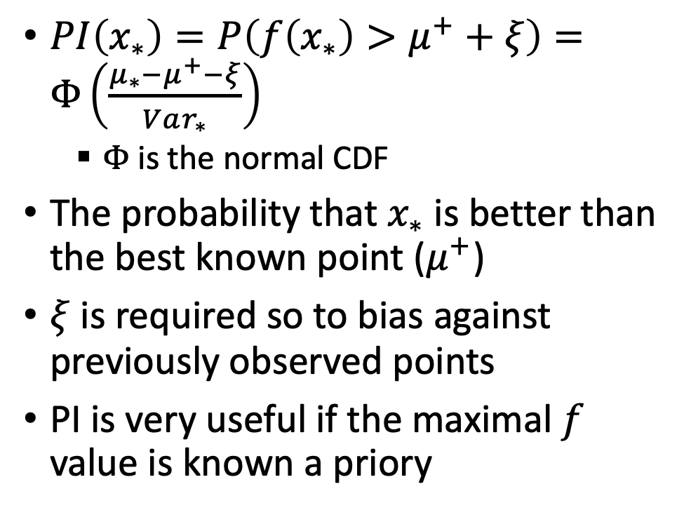
Probability of Improvement [Kushner, 1964]
$PI\left(x_{∗}\right)=P\left(f\left(x_{∗}\right)>μ^{+}+ξ\right)=Φ\left(\frac{μ_{∗}−μ^{+}−ξ}{Var_{∗}}\right)$
  $Φ$ is the normal CDF
The probability that $x_{∗}$ is better than the best known point ($μ^{+}$)
$ξ$ is required so to bias against previously observed points
PI is very useful if the maximal $f$ value is known a priory

Slide 35
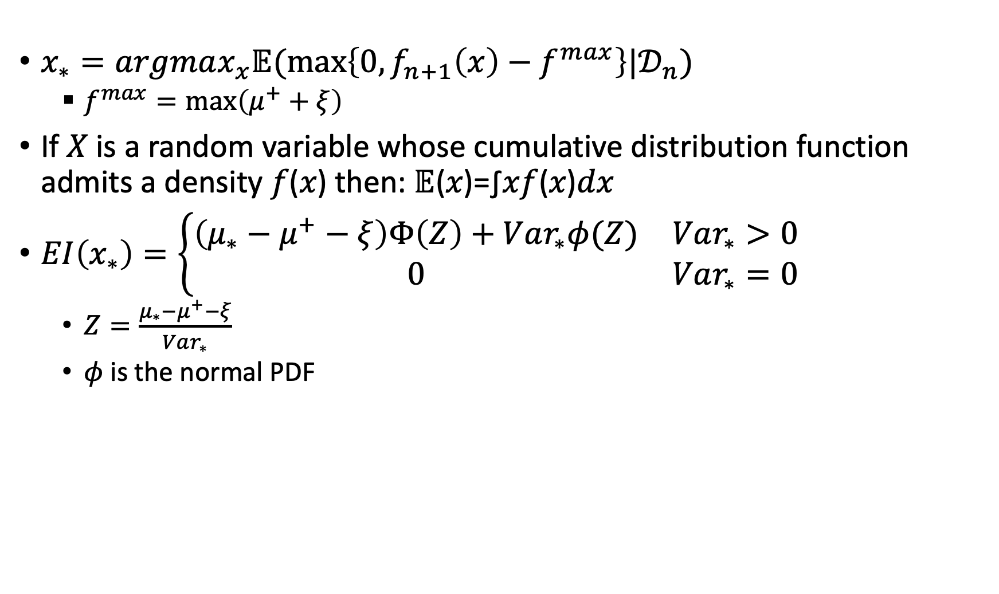
Expected Improvement [Mockus 1978]
$x_{∗}=argmax_{x}𝔼(\max\left\{0,f_{n+1}\left(x\right)−f^{max}\right\}|𝒟_{n})$
  $f^{max}=\max\left(μ^{+}+ξ\right)$
If 𝑋 is a random variable whose cumulative distribution function admits a density 𝑓(𝑥) then: 𝔼(𝑥)=∫𝑥𝑓(𝑥)𝑑𝑥
$EI\left(x_{∗}\right)=\left\{\begin{matrix}\left(μ_{∗}−μ^{+}−ξ\right)Φ\left(Z\right)+Var_{∗}φ(Z) & Var_{∗}>0 \\ 0 & Var_{∗}=0\end{matrix}\right.$
  $Z=\frac{μ_{∗}−μ^{+}−ξ}{Var_{∗}}$
  $φ$ is the normal PDF

Slide 36

GP-UCB [Srinivas et al. 2010]
$GPUCB\left(x_{∗}\right)=μ_{∗}+\sqrt{vβ_{t}}Var_{∗}$
Linear combination of the mean and variance
Setting $v=1$ and $β_{t}=2\log\left(\frac{t^{d/2+2}π^{2}}{3δ}\right)$ leads to no regret with high probability: $\lim_{T→∞}{\frac{R_{T}}{T}=0}$
  $R_{T}=r\left(x_{1}\right)+…+r\left(x_{T}\right)$
  $r\left(x\right)=f\left(x^{∗}\right)−f\left(x\right)$

Slide 37

Acquisition functions
PI: Probability improvement
EI: Expected improvement
GP-UCB: Gaussian process upper confidence bound

Slide 38

Acquisition functions

Slide 39


Thompson Sampling
Sample a function from the Gaussian Process
The function is sampled as a set of $f_{∗}$ values from the distribution $\left[\begin{matrix}f \\ f_{∗}\end{matrix}\right]\sim 𝒩\left(\begin{matrix}μ \\ μ_{∗}\end{matrix}, \left[\begin{matrix}k & k_{∗} \\ k_{∗}^{T} & k_{∗∗}\end{matrix}\right]\right)$ given $f$
Chosen point is the optimum of the sampled function

Slide 40

Branch and bound approach
A general approach in planning and scheduling
If best > upper bound then prune

Slide 41

Extra reading
https://www.youtube.com/watch?v=SQtOI9jsrJ0&list=PLCJPYIcPhgPAiiBjjVxi5St_lC_cXHFCK&index=9
https://www.youtube.com/watch?v=4vGiHC35j9s

