Slide 1
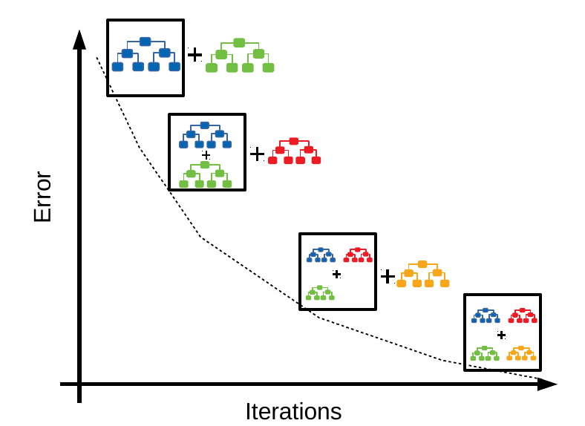
CSCE-633 Machine Learning
15. Boosting
Instructor: Guni Sharon
Examples by: Kilian Weinberger

Slide 2
Midterm exam
Online through Canvas
You may use the lecture slides + your notes, calculator/excel
CSCE633-700:
  Begin the exam on 8:00am, April 12
  Join the class Zoom meeting and leave your camera on facing you
CSCE633-600:
  You must physically attend the classroom
  Bring your laptop to the classroom

Slide 3
Midterm exam
All question have the same weight in the final score
Questions 1 and 2: numerical computation of weight vectors
Question 3: question on feature mapping/kernelization
Question 4: multiple answer question on Bias-Var tradeoff
Question 5,6: numerical computation question regarding decision trees and entropy
Question 7: multiple answer question regarding bagging

Slide 4
Announcements
Due:
  Quiz 5: decision trees and bagging, due April 14
  Assignment (P3): SVM, linear regression and kernelization, due April-12 14
  Assignment (P4): Decision trees, due April 19

Slide 5
Disadvantages of Bagging
Loss of interpretability: the underlying model might be interpretable, e.g., decision trees. However, an ensemble prediction is harder to make sense of.
Computationally expensive: Bagging slows down and grows more intensive as the number of iterations increase
Unstable benefit (across models): Bagging is not beneficial for models that suffer from low variance
  “bagging a linear regression model will effectively just return the original predictions” [Hands-On Machine Learning, Boehmke & Greenwell]

Slide 6
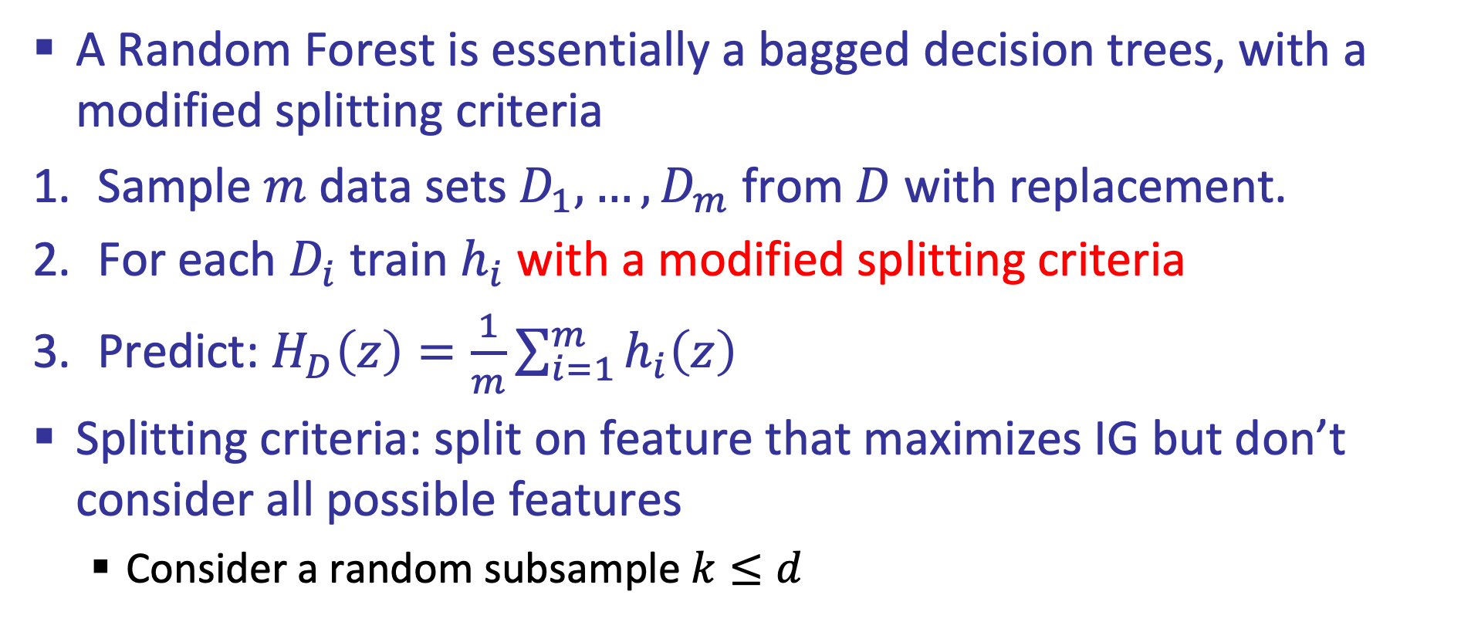
Random Forest
A Random Forest is essentially a bagged decision trees, with a modified splitting criteria
Sample $m$ data sets $D_{1},…,D_{m}$from $D$ with replacement.
For each $D_{i}$ train $h_{i}$ with a modified splitting criteria
Predict: $H_{D}\left(z\right)=\frac{1}{m}\sum_{i=1}^{m}{h_{i}\left(z\right)}$
Splitting criteria: split on feature that maximizes IG but don’t consider all possible features
  Consider a random subsample $k≤d$

Slide 7
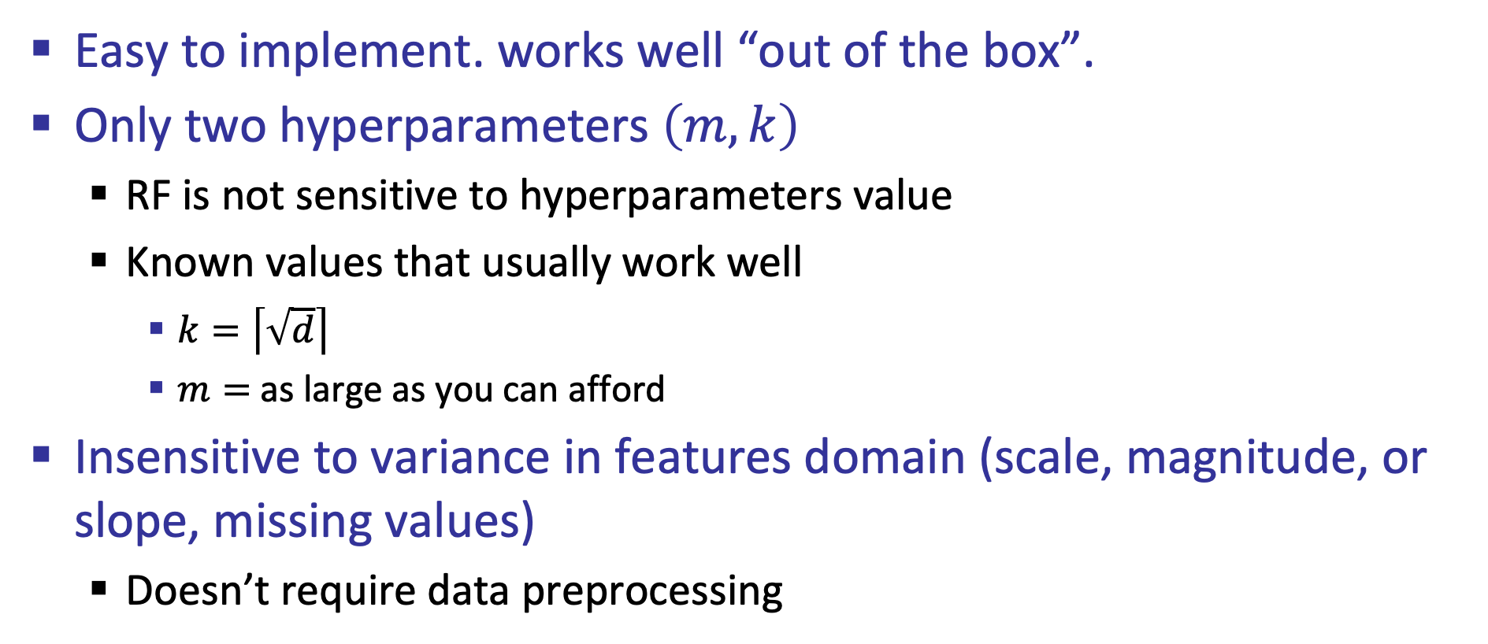
Advantages of Random Forest
Easy to implement. works well “out of the box”.
Only two hyperparameters $\left(m,k\right)$
  RF is not sensitive to hyperparameters value
  Known values that usually work well
    $k=\left\lceil \sqrt{d}\right\rceil$
    $m=$ as large as you can afford
Insensitive to variance in features domain (scale, magnitude, or slope, missing values)
  Doesn’t require data preprocessing

Slide 8
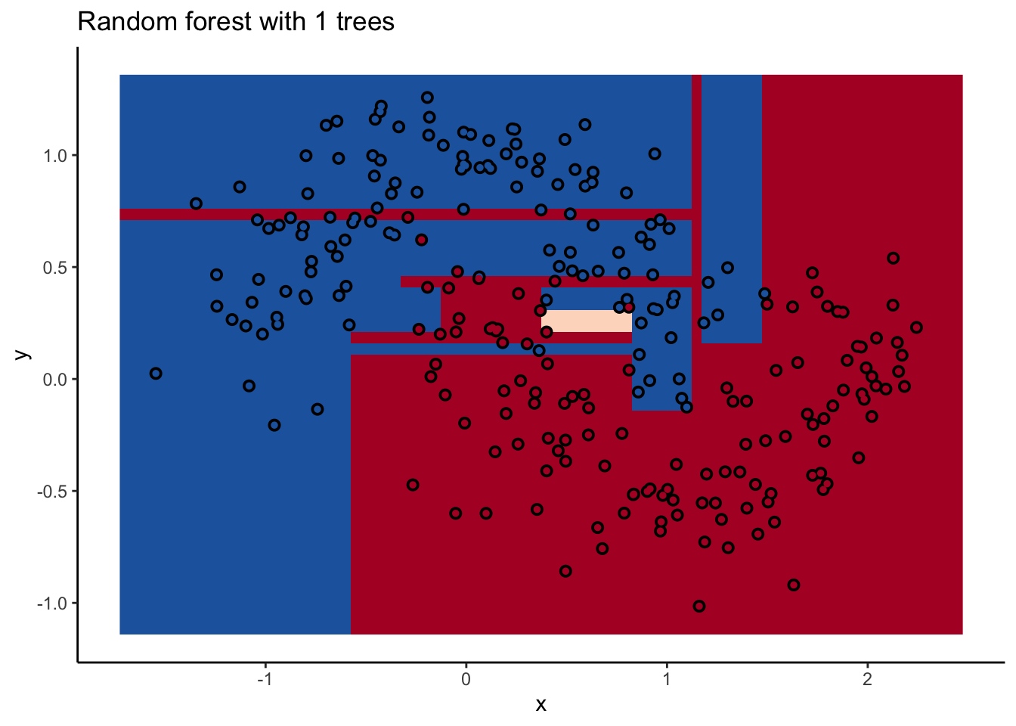

Slide 9
What about bias?
Model with high variance –> use bagging!
What if we have high bias = underfitting = the model is too weak = can’t capture data structure
  Both training and testing losses are high
  More training data won’t help
Can we address this with an ensemble approach?
  Can weak learners be combined to generate a strong learner with low bias?
  Weak learners := slightly better than random guessing

Slide 10
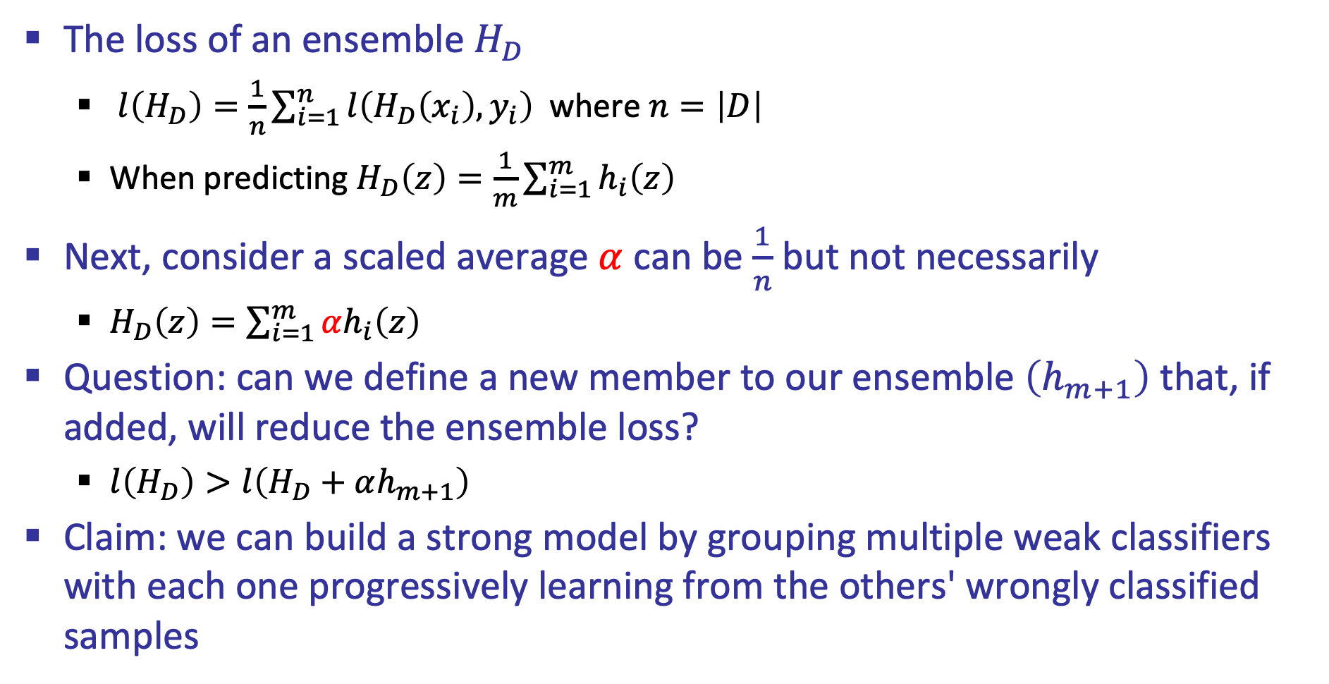
Ensemble loss
The loss of an ensemble $H_{D}$
  $l\left(H_{D}\right)=\frac{1}{n}\sum_{i=1}^{n}{l\left(H_{D}\left(x_{i}\right),y_{i}\right)}$ where $n=\left|D\right|$
  When predicting $H_{D}\left(z\right)=\frac{1}{m}\sum_{i=1}^{m}{h_{i}\left(z\right)}$
Next, consider a scaled average $α$ can be $\frac{1}{n}$ but not necessarily
  $H_{D}\left(z\right)=\sum_{i=1}^{m}{αh_{i}\left(z\right)}$
Question: can we define a new member to our ensemble $\left(h_{m+1}\right)$ that, if added, will reduce the ensemble loss?
  $l\left(H_{D}\right)>l\left(H_{D}+αh_{m+1}\right)$
Claim: we can build a strong model by grouping multiple weak classifiers with each one progressively learning from the others' wrongly classified samples

Slide 11
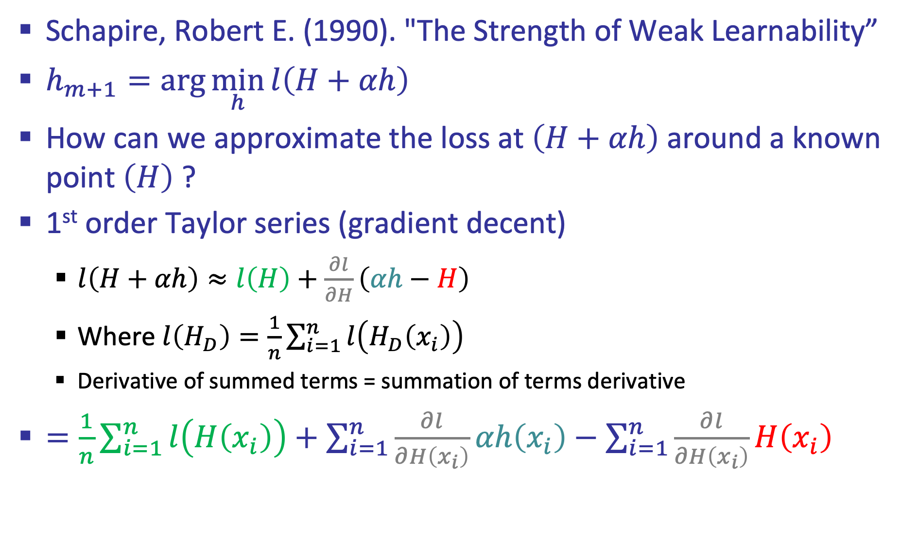
Boosting
Schapire, Robert E. (1990). "The Strength of Weak Learnability”
$h_{m+1}=\arg{\min_{h}{l\left(H+αh\right)}}$
How can we approximate the loss at $\left(H+αh\right)$ around a known point $\left(H\right)$ ?
1st order Taylor series (gradient decent)
  $l\left(H+αh\right)≈l\left(H\right)+\frac{∂l}{∂H}\left(αh−H\right)$
  Where $l\left(H_{D}\right)=\frac{1}{n}\sum_{i=1}^{n}{l\left(H_{D}\left(x_{i}\right)\right)}$
  Derivative of summed terms = summation of terms derivative
$=\frac{1}{n}\sum_{i=1}^{n}{l\left(H\left(x_{i}\right)\right)}+\sum_{i=1}^{n}{\frac{∂l}{∂H\left(x_{i}\right)}}αh\left(x_{i}\right)−\sum_{i=1}^{n}{\frac{∂l}{∂H\left(x_{i}\right)}}H\left(x_{i}\right)$

Slide 12

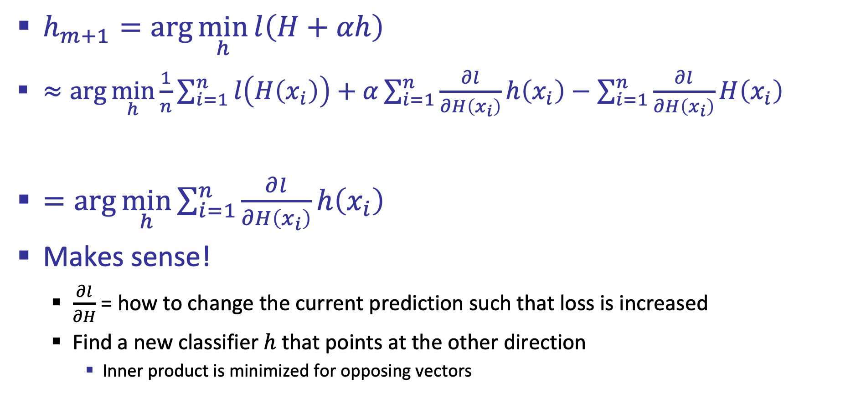

Boosting
$h_{m+1}=\arg{\min_{h}{l\left(H+αh\right)}}$
$≈\arg{\min_{h}{\frac{1}{n}\sum_{i=1}^{n}{l\left(H\left(x_{i}\right)\right)}+α\sum_{i=1}^{n}{\frac{∂l}{∂H\left(x_{i}\right)}}h\left(x_{i}\right)−\sum_{i=1}^{n}{\frac{∂l}{∂H\left(x_{i}\right)}}H\left(x_{i}\right)}}$
$=\arg{\min_{h}{\sum_{i=1}^{n}{\frac{∂l}{∂H\left(x_{i}\right)}}h\left(x_{i}\right)}}$
Makes sense!
  $\frac{∂l}{∂H}$ = how to change the current prediction such that loss is increased
  Find a new classifier $h$ that points at the other direction
    Inner product is minimized for opposing vectors
Independent of $h$
Scalar
Independent of $h$

Slide 13
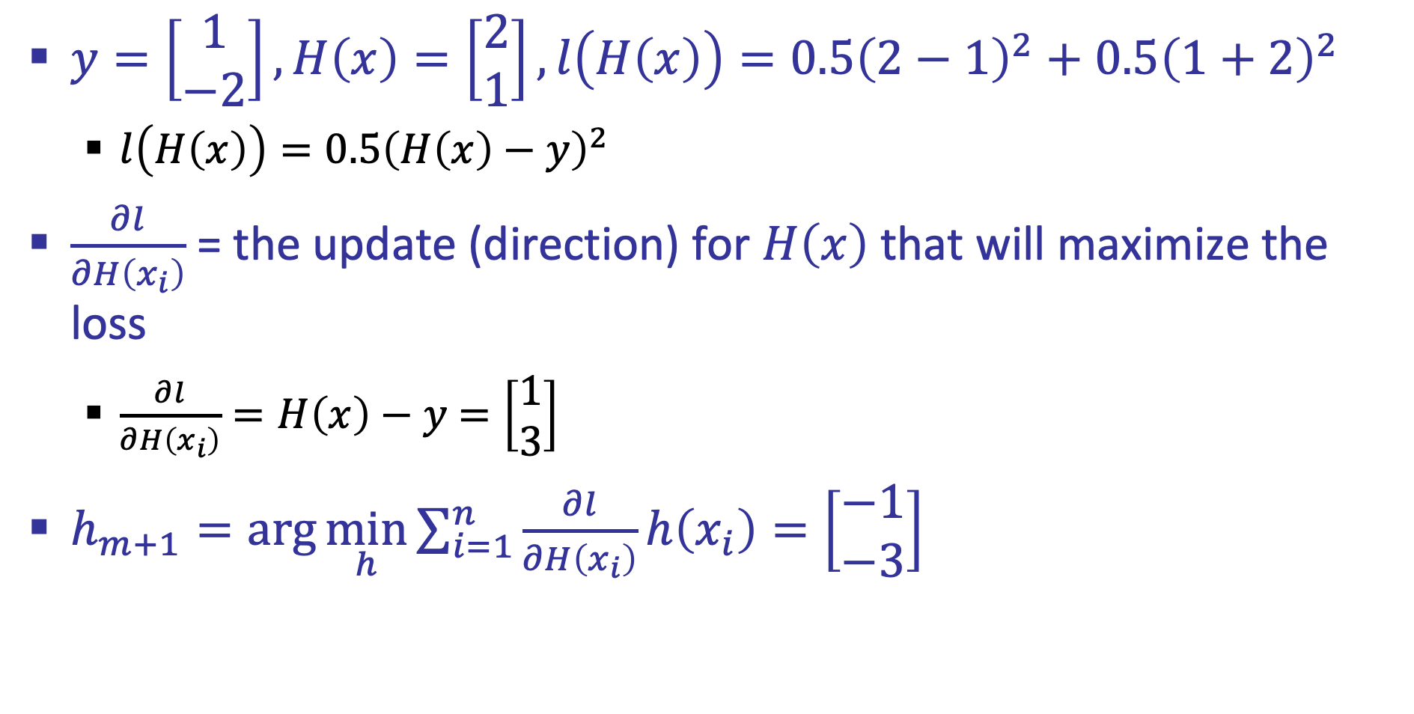
Example
$y=\left[\begin{matrix}1 \\ −2\end{matrix}\right],H\left(x\right)=\left[\begin{matrix}2 \\ 1\end{matrix}\right], l\left(H\left(x\right)\right)={0.5\left(2−1\right)}^{2}+{0.5\left(1+2\right)}^{2}$
  $l\left(H\left(x\right)\right)=0.5{\left(H\left(x\right)−y\right)}^{2}$
$\frac{∂l}{∂H\left(x_{i}\right)}$ = the update (direction) for $H\left(x\right)$ that will maximize the loss
  $\frac{∂l}{∂H\left(x_{i}\right)}=H\left(x\right)−y$ $=\left[\begin{matrix}1 \\ 3\end{matrix}\right]$
$h_{m+1}=\arg{\min_{h}{\sum_{i=1}^{n}{\frac{∂l}{∂H\left(x_{i}\right)}}h\left(x_{i}\right)}}=\left[\begin{matrix}−1 \\ −3\end{matrix}\right]$

Slide 14
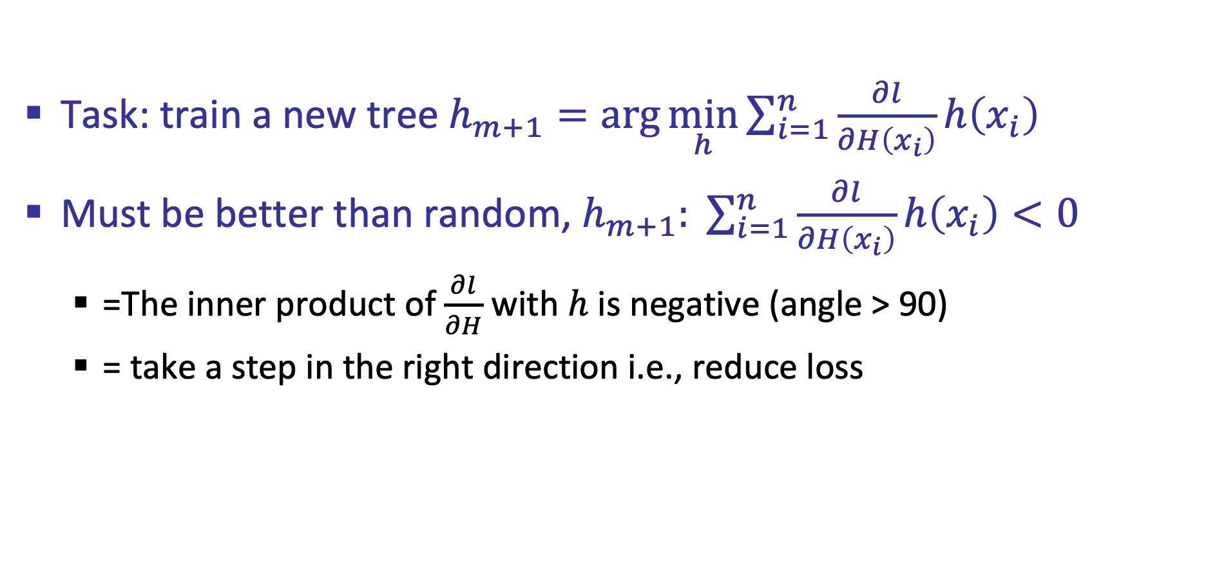
Gradient boost
Task: train a new tree $h_{m+1}=\arg{\min_{h}{\sum_{i=1}^{n}{\frac{∂l}{∂H\left(x_{i}\right)}}h\left(x_{i}\right)}}$
Must be better than random, $h_{m+1}: \sum_{i=1}^{n}{\frac{∂l}{∂H\left(x_{i}\right)}}h\left(x_{i}\right)<0$
  =The inner product of $\frac{∂l}{∂H}$ with $h$ is negative (angle > 90)
  = take a step in the right direction i.e., reduce loss

Slide 15
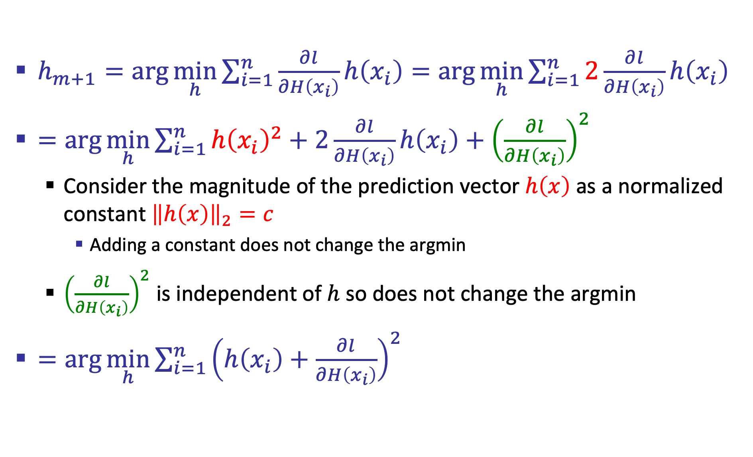
Gradient boost
$h_{m+1}=\arg{\min_{h}{\sum_{i=1}^{n}{\frac{∂l}{∂H\left(x_{i}\right)}}h\left(x_{i}\right)}}=\arg{\min_{h}{\sum_{i=1}^{n}{2\frac{∂l}{∂H\left(x_{i}\right)}}h\left(x_{i}\right)}}$
$=\arg{\min_{h}{\sum_{i=1}^{n}{h{\left(x_{i}\right)}^{2}+2\frac{∂l}{∂H\left(x_{i}\right)}}h\left(x_{i}\right)+{\left(\frac{∂l}{∂H\left(x_{i}\right)}\right)}^{2}}}$
  Consider the magnitude of the prediction vector $h\left(x\right)$ as a normalized constant ${\left\|h\left(x\right)\right\|}_{2}=c$
    Adding a constant does not change the argmin
  ${\left(\frac{∂l}{∂H\left(x_{i}\right)}\right)}^{2}$ is independent of $h$ so does not change the argmin
$=\arg{\min_{h}{\sum_{i=1}^{n}{{\left(h\left(x_{i}\right)+\frac{∂l}{∂H\left(x_{i}\right)}\right)}^{2}}}}$

Slide 16

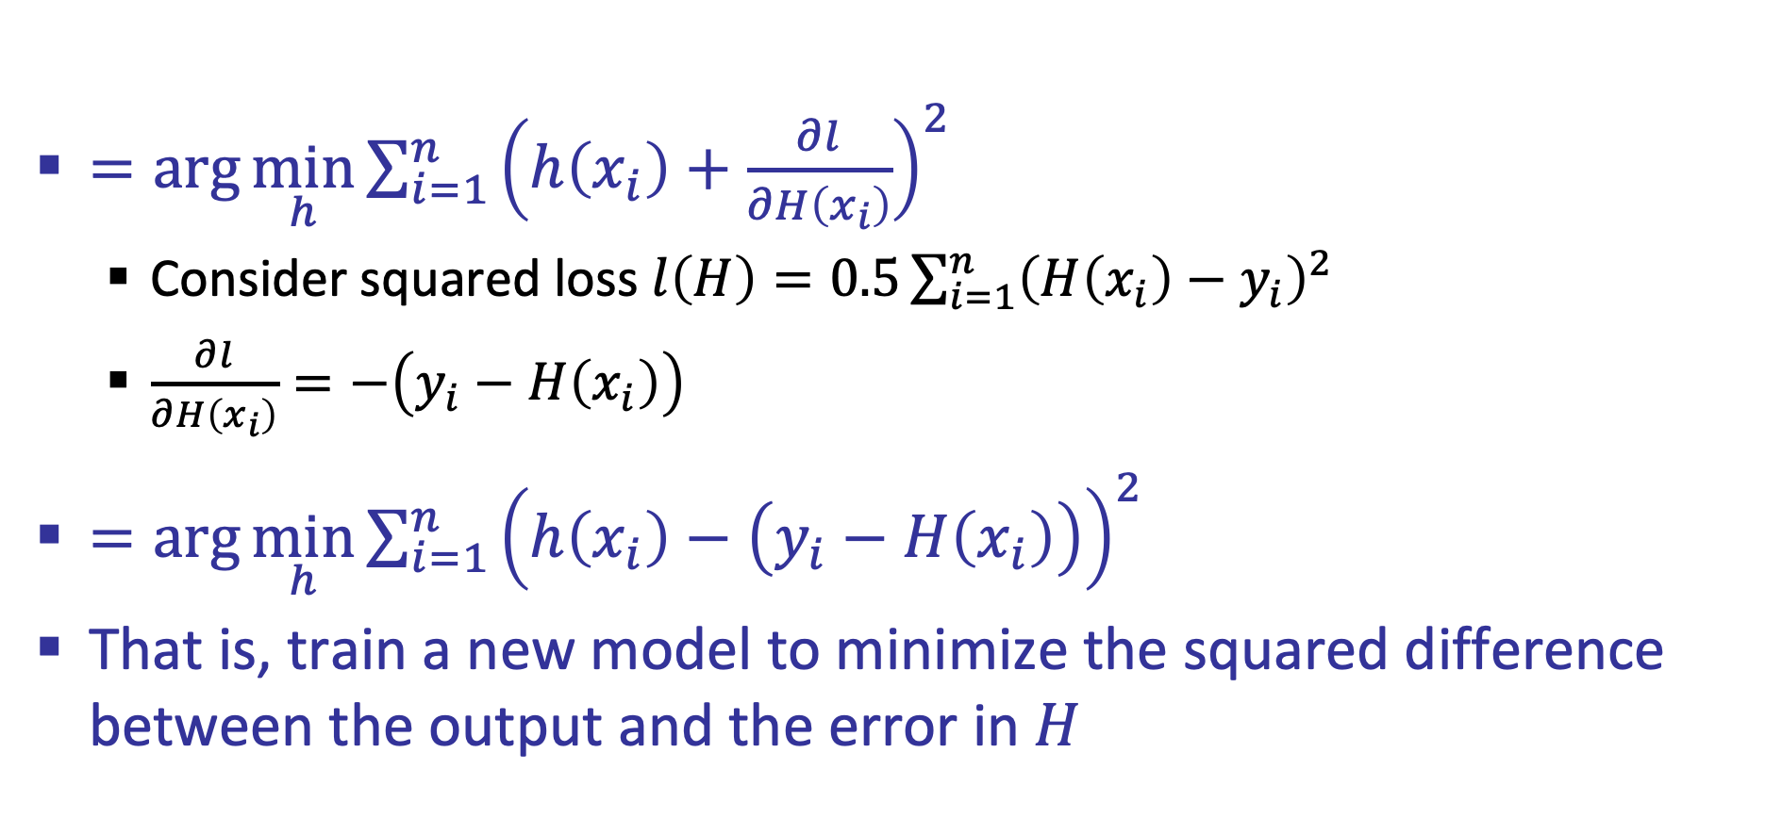
Gradient boost
$=\arg{\min_{h}{\sum_{i=1}^{n}{{\left(h\left(x_{i}\right)+\frac{∂l}{∂H\left(x_{i}\right)}\right)}^{2}}}}$
  Consider squared loss $l\left(H\right)=0.5\sum_{i=1}^{n}{{\left(H\left(x_{i}\right)−y_{i}\right)}^{2}}$
  $\frac{∂l}{∂H\left(x_{i}\right)}=−\left(y_{i}−H\left(x_{i}\right)\right)$
$=\arg{\min_{h}{\sum_{i=1}^{n}{{\left(h\left(x_{i}\right)−\left(y_{i}−H\left(x_{i}\right)\right)\right)}^{2}}}}$
That is, train a new model to minimize the squared difference between the output and the error in $H$
The current error in $H$

Slide 17
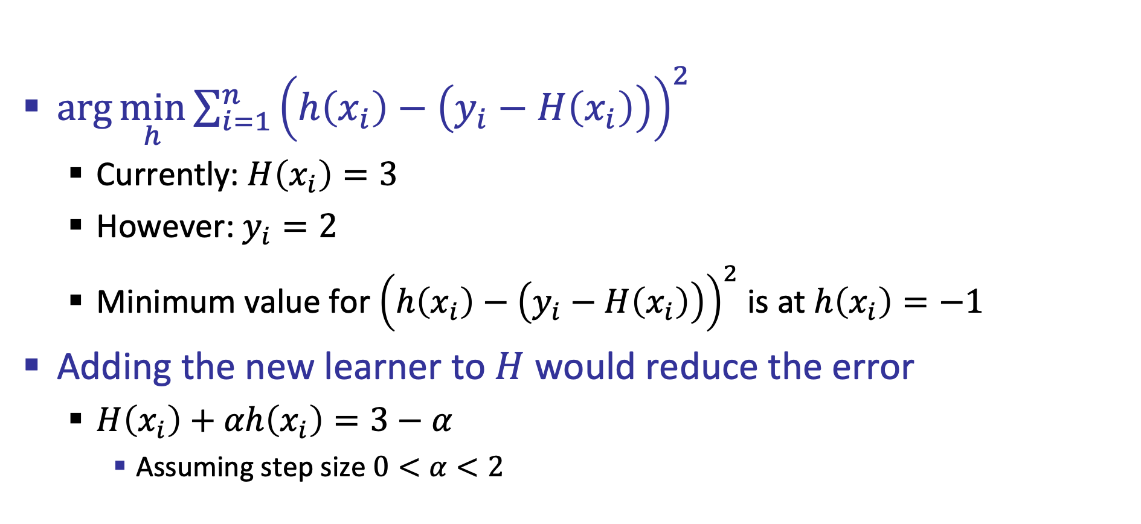
Sanity check
$\arg{\min_{h}{\sum_{i=1}^{n}{{\left(h\left(x_{i}\right)−\left(y_{i}−H\left(x_{i}\right)\right)\right)}^{2}}}}$
  Currently: $H\left(x_{i}\right)=3$
  However: $y_{i}=2$
  Minimum value for ${\left(h\left(x_{i}\right)−\left(y_{i}−H\left(x_{i}\right)\right)\right)}^{2}$ is at $h\left(x_{i}\right)=−1$
Adding the new learner to $H$ would reduce the error
  $H\left(x_{i}\right)+αh\left(x_{i}\right)=3−α$
    Assuming step size $0<α<2$

Slide 18
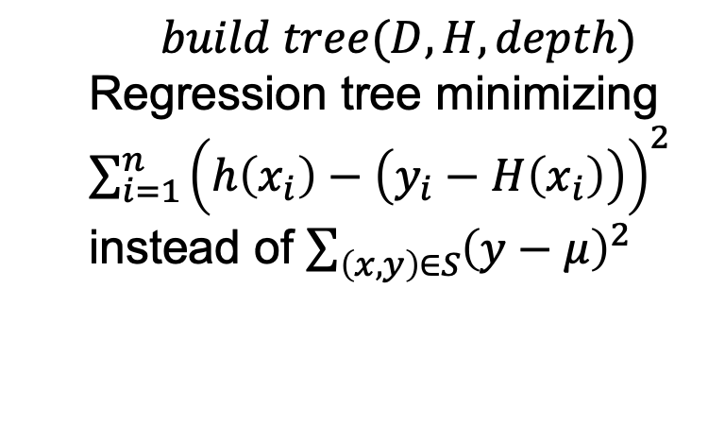
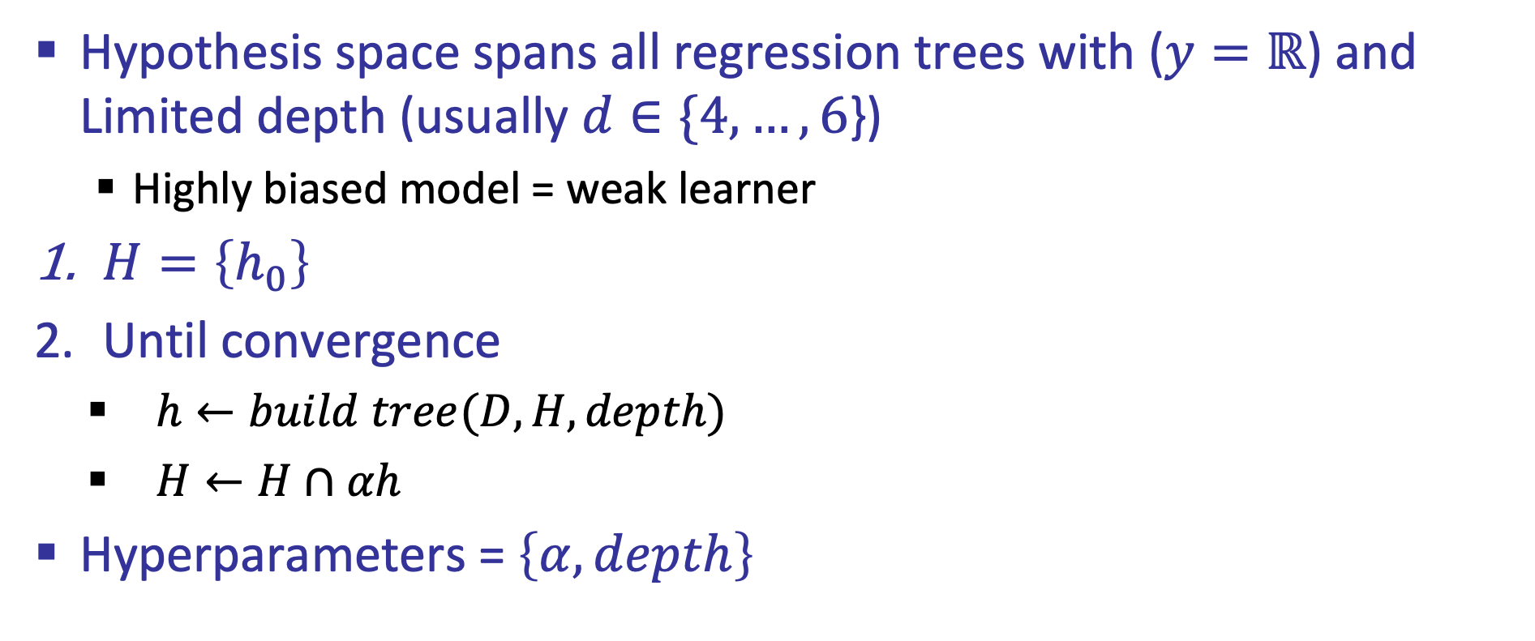
Gradient boost for trees
Hypothesis space spans all regression trees with ($y=ℝ$) and Limited depth (usually $d∈\{4,…,6$})
  Highly biased model = weak learner
$H=\left\{h_{0}\right\}$
Until convergence
  $h←build tree(D,H,depth)$
  $H←H∩αh$
Hyperparameters = $\left\{α,depth\right\}$
$$build tree(D,H,depth)$$
Regression tree minimizing $\sum_{i=1}^{n}{{\left(h\left(x_{i}\right)−\left(y_{i}−H\left(x_{i}\right)\right)\right)}^{2}}$ instead of $\sum_{\left(x,y\right)∈S}{{\left(y−μ\right)}^{2}}$

Slide 19
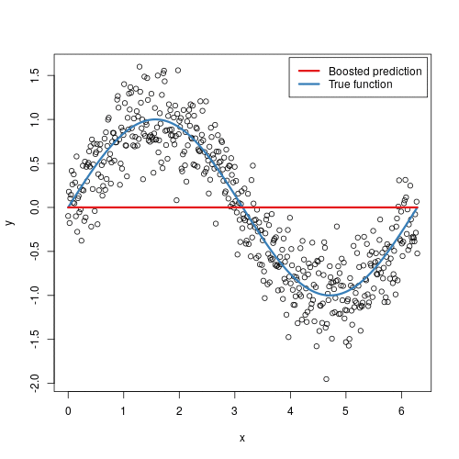

Slide 20
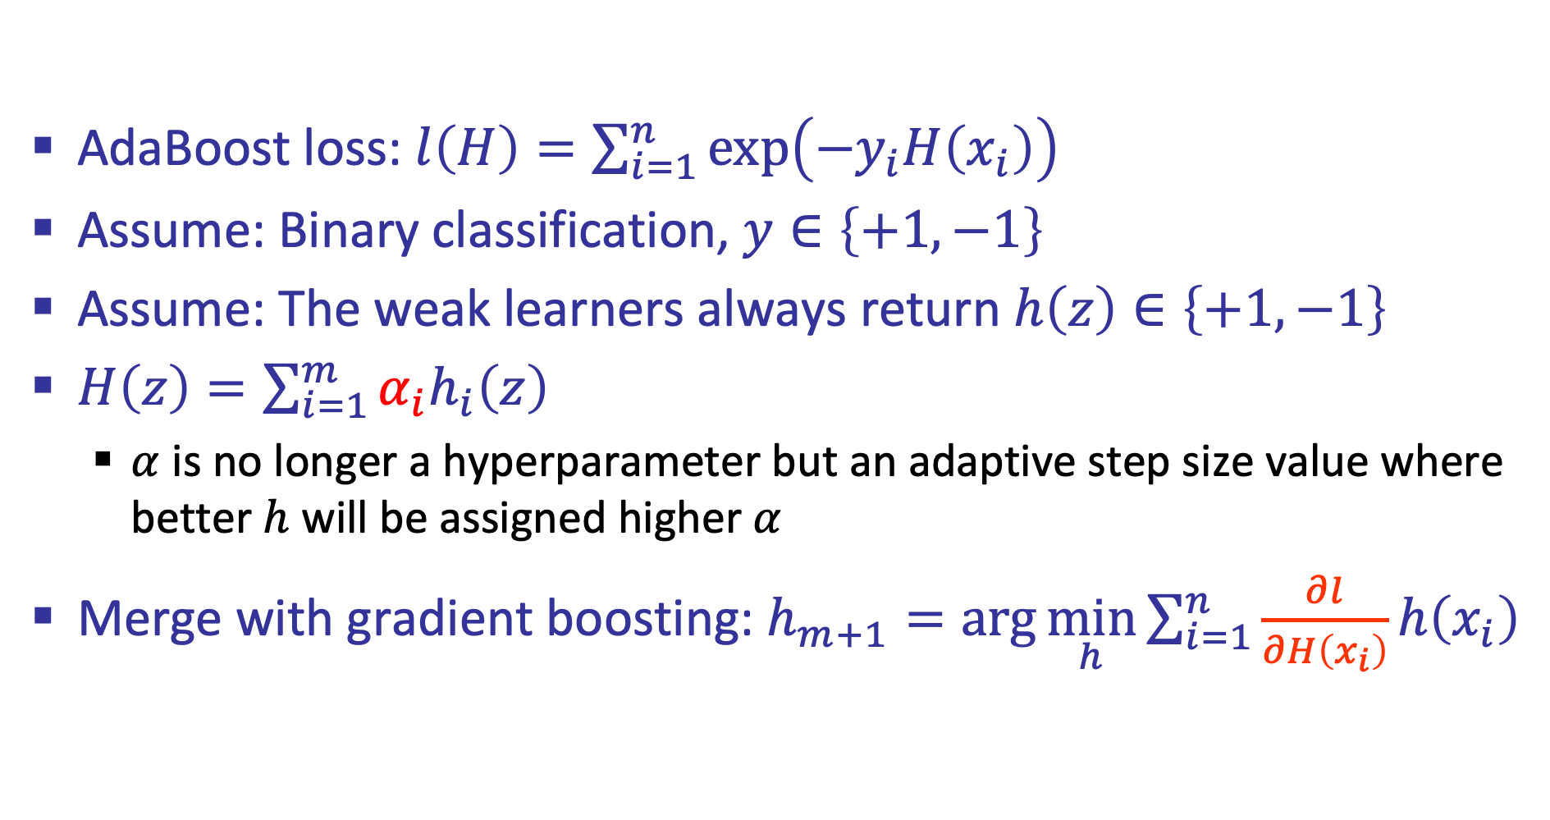
Adaptive Boost
AdaBoost loss: $l\left(H\right)=\sum_{i=1}^{n}{\exp\left(−y_{i}H\left(x_{i}\right)\right)}$
Assume: Binary classification, $y∈\left\{+1,−1\right\}$
Assume: The weak learners always return $h\left(z\right)∈\left\{+1,−1\right\}$
$H\left(z\right)=\sum_{i=1}^{m}{α_{i}h_{i}\left(z\right)}$
  $α$ is no longer a hyperparameter but an adaptive step size value where better $h$ will be assigned higher $α$
Merge with gradient boosting: $h_{m+1}=\arg{\min_{h}{\sum_{i=1}^{n}{\frac{∂l}{∂H\left(x_{i}\right)}}h\left(x_{i}\right)}}$

Slide 21
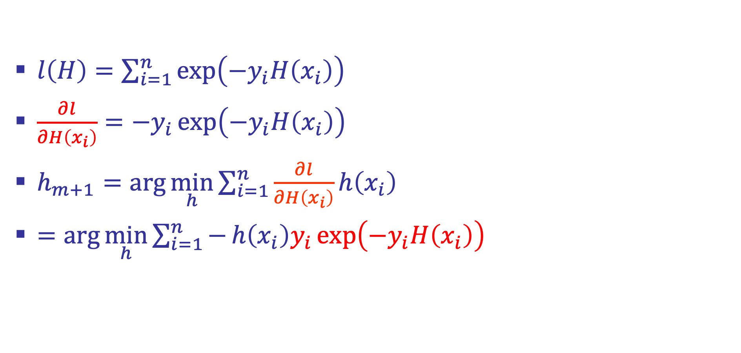
AdaBoost
$l\left(H\right)=\sum_{i=1}^{n}{\exp\left(−y_{i}H\left(x_{i}\right)\right)}$
$\frac{∂l}{∂H\left(x_{i}\right)}=−y_{i}\exp\left(−y_{i}H\left(x_{i}\right)\right)$
$h_{m+1}=\arg{\min_{h}{\sum_{i=1}^{n}{\frac{∂l}{∂H\left(x_{i}\right)}}h\left(x_{i}\right)}}$
$=\arg{\min_{h}{\sum_{i=1}^{n}{−}h\left(x_{i}\right)y_{i}\exp\left(−y_{i}H\left(x_{i}\right)\right)}}$

Slide 22
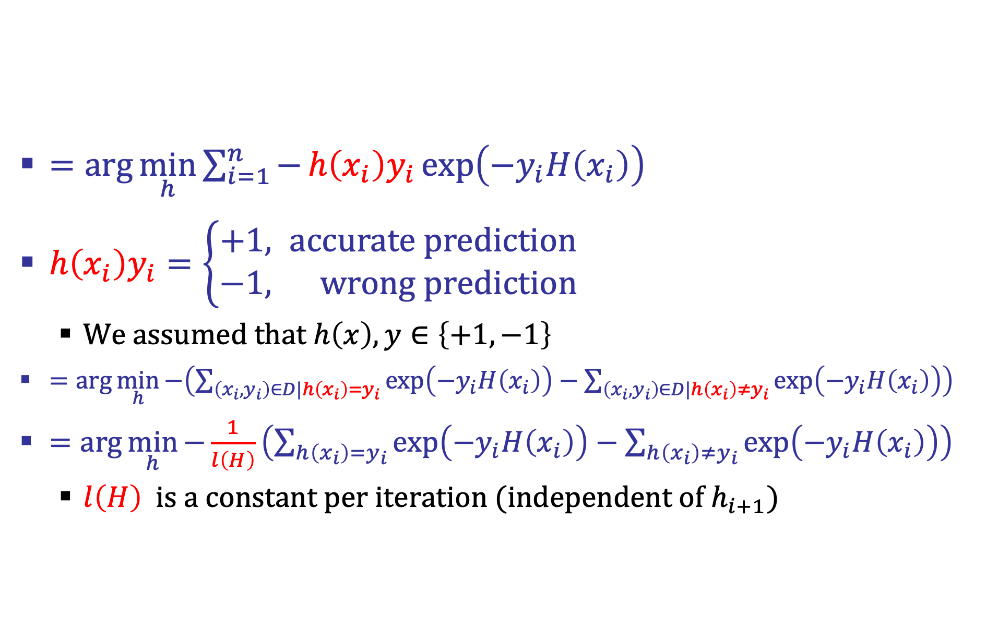
AdaBoost
$=\arg{\min_{h}{\sum_{i=1}^{n}{−}h\left(x_{i}\right)y_{i}\exp\left(−y_{i}H\left(x_{i}\right)\right)}}$
$h\left(x_{i}\right)y_{i}=\left\{\begin{aligned}+1, accurate prediction \\ &−1, wrong prediction\end{aligned}\right.$
  We assumed that $h\left(x\right),y∈\left\{+1,−1\right\}$
$=\arg{\min_{h}{−\left(\sum_{\left(x_{i},y_{i}\right)∈D|h\left(x_{i}\right)=y_{i}}{\exp\left(−y_{i}H\left(x_{i}\right)\right)}−\sum_{\left(x_{i},y_{i}\right)∈D|h\left(x_{i}\right)≠y_{i}}{\exp\left(−y_{i}H\left(x_{i}\right)\right)}\right)}}$
$=\arg{\min_{h}{−\frac{1}{l\left(H\right)}\left(\sum_{h\left(x_{i}\right)=y_{i}}{\exp\left(−y_{i}H\left(x_{i}\right)\right)}−\sum_{h\left(x_{i}\right)≠y_{i}}{\exp\left(−y_{i}H\left(x_{i}\right)\right)}\right)}}$
  $l\left(H\right)$ is a constant per iteration (independent of $h_{i+1}$)

Slide 23
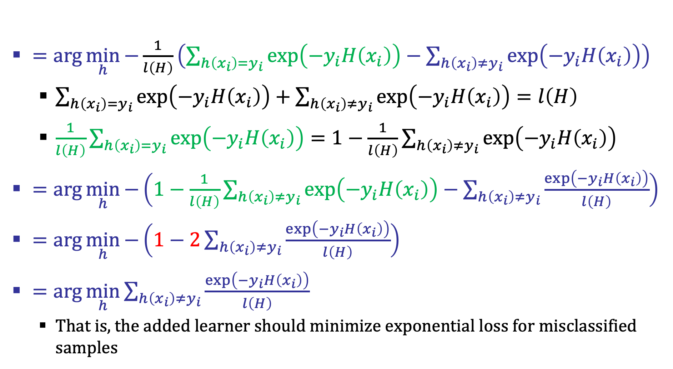
AdaBoost
$=\arg{\min_{h}{−\frac{1}{l\left(H\right)}\left(\sum_{h\left(x_{i}\right)=y_{i}}{\exp\left(−y_{i}H\left(x_{i}\right)\right)}−\sum_{h\left(x_{i}\right)≠y_{i}}{\exp\left(−y_{i}H\left(x_{i}\right)\right)}\right)}}$
  $\sum_{h\left(x_{i}\right)=y_{i}}{\exp\left(−y_{i}H\left(x_{i}\right)\right)}+\sum_{h\left(x_{i}\right)≠y_{i}}{\exp\left(−y_{i}H\left(x_{i}\right)\right)}=l\left(H\right)$
  $\frac{1}{l\left(H\right)}\sum_{h\left(x_{i}\right)=y_{i}}{\exp\left(−y_{i}H\left(x_{i}\right)\right)}=1−\frac{1}{l\left(H\right)}\sum_{h\left(x_{i}\right)≠y_{i}}{\exp\left(−y_{i}H\left(x_{i}\right)\right)}$
$=\arg{\min_{h}{−\left(1−\frac{1}{l\left(H\right)}\sum_{h\left(x_{i}\right)≠y_{i}}{\exp\left(−y_{i}H\left(x_{i}\right)\right)}−\sum_{h\left(x_{i}\right)≠y_{i}}{\frac{\exp\left(−y_{i}H\left(x_{i}\right)\right)}{l\left(H\right)}}\right)}}$
$=\arg{\min_{h}{−\left(1−2\sum_{h\left(x_{i}\right)≠y_{i}}{\frac{\exp\left(−y_{i}H\left(x_{i}\right)\right)}{l\left(H\right)}}\right)}}$
$=\arg{\min_{h}{\sum_{h\left(x_{i}\right)≠y_{i}}{\frac{\exp\left(−y_{i}H\left(x_{i}\right)\right)}{l\left(H\right)}}}}$
  That is, the added learner should minimize exponential loss for misclassified samples

Slide 24
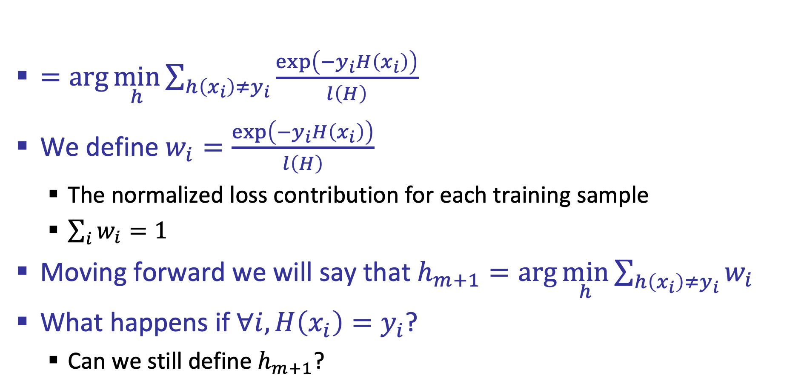
AdaBoost
$=\arg{\min_{h}{\sum_{h\left(x_{i}\right)≠y_{i}}{\frac{\exp\left(−y_{i}H\left(x_{i}\right)\right)}{l\left(H\right)}}}}$
We define $w_{i}=\frac{\exp\left(−y_{i}H\left(x_{i}\right)\right)}{l\left(H\right)}$
  The normalized loss contribution for each training sample
  $\sum_{i}{w_{i}}=1$
Moving forward we will say that $h_{m+1}=\arg{\min_{h}{\sum_{h\left(x_{i}\right)≠y_{i}}{w_{i}}}}$
What happens if $∀i, H\left(x_{i}\right)=y_{i}$?
  Can we still define $h_{m+1}$?

Slide 25
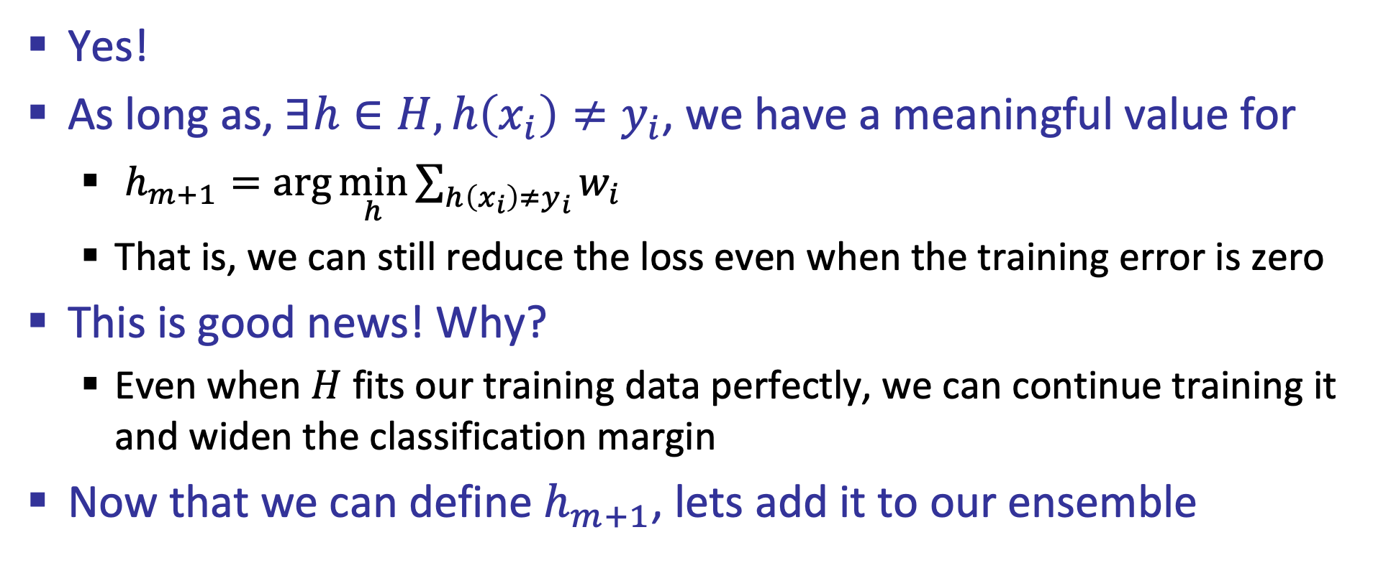
Yes!
As long as, $∃h∈H, h\left(x_{i}\right)≠y_{i}$, we have a meaningful value for
  $h_{m+1}=\arg{\min_{h}{\sum_{h\left(x_{i}\right)≠y_{i}}{w_{i}}}}$
  That is, we can still reduce the loss even when the training error is zero
This is good news! Why?
  Even when $H$ fits our training data perfectly, we can continue training it and widen the classification margin
Now that we can define $h_{m+1}$, lets add it to our ensemble

Slide 26
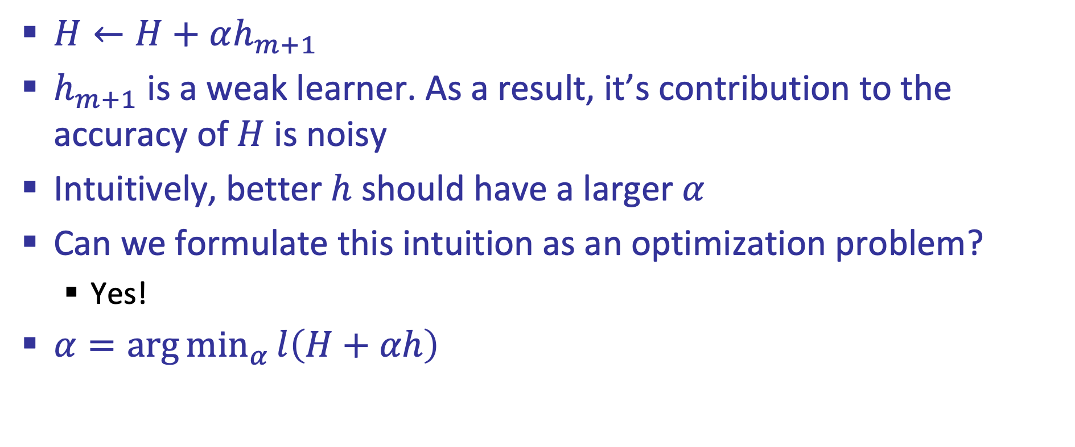
Adaptive Boosting
$H←H+αh_{m+1}$
$h_{m+1}$ is a weak learner. As a result, it’s contribution to the accuracy of $H$is noisy
Intuitively, better $h$ should have a larger $α$
Can we formulate this intuition as an optimization problem?
  Yes!
$α=\arg{\min_{α}{l\left(H+αh\right)}}$

Slide 27
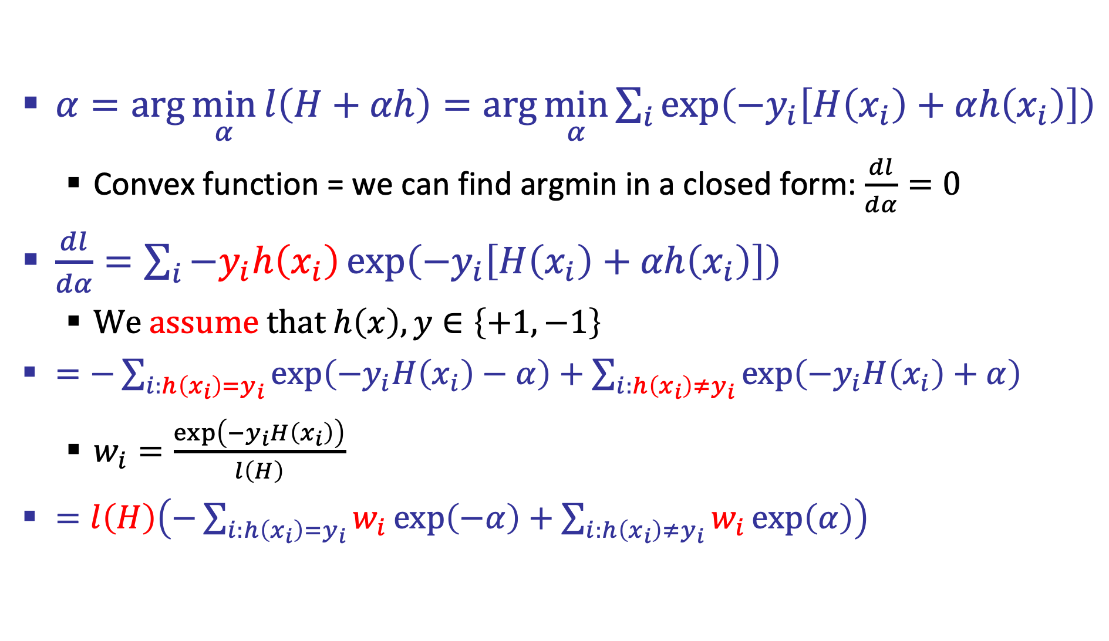
Adaptive Boosting
$α=\arg{\min_{α}{l\left(H+αh\right)}}=\arg{\min_{α}{\sum_{i}{\exp\left(−y_{i}\left[H\left(x_{i}\right)+αh\left(x_{i}\right)\right]\right)}}}$
  Convex function = we can find argmin in a closed form: $\frac{dl}{dα}=0$
$\frac{dl}{dα}=\sum_{i}{−y_{i}h\left(x_{i}\right)\exp\left(−y_{i}\left[H\left(x_{i}\right)+αh\left(x_{i}\right)\right]\right)}$
  We assume that $h\left(x\right),y∈\left\{+1,−1\right\}$
$=−\sum_{i:h\left(x_{i}\right)=y_{i}}{\exp\left(−y_{i}H\left(x_{i}\right)−α\right)}+\sum_{i:h\left(x_{i}\right)≠y_{i}}{\exp\left(−y_{i}H\left(x_{i}\right)+α\right)}$
  $w_{i}=\frac{\exp\left(−y_{i}H\left(x_{i}\right)\right)}{l\left(H\right)}$
$=l\left(H\right)\left(−\sum_{i:h\left(x_{i}\right)=y_{i}}{w_{i}\exp\left(−α\right)}+\sum_{i:h\left(x_{i}\right)≠y_{i}}{w_{i}\exp\left(α\right)}\right)$

Slide 28
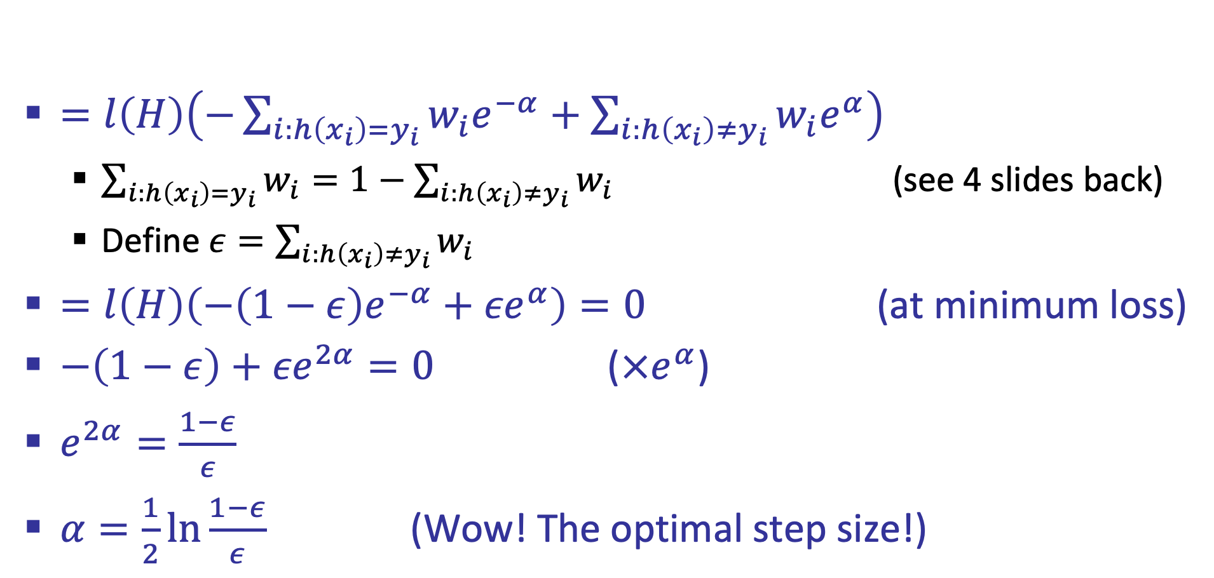
Adaptive Boosting
$=l\left(H\right)\left(−\sum_{i:h\left(x_{i}\right)=y_{i}}{w_{i}e^{−α}}+\sum_{i:h\left(x_{i}\right)≠y_{i}}{w_{i}e^{α}}\right)$
  $\sum_{i:h\left(x_{i}\right)=y_{i}}{w_{i}}=1−\sum_{i:h\left(x_{i}\right)≠y_{i}}{w_{i}}$ (see 4 slides back)
  Define $ε=\sum_{i:h\left(x_{i}\right)≠y_{i}}{w_{i}}$
$=l\left(H\right)\left(−{\left(1−ε\right)e}^{−α}+{εe}^{α}\right)=0$ (at minimum loss)
$−\left(1−ε\right)+{εe}^{2α}=0$ ($×e^{α}$)
$e^{2α}=\frac{1−ε}{ε}$
$α=\frac{1}{2}\ln{\frac{1−ε}{ε}}$ (Wow! The optimal step size!)

Slide 29
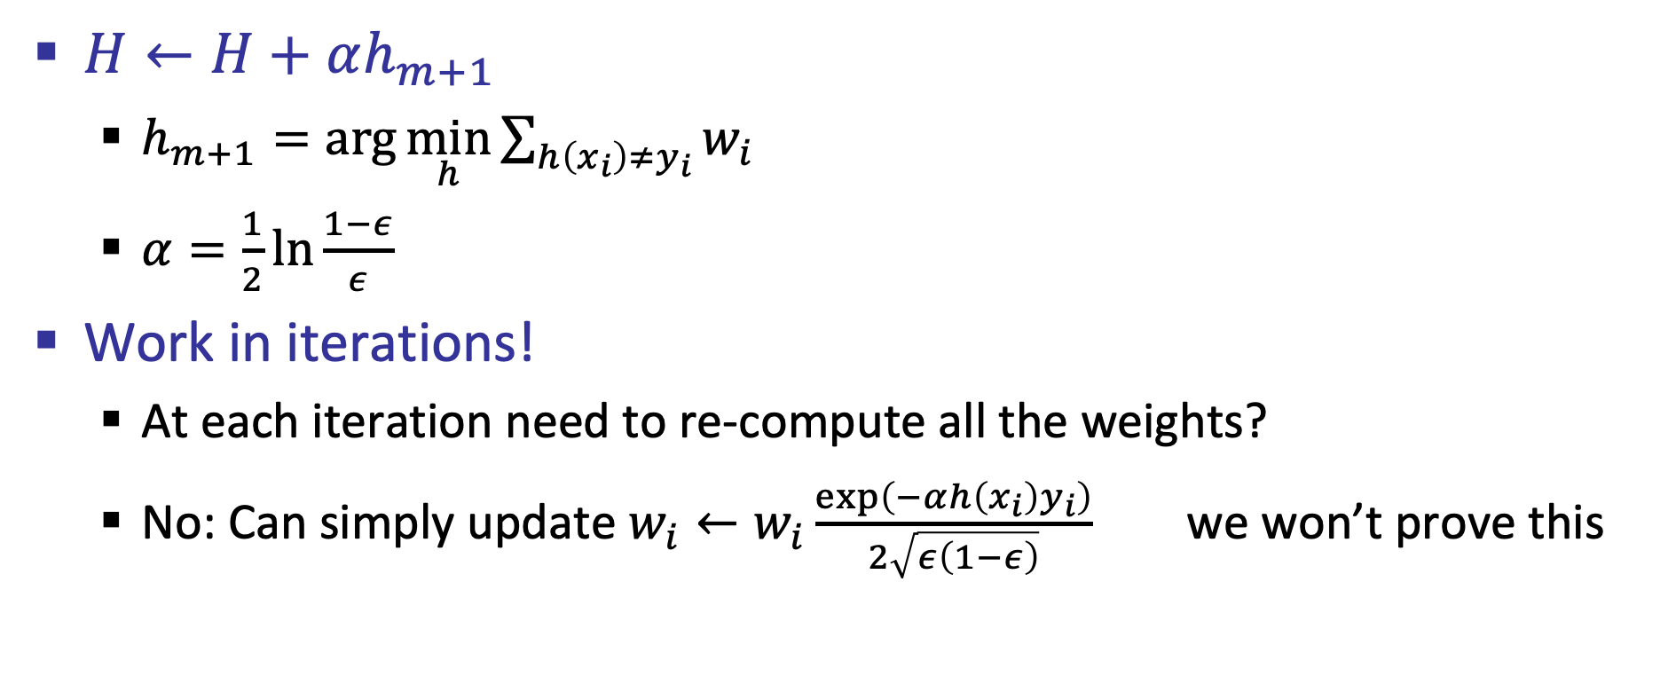
AdaBoost
$H←H+αh_{m+1}$
  $h_{m+1}=\arg{\min_{h}{\sum_{h\left(x_{i}\right)≠y_{i}}{w_{i}}}}$
  $α=\frac{1}{2}\ln{\frac{1−ε}{ε}}$
Work in iterations!
  At each iteration need to re-compute all the weights?
  No: Can simply update $w_{i}←w_{i}\frac{\exp\left(−αh\left(x_{i}\right)y_{i}\right)}{2\sqrt{ε\left(1−ε\right)}}$ we won’t prove this

Slide 30
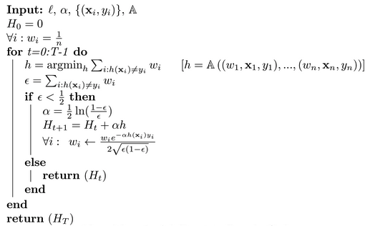
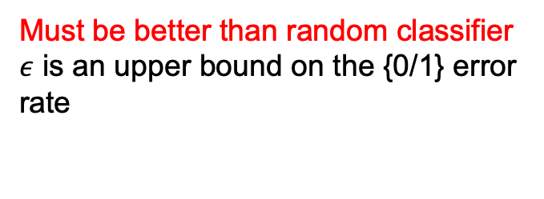
AdaBost
Must be better than random classifier
$ε$ is an upper bound on the {0/1} error rate

Slide 31
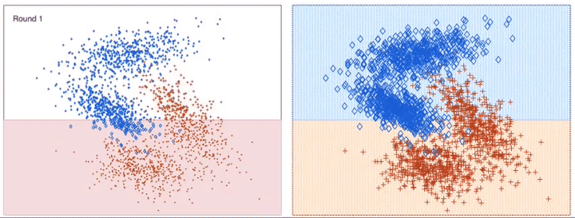

Slide 32
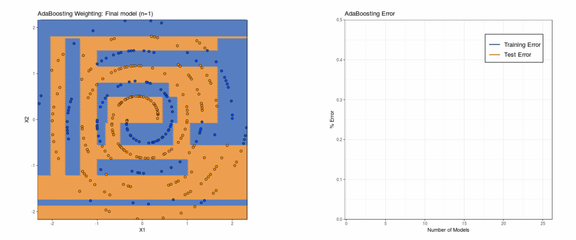

Slide 33
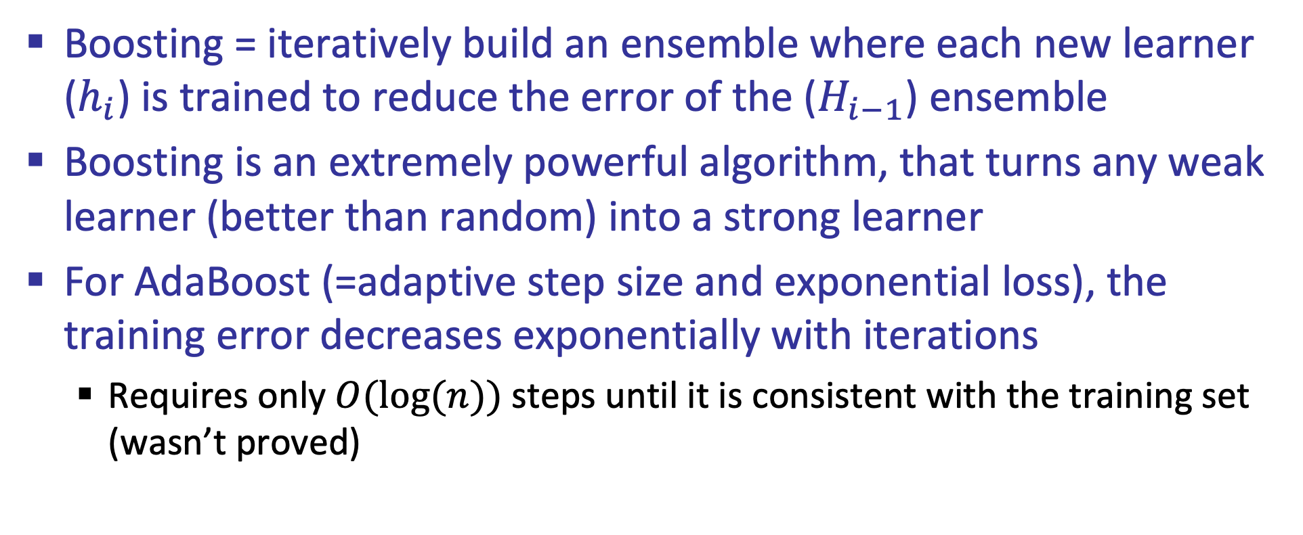
What did we learn?
Boosting = iteratively build an ensemble where each new learner ($h_{i}$) is trained to reduce the error of the ($H_{i−1}$) ensemble
Boosting is an extremely powerful algorithm, that turns any weak learner (better than random) into a strong learner
For AdaBoost (=adaptive step size and exponential loss), the training error decreases exponentially with iterations
  Requires only $O(log⁡(n))$steps until it is consistent with the training set (wasn’t proved)

Slide 34
What next?
Class: Neural Networks
Assignments:
  Assignment (P3): SVM, linear regression and kernelization, due April-14
  Assignment (P4): Decision trees, due April 19

