Slide 1
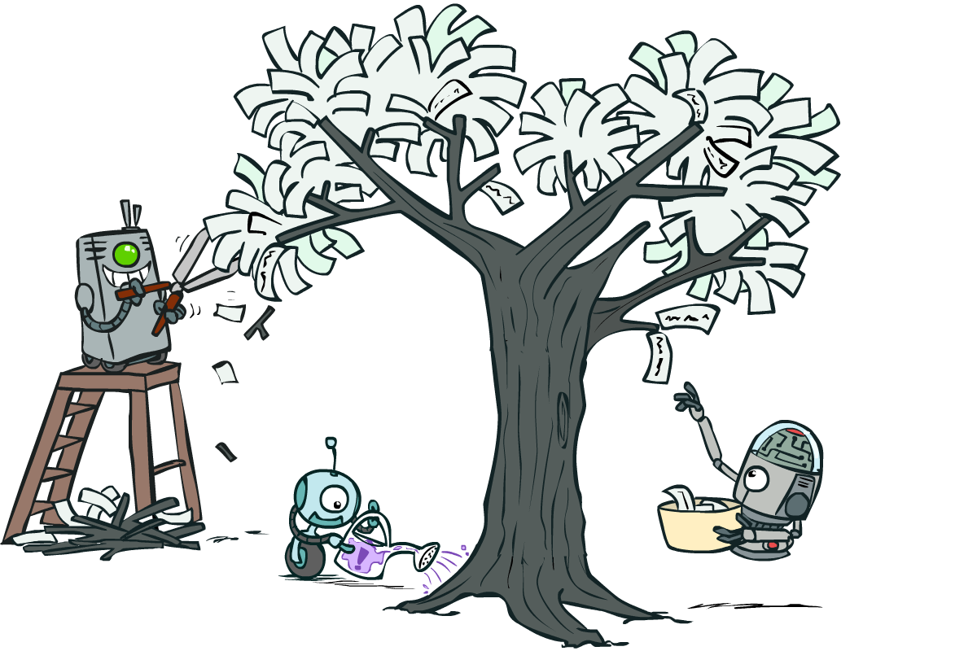
CSCE-421 Machine Learning
14. Decision Trees
Instructor: Guni Sharon
Based on slides by: Pieter Abbeel, Dan Klein

Slide 2
Announcements
  Midterm on Tuesday, April 12 during class
Due:
  Quiz 4: ML debugging and kernelization, due Wednesday April-4
  Assignment (P3): SVM, linear regression and kernelization, due April-12

Slide 3
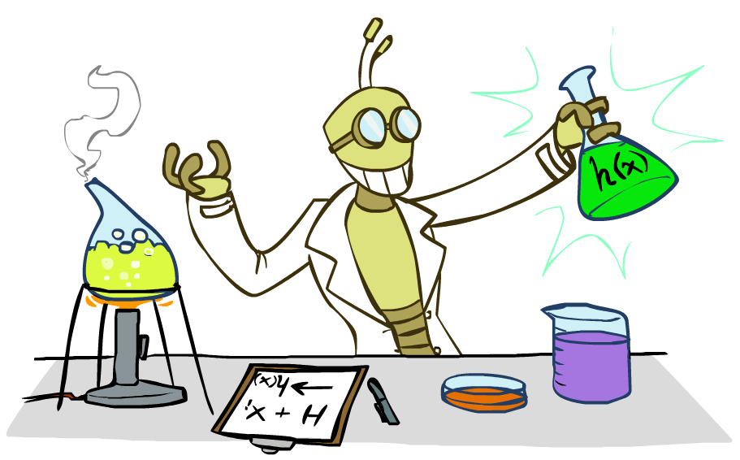
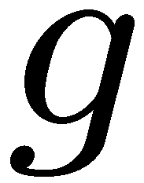


Supervised Learning
Simplest form: learn a function from examples
  A target function: g
  Observations: input-output pairs (x, g(x))
  E.g. x is an email and g(x) is spam / ham
  E.g. x is a house and g(x) is its selling price
Problem:
  Given a hypothesis space H
  Given a training set of examples x
  Find a hypothesis h(x) such that h ~ g
Includes:
  Classification (outputs = class labels)
  Regression (outputs = real numbers)
How does naïve Bayes fit in? (H, h, g)

Slide 4
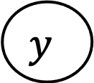
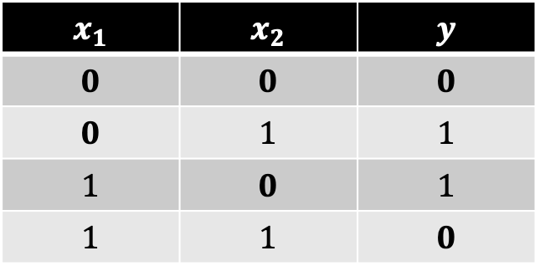
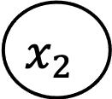
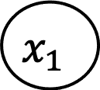
Supervised learning with Naïve Bayes
Given a training set composed of (x <features value>, y <label>)
Learns a correlation between each feature value and each label
Very limiting assumption of independency (limited H)
Can we train a Naïve Bayes model to output a XOR function?
$$y$$
$$x_{1}$$ | $$x_{2}$$ | $$y$$
$$0$$ | $$0$$ | $$0$$
$$0$$ | $$1$$ | $$1$$
$$1$$ | $$0$$ | $$1$$
$$1$$ | $$1$$ | $$0$$
$$x_{1}$$
$$x_{2}$$

Slide 5
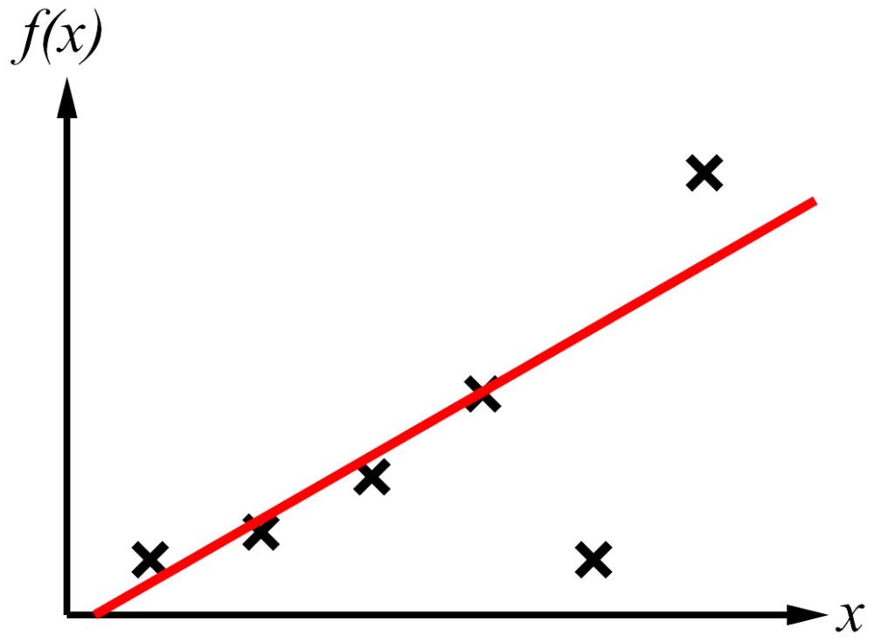
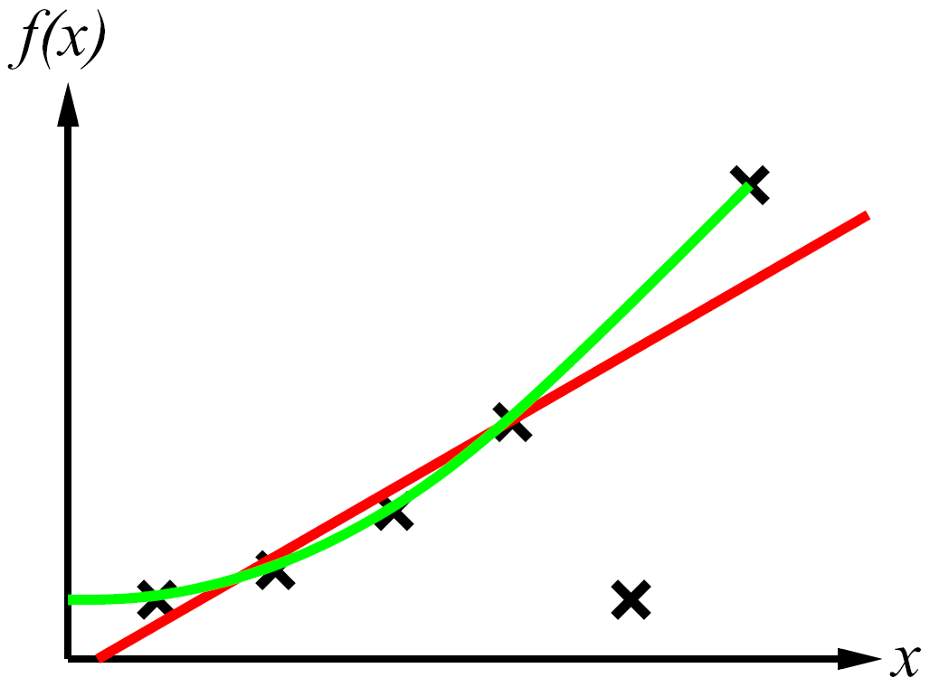
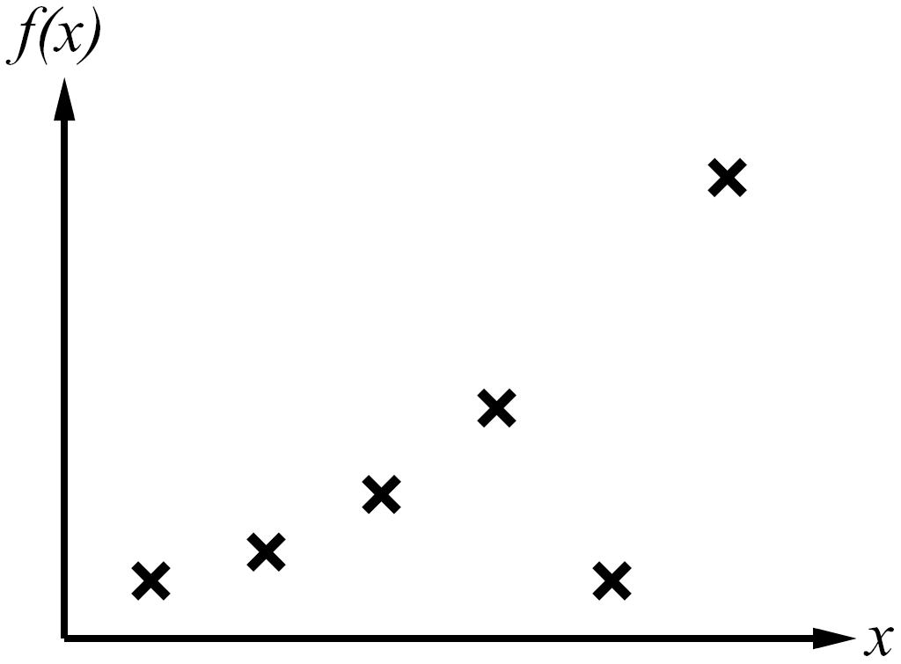
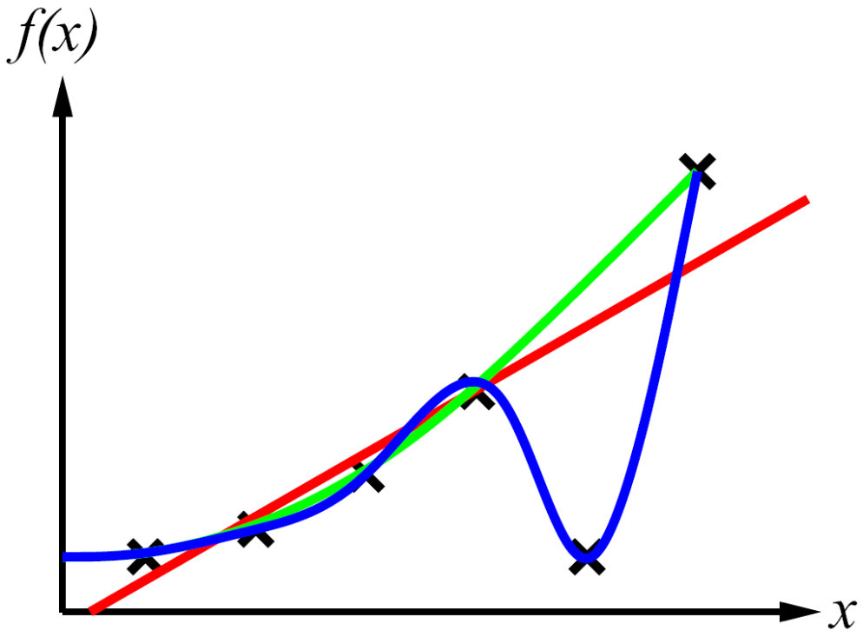
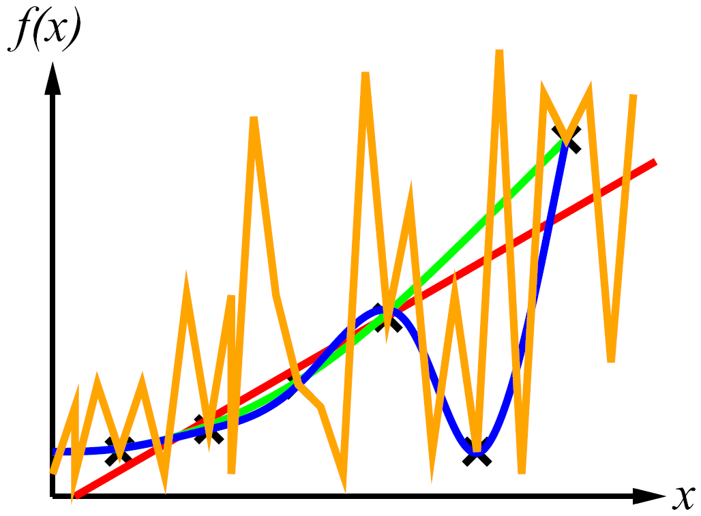
Supervised Learning
Curve fitting (regression, function approximation):
bias vs. variance
Occam’s razor

Slide 6
Bias vs. Variance
Fundamental tradeoff: bias (due to limited H) vs. variance (due to overfitting on training)
ML algorithms tend to overfit by default (why?)
Several ways to reduce variance
  Reduce the hypothesis space
    Restrictive assumptions: e.g., independence assumptions, as in naïve Bayes
    Have fewer, better features (feature selection)
    Other structural limitations
  Regularization
    Smoothing
    Many other generalization parameters (pruning cutoffs today)
      Hypothesis space stays big, but discouraged from getting to the outskirts

Slide 7
Decision Trees

Slide 8
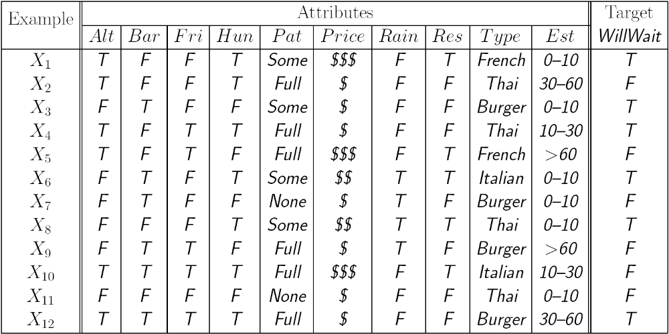
Reminder: Features
Features:
  E.g., TYPE=French

Slide 9
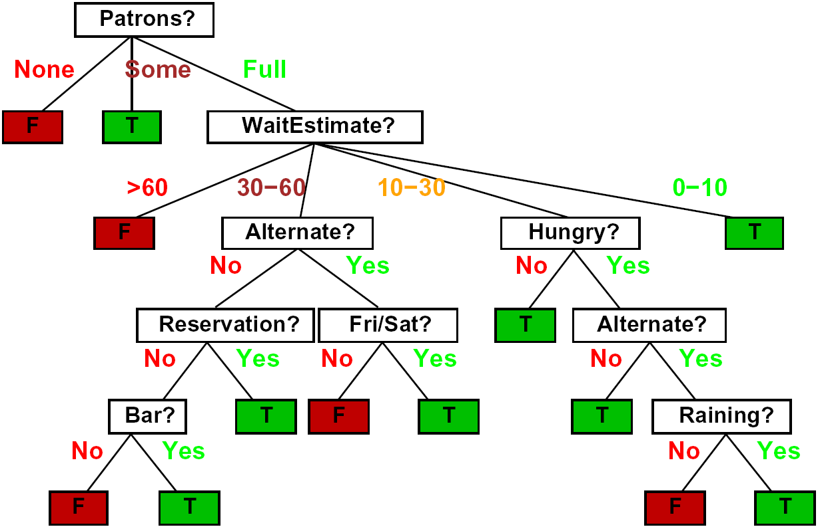
Decision Trees
Compact representation of a truth table:
  Specifies a class (label) for every feature combination
  Depth = O(number of features)
True function
  Realizable: in H
    For discreate features domain

Slide 10
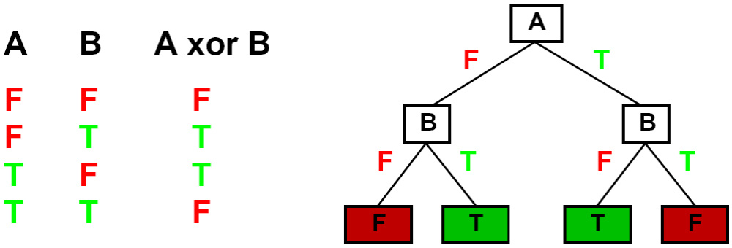
Expressiveness of DTs
Can express any function of the (discreate) features
However, we hope for compact trees

Slide 11
Comparison: Perceptrons
What are the limitations on H for a Naïve Bayes model?
Naïve Bayes model: feature’s contribution is independent (close ghost -> danger)
  If you want one feature’s effect to depend on another, you must add a new conjunction feature
  E.g., adding “close_ghost ∧ is_scared” allows a NB to model the interaction between the two atomic features
DTs automatically conjoin features / attributes
  Features can have different effects in different branches of the tree!
  Can model complex feature interactions
  Though if the interactions are too complex, may not find the DT greedily (more on tree construction later today)

Slide 12
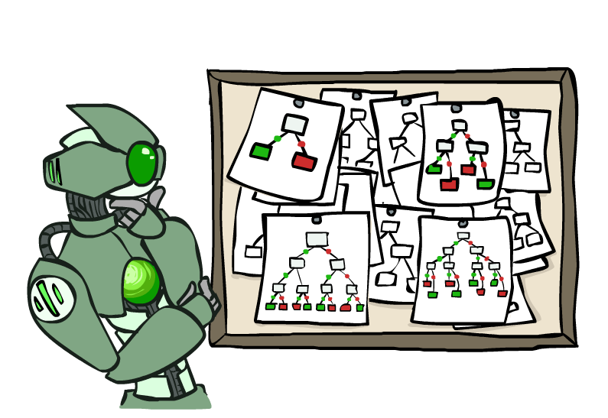
Hypothesis Spaces (why prune?)
How many distinct decision trees with n eatures each with d possible values?
  = number of classification functions for m labels over n attributes
  = number of distinct truth tables with d^{n} rows
  = m^(d^{n})
  E.g., with 6 Boolean features and Boolean classification, there are
  18,446,744,073,709,551,616 unique trees
How many trees of depth 1 (decision stumps)?
  = number of Boolean functions over 1 attribute
  = number of truth tables with 2 rows, times n
  = 4n
  E.g. with 6 Boolean attributes, there are 24 decision stumps
More expressive hypothesis space:
  Increases chance that target function can be expressed (good)
  Increases number of hypotheses consistent with training set (bad, why?)
  Means we can better fit the true data patterns (lower bias)
  But we might overfit on the training data (higher variance)

Slide 13
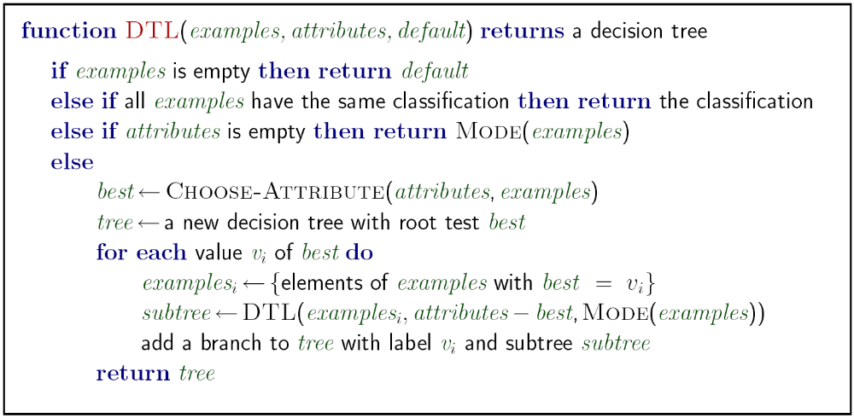









Decision Tree Learning
Aim: find a small tree consistent with the training examples
Idea: (recursively) choose “most significant” attribute as root of (sub)tree
$$samples, features$$
$$samples$$
$$samples$$
$$features$$
$$samples$$
Choose-Feature($samples, features$)
$$samples_{i}$$
$$samples$$
$$samples_{i}, features$$
$$samples$$

Slide 14
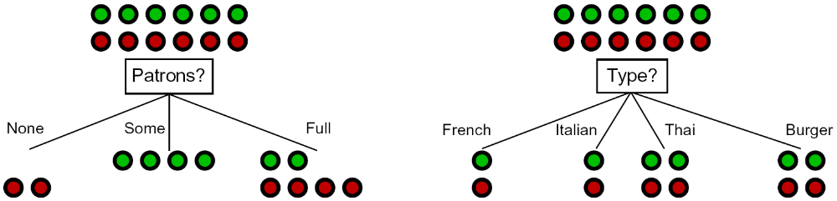
Choosing a feature
Idea: a good feature splits the examples into subsets that are (ideally) “all positive” or “all negative”
So: we need a measure of how “good” a split is, even if the results aren’t perfectly separated out

Slide 15
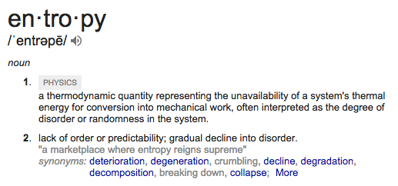
Entropy

Slide 16
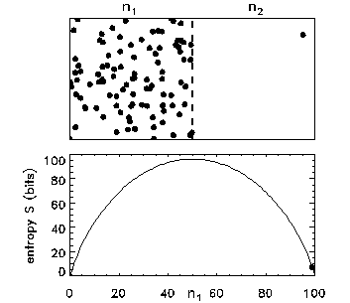
Entropy

Slide 17
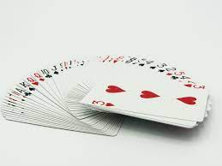
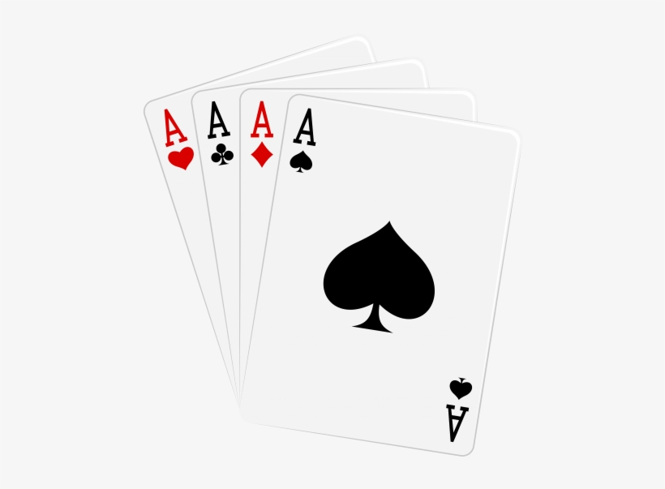
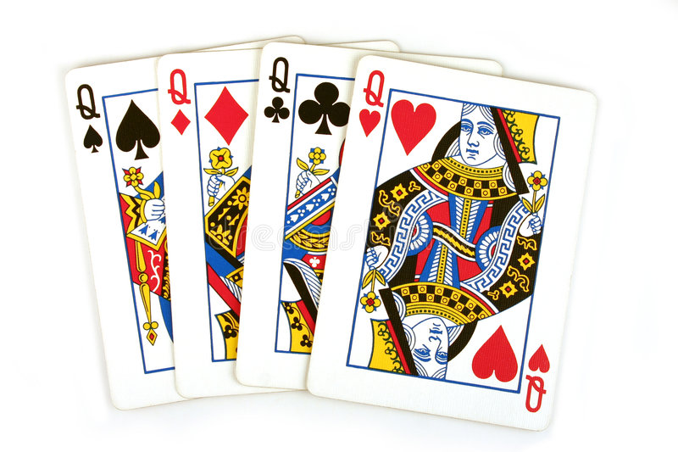
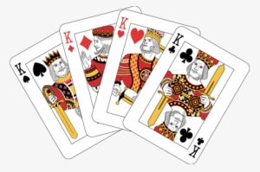
Disorder is the most probable state
What is the probability of getting a specific card order after shuffling a deck?
  1 over all possible configurations (52!)
    52!=80,658,175,170,943,878,571,660,636, 856,403,766,975,289,505,440, 883,277,824,000,000,000,000
What is the probability of getting a configuration where cards are grouped together based on value?
  Number of configurations where cards are grouped together over number 52!
Why is it not probable to shuffle cards and get grouped values?

Slide 18
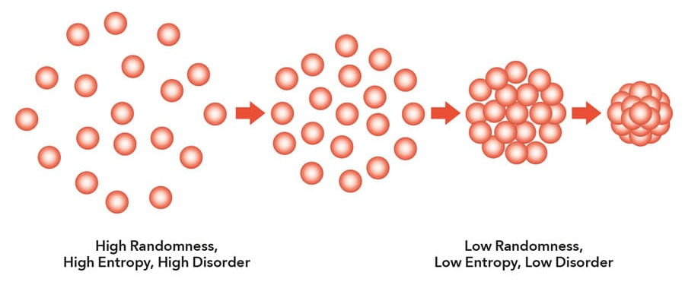
Entropy
The 2nd law of thermodynamics states that the total entropy of an isolated system can never decrease over time. Isolated systems spontaneously evolve towards thermodynamic equilibrium, the state with maximum entropy
How much information is required to represent each state?

Slide 19
Entropy in Information Theory
Information answers questions
  The more uncertain about the answer initially, the more information in the answer
  Scale: bits
    Answer to Boolean question with prior <1/2, 1/2>?
    Answer to 4-way question with prior <1/4, 1/4, 1/4, 1/4>?
    Answer to 4-way question with prior <0, 0, 0, 1>?
    Answer to 3-way question with prior <1/3, 1/3, 1/3>?
    Answer to 3-way question with prior <1/2, 1/4, 1/4>?
High entropy p-way question:
  A uniform distribution with probability 1/p
  Requires a code of length O(log₂ 1/p)
1 bit
2 bits
0 bits
1+0.667x1=1.667 bits
1+0.5x1=1.5 bits

Slide 20
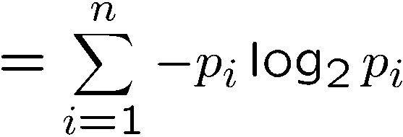
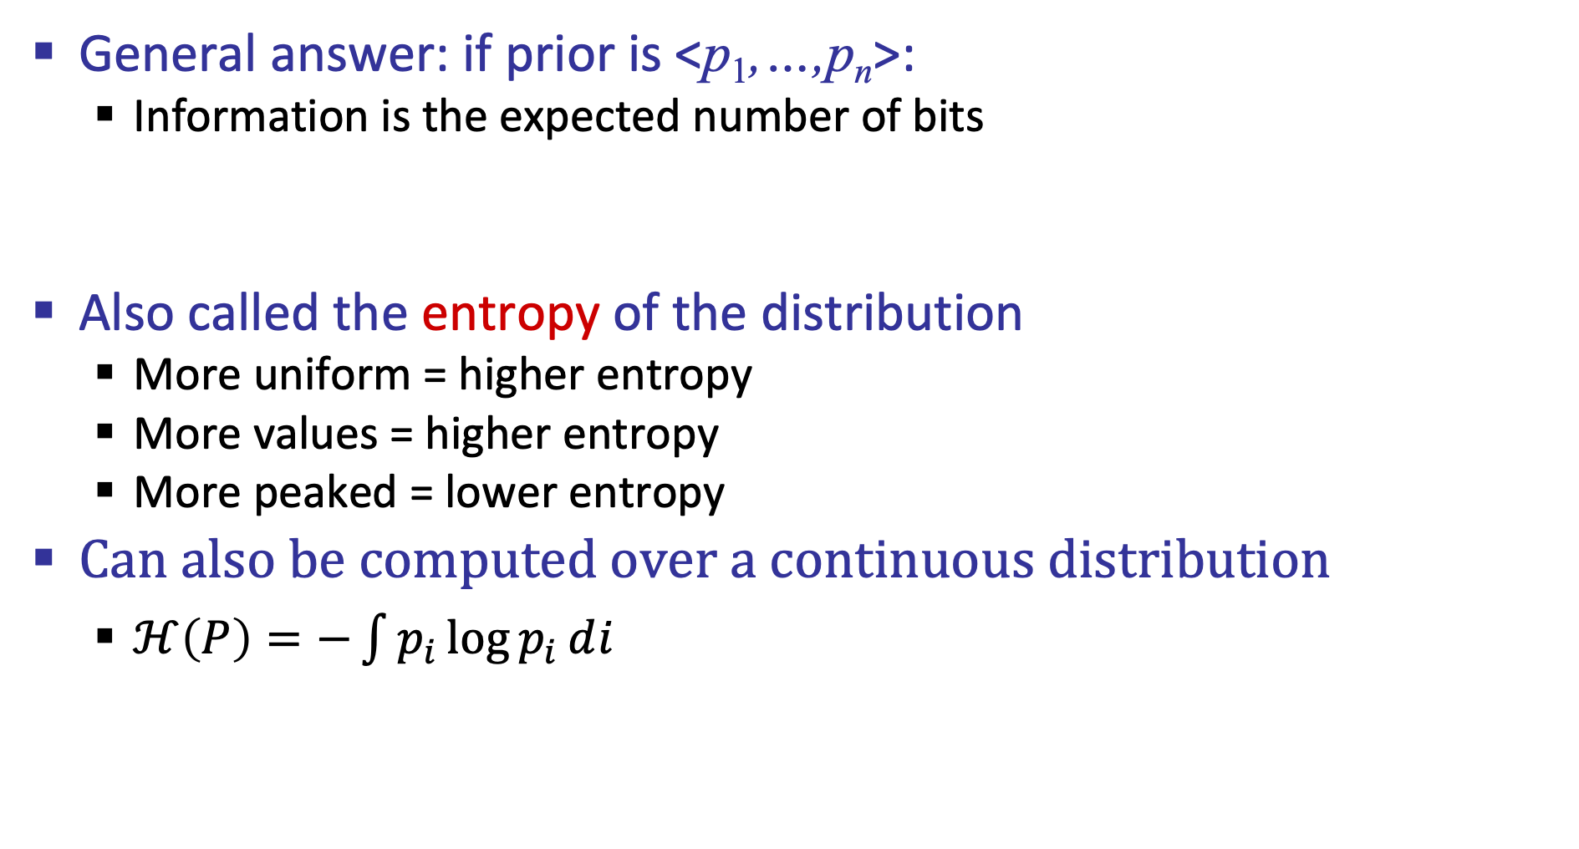
Entropy
General answer: if prior is <p₁,…,p_{n}>:
  Information is the expected number of bits
Also called the entropy of the distribution
  More uniform = higher entropy
  More values = higher entropy
  More peaked = lower entropy
Can also be computed over a continuous distribution
  $ℋ\left(P\right)=−\int{p_{i}\log{p_{i}}}ⅆi$
1 bit
0 bits
0.5 bit

Slide 21
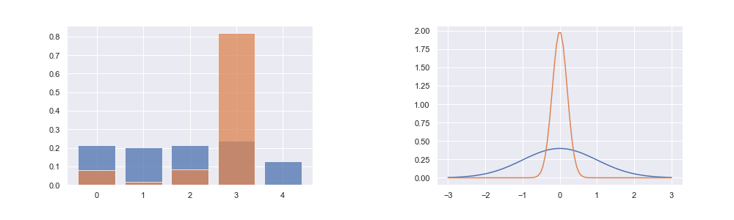
Entropy
Categorical (left), and Gaussian (Right) distributions. Orange shows low-entropy distributions, while blue shows high-entropy distributions.
Picture credit: Arthur Juliani

Slide 22
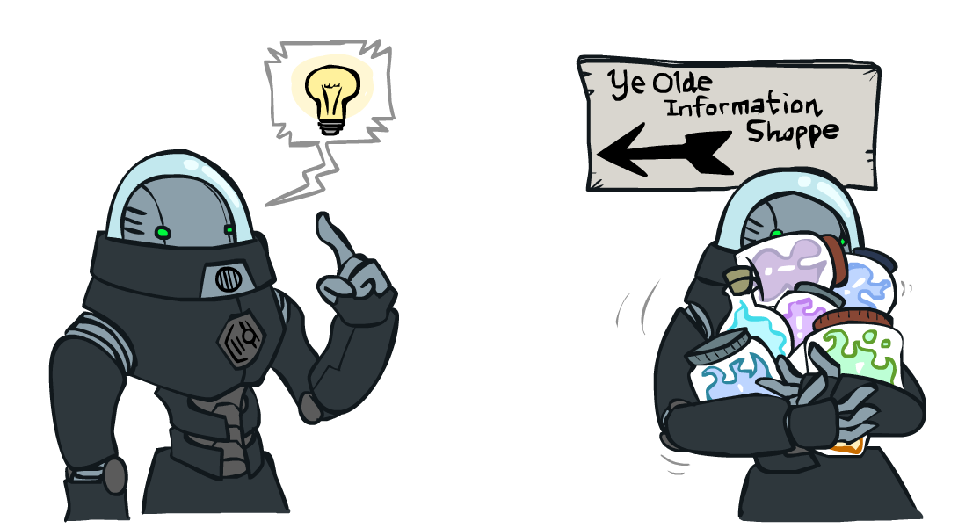
Information Gain
Back to decision trees!
For each split, compare entropy before and after
  Difference is the information gain
  Problem: there’s more than one distribution after split!
  Solution: use expected entropy = sum H(t) weighted by the number of examples

Slide 23
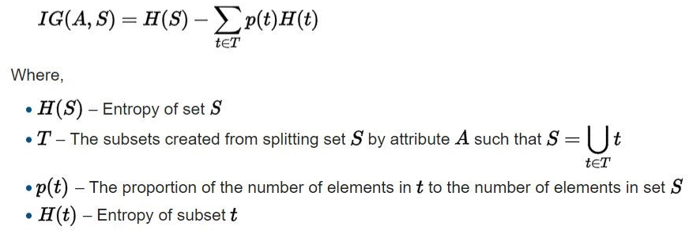
Information Gain
feature
Split on the feature with the max IG

Slide 24
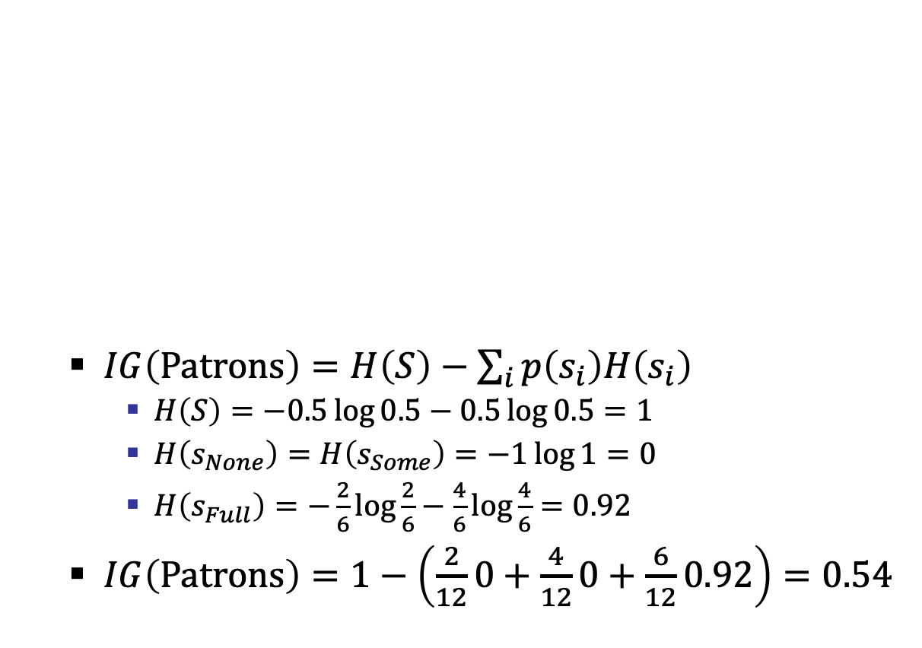
Information Gain
  $IG\left(Patrons\right)=H\left(S\right)−\sum_{i}{p\left(s_{i}\right)H\left(s_{i}\right)}$
    $H\left(S\right)=−0.5\log{0.5}−0.5\log{0.5}=1$
    $H\left(s_{None}\right)=H\left(s_{Some}\right)=−1\log{1}=0$
    $H\left(s_{Full}\right)=−\frac{2}{6}\log{\frac{2}{6}}−\frac{4}{6}\log{\frac{4}{6}}=0.92$
  $IG\left(Patrons\right)=1−\left(\frac{2}{12}0+\frac{4}{12}0+\frac{6}{12}0.92\right)=0.54$

Slide 25
Next Step: Recurse
Now we need to keep growing the tree!
Two branches are done (why?)
What should we do under “full”?
  See what examples are there…

Slide 26
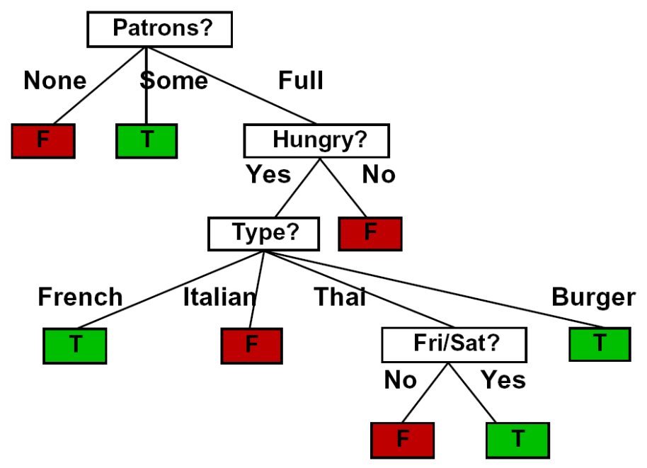
Example: Learned Tree
Decision tree learned from these 12 examples:
Substantially simpler than the full tree
  A more complex hypothesis isn't justified by data

Slide 27
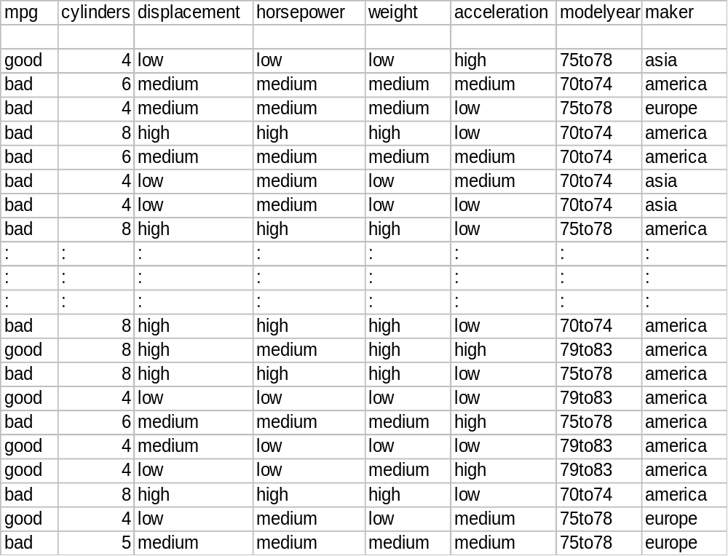
Example: Miles Per Gallon
label
40 Examples

Slide 28
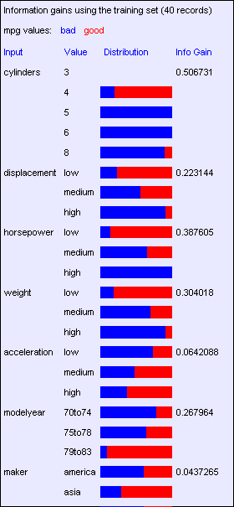
Find the First Split
Look at information gain for each attribute
What do we split on?

Slide 29
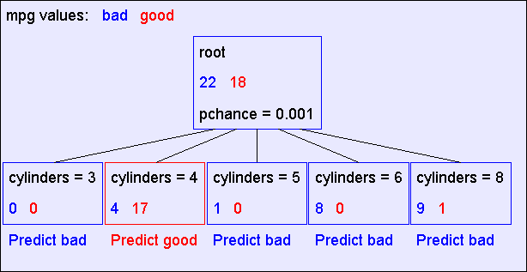
Result: Decision Stump
2 leaves don’t have a definitive label

Slide 30
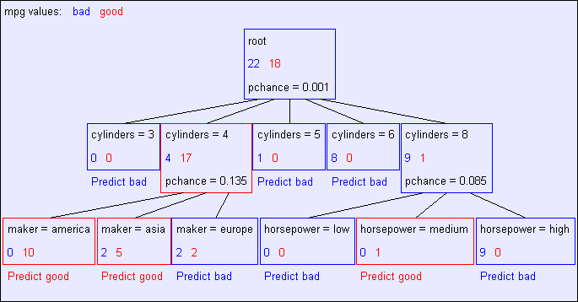
Second Level
3 leaves don’t have a definitive label.
Only 2 are still “splitable”

Slide 31
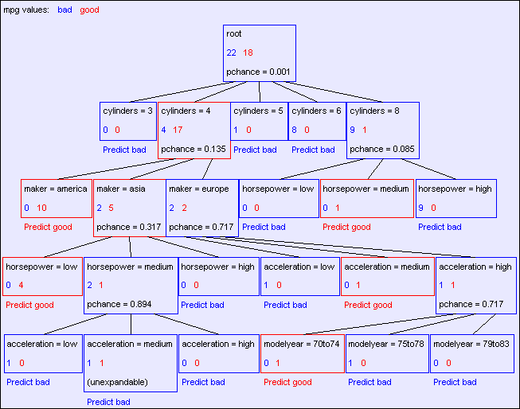
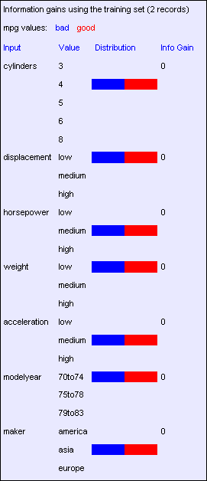
Final Tree
No value in splitting on the same attribute along any branch

Slide 32
Reminder: Overfitting
Overfitting:
  When you stop modeling the patterns in the training data (which generalize)
  And start modeling the noise (which doesn’t)
We had this before:
  Naïve Bayes: needed to smooth
  Linear regression/classifier: needed regularization

Slide 33
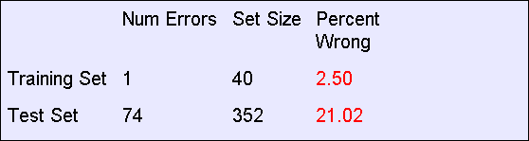

MPG Training Error
The test set error is much worse than the training set error…
…why?

Slide 34
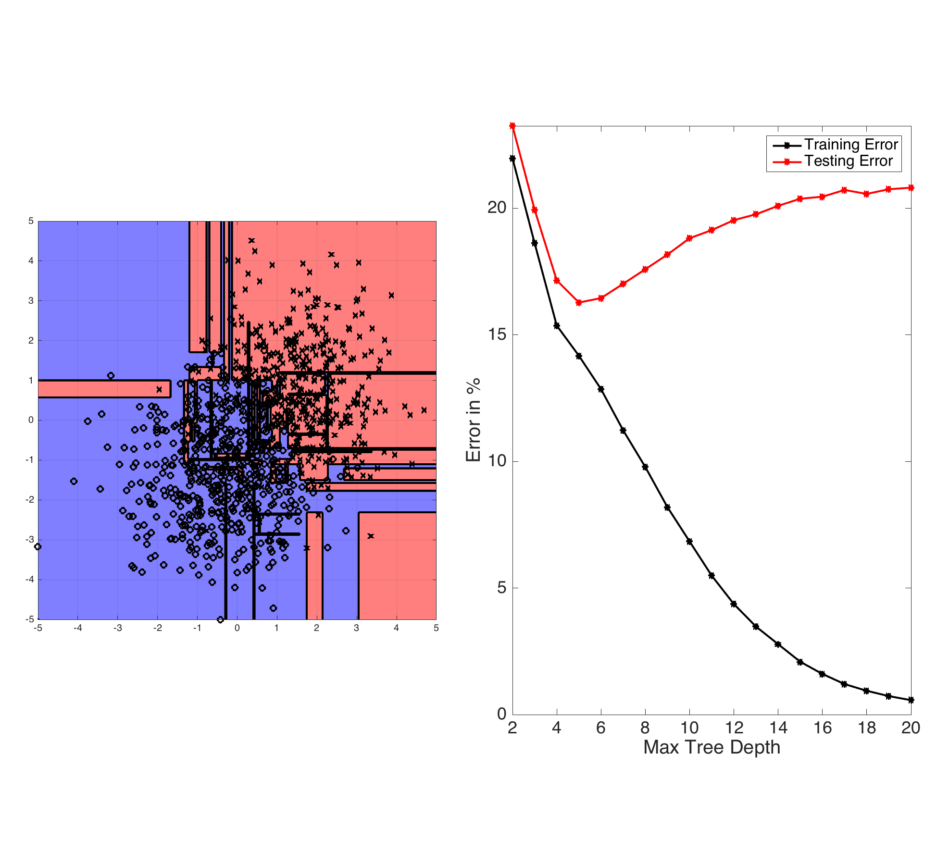
Two continuous features that can be broken down into many intervals. Each interval is a binary feature (inside/outside).

Slide 35
Let’s Consider this split
IG=0.25

Slide 36
Significance of a Split
Starting with:
  Three cars with 4 cylinders, from Asia, with medium HP
  2 bad MPG
  1 good MPG
What do we expect from a three-way split?
  Maybe each example in its own subset?
  Maybe just what we saw in the last slide?
Probably shouldn’t split if the information gain is small

Slide 37
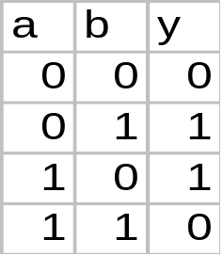
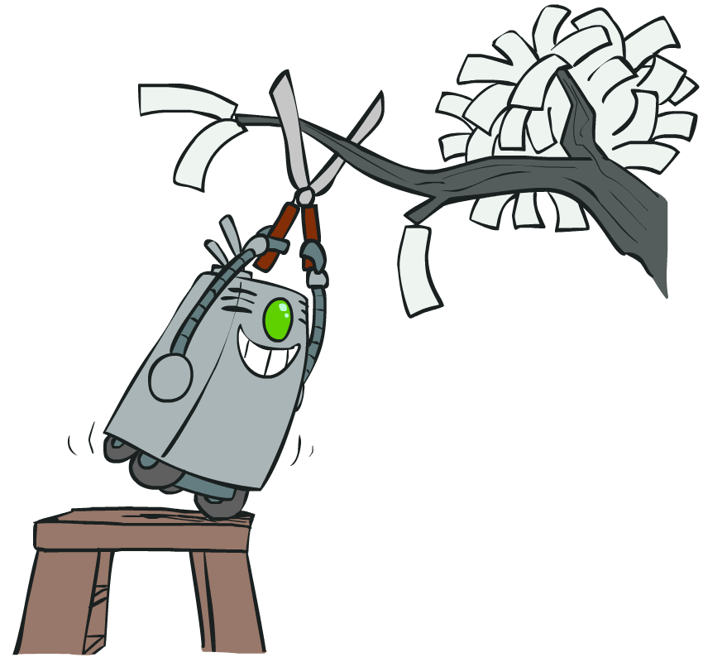
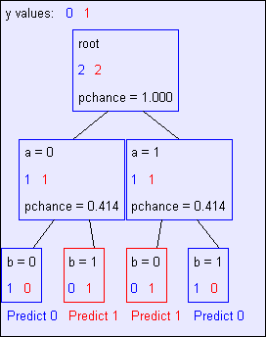
Keeping it General
Pruning:
  Build the full decision tree
  Begin at the bottom of the tree
  Delete splits in which
  IG < Threshold
  Continue working upward until there are no more prunable nodes
Why can’t we prune during training (forward)?
y = a XOR b

Slide 38
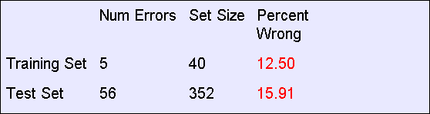
Pruning example
With Threshold = 0.3:
Note the improved test set accuracy compared with the unpruned tree

Slide 39
Regularization
Threshold is a regularization parameter
Generally, set it using held-out data (validation set)
Training
Held-out / Test
Accuracy
Decreasing
Increasing
Threshold
Small Trees
Large Trees
High Bias
High Variance

Slide 40
Overfitting in tress summary
Limit the hypothesis space
  E.g., limit the max depth of trees
  Easier to analyze
Regularize the hypothesis selection
  E.g., IG cutoff threshold
  Disprefer most of the hypotheses unless data is clearly supportive
  Commonly used

Slide 41
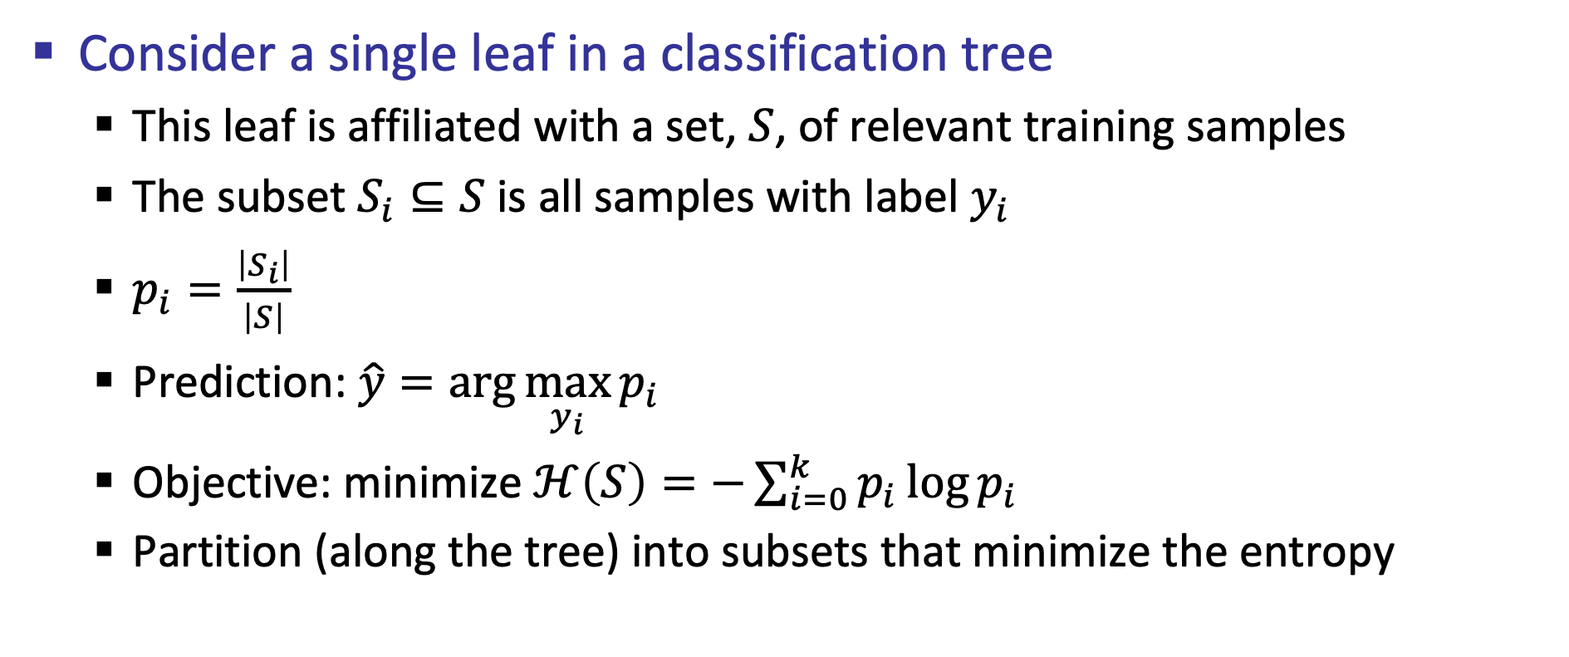
Classification and Regression Trees
Consider a single leaf in a classification tree
  This leaf is affiliated with a set, $S$, of relevant training samples
  The subset $S_{i}⊆S$ is all samples with label $y_{i}$
  $p_{i}=\frac{\left|S_{i}\right|}{\left|S\right|}$
  Prediction: $\hat{y}=\arg{\max_{y_{i}}{p_{i}}}$
  Objective: minimize $ℋ\left(S\right)=−\sum_{i=0}^{k}{p_{i}\log{p_{i}}}$
  Partition (along the tree) into subsets that minimize the entropy

Slide 42
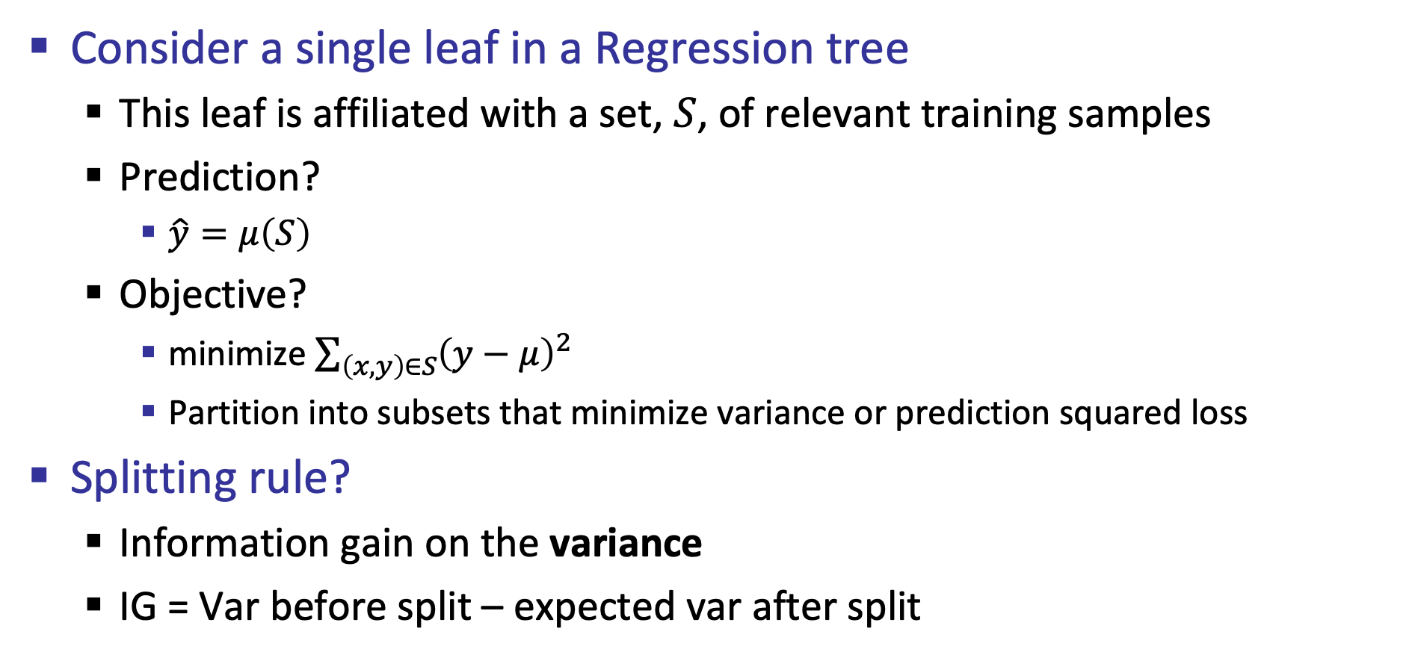
Classification and Regression Trees
Consider a single leaf in a Regression tree
  This leaf is affiliated with a set, $S$, of relevant training samples
  Prediction?
    $\hat{y}=μ\left(S\right)$
  Objective?
    minimize $\sum_{\left(x,y\right)∈S}{{\left(y−μ\right)}^{2}}$
    Partition into subsets that minimize variance or prediction squared loss
Splitting rule?
  Information gain on the variance
  IG = Var before split – expected var after split

Slide 43
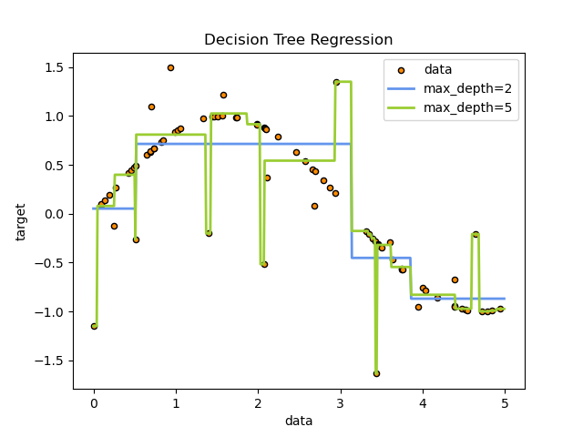
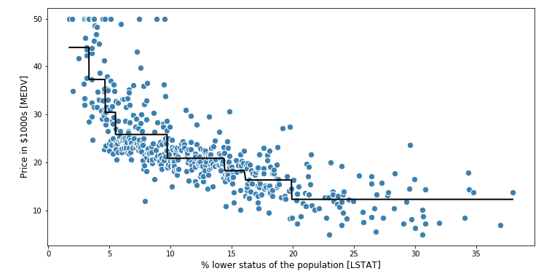
Regression Tree
How would overfitting look like?

Slide 44
Debugging trees
Trees usually suffer from large bias (overgeneralization) and/or large variance (overfitting)
Over the years, good solutions were proposed to address these issues
  We will review these in the context of trees, but they are generally applicable across ML
  [“Bagging Predictors”, Leo Bbeiman, 1996]
  ["The Strength of Weak Learnability”, Robert Schapire, 1990]

Slide 45
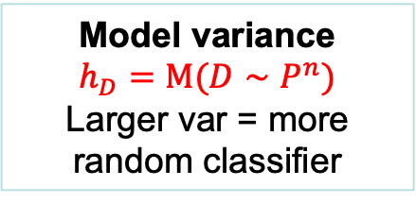
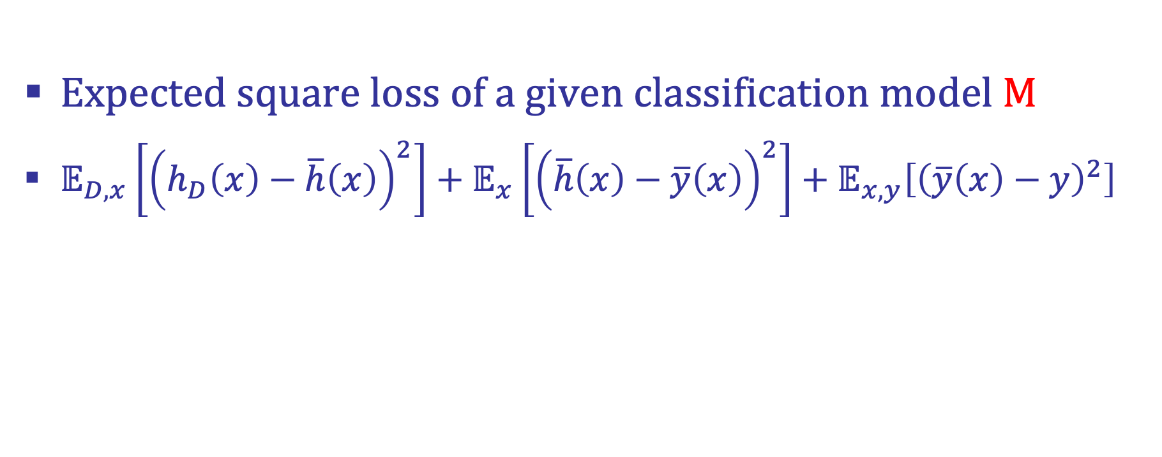

Bias and Variance
Expected square loss of a given classification model M
$𝔼_{D,x}\left[{\left(h_{D}\left(x\right)−\overline{h}\left(x\right)\right)}^{2}\right]+𝔼_{x}\left[{\left(\overline{h}\left(x\right)−\overline{y}\left(x\right)\right)}^{2}\right]+𝔼_{x,y}\left[{\left(\overline{y}\left(x\right)−y\right)}^{2}\right]$
Model variance
$$h_{D}=M(D∼P^{n})$$
Larger var = more random classifier
Model bias (^2)
$$\overline{h}=𝔼_{D∼P^{n}}\left[M\left(D\right)\right]$$
Larger bias = lower ability of the model to fit the data
Data variance (noise)
Larger var = harder to predict (objectively)

Slide 46

Model variance
$𝔼_{D,x}\left[{\left(h_{D}\left(x\right)−\overline{h}\left(x\right)\right)}^{2}\right]$
  Indicates overfitting
  Training our model on different training sets $D∼P$ results in substantially different predictions
Can we learn the expected model and eliminate variance (without overgeneralizing)
$\overline{h}\left(x\right)≐\frac{1}{m}\sum_{i=1}^{m}{h_{D_{i}}\left(x\right)}$ Yes, when $m→∞$ and $D_{i}∼P$ is IID
  weak law of large numbers

Slide 47

Ensemble learning
$\overline{h}\left(x\right)≐\frac{1}{m}\sum_{i=1}^{m}{h_{D_{i}}\left(x\right)}$ as $m→∞$ and when $D_{i}∼P$ is IID
So if we train infinite models using infinite training sets, we can eliminate variance
  Not very helpful. We have a finite training set
However, this approach of ensemble learning might still be useful

Slide 48
Ensemble learning
Ensemble learning refers to a group (or ensemble) of base learners, or models, which work collectively to achieve a better final prediction
A single model, also known as a base or weak learner, may not perform well individually due to high variance or high bias
When weak learners are aggregated, they can form a strong learner, as their combination reduces bias and/or variance

Slide 49


Bootstrap aggregation (Bagging)
Sounds good but we will still need $m$ training sets. We have 1
The main idea behind bagging is creating $m$ diverse training sets by sampling data points from $D$ at random and with replacement
  $D_{i}=[{\left(x,y\right)}^{n}∼D]$
  Also know as bootstrapping
Claim: each sample $x_{i}∈D_{i},\text{is} \text{drawn} x_{i}∼P$
$P\left(x_{i}|D\right)=\sum_{k=1}^{n}{\left({n \atop k}\right)p_{i}^{k}{\left(1−p_{i}\right)}^{n−k}\frac{k}{n}}$
Probability that $x_{i}$ appears $k$ times in $D$
Probability of sampling one of the copies

Slide 50


Bagging
$P\left(x_{i}|D\right)=\sum_{k=1}^{n}{\left({n \atop k}\right)p_{i}^{k}{\left(1−p_{i}\right)}^{n−k}\frac{k}{n}}$
$=\frac{1}{n}\sum_{k=1}^{n}{\left({n \atop k}\right)p_{i}^{k}{\left(1−p_{i}\right)}^{n−k}k}$
$=\frac{1}{n}np_{i}=p_{i}$
Does this mean that $\overline{h}\left(x\right)≐\frac{1}{m}\sum_{i=1}^{m}{h_{D_{i}}\left(x\right)}$ when using bagging?
  No! the samples $D_{i}=[{\left(x,y\right)}^{n}∼D]$ are not IID from $P$
Expected value of Binomial distribution $𝔼\left[𝔹\left(p_{i},n\right)\right]=np_{i}$
independent and identically distributed

Slide 51

Bagging
Sample $m$ data sets $D_{1},…,D_{m}$from $D$ with replacement.
For each $D_{i}$ train $h_{i}$ # Overfit
Predict: $H_{D}\left(z\right)=\frac{1}{m}\sum_{i=1}^{m}{h_{i}\left(z\right)}$ # AKA Ensemble prediction
Increasing $m$ will reduce variance=reduce error rate but will also slow down your classifier
  At some point, increasing $m$ will only slow you down and won’t contribute to test accuracy any more

Slide 52
Advantages of Bagging
Simple and easy to implement
Independent of the underlying ML algorithm
Reduces variance without increasing bias
  Strong impact on high variance classifiers
Free test sets (out of bag error)
  For each observation in the training set, measure its classification error by averaging all classifiers that were not trained on it
  Return mean error over all training observations
Provides prediction distribution (given by the set of hypotheses)
  Can compute and report prediction variance/uncertainty

Slide 53


prediction variance/uncertainty
Certain
Uncertain
$$h_{1}$$
Uncertain
Certain
$$h_{2}$$

Slide 54



$$m=3$$
$$m=6$$

Slide 55
Disadvantages of Bagging
Loss of interpretability: the underlying model might be interpretable, e.g., decision trees. However, an ensemble prediction is harder to make sense of.
Computationally expensive: Bagging slows down and grows more intensive as the ensample size increases
Unstable benefit (across models): Bagging is not beneficial for models that suffer from low variance
  “bagging a linear regression model will effectively just return the original predictions” [Hands-On Machine Learning, Boehmke & Greenwell]

Slide 56

Random Forest
A Random Forest is essentially a bagged decision tree ensemble, with a modified splitting criteria
Sample $m$ data sets $D_{1},…,D_{m}$from $D$ with replacement.
For each $D_{i}$ train $h_{i}$ with a modified splitting criteria
Predict: $H_{D}\left(z\right)=\frac{1}{m}\sum_{i=1}^{m}{h_{i}\left(z\right)}$
Splitting criteria: split on feature that maximizes the IG but don’t consider all possible features
  Consider a random subsample $k≤d$ (resample at each node)

Slide 57

Advantages of Random Forest
Easy to implement. works well “out of the box”.
Only two hyperparameters $\left(m,k\right)$
  RF is not sensitive to hyperparameters value
  Known values that usually work well
    $k=\left\lceil \sqrt{d}\right\rceil$
    $m=$ as large as you can afford
Insensitive to variance in features domain (scale, magnitude, slope, missing values)
  Doesn’t require data preprocessing

Slide 58

Not too shabby.
Bagging allows bad ML models (trees) to perform OKish.
The 1-D borders are still a pain (high bias)

Slide 59
What about bias?
Trees with high variance –> use bagging!
What if we have high bias = underfitting = the model is too weak = can’t capture data patterns
  Both training and testing losses are high
  More training data won’t help
Can this problem be addressed with an ensemble approach?
  Can weak learners be combined to generate a strong learner with low bias? Weak learner := slightly better than random guessing
  Yes! With Boosting. To be continued…

Slide 60
What did we learn?
Classification and regression trees (CART) are built towards minimizing training samples entropy at leaves
Optimal CART is NP-Hard. Use optimal myopic (1 step horizon) splitting rule = split that maximizes information gain
Trees suffer from high variance
Regularize trees by pruning leaves based on IG threshold (post pruning, bottom up)
Use ensemble learning (m trees) with bagging (m datasets) with randomness (split sample) = random forest

Slide 61
What next?
Class: Reducing bias with boosting
Assignments:
  Assignment (P3): SVM, linear regression and kernelization, due April-12
  Assignment (P4): Decision trees, due April 19
Quizzes:
  Quiz 5: decision trees and bagging, due April 11

