Slide 1

CSCE-633 Machine Learning
13. Kernel Machines
Instructor: Guni Sharon
Based on a lecture by Kilian Weinberger and Joaquin Vanschoren

Slide 2
Announcements
  Midterm on Tuesday, April 12 during class
Due:
  Quiz 4: ML debugging and kernelization, due Wednesday April-4
  Assignment (P3): SVM, linear regression and kernelization, due April-12

Slide 3
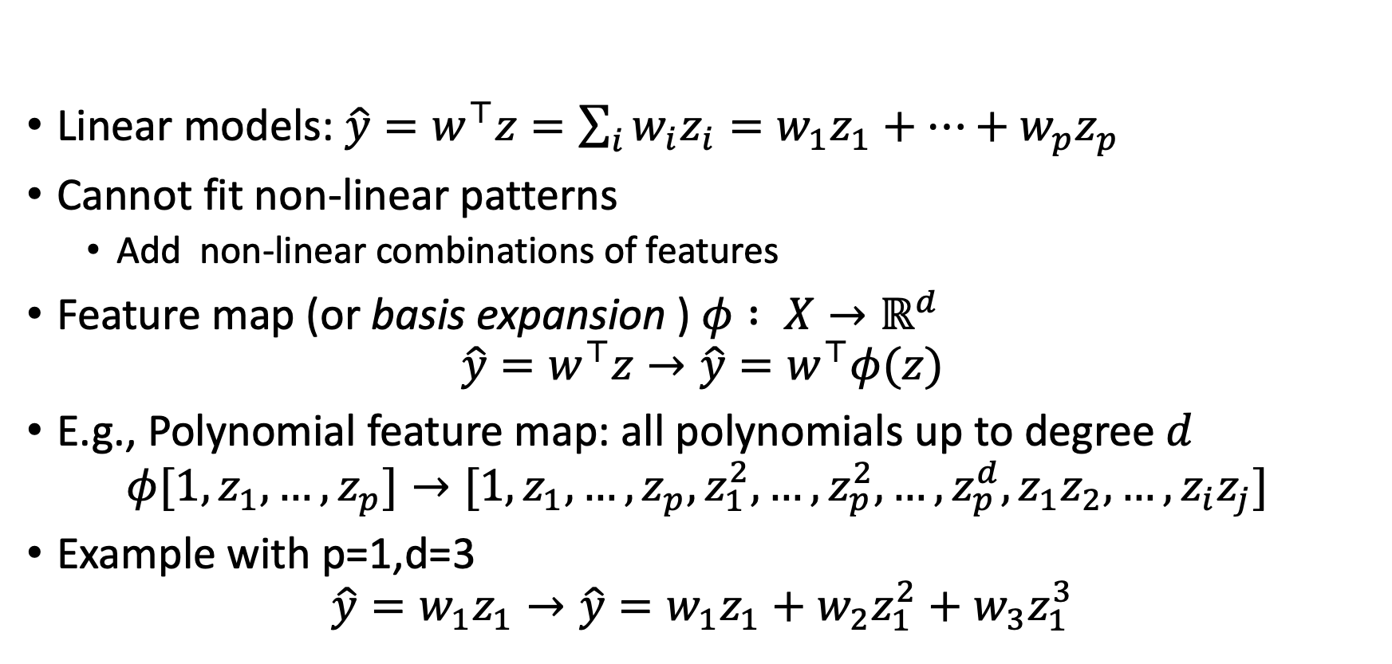
Feature Maps
Linear models: $\hat{y}=w^{⊤}z=\sum_{i}{w_{i}z_{i}}=w_{1}z_{1}+…+w_{p}z_{p}$
Cannot fit non-linear patterns
  Add non-linear combinations of features
Feature map (or basis expansion ) $φ : X→ℝ^{d}$
$$\hat{y}=w^{⊤}z→\hat{y}=w^{⊤}φ(z)$$
E.g., Polynomial feature map: all polynomials up to degree $d$
$$φ[1,z_{1},…,z_{p}]→[1,z_{1},…,z_{p},z_{1}^{2},…,z_{p}^{2},…,z_{p}^{d},z_{1}z_{2},…,z_{i}z_{j}]$$
Example with p=1,d=3
$$\hat{y}=w_{1}z_{1}→\hat{y}=w_{1}z_{1}+w_{2}z_{1}^{2}+w_{3}z_{1}^{3}$$

Slide 4
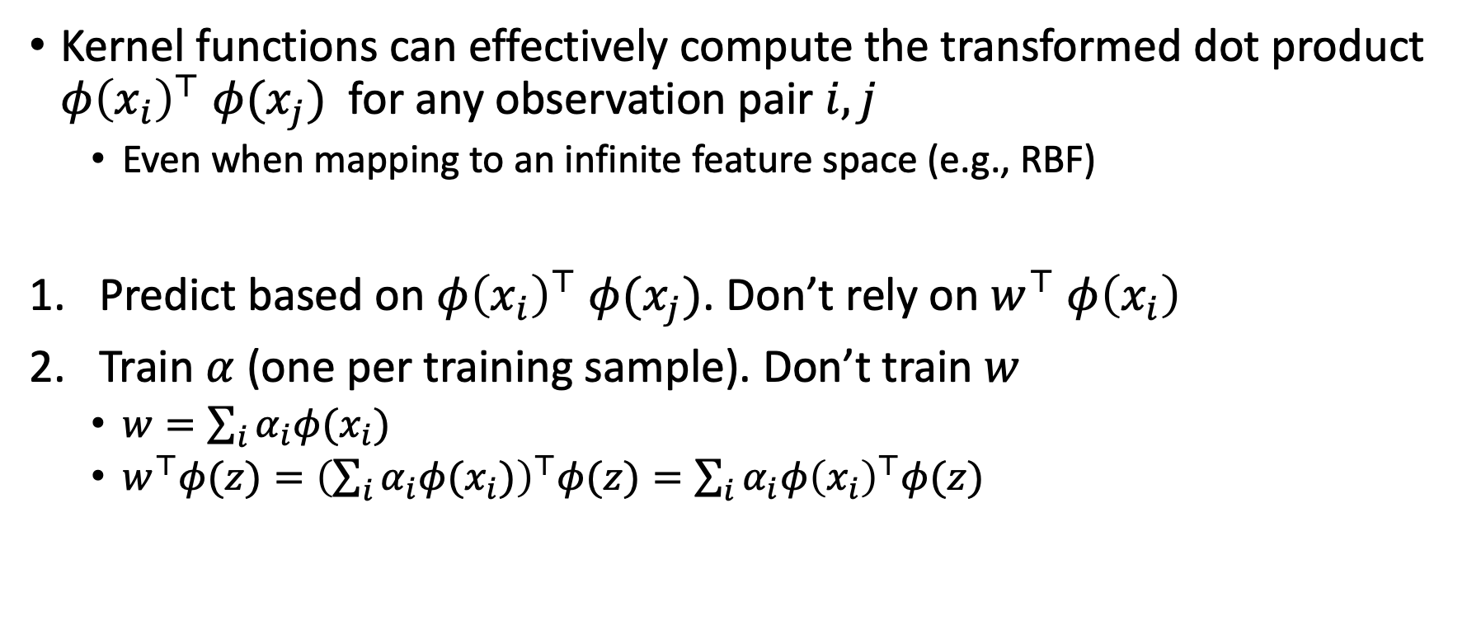
Realization
Kernel functions can effectively compute the transformed dot product $φ{\left(x_{i}\right)}^{⊤}$ $φ(x_{j})$ for any observation pair $i,j$
  Even when mapping to an infinite feature space (e.g., RBF)
Predict based on $φ{\left(x_{i}\right)}^{⊤}$ $φ(x_{j})$. Don’t rely on $w^{⊤}$ $φ\left(x_{i}\right)$
Train $α$ (one per training sample). Don’t train $w$
  $w=\sum_{i}{α_{i}φ(x_{i}) }$
  $w^{⊤}φ(z)={\left(\sum_{i}{α_{i}φ(x_{i})}\right)}^{⊤}φ(z)=\sum_{i}{α_{i}φ{\left(x_{i}\right)}^{⊤}φ(z)}$

Slide 5

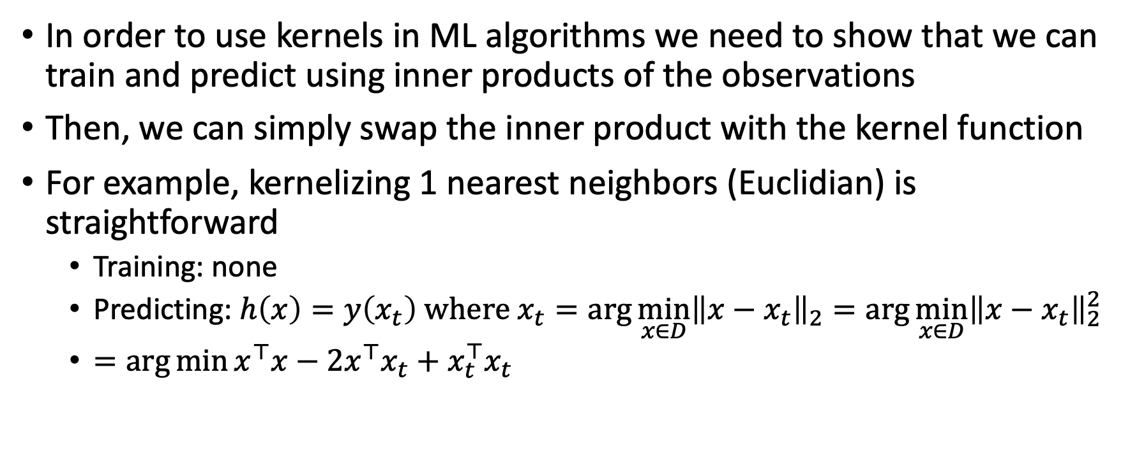


Using kernels in ML
In order to use kernels in ML algorithms we need to show that we can train and predict using inner products of the observations
Then, we can simply swap the inner product with the kernel function
For example, kernelizing 1 nearest neighbors (Euclidian) is straightforward
  Training: none
  Predicting: $h\left(x\right)=y\left(x_{t}\right) where x_{t}=\arg{\min_{x∈D}{{\left\|x−x_{t}\right\|}_{2}}}=\arg{\min_{x∈D}{{\left\|x−x_{t}\right\|}_{2}^{2}}}$
  $=\arg{\min{x^{⊤}x−2x^{⊤}x_{t}+x_{t}^{⊤}x_{t}}}$
$$K\left(x,x\right)$$
$$K\left(x,x_{t}\right)$$
$$K\left(x_{t},x_{t}\right)$$

Slide 6
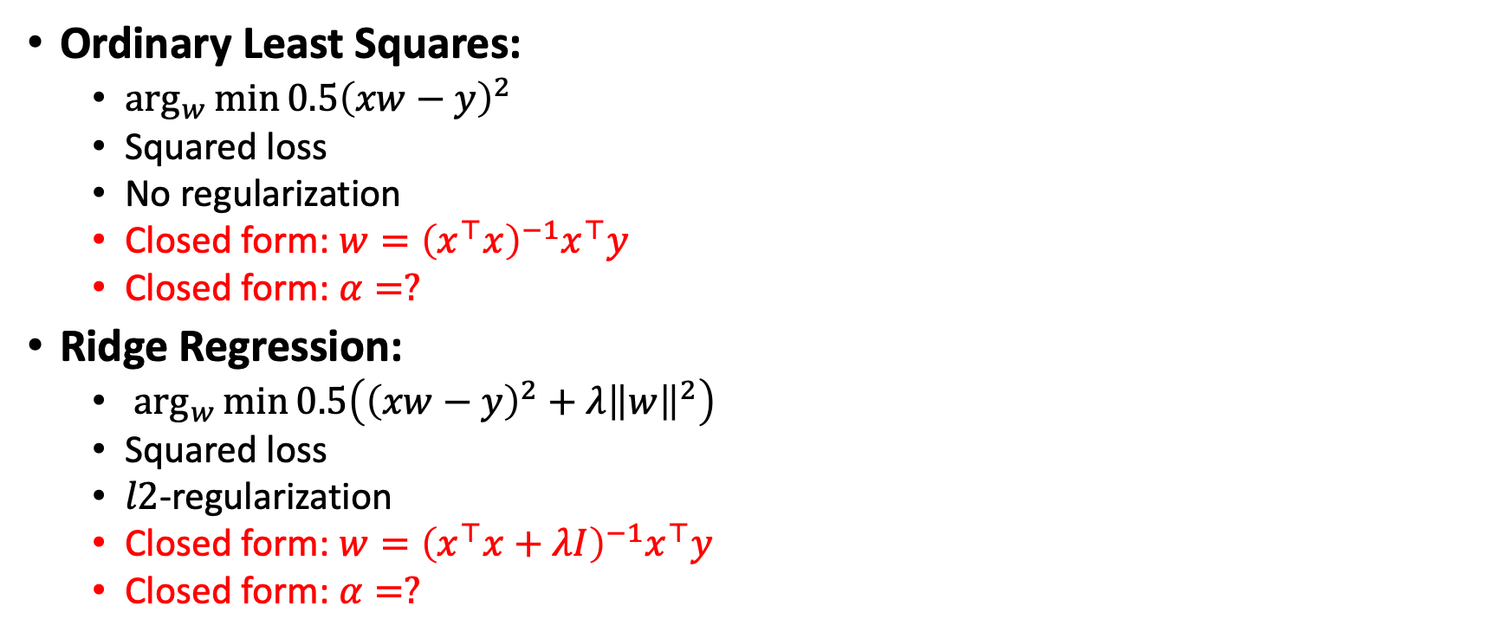
Using kernels in ML
Ordinary Least Squares:
  $\arg_{w}{\min{0.5{\left(xw−y\right)}^{2}}}$
  Squared loss
  No regularization
  Closed form: $w={\left(x^{⊤}x\right)}^{−1}x^{⊤}y$
  Closed form: $α=?$
Ridge Regression:
  $\arg_{w}{\min{0.5\left({\left(xw−y\right)}^{2}+λ{\left\|w\right\|}^{2}\right)}}$
  Squared loss
  $l2$-regularization
  Closed form: $w={\left(x^{⊤}x+λI\right)}^{−1}x^{⊤}y$
  Closed form: $α=?$

Slide 7
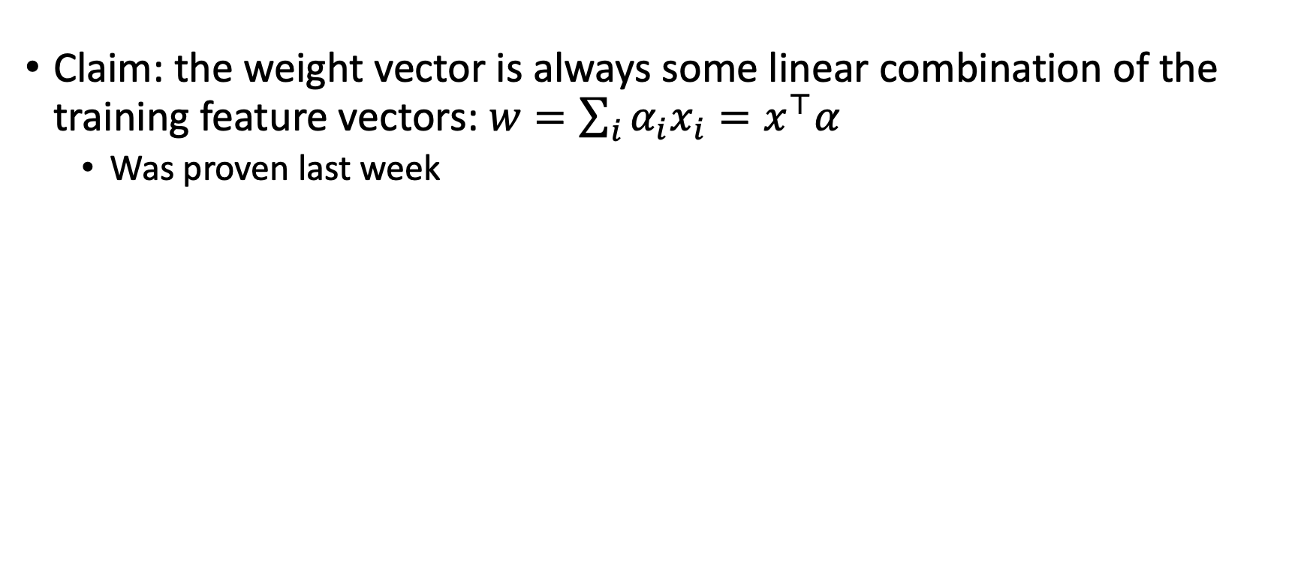

From $w$ to inner product
Claim: the weight vector is always some linear combination of the training feature vectors: $w=\sum_{i}{α_{i}x_{i}}=x^{⊤}α$
  Was proven last week

Slide 8
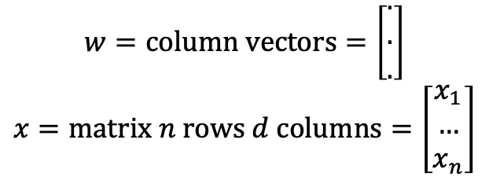
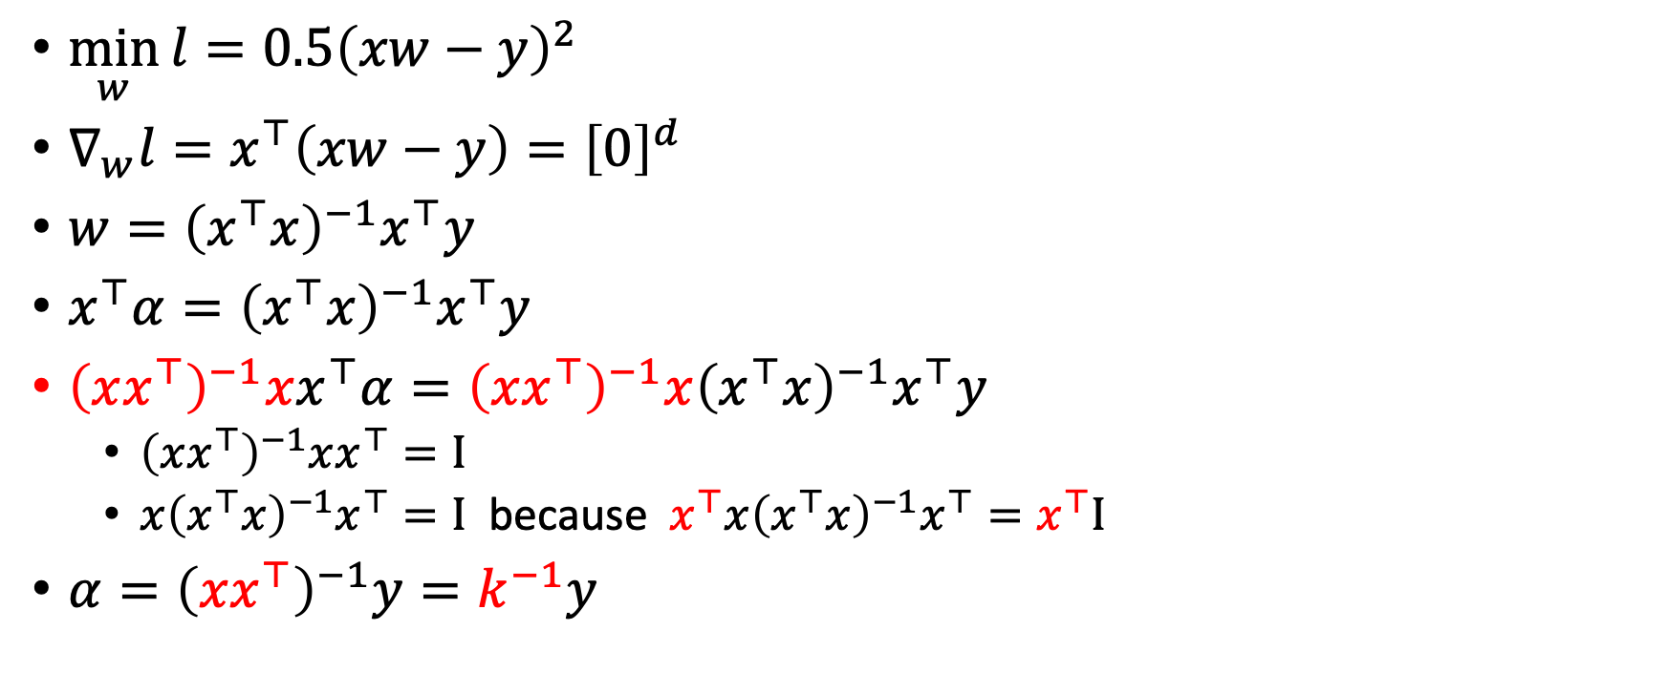
Kernelizing Ordinary Least Squares
$$w=column vectors=\left[\begin{matrix}. \\ . \\ .\end{matrix}\right]$$
$$x=matrix n rows d columns=\left[\begin{matrix}x_{1} \\ … \\ x_{n}\end{matrix}\right]$$
$\min_{w}{{l=0.5\left(xw−y\right)}^{2}}$
$∇_{w}l=x^{⊤}\left(xw−y\right)={\left[0\right]}^{d}$
$w={\left(x^{⊤}x\right)}^{−1}x^{⊤}y$
$x^{⊤}α={\left(x^{⊤}x\right)}^{−1}x^{⊤}y$
${\left(xx^{⊤}\right)}^{−1}xx^{⊤}α={\left(xx^{⊤}\right)}^{−1}x{\left(x^{⊤}x\right)}^{−1}x^{⊤}y$
  ${\left(xx^{⊤}\right)}^{−1}xx^{⊤}=I$
  $x{\left(x^{⊤}x\right)}^{−1}x^{⊤}=I$ because $x^{⊤}x{\left(x^{⊤}x\right)}^{−1}x^{⊤}=x^{⊤}I$
$α={\left(xx^{⊤}\right)}^{−1}y=k^{−1}y$

Slide 9
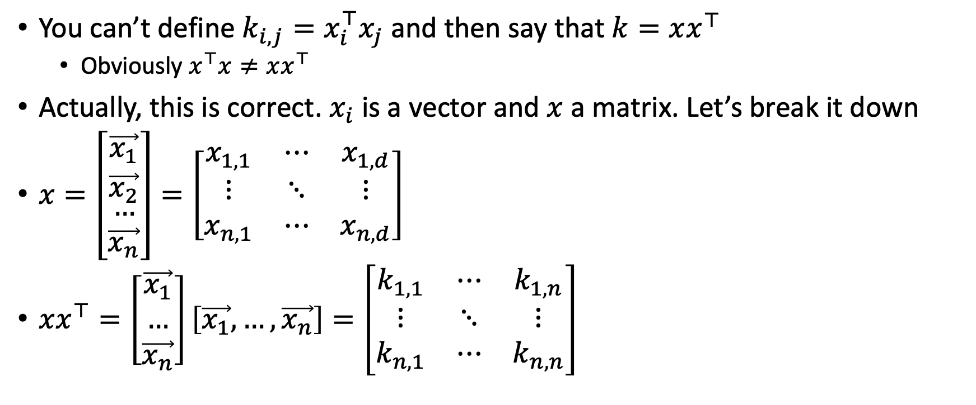
You can’t do that…
You can’t define $k_{i,j}=x_{i}^{⊤}x_{j}$ and then say that $k=xx^{⊤}$
  Obviously $x^{⊤}x≠xx^{⊤}$
Actually, this is correct. $x_{i}$ is a vector and $x$ a matrix. Let’s break it down
$x=\left[\begin{matrix}\vec{x_{1}} \\ \vec{x_{2}} \\ \begin{matrix}… \\ \vec{x_{n}}\end{matrix}\end{matrix}\right]=\left[\begin{matrix}x_{1,1} & ⋯ & x_{1,d} \\ ⋮ & ⋱ & ⋮ \\ x_{n,1} & ⋯ & x_{n,d}\end{matrix}\right]$
$xx^{⊤}=\left[\begin{matrix}\vec{x_{1}} \\ … \\ \vec{x_{n}}\end{matrix}\right]\left[\vec{x_{1}},…,\vec{x_{n}}\right]=\left[\begin{matrix}k_{1,1} & ⋯ & k_{1,n} \\ ⋮ & ⋱ & ⋮ \\ k_{n,1} & ⋯ & k_{n,n}\end{matrix}\right]$

Slide 10
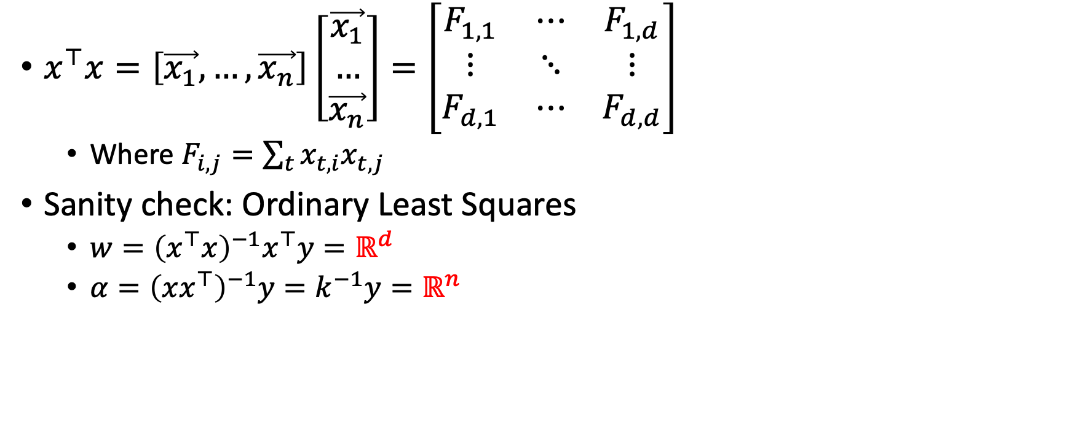

OK so what is $x^{⊤}x$ ?
$x^{⊤}x=\left[\vec{x_{1}},…,\vec{x_{n}}\right]\left[\begin{matrix}\vec{x_{1}} \\ … \\ \vec{x_{n}}\end{matrix}\right]=\left[\begin{matrix}F_{1,1} & ⋯ & F_{1,d} \\ ⋮ & ⋱ & ⋮ \\ F_{d,1} & ⋯ & F_{d,d}\end{matrix}\right]$
  Where $F_{i,j}=\sum_{t}{x_{t,i}x_{t,j}}$
Sanity check: Ordinary Least Squares
  $w={\left(x^{⊤}x\right)}^{−1}x^{⊤}y=ℝ^{d}$
  $α={\left(xx^{⊤}\right)}^{−1}y=k^{−1}y=ℝ^{n}$

Slide 11
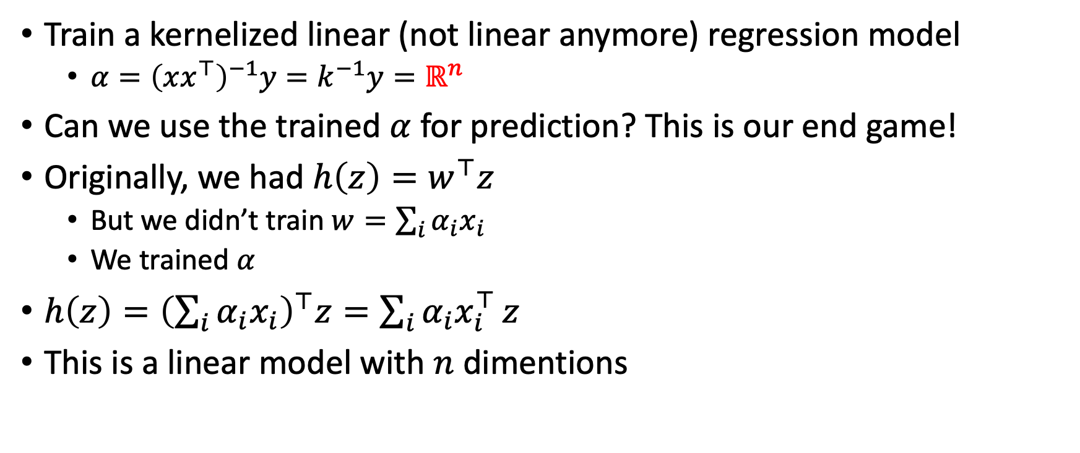
What about predictions?
Train a kernelized linear (not linear anymore) regression model
  $α={\left(xx^{⊤}\right)}^{−1}y=k^{−1}y=ℝ^{n}$
Can we use the trained $α$ for prediction? This is our end game!
Originally, we had $h\left(z\right)=w^{⊤}z$
  But we didn’t train $w=\sum_{i}{α_{i}x_{i}}$
  We trained $α$
$h\left(z\right)={\left(\sum_{i}{α_{i}x_{i}}\right)}^{⊤}z=\sum_{i}{α_{i}x_{i}^{⊤}}z$
This is a linear model with $n$ dimentions

Slide 12
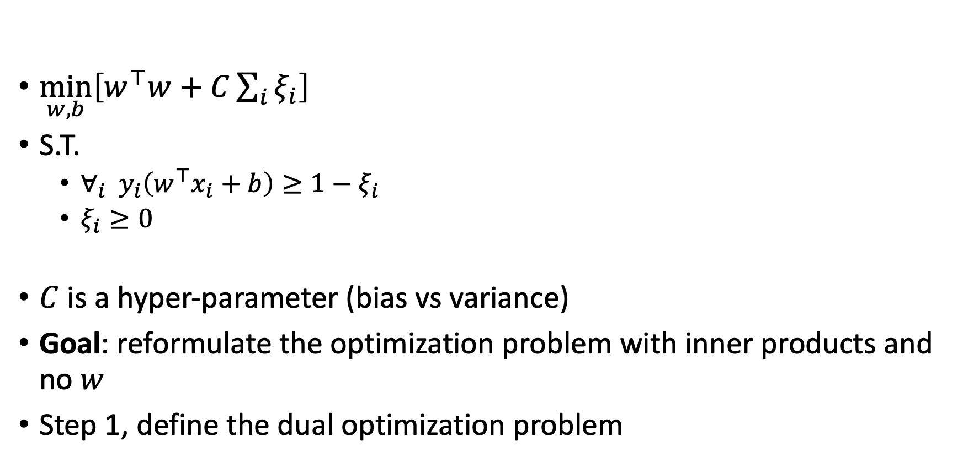
Kernelized Support Vector Machines
$\min_{w,b}\left[w^{⊤}w+C\sum_{i}{ξ_{i}}\right]$
S.T.
  $∀_{i} y_{i}\left(w^{⊤}x_{i}+b\right)≥1−ξ_{i}$
  $ξ_{i}≥0$
$C$ is a hyper-parameter (bias vs variance)
Goal: reformulate the optimization problem with inner products and no $w$
Step 1, define the dual optimization problem

Slide 13
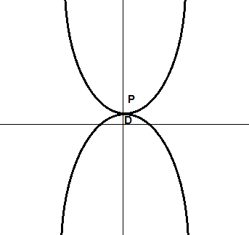
Duality principle in optimization
Optimization problems may be viewed from either of two perspectives, the primal problem or the dual problem
The solution to the dual problem provides a lower bound to the solution of the primal (minimization) problem
For convex optimization problems, the duality gap is zero under a constraint qualification condition
Duality gap

Slide 14
The dual problem
Form the Lagrangian of a minimization problem by using nonnegative Lagrange multipliers
solve for the primal variable values that maximize the dual problem (minimize the original objective function)
The dual problem gives the primal variables as functions of the Lagrange multipliers, which are called dual variables, so that the new problem is to maximize the objective function with respect to the dual variables + derived constraints

Slide 15
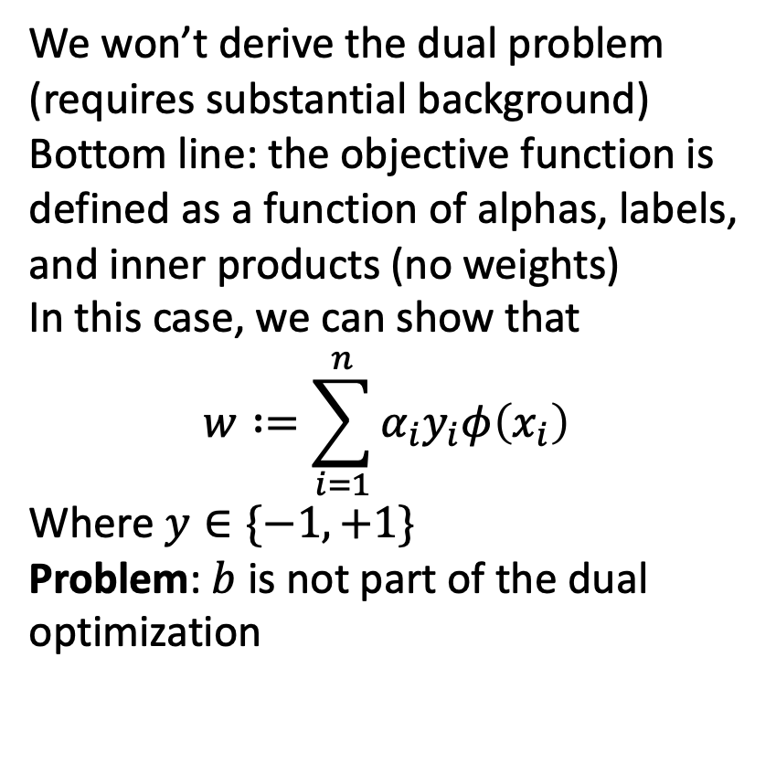
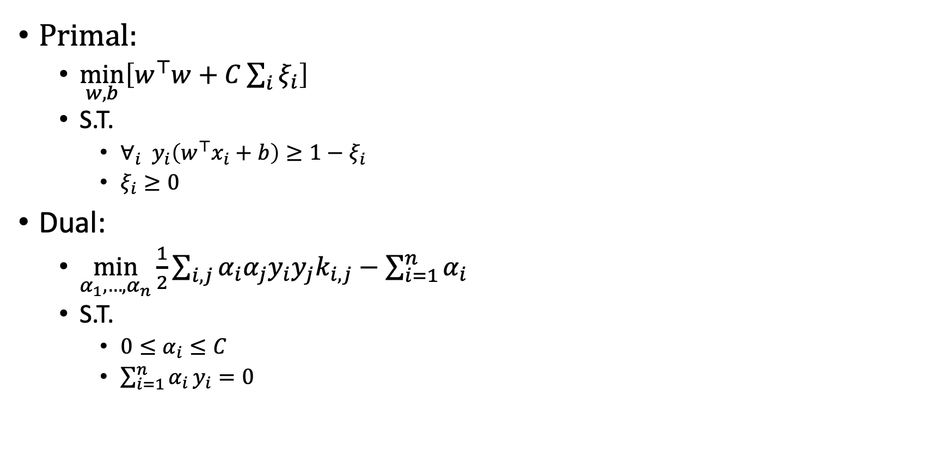
Kernelized Support Vector Machines
Primal:
  $\min_{w,b}\left[w^{⊤}w+C\sum_{i}{ξ_{i}}\right]$
  S.T.
    $∀_{i} y_{i}\left(w^{⊤}x_{i}+b\right)≥1−ξ_{i}$
    $ξ_{i}≥0$
Dual:
  $\min_{α_{1},…,α_{n}}{\frac{1}{2}\sum_{i,j}{α_{i}α_{j}y_{i}y_{j}k_{i,j}}−\sum_{i=1}^{n}{α_{i}}}$
  S.T.
    $0≤α_{i}≤C$
    $\sum_{i=1}^{n}{α_{i}}y_{i}=0$
We won’t derive the dual problem
(requires substantial background)
Bottom line: the objective function is defined as a function of alphas, labels, and inner products (no weights)
In this case, we can show that
$$w∶=\sum_{i=1}^{n}{α_{i}y_{i}φ\left(x_{i}\right)}$$
Where $y∈\{−1,+1\}$
Problem: $b$ is not part of the dual optimization

Slide 16
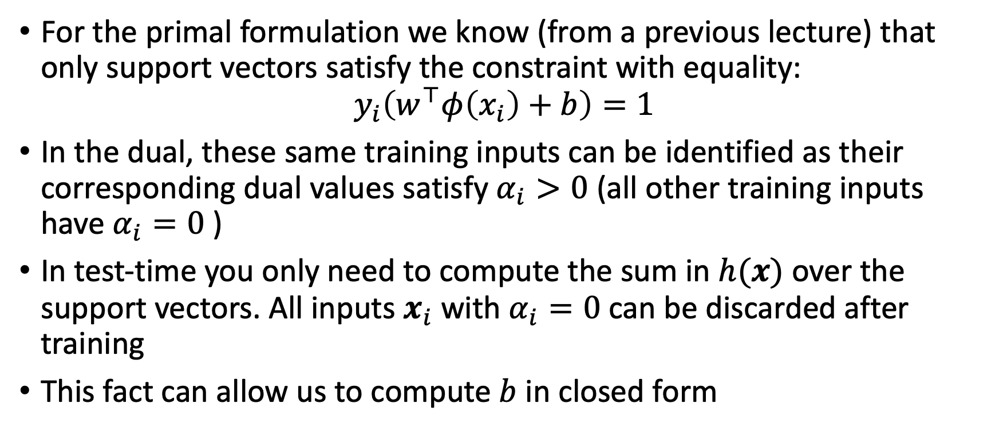
Kernelized Support Vector Machines
For the primal formulation we know (from a previous lecture) that only support vectors satisfy the constraint with equality:
$$y_{i}\left(w^{⊤}φ\left(x_{i}\right)+b\right)=1$$
In the dual, these same training inputs can be identified as their corresponding dual values satisfy $α_{i}>0$ (all other training inputs have $α_{i}=0$ )
In test-time you only need to compute the sum in $h(x)$ over the support vectors. All inputs $x_{i}$ with $α_{i}=0$ can be discarded after training
This fact can allow us to compute $b$ in closed form

Slide 17
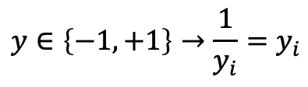
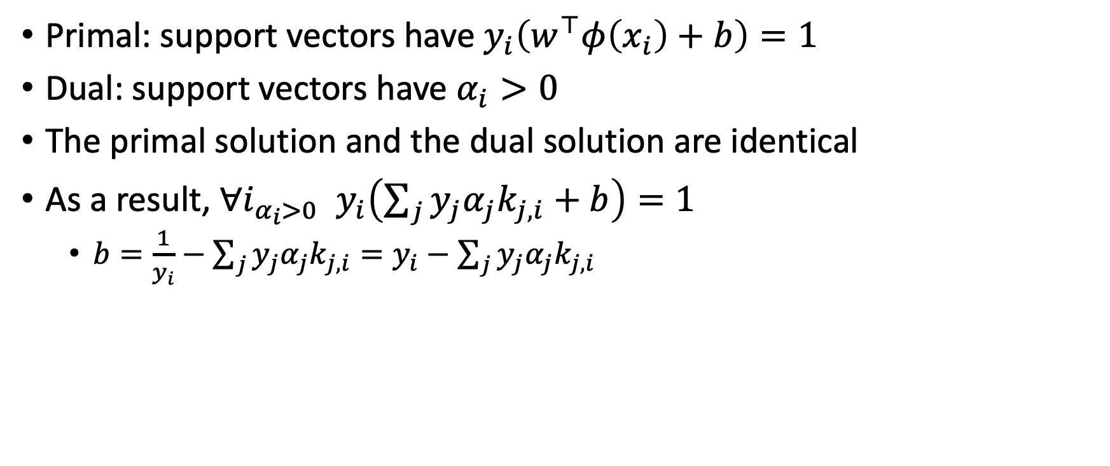
Kernelized Support Vector Machines
Primal: support vectors have $y_{i}\left(w^{⊤}φ\left(x_{i}\right)+b\right)=1$
Dual: support vectors have $α_{i}>0$
The primal solution and the dual solution are identical
As a result, $∀i_{α_{i}>0 } y_{i}\left(\sum_{j}{y_{j}α_{j}k_{j,i}}+b\right)=1$
  $b=\frac{1}{y_{i}}−\sum_{j}{y_{j}α_{j}k_{j,i}}=y_{i}−\sum_{j}{y_{j}α_{j}k_{j,i}}$
$$y∈\left\{−1,+1\right\}→\frac{1}{y_{i}}=y_{i}$$

Slide 18
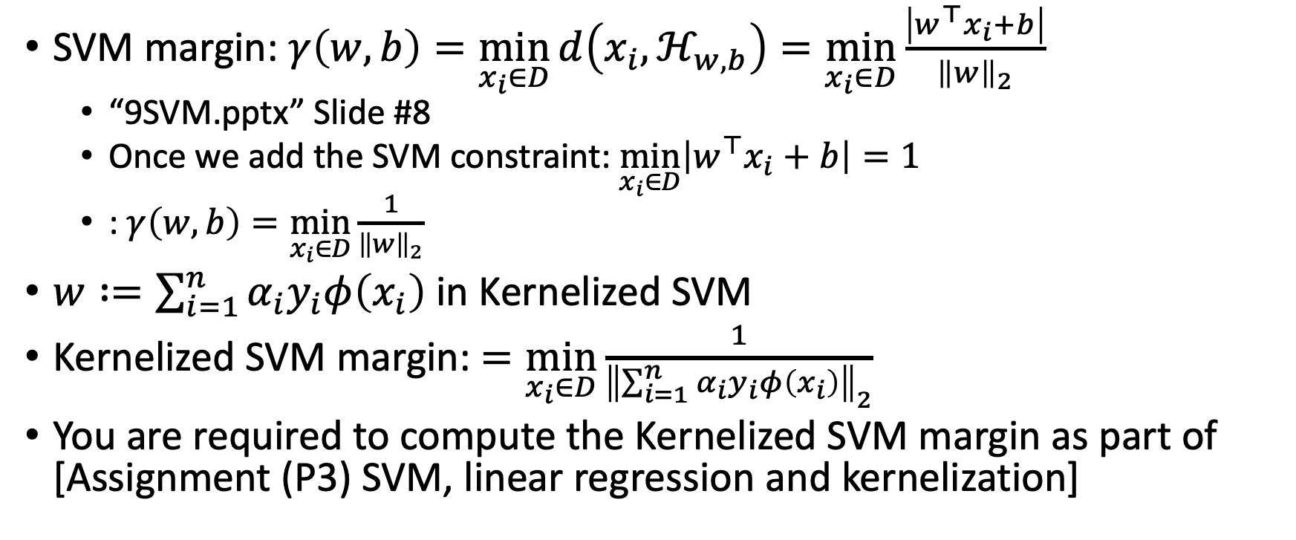
Calculating the support vectors margin
SVM margin: $γ\left(w,b\right)=\min_{x_{i}∈D}{d\left(x_{i},ℋ_{w,b}\right)}=\min_{x_{i}∈D}{\frac{\left|w^{⊤}x_{i}+b\right|}{{\left\|w\right\|}_{2}}}$
  “9SVM.pptx” Slide #8
  Once we add the SVM constraint: $\min_{x_{i}∈D}\left|w^{⊤}x_{i}+b\right|=1$
  : $γ\left(w,b\right)=\min_{x_{i}∈D}{\frac{1}{{\left\|w\right\|}_{2}}}$
$w∶=\sum_{i=1}^{n}{α_{i}y_{i}φ\left(x_{i}\right)}$ in Kernelized SVM
Kernelized SVM margin: $=\min_{x_{i}∈D}{\frac{1}{{\left\|\sum_{i=1}^{n}{α_{i}y_{i}φ\left(x_{i}\right)}\right\|}_{2}}}$
You are required to compute the Kernelized SVM margin as part of [Assignment (P3) SVM, linear regression and kernelization]

Slide 19
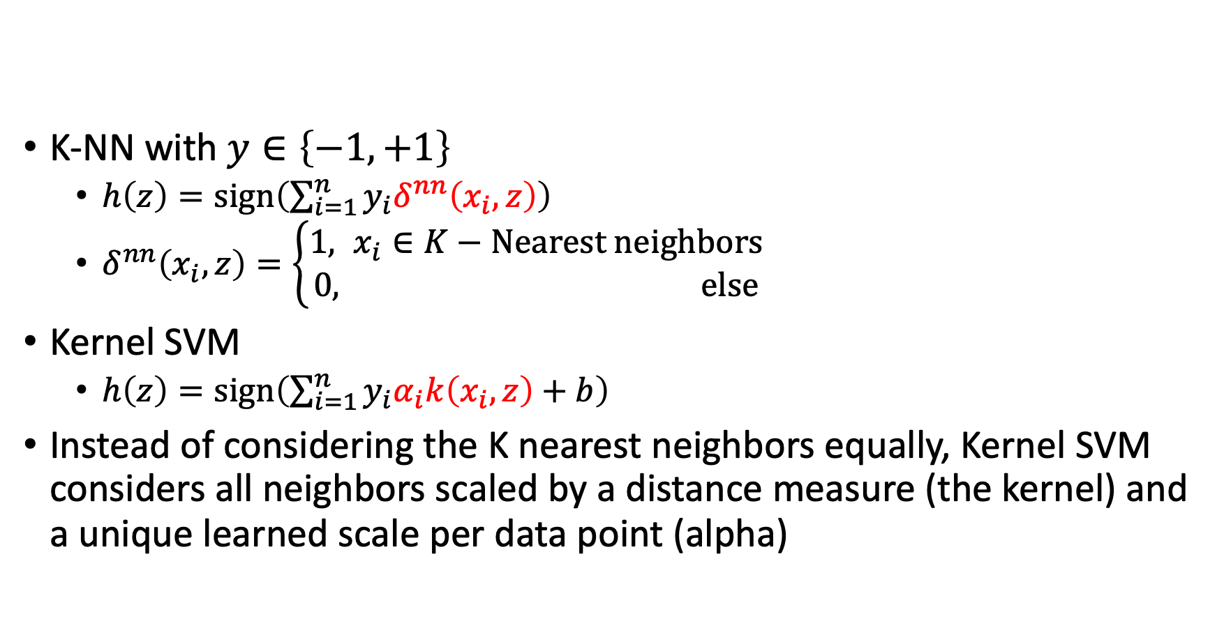
Kernel SVM = weighted K-NN
K-NN with $y∈\left\{−1,+1\right\}$
  $h\left(z\right)=sign\left(\sum_{i=1}^{n}{y_{i}δ^{nn}\left(x_{i},z\right)}\right)$
  $δ^{nn}\left(x_{i},z\right)=\left\{\begin{aligned}1, x_{i}∈K−Nearest neighbors \\ &0, else\end{aligned}\right.$
Kernel SVM
  $h\left(z\right)=sign\left(\sum_{i=1}^{n}{y_{i}α_{i}k\left(x_{i},z\right)+b}\right)$
Instead of considering the K nearest neighbors equally, Kernel SVM considers all neighbors scaled by a distance measure (the kernel) and a unique learned scale per data point (alpha)

Slide 20
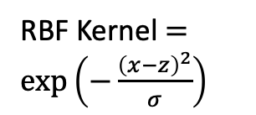
RBF Kernel $=\exp\left(−\frac{{\left(x−z\right)}^{2}}{σ}\right)$

Slide 21
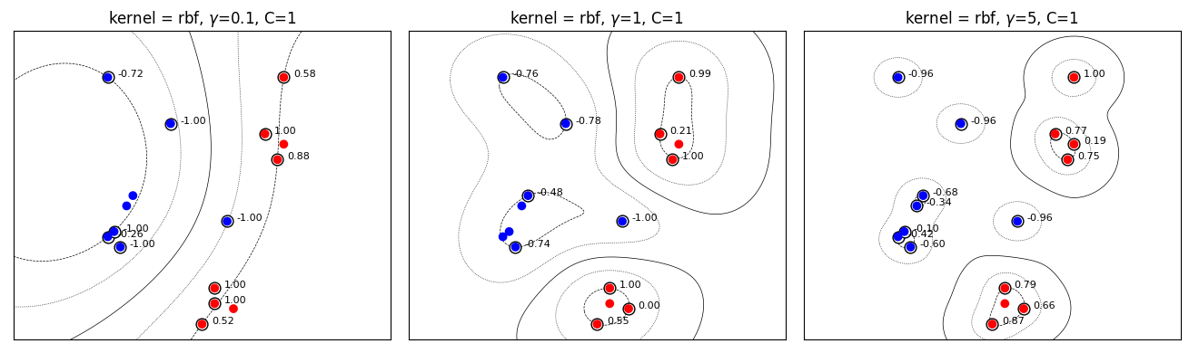
SVM with soft constraints (C hyperparameter)

Slide 22
Kernelized SVM
Pros
  SVM classification can be very efficient, because it uses only a subset of the training data, only the support vectors
  Works very well on smaller data sets, on non-linear data sets, and high dimensional spaces
  Is very effective in cases where number of dimensions is greater than the number of samples
  It can have high accuracy, sometimes can perform even better than neural networks
  Not very sensitive to overfitting
Cons
  Training time is high when we have large data sets
  When the data set has more noise (i.e. target classes are overlapping) SVM doesn’t perform well

Slide 23
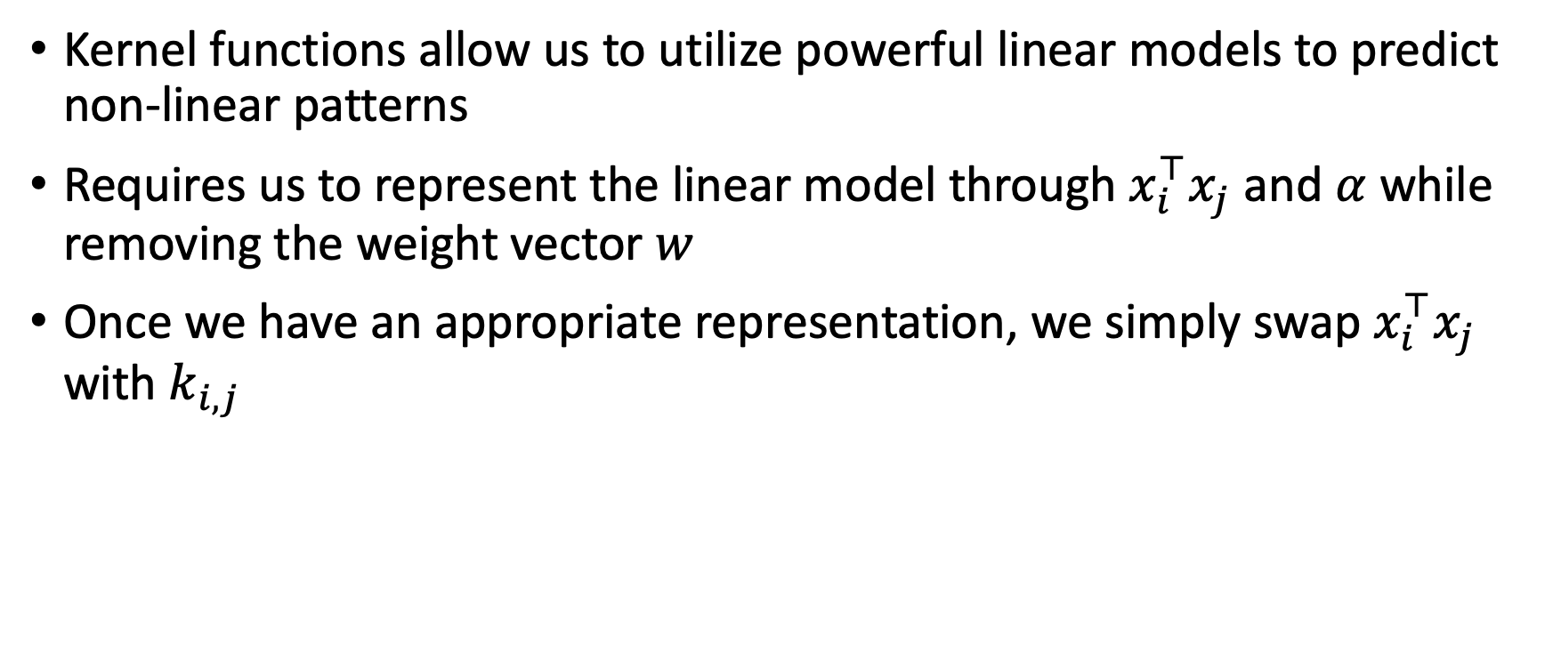
What did we learn?
Kernel functions allow us to utilize powerful linear models to predict non-linear patterns
Requires us to represent the linear model through $x_{i}^{⊤}x_{j}$ and $α$ while removing the weight vector $w$
Once we have an appropriate representation, we simply swap $x_{i}^{⊤}x_{j}$ with $k_{i,j}$

Slide 24
What next?
Class: Decision trees
Assignments:
  Assignment (P3): SVM, linear regression and kernelization, due April-12
Quizzes:
  Quiz 4: ML debugging and kernelization, due Wednesday April-4

