Slide 1



CSCE-633 Machine Learning
12. Kernelization
$$x=ℝ^{n×d}$$
$$φ\left(x\right)=ℝ^{n×∞}$$
$$φ{\left(x\right)}^{⊤}φ\left(x\right)=ℝ^{n×n}$$
Instructor: Guni Sharon
Based on a lecture by Kilian Weinberger and Joaquin Vanschoren

Slide 2
Announcements
Announcements
  Midterm on Tuesday, April 12 during class
Overdue:
  Programming assignment 2: Linear and Logistic Regression, due by March-21
Due:

Slide 3
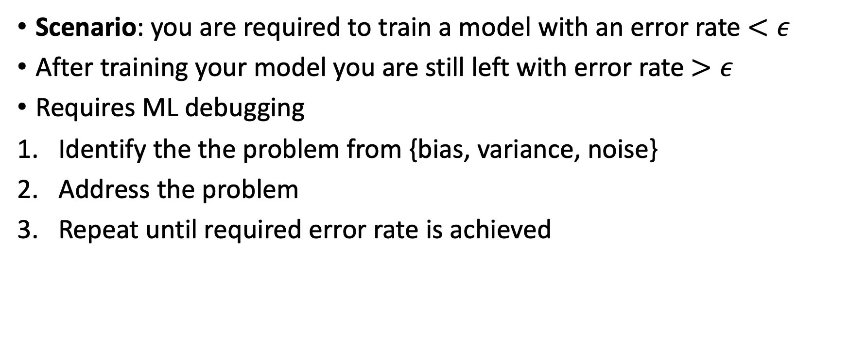
ML debugging (continuing from )
Scenario: you are required to train a model with an error rate $<ε$
After training your model you are still left with error rate $>ε$
Requires ML debugging
Identify the the problem from {bias, variance, noise}
Address the problem
Repeat until required error rate is achieved

Slide 4
Identifying the main error contributor
High variance leads to overfitting
High bias leads to overgeneralization
Noisy data lead to inability to fit
What measurements can help us identify the problem?
  Training error, testing error
Possible observations
Training error | Testing error | Indication
Low | Low | Good job!
Low | High | High variance
High | High | High bias/noise
High | Low | You have a bug

Slide 5
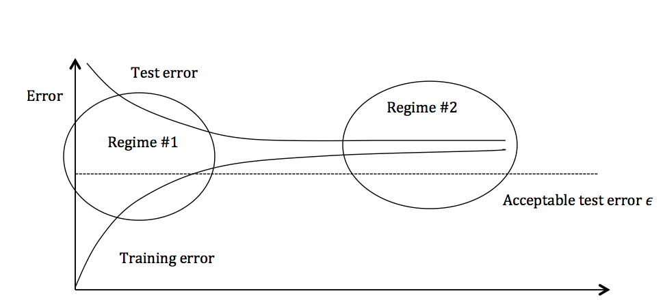
Identifying the main error contributor
Regime #1:
  High variance
  Overfitting
Regime #2:
  High bias
  Underfitting
  Noisy data

Slide 6
Regime 1 (High Variance)
In the first regime, the cause of the poor performance is high variance
Symptoms:
  Training error is much lower than test error
Remedies:
  Add more training data
  Reduce model complexity – increase regularization
  Bagging (will be covered later in the course)

Slide 7
Regime 2 (High Bias)
Indicates high bias or noise: the model being used is not expressive enough to produce an accurate prediction
Symptoms:
  Both train and test error are high
Remedies:
  Use a more complex model (e.g., kernelization, use non-linear models, reduce regularization)
  Add features – reduces noise
  Boosting (will be covered later in the course)

Slide 8
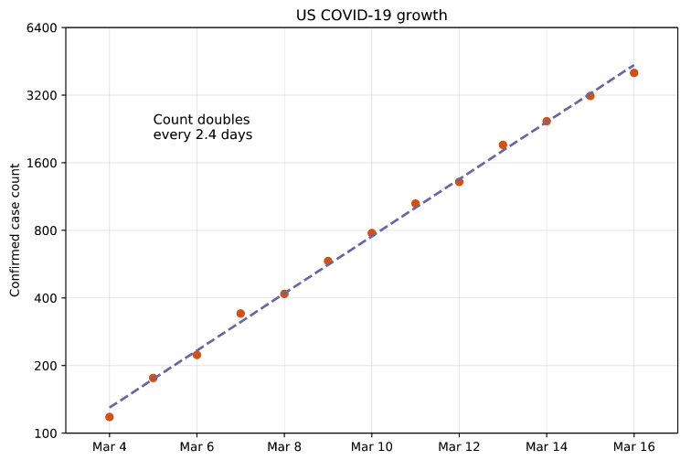
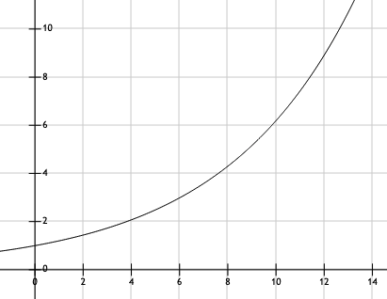

Feature mapping
Create new artificial features from existing features
Transforming existing features can be viewed as bending the underlying state space
$$x^{2}≡log\left(y\right)$$

Slide 9
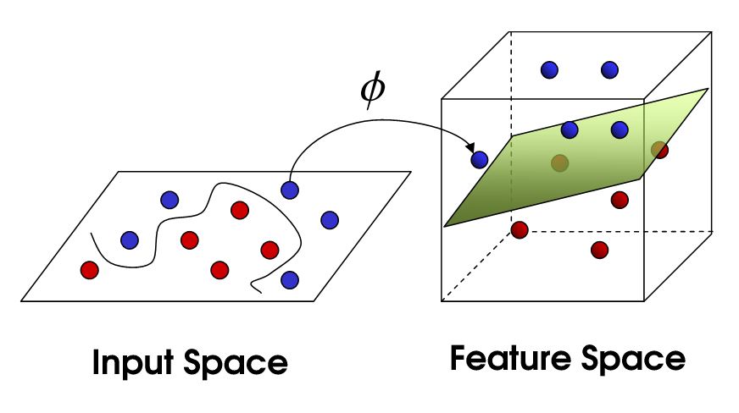
Feature mapping
A mapping function transforms existing (input) features
The transformation is our new feature vector
The new feature/s can result in linear separability
Use SVM to compute a max margin hyperplane

Slide 10
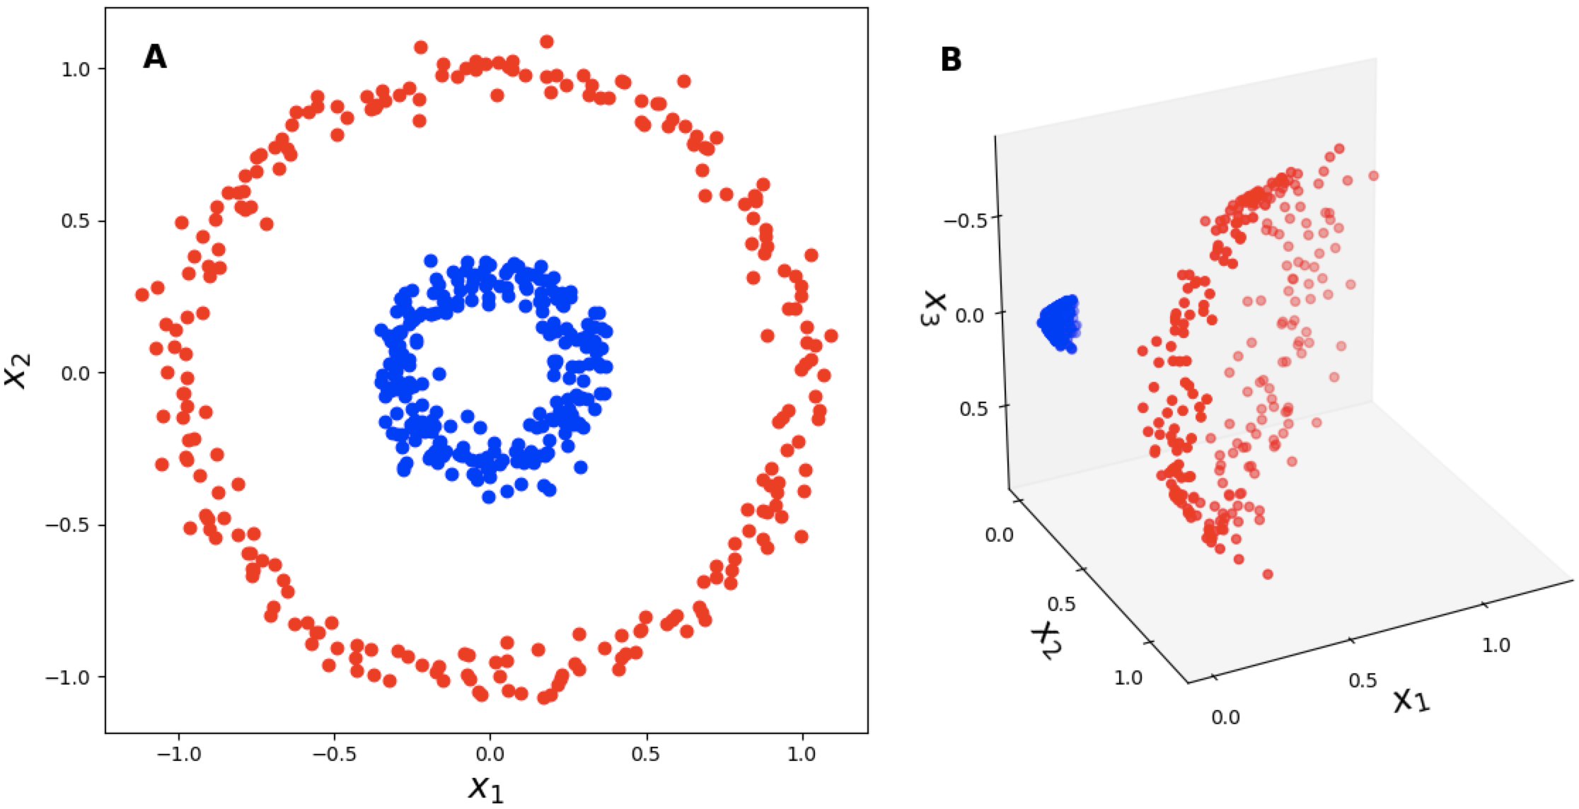
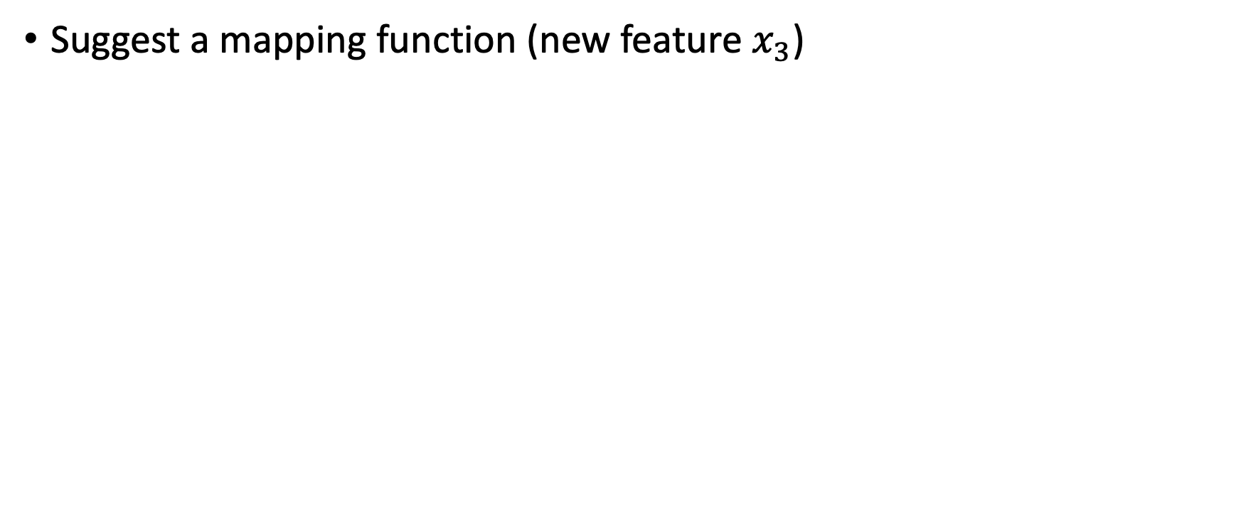
Mapping quiz
Suggest a mapping function (new feature $x_{3}$)

Slide 11
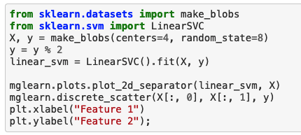
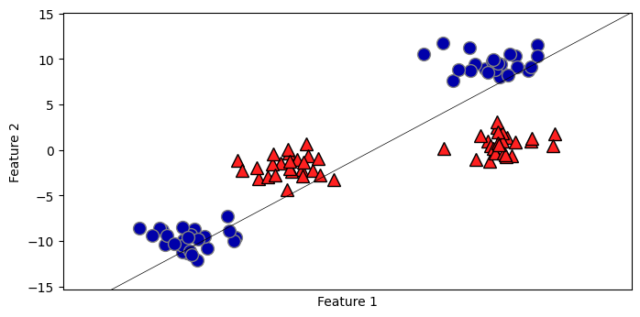

Slide 12
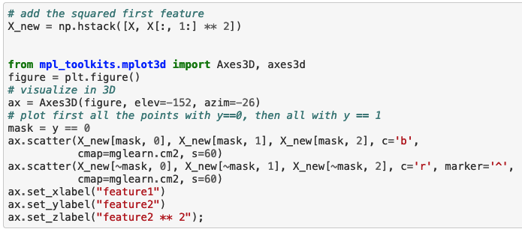
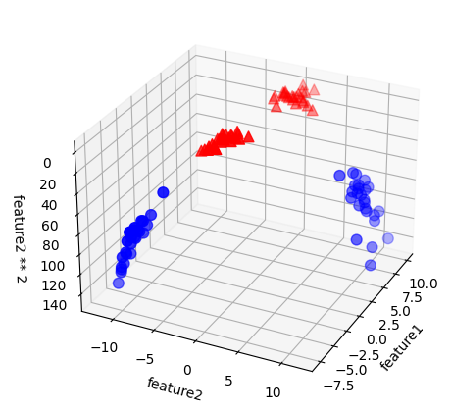
We can add a new feature by taking the squares of feature2

Slide 13
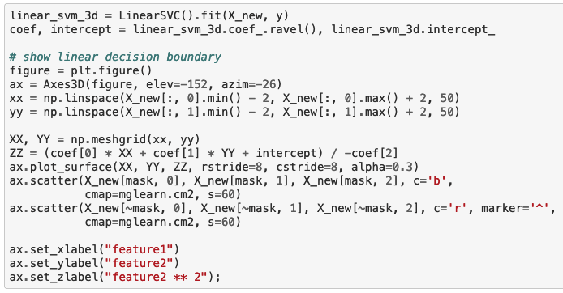
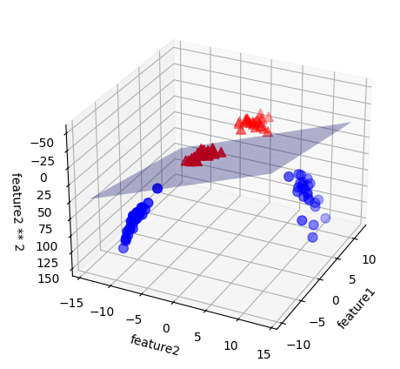
Now we can fit a linear model

Slide 14
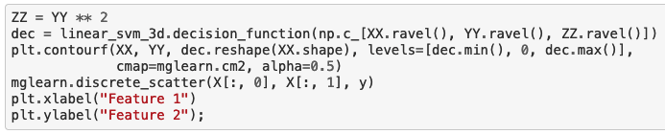
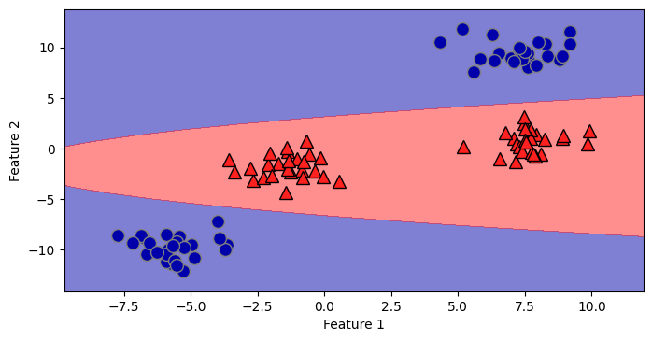
As a function of the original features, the decision boundary is now a polynomial

Slide 15
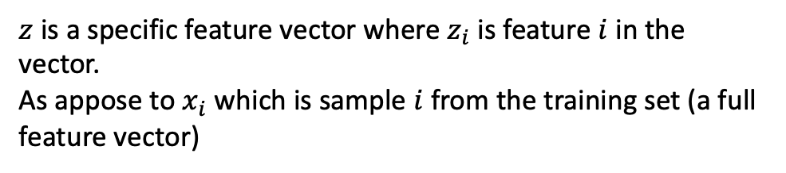
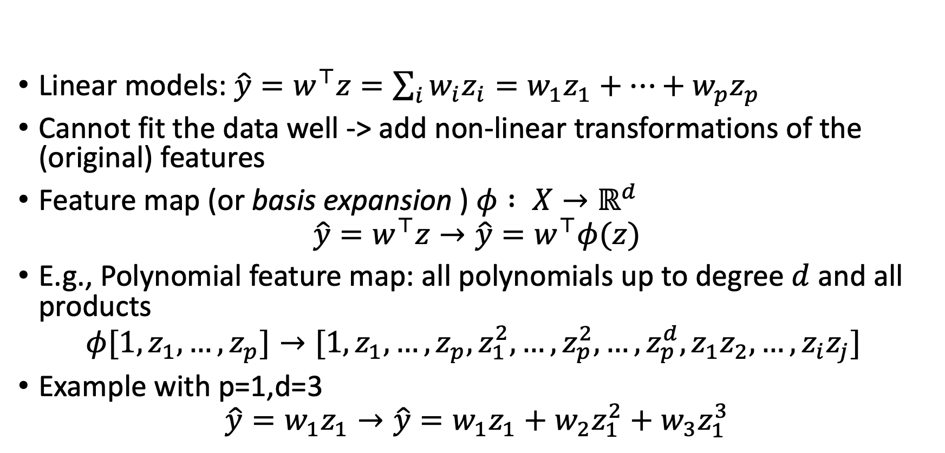
Feature Maps
$z$ is a specific feature vector where $z_{i}$ is feature $i$ in the vector.
As appose to $x_{i}$ which is sample $i$ from the training set (a full feature vector)
Linear models: $\hat{y}=w^{⊤}z=\sum_{i}{w_{i}z_{i}}=w_{1}z_{1}+…+w_{p}z_{p}$
Cannot fit the data well -> add non-linear transformations of the (original) features
Feature map (or basis expansion ) $φ : X→ℝ^{d}$
$$\hat{y}=w^{⊤}z→\hat{y}=w^{⊤}φ(z)$$
E.g., Polynomial feature map: all polynomials up to degree $d$ and all products
$$φ[1,z_{1},…,z_{p}]→[1,z_{1},…,z_{p},z_{1}^{2},…,z_{p}^{2},…,z_{p}^{d},z_{1}z_{2},…,z_{i}z_{j}]$$
Example with p=1,d=3
$$\hat{y}=w_{1}z_{1}→\hat{y}=w_{1}z_{1}+w_{2}z_{1}^{2}+w_{3}z_{1}^{3}$$

Slide 16
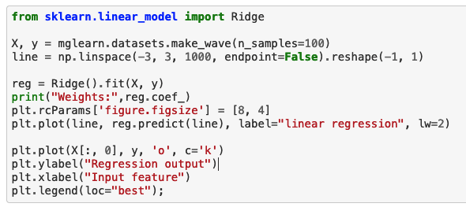
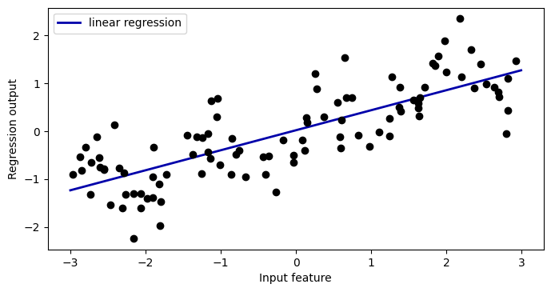
w=[0.418]

Slide 17
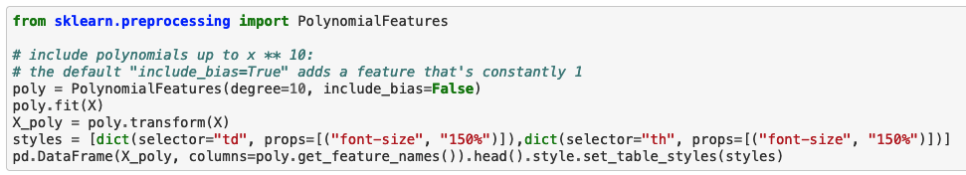
Add all polynomials $x^{d}$ up to degree 10 as new features
The new dataset (including 9 extra features per observation)
i | x | x^2 | x^3 | x^4 | x^5 | x^6 | x^7 | x^8 | x^9 | x^10
0 | -0.75 | 0.57 | -0.43 | 0.32 | -0.24 | 0.18 | -0.14 | 0.1 | -0.078 | 0.058
1 | 2.7 | 7.3 | 20 | 53 | 1.4e+02 | 3.9e+02 | 1.1e+03 | 2.9e+03 | 7.7e+03 | 2.1e+04
2 | 1.4 | 1.9 | 2.7 | 3.8 | 5.2 | 7.3 | 10 | 14 | 20 | 27
3 | 0.59 | 0.35 | 0.21 | 0.12 | 0.073 | 0.043 | 0.025 | 0.015 | 0.0089 | 0.0053
4 | -2.1 | 4.3 | -8.8 | 18 | -37 | 77 | -1.6e+02 | 3.3e+02 | -6.8e+02 | 1.4e+03
…

Slide 18
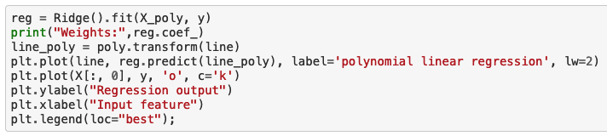
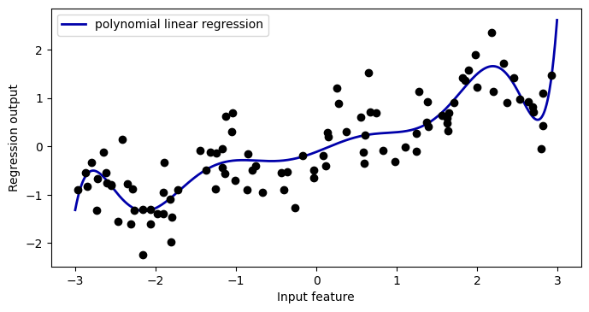

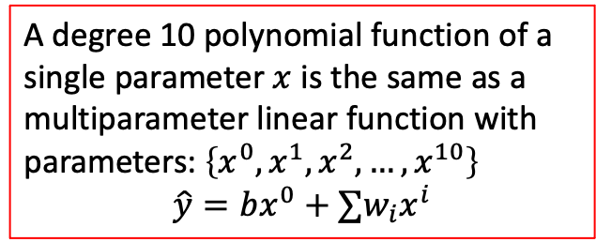
w=[ 0.643 0.297 -0.69 -0.264 0.41 0.096 -0.076 -0.014 0.004 0.001]
A degree 10 polynomial function of a single parameter $x$ is the same as a multiparameter linear function with parameters: $\left\{x^{0},x^{1},x^{2},…,x^{10}\right\}$
$$\hat{y}=bx^{0}+∑w_{i}x^{i}$$

Slide 19
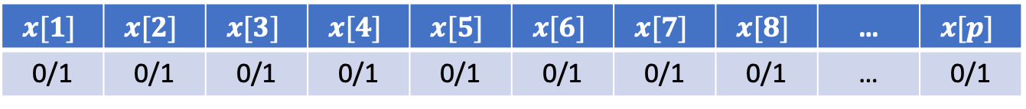
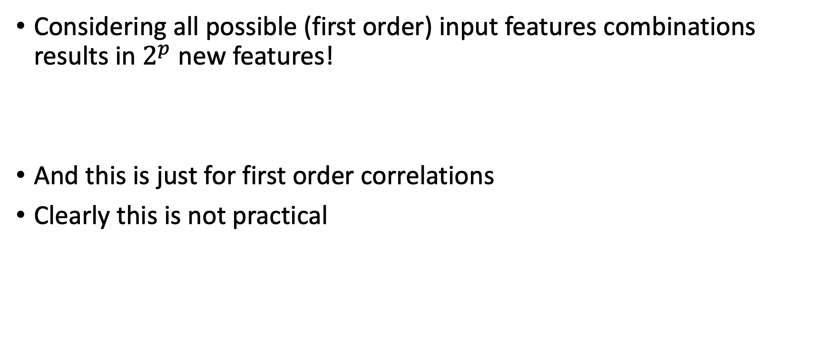
Nice idea but is it practical?
Considering all possible (first order) input features combinations results in $2^{p}$ new features!
And this is just for first order correlations
Clearly this is not practical
$$x[1]$$ | $$x[2]$$ | $$x[3]$$ | $$x[4]$$ | $$x[5]$$ | $$x[6]$$ | $$x[7]$$ | $$x[8]$$ | … | $$x[p]$$
0/1 | 0/1 | 0/1 | 0/1 | 0/1 | 0/1 | 0/1 | 0/1 | … | 0/1

Slide 20
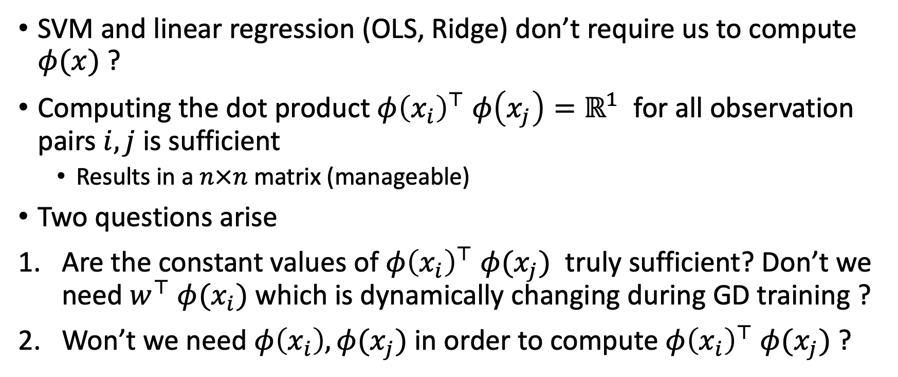
Realization
SVM and linear regression (OLS, Ridge) don’t require us to compute $φ(x)$ ?
Computing the dot product $φ{\left(x_{i}\right)}^{⊤}$ $φ\left(x_{j}\right)=ℝ^{1}$ for all observation pairs $i,j$ is sufficient
  Results in a $n×n$ matrix (manageable)
Two questions arise
Are the constant values of $φ{\left(x_{i}\right)}^{⊤}$ $φ(x_{j})$ truly sufficient? Don’t we need $w^{⊤}$ $φ(x_{i})$ which is dynamically changing during GD training ?
Won’t we need $φ\left(x_{i}\right),φ(x_{j})$ in order to compute $φ{\left(x_{i}\right)}^{⊤}$ $φ(x_{j})$ ?

Slide 21
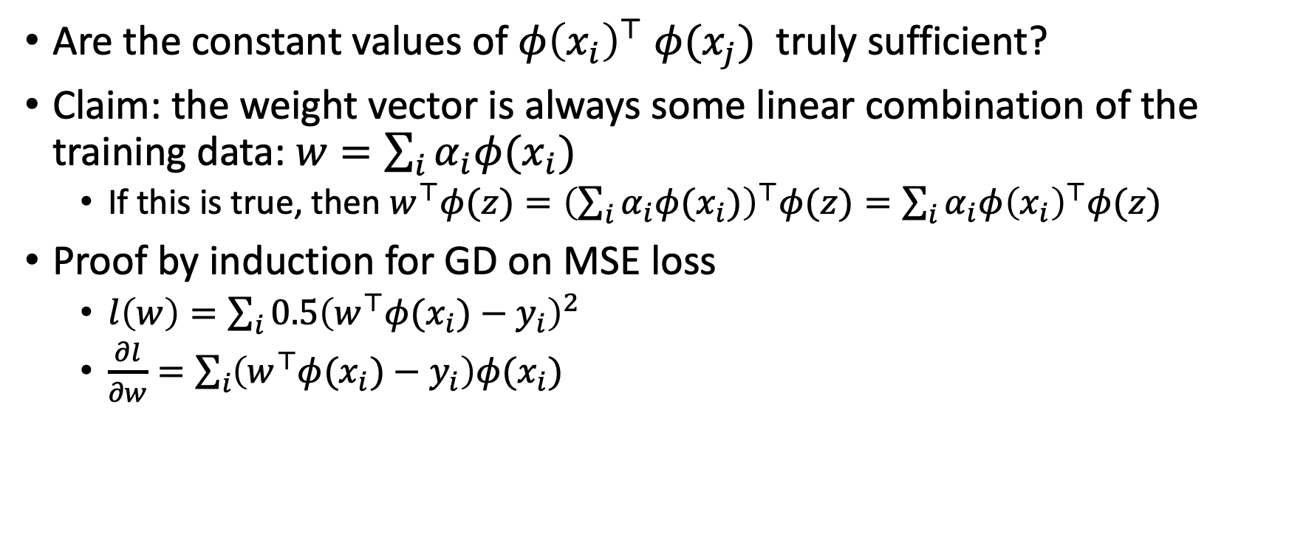

Don’t we need $w^{⊤}$ $φ(x_{i})$ ?
Are the constant values of $φ{\left(x_{i}\right)}^{⊤}$ $φ(x_{j})$ truly sufficient?
Claim: the weight vector is always some linear combination of the training data: $w=\sum_{i}{α_{i}φ(x_{i}) }$
  If this is true, then $w^{⊤}φ(z)={\left(\sum_{i}{α_{i}φ(x_{i})}\right)}^{⊤}φ(z)=\sum_{i}{α_{i}φ{\left(x_{i}\right)}^{⊤}φ(z)}$
Proof by induction for GD on MSE loss
  $l\left(w\right)=\sum_{i}{0.5{\left(w^{⊤}φ(x_{i})−y_{i}\right)}^{2}}$
  $\frac{∂l}{∂w}=\sum_{i}{\left(w^{⊤}φ(x_{i})−y_{i}\right)φ(x_{i})}$

Slide 22
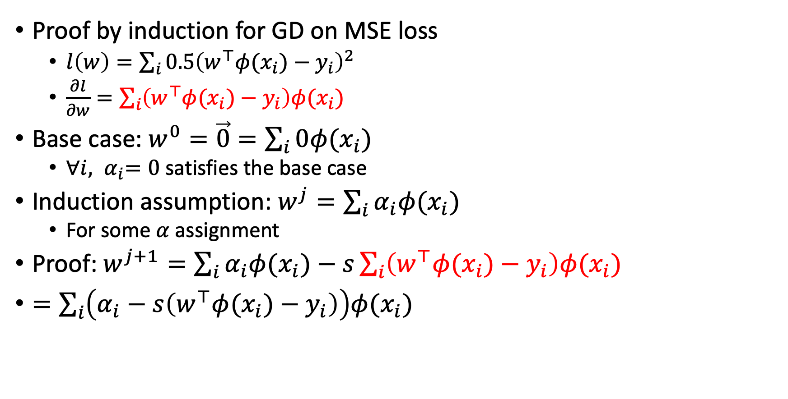
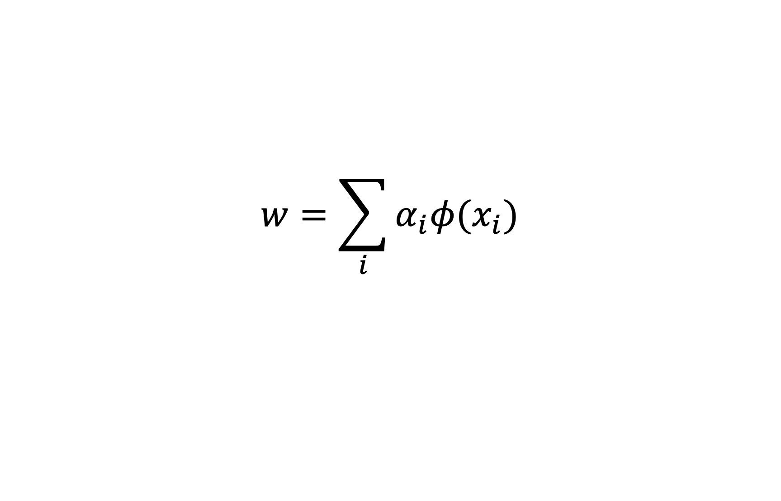

$$w=\sum_{i}{α_{i}φ(x_{i})}$$
Proof by induction for GD on MSE loss
  $l\left(w\right)=\sum_{i}{0.5{\left(w^{⊤}φ(x_{i})−y_{i}\right)}^{2}}$
  $\frac{∂l}{∂w}=\sum_{i}{\left(w^{⊤}φ(x_{i})−y_{i}\right)φ(x_{i})}$
Base case: $w^{0}=\vec{0}=\sum_{i}{0φ(x_{i})}$
  ${∀i, α}_{i}=0$ satisfies the base case
Induction assumption: $w^{j}=\sum_{i}{α_{i}φ(x_{i})}$
  For some $α$ assignment
Proof: $w^{j+1}=\sum_{i}{α_{i}φ(x_{i})}−s\sum_{i}{\left(w^{⊤}φ(x_{i})−y_{i}\right)φ(x_{i})}$
$=\sum_{i}{\left(α_{i}−s\left(w^{⊤}φ(x_{i})−y_{i}\right)\right)φ(x_{i})}$
Step size
Scalar = $α_{i+1}$

Slide 23
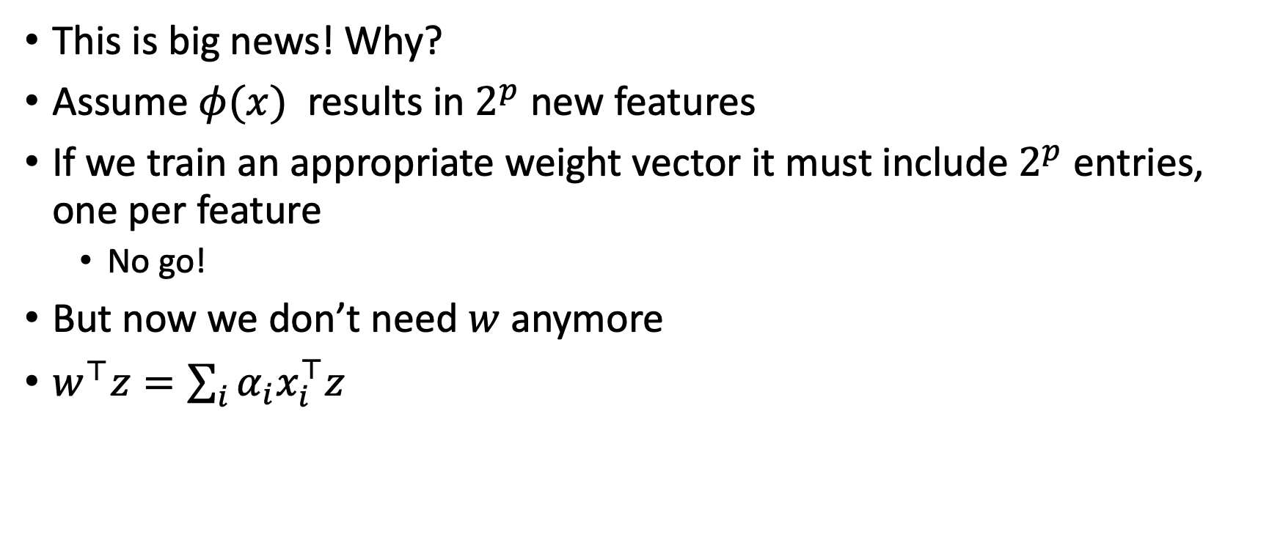
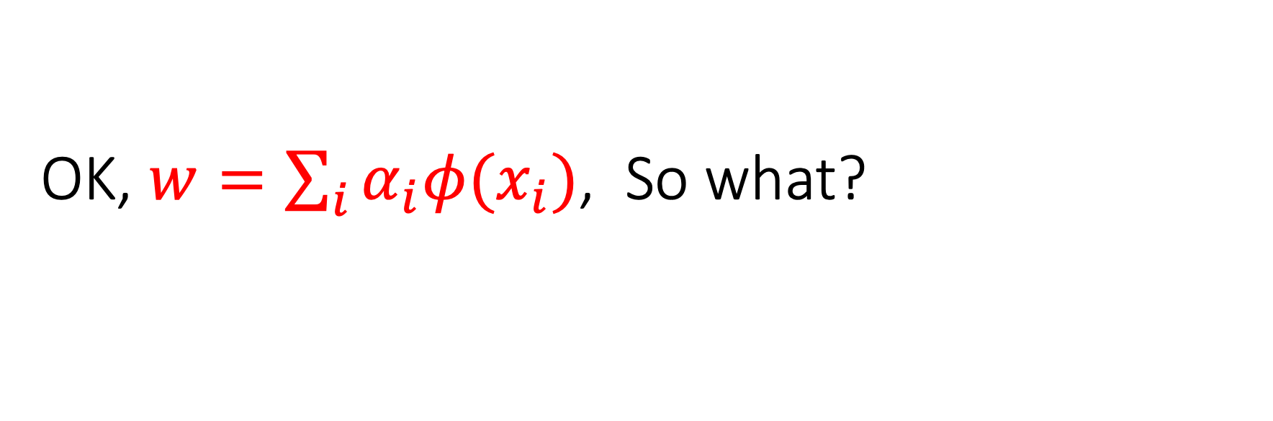

OK, $w=\sum_{i}{α_{i}φ(x_{i})}$, So what?
This is big news! Why?
Assume $φ(x)$ results in $2^{p}$ new features
If we train an appropriate weight vector it must include $2^{p}$ entries, one per feature
  No go!
But now we don’t need $w$ anymore
$w^{⊤}z=\sum_{i}{α_{i}x_{i}^{⊤}z}$
Still need to learn $α$
One scalar per observation in our training set

Slide 24
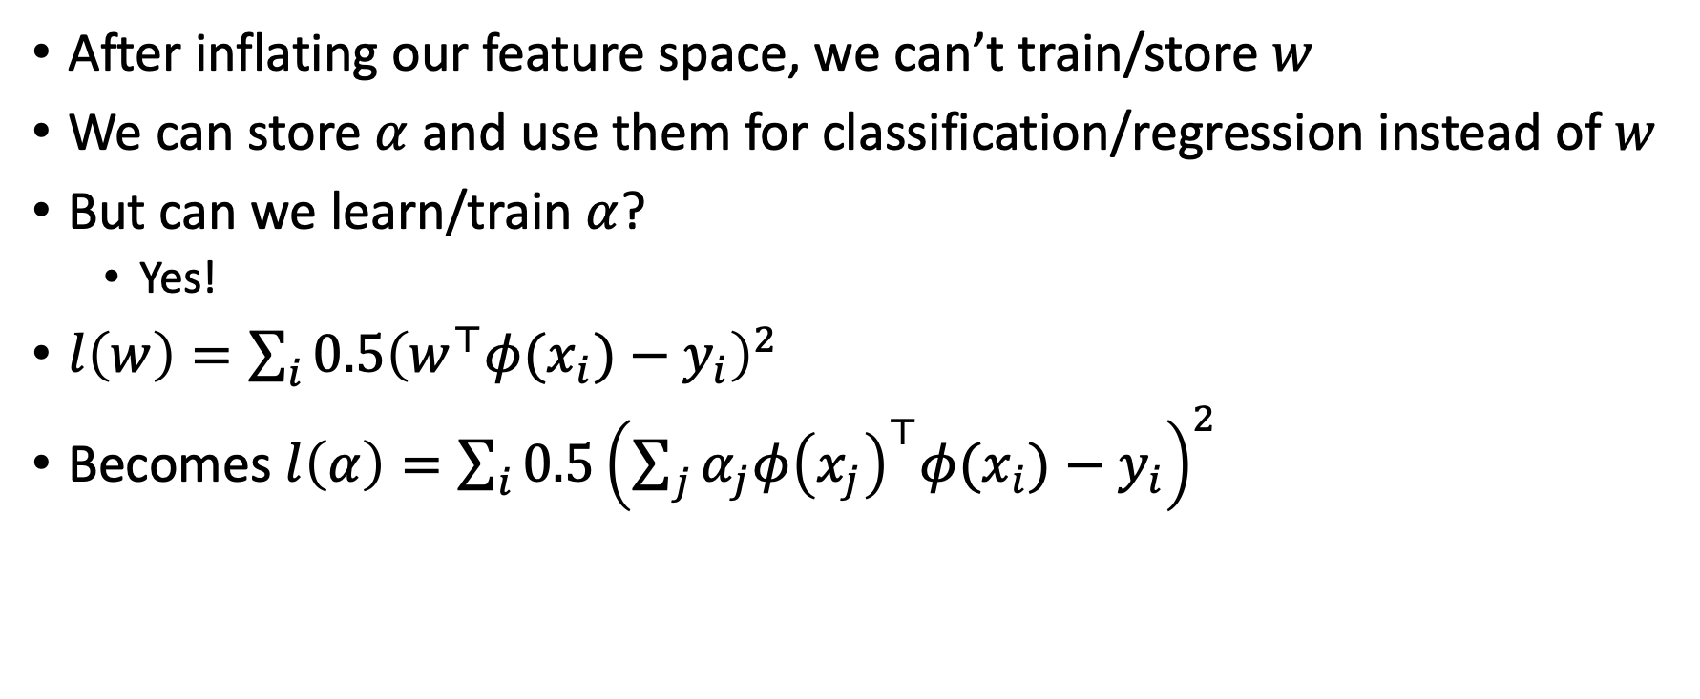
Learning alpha
After inflating our feature space, we can’t train/store $w$
We can store $α$ and use them for classification/regression instead of $w$
But can we learn/train $α$?
  Yes!
$l\left(w\right)=\sum_{i}{0.5{\left(w^{⊤}φ(x_{i})−y_{i}\right)}^{2}}$
Becomes $l\left(α\right)=\sum_{i}{0.5{\left(\sum_{j}{α_{j}φ{\left(x_{j}\right)}^{⊤}φ(x_{i})}−y_{i}\right)}^{2}}$
constant

Slide 25
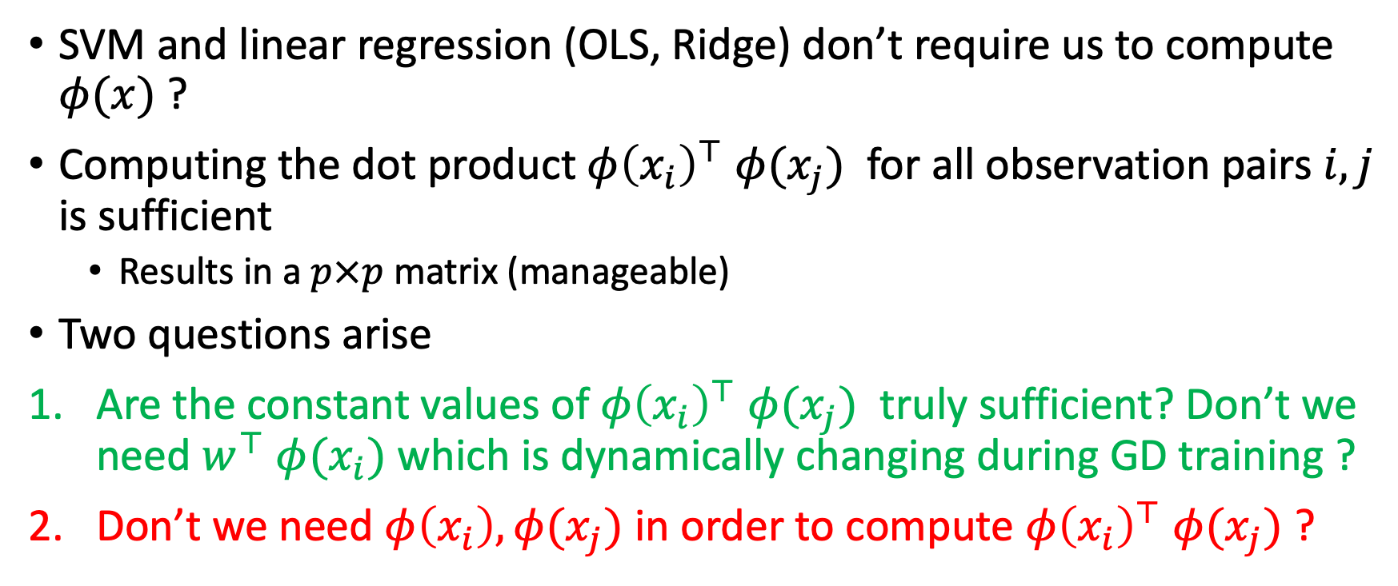
Realization
SVM and linear regression (OLS, Ridge) don’t require us to compute $φ(x)$ ?
Computing the dot product $φ{\left(x_{i}\right)}^{⊤}$ $φ(x_{j})$ for all observation pairs $i,j$ is sufficient
  Results in a $p×p$ matrix (manageable)
Two questions arise
Are the constant values of $φ{\left(x_{i}\right)}^{⊤}$ $φ(x_{j})$ truly sufficient? Don’t we need $w^{⊤}$ $φ(x_{i})$ which is dynamically changing during GD training ?
Don’t we need $φ\left(x_{i}\right),φ(x_{j})$ in order to compute $φ{\left(x_{i}\right)}^{⊤}$ $φ(x_{j})$ ?

Slide 26
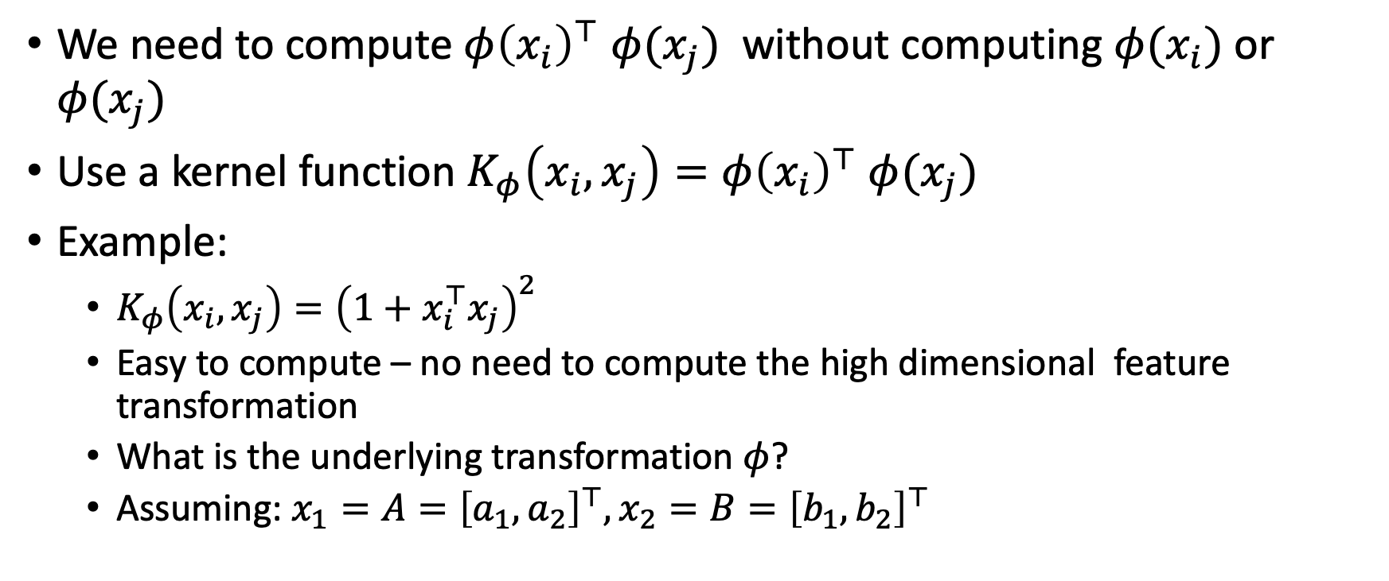
Kernelization
We need to compute $φ{\left(x_{i}\right)}^{⊤}$ $φ(x_{j})$ without computing $φ(x_{i})$ or $φ(x_{j})$
Use a kernel function $K_{φ}\left(x_{i},x_{j}\right)=φ{\left(x_{i}\right)}^{⊤} φ(x_{j})$
Example:
  $K_{φ}\left(x_{i},x_{j}\right)={\left(1+x_{i}^{⊤}x_{j}\right)}^{2}$
  Easy to compute – no need to compute the high dimensional feature transformation
  What is the underlying transformation $φ$?
  Assuming: $x_{1}=A={\left[a_{1},a_{2}\right]}^{⊤},x_{2}=B={\left[b_{1},b_{2}\right]}^{⊤}$

Slide 27
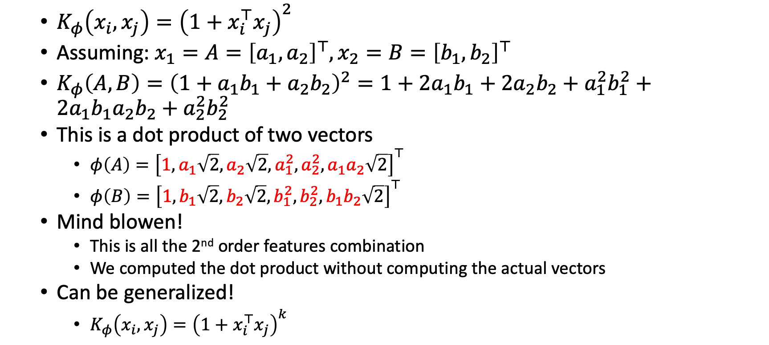
Polynomial kernel
  $K_{φ}\left(x_{i},x_{j}\right)={\left(1+x_{i}^{⊤}x_{j}\right)}^{2}$
  $\text{Assuming}\text{: }x_{1}=A={\left[a_{1},a_{2}\right]}^{⊤},x_{2}=B={\left[b_{1},b_{2}\right]}^{⊤}$
  $K_{φ}\left(A,B\right)={\left(1+a_{1}b_{1}+a_{2}b_{2}\right)}^{2}=1+2a_{1}b_{1}+2a_{2}b_{2}+a_{1}^{2}b_{1}^{2}+2a_{1}b_{1}a_{2}b_{2}+a_{2}^{2}b_{2}^{2}$
  This is a dot product of two vectors
    $φ\left(A\right)={\left[1,a_{1}\sqrt{2},a_{2}\sqrt{2},a_{1}^{2},a_{2}^{2},a_{1}a_{2}\sqrt{2}\right]}^{⊤}$
    $φ\left(B\right)={\left[1,b_{1}\sqrt{2},b_{2}\sqrt{2},b_{1}^{2},b_{2}^{2},b_{1}b_{2}\sqrt{2}\right]}^{⊤}$
  Mind blowen!
    This is all the 2nd order features combination
    We computed the dot product without computing the actual vectors
  Can be generalized!
    $K_{φ}\left(x_{i},x_{j}\right)={\left(1+x_{i}^{⊤}x_{j}\right)}^{k}$

Slide 28
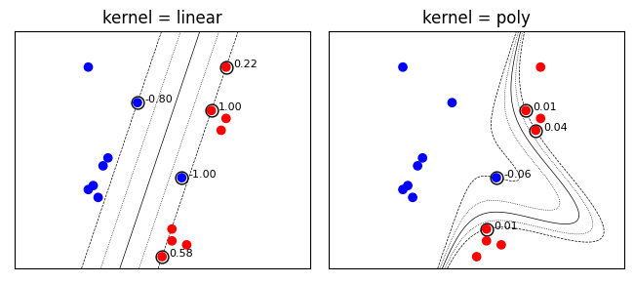

Polynomial kernel
(K=2)
Linear kernel: $K_{φ}\left(x_{i},x_{j}\right)=x_{i}^{⊤}x_{j}$
The circled samples are support vectors, together with their coefficients.

Slide 29

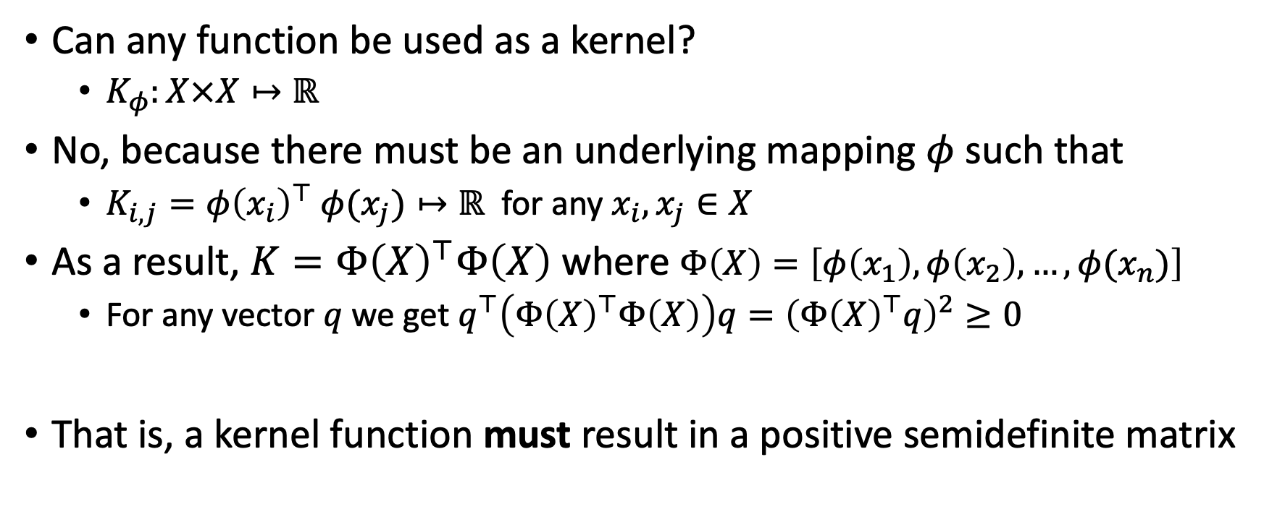
Kernel functions (in general)
Can any function be used as a kernel?
  $K_{φ}:X×X↦ℝ$
No, because there must be an underlying mapping $φ$ such that
  $K_{i,j}=φ{\left(x_{i}\right)}^{⊤} φ(x_{j})↦ℝ$ for any $x_{i},x_{j}∈X$
As a result, $K=Φ{\left(X\right)}^{⊤}Φ\left(X\right)$ where $Φ\left(X\right)=\left[φ\left(x_{1}\right),φ\left(x_{2}\right),…,φ(x_{n})\right]$
  For any vector $q$ we get $q^{⊤}\left(Φ{\left(X\right)}^{⊤}Φ\left(X\right)\right)q={\left(Φ{\left(X\right)}^{⊤}q\right)}^{2}≥0$
That is, a kernel function must result in a positive semidefinite matrix
$$K$$

Slide 30
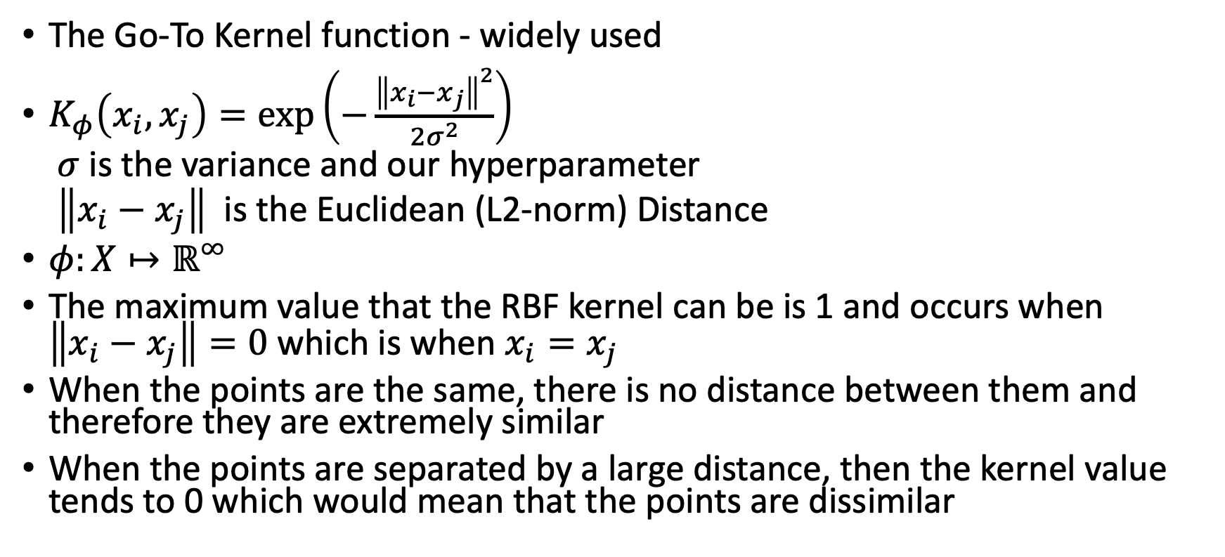
Radial basis function (RBF) kernel
The Go-To Kernel function - widely used
$K_{φ}\left(x_{i},x_{j}\right)=\exp\left(−\frac{{\left\|x_{i}−x_{j}\right\|}^{2}}{2σ^{2}}\right)$
$σ$ is the variance and our hyperparameter
$\left\|x_{i}−x_{j}\right\|$ is the Euclidean (L2-norm) Distance
$φ:X↦ℝ^{∞}$
The maximum value that the RBF kernel can be is 1 and occurs when $\left\|x_{i}−x_{j}\right\|=0$which is when $x_{i}=x_{j}$
When the points are the same, there is no distance between them and therefore they are extremely similar
When the points are separated by a large distance, then the kernel value tends to 0 which would mean that the points are dissimilar

Slide 31
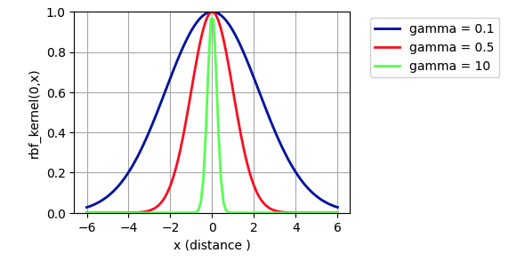
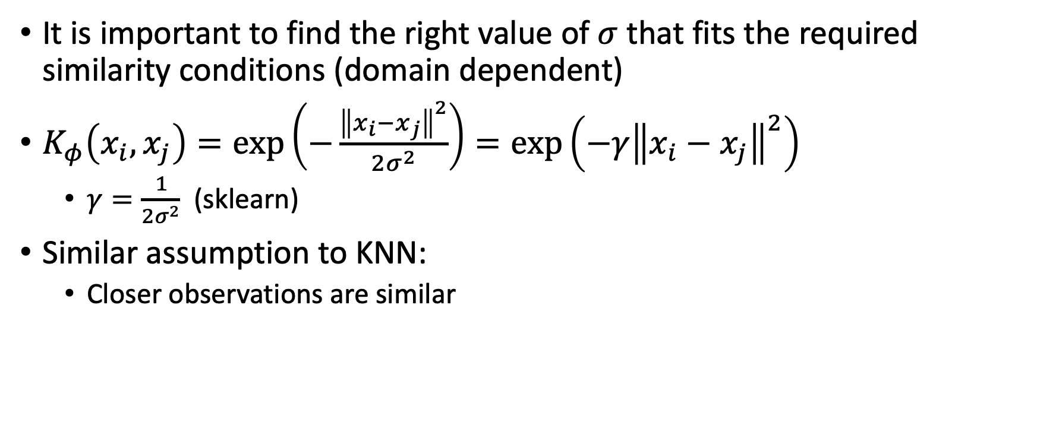
Radial basis function (RBF) kernel
It is important to find the right value of $σ$ that fits the required similarity conditions (domain dependent)
$K_{φ}\left(x_{i},x_{j}\right)=\exp\left(−\frac{{\left\|x_{i}−x_{j}\right\|}^{2}}{2σ^{2}}\right)=\exp\left(−γ{\left\|x_{i}−x_{j}\right\|}^{2}\right)$
  $γ=\frac{1}{2σ^{2}}$ (sklearn)
Similar assumption to KNN:
  Closer observations are similar

Slide 32
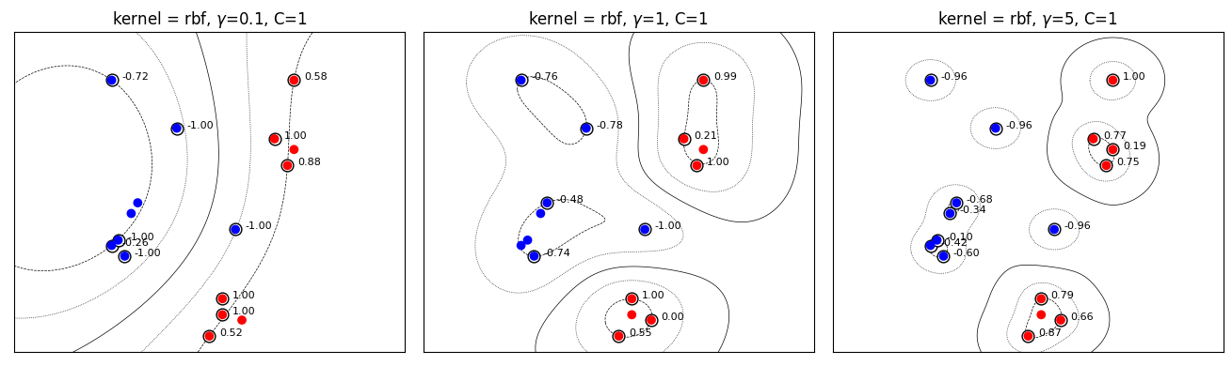
SVM with soft constraints (C hyperparameter)
These boundaries are still linear (in some high dimensional feature space)

Slide 33
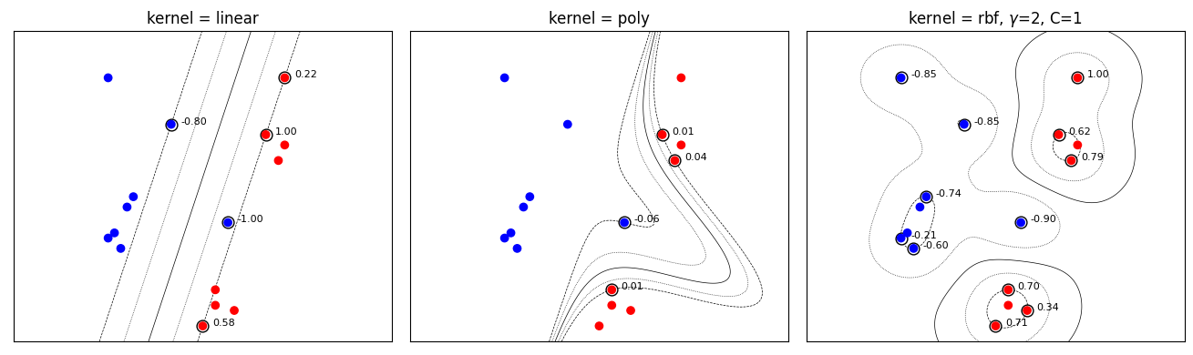

Slide 34
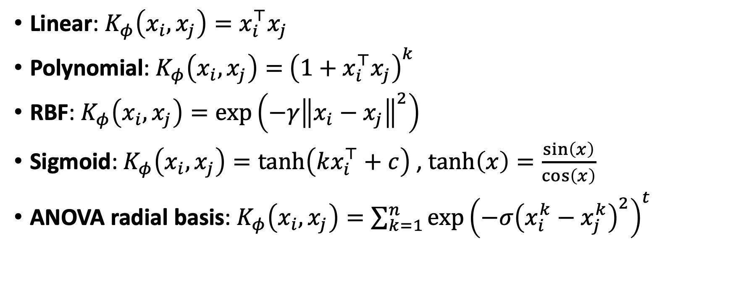
Common Kernel functions
Linear: $K_{φ}\left(x_{i},x_{j}\right)=x_{i}^{⊤}x_{j}$
Polynomial: $K_{φ}\left(x_{i},x_{j}\right)=$ ${\left(1+x_{i}^{⊤}x_{j}\right)}^{k}$
RBF: $K_{φ}\left(x_{i},x_{j}\right)=\exp\left(−γ{\left\|x_{i}−x_{j}\right\|}^{2}\right)$
Sigmoid: $K_{φ}\left(x_{i},x_{j}\right)=\tanh\left(kx_{i}^{⊤}+c\right)$ , $tanh\left(x\right)=\frac{\sin\left(x\right)}{\cos\left(x\right)}$
ANOVA radial basis: $K_{φ}\left(x_{i},x_{j}\right)=\sum_{k=1}^{n}{\exp{{\left(−σ{\left(x_{i}^{k}−x_{j}^{k}\right)}^{2}\right)}^{t}}}$

Slide 35
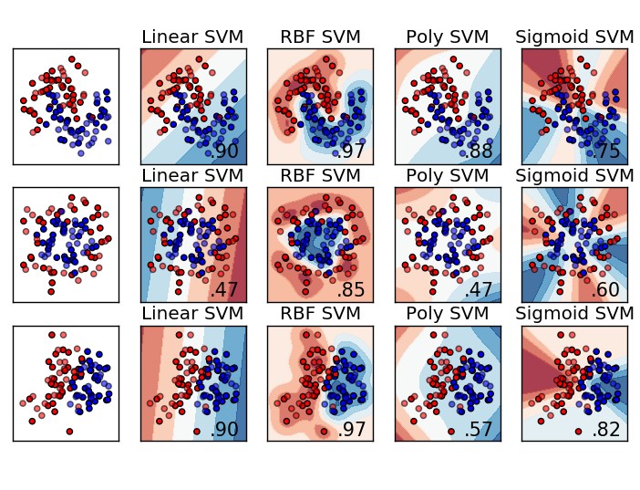

Slide 36
Kernel function should fit data patterns
Kernelization can be powerful if you have some prior knowledge regarding feature correlations and dependencies
  E.g., if you expect seasonal correlation then add a scaled sinus/cosinus/tanh function
But you just said that we can’t build arbitrary kernel functions!
We actually can, just need to construct them correctly
  In a way that results in a positive semidefinite matrix

Slide 37
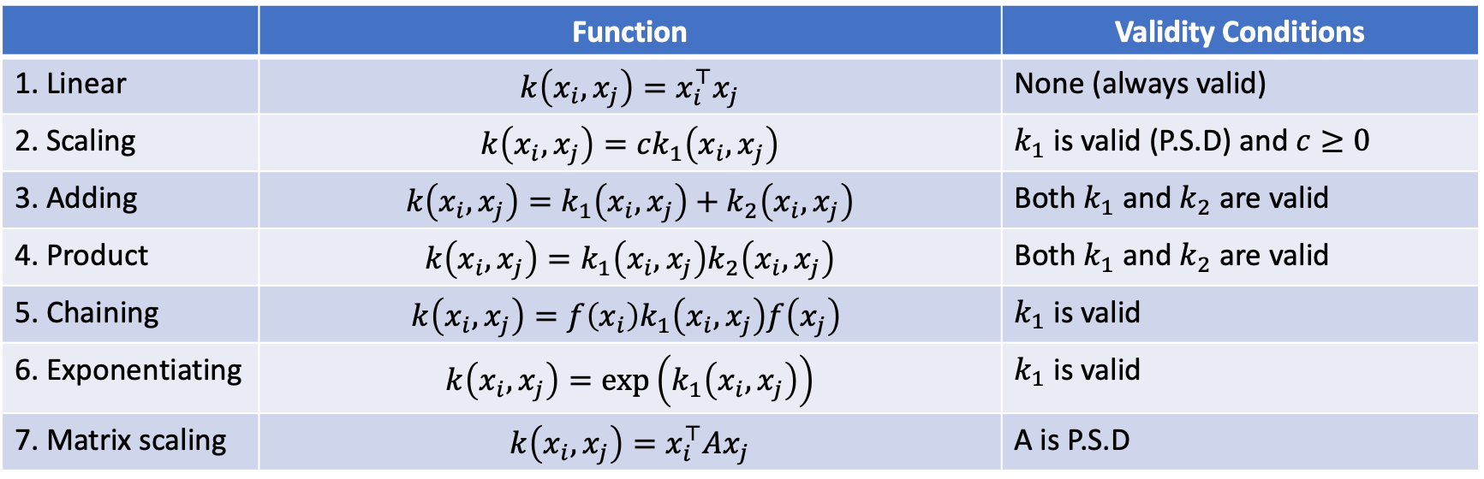
Kernel building kit
 | Function | Validity Conditions
1. Linear | $$k\left(x_{i},x_{j}\right)=x_{i}^{⊤}x_{j}$$ | None (always valid)
2. Scaling | $$k\left(x_{i},x_{j}\right)=ck_{1}\left(x_{i},x_{j}\right)$$ | $k_{1}$ is valid (P.S.D) and $c≥0$
3. Adding | $$k\left(x_{i},x_{j}\right)=k_{1}\left(x_{i},x_{j}\right)+k_{2}\left(x_{i},x_{j}\right)$$ | Both $k_{1}$ and $k_{2}$ are valid
4. Product | $$k\left(x_{i},x_{j}\right)=k_{1}\left(x_{i},x_{j}\right)k_{2}\left(x_{i},x_{j}\right)$$ | Both $k_{1}$ and $k_{2}$ are valid
5. Chaining | $$k\left(x_{i},x_{j}\right)=f\left(x_{i}\right)k_{1}\left(x_{i},x_{j}\right)f\left(x_{j}\right)$$ | $k_{1}$ is valid
6. Exponentiating | $$k\left(x_{i},x_{j}\right)=\exp\left(k_{1}\left(x_{i},x_{j}\right)\right)$$ | $k_{1}$ is valid
7. Matrix scaling | $$k\left(x_{i},x_{j}\right)=x_{i}^{⊤}Ax_{j}$$ | A is P.S.D
https://people.engr.tamu.edu/guni/csce421/files/kernels.pdf for full proofs

Slide 38
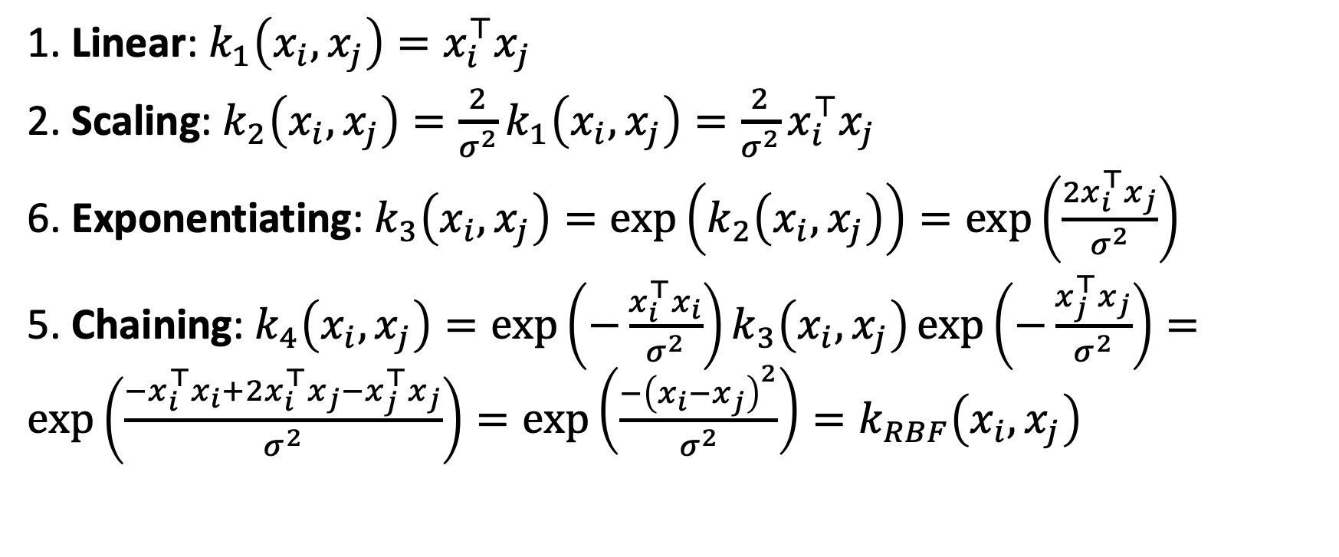
Example: RBF
1. Linear: $k_{1}\left(x_{i},x_{j}\right)=x_{i}^{⊤}x_{j}$
2. Scaling: $k_{2}\left(x_{i},x_{j}\right)=\frac{2}{σ^{2}}k_{1}\left(x_{i},x_{j}\right)=\frac{2}{σ^{2}}x_{i}^{⊤}x_{j}$
6. Exponentiating: $k_{3}\left(x_{i},x_{j}\right)=\exp\left(k_{2}\left(x_{i},x_{j}\right)\right)=\exp\left(\frac{2x_{i}^{⊤}x_{j}}{σ^{2}}\right)$
5. Chaining: $k_{4}\left(x_{i},x_{j}\right)=\exp\left(−\frac{x_{i}^{⊤}x_{i}}{σ^{2}}\right)k_{3}\left(x_{i},x_{j}\right)\exp\left(−\frac{x_{j}^{⊤}x_{j}}{σ^{2}}\right)=\exp\left(\frac{−x_{i}^{⊤}x_{i}+2x_{i}^{⊤}x_{j}−x_{j}^{⊤}x_{j}}{σ^{2}}\right)=\exp\left(\frac{−{\left(x_{i}−x_{j}\right)}^{2}}{σ^{2}}\right)=k_{RBF}\left(x_{i},x_{j}\right)$

Slide 39
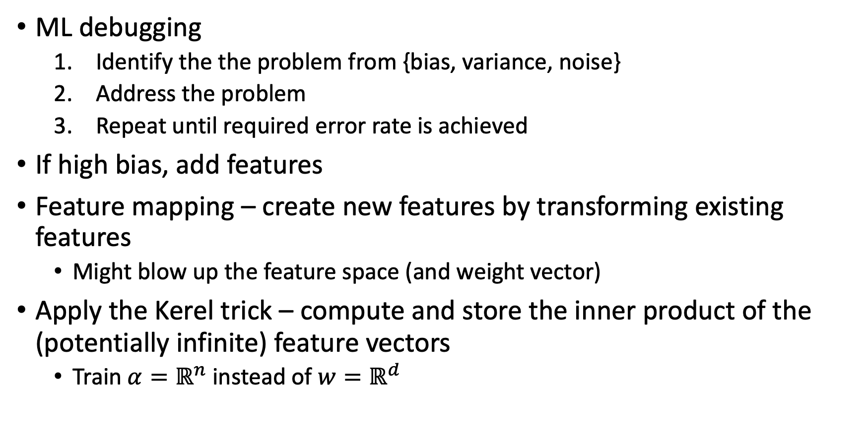
What did we learn?
ML debugging
  Identify the the problem from {bias, variance, noise}
  Address the problem
  Repeat until required error rate is achieved
If high bias, add features
Feature mapping – create new features by transforming existing features
  Might blow up the feature space (and weight vector)
Apply the Kerel trick – compute and store the inner product of the (potentially infinite) feature vectors
  Train ${α=ℝ}^{n}$ instead of ${w=ℝ}^{d}$

Slide 40
What next?
Class: Kernel Machines
Assignments:
Quizzes:
  Quiz 4: ML debugging and kernelization, due Wednesday March30

