Slide 1
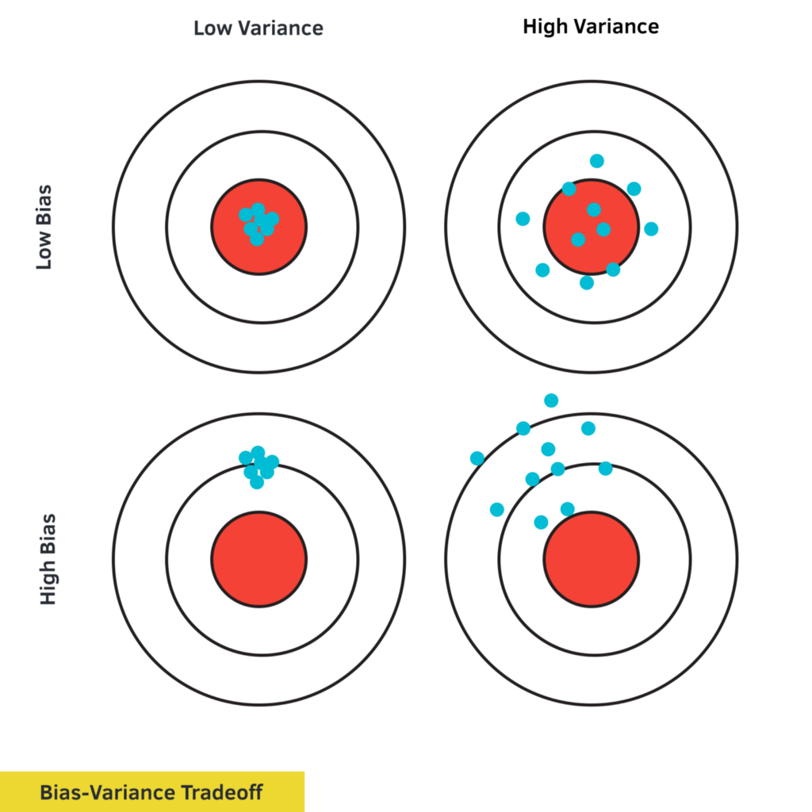
CSCE-633 Machine Learning
11. Bias vs Variance
Instructor: Guni Sharon

Slide 2
Announcements
Announcements
  Midterm on Tuesday, April 12 during class
Overdue:
Due:
  Programming assignment 2: Linear and Logistic Regression, due by March-21
  Quiz 3: Naïve Bayes and SVM, finish by March-13

Slide 3
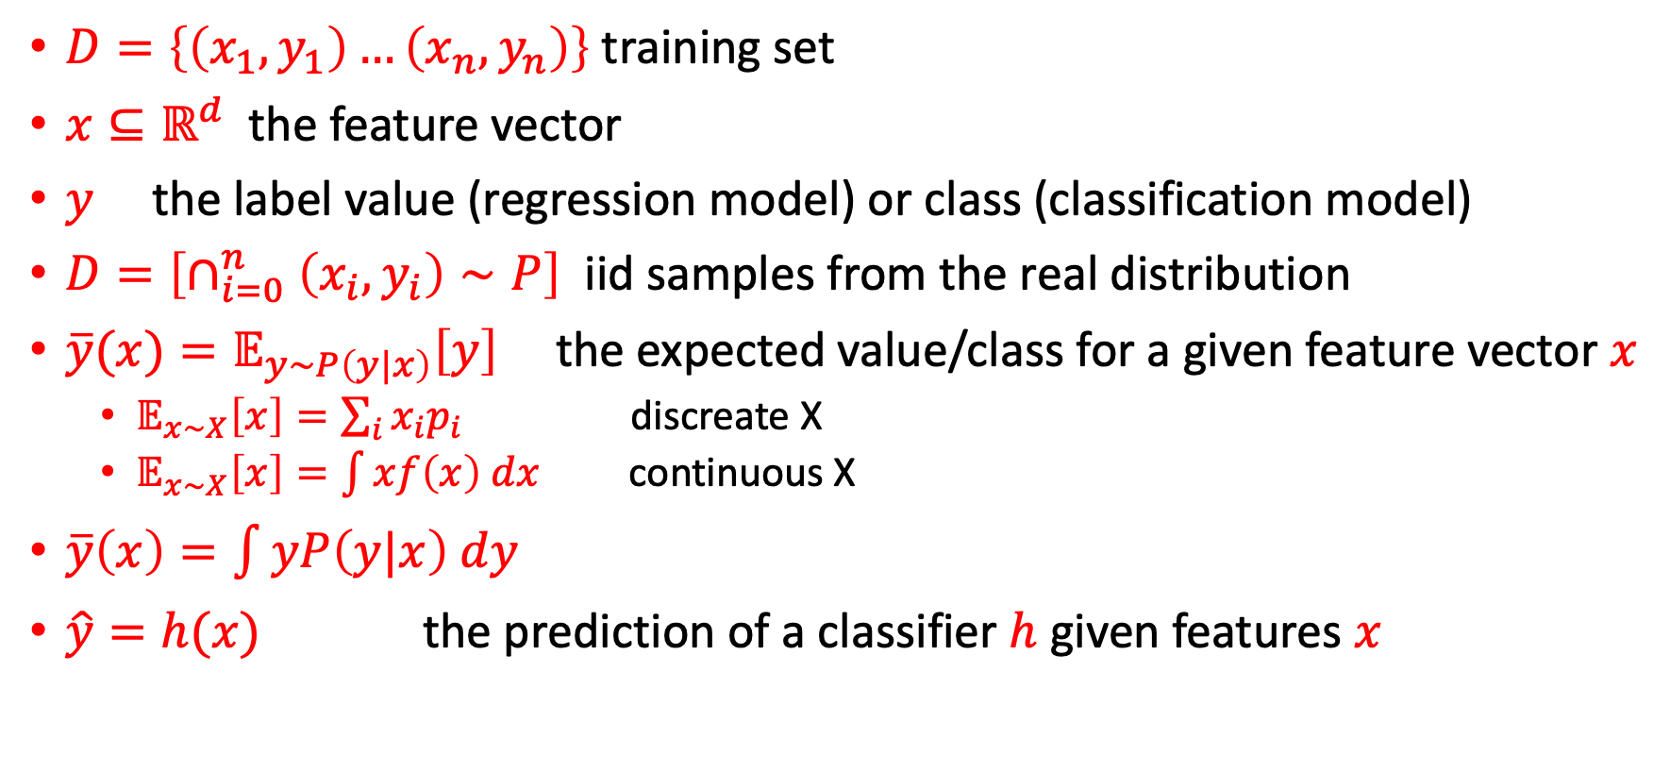
Notation
$D=\left\{\left(x_{1},y_{1}\right)…\left(x_{n},y_{n}\right)\right\}$ training set
$x⊆ℝ^{d}$ the feature vector
$y$ the label value (regression model) or class (classification model)
$D=\left[∩_{i=0}^{n}\left(x_{i},y_{i}\right)∼P\right]$ iid samples from the real distribution
$\overline{y}(x)=𝔼_{y∼P\left(y|x\right)}\left[y\right]$ the expected value/class for a given feature vector $x$
  $𝔼_{x∼X}\left[x\right]=\sum_{i}{x_{i}p_{i}}$ discreate X
  $𝔼_{x∼X}\left[x\right]=\int{xf\left(x\right) dx}$ continuous X
$\overline{y}\left(x\right)=\int{yP\left(y|x\right) dy}$
$\hat{y}=h(x)$ the prediction of a classifier $h$ given features $x$
Definition of expected value for a random variable X

Slide 4
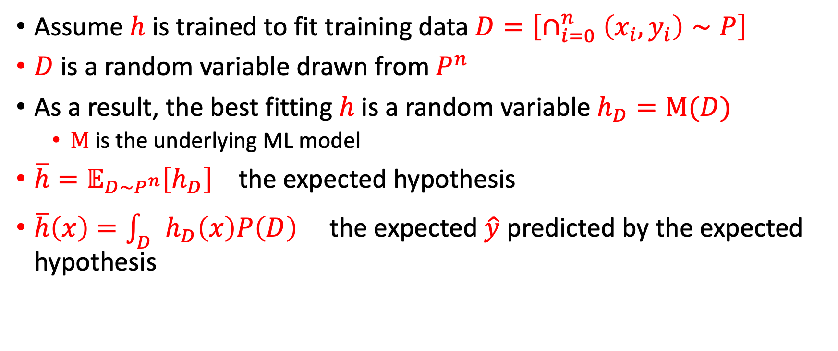
The expected classifier
Assume $h$ is trained to fit training data $D=\left[∩_{i=0}^{n}\left(x_{i},y_{i}\right)∼P\right]$
$D$ is a random variable drawn from $P^{n}$
As a result, the best fitting $h$ is a random variable $h_{D}=M(D)$
  $M$ is the underlying ML model
$\overline{h}=𝔼_{D∼P^{n}}\left[h_{D}\right]$ the expected hypothesis
$\overline{h}\left(x\right)=\int_{D}{h_{D}\left(x\right)P\left(D\right)}$ the expected $\hat{y}$ predicted by the expected hypothesis

Slide 5
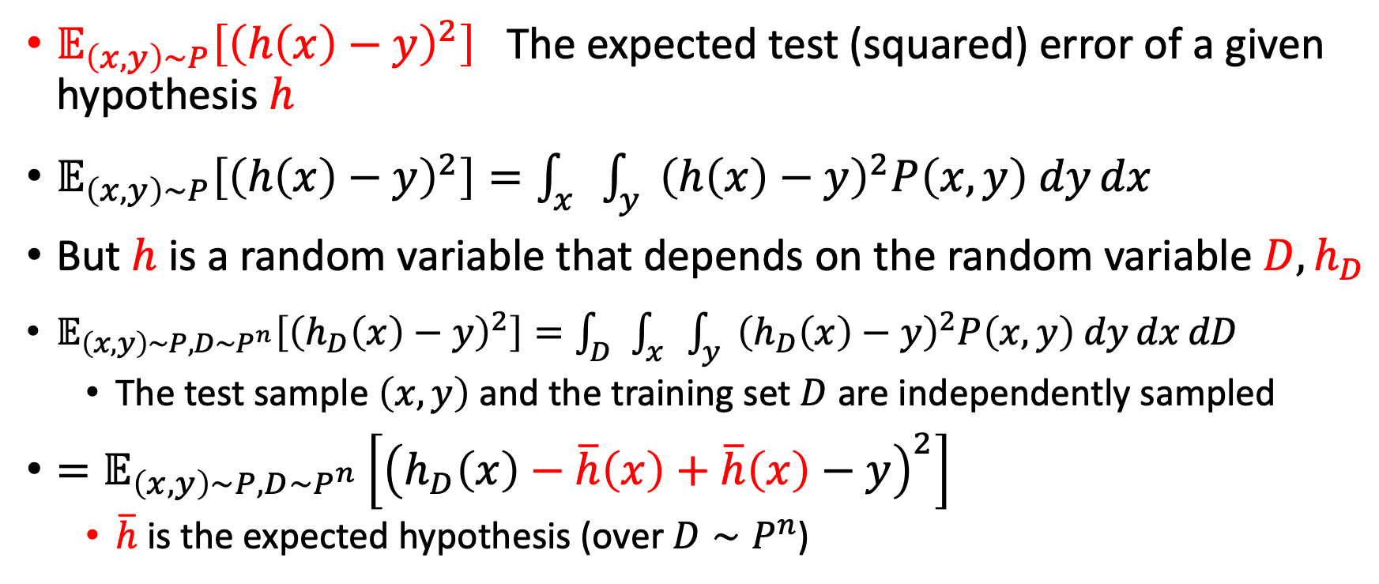
The expected classification error
$𝔼_{\left(x,y\right)∼P}\left[{\left(h\left(x\right)−y\right)}^{2}\right]$ $\text{The} \text{expected} \text{test}\text{ (}\text{squared}\text{) }\text{error}$of a given hypothesis $h$
$𝔼_{\left(x,y\right)∼P}\left[{\left(h\left(x\right)−y\right)}^{2}\right]=\int_{x}{\int_{y}{{\left(h\left(x\right)−y\right)}^{2}P\left(x,y\right) dy}dx}$
But $h$ is a random variable that depends on the random variable $D, h_{D}$
$𝔼_{\left(x,y\right)∼P, D∼P^{n}}\left[{\left(h_{D}\left(x\right)−y\right)}^{2}\right]=\int_{D}{\int_{x}{\int_{y}{{\left(h_{D}\left(x\right)−y\right)}^{2}P\left(x,y\right) dy}dx}dD}$
  The test sample $\left(x,y\right)$ and the training set $D$ are independently sampled
$=𝔼_{\left(x,y\right)∼P, D∼P^{n}}\left[{\left(h_{D}\left(x\right)−\overline{h}\left(x\right)+\overline{h}\left(x\right)−y\right)}^{2}\right]$
  $\overline{h}$ is the expected hypothesis (over $D∼P^{n}$)

Slide 6
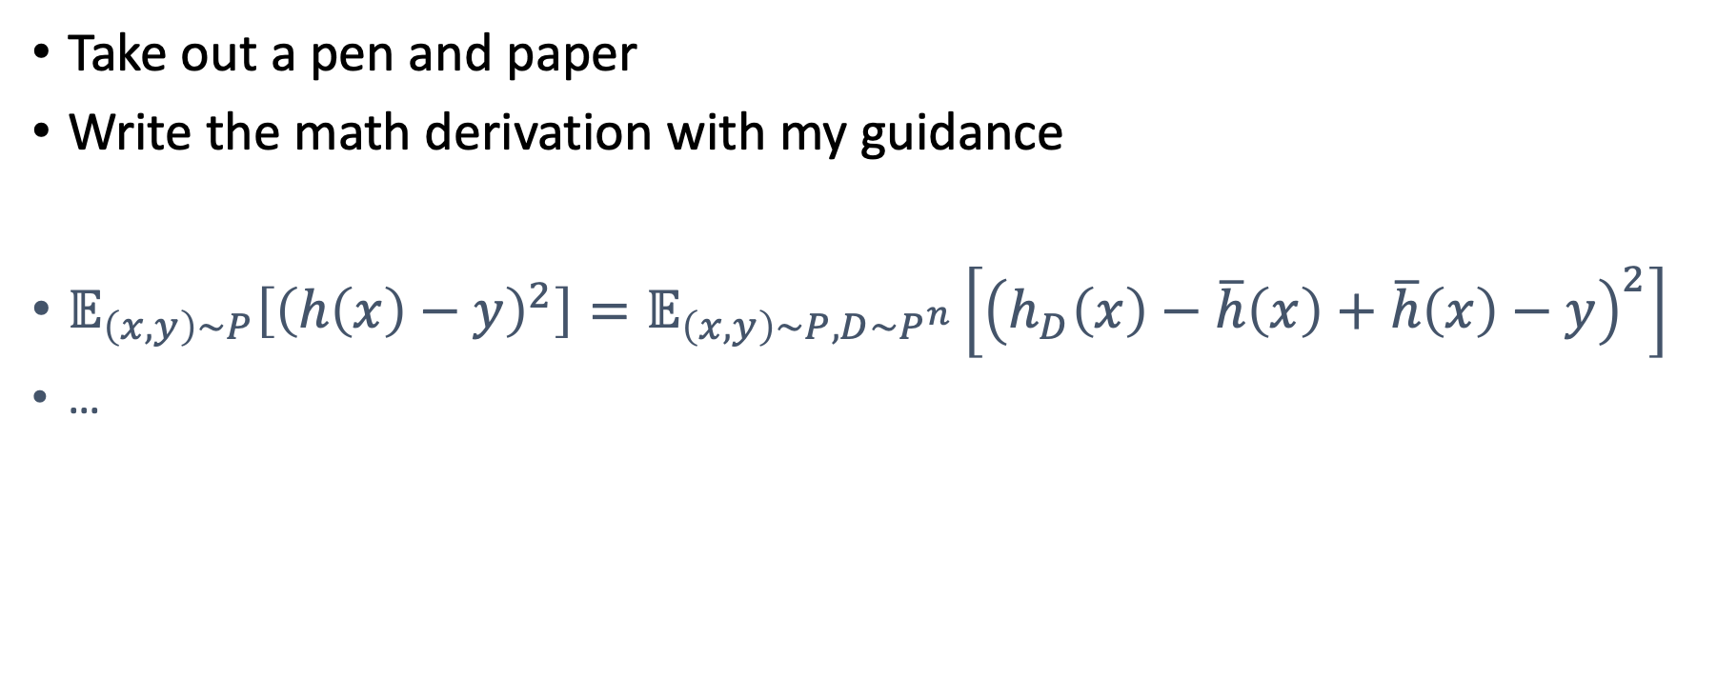
Suggestion
Take out a pen and paper
Write the math derivation with my guidance
$𝔼_{\left(x,y\right)∼P}\left[{\left(h\left(x\right)−y\right)}^{2}\right]=𝔼_{\left(x,y\right)∼P, D∼P^{n}}\left[{\left(h_{D}\left(x\right)−\overline{h}\left(x\right)+\overline{h}\left(x\right)−y\right)}^{2}\right]$
…

Slide 7
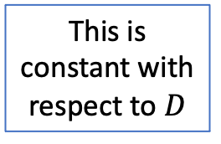
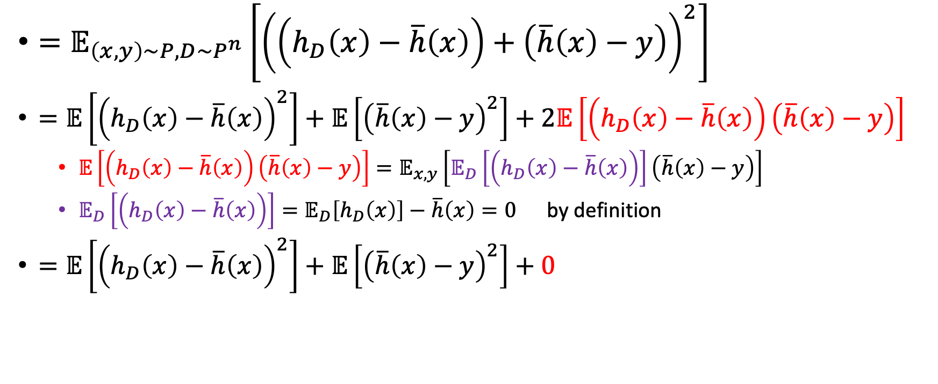
The expected classification error
$=𝔼_{\left(x,y\right)∼P, D∼P^{n}}\left[{\left(\left(h_{D}\left(x\right)−\overline{h}\left(x\right)\right)+\left(\overline{h}\left(x\right)−y\right)\right)}^{2}\right]$
$=𝔼\left[{\left(h_{D}\left(x\right)−\overline{h}\left(x\right)\right)}^{2}\right]+𝔼\left[{\left(\overline{h}\left(x\right)−y\right)}^{2}\right]+2𝔼\left[\left(h_{D}\left(x\right)−\overline{h}\left(x\right)\right)\left(\overline{h}\left(x\right)−y\right)\right]$
  $𝔼\left[\left(h_{D}\left(x\right)−\overline{h}\left(x\right)\right)\left(\overline{h}\left(x\right)−y\right)\right]=𝔼_{x,y}\left[𝔼_{D}\left[\left(h_{D}\left(x\right)−\overline{h}\left(x\right)\right)\right]\left(\overline{h}\left(x\right)−y\right)\right]$
  $𝔼_{D}\left[\left(h_{D}\left(x\right)−\overline{h}\left(x\right)\right)\right]=𝔼_{D}\left[h_{D}\left(x\right)\right]−\overline{h}\left(x\right)=0$ by definition
$=𝔼\left[{\left(h_{D}\left(x\right)−\overline{h}\left(x\right)\right)}^{2}\right]+𝔼\left[{\left(\overline{h}\left(x\right)−y\right)}^{2}\right]+0$
This is constant with respect to $D$

Slide 8
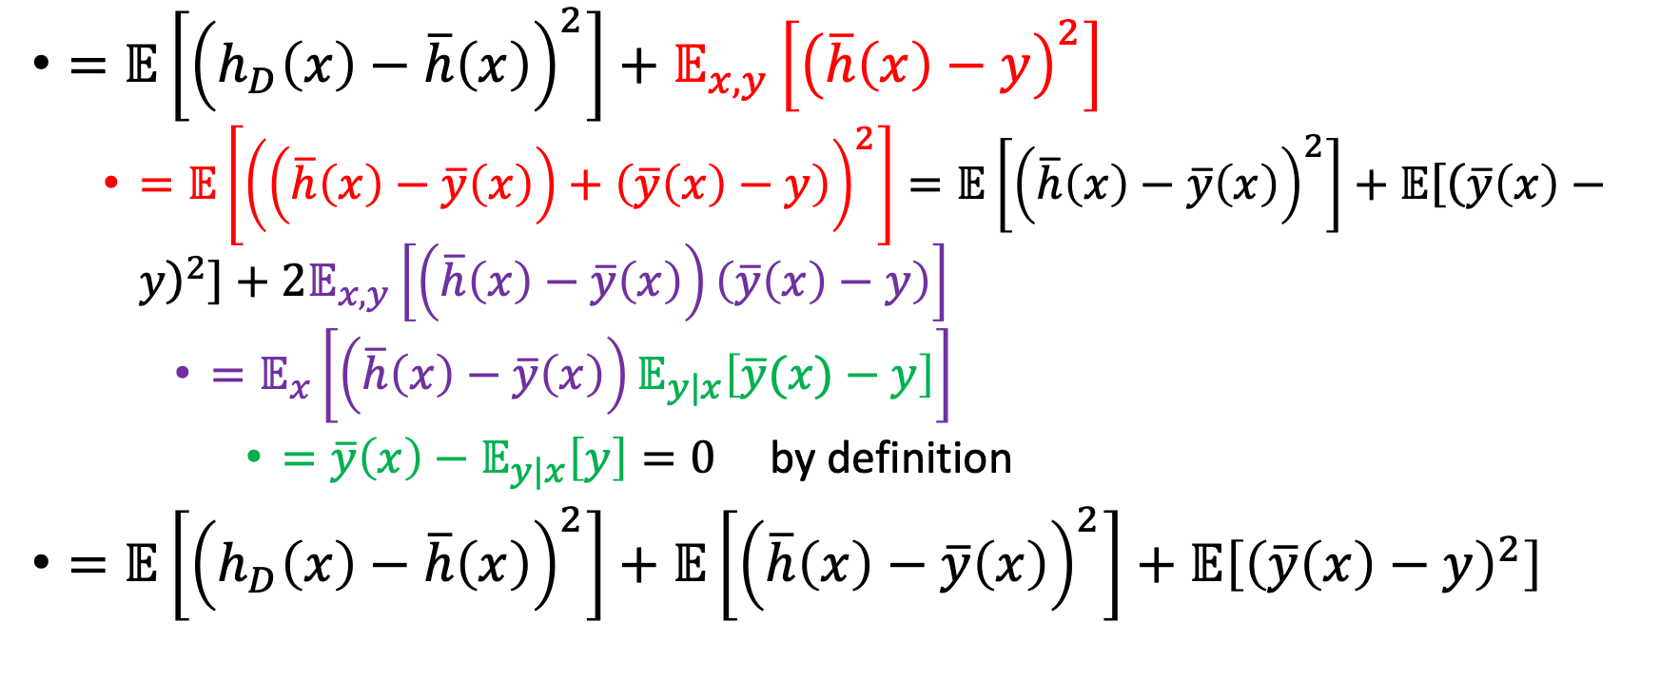
The expected classification error
$=𝔼\left[{\left(h_{D}\left(x\right)−\overline{h}\left(x\right)\right)}^{2}\right]+𝔼_{x,y}\left[{\left(\overline{h}\left(x\right)−y\right)}^{2}\right]$
  $=𝔼\left[{\left(\left(\overline{h}\left(x\right)−\overline{y}\left(x\right)\right)+\left(\overline{y}\left(x\right)−y\right)\right)}^{2}\right]=𝔼\left[{\left(\overline{h}\left(x\right)−\overline{y}\left(x\right)\right)}^{2}\right]+𝔼\left[{\left(\overline{y}\left(x\right)−y\right)}^{2}\right]+2𝔼_{x,y}\left[\left(\overline{h}\left(x\right)−\overline{y}\left(x\right)\right)\left(\overline{y}\left(x\right)−y\right)\right]$
    $=𝔼_{x}\left[\left(\overline{h}\left(x\right)−\overline{y}\left(x\right)\right)𝔼_{y|x}\left[\overline{y}(x)−y\right]\right]$
      $=\overline{y}\left(x\right)−𝔼_{y|x}\left[y\right]=0$ by definition
$=𝔼\left[{\left(h_{D}\left(x\right)−\overline{h}\left(x\right)\right)}^{2}\right]+𝔼\left[{\left(\overline{h}\left(x\right)−\overline{y}\left(x\right)\right)}^{2}\right]+𝔼\left[{\left(\overline{y}\left(x\right)−y\right)}^{2}\right]$

Slide 9
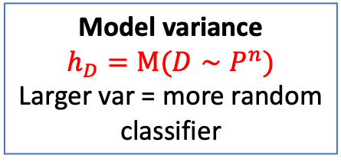
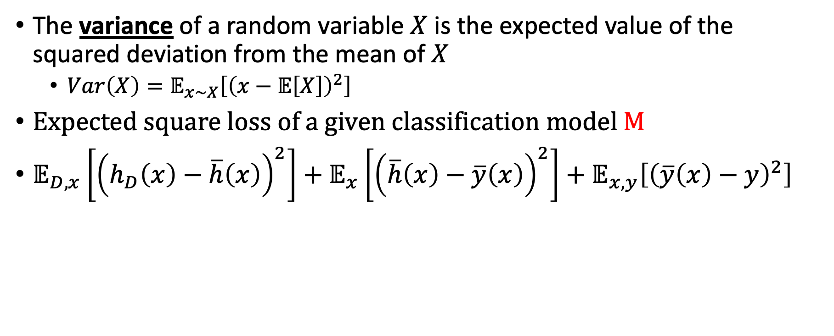
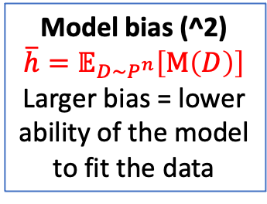
Variance
The variance of a random variable $X$ is the expected value of the squared deviation from the mean of $X$
  $Var\left(X\right)=𝔼_{x∼X}\left[{\left(x−𝔼\left[X\right]\right)}^{2}\right]$
Expected square loss of a given classification model M
$𝔼_{D,x}\left[{\left(h_{D}\left(x\right)−\overline{h}\left(x\right)\right)}^{2}\right]+𝔼_{x}\left[{\left(\overline{h}\left(x\right)−\overline{y}\left(x\right)\right)}^{2}\right]+𝔼_{x,y}\left[{\left(\overline{y}\left(x\right)−y\right)}^{2}\right]$
Model variance
$$h_{D}=M(D∼P^{n})$$
Larger var = more random classifier
Model bias (^2)
$$\overline{h}=𝔼_{D∼P^{n}}\left[M\left(D\right)\right]$$
Larger bias = lower ability of the model to fit the data
Data variance (noise)
Larger var = harder to predict (objectively)

Slide 10
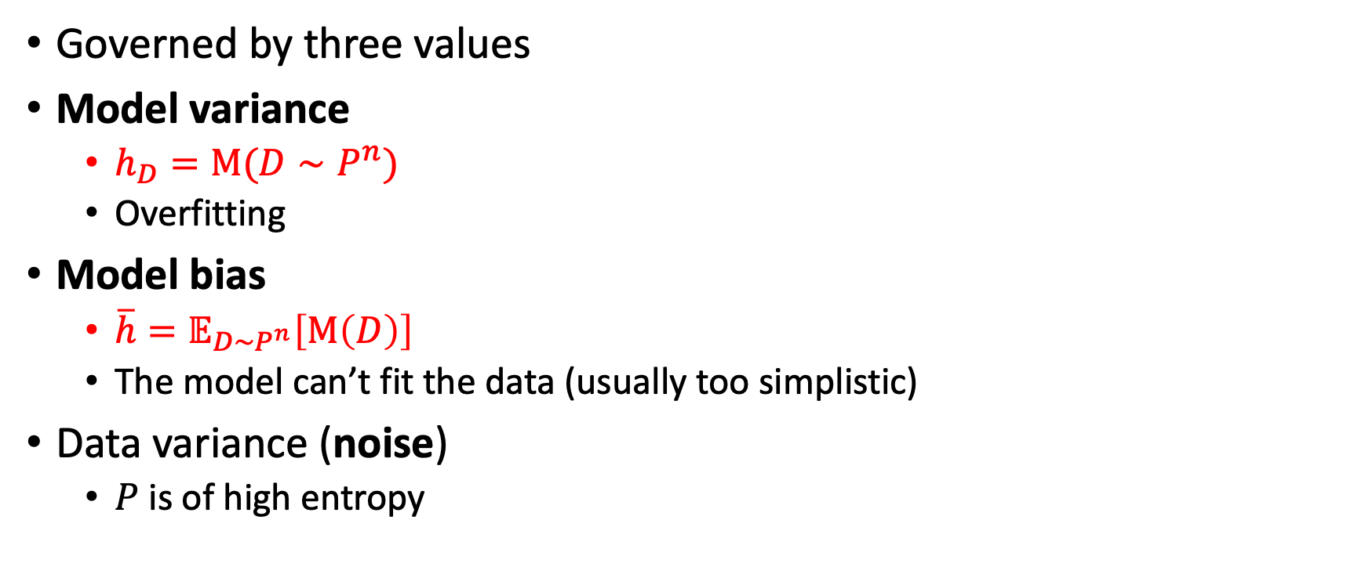
The expected classification error
Governed by three values
Model variance
  $h_{D}=M(D∼P^{n})$
  Overfitting
Model bias
  $\overline{h}=𝔼_{D∼P^{n}}\left[M\left(D\right)\right]$
  The model can’t fit the data (usually too simplistic)
Data variance (noise)
  $P$ is of high entropy

Slide 11
An inherent approximation error. More data won’t help. E.g., error from fitting a linear line to a hyperbola. Even when given all possible data point, the error will persist.

Slide 12
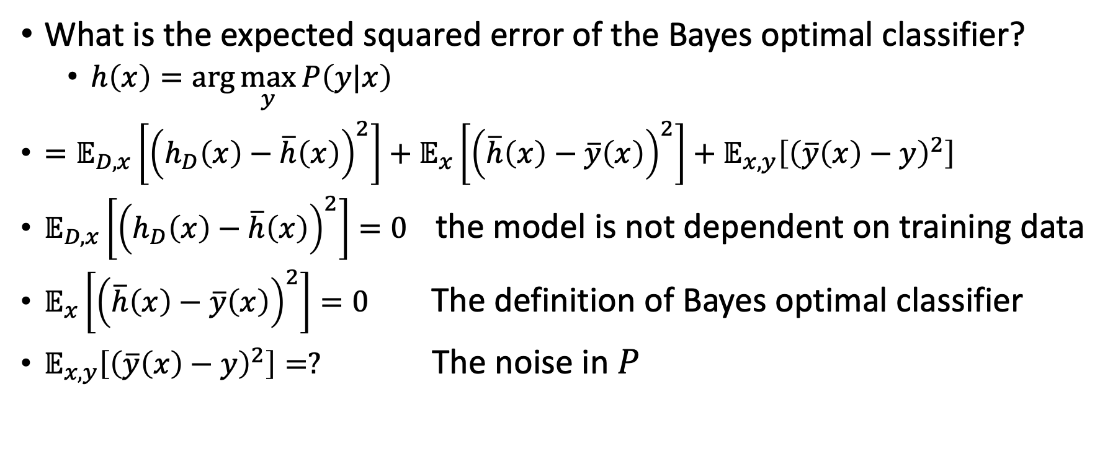
Example: Bayes optimal classifier
What is the expected squared error of the Bayes optimal classifier?
  $h\left(x\right)=\arg{\max_{y}{P\left(y|x\right)}}$
$=𝔼_{D,x}\left[{\left(h_{D}\left(x\right)−\overline{h}\left(x\right)\right)}^{2}\right]+𝔼_{x}\left[{\left(\overline{h}\left(x\right)−\overline{y}\left(x\right)\right)}^{2}\right]+𝔼_{x,y}\left[{\left(\overline{y}\left(x\right)−y\right)}^{2}\right]$
$𝔼_{D,x}\left[{\left(h_{D}\left(x\right)−\overline{h}\left(x\right)\right)}^{2}\right]=0$ the model is not dependent on training data
$𝔼_{x}\left[{\left(\overline{h}\left(x\right)−\overline{y}\left(x\right)\right)}^{2}\right]=0$ The definition of Bayes optimal classifier
$𝔼_{x,y}\left[{\left(\overline{y}\left(x\right)−y\right)}^{2}\right]=?$ The noise in $P$

Slide 13
Fitting a model
Given a model, e.g., linear regression
  learn the tunable parameters, e.g., weight vector
  Each model has a unique learning approach, e.g., Ordinary Least Squares
But how do we fit a model?
  Model = arg (model) min expected classifier loss
  Identify the component that contribute mostly to the loss
    Model variance, Model bias (squared), Noisy data
  Apply relevant methods (variance reduction, bias reduction, data entropy reduction)
  This is what makes good ML engineers

Slide 14
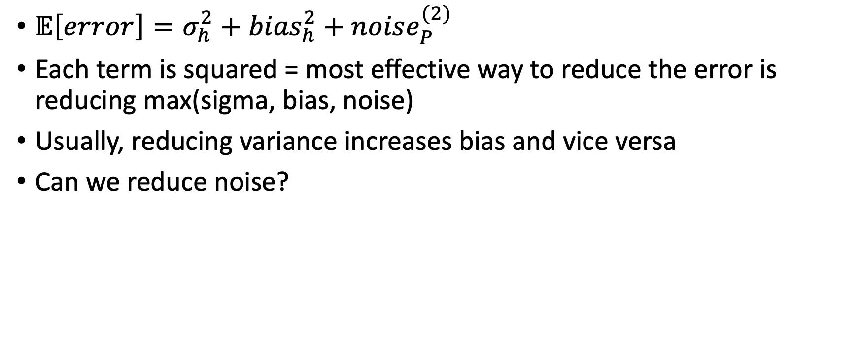
Fitting a model
$𝔼\left[error\right]=σ_{h}^{2}+{bias}_{h}^{2}+noise_{P}^{(2)}$
Each term is squared = most effective way to reduce the error is reducing max(sigma, bias, noise)
Usually, reducing variance increases bias and vice versa
Can we reduce noise?

Slide 15
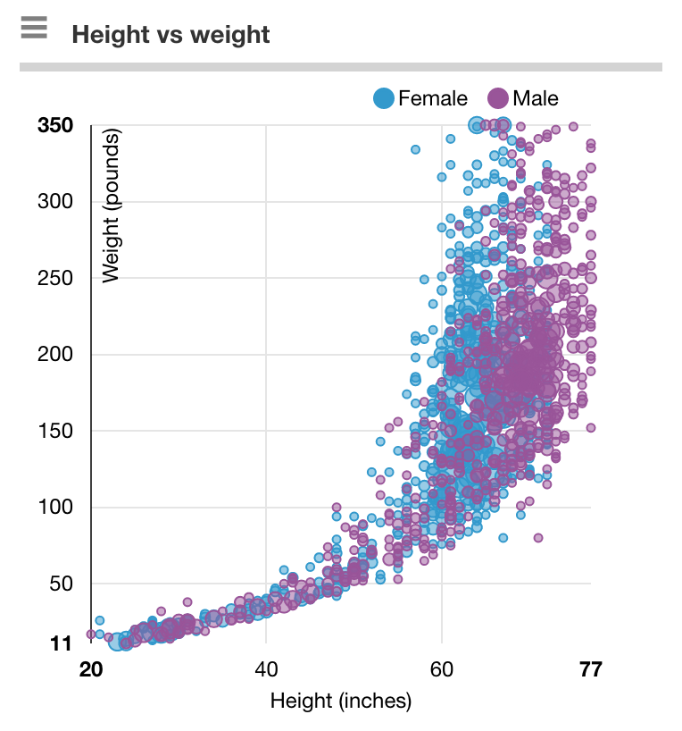
Reducing noise
Adding (relevant) features will usually reduce noise
Not always possible
Requires expert knowledge in many cases

Slide 16
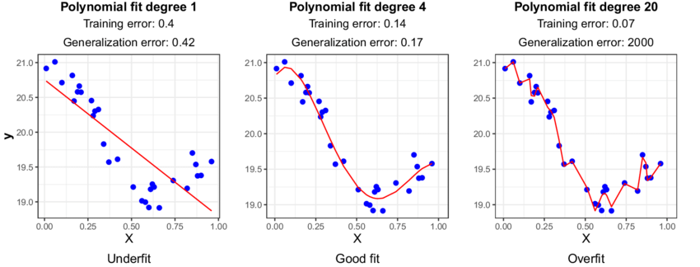
Bias vs variance
Polynomial fit degree 1 (linear)
High training error
High testing (generalization) error
What contributes mostly to the error?
  Variance, bias, noise
Low variance
  Sampling different training points (from the same underlying distribution) won’t change the model significantly

Slide 17
Bias vs variance
Polynomial fit degree 20
Low training error
High testing (generalization) error
What contributes mostly to the error?
  Variance, bias, noise
High variance
  Sampling different training points will significantly change the model

Slide 18
Bias vs variance
A good balance

Slide 19
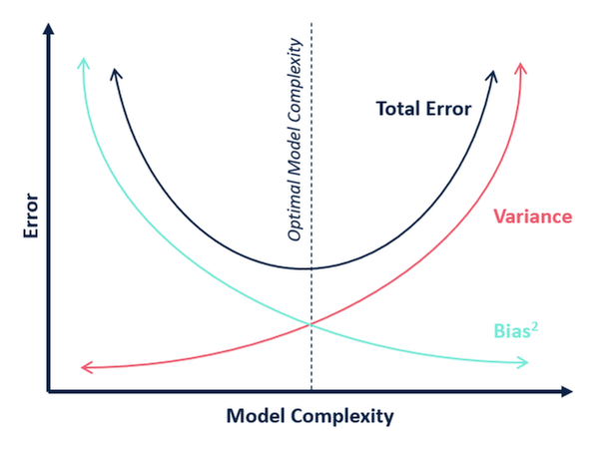

Slide 20
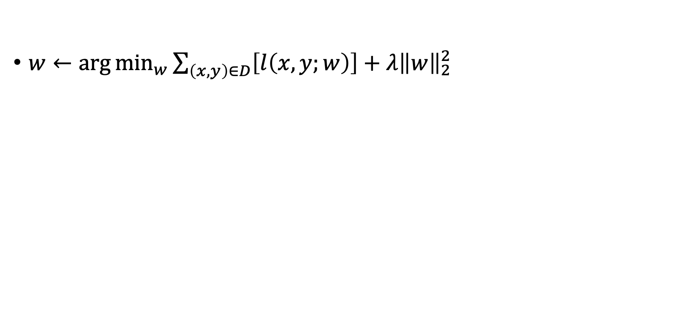

Regularization as a balancing factor
$w←\arg{\min_{w}{\sum_{\left(x,y\right)∈D}{\left[l\left(x,y;w\right)\right]}+λ{\left\|w\right\|}_{2}^{2}}}$
$$\frac{1}{λ}$$

Slide 21
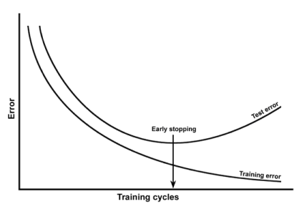


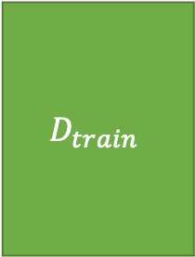

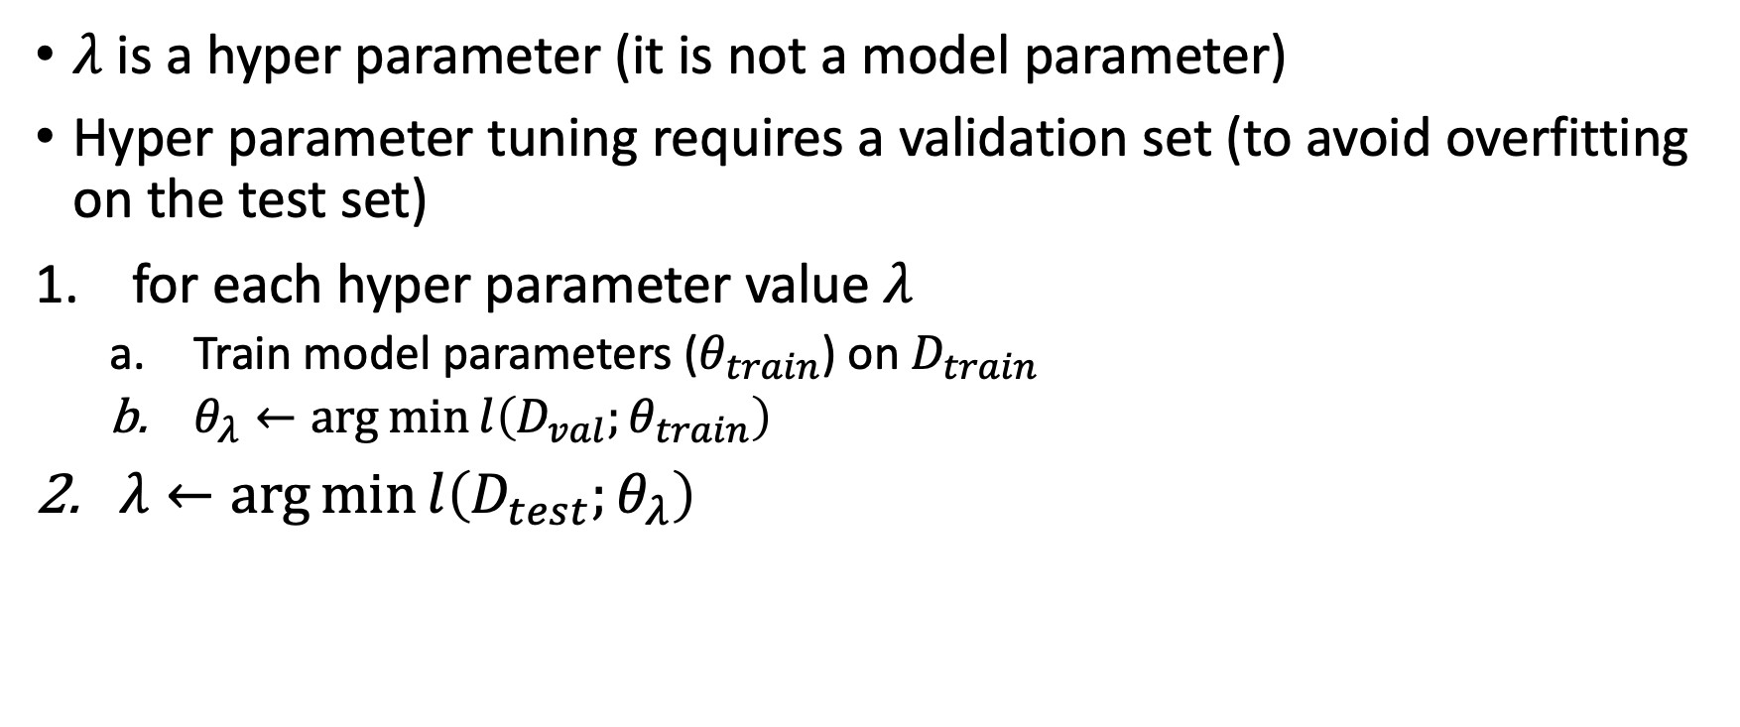
Finding the best $λ$
$λ$ is a hyper parameter (it is not a model parameter)
Hyper parameter tuning requires a validation set (to avoid overfitting on the test set)
for each hyper parameter value $λ$
  Train model parameters ($θ_{train}$) on $D_{train}$
  $θ_{λ}←\arg{\min{l\left(D_{val};θ_{train}\right)}}$
$λ←\arg{\min{l\left(D_{test};θ_{λ}\right)}}$
$$D_{test}$$
$$D_{val}$$
$$D_{train}$$

Slide 22
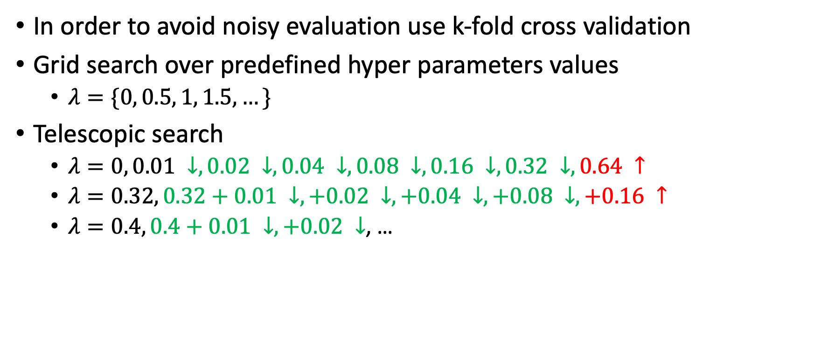
Finding the best $λ$
In order to avoid noisy evaluation use k-fold cross validation
Grid search over predefined hyper parameters values
  $λ=\{0, 0.5, 1, 1.5, …\}$
Telescopic search
  $λ=0, 0.01 ↓,0.02 ↓, 0.04 ↓,0.08 ↓,0.16 ↓, 0.32 ↓,0.64 ↑$
  $λ=0.32, 0.32+0.01 ↓,+0.02 ↓, +0.04 ↓,+0.08 ↓,+0.16 ↑$
  $λ=0.4, 0.4+0.01 ↓,+0.02 ↓$, …
$$D_{test}$$
$$D_{val}$$
$$D_{train}$$

Slide 23
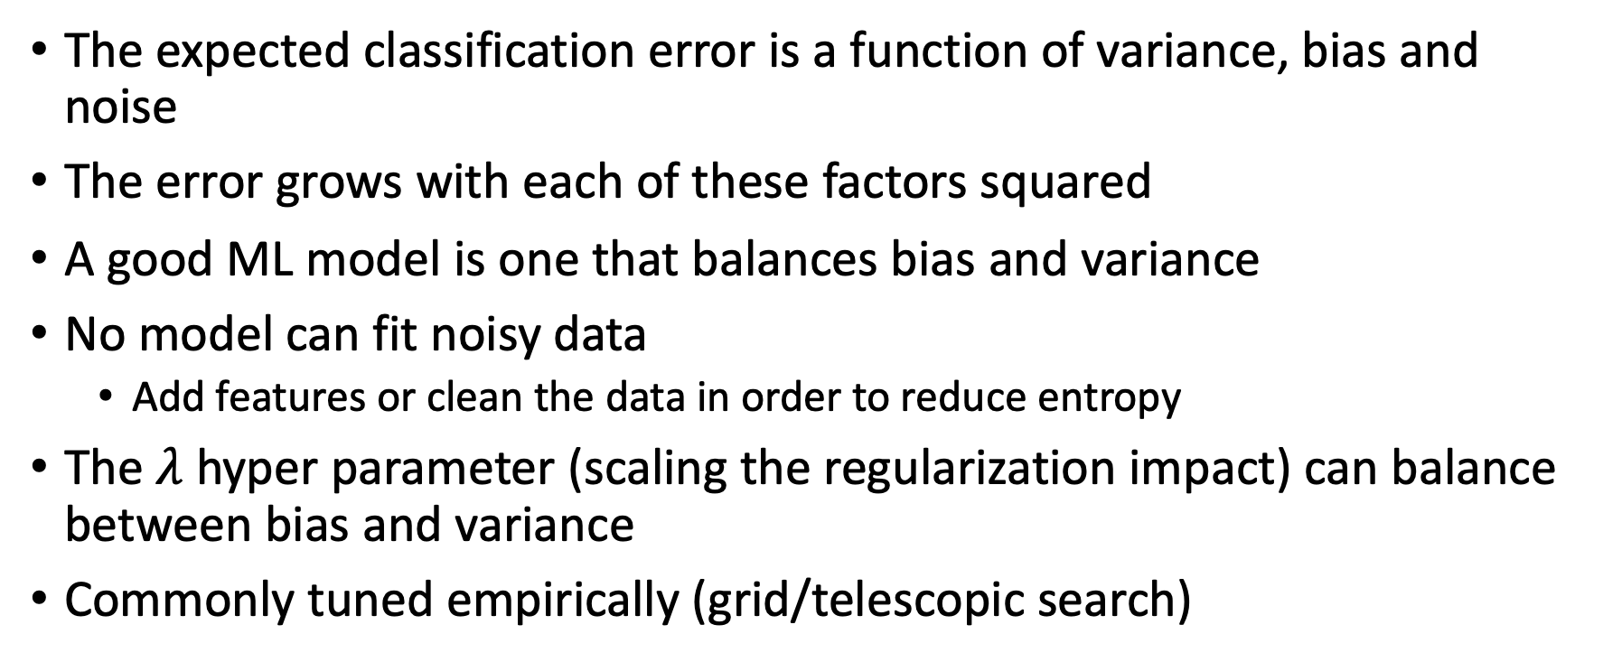
What did we learn?
The expected classification error is a function of variance, bias and noise
The error grows with each of these factors squared
A good ML model is one that balances bias and variance
No model can fit noisy data
  Add features or clean the data in order to reduce entropy
The $λ$ hyper parameter (scaling the regularization impact) can balance between bias and variance
Commonly tuned empirically (grid/telescopic search)

Slide 24
What next?
Class: Kernelization
Assignments:
  Programming assignment 2: Linear and Logistic Regression, due by March-21
Quizzes:
  Quiz 3: Naïve Bayes and SVM, finish by March-13

