Slide 1

CSCE-633 Machine Learning
10. Empirical Risk Minimization
Instructor: Guni Sharon

Slide 2
Announcements
Announcements
  Midterm on Tuesday, April 12 during class
Overdue:
Due:
  Programming assignment 2: Linear and Logistic Regression, due by March-15
  Quiz 3: Naïve Bayes and SVM, finish by March-13

Slide 3
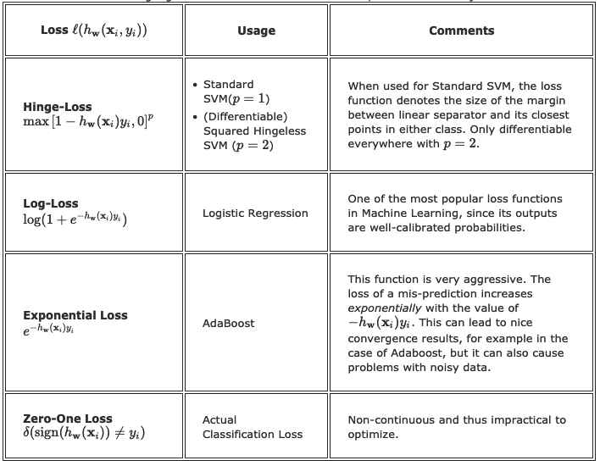
Classification loss functions so far
Table by Kilian Weinberger

Slide 4
Classification loss functions so far
Table by Kilian Weinberger

Slide 5
Classification loss functions so far
Table by Kilian Weinberger

Slide 6
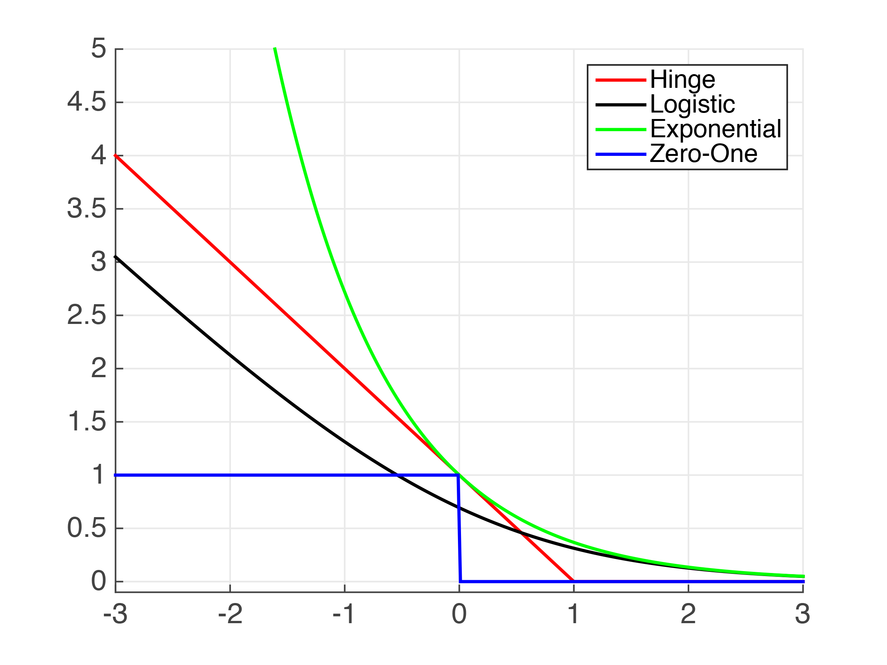

Classification loss functions so far
Important realization: Hinge and Exponential loss are an upper bound for the true classification error (zero-one loss)
Provide an upper bound on the expected error
$$h_{w}\left(x_{i}\right)y_{i}$$
Examples by Kilian Weinberger

Slide 7
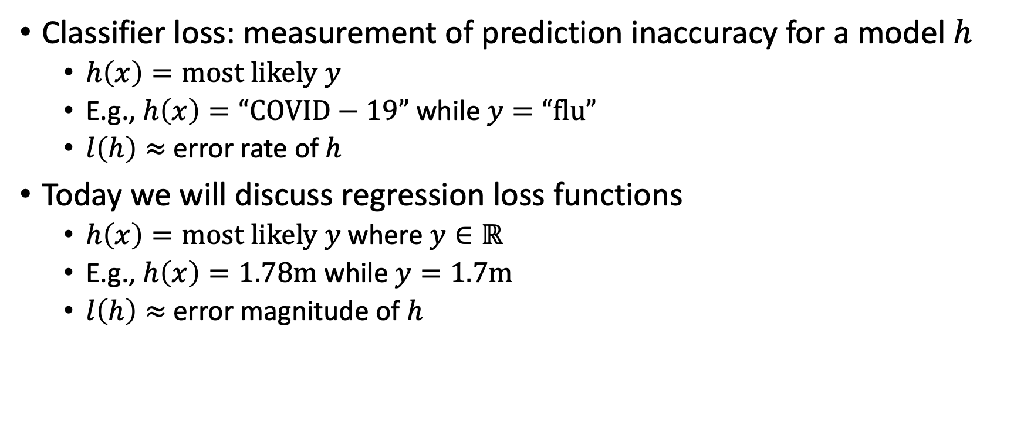
Classifiers Vs regression models
Classifier loss: measurement of prediction inaccuracy for a model $h$
  $h\left(x\right)=most likely y$
  E.g., $h\left(x\right)=“COVID−19”$ while $y=“flu”$
  $l\left(h\right)≈$ error rate of $h$
Today we will discuss regression loss functions
  $h\left(x\right)=most likely y$where $y∈ℝ$
  E.g., $h\left(x\right)=1.78m$ while $y=1.7m$
  $l\left(h\right)≈$ error magnitude of $h$

Slide 8
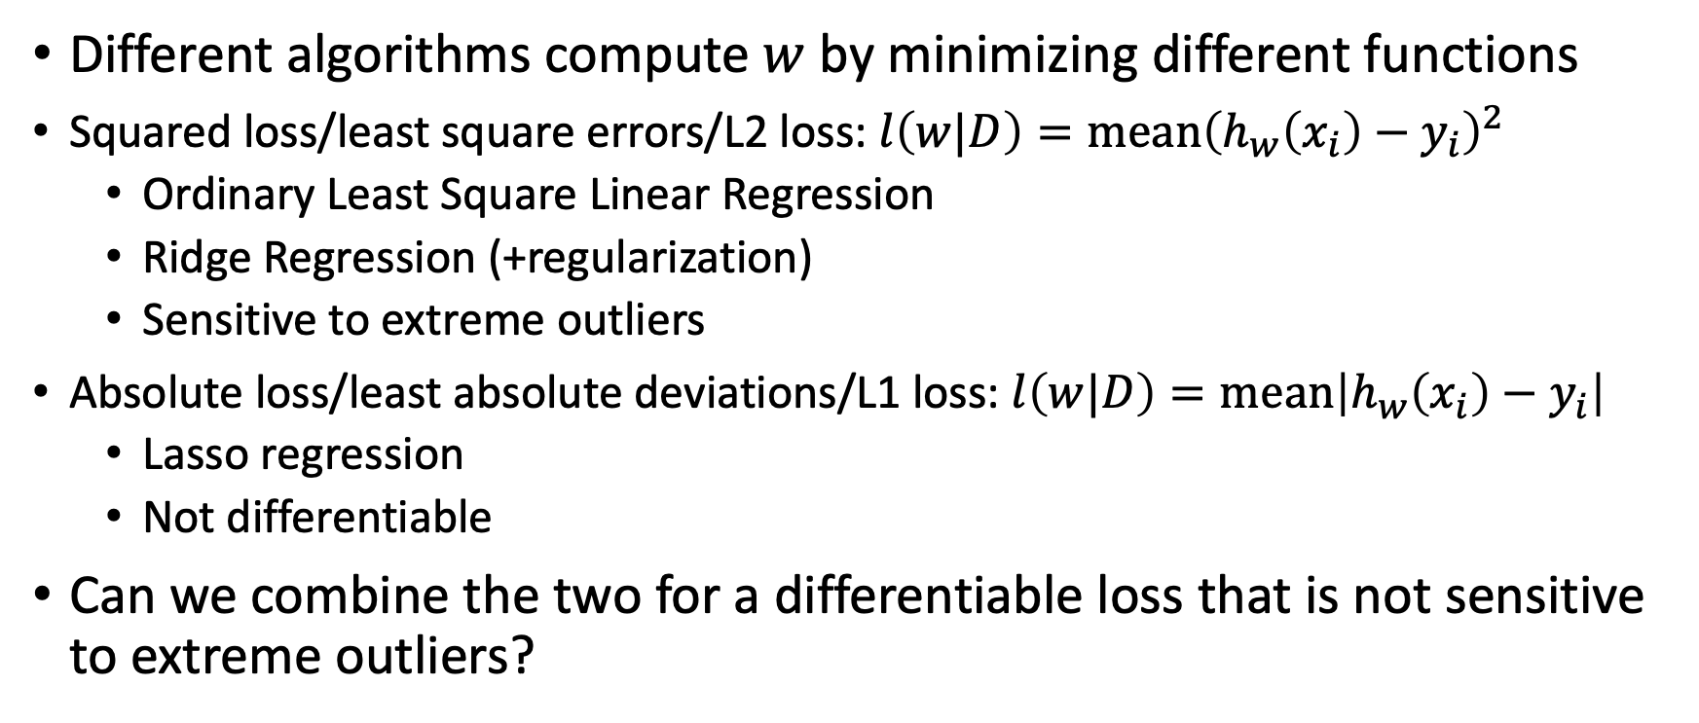
Regression loss functions so far
Different algorithms compute $w$ by minimizing different functions
Squared loss/least square errors/L2 loss: $l\left(w|D\right)=mean{\left(h_{w}\left(x_{i}\right)−y_{i}\right)}^{2}$
  Ordinary Least Square Linear Regression
  Ridge Regression (+regularization)
  Sensitive to extreme outliers
Absolute loss/least absolute deviations/L1 loss: $l\left(w|D\right)=mean\left|h_{w}\left(x_{i}\right)−y_{i}\right|$
  Lasso regression
  Not differentiable
Can we combine the two for a differentiable loss that is not sensitive to extreme outliers?

Slide 9
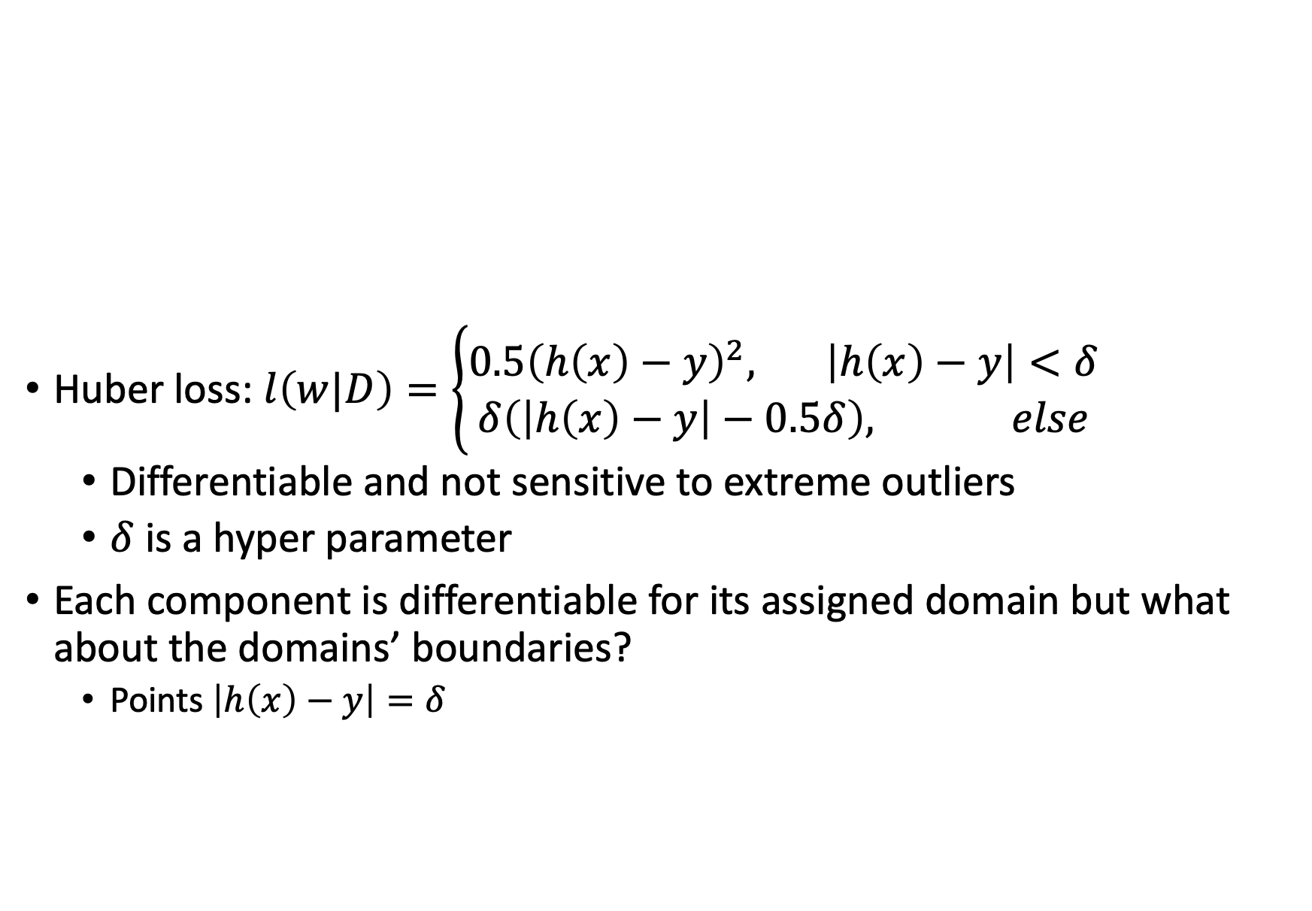
Regression loss functions
Huber loss: $l\left(w|D\right)=\left\{\begin{aligned}0.5{\left(h\left(x\right)−y\right)}^{2}, \left|h\left(x\right)−y\right|<δ \\ &δ\left(\left|h\left(x\right)−y\right|−0.5δ\right), else\end{aligned}\right.$
  Differentiable and not sensitive to extreme outliers
  $δ$ is a hyper parameter
Each component is differentiable for its assigned domain but what about the domains’ boundaries?
  Points $\left|h\left(x\right)−y\right|=δ$

Slide 10
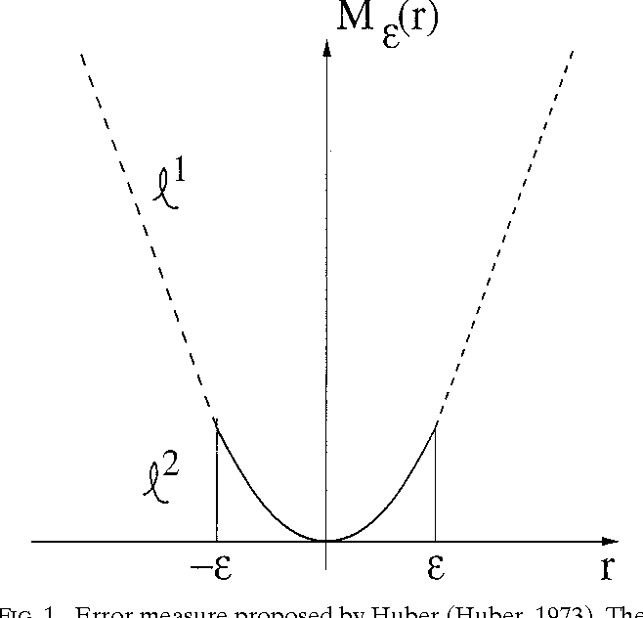
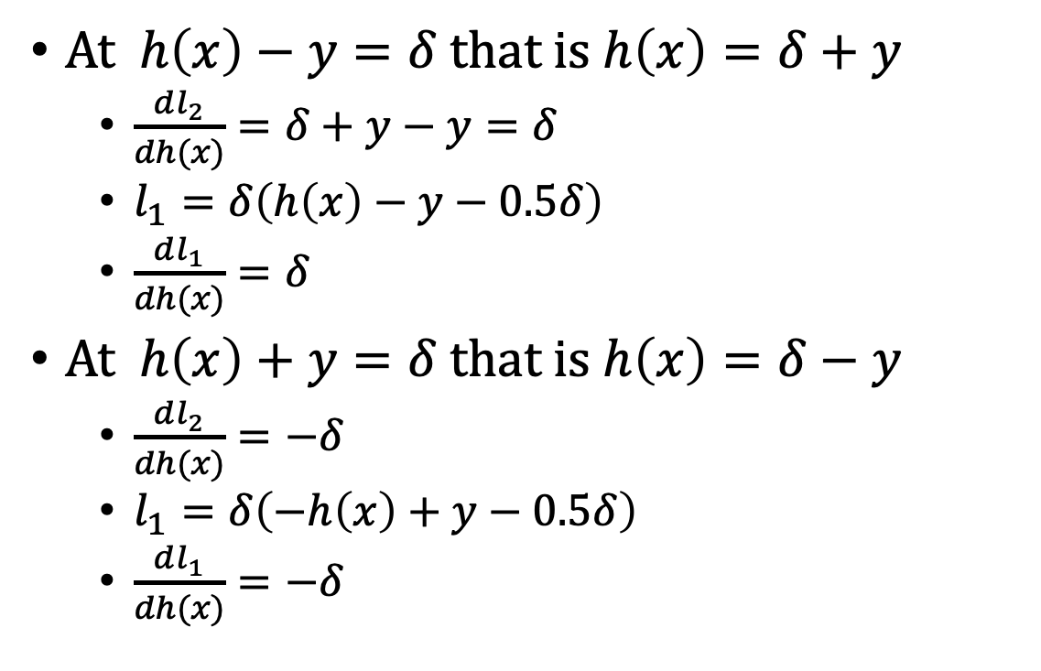
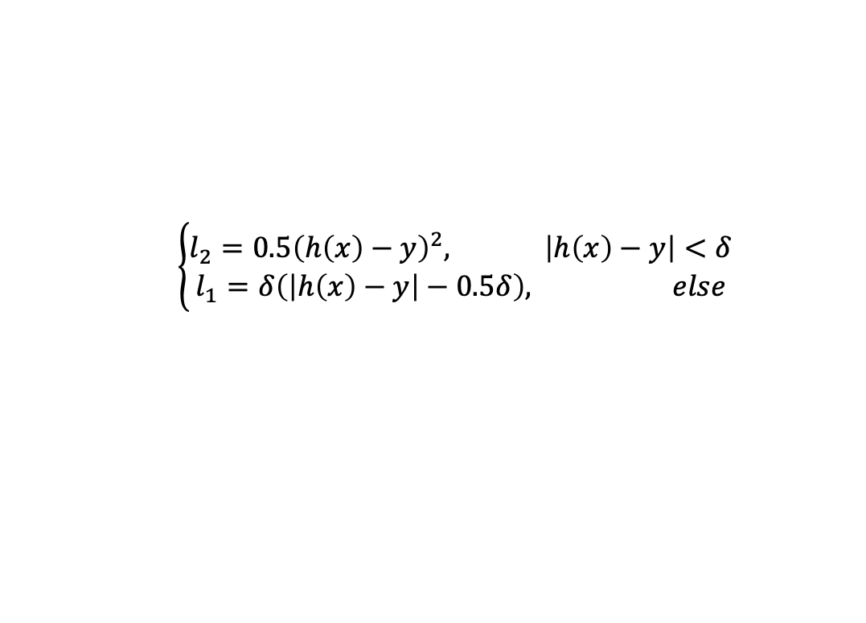


Huber loss
$$\left\{\begin{aligned}l_{2}=0.5{\left(h\left(x\right)−y\right)}^{2}, \left|h\left(x\right)−y\right|<δ \\ l_{1}=&δ\left(\left|h\left(x\right)−y\right|−0.5δ\right), else\end{aligned}\right.$$
At $h\left(x\right)−y=δ$ that is $h\left(x\right)=δ+y$
  $\frac{dl_{2}}{dh(x)}=δ+y−y=δ$
  $l_{1}=δ\left(h\left(x\right)−y−0.5δ\right)$
  $\frac{dl_{1}}{dh(x)}=δ$
At $h\left(x\right)+y=δ$ that is $h\left(x\right)=δ−y$
  $\frac{dl_{2}}{dh(x)}=−δ$
  $l_{1}=δ\left(−h\left(x\right)+y−0.5δ\right)$
  $\frac{dl_{1}}{dh(x)}=−δ$
$$−δ$$
$$δ$$

Slide 11
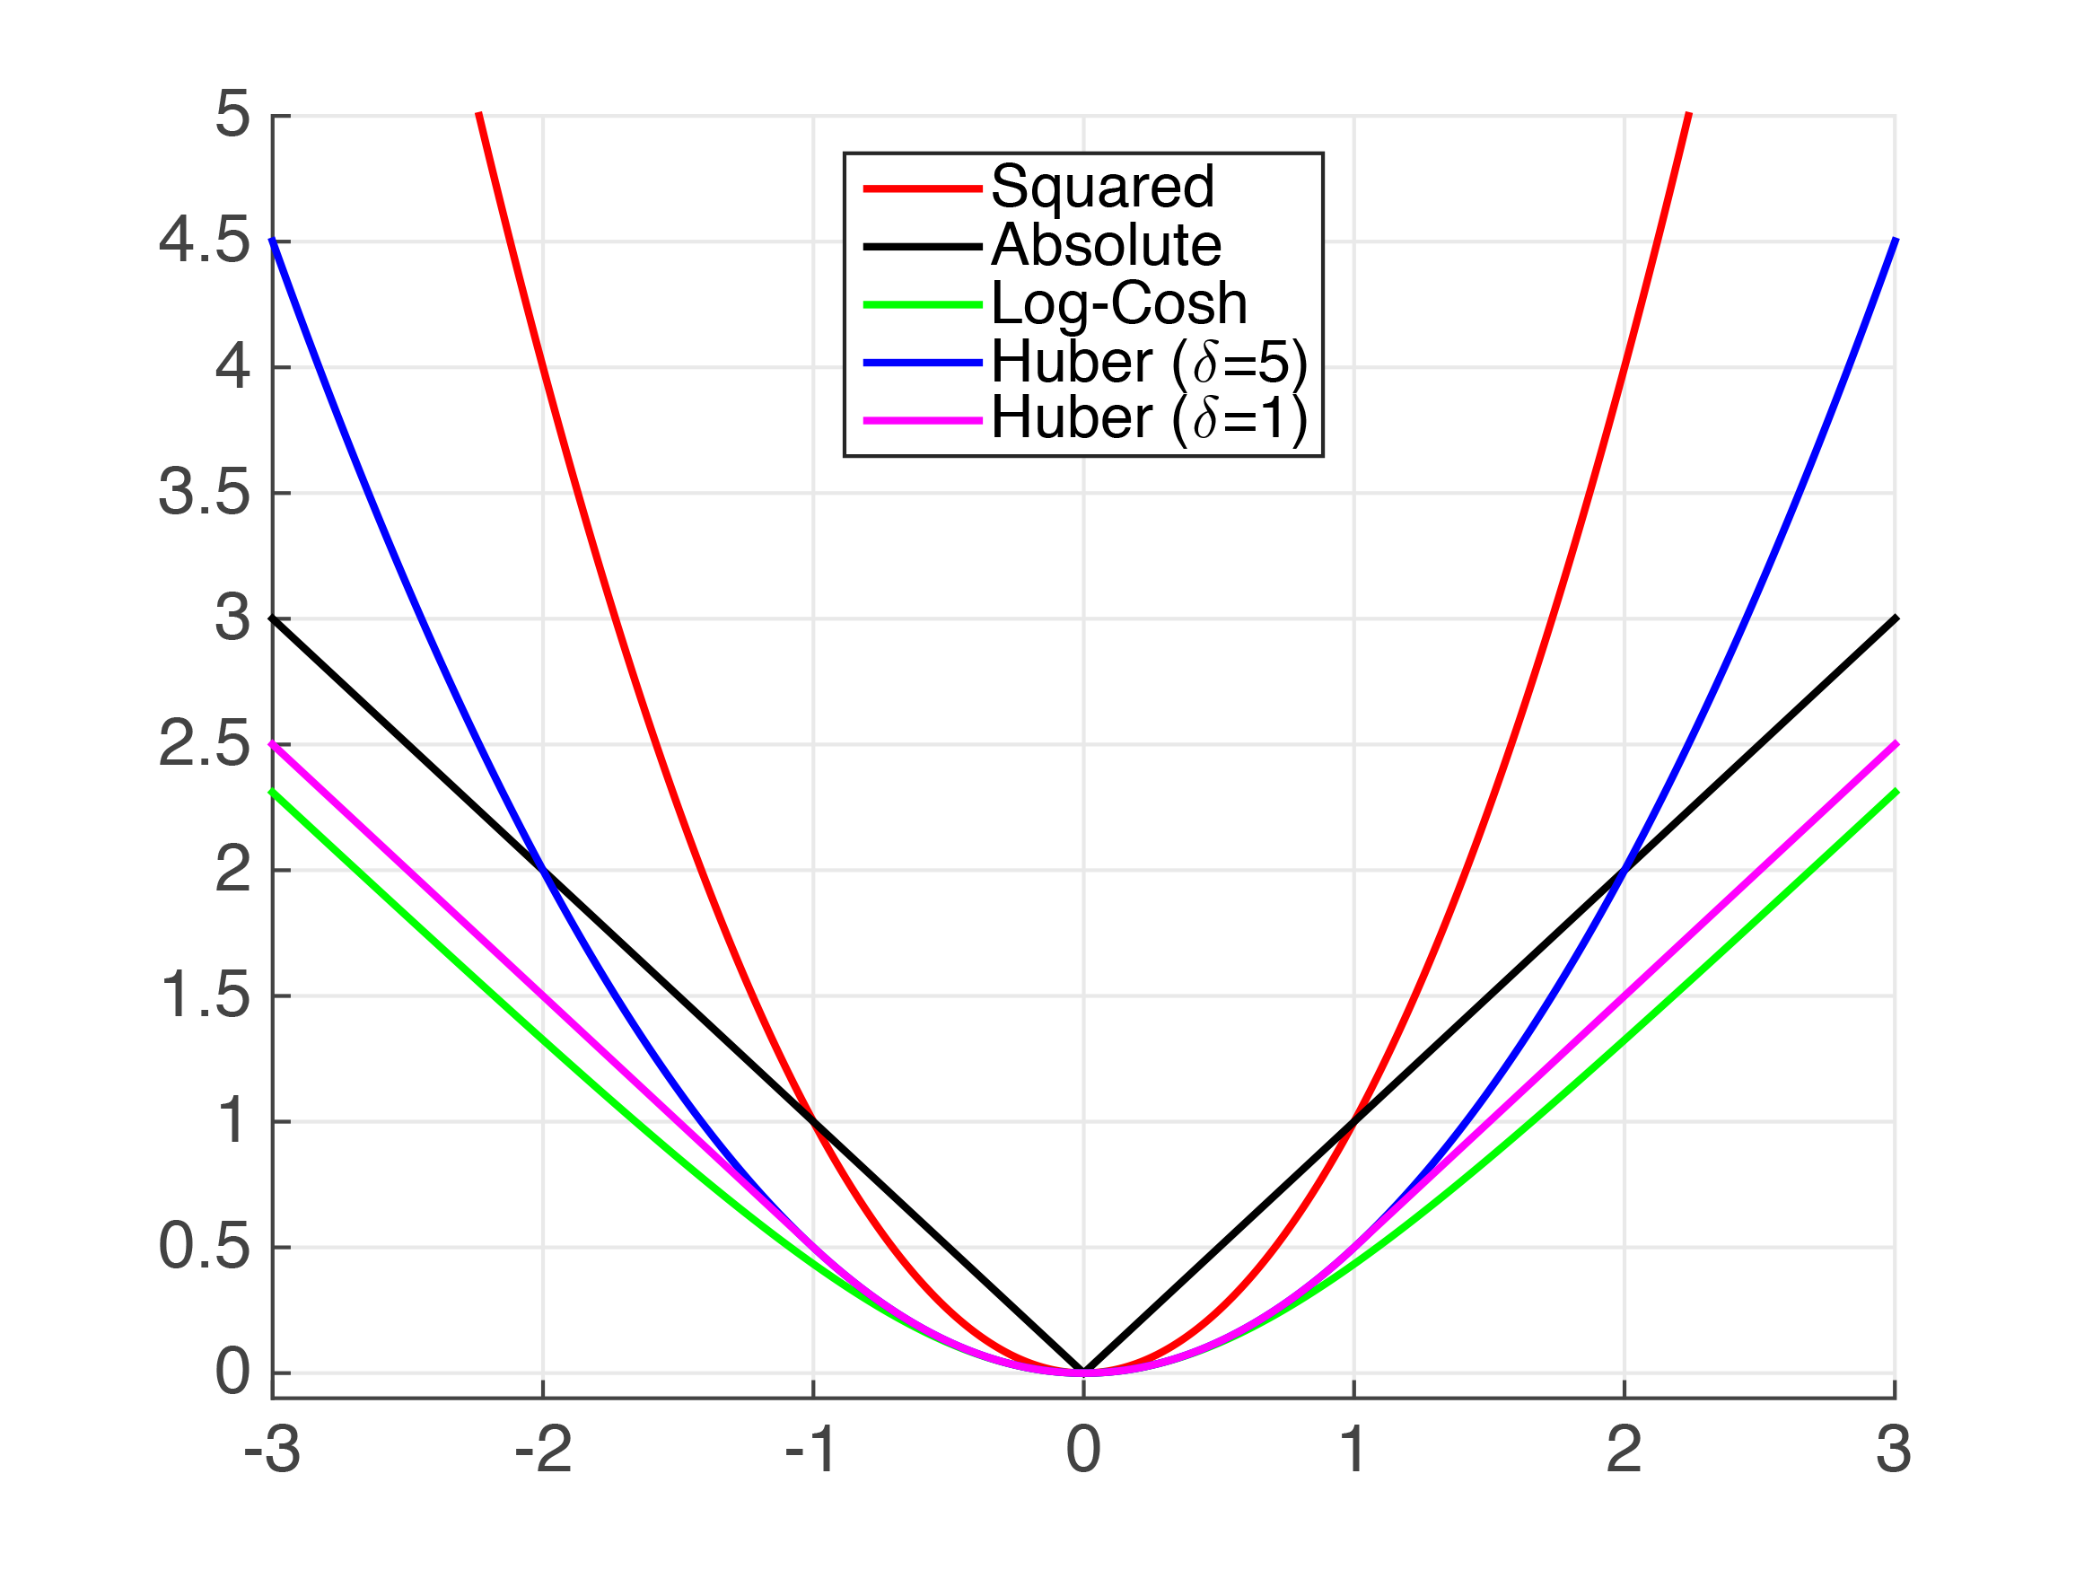
Examples by Kilian Weinberger

Slide 12
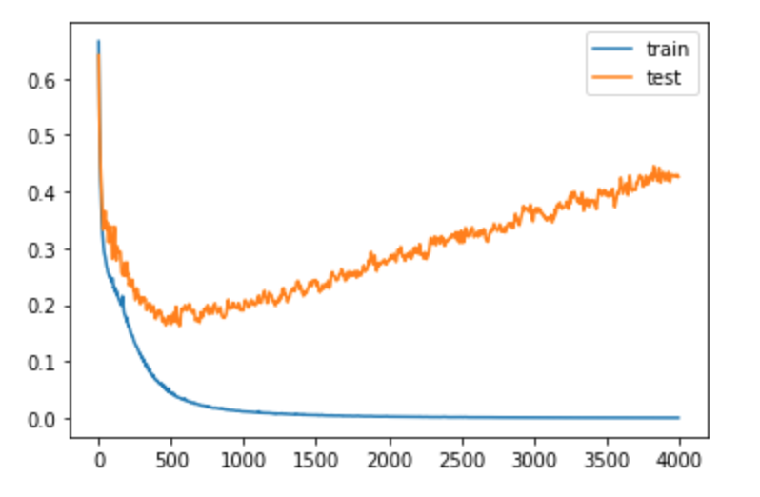
Overfitting the loss function

Slide 13
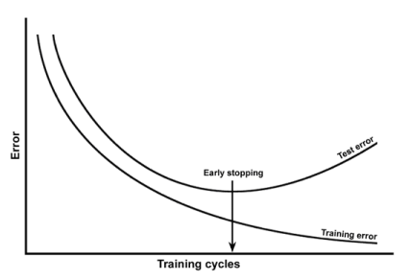
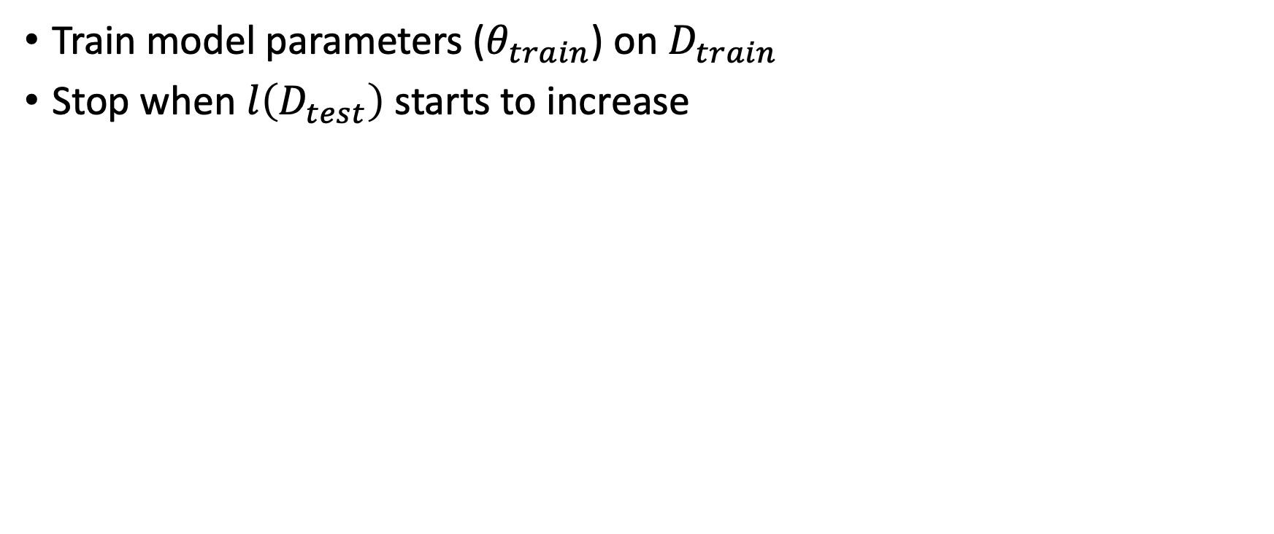
1. Early stopping
Train model parameters ($θ_{train}$) on $D_{train}$
Stop when $l\left(D_{test}\right)$ starts to increase

Slide 14
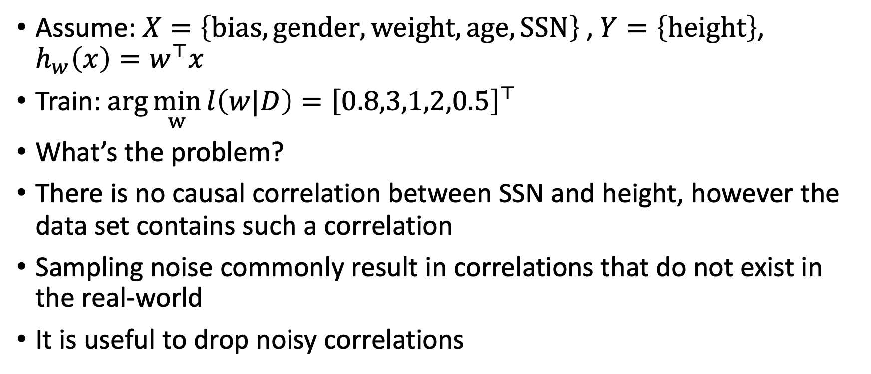
2. Feature selection (elimination)
Assume: $X=\left\{bias, gender, weight, age, SSN\right\}$ , $Y=\left\{height\right\}$, $h_{w}\left(x\right)=w^{⊤}x$
Train: $\arg{\min_{w}{l\left(w|D\right)}}={\left[0.8,3,1,2,0.5\right]}^{⊤}$
What’s the problem?
There is no causal correlation between SSN and height, however the data set contains such a correlation
Sampling noise commonly result in correlations that do not exist in the real-world
It is useful to drop noisy correlations

Slide 15
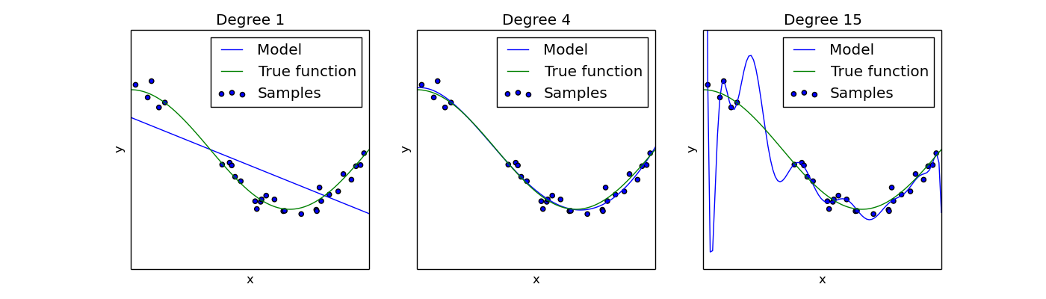



Feature reduction
$$f=\left\{x\right\}$$
$$f=\left\{x,x^{2},x^{3},x^{4}\right\}$$
$$f=\left\{x,x^{2},…,x^{15}\right\}$$

Slide 16
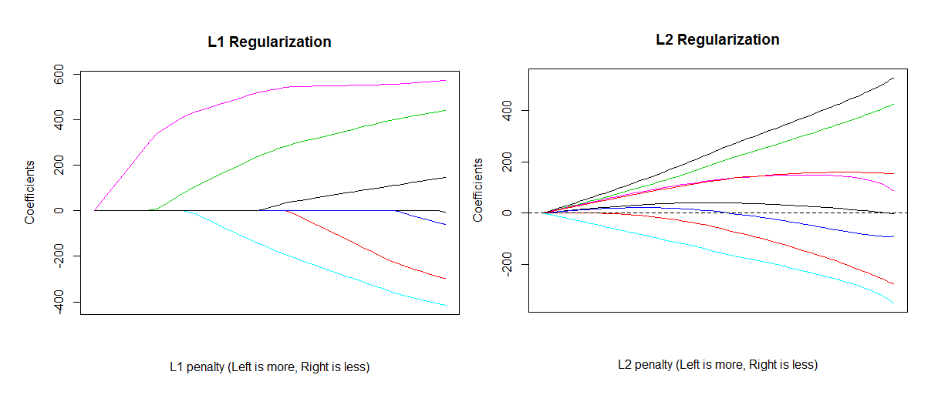
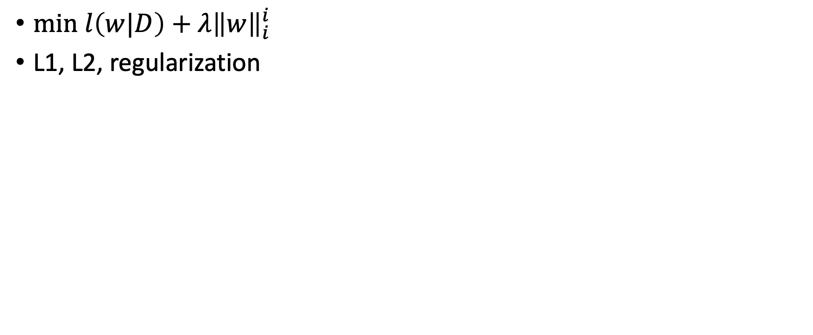


3. bound the sum of coefficients magnitude
${min l\left(w|D\right)+λ\left\|w\right\|}_{i}^{i}$
L1, L2, regularization
$$+ ←λ→−$$
$$+ ←λ→−$$

Slide 17
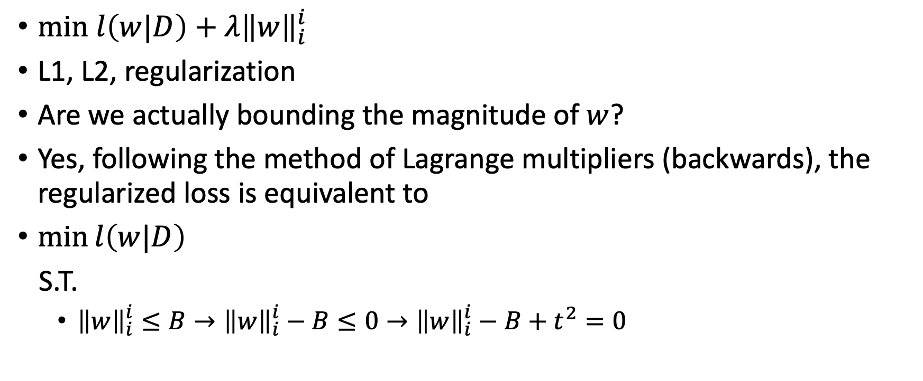
bound the sum of coefficients magnitude
${min l\left(w|D\right)+λ\left\|w\right\|}_{i}^{i}$
L1, L2, regularization
Are we actually bounding the magnitude of $w$?
Yes, following the method of Lagrange multipliers (backwards), the regularized loss is equivalent to
$\min{l\left(w|D\right)}$
S.T.
  ${\left\|w\right\|}_{i}^{i}≤B→{\left\|w\right\|}_{i}^{i}−B≤0→{\left\|w\right\|}_{i}^{i}−B+t^{2}=0$
slack variable
$L\left(w,λ\right)=l\left(w|D\right)+λ\left({\left\|w\right\|}_{i}^{i}−B+t^{2}\right)$ the constraint optimization solution must satisfy the KKT conditions, i.e., either the gradient is zero OR the constraint is ‘active’.

Slide 18
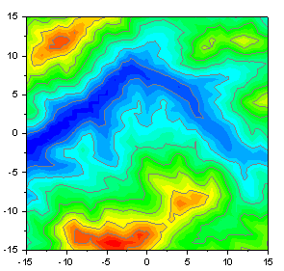
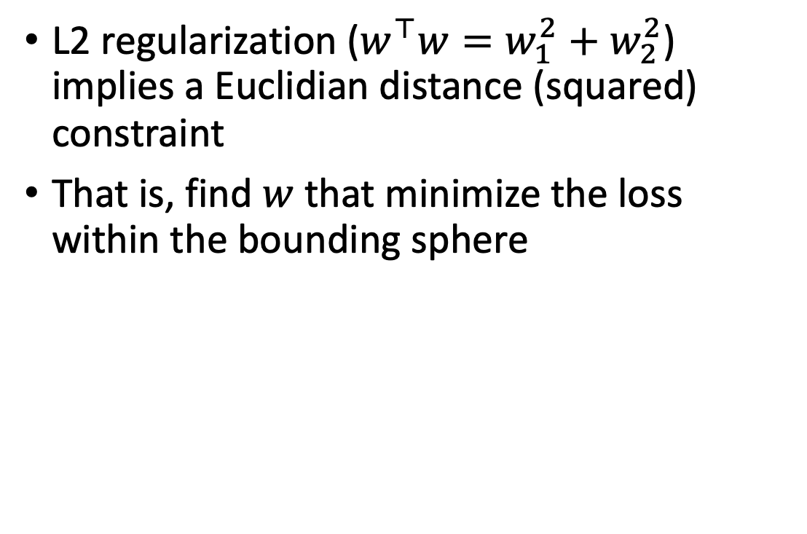


Regularization as constraint optimization
L2 regularization ($w^{⊤}w=w_{1}^{2}+w_{2}^{2}$) implies a Euclidian distance (squared) constraint
That is, find $w$ that minimize the loss within the bounding sphere
$$w_{1}$$
B
$$w_{2}$$

Slide 19
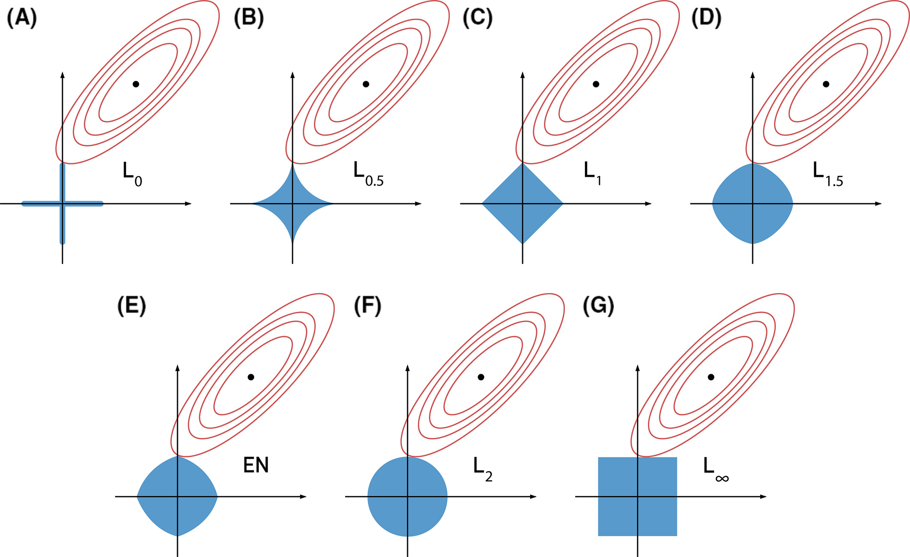
Elastic nets (weighted combination of L1 and L2 regularization)

Slide 20
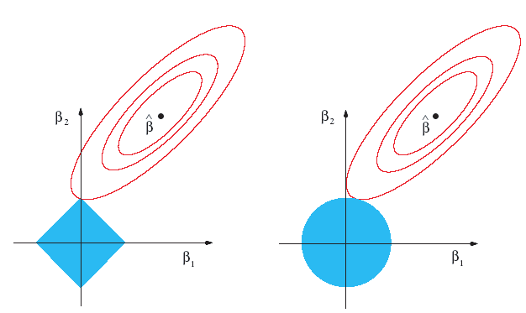
Regularization discussion
Which regularization term should be applied when expecting significant correlation noise or many irrelevant features?
Which should be used for better model Explainability and Interpretability ?
L1
L2

Slide 21
Convex set
Intuitively, a convex set does not have any “holes” or “bites” in it

Slide 22
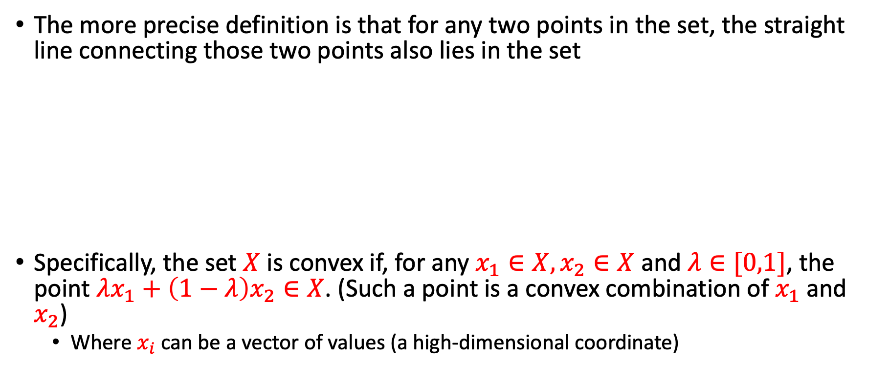
Convex set
The more precise definition is that for any two points in the set, the straight line connecting those two points also lies in the set
Specifically, the set $X$ is convex if, for any $x_{1}∈X,x_{2}∈X$ and $λ∈[0,1]$, the point $λx_{1}+\left(1−λ\right)x_{2}∈X$. (Such a point is a convex combination of $x_{1}$and $x_{2}$)
  Where $x_{i}$ can be a vector of values (a high-dimensional coordinate)

Slide 23
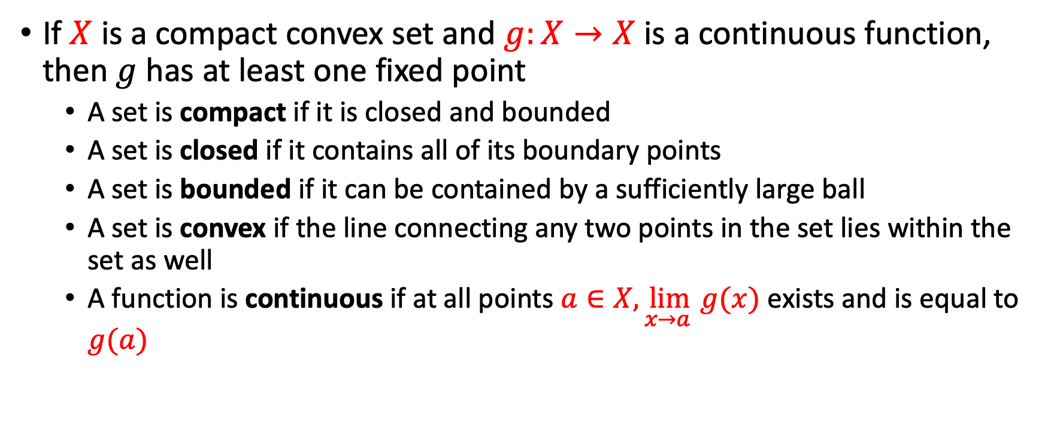
Brouwer's Theorem
If $X$ is a compact convex set and $g:X→X$ is a continuous function, then$g$has at least one fixed point
  A set is compact if it is closed and bounded
  A set is closed if it contains all of its boundary points
  A set is bounded if it can be contained by a sufficiently large ball
  A set is convex if the line connecting any two points in the set lies within the set as well
  A function is continuous if at all points $a∈X,\lim_{x→a }{g(x)}$ exists and is equal to $g(a)$

Slide 24
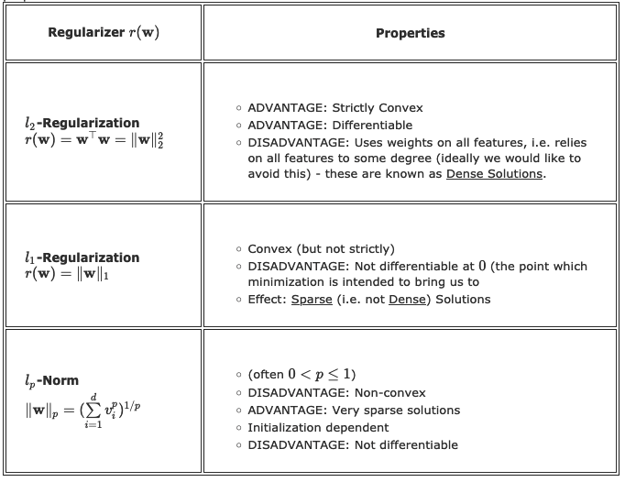
Types of Regularizers
Image by Kilian Weinberger

Slide 25
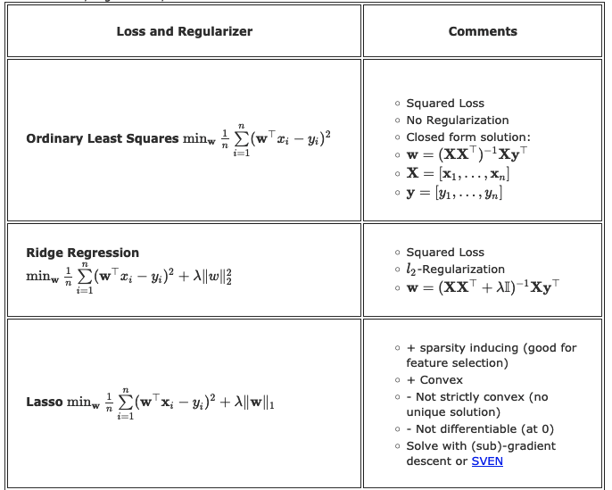
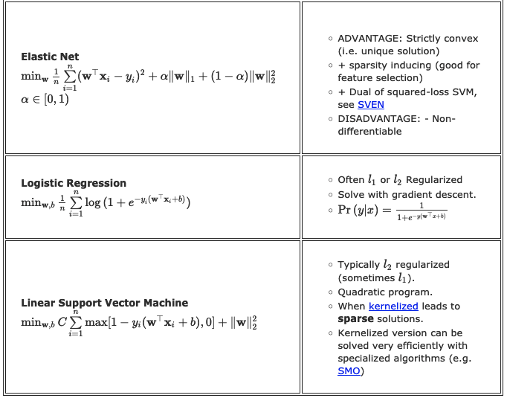
Special Cases
Image by Kilian Weinberger

Slide 26
What did we learn?
Minimizing a loss function over a training set leads to overfitting
Remedies include:
  Decreasing sensitivity to outliers, e.g., Huber loss
  Early stopping when loss of test set increases
  Feature selection/elimination
  Bound coefficients (regularization)
It is beneficial to have a loss function + regularizer that is both convex and differentiable
  Guarantees a fixed-point solution for gradient decent

Slide 27
What next?
Class: Bias vs Variance tradeoff
Assignments:
  Programming assignment 2: Linear and Logistic Regression, due by March-15
Quizzes:
  Quiz 3: Naïve Bayes and SVM, finish by March-13

