Slide 1
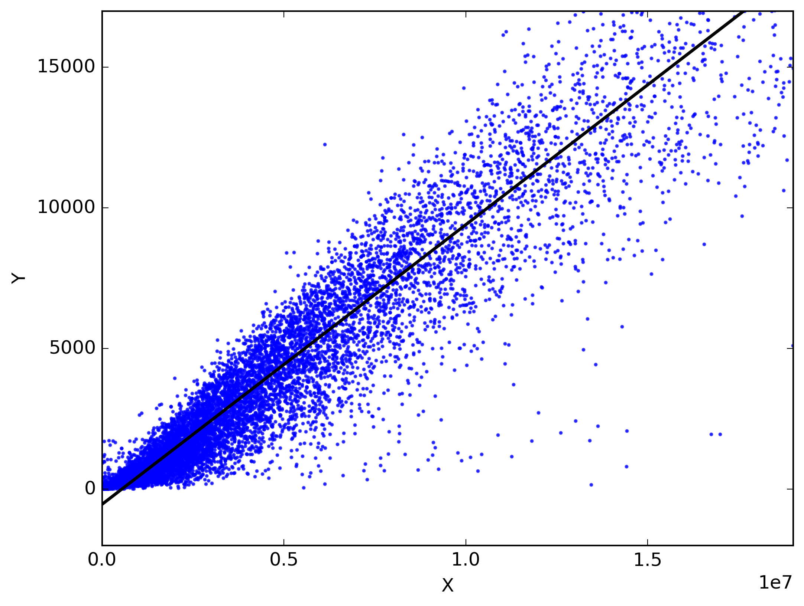
CSCE-421 Machine Learning
8. Linear regression
Instructor: Guni Sharon, classes: TR 3:55-5:10, HRBB 124

Slide 2
Announcements
Announcements
  Midterm on Tuesday, November-23 (in class)
Overdue:
Due:
  Assignment (P2): Logistic and Linear Regression, due Tuesday Oct-26

Slide 3
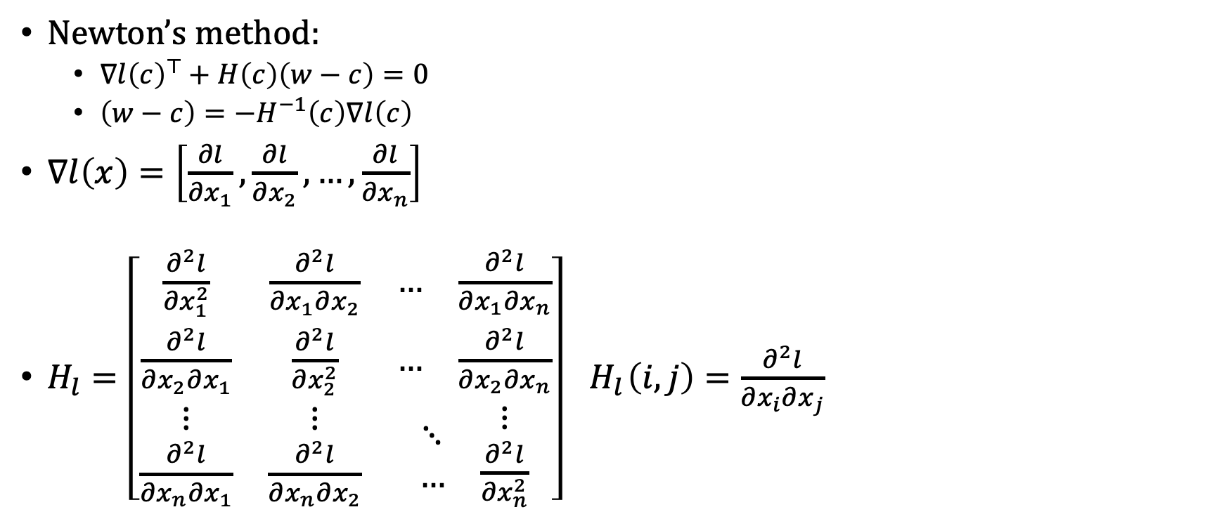
Last class…
Newton’s method:
  $∇l{\left(c\right)}^{⊤}+H\left(c\right)\left(w−c\right)=0$
  $\left(w−c\right)=−H^{−1}\left(c\right)∇l\left(c\right)$
$∇l\left(x\right)=\left[\frac{∂l}{∂x_{1}},\frac{∂l}{∂x_{2}},…,\frac{∂l}{∂x_{n}}\right]$
$H_{l}=\left[\begin{matrix}\frac{∂^{2}l}{∂x_{1}^{2}} & \frac{∂^{2}l}{∂x_{1}∂x_{2}} & \begin{matrix}… & \frac{∂^{2}l}{∂x_{1}∂x_{n}}\end{matrix} \\ \frac{∂^{2}l}{∂x_{2}∂x_{1}} & \frac{∂^{2}l}{∂x_{2}^{2}} & \begin{matrix}… & \frac{∂^{2}l}{∂x_{2}∂x_{n}}\end{matrix} \\ \begin{matrix}⋮ \\ \frac{∂^{2}l}{∂x_{n}∂x_{1}}\end{matrix} & \begin{matrix}⋮ \\ \frac{∂^{2}l}{∂x_{n}∂x_{2}}\end{matrix} & \begin{matrix}\begin{matrix}⋱ \\ …\end{matrix} & \begin{matrix}⋮ \\ \frac{∂^{2}l}{∂x_{n}^{2}}\end{matrix}\end{matrix}\end{matrix}\right] { H}_{l}\left(i,j\right)=\frac{∂^{2}l}{∂x_{i}∂x_{j}}$

Slide 4
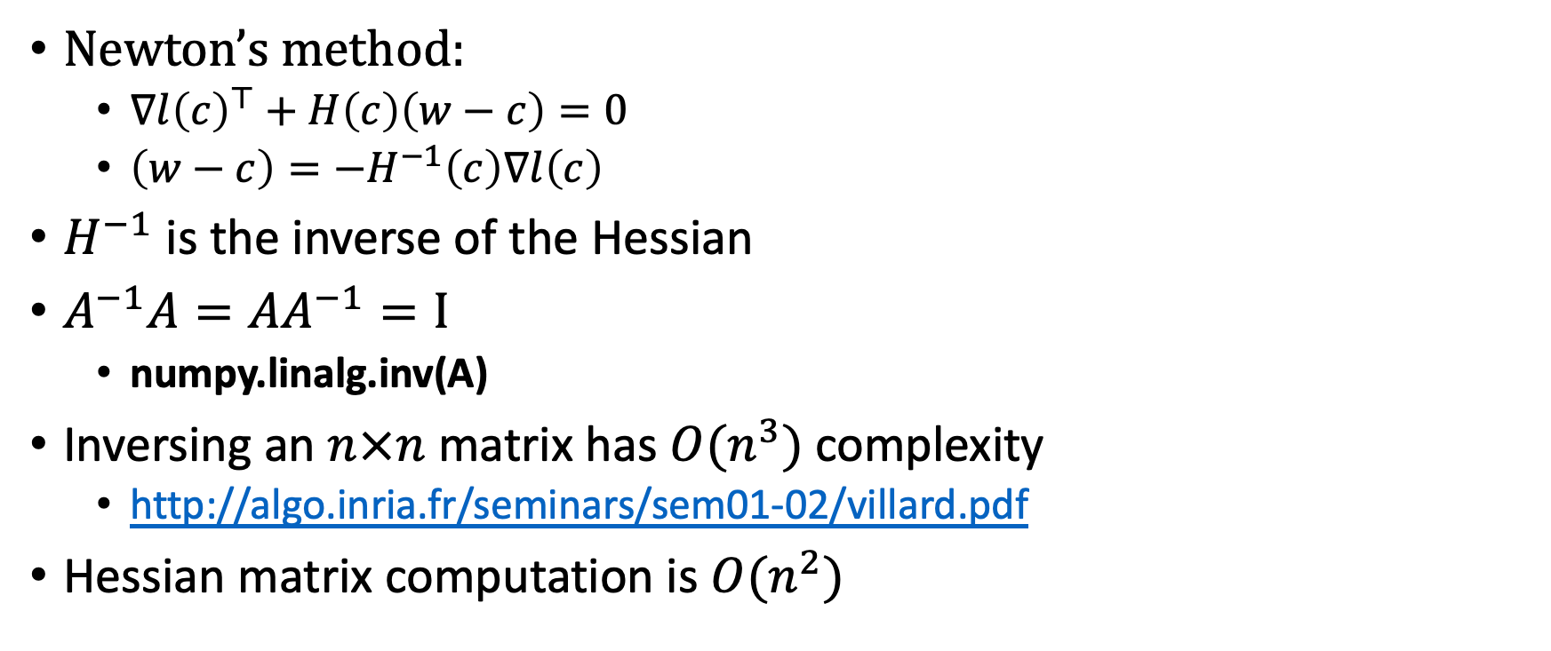
Last class…
Newton’s method:
  $∇l{\left(c\right)}^{⊤}+H\left(c\right)\left(w−c\right)=0$
  $\left(w−c\right)=−H^{−1}\left(c\right)∇l\left(c\right)$
$H^{−1}$ is the inverse of the Hessian
$A^{−1}A=AA^{−1}=I$
  numpy.linalg.inv(A)
Inversing an $n×n$ matrix has $O(n^{3})$complexity
  http://algo.inria.fr/seminars/sem01-02/villard.pdf
Hessian matrix computation is $O(n^{2})$

Slide 5
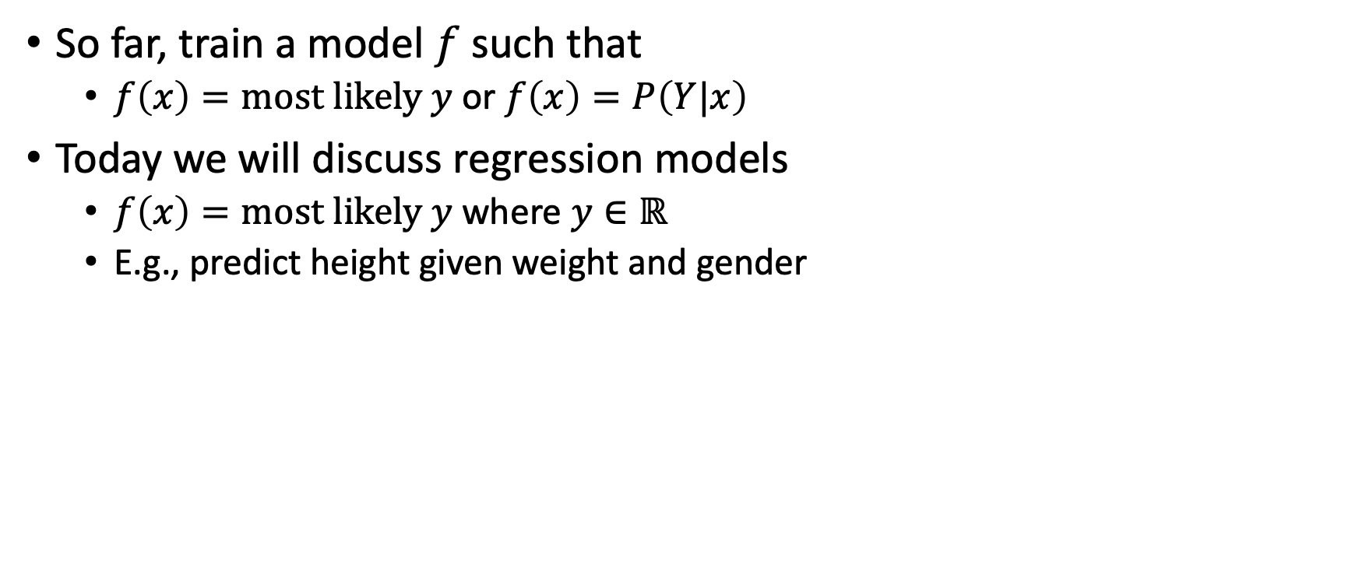
Classifiers vs regression models
So far, train a model $f$ such that
  $f\left(x\right)=most likely y$or $f\left(x\right)=P\left(Y|x\right)$
Today we will discuss regression models
  $f\left(x\right)=most likely y$where $y∈ℝ$
  E.g., predict height given weight and gender

Slide 6
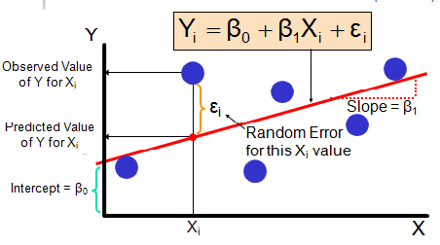
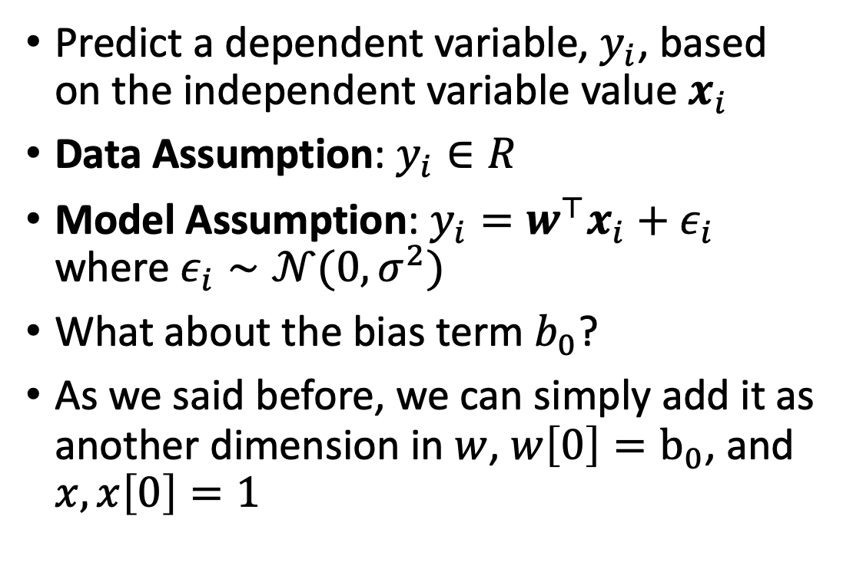
Linear regression
Predict a dependent variable, $y_{i}$, based on the independent variable value $x_{i}$
Data Assumption: $y_{i}∈R$
Model Assumption: $y_{i}=w^{⊤}x_{i}+ε_{i}$ where $ε_{i}∼𝒩(0,σ^{2})$
What about the bias term $b_{0}$?
As we said before, we can simply add it as another dimension in $w$, $w\left[0\right]=b_{0}$, and $x, x\left[0\right]=1$

Slide 7

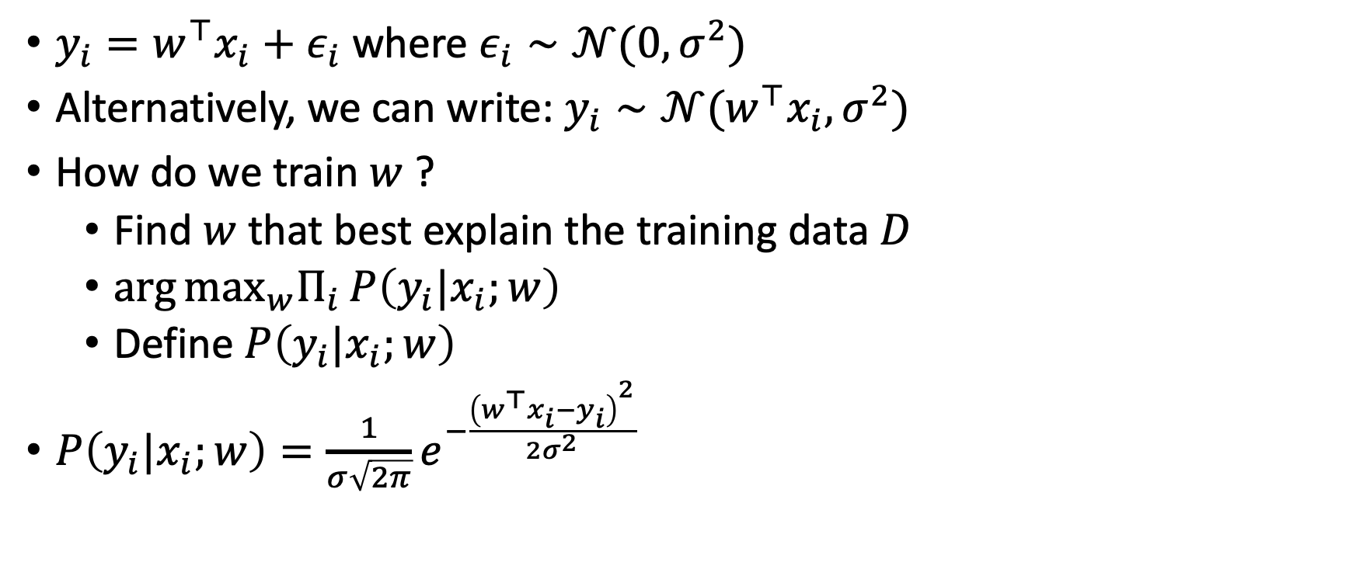
Linear regression
$y_{i}=w^{⊤}x_{i}+ε_{i}$ where $ε_{i}∼𝒩(0,σ^{2})$
Alternatively, we can write: $y_{i}∼𝒩(w^{⊤}x_{i},σ^{2})$
How do we train $w$ ?
  Find $w$ that best explain the training data $D$
  $\arg{\max_{w}Π_{i}{P\left(y_{i}|x_{i};w\right)}}$
  Define $P\left(y_{i}|x_{i};w\right)$
$P\left(y_{i}|x_{i};w\right)=\frac{1}{σ\sqrt{2π}}e^{−\frac{{\left(w^{⊤}x_{i}−y_{i}\right)}^{2}}{{2σ}^{2}}}$

Slide 8
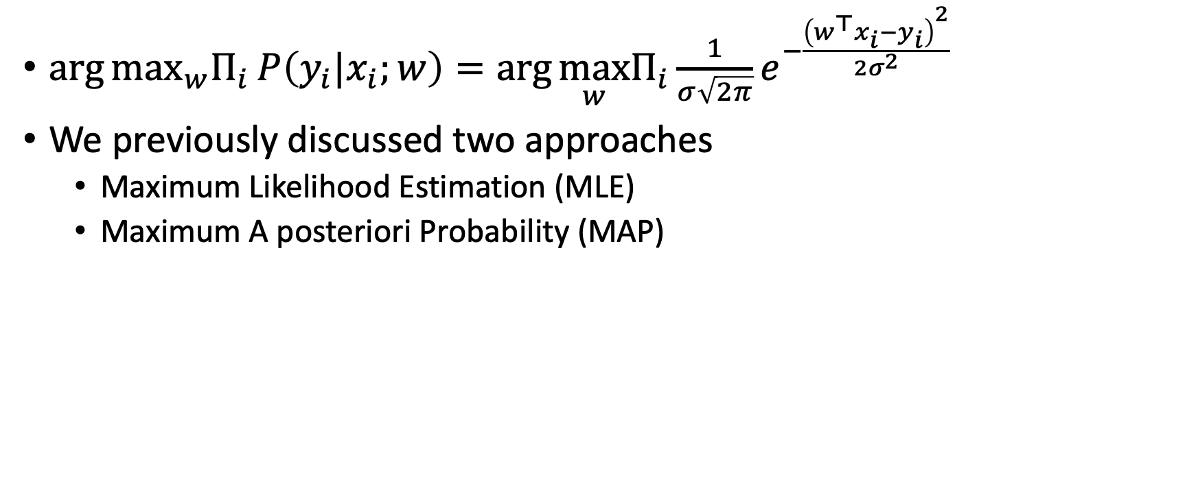

Optimal $w$
$\arg{\max_{w}Π_{i}{P\left(y_{i}|x_{i};w\right)}}=\arg{\max_{w}Π_{i}{\frac{1}{σ\sqrt{2π}}e^{−\frac{{\left(w^{⊤}x_{i}−y_{i}\right)}^{2}}{{2σ}^{2}}}}}$
We previously discussed two approaches
  Maximum Likelihood Estimation (MLE)
  Maximum A posteriori Probability (MAP)

Slide 9

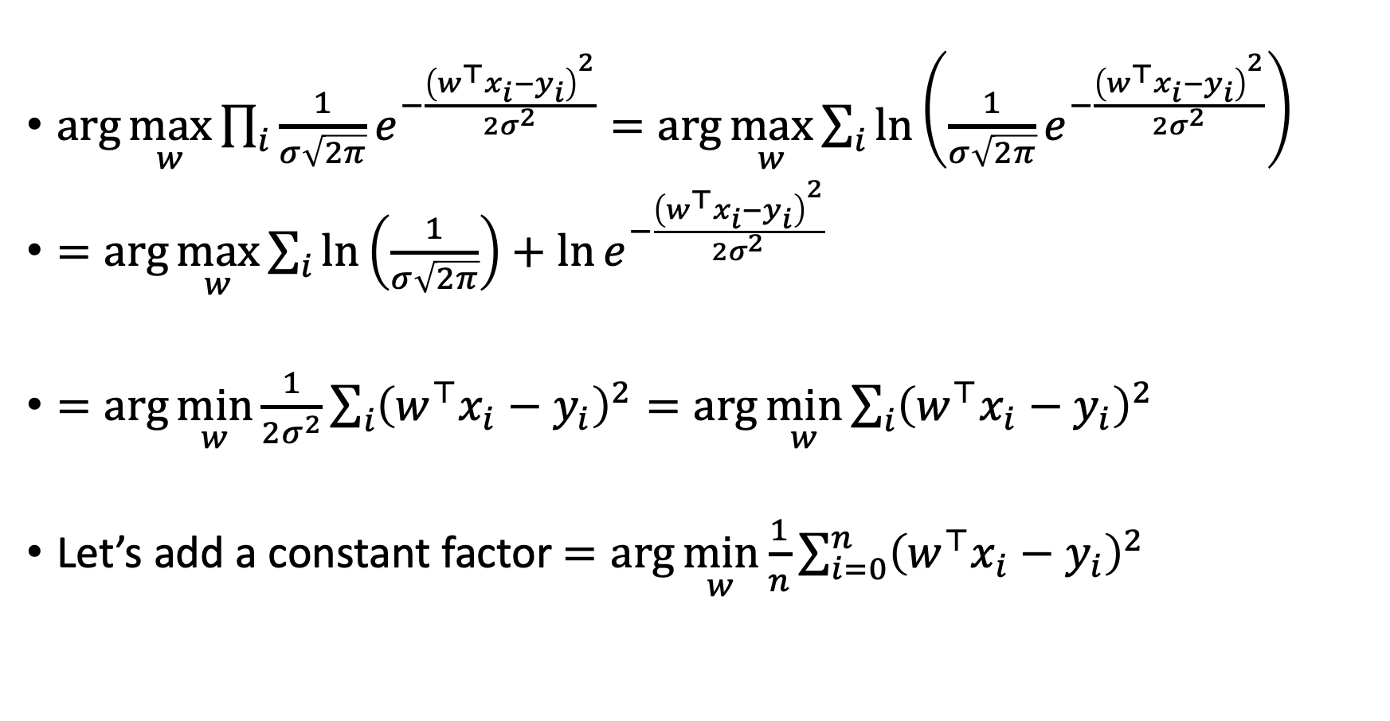

Maximum Likelihood Estimation (MLE)
$\arg{\max_{w}\prod_{i}{\frac{1}{σ\sqrt{2π}}e^{−\frac{{\left(w^{⊤}x_{i}−y_{i}\right)}^{2}}{{2σ}^{2}}}}}=\arg{\max_{w}\sum_{i}{\ln\left(\frac{1}{σ\sqrt{2π}}e^{−\frac{{\left(w^{⊤}x_{i}−y_{i}\right)}^{2}}{{2σ}^{2}}}\right)}}$
$=\arg{\max_{w}\sum_{i}{\ln\left(\frac{1}{σ\sqrt{2π}}\right)+\ln{e^{−\frac{{\left(w^{⊤}x_{i}−y_{i}\right)}^{2}}{{2σ}^{2}}}}}}$
$=\arg{\min_{w}\frac{1}{{2σ}^{2}}\sum_{i}{{\left(w^{⊤}x_{i}−y_{i}\right)}^{2}}}=\arg{\min_{w}\sum_{i}{{\left(w^{⊤}x_{i}−y_{i}\right)}^{2}}}$
Let’s add a constant factor $=\arg{\min_{w}\frac{1}{n}\sum_{i=0}^{n}{{\left(w^{⊤}x_{i}−y_{i}\right)}^{2}}}$
Constant w.r.t $w$
Constant w.r.t $w$
Mean Squared Error!

Slide 10
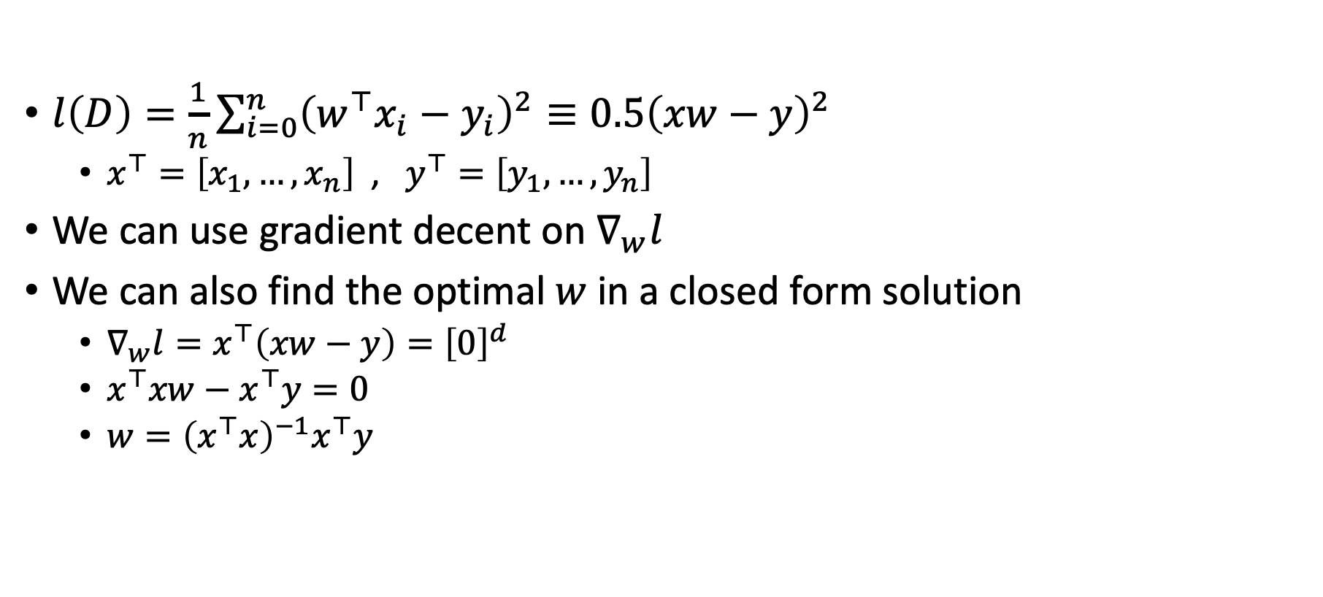
Ordinary Least Square Linear Regression
$l\left(D\right)=\frac{1}{n}\sum_{i=0}^{n}{{\left(w^{⊤}x_{i}−y_{i}\right)}^{2}}≡0.5{\left(xw−y\right)}^{2}$
  $x^{⊤}=\left[x_{1},…, x_{n}\right]$ , $y^{⊤}=\left[y_{1},…, y_{n}\right]$
We can use gradient decent on $∇_{w}l$
We can also find the optimal $w$ in a closed form solution
  $∇_{w}l=x^{⊤}\left(xw−y\right)={\left[0\right]}^{d}$
  $x^{⊤}xw−x^{⊤}y=0$
  $w={\left(x^{⊤}x\right)}^{−1}x^{⊤}y$
Demo…

Slide 11
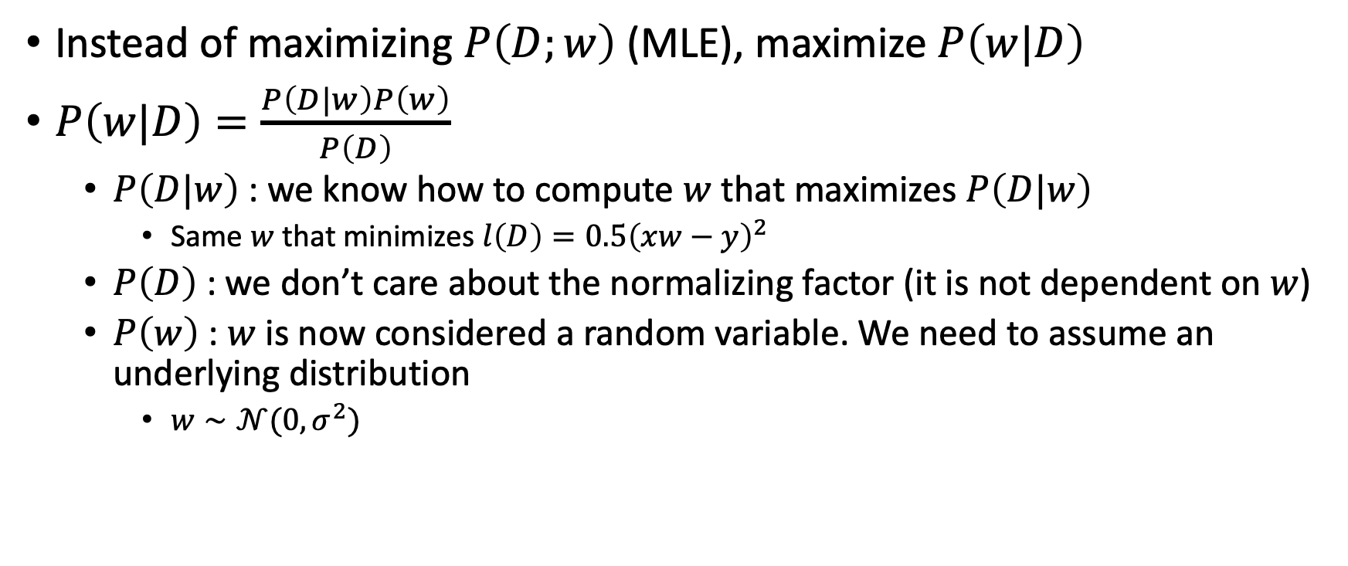
Maximum A posteriori Probability (MAP)
Instead of maximizing $P\left(D;w\right)$ (MLE), maximize $P\left(w|D\right)$
$P\left(w|D\right)=\frac{P\left(D|w\right)P\left(w\right)}{P\left(D\right)}$
  $P\left(D|w\right)$ : we know how to compute $w$ that maximizes $P\left(D|w\right)$
    Same $w$ that minimizes $l\left(D\right)=0.5{\left(xw−y\right)}^{2}$
  $P\left(D\right)$ : we don’t care about the normalizing factor (it is not dependent on $w$)
  $P\left(w\right)$ : $w$ is now considered a random variable. We need to assume an underlying distribution
    $w∼𝒩(0,σ^{2})$

Slide 12
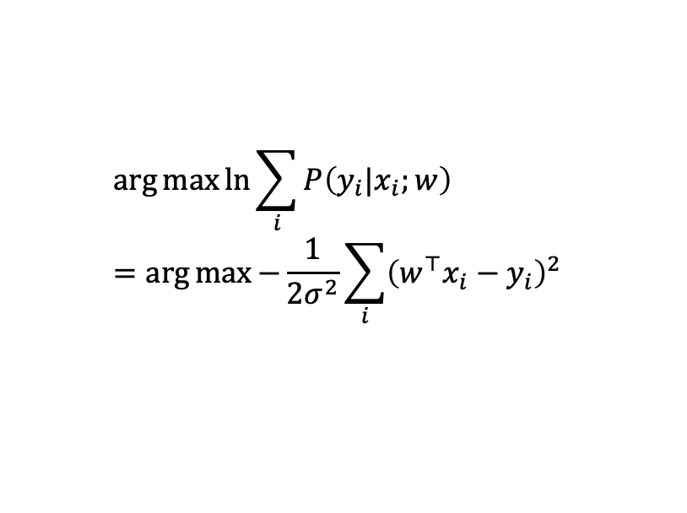

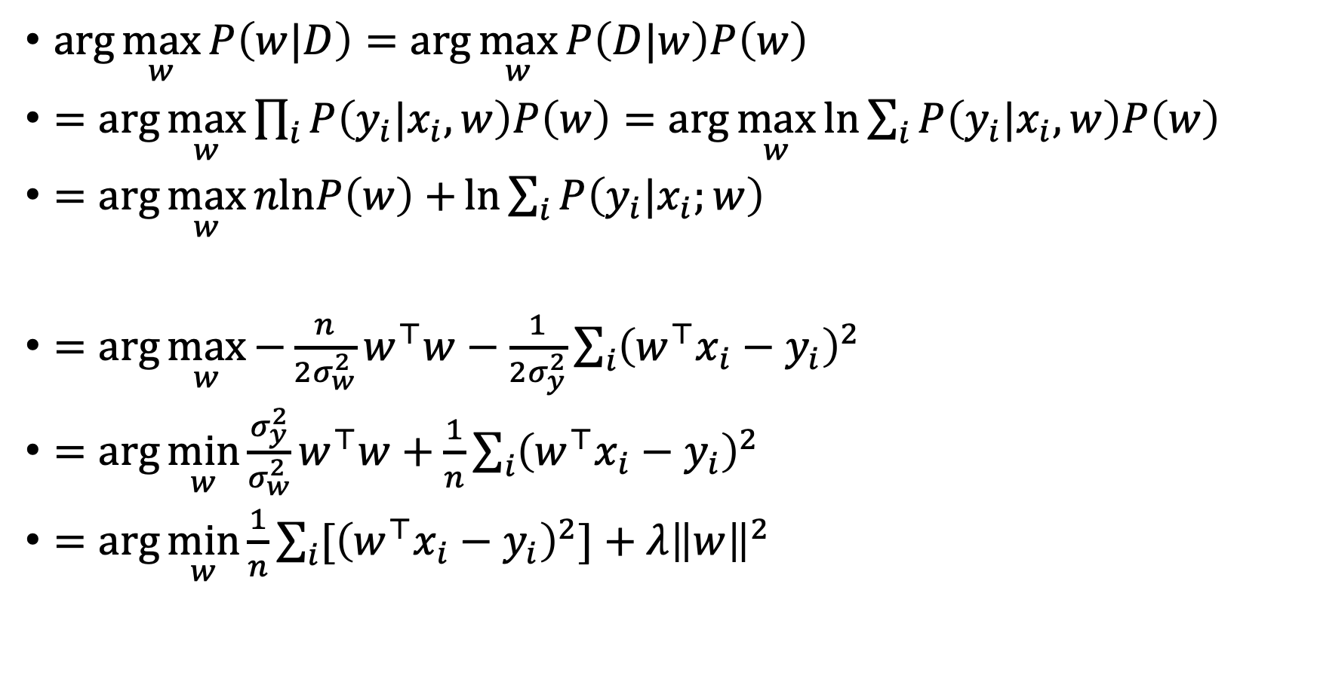
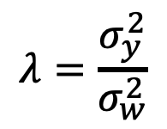

Ridge Regression
$X$ are independent of $w$
$\arg{\max_{w}{P\left(w|D\right)}}=\arg{\max_{w}{P\left(D|w\right)P\left(w\right)}}$
$=\arg{\max_{w}{\prod_{i}{P\left(y_{i}|x_{i},w\right)P\left(w\right)}}}=\arg{\max_{w}{\ln{\sum_{i}{P\left(y_{i}|x_{i},w\right)P\left(w\right)}} }}$
$=\arg{\max_{w}{nlnP\left(w\right)+{\ln{\sum_{i}{P\left(y_{i}|x_{i};w\right)}}} }}$
$=\arg{\max_{w}{−\frac{n}{{2σ}_{w}^{2}}w^{⊤}w−\frac{1}{{2σ}_{y}^{2}}\sum_{i}{{\left(w^{⊤}x_{i}−y_{i}\right)}^{2}}}}$
$=\arg{\min_{w}{\frac{σ_{y}^{2}}{σ_{w}^{2}}w^{⊤}w+\frac{1}{n}\sum_{i}{{\left(w^{⊤}x_{i}−y_{i}\right)}^{2}}}}$
$=\arg{\min_{w}{\frac{1}{n}\sum_{i}{{[\left(w^{⊤}x_{i}−y_{i}\right)}^{2}]}+λ{\left\|w\right\|}^{2}}}$
$$\arg{\max{\ln{\sum_{i}{P\left(y_{i}|x_{i};w\right)}}}}=\arg{\max{−\frac{1}{{2σ}^{2}}\sum_{i}{{\left(w^{⊤}x_{i}−y_{i}\right)}^{2}} }}$$
$$μ=0$$
$$λ=\frac{σ_{y}^{2}}{σ_{w}^{2}}$$

Slide 13
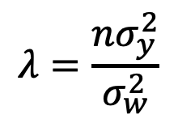
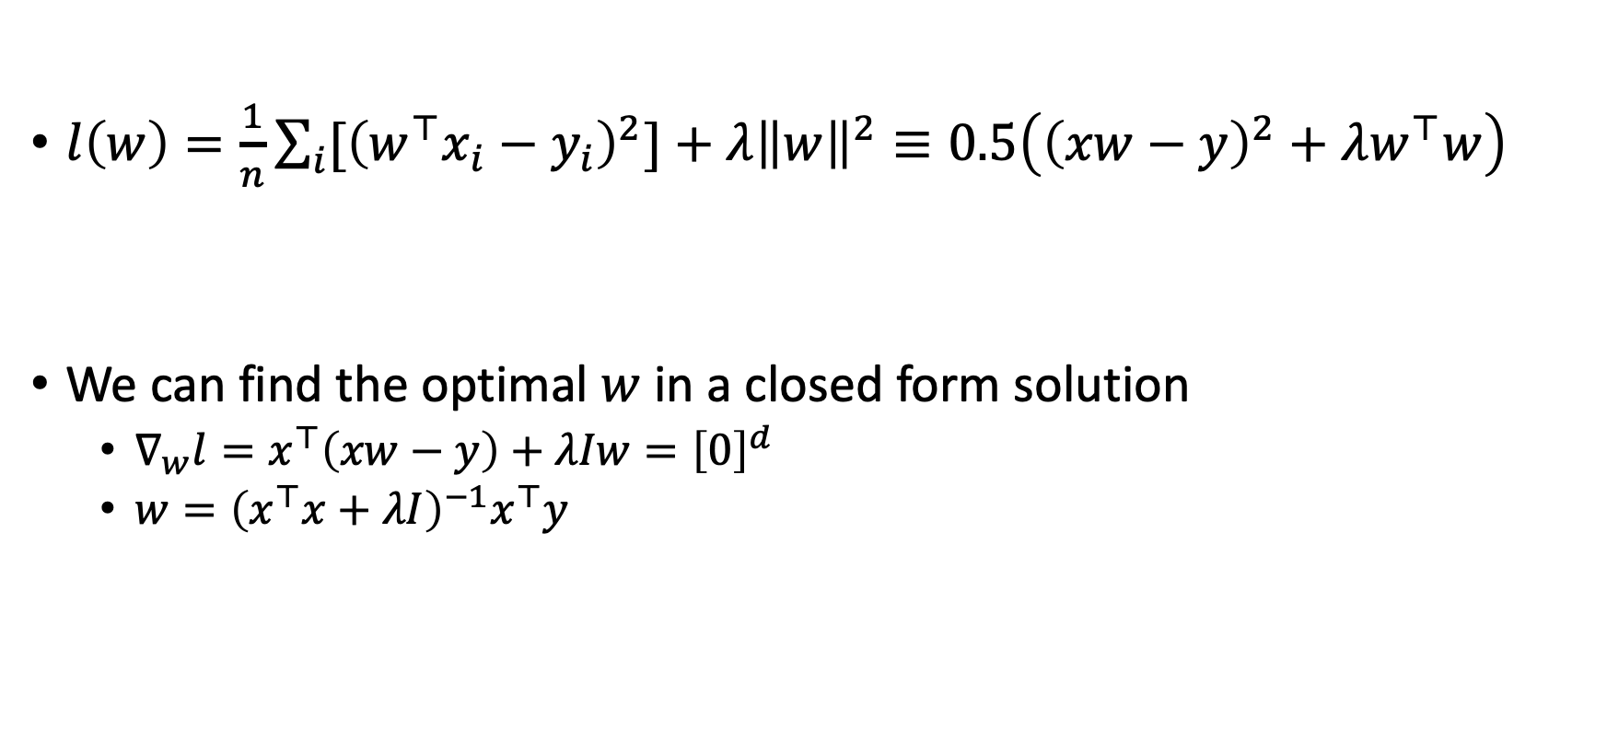
Ridge Regression
$l\left(w\right)=\frac{1}{n}\sum_{i}{{[\left(w^{⊤}x_{i}−y_{i}\right)}^{2}]}+λ{\left\|w\right\|}^{2}≡0.5\left({\left(xw−y\right)}^{2}+λw^{⊤}w\right)$
We can find the optimal $w$ in a closed form solution
  $∇_{w}l=x^{⊤}\left(xw−y\right)+λIw={\left[0\right]}^{d}$
  $w={\left(x^{⊤}x+λI\right)}^{−1}x^{⊤}y$
$$λ=\frac{{nσ}_{y}^{2}}{σ_{w}^{2}}$$
Demo…

Slide 14
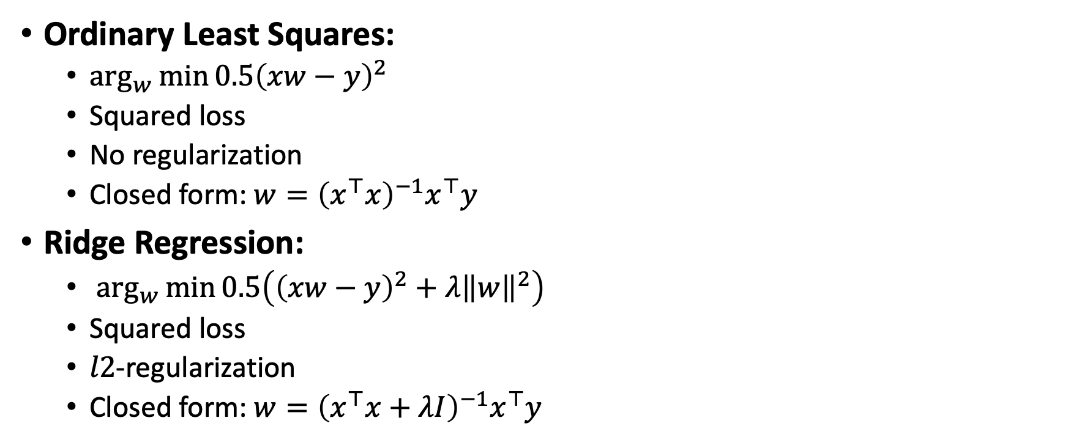
What did we learn?
Ordinary Least Squares:
  $\arg_{w}{\min{0.5{\left(xw−y\right)}^{2}}}$
  Squared loss
  No regularization
  Closed form: $w={\left(x^{⊤}x\right)}^{−1}x^{⊤}y$
Ridge Regression:
  $\arg_{w}{\min{0.5\left({\left(xw−y\right)}^{2}+λ{\left\|w\right\|}^{2}\right)}}$
  Squared loss
  $l2$-regularization
  Closed form: $w={\left(x^{⊤}x+λI\right)}^{−1}x^{⊤}y$

Slide 15
What next?
Class: Support Vector Machines
Assignments:
  Assignment (P2): Logistic and Linear Regression, due Tuesday Oct-26

