Slide 1
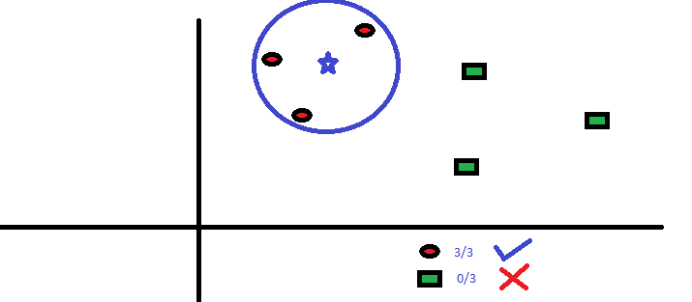
CSCE-421 Machine Learning
2. KNN
Instructor: Guni Sharon, classes: TR 3:55-5:10, HRBB 124

Slide 2
Assignments
Overdue:
  Programming assignment 0: Python Warmup (due Monday, Sep 6)
Due:
  Written assignment 1: K Nearest Neighbors + Linear algebra (due Monday, Sep 13)

Slide 3
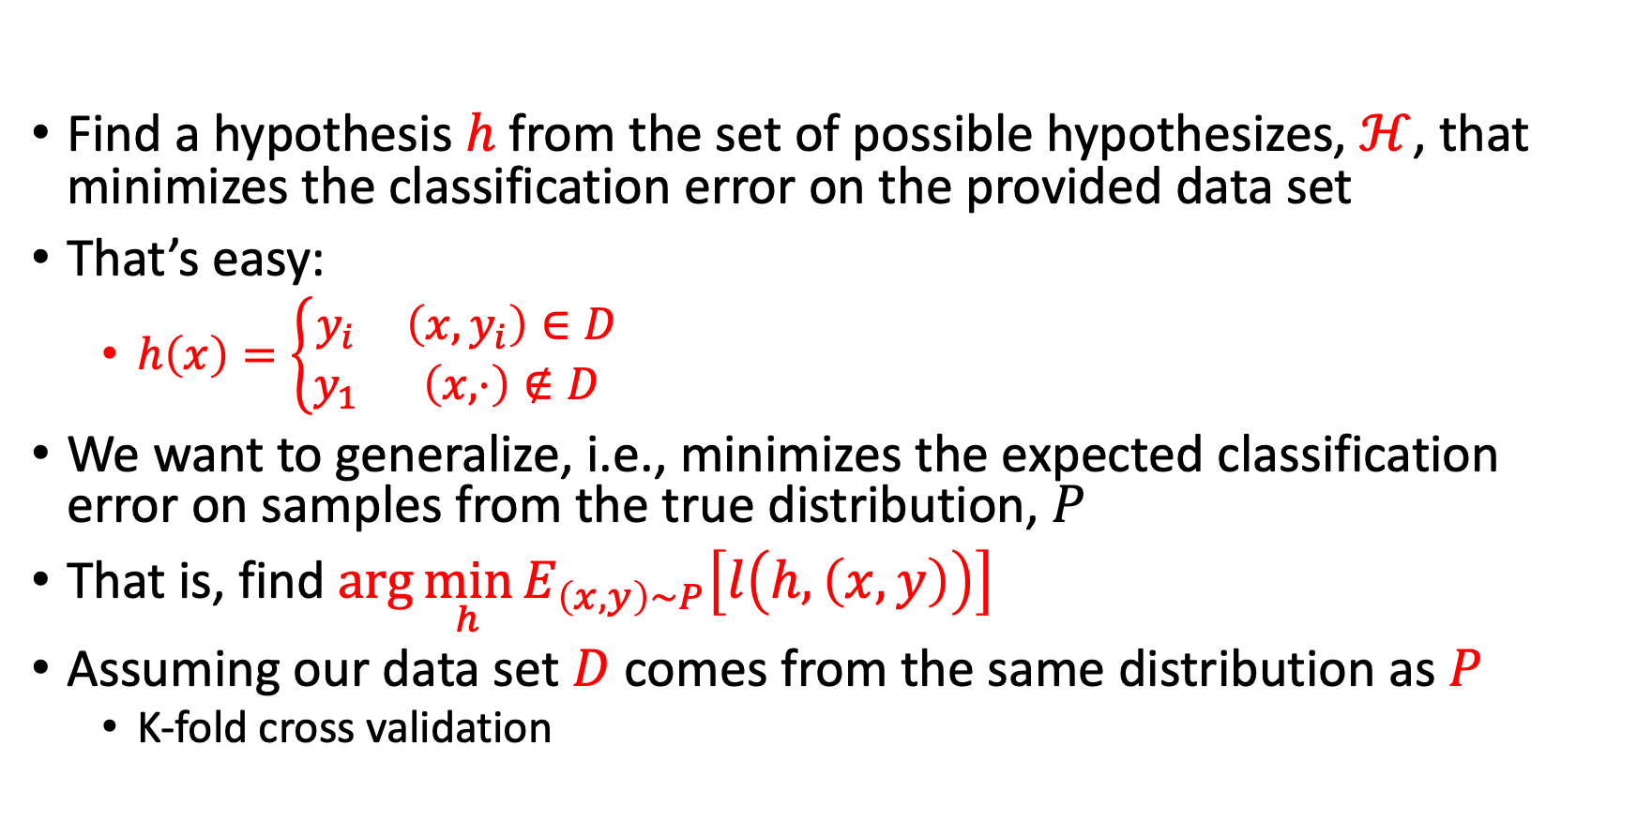
Classification problem
Find a hypothesis $h$ from the set of possible hypothesizes, $ℋ$, that minimizes the classification error on the provided data set
That’s easy:
  $h\left(x\right)=\left\{\begin{matrix}y_{i} & \left(x,y_{i}\right)∈D \\ y_{1} & \left(x,⋅\right)∉D\end{matrix}\right.$
We want to generalize, i.e., minimizes the expected classification error on samples from the true distribution, $P$
That is, find $\arg{\min_{h}{E_{\left(x,y\right)∼P}\left[l\left(h,\left(x,y\right)\right)\right]}}$
Assuming our data set $D$ comes from the same distribution as $P$
  K-fold cross validation

Slide 4
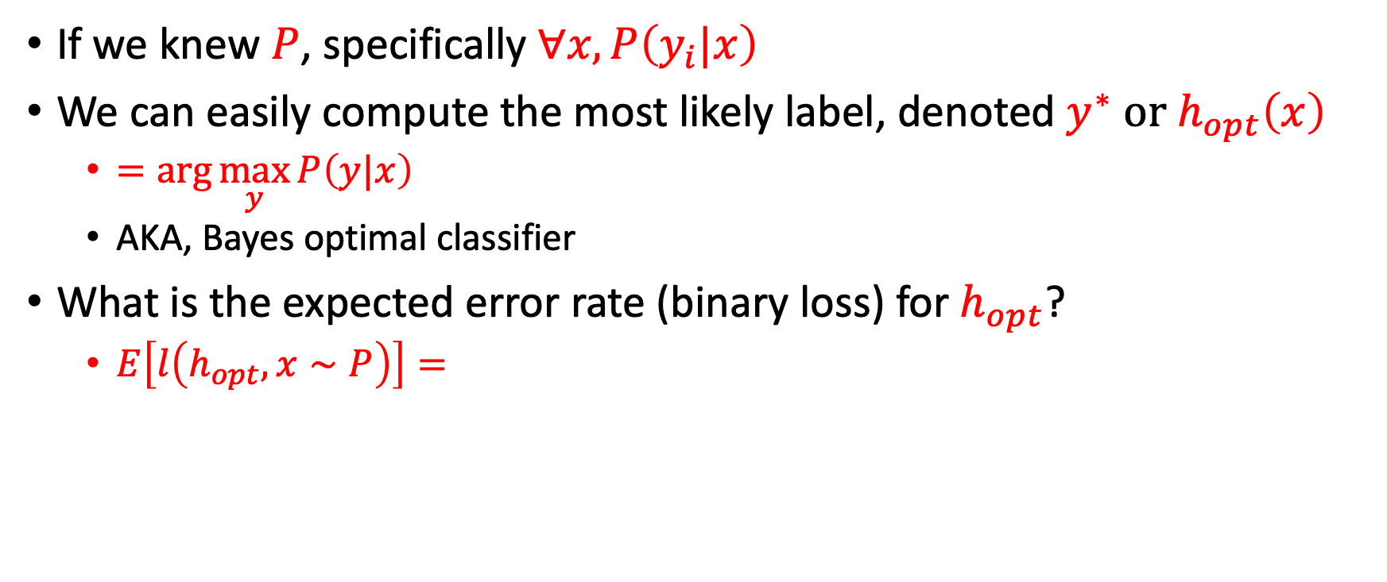
The best we can hope for
If we knew $P$, specifically $∀x, P\left(y_{i}|x\right)$
We can easily compute the most likely label, denoted $y^{∗} or h_{opt}\left(x\right)$
  $=\arg{\max_{y}{P\left(y|x\right)}}$
  AKA, Bayes optimal classifier
What is the expected error rate (binary loss) for $h_{opt}$?
  $E\left[l\left(h_{opt},x∼P\right)\right]=$

Slide 5
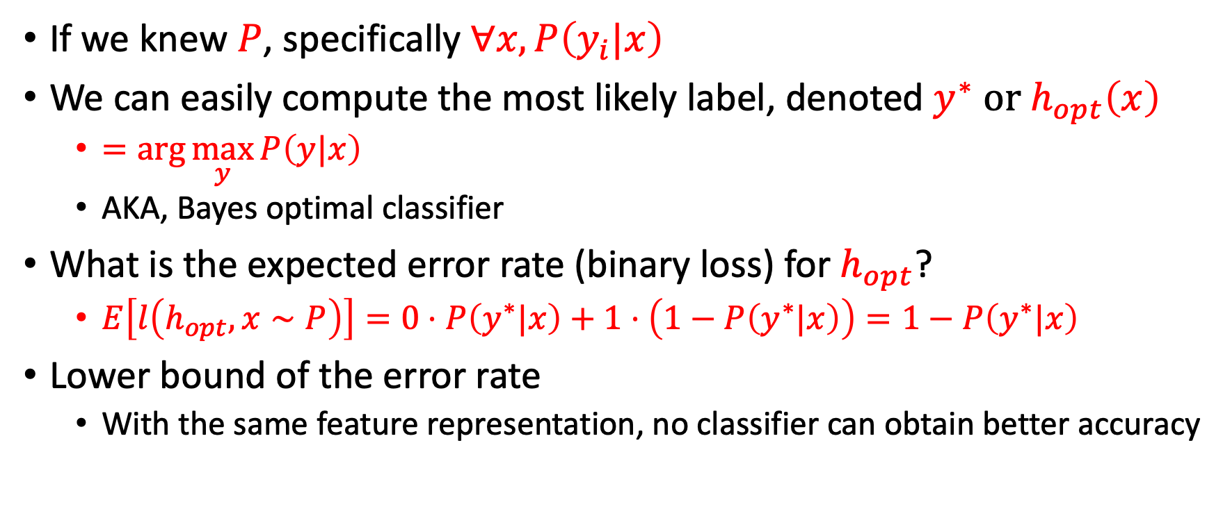
The best we can hope for
If we knew $P$, specifically $∀x, P\left(y_{i}|x\right)$
We can easily compute the most likely label, denoted $y^{∗} or h_{opt}\left(x\right)$
  $=\arg{\max_{y}{P\left(y|x\right)}}$
  AKA, Bayes optimal classifier
What is the expected error rate (binary loss) for $h_{opt}$?
  $E\left[l\left(h_{opt},x∼P\right)\right]=0⋅P\left(y^{∗}|x\right)+1⋅\left(1−P\left(y^{∗}|x\right)\right)=1−P\left(y^{∗}|x\right)$
Lower bound of the error rate
  With the same feature representation, no classifier can obtain better accuracy

Slide 6
Optimal error rate
Assume that we have a classifier for predicting if it is going to rain tomorrow
Assume that if the atmospheric pressure = 0.95 bar, there is a probability of 0.8 that it will rain the next day
What is the best prediction we can make if we know that atmospheric pressure = 0.95 and don’t know anything else?
What is our expected error rate for the best prediction?
Suboptimality of a classification model can be defined with respect to this optimal error rate

Slide 7


Worst-case accuracy
The best accuracy we can hope for is that of the Bayes optimal classifier
What is the worst accuracy that we should never underperform?
Constant classifier, essentially predicts the same label independent of any feature vectors
The best constant in classification is the most common label in the training set
you should show that your classifier outperforms the best Constant classifier
Your classifier error
$$1−P\left(y^{∗}|⋅\right)$$
$$1−P\left(y^{∗}|x\right)$$

Slide 8
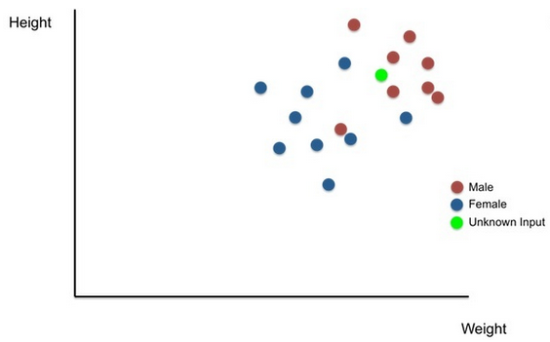
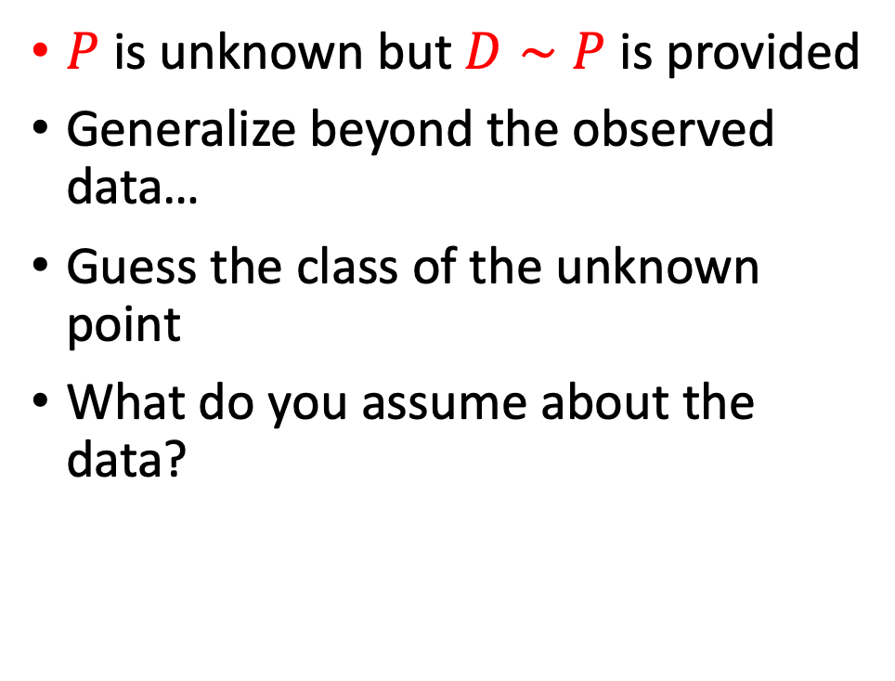
An intuitive classification model
$P$ is unknown but $D∼P$ is provided
Generalize beyond the observed data…
Guess the class of the unknown point
What do you assume about the data?

Slide 9
K-nearest neighbors
Assign the majority class among the k-nearest neighbors
K=2 ?
K=17 ?

Slide 10
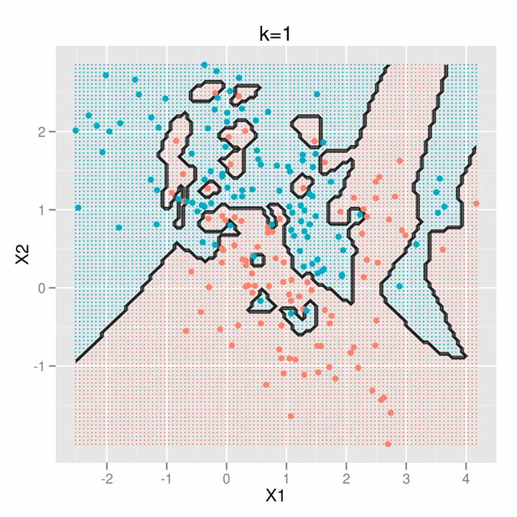

Slide 11
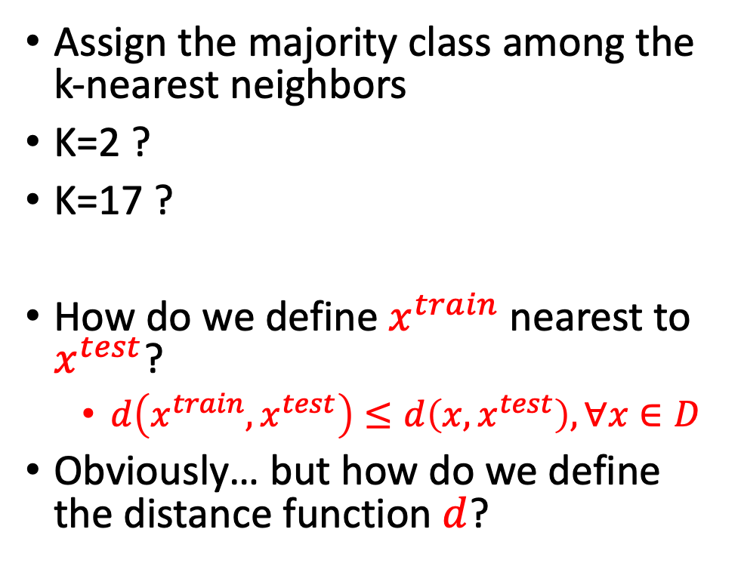
K-nearest neighbors
Assign the majority class among the k-nearest neighbors
K=2 ?
K=17 ?
How do we define $x^{train}$nearest to $x^{test}$?
  $d\left(x^{train},x^{test}\right)≤d\left(x,x^{test}\right), ∀x∈D$
Obviously… but how do we define the distance function $d$?

Slide 12
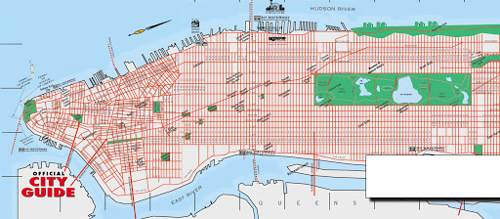
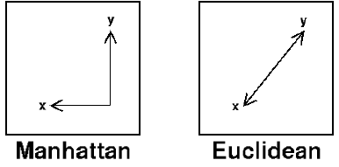
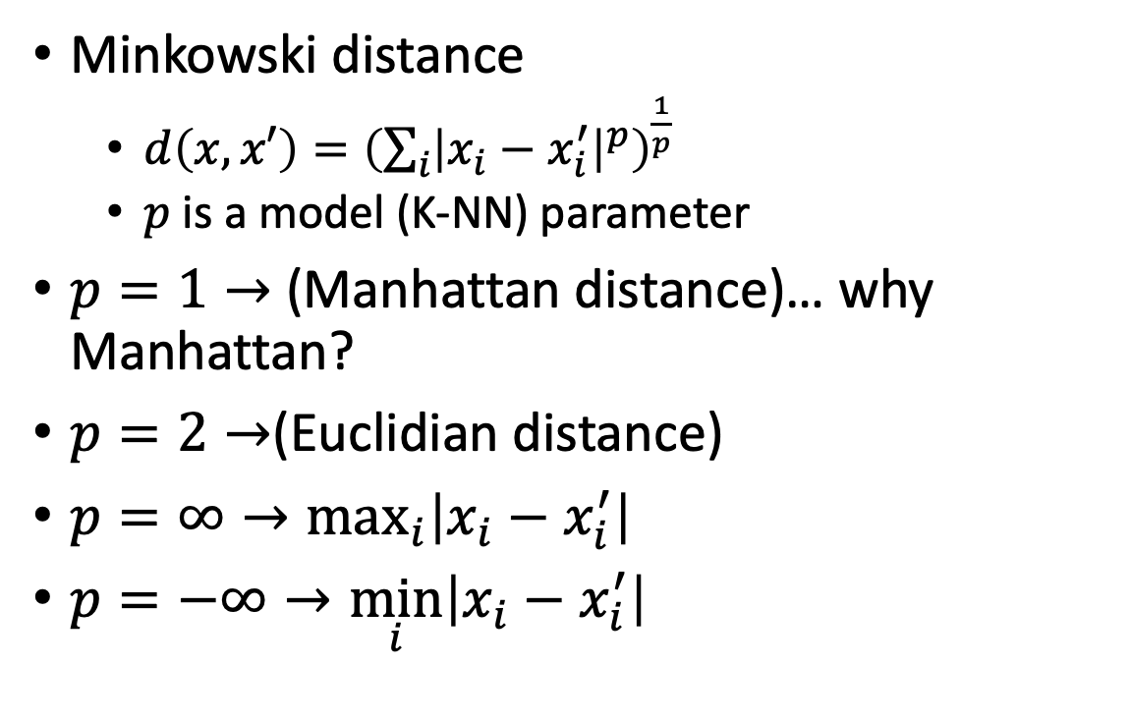
Distance/similarity metric
Minkowski distance
  $d\left(x,x′\right)={\left(\sum_{i}{{\left|x_{i}−x_{i}^{′}\right|}^{p}}\right)}^{\frac{1}{p}}$
  $p$ is a model (K-NN) parameter
$p=1→$ (Manhattan distance)… why Manhattan?
$p=2→$(Euclidian distance)
$p=∞→\max_{i}\left|x_{i}−x_{i}^{′}\right|$
$p=−∞→\min_{i}\left|x_{i}−x_{i}^{′}\right|$

Slide 13

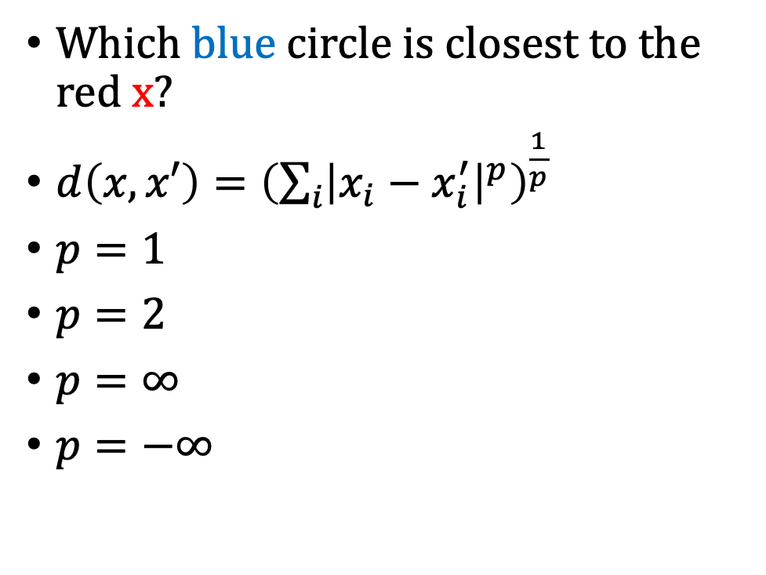
Minkowski distance quiz
Which blue circle is closest to the red x?
$d\left(x,x′\right)={\left(\sum_{i}{{\left|x_{i}−x_{i}^{′}\right|}^{p}}\right)}^{\frac{1}{p}}$
$p=1$
$p=2$
$p=∞$
$p=−∞$
1
2
3

Slide 14
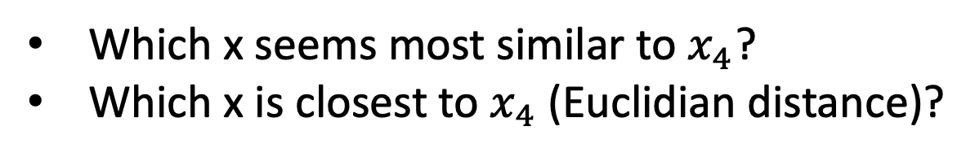
Feature scaling
Distance based algorithms are affected by the scale of the variables
Index | X |  | Y
 | Age | Income | House owner
1 | 25 | 45,000 | 0
2 | 34 | 56,000 | 1
3 | 27 | 90,000 | 0
4 | 23 | 51,000 | 0
5 | 42 | 105,000 | 1
Which x seems most similar to $x_{4}$?
Which x is closest to $x_{4}$ (Euclidian distance)?

Slide 15
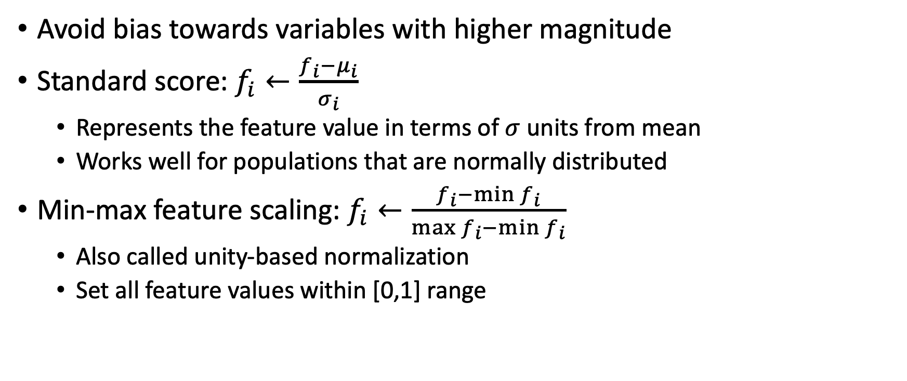
Feature scaling - Normalization
Avoid bias towards variables with higher magnitude
Standard score: $f_{i}←\frac{f_{i}−μ_{i}}{σ_{i}}$
  Represents the feature value in terms of $σ$ units from mean
  Works well for populations that are normally distributed
Min-max feature scaling: $f_{i}←\frac{f_{i}−\min{f_{i}}}{\max{f_{i}}−\min{f_{i}}}$
  Also called unity-based normalization
  Set all feature values within [0,1] range

Slide 16
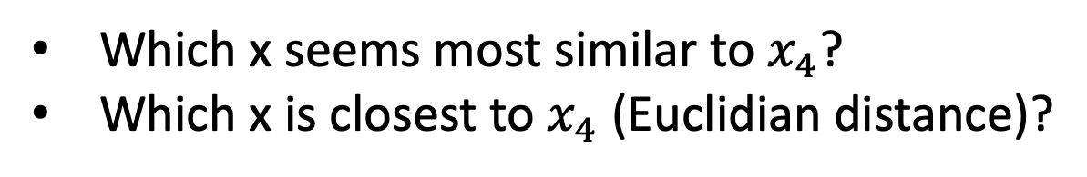
Feature scaling
Min-max feature scaling
Index | X |  | Y
 | Age | Income | House owner
1 | 25 | 45,000 | 0
2 | 34 | 56,000 | 1
3 | 27 | 90,000 | 0
4 | 23 | 51,000 | 0
5 | 42 | 105,000 | 1
Index | X |  | Y
 | Age | Income | House owner
1 | 0.1 | 0 | 0
2 | 0.58 | 0.18 | 1
3 | 0.21 | 0.75 | 0
4 | 0 | 0.1 | 0
5 | 1 | 1 | 1
Which x seems most similar to $x_{4}$?
Which x is closest to $x_{4}$ (Euclidian distance)?

Slide 17
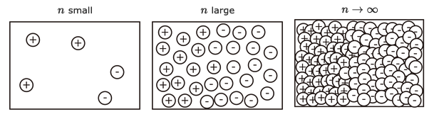
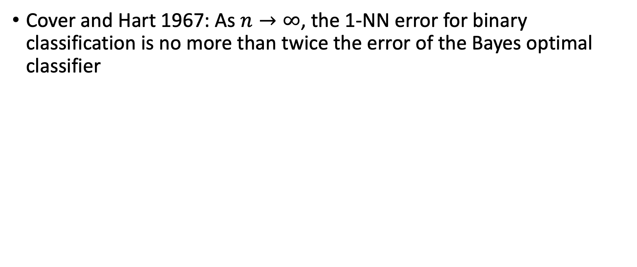
Accuracy guarantees for K-NN
Cover and Hart 1967: As $n→∞$, the 1-NN error for binary classification is no more than twice the error of the Bayes optimal classifier

Slide 18
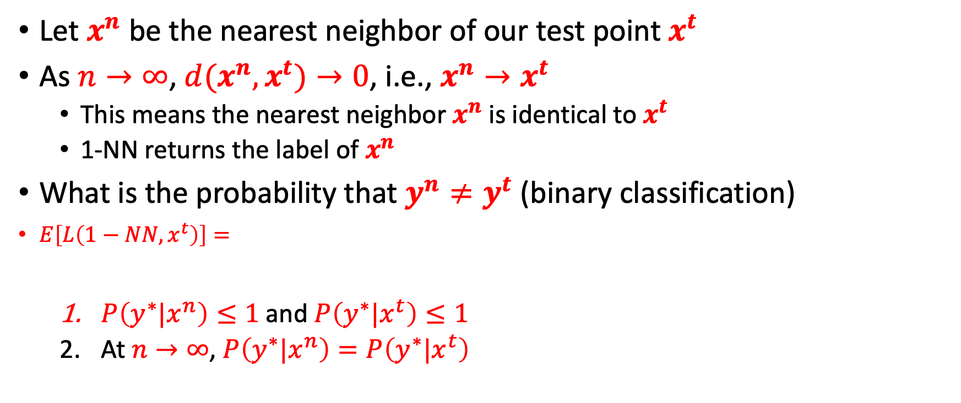
Accuracy guarantees for 1-NN
Let $x^{n}$ be the nearest neighbor of our test point $x^{t}$
As $n→∞$, $d(x^{n},x^{t})→0$, i.e., $x^{n}→x^{t}$
  This means the nearest neighbor $x^{n}$ is identical to $x^{t}$
  1-NN returns the label of $x^{n}$
What is the probability that $y^{n}≠y^{t}$ (binary classification)
$E\left[L\left(1−NN,x^{t}\right)\right]=$
  $P\left(y^{∗}|x^{n}\right)≤1$and $P\left(y^{∗}|x^{t}\right)≤1$
  At $n→∞$, $P\left(y^{∗}|x^{n}\right)=P\left(y^{∗}|x^{t}\right)$

Slide 19
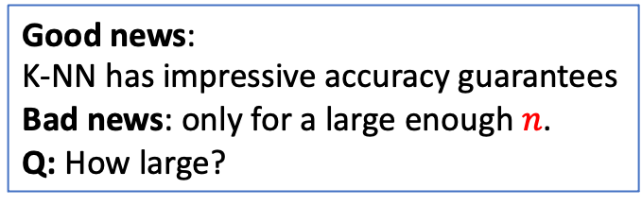
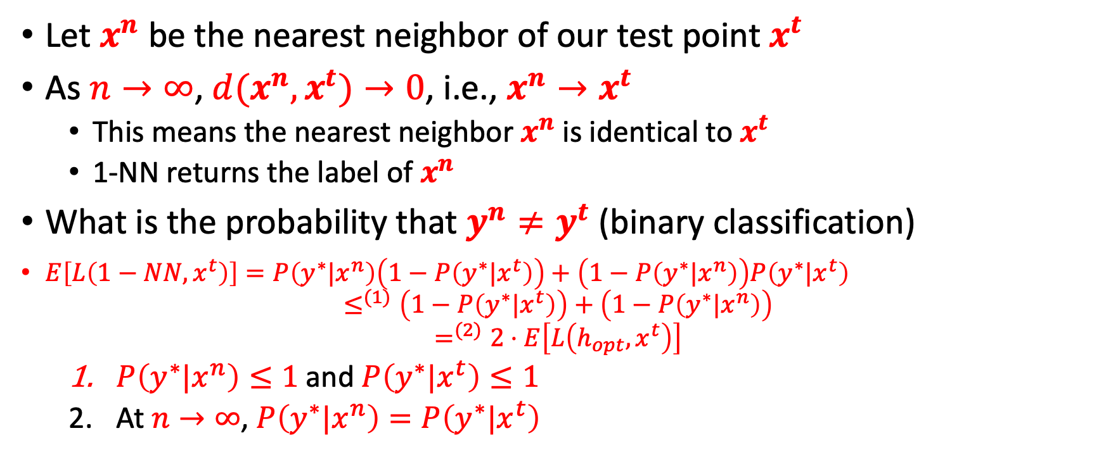
Accuracy guarantees for 1-NN
Let $x^{n}$ be the nearest neighbor of our test point $x^{t}$
As $n→∞$, $d(x^{n},x^{t})→0$, i.e., $x^{n}→x^{t}$
  This means the nearest neighbor $x^{n}$ is identical to $x^{t}$
  1-NN returns the label of $x^{n}$
What is the probability that $y^{n}≠y^{t}$ (binary classification)
$E\left[L\left(1−NN,x^{t}\right)\right]=P\left(y^{∗}|x^{n}\right)\left(1−P\left(y^{∗}|x^{t}\right)\right)+\left(1−P\left(y^{∗}|x^{n}\right)\right)P\left(y^{∗}|x^{t}\right)$
$$≤^{(1)}\left(1−P\left(y^{∗}|x^{t}\right)\right)+\left(1−P\left(y^{∗}|x^{n}\right)\right)$$
$$=^{(2)}2⋅E\left[L\left(h_{opt},x^{t}\right)\right]$$
  $P\left(y^{∗}|x^{n}\right)≤1$and $P\left(y^{∗}|x^{t}\right)≤1$
  At $n→∞$, $P\left(y^{∗}|x^{n}\right)=P\left(y^{∗}|x^{t}\right)$
Good news:
K-NN has impressive accuracy guarantees
Bad news: only for a large enough $n$.
Q: How large?

Slide 20

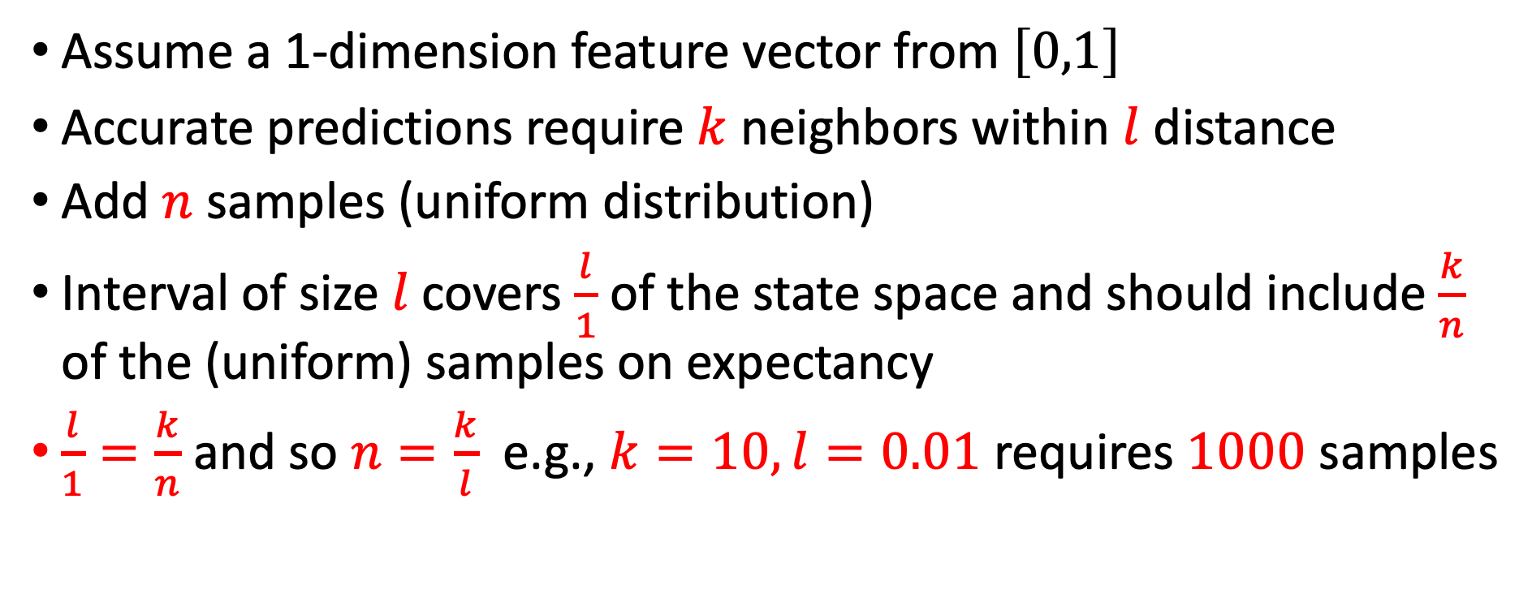

Required number of samples
Assume a 1-dimension feature vector from $\left[0,1\right]$
Accurate predictions require $k$ neighbors within $l$ distance
Add $n$ samples (uniform distribution)
Interval of size$l$covers $\frac{l}{1}$ of the state space and should include $\frac{k}{n}$ of the (uniform) samples on expectancy
$\frac{l}{1}=\frac{k}{n}$ and so $n=\frac{k}{l}$ e.g., $k=10, l=0.01$ requires $1000$ samples
$$0$$
$$1$$

Slide 21

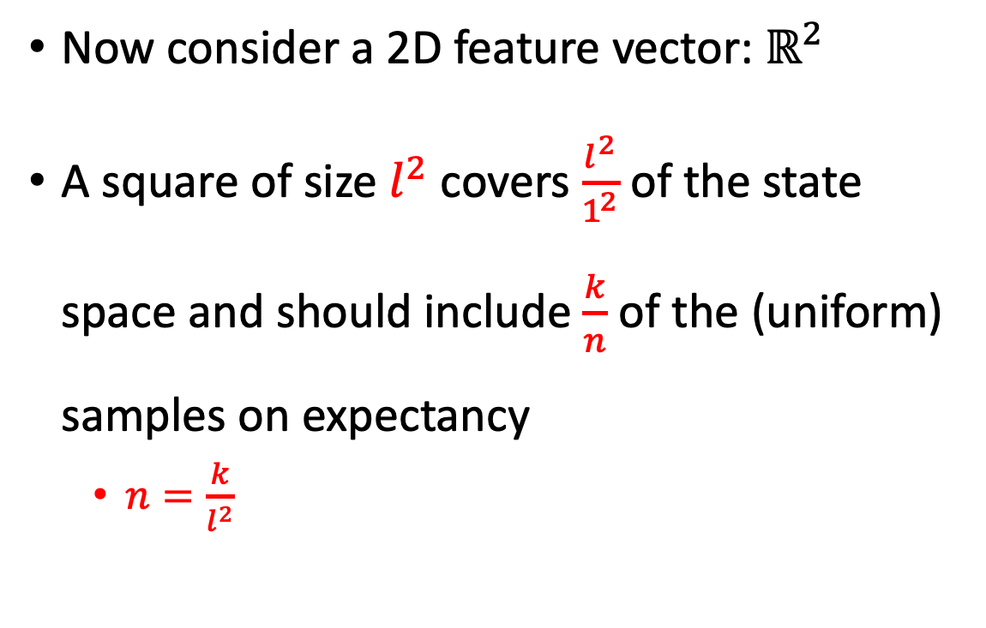
Required number of samples
Now consider a 2D feature vector: $ℝ^{2}$
A square of size$l^{2}$covers $\frac{l^{2}}{1^{2}}$ of the state space and should include $\frac{k}{n}$ of the (uniform) samples on expectancy
  $n=\frac{k}{l^{2}}$
1
$$l$$
1

Slide 22
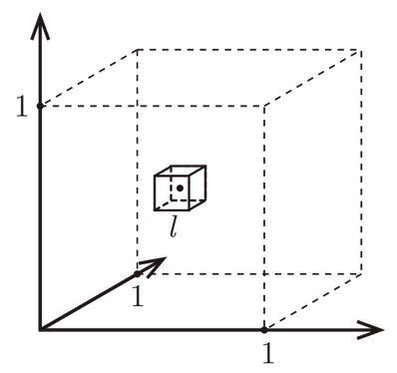
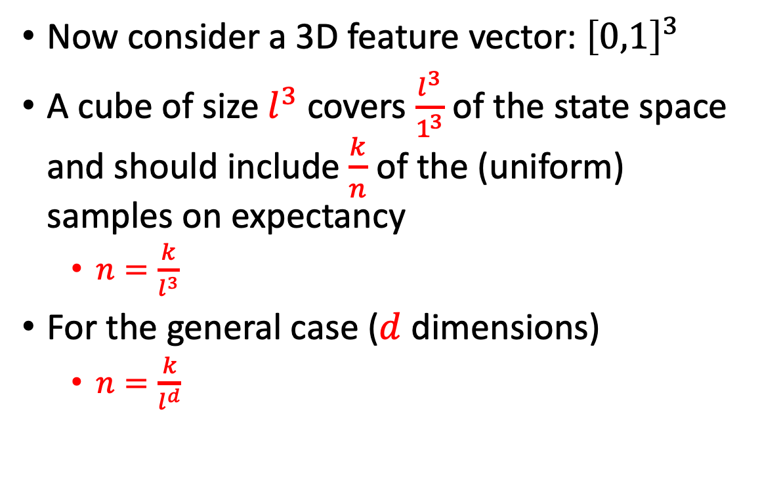
Required number of samples
Now consider a 3D feature vector: ${\left[0,1\right]}^{3}$
A cube of size$l^{3}$covers $\frac{l^{3}}{1^{3}}$ of the state space and should include $\frac{k}{n}$ of the (uniform) samples on expectancy
  $n=\frac{k}{l^{3}}$
For the general case ($d$ dimensions)
  $n=\frac{k}{l^{d}}$

Slide 23
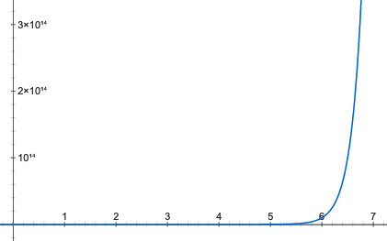
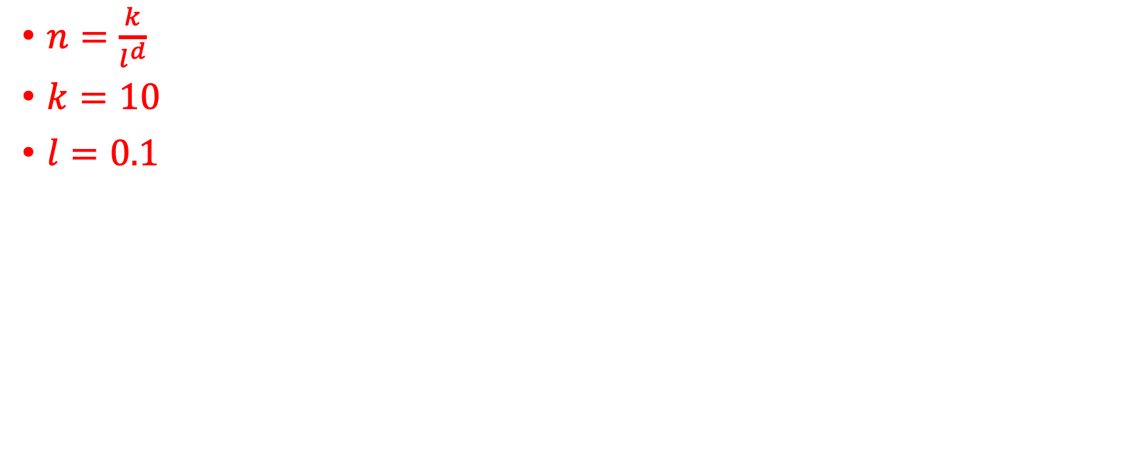


Curse of dimensionality
$$n$$
$n=\frac{k}{l^{d}}$
$k=10$
$l=0.1$
$$d$$

Slide 24
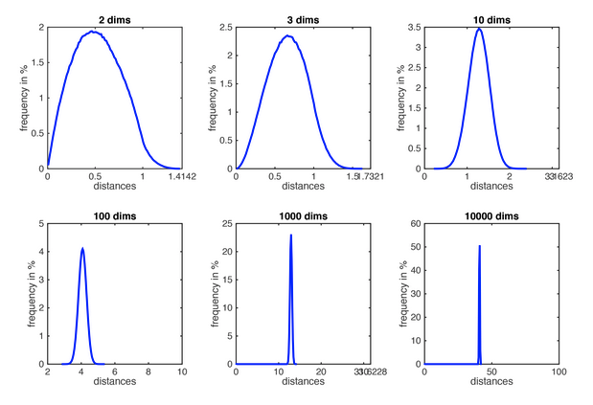
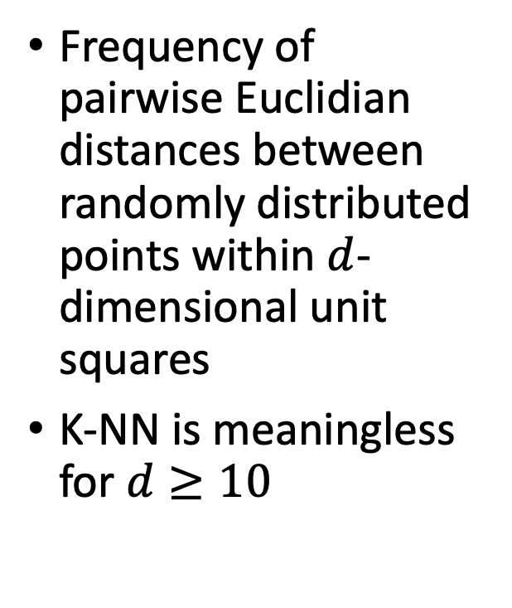
Curse of dimensionality
Frequency of pairwise Euclidian distances between randomly distributed points within $d$-dimensional unit squares
K-NN is meaningless for $d≥10$

Slide 25
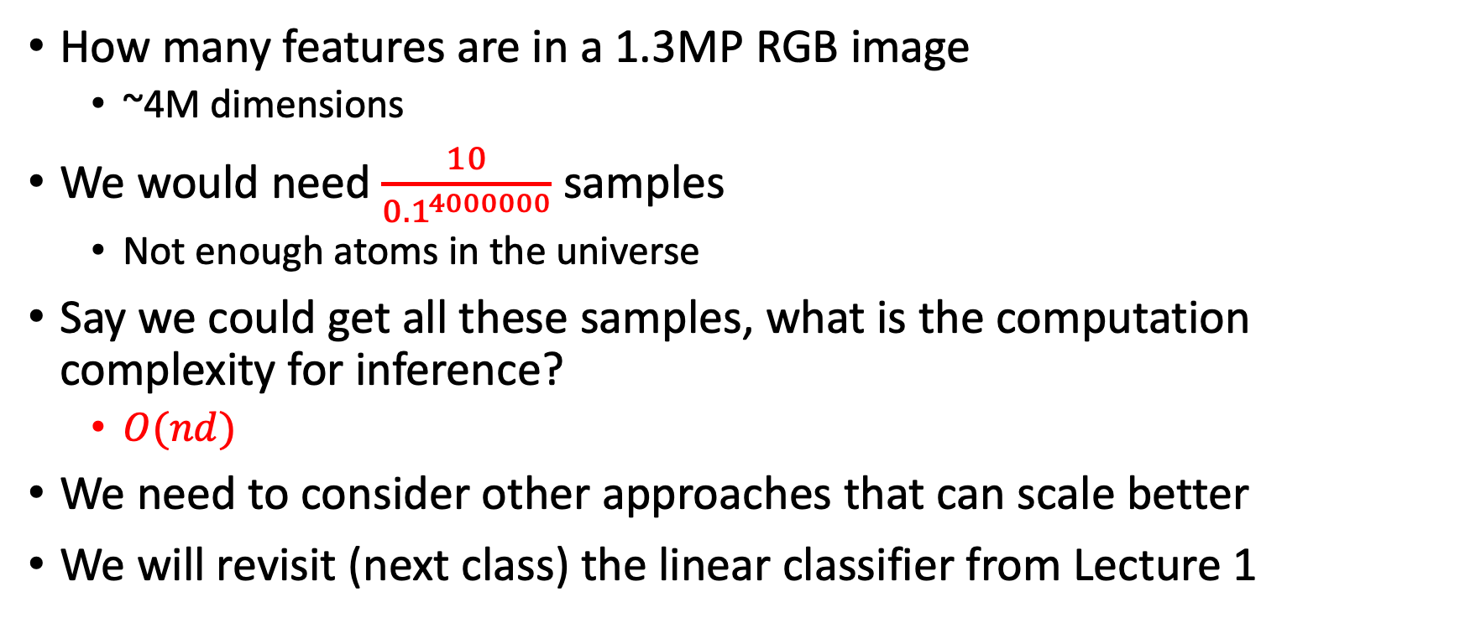
Curse of dimensionality
How many features are in a 1.3MP RGB image
  ~4M dimensions
We would need $\frac{10}{{0.1}^{4000000}}$ samples
  Not enough atoms in the universe
Say we could get all these samples, what is the computation complexity for inference?
  $O(nd)$
We need to consider other approaches that can scale better
We will revisit (next class) the linear classifier from Lecture 1

Slide 26
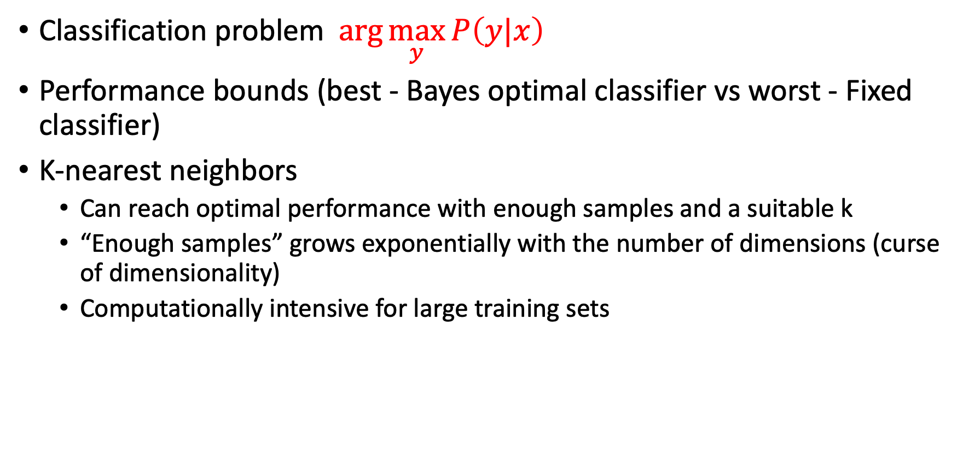
What did we learn?
Classification problem $\arg{\max_{y}{P\left(y|x\right)}}$
Performance bounds (best - Bayes optimal classifier vs worst - Fixed classifier)
K-nearest neighbors
  Can reach optimal performance with enough samples and a suitable k
  “Enough samples” grows exponentially with the number of dimensions (curse of dimensionality)
  Computationally intensive for large training sets

Slide 27
What next?
Class:
  linear classifier (perceptron)
Assignments:
  Written assignment 1: K Nearest Neighbors + Linear algebra (due Monday, Sep 13)

