Slide 1
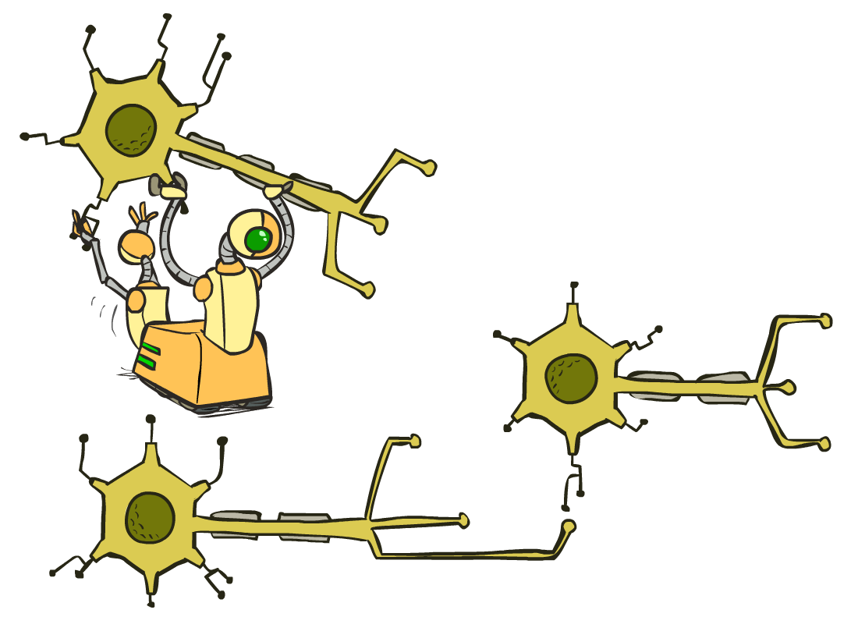
CSCE-420: Artificial Intelligence
Neural Nets
Instructor: Guni Sharon

Slide 2
Announcements
Quiz 11 - naïve Bayes, due April 23, EoD.
Quiz12: Decision Trees, due April 28, EoD.
Assignment 5: Machine Learning (Extra credit), due May 1, EoD
Contest 3: Multiagent Adversarial Pacman, due May 1, EoD
  You are encouraged to combine various AI tools
    Heuristic search for deterministic planning
    Adversarial search and game theory for modeling opponents
    MDPs for modeling uncertainties
    Reinforcement learning for solving MDPs
    Bayes nets for inference
    DNN as function approximators

Slide 3
Course Evaluations
Student Course Evaluation for Spring 2025 - College Station will begin on 04-15-2025, and be available until 04-30-2025 . Please encourage your students to take the course evaluations in AEFIS (https://tamu.aefis.net/). Note that the preferred browsers are Chrome and Firefox.

Slide 4
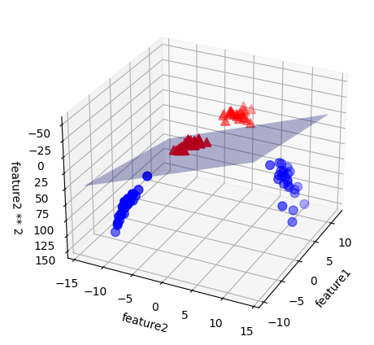
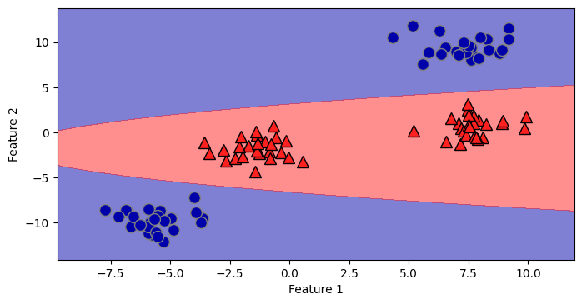
Trainig a parametrized function
Consider training linear functions
  This is easy -> can be computed in closed form
    Ordinary Least Squares regression, Ridge regression
  Highly biased: linear correlations are rare
Linear separability is usually possible once we add transformed features (extra dimensions)
A projection of a hyperplane to the lower (original) dimensionality can then fit non-linear patterns

Slide 5
Fitting to non-linear data
One possibility: bending the feature space and fitting a hyperplane (kernelized machines)
Today: fitting a general non-linear function to the original feature space
How can we define a “general non-linear function”?
  We must commit to some structure. Won’t that limit our hypothesis space?
How can we fit a “general non-linear function”?
  Both a closed form solution and an approximate solution (GD) require us to compute the gradient of the loss w.r.t. the function’s parameters
  How can we compute a gradient for a “general non-linear function”?

Slide 6
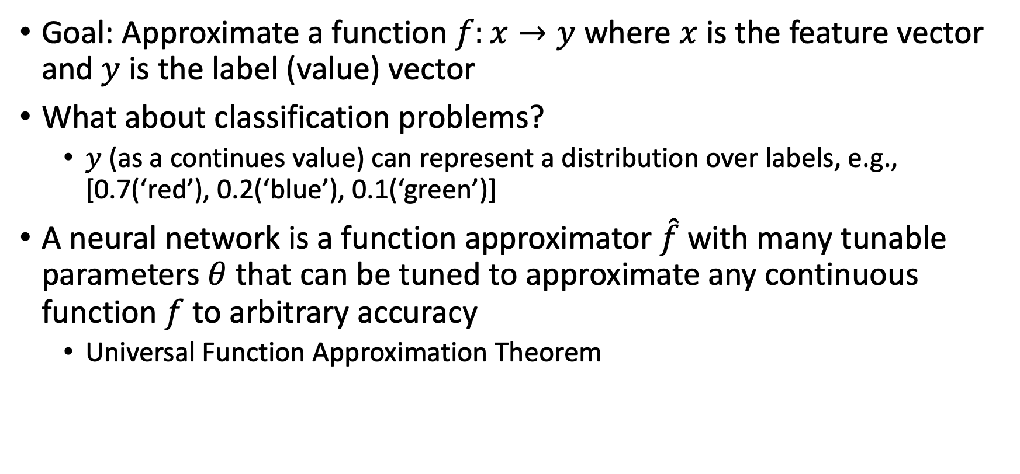
Function approximator
Goal: Approximate a function $f:x→y$ where $x$ is the feature vector and $y$ is the label (value) vector
What about classification problems?
  $y$ (as a continues value) can represent a distribution over labels, e.g., [0.7(‘red’), 0.2(‘blue’), 0.1(‘green’)]
A neural network is a function approximator $\hat{f}$ with many tunable parameters $θ$ that can be tuned to approximate any continuous function $f$ to arbitrary accuracy
  Universal Function Approximation Theorem

Slide 7
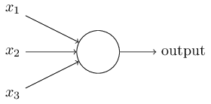
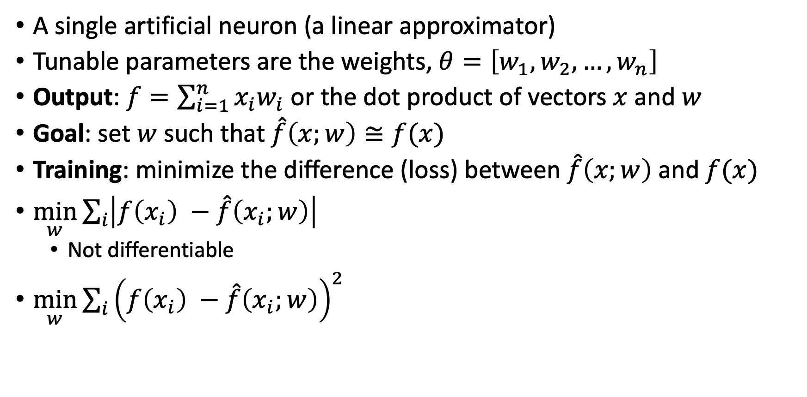
Perceptrons
A single artificial neuron (a linear approximator)
Tunable parameters are the weights, $θ=\left[w_{1},w_{2},…,w_{n}\right]$
Output: $f=\sum_{i=1}^{n}{x_{i}w_{i}}$ or the dot product of vectors $x$ and $w$
Goal: set $w$ such that $\hat{f}\left(x;w\right)≅f(x)$
Training: minimize the difference (loss) between $\hat{f}\left(x;w\right) \text{and} f(x)$
$\min_{w}\sum_{i}{\left|f\left(x_{i}\right) −\hat{f}\left(x_{i};w\right)\right|}{}$
  Not differentiable
$\min_{w}\sum_{i}{{\left(f\left(x_{i}\right) −\hat{f}\left(x_{i};w\right)\right)}^{2}}$
$$w_{1}$$
$$w_{2}$$
$$w_{3}$$

Slide 8
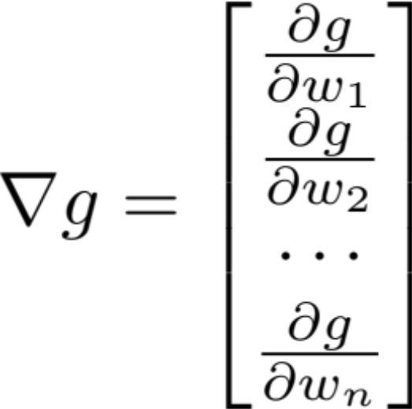
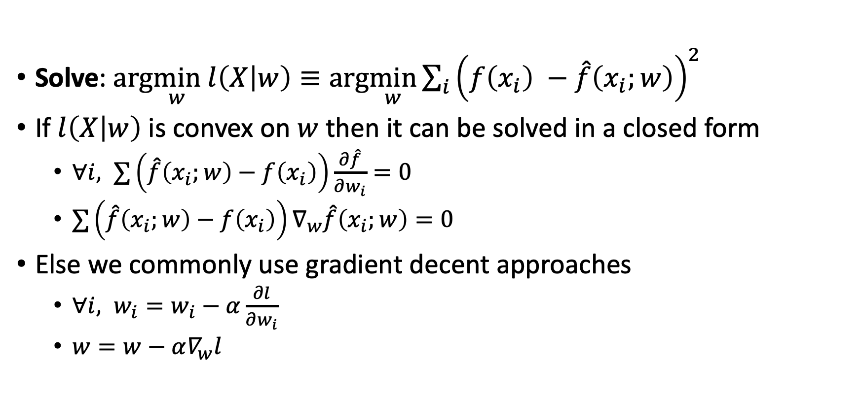
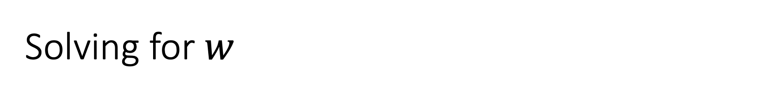
Solving for $w$
Solve: $arg\min_{w} l\left(X | w\right)≡arg\min_{w}\sum_{i}{{\left(f\left(x_{i}\right) −\hat{f}\left(x_{i};w\right)\right)}^{2}}$
If $l\left(X | w\right)$ is convex on $w$ then it can be solved in a closed form
  $∀i, ∑\left(\hat{f}\left(x_{i};w\right)−f\left(x_{i}\right)\right)\frac{∂\hat{f}}{∂w_{i}}=0$
  $∑\left(\hat{f}\left(x_{i};w\right)−f\left(x_{i}\right)\right)∇_{w}\hat{f}\left(x_{i};w\right)=0$
Else we commonly use gradient decent approaches
  $∀i, w_{i}=w_{i}−α\frac{∂l}{∂w_{i}}$
  $w=w−α∇_{w}l$

Slide 9
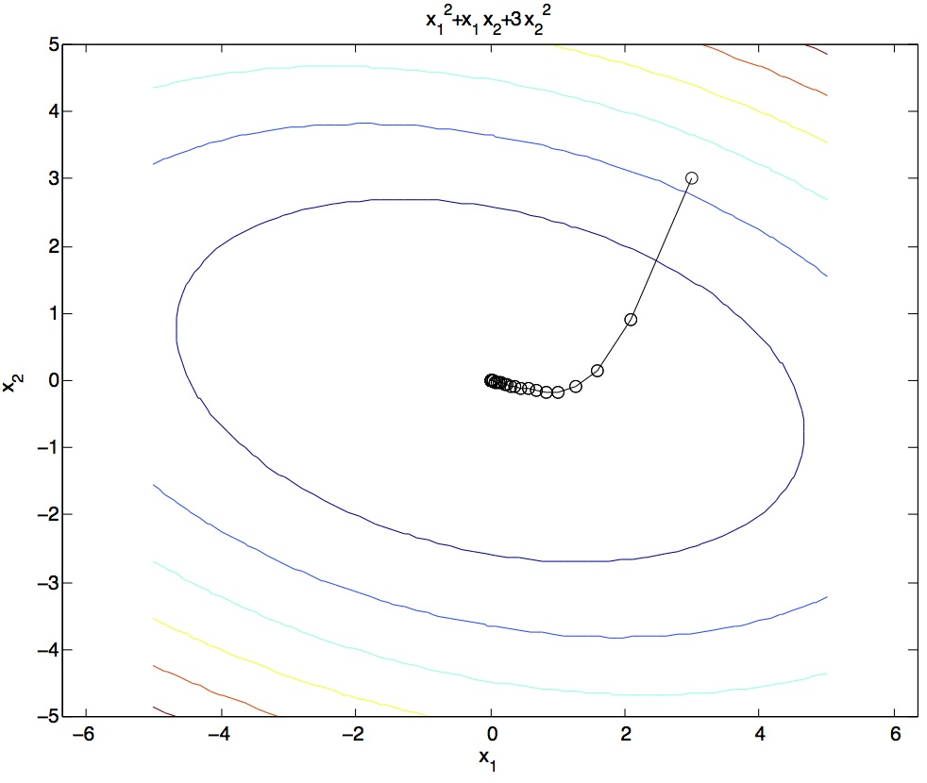
Gradient Ascent
Idea:
  Start somewhere
  Repeat: Take a step in the gradient direction
Figure source: Mathworks

Slide 10
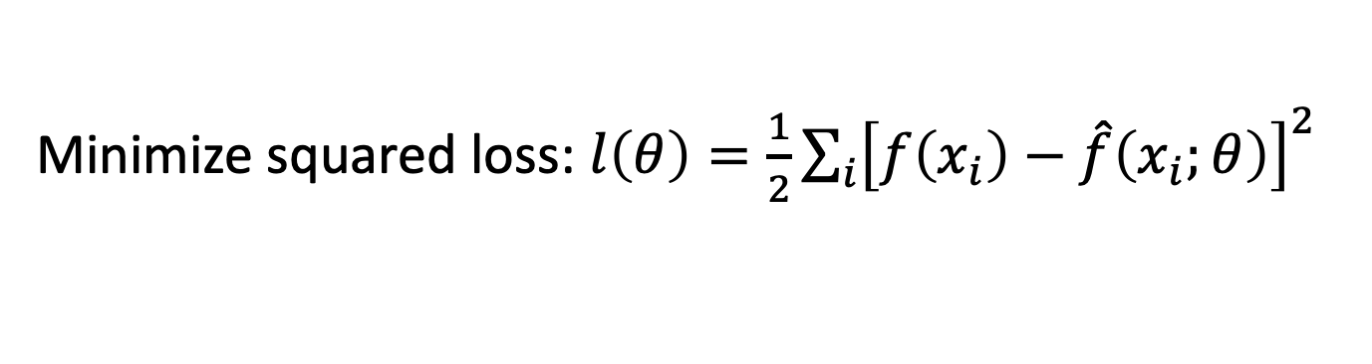
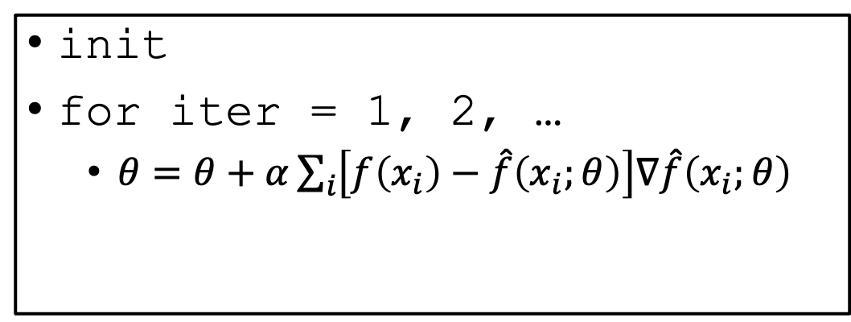
Batch Gradient Decent
Minimize squared loss: $l\left(θ\right)=\frac{1}{2}{\sum_{i}{\left[f\left(x_{i}\right)−\hat{f}\left(x_{i};θ\right)\right]}}^{2}$
init
for iter = 1, 2, …
  $θ=θ+α\sum_{i}{\left[f\left(x_{i}\right)−\hat{f}\left(x_{i};θ\right)\right]∇\hat{f}\left(x_{i};θ\right)}$

Slide 11
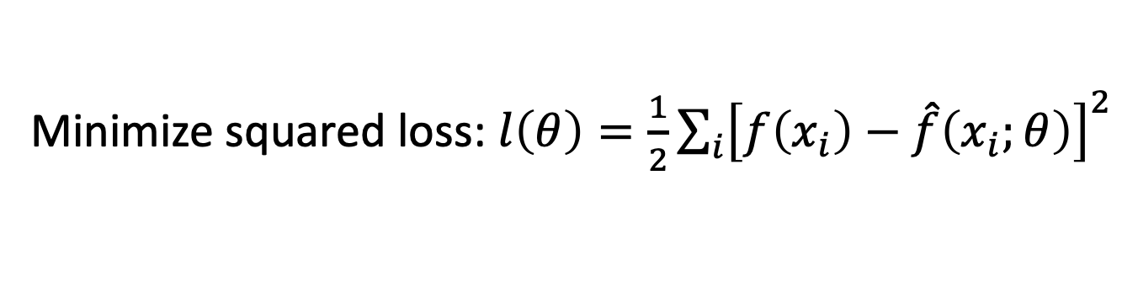
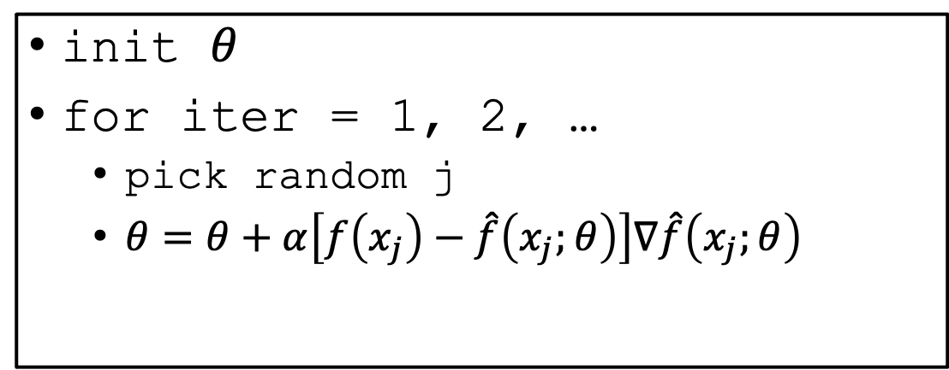
Stochastic Gradient Decent (SGD)
Minimize squared loss: $l\left(θ\right)=\frac{1}{2}{\sum_{i}{\left[f\left(x_{i}\right)−\hat{f}\left(x_{i};θ\right)\right]}}^{2}$
Observation: once gradient on one training example has been computed, might as well incorporate before computing next one
init $θ$
for iter = 1, 2, …
  pick random j
  $θ=θ+α\left[f\left(x_{j}\right)−\hat{f}\left(x_{j};θ\right)\right]∇\hat{f}\left(x_{j};θ\right)$

Slide 12
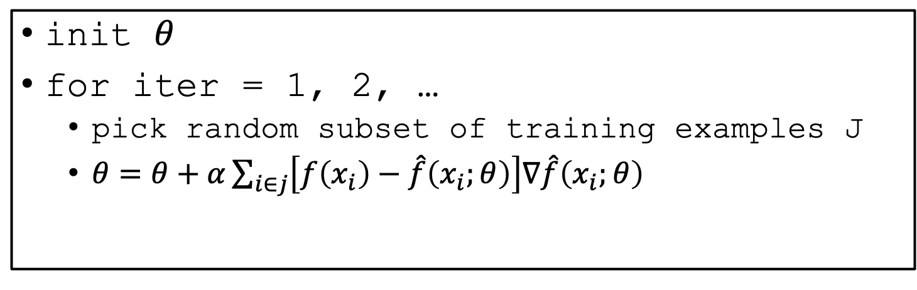
Mini-Batch Gradient Decent
Minimize squared loss: $l\left(θ\right)=\frac{1}{2}{\sum_{i}{\left[f\left(x_{i}\right)−\hat{f}\left(x_{i};θ\right)\right]}}^{2}$
Observation: gradient over small set of training examples (=mini-batch) can be computed in parallel, might as well do that instead of a single one
init $θ$
for iter = 1, 2, …
  pick random subset of training examples J
  $θ=θ+α\sum_{i∈j}{\left[f\left(x_{i}\right)−\hat{f}\left(x_{i};θ\right)\right]∇\hat{f}\left(x_{i};θ\right)}$

Slide 13
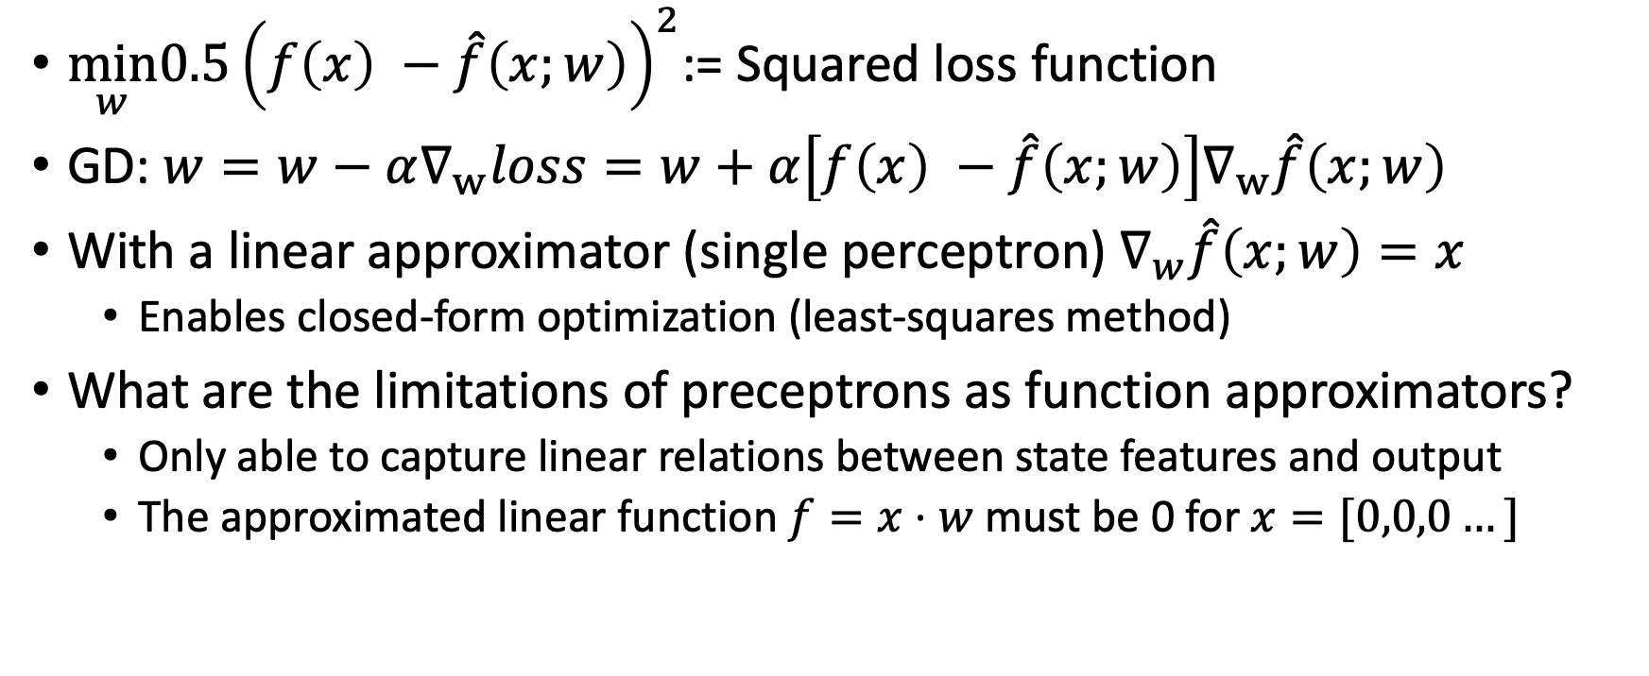
Training Perceptrons with GD
$\min_{w}0.5{\left(f\left(x\right) −\hat{f}\left(x;w\right)\right)}^{2}$:= Squared loss function
GD: $w=w−α∇_{w}loss=w+α\left[f\left(x\right) −\hat{f}\left(x;w\right)\right]∇_{w}\hat{f}\left(x;w\right)$
With a linear approximator (single perceptron) $∇_{w}\hat{f}\left(x;w\right)=x$
  Enables closed-form optimization (least-squares method)
What are the limitations of preceptrons as function approximators?
  Only able to capture linear relations between state features and output
  The approximated linear function $f=x⋅w$ must be 0 for $x=[0,0,0…]$

Slide 14
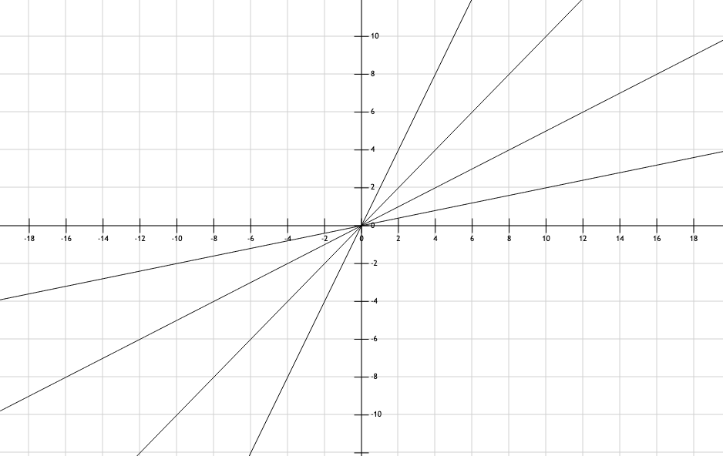
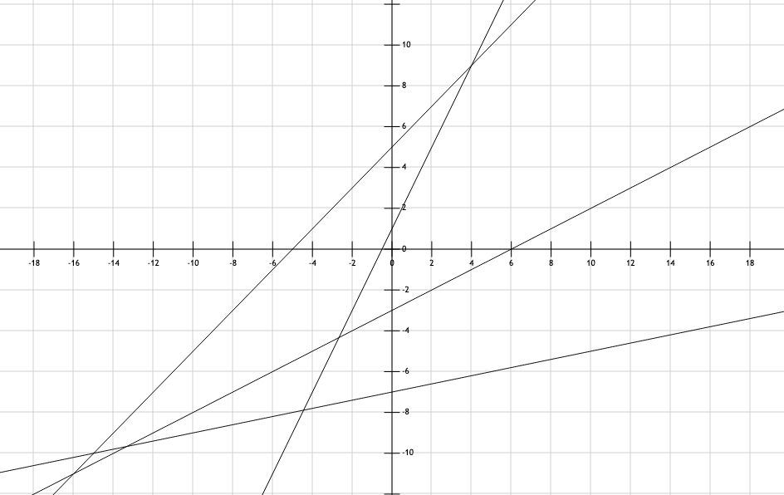
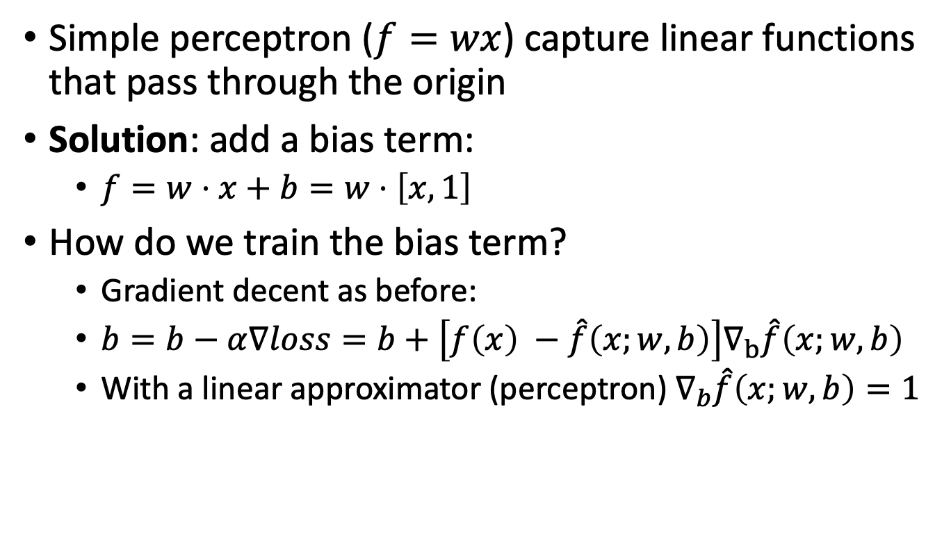
Add bias
Simple perceptron ($f=wx$) capture linear functions that pass through the origin
Solution: add a bias term:
  $f=w⋅x+b=w⋅\left[x,1\right]$
How do we train the bias term?
  Gradient decent as before:
  $b=b−α∇loss=b+\left[f\left(x\right) −\hat{f}\left(x;w,b\right)\right]∇_{b}\hat{f}\left(x;w,b\right)$
  With a linear approximator (perceptron) $∇_{b}\hat{f}\left(x;w,b\right)=1$

Slide 15
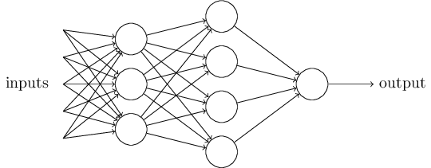
Beyond linearity: connecting perceptrons
What if we connect several preceptors to combine a net?
$x$ is the input, $z^{i}$ is the output (activation) vector for layer $i$, $w^{i}$ is a weight matrix for layers $\left(i−1, i\right)$ with dimensions $\left(z^{i−1},z^{i}\right)$
What is the activation for layer 1?
  $z_{1}^{1}=x_{i}w_{1}^{1}$, $z_{2}^{1}=x_{i}w_{2}^{1}$…
  $z^{1}=xw^{1}$
What is the activation of $z^{3}$?
  $z^{3}=\left(\left(xw^{1}\right)w^{2}\right)w^{3}$
$$z^{2}$$
$$w^{1}$$
$$z^{1}$$
$$w^{2}$$
$$x_{1}$$
$$w^{3}$$
$$x_{2}$$
$$z^{3}$$
$$=x⋅w^{′}$$
Where $w^{′}=w^{1}w^{2}w^{3}$
$$x_{4}$$
$$z^{1}$$
$$x_{5}$$
Matrix product is associative i.e., (AB)C=A(BC)
$$z^{2}$$
Not more powerful than a single preceptron
$$z^{3}$$

Slide 16
Introducing non-linearity
In order to represent general functions, the output of a neuron needs to be nonlinear w.r.t. the activation $\left(z\right)$
We need an Activation Function $g\left(z\right)$
$output=g\left(wx+b\right)$
Activation function Job description:
  Well defined gradient (differentiable)
  Informative gradient values (how to improve the objective)
  Monotonic (since local optimums lead to suboptimal solutions with GD)
  Fast to compute (intense working environment)
  Covers the required output range
Let's look at some candidates
$$w_{1}$$
$$w_{2}$$
$$w_{3}$$

Slide 17
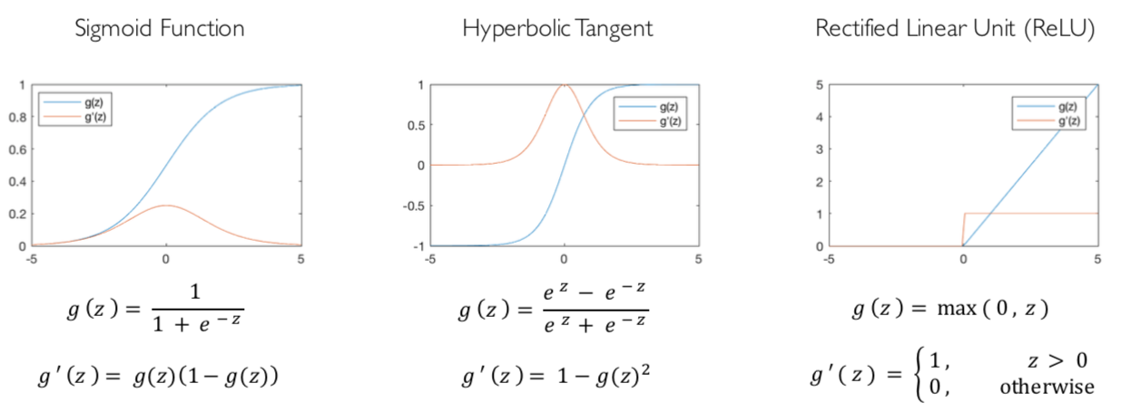
Common Activation Functions
  Defined derivatives
  Informative derivative values
  Monotonic
  Fast to compute
  Covers the required output range
[source: MIT 6.S191 introtodeeplearning.com]

Slide 18
Common Activation Functions
  Defined derivatives
  Informative derivative values
  Monotonic
  Fast to compute
  Covers the required output range
[source: MIT 6.S191 introtodeeplearning.com]

Slide 19
Common Activation Functions
  Defined derivatives
  Informative derivative values
  Monotonic
  Fast to compute
  Covers the required output range
[source: MIT 6.S191 introtodeeplearning.com]

Slide 20
Common Activation Functions
  Defined derivatives
  Informative derivative values
  Monotonic
  Fast to compute
  Covers the required output range
[source: MIT 6.S191 introtodeeplearning.com]

Slide 21
Example: Sigmoid neuron
Assume a single neuron with a Sigmoid activation function
  $g\left(z\right)=\frac{1}{1+e^{−z}}$ $g′\left(z\right)=g\left(z\right)\left(1−g\left(z\right)\right)$
  Where $z=wx+b$
  How can we compute $\frac{∂l}{∂w}$ or $\frac{∂l}{∂b}$ ?
  The chain rule! $\frac{∂l}{∂w}=\frac{∂l}{∂g\left(z\right)}\frac{∂g(z)}{∂z}⋅\frac{∂z}{∂w}$
Given a set of labeled observations $x,y$ perform a GD step
$w=w−α∇loss=w−\left[\hat{f}\left(x;w,b\right)−y\right]∇_{w}\hat{f}\left(x;w,b\right)$
$=w−\left[\frac{1}{1+e^{−z}}−y\right]\frac{1}{1+e^{−z}}\left(1−\frac{1}{1+e^{−z}}\right)x$
$$w_{1}$$
$$w_{2}$$
$$b$$
$$w_{3}$$
Derivative of squared error loss $\frac{∂l}{∂g\left(z\right)}$

Slide 22
Example: Sigmoid neuron
Assume a single neuron with a Sigmoid activation function
  $g\left(z\right)=\frac{1}{1+e^{−z}}$ $g′\left(z\right)=g\left(z\right)\left(1−g\left(z\right)\right)$
  Where $z=wx+b$
  How can we compute $\frac{∂l}{∂w}$ or $\frac{∂l}{∂b}$ ?
  The chain rule! $\frac{∂l}{∂w}=\frac{∂l}{∂g\left(z\right)}\frac{∂g(z)}{∂z}⋅\frac{∂z}{∂w}$
Given a set of labeled observations $x,y$ perform a GD step
$w=w−α∇loss=w−\left[\hat{f}\left(x;w,b\right)−y\right]∇_{w}\hat{f}\left(x;w,b\right)$
$=w−\left[\frac{1}{1+e^{−z}}−y\right]\frac{1}{1+e^{−z}}\left(1−\frac{1}{1+e^{−z}}\right)x$
$$w_{1}$$
$$w_{2}$$
$$b$$
$$w_{3}$$
$$\frac{∂z}{∂w}=x$$
$\frac{∂z}{∂b}=1$
$$\frac{∂g\left(z\right)}{∂z}=g\left(z\right)\left(1−g\left(z\right)\right)$$

Slide 23
Connecting neurons
What if we connect several neurons to combine a net?
$x$ is the input, $z^{i}$ is the activation vector for layer $i$, $w^{i}$ is a weight matrix for layers $\left(i−1, i\right)$ with dimensions $\left(z^{i−1},z^{i}\right)$
What is the output of layer 1?
  ${g(z}_{1}^{1})=g\left(b+xw_{1}^{1}\right)$, $g(z_{2}^{1})=g\left(b+xw_{2}^{1}\right)$ …
  $g\left(z^{1}\right)=g\left(xw^{1}+b\right)$
What is the output of the network?
  $g\left(z^{3}\right)=g\left(g\left(g\left(xw^{1}+b\right)w^{2}+b\right)w^{3}+b\right)$
Can represent any continuous function!
$$z^{2}$$
$$w^{1}$$
$$z^{1}$$
$$w^{2}$$
$$b$$
$$x_{1}$$
$$b$$
$$w^{3}$$
$$x_{2}$$
$$b$$
$$z^{3}$$
$$b$$
$$b$$
$$x_{4}$$
$$b$$
$$x_{5}$$
$$b$$
$$b$$

Slide 24
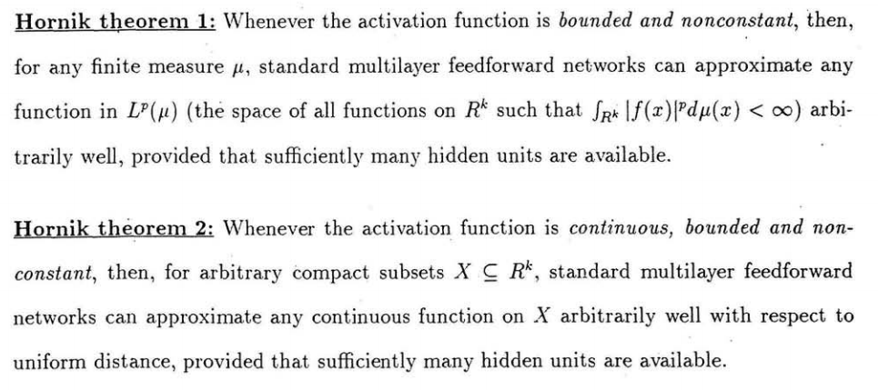
Universal Function Approximation Theorem
In words: Given any continuous function f(x), if a 2-layer neural network has enough hidden units, then there is a choice of weights that allow it to closely approximate f(x)
Cybenko (1989) “Approximations by superpositions of sigmoidal functions”
Hornik (1991) “Approximation Capabilities of Multilayer Feedforward Networks”
Leshno and Schocken (1991) ”Multilayer Feedforward Networks with Non-Polynomial Activation Functions Can Approximate Any Function”

Slide 25
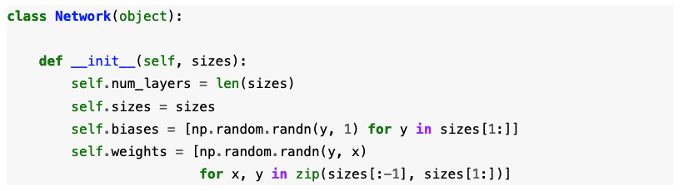
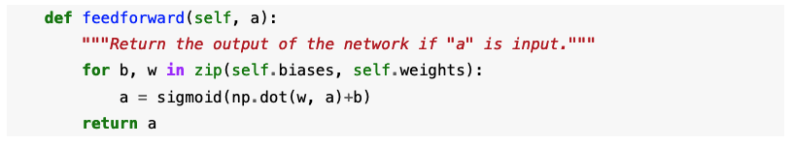
Defining a neural net with Numpy
http://neuralnetworksanddeeplearning.com/

Slide 26
Gradient decent for a full network
Step1: compute the loss gradient with respect to $z^{3}$
  $\frac{∂loss}{∂z^{3}}=\frac{∂loss}{∂g\left(z^{3}\right)}⋅\frac{∂g\left(z^{3}\right)}{∂z^{3}}$
  For $g$=sigmoid and loss = squared:
  $\frac{∂loss}{∂z^{3}}=\left[\frac{1}{1+e^{−z^{3}}}−y\right]\frac{1}{1+e^{−z^{3}}}\left(1−\frac{1}{1+e^{−z^{3}}}\right)$
$$z^{2}$$
$$w^{1}$$
$$z^{1}$$
$$w^{2}$$
$$b$$
$$x_{1}$$
$$b$$
$$w^{3}$$
$$x_{2}$$
$$b$$
$$z^{3}$$
$$b$$
$$b$$
$$x_{4}$$
$$b$$
$$x_{5}$$
$$b$$
$$b$$

Slide 27
Gradient decent for a full network
Step1: compute the loss gradient with respect to $z^{3}$
  $\frac{∂loss}{∂z^{3}}=\frac{∂loss}{∂g\left(z^{3}\right)}⋅\frac{∂g\left(z^{3}\right)}{∂z^{3}}$
  For $g$=sigmoid and loss = squared:
  $\frac{∂loss}{∂z^{3}}=\left[\frac{1}{1+e^{−z^{3}}}−y\right]\frac{1}{1+e^{−z^{3}}}\left(1−\frac{1}{1+e^{−z^{3}}}\right)$
$$z^{2}$$
$$w^{1}$$
$$z^{1}$$
$$w^{2}$$
$$b$$
$$x_{1}$$
$$b$$
$$w^{3}$$
$$x_{2}$$
$$b$$
$$z^{3}$$
$$b$$
$$b$$
$$x_{4}$$
$$b$$
$$x_{5}$$
$$b$$
$$b$$

Slide 28
Gradient decent for a full network
Step1: compute the loss gradient with respect to $z^{3}$
  $\frac{∂loss}{∂z^{3}}=\frac{∂loss}{∂g\left(z^{3}\right)}⋅\frac{∂g\left(z^{3}\right)}{∂z^{3}}$
  For $g$=sigmoid and loss = squared:
  $\frac{∂loss}{∂z^{3}}=\left[\frac{1}{1+e^{−z^{3}}}−y\right]\frac{1}{1+e^{−z^{3}}}\left(1−\frac{1}{1+e^{−z^{3}}}\right)$
$$z^{2}$$
$$w^{1}$$
$$z^{1}$$
$$w^{2}$$
$$b$$
$$x_{1}$$
$$b$$
$$w^{3}$$
$$x_{2}$$
$$b$$
$$z^{3}$$
$$b$$
$$b$$
$$x_{4}$$
$$b$$
$$x_{5}$$
$$b$$
$$b$$

Slide 29
Gradient decent for a full network
Step1: compute the loss gradient with respect to $z^{3}$
  $\frac{∂loss}{∂z^{3}}=\frac{∂loss}{∂g\left(z^{3}\right)}⋅\frac{∂g\left(z^{3}\right)}{∂z^{3}}$
  For $g$=sigmoid and loss = squared:
  $\frac{∂loss}{∂z^{3}}=\left[\frac{1}{1+e^{−z^{3}}}−y\right]\frac{1}{1+e^{−z^{3}}}\left(1−\frac{1}{1+e^{−z^{3}}}\right)$
Step2: Compute the loss gradient with respect to $w^{3}$ and $b^{3}$
  $\frac{∂loss}{∂w^{3}}=\frac{∂loss}{∂z^{3}}⋅\frac{∂z^{3}}{∂w^{3}}=\frac{∂loss}{∂z^{3}}⋅{\left[g\left(z^{2}\right)\right]}^{}$
  $\frac{∂loss}{∂b^{3}}=\frac{∂loss}{∂z^{3}}⋅\frac{∂z^{3}}{∂b^{3}}=\frac{∂loss}{∂z^{3}}⋅1$
$$z^{2}$$
$$w^{1}$$
$$z^{1}$$
$$w^{2}$$
$$b$$
$$x_{1}$$
$$b$$
$$w^{3}$$
$$x_{2}$$
$$b$$
$$z^{3}$$
$$b$$
$$b$$
$$x_{4}$$
$$b$$
$$x_{5}$$
$$b$$
$$b$$

Slide 30
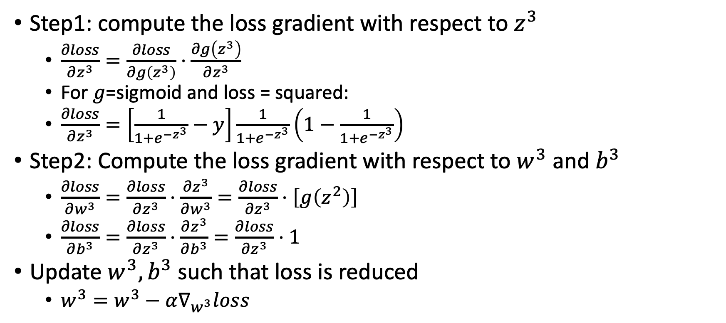
Gradient decent for a full network
Step1: compute the loss gradient with respect to $z^{3}$
  $\frac{∂loss}{∂z^{3}}=\frac{∂loss}{∂g\left(z^{3}\right)}⋅\frac{∂g\left(z^{3}\right)}{∂z^{3}}$
  For $g$=sigmoid and loss = squared:
  $\frac{∂loss}{∂z^{3}}=\left[\frac{1}{1+e^{−z^{3}}}−y\right]\frac{1}{1+e^{−z^{3}}}\left(1−\frac{1}{1+e^{−z^{3}}}\right)$
Step2: Compute the loss gradient with respect to $w^{3}$ and $b^{3}$
  $\frac{∂loss}{∂w^{3}}=\frac{∂loss}{∂z^{3}}⋅\frac{∂z^{3}}{∂w^{3}}=\frac{∂loss}{∂z^{3}}⋅{\left[g\left(z^{2}\right)\right]}^{}$
  $\frac{∂loss}{∂b^{3}}=\frac{∂loss}{∂z^{3}}⋅\frac{∂z^{3}}{∂b^{3}}=\frac{∂loss}{∂z^{3}}⋅1$
Update $w^{3},b^{3}$ such that loss is reduced
  $w^{3}=w^{3}−α∇_{w^{3}}loss$
$$z^{2}$$
$$w^{1}$$
$$z^{1}$$
$$w^{2}$$
$$b$$
$$x_{1}$$
$$b$$
$$w^{3}$$
$$x_{2}$$
$$b$$
$$z^{3}$$
$$b$$
$$b$$
$$x_{4}$$
$$b$$
$$x_{5}$$
$$b$$
$$b$$

Slide 31
Gradient decent for a full network
Next: compute the loss gradient with respect to $z^{2}$
  $\frac{∂loss}{∂z^{2}}=\frac{∂loss}{∂g\left(z^{3}\right)}⋅\frac{∂g\left(z^{3}\right)}{∂z^{3}}⋅\frac{∂z^{3}}{∂g\left(z^{2}\right)}⋅\frac{∂g\left(z^{2}\right)}{∂z^{2}}$
$$z^{2}$$
$$w^{1}$$
$$z^{1}$$
$$w^{2}$$
$$b$$
$$x_{1}$$
$$b$$
$$w^{3}$$
$$x_{2}$$
$$b$$
$$z^{3}$$
$$b$$
$$b$$
$$x_{4}$$
$$b$$
$$x_{5}$$
$$b$$
$$b$$

Slide 32
Gradient decent for a full network
Next: compute the loss gradient with respect to $z^{2}$
  $\frac{∂loss}{∂z^{2}}=\frac{∂loss}{∂g\left(z^{3}\right)}⋅\frac{∂g\left(z^{3}\right)}{∂z^{3}}⋅\frac{∂z^{3}}{∂g\left(z^{2}\right)}⋅\frac{∂g\left(z^{2}\right)}{∂z^{2}}$
We know this!
We computed it in the previous step
$$=\frac{∂loss}{∂z^{3}}$$
$$z^{2}$$
$$w^{1}$$
$$z^{1}$$
$$w^{2}$$
$$b$$
$$x_{1}$$
$$b$$
$$w^{3}$$
$$x_{2}$$
$$b$$
$$z^{3}$$
$$b$$
$$b$$
$$x_{4}$$
$$b$$
$$x_{5}$$
$$b$$
$$b$$

Slide 33
Gradient decent for a full network
Next: compute the loss gradient with respect to $z^{2}$
  $\frac{∂loss}{∂z^{2}}=\frac{∂loss}{∂z^{3}}⋅\frac{∂z^{3}}{∂g\left(z^{2}\right)}⋅\frac{∂g\left(z^{2}\right)}{∂z^{2}}$
We know this!
We computed it in the previous step
$$=\frac{∂loss}{∂z^{3}}$$
$$z^{2}$$
$$w^{1}$$
$$z^{1}$$
$$w^{2}$$
$$b$$
$$x_{1}$$
$$b$$
$$w^{3}$$
$$x_{2}$$
$$b$$
$$z^{3}$$
$$b$$
$$b$$
$$x_{4}$$
$$b$$
$$x_{5}$$
$$b$$
$$b$$

Slide 34
Gradient decent for a full network
In general: compute the loss gradient with respect to $z^{i}$
  $\frac{∂loss}{∂z^{i}}=\frac{∂loss}{∂z^{i+1}}⋅\frac{∂z^{i+1}}{∂g(z^{i})}⋅\frac{∂g\left(z^{i}\right)}{∂z^{i}}$
We know this!
We computed it in the previous step
$$=\frac{∂loss}{∂z^{i+1}}$$
$$z^{2}$$
$$w^{1}$$
$$z^{1}$$
$$w^{2}$$
$$b$$
$$x_{1}$$
$$b$$
$$w^{3}$$
$$x_{2}$$
$$b$$
$$z^{3}$$
$$b$$
$$b$$
$$x_{4}$$
$$b$$
$$x_{5}$$
$$b$$
$$b$$

Slide 35
Back propagation
In general: compute the loss gradient with respect to $z^{i}$
  $\frac{∂loss}{∂z^{i}}=\frac{∂loss}{∂z^{i+1}}⋅\frac{∂z^{i+1}}{∂g(z^{i})}⋅\frac{∂g\left(z^{i}\right)}{∂z^{i}}$
Compute the loss gradient with respect to $w^{i}$ and $b^{i}$
  $\frac{∂loss}{∂w^{i}}=\frac{∂loss}{∂z^{i}}⋅\frac{∂z^{i}}{∂w^{i}}=\frac{∂loss}{∂z^{i}}⋅g\left(z^{i−1}\right)$
  $\frac{∂loss}{∂b^{i}}=\frac{∂loss}{∂z^{i}}⋅\frac{∂z^{i}}{∂b^{i}}=\frac{∂loss}{∂z^{i}}⋅1$
Later: update $w,b$ such that loss is reduced
  $w^{i}=w^{i}−α∇_{w^{i}}loss$
$$z^{2}$$
$$w^{1}$$
$$z^{1}$$
$$w^{2}$$
$$b$$
$$x_{1}$$
$$b$$
$$w^{3}$$
$$x_{2}$$
$$b$$
$$z^{3}$$
$$b$$
$$b$$
$$x_{4}$$
$$b$$
$$x_{5}$$
$$b$$
$$b$$

Slide 36
Numerical example
$$x^{1}$$
$$x^{2}$$
$$x^{3}$$
One training sample: $x={\left[1,2,3\right]}^{⊤} y=20$
Network = $\left[3,4,1\right]$ // [input, hidden layer, output]
Hidden layer uses a ReLU activation function
Init: $w^{1}=\left[\begin{aligned}1 \\ 1 \\ 1 \\ 1\end{aligned} \begin{aligned}1 \\ 1 \\ 1 \\ 1\end{aligned} \begin{aligned}1 \\ 1 \\ 1 \\ 1\end{aligned}\right]$ $b^{1}=\left[\begin{aligned}0 \\ 0 \\ 0 \\ 0\end{aligned}\right]$ $w^{2}=\left[\begin{aligned}1 \\ 1 \\ 1 \\ 1\end{aligned}\right]$
$\hat{y}=z^{2}=g{\left(w^{1}x+b^{1}\right)}^{⊤}w^{2}=g\left(\left[6 6 6 6\right]\right){⋅w}^{2}=24$
Squared loss = ${0.5\left(y−\hat{y}\right)}^{2}=8$
Uniform values are a bad idea in general

Slide 37
Numerical example
$$x^{1}$$
$$x^{2}$$
$$x^{3}$$
Init: $w^{1}=\left[\begin{aligned}1 \\ 1 \\ 1 \\ 1\end{aligned} \begin{aligned}1 \\ 1 \\ 1 \\ 1\end{aligned} \begin{aligned}1 \\ 1 \\ 1 \\ 1\end{aligned}\right]$ $b^{1}=\left[\begin{aligned}0 \\ 0 \\ 0 \\ 0\end{aligned}\right]w^{2}=\left[\begin{aligned}1 \\ 1 \\ 1 \\ 1\end{aligned}\right]$
$\hat{y}=g{\left(w^{1}x+b^{1}\right)}^{⊤}w^{2}=g\left(\left[6 6 6 6\right]\right)w^{2}=24$
Squared loss = ${0.5\left(y−z^{2}\right)}^{2}=8$, $\frac{∂loss}{∂z^{2}}=−1⋅\left(20−24\right)=4$
$\frac{∂loss}{∂w^{2}}=\frac{∂loss}{∂z^{2}}⋅\frac{∂z^{2}}{∂w^{2}}=4⋅g\left(z^{1}\right)=\left[24 24 24 24 \right]$
$\frac{∂loss}{∂z^{1}}=\frac{∂loss}{∂z^{2}}⋅\frac{∂z^{2}}{∂g\left(z^{1}\right)}⋅\frac{∂g\left(z^{1}\right)}{∂z^{1}}=4⋅w^{2}⊙\left[1 1 1 1\right]=\left[4 4 4 4\right]$
$\frac{∂loss}{∂w^{1}}=\text{For} \text{each} \text{row} i \left[\frac{∂loss}{∂z_{i}^{1}}⋅\frac{∂z_{i}^{1}}{∂w_{i}^{1}}\right]=\left[4x 4x 4x 4x\right]$
For all $i$, $z_{i}^{1}>0$
Hadamard-product
3 by 4 matrix

Slide 38
Numerical example
$$x^{1}$$
$$x^{2}$$
$$x^{3}$$
One training sample: $x={\left[1,2,3\right]}^{⊤} y=20$
In order to reduce the loss $0.5{\left(y−\hat{y}\right)}^{2}={0.5\left(20−24\right)}^{2}=8$
Update: $w=w−α∇_{w}loss$
$w^{2}=\left[1 1 1 1\right]−0.01\left[24 24 24 24 \right]=\left[0.76 0.76 0.76 0.76\right]$
$w^{1}=\left[\begin{aligned}1 \\ 1 \\ 1 \\ 1\end{aligned} \begin{aligned}1 \\ 1 \\ 1 \\ 1\end{aligned} \begin{aligned}1 \\ 1 \\ 1 \\ 1\end{aligned}\right]−0.01\left[\begin{aligned}4 \\ 4 \\ 4 \\ 4\end{aligned} \begin{aligned}8 \\ 8 \\ 8 \\ 8\end{aligned} \begin{aligned}12 \\ 12 \\ 12 \\ 12\end{aligned}\right]=\left[\begin{aligned}0.96 \\ 0.96 \\ 0.96 \\ 0.96\end{aligned} \begin{aligned}0.92 \\ 0.92 \\ 0.92 \\ 0.92\end{aligned} \begin{aligned}0.88 \\ 0.88 \\ 0.88 \\ 0.88\end{aligned}\right]$
After update:
  $\hat{y}=g\left(xw^{1}+b^{1}\right)w^{2}=g\left({\left[5.44 5.44 5.44 5.44\right]}^{⊤}\right)w^{2}=16.54$
  New loss ${0.5\left(y−\hat{y}\right)}^{2}={0.5\left(20−16.54\right)}^{2}=6$

Slide 39
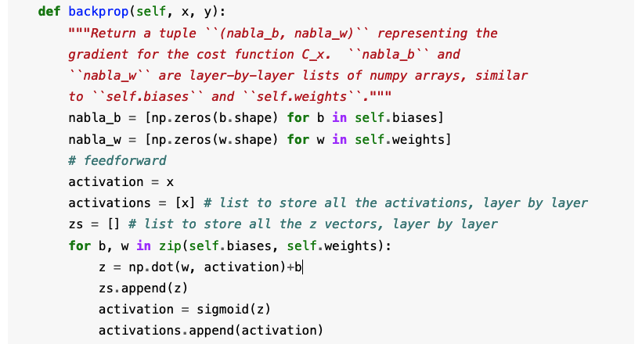
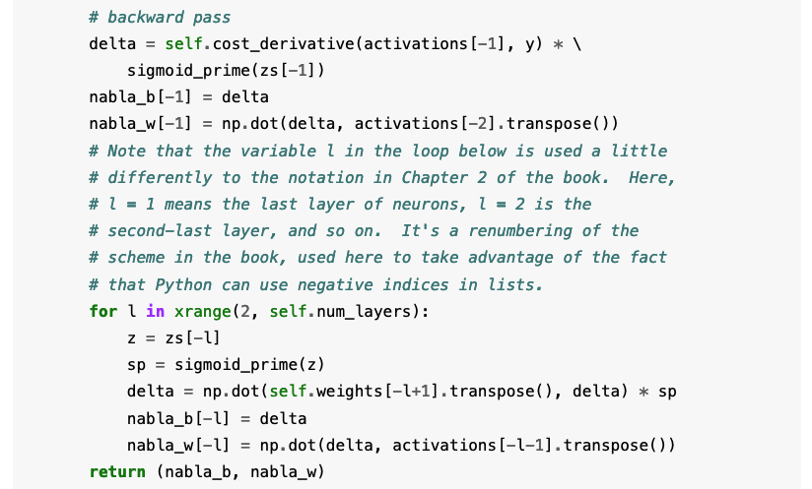
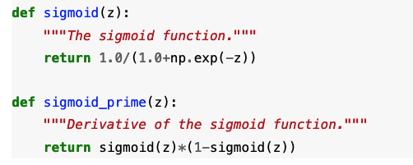
http://neuralnetworksanddeeplearning.com/

Slide 40
Activation functions
Each layer can be assigned a different activation function
The output layer should be assigned an activation that is appropriate to the desired output range (can be linear)
What is the appropriate activation:
  If output represents probability?
  If output represents steering control from [-1,1]?
  If output represents a Q value?

Slide 41
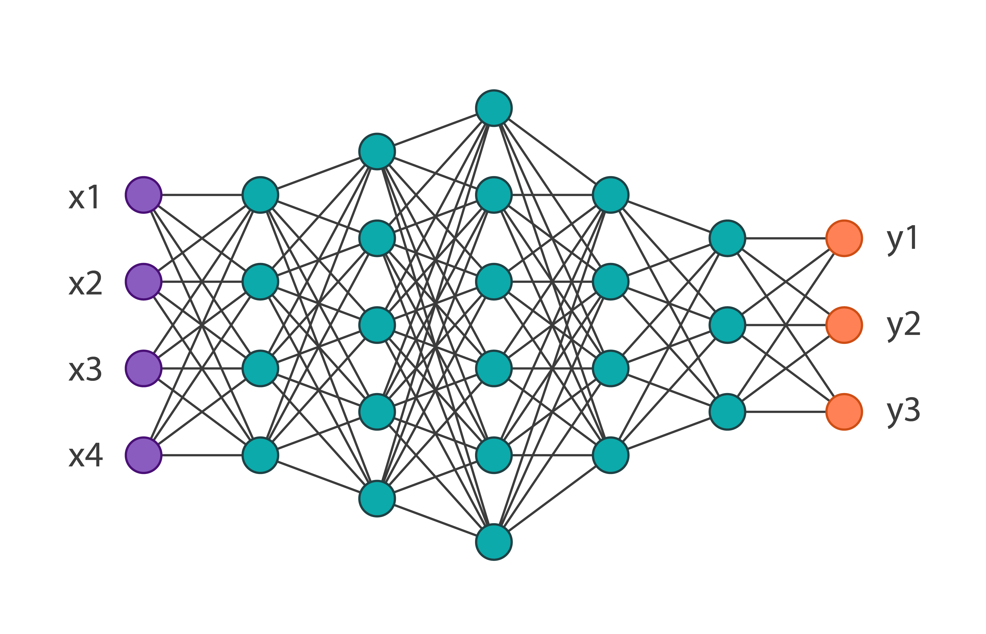
Output vector
Neural nets can be generalized to produce an output vector
For instance, it is generally more efficient (why?) to assign an output value for each class in a multi-class classification task
  What activation function should we use at the final layer?
    Sigmoid, TanH, Relu, Softmax
  What loss function should we use?

Slide 42
Common loss functions
Regression Loss Functions
  When required to fit a continuous function
    Absolute Error Loss
    Squared Error Loss
    Huber Loss
Multi-class Classification Loss Functions
  When required to predict one of many classes
    Cross Entropy Loss (usually over a Softmax activation for the output layer)
Distribution approximation
  When required to fit a distribution
    Kullback-Liebler (KL) Divergence

Slide 43

Squared Error Loss
also known as L2 Loss, is the square of the difference between the actual and the predicted values
The Squared Error loss function penalizes the model for making large errors by squaring them
Change in loss grows with the prediction error i.e., $\frac{dL}{df(x)}$ grows with $\left(f\left(x\right)−y\right)$
This property makes the Squared Error Loss function less robust to outliers. Therefore, it should not be used if our data is prone to many outliers

Slide 44

Absolute Error Loss
Also known as the L1 loss
More robust to outliers as compared to Squared Error Loss
Not differentiable at x=0
The derivative is not continuous around zero which is problematic for convergence

Slide 45
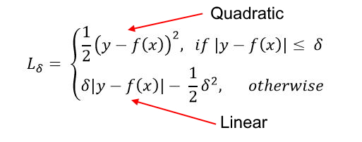
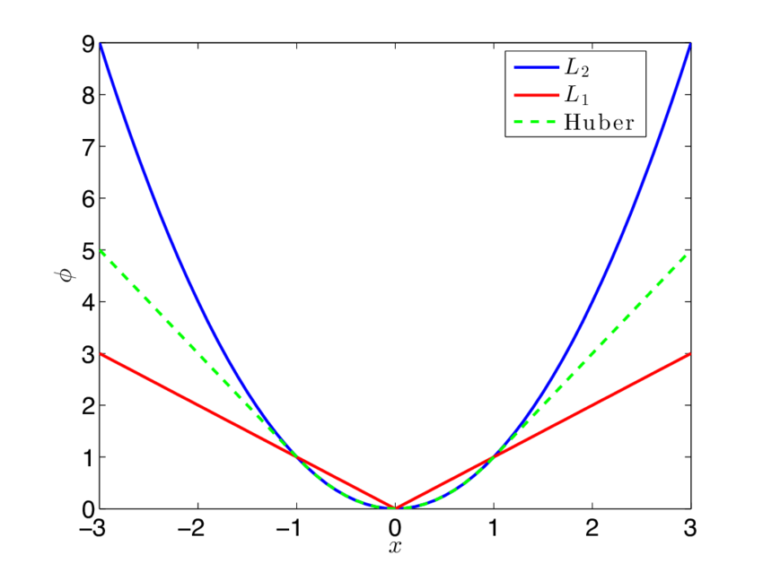
Huber Loss
Quadratic for smaller errors and linear otherwise
Requires tuning of the delta hyper-parameter
More robust to outliers as compared to Squared Error Loss
Differentiable and continuous

Slide 46
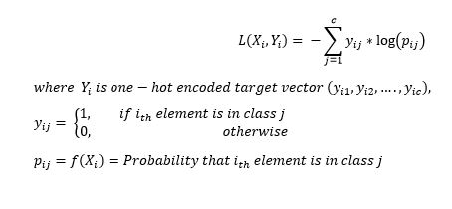
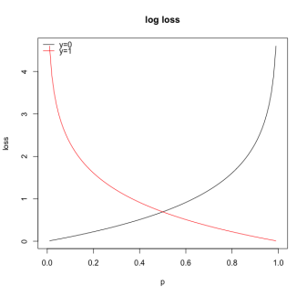
Cross Entropy Loss
also called Log-Loss
Penalizes large errors in predicted distribution
Goes in tandem with the softmax function

Slide 47
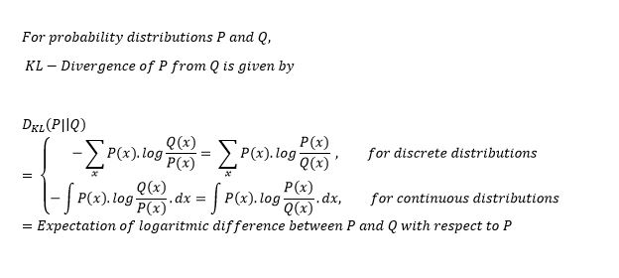
Kullback-Liebler (KL) Divergence
Measures similarity between two distributions
A KL-divergence of zero indicates that the distributions are identical
Relative entropy of P with respect to Q, $D_{KL}(P∥Q)≢D_{KL}(Q∥P)$
Measuring dissimilarity (not distance) between two soft policies

Slide 48
Overfitting
We can now define a neural network with non-linear activation and set an appropriate loss function
We know how to compute the gradient of the loss with respect to the tunable parameters
Can we perform successive gradient decent steps until loss=0 ?
  Universal Function Approximation Theorem tells us that it is possible to reach loss=0
  However, parameter assignment space is nonconvex with respect to the loss
  We might converge on a local optimum
  In any case, that is probably not a good idea. Doing so usually implies memorizing the training data (overfitting). In such cases predicting unseen observations is usually inaccurate

Slide 49
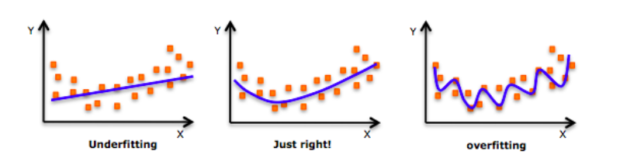
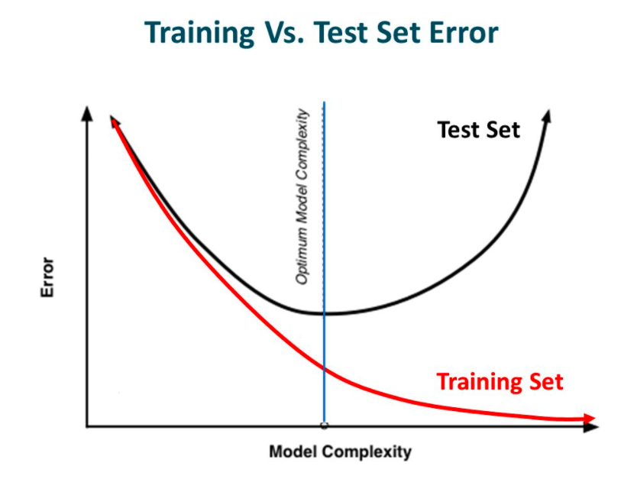
Regularization
Early stopping
Penalize complex model
  Add model complexity penalty to the loss function
    L1 regularization
    L2 regularization
Enforce model simplicity
  Dropout

Slide 50
Early stopping
Usually, more training = higher accuracy on training set
At some point the model starts memorizing the training examples
In order to avoid such overfitting
  Keep track of test set accuracy
  Stop training when it declines

Slide 51
L1 & L2 regularization
Assumes that a neural network with a smaller weight norm leads to simpler models
Therefore, it will also reduce overfitting
Add model complexity penalty to the loss function
$penalty_{L1}=\frac{λ}{2n}\sum_{W}{\left|w\right|}$ , $penalty_{L2}=\frac{λ}{2n}{\sum_{W}{w}}^{2}$
  $λ>0$ is the regularization parameter, $n$ is the size of the training set, $W$ is the set of all weights in the network
How will adding these penalties affect the weight gradient?
*L2 regularization has a deeper theoretical meaning which we won’t cover

Slide 52
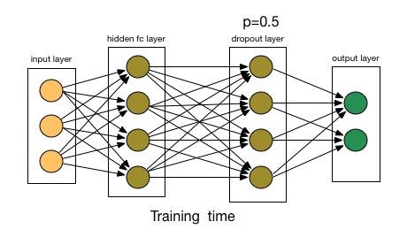
Dropout
Common regularization technique (these days)
At every iteration, randomly (and temporarily) remove some nodes along with their incoming and outgoing connections
  Train a minibatch of observation on the augmented network
Each iteration trains a different subset of the network
Dropout probability is a hyper parameter

Slide 53
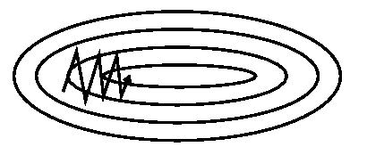
Adaptive learning rates
SGD has trouble navigating ravines, i.e., areas where the surface curves much more steeply in one dimension than in another, which are common around local optima
In these scenarios, SGD oscillates across the slopes of the ravine while only making hesitant progress along the bottom towards the local optimum

Slide 54
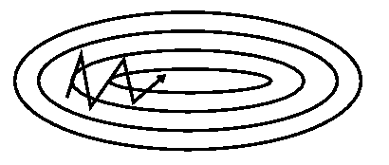
Momentum
Keep an exponential weighted average of the gradient over successive iterations
  $v_{t}=βv_{t−1}+\left(1−β\right)∇_{θ}loss$
Update the model using SGD towards ${−v}_{t}$
  $θ=θ−αv_{t}$

Slide 55
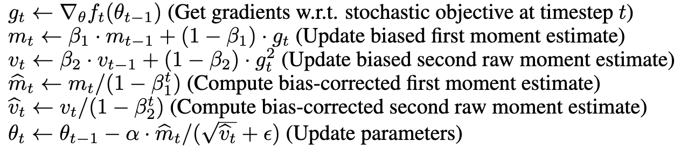
Adaptive Moment Estimation (ADAM)
Keeps an exponentially decaying average of past gradients, as in vanilla momentum
Keeps an exponentially decaying average of past squared gradients
Computes adaptive learning rates for each parameter
  Invariant to the magnitude of the gradient, which helps a lot when going through areas with tiny gradients
Commonly used these days

Slide 56
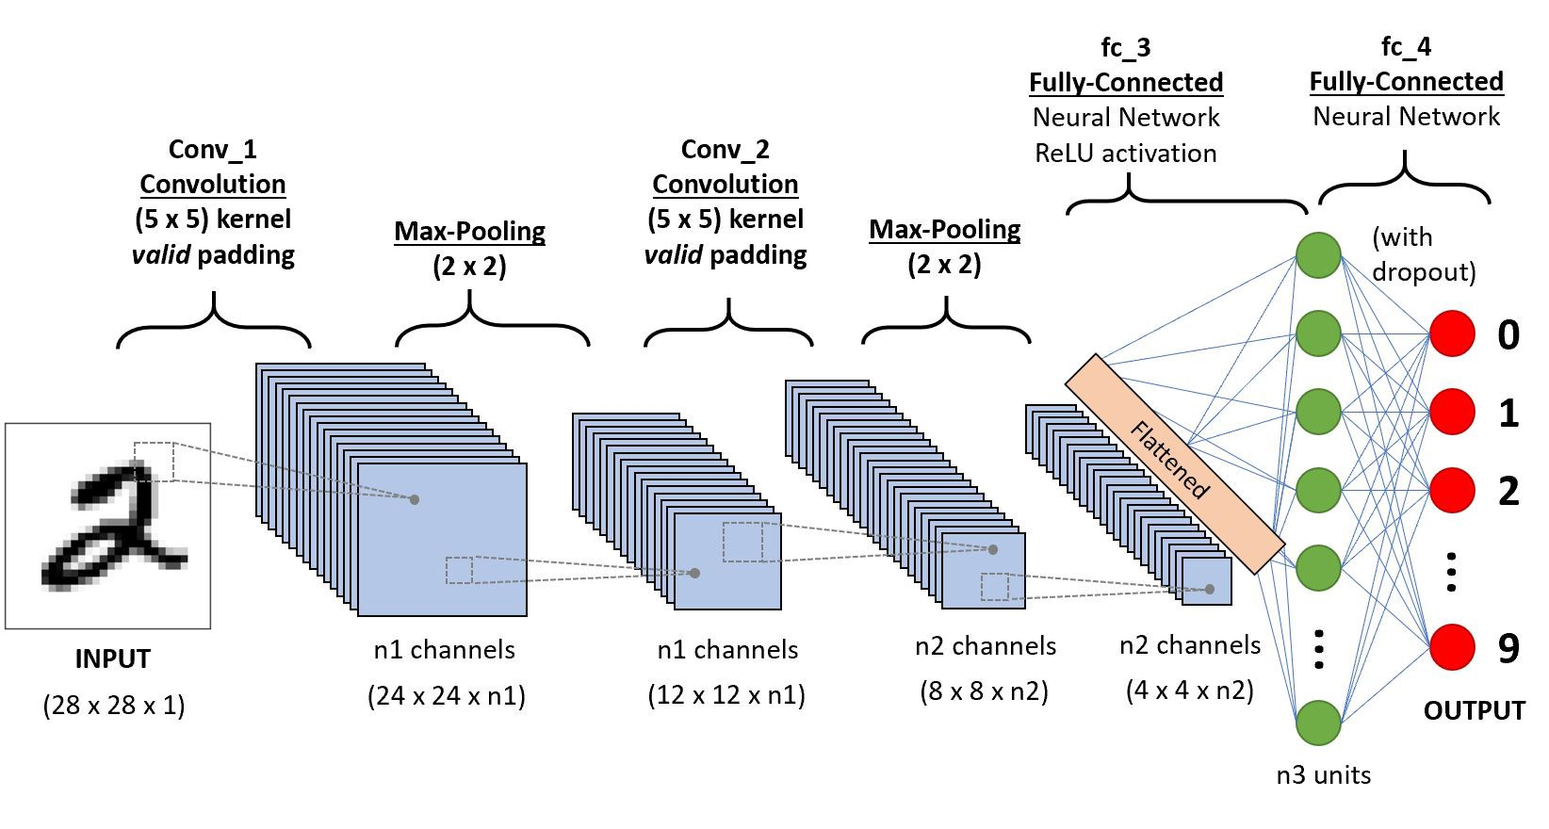
Conv layers
Spatial structure can be inferred for some inputs (e.g., images)
We would like to take advantage of the spatial structure in such cases
CNN use three basic ideas: local receptive fields, shared weights, and pooling
Image credit: towardsdatascience.com

Slide 57
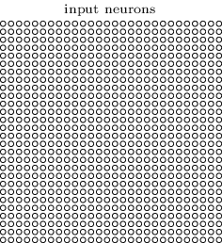
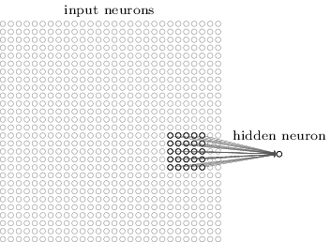
Local receptive fields
Instead of connecting all inputs to every hidden neuron at $l1$, connect only a subset of spatially connected input neurons
That region in the input image is called the local receptive field for the hidden neuron
You can think of that particular hidden neuron as learning to analyze its particular local receptive field
Image/text credit: http://neuralnetworksanddeeplearning.com/

Slide 58
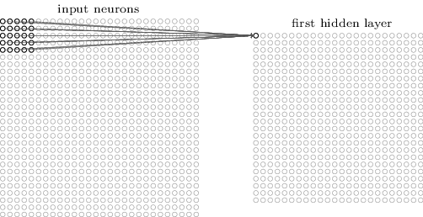
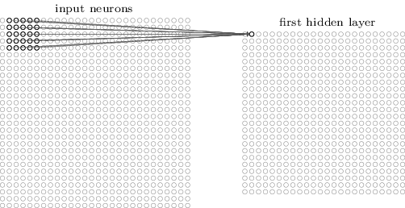
Local receptive fields
Start with a local receptive field in the top-left corner
Then slide the local receptive field over by one pixel
if we have a 28×28 input image, and 5×5 local receptive fields, then there will be 24×24 neurons in the hidden layer
Image/text credit: http://neuralnetworksanddeeplearning.com/

Slide 59
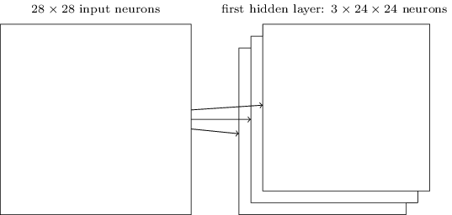
Shared weights and biases
Use the same weights and bias for each hidden neuron in the conv layer
This means that all the neurons in the first hidden layer detect the same feature
What if we want to identify more than one feature?
  Affiliate each local receptive field with n hidden neurons (channels)
  Each feature has its own shared weights and biases across all local fields
3 channels
Image/text credit: http://neuralnetworksanddeeplearning.com/

Slide 60
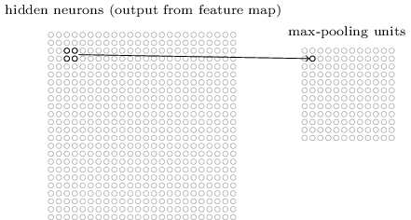
Pooling layers
Pooling layers are usually used immediately after convolutional layers
Creates a condensed feature map
E.g., max-pooling outputs the maximum activation in an input region
Image/text credit: http://neuralnetworksanddeeplearning.com/

Slide 61
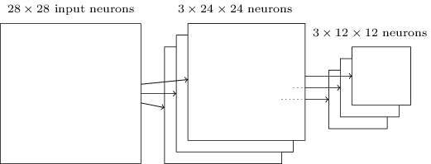
Pooling layers
We apply pooling to each feature map separately
Finally, don’t forget to add at least one fully connected layer
Image/text credit: http://neuralnetworksanddeeplearning.com/

Slide 62
Keras (Python library based on TensorFlow)
Create a CNN with 5 hidden layers:
32 channels (hidden features) over 3×3 local receptive fields that slide 1 pixel from each other in each direction.
A second conv layer connected to the first one. Further extraction of local features.
Pooling layer with dropout regularization
A fully connected layer with dropout regulation
Finally a softmax layer
The loss function is defined to be the cross-entropy loss. The SGD optimizer is ADAM. The matric for evaluation is total accuracy on the test set.
model = Sequential()
model.add(Conv2D(32, kernel_size=(3, 3), strides=(1, 1)
activation='relu',
input_shape=input_shape))
model.add(Conv2D(64, (3, 3), activation='relu'))
model.add(MaxPooling2D(pool_size=(2, 2)))
model.add(Dropout(0.25))
model.add(Flatten())
model.add(Dense(128, activation='relu'))
model.add(Dropout(0.5))
model.add(Dense(num_classes, activation='softmax'))
model.compile(loss=keras.losses.categorical_crossentropy,
optimizer=keras.optimizers.Adam(),
metrics=['accuracy'])

Slide 63
Keras: train
model.fit(x_train, y_train,
batch_size=batch_size,
epochs=epochs,
validation_data=(x_test, y_test))
Predication:
model.predict(x)
model.predict_on_batch(x)

Slide 64
Pytorch
class ConvNet(nn.Module):
def __init__(self):
super(ConvNet, self).__init__()
self.layer1 = nn.Sequential(
nn.Conv2d(1, 32, kernel_size=5, stride=1, padding=2),
nn.ReLU(),
nn.MaxPool2d(kernel_size=2, stride=2))
self.layer2 = nn.Sequential(
nn.Conv2d(32, 64, kernel_size=5, stride=1, padding=2),
nn.ReLU(),
nn.MaxPool2d(kernel_size=2, stride=2))
self.drop_out = nn.Dropout(0.5)
self.fc1 = nn.Linear(7 * 7 * 64, 1000)
self.fc2 = nn.Linear(1000, 10)
Conv1: 1 input channel (the image), 32 output channels (unique local features), 5x5 conv filters, padding =2 such that the output will be 28x28, ReLU activation, max pool layer over 2x2 kernels.
Conv2: similar to conv1 with 32 input channels and 64 output channels each is a 7x7 feature matrix.
Drop_out: dropout regularization. Removes every value in a specific layer with 0.5 probability when applied.
Fully connected (fc1): 7*7*64 input size and 1000 output size. (fc2 is similar)

Slide 65
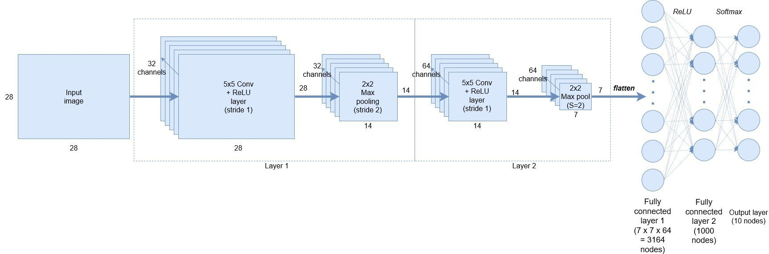
Pytorch: connect the layers (also your prediction function)
def forward(self, x):
out = self.layer1(x)
out = self.layer2(out)
out = out.reshape(out.size(0), -1)
out = self.drop_out(out)
out = self.fc1(out)
out = self.fc2(out)
return out
Define the data flow along the network:
conv1 -> max pool 1 -> conv2 -> max pool 2 -> flatten 64*7*7 -> 1 vector -> drop some values (to avoid overfitting) -> 2 fully connected layers.

Slide 66
Pytorch: train
model = ConvNet()
# Loss and optimizer
criterion = nn.CrossEntropyLoss()
optimizer = torch.optim.Adam(model.parameters(), lr=learning_rate)
# Run the forward pass
outputs = model(images)
loss = criterion(outputs, labels)
# Backprop and perform Adam optimisation
optimizer.zero_grad()
loss.backward()
optimizer.step()
the CrossEntropyLoss function combines both a SoftMax activation with the log loss function. Set the Adam optimizer over all tunable parameters.
Get the outputs for a batch of images and compute the loss with respect to the labels.
Next, init all gradients to zero, compute new gradients (backpropagate), update parameters based on new gradients.

Slide 67
Chat-GPT
Certainly! Below is an example of a simple Convolutional Neural Network (CNN) defined using PyTorch. This CNN consists of three convolutional layers followed by two fully connected layers. It's a basic architecture that you can further customize based on your specific task and dataset.
```python
import torch
import torch.nn as nn
class SimpleCNN(nn.Module):
def __init__(self, num_classes):
super(SimpleCNN, self).__init__()
# First Convolutional Layer
self.conv1 = nn.Conv2d(in_channels=3, out_channels=16, kernel_size=3, stride=1, padding=1)
self.relu1 = nn.ReLU()
self.pool1 = nn.MaxPool2d(kernel_size=2, stride=2)
# Second Convolutional Layer
self.conv2 = nn.Conv2d(in_channels=16, out_channels=32, kernel_size=3, stride=1, padding=1)
self.relu2 = nn.ReLU()
self.pool2 = nn.MaxPool2d(kernel_size=2, stride=2)
# Third Convolutional Layer
self.conv3 = nn.Conv2d(in_channels=32, out_channels=64, kernel_size=3, stride=1, padding=1)
self.relu3 = nn.ReLU()
self.pool3 = nn.MaxPool2d(kernel_size=2, stride=2)
# Fully Connected Layers
self.fc1 = nn.Linear(64 * 4 * 4, 128) # Adjust input size based on your image dimensions
self.relu4 = nn.ReLU()
self.fc2 = nn.Linear(128, num_classes)
def forward(self, x):
x = self.pool1(self.relu1(self.conv1(x)))
x = self.pool2(self.relu2(self.conv2(x)))
x = self.pool3(self.relu3(self.conv3(x)))
x = x.view(x.size(0), -1) # Flatten the output for the fully connected layers
x = self.relu4(self.fc1(x))
x = self.fc2(x)
return x
# Create an instance of the SimpleCNN model
num_classes = 10 # Change this to the number of classes in your classification task
model = SimpleCNN(num_classes)
# Print the model architecture
print(model)
```
In this code, we define a `SimpleCNN` class with three convolutional layers, each followed by a ReLU activation and max-pooling operation. Then, there are two fully connected layers for classification. You should adapt the number of channels, kernel sizes, and fully connected layer sizes to match your specific problem. Additionally, adjust the input size of the first fully connected layer to match your image dimensions.
“Define a CNN using Pytorch”

Slide 68
Chat-GPT
To add an optimizer using the Cross Entropy Loss function and define a training function for the CNN, you can follow this example. We'll use the Adam optimizer and train the model on a sample dataset. Make sure you have a dataset and dataloaders for your specific task.
```python
import torch
import torch.nn as nn
import torch.optim as optim
# Define the CNN architecture as previously shown
class SimpleCNN(nn.Module):
# ... (same as before)
# Create an instance of the SimpleCNN model
num_classes = 10 # Change this to the number of classes in your dataset
model = SimpleCNN(num_classes)
# Define the loss function (CrossEntropyLoss) and optimizer (Adam)
criterion = nn.CrossEntropyLoss()
optimizer = optim.Adam(model.parameters(), lr=0.001) # You can adjust the learning rate as needed
# Define the training function
def train_model(model, train_loader, num_epochs):
for epoch in range(num_epochs):
model.train() # Set the model to training mode
running_loss = 0.0
for inputs, labels in train_loader:
optimizer.zero_grad() # Zero the gradients
# Forward pass
outputs = model(inputs)
# Compute the loss
loss = criterion(outputs, labels)
# Backpropagation and optimization
loss.backward()
optimizer.step()
running_loss += loss.item()
# Print the average loss for this epoch
print(f"Epoch {epoch+1}/{num_epochs}, Loss: {running_loss/len(train_loader)}")
# Example usage:
# Assuming you have a DataLoader named 'train_loader' and 'num_epochs' is the number of training epochs
# train_model(model, train_loader, num_epochs)
```
In this code, we added the loss function (`nn.CrossEntropyLoss()`) and defined the Adam optimizer (`optim.Adam()`) with a learning rate of 0.001. The `train_model` function takes the model, training data loader (`train_loader`), and the number of training epochs (`num_epochs`) as input and performs the training loop.
You should replace `'train_loader'` with your actual training data loader and specify the number of epochs based on your training requirements. After defining and running this training function, your CNN will be trained using the specified optimizer and loss function.
“Add an ADAM optimizer using the Cross Entropy Loss function. Define the training function.”

Slide 69
What did we cover?
DNN are nonlinear functions with many tunable parameters (weights and biases)
Using the backpropagation algorithm, we can easily compute the partial derivative in the approximation error (loss) w.r.t the tunable parameters (w,b)
Using (stochastic) gradient decent steps, we optimize our model such that the error is reduced (in expectancy)
DNN can approximate any continuous function to arbitrary precision
  Choose an appropriate loss function
  Avoid overfitting! Regulate
  Hyper parameter tuning: network’s structure (depth, width, convolution layers, pooling layers, fully connected layers), momentum, activation functions, Regularization technique.

