Slide 1
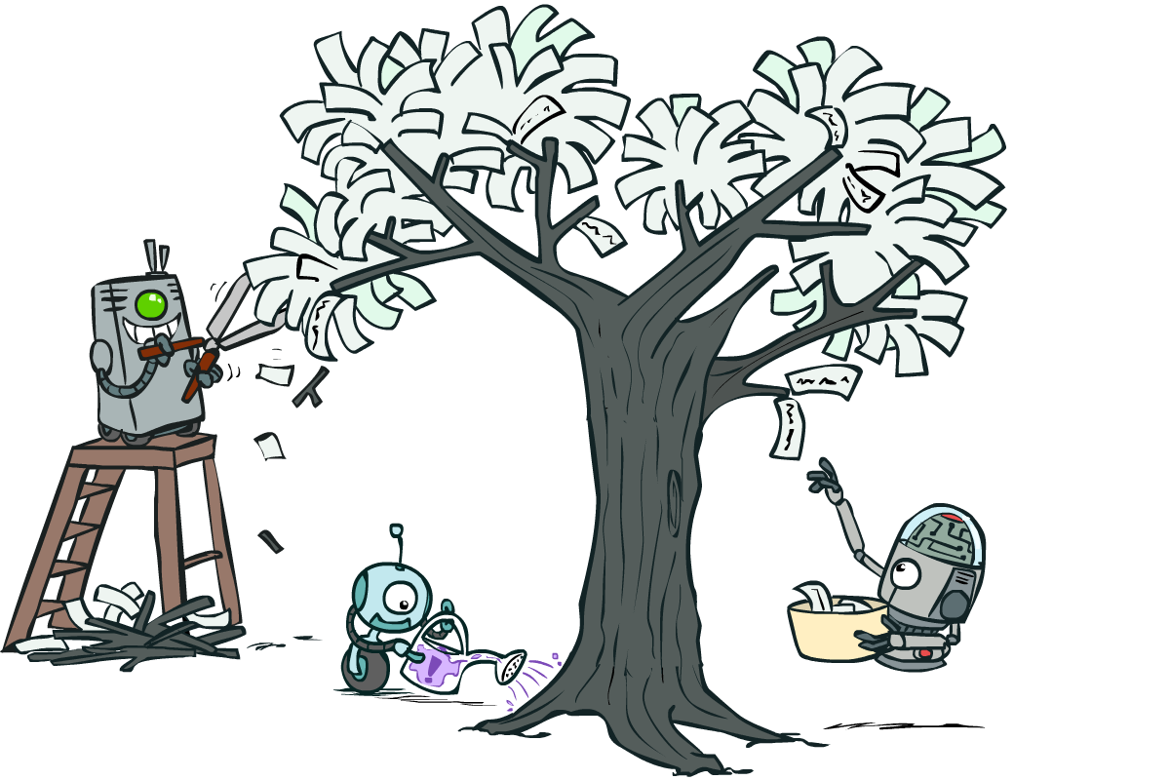
CSCE-420: Artificial Intelligence
Decision Trees
Instructor: Guni Sharon
Based on slides by: Pieter Abbeel, Dan Klein

Slide 2
Announcements
Assignment 4 – Bayes Nets and HMMs, due April 21, EoD
Quiz 11 - naïve Bayes, due April 23, EoD.
Quiz12: Decision Trees, due April 28, EoD.
Assignment 5: Machine Learning (Extra credit), due May 1, EoD
Contest 3: Multiagent Adversarial Pacman, due May 1, EoD
  You are encouraged to combine various AI tools
    Heuristic search for deterministic planning
    Adversarial search and game theory for modeling opponents
    MDPs for modeling uncertainties
    Reinforcement learning for solving MDPs
    Bayes nets for inference
    DNN as function approximators

Slide 3
Today
Formalizing Learning
  Consistency
  Simplicity
Decision Trees
  Expressiveness
  Information Gain
  Overfitting
K-Nearest Neighbors

Slide 4
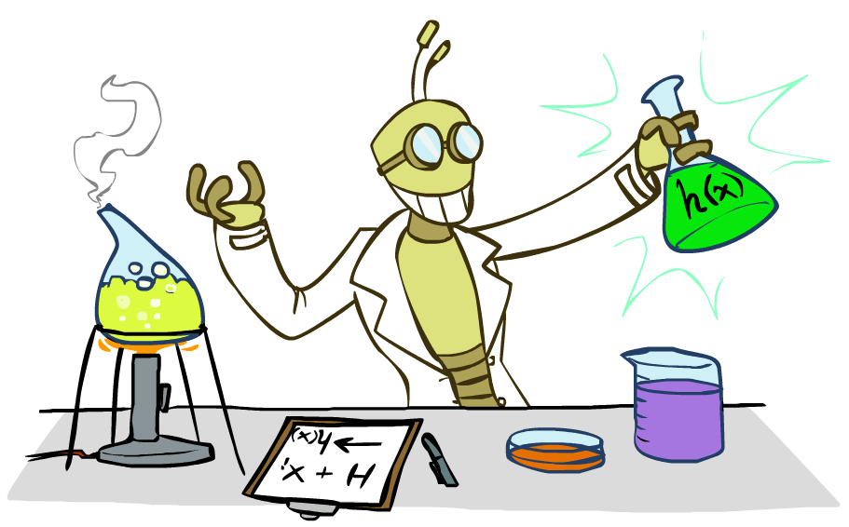
Supervised Learning

Slide 5
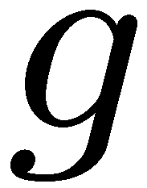


Supervised Learning
Simplest form: learn a function from examples
  A target function: g
  Examples: input-output pairs (x, g(x))
  E.g. x is an email and g(x) is spam / ham
  E.g. x is a house and g(x) is its selling price
Problem:
  Given a hypothesis space H
  Given a training set of examples x_{i}
  Find a hypothesis h(x) such that h ~ g
Includes:
  Classification (outputs = class labels)
  Regression (outputs = real numbers)
How does naïve Bayes fit in? (H, h, g)

Slide 6
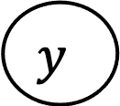
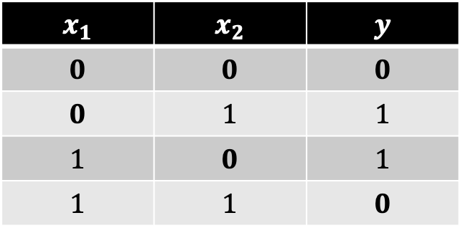
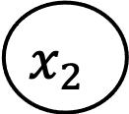
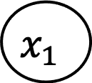
Supervised learning with Naïve Bayes
Given a training set composed of (x <features value>, y <label>)
Learns a correlation between each feature value and each label
Very limiting assumption of independency (limited H)
Train a Naïve Bayes model to output a XOR function…
$$y$$
$$x_{1}$$ | $$x_{2}$$ | $$y$$
$$0$$ | $$0$$ | $$0$$
$$0$$ | $$1$$ | $$1$$
$$1$$ | $$0$$ | $$1$$
$$1$$ | $$1$$ | $$0$$
$$x_{1}$$
$$x_{2}$$

Slide 7
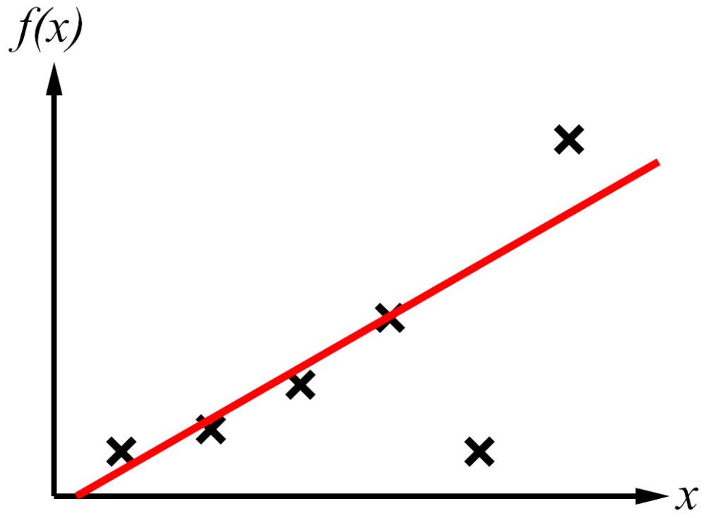
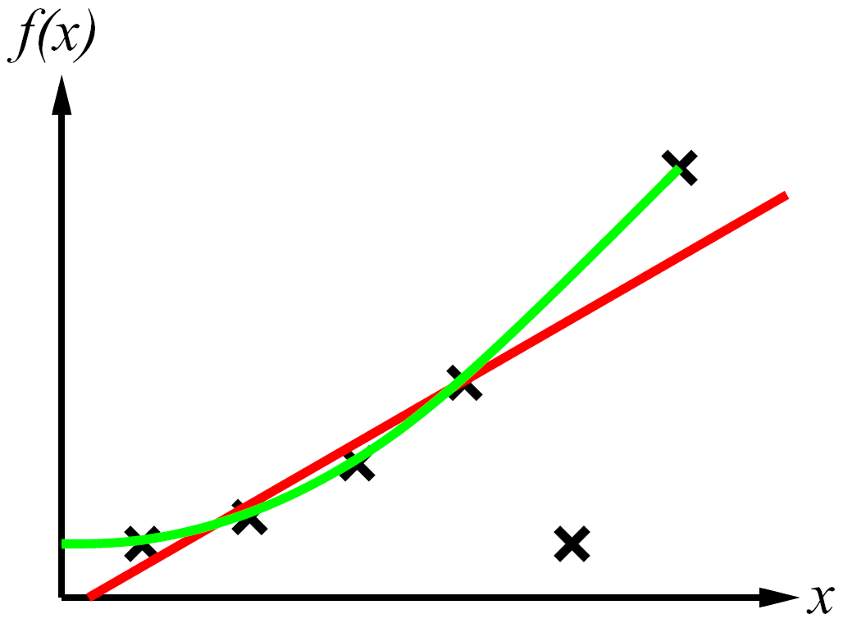
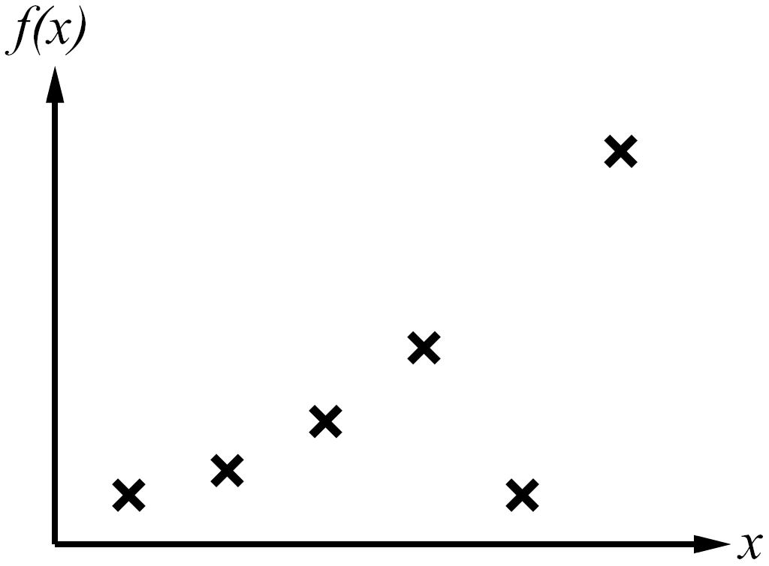
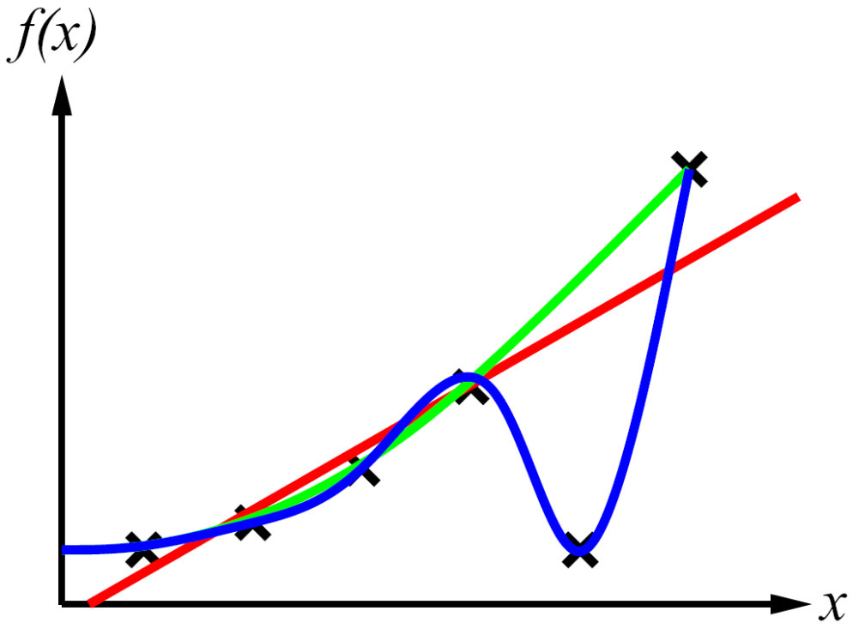
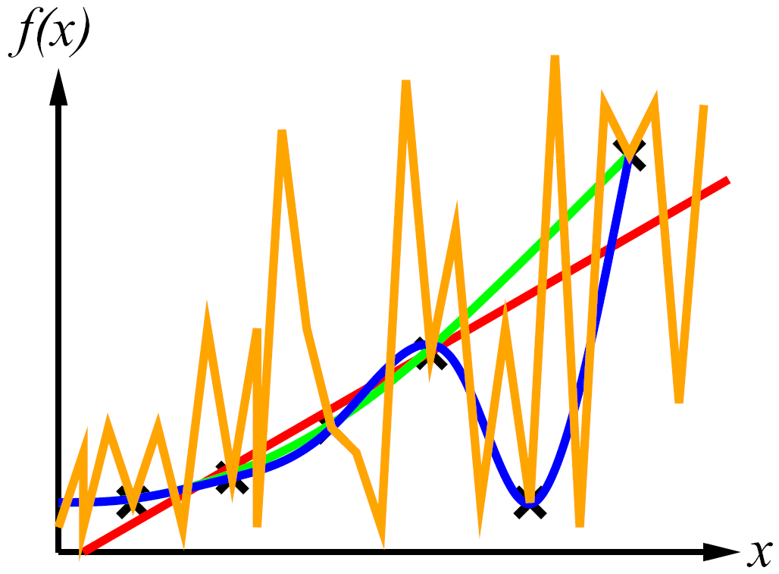
Supervised Learning
Curve fitting (regression, function approximation):
Consistency vs. simplicity
Occam’s razor
Suppose an event has two possible explanations. The explanation that requires the fewest assumptions is usually correct.

Slide 8

Occam’s razor, principle stated by the Scholastic philosopher William of Ockham(1285–1347/49) that “plurality should not be posited without necessity.” The principle gives precedence to simplicity: of two competing theories, the simpler explanation of an entity is to be preferred. The principle is also expressed as “Entities are not to be multiplied beyond necessity.”

Slide 9
Consistency vs. Simplicity
Fundamental tradeoff: bias (due to limited H) vs. accuracy variance (due to overfitting on training)
Usually algorithms prefer consistency by default (why?)
Several ways to operationalize “simplicity”
  Reduce the hypothesis space
    Assume more: e.g. independence assumptions, as in naïve Bayes
    Have fewer, better features / attributes: feature selection
    Other structural limitations
  Regularization
    Smoothing
    Many other generalization parameters (pruning cutoffs today)
      Hypothesis space stays big, but discouraged from getting to the outskirts

Slide 10
Decision Trees

Slide 11
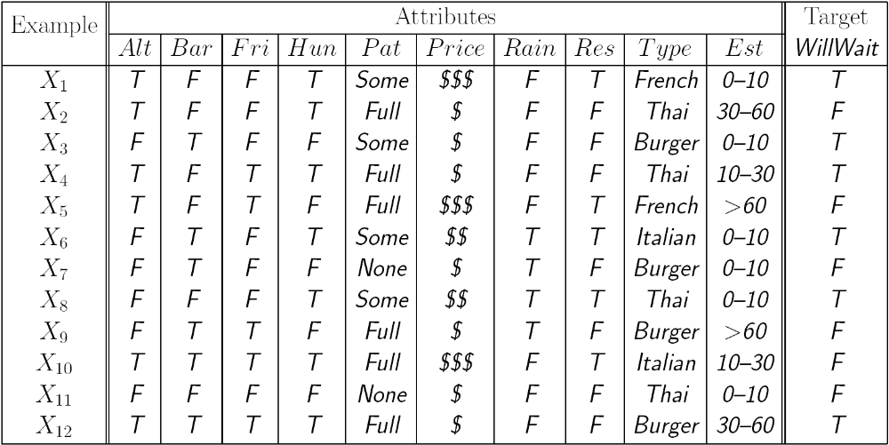
Reminder: Features
Features, aka attributes
  Sometimes: TYPE=French
  Sometimes: f_{TYPE=French}(x) = 1

Slide 12
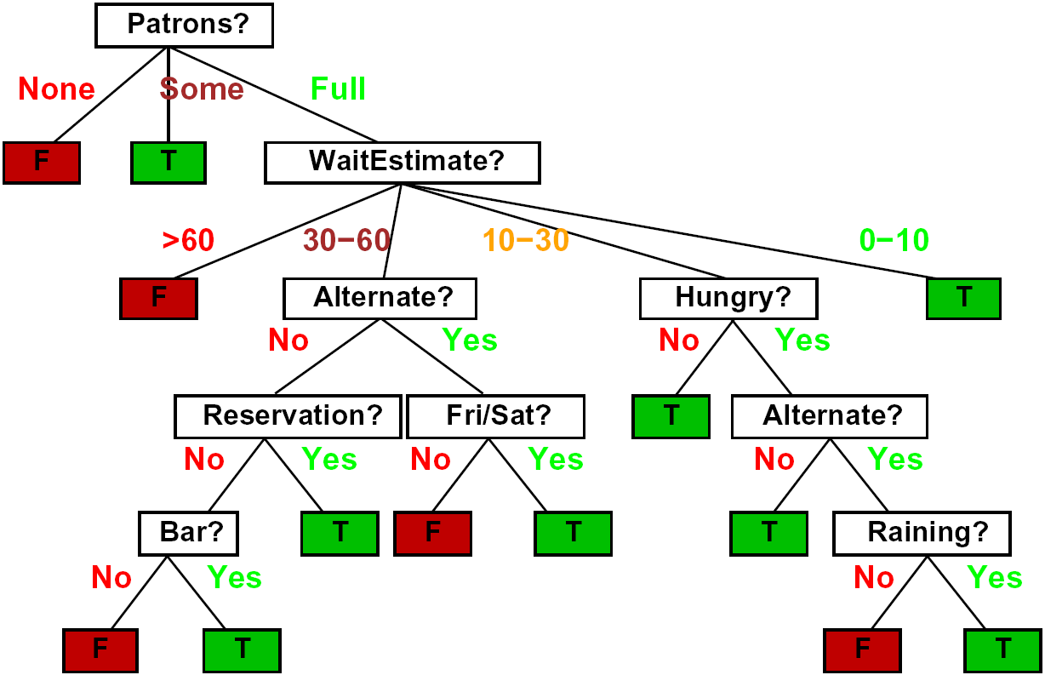
Decision Trees
Compact representation of a truth table:
  Specifies a class (label) for every feature combination
  Depth = O(number of features)
True function
  Realizable: in H
    For discreate features domain

Slide 13
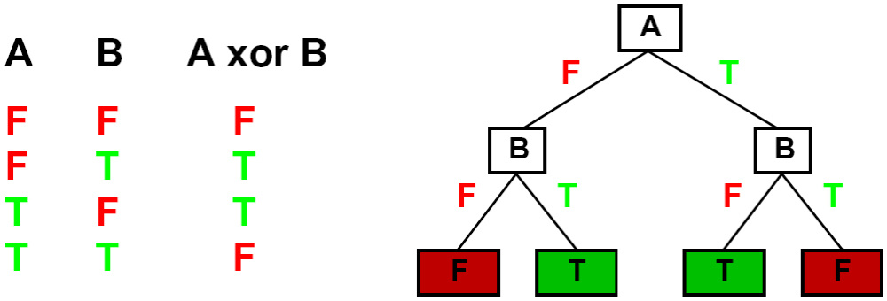
Expressiveness of DTs
Can express any function of the (discreate) features

Slide 14
Comparison: Perceptrons
What are the limitations on H for a Naïve Bayes model?
Naïve Bayes model: feature’s contribution is independent (close ghost -> danger)
  If you want one feature’s effect to depend on another, you must add a new conjunction feature
  E.g. adding “close_ghost ∧ is_scared” allows a NB to model the interaction between the two atomic features
DTs automatically conjoin features / attributes
  Features can have different effects in different branches of the tree!
Difference between modeling independence evidence weighting (NB) and complex evidence interaction (DTs)
  Though if the interactions are too complex, may not find the DT greedily (more on tree construction later today)

Slide 15
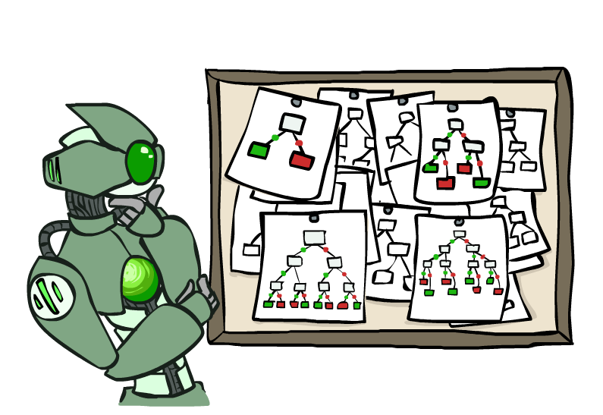
Hypothesis Spaces (why prune?)
How many distinct decision trees with n attributes each with d possible values?
  = number of classification functions for m labels over n attributes
  = number of distinct truth tables with d^{n} rows
  = m^(d^{n})
  E.g., with 6 Boolean attributes and Boolean classification, there are
  18,446,744,073,709,551,616 trees
How many trees of depth 1 (decision stumps)?
  = number of Boolean functions over 1 attribute
  = number of truth tables with 2 rows, times n
  = 4n
  E.g. with 6 Boolean attributes, there are 24 decision stumps
More expressive hypothesis space:
  Increases chance that target function can be expressed (good)
  Increases number of hypotheses consistent with training set (bad, why?)
  Means we can get better predictions (lower bias)
  But we may get worse predictions (higher variance)

Slide 16
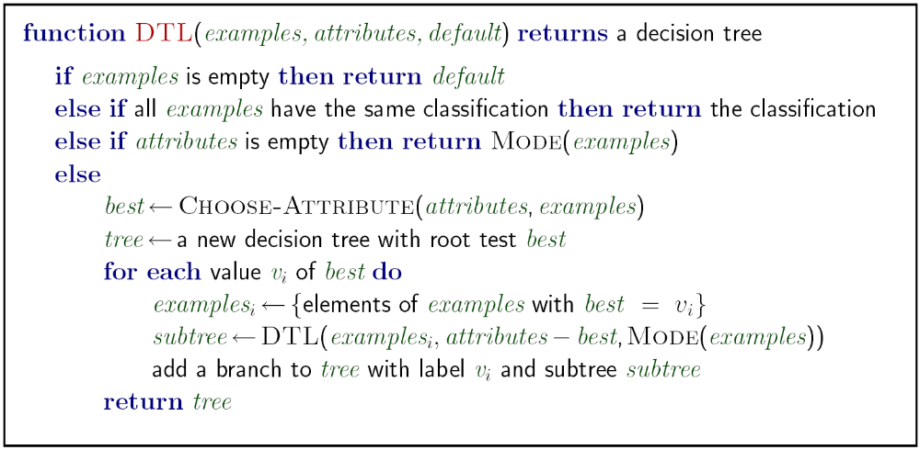
Decision Tree Learning
Aim: find a small tree consistent with the training examples
Idea: (recursively) choose “most significant” attribute as root of (sub)tree

Slide 17
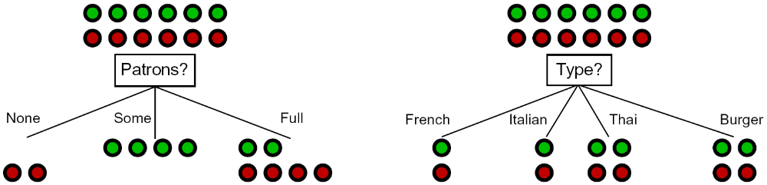
Choosing an Attribute
Idea: a good attribute splits the examples into subsets that are (ideally) “all positive” or “all negative”
So: we need a measure of how “good” a split is, even if the results aren’t perfectly separated out

Slide 18
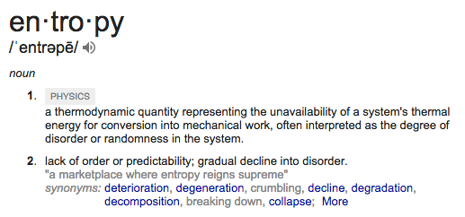
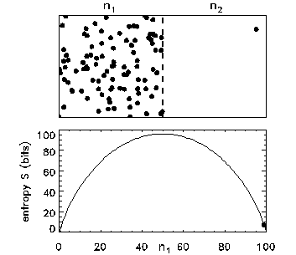
Entropy

Slide 19
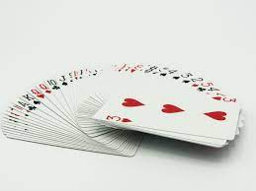
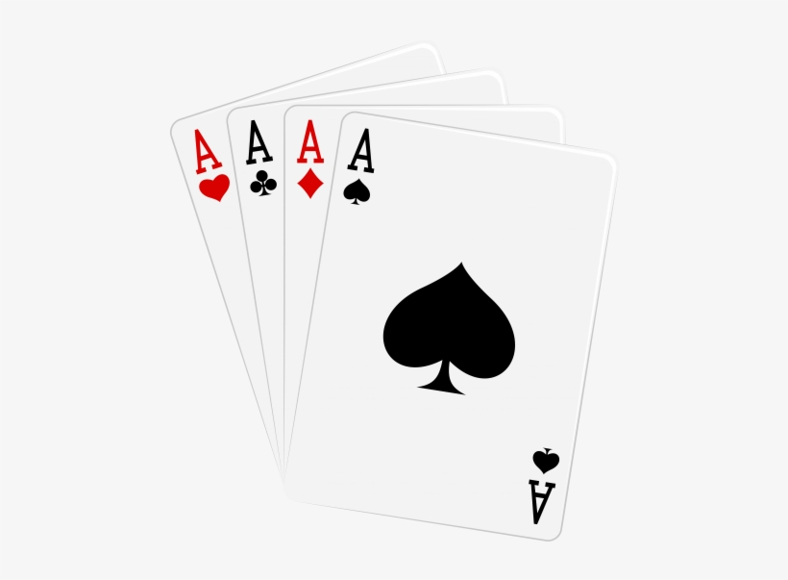
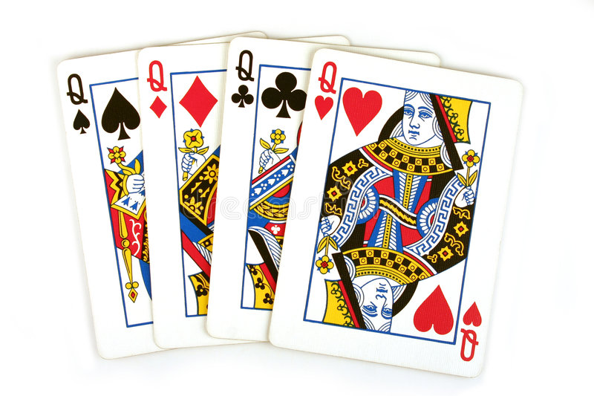
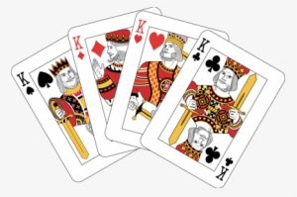
Disorder is the most probable state
What is the probability of getting a specific card order after shuffling a deck?
  1 over all possible configurations (52!)
    52!=80,658,175,170,943,878,571,660,636, 856,403,766,975,289,505,440, 883,277,824,000,000,000,000
What is the probability of getting a configuration where cards are ordered based on value?
  Number of configurations where cards are ordered over number 52!
Why is it not probable to shuffle cards and get ordered values?

Slide 20
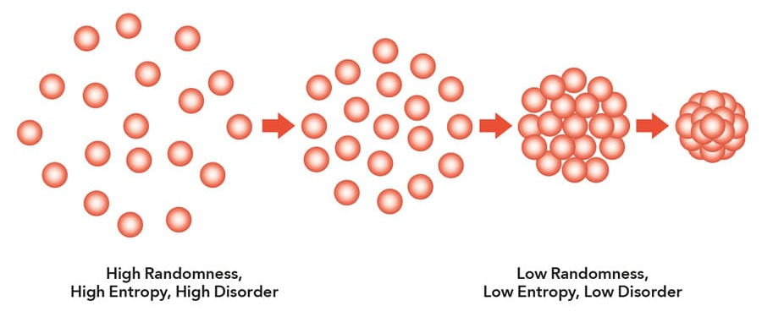
Entropy
The 2nd law of thermodynamics states that the total entropy of an isolated system can never decrease over time. Isolated systems spontaneously evolve towards thermodynamic equilibrium, i.e., the state with maximum entropy
How much information is required to represent each state?

Slide 21
Entropy in Information Theory
Information answers questions
  The more uncertain about the answer initially, the more information in the answer
  Scale: bits
    Answer to Boolean question with prior <1/2, 1/2>?
    Answer to 4-way question with prior <1/4, 1/4, 1/4, 1/4>?
    Answer to 4-way question with prior <0, 0, 0, 1>?
    Answer to 3-way question with prior <1/3, 1/3, 1/3>?
    Answer to 3-way question with prior <1/2, 1/4, 1/4>?
High entropy p-way question:
  A uniform distribution with probability 1/p
  Requires O(log₂ 1/p) bits
1 bit
2 bits
0 bits
1+0.667x1=1.667 bits
1+0.5x1=1.5 bits

Slide 22
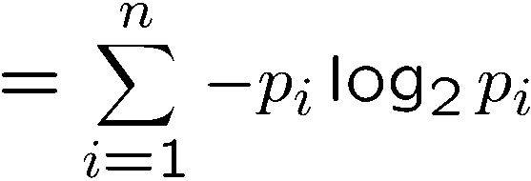
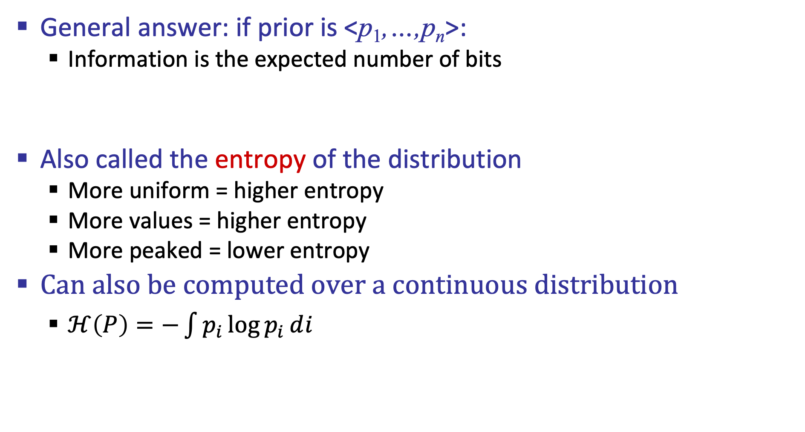
Entropy
General answer: if prior is <p₁,…,p_{n}>:
  Information is the expected number of bits
Also called the entropy of the distribution
  More uniform = higher entropy
  More values = higher entropy
  More peaked = lower entropy
Can also be computed over a continuous distribution
  $ℋ\left(P\right)=−\int{p_{i}\log{p_{i}}}ⅆi$
1 bit
0 bits
0.5 bit

Slide 23
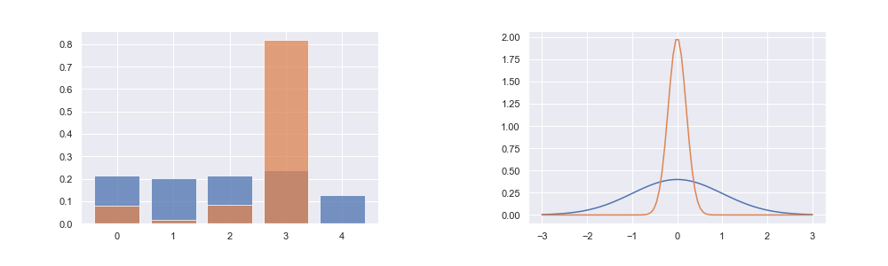
Entropy
Categorical (left), and Gaussian (Right) distributions. Orange shows low-entropy distributions, while blue shows high-entropy distributions.
Picture credit: Arthur Juliani

Slide 24
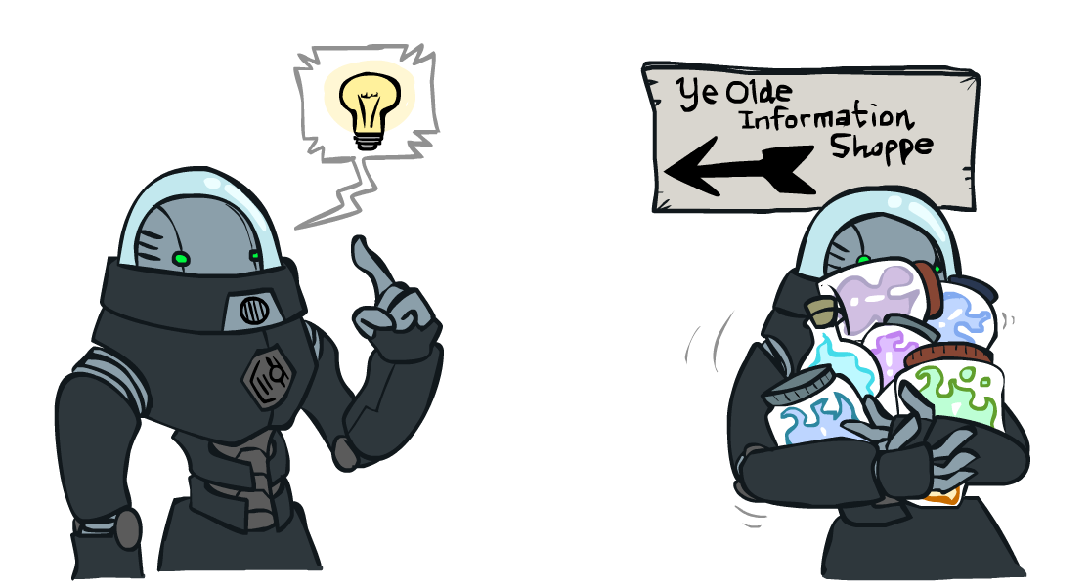
Information Gain
Back to decision trees!
For each split, compare entropy before and after
  Difference is the information gain
  Problem: there’s more than one distribution after split!
  Solution: use expected entropy, weighted by the number of examples

Slide 25
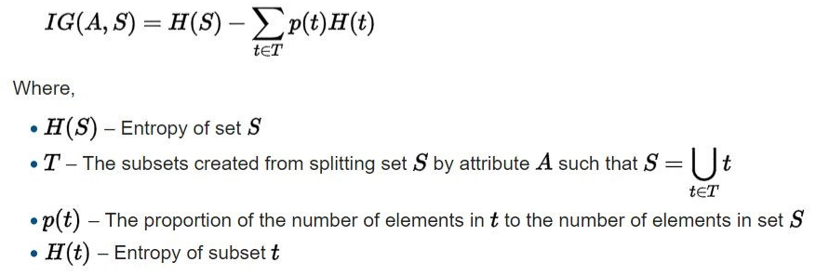
Information Gain

Slide 26
Information Gain
Back to decision trees!
For each split, compare entropy before and after
  Difference is the information gain
  Problem: there’s more than one distribution after split!
  Solution: use expected entropy, weighted by the number of examples
  Note: hidden problem here! Gain needs to be adjusted for large-domain splits – why?

Slide 27
Next Step: Recurse
Now we need to keep growing the tree!
Two branches are done (why?)
What should we do under “full”?
  See what examples are there…

Slide 28
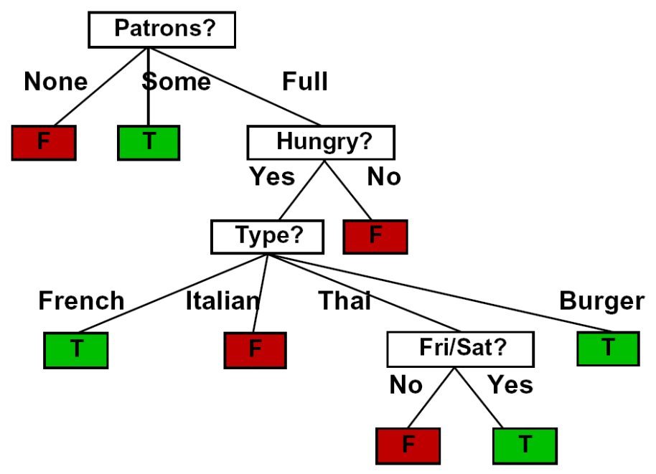
Example: Learned Tree
Decision tree learned from these 12 examples:
Substantially simpler than the full tree
  A more complex hypothesis isn't justified by data

Slide 29
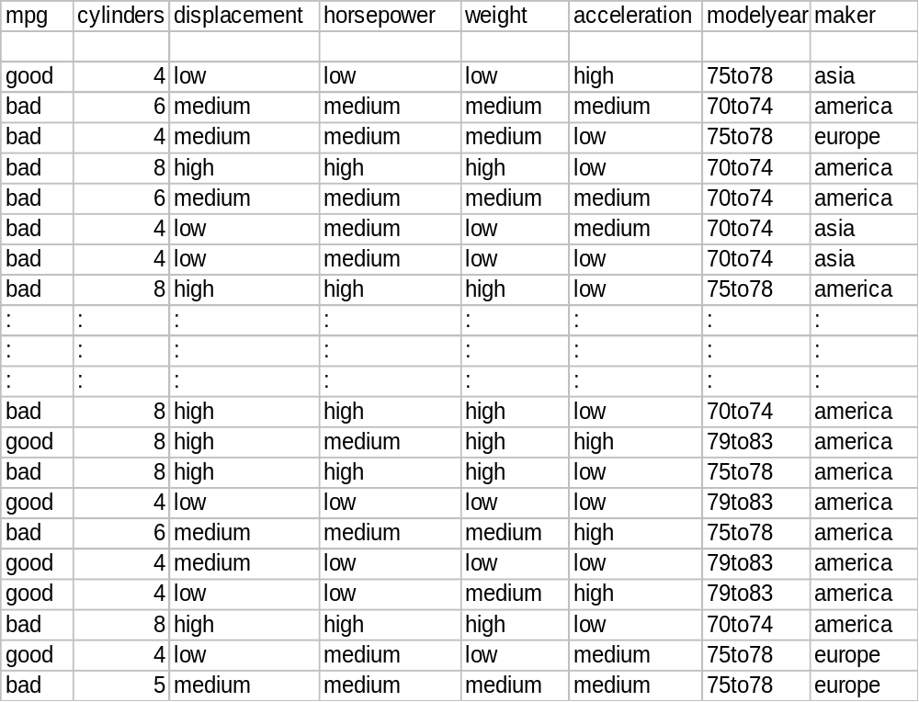
Example: Miles Per Gallon
40 Examples

Slide 30
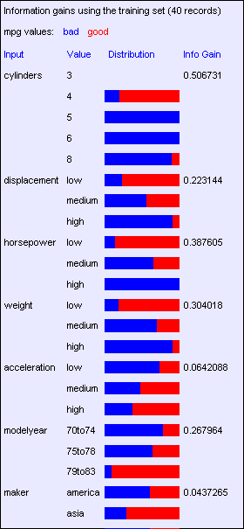
Find the First Split
Look at information gain for each attribute
Note that each attribute is correlated with the target!
What do we split on?

Slide 31
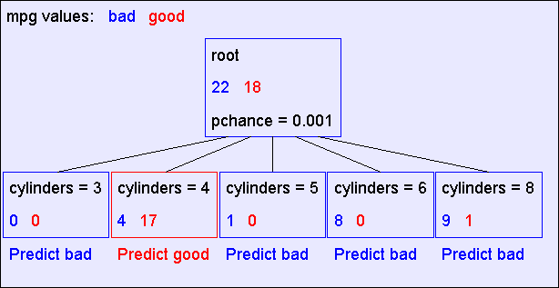
Result: Decision Stump

Slide 32
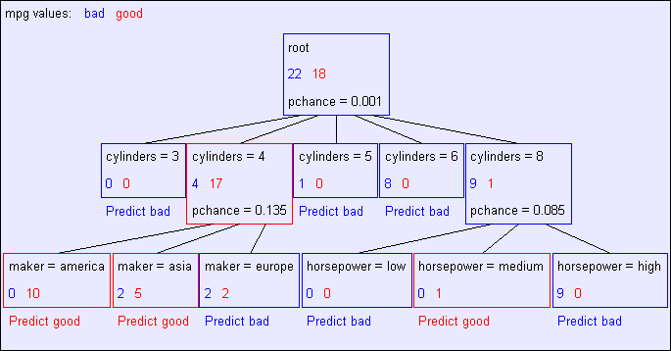
Second Level

Slide 33
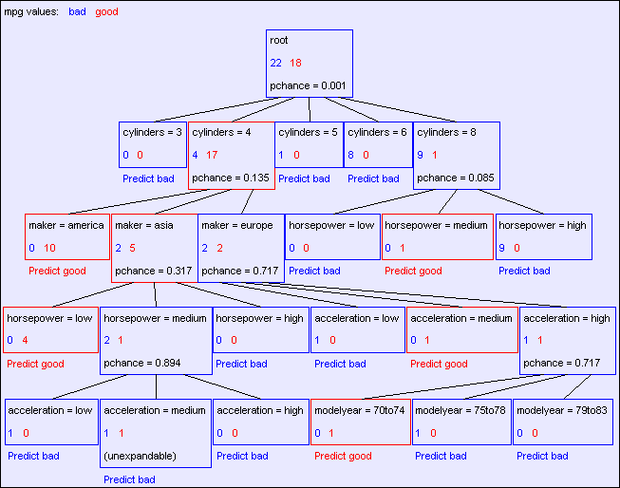
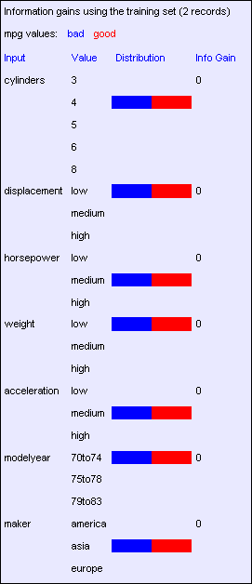
Final Tree

Slide 34
Reminder: Overfitting
Overfitting:
  When you stop modeling the patterns in the training data (which generalize)
  And start modeling the noise (which doesn’t)
We had this before:
  Naïve Bayes: needed to smooth

Slide 35

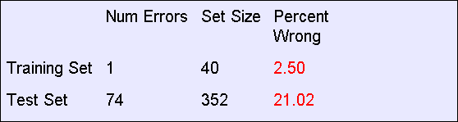
MPG Training Error
The test set error is much worse than the training set error…
…why?

Slide 36
Consider this split
IG=0.25

Slide 37
Significance of a Split
Starting with:
  Three cars with 4 cylinders, from Asia, with medium HP
  2 bad MPG
  1 good MPG
What do we expect from a three-way split?
  Maybe each example in its own subset?
  Maybe just what we saw in the last slide?
Probably shouldn’t split if the information gain is small

Slide 38
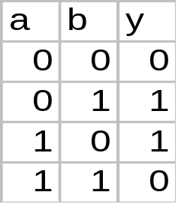

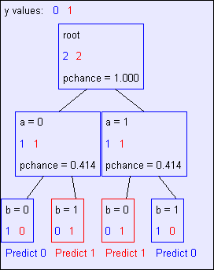
Keeping it General
Pruning:
  Build the full decision tree
  Begin at the bottom of the tree
  Delete splits in which
  IG < Threshold
  Continue working upward until there are no more prunable nodes
y = a XOR b

Slide 39
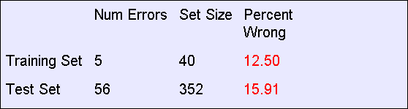
Pruning example
With Threshold = 0.3:
Note the improved test set accuracy compared with the unpruned tree

Slide 40
Regularization
Threshold is a regularization parameter
Generally, set it using held-out data (as usual)
Training
Held-out / Test
Accuracy
Decreasing
Increasing
Threshold
Small Trees
Large Trees
High Bias
High Variance

Slide 41
Two Ways of Controlling Overfitting
Limit the hypothesis space
  E.g. limit the max depth of trees
  Easier to analyze
Regularize the hypothesis selection
  E.g. chance cutoff
  Disprefer most of the hypotheses unless data is clear
  Commonly used

Slide 42
What did we learn?
Consistency (accuracy variance) vs. Simplicity (bias) tradeoff
Greedy approach for building decision trees (one step information gain)
  Information entropy
Regularization via post pruning (cutoffs)

