Slide 1

Optimizing Intelligence: Bridging AI and Real-World Decision-Making with Mathematical Tools
Guni Sharon
Texas A&M University

Slide 2
The talk’s goal
My research does rely on mathematical tools but has limited relevancy to education.
We would like to learn about your current research with connections to the mathematics involved in your work. Tell us how mathematics is important to what you do.

Slide 3
Breaking it down…
Congestion pricing for optimized traffic flow
Deep reinforcement learning for traffic signal control
Inference and management of epidemic progression
Optimizing video-game design
Optimizing indoor daylight in architectural design
Other applications…

Slide 4
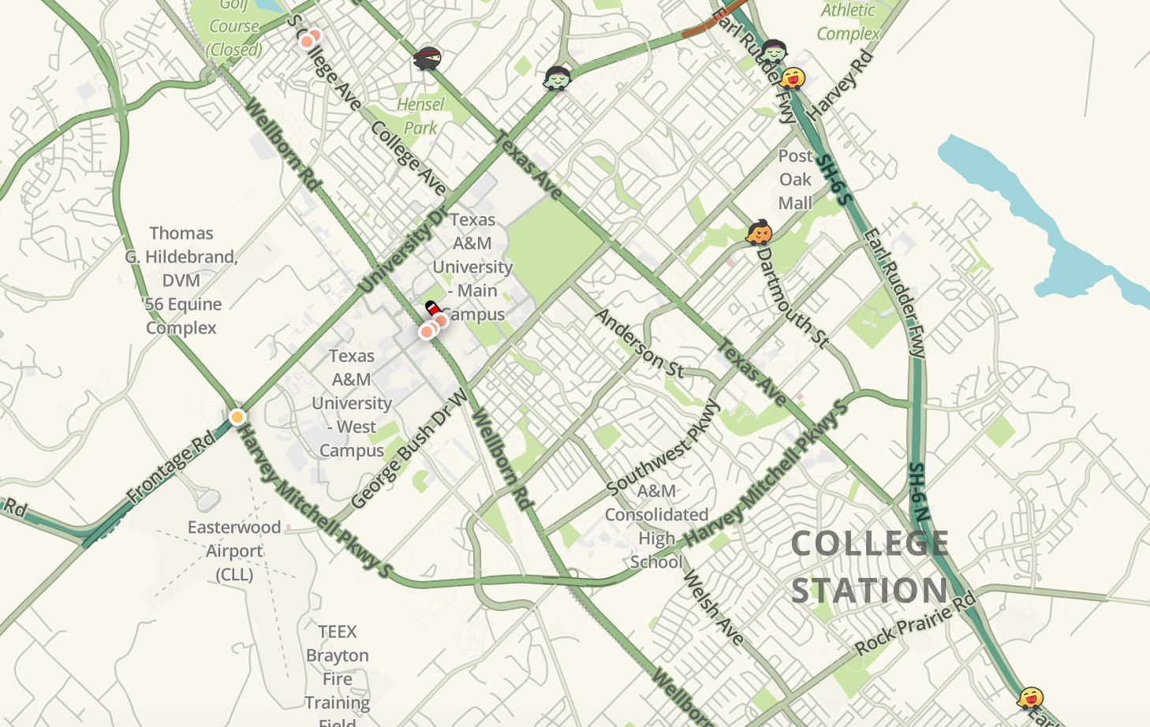
Question:
How to model traffic networks?

Slide 5

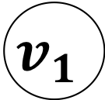
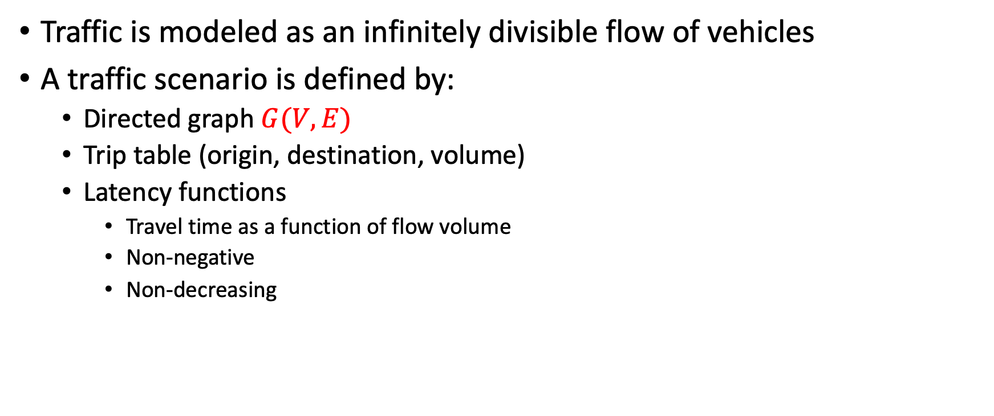


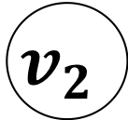

Macro-level modeling
Traffic is modeled as an infinitely divisible flow of vehicles
A traffic scenario is defined by:
  Directed graph $G(V,E)$
  Trip table (origin, destination, volume)
  Latency functions
    Travel time as a function of flow volume
    Non-negative
    Non-decreasing
$$l\left(x\right)=1$$
$$v_{1}$$
$$v_{2}$$
$$v_{1}→v_{2}$$
$$100×$$
$$l\left(x\right)=x$$

Slide 6
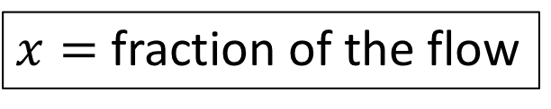


Example network
0%
$$l\left(x\right)=1$$
S
1 Hrs
T
S
T
1 HR
100%
$$l\left(x\right)=x$$
1 HR
50%
$x=$ fraction of the flow
S
0.75 Hrs
T
0.5 HR
50%

Slide 7
Example network
0%
User Equilibrium:
No amount of flow can be unitarily assigned a faster path
S
1 Hrs
T
1 HR
100%
System Optimum:
No amount of flow can be rerouted such that the total travel time is reduced
1 HR
50%
S
0.75 Hrs
T
0.5 HR
50%

Slide 8

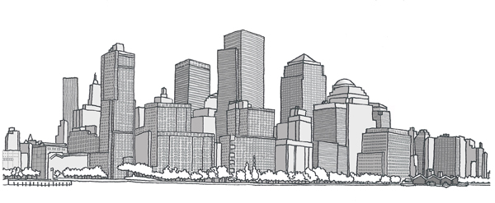



Self-interested routing
1 Hr
59 Min

Slide 9


From anarchy to system optimum
User equilibrium
All drivers are self interested
Traveling along the shortest (fastest) route
System optimum
All drivers are social
Traveling along the route that optimizes system performance
Results in the system optimal flow
Mr. Greedy
Miss Helpful

Slide 10
Question:
How do we get self-interested drivers to act socially?
?

Slide 11
Vickrey-Clarke-Groves (VCG) mechanism
Externality-Based Payments: Each participant pays (or is compensated) based on the harm or benefit they impose on others.
Truthful (Incentive Compatible): Participants have no incentive to misreport their preferences; their best strategy is to be honest.
Allocatively Efficient: The mechanism selects the outcome that maximizes total social welfare.
Individually Rational (Voluntary Participation): Participants do not end up worse off than if they did not participate.

Slide 12
Marginal-cost tolling
Each player pays its “social cost” (how much its existence hurts the others)
When applying Marginal-Cost Tolling
  UE and SO align
  [Pigou 1920; Beckmann et al. 1956; Braess 1969]
1$ delay
$1 delay
To: turtle
$2 toll

Slide 13
Question:
How do we apply MCT in a macro-model?

Slide 14
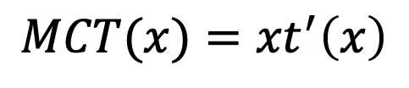
Applying MCT in a macro model
Assume a latency function
What is the marginal impact of vehicle #15?
Vehicle #15 increases the travel time by 5
15 vehicle suffer from the increased travel time
For the general case:
Travel time
$$MCT(x)={xt}^{′}\left(x\right)$$
Flow volume

Slide 15
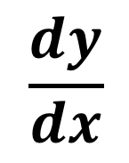
Question
What is the latency function?
?
$$\frac{dy}{dx}$$

Slide 16
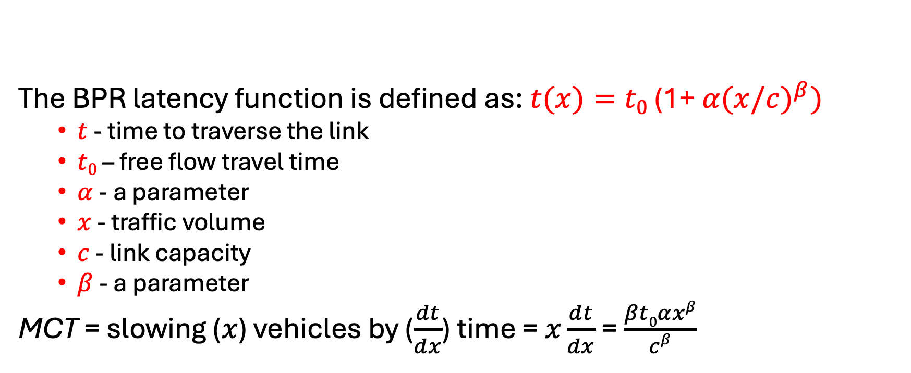
BPR latency function
The BPR latency function is defined as: $t(x)=t0$ (1+ $α{(x/c)}^{β})$
  $t$ - time to traverse the link
  $t0$ – free flow travel time
  $α$ - a parameter
  $x$ - traffic volume
  $c$ - link capacity
  $β$ - a parameter
MCT = slowing ($x$) vehicles by ($\frac{dt}{dx}$) time = $x\frac{dt}{dx}$ = $\frac{βt0αxβ}{cβ}$

Slide 17
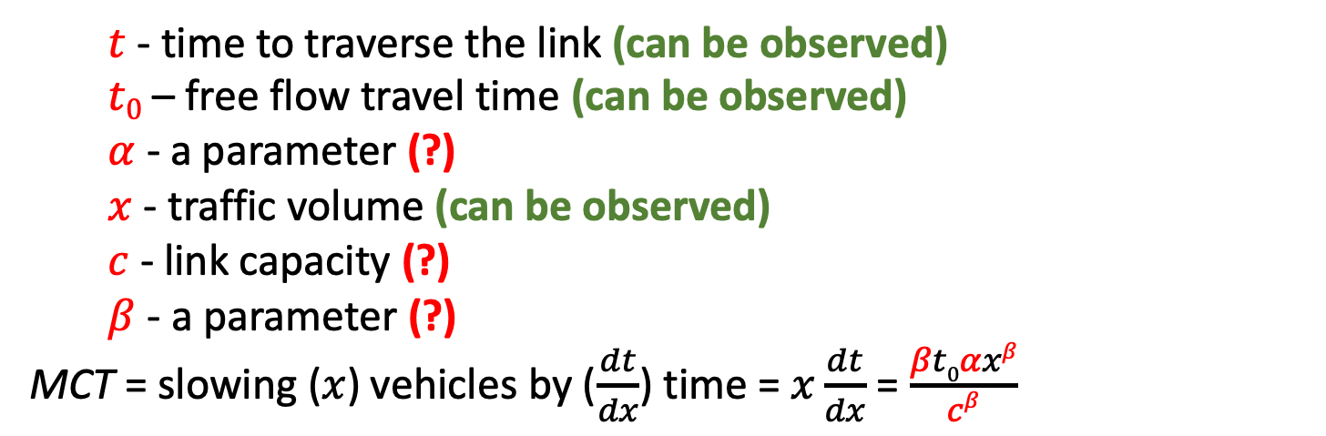
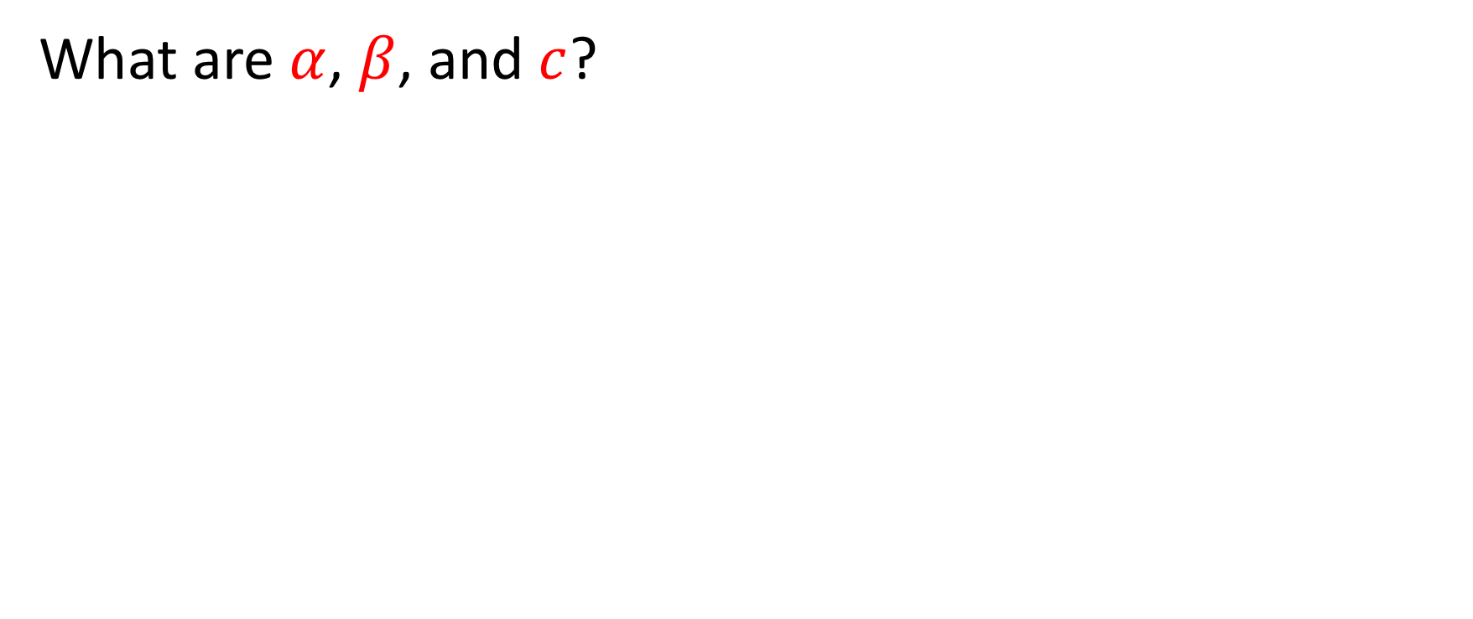
Question
What are $α$,$β$, and $c$?
  $t$ - time to traverse the link (can be observed)
  $t0$ – free flow travel time (can be observed)
  $α$ - a parameter (?)
  $x$ - traffic volume (can be observed)
  $c$ - link capacity (?)
  $β$ - a parameter (?)
MCT = slowing ($x$) vehicles by ($\frac{dt}{dx}$) time = $x\frac{dt}{dx}$ = $\frac{βt0αxβ}{cβ}$

Slide 18

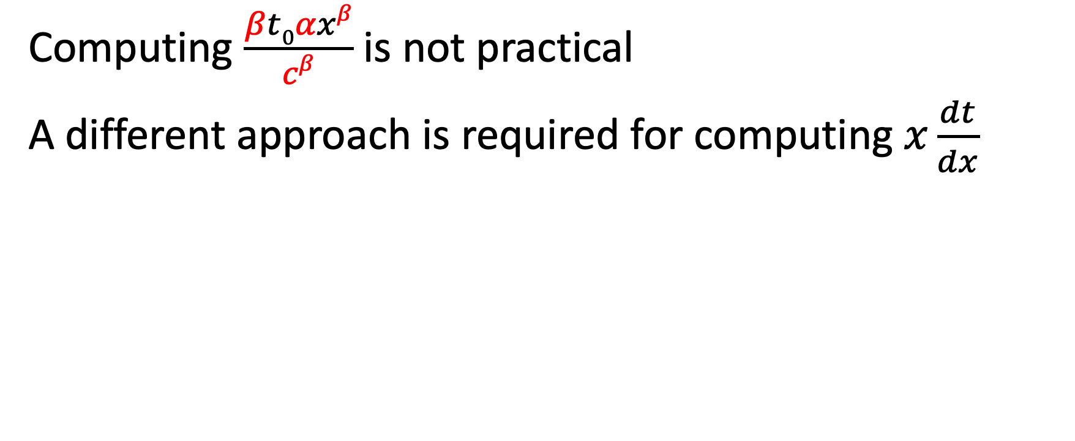
Realization
Computing $\frac{βt0αxβ}{cβ}$ is not practical
A different approach is required for computing$x\frac{dt}{dx}$

Slide 19
Previous work: tolling schemes
Assumed known or fixed demand: (Wie and Tobin, 1998; Joksimovic, Bliemer, and Bovy, 2005)
Assumed known or fixed road capacity: (Joksimovic, Bliemer, and Bovy, 2005; Lin, Unnikrishnan, and Waller, 2011)
Assumed homogeneous values of time: (Yang, Meng, and Lee, 2004; Zhou et al., 2015)
Assumed that traffic follows a specific model: (Wie and Tobin, 1998; Joksimovic, Bliemer, and Bovy, 2005; Lin, Unnikrishnan, and Waller, 2011; Friesz, Bernstein, and Kydes, 2004)
Intractable for large networks: (Wie, 2007; Lin, Unnikrishnan, and Waller, 2011; Do Chung et al., 2012)
Not adaptive: (Beckmann, McGuire, and Winsten, 1956; Verhoef, 2002; Hearn and Yildirim, 2002)
Optimizated a single corridor: (Yin and Lou, 2009; Gardner, Bar-Gera, and Boyles, 2013; Gardner et al., 2015)

Slide 20


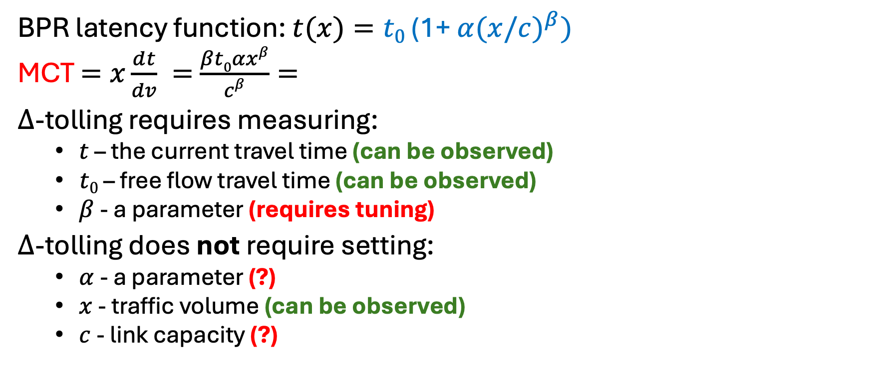

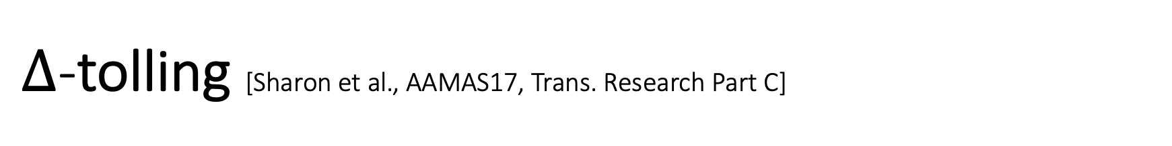
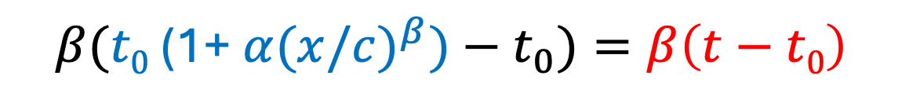
$Δ$-tolling [Sharon et al., AAMAS17, Trans. Research Part C]
BPR latency function: $t(x)=t0$ (1+ $α{(x/c)}^{β})$
MCT $=x\frac{dt}{dv} =$ $\frac{βt0αxβ}{cβ}=$
$Δ$-tolling requires measuring:
  $t$ – the current travel time (can be observed)
  $t0$ – free flow travel time (can be observed)
  $β$ - a parameter (requires tuning)
$Δ$-tolling does not require setting:
  $α$ - a parameter (?)
  $x$ - traffic volume (can be observed)
  $c$ - link capacity (?)
$$β(t0\text{ (1+ }α{(x/c)}^{β})−t_{0})=β\left(t−t0\right)$$
$$t0$$
$$t$$

Slide 21
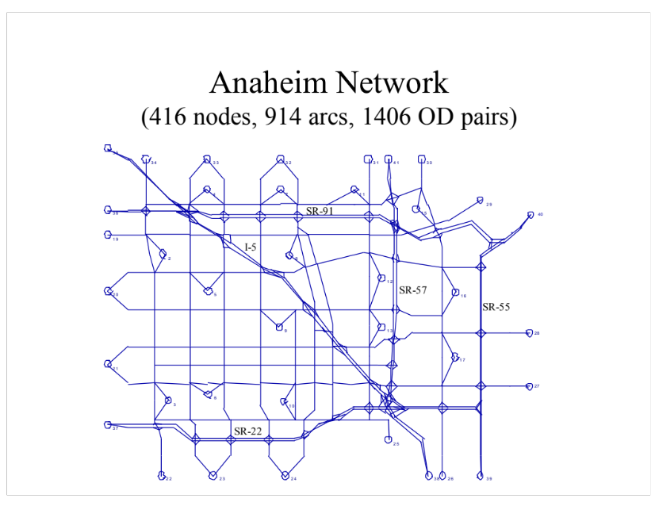
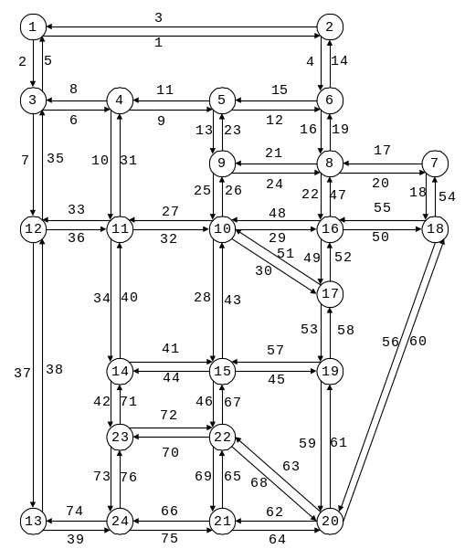
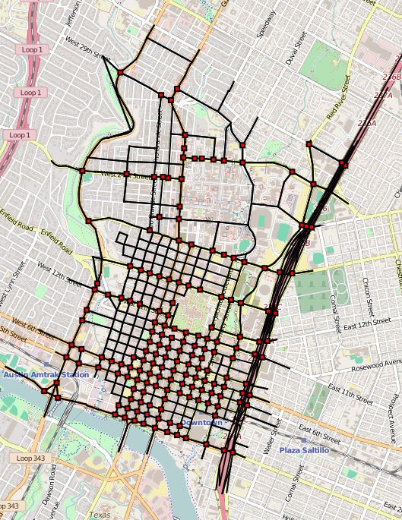
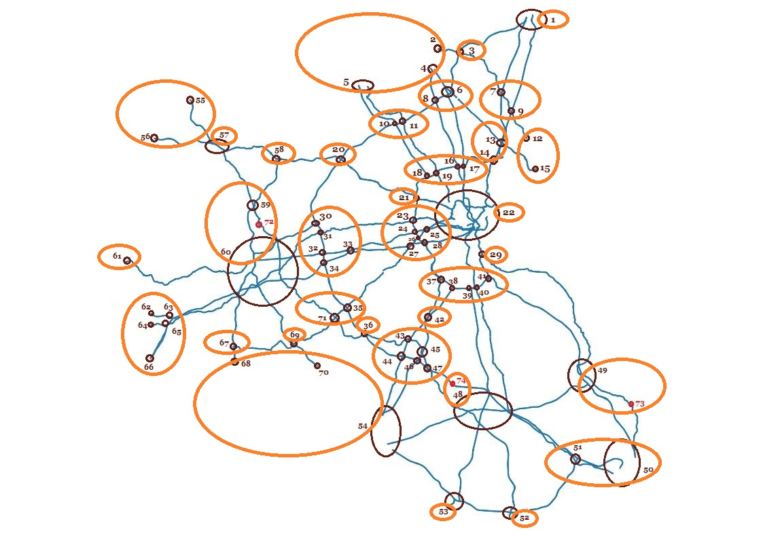
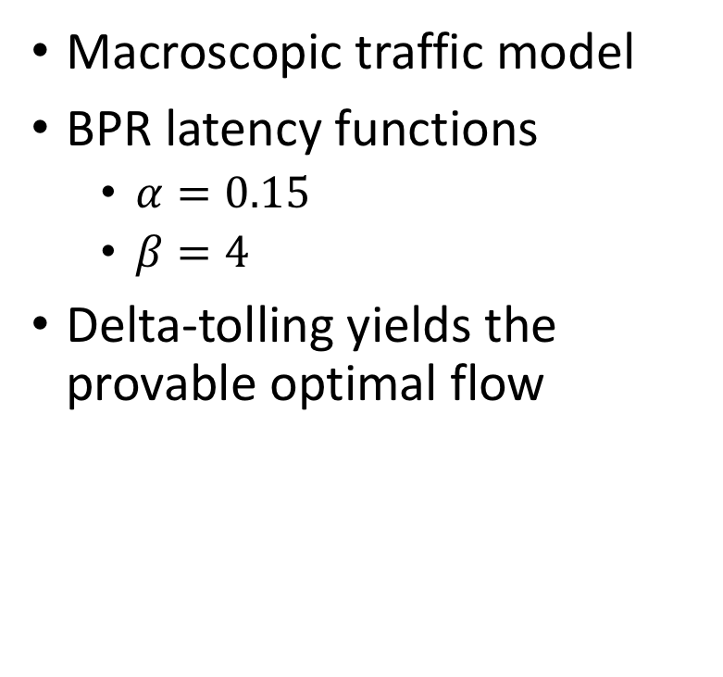
Empirical results
Macroscopic traffic model
BPR latency functions
  $α=0.15$
  $β=4$
Delta-tolling yields the provable optimal flow

Slide 22
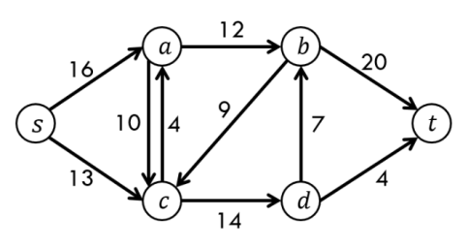
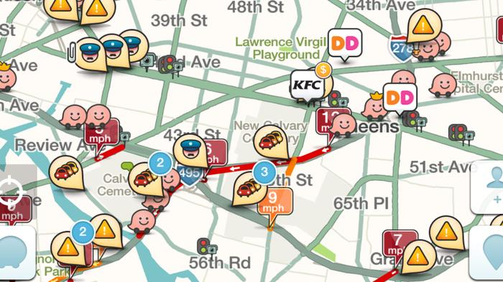
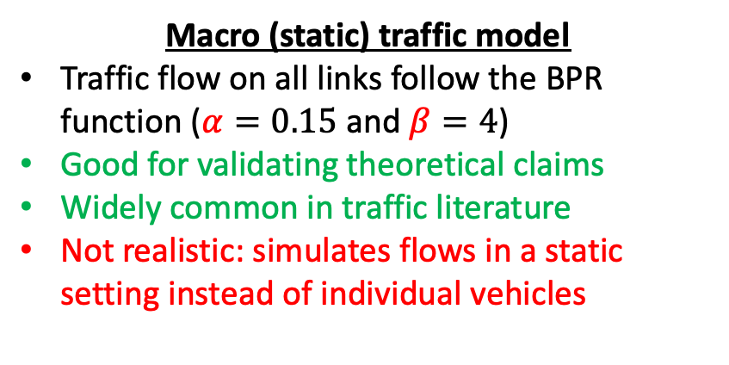
Moving towards a dynamic setting
Macro (static) traffic model
Traffic flow on all links follow the BPR function ($α=0.15$and $β=4$)
Good for validating theoretical claims
Widely common in traffic literature
Not realistic: simulates flows in a static setting instead of individual vehicles
Dynamic traffic assignment
Simulates individual vehicles
Able to model:
  Time-varying demand and congestion patterns
  Intersection influences e.g., queue spillbacks
  Low level details such as lane changing, traffic signals, stop signs

Slide 23

Change of hats
Macro (static) traffic model
Dynamic traffic assignment
Theoretical
Empirical

Slide 24
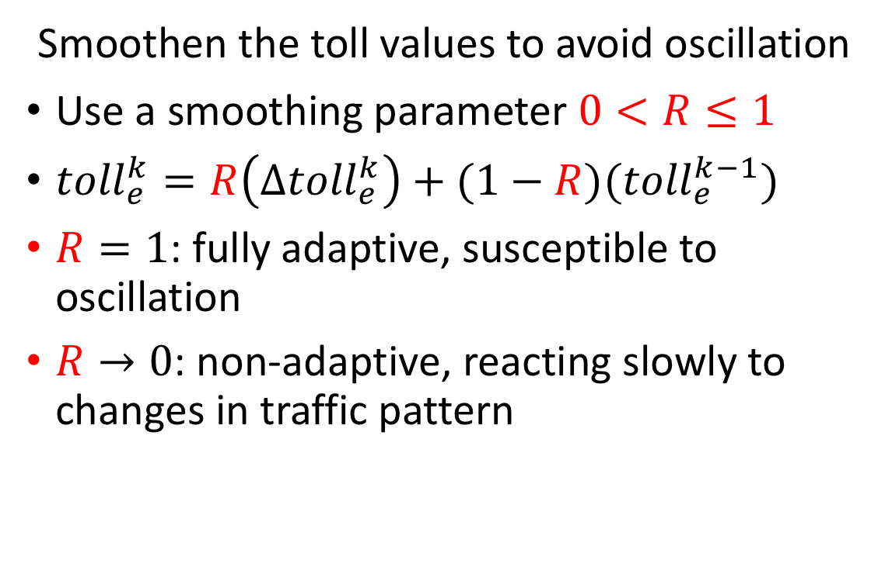
Oscillation Effect and Toll Spikes
Smoothen the toll values to avoid oscillation
Use a smoothing parameter $0<R≤1$
${toll}_{e}^{k}=R\left(Δ{toll}_{e}^{k}\right)+(1−R)({toll}_{e}^{k−1})$
$R=1$: fully adaptive, susceptible to oscillation
$R→0$: non-adaptive, reacting slowly to changes in traffic pattern
s
t
s
t

Slide 25
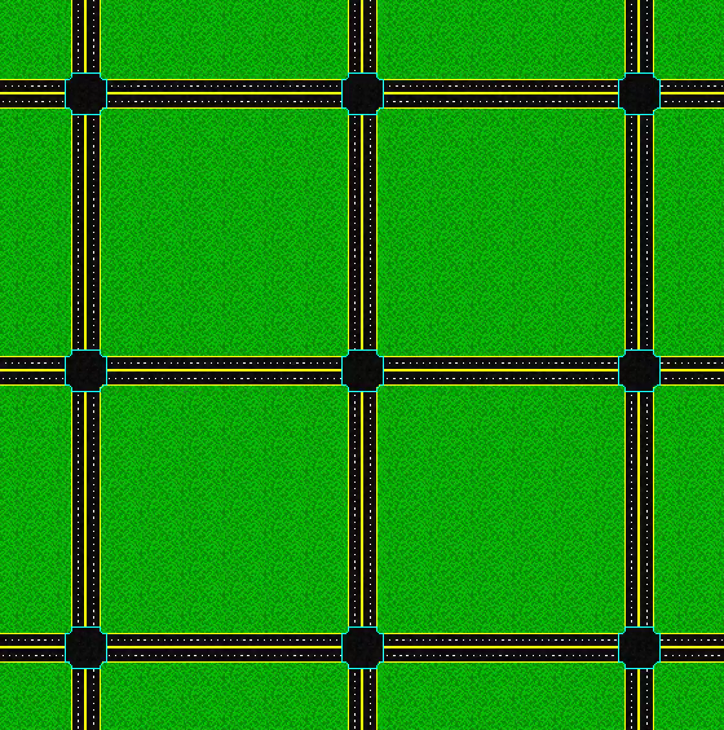
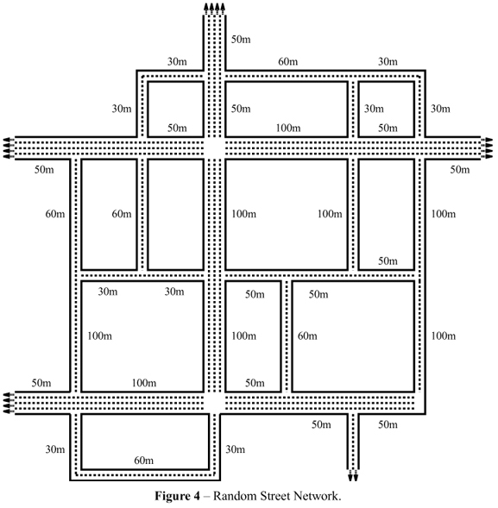
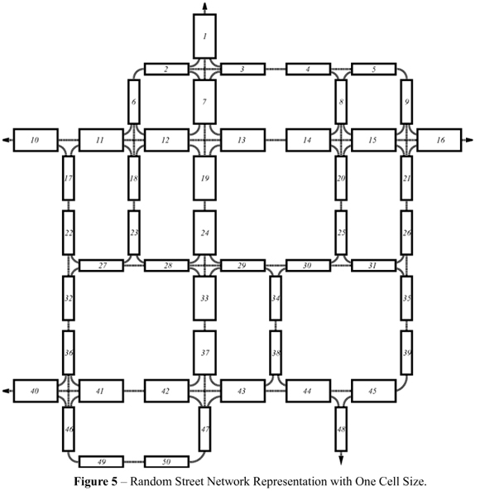
Experimental setting - DTA
Cell transmission model
Mesoscopic level
  Based on the kinematic wave theory of traffic flow [Whitham, G. B., 1955]
  Able to model time-varying demand and congestion patterns
  Simplified kinematics
Microscopic traffic model
Most detailed model
Detailed kinematics
High computational requirements
  doesn't scale to large networks

Slide 26
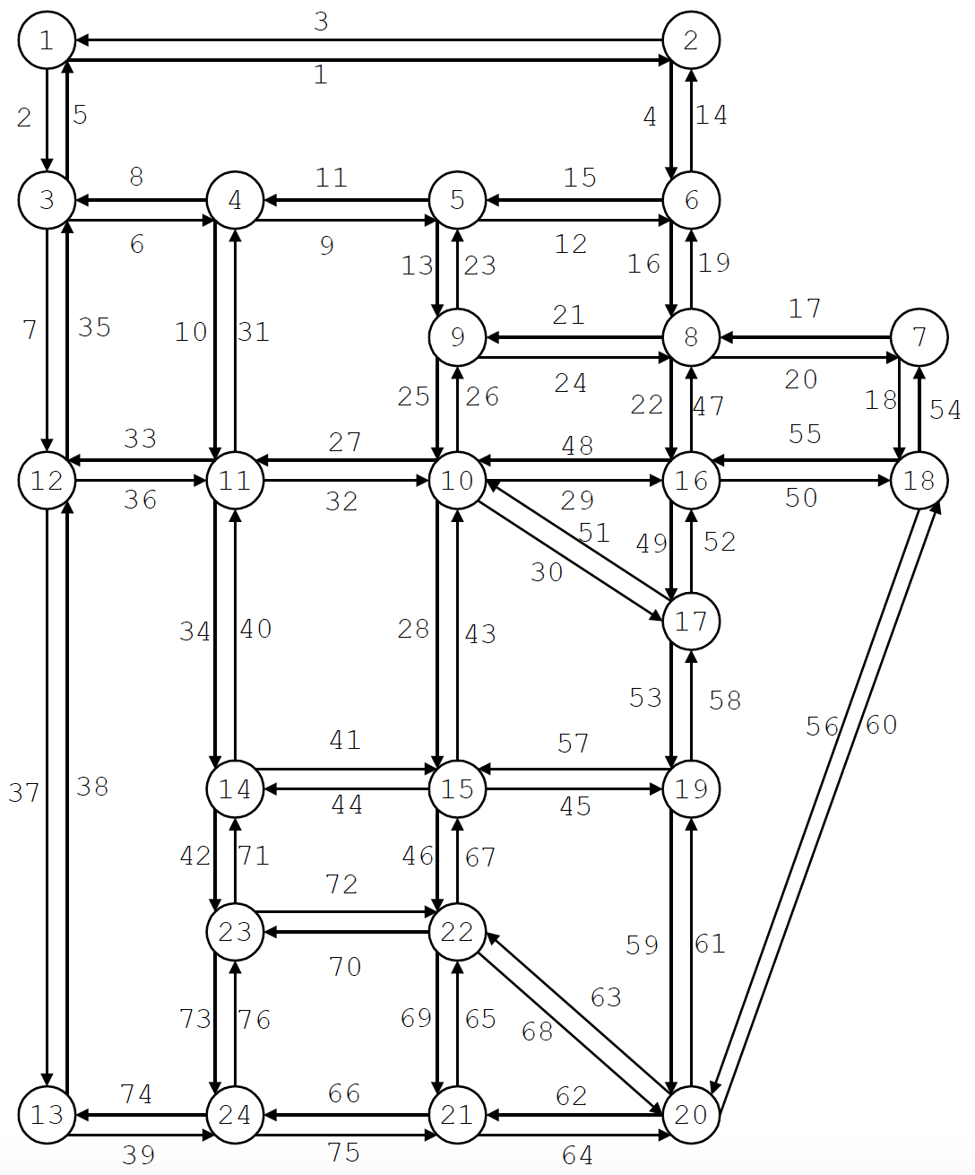
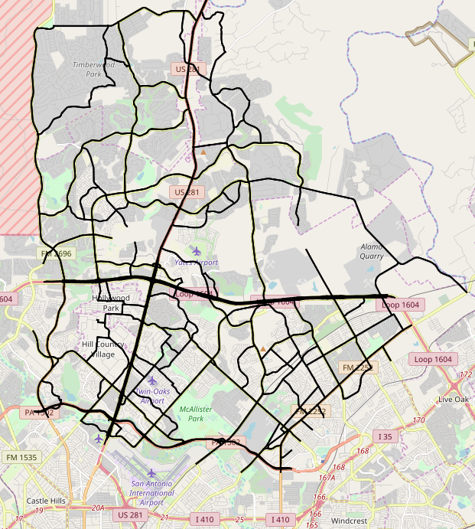
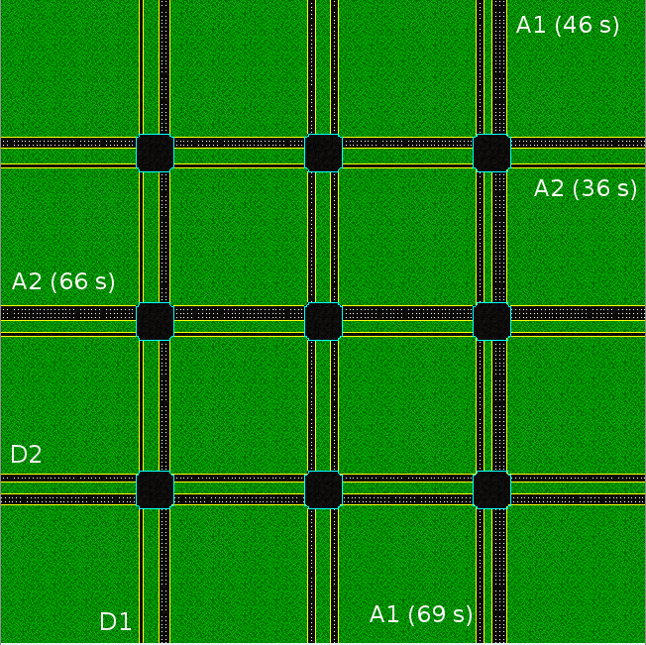
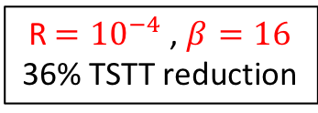
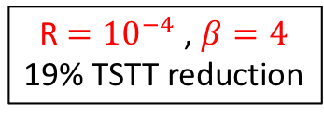
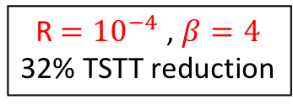
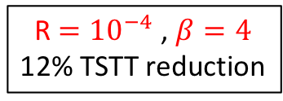
Experimental results - DTA
R $={10}^{−4}$ , $β=4$
19% TSTT reduction
R $={10}^{−4}$ , $β=4$
32% TSTT reduction
R $={10}^{−4}$ , $β=4$
12% TSTT reduction
R $={10}^{−4}$ , $β=16$
36% TSTT reduction
Sioux Falls
24 nodes, 76 links
28,835 trips in 3 hours
Downtown Austin
2,546 nodes, 1,247 links
62,836 trips in 2 hours
Uptown San Antonio
742 nodes, 1,259 links
223,479 trips in 3 hours
Micro-simulator
Randomly generated 3x3 grid networks

Slide 27
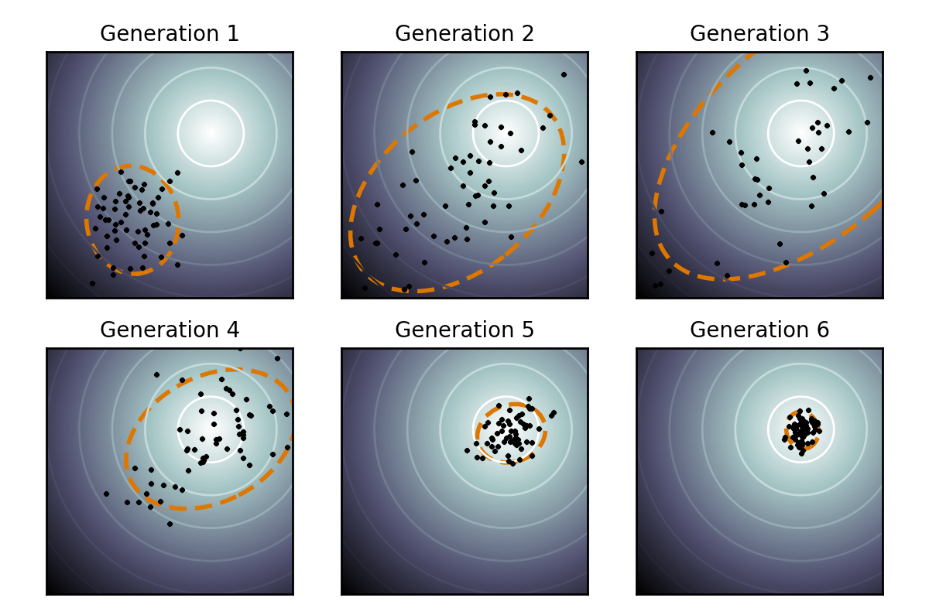

Online parameter tuning for R and $β$
Finite difference
  Less exploration
  Safer
  Harder to escape a local minima
CMA-ES
  More exploration
  Less safe
  Easier to escape a local minima
Iteration
Iteration
Iteration
Iteration
Iteration
Iteration

Slide 28
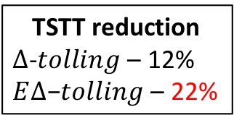
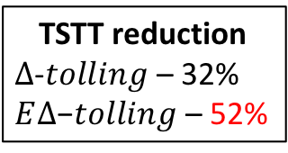

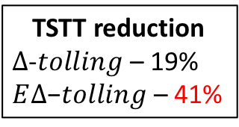
Enhanced $Δ$-tolling [Mirzaei et al., ITSC18]
TSTT reduction
$∆\text{−}tolling$ – 19%
$E∆\text{−}tolling$ – 41%
TSTT reduction
$∆\text{−}tolling$ – 32%
$E∆\text{−}tolling$ – 52%
TSTT reduction
$∆\text{−}tolling$ – 12%
$E∆\text{−}tolling$ – 22%
Sioux Falls
24 nodes, 76 links
28,835 trips in 3 hours
Downtown Austin
2,546 nodes, 1,247 links
62,836 trips in 2 hours
Uptown San Antonio
742 nodes, 1,259 links
223,479 trips in 3 hours

Slide 29
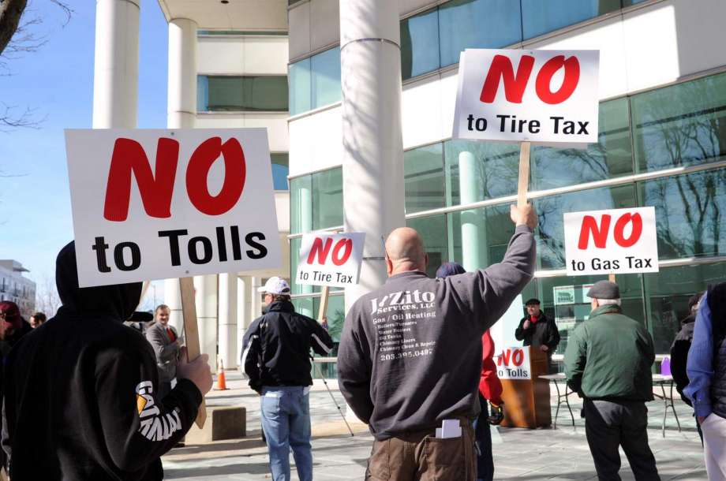

Avoid mandatory road tolls
Can we optimize traffic flow without mandatory tolls?
No tolls!

Slide 30
Realization
Achieving optimal flow doesn’t require us to influence all drivers
1 HR
50%
S
0.75 Hrs
T
0.5 HR
Best interest
50%

Slide 31
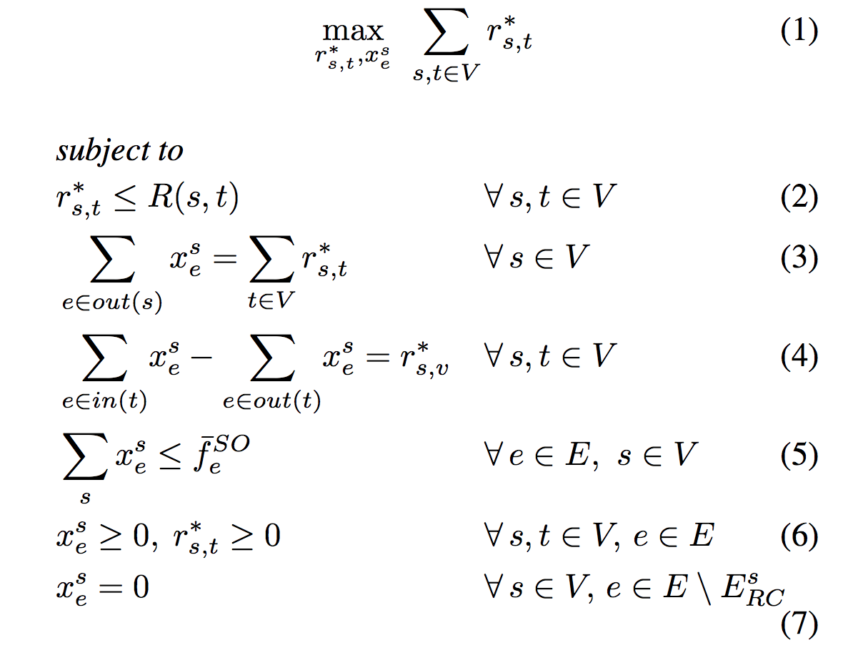
How many compliant drivers are needed?
Can be solved through LP [Sharon et al. AAAI-18]
Scenario | Required compliance %
Sioux Falls | 13.04
Eastern Massachusetts | 19.73
Anaheim | 19.76
Chicago Sketch | 27.29
Philadelphia | 49.59
Chicago Regional | 53.34

Slide 32
Congestion pricing for optimized traffic flow
“Network-wide adaptive tolling for connected and automated vehicles”, Transportation Research Part C: Emerging Technologies, 2017
“Real-time Adaptive Tolling Scheme for Optimized Social Welfare in Traffic Networks”, AAMAS 2017
“Traffic Optimization For a Mixture of Self-interested and Compliant Agents”, AAAI 2018
“Dyetc: Dynamic electronic toll collection for traffic congestion alleviation”, AAAI 2018
“Enhanced delta-tolling: Traffic optimization via policy gradient reinforcement learning”, ITS 2018
"Marginal Cost Pricing with a Fixed Error Factor in Traffic Networks”, AAMAS 2019.
“Selecting compliant agents for opt-in micro-tolling”, AAAI 2019
Josiah P. Hanna, Tarun Rambha, Michael W. Levin, Michael Albert, Stephen D. Boyles, Peter Stone, Hamid Mirzaei, Haipeng Chen, Bo An, Shani Alkoby

Slide 33
Breaking it down…
Congestion pricing for optimized traffic flow
Deep reinforcement learning for traffic signal control
Inference and management of epidemic progression
Optimizing video-game design
Optimizing indoor daylight in architectural design
Other applications…

Slide 34
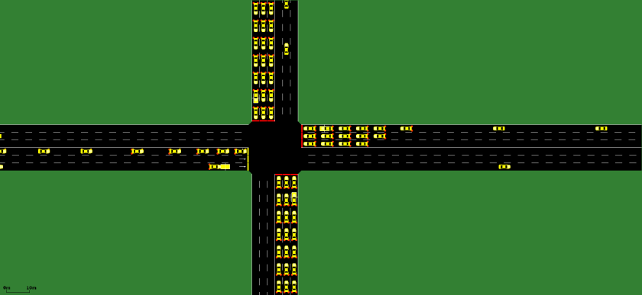
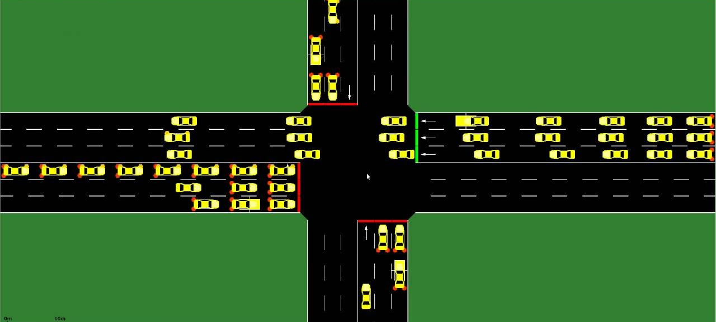

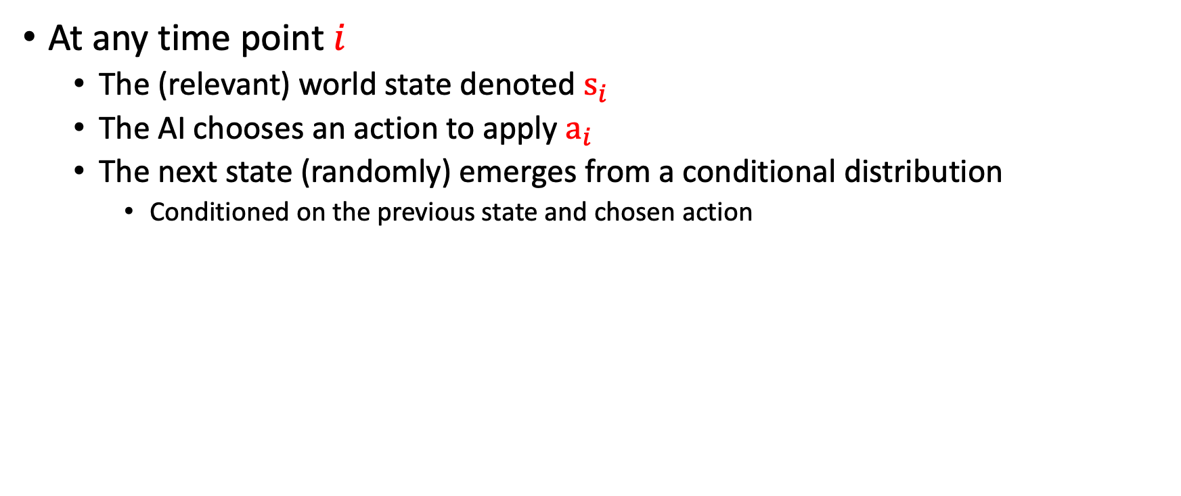
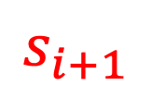

Background: Markov Decision Process
At any time point $i$
  The (relevant) world state denoted $s_{i}$
  The AI chooses an action to apply $a_{i}$
  The next state (randomly) emerges from a conditional distribution
    Conditioned on the previous state and chosen action
$$s_{i}$$
$$s_{i+1}$$
$$P\left(s_{i+1}|s_{i},a_{i}\right)$$

Slide 35
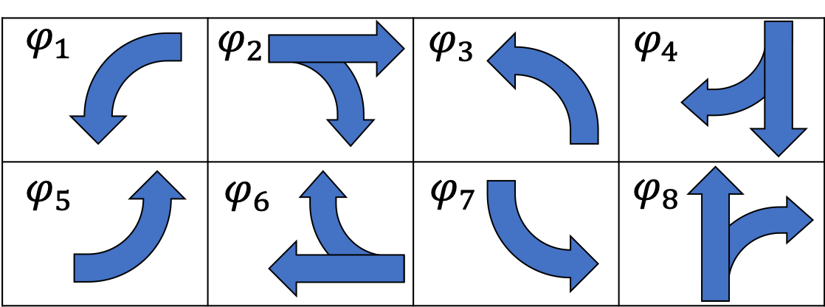
Signal Control as an MDP [Ault and Sharon, NeurIPS 2021]
State:
  Incoming vehicles (incoming lane, speed, waiting time, queue length)
  Current signal (enabled phase) assignment
Action:
  Enable a set of non-conflicting phases
Transitions:
  Defined by the traffic progression model
Reward:
  Sum of delays, stopped time, queue length, traffic pressure

Slide 36
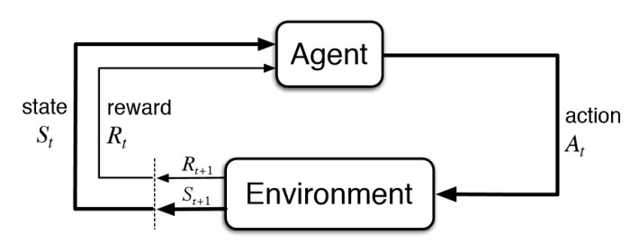
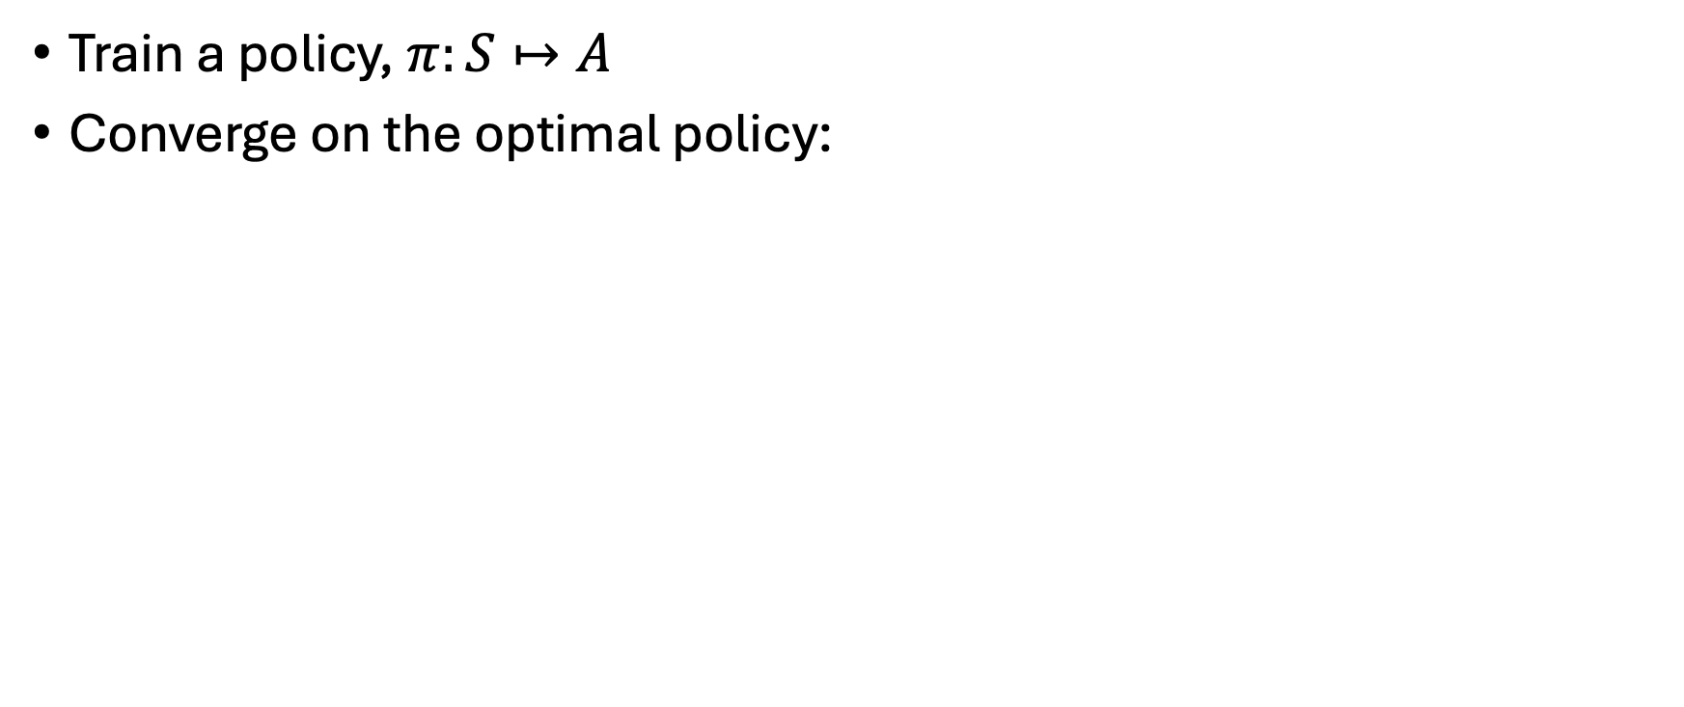
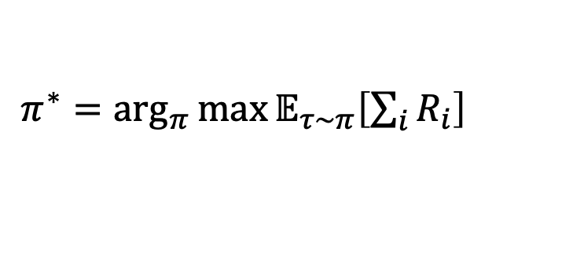
Reinforcement learning
Train a policy, $π:S↦A$
Converge on the optimal policy:
$π^{∗}=\arg_{π}{\max{𝔼_{τ∼π}\left[\sum_{i}{R_{i}}\right] }}$

Slide 37
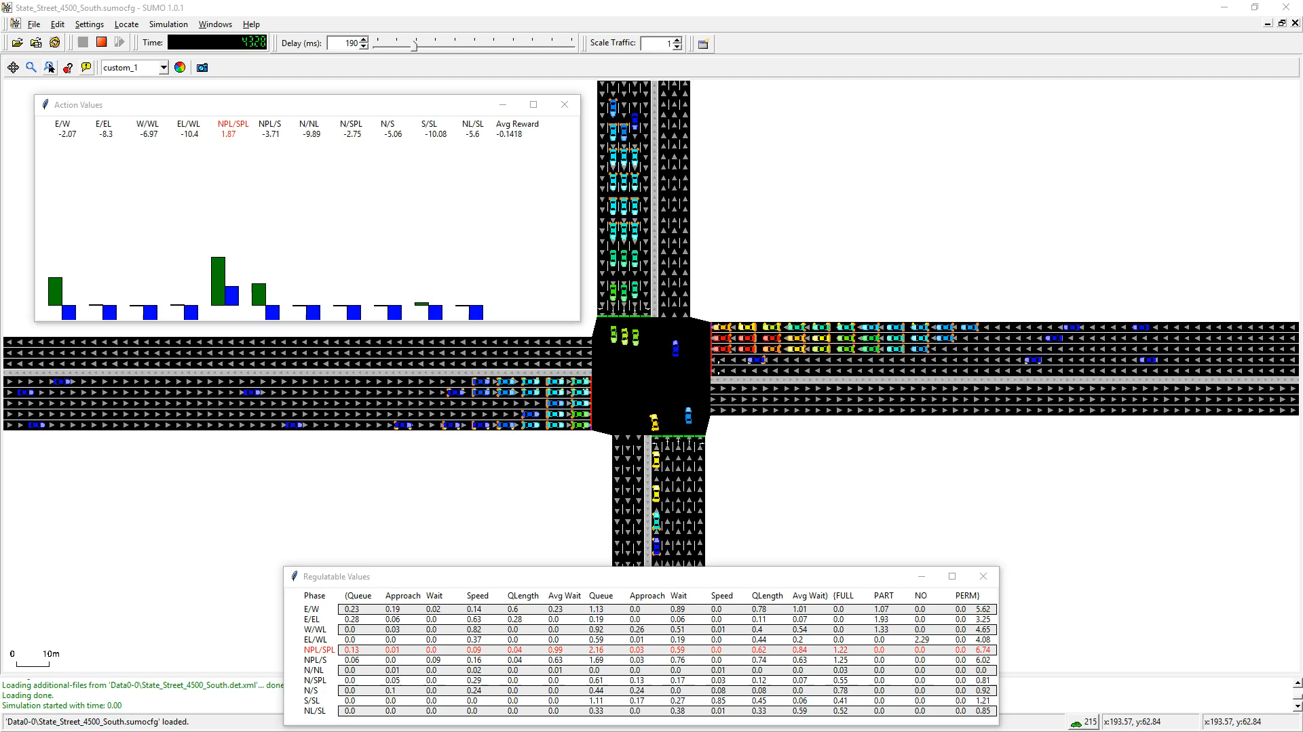
Initial performance

Slide 38
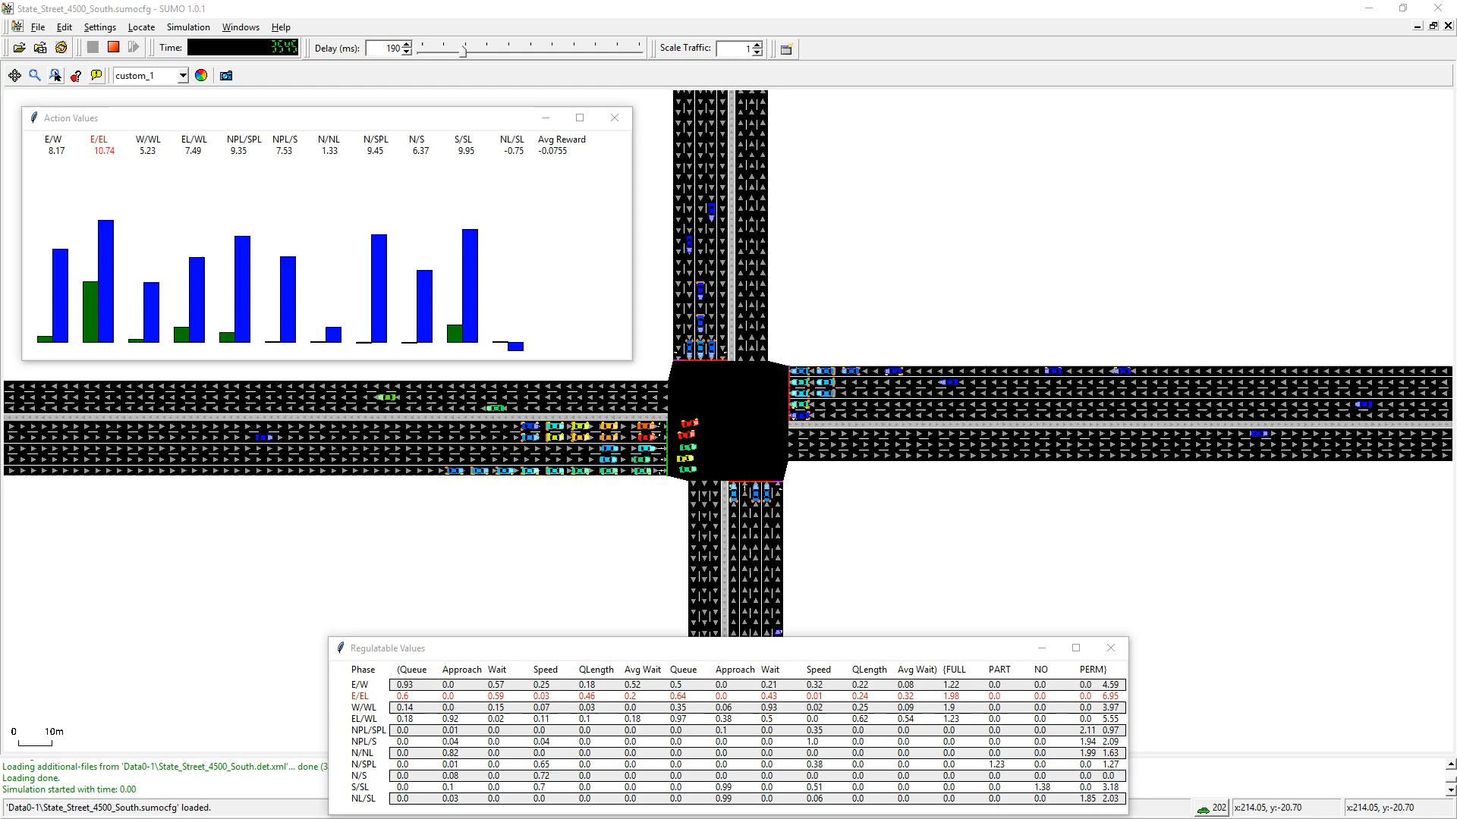
After 20 simulated days

Slide 39

Regulating AI controllers
Signal control should be regulated

Slide 40

Distilling a DNN controller to a Polynomial
DRQ: Targeting the DNN control function values
  MSE loss
DRSQ: Targeting the DNN Boltzmann distribution over its output
  Cross-Entropy Loss with Soft Labels
DRHQ: Targeting the hardmax action from the DNN
  Cross-Entropy Loss (hard labels)

Slide 41


Slide 42
Deep reinforcement learning for traffic signal control
“Learning an Interpretable Traffic Signal Control Policy”, AAMAS 2019
“Reinforcement learning benchmarks for traffic signal control”, NeurIPS 2021
“Reinforcement Learning for Traffic Signal Control: Applicability Study on Realistic Benchmarks”, under submission…

Slide 43
Breaking it down…
Congestion pricing for optimized traffic flow
Deep reinforcement learning for traffic signal control
Inference and management of epidemic progression
Optimizing video-game design
Optimizing indoor daylight in architectural design
Other applications…

Slide 44



Who is most likely to be infected?
Thicker arrow → longer exposure
Notes:
2 households
Use arrows to display contacts
1 has friends that live somewhere else

Slide 45


Who is most likely to be infected?
Thicker arrow → longer exposure
No Symptoms
Symptomatic
C
A
B
Notes:
4 report symptomatic
Test 1

Slide 46


Who is most likely to be infected?
Thicker arrow → longer exposure
No Symptoms
Symptomatic
Confirmed Infection
C
A
B
Notes:
Suppose person A and B live in the same household, then person B gets a positive test
Person 3 has reported to have symptoms, while no others in their household have
All of person 2’s recent contacts have reported symptoms as well
We have only a single test to give, who should get it?
Following Grushka’s, person 3, as they have both had exposure to a positive case and reported symptoms
Intuitively however we see that person 2 is more likely to have been infected, they’re in the same house!
Now scale this outside of the simple case of a household, into offices and schools where the decision is less clear
This is what we hoped to capture in this work

Slide 47

Previous work
4
4
4
Grushka et al Method
  Correlation to positive COVID-19 test
    Positive tested
    Exposure & symptomatic
    Exposure
    Symptomatic
    Non-symptomatic
More information
  False positive/negative test rates
  Probability of transmission between contacts
  Symptomatic rate
2
5
5
Higher Infection Likelihood
3
1

Slide 48

Bayesian inference
A statistical method that updates beliefs about an unknown parameter using Bayes’ theorem, incorporating prior knowledge with observed data
Bayes’ Theorem: $P(θ|D) = \frac{P(D|θ) P(θ)}{P(D)}$
$P(θ|D)$is the posterior, $P\left(D | θ\right)$is the likelihood, $P(θ)$is the prior, and $P(D)$ is the evidence
Prior Distribution: Represents initial beliefs about the parameter before observing data
Likelihood Function: Describes how likely the observed data is given different values of the parameter. It influences the posterior distribution.
Posterior Distribution: The updated probability distribution of the parameter after incorporating observed data, used for decision-making and predictions
Applications: Used in machine learning, reinforcement learning, probabilistic modeling, and real-world problems like traffic forecasting, medical diagnosis, and financial risk assessment

Slide 49


Infection Probability from Contact
Recovery probability over k days
Probability person j was infected on day t-k
Probability person i and person j were in contact on day t-k
Probability person i was not already sick on day t-k
Assumption 2: Infection events are mutually exclusive over days
Notes:
Assumption 1: there is a constant per day recovery rate

Slide 50



Infection Probability from Contact
Using proposition 2 and the probability that no mutually exclusive events happening:
  Prop. 3: the probability that an individual is currently sick
k days in the past
Prop. 2
Lemma 1:
All contacts of i
Substitute w/ lemma 1 and distribute:
  Prop. 4: the probability that an individual is sick in the next time step
Double-decayed contact matrix
Triple-decayed contact matrix
Notes:
Assuming that infection events are mutually exclusive over days, gives us proposition 3, 1 – sum of event probabilities
Lemma 1, prob. K days in past is product of current and recovery probability
Full proof in the paper
Take k to be 1, can be computed with 2 contact matricies

Slide 51





Empirical Evaluation via Simulation
Microscopic pandemic simulator with individual contact tracing
Full Tracing
Half Tracing
Passive Tracing : Contact from home/work/school address
github.com/SonyAI/PandemicSimulator
Notes:
Simulator developed by Sony AI and UT Austin, which is now publicly available
Necessary because existing simulators don’t have the resolution to track individuals in the population
3 people work here
A visitor
Full trace: we know full contact information, length of contact
Half: still know the 2 participants did not contact,
Passive: we only know that these 4 work together and had some chance of contact

Slide 52
Empirical Evaluation via Simulation
Microscopic pandemic simulator with individual contact tracing
Full Tracing
Half Tracing
Passive Tracing : Contact from home/work/school address
github.com/SonyAI/PandemicSimulator
Notes:
lose most of the contact information, only have full information between participants
grey lines use estimate of location contact rate
No longer know visitor was ever there, no recorded contact

Slide 53

Empirical Evaluation via Simulation
Microscopic pandemic simulator with individual contact tracing
Full Tracing
Half Tracing
Passive Tracing : Contact from home/work/school address
github.com/SonyAI/PandemicSimulator
Notes:
Only have the estimated contact rate
Visitor unknown

Slide 54



Hit ratio
95% confidence interval over 60 random trials shaded
1% tested, 2% quarantine cap
1,000-person population
Full Tracing: Entire population participates
Half Tracing: Only 50% of the population participates. Far less than 50% of contacts are recorded
Passive Tracing: No active participants. Assumes work/home/school known. Contact rates for each estimated

Slide 55

Updated Simulation
Calibrated to Sweden’s hospitalization data
4,000-person population
Continues to achieve better outcomes than baselines
Significant advantage also in Passive Tracing!
Notes:
Preview/unpublished results
Sim went through improvements/calibration

Slide 56
Inference and management of epidemic progression
"Agent-based Markov modeling for improved COVID-19 mitigation policies”, Capobianco, Roberto, Varun Kompella, James Ault, Guni Sharon, Stacy Jong, Spencer Fox, Lauren Meyers, Peter R. Wurman, and Peter Stone. Journal of Artificial Intelligence Research 71 (2021): 953-992.
"Multiagent epidemiologic inference through realtime contact tracing”, Sharon Guni, James Ault, Peter Stone, Varun Kompella, and Roberto Capobianco. Autonomous Agents and Multiagent Systems (2021).

Slide 57
Breaking it down…
Congestion pricing for optimized traffic flow
Deep reinforcement learning for traffic signal control
Inference and management of epidemic progression
Optimizing video-game design
Optimizing indoor daylight in architectural design
Other applications…

Slide 58




Optimizing video-game design
Use Nash Monte-Carlo reinforcement learning to approximate the mixed-strategy Nash equilibrium
Use a gradient-free optimization method (CMA-ES) to adjust game parameters to maximize strategy entropy
Scales significantly better in large combinatorial strategy spaces
Avoids degenerate solutions where all strategies become equally viable
Power: 20
Stamina: 30
Health: 40
Power: 40
Stamina: 30
Health: 20
Power: 30
Stamina: 30
Health: 30
Power: 40
Stamina: 40
Health: 40

Slide 59
Optimizing indoor daylight in architectural design
Use a gradient-free optimization method (CMA-ES) to optimize indoor daylight by adjusting window parameters
Objective: Maximizing daylight while minimizing glare, using a novel combination of Spatial Daylight Autonomy (sDA) and Annual Sunlight Exposure (ASE) as a single-objective function.
CMA-ES provides more reliable and stable daylight optimization across different locations compared to prior approaches

Slide 60





Slide 61
Further reading
"Bilevel entropy-based mechanism design for balancing meta in video games”, Sumedh Pendurkar, Chris Chow, and Guni Sharon. In Proceedings of the 2023 International Conference on Autonomous Agents and Multiagent Systems.
"Comparison between popular Genetic Algorithm (GA)-based tool and Covariance Matrix Adaptation-Evolutionary Strategy (CMA-ES) for optimizing indoor daylight”, Anis, Manal, Sumedh Pendurkar, Yun Kyu Yi, and Guni Sharon. In Proceedings of Building Simulation 2023: 18th Conference of IBPSA.

Slide 62
Other applications…
Stable imitation-reinforcement learning combination:
  Dey, Sheelabhadra, Sumedh Pendurkar, Guni Sharon, and Josiah P. Hanna. "A joint imitation-reinforcement learning framework for reduced baseline regret." In 2021 IEEE/RSJ International Conference on Intelligent Robots and Systems (IROS), pp. 3485-3491. IEEE, 2021.
  Bajaj, Vaibhav, Guni Sharon, and Peter Stone. "Task phasing: Automated curriculum learning from demonstrations." In Proceedings of the International Conference on Automated Planning and Scheduling, vol. 33, pp. 542-550. 2023.
  “Addressing Negative Transfer and Conflicting Gradients when Combining Imitation and Reinforcement Learning”, under submission…
Multi-Agent Pathfinding:
  “Conflict-based search for optimal multi-agent pathfinding”, Artificial Intelligence, 2015
  “Multi-Agent Pathfinding as a Combinatorial Auction”, AAAI 2015
  “Goal Distribution in Conflict-Based Search for Multi-Agent Pathfinding and its Implications to Monte-Carlo Sampling”, under submission…

