Slide 1
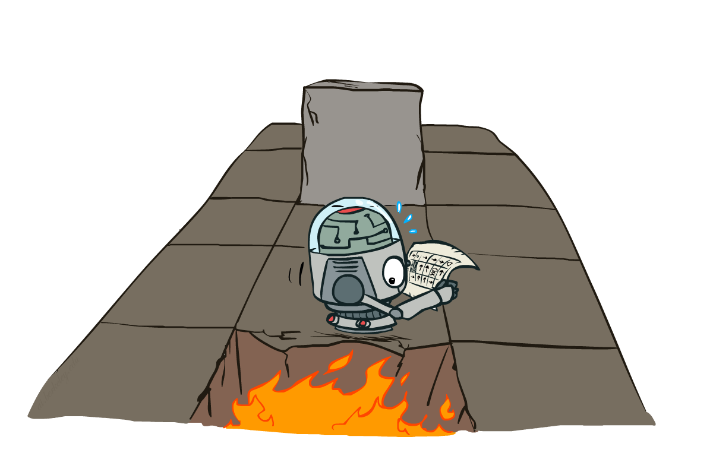
CSCE-420: Artificial Intelligence
Markov Decision Processes II
Instructor: Guni Sharon
Based on slides by: Pieter Abbeel, Dan Klein

Slide 2
Announcements
Assignment 2: Multi-Player Games, due by Monday Feb. 24, EoD
Midterm: March 25 during class (bring your ID)
Quiz5: Game Theory, due by Feb. 26, EoD
Contest 2: Repeated Prisoner Dilemma, due Monday, March 10, EoD
Quiz6: MDP, due by Mar. 3, EoD
Updated office hours: Tuesday 14:00—15:00

Slide 3
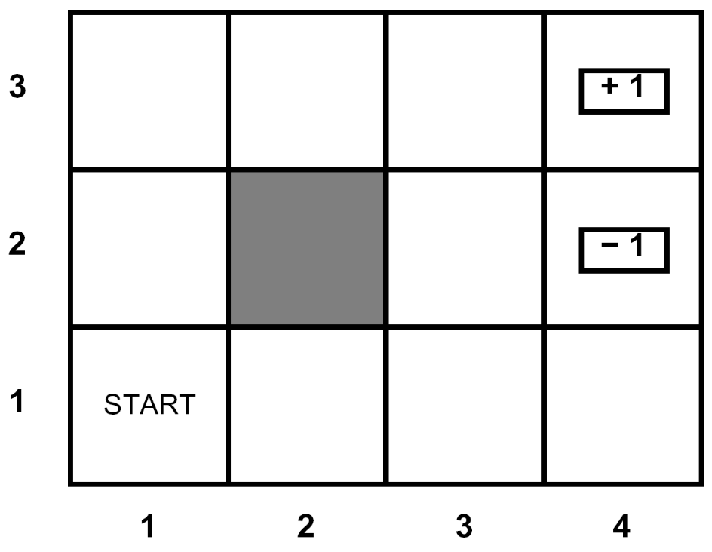
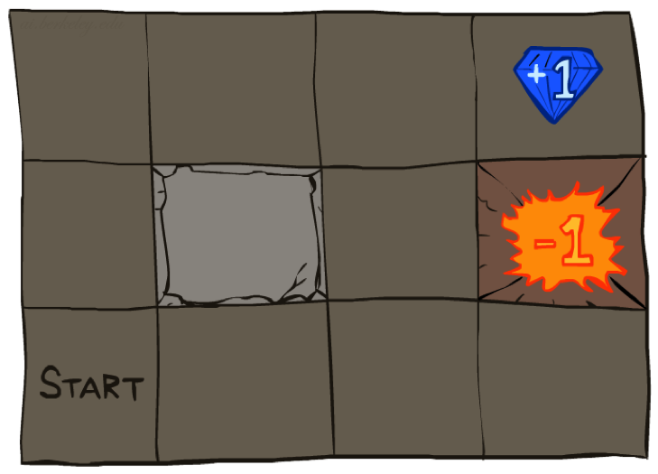




Example: Grid World
A maze-like problem
  The agent lives in a grid
  Walls block the agent’s path
Noisy movement: actions do not always go as planned
  80% of the time, the action North takes the agent North
  10% of the time, North takes the agent West; 10% East
  If there is a wall in the direction the agent would have been taken, the agent stays put
The agent receives rewards each time step
  Small “living” reward each step (can be negative)
  Big rewards come at the end (good or bad)
Goal: maximize sum of (discounted) rewards
Notes:
[cut demo of moving around in grid world program]

Slide 4
Recap: MDPs
s
Markov decision processes:
  States S
  Actions A
  Transitions P(s’|s,a) (or T(s,a,s’))
  Rewards R(s,a,s’) (and discount γ)
  Start state s₀
Quantities:
  Policy = map of states to actions
  Utility = sum of (discounted) rewards
  State values = expected future utility from a state (max node)
  Q-Values = expected future utility from a q-state (chance node)
a
s, a
s,a,s’
s’

Slide 5
Optimal Quantities
The value of a state s:
  V*(s) = expected utility starting in s and acting optimally
The value of a q-state (s,a):
  Q*(s,a) = expected utility starting out having taken action a from state s and (thereafter) acting optimally
The optimal policy:
  π*(s) = optimal action from state s
s
s is a state
a
(s, a) is a q-state
s, a
s,a,s’
(s,a,s’) is a
transition
s’
Notes:
Demo just shows V and Q values, snapshots on next slides.

Slide 6
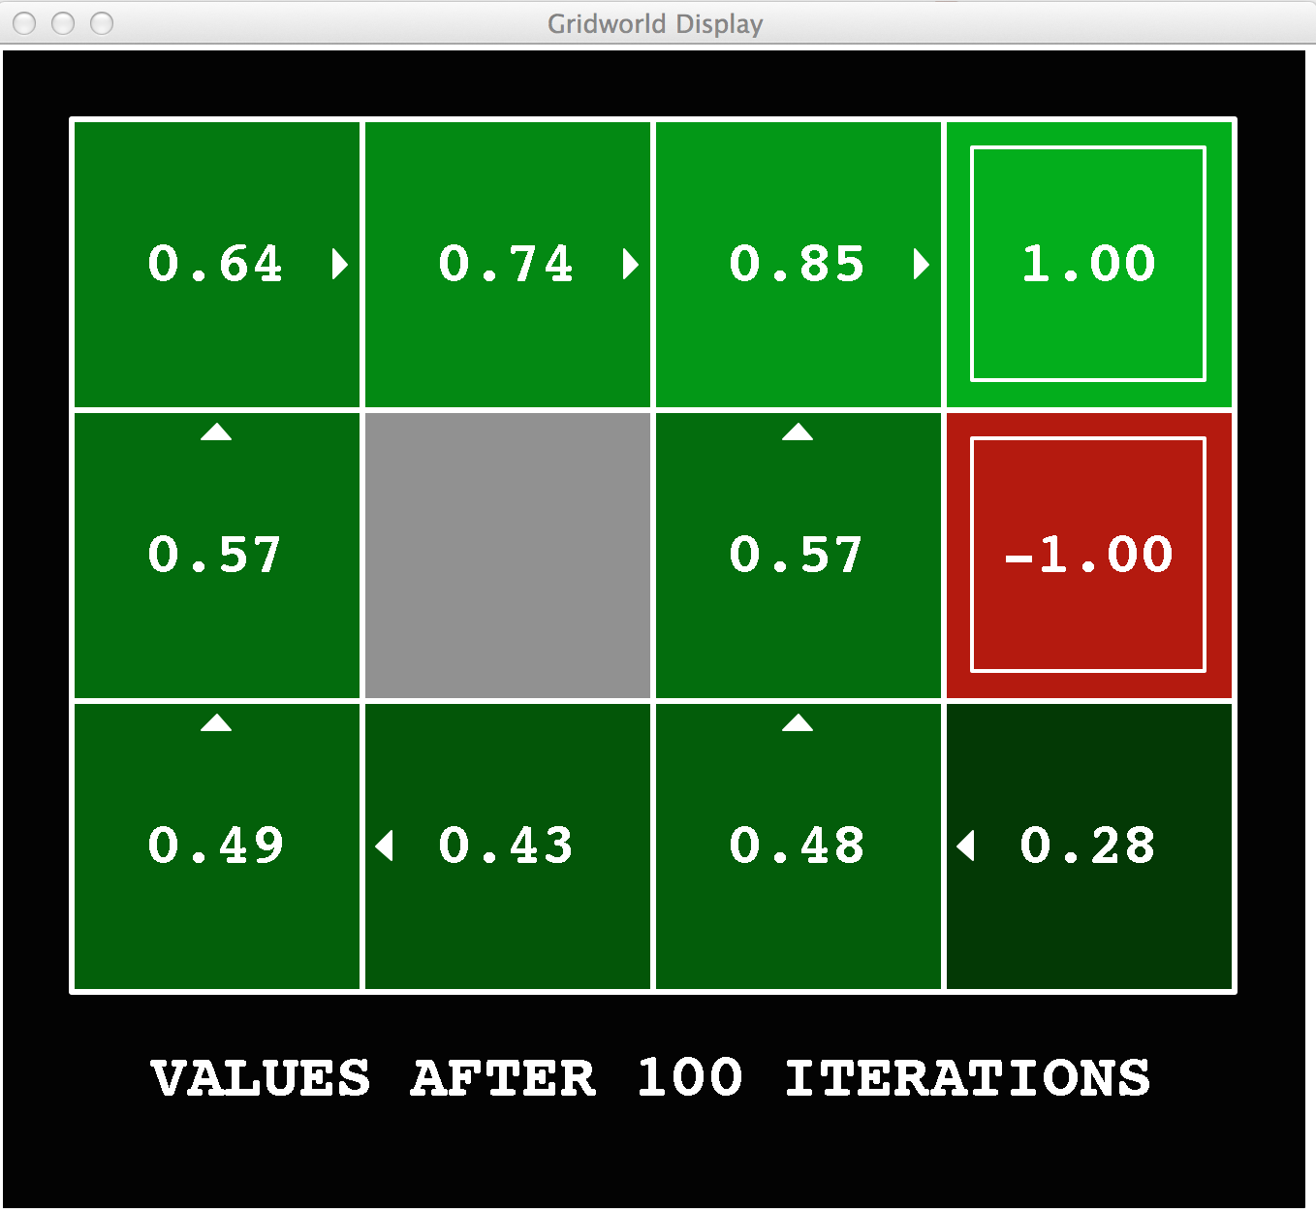
Gridworld Values V*

Slide 7
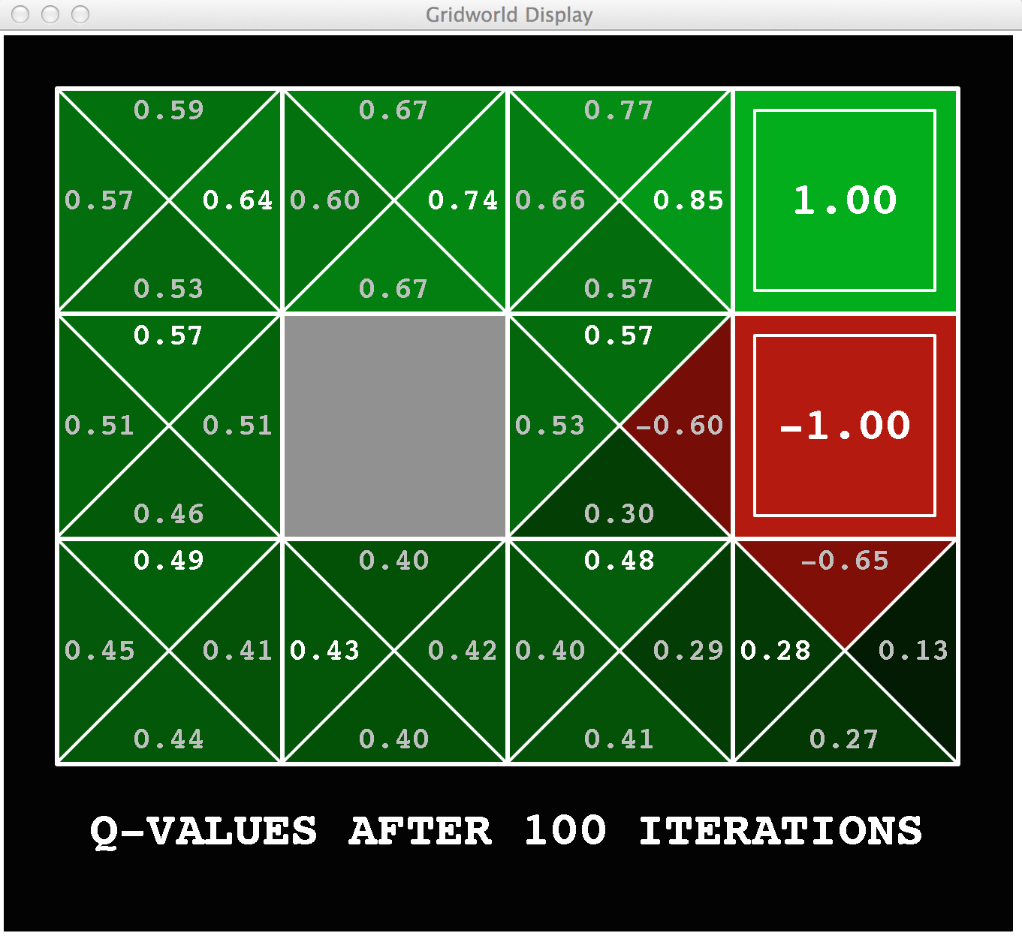
Gridworld: Q*

Slide 8

The Bellman Equations
Local expectimax updates
Guaranteed to converge for 0<γ<1

Slide 9

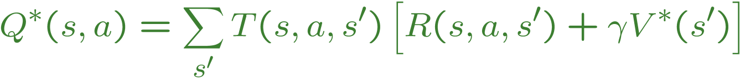
The Bellman Equations
Definition of “optimal utility” via expectimax recurrence gives a simple one-step lookahead relationship amongst optimal utility values
These are the Bellman equations, and they characterize optimal values in a way we’ll use over and over
s
a
s, a
s,a,s’
s’
Notes:
Let’s start by equations that characterize these quantities through mutual recursions. [step through this by writing on slide, one step at a time]
Recursive characterization of V* in terms of V*; not necessarily helpful; but it is a characterization.
Note: this is a set of equations that needs to be satisfied; but it could have multiple solutions (it does not, but at this stage of our knowledge it could).

Slide 10
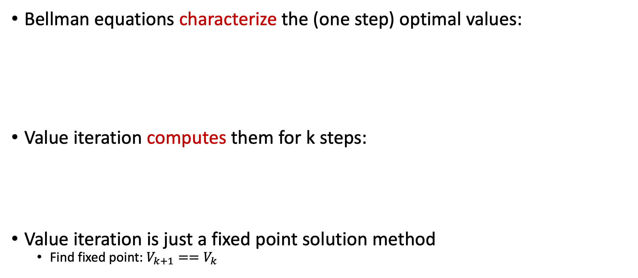
Value Iteration
Bellman equations characterize the (one step) optimal values:
Value iteration computes them for k steps:
Value iteration is just a fixed point solution method
  Find fixed point: $V_{k+1}==V_{k}$
V(s)
a
s, a
s,a,s’
V(s’)
Notes:
Discuss computational complexity: S * A * S times number of iterations
Note: updates not in place [if in place, it means something else and not even clear what it means]

Slide 11
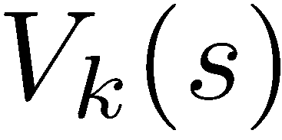
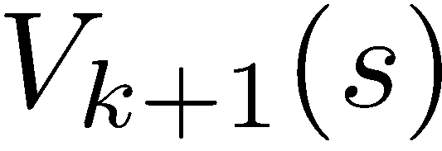
Convergence
How do we know the V_{k} vectors are going to converge?
Case 1: If the tree has maximum depth M, then V_{M} holds the actual untruncated values
Case 2: If the discount is less than 1
  Sketch: For any state V_{k} and V_{k+1} can be viewed as depth k+1 expectimax results in nearly identical search trees
  The difference is that on the bottom layer, V_{k+1} has actual rewards while V_{k} has zeros
  That last layer is at best all R_{MAX}
  It is at worst R_{MIN}
  But everything is discounted by γ^{k} that far out
  So V_{k} and V_{k+1} are at most γ^{k} max|R| different
  So as k increases, the values converge

Slide 12

Asynchronous Value Iteration
In value iteration, we update every state in each iteration
  Actually, any sequences of Bellman updates will converge if every state is visited infinitely often
In fact, we can update each state as seldom or often as we like, and we will still converge
Idea: Update states whose value we expect to change:
If is large then update predecessors of s

Slide 13
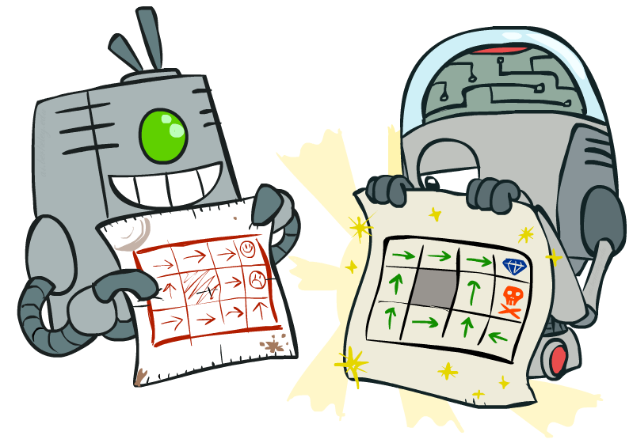
Policy Methods

Slide 14
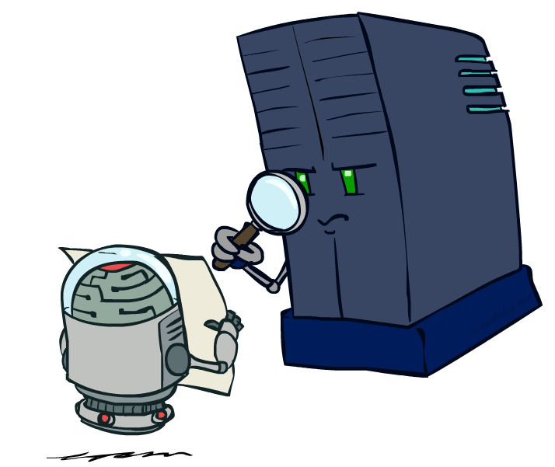
Policy Evaluation

Slide 15
Fixed Policies
Follow the optimal action
Follow π
s
s
a
π(s)
s, a
s, π(s)
s,a,s’
s, π(s),s’
s’
s’
Expectimax trees max over all actions to compute the optimal values
If we fixed some policy π(s), then the tree would be simpler – only one action per state
  … though the tree’s value would depend on which policy we fixed

Slide 16
Utilities for a Fixed Policy
Another basic operation: compute the utility of a state s under a fixed (generally non-optimal) policy
Define the utility of a state s, under a fixed policy π:
  V^{π}(s) = expected total discounted rewards starting in s and following π
Recursive relation (one-step look-ahead / Bellman equation):
s
π(s)
s, π(s)
s, π(s),s’
s’

Slide 17
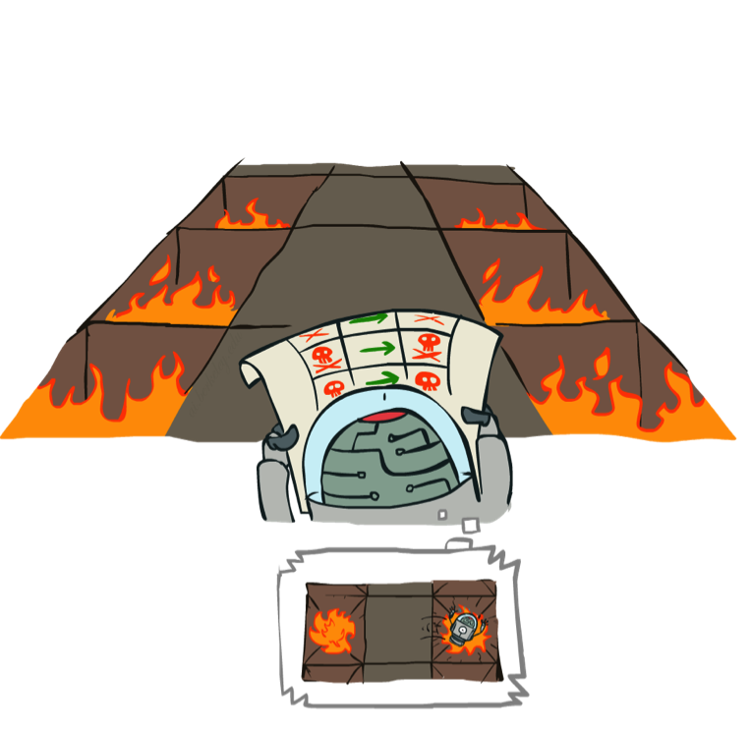
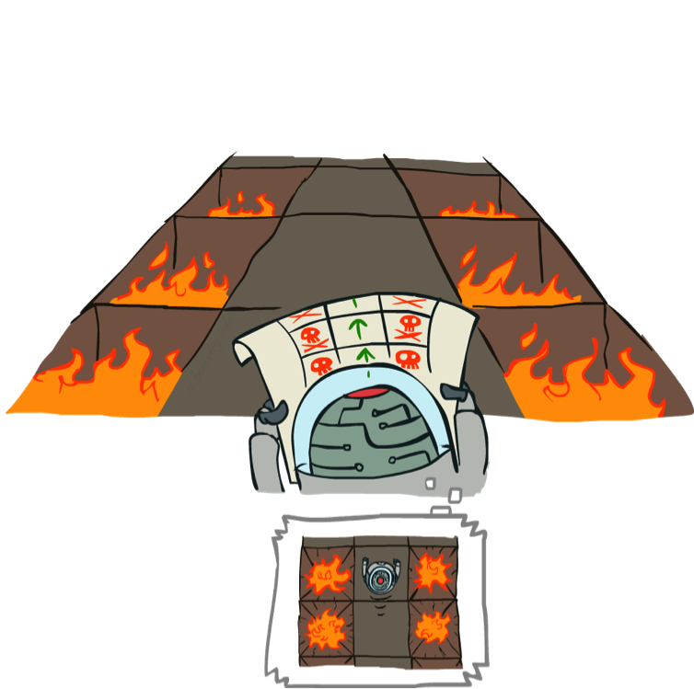
Example: Policy Evaluation
Always Go Right
Always Go Forward

Slide 18
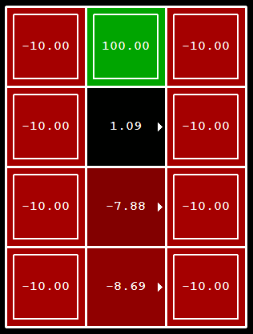
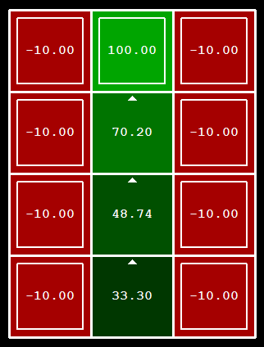
Example: Policy Evaluation
Always Go Right
Always Go Forward

Slide 19

Policy Evaluation
s
π(s)
s, π(s)
How do we calculate the V’s for a fixed policy π?
Idea 1: Turn recursive Bellman equations into updates
(like value iteration)
Efficiency: O(S²) per iteration
Idea 2: Without the maxes, the Bellman equations are just a linear system
s, π(s),s’
s’

Slide 20
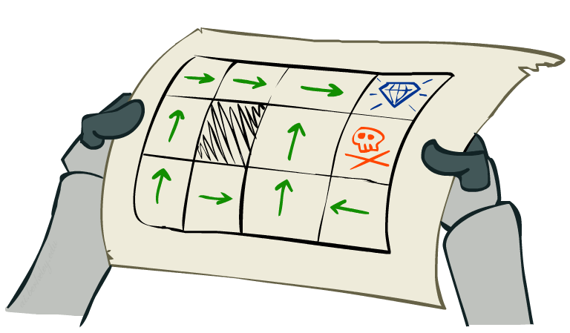
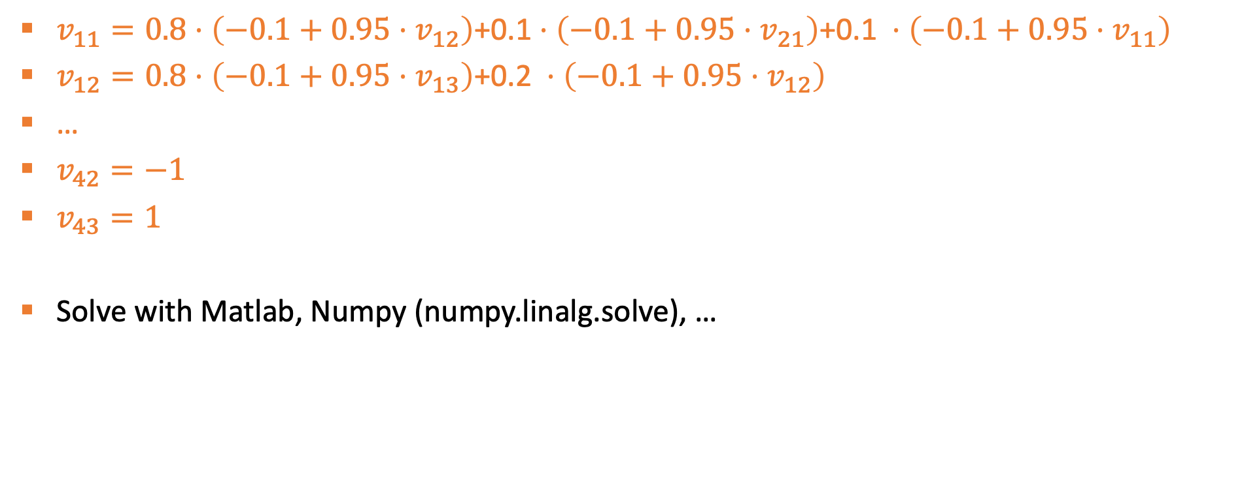
Policy value as Linear program
$v_{11}=0.8⋅\left(−0.1+0.95⋅v_{12}\right)$+0.1 $⋅\left(−0.1+0.95⋅v_{21}\right)\text{+0.1} ⋅\left(−0.1+0.95⋅v_{11}\right)$
$v_{12}=0.8⋅\left(−0.1+0.95⋅v_{13}\right)\text{+0.}\text{2} ⋅\left(−0.1+0.95⋅v_{12}\right)$
…
$v_{42}=−1$
$v_{43}=1$
Solve with Matlab, Numpy (numpy.linalg.solve), …
Notes:
[cut demo of moving around in grid world program]

Slide 21
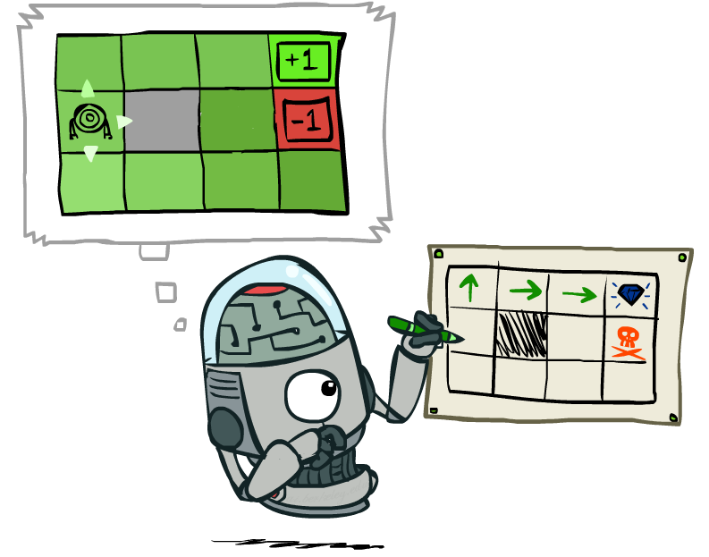
Policy Extraction

Slide 22
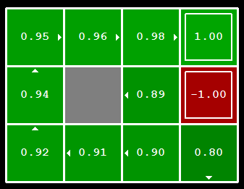

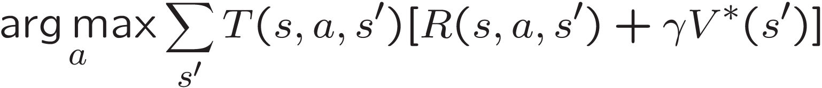
Computing Actions from Values
Let’s imagine we have the optimal values V*(s)
How should we act?
We need to do a mini-expectimax (one step)
This is called policy extraction, since it gets the policy implied by the values

Slide 23
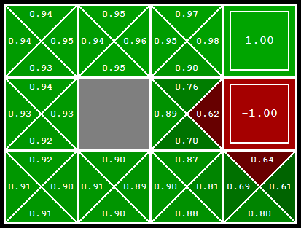
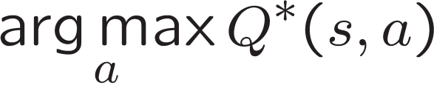
Computing Actions from Q-Values
Let’s imagine we have the optimal q-values:
How should we act?

Slide 24

Policy Iteration

Slide 25
Problems with Value Iteration
s
a
Value iteration repeats the Bellman updates:
Issue 1: It’s slow – O(S²A) per iteration
Issue 2: The “max” at each state rarely changes
Issue 3: The policy often converges long before the values
s, a
s,a,s’
s’
Notes:
Demo steps through value iteration; snapshots of values shown on next slides.

Slide 26
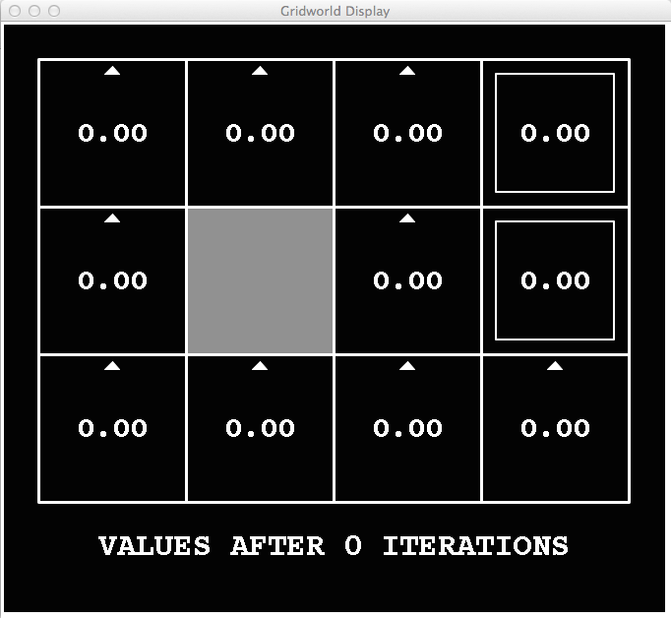
k=0
Noise = 0.2
Discount = 0.9
Living reward = 0
Notes:
Assuming zero living reward

Slide 27
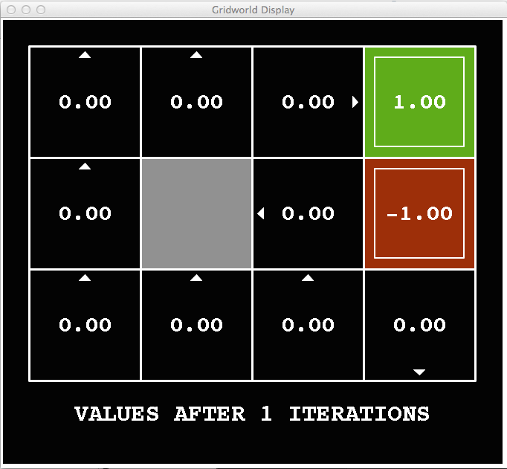
k=1
Noise = 0.2
Discount = 0.9
Living reward = 0
Notes:
Assuming zero living reward

Slide 28
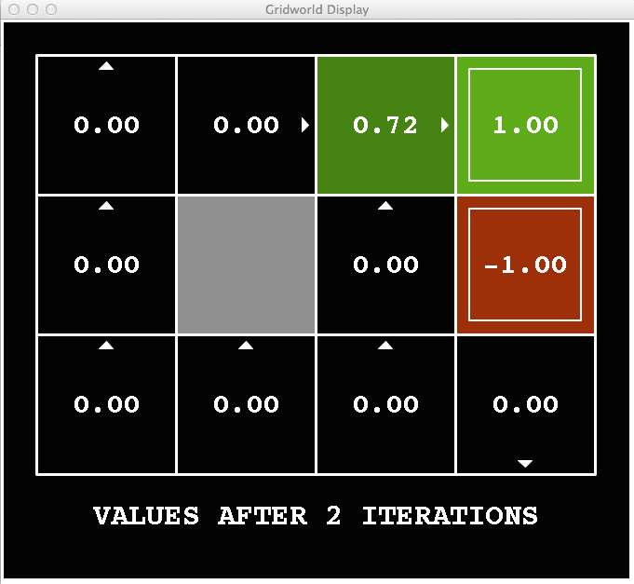
k=2
Noise = 0.2
Discount = 0.9
Living reward = 0
Notes:
Assuming zero living reward

Slide 29
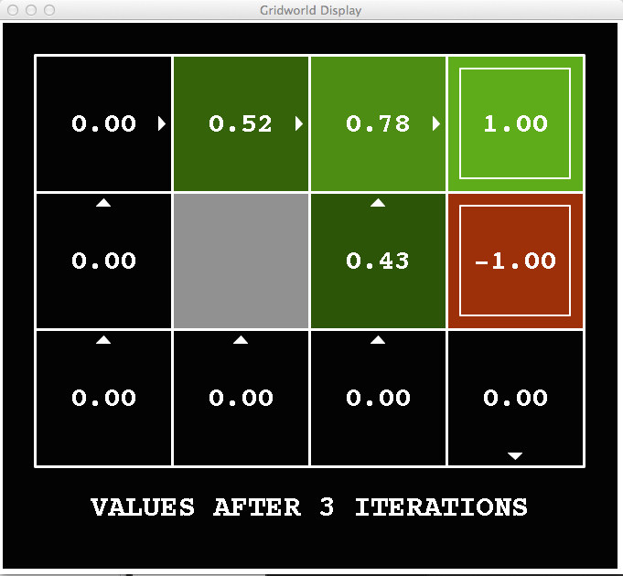
k=3
Noise = 0.2
Discount = 0.9
Living reward = 0
Notes:
Assuming zero living reward

Slide 30
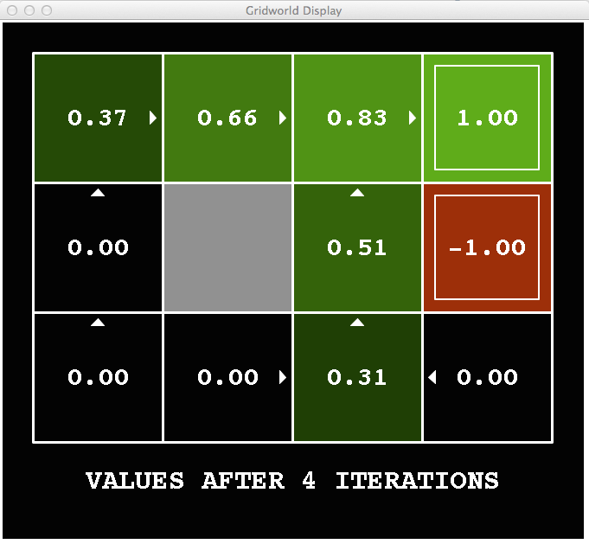
k=4
Noise = 0.2
Discount = 0.9
Living reward = 0
Notes:
Assuming zero living reward

Slide 31
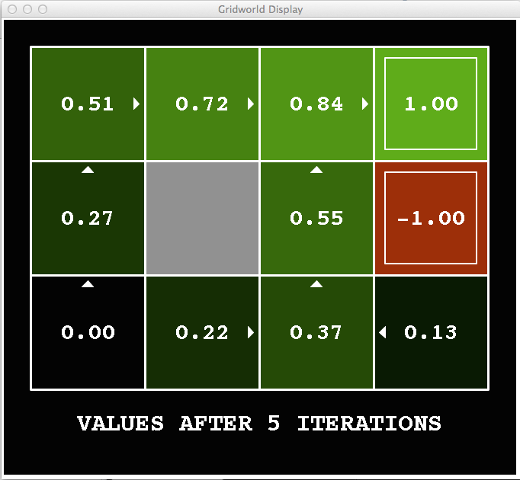
k=5
Noise = 0.2
Discount = 0.9
Living reward = 0
Notes:
Assuming zero living reward

Slide 32
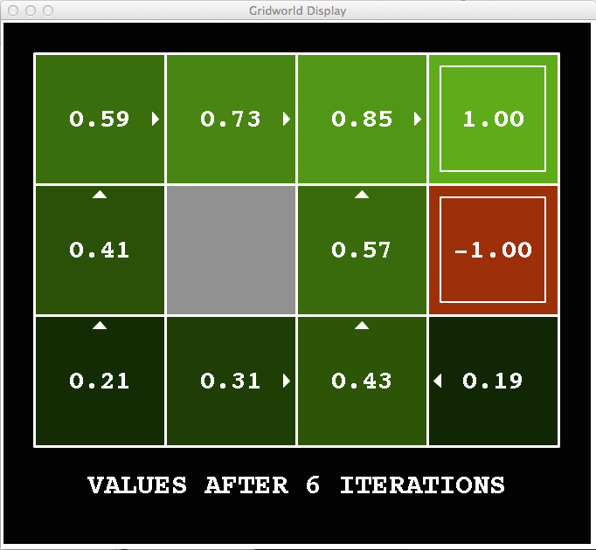
k=6
Noise = 0.2
Discount = 0.9
Living reward = 0
Notes:
Assuming zero living reward

Slide 33
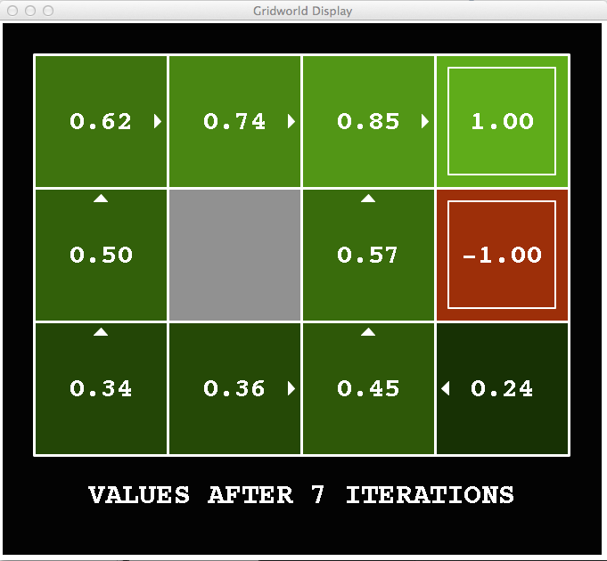
k=7
Noise = 0.2
Discount = 0.9
Living reward = 0
Notes:
Assuming zero living reward

Slide 34
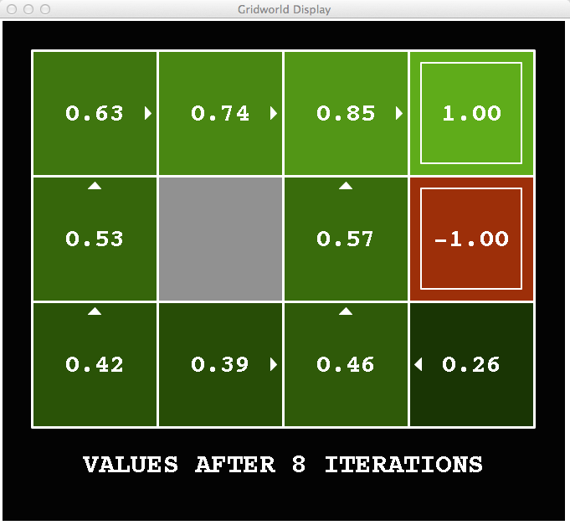
k=8
Noise = 0.2
Discount = 0.9
Living reward = 0
Notes:
Assuming zero living reward

Slide 35
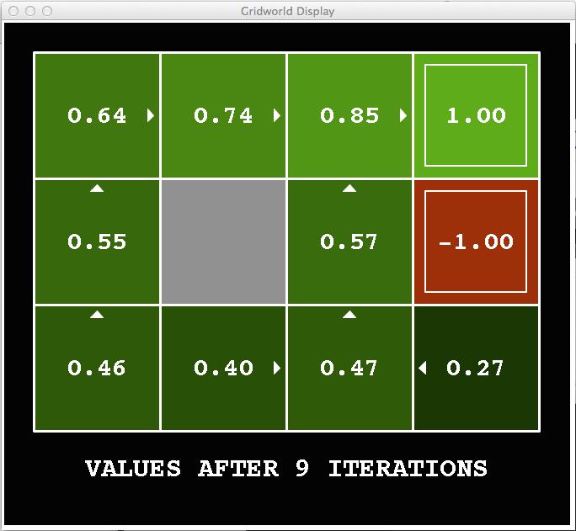
k=9
Noise = 0.2
Discount = 0.9
Living reward = 0
Notes:
Assuming zero living reward

Slide 36

k=10
Noise = 0.2
Discount = 0.9
Living reward = 0
Notes:
Assuming zero living reward

Slide 37

k=11
Noise = 0.2
Discount = 0.9
Living reward = 0
Notes:
Assuming zero living reward

Slide 38
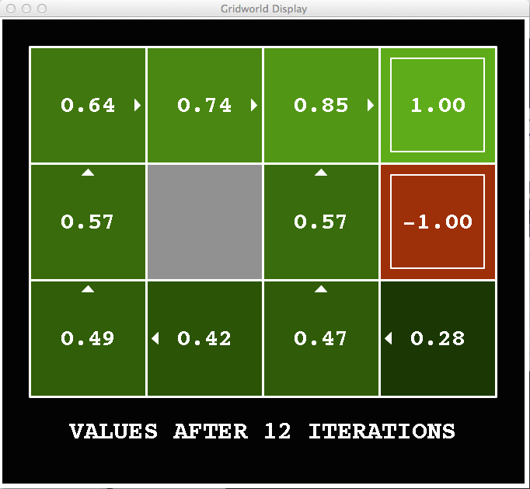
k=12
Noise = 0.2
Discount = 0.9
Living reward = 0
Notes:
Assuming zero living reward

Slide 39

k=100
Noise = 0.2
Discount = 0.9
Living reward = 0
Notes:
Assuming zero living reward

Slide 40
Policy Iteration
Alternative approach for computing the optimal values:
  Step 1: Policy evaluation: calculate utilities for some fixed policy (not optimal utilities!)
  Step 2: Policy improvement: update policy using one-step look-ahead with resulting converged (but not optimal!) utilities as future values
  Repeat steps until policy converges
This is policy iteration
  It’s still optimal!
  Can converge (much) faster under some conditions

Slide 41
Policy Iteration
Evaluation: For fixed current policy π, find values with policy evaluation:
  Iterate until values converge:
Improvement: For fixed values, get a better policy using policy extraction
  One-step look-ahead:

Slide 42
Policy iteration
0.7
0.8
0.9
0.7
0.6
0.4
0.6
0.5

Slide 43
Comparison
Both value iteration and policy iteration compute the same thing (all optimal values)
In value iteration:
  Every iteration updates both the values and (implicitly) the policy
  We don’t track the policy, but taking the max over actions implicitly recomputes it
In policy iteration:
  Update utilities with fixed policy (fast because we consider only one action, not all of them)
  After the policy is evaluated, a new policy is chosen (slow like a value iteration pass)
  The new policy will be better (or we’re done)

Slide 44
Summary: MDP Algorithms
So you want to….
  Compute optimal values: use value iteration or policy iteration
  Compute values for a particular policy: use policy evaluation
  Turn your values into a policy: use policy extraction (one-step lookahead)
These all look the same!
  They basically are – they are all variations of Bellman updates
  They all use one-step lookahead expectimax fragments
  They differ only in whether we plug in a fixed policy or max over actions

Slide 45
Moving on…
So far: offline MDP solvers – assume known transition function
  Is this assumption reasonable in real-world problems?
Next, we’ll drop this assumption
  Can we use offline solvers?
Can we learn the transition function?
Do we need to learn the transition function?
Let’s start by examining these questions in a simplified setting
  Stateless MDP

Slide 46
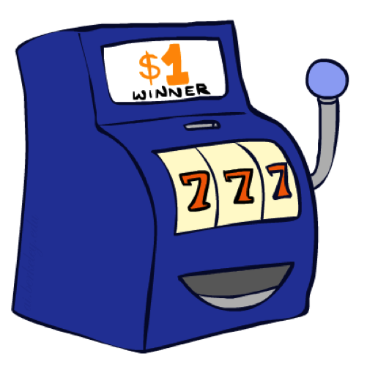
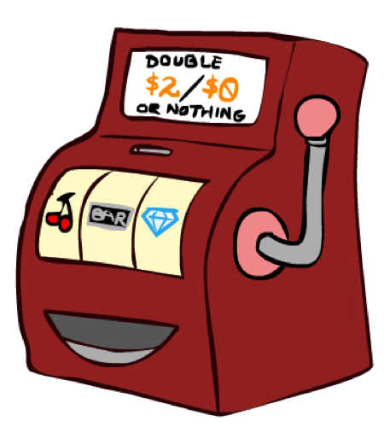

Multi-Armed Bandits (stateless MDPs)

Slide 47
Double-Bandit MDP
Actions: Blue, Red
States: 1 state
No discount
100 time steps
Both states have the same value
0.25 $0
S
0.75
$2
$1
1.0

Slide 48
Offline Planning
So far: solving MDPs is offline planning
  You determine all quantities through computation
  You need to know the details of the MDP
  You do not actually play the game!
No discount
100 time steps
Both states have the same value
0.25 $0
Value
S
0.75
$2
Play Red
150
$1
1.0
Play Blue
100

Slide 49
Let’s Play!
$2
$2
$0
$2
$2
$2
$2
$0
$0
$0

Slide 50
Online Planning
Rules changed! Red’s win chance is different.
? $0
S
?
$2
$1
1.0

Slide 51
Let’s Play!
$0
$0
$0
$2
$0
$2
$0
$0
$0
$0

Slide 52
What Just Happened?
That wasn’t planning, it was learning!
  Specifically, reinforcement learning
  There was an MDP, but you couldn’t solve it with just computation
  You needed to actually act to figure it out
Important ideas in reinforcement learning that came up
  Exploration: you have to try unknown actions to get information
  Exploitation: eventually, you have to use what you know
  Regret: even if you learn intelligently, you make mistakes during learning
  Sampling: because of chance, you have to try things repeatedly
  Difficulty: learning can be much harder than solving a known MDP

Slide 53
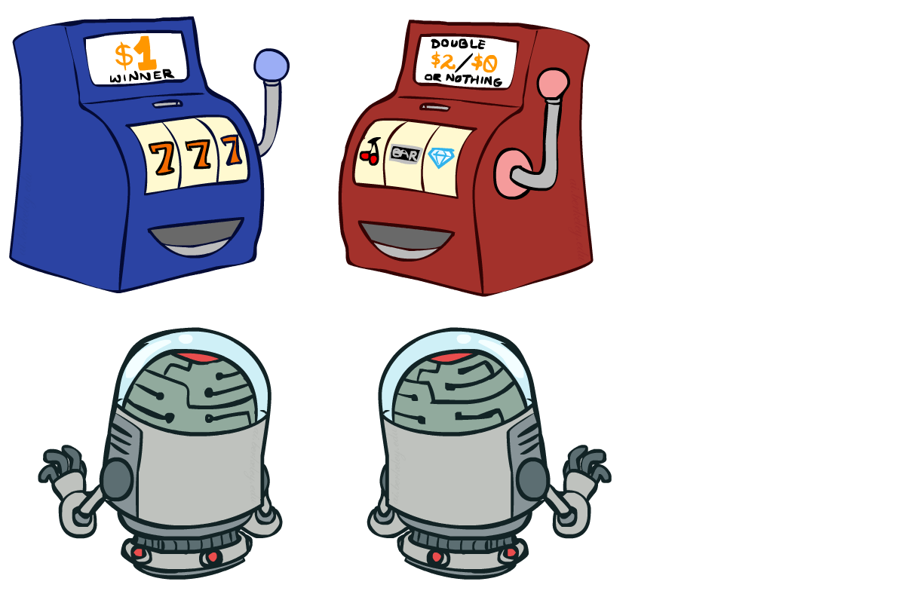
Interlude

Slide 54
What did we learn?
Optimal state values imply optimal policy
Computing optimal state values is computationally intensive
Computing state values for a given policy is easy (linear programing)
Policy iteration: policy evaluation -> policy extraction -> repeat
Usually much faster than value iteration
Both PI and VI assume a known model
Next Time: Reinforcement Learning (unknown model)!

