Slide 1
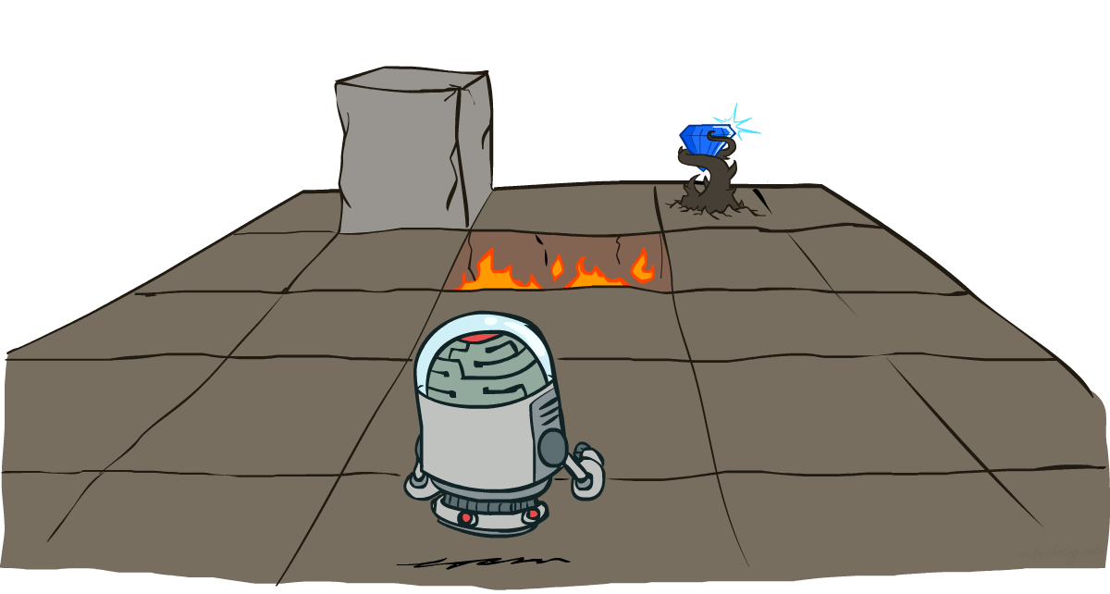
CSCE-420: Artificial Intelligence
Markov Decision Processes
Instructor: Guni Sharon
Based on slides by: Pieter Abbeel, Dan Klein

Slide 2
Announcements
Assignment 2: Multi-Player Games, due by Monday Feb. 24, EoD
Midterm: March 25 during class (bring your ID)
Quiz5: Game Theory, due by Feb. 26, EoD
Contest 2: Repeated Prisoner Dilemma, due Monday, March 10, EoD
Quiz6: MDP, due by Mar. 3, EoD
Updated office hours: Tuesday 14:00—15:00

Slide 3
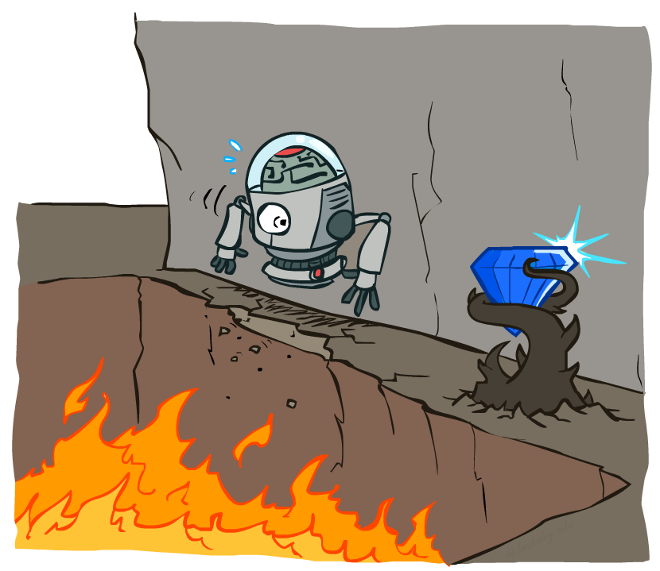
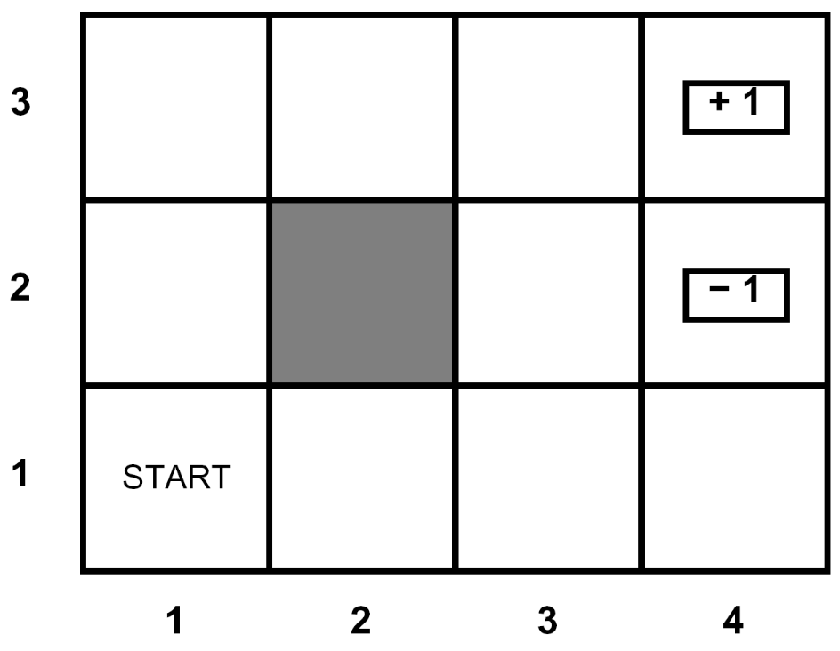
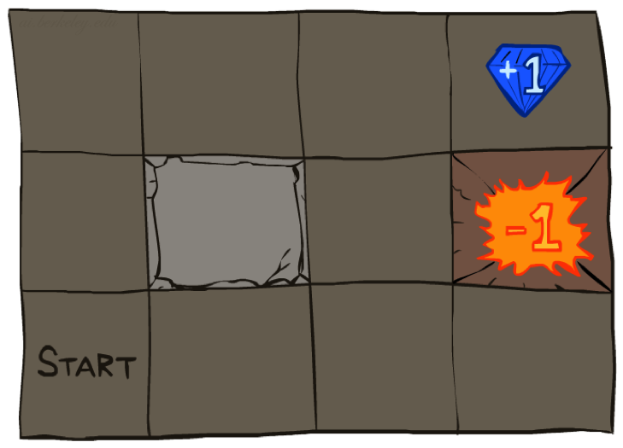




Non-Deterministic planning
Example:
A maze-like problem
  The agent lives in a grid
  Walls block the agent’s path
Noisy movement: actions do not always go as planned
  80% of the time, the action North takes the agent North
  (if there is no wall there)
  10% of the time, North takes the agent West; 10% East
  If there is a wall in the direction the agent would have been taken, the agent stays put
The agent receives rewards each time step
  Small “living” reward each step (can be negative)
  Big rewards come at the end (good or bad)
Goal: maximize sum of rewards
Notes:
[cut demo of moving around in grid world program]

Slide 4
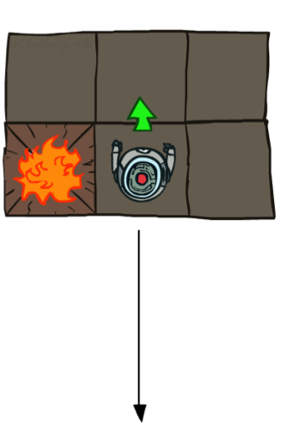
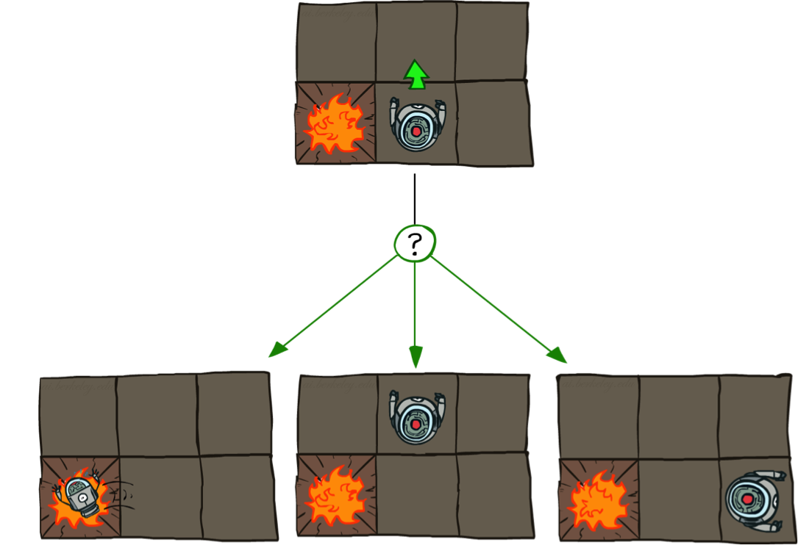
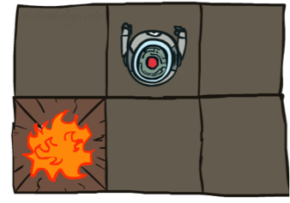
Grid World Actions
Deterministic Grid World
Stochastic Grid World

Slide 5
Markov Decision Processes
An MDP is defined by:
  A set of states s ∈ S
  A set of actions a ∈ A
  A transition function T(s, a, s’)
    Probability that a from s leads to s’, i.e., P(s’| s, a)
    Also called the model or the dynamics
  A reward function R(s, a, s’)
    Sometimes just R(s,a) or R(s)
  A start state
  Maybe a terminal state
MDPs are non-deterministic search problems
  One way to solve them is with expectimax search
    Intractable for anything but the simplest problems
  We’ll have a new tool soon
Notes:
In search problems: did not talk about actions, but about successor functions --- now the information inside the successor function is unpacked into actions, transitions and reward
Write out S, A, example entry in T, entry in R
Reward function different from the book : R(s,a,s’)
In book simpler for equations, but not useful for the projects.
Need to modify expectimax a tiny little bit to account for rewards along the way, but that’s something you should be able to do, and so you can already solve MDP’s (not in most efficient way)

Slide 6
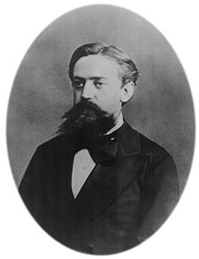

The Markovian property
The Markovian property generally means that given the present state, the future and the past are independent
For Markov decision processes, “Markov” means action outcomes depend only on the current state
This is just like search, where the successor function could only depend on the current state (not the history)
Andrey Markov (1856-1922)
Notes:
Like search: successor function only depended on current state
Can make this happen by stuffing more into the state;
Very similar to search problems: when solving a maze with food pellets, we stored which food pellets were eaten

Slide 7


The Markovian property
But sometimes history matters…
Can MDPs still be useful in such cases?
Yes, we can include relevant features as part of the state space in a way that preserves the Markovian property

Slide 8
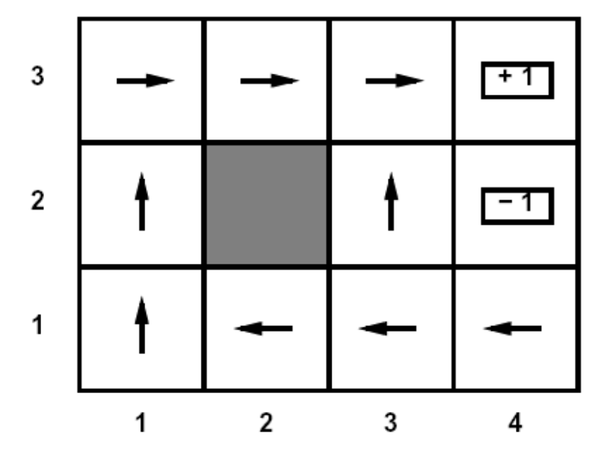
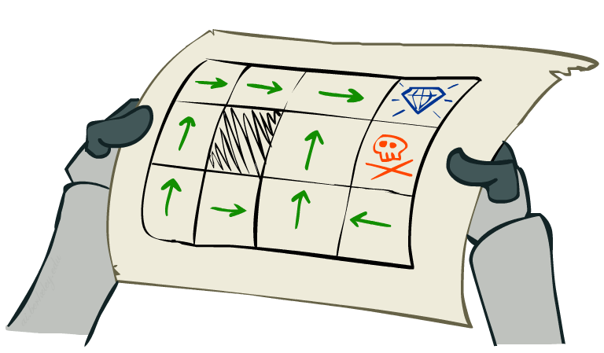
Policies
In deterministic single-agent search problems, we wanted an optimal plan, or sequence of actions, from start to a goal
For MDPs, we want an optimal policy π*: S → A
  A policy π returns an action for each state
  An optimal policy is one that maximizes the expected utility if followed
Optimal policy when living reward = -0.4
Notes:
Dan has a DEMO for this.

Slide 9
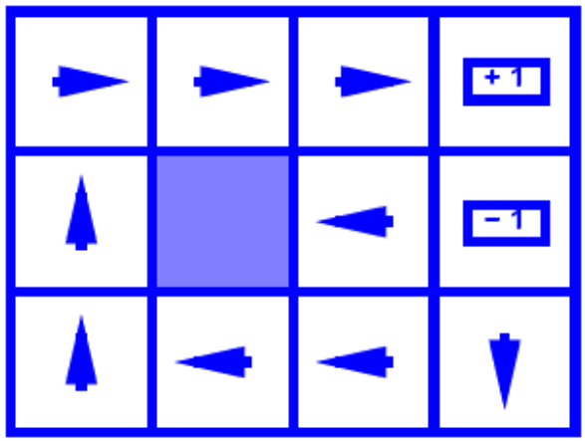
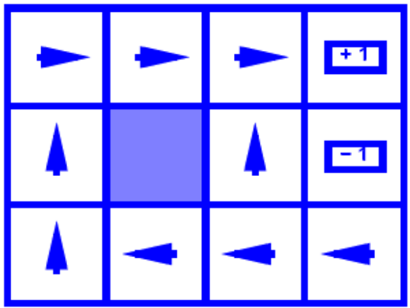
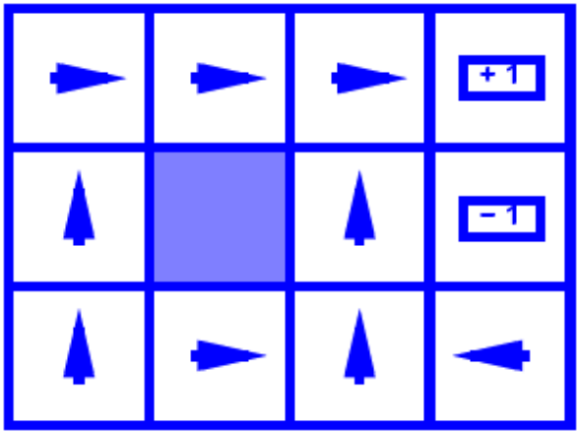
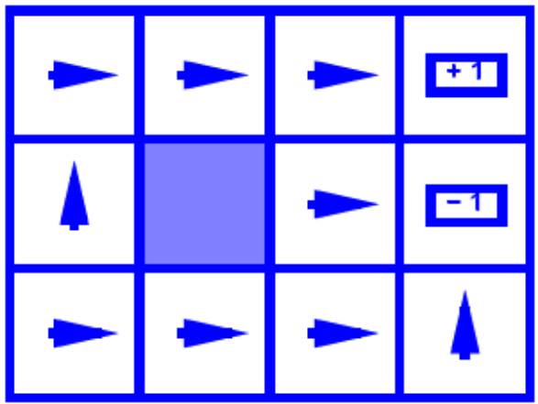
Optimal Policies
R(s) = -0.01
R(s) = -0.03
R(s) = -0.4
R(s) = -2.0
Notes:
R(s) = the “living reward”

Slide 10
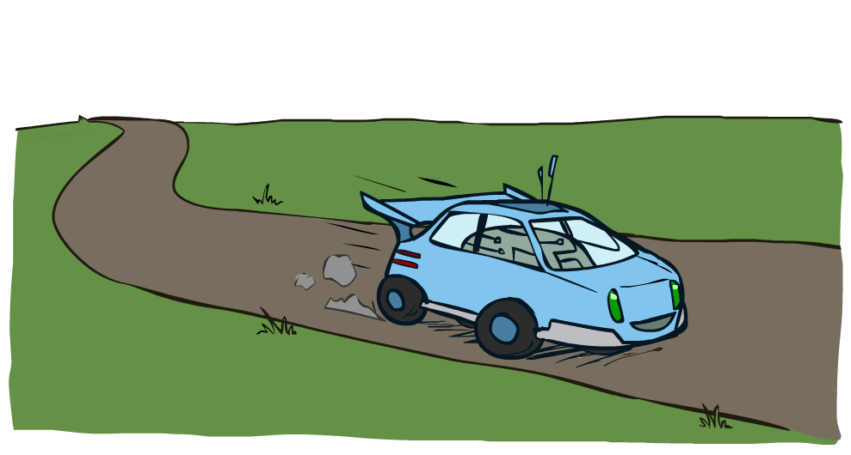
Example: Racing

Slide 11
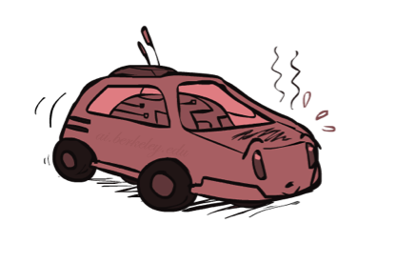
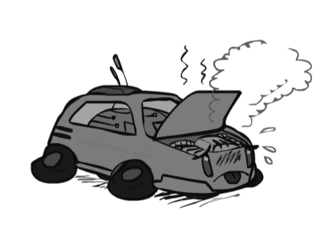

Example: Racing
A robot car wants to travel far, quickly
Three states: Cool, Warm, Overheated
Two actions: Slow, Fast
Going faster gets double reward
0.5
+1
1.0
Fast
Slow
-10
+1
0.5
Warm
Slow
Fast
0.5
+2
Cool
0.5
Overheated
+1
1.0
+2

Slide 12


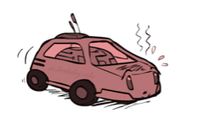
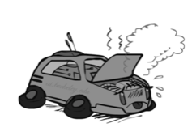
Racing Expectimax Search Tree

Slide 13
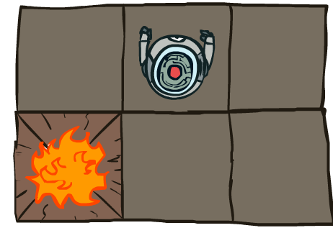
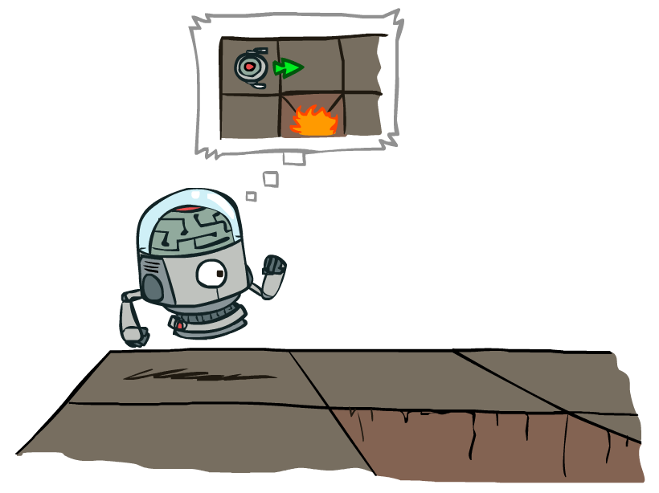
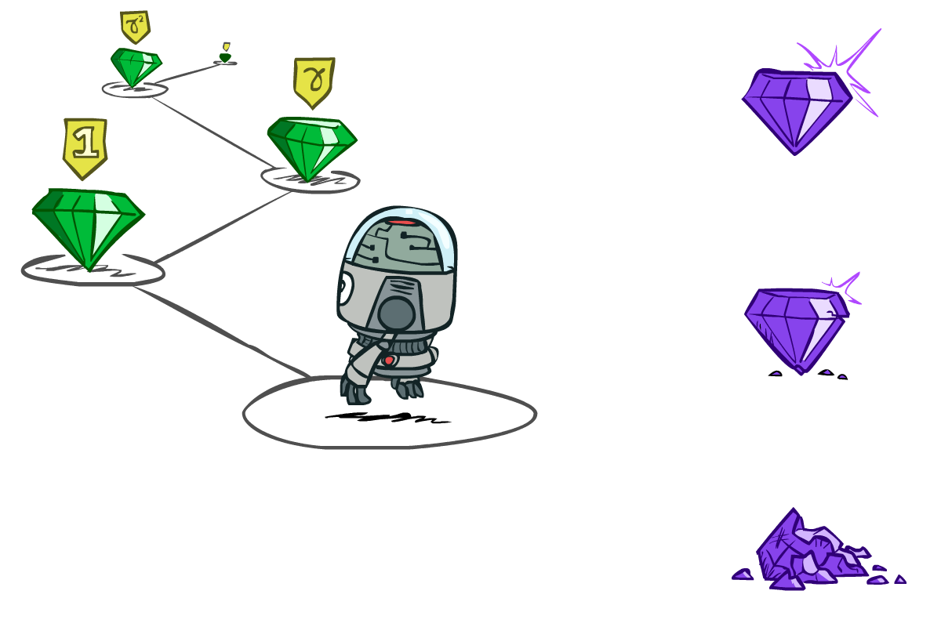
MDP Notation
s
s is a state
a
(s, a) is a q-state
s, a
(s,a,s’) called a transition
T(s,a,s’) = P(s’|s,a)
R(s,a,s’)
s,a,s’
s’
Notes:
In MDP chance node represents uncertainty about what might happen based on (s,a) [as opposed to being a random adversary]
Q-state (s,a) is when you were in a state and took an action

Slide 14
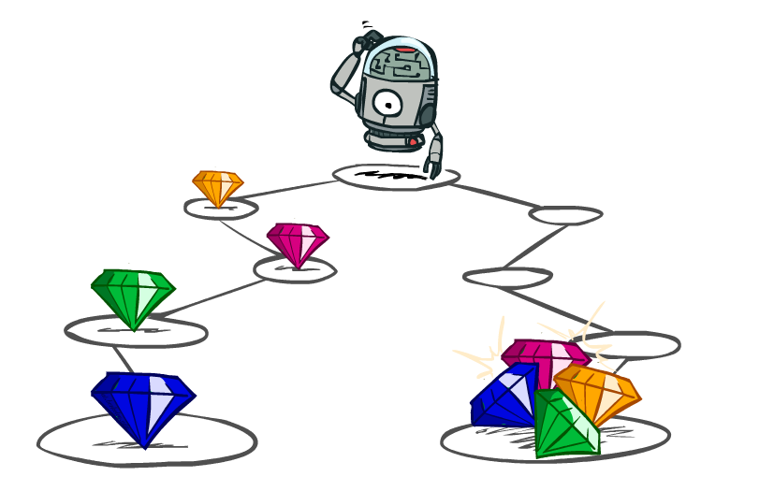
Utilities of Sequences

Slide 15
Utilities of Sequences
What preferences should an agent have over reward sequences?
More or less?
Now or later?
[1, 2, 2]
or
[2, 3, 4]
[0, 0, 1]
or
[1, 0, 0]

Slide 16


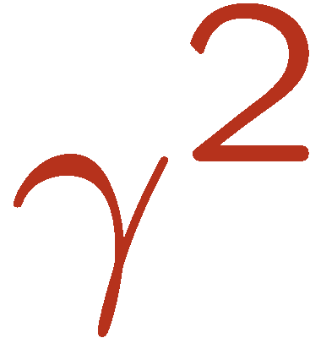

Discounting
It’s reasonable to maximize the sum of rewards
It’s also reasonable to prefer rewards now to rewards later
One solution: values of rewards decay exponentially
Worth Now
Worth Next Step
Worth In Two Steps

Slide 17

Discounting
How to discount?
  Each time we descend a level, we multiply in the discount once
Why discount?
  Sooner rewards probably do have higher utility than later rewards
  Also helps our algorithms converge
Example: discount of 0.5
  U([1,2,3]) = 1*1 + 0.5*2 + 0.25*3
  U([1,2,3]) < U([3,2,1])
Notes:
Rewards in the future (deeper in the tree) matter less
Interesting: running expectimax, if having to truncate the search, then not losing much; e.g., less then \gamma^d / (1-\gamma)

Slide 18
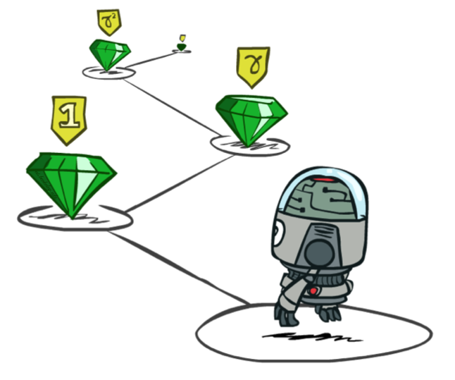
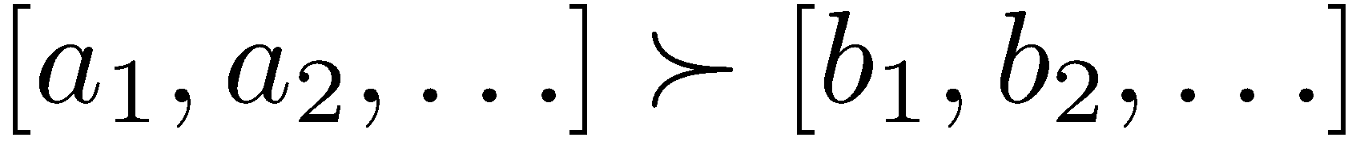
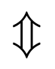
Stationary Preferences
Theorem: if we assume stationary preferences:
Then: there are only two ways to define utilities
  Additive utility:
  Discounted utility:

Slide 19


Quiz: Discounting
Given grid world:
  Actions: East, West, and Exit (‘Exit’ only available in terminal states: a, e)
  Rewards are given only after an exit action
  Transitions: deterministic
Quiz 1: For γ = 1, what is the optimal policy?
Quiz 2: For γ = 0.1, what is the optimal policy?
Quiz 3: For which γ are West and East equally good when in state d?

Slide 20

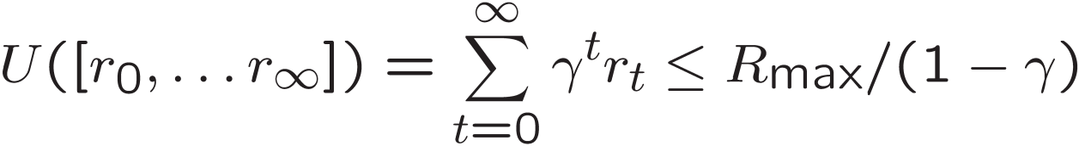
Infinite Utilities?!
Problem: What if the game lasts forever? Do we get infinite rewards?
Solutions:
  Finite horizon: (similar to depth-limited search)
    Terminate episodes after a fixed T steps (e.g. life)
    Gives nonstationary policies (π depends on time left)
  Discounting: use 0 < γ < 1
    Smaller γ means smaller “horizon” – shorter term focus
  Absorbing Markov chain: guarantee that for every policy, a terminal state will eventually be reached
(infinite geometric series)

Slide 21
Recap: Defining MDPs
Markov decision processes:
  Set of states S
  Start state s₀
  Set of actions A
  Transitions P(s’|s,a) (or T(s,a,s’))
  Rewards R(s,a,s’) (and discount γ)
MDP quantities so far:
  Policy = Choice of action for each state
  Utility = sum of (discounted) rewards
s
a
s, a
s,a,s’
s’

Slide 22
Solving MDPs

Slide 23
Optimal Quantities
The value (utility) of a state s:
  V*(s) = expected utility after starting in s and acting optimally
The value (utility) of a q-state (s,a):
  Q*(s,a) = expected utility starting out having taken action a from state s and (thereafter) acting optimally
The optimal policy:
  π*(s) = argmax_{a}[Q*(s,a)]
s
s is a state
a
(s, a) is a q-state
s, a
s,a,s’
(s,a,s’) is a
transition
s’
Notes:
[Note: this demo doesn’t show anything in action, just pops up V and Q values.]

Slide 24
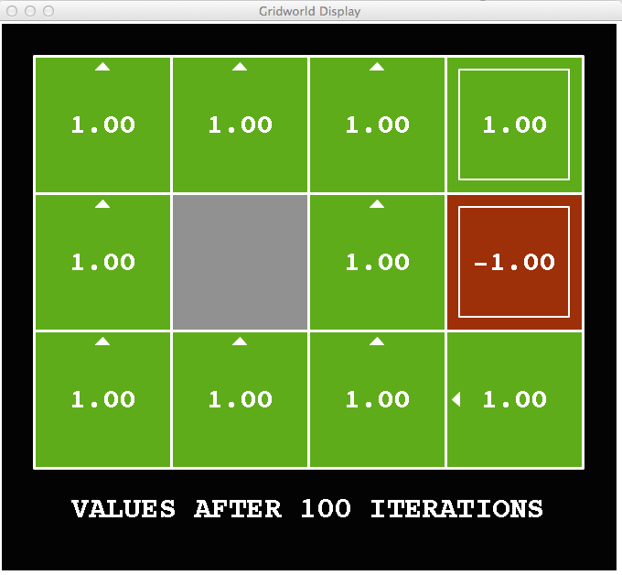
Snapshot of Demo – Gridworld V Values
Noise = 0
Discount = 1
Living reward = 0
Notes:
This demo doesn’t show anything in action, it just shows the V and Q values.

Slide 25
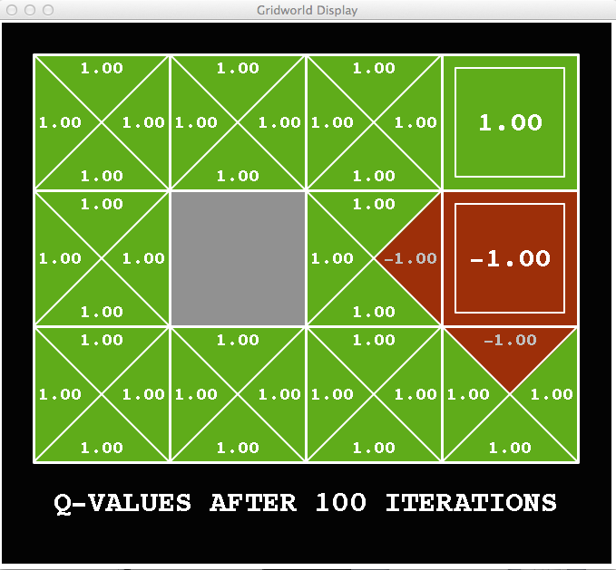
Snapshot of Demo – Gridworld Q Values
Noise = 0
Discount = 1
Living reward = 0
Notes:
This demo doesn’t show anything in action, it just shows the V and Q values.

Slide 26

Snapshot of Demo – Gridworld V Values
Noise = 0.2
Discount = 1
Living reward = 0
Notes:
This demo doesn’t show anything in action, it just shows the V and Q values.

Slide 27
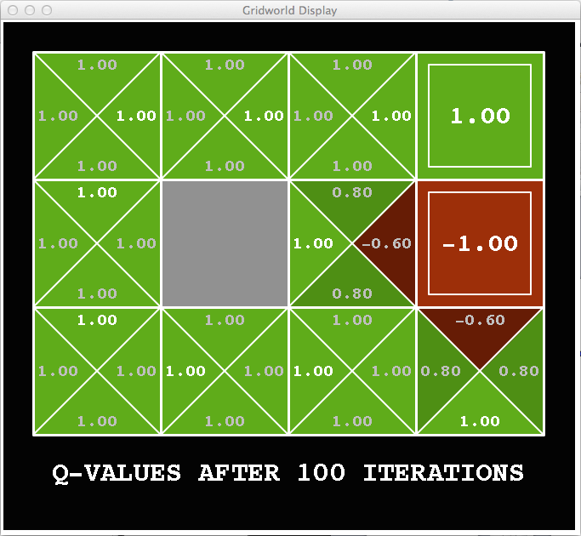
Snapshot of Demo – Gridworld Q Values
Noise = 0.2
Discount = 1
Living reward = 0
Notes:
This demo doesn’t show anything in action, it just shows the V and Q values.

Slide 28
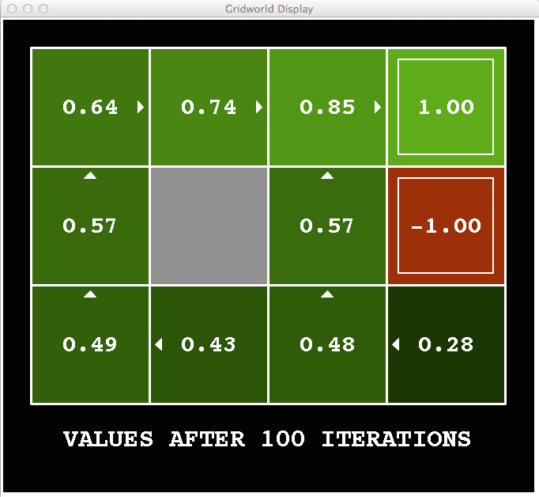
Snapshot of Demo – Gridworld V Values
Noise = 0.2
Discount = 0.9
Living reward = 0
Notes:
This demo doesn’t show anything in action, it just shows the V and Q values.

Slide 29
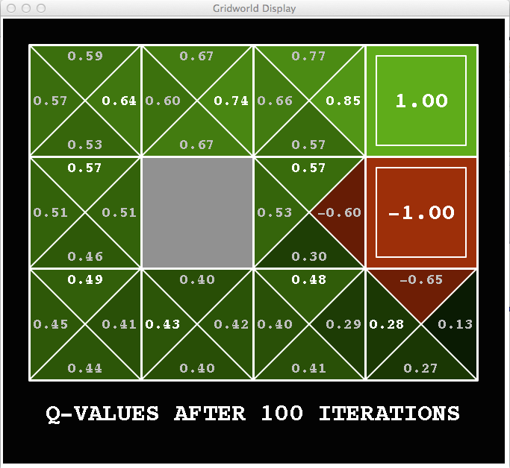
Snapshot of Demo – Gridworld Q Values
Noise = 0.2
Discount = 0.9
Living reward = 0
Notes:
This demo doesn’t show anything in action, it just shows the V and Q values.

Slide 30
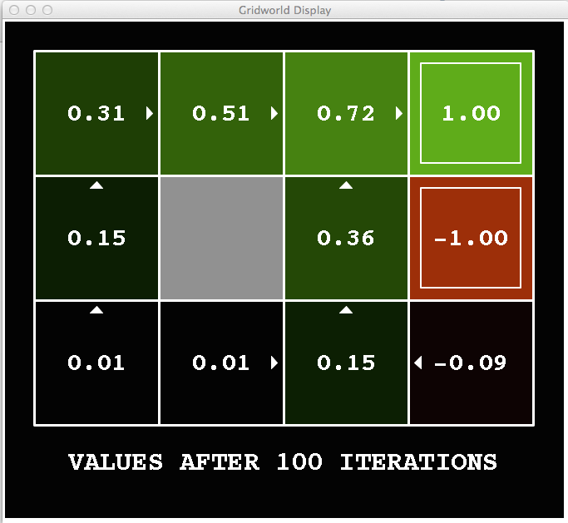
Snapshot of Demo – Gridworld V Values
Noise = 0.2
Discount = 0.9
Living reward = -0.1
Notes:
This demo doesn’t show anything in action, it just shows the V and Q values.

Slide 31
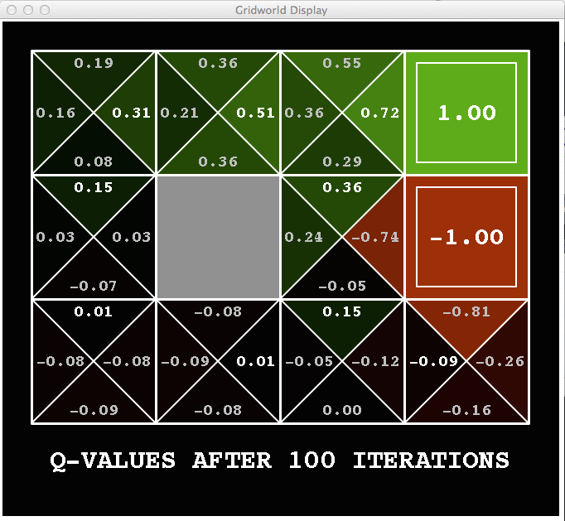
Snapshot of Demo – Gridworld Q Values
Noise = 0.2
Discount = 0.9
Living reward = -0.1
Notes:
This demo doesn’t show anything in action, it just shows the V and Q values.

Slide 32

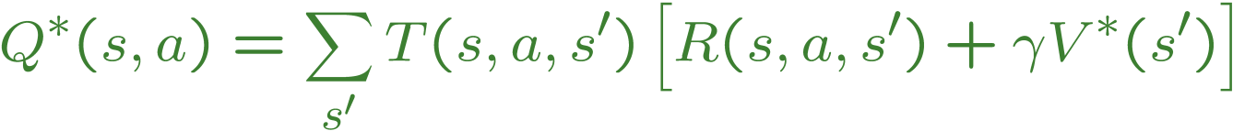
Values of States
Fundamental operation: compute the (expectimax) value of a state
  Expected utility under optimal action
  Average sum of (discounted) rewards
  This is just what expectimax computed!
Recursive definition of value:
s
a
s, a
s,a,s’
s’

Slide 33
Racing Expectimax Search Tree

Slide 34


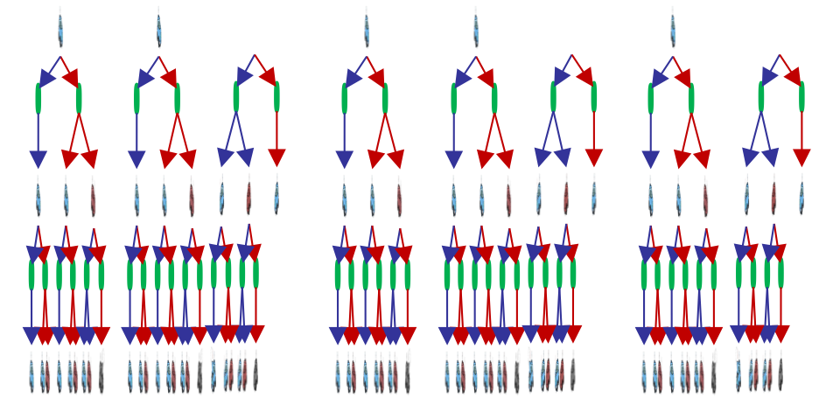

Racing Search Tree

Slide 35
Racing Expectimax Search Tree
We’re doing way too much work with expectimax!
Problem: States are repeated
  Idea: Only compute needed quantities once
Problem: Tree goes on forever
  Idea: Do a depth-limited computation, but with increasing depths until change is small
  Note: deep parts of the tree eventually don’t matter if γ < 1

Slide 36


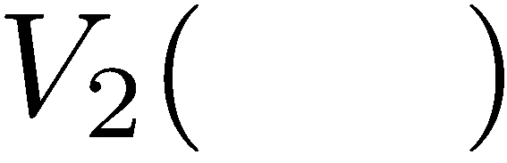


Time-Limited Values
Key idea: time-limited values
Define V_{k}(s) to be the optimal value of s if the game ends in k more time steps
  Equivalently, it’s what a depth-k expectimax would give from s
Notes:
This demo generates the time-limited values for gridworld as snapshotted onto the next slides.

Slide 37
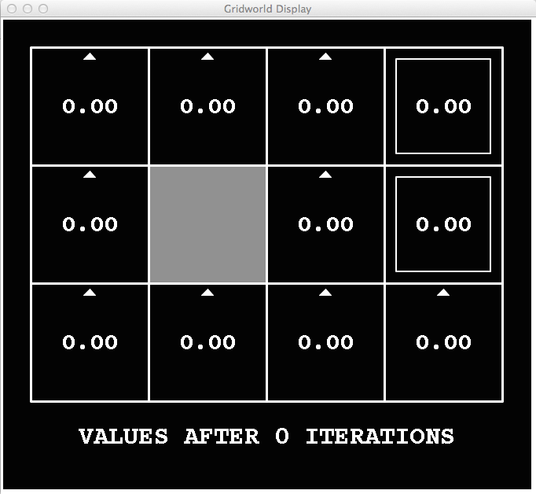
k=0
Noise = 0.2
Discount = 0.9
Living reward = 0
Notes:
Assuming zero living reward

Slide 38
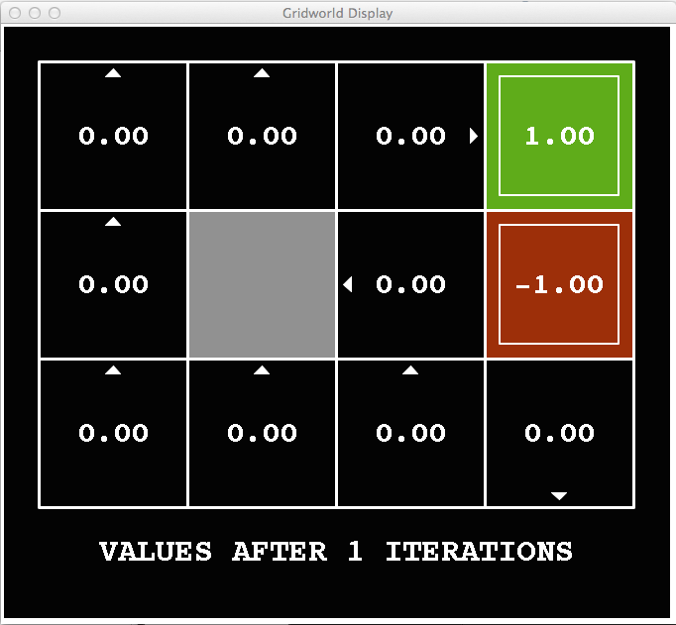
k=1
Noise = 0.2
Discount = 0.9
Living reward = 0
Notes:
Assuming zero living reward

Slide 39
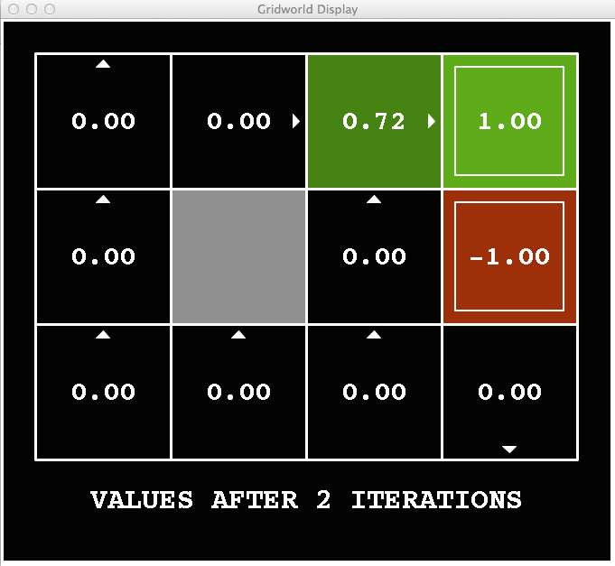
k=2
Noise = 0.2
Discount = 0.9
Living reward = 0
Notes:
Assuming zero living reward

Slide 40
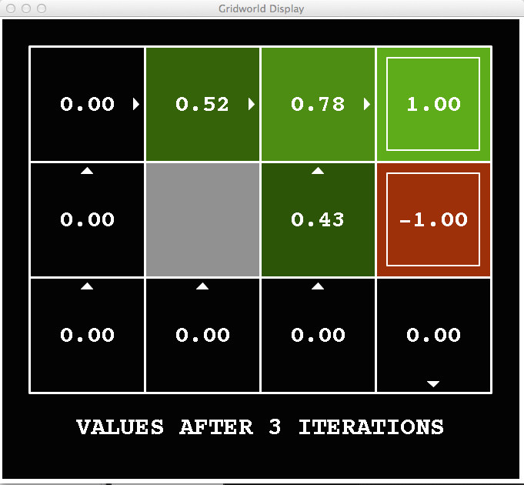
k=3
Noise = 0.2
Discount = 0.9
Living reward = 0
Notes:
Assuming zero living reward

Slide 41
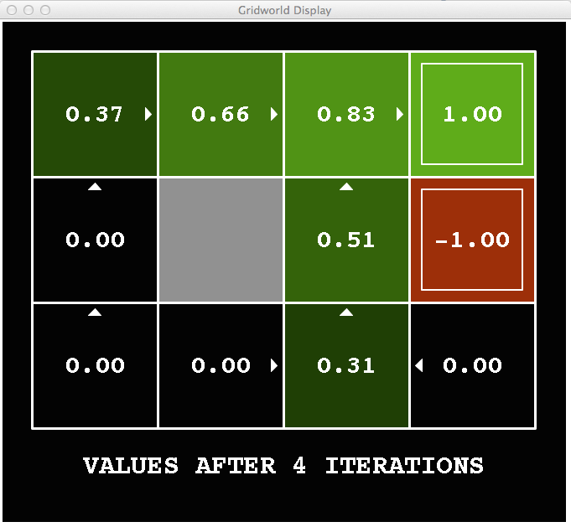
k=4
Noise = 0.2
Discount = 0.9
Living reward = 0
Notes:
Assuming zero living reward

Slide 42
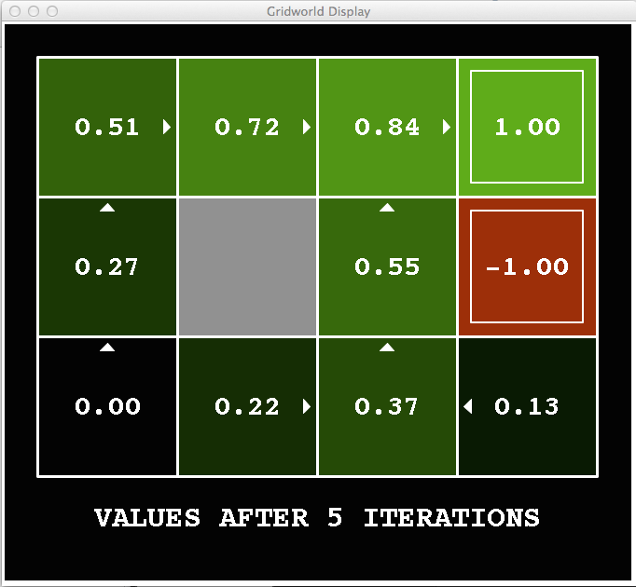
k=5
Noise = 0.2
Discount = 0.9
Living reward = 0
Notes:
Assuming zero living reward

Slide 43
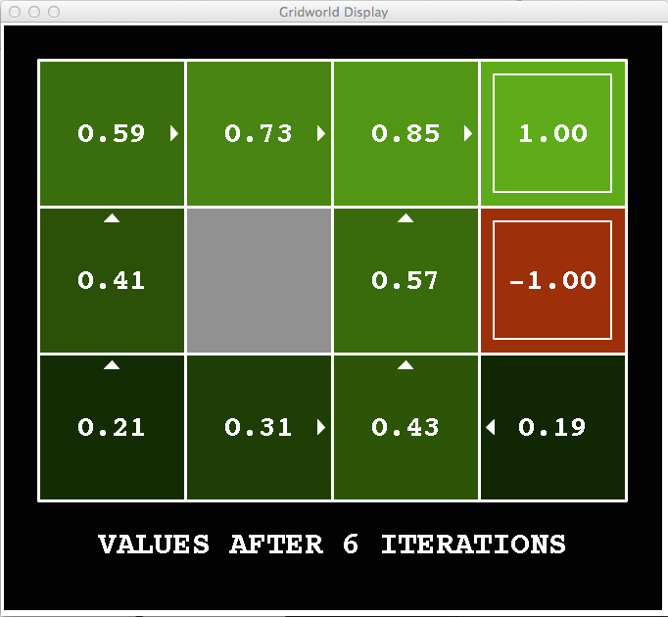
k=6
Noise = 0.2
Discount = 0.9
Living reward = 0
Notes:
Assuming zero living reward

Slide 44
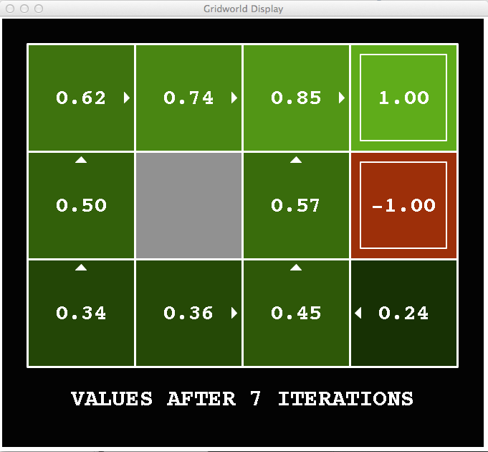
k=7
Noise = 0.2
Discount = 0.9
Living reward = 0
Notes:
Assuming zero living reward

Slide 45
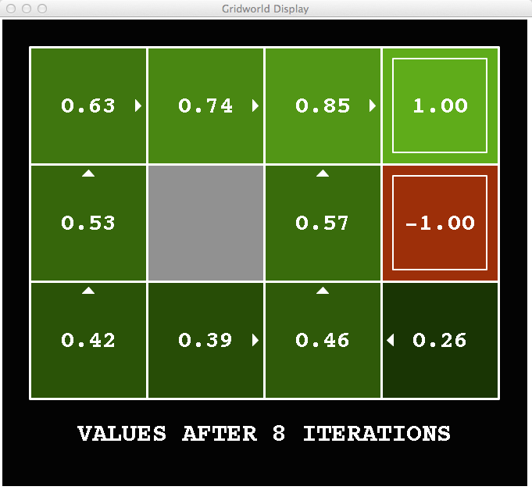
k=8
Noise = 0.2
Discount = 0.9
Living reward = 0
Notes:
Assuming zero living reward

Slide 46
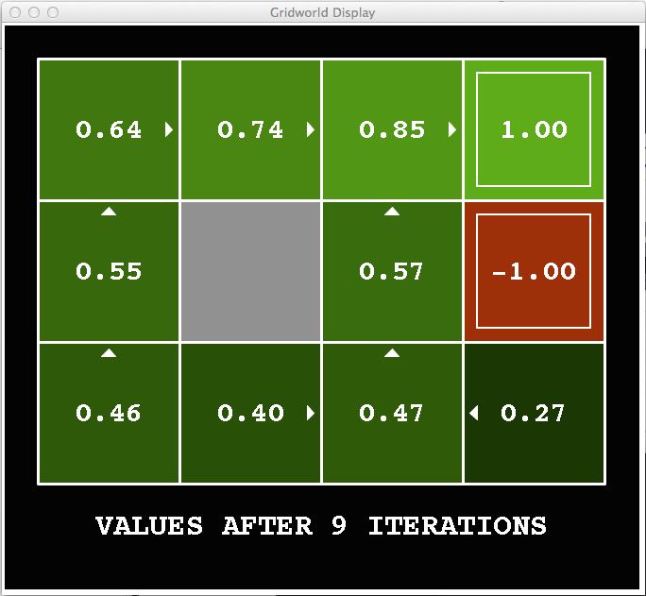
k=9
Noise = 0.2
Discount = 0.9
Living reward = 0
Notes:
Assuming zero living reward

Slide 47

k=10
Noise = 0.2
Discount = 0.9
Living reward = 0
Notes:
Assuming zero living reward

Slide 48

k=11
Noise = 0.2
Discount = 0.9
Living reward = 0
Notes:
Assuming zero living reward

Slide 49

k=12
Noise = 0.2
Discount = 0.9
Living reward = 0
Notes:
Assuming zero living reward

Slide 50

k=100
Noise = 0.2
Discount = 0.9
Living reward = 0
Notes:
Assuming zero living reward

Slide 51
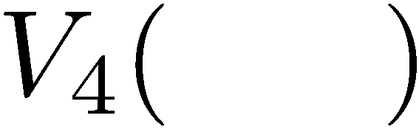

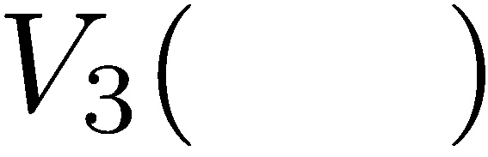


Computing Time-Limited Values

Slide 52

Value Iteration

Slide 53
Value Iteration
Start with V₀(s) = 0: no time steps left means an expected reward sum of zero
Given vector of V_{k}(s) values, do one ply of expectimax from each state:
Repeat until convergence
Complexity of each iteration: O(S²A)
Theorem: will converge to unique optimal values
  Basic idea: approximations get refined towards optimal values
  Policy may converge long before values do
V_{k+1}(s)
a
s, a
s,a,s’
V_{k}(s’)
Notes:
Discuss computational complexity: S * A * S times number of iterations
Note: updates not in place [if in place, it means something else and not even clear what it means]

Slide 54







Example: Value Iteration
3.5 2.5 0
2 1 0
Assume no discount!
0 0 0

Slide 55


Convergence*
How do we know the V_{k} vectors are going to converge?
Case 1: If the tree has maximum depth M, then V_{M} holds the actual untruncated values
Case 2: If the discount is less than 1
  Sketch: For any state V_{k} and V_{k+1} can be viewed as depth k+1 expectimax results in nearly identical search trees
  The difference is that on the bottom layer, V_{k+1} has actual rewards while V_{k} has zeros
  That last layer is at best all R_{MAX}
  It is at worst R_{MIN}
  But everything is discounted by γ^{k} that far out
  So V_{k} and V_{k+1} are at most γ^{k} max|R| different
  So as k increases, the values converge

Slide 56

What did we learn?
MDPs represent a fully observable environment with non-deterministic actions
The Bellman equation represents a 1 step expectimax update
$0<γ<1$ (the Bellman equation is a Contraction mapping) guarantees convergence
Next topic: Policy-Based Methods

