Slide 1
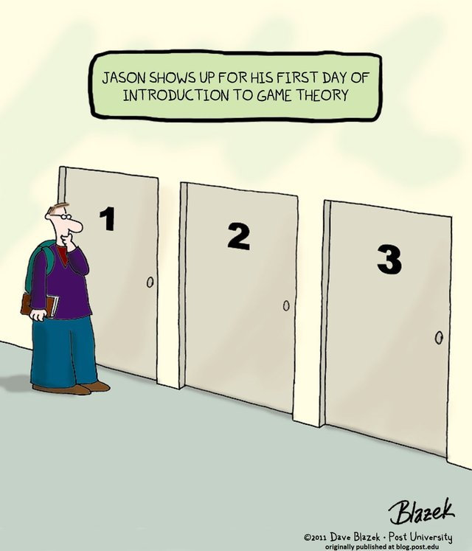
CSCE-420: Artificial Intelligence
Algorithmic Game Theory
Instructor: Guni Sharon

Slide 2
Announcements
Contest 1: Multi-Agent Pacman, due by Feb 17, EoD
Quiz4: Adversarial Search, due by Tuesday Feb. 12, EoD
Assignment 2: Multi-Player Games, due by Monday Feb. 24, EoD
Midterm: April 8 during class (bring your ID)

Slide 3
Game Theory
Rational Player
  Prioritizes possible actions according to utility or cost
    Von Neumann–Morgenstern utility theorem
  Strives to maximize utility or to minimize cost
Competitive Environment
  More than one player at the same time
  Game Theory analyzes how rational players behave in competitive environments

Slide 4
What is AGT?
Computing/proving the inefficiency of user equilibrium (price of anarchy)
Complexity of computing the user equilibrium
Mechanism design: “We consider algorithmic problems in a distributed setting where the participants cannot be assumed to follow the algorithm but rather their own self-interest. As such participants, termed agents, are capable of manipulating the algorithm, the algorithm designer should ensure in advance that the agents' interests are best served by behaving correctly.” Nisan, N., & Ronen, A. (2001). Algorithmic mechanism design. Games and Economic behavior, 35(1-2), 166-196.

Slide 5
Strategic Games
The game consists of only one ‘turn’
All the players play simultaneously and are unaware of what the other players strategy
Players are selfish, seek to maximize their own benefit

Slide 6
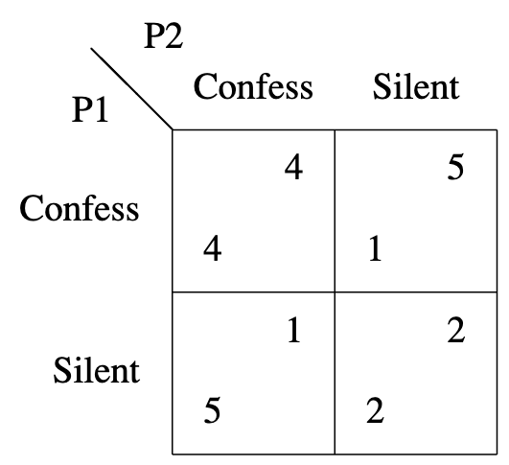
The Prisoner’s Dilemma
Cost matrix
  contains the cost outcome for each player per playing strategy
Stable solution?
  No player has incentive to deviate
Socially optimal solution?
  Maximal sum of utilities

Slide 7
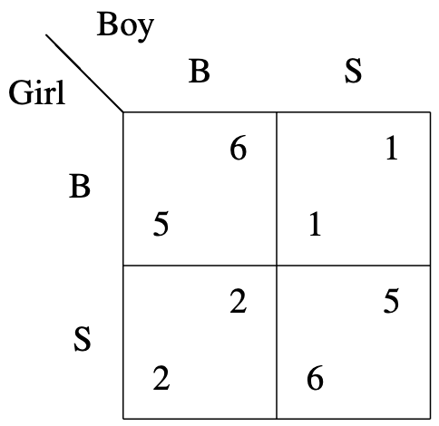
Battle of the sexes
Utility (-cost) matrix
The boy prefers baseball, and the girl prefers softball, but they both would like to spend the evening together rather than separately
Stable solutions?
What strategy should boy/girl follow?

Slide 8
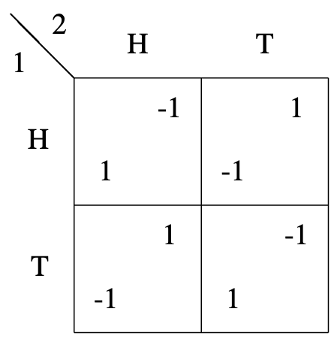
Matching pennies
The row player wins if the two pennies match (heads/tails), while the column player wins if they do not match
Stable solutions?
What strategy should row/column follow?

Slide 9
Dominant Strategy Solution
Dominant Strategy: A player has a best strategy, independent of the strategies played by the other players
Which game has a Dominant Strategy Solution?

Slide 10
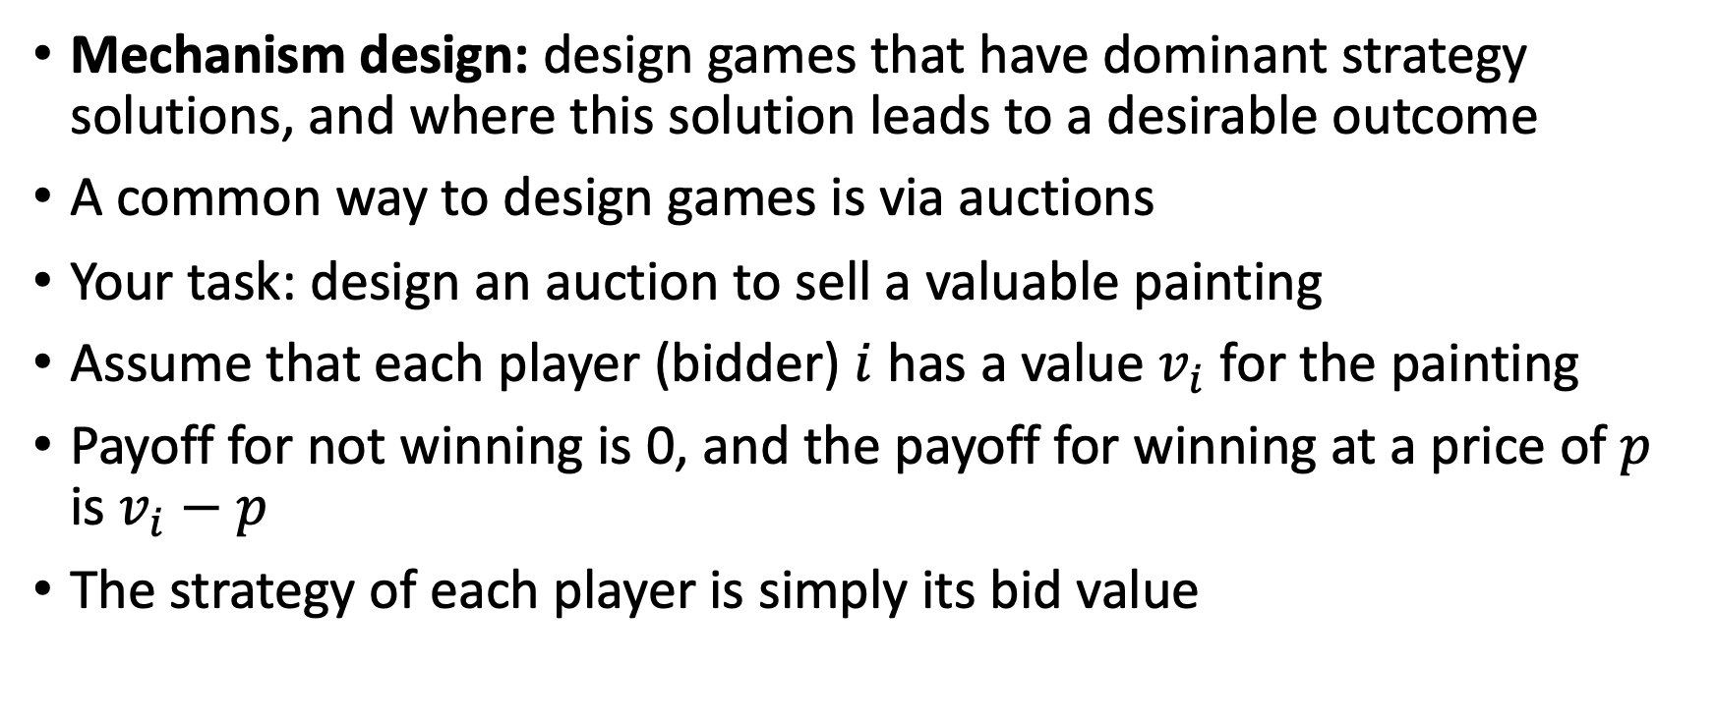
Mechanism design
Mechanism design: design games that have dominant strategy solutions, and where this solution leads to a desirable outcome
A common way to design games is via auctions
Your task: design an auction to sell a valuable painting
Assume that each player (bidder) $i$ has a value $v_{i}$ for the painting
Payoff for not winning is 0, and the payoff for winning at a price of $p$ is $v_{i}−p$
The strategy of each player is simply its bid value

Slide 11
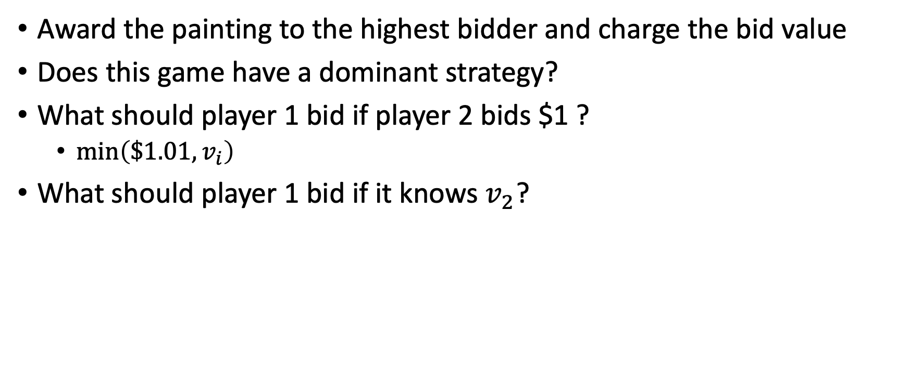
Solution 1
Award the painting to the highest bidder and charge the bid value
Does this game have a dominant strategy?
What should player 1 bid if player 2 bids $1 ?
  $\min\left(\$1.01, v_{i}\right)$
What should player 1 bid if it knows $v_{2}$?

Slide 12
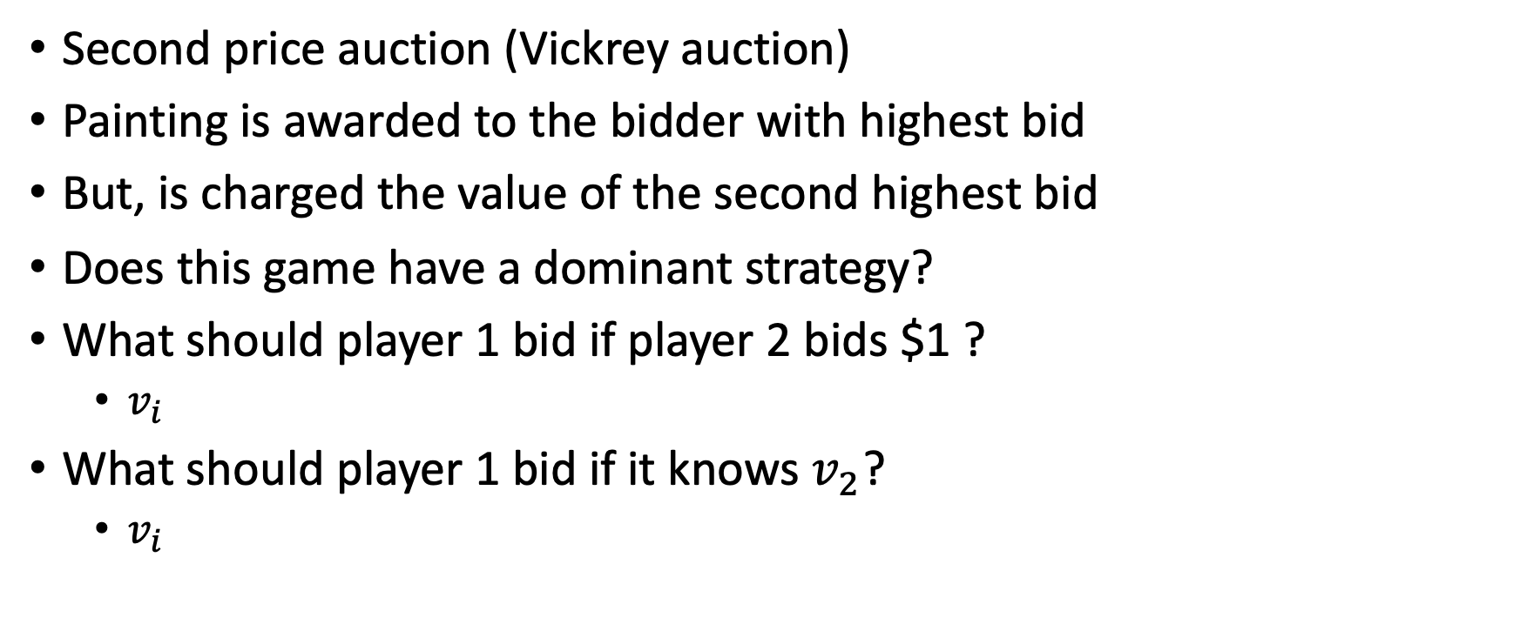
Solution 2
Second price auction (Vickrey auction)
Painting is awarded to the bidder with highest bid
But, is charged the value of the second highest bid
Does this game have a dominant strategy?
What should player 1 bid if player 2 bids $1 ?
  $v_{i}$
What should player 1 bid if it knows $v_{2}$?
  $v_{i}$

Slide 13
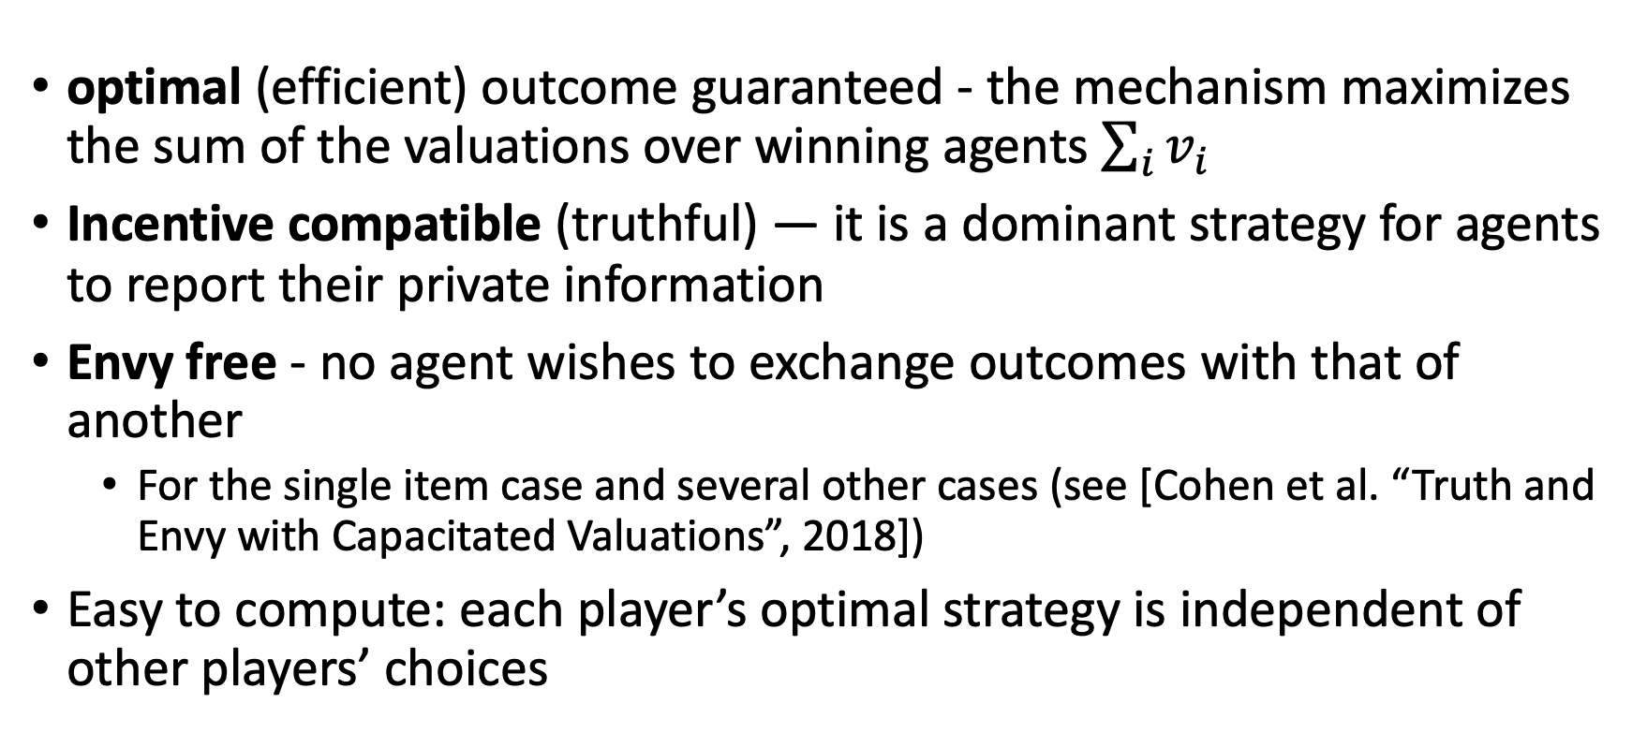
Second price (Vickrey) auction
optimal (efficient) outcome guaranteed - the mechanism maximizes the sum of the valuations over winning agents $\sum_{i}{v_{i}}$
Incentive compatible (truthful) — it is a dominant strategy for agents to report their private information
Envy free - no agent wishes to exchange outcomes with that of another
  For the single item case and several other cases (see [Cohen et al. “Truth and Envy with Capacitated Valuations”, 2018])
Easy to compute: each player’s optimal strategy is independent of other players’ choices

Slide 14
Pure Strategy Nash Equilibrium
Games (non designed) rarely possess dominant strategy solutions
Players’ strategy: maximize own payoff based on anticipated opponents' strategy
Nash equilibrium: a solution (strategy per player) where no player can benefit from unilaterally deviating from the solution
Can there be more than one NE?
  Battelle of the sexes
A set of dominant strategies is a Nash equilibrium (not necessary the other way around)
A strictly dominating solution is a unique Nash equilibrium

Slide 15
Nash Equilibrium
Does a NE guarantee optimal social welfare (sum of the payoffs)?
Must the social optimal solution be a NE?
Why are NE useful?
  Anticipating the game’s outcome
  Manipulate the game towards a desired NE
multiple Nash equilibria add uncertainty:
  which equilibrium should we expect?
  But at least a Nash equilibrium is stable – once proposed, the players do not want to deviate

Slide 16
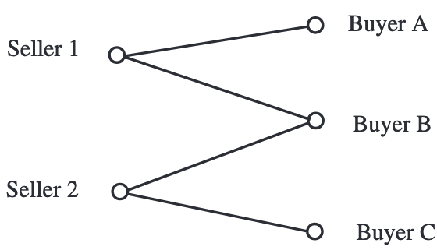
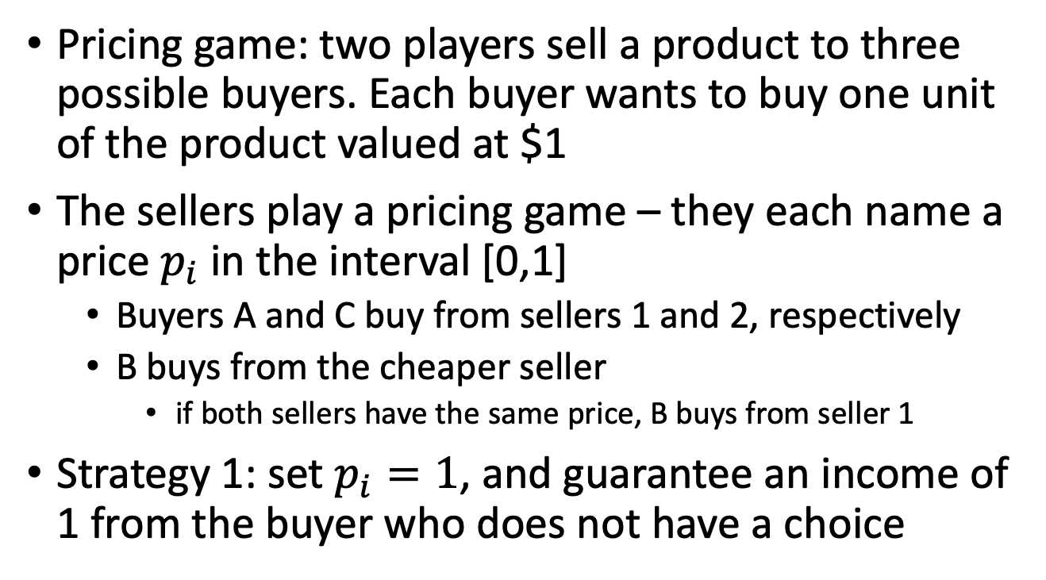
Games with No Nash Equilibria
Pricing game: two players sell a product to three possible buyers. Each buyer wants to buy one unit of the product valued at $1
The sellers play a pricing game – they each name a price $p_{i}$ in the interval [0,1]
  Buyers A and C buy from sellers 1 and 2, respectively
  B buys from the cheaper seller
    if both sellers have the same price, B buys from seller 1
Strategy 1: set $p_{i}=1$, and guarantee an income of 1 from the buyer who does not have a choice

Slide 17
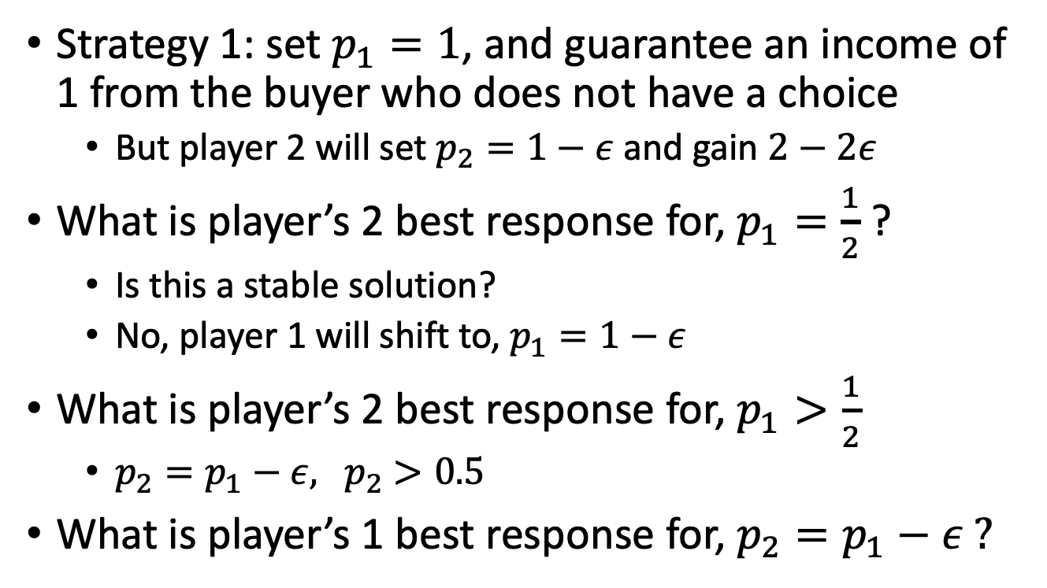
Games with No Nash Equilibria
Strategy 1: set $p_{1}=1$, and guarantee an income of 1 from the buyer who does not have a choice
  But player 2 will set $p_{2}=1−ε$ and gain $2−2ε$
What is player’s 2 best response for, $p_{1}=\frac{1}{2}$ ?
  Is this a stable solution?
  No, player 1 will shift to, $p_{1}=1−ε$
What is player’s 2 best response for, $p_{1}>\frac{1}{2}$
  $p_{2}=p_{1}−ε, { p}_{2}>0.5$
What is player’s 1 best response for, $p_{2}=p_{1}−ε ?$

Slide 18
Mixed Strategy Nash Equilibria
Pure strategy = each player deterministically plays its assigned action
  Goal: maximize the payoff
  A game need not possess any pure strategy Nash equilibria (Pennies game)
Mixed strategy = distribution over pure strategies
  Goal: maximize the expected payoff
  Nash [1951]: Any game with a finite set of players and finite set of strategies has a NE of mixed strategies
What is the mixed strategy Nash Equilibria for the Pennies game?

Slide 19
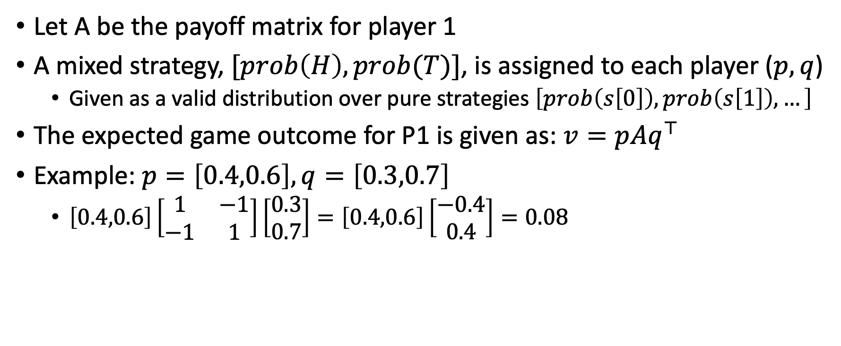
Compute NE: Two-Player Zero-Sum Games
Let A be the payoff matrix for player 1
A mixed strategy, $[prob\left(H\right),prob(T)]$, is assigned to each player ($p,q$)
  Given as a valid distribution over pure strategies $\left[prob\left(s\left[0\right]\right),prob\left(s\left[1\right]\right),…\right]$
The expected game outcome for P1 is given as: $v=pAq^{⊤}$
Example: $p=\left[0.4,0.6\right], q=\left[0.3,0.7\right]$
  $\left[0.4,0.6\right]\left[\begin{matrix}1 & −1 \\ −1 & 1\end{matrix}\right]\left[\begin{aligned}0.3 \\ 0.7\end{aligned}\right]=\left[0.4,0.6\right]\left[\begin{aligned}−0.4 \\ 0.4\end{aligned}\right]=0.08$

Slide 20
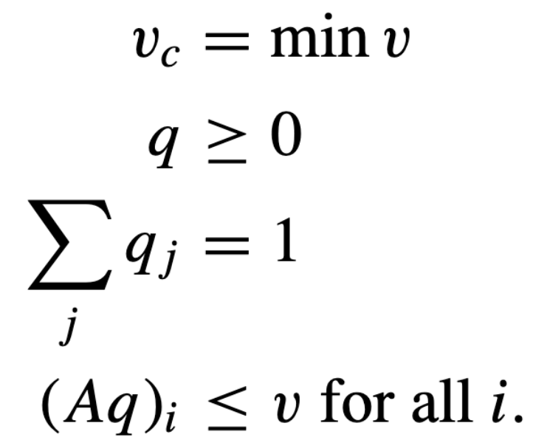
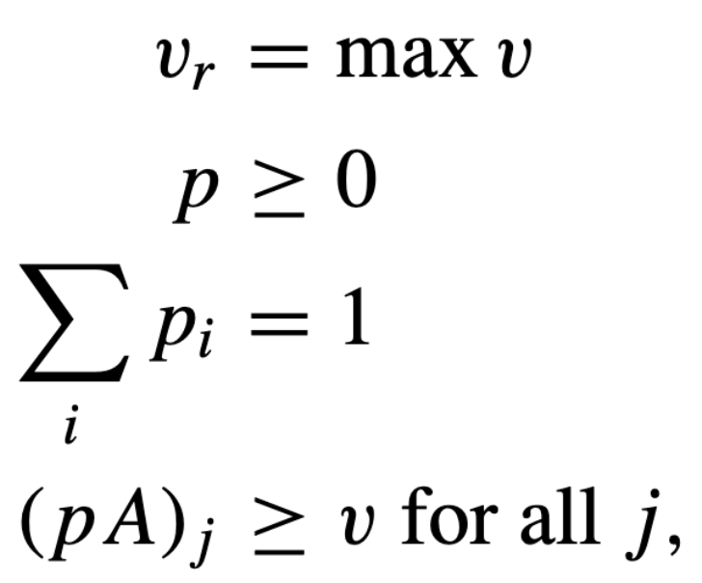
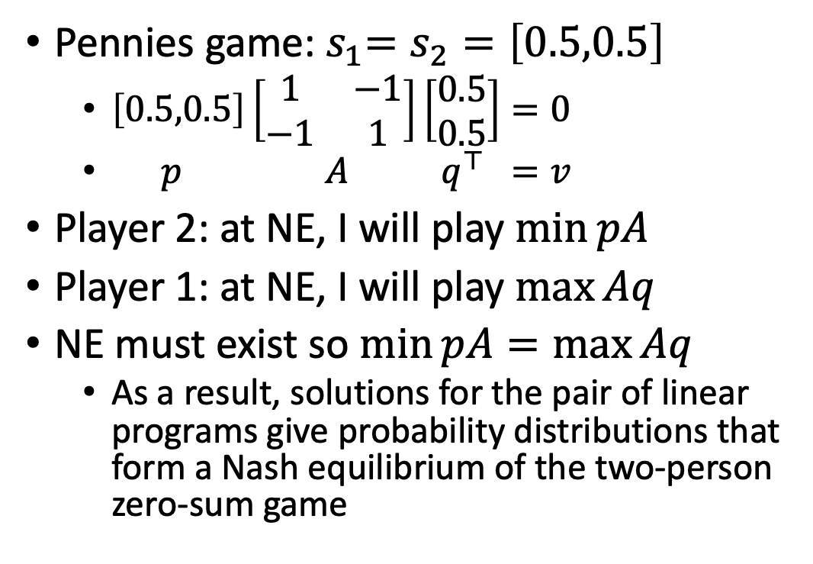
Compute NE: Two-Player Zero-Sum Games
Pennies game:${ s}_{1}=s_{2}=\left[0.5,0.5\right]$
  $\left[0.5,0.5\right]\left[\begin{matrix}1 & −1 \\ −1 & 1\end{matrix}\right]\left[\begin{aligned}0.5 \\ 0.5\end{aligned}\right]=0$
  $p A q^{⊤} =v$
Player 2: at NE, I will play $\min{pA}$
Player 1: at NE, I will play $\max{Aq}$
NE must exist so $\min{pA}=\max{Aq}$
  As a result, solutions for the pair of linear programs give probability distributions that form a Nash equilibrium of the two-person zero-sum game

Slide 21
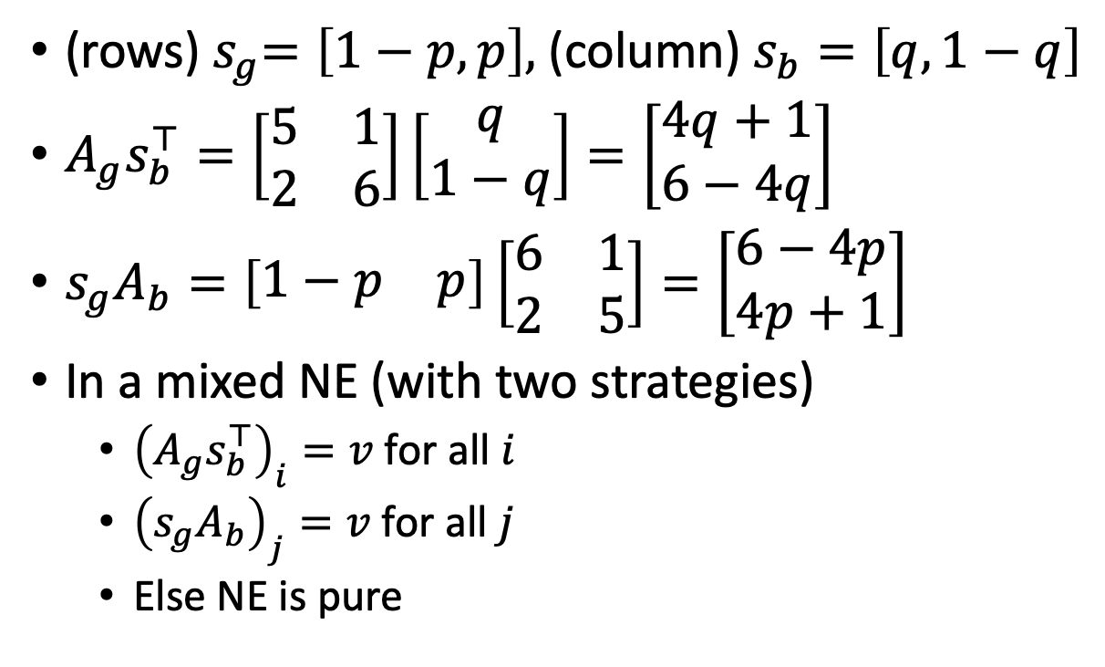
Compute mixed NE: battle of the sexes
(rows)${ s}_{g}=\left[1−p,p\right],$(column)$s_{b}=\left[q,1−q\right]$
$A_{g}s_{b}^{⊤}=\left[\begin{matrix}5 & 1 \\ 2 & 6\end{matrix}\right]\left[\begin{aligned}q \\ 1−q\end{aligned}\right]=\left[\begin{aligned}4q+1 \\ 6−4q\end{aligned}\right]$
${s_{g}A}_{b}=\left[\begin{matrix}1−p & p\end{matrix}\right]\left[\begin{matrix}6 & 1 \\ 2 & 5\end{matrix}\right]=\left[\begin{aligned}6−4p \\ 4p+1\end{aligned}\right]$
In a mixed NE (with two strategies)
  ${\left(A_{g}s_{b}^{⊤}\right)}_{i}=v$ for all $i$
  ${\left({s_{g}A}_{b}\right)}_{j}=v$ for all $j$
  Else NE is pure

Slide 22
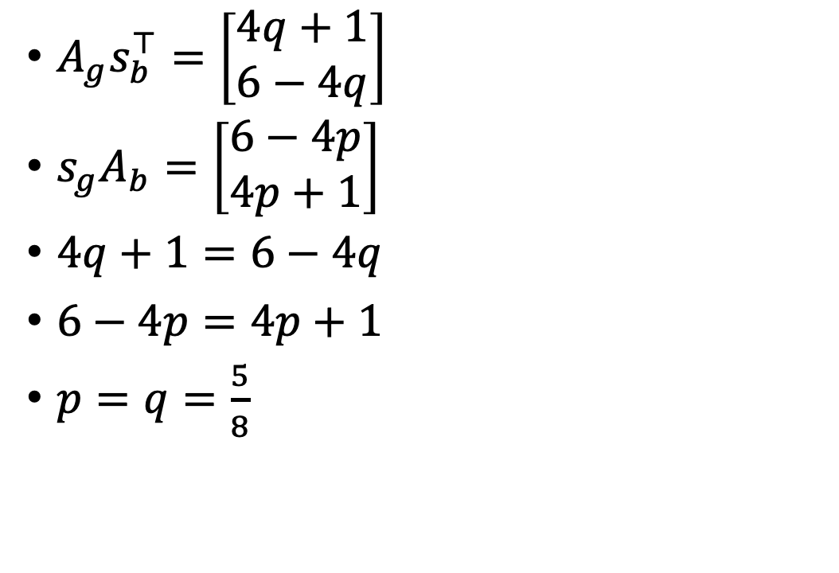
Compute mixed NE: battle of the sexes
$A_{g}s_{b}^{⊤}=\left[\begin{aligned}4q+1 \\ 6−4q\end{aligned}\right]$
${s_{g}A}_{b}=\left[\begin{aligned}6−4p \\ 4p+1\end{aligned}\right]$
$4q+1=6−4q$
$6−4p=4p+1$
$p=q=\frac{5}{8}$

Slide 23
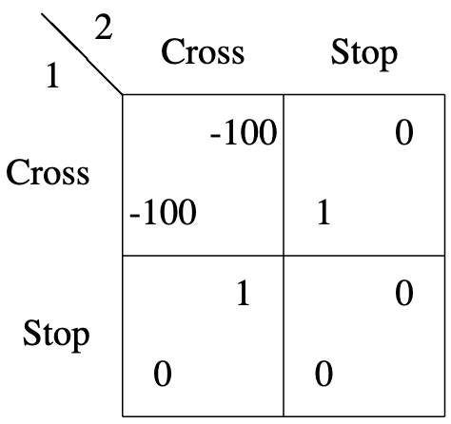
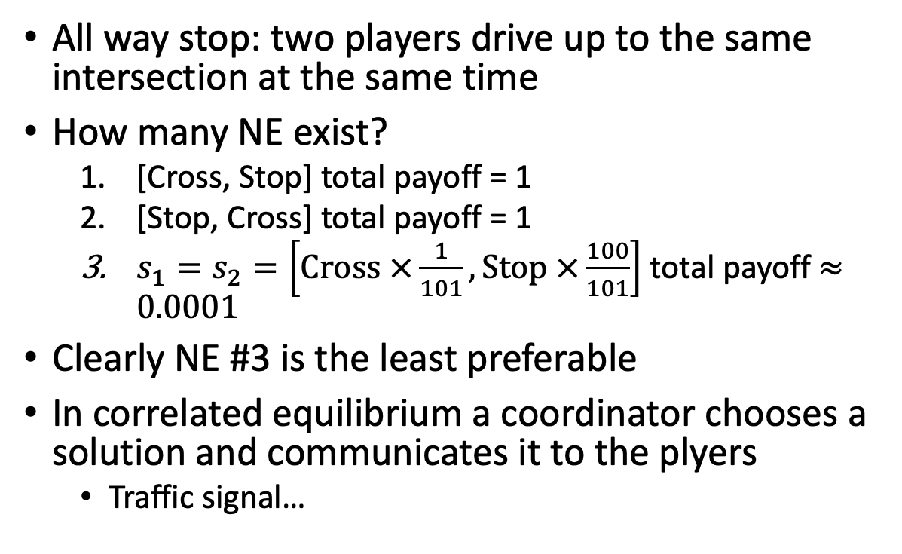
Correlated Equilibrium
All way stop: two players drive up to the same intersection at the same time
How many NE exist?
  [Cross, Stop] total payoff = 1
  [Stop, Cross] total payoff = 1
  $s_{1}=s_{2}=\left[Cross ×\frac{1}{101},Stop ×\frac{100}{101}\right]$ total payoff $≈0.0001$
Clearly NE #3 is the least preferable
In correlated equilibrium a coordinator chooses a solution and communicates it to the plyers
  Traffic signal…

Slide 24
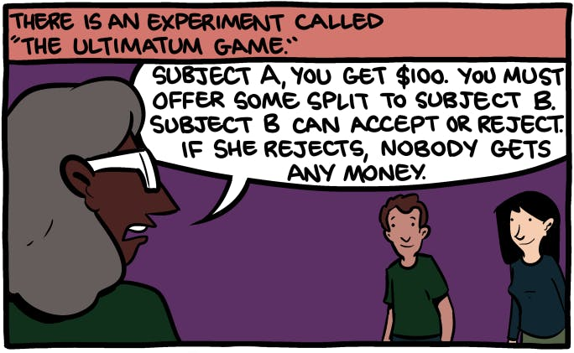
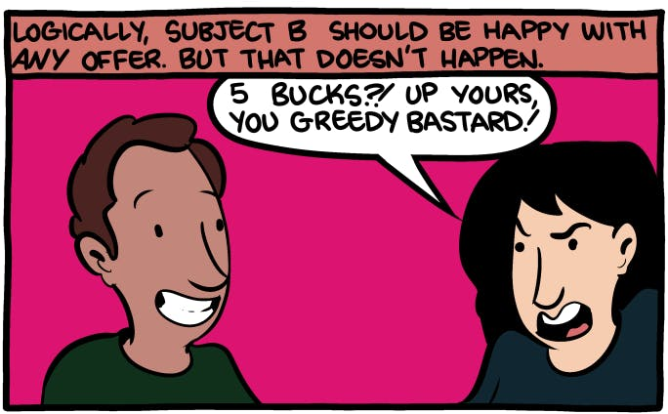
Games with Turns: Ultimatum game
Player 1 decides how to split
Player 2 decides Accept/Reject
What is the NE if player 1 goes first?
What happens in practice?
  Most proposers offer between 40% and 50% of the endowed amount. This split is almost always accepted by responders.
Are humans not rational?

Slide 25
Complexity of Finding Nash Equilibria
Is computing NASH Equilibrium NP-Complete?
  NP-completeness is not an appropriate concept for computing NE
  Typical NP-complete problem such as satisfiability, are formulated as a Decision problem
  But, every game is guaranteed to have a Nash equilibrium
    BTW, the question whether a second equilibrium exists is NP complete
The NASH Equilibrium Problem belong to class of problems denoted polynomial parity argument (PPAD)
  An equilibrium is known to exist but finding it is probably intractable
    Unless making simplifying assumptions
    In a similar way that NP-C problems are probably intractable
  For full proof see Daskalakiset al. (2006) and Goldberg and Papadimitriou (2006)

Slide 26
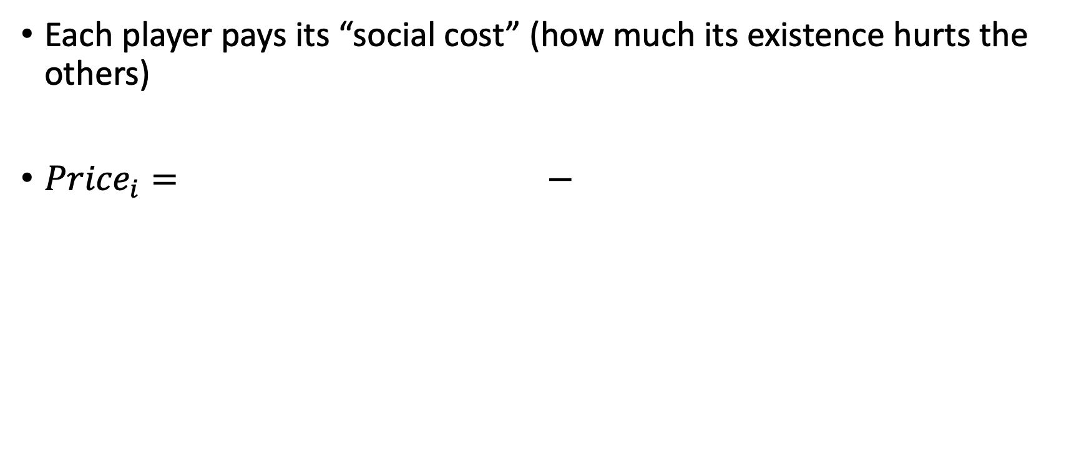
Vickrey–Clarke–Groves mechanism
Each player pays its “social cost” (how much its existence hurts the others)
${Price}_{i}= −$
Optimal welfare (for the other players) if player i was not participating
Welfare of the other players from the system outcome
1$ delay
$1 delay
To: turtle
$2 toll

Slide 27
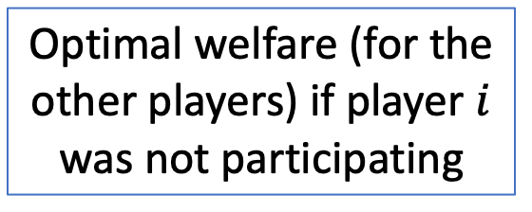
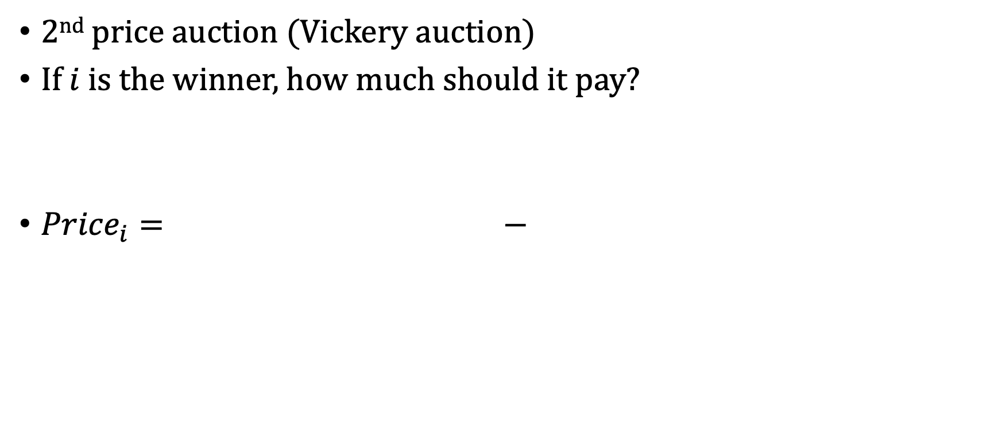
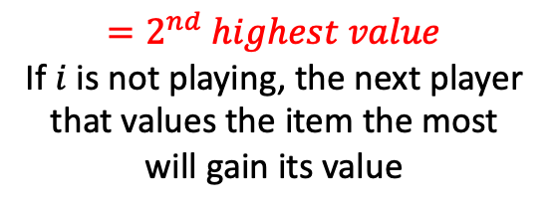
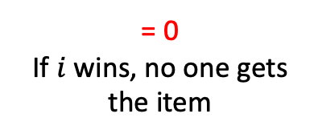
VCG in a single item auction
2nd price auction (Vickery auction)
If $i$ is the winner, how much should it pay?
${Price}_{i}= −$
Optimal welfare (for the other players) if player $i$ was not participating
Welfare of the other players from the system outcome
$$=2^{nd} highest value$$
If $i$ is not playing, the next player that values the item the most will gain its value
= 0
If $i$ wins, no one gets the item

Slide 28
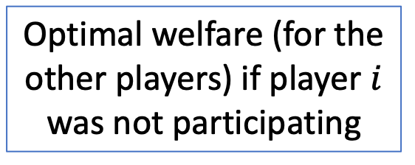
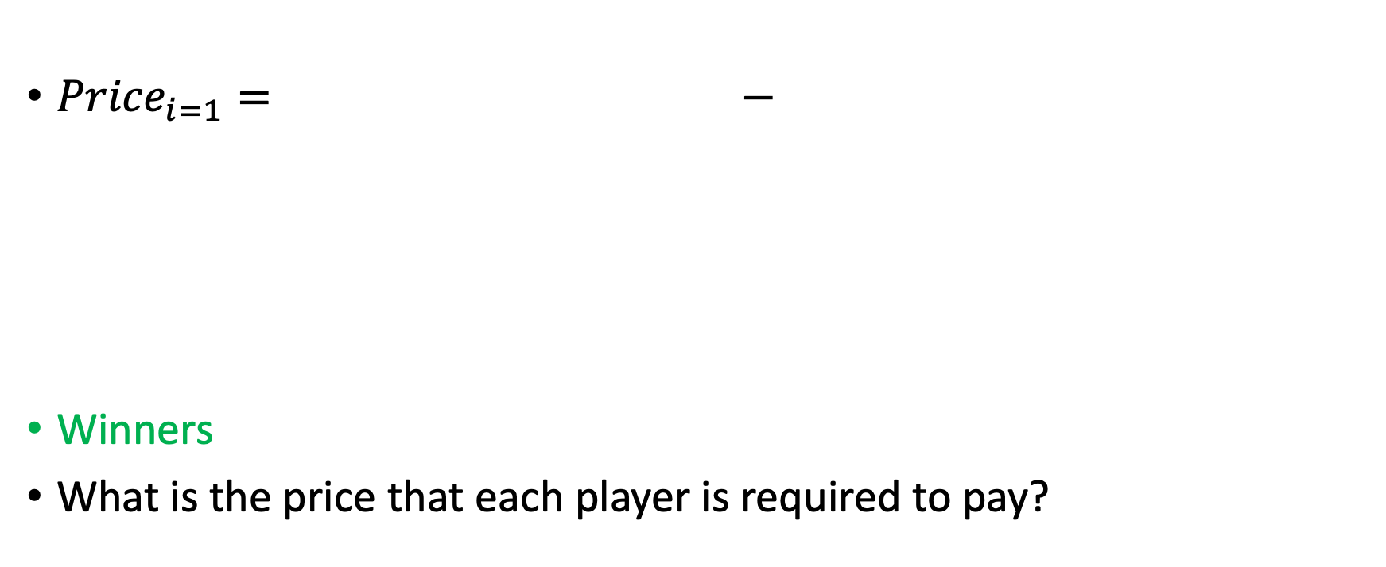
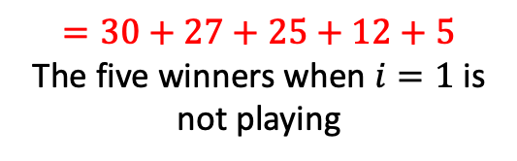
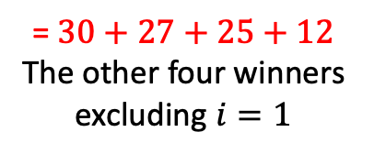
VCG in a 5-item auction
Player | Value ($)
1 | 70
2 | 30
3 | 27
4 | 25
5 | 12
6 | 5
7 | 2
${Price}_{i=1}= −$
Winners
What is the price that each player is required to pay?
Optimal welfare (for the other players) if player $i$ was not participating
Welfare of the other players from the system outcome
$$=30+27+25+12+5$$
The five winners when $i=1$ is not playing
= $30+27+25+12$
The other four winners excluding $i=1$

Slide 29
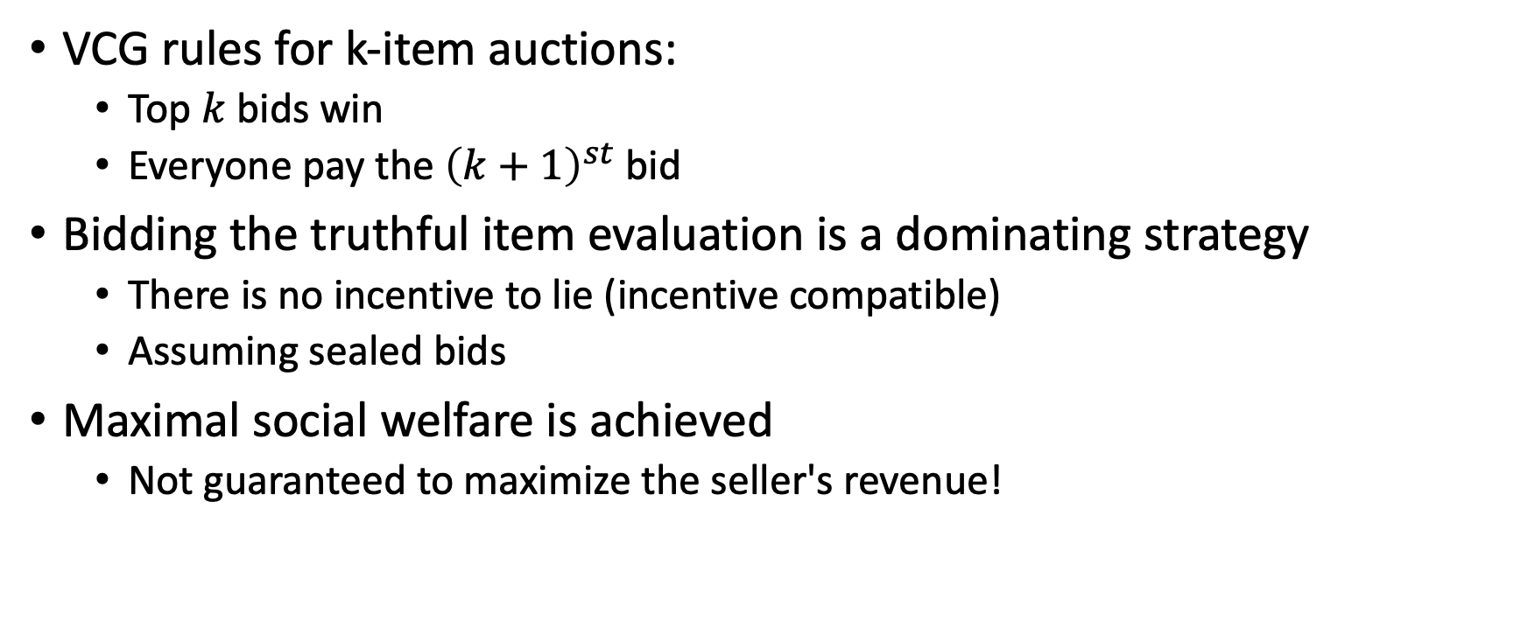

VCG in a $k$ item auction
VCG rules for k-item auctions:
  Top $k$ bids win
  Everyone pay the ${\left(k+1\right)}^{st}$bid
Bidding the truthful item evaluation is a dominating strategy
  There is no incentive to lie (incentive compatible)
  Assuming sealed bids
Maximal social welfare is achieved
  Not guaranteed to maximize the seller's revenue!

Slide 30
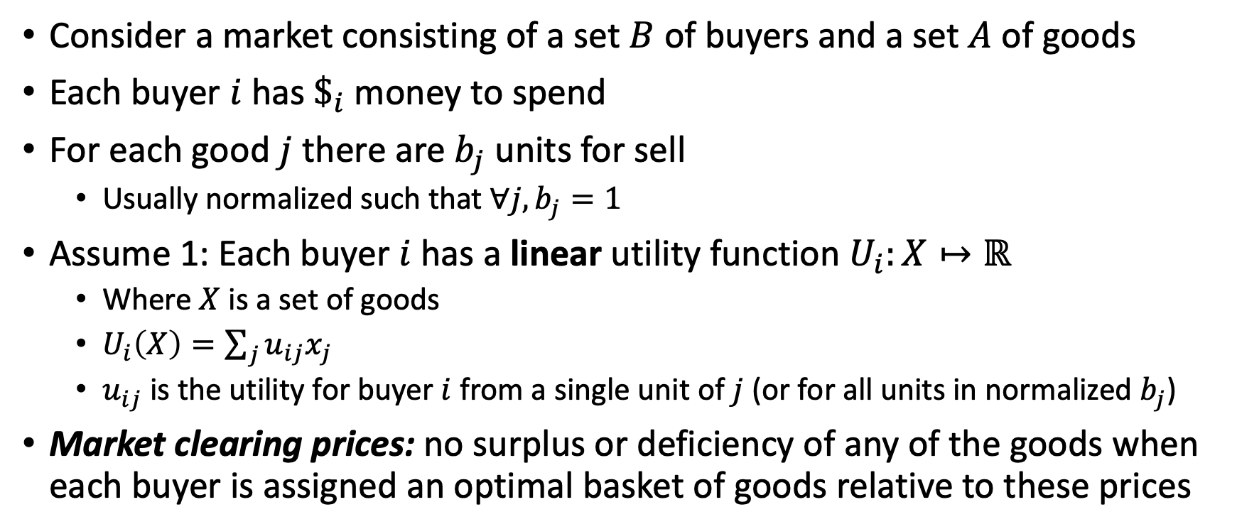
Fisher’s linear case
Consider a market consisting of a set $B$ of buyers and a set $A$ of goods
Each buyer $i$ has $\$_{i}$ money to spend
For each good $j$ there are $b_{j}$ units for sell
  Usually normalized such that $∀j, b_{j}=1$
Assume 1: Each buyer $i$ has a linear utility function $U_{i}:X↦ℝ$
  Where $X$ is a set of goods
  $U_{i}\left(X\right)=\sum_{j}{u_{ij}x_{j}}$
  $u_{ij}$ is the utility for buyer $i$ from a single unit of $j$ (or for all units in normalized $b_{j}$)
Market clearing prices: no surplus or deficiency of any of the goods when each buyer is assigned an optimal basket of goods relative to these prices

Slide 31
Market clearing prices
Our goal: compute such prices in polynomial time
Assume 2: each good has a potential buyer with nonzero utility from this good
Under assumption 1 and 2 (Fisher’s linear case), market clearing prices must exist and can be computed in poly-time
Can be solved through convex programming

Slide 32
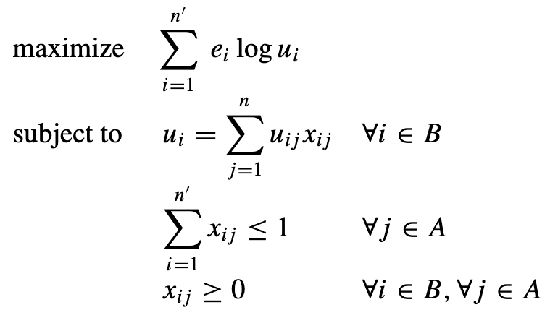
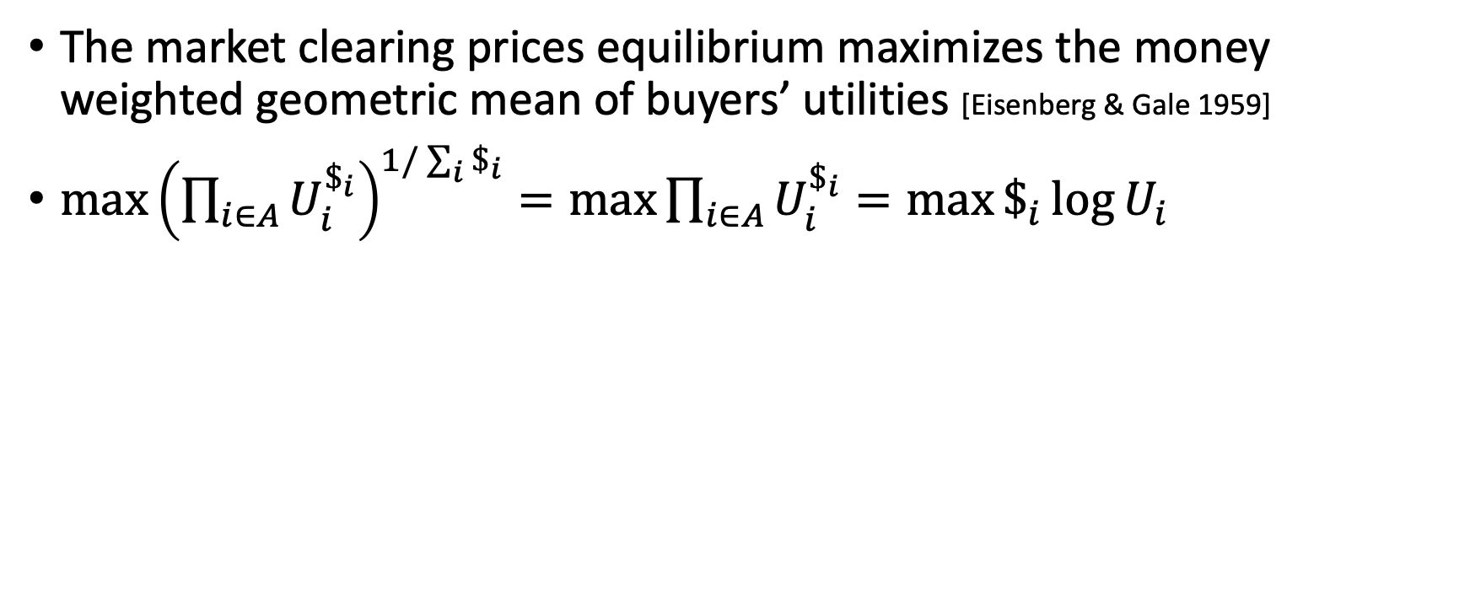
Eisenberg–Gale convex program
The market clearing prices equilibrium maximizes the money weighted geometric mean of buyers’ utilities [Eisenberg & Gale 1959]
$\max{{\left(\prod_{i∈A}{U_{i}^{\$_{i}}}\right)}^{1/\sum_{i}{\$_{i}}}=\max{\prod_{i∈A}{U_{i}^{\$_{i}}}}=\max{\$_{i}\log{U_{i}}}}$
Goods allocation can be solved using the method of Lagrange multipliers
KKT conditions enforce equilibrium
The Lagrange variables are the affiliated price of good

Slide 33
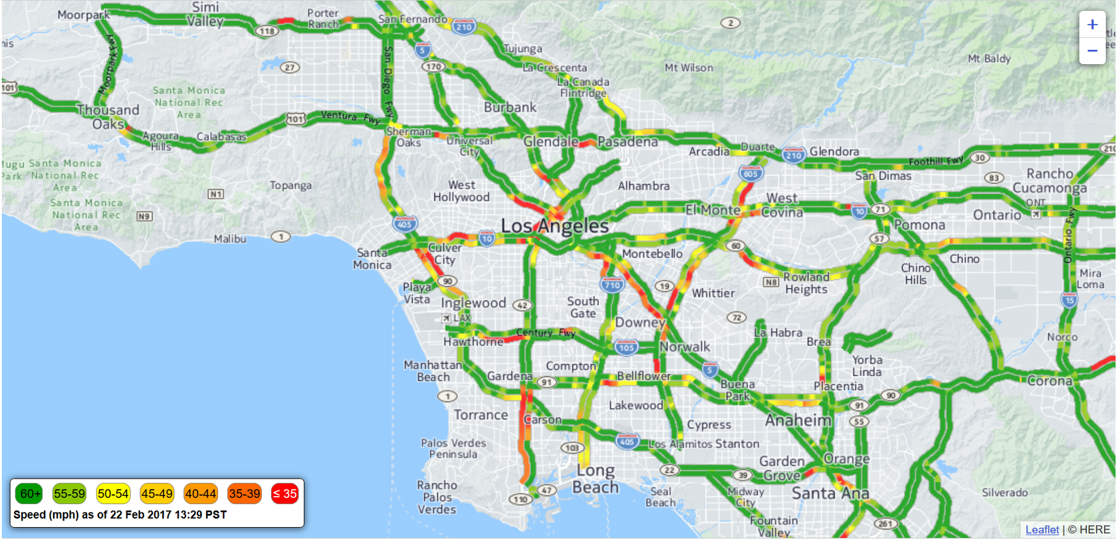
Real-world application: traffic flow optimization

Slide 34


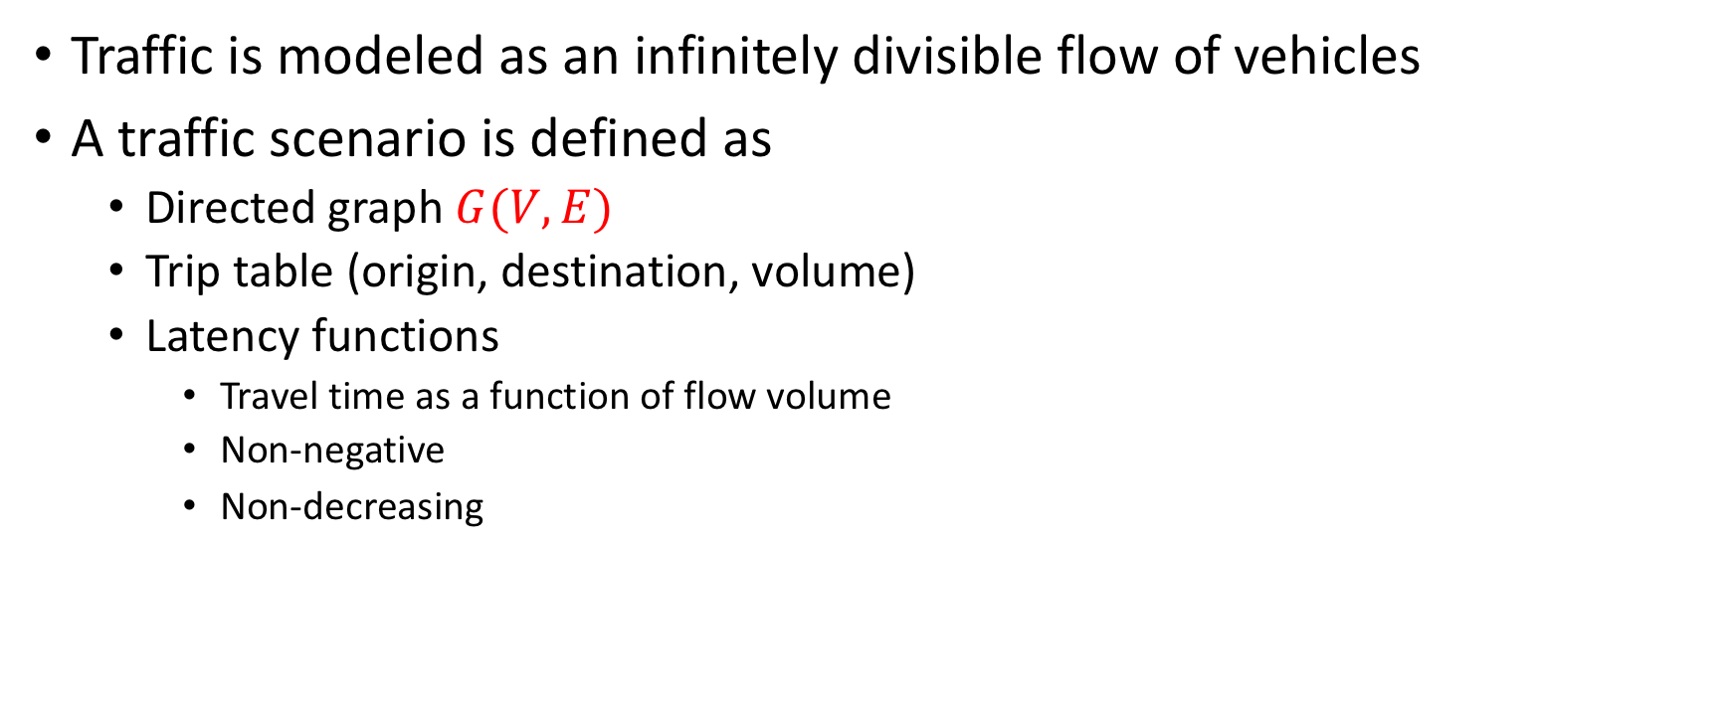




Flow model
Traffic is modeled as an infinitely divisible flow of vehicles
A traffic scenario is defined as
  Directed graph $G(V,E)$
  Trip table (origin, destination, volume)
  Latency functions
    Travel time as a function of flow volume
    Non-negative
    Non-decreasing
$$l\left(x\right)=1$$
$$v_{1}$$
$$v_{2}$$
$$v_{1}→v_{2}$$
$$100×$$
$$l\left(x\right)=x$$

Slide 35
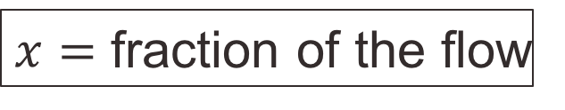


Example network
0%
$$l\left(x\right)=1$$
S
1 Hrs
T
1 HR
S
T
100%
$$l\left(x\right)=x$$
1 HR
50%
$x=$ fraction of the flow
S
0.75 Hrs
T
0.5 HR
50%

Slide 36
Example network
0%
User Equilibrium:
No amount of flow can be unitarily assigned a shorter path
1 Hrs
S
T
1 HR
100%
1 HR
System Optimum:
No amount of flow can be rerouted such that the total travel time is reduced
50%
S
0.75 Hrs
T
0.5 HR
50%

Slide 37
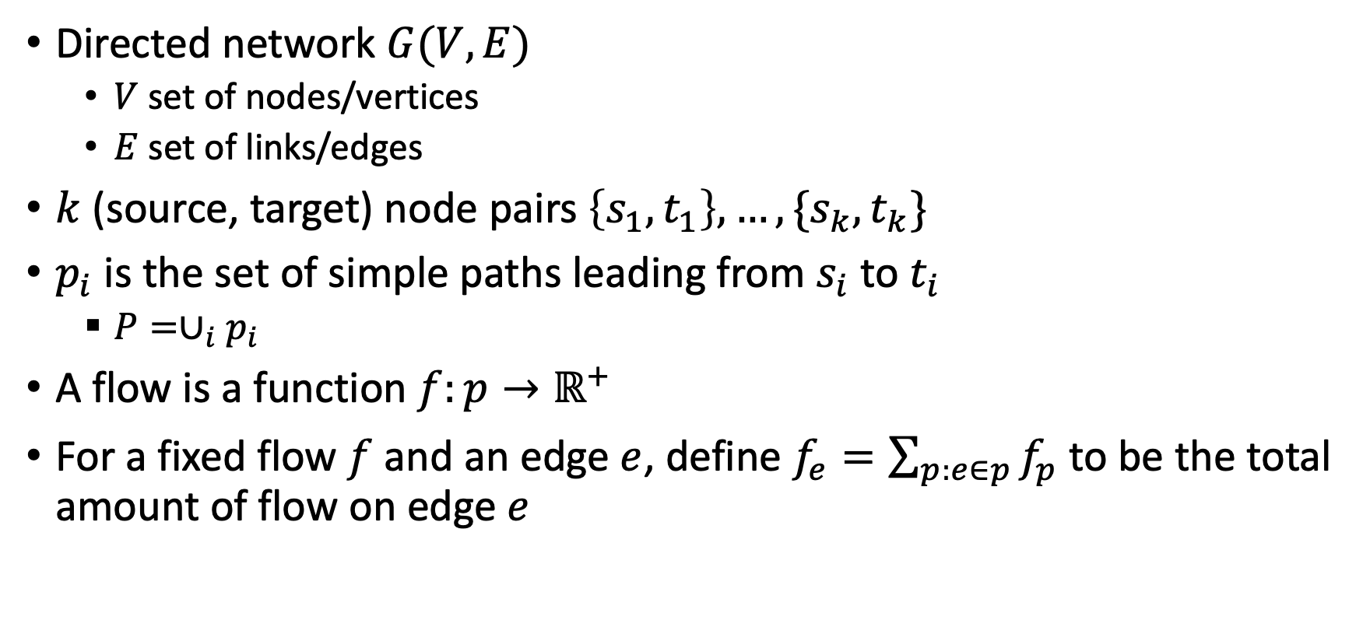
Flow model
Directed network $G(V,E)$
  $V$ set of nodes/vertices
  $E$ set of links/edges
$k$ (source, target) node pairs $\left\{s_{1},t_{1}\right\},…,\{s_{k},t_{k}\}$
$p_{i}$ is the set of simple paths leading from $s_{i}$ to $t_{i}$
  $P=∪_{i}p_{i}$
A flow is a function $f:p→ℝ^{+}$
For a fixed flow $f$ and an edge $e$, define $f_{e}=\sum_{p:e∈p}{f_{p}}$ to be the total amount of flow on edge $e$

Slide 38
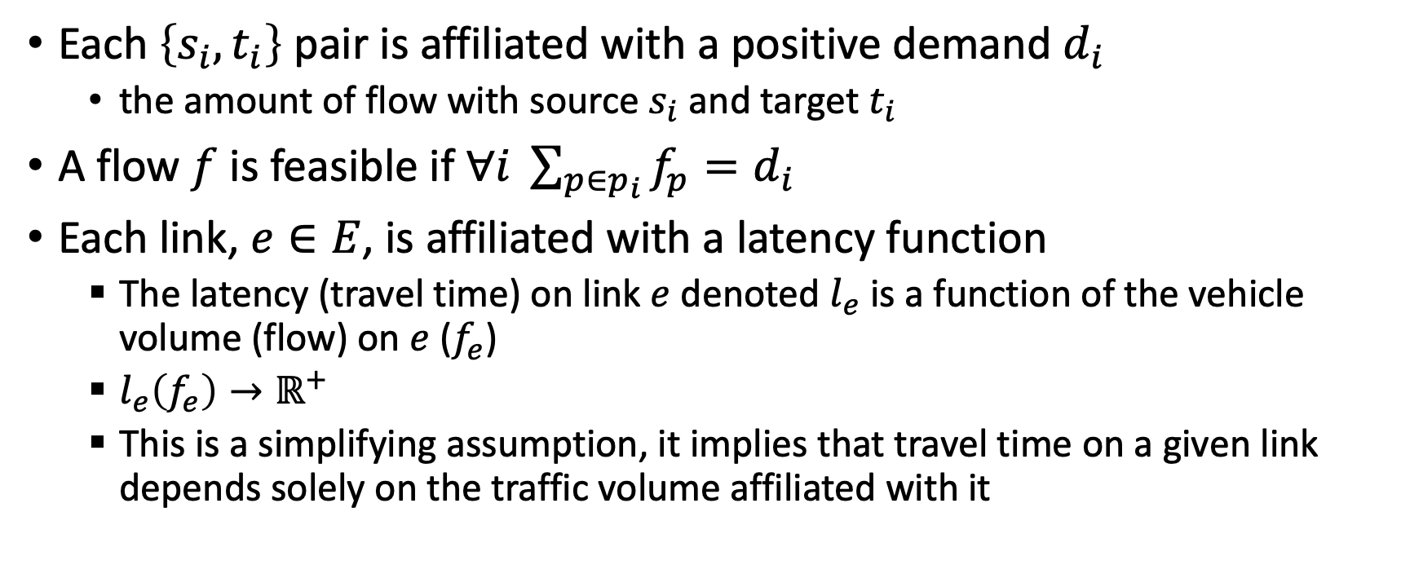
Flow model
Each $\left\{s_{i},t_{i}\right\}$ pair is affiliated with a positive demand $d_{i}$
  the amount of flow with source $s_{i}$ and target $t_{i}$
A flow $f$ is feasible if $∀i \sum_{p∈p_{i}}{f_{p}}=d_{i}$
Each link, $e∈E$, is affiliated with a latency function
  The latency (travel time) on link $e$ denoted $l_{e}$ is a function of the vehicle volume (flow) on $e$ ($f_{e}$)
  $l_{e}\left(f_{e}\right)→ℝ^{+}$
  This is a simplifying assumption, it implies that travel time on a given link depends solely on the traffic volume affiliated with it

Slide 39
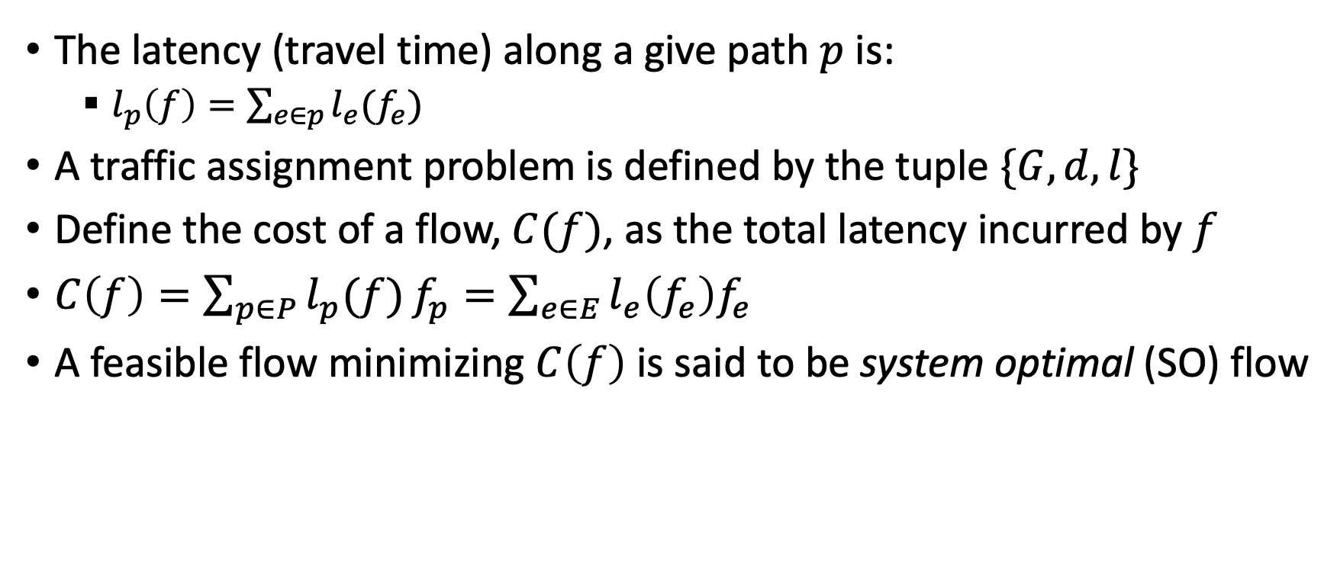
Flow model
The latency (travel time) along a give path $p$ is:
  $l_{p}\left(f\right)=\sum_{e∈p}{l_{e}(f_{e})}$
A traffic assignment problem is defined by the tuple $\{G,d,l\}$
Define the cost of a flow, $C(f)$, as the total latency incurred by $f$
$C\left(f\right)=\sum_{p∈P}{l_{p}(f)}f_{p}=\sum_{e∈E}{l_{e}\left(f_{e}\right)f_{e}}$
A feasible flow minimizing $C\left(f\right)$ is said to be system optimal (SO) flow

Slide 40


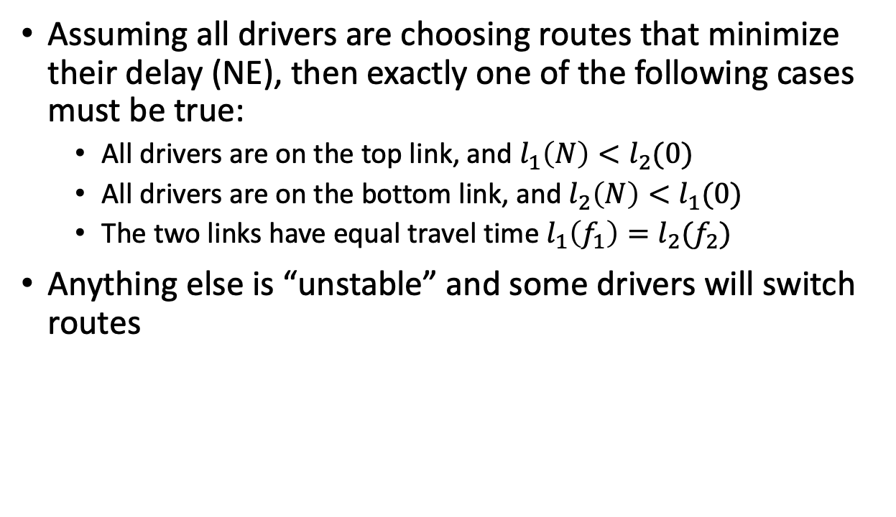



User equilibrium
Assuming all drivers are choosing routes that minimize their delay (NE), then exactly one of the following cases must be true:
  All drivers are on the top link, and $l_{1}\left(N\right)<l_{2}(0)$
  All drivers are on the bottom link, and $l_{2}\left(N\right)<l_{1}(0)$
  The two links have equal travel time $l_{1}\left(f_{1}\right)=l_{2}(f_{2})$
Anything else is “unstable” and some drivers will switch routes
$$l_{1}(f_{1})$$
$$v_{1}$$
$$v_{2}$$
$$l_{2}(f_{2})$$
$$d_{12}=N$$

Slide 41
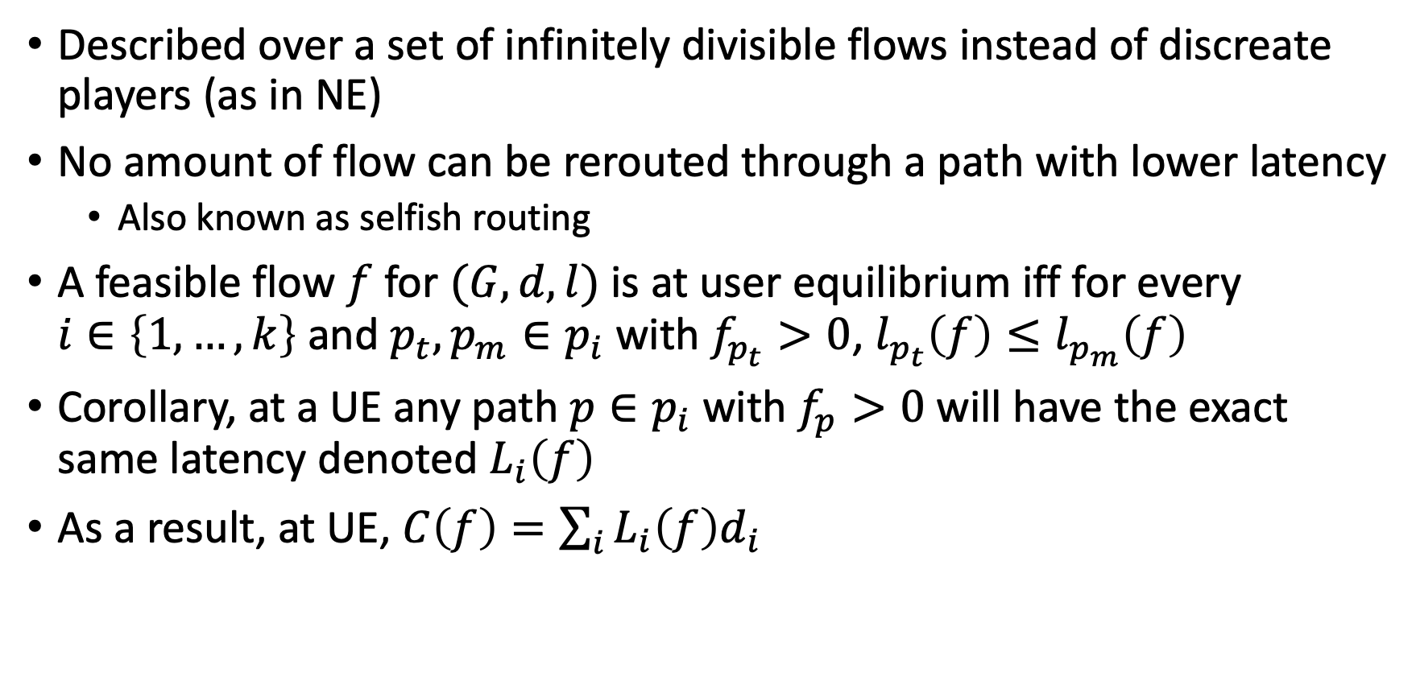
Principle of user equilibrium
Described over a set of infinitely divisible flows instead of discreate players (as in NE)
No amount of flow can be rerouted through a path with lower latency
  Also known as selfish routing
A feasible flow $f$ for $(G,d,l)$ is at user equilibrium iff for every $i∈\left\{1,…,k\right\}$ and $p_{t},p_{m}∈p_{i}$ with $f_{p_{t}}>0$, $l_{p_{t}}\left(f\right)≤l_{p_{m}}\left(f\right)$
Corollary, at a UE any path $p∈p_{i}$ with $f_{p}>0$ will have the exact same latency denoted $L_{i}\left(f\right)$
As a result, at UE, $C\left(f\right)=\sum_{i}{L_{i}\left(f\right)d_{i}}$

Slide 42
Principle of user equilibrium
Note that this principle follows directly from the assumptions that drivers choose minimum time paths, and are well-informed about network conditions
If you accept these assumptions, then you must also accept the principle of user equilibrium
Equivalently, if you disagree with the principle of user equilibrium, then you must either believe that drivers do not choose minimum time paths, or do not know the travel times on available paths

Slide 43
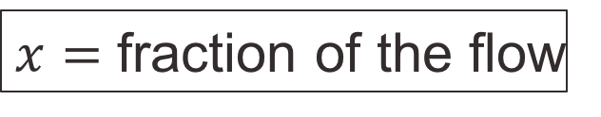
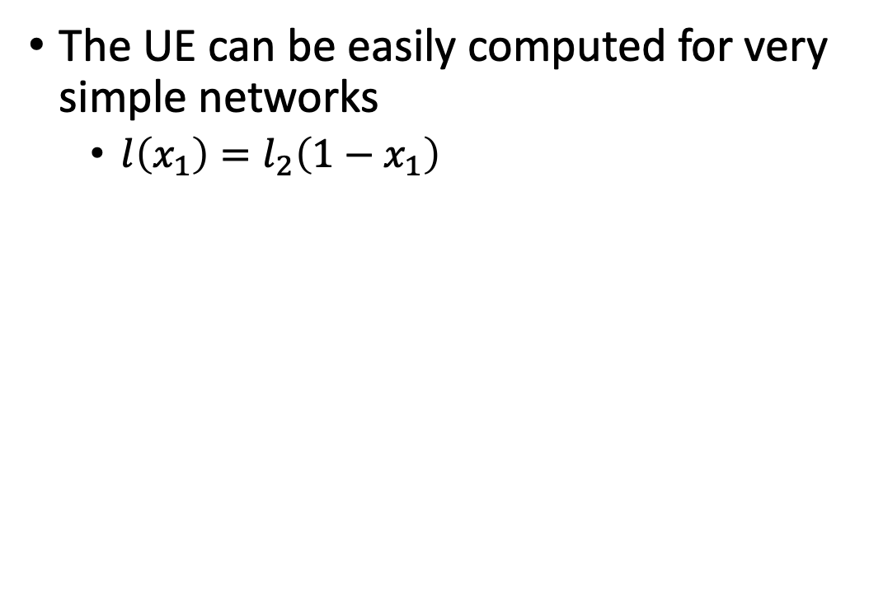


User equilibrium
$$l_{1}\left(x_{1}\right)=1$$
The UE can be easily computed for very simple networks
  $l\left(x_{1}\right)=l_{2}\left(1−x_{1}\right)$
S
T
$$l_{2}\left(x_{2}\right)=x$$
0%
$x=$ fraction of the flow
S
1 Hrs
T
1 HR
100%

Slide 44
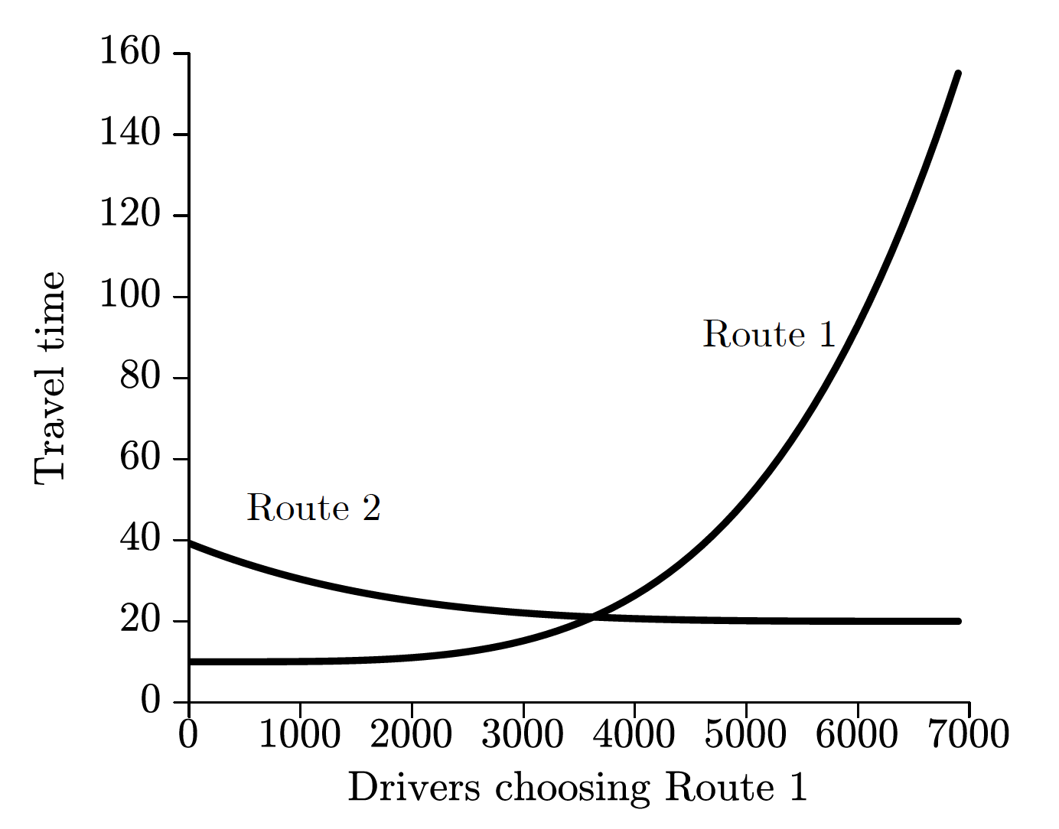





User equilibrium
A graphical method can be used when there are only 2 paths
$$l_{1}(x_{1})$$
$$v_{1}$$
$$v_{2}$$
$$l_{2}(x_{2})$$
$$d_{12}=N$$

Slide 45
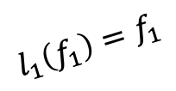
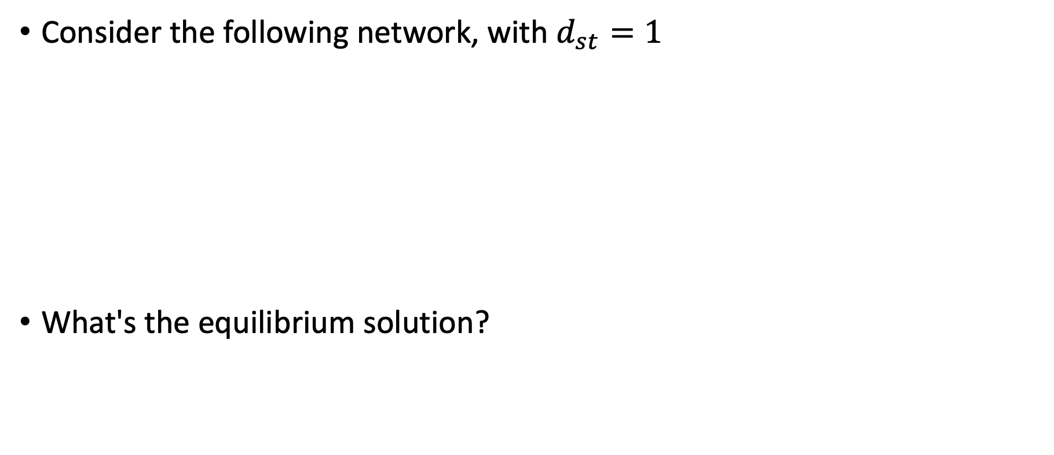
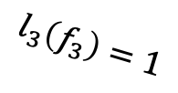
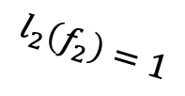
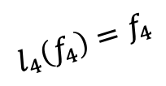
Braess’s paradox
Consider the following network, with $d_{st}=1$
What's the equilibrium solution?
$$l_{1}\left(f_{1}\right)=f_{1}$$
$$l_{3}\left(f_{3}\right)=1$$
s
t
$$l_{2}\left(f_{2}\right)=1$$
$$l_{4}\left(f_{4}\right)=f_{4}$$

Slide 46





Braess’s paradox
TxDOT built a new road
What’s the new UE?
$$l_{1}\left(f_{1}\right)=f_{1}$$
$$l_{3}\left(f_{3}\right)=1$$
s
$$0$$
t
$$l_{2}\left(f_{2}\right)=1$$
$$l_{4}\left(f_{4}\right)=f_{4}$$

Slide 47

Braess’s paradox
User equilibrium is not optimal ($C\left(UE\right)≥C\left(SO\right)$)
The “invisible hand” does not function well in traffic networks
There may be room for engineers and policy makers to design better mechanisms
Define price of anarchy (PoA) the ratio between the 'worst equilibrium' and the optimal 'centralized' solution
  $PoA=\frac{\max_{f is UE}{C\left(f\right)}}{\min_{f is feasible}{C\left(f\right)}}$

Slide 48

Price of anarchy – network routing
“If the latency of each edge is a linear function of its congestion, then the total latency of the routes chosen by selfish network users is at most $\frac{4}{3}$ times the minimum possible total latency” PoA in data networks
In the general case: “The total latency of the routes chosen by unregulated selfish network users may be arbitrarily larger than the minimum possible total latency” Unbounded PoA
“However, it is no more than the total latency incurred by optimally routing twice as much traffic”
  [Roughgarden and Tardos 2002, “How Bad is Selfish Routing?”]

Slide 49
Computing the UE
There are three important questions you should be asking at this point:
  Does a user equilibrium solution always exist?
  If so, is the user equilibrium solution unique?
  Is there any practical way to find an equilibrium in large networks?

Slide 50

Brouwer's Theorem
If $X$ is a compact convex set and $g:X→X$ is a continuous function, then$g$has at least one fixed point
  A set is compact if it is closed and bounded
  A set is closed if it contains all of its boundary points
  A set is bounded if it can be contained by a sufficiently large ball
  A set is convex if the line connecting any two points in the set lies within the set as well
  A function is continuous if at all points $a∈X,\lim_{x→a }{g(x)}$ exists and equal to $g(a)$

Slide 51
Convex set
Intuitively, a convex set does not have any “holes” or “bites” in it

Slide 52

Convex set
The more precise definition is that for any two points in the set, the straight line connecting those two points also lies in the set
Specifically, the set $X$ is convex if, for any $x_{1}∈X,x_{2}∈X$ and $λ∈[0,1]$, the point $λx_{1}+\left(1−λ\right)x_{2}∈X$.
  Such a point is a convex combination of $x_{1}$and $x_{2}$
  $x$ can be a high-dimensional coordinate

Slide 53







Convex set - example
The set of feasible flows is
  $f_{1}+f_{2}+f_{3}=100$
Pick any $\left(f_{1},f_{2},f_{3}\right)$ and $\left({f′}_{1},{f′}_{2},{f′}_{3}\right)$ from this set and $λ∈[0,1]$
Then the convex combination is
  $\left({λf}_{1}+\left(1−λ\right)f_{1}^{′},{λf}_{2}+\left(1−λ\right)f_{2}^{′},{ λf}_{3}+\left(1−λ\right)f_{3}^{′}\right)$
The set in question is convex if:
  ${λf}_{1}+\left(1−λ\right)f_{1}^{′}+{λf}_{2}+\left(1−λ\right)f_{2}^{′}+{ λf}_{3}+\left(1−λ\right)f_{3}^{′}=100$
  ${λ(f}_{1}+f_{2}+f_{3})+\left(1−λ\right)(f_{1}^{′}+f_{2}^{′}+f_{3}^{′})=100$
  $100λ +100\left(1−λ\right)=100$
The set of feasible flows is convex!
$$e_{1}$$
$$v_{1}$$
$$e_{2}$$
$$v_{2}$$
$$e_{3}$$
$$d_{12}=100$$

Slide 54

Brouwer's Theorem - example
Assume:
  $X=\left[1,0\right]$
  $g\left(x\right)=x^{2}$
What is a fixed point for $g$ ?
  What about $g\left(x\right)=2x$ ?
  $$g:X→X$$

Slide 55

Brouwer's Theorem
Does the traffic assignment problem satisfy the conditions of Brouwer's theorem?
Let $H$ be the set of all feasible flows. $H$ is closed, bounded, and convex
But what is $g:H→H$ ?
  We will define $g$ using a technique called variational inequality
    Inequality that applies over a set of variable (e.g., for all $f∈H$)

Slide 56

Variational inequality
  First, we want $g$ to be stable at UE flow and only there
  Assume $f^{UE}$ is a UE flow
    $C\left(f^{UE}\right)=\sum_{p∈P}{l_{p}(f^{UE})}f_{p}^{UE}$
    At UE all used paths for a given $\left\{s,t\right\}$ pair have equal travel time
  Assume that travel times are fixed at $l_{p}(f^{UE})$
  Assume a non-UE flow $f$
  It must be that $C\left(f^{UE}\right)=\sum_{p∈P}{l_{p}(f^{UE})}f_{p}^{UE}≤\sum_{p∈P}{l_{p}\left(f^{UE}\right)}f_{p}$
    Shifting flow between paths that were used at the UE solution makes no difference
    Shifting flow towards paths that were not used at the UE solution can only increases the total cost

Slide 57

Variational inequality
Lets rewrite the system cost affiliated with a given flow $f$
  $C\left(f\right)=\sum_{p∈P}{l_{p}(f)}f_{p}=l_{P}∙f$
    dot product of path latency vector and path flow vector
  A flow $f∈H$ is stable iff $l_{P}∙f≤l_{P}∙f′$ for all $f^{′}∈H$
    $l_{P}∙(f−f^{′})≤0$
  This is a variational inequality: find $f$ that satisfies the inequality for all $f^{′}∈H$
We can define a stable point at the UE
  But we are seeking a continuous function $g:H→H$ with a stable point at UE

Slide 58


$$g:H→H$$
Define $g\left(f\right)=proj_{H}\left(f−l_{P}\left(f\right)\right)$
  Reduce flow from paths proportional to travel time on those paths
  $proj_{H}$ means projection onto the feasible set $H$
If $l_{P}$ is continuous, so is $g\left(f\right)$
If a flow $f$ solves the previously defined VI then it is a fixed point $g\left(f\right)=f$
  $l_{P}\left(f\right)$ is equal over all used paths
Brouwer's theorem guarantees at least one fixed point of $g$, which is a solution of the VI, and which therefore satisfies the principle of user equilibrium
So how can we compute the UE flow?
It turns out that computing the SO flow is easier so let’s start there

Slide 59

System optimal flow
A feasible flow $f$ is defined as a system optimum (SO) if $C(f)$ is minimal over the set of feasible flows
A feasible flow $f$ is defined as a local optimum if the marginal benefit from decreasing flow along any $\left\{s_{i},t_{i}\right\}$ path is at most the marginal cost of increasing flow on another $\left\{s_{i},t_{i}\right\}$ path
Finding a local minimum is easy
  The cost function is well defined: $C\left(f\right)=\sum_{e}{l_{e}\left(f_{e}\right)f_{e}}$
  Use gradient decent methods: $∇C(f)$
    Frank-Wolfe method, Bisection, Newton's method
How can we find the global minimum (SO)?

Slide 60


System optimal flow
$Minimize C\left(f\right)=\sum_{e}{l_{e}\left(f_{e}\right)f_{e}}$
S.T.
    $\sum_{p∈p_{i}}{f_{p}}=d_{i} ∀i∈\left\{1,…,k\right\}$
    $f_{e}=\sum_{p∈P:e∈p}{f_{p}} ∀e∈E$
    $f_{p}≥0 ∀p∈P$
Linear program?
  $l_{e}\left(.\right)$ is not assumed to be linear
  Oh no! a non-linear program, how will we solve it?
We can capture all the constraints without $f_{p}$ variables by adding flow preservation constraints on all $f_{e}$ variables, i.e., sum of flow entering each node equals the sum of existing flow (excluding source and target nodes)
Number of paths can grow exponentially with the number of edges

Slide 61

Captain convex to the rescue
The local and global minima of a convex function on a convex set coincide!
  We can solve through gradient decent methods
Is the function: $C\left(f\right)=\sum_{e}{l_{e}\left(f_{e}\right)f_{e}}$ convex?
Define Convex function…

Slide 62
Convex function
Intuitively, a convex function lies below its secant lines

Slide 63


Convex function: definition 1
A function $f:X→ℝ$ is convex if, for every $x_{1},x_{2}∈X$ and every $λ∈(0,1)$
  $f\left(λx_{1}+\left(1−λ\right)x_{2}\right)≤λf\left(x_{1}\right)+\left(1−λ\right)f(x_{2})$
This definition, though intuitive, isn’t convenient to work with in many cases
Lets examine other definitions of convexity
If “<“ applies instead of “$≤$” then the function is said to be strictly convex

Slide 64

Convex function: definition 2
If the function is differentiable, convexity can be characterized in terms of a function's tangent lines
The function f is convex if it lies above all of its tangents
Formally, if $f$ is differentiable on its domain, then $f$ is convex iff
  $f\left(x_{2}\right)≥f\left(x_{1}\right)+f′(x_{1})(x_{2}−x_{1})$
  for all $x_{2},x_{1}∈X$

Slide 65

Convex function - example
Is ${f\left(x\right)=x}^{2}$ convex?
Pick any $x_{1}, x_{2}$. Since $f^{′}\left(x\right)=2x$, we need to show that
  $x_{2}^{2}≥x_{1}^{2}+2x_{1}\left(x_{2}−x_{1}\right)$
  $x_{2}^{2}≥x_{1}^{2}−2x_{1}^{2}+2x_{1}x_{2}$
  $x_{2}^{2}−2x_{1}x_{2}+x_{1}^{2}≥0$
  ${\left(x_{2}−x_{1}\right)}^{2}≥0$
Which is always true, so $f$ is convex
If the function in question is twice differentiable then proving convexity is even simpler

Slide 66

Convex function: definition 3
If $f$ is twice differentiable on its domain, then $f$ is convex iff $f^{′′}\left(x\right)≥0$ everywhere
Example: $x^{2}$is strictly convex because $f^{′′}\left(x\right)=2>0$

Slide 67

High-dimensional derivatives
When $f$ is a function of multiple variables e.g., a flow assignment over $n$ links, the convexity definition (2 and 3) involving first and second derivatives must change
The analogue of the first derivative is
  the gradient vector: $∇f={\left[\frac{∂f}{∂x_{1}},\frac{∂f}{∂x_{2}},…,\frac{∂f}{∂x_{n}}\right]}^{T}$
The analogue of the second derivative is
  the Hessian matrix $Hf=\left[\begin{matrix}\frac{∂^{2}f}{∂x_{1}^{2}} & ⋯ & \frac{∂^{2}f}{∂x_{1}∂x_{n}} \\ ⋮ & ⋱ & ⋮ \\ \frac{∂^{2}f}{∂x_{n}∂x_{1}} & ⋯ & \frac{∂^{2}f}{∂x_{n}^{2}}\end{matrix}\right]$

Slide 68

Convexity of high-dimensional functions
  Definition 1: $f\left(λx_{1}+\left(1−λ\right)x_{2}\right)≤λf\left(x_{1}\right)+\left(1−λ\right)f(x_{2})$
  Unchanged
Definition 2: $f\left(x_{2}\right)≥f\left(x_{1}\right)+f′(x_{1})(x_{2}−x_{1})$
  Becomes: $f\left(x_{2}\right)≥f\left(x_{1}\right)+∇f^{T}(x_{2}−x_{1})$
Definition 3: $f^{′′}\left(x\right)≥0$
  Becomes: $Hf(x)$ is positive semidefinite
    $y^{T}Hf\left(x\right)y≥0$ for all vectors $y$
  Tip: a diagonal matrix is positive definite (semidefinite) if all of its diagonal entries are positive (nonnegative)

Slide 69

Example
Are the following functions convex? Strictly convex? Over what domain?
  $f\left(x,y\right)=5x^{2}+2y^{2}$
  $g\left(x,y\right)=2x^{3}+4y^{2}$
  $Hf=\left[\begin{matrix}10 & 0 \\ 0 & 4\end{matrix}\right]$
  $Hg=\left[\begin{matrix}6 & 0 \\ 0 & 8\end{matrix}\right]$

Slide 70

Tricks for proving convexity
Any linear (affine) function is convex
A nonnegative multiple of a convex function is convex
  $cf\left(x\right) c≥0$
The sum of convex functions is convex
  $f\left(x\right)+g(x)$
The composition of convex functions is convex
  $f\left(g\left(x\right)\right)$

Slide 71
Convexity implications
If the objective is a convex function, and the feasible region is a convex set, the following hold true:
  If x is a local minimum, it is also a global minimum
  Uniqueness: If g is strictly convex, the global minimum is unique
  Connectedness: The set of global minima is a convex set
From here on out, we will assume that the objective function is convex (but not necessarily strictly convex)

Slide 72

Convexity and optimization
If there are no constraints and a single variable, $min⁡g(x)$ is easy to solve if $g$ is differentiable
Set $g^{′}\left(x\right)=0$ and solve for $x$
Since $g$ is convex we don't have to check whether this point is a minimum or a maximum, local or global, etc.

Slide 73

Convexity and optimization
What happens if there is a non-negativity constraint: $min⁡g(x)$ such that $x≥0$
There are two possibilities:
  $x≥0$ and $g^{′}\left(x\right)=0$ (same as before, just checking that x is feasible)
  $x=0$ and $g^{′}\left(x\right)≥0$ (the optimal point is at $x=0$)
We want to summarize these conditions with equations
We need both $x$ and $g^{′}\left(x\right)$ to be nonnegative, but at least one of them must be zero

Slide 74

The optimality conditions
The solution must follow the non-negativity optimality conditions:
  $x≥0$
  $g^{′}\left(x\right)≥0$
  $xg^{′}\left(x\right)=0$
If we can find a value of $x$ that satisfies all three conditions, it is the optimal solution

Slide 75

Example
Find the minimum for:
  $g\left(x\right)=x^{2}+4x+5$
  S.T.
    $x≥0$

Slide 76

Example
Find the minimum for:
  $g\left(x\right)=x^{2}+4x+5$
  S.T.
    $x≥0$
$g^{′}\left(x\right)=2x+4=0$
$x=−\frac{4}{2}, 0$
  $x≥0$
  $g^{′}\left(x\right)≥0$
  $xg^{′}\left(x\right)=0$

Slide 77

Multivariable functions
What if there is more than one decision variable, all of which must be nonnegative?
For instance, set of path-flow assignment
  $\min{g(X)}$
  s.t.
    $∀x∈X, x≥0$

Slide 78

Multivariable functions
Using the same logic as before, we can derive the following optimality conditions which must hold for every decision variable $x∈X$:
  $x≥0$
  $\frac{∂g}{∂x}≥0$
  $x\frac{∂g}{∂x}=0$

Slide 79

Example
Find the minimum for:
  $g\left(x,y\right)=x^{2}+y^{2}+3x−3y+5$
  S.T.
    $x,y≥0$

Slide 80

Example
Find the minimum for:
  $g\left(x,y\right)=x^{2}+y^{2}+3x−3y+5$
  S.T.
    $x,y≥0$
  $x≥0$
  $\frac{∂g}{∂x}≥0 2x+3≥0$
  $\frac{∂g}{∂y}≥0 2y−3≥0$
  $x\frac{∂g}{∂x}=0 x\left(2x+3\right)=0 x=0,−\frac{3}{2}$
  $y\frac{∂g}{∂y}=0 y\left(2y−3\right)=0 y=0,\frac{3}{2}$

Slide 81

Back to flow optimization
$Minimize C\left(f\right)=\sum_{e}{l_{e}\left(f_{e}\right)f_{e}}$
S.T.
    $\sum_{p∈p_{i}}{f_{p}}=d_{i} ∀i∈\left\{1,…,k\right\}$
    $f_{e}=\sum_{p∈P:e∈p}{f_{p}} ∀e∈E$
    $f_{p}≥0 ∀p∈P$
We know how to minimize a convex function under non-negativity constraints
What about the equality constraints?

Slide 82


Method of Lagrange multipliers
Unite the equality constraints with the objective function
  The resulting function is the Lagrangian function $ℒ$
  Find the optimal point of the Lagrangian function $ℒ$ by setting its gradient (all partial derivatives) to the zero vector
  The optimal solution for the Lagrangian function is also the optimal solution for the original function

Slide 83

Example
Find the minimum for:
  $g\left(x,y\right)=x^{2}+y^{2}$
  S.T.
    $x+y=5$

Slide 84

Example
Find the minimum for:
  $g\left(x,y\right)=x^{2}+y^{2}$
  S.T.
    $x+y=5$
$ℒ\left(x,y,λ\right)=x^{2}+y^{2}+λ\left(x+y−5\right)$
$∇ℒ\left(x,y,λ\right)=0$

Slide 85

Equality + nonnegativity
$minimize: g\left(x_{1},x_{2},…,x_{n}\right)$
S.T.
  $\sum_{i=1}^{n}{a_{1i}x_{i}}=b_{1}$
  $\sum_{i=1}^{n}{a_{2i}x_{i}}=b_{2}$
  …
  $\sum_{i=1}^{n}{a_{mi}x_{i}}=b_{m}$
  $x_{1},…,x_{n}≥0$
The Lagrangian function contains a Lagrange multiplier and term for each constraint
$ℒ\left(x_{1},…,x_{n},λ_{1},…,λ_{m}\right)=g\left(x_{1},…,x_{n}\right)+λ_{1}\left(b_{1}−\sum_{i=1}^{n}{a_{1i}x_{i}}\right)+…+λ_{m}\left(b_{m}−\sum_{i=1}^{n}{a_{mi}x_{i}}\right)$

Slide 86

Equality + nonnegativity
What about the nonnegativity?
We combine the Lagrangian approach with the optimality conditions from before, to obtain the following conditions
    $∀i∈\{1,…,n\}$, $∀j∈\{1,…,m\}$
  $x_{i}≥0$
  $\frac{∂ℒ}{∂x_{i}}≥0$
  $x_{i}\frac{∂ℒ}{∂x_{i}}=0$
  $\frac{∂ℒ}{∂λ_{j}}=0$

Slide 87

Back to flow optimization
$Minimize C\left(f\right)=\sum_{e}{l_{e}\left(f_{e}\right)f_{e}}$
S.T.
    $\sum_{p∈p_{i}}{f_{p}}=d_{i} ∀i∈\left\{1,…,k\right\}$
    $f_{e}=\sum_{p∈P:e∈p}{f_{p}} ∀e∈E$
    $f_{p}≥0 ∀p∈P$
$C\left(f\right)=\sum_{e}{l_{e}\left(f_{e}\right)f_{e}}=\sum_{p}{\sum_{e∈p}{f_{p}l_{e}(f_{e})}=\sum_{p}{f_{p}\sum_{e∈p}{l_{e}(f_{e})}=\sum_{p}{f_{p}l_{p}(f)}}}$
The flow constraint can be incorporated in the objective function

Slide 88




Traffic assignment
$Minimize C\left(f\right)=\sum_{p}{l_{p}\left(f\right)f_{p}}$
S.T.
    $\sum_{p∈p_{i}}{f_{p}}=d_{i} ∀i∈\left\{1,…,k\right\}$
    $f_{p}≥0 ∀p∈P$
$Minimize C\left(f\right)=\sum_{p}{l_{p}\left(f\right)f_{p}}$
S.T.
    $d_{i}−\sum_{p∈p_{i}}{f_{p}}=0 ∀i∈\left\{1,…,k\right\}$
$${λ_{i}\left(d_{i}−\sum_{p∈p_{i}}{f_{p}}\right)}_{}$$
$\text{Lagrangian} \text{function}\text{:}$
  $ℒ\left(f,λ\right)=\sum_{p}{\left[l_{p}\left(f\right)f_{p}\right]+\sum_{i}{λ_{i}\left(d_{i}−\sum_{p∈p_{i}}{f_{p}}\right)}}$

Slide 89



Traffic assignment
$ℒ\left(f,λ\right)=\sum_{p}{\left[l_{p}\left(f\right)f_{p}\right]+\sum_{i}{λ_{i}\left(d_{i}−\sum_{p∈p_{i}}{f_{p}}\right)}}$
  $f_{p}≥0$
  $\frac{∂ℒ}{∂f_{p}}=l_{p}\left(f\right)+f_{p}l_{p}^{′}\left(f\right)−λ_{i:p∈p_{i}}≥0≡l_{p}\left(f\right)+f_{p}l_{p}^{′}\left(f\right)≥λ_{i:p∈p_{i}}$
  $f_{p}\frac{∂ℒ}{∂f_{p}}=f_{p}\left(l_{p}\left(f\right)+f_{p}l_{p}^{′}\left(f\right)−λ_{i}\right)=0$
  $\frac{∂ℒ}{∂λ_{i}}=0$
$λ_{i}$= minimal path cost for $\{s_{i},t_{i}\}$
Must travel the least cost path with regards to: $l_{p}\left(f_{p}\right)+f_{p}l_{p}^{′}\left(f_{p}\right)$
We will revisit this cost function…

Slide 90

Working backwards
At the UE, all flow must follow a least cost path with regards to $l_{p}\left(f\right)$
  As appose to $l_{p}\left(f_{p}\right)+f_{p}l_{p}^{′}\left(f\right)$ at the SO
SO:
  $\frac{∂ℒ}{∂f_{p}}=l_{p}\left(f\right)+f_{p}l_{p}^{′}\left(f\right)−λ_{i}$
  $ℒ=\sum_{p}{\left[l_{p}\left(f\right)f_{p}\right]}+…$
UE:
  $\frac{∂ℒ}{∂f_{p}}=l_{p}\left(f\right)−λ_{i}$
  $ℒ=$

Slide 91

Working backwards
At the UE, all flow must follow a least cost path with regards to $l_{p}\left(f\right)$
  As appose to $l_{p}\left(f_{p}\right)+f_{p}l_{p}^{′}\left(f\right)$ at the SO
SO:
  $\frac{∂ℒ}{∂f_{p}}=l_{p}\left(f\right)+f_{p}l_{p}^{′}\left(f\right)−λ_{i}$
  $ℒ=\sum_{p}{\left[l_{p}\left(f\right)f_{p}\right]}+…$
UE:
  $\frac{∂ℒ}{∂f_{p}}=l_{p}\left(f\right)−λ_{i}$
  $ℒ=\sum_{p}{\int_{0}^{f_{p}}{l_{p}\left(z\right)}dz}+…$

Slide 92


Objective function for UE
For the UE, the optimality conditions should be:
  $f_{p}≥0$
  $\frac{∂ℒ}{∂f_{p}}=l_{p}\left(f\right)−λ_{i:p∈p_{i}}−\sum_{e∈p}{λ_{e}}≥0≡l_{p}\left(f\right)≥λ_{i:p∈p_{i}}$
  $f_{p}\frac{∂ℒ}{∂f_{p}}=f_{p}\left(l_{p}\left(f\right)−λ_{i}\right)=0$
  $\frac{∂ℒ}{∂λ_{i}}=0$
$ℒ\left(f,λ\right)=\sum_{p}{\int_{0}^{f_{p}}{l_{p}\left(z\right)}dz}+\sum_{i}{λ_{i}\left(d_{i}−\sum_{p∈p_{i}}{f_{p}}\right)}$
$λ_{i}$= minimal path cost for $\{s_{i},t_{i}\}$

Slide 93

UE criteria (Beckmann function)
Working backwards from the UE optimality conditions we get the following optimization problem
$Minimize C\left(f\right)=\sum_{p}{\int_{0}^{f_{p}}{l_{p}\left(z\right)}dz}$
S.T.
    $\sum_{p∈p_{i}}{f_{p}}=d_{i} ∀i∈\left\{1,…,k\right\}$
    $f_{p}≥0 ∀p∈P$
Hurray! We found a differentiable, convex function and now we can solve it as a convex program

Slide 94

SO flow
The optimality conditions for SO flow require that all flow is assigned minimal path cost
Where cost is defined as:
  $l_{p}\left(f\right)+f_{p}l_{p}^{′}\left(f\right)$
Lets brake it down to link level
  $l_{p}\left(f_{p}\right)=\sum_{e∈p}{l_{e}(f_{e})}$
  $l_{p}^{′}\left(f_{p}\right)=\sum_{e∈p}{l_{e}^{′}(f_{e})}$
Travel time
?

Slide 95


Meaning of $l_{e}\left(f_{e}\right)+f_{e}l_{e}^{′}\left(f_{e}\right)$
Assume that there are currently 14 vehicles on this link
  $l_{e}\left(f_{e}\right)=20$
What is the impact on TSTT from adding another vehicle?
TSTT $+=25$ which is the travel time of the added vehicle $l_{e}\left(f_{e}\right)$
The travel time was increased by $5$ for all ($14$) vehicles on this link
  TSTT $+=f_{e}l_{e}^{′}\left(f_{e}\right)$
Travel time
Flow volume

Slide 96

Vickrey–Clarke–Groves mechanism
Each player pays his “social cost” (how much his existence hurts the others)
When applying Marginal-Cost Toll
  UE and SO align
  (Pigou 1920; Beckmann et al. 1956; Braess 1969)
For the traffic assignment problem, add a cost for each path $={f_{p}l}_{p}^{′}(f)$ such that self interested agents would seek a path with minimal $l_{p}\left(f_{p}\right)+f_{p}l_{p}^{′}\left(f\right)$
1$ delay
$1 delay
To: turtle
$2 toll

Slide 97
Extra reading
“Network-wide Adaptive Tolling for Connected and Automated Vehicles.”, Sahron et al. 2017.
  Real time VCG price approximation for traffic networks
“Marginal Cost Pricing with a Fixed Error Factor in Traffic Networks.”, Sahron et al. 2019.
  System performance bounds when the VCG price approximation for traffic networks is wrong
“Socially Optimal Non-Discriminatory Restrictions for Continuous-Action Games.”, Oesterle and Sharon
“Bilevel Entropy based Mechanism Design for Balancing Meta in Video Games.” Sumedh Pendurkar, Chris Chow, Luo Jie, and Guni Sharon

Slide 98
Mechanism Design
Mechanism Design attempts implementing desired social choices in a strategic setting
Assuming that the different members of society each act rationally in a game theoretic sense
Goal: design a mechanism that results in a desired outcome given that members of the society are self interested and rational

Slide 99

Incentive compatible mechanism
Three students are voting on what to have for dinner
  One vote per student, single winner, ties broken for pizza
  Pizza (p), sushi (s), hamburger (h)
Their preferences are as follows:
  1: $p≺_{1}s≺_{1}h$
  2: $s≺_{1}p≺_{1}h$
  3: $h≺_{1}s≺_{1}p$
Knowing the preferences of 1 and 2, what should 3 vote for?
  3 can strategically manipulate the mechanism by misrepresenting preferences
A mechanism is incentive compatible if it cannot be manipulated

Slide 100
What did we learn?
Mechanism design – design a game such that rational players will reach a desirable equilibrium
A VCG mechanism: each player is charged the utility decrease it inflicts on others – is both efficient (socially optimal) and incentive compatible (truthful)
Nash equilibrium – no player can benefit from unilaterally changing its strategy
Pure NE doesn’t always exist
Mixed NE always exists (assuming finite set of players and finite set of strategies)
NE are not necessarily efficient (price of anarchy)

