Slide 1
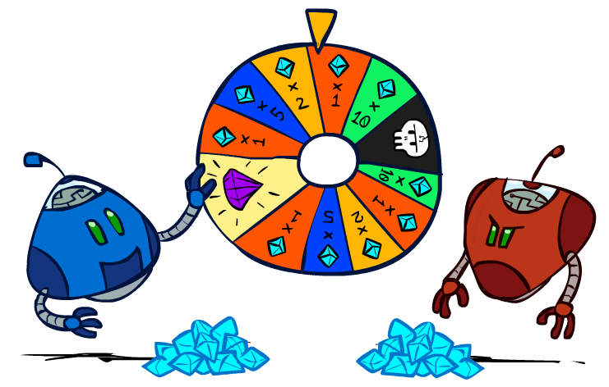
CSCE-420: Artificial Intelligence
Uncertainty and Utilities
Instructor: Guni Sharon
Based on slides by: Pieter Abbeel, Dan Klein

Slide 2
Announcements
Assignment 1 is available, due by Feb 10, EoD
Quiz 3 is available on Canvas, due by Feb 6, EoD
Contest 1: Multi-Agent Pacman, due by Feb 17, EoD
Quiz4: Adversarial Search, due by Tuesday Feb. 12, EoD
Assignment 2: Multi-Player Games, due by Monday Feb. 24, EoD

Slide 3
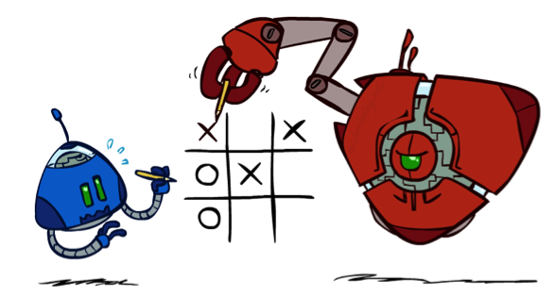
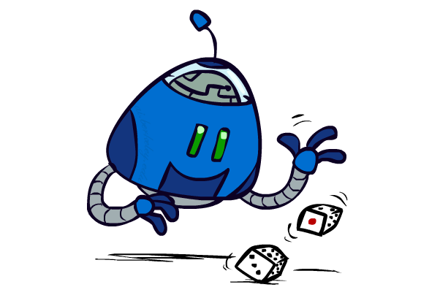
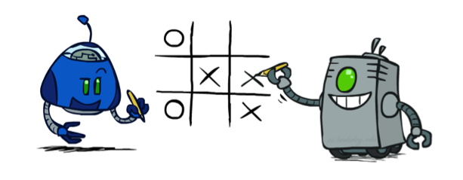
Worst-Case vs. Average Case vs. Random
max
min
10
10
9
100
New principle: Uncertain outcomes controlled by chance, not an adversary!
Notes:
At least 10, or otherwise just rather dead; or just 100, or otherwise rather dead; that’s yet something different than minimax or expectimax

Slide 4
Expectimax Search
Why wouldn’t we know what the result of an action will be?
  Explicit randomness: rolling dice
  Unpredictable opponents: the ghosts respond randomly
  Actions can fail: when moving a robot, wheels might slip
Values should now reflect average-case (expectimax) outcomes, not worst-case (minimax) outcomes
Expectimax search: compute the average score under optimal play
  Max nodes as in minimax search
  Chance nodes are like min nodes but the outcome is uncertain
  Calculate their expected utilities
  I.e. take weighted average (expectation) of children
Later, we’ll learn how to formalize the underlying uncertain-result problems as Markov Decision Processes
max
chance
10
10
4
10
5
9
7
100

Slide 5

Video of Demo Minimax vs Expectimax (Min)

Slide 6
Video of Demo Minimax vs Expectimax (Exp)

Slide 7
Expectimax Pseudocode
def value(state):
  if the state is a terminal state: return the state’s utility
  if the next agent is MAX: return max-value(state)
  if the next agent is EXP: return exp-value(state)
def max-value(state):
  initialize v = -∞
  for each successor of state:
    v = max(v, value(successor))
  return v
def exp-value(state):
  initialize v = 0
  for each successor of state:
  p = probability(successor)
    v += p * value(successor)
  return v
Notes:
Pick an order for two reasons: sequential processor and pruning

Slide 8
Expectimax Pseudocode
def exp-value(state):
  initialize v = 0
  for each successor of state:
  p = probability(successor)
    v += p * value(successor)
  return v
1/2
1/6
1/3
5
8
7
24
-12
v = (1/2) (8) + (1/3) (24) + (1/6) (-12) = 10

Slide 9
Expectimax Example
3
12
9
2
4
6
15
6
0

Slide 10
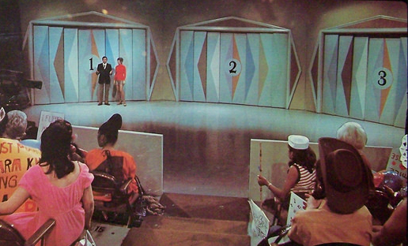
Example: Monty Hall Problem
Choose the right door and get a 10 minutes early release!
I need a volunteer…

Slide 11
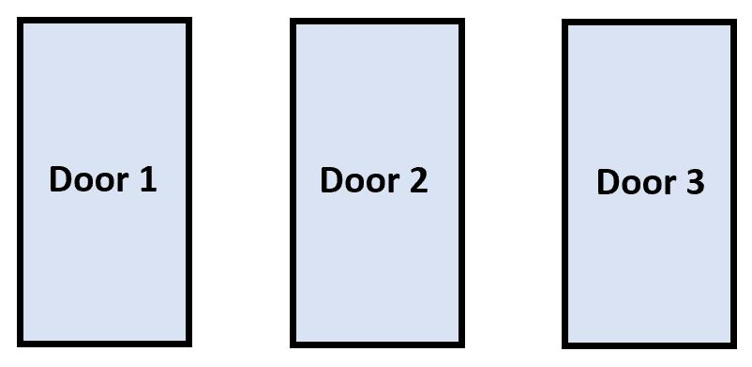
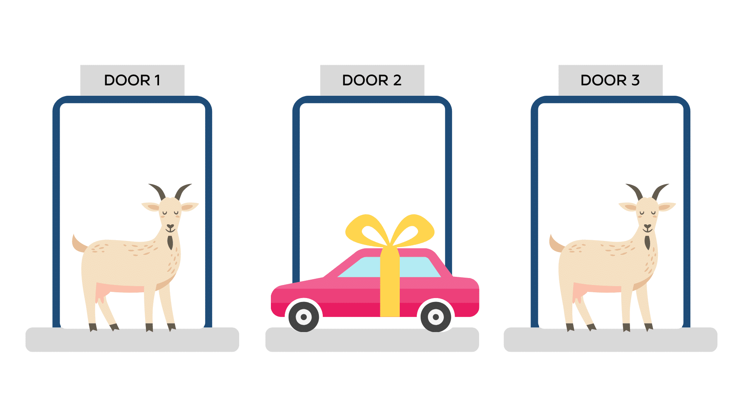
Game rules
There’s a big prize behind one of the doors
There’s a goat behind the other two
Choose one of the three doors
If you guessed right, you get a new car 10 minutes early release

Slide 12



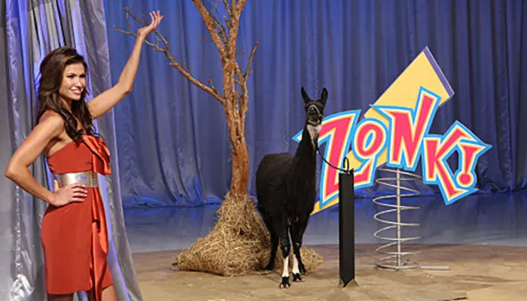


Slide 13
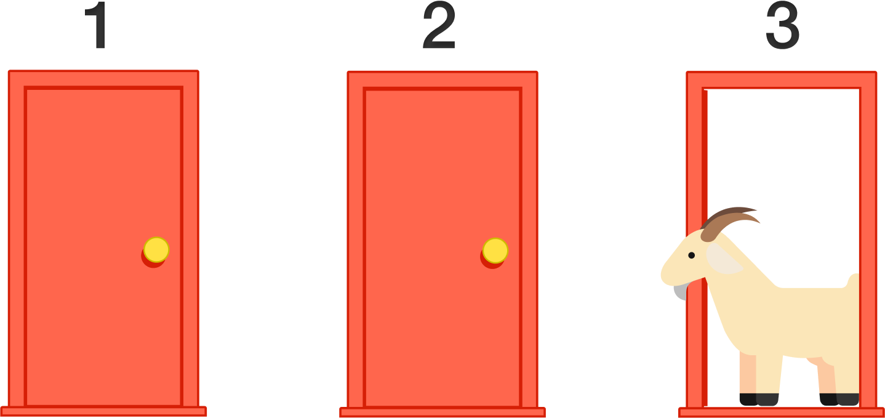
Stay
Switch
?
?
?
?
0
+10
+10
0

Slide 14
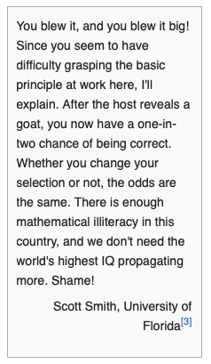
Fun fact
The correct solution for this problem was first provided in 1990 by Marilyn vos Savant
  an American magazine columnist. she has written "Ask Marilyn", a Parade magazine column wherein she solves puzzles and answers questions on various subjects
“She received thousands of letters from her readers – the vast majority of which, including many from readers with PhDs, disagreed with her answer”
The correct solution for this problem was first provided in 1990 by Marilyn vos Savant
  an American magazine columnist. she has written "Ask Marilyn", a Parade magazine column wherein she solves puzzles and answers questions on various subjects
“She received thousands of letters from her readers – the vast majority of which, including many from readers with PhDs, disagreed with her answer”

Slide 15
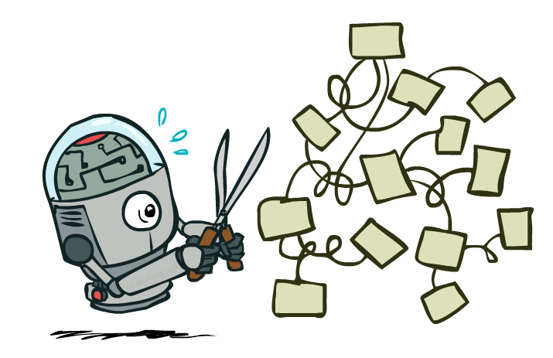
Expectimax Pruning?
3
12
9
2

Slide 16



Depth-Limited Expectimax
Estimate of true expectimax value (which would require a lot of work to compute)
400
300
…
…
492
362
…

Slide 17
Sampling-based Expectimax
Samples comes from the same distribution so unbiased
492
362
…
…
492
362
…

Slide 18
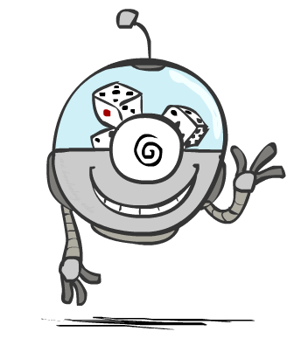
Probabilities

Slide 19
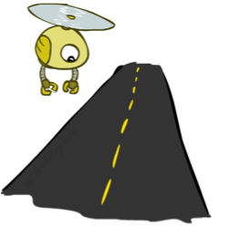
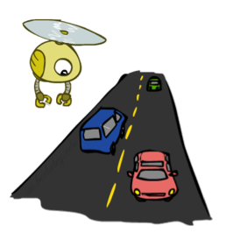
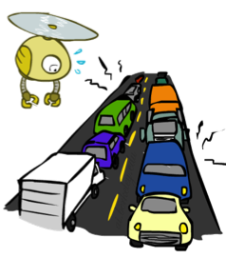
Reminder: Probabilities
0.25
A random variable represents an event whose outcome is unknown
A probability distribution is an assignment of weights to outcomes
Example: Traffic on freeway
  Random variable: T = whether there’s traffic
  Outcomes: T in {none, light, heavy}
  Distribution: P(T=none) = 0.25, P(T=light) = 0.50, P(T=heavy) = 0.25
Some laws of probability (more later):
  Probabilities are always non-negative
  Probabilities over all possible outcomes sum to one
As we get more evidence, probabilities may change:
  P(T=heavy) = 0.25, P(T=heavy | Hour=8am) = 0.60
  We’ll talk about methods for reasoning and updating probabilities later
0.50
0.25

Slide 20
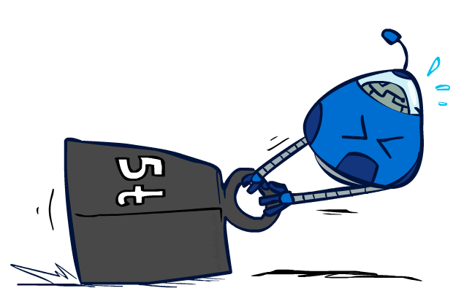
Reminder: Expectations
The expected value of a function of a random variable is the average, weighted by the probability distribution over outcomes
Example: How long to get to the airport?
Time:
20 min
30 min
60 min
+
+
35 min
x
x
x
Probability:
0.25
0.50
0.25

Slide 21

What Probabilities to Use?
In expectimax search, we have a probabilistic model of how the opponent (or environment) will behave in any state
  Model could be a simple uniform distribution (roll a dice)
  Model could be sophisticated and require a great deal of computation
  We have a chance node for any outcome out of our control: opponent or environment
  The model might say that adversarial actions are likely!
For now, assume each chance node magically comes along with probabilities that specify the distribution over its outcomes
Having a probabilistic belief about another agent’s action does not mean that the agent is flipping any coins!

Slide 22
Quiz: Informed Probabilities
Let’s say you know that your opponent is actually running a depth 2 minimax, using the result 80% of the time, and moving randomly otherwise
Question: What tree search should you use?
Answer: Expectimax!
  To figure out EACH chance node’s probabilities, you have to run a simulation of your opponent
  This kind of thing gets very slow very quickly
  Even worse if you have to simulate your opponent simulating you…
  … except for minimax, which has the nice property that it all collapses into one game tree
0.1 0.9

Slide 23

Modeling Assumptions

Slide 24
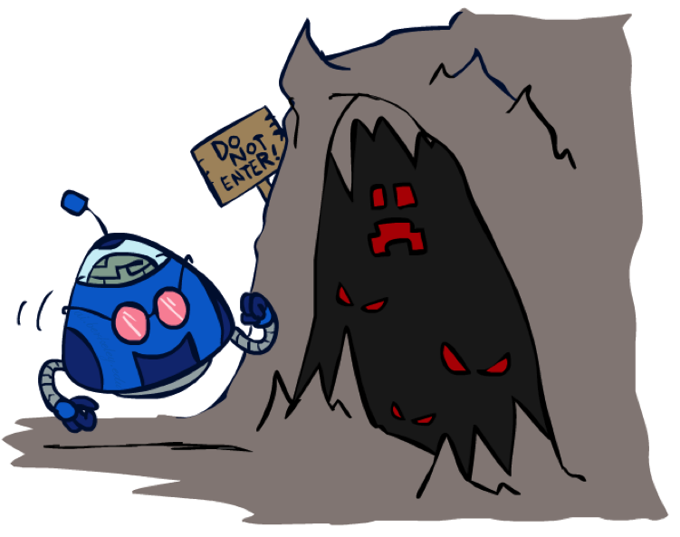
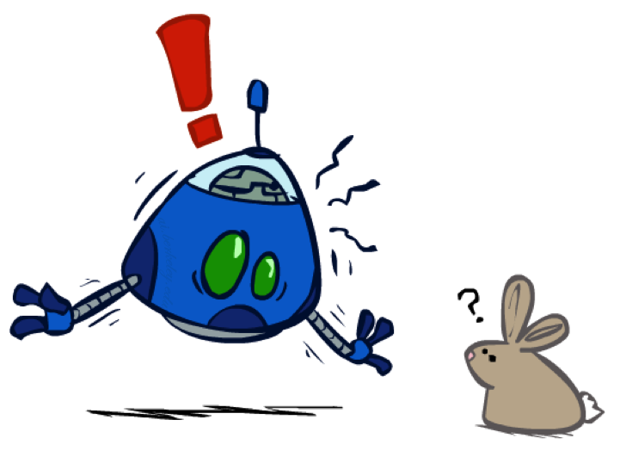
The Dangers of Optimism and Pessimism
Dangerous Optimism
Assuming chance when the world is adversarial
Dangerous Pessimism
Assuming the worst case when it’s not likely

Slide 25
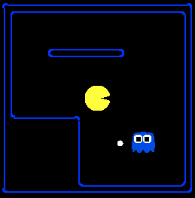
Assumptions vs. Reality
 | Adversarial Ghost | Random Ghost
Minimax Pacman | Won 5/5 Avg. Score: 483 | Won 5/5 Avg. Score: 493
Expectimax Pacman | Won 1/5 Avg. Score: -303 | Won 5/5 Avg. Score: 503
Results from playing 5 games
Pacman used depth 4 search with an eval function that avoids trouble
Ghost used depth 2 search with an eval function that seeks Pacman
[Demos: world assumptions (L7D3,4,5,6)]
Notes:
python pacman.py -g SmartGhost -l trapped2 -p ExpectimaxAgent -a depth=4,evalFn=better

Slide 26
Assumptions vs. Reality
 | Adversarial Ghost | Random Ghost
Minimax Pacman | Won 5/5 Avg. Score: 483 | Won 5/5 Avg. Score: 493
Expectimax Pacman | Won 1/5 Avg. Score: -303 | Won 5/5 Avg. Score: 503
Results from playing 5 games
Pacman used depth 4 search with an eval function that avoids trouble
Ghost used depth 2 search with an eval function that seeks Pacman
[Demos: world assumptions (L7D3,4,5,6)]
Notes:
python pacman.py -g SmartGhost -l trapped2 -p ExpectimaxAgent -a depth=4,evalFn=better

Slide 27
Video of Demo World Assumptions
Random Ghost – Expectimax Pacman

Slide 28
Video of Demo World Assumptions
Adversarial Ghost – Minimax Pacman

Slide 29
Video of Demo World Assumptions
Adversarial Ghost – Expectimax Pacman

Slide 30
Video of Demo World Assumptions
Random Ghost – Minimax Pacman

Slide 31

Other Game Types

Slide 32



Mixed Layer Types
E.g. Backgammon
Expectiminimax
  Environment is an extra “random agent” player that moves after each min/max agent
  Each node computes the appropriate combination of its children
Notes:
If it’s terminal or we reached our depth limit, return utility

Slide 33
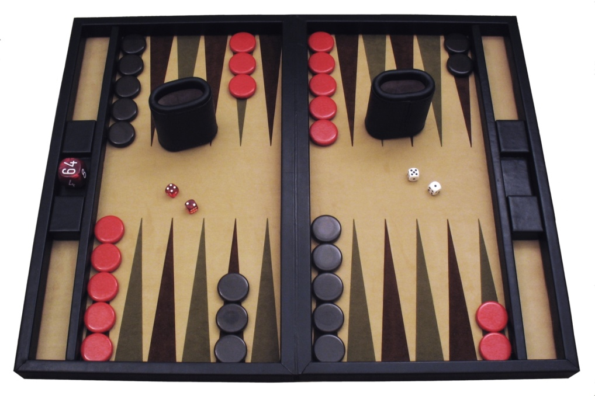
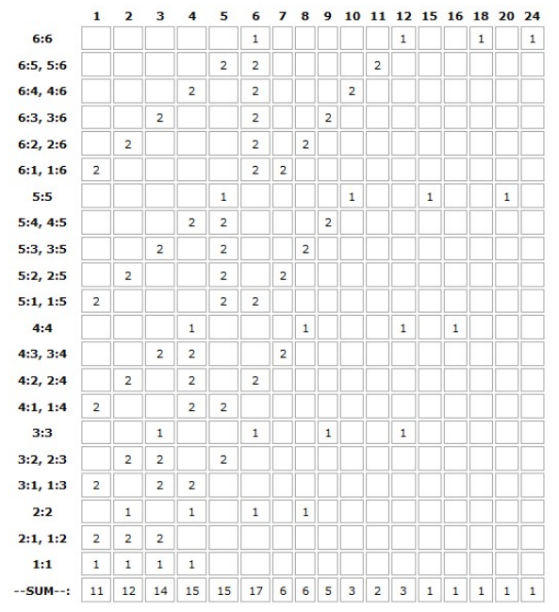
Example: Backgammon
Dice rolls increase b: 21 possible rolls with 2 dice
  Backgammon ≈ 20 legal moves
  Depth 2 (+ current move) = 20 x (21 x 20)³ = 1.2 x 10⁹
As depth increases, probability of reaching a given search node shrinks
  So usefulness of search is diminished
  So limiting depth is less damaging
  But pruning is trickier…
Historic AI: TDGammon uses depth-2 search + very good evaluation function + reinforcement learning:
world-champion level play
1st AI world champion in any game! (1992)
Image: Wikipedia

Slide 34
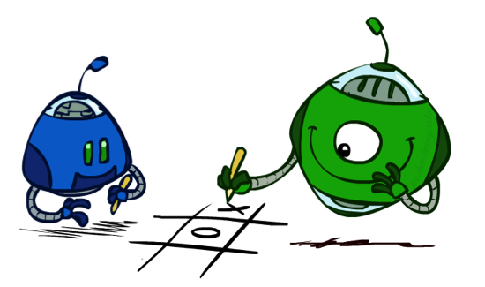
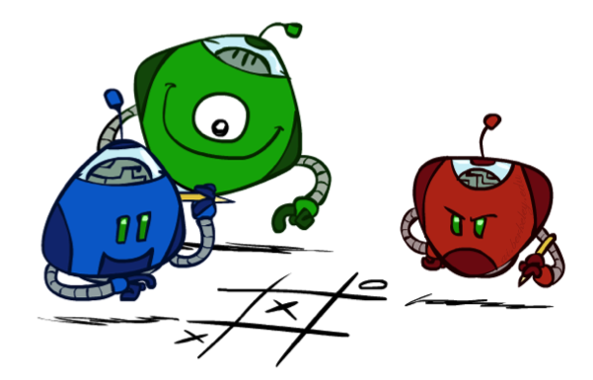
Multi-Agent Utilities
What if the game is not zero-sum, or has multiple players?
Generalization of minimax:
  Terminals have utility tuples
  Node values are also utility tuples
  Each player maximizes its own component
  Can give rise to cooperation and
  competition dynamically…
1,6,6
7,1,2
6,1,2
7,2,1
5,1,7
1,5,2
7,7,1
5,2,5

Slide 35
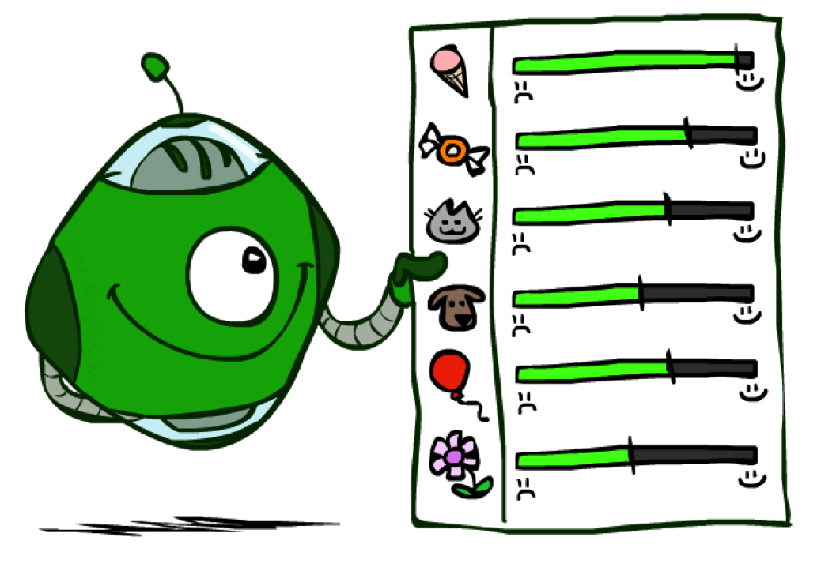
Utilities

Slide 36

Maximum Expected Utility
Why should we average utilities? Why not minimax?
Principle of maximum expected utility:
  A rational agent should chose the action that maximizes its expected utility, given its knowledge
Questions:
  Where do utilities come from?
  How do we know such utilities even exist?
  How do we know that averaging even makes sense?
  What if our behavior (preferences) can’t be described by utilities?

Slide 37
What Utilities to Use?
0
40
20
30
x²
0
1600
400
900
For worst-case minimax reasoning, terminal function scale doesn’t matter
  We just want better states to have higher evaluations (get the ordering right)
  We call this insensitivity to monotonic transformations
For average-case expectimax reasoning, we need magnitudes to be meaningful

Slide 38

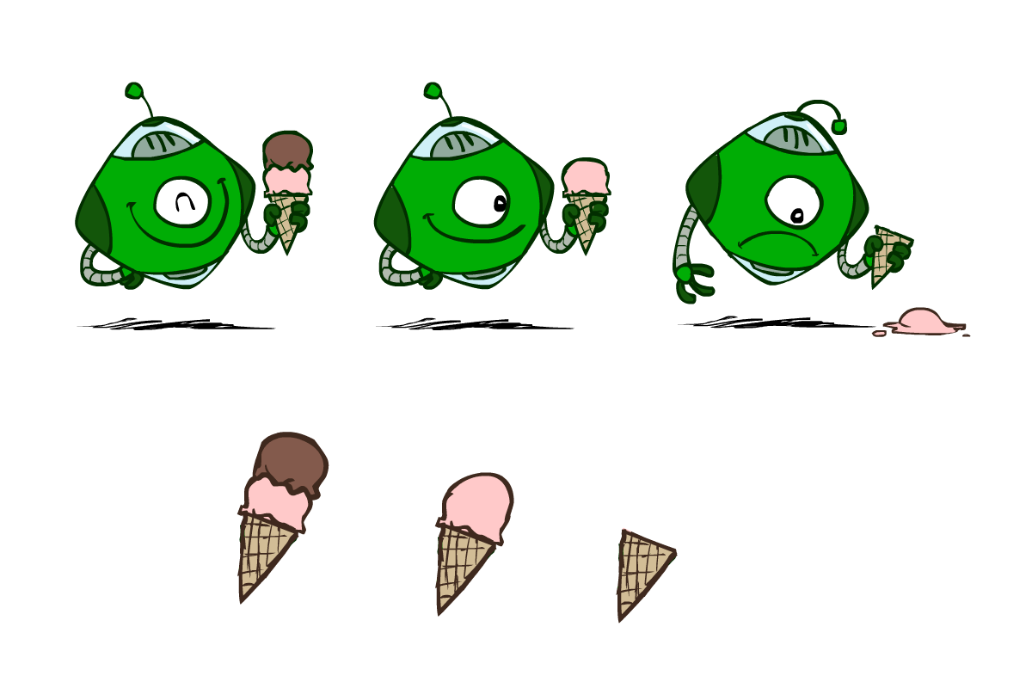
Utilities
Utilities are functions from outcomes (states of the world) to real numbers that describe an agent’s preferences
Where do utilities come from?
  In a game, may be simple (+1/-1)
  Utilities summarize the agent’s goals
  Theorem: any “rational” preferences can be summarized as a utility function
We hard-wire utilities and let behaviors emerge

Slide 39

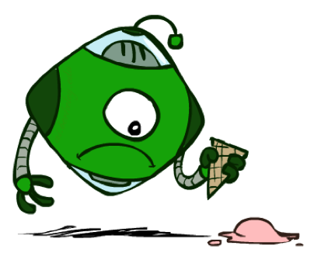

Utilities: Uncertain Outcomes
Getting ice cream
Get Single
Get Double
Oops
Whew!

Slide 40
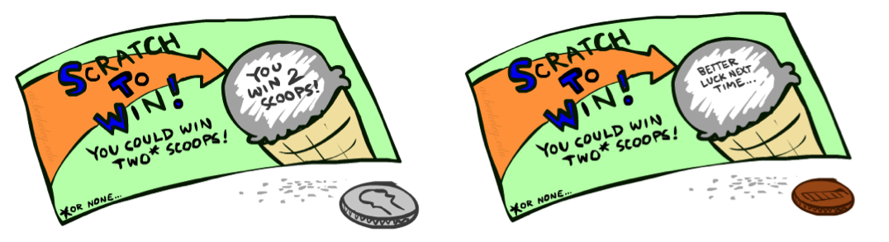
Preferences
A Prize
A Lottery
An agent must have preferences among:
  Prizes: A, B, etc.
  Lotteries: situations with uncertain prizes
Notation:
  Preference:
  Indifference:
A
p 1-p
A B

Slide 41
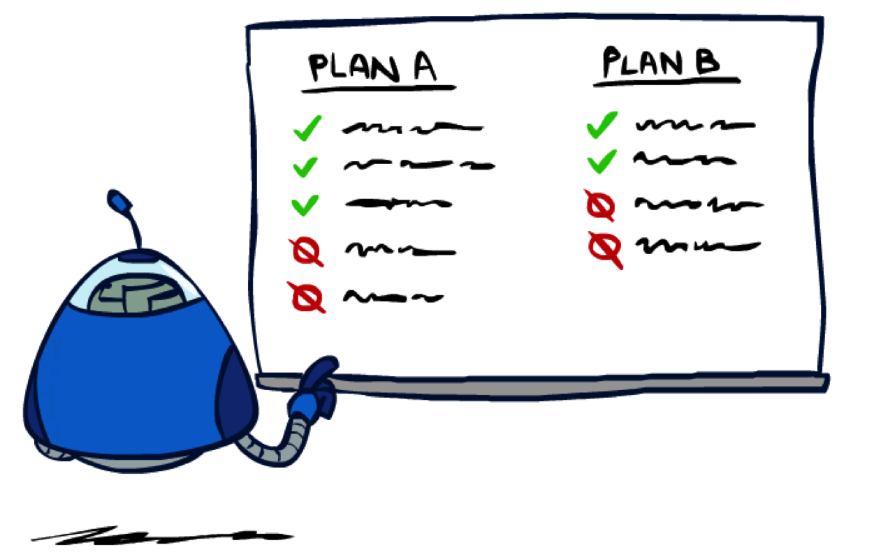
Rationality

Slide 42

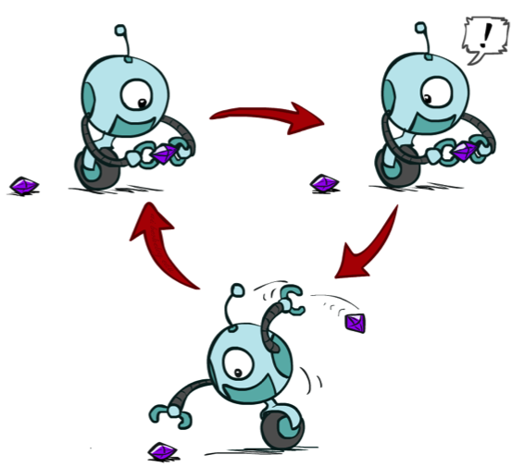
Rational Preferences
We want some constraints on preferences before we call them rational, such as:
For example: an agent with intransitive preferences can
be induced to give away all of its money
  If B > C, then an agent with C would pay (say) 1 cent to get B
  If A > B, then an agent with B would pay (say) 1 cent to get A
  If C > A, then an agent with A would pay (say) 1 cent to get C
Axiom of Transitivity:
Notes:
Apple, banana, carrot

Slide 43

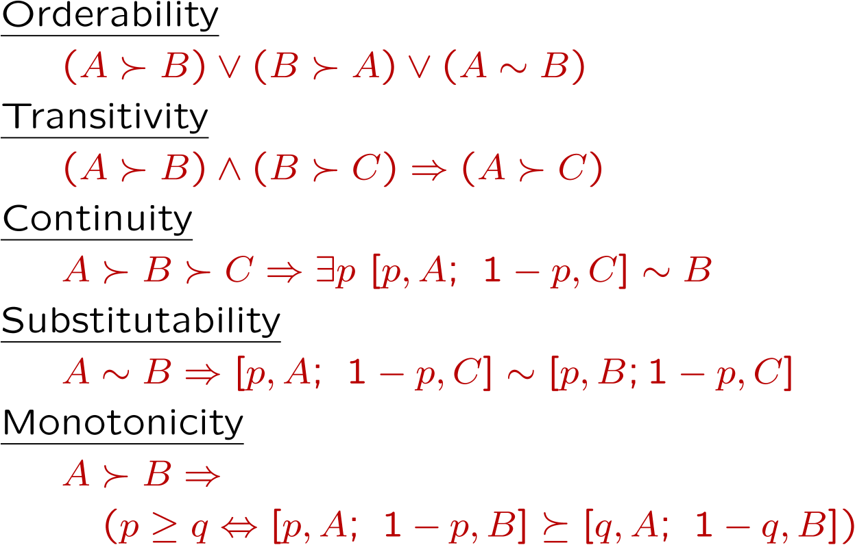
Rational Preferences
The Axioms of Rationality
Theorem: Rational preferences imply behavior describable as maximization of expected utility

Slide 44
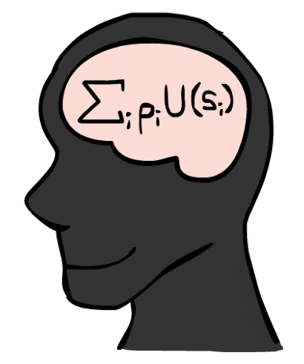
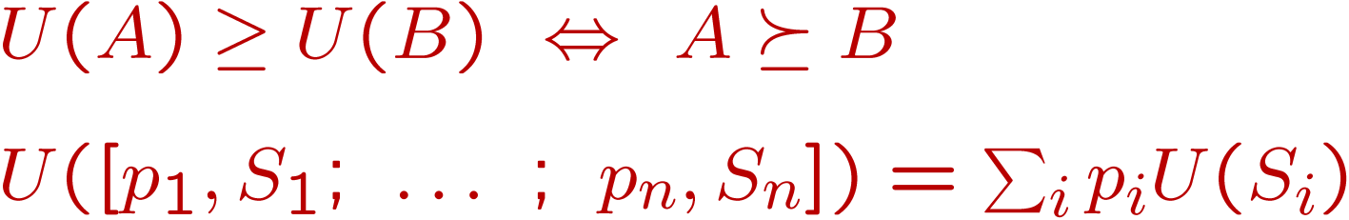
MEU Principle
Theorem [Ramsey, 1931; von Neumann & Morgenstern, 1944]
  Given any preferences satisfying these constraints, there exists a real-valued
  function U such that:
  I.e. values assigned by U preserve preferences of both prizes and lotteries!
Maximum expected utility (MEU) principle:
  Choose the action that maximizes expected utility
  Note: an agent can act entirely rational (consistent with MEU) without ever representing or manipulating utilities and probabilities
  E.g., a lookup table for perfect tic-tac-toe, a reflex vacuum cleaner

Slide 45

Utility Scales
Normalized utilities: u₊ = 1.0, u₋ = 0.0
Micromorts: one-millionth chance of death, useful for paying to reduce product risks, etc.
QALYs: quality-adjusted life years, useful for medical decisions involving substantial risk
Note: behavior is invariant under positive linear transformation
With deterministic prizes only (no lottery choices), only ordinal utility can be determined, i.e., total order on prizes

Slide 46
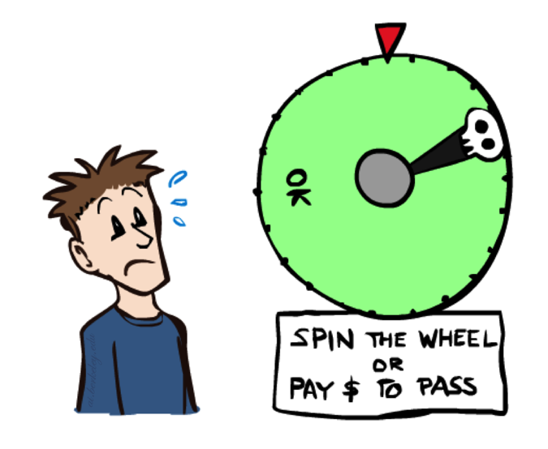

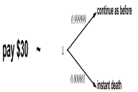
Human Utilities
Utilities map states to real numbers. Which numbers?
Standard approach to assessment (elicitation) of human utilities to [0,1]:
  Compare a prize A to a standard lottery L_{p} between
    “best possible prize” u₊ with probability p
    “worst possible catastrophe” u₋ with probability 1-p
  Adjust lottery probability p until indifference: A ~ L_{p}
  Resulting p is a utility for playing the game in [0,1]
Pay $30
0.999999 0.000001
No change
Instant death

Slide 47
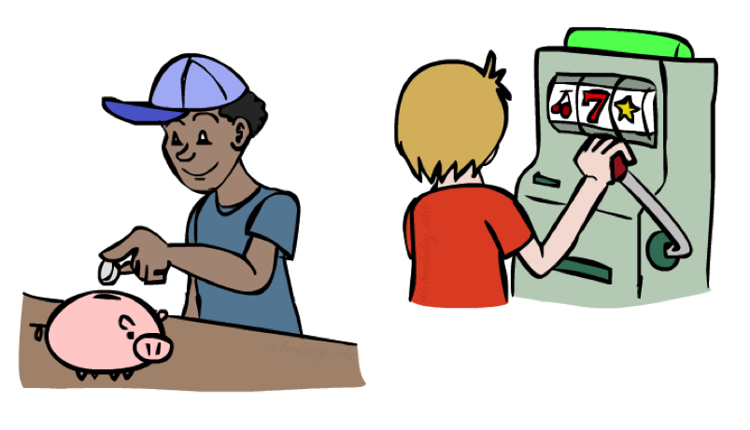
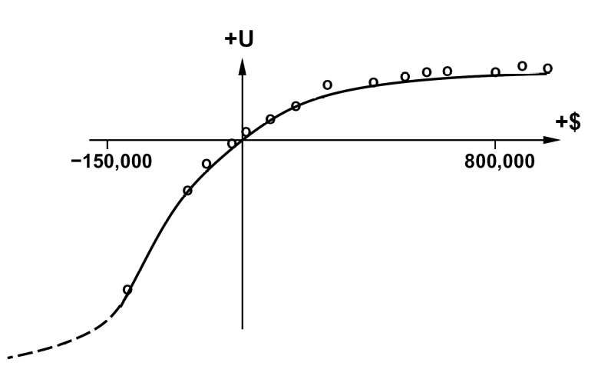
Money
Money does not behave as a utility function, but we can talk about the utility of having money (or being in debt)
Given a lottery L = [p, $X; (1-p), $Y]
  The expected monetary value EMV(L) is p*X + (1-p)*Y
  U(L) =? p*U($X) + (1-p)*U($Y)
  Typically, U(L) < U( EMV(L) )
  In this sense, people are risk-averse
  When deep in debt, people are risk-prone
Notes:
Draw Jensen’s for utility curve

Slide 48
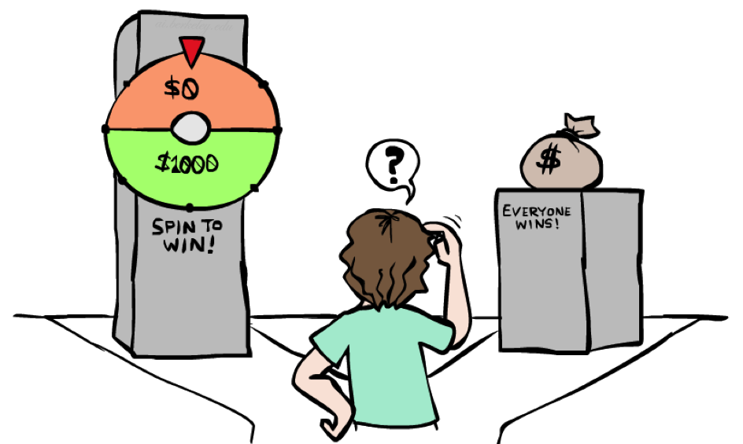
Example: Insurance
Consider the lottery [0.5, $1000; 0.5, $0]
  What is its expected monetary value? ($500)
  What is its certainty equivalent?
    Monetary value acceptable in lieu of lottery
    $400 for most people
  Difference of $100 is the insurance premium
    There’s an insurance industry because people will pay to reduce their risk
    If everyone were risk-neutral, no insurance needed!
  It’s win-win: you’d rather have the $400 and the insurance company would rather have the lottery (their utility curve is flat and they have many lotteries)

Slide 49

Example: Human Rationality?
Famous example of Allais (1953)
  A: [0.8, $4k; 0.2, $0]
  B: [1.0, $3k; 0.0, $0]
  C: [0.2, $4k; 0.8, $0]
  D: [0.25, $3k; 0.75, $0]
Most people prefer B > A, C > D
But if U($0) = 0, then
  B > A ⇒ U($3k) > 0.8 U($4k)
  C > D ⇒ 0.2 U($4k) > 0.25 U($3k) ⇒ 0.8 U($4k) > U($3k)

Slide 50
What did we learn?
In the face of uncertainty a rational agent seeks to maximize expected utility
Computing the expectation requires reasoning over all possible outcomes (can’t prune the search tree)
Rational preferences imply a utility function
Utility functions allow computation of expected utility
Getting a utility function from humans is challenging
Next lecture: Game theory

